Slide 1
View on Future Accelerators/Concepts

Slide 2

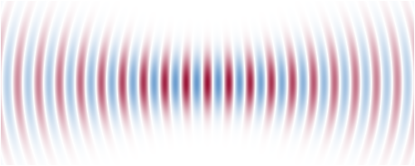
Energy Frontier
I don’t know what I’m talking about in this part of the talk (can skip if already covered)
Assumes there is no easy new physics and a large “energy desert” to cross
“Beams” may be holding us back, should try accelerating single particles

Slide 3
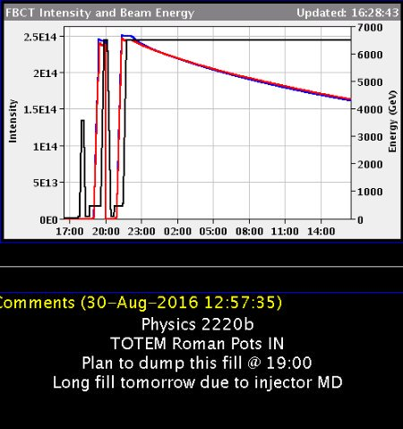
The Case for Optimism
2 * 2.5e14 * 6500 GeV
= 521 MJ
= 0.266 E_{Planck}
Total energy is OK but it’s in too many particles
@JoshMcFayden (UCL/ATLAS) via Twitter

Slide 4
Single-Particle Accelerators
Wavefunction propagates through lattice
  Can still form optical foci like with laser photons
Use emerging ultra-cold and precision alignment technology (e.g. LIGO)
  Collaboration with unfamiliar institutes
Cleaner, more customised physics output in detector, better luminosity (per particle)
  Perhaps gets rid of “beamstrahlung” problem

Slide 5
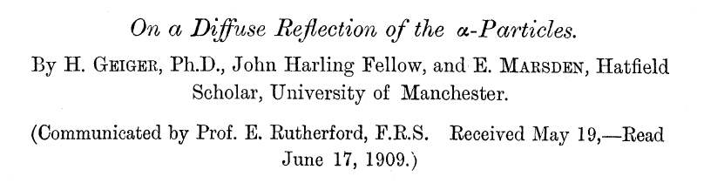
Gradients in a 2*10km-long Facility
Energy
1 TeV
10¹⁰ TeV
10¹⁶ TeV
E_{Planck}
100 MV/m
Gradient
10²⁴ V/m
1e15 V/m
ELI-NP laser, Romania
1.3e18 V/m
Schwinger limit
5e19 V/m
Achieved (briefly)
“Throw particles at each other”
Still not quite at the Planck energy, what can we do about that? In 10km.

Slide 6
Solution: Make a Bigger Black Hole
Instead of putting 1 E_{Planck} in 1 L_{planck} …
  Put 10⁶ E_{Planck} in 10⁶ L_{planck}
  Schwarzschild radius scales linearly with mass
Now we need a diffraction-limited focus of 10¹² 10¹⁰ TeV particles
  Instead of two 10¹⁶ TeV particles
  Energy requirement goes up by 10⁶ to 543 GW.h
Overall scale is not the show stopper

Slide 7
The Problems
(#1) To be efficient, want to only energise a small volume with large gradient → spatially confined, high momentum uncertainty photons → scattering
  Same would happen with the “throwing gold nuclei at it” approach
But want a very small final focus (~ 10⁻²⁸ m)
  (#2) Diffraction limit requires large angles, but can’t bend the beam, so large incoming “cone”

Slide 8

(#1) Cheating with Entanglement
We don’t want to constrain all N~10¹⁶ photon momenta, only a couple of sums
  Final momentum Σp_{i} and position Σ(N-i)p_{i}
Large uncertainty in Σx_{i}/√N becomes ~√N times smaller in terms of individual x_{i}
Ψ(x₁,x₂)
x₂
Gaussian wavefunction with no preference
x₂
Gaussian wavefunction with reduced uncertainty in Σp_{i}
x₁
x₁

Slide 9
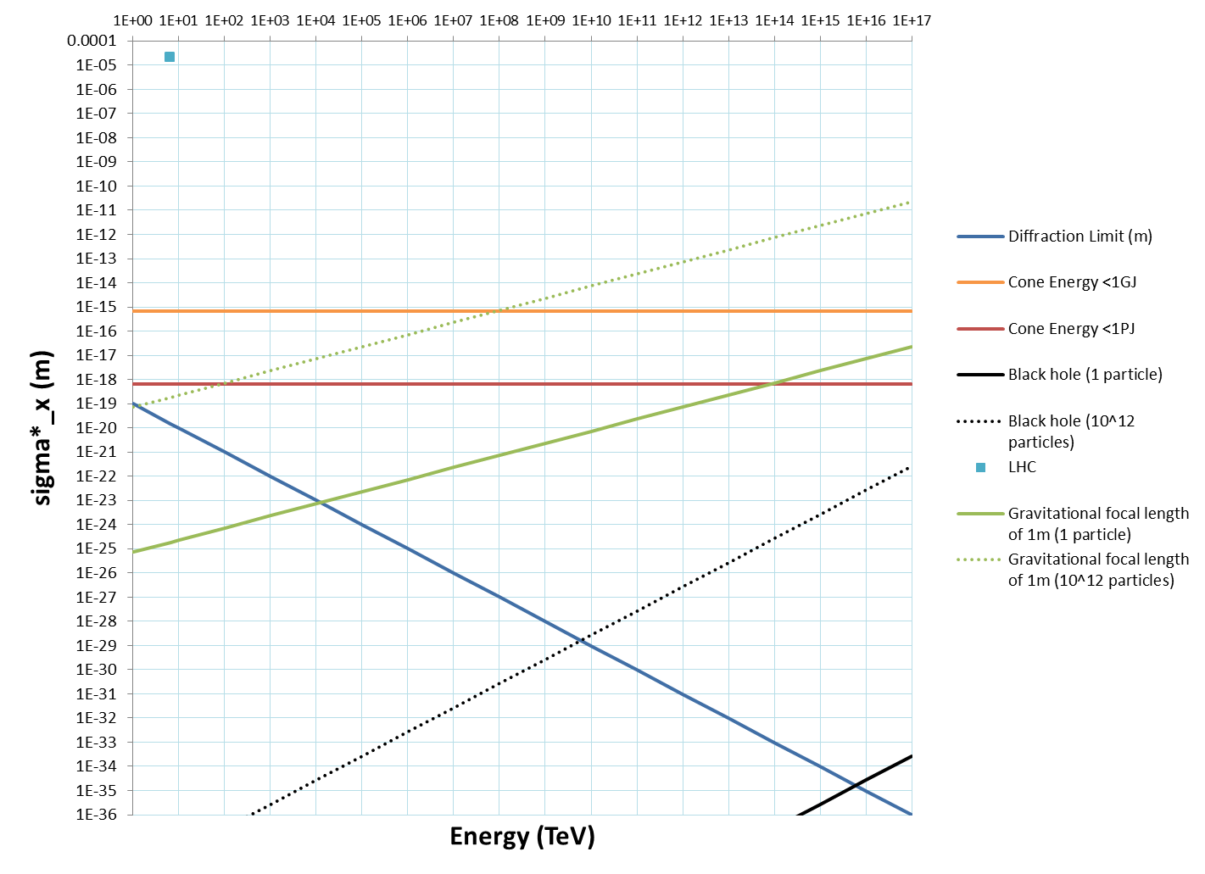
(#2) Energy in the Cone
Energy limit here is dependent only on focus size
But still a long way to go before we reach it
Would be useful to be able to bend/focus without emitting SR
Gravity can do it but usually lousy focal length (exceptions on this chart)

Slide 10
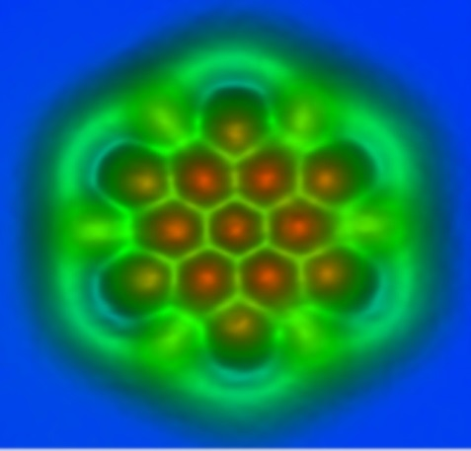
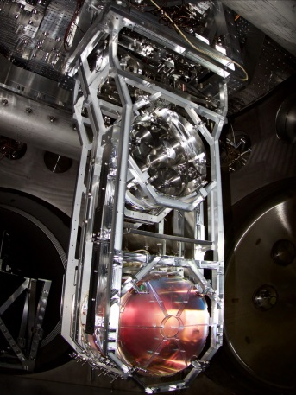
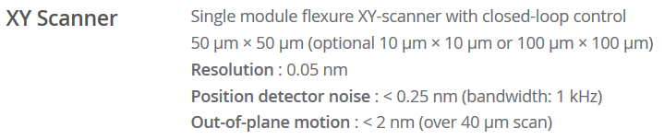

Spinoff: Nucleus-Level Alignment?
Can we demonstrate changing a nuclear reaction rate by a spatial/positioning effect?
  AFM tip <= 5e-11 m
  LIGO mirrors ~10⁻¹⁶ m
    Measurement ~10⁻¹⁸ m
Or could use crystal channelling alignment
AFM
LIGO
Park NX10

Slide 11
Neutralised Focus: Solution in Search of a Problem
No good for beam-beam limit
  Instability governed by dForce/dx not size of Force
Probably no good for fusion (ICF)
  Requires awkward energy recovery system
Maybe can make dense/degenerate matter?

Slide 12
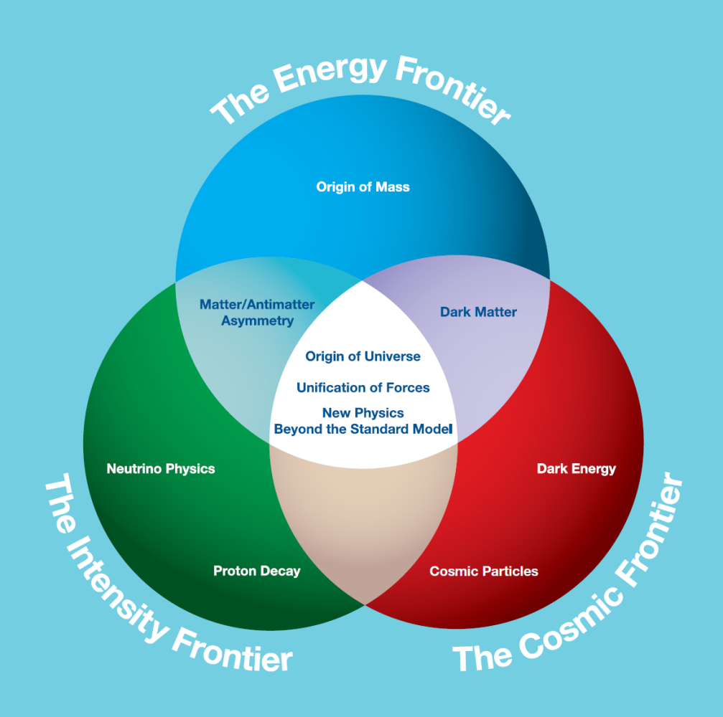

Cheapness Frontier
Mass-produced parts
Benefit from other industries
Don’t over-spec
Evade precision requirements by staging and feedback
Automation
Manpower will be the most expensive item in the future
3D printing, robotics
AI / automated design
Recycling
Energy recovery, multi-pass
Why? Since accelerators are already at the limits of government research budgets

Slide 13
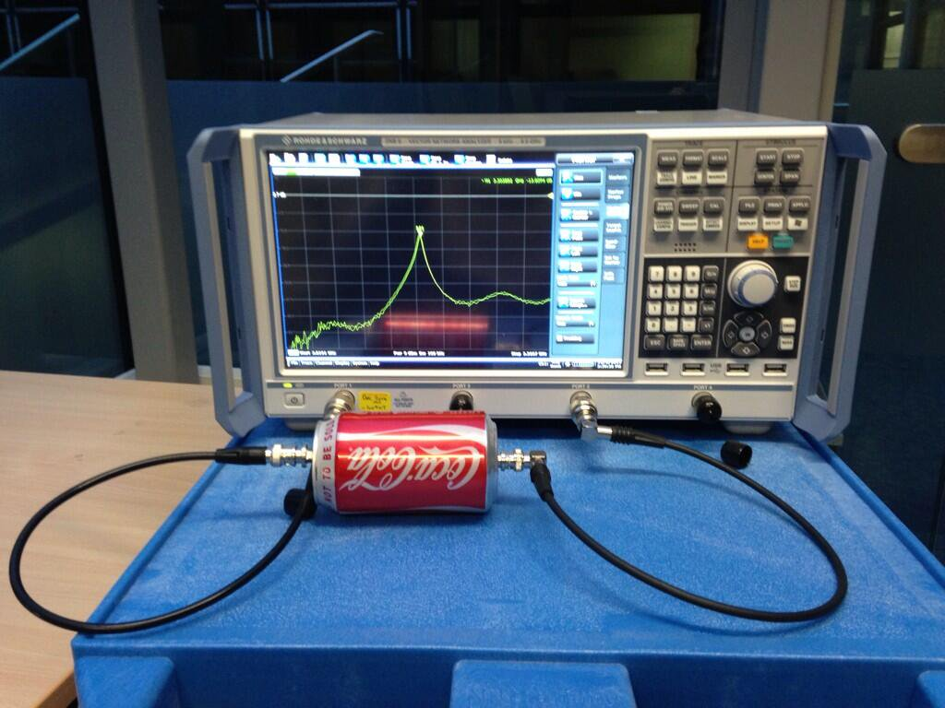
f = 3.3 GHz, Q = 50
Ciprian Plostinar (RAL/STFC)

Slide 14
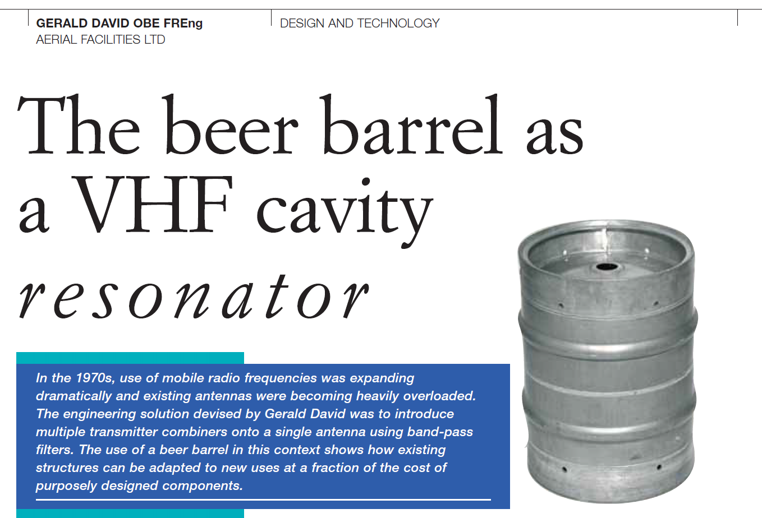
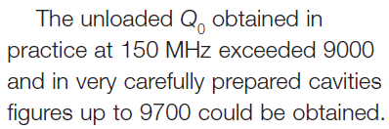
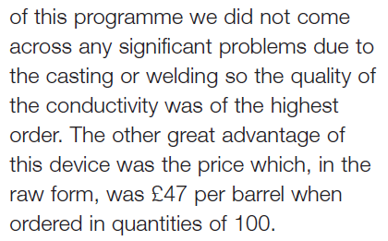
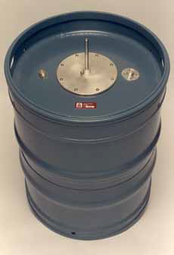
f = 150-165 MHz, Q = 9700

Slide 15
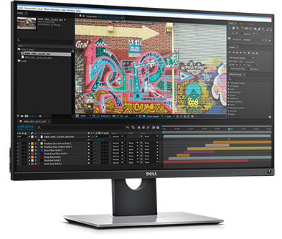
Multi-Channel Power Supply
Generic rack power supply
  >$1000 for one channel
My monitor
  $699 for 11M channels
    2560*1440*3
  $0.000063 per channel
Factor of >10⁷ is available if all you want is a large number of independent outputs
  Via mass production, lithography industry etc.

Slide 16
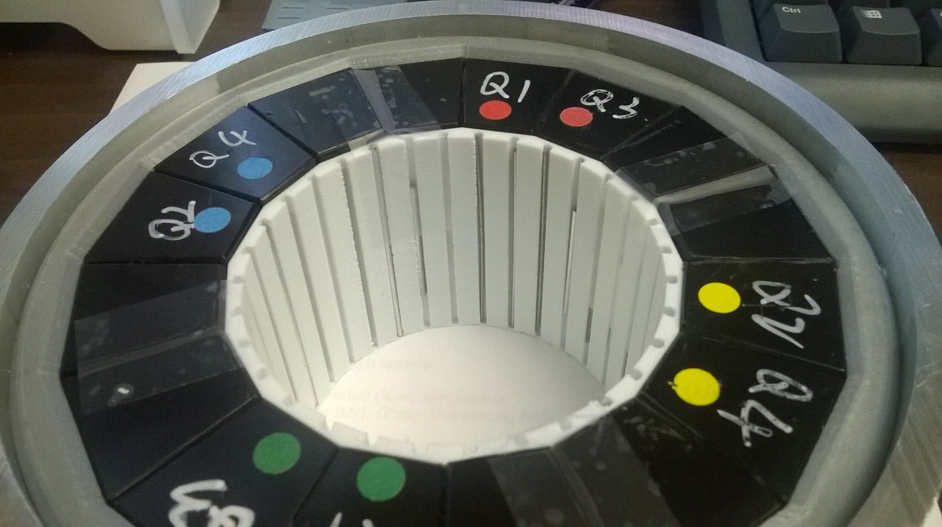
Magnet with 3D Printed Parts
Halbach quadrupole using NdFeB, 23.6 T/m, R=34.7mm bore (0.82T max), 10⁻⁴ errors at R=10mm
Material cost: $1100. No alignment better than 0.25mm required anywhere. Assembled with mallet.

Slide 17
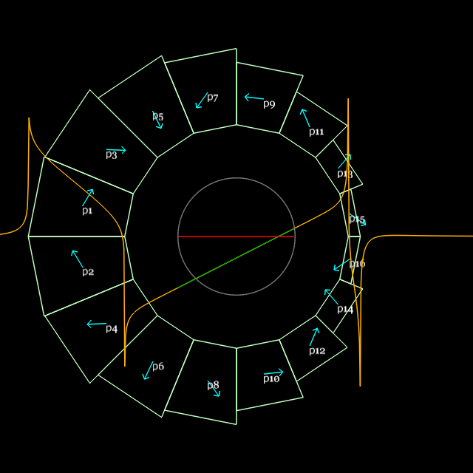
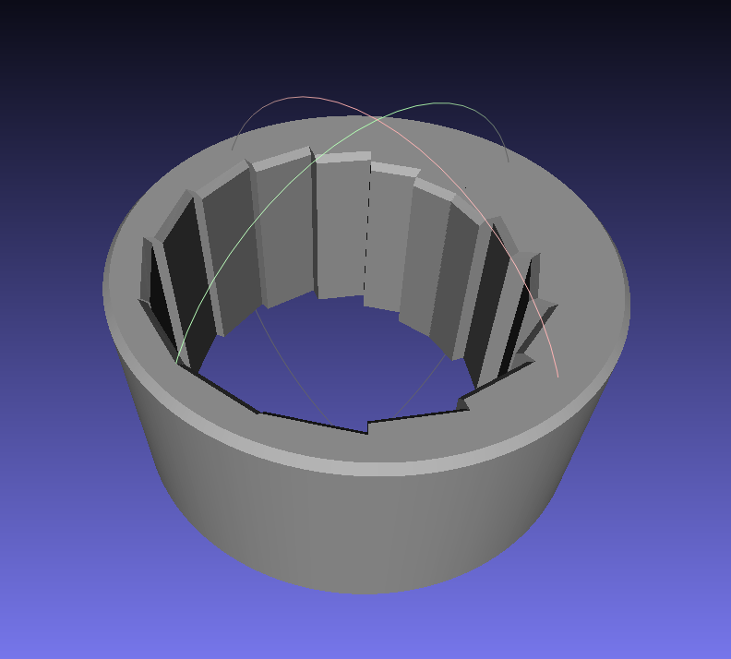
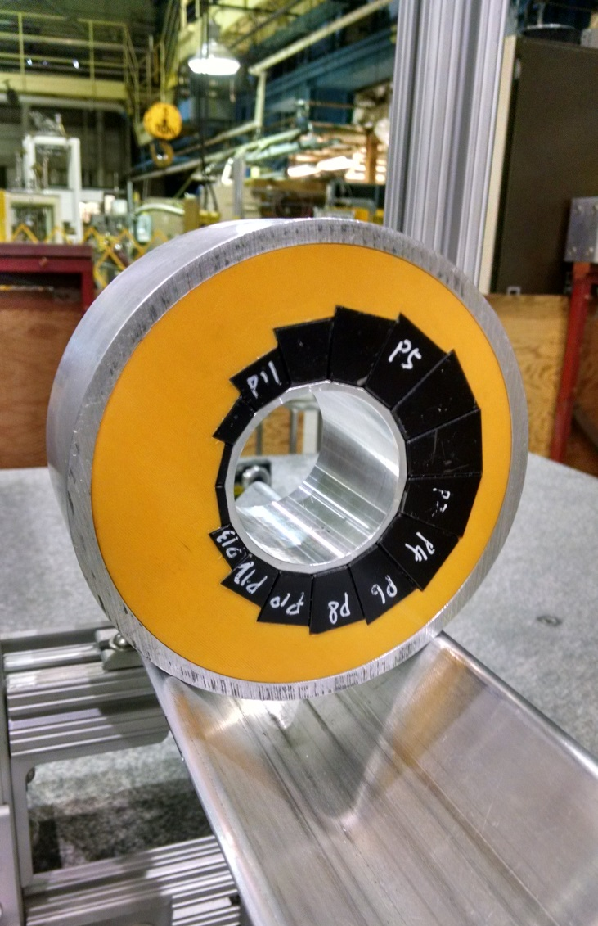
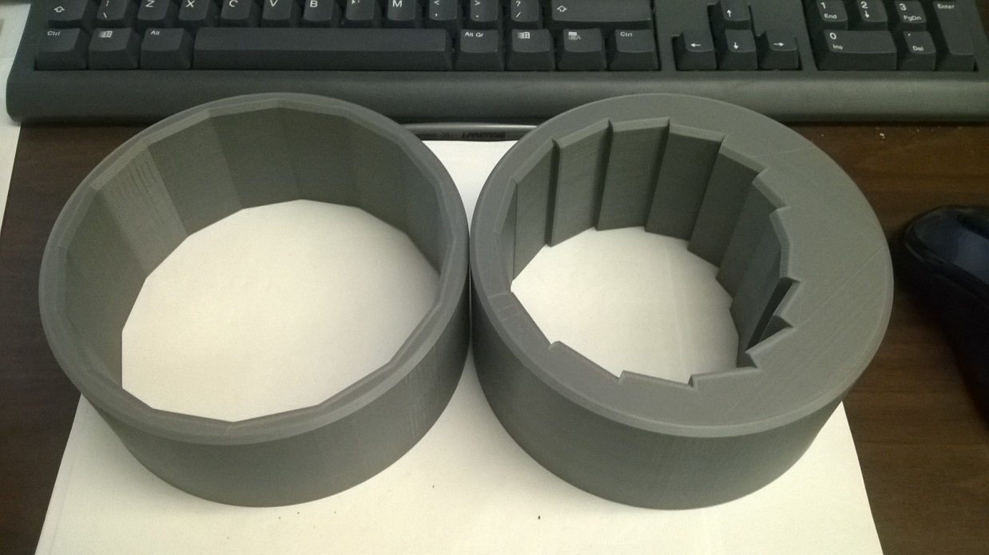
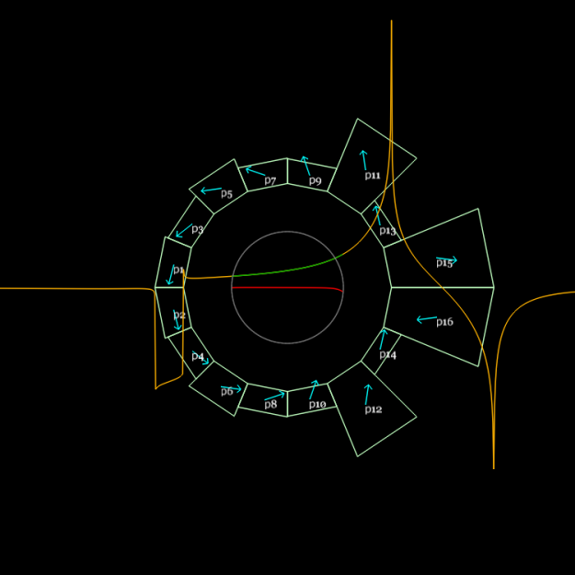
Custom and Cheap – is it possible?
Combined function dipole+quad
Magnet design program generates mesh
Design for B_{y} = B₀r^{k}
3D printed
Material cost: $800

Slide 18
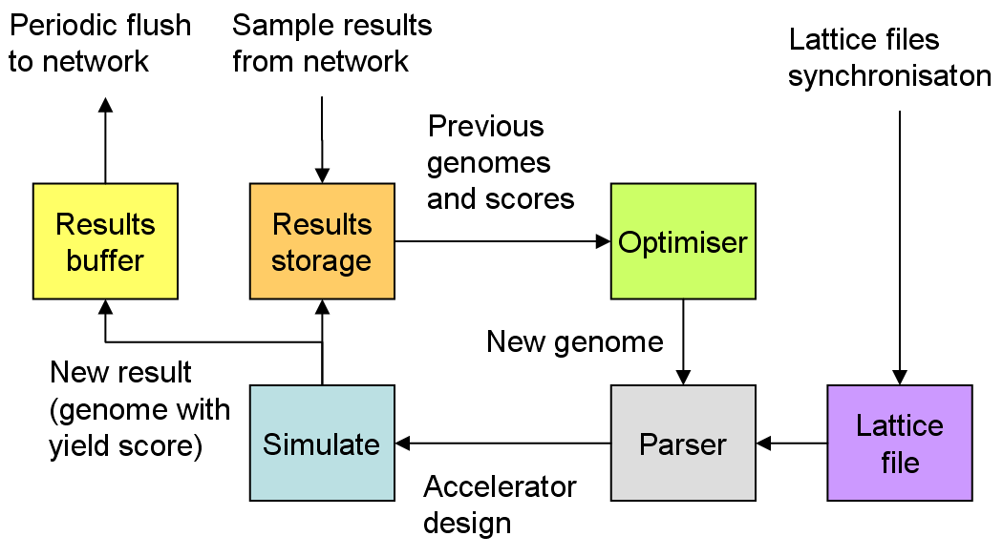
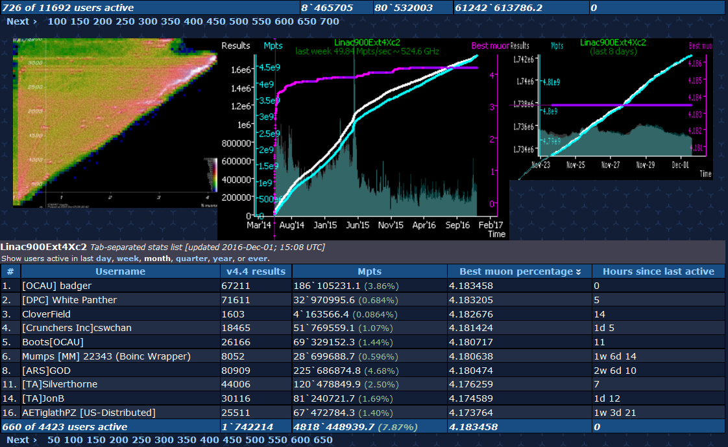
Automated Design: Muon1
Optimisation of design space with 100s of parameters using a genetic algorithm and distributed computing. The same optimiser designed the eRHIC FFAGs.
Stephen Brooks, (2010). Muon capture schemes for the neutrino factory. DPhil. University of Oxford.

Slide 19
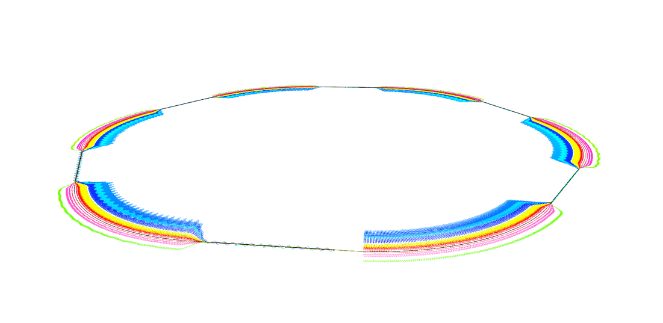
Re-use/Recycle: eRHIC e-A Collider
* This is the “ultimate” eRHIC design, not the “baseline” that lacks some features
Superconducting linac
  With energy recovery (0.5GW power in beam, much less actually used)
  Used multiple times (more energy per hardware)
Permanent magnet recirculating lines (low/zero power)
  Used multiple times in FFAG optics (up to 16 energies in 2 lines)
Luminosity increase by nonlinear beam-beam

Slide 20
BACKUP

Slide 21
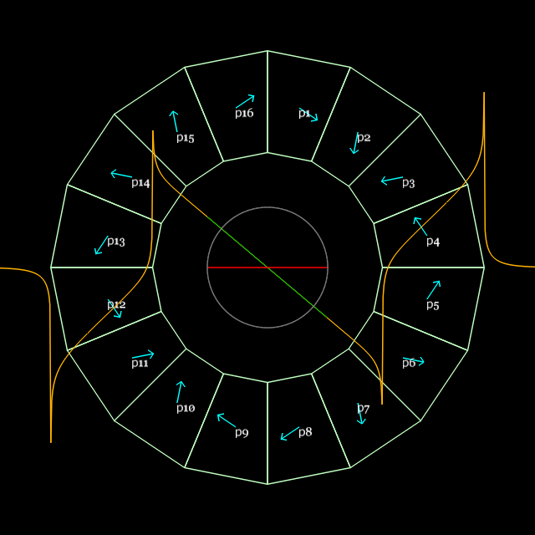
Generalised Halbach design
My current sheet approximation code (PM2D) is good enough
Material grade: N35SH from AllStar Magnetics, B_{r}(eff.)=1.194T

Slide 22
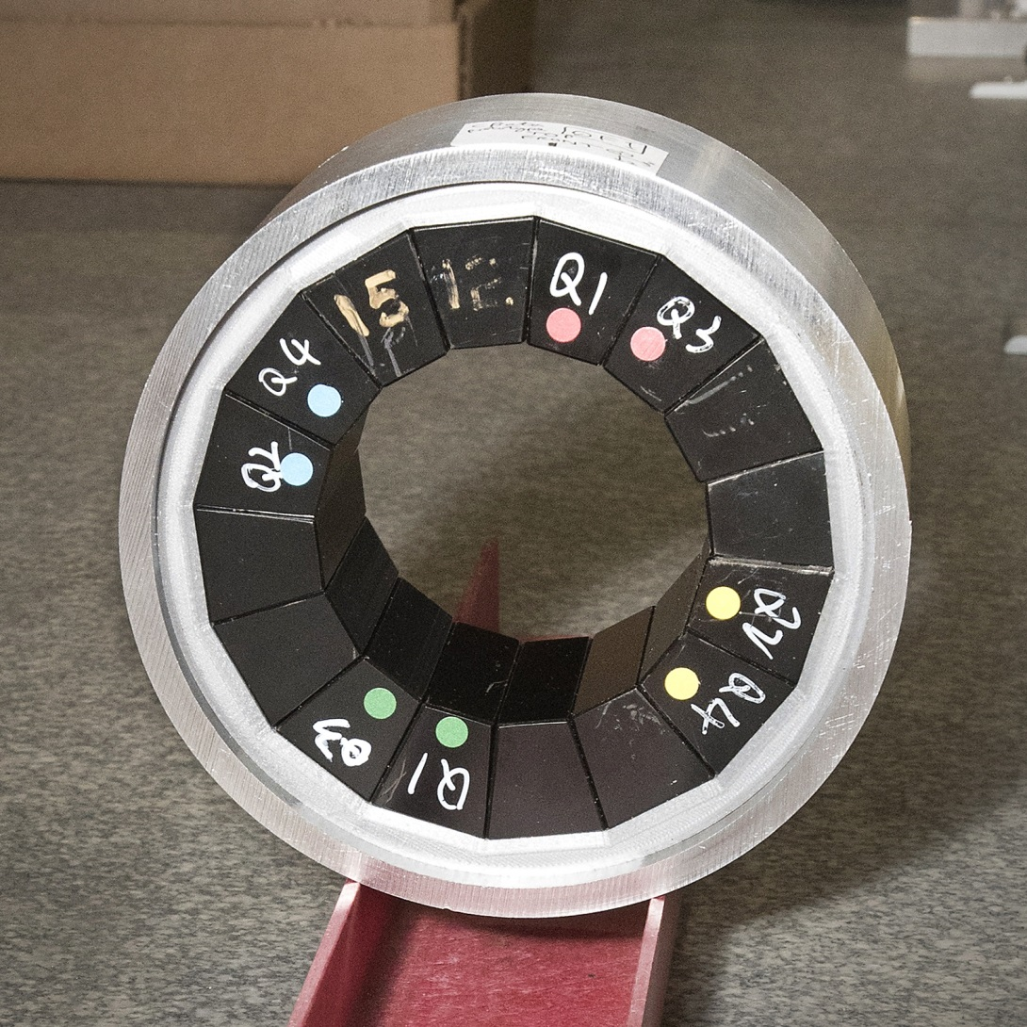
Photos of magnets (unshimmed)

Slide 23
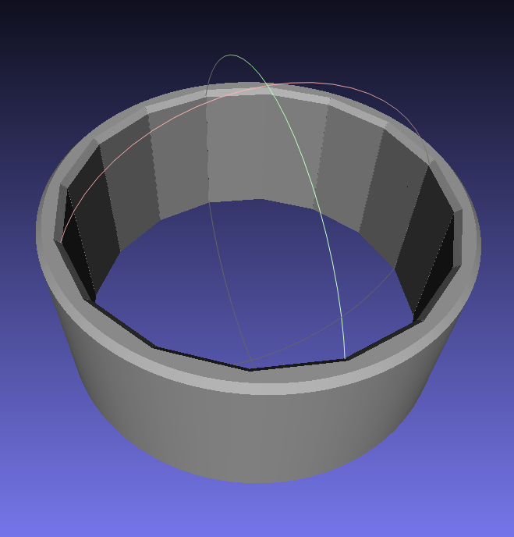
3D Printed Magnet Holder
Field optimiser
→ Magnet wedge dimensions
3D print file (.stl mesh)
and block spec. for manufacturer

Slide 24
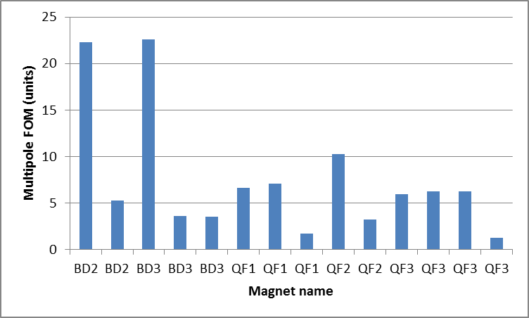
Shimming Results (one iteration)
One iteration of shimming reduces multipoles by between 3.2x and 6.5x
Re-measured on different sized rotating coil check
Re-aligned the coil, check
Software error!
No improvement

Slide 25
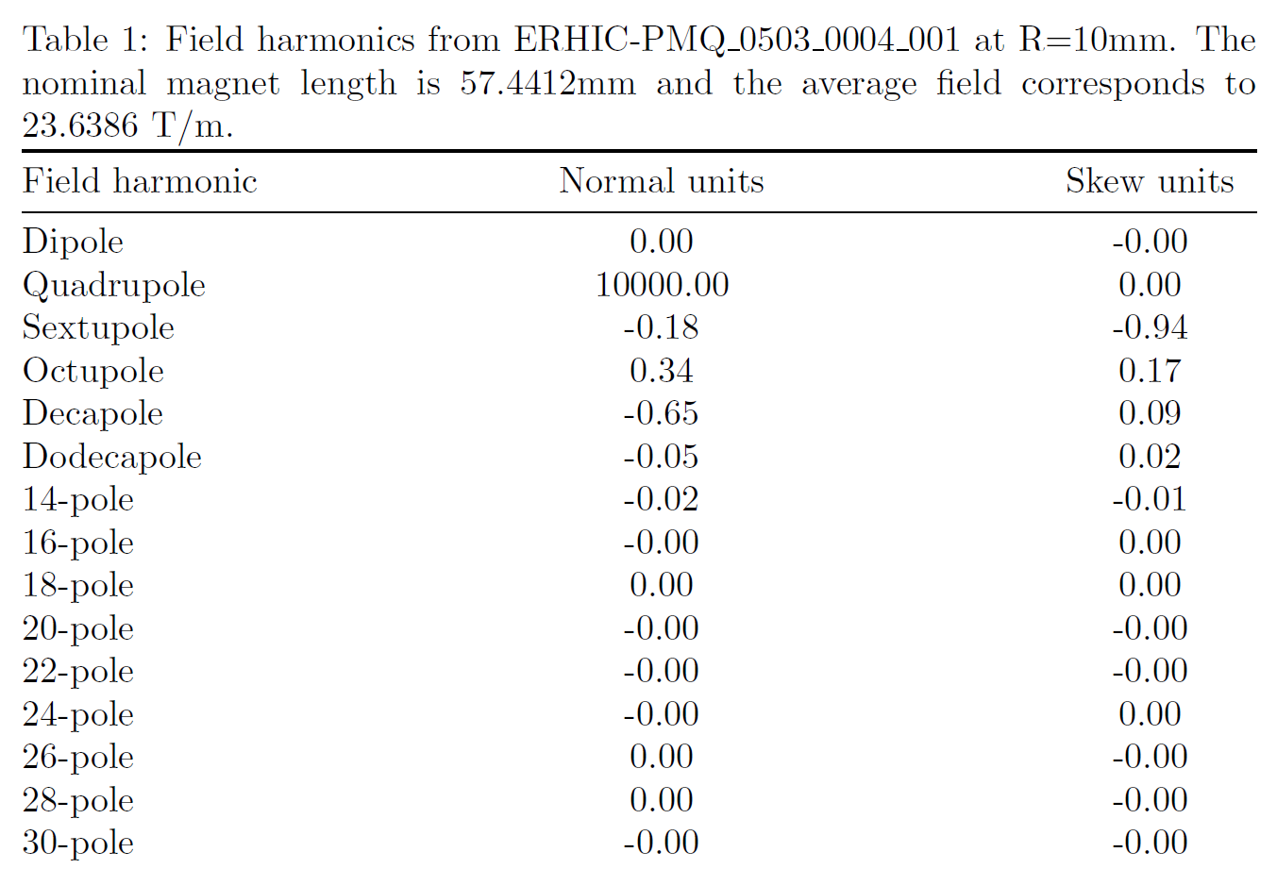
Best so far: QF3

Slide 26
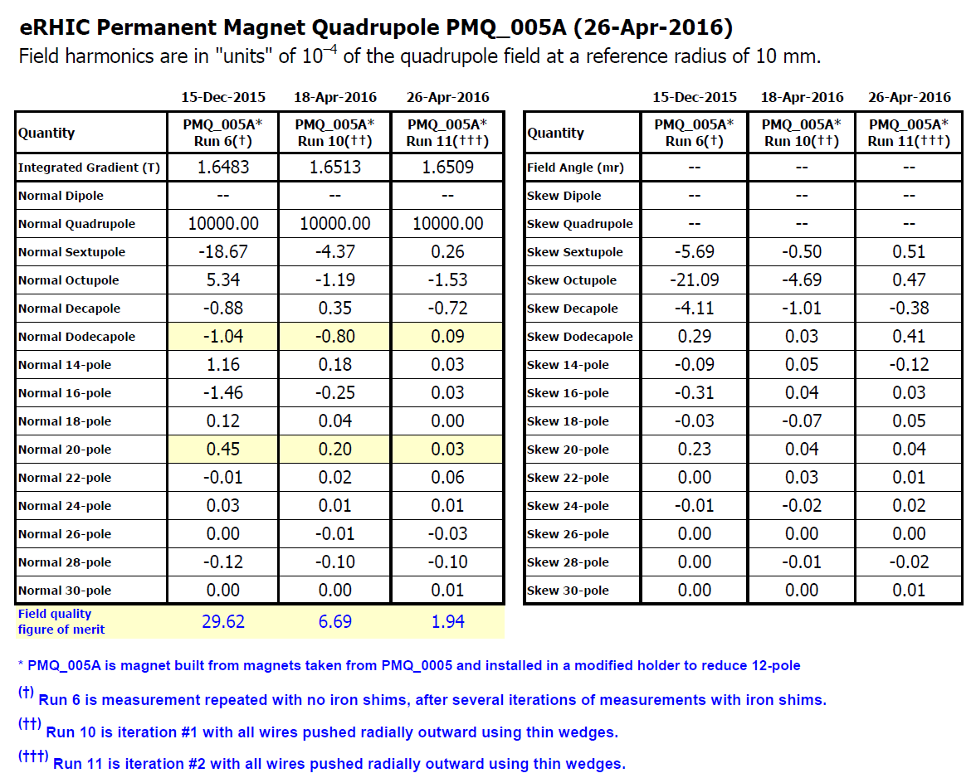
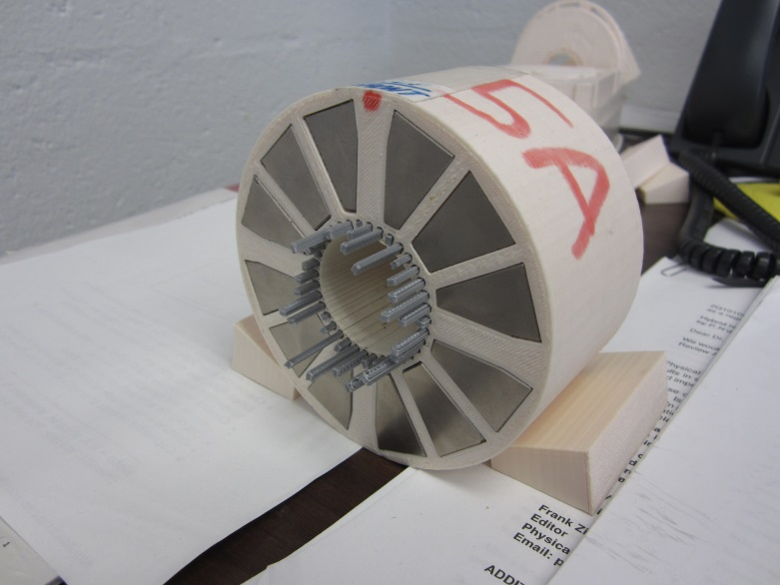
2nd shimming iteration
Of a previous test quadrupole magnet “5A”
3D printer was worse so had to use clamps for position accuracy!
1 iter → 4.4x, 2 iters → 15.3x

Slide 27
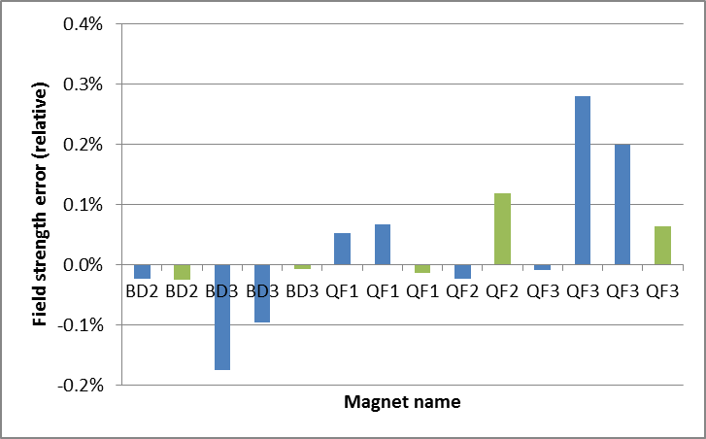
Field Strength vs. Spec
Average (integrated) quadrupole for 1st shim iteration:
-19.1142, -19.1176 T/m for BD
goal: 19.1191 T/m
23.6203 to 23.6514 T/m for QF
goal: -23.6236 T/m
Overall sign error because I got the Hall probe the wrong way around during block testing

Slide 28
Cost and Labour per Magnet
Permanent magnet wedges (AllStar N35SH)
  $1052.67 per QF magnet (16 wedges)
  $758.00 per BD magnet (16 wedges)
Labour ~8h per magnet: 3h measurement, 2h shimming, 2h assembly, 1h 3D printer setup
Required infrastructure
  3D printer ($2-3k), used Ultimaker 2 Extended+
  Rotating coil (~$50k)

Slide 29
Benefits
No power consumption
  No power supply, no copper wires or windings
Any field shape you like within strength limits
No “cross-talk” between iron surfaces in compact lattices
Can be assembled with mallet
1e-4 accuracy is possible after shimming
Seems cheap, at least for short magnet length

