Slide 1
Test of Linear-Field Non-Scaling FFAG Arc with a Wide Energy Range
Tested at the BNL ATF-1 facility

Slide 2
Outline of Main Components
Beam stop
Fixed table
Injection X position and angle adjustment
Beam direction
Movable table
Screen (POP11)
Screen (POP10)
ATF beam pipe
1” diam.
2” diam.
Triplet
Beam screen (FFAG) and camera
FFAG pipe through magnets
Steerer (GT7)
Steerer (GT3)
Flexible bellows and flange size adapter
For each energy, do 2D steerer current scans
  GT3X, GT7X (x,x’)
  GT3Y, GT7Y (y,y’)
  GT7X, GT7Y (x,y)
Plus four larger-range 1D scans and a quad scan of the triplet

Slide 3
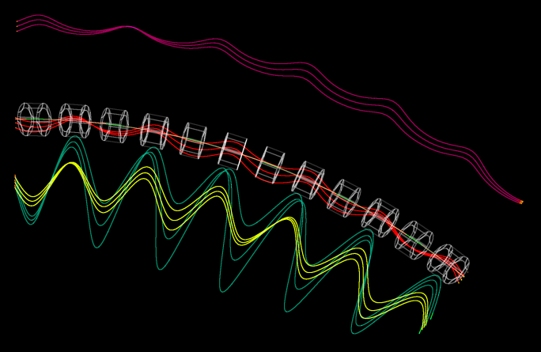
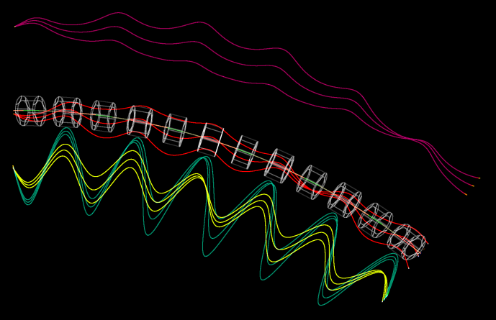
Tracking of (x,x’) Offsets
Trajectories have been magnified transversely by 16x for visibility
x_{in} ±1mm
x’_{in} ±10mrad

Slide 4
NS-FFAG Beamline Parameters
Parameter | Value | Units
Particle species | Electron
Energy range | 18-72 | MeV
Cell Length | 0.234301 | m
Cell Angle | 6.666… | degrees (54 per turn)
R = avg. radius of curvature | 2.01367 | m
Max orbit excursion | 18.21 | mm (from circle radius R)
Tune range per cell | Q_{y,72} = 0.029, Q_{x,18} = 0.411 | cycles
Cell lattice | halfD2, QF, D1, BD, halfD2
Drift lengths | D1 = 57.35, D2 = 57.65 | mm
Number of cells | 6
Total length | 1.40581 | m
Total angle | 40 | degrees

Slide 5
EMMA Comparison (pros and cons)
Parameter | EMMA | ATF-FFAG | Units
Energy range | 10.0–20.0 | 18.0–70.489 | MeV kinetic energy
Momentum ratio | 1.952 | 3.837 | ×
Radius of curvature | 2.63720 | 2.01367 | m
Effective avg. dipole | 0.02593 | 0.11761 | T
Total angle | 360 | 40 | degrees
Operation mode | Storage ring | Transfer line
Acceleration? | Yes (lots!) | None
Lattice | Doublet | Very close to FODO
Cell length | 0.394524 | 0.234301 | m
Cells per turn | 42 | 54 (extrapolated)
Length built | 16.57 | 1.40581 | m

Slide 6
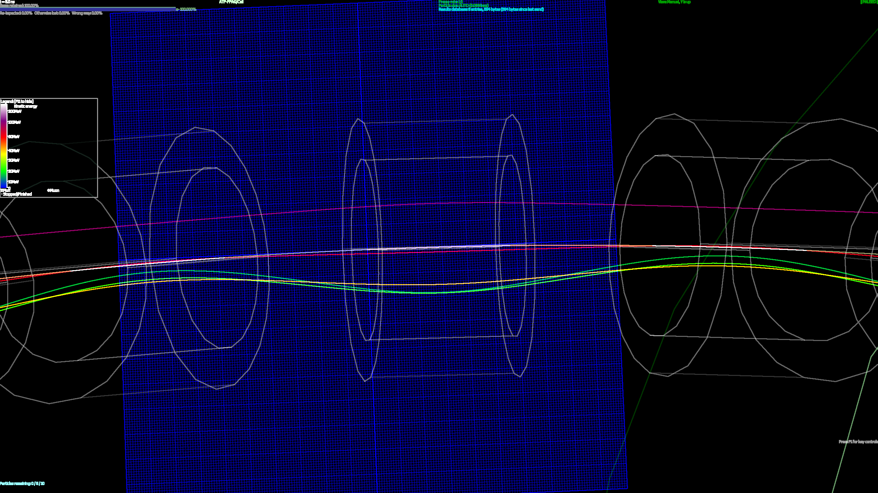
Matched Orbits through Fieldmaps
18, 24, 36, 54, 72MeV

Slide 7
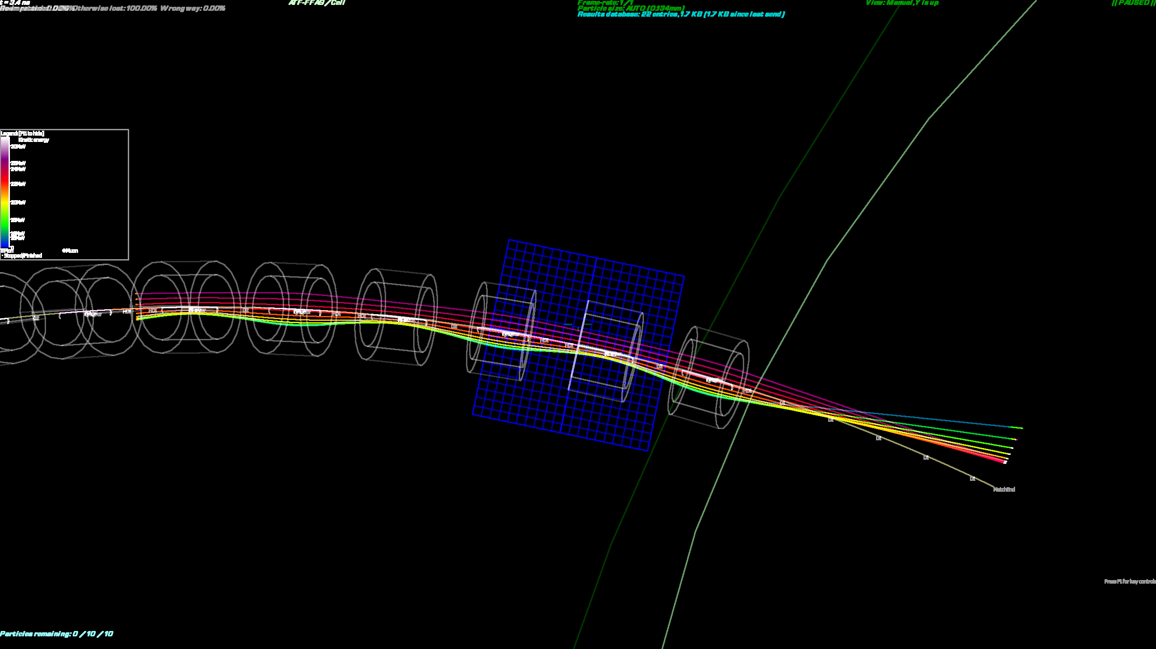
Beams Exit from Periodic Cell

Slide 8
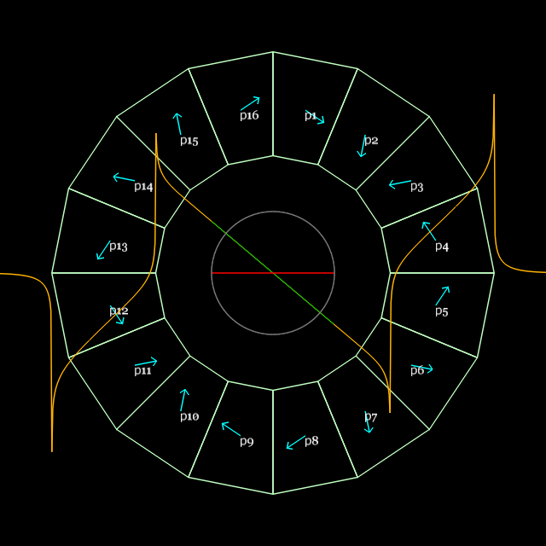
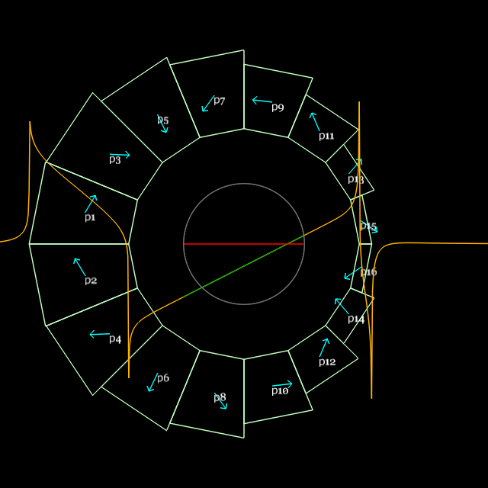
Magnet Design and Parameters
S.J. Brooks, “Production of Low Cost, High Field Quality Halbach Magnets”, Proc. IPAC’17
QF
BD
Parameter | “QF” magnet | “BD” magnet | Units
Length | 57.44 | 61.86 | mm
Dipole B_{y}(x=0) | 0 | -0.37679 | T
Quadrupole dB_{y}/dx | -23.624 | 19.119 | T/m
Inner radius (magnet pieces) | 37.20 | 30.70 | mm
(shim holder) | 34.70 | 27.60 | mm
“Pole-tip” field (magnet pieces) | 0.879 | (-)0.964 | T
Outer radius (magnet pieces) | 62.45 | 59.43 | mm
(tubular support) | 76.2 | 76.2 | mm

Slide 9
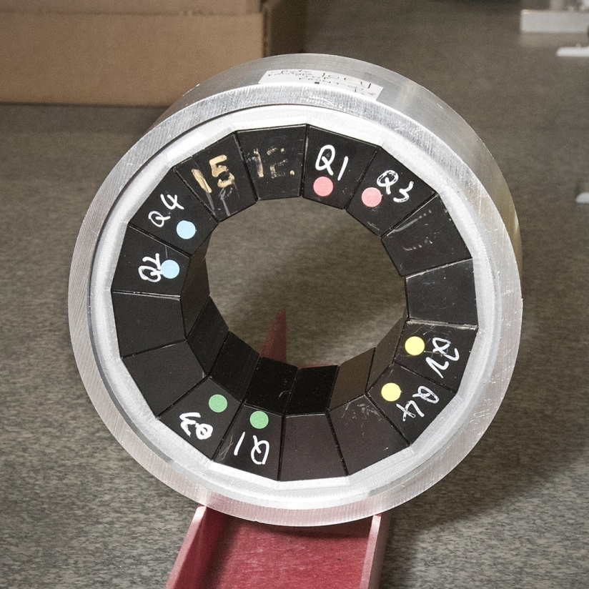
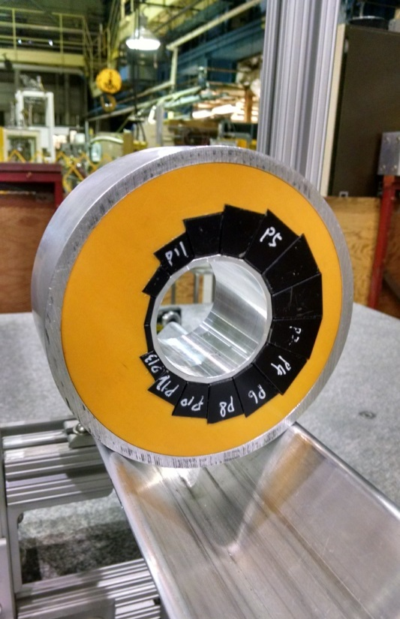
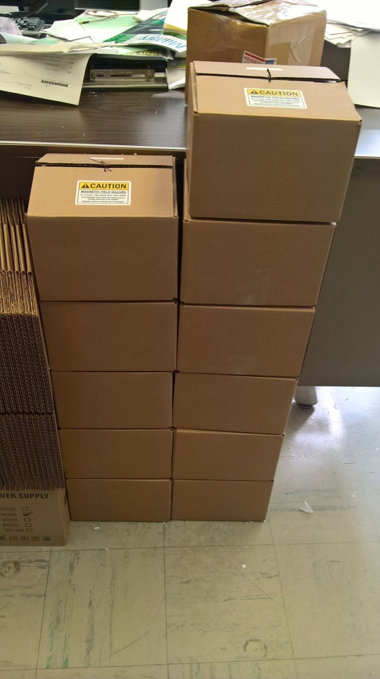
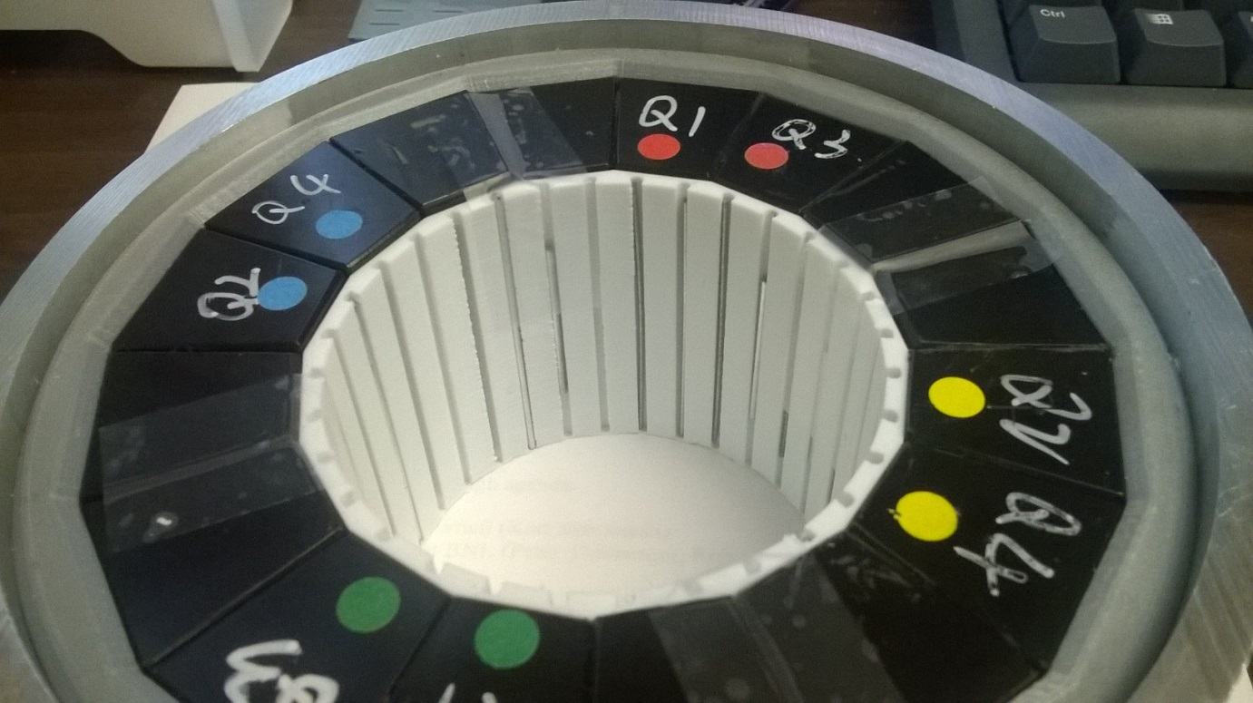
All the magnets had already been built as part of CBETA R&D and all have had iron wires inserted.

Slide 10
Radii/Clearances
 | Radius wrt torus (mm) | Distance to previous (mm)
Maximum beam excursion | 18.21
Vacuum pipe inside | 23.75 | 5.54 (12.00 in CBETA)
Vacuum pipe outside | 25.40 | 1.65 (pipe thickness)
Shim holder inside (BD) | 27.45 (27.60 straight) | 2.05 (air gap)
PM block inside edges (BD) | 30.55 (30.70 straight) | 3.10 (shim holder)
May have been a bit over-optimistic with beam clearance, seeing scraping near 36MeV
Re-aligned pipe after 36MeV run because it was being pulled off-centre by bellows

Slide 11
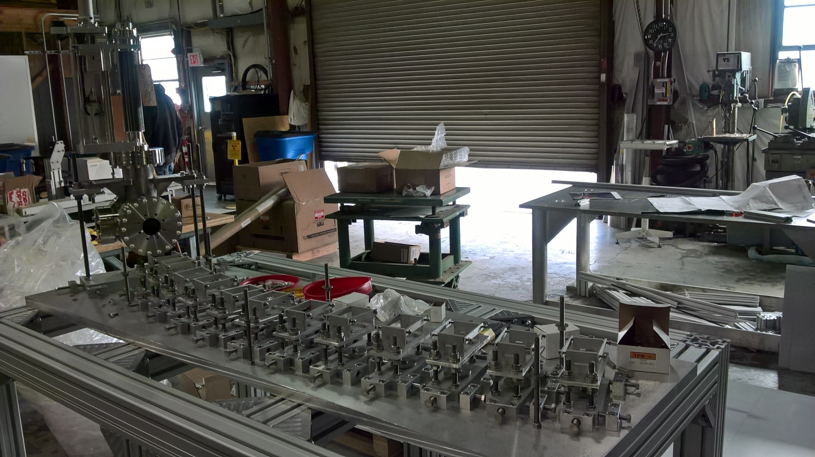
Girder and Supports Construction
Feb 22, 2017

Slide 12
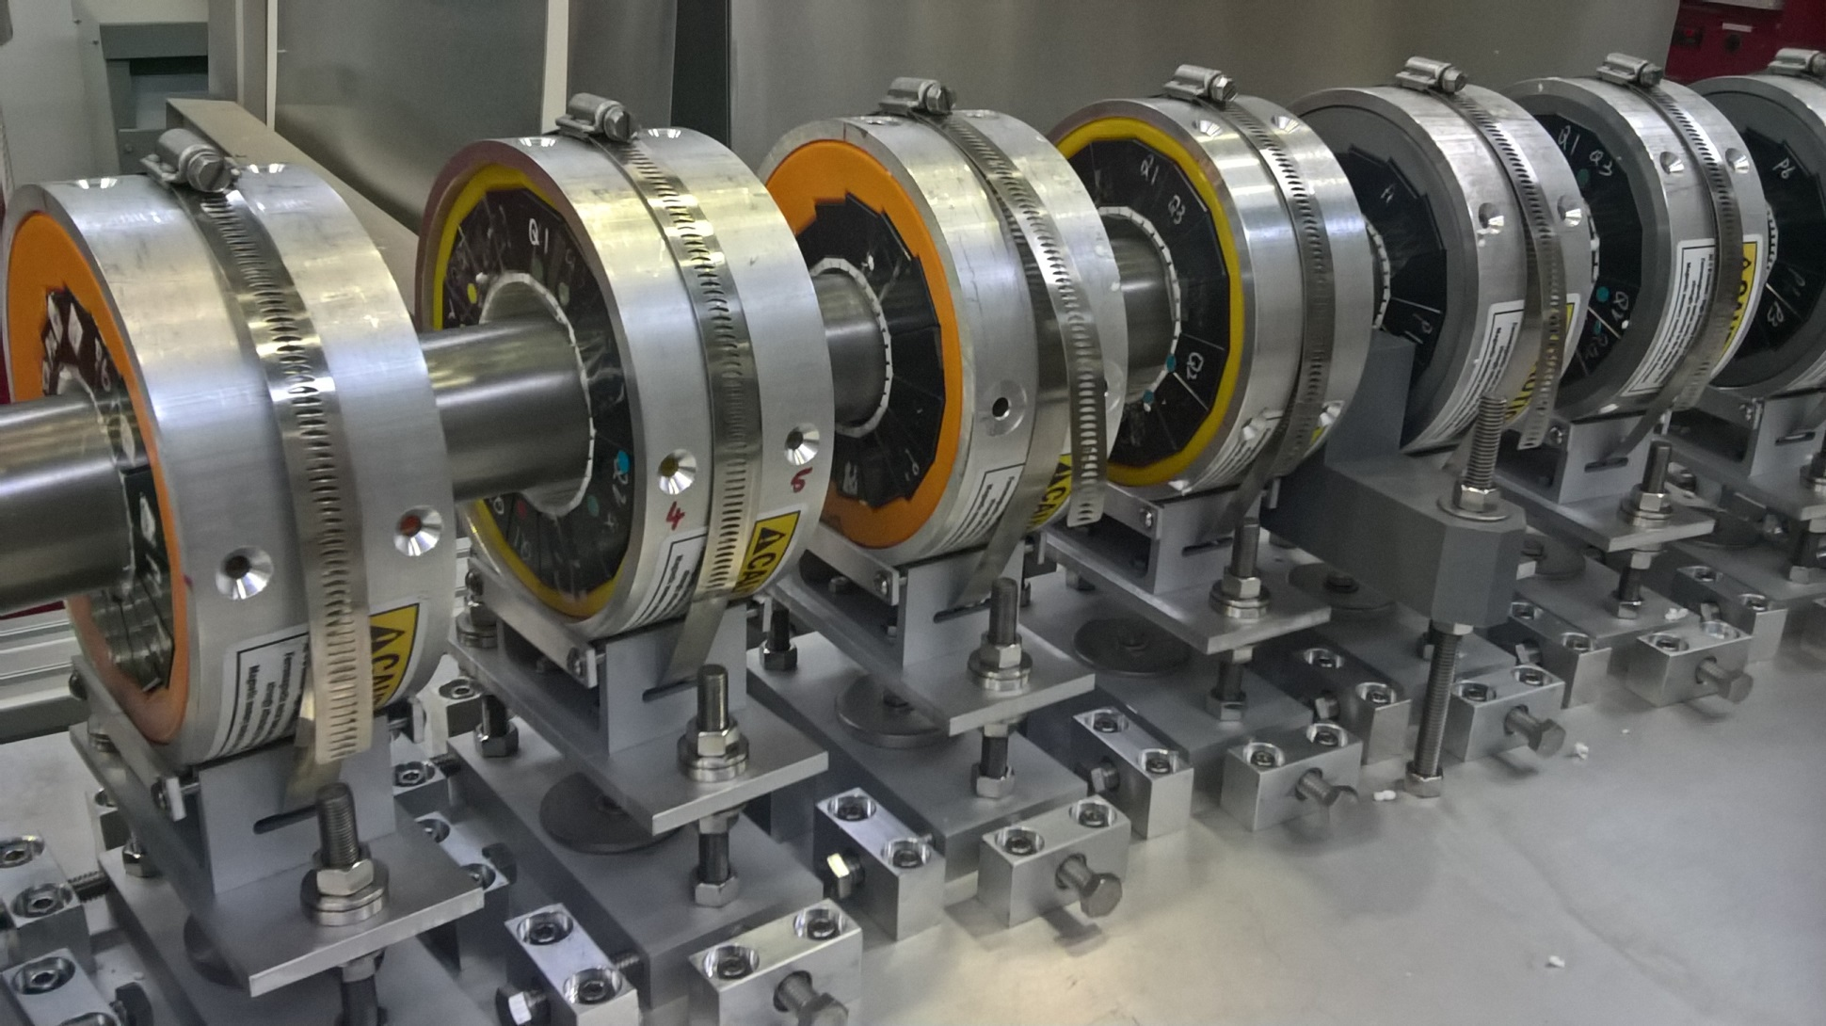
Detail: Magnets on the Girder
Apr 7, 2017

Slide 13
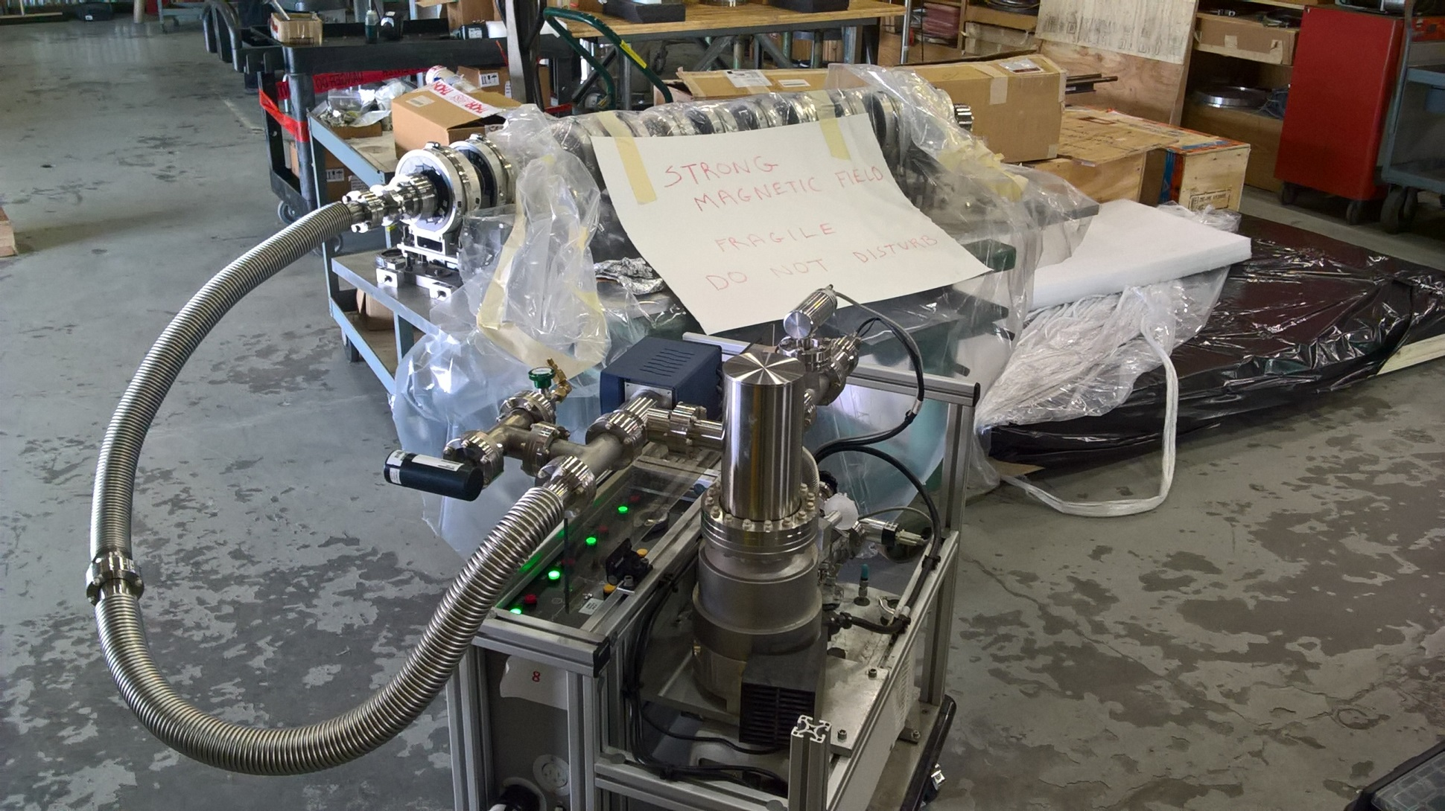
Pipe undergoing Leak Check
Apr 14, 2017

Slide 14
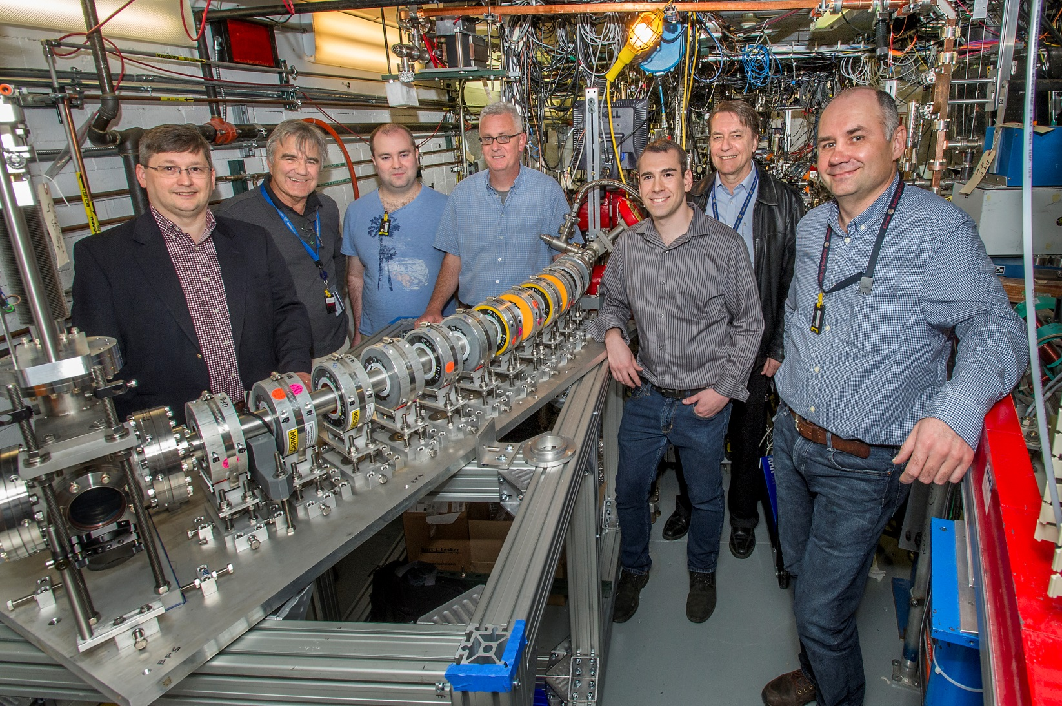
Picture of Everyone Standing By It
ATF experiment AE79
May 1, 2017

Slide 15
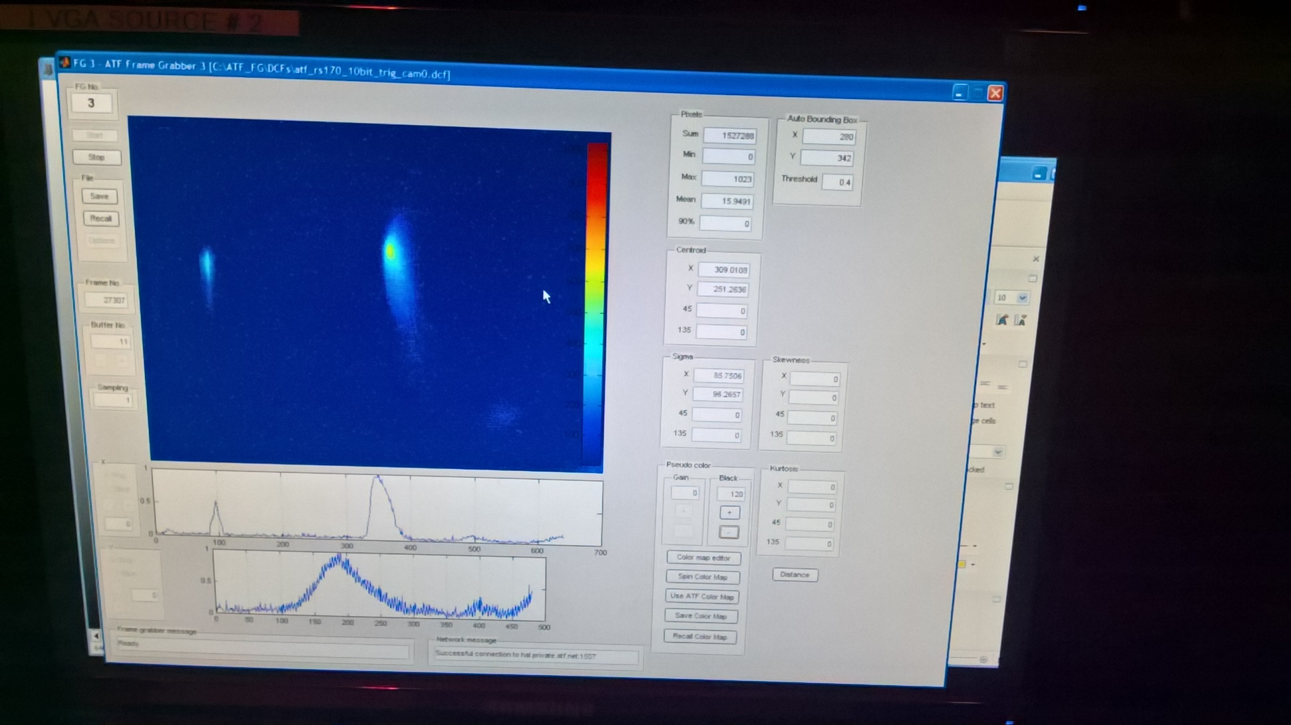
First Beam during Fault Studies
54MeV was the first energy to be tested
May 4, 2017

Slide 16
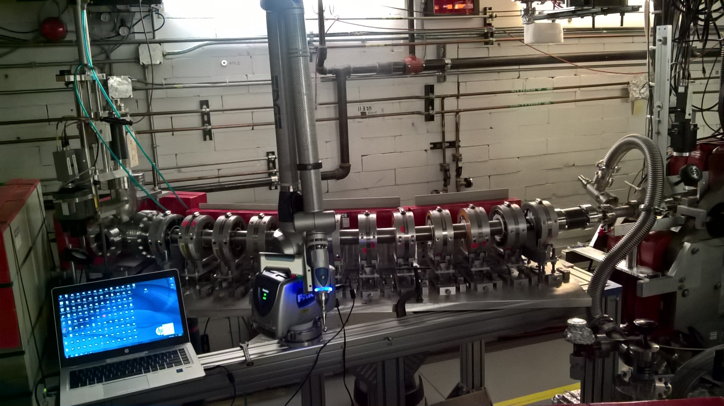
With Survey “Faro Arm” Attached
Most magnet offsets <0.2mm; RMS 0.1mm or better
May 5, 2017

Slide 17
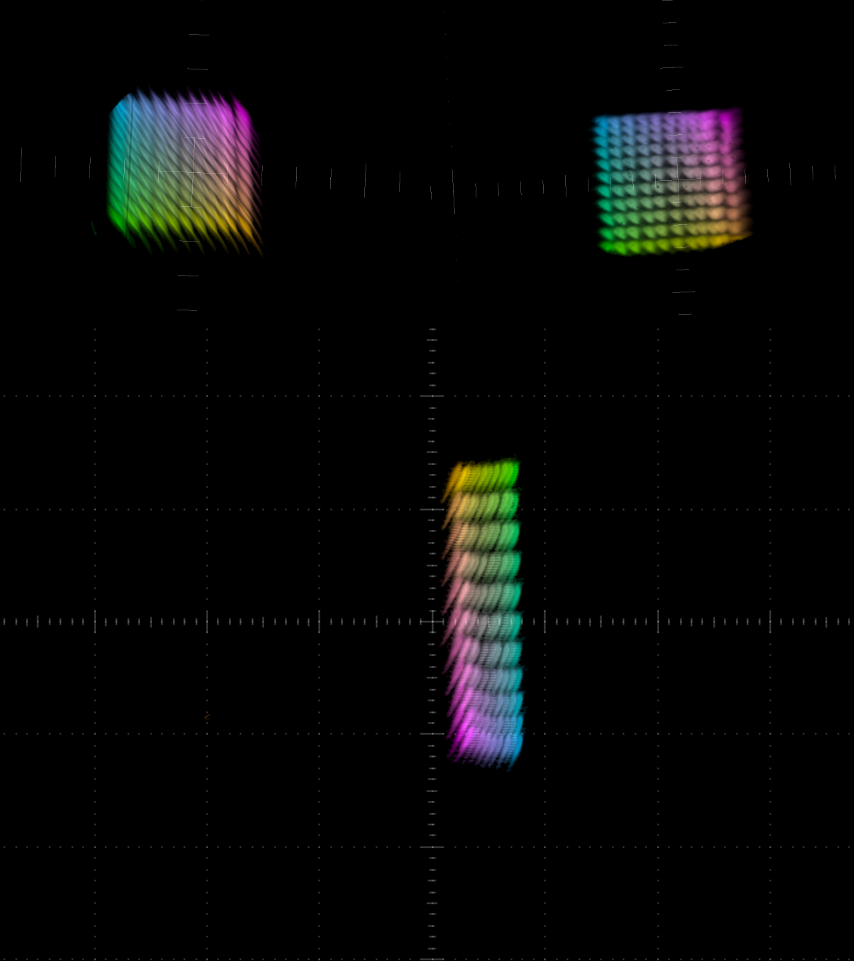
Beam X,Y Scan at 54MeV
May 8-9, 2017
POP10
POP11
Each setting in the 2D current scan is given a colour and all the 11*11 beams at each diagnostic overlayed
Tracking model:
Q_{x} = 0.119
Q_{y} = 0.055
6Q_{x} = 0.713
6Q_{y} = 0.329
FFAG

Slide 18
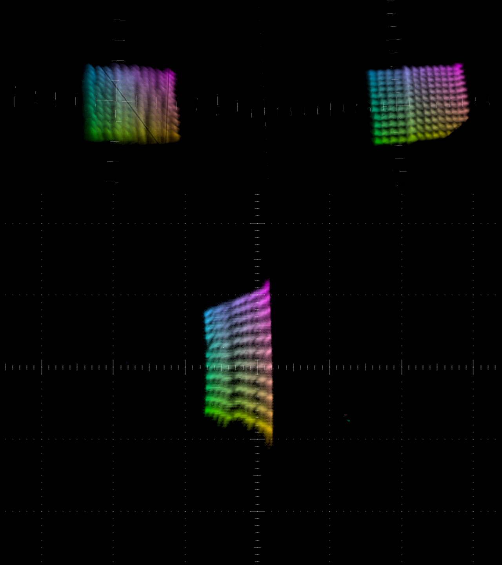
Beam X,Y Scan at 36MeV
May 11-12, 2017
POP10
POP11
Here we encountered beam scraping quite close (~2mm away) to the nominal closed orbit
Later turned out to be injection and pipe misalignment, fixed on later runs
Tracking model:
Q_{x} = 0.176
Q_{y} = 0.122
6Q_{x} = 1.056
6Q_{y} = 0.734
FFAG

Slide 19
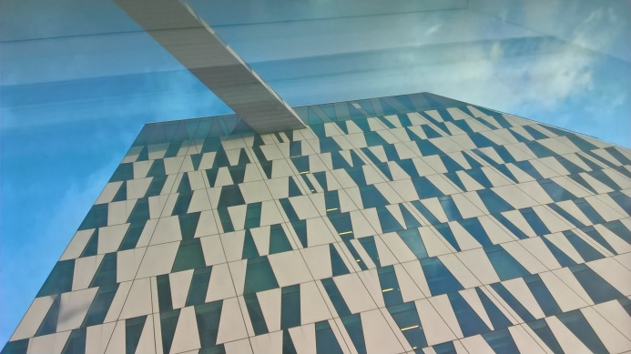
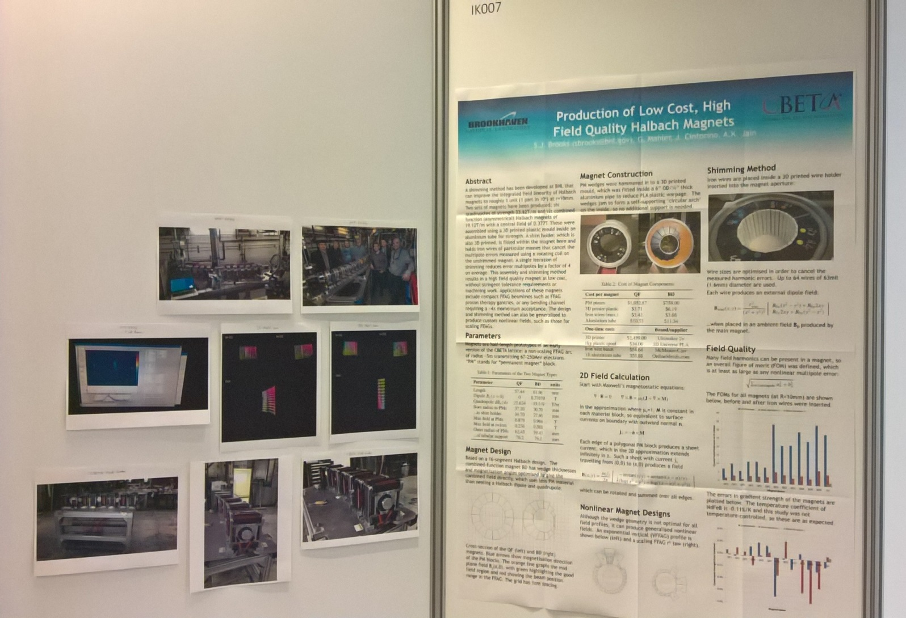
Interlude: IPAC’17
May 18, 2017

Slide 20
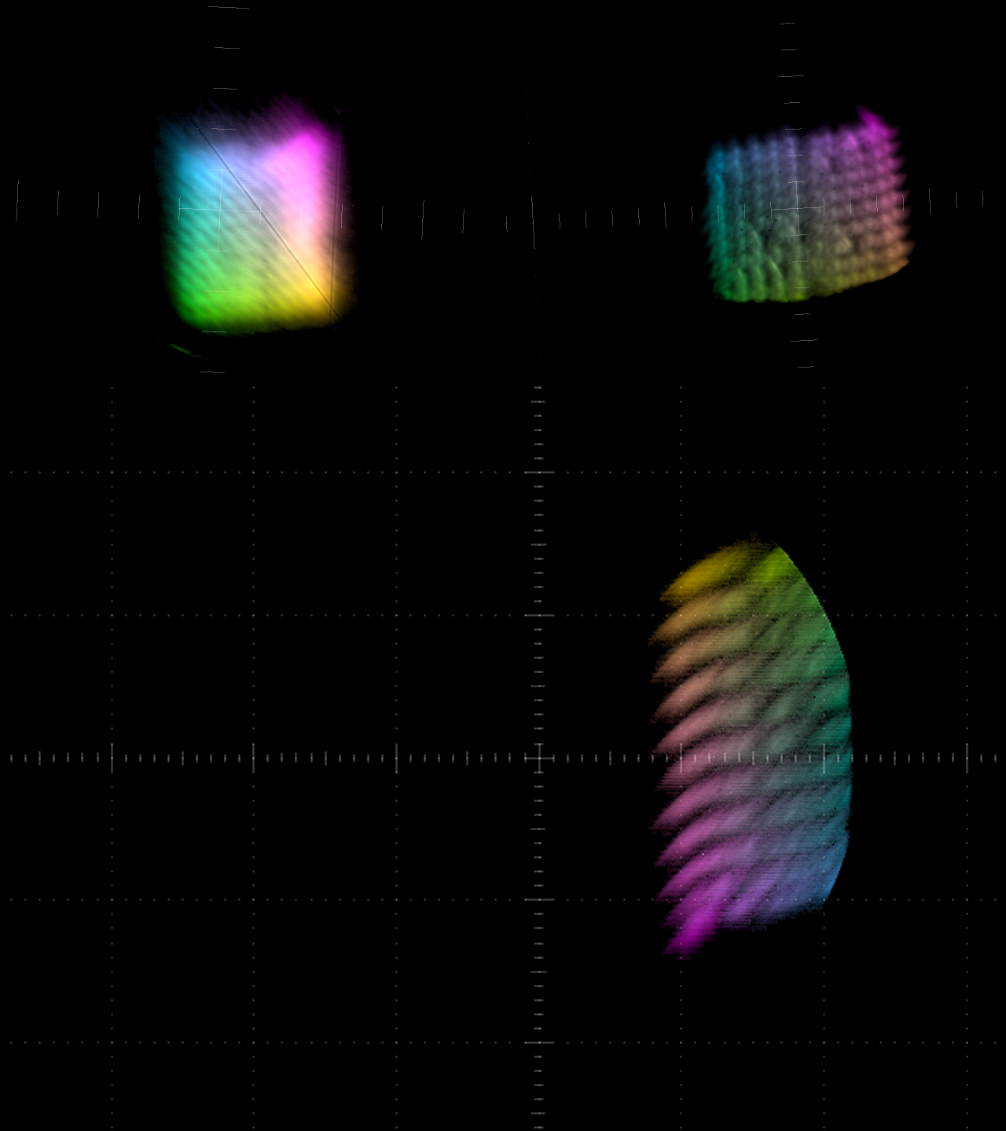
Beam X,Y Scan at 70MeV
Jun 20, 2017
POP10
POP11
The FFAG was aligned for 72MeV k.e. but ATF could only do 70.489MeV
Accepted results taking energy error into account in tracking (hence rightward shift)
Tracking model:
Q_{x} = 0.098
Q_{y} = 0.029
6Q_{x} = 0.587
6Q_{y} = 0.175
FFAG

Slide 21
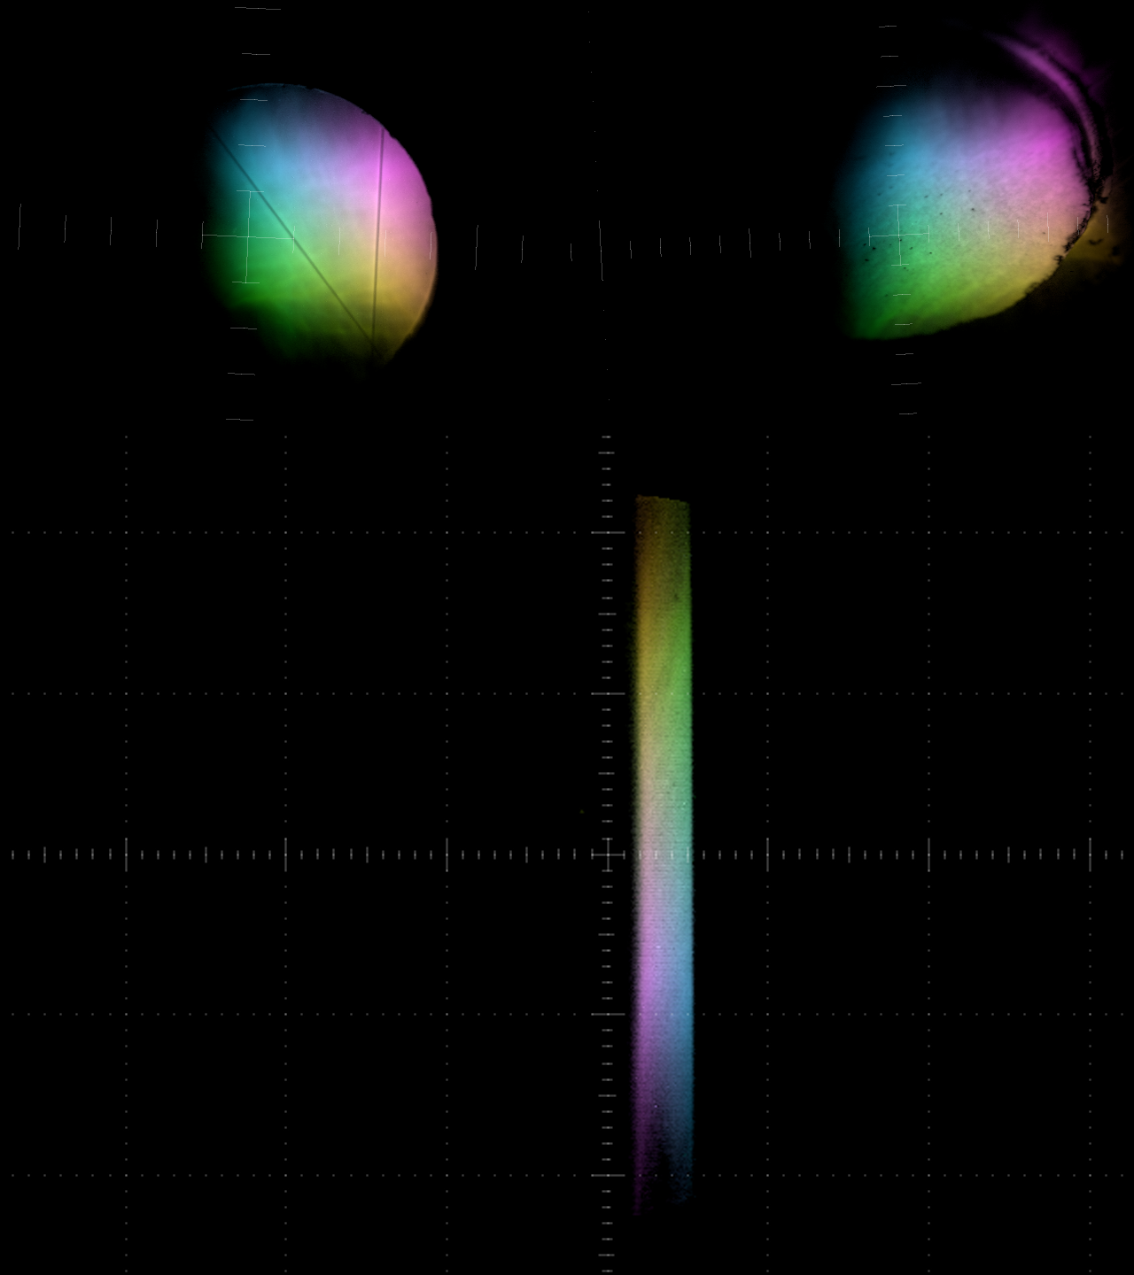
Beam X,Y Scan at 24MeV
Jun 23, 2017
POP10
POP11
At 24MeV and below, the ATF beam becomes much larger due to deceleration in second linac section
Horizontal scraping on the vacuum pipe is visible on both sides
Tracking model:
Q_{x} = 0.271
Q_{y} = 0.212
6Q_{x} = 1.629
6Q_{y} = 1.274
FFAG

Slide 22
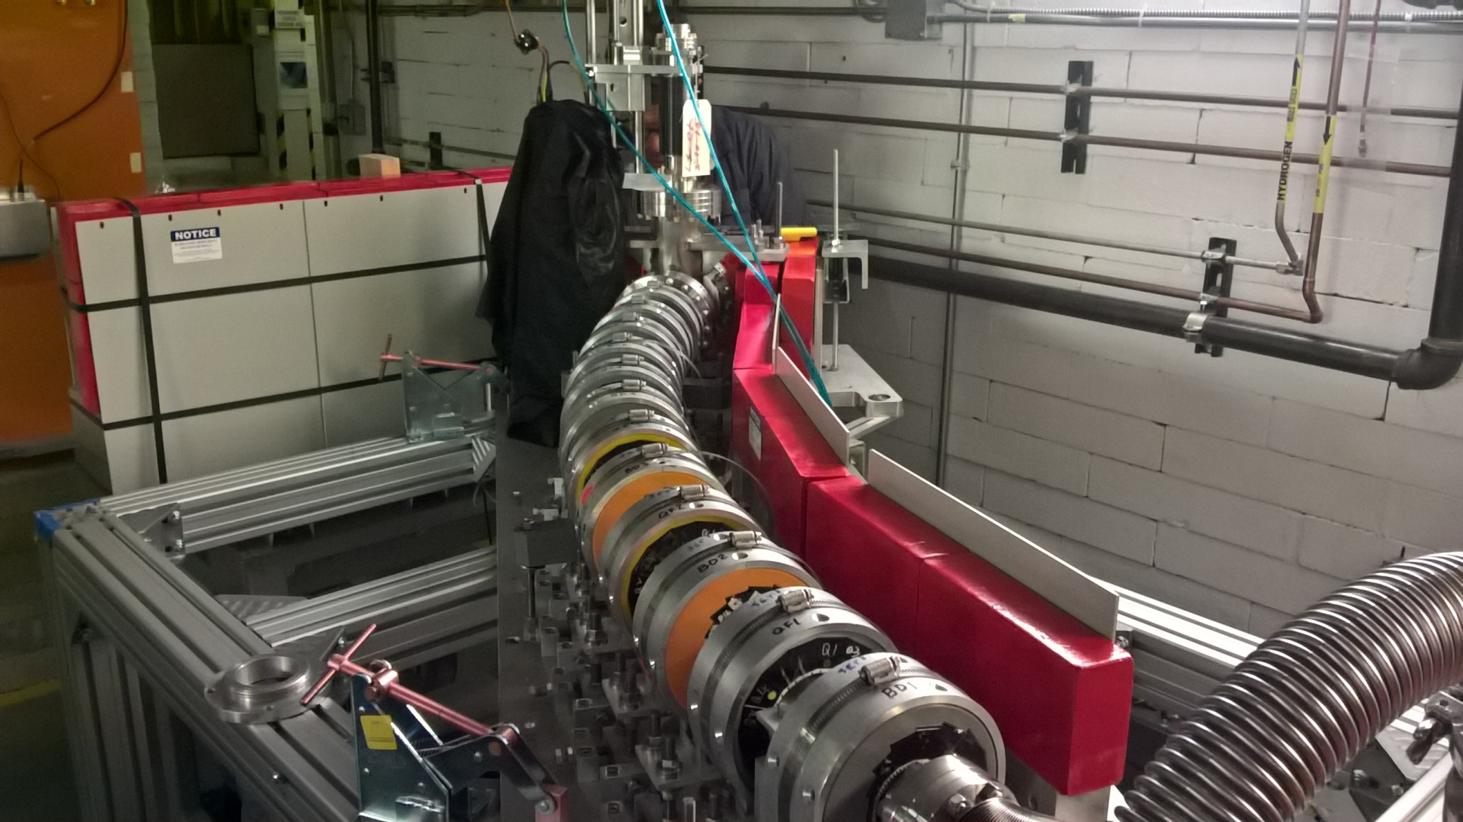
Aligned at 18MeV: Extreme Angle
Jun 28, 2017

Slide 23
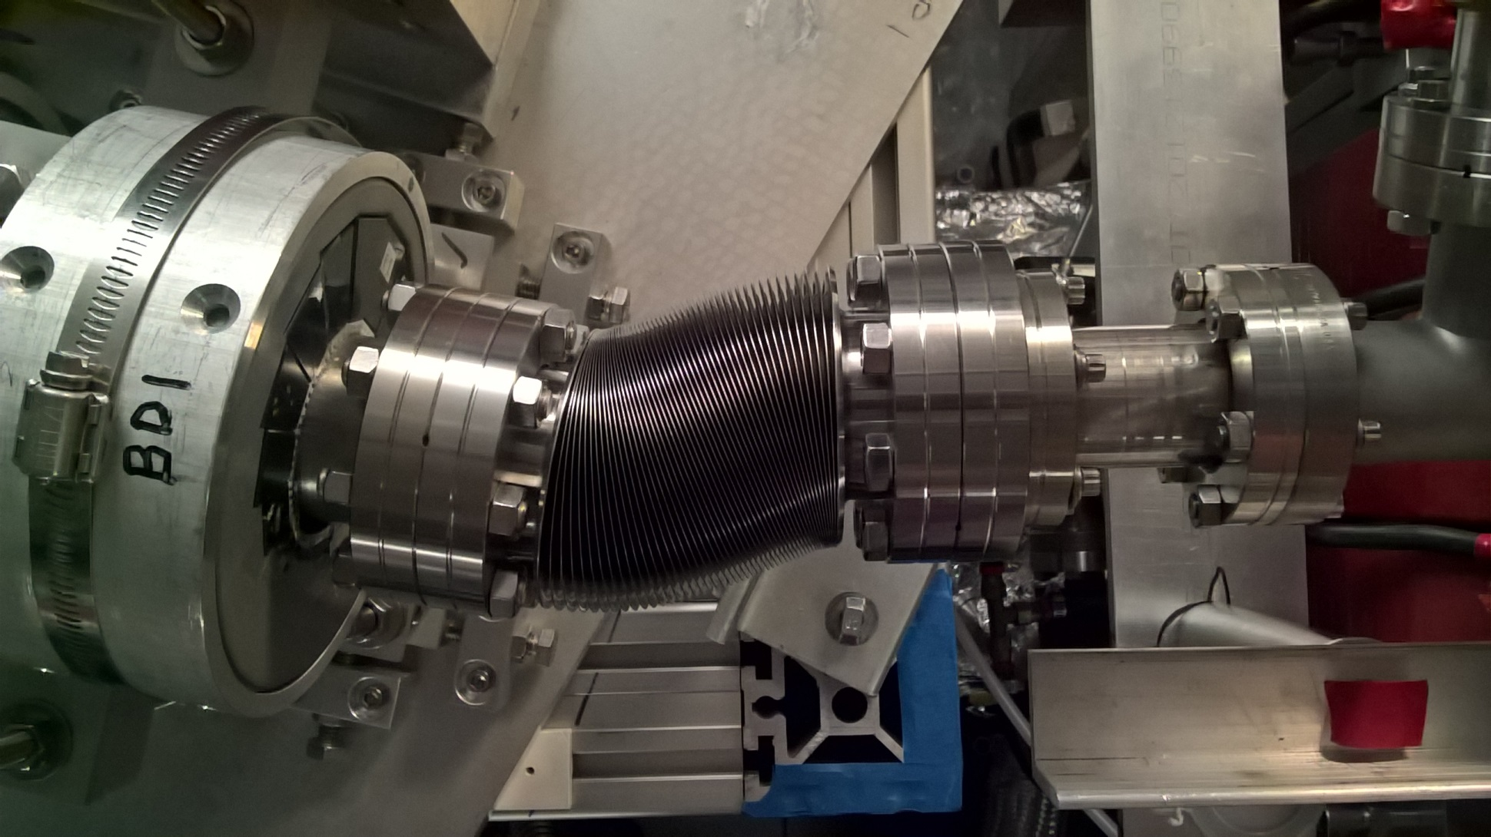
Aligned at 18MeV: Kinked Bellows
Jun 28, 2017

Slide 24
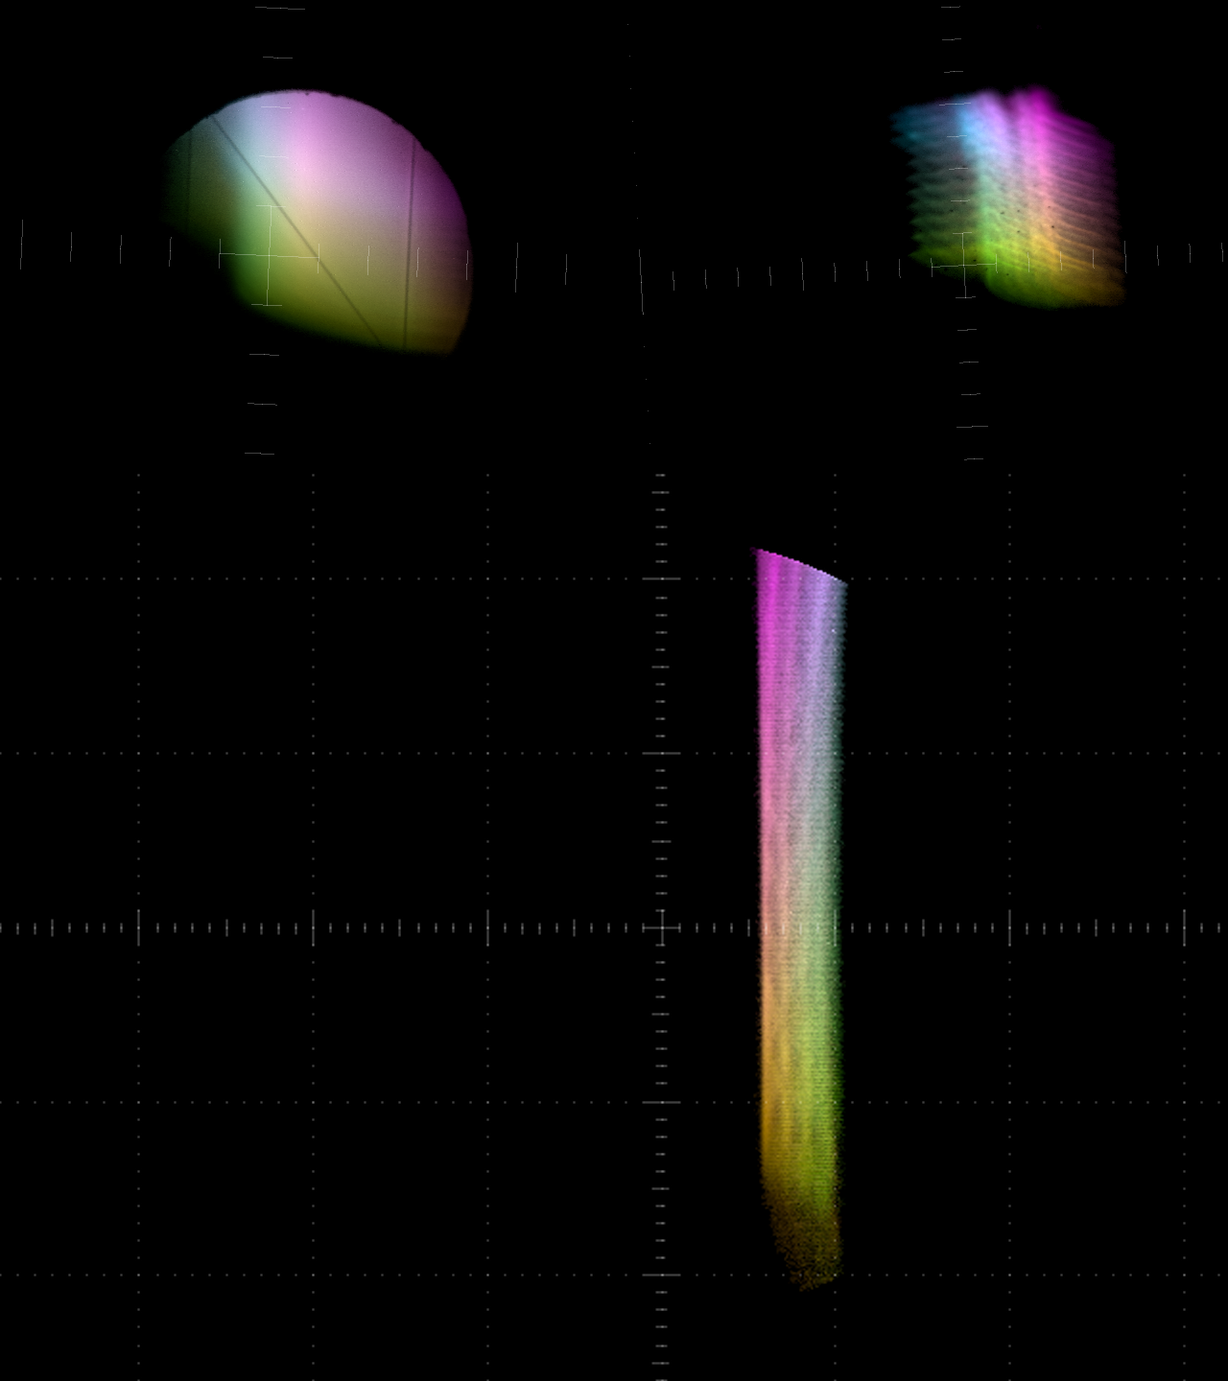
Beam X,Y Scan at 18MeV
Jul 3, 2017
POP10
POP11
Beam got through once again showing X scraping on both sides, but with different vertical phase advance
Experiment complete!
Uninstalled by end of July
Tracking model:
Q_{x} = 0.411
Q_{y} = 0.312
6Q_{x} = 2.463
6Q_{y} = 1.871
FFAG

Slide 25
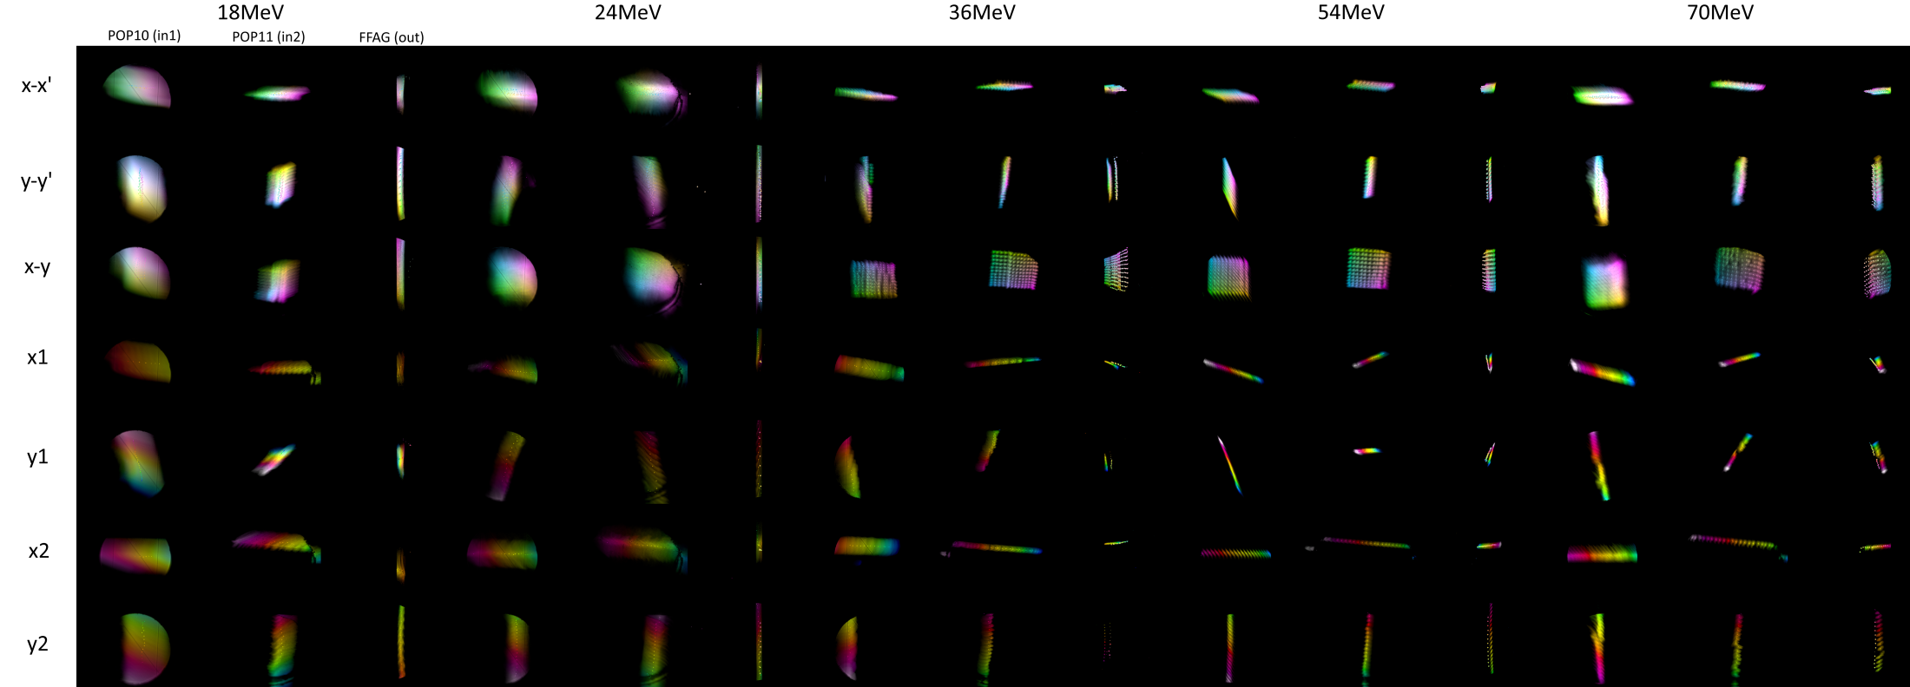
(Almost) all the Data
(5 energies)*(8 scans)*(31–121 points)*(3 screens)*(3–5 pulses) = 25113 images
Quad scan is not on this plot
Torrent of the results is available at http://stephenbrooks.org/ap/ATF-FFAG

Slide 26
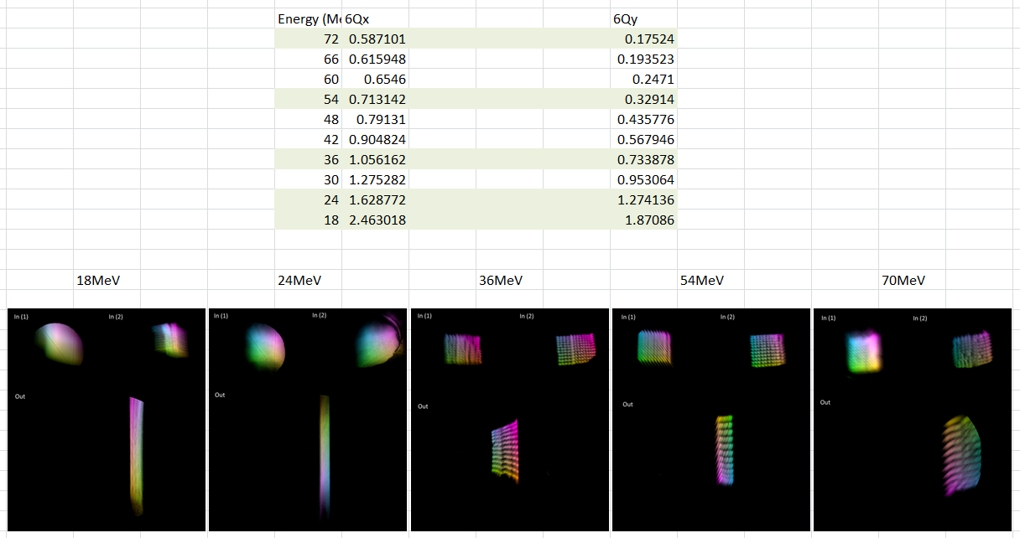
All Energies Phase Advance

Slide 27
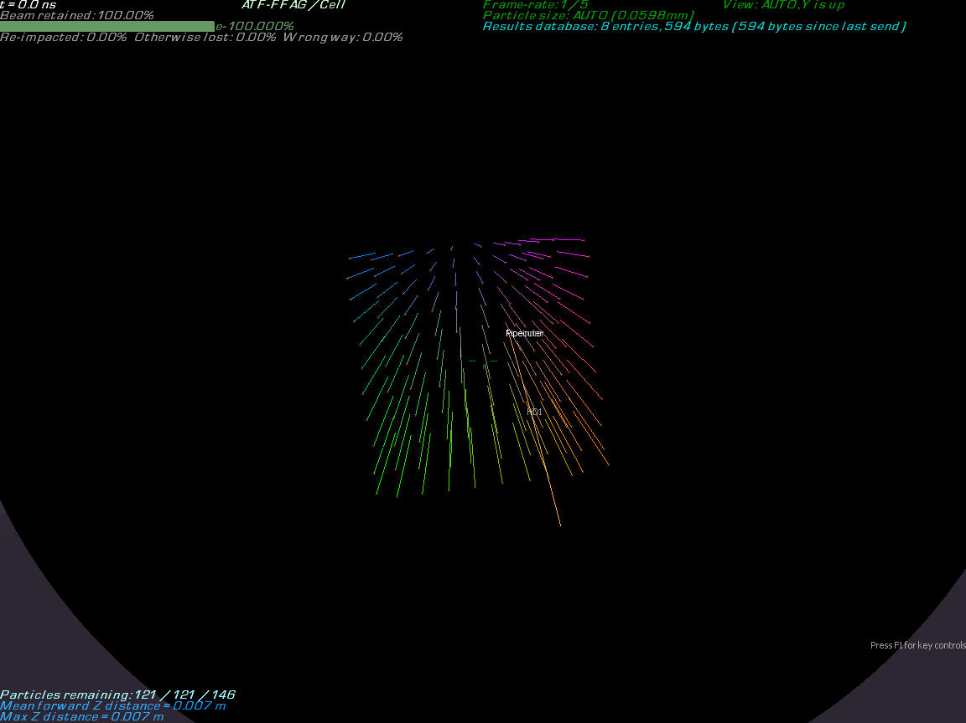

Slide 28
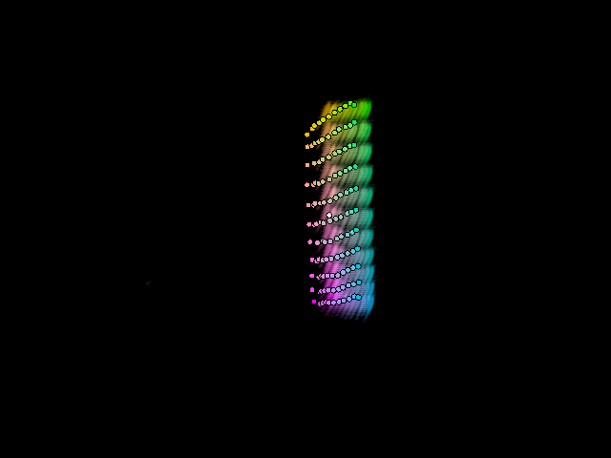
54MeV Results vs. Raw Tracking

Slide 29

Input Camera Roll Angle Correction
Looks better, has some offset.

Slide 30

Fitting X,Y Offset at Output
Required shift:
(1.84,0.38)mm

Slide 31
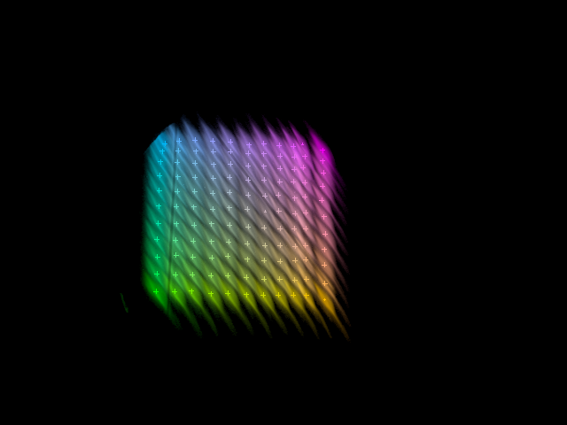
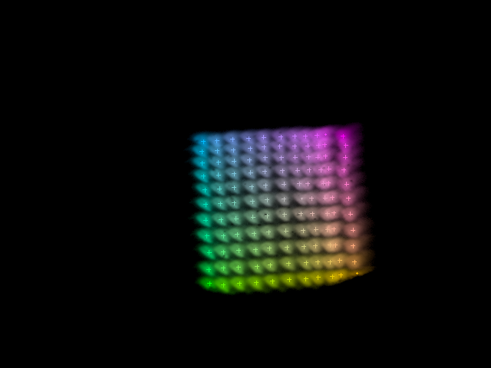
Evidence of Camera Roll Angle
These scan patterns formed by energising the same corrector
POP10 estimated 2.6° clockwise
POP11 estimated 3° anticlockwise
y
y
x
x
Could also be mirror angle errors (multiple mirrors also involved)

Slide 32
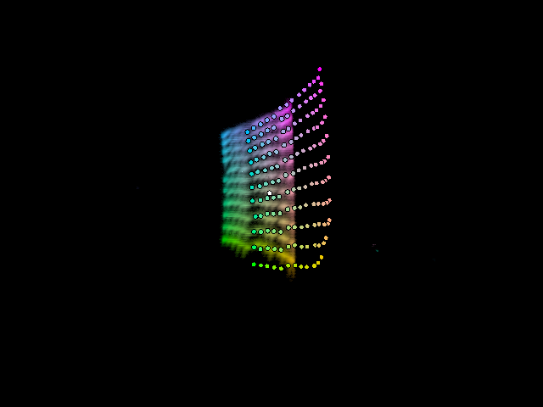
36MeV Results vs. Raw Tracking

Slide 33
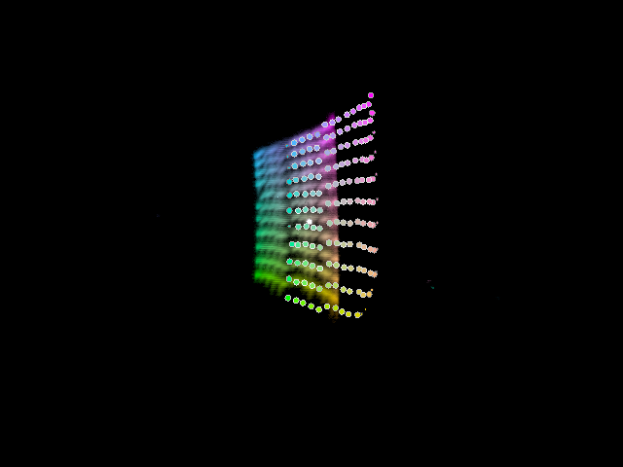
Input Camera Roll Angle Correction
“Perspective” nonlinearity reproduced.
Looks like offset
could be at start
of beamline not
end.
NB: input positions measured relative to HeNe laser, which has thermal drifts, not necessarily actual axis of ATF beamline…

Slide 34
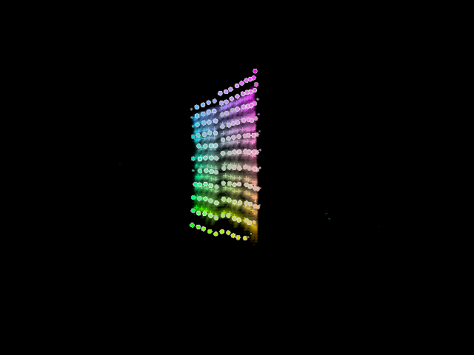
Fitting X,Y Offset at Output
Required shift:
(-3.96,0.21)mm

Slide 35
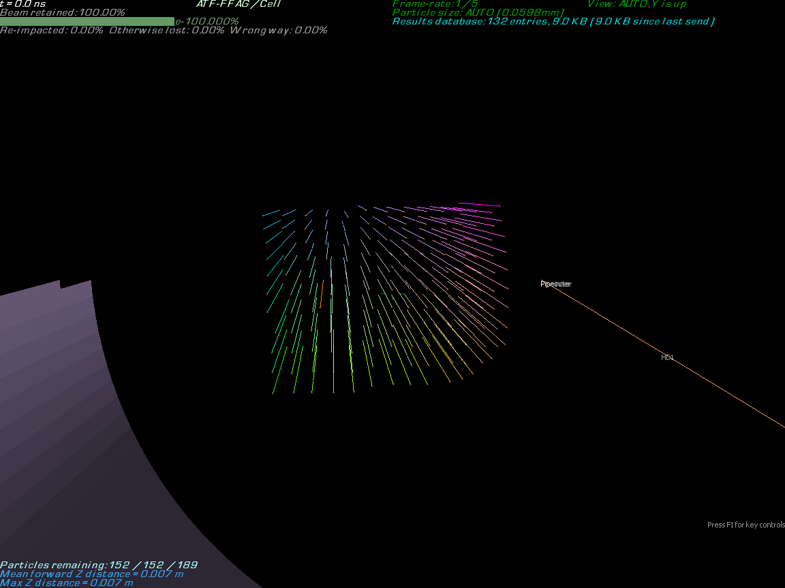

Slide 36
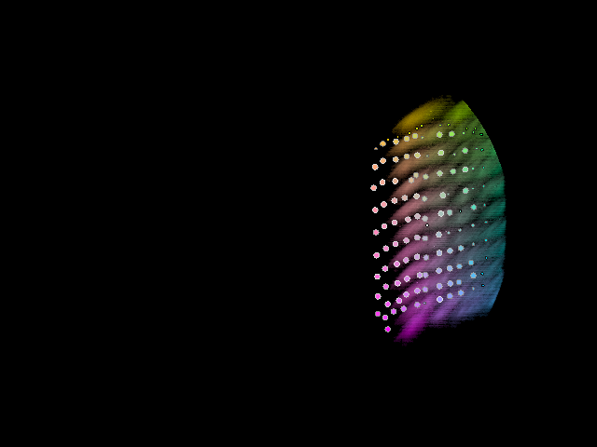
70MeV Results vs. Tracking

Slide 37
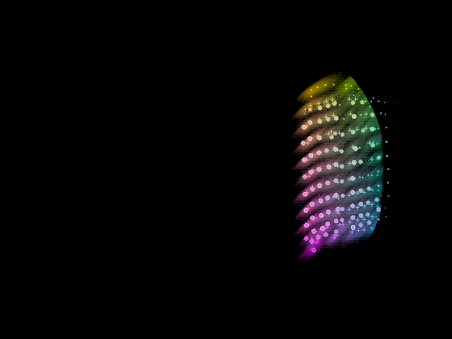
Fitting X,Y Offset at Output
Required shift:
(3.15,-0.09)mm

Slide 38
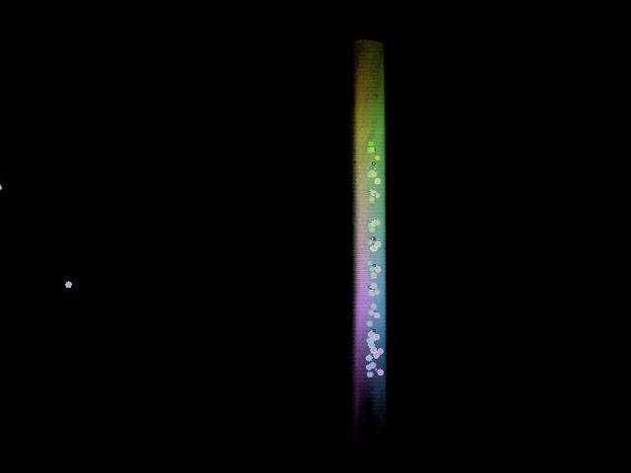
24MeV Results vs. Tracking
Seems to be at an X focus.
Tracking has different sign of X movement, but near zero in either case.

Slide 39
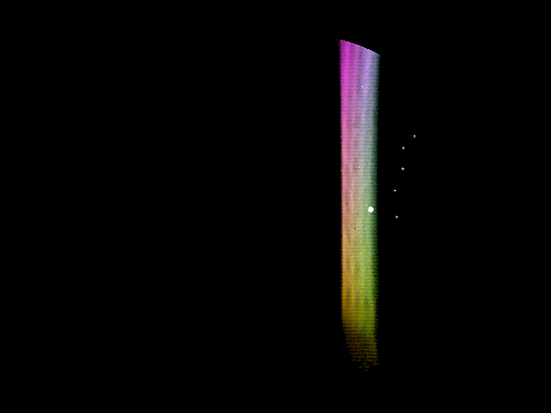
18MeV Results vs. “Tracking”
Tracking went wrong with measured centroids (particles falling out of fieldmap?)
Probably need to apply input shift in order to make the tracked particles go through (white dot is periodic orbit).

Slide 40
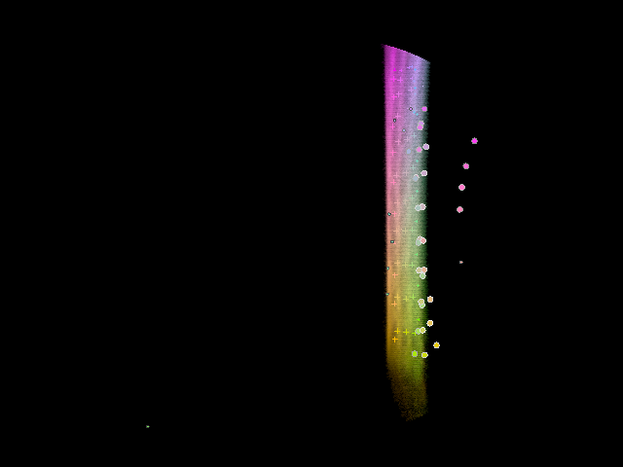
18MeV with Input Shift (arbitrary)
Picked a beam that got through and applied an input shift to put it on the closed orbit.
Required shift:
(-2.60,-2.65)mm

Slide 41
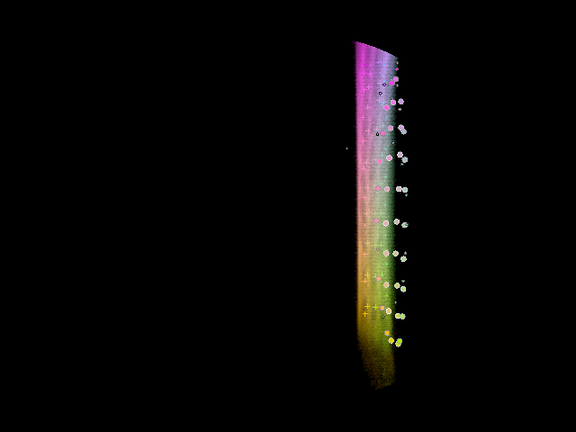
18MeV with Input Shift (no FM)
Replaced OPERA-3D fieldmaps by Muon1 soft-edge field model.
Much better!
Should check not going out of bounds in fieldmaps or something.

Slide 42
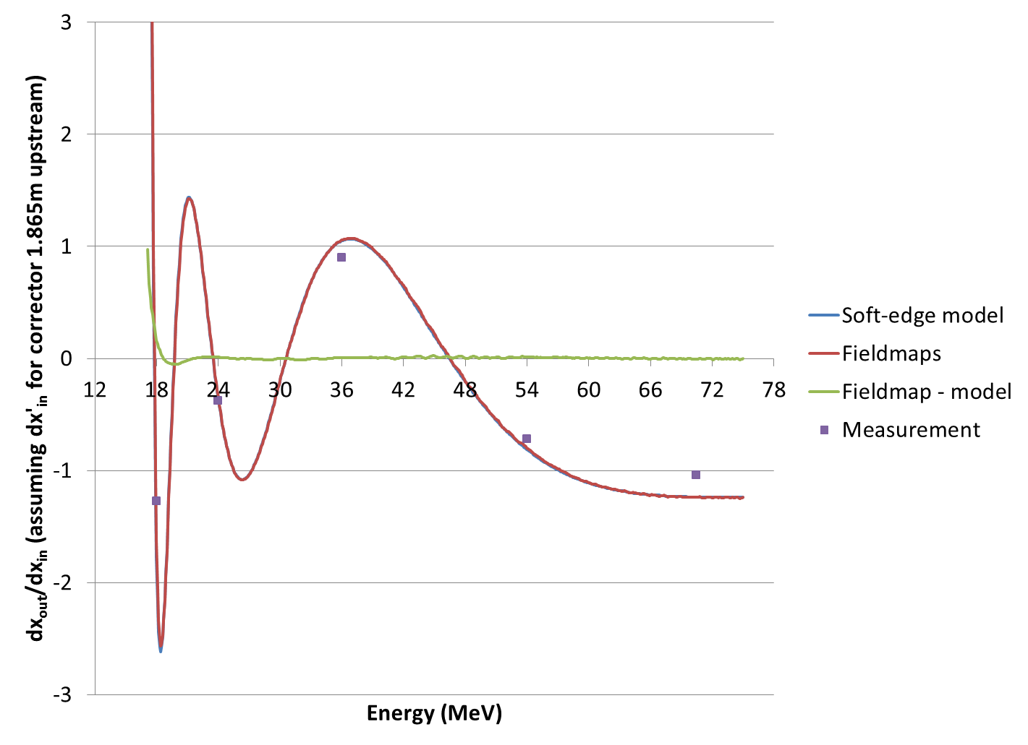
Transfer Matrix XX Element
“Measurement” is just taking the difference of a pair of centroids in the good area of the scan

Slide 43
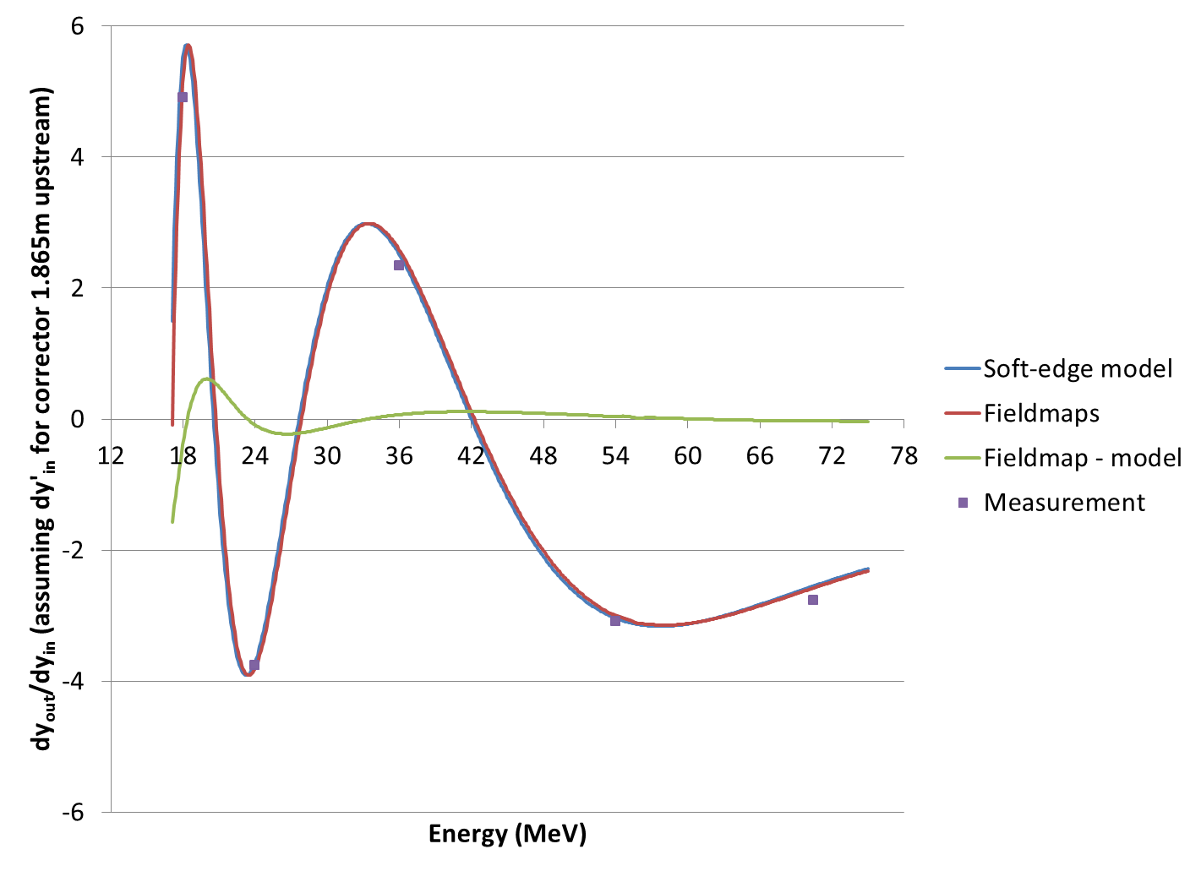
Transfer Matrix YY Element

Slide 44
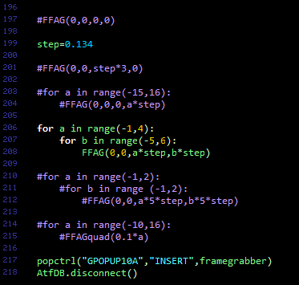
Source Code, Open Data
Torrent of the results is available at http://stephenbrooks.org/ap/ATF-FFAG

Slide 45
Conclusion & Future Plans
Beam has turned a nontrivial angle (40°) in six cells of a non-scaling FFAG
  Over a 3.8x momentum range (NS-FFAG record)
  At an energy of up to 70MeV (NS-FFAG record)
  Using compact permanent magnet technology
No highly nonlinear aberrations seen
  More data processing needed to get good fit to tracking at lower energies
Demonstrates technology for CBETA and more

Slide 46
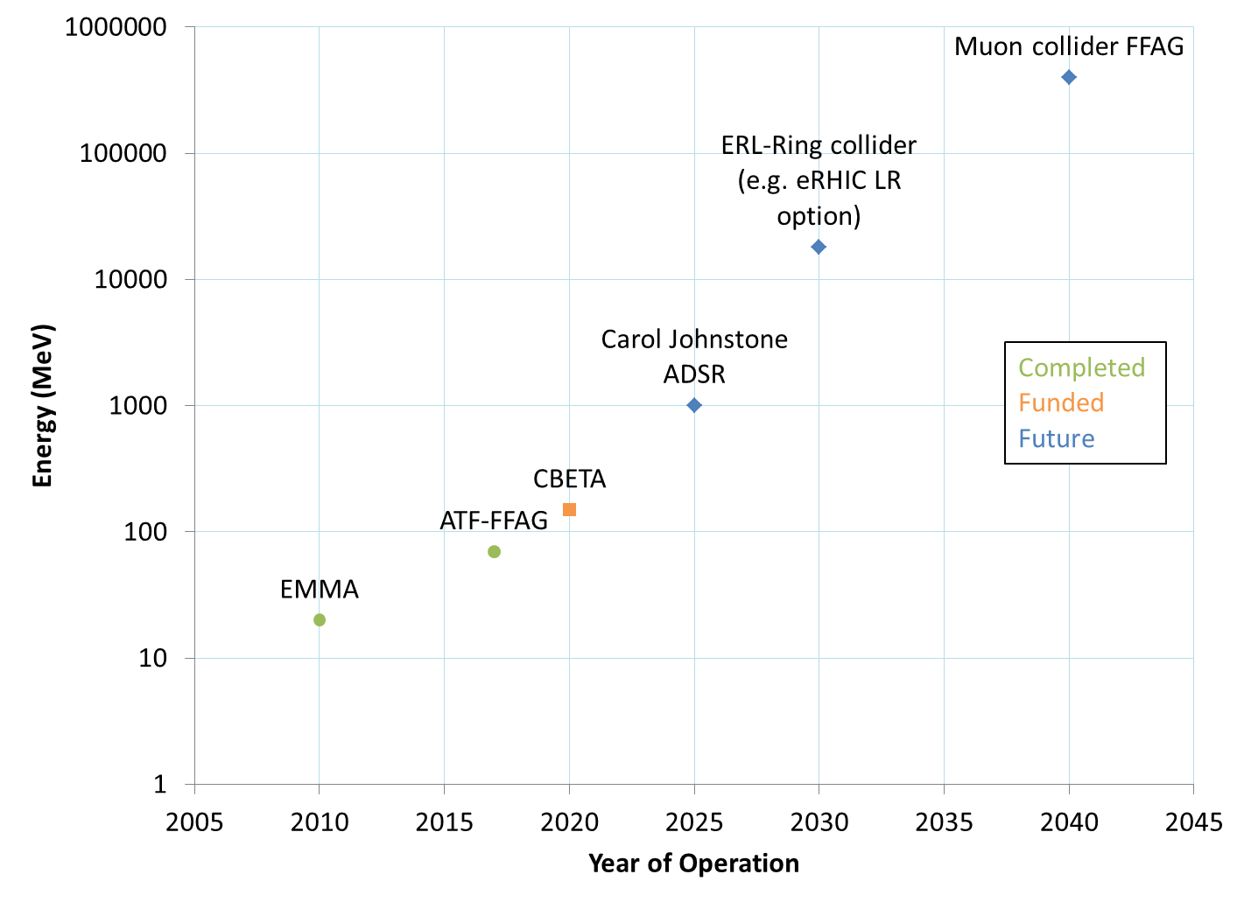
NS-FFAG Livingstone Plot?

Slide 47
BACKUP

Slide 48
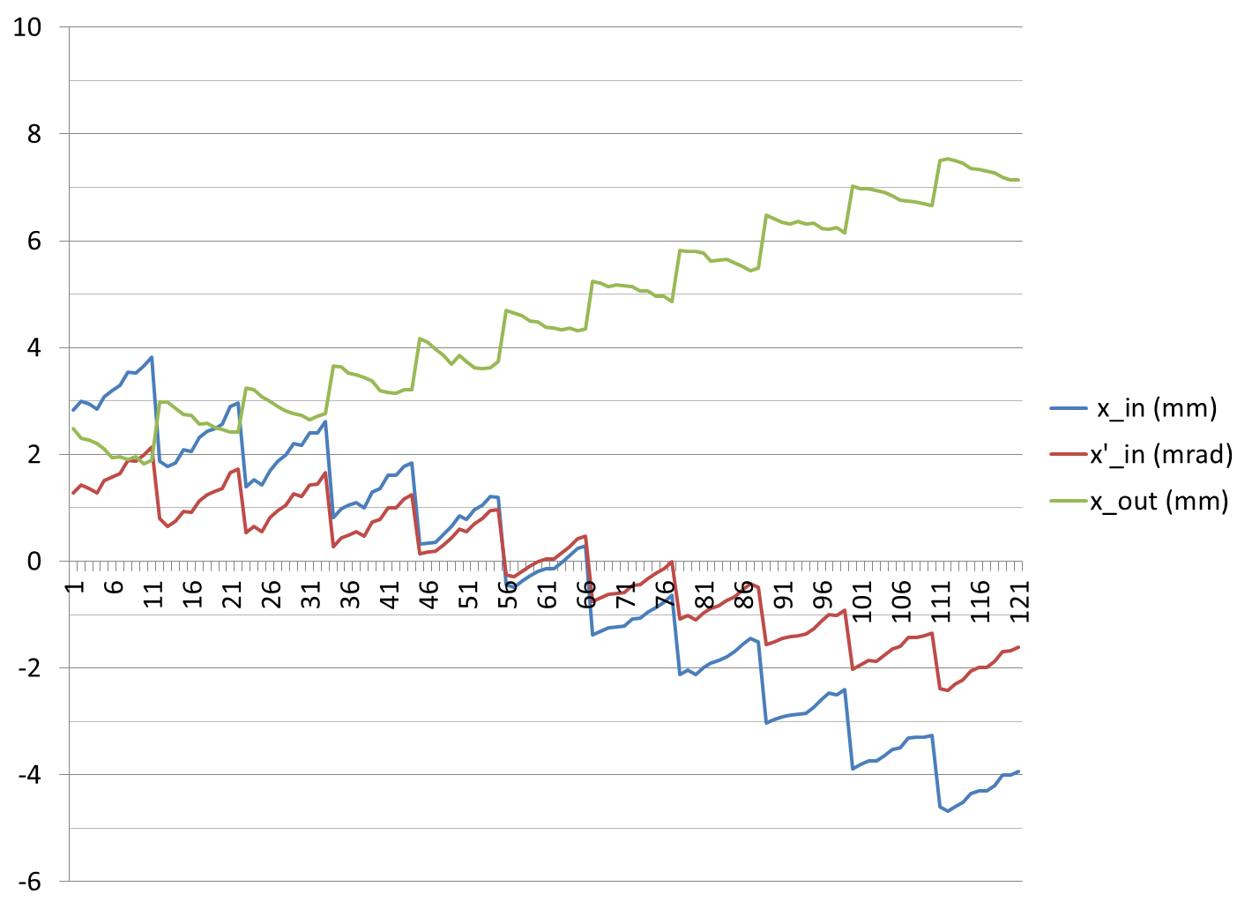
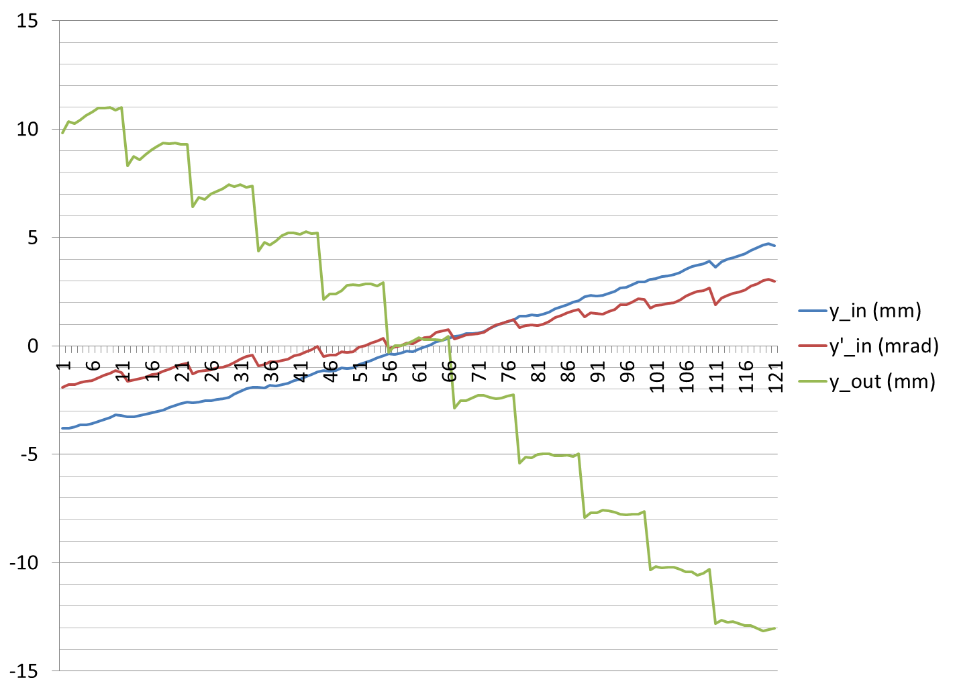
Input/Output Position at 54MeV

Slide 49
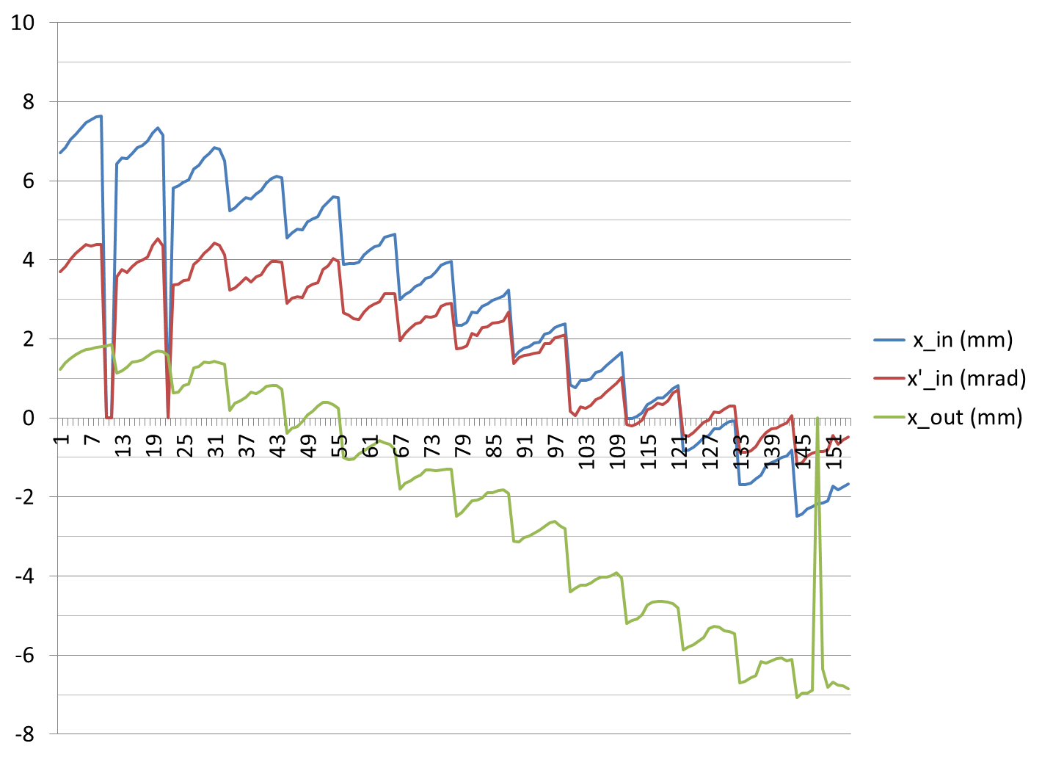
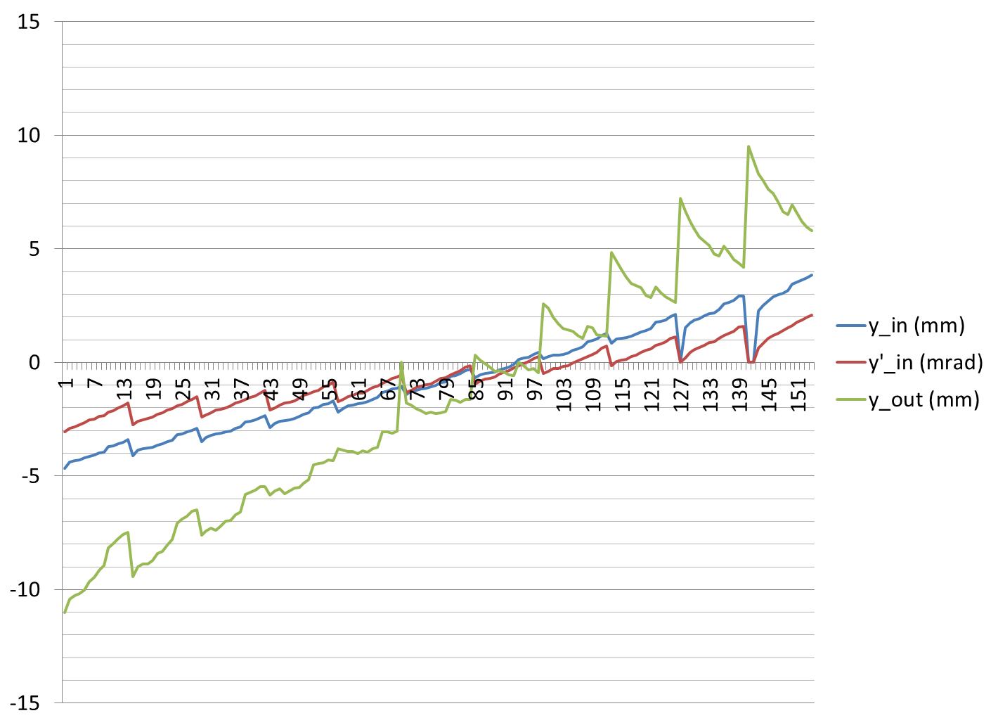
Input/Output Position at 36MeV

Slide 50
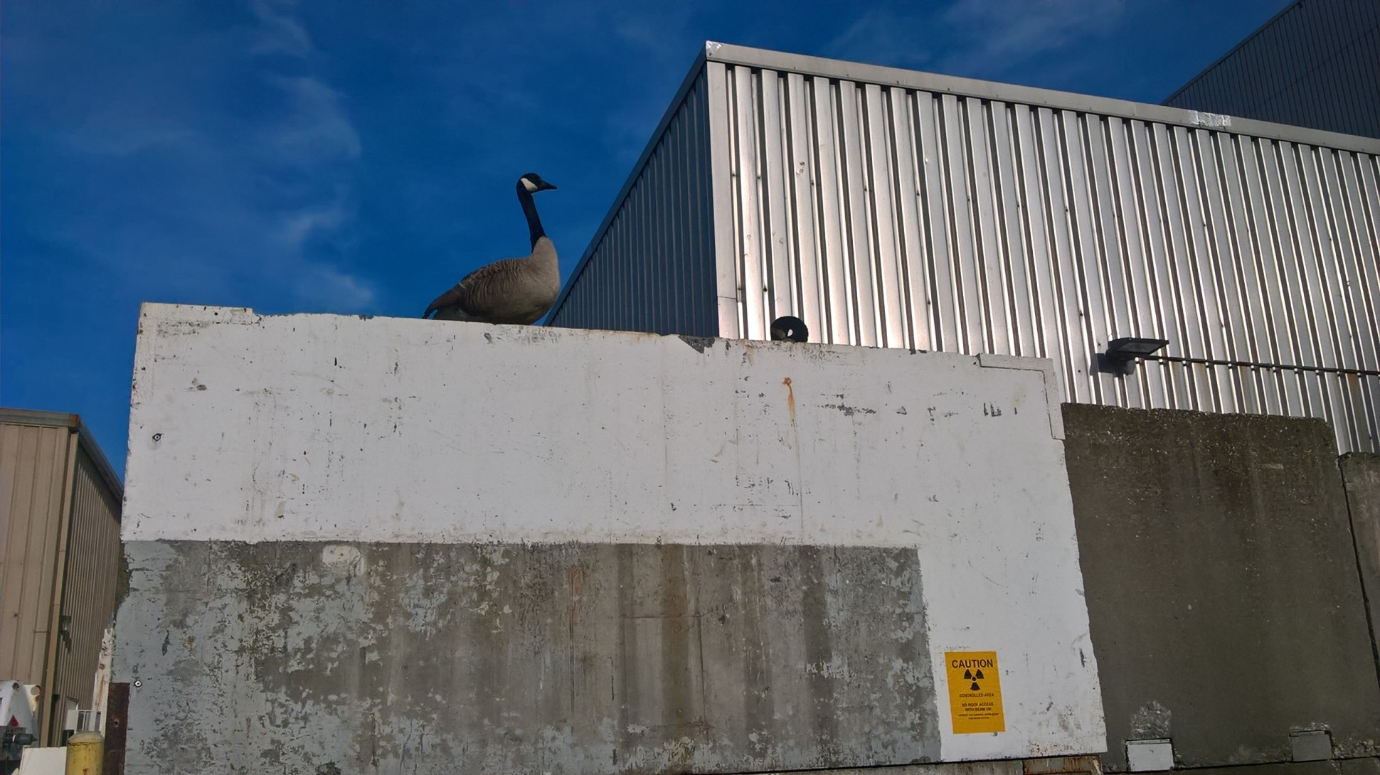
Geese on Shielding at 36MeV
May 11, 2017

Slide 51

24MeV Results vs. Tracking (no FM)
Replaced OPERA-3D fieldmaps by Muon1 soft-edge field model.
X movement has right sign.

Slide 52









Other interesting stuff at IPAC’17

Slide 53

Compensating for Output Offset

Slide 54

Errors vs. Tracking, Output Offset

Slide 55

Best Fit X,Y Offsets at Output

Slide 56

Best Fit X,Y Offsets at Output

