Slide 1
Potential and Issues for Future Accelerators and Ultimate Colliders
Including a few things from the “F3iA 2016” meeting in Germany
(look it up for others’ perspectives)
https://indico.desy.de/indico/event/15657/

Slide 2
Energy Frontier
What if there is no easy new physics and a large “energy desert” to cross?
Let’s examine an extreme example and see what could be different about energy frontier machines in the far future that are capable of discovering new physics
  Context for the F3iA meeting was “accelerators in the 2nd half of the 21st century”
  What I describe here could be even further out

Slide 3
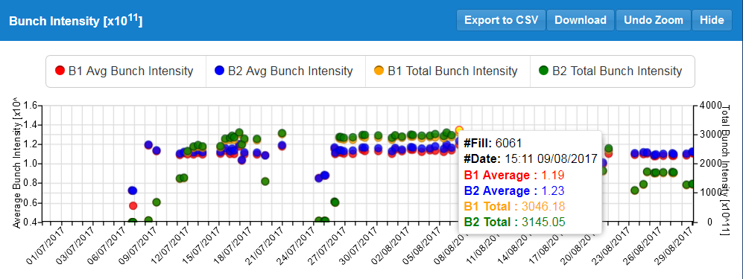
The Case for Optimism
http://acc-stats.web.cern.ch/acc-stats/#lhc/run-details
2 * 3.1e14 * 6500 GeV = 645 MJ = 0.33 E_{Planck}
Total energy is OK but in too many particles
  Maybe we should try 1 particle per beam?

Slide 4
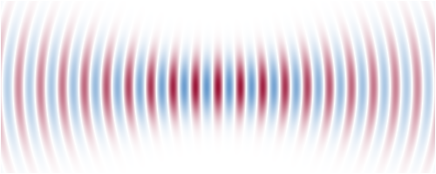
Single-Particle Accelerators
Wavefunction propagates through lattice
  Can still form optical foci like with laser photons
  Minimum emittance ε_{N,rms}=ħ/2mc
  set by uncertainty principle
Need emerging ultra-cold and precision alignment technology
  Unfamiliar areas for us!
Collaboration with:
Atomic physics
Quantum computing
Ultra-cold physics
Metrology
Gravitational wave detection
Experiment example:
Put single particles with quantum behaviour (e.g. from “double slit”) through accelerator-type optics and final focus

Slide 5
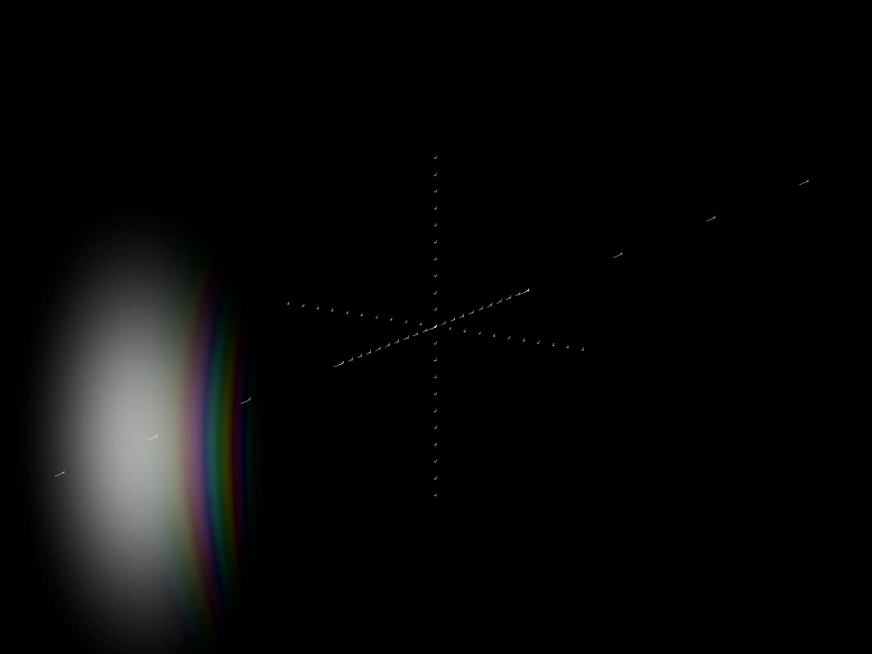

Slide 6
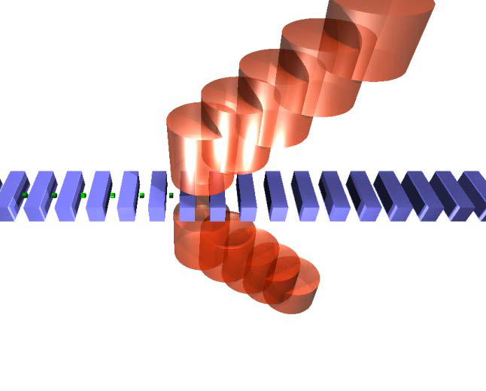
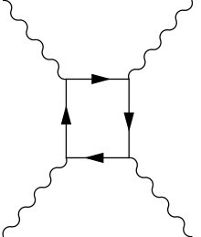
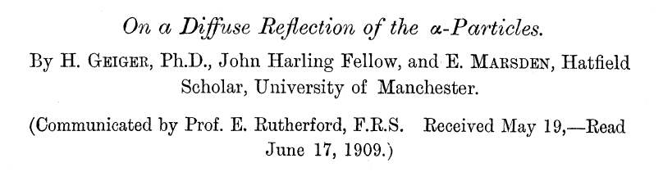
Gradients in a 2×10km-long Facility
A. Pukhov et al., Eur. Phys. J. ST 223, 1197–1206 (2014)
Fibre laser + dielectric proposal
2 TV/m
E.R. Caianiello, Lett. Nuovo Cimento 41, 370 (1984)
G. Papini, arXiv:quant-ph/0407115 (2004)
Cosmic ray
3×10⁸ TeV
Quantum maximum acceleration
a_{max}=2mc³/ħ → G_{max}= 2m²c³/ħq
Energy
1 TeV
e
μ
10¹⁶ TeV
10¹⁰ TeV
E_{Planck}
1 GV/m
1 TV/m
10²⁴ V/m
100 MV/m
Gradient
10¹⁵ V/m
ELI-NP laser, Romania
1.3×10¹⁸ V/m
Schwinger limit
5×10¹⁹ V/m
Achieved (briefly)
At ~10¹⁸ V/m gradient, would need ~10 million km to get to the Planck energy. Or can we do something about that? In 10km.

Slide 7
Shortcut to Planck scale: Black Hole
M.W. Choptuik and F. Pretorius, Phys. Rev. Lett. 104, 111101 (2010)
Black holes can form from k.e. in collisions
  Schwarzschild radius scales linearly with mass
  Instead of putting 1 E_{Planck} in 1 L_{planck} …
  Put 10⁶ E_{Planck} in 10⁶ L_{planck}
Need a diffraction-limited focus of 10¹² particles at 10¹⁰ TeV (instead of 2 at 10¹⁶ TeV)
  Energy requirement goes up by 10⁶ to 893 GW.h
    Large but not a show-stopper in the long run
r_{s}=2GM/c²
If we don’t make a black hole (e.g. in the case of Einstein-Cartan theory), that’s OK, we’ve still probed new physics

Slide 8
Black Hole Factory Parameter Table
Parameter | Bosons e.g. photons (overlapping) | Fermions or non-overlapping bosons
Energy | 10¹⁰ TeV | 10¹² TeV
Length | 10 km | 1000 km (space)
Gradient | 10¹⁸ V/m | 10¹⁸ V/m
Number of particles | 10¹² | 10¹²
Total energy per pulse | 3.22×10¹⁵ J = 893 GW.h | 3.22×10¹⁷ J=89.3 TW.h
Repetition period | 14 days | 14 days
Average power | 2.66 GW | 266 GW
σ_{x}* = σ_{y}* = σ_{z}* | 1.97×10⁻²⁹ m | 1.97×10⁻²⁷ m (beam)
σ_{θ}* = σ_{E}*/E | 0.5 rad = 50% | 0.5 rad = 50%
Black hole radius = 2.14σ_{x}* | 4.22×10⁻²⁹ m | 4.22×10⁻²⁷ m
Black hole mass | 28.4 grams | 2.84 kg
Black hole lifetime | 1.10×10⁻²² s (evaporation) | 1.10×10⁻¹⁶ s
Deepest mine=4km, allows +/-226km laterally within Earth
worse
$107M per shot at US avg. electricity price
worse
By far the hardest parameters are the alignment & emittance
6D phase space N times larger, N^{1/3} each plane
S.W. Hawking, Nature 248, 30 (1974)
D.N. Page, Phys. Rev. D 13, 198–206 (1976)

Slide 9
Compare at 100km Length
Parameter | Bosons e.g. photons (overlapping) | Fermions or non-overlapping bosons
Energy | 10¹¹ TeV | 10¹¹ TeV
Length | 100 km | 100 km
Gradient | 10¹⁸ V/m | 10¹⁸ V/m
Number of particles | 10¹⁰ | 10¹⁵
Total energy per pulse | 3.22×10¹⁴ J = 89.3 GW.h | 3.22×10¹⁹ J = 8.93 PW.h
Repetition period | 14 days | 14 days
Average power | 266 MW | 26.6 TW
σ_{x}* = σ_{y}* = σ_{z}* | 1.97×10⁻³⁰ m | 1.97×10⁻²⁵ m (beam)
σ_{θ}* = σ_{E}*/E | 0.5 rad = 50% | 0.5 rad = 50%
Black hole radius = 2.14σ_{x}* | 4.22×10⁻³⁰ m | 4.22×10⁻²⁵ m
Black hole mass | 2.84 grams | 284 kg
Black hole lifetime | 1.10×10⁻²⁵ s | 1.10×10⁻¹⁰ s
better
way worse
$10.7M per shot at US avg. electricity price
better
way worse

Slide 10
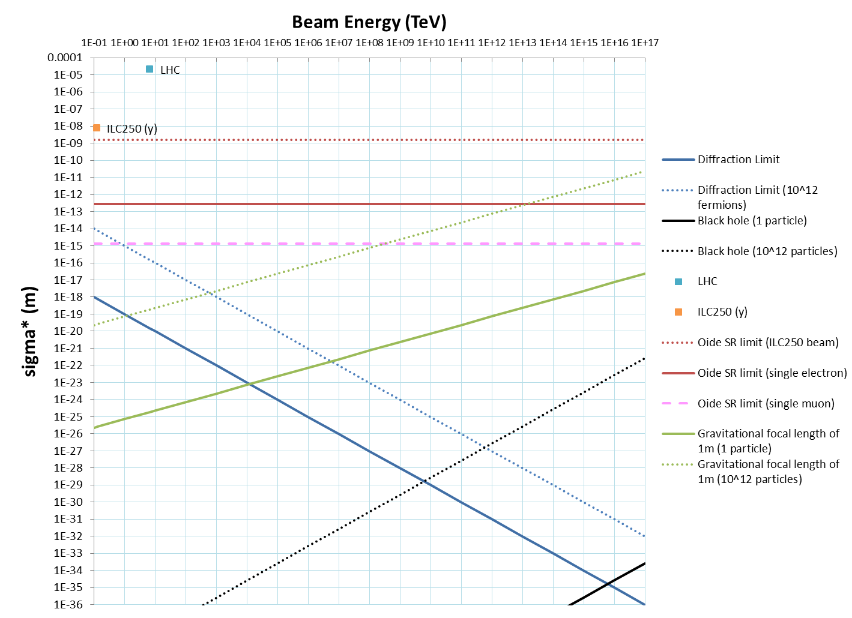
Energy vs. Focus Size
K. Oide, Phys. Rev. Lett. 61, 1713 (1988)
fermions
bosons
Planck scale

Slide 11
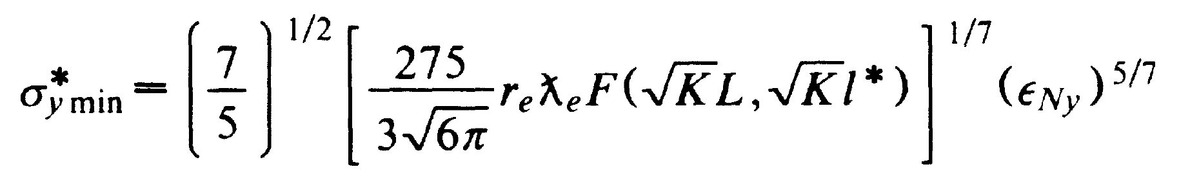
Limit? Emittance Growth from SR
Oide’s bound depends only on ε_{N}
The final focus magnets themselves cause synchrotron radiation emission and scattering
Exceptions to the assumptions of this formula:
  (A) Bending happens at lower energy than focus
  (B) Quantum effects (coherence, entanglement)
  (C) Non-electromagnetic focussing
K. Oide, Phys. Rev. Lett. 61, 1713 (1988)

Slide 12
(A) Even Linearer Colliders
Rings bend 360 degrees per turn up to highest energy
Linear colliders bend by ~mrad at highest energy
Bend at lowest energy and then accelerate afterwards?

Slide 13
(A) Beyond the Lower Bound
L
Consider the optimised focus
Bend in magnet is x’_{max}
Now add E-field parallel to trajectories, reduces Δx’
Bend in E-field only Δx’ = σ_{x}*/L
  Can make this arbitrarily small, so not a significant source of SR
σ_{x}*
Δx’
x’_{max}
E
Experiment:
Can we break K. Oide’s lower bound on focus size in the lab?
Pillbox cavity with spherical ends

Slide 14
(B) The Problem in Quantum Terms
Is there an initial state that…
  Forms a black hole on a reasonable time-scale
  No high energy particles, total size R<10km, total mass-energy and density ~= everyday objects?
Answer: yes
  Construction: take the state just before Planck black hole formation and track backwards in time using CPT theorem, particles hit walls, produce showers, eventually a few MJ-GJ of energy absorbed; result: warm concrete walls
This state is entangled in a very particular way
  Also applies to Mössbauer accelerators

Slide 15
(B) Mössbauer Accelerator
R.L. Mössbauer, Z. Physik 151, 124 (1958)
P.P. Craig et al., Phys. Rev. Lett. 3, 221–223 (1959)
A.-S. Müller, talk at F3iA 2016 meeting
crystal
γ
Mössbauer effect:
Gamma ray from nuclear excitation recoils against the entire mass of the crystal, giving very low energy spread
If many nuclei are excited, could the entire energy be transferred to a single emitted particle, since the crystal is acting coherently?
γ
t
E.g. ¹⁹¹Ir* emits 129keV gamma rays, a macroscopic crystal of 9.5×10²² iridium atoms (30 grams) could emit E_{Planck}
F. Vagizov et al., “Coherent control of the waveforms of recoilless γ-ray photons”, Nature 508, 80–83 (2014)
← Another useful application: modulating the wavefunction of a single gamma photon using the Doppler shift

Slide 16
(B) Time Reversal of SR Emission
γ γ γ
γ γ γ
B
CPT transformation
B
e⁻
e⁻
e⁺
e⁺
small emittance
large emittance
large emittance
small emittance
There are some quantum scenarios where emittance growth from SR can be stopped or even reversed. Below is a generic “cooling” system.
Experiment:
Can we make the photon state in the diagram above? NB: it’s probably entangled with the input positron
γ γ γ
γ
larger entropy
large entropy
e⁻
Simulation/experiment:
Does such a process X exist and it be realised?
e⁻
e⁻
small entropy
X
still small entropy

Slide 17
(B) Unused Degrees of Freedom
Non-thermal distributions of particles
Control of particle wavefunctions
  Beam particle(s)
  Accelerating photons (RF/laser)
Entanglement
  Between beam particles
  Between beam and RF/laser
  Between RF/laser and itself
As experimenters, we make both the beam and the accelerating photons, so no reason why this is not allowed

Slide 18
(C) Gravitational Final Focus
If you can make a black hole, you can make a gravitational lens at lower densities
  Use it to help reduce opening angle of final focus
2D, completely-linear gravitational dipole and quadrupole, based on subtracting two K-V distributions of mass
a
a
No synchrotron radiation emitted because gravity redefines what a “straight line” is
a
Linear “monopole” focussing lens also possible but the beams would collide! A shame because two interpenetrating KV beams would self-focus analogous to high intensity e-p IRs

Slide 19
(C) Simplified Calculation
Assume you only have σ_{θ}*=0.5/N rad (N× low)
  So can only make σ_{x}* N× that needed for BH
Deflection from lensing θ = 2r_{s}/r = 2/N rad
  So need at least 0.5/(2/N) = N/4 times the mass
Extra mass required scales up as inverse of originally achievable σ_{θ}*
  Particles forming lenses do not create black hole
    So candidates for energy recovery

Slide 20
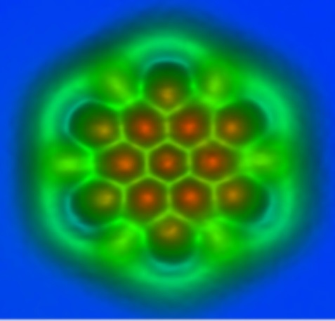
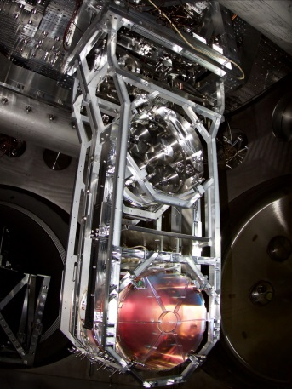
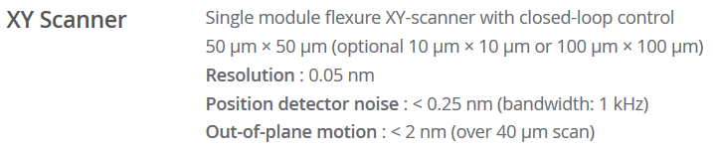
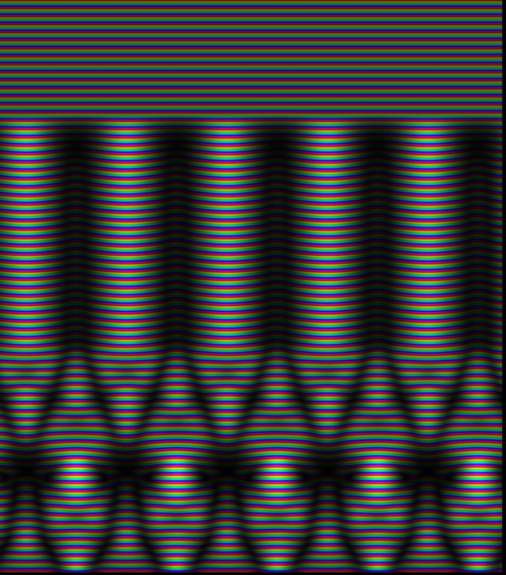
Nucleus-Level Alignment?
Nearer-term experiments
Collaboration with:
Nanotechnology, fusion(?)
Can we demonstrate changing a nuclear reaction rate by a spatial/positioning effect?
  AFM tip ≤ 5×10⁻¹¹ m
  LIGO mirrors ~10⁻¹⁶ m
    Measurement ~10⁻¹⁸ m
Or could use crystal channelling alignment
AFM
LIGO
Park NX10

Slide 21
Summary: Single-Particle Collider
Currently, we collide a billion+ particle bunch and get ~10 events per crossing
  Somehow a >10⁸ factor in efficiency has been lost
  Various factors to blame: with 20th century technology this was the only way to get it to work
    And it’s still hard
    But big reward
      e.g. LC power limit
There is no intra-beam scattering if you only have one particle per bunch
Experiment:
Apparatus to collide particles individually, then gradually increase accelerating voltage

Slide 22
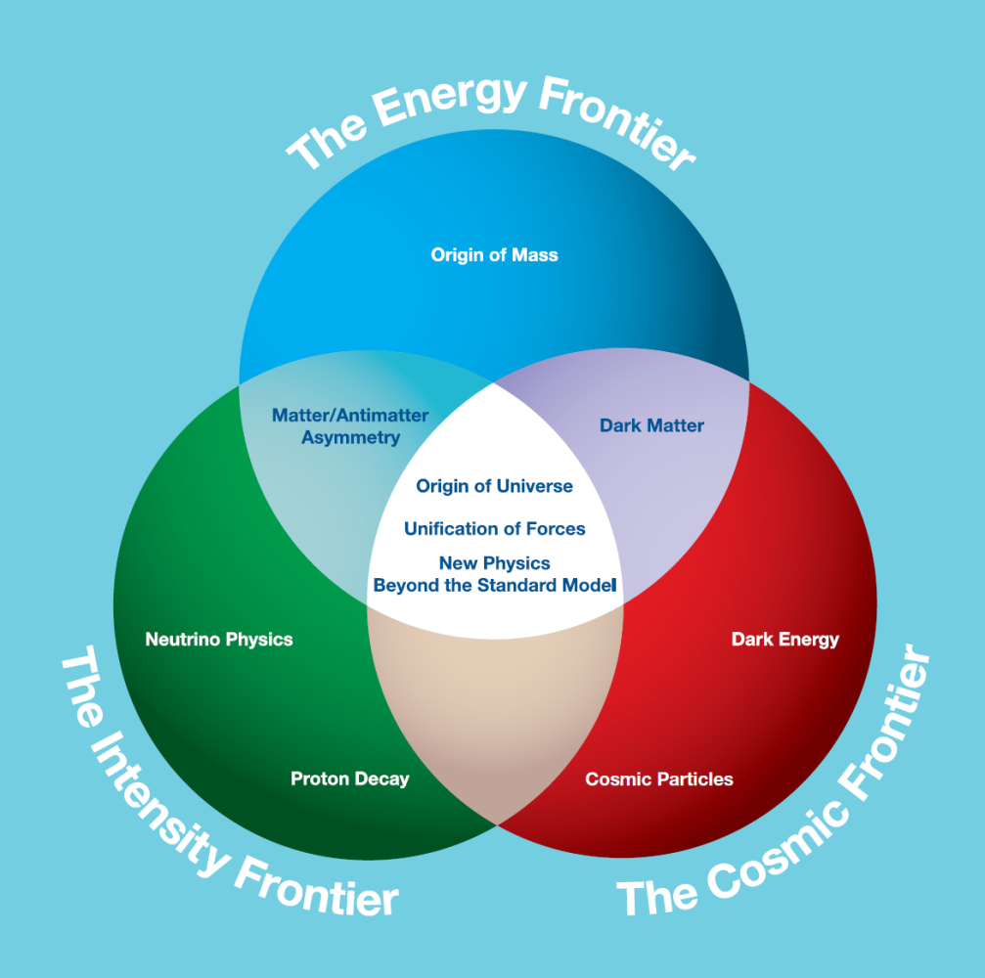

Cheapness Frontier
Mass-produced parts
Benefit from other industries
Don’t over-spec
Evade precision requirements by staging and feedback
Automation
Manpower will be the most expensive item in the future
3D printing, robotics
AI / automated design
Recycling
Energy recovery, multi-pass
Why? Since accelerators are already at the limits of government research budgets

Slide 23
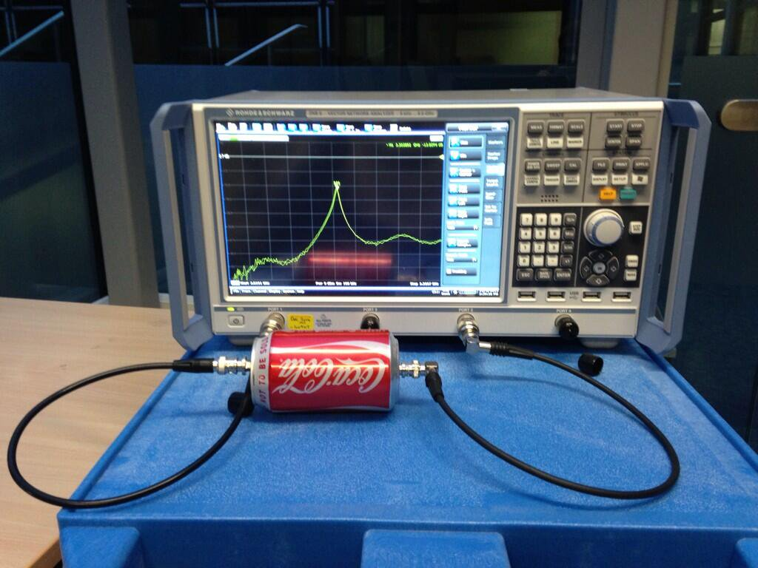
f = 3.3 GHz, Q = 50
Ciprian Plostinar (RAL/STFC, now ESS)

Slide 24
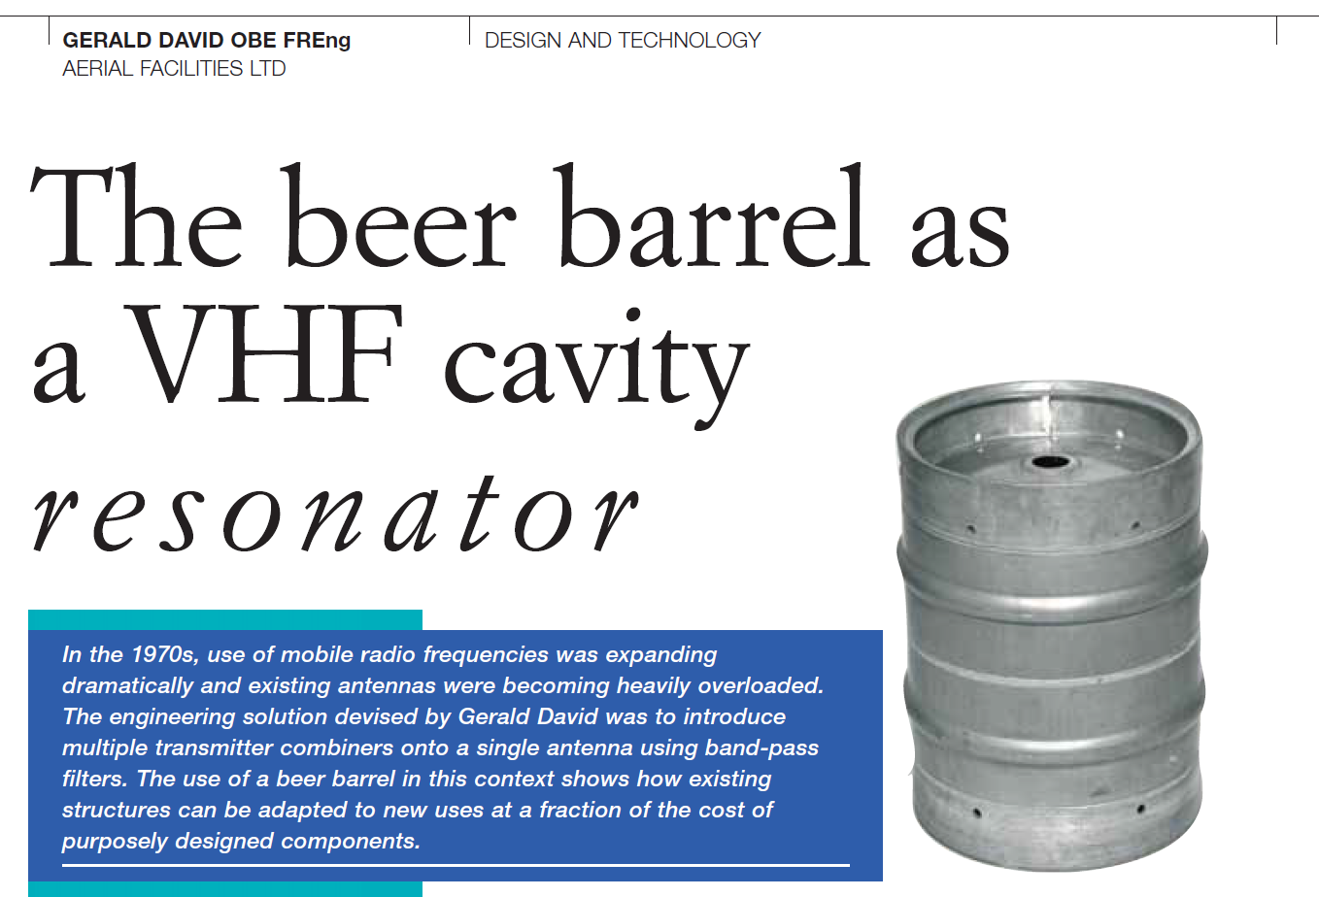
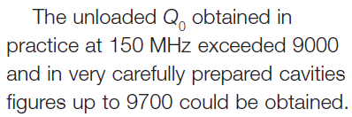
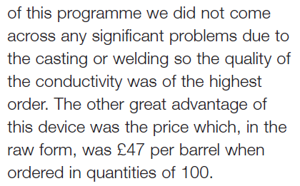
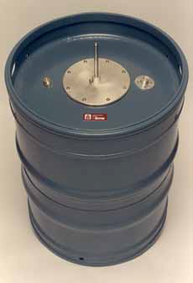
f = 150-165 MHz, Q = 9700
G. David, Ingenia Magazine 18, 21–25 (2004)

Slide 25
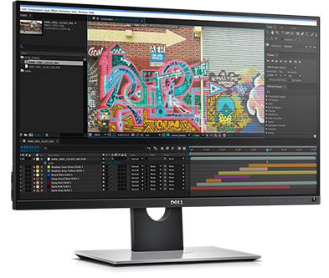
Multi-Channel Power Supply
Generic rack power supply
  >$1000 for one channel
My monitor
  $699 for 11M channels
    2560*1440*3
  $0.000063 per channel
Factor of >10⁷ is available if all you want is a large number of independent outputs
  Via mass production, lithography industry etc.

Slide 26
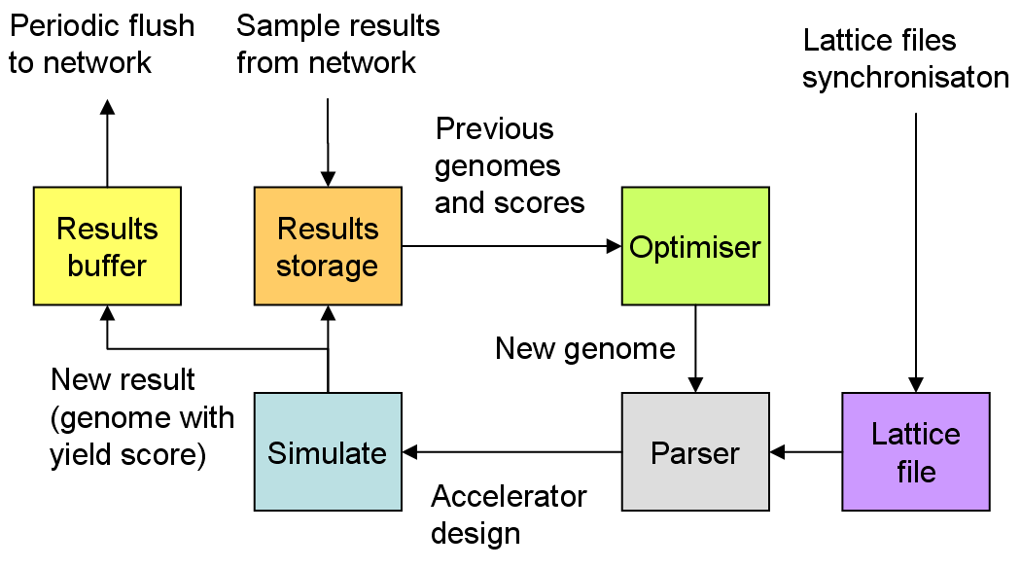
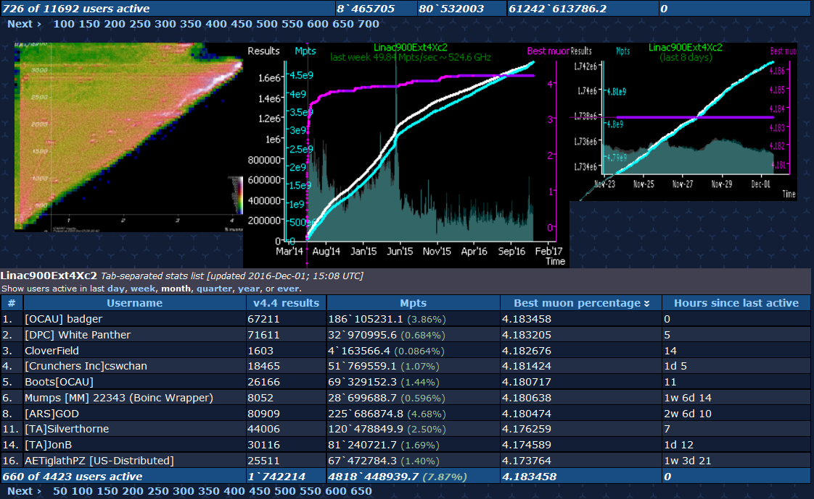
Automated Design: Muon1
Optimisation of design space with 100s of parameters using a genetic algorithm and distributed computing. The same optimiser designed the ATF fixed-field line.
S.J. Brooks, “Muon capture schemes for the neutrino factory”, DPhil. University of Oxford (2010)
Designs lattice starting from almost nothing: labour-saving!

Slide 27
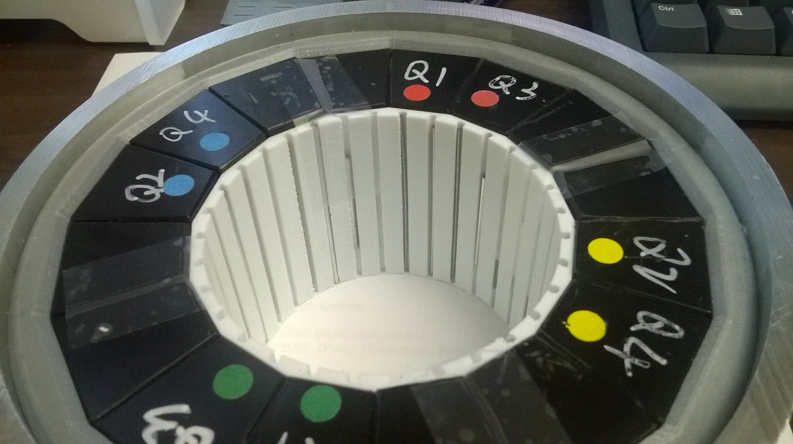
Magnet with 3D Printed Parts
S.J. Brooks et al., “Production of Low Cost, High Field Quality Halbach Magnets”, Proc. IPAC 2017
Split accuracy task into two stages
Halbach quadrupole using NdFeB, 23.6 T/m, R=34.7mm bore (0.82T max), 10⁻⁴ errors at R=10mm
Material cost: $1100. No alignment better than 0.25mm required anywhere. Assembled with mallet.

Slide 28
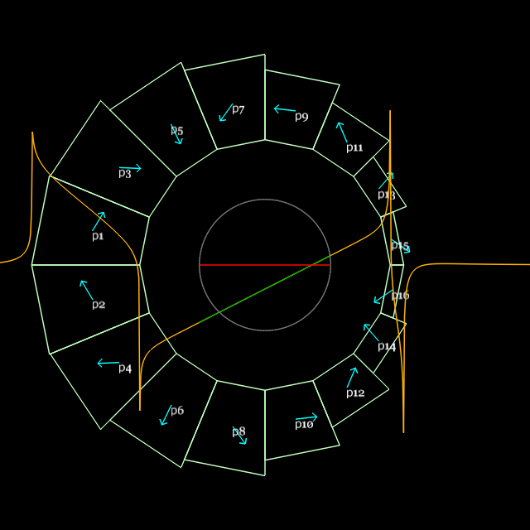
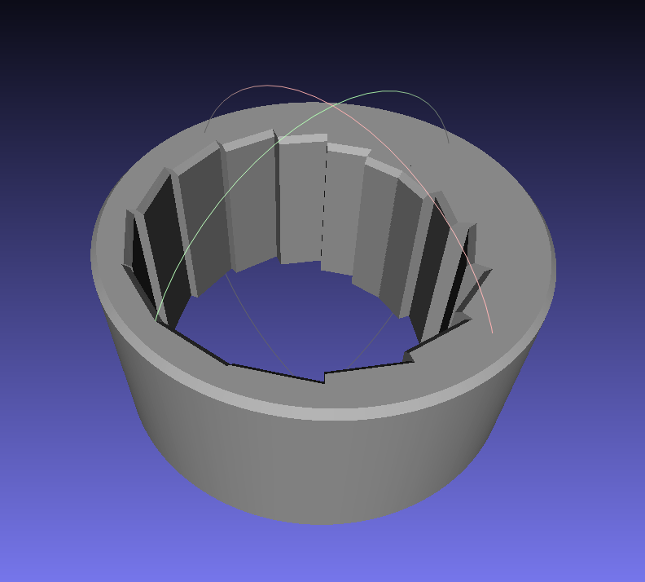
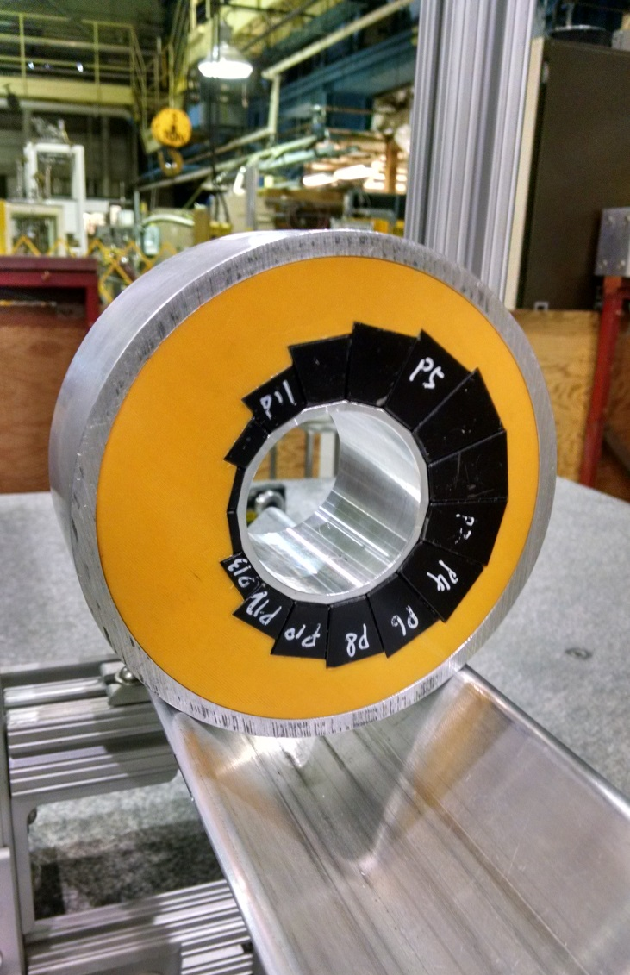
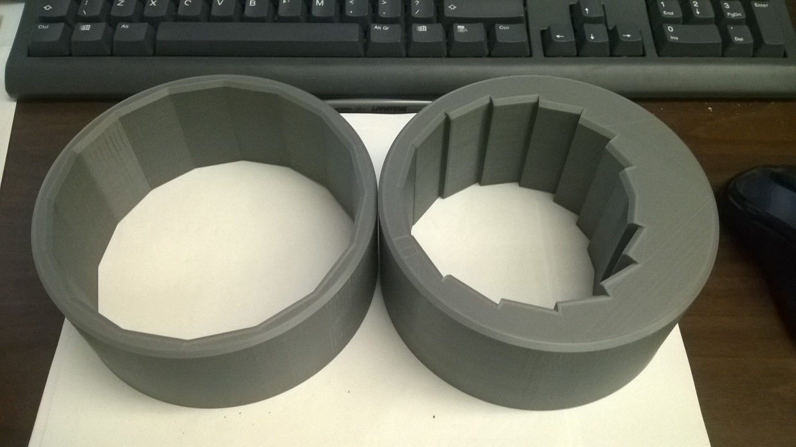
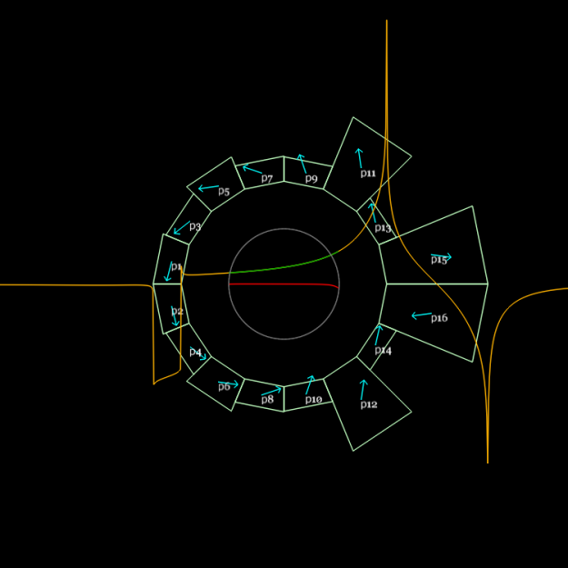
Custom and Cheap – is it possible?
Combined function dipole+quad
Magnet design program generates mesh
Design for B_{y} = B₀r^{k}
3D printed
Material cost: $800

Slide 29
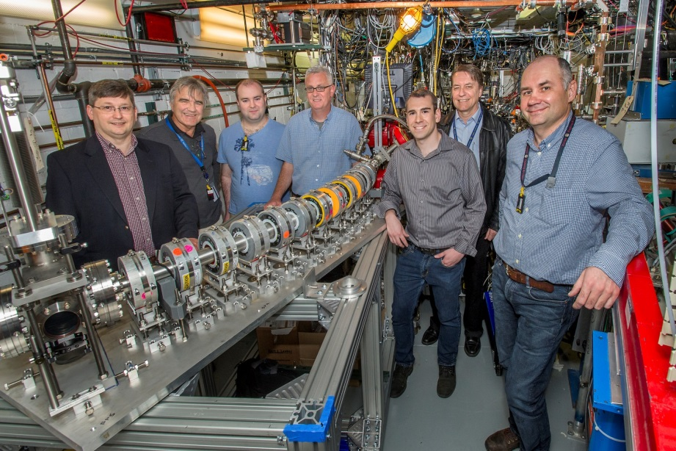
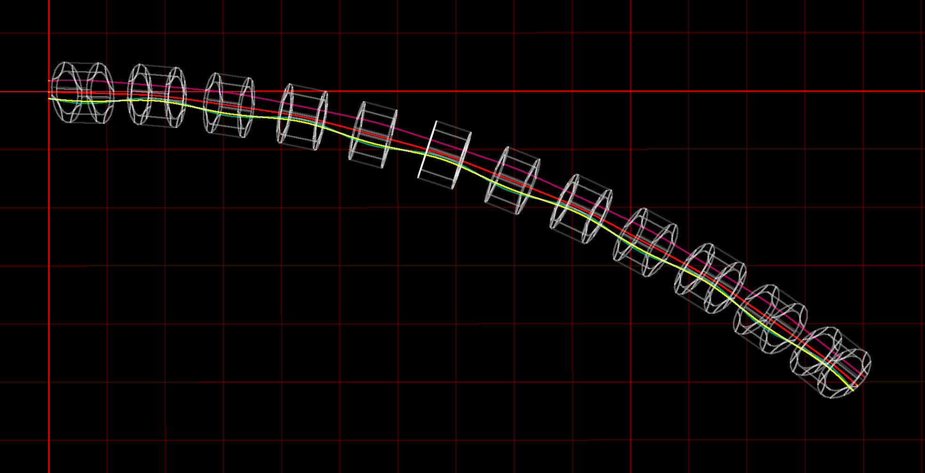
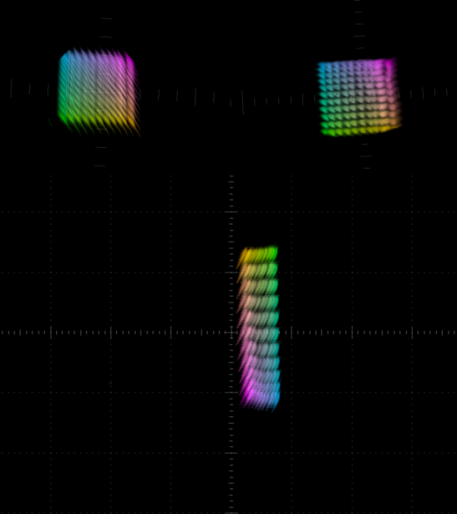
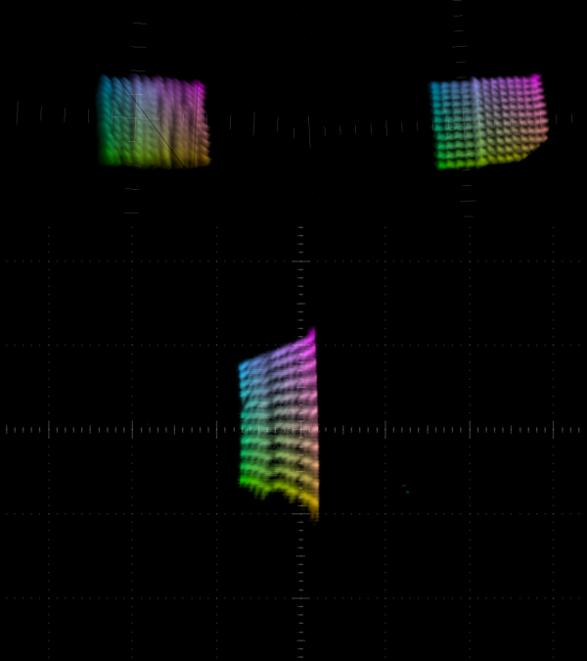
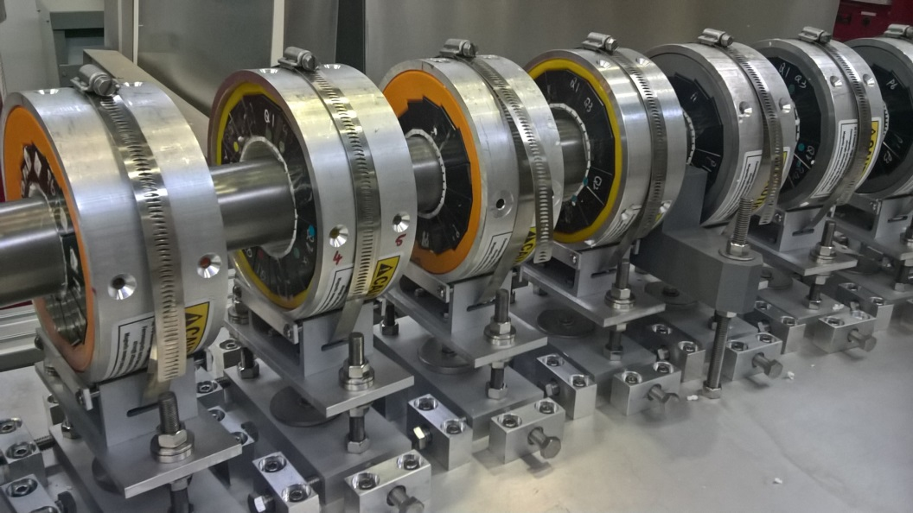
ATF1 Fixed-Field Arc Test (AE79)
S.J. Brooks, talk at FFAG 2017 workshop
No power required for magnets
3.8× energy range in one line

Slide 30
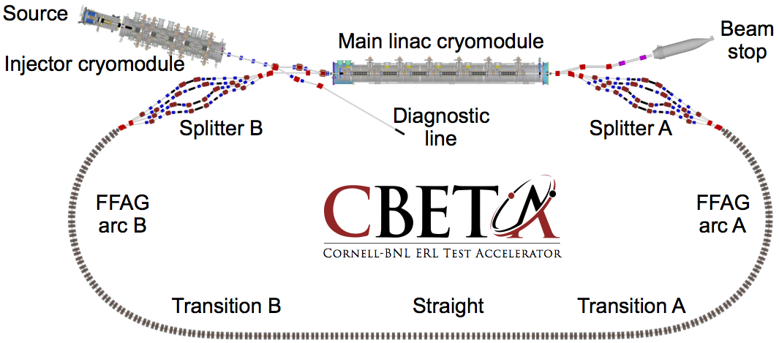
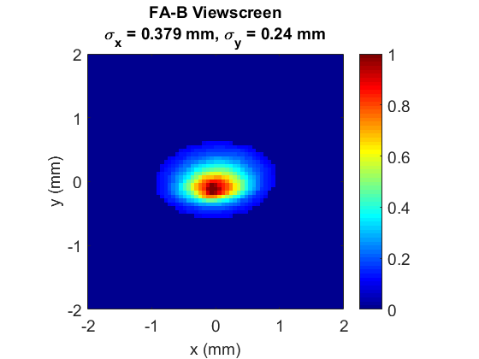
Re-use/Recycle: CBETA ERL
G.H. Hoffstaetter et al., “CBETA Design Report, Cornell-BNL ERL Test Accelerator”, arXiv:1706.04245
Also several papers at this conference: TUYGBE2, TUPMF023, TUPMF024, TUPMF066, WEPMF038, THPAF021, THPAF022, THPAF023
First beam to here, April 18th
Superconducting linac module
  With energy recovery (150MeV*40mA = 6MW power in beam, 45kW of actual RF amplifiers)
  36MeV energy gain module used 4 times (more energy per hardware)
Permanent magnet recirculating lines (low/zero power)
  Used multiple times in fixed-field optics (4 energies in one line, CW)

Slide 31
BACKUP

Slide 32

Warning
Lots of this talk is speculative

Slide 33
Neutralised Focus: Solution in Search of a Problem
No good for beam-beam limit
  Instability governed by dForce/dx not size of Force
Probably no good for fusion (ICF)
  Requires awkward energy recovery system
Maybe can make dense/degenerate matter?

Slide 34
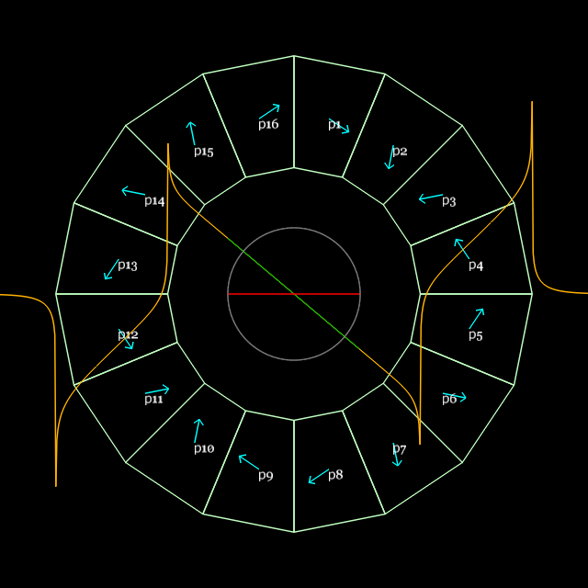
Generalised Halbach design
My current sheet approximation code (PM2D) is good enough
Material grade: N35SH from AllStar Magnetics, B_{r}(eff.)=1.194T

Slide 35
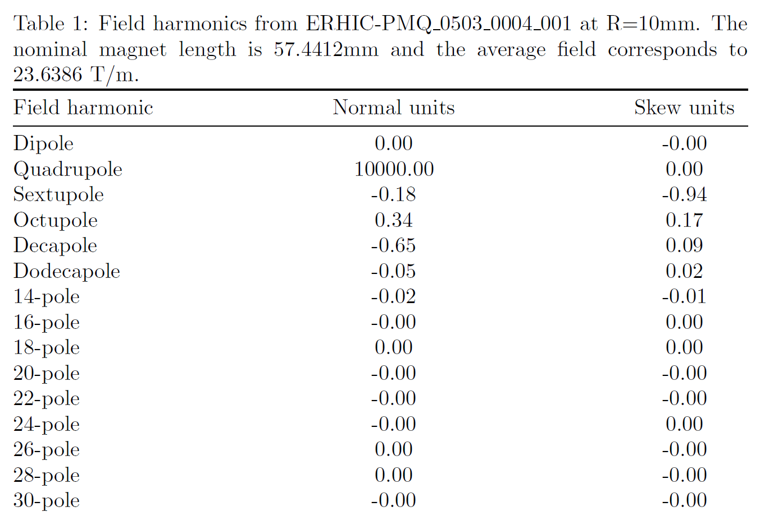
Best so far: QF3

Slide 36
Cost and Labour per Magnet
Permanent magnet wedges (AllStar N35SH)
  $1052.67 per QF magnet (16 wedges)
  $758.00 per BD magnet (16 wedges)
Labour ~8h per magnet: 3h measurement, 2h shimming, 2h assembly, 1h 3D printer setup
Required infrastructure
  3D printer ($2-3k), used Ultimaker 2 Extended+
  Rotating coil (~$50k)

Slide 37
Benefits
No power consumption
  No power supply, no copper wires or windings
Any field shape you like within strength limits
No “cross-talk” between iron surfaces in compact lattices
Can be assembled with mallet
1e-4 accuracy is possible after shimming
Seems cheap, at least for short magnet length

