Slide 1
CBETA Magnet Production
and non-scaling FFA proliferation

Slide 2
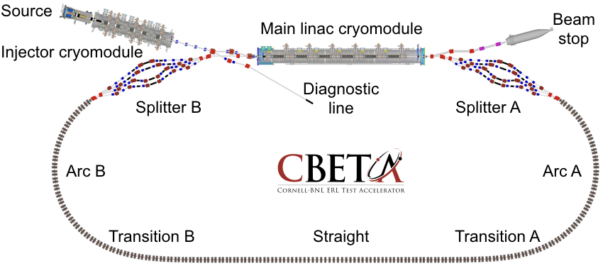
What is CBETA?
It’s a non-scaling (linear field) FFA
It’s an energy-recovery linac (ERL)
It’s both at the same time
  EMMA was an FFA ring with ERL injector (ALICE)
  CBETA is a racetrack FFA with linac inside it
Dejan has probably explained this already

Slide 3
Timeline
Summer 2017: ATF-FFA girder with beam at BNL, 3.8x momentum range (my FFA’17 talk)
  12 permanent magnets
May 2018: CBETA girder beam test at Cornell
Now: CBETA magnet+girder production ~50% complete, estimate finish end of November
  100+ → 216 permanent magnets
March 2019: CBETA commissioning starts

Slide 4
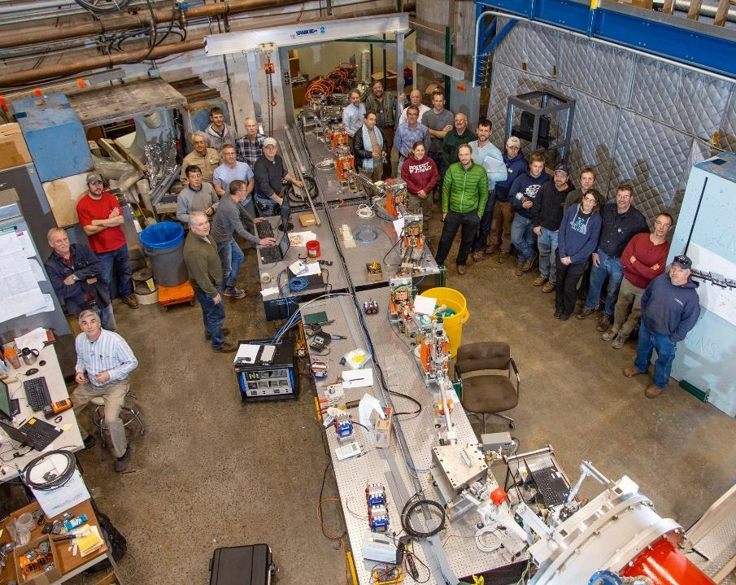
FFA girder
CBETA first splitter line and first FFA girder at Cornell

Slide 5
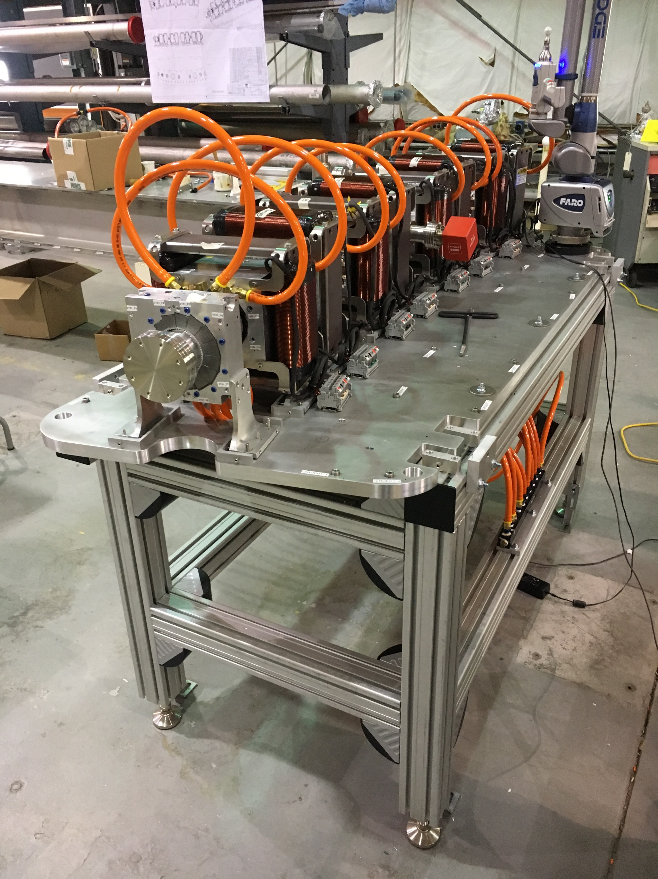
CBETA first FFA girder at BNL
Half-length magnet for matching

Slide 6
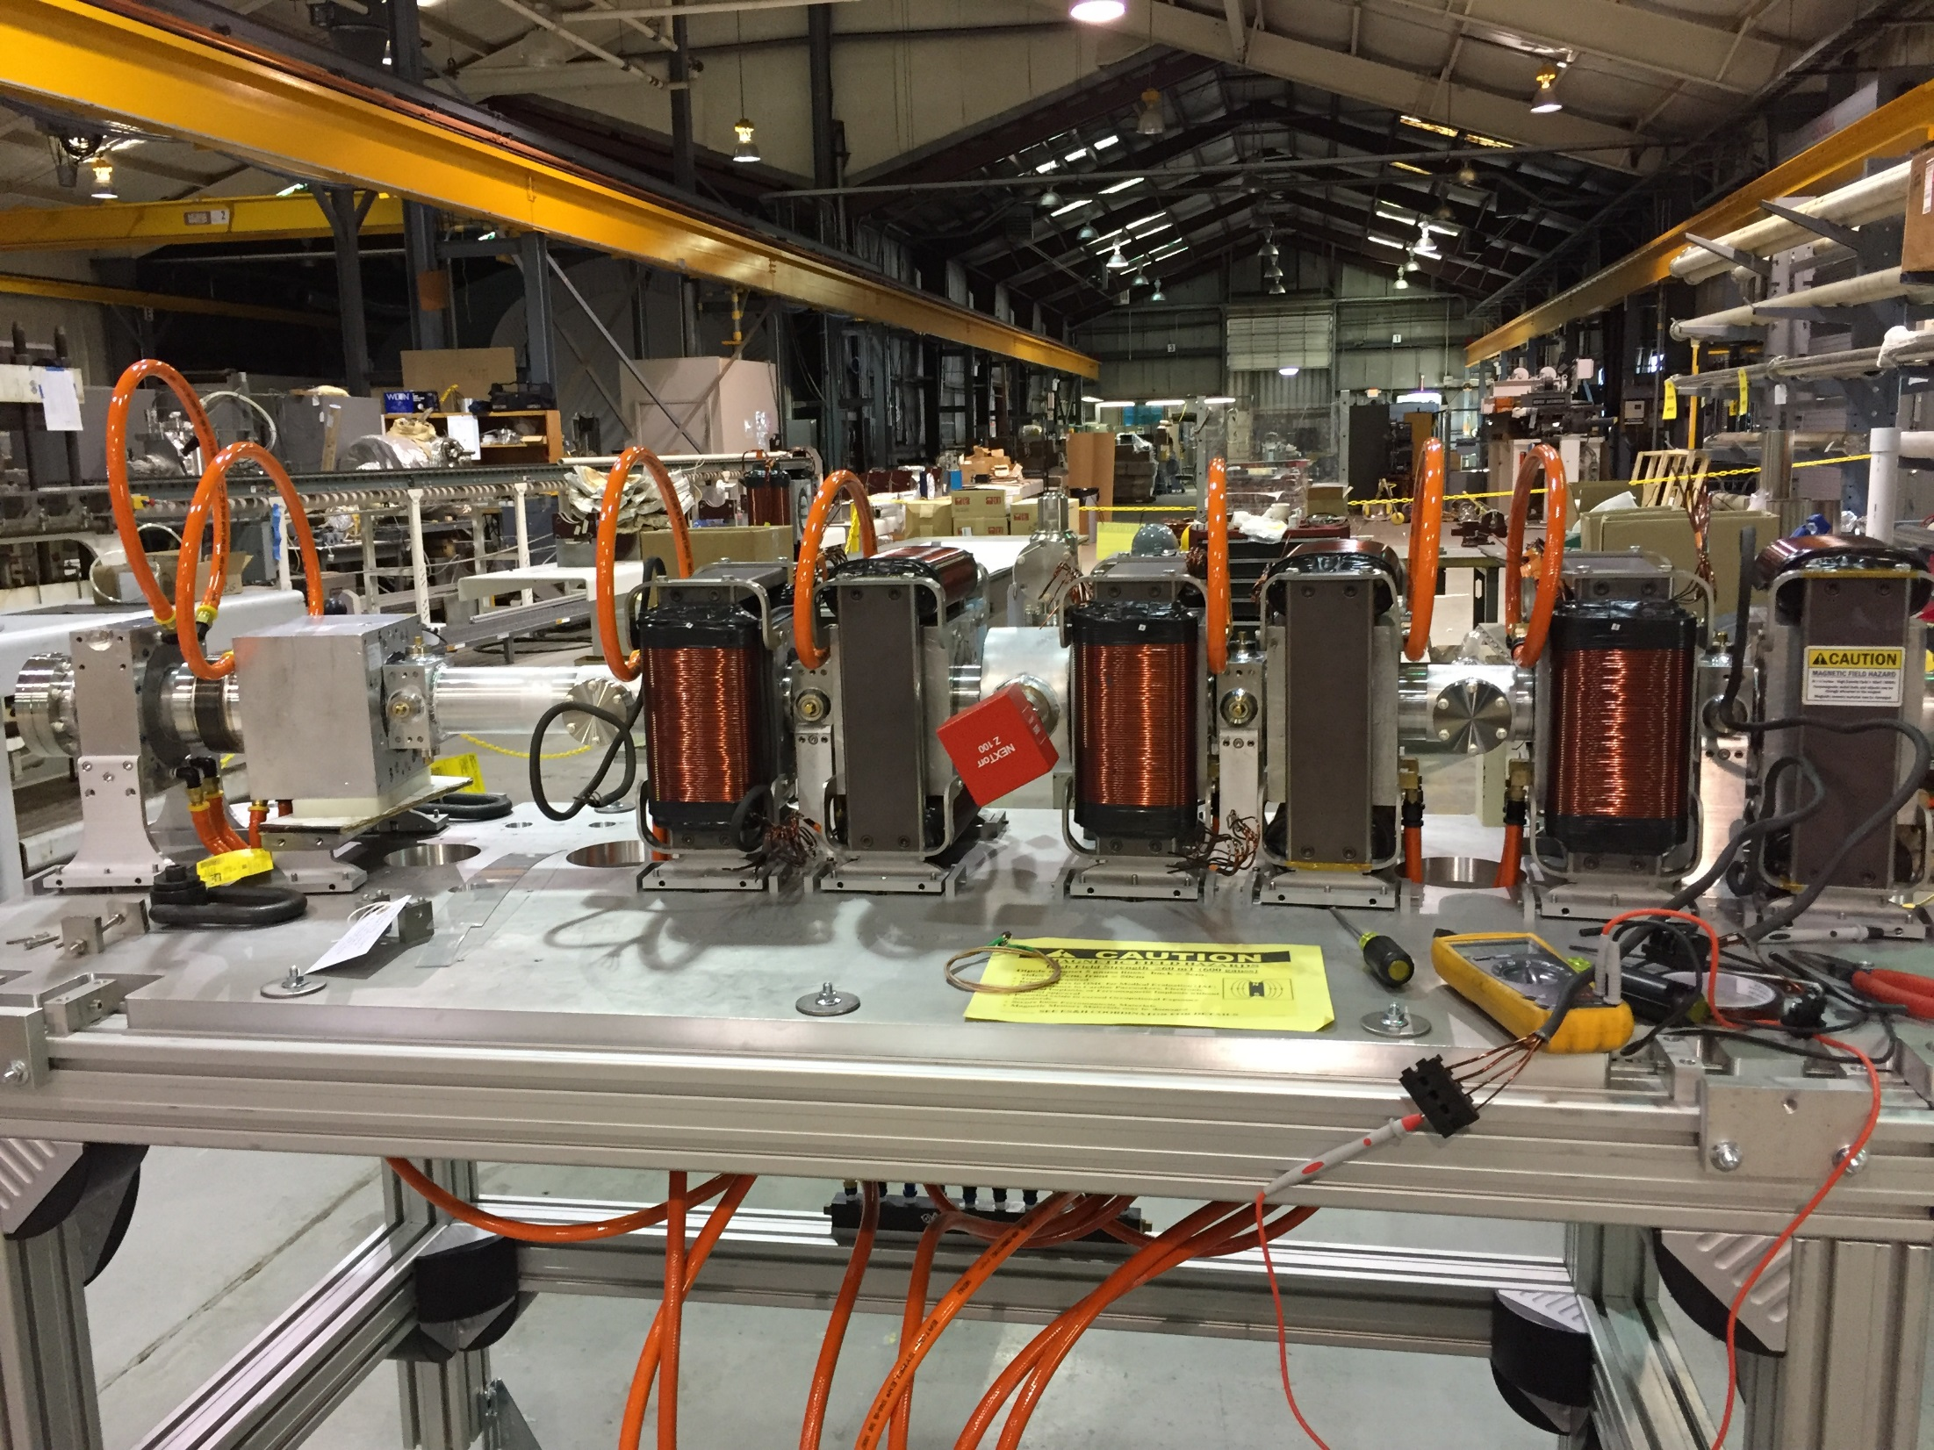
CBETA first FFA girder under construction at BNL

Slide 7
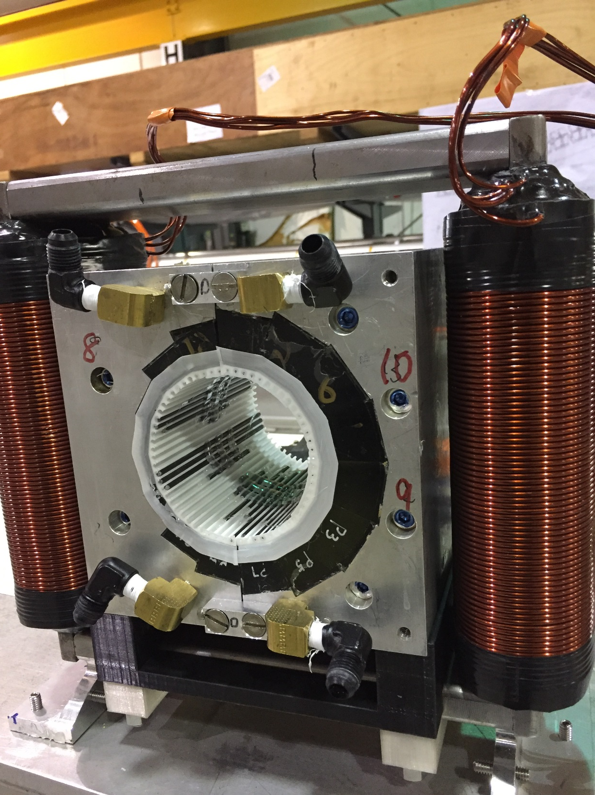
CBETA permanent magnet containing tuning wire insert

Slide 8
EMMA/ATF/CBETA Comparison
Parameter | EMMA | ATF-FFA | CBETA girder | CBETA (future) | Units
Energy range | 10.0–20.0 | 18.0–70.5 | 37.5–58.5 | 41.5–149.5 | MeV k.e.
Momentum ratio | 1.953 | 3.837 | 1.553 | 3.572 | ×
Radius of curvature | 2.63720 | 2.01367 | 5.08787 | 5.08787–∞ | m
Effective avg. dipole | 0.02594 | 0.11761 | (0.09834) | 0.09834 | T
Total angle | 360 | 40 | 20 | 280 | degrees
Operation mode | Storage ring | Transfer line | Transfer line | ERL
Acceleration? | Yes (lots!) | None | None | Yes (linac)
Lattice | Doublet | Close to FODO | Doublet | Doublet
Cell length | 0.394524 | 0.234301 | 0.444 | 0.444 | m
Cells per turn | 42 | 54 (extrapolated) | 72 (extrapolated) | 107.5 (racetrack)
Length built | 16.57 | 1.40581 | 1.776 | 47.73 | m

Slide 9
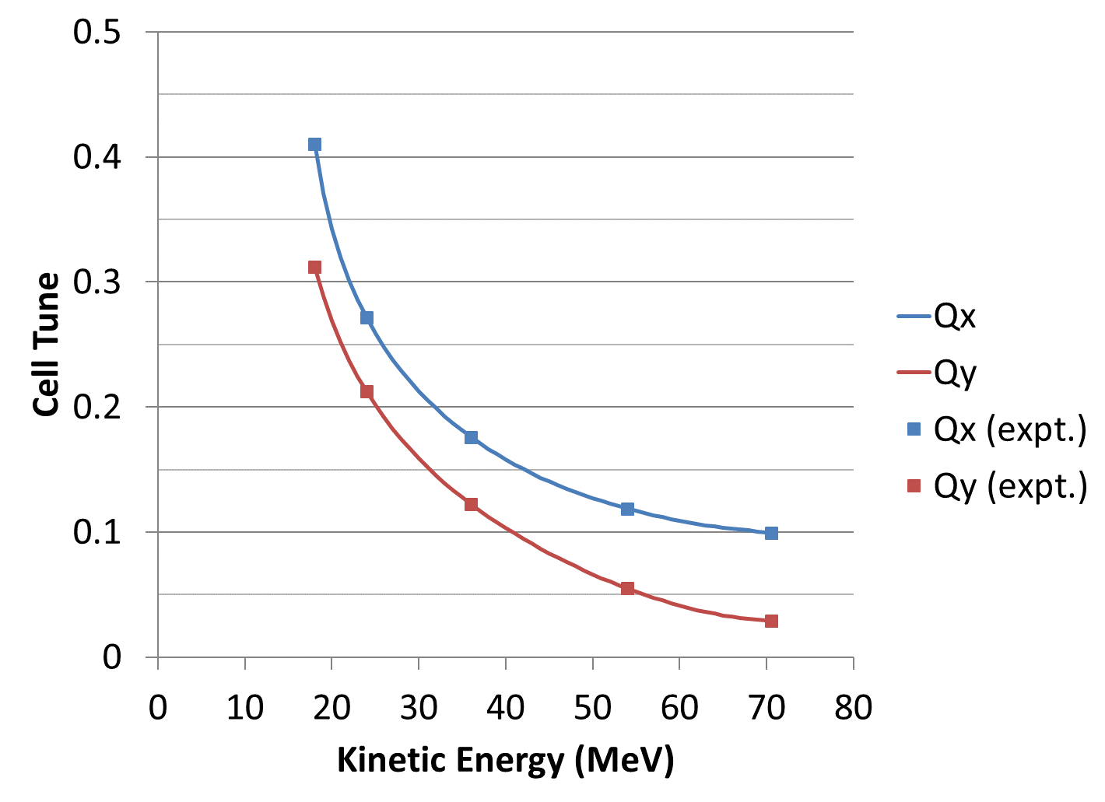
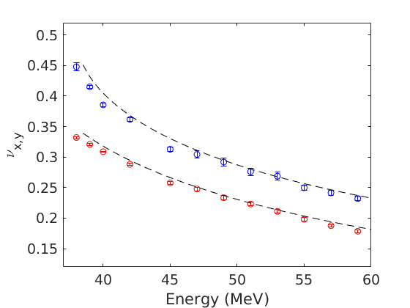
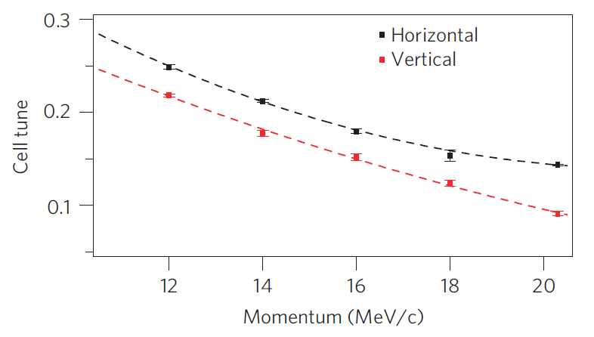
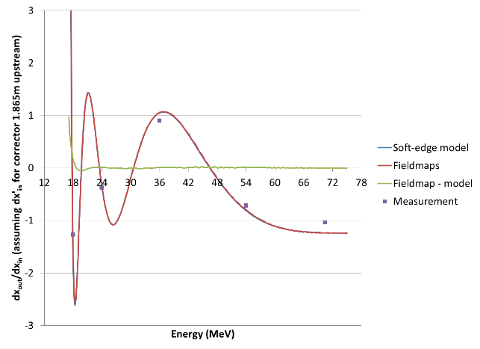
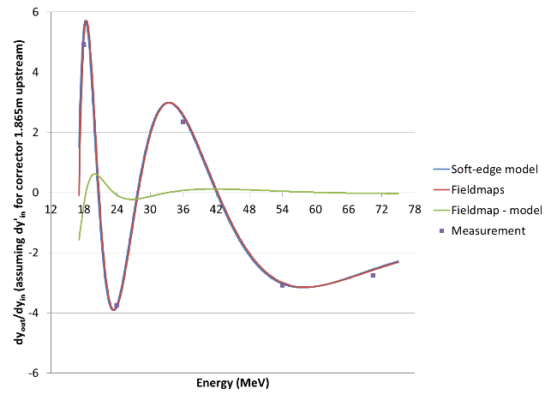
Cell Tunes × 3
ATF-FFA
CBETA girder test
EMMA
model
data
NB: ATF-FFA’s data fit is on matrix elements not tunes (graphs on bottom row)

Slide 10
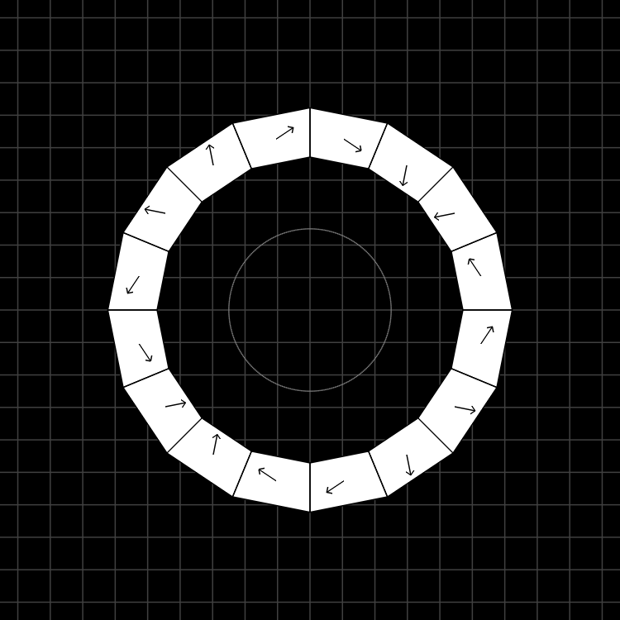
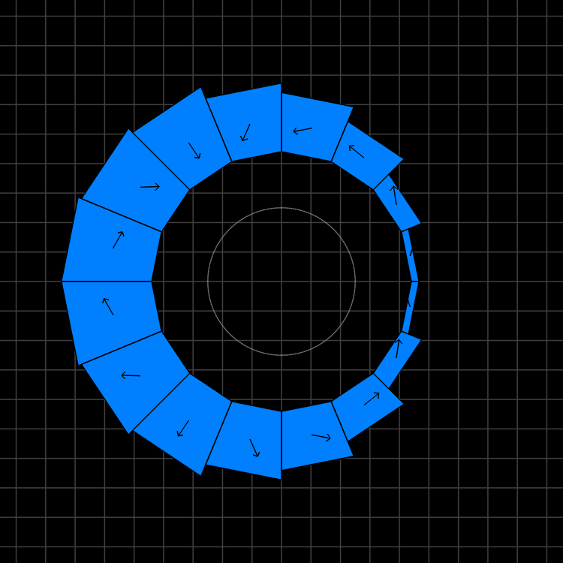
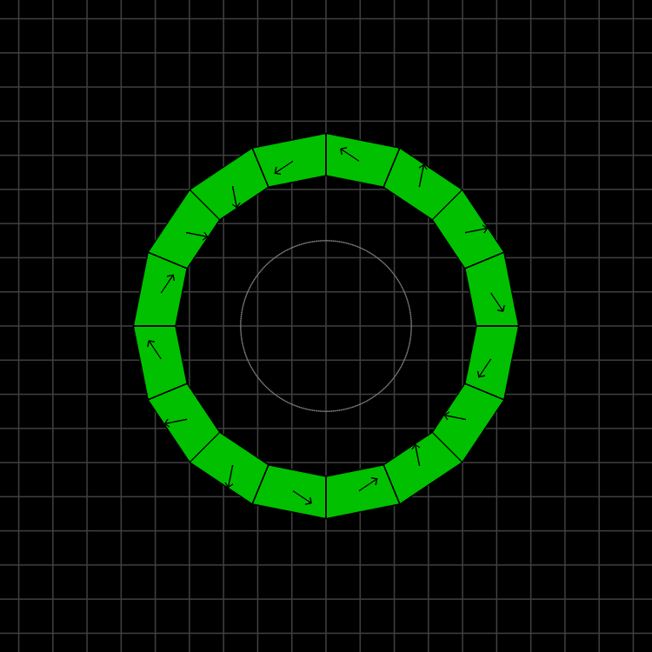
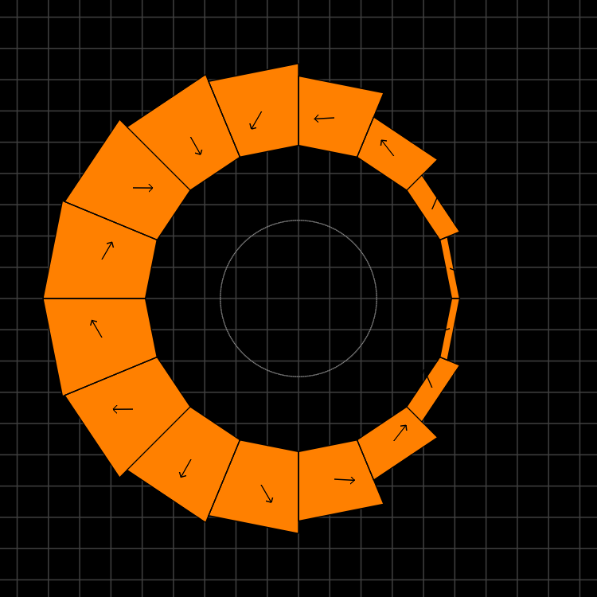
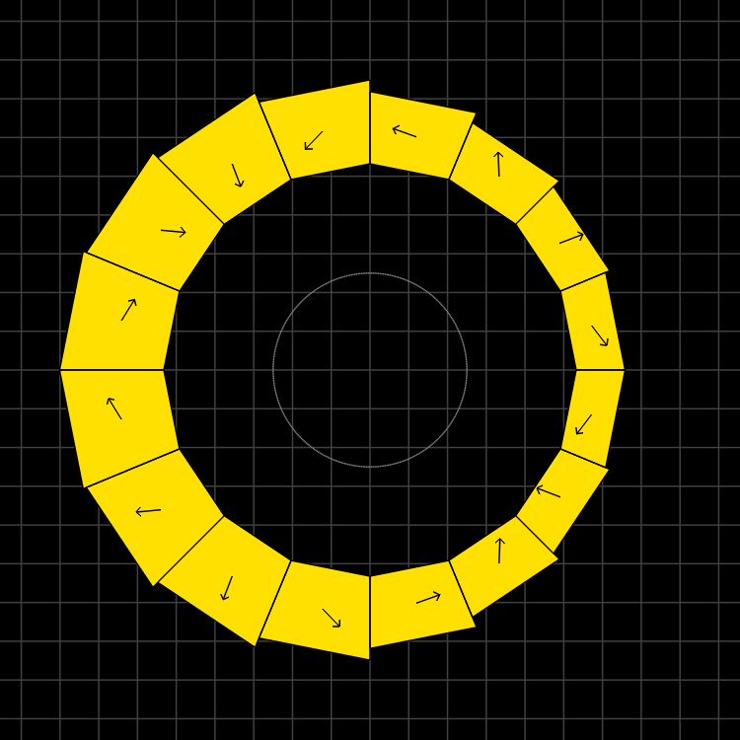
Magnet Types and Parameters
QF
BD
QD
BDT2
BDT1
Magnet | Dipole (T) | Quad (T/m) | Good field radius (mm) | Aperture radius (mm) | Max field (T) (good region) | Max field (T) (aperture)
QF | 0 | -11.5624 | 25 | 43.1 | 0.2891 | 0.4983
BD | -0.3081 | 11.1475 | 25 | 40.1 | 0.5868 | 0.7551
BDT2 | -0.2543 | 11.1475 | 25 | 44.938 | 0.5330 | 0.7552
BDT1 | -0.1002 | 11.1475 | 25 | 49.085 | 0.3789 | 0.6474
QD | 0 | 11.1434 | 25 | 40.1 | 0.2786 | 0.4469

Slide 11
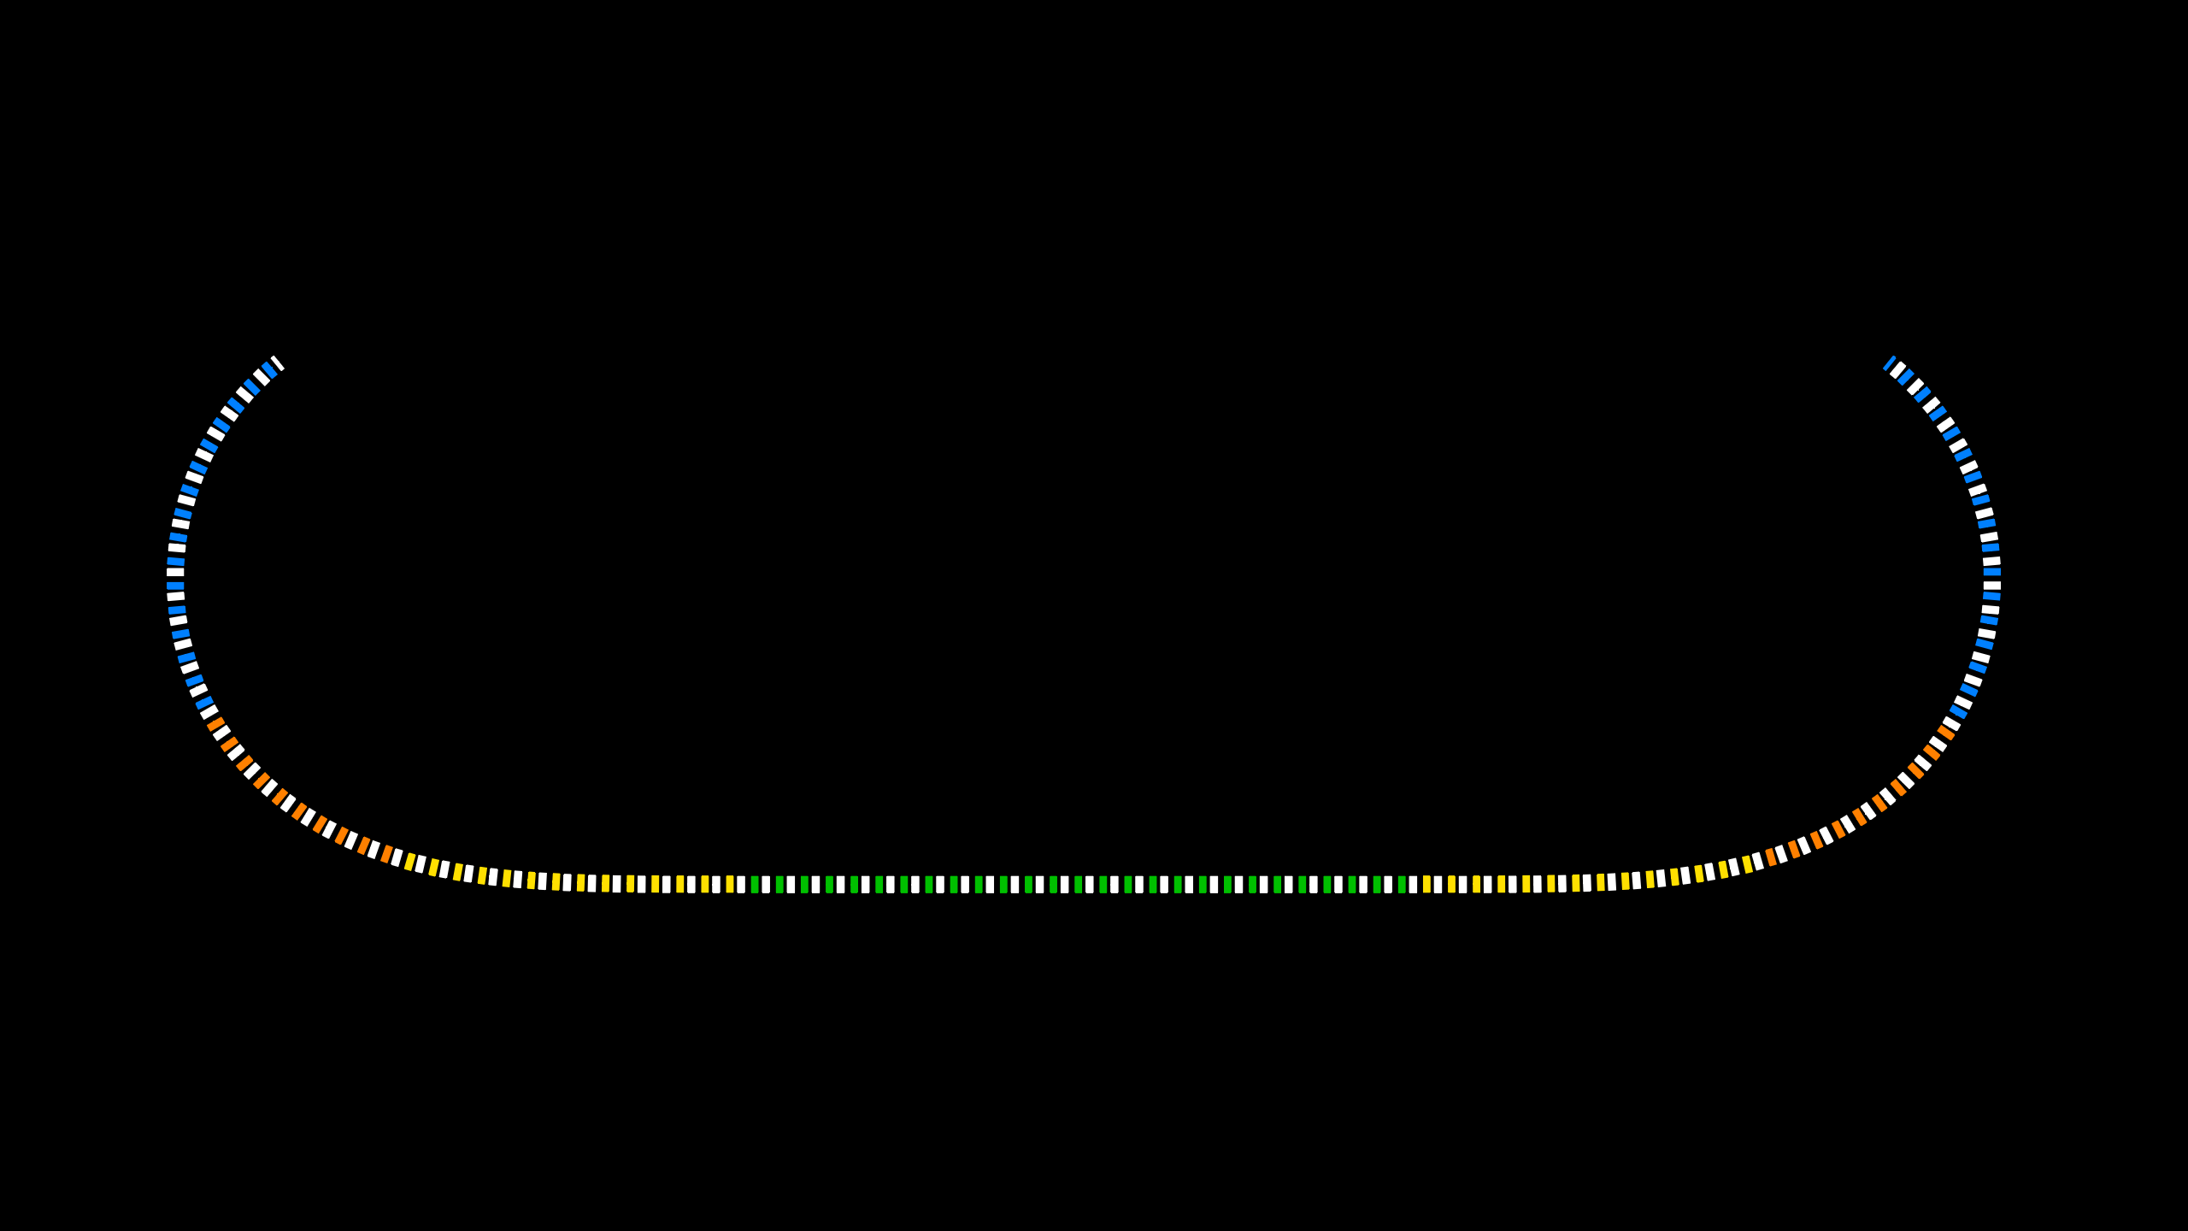
Layout and Magnet Counts
Permanent magnet total: 216
QF: 107
BD: 32
BDT2: 20
BDT1: 28
QD: 27
QFH: 1 (half length)
BDH: 1

Slide 12




Production and Testing Flow
KYMA
assembly
3
4
AllStar
PM wedges
1
BNL
tuning
2
Helmholtz testing at AllStar, 100% of blocks but not temperature controlled
Temperature-controlled Helmholtz test of ~15% sample at BNL for verification
Remainder of blocks shipped directly to KYMA, who also re-test ~10% sample
Rotating coil measurement of bare magnet at BNL
Rotating coil measurement of tuned magnet at BNL
5
Accept

Slide 13
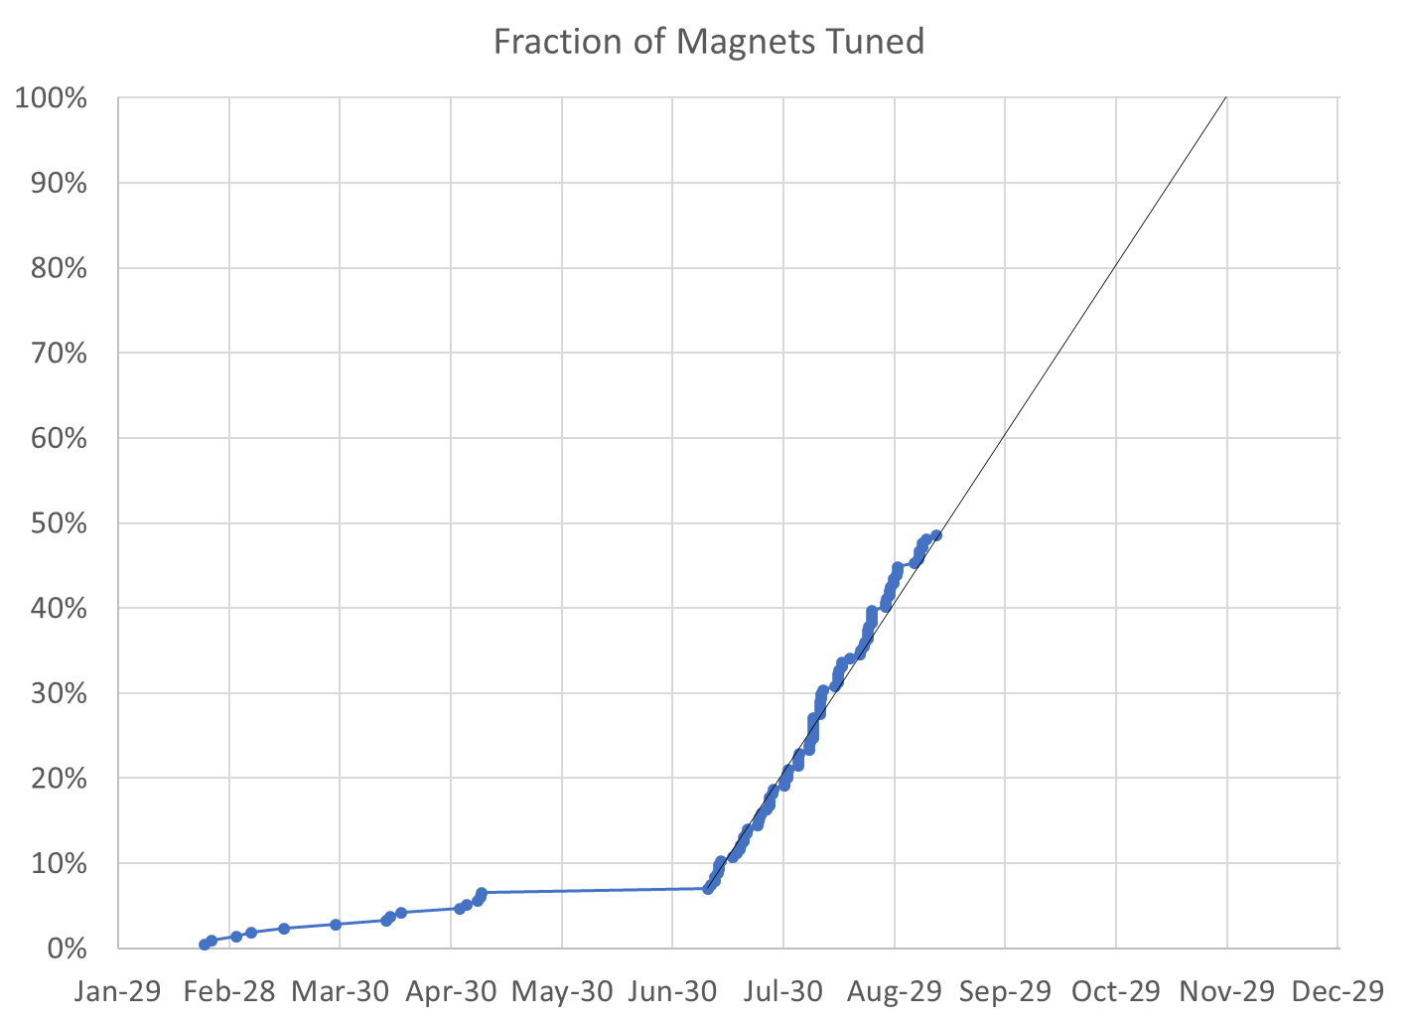
48% complete
104 / 214 magnets (110 remaining)

Slide 14
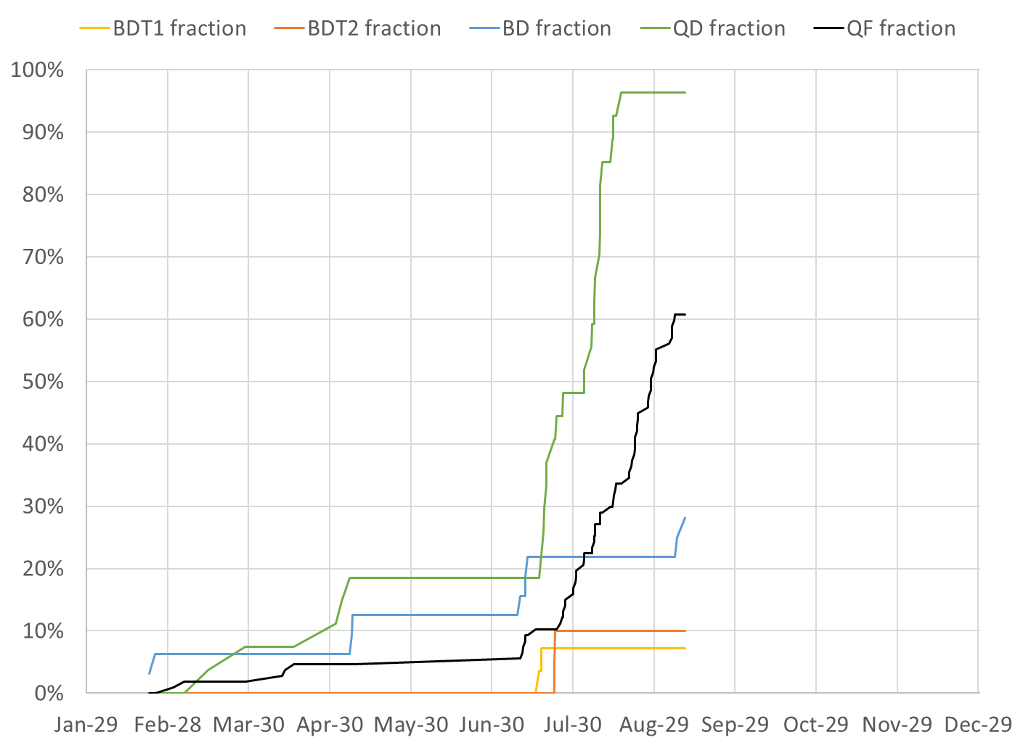
BDT1 2 / 28 magnets (26 remaining)
BDT2 2 / 20 magnets (18 remaining)
BD 9 / 32 magnets (23 remaining)
QD 26 / 27 magnets (1 remaining)
QF 65 / 107 magnets (42 remaining)

Slide 15
Projections
Method | Rotating Coil Measurements per Week | Magnets Tuned per Week | Projected Finish Date | Speed-up Required to Finish Nov-30
Magnets rate since main production start |  | 9.92 | Nov-26 | 4 calendar days spare
Rotating coil rate last 3 weeks plus model | 30.3 | 10.76 | Nov-20 | 10 calendar days spare
Rotating coil rate since start | 26.9 | 9.46 | Nov-30 | 0.5%
Required to hit deadline | 27.0 | 9.51 | Nov-30 | 0%

Slide 16
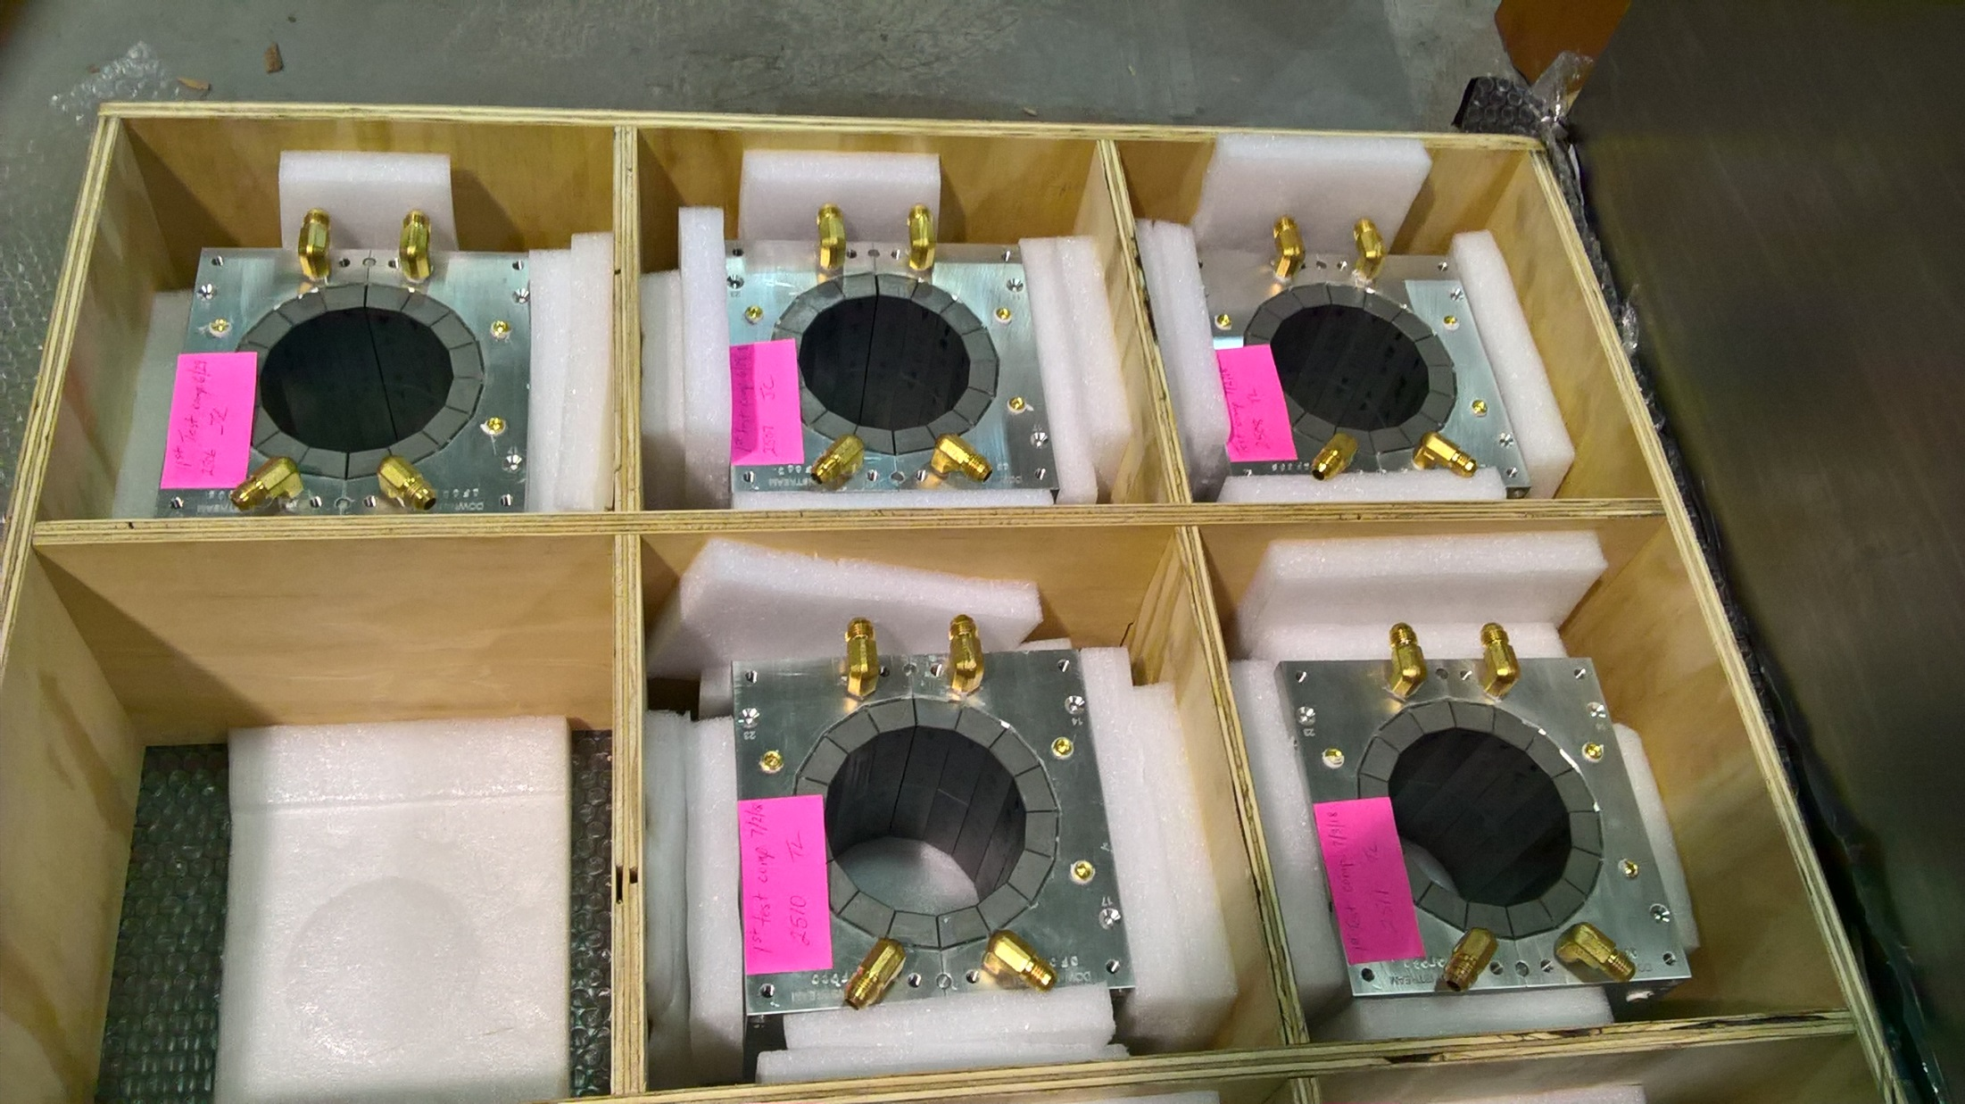
Permanent magnets shipped from KYMA

Slide 17
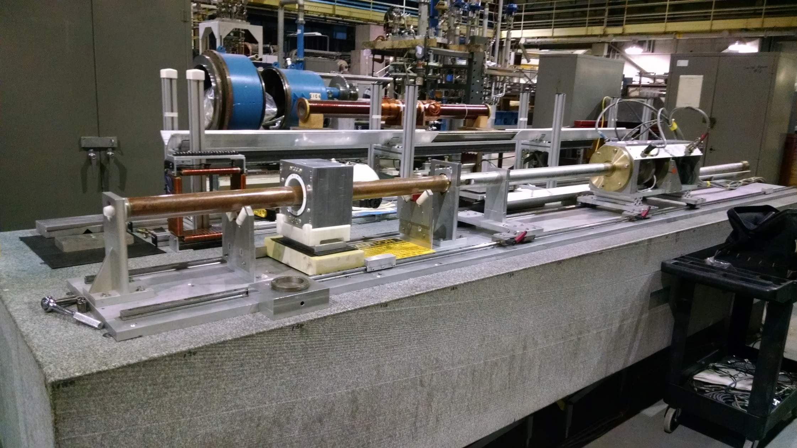
Rotating coil magnet measurement at BNL

Slide 18
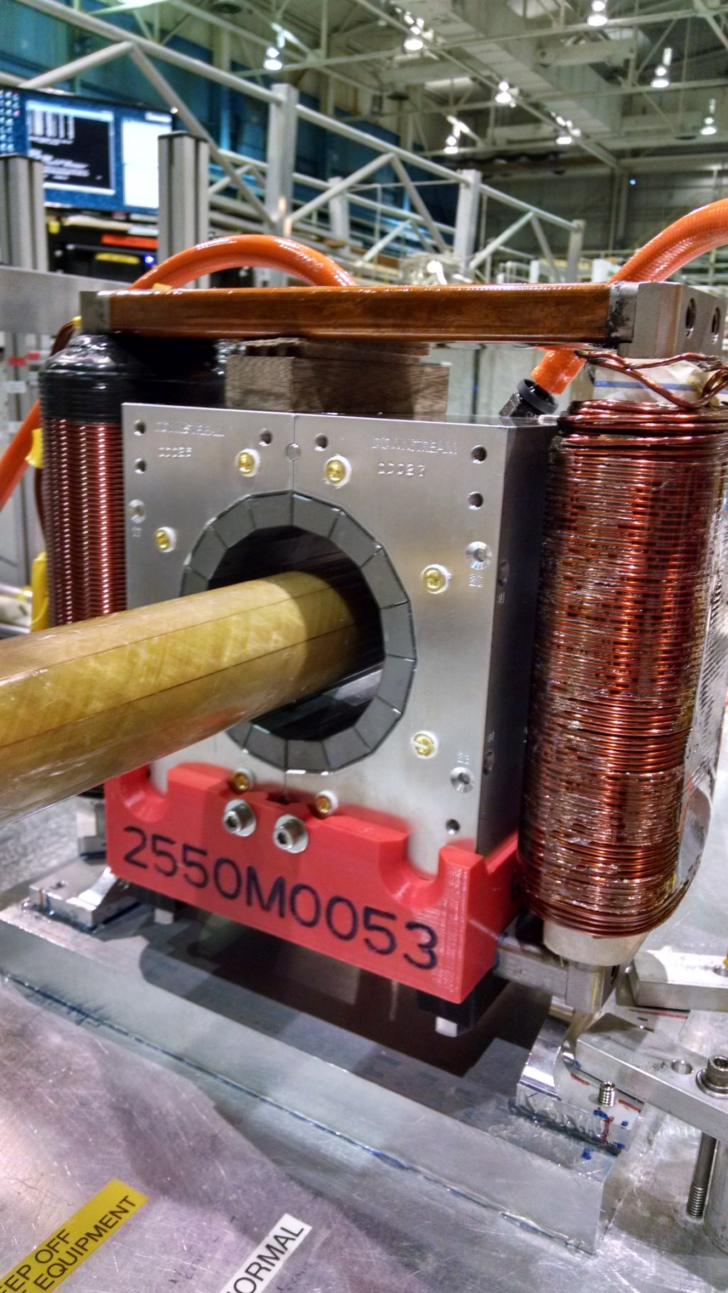
Rotating coil magnet measurement at BNL

Slide 19
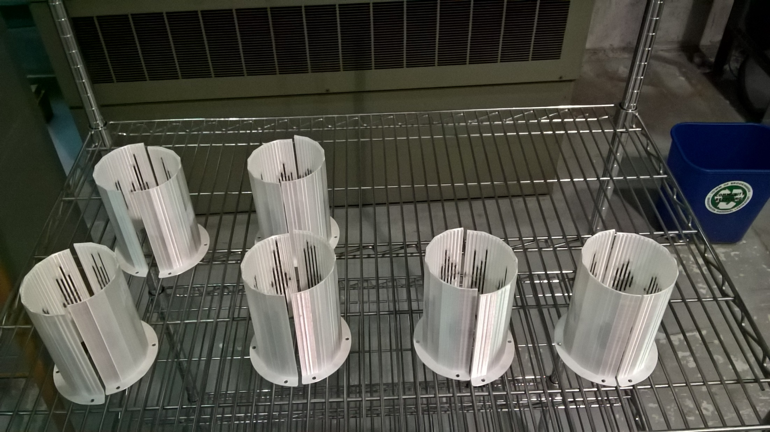
Wire tuning packs for CBETA magnets

Slide 20
Tuned Magnets Criteria
Midplane error (G) | Units FOM | CBETA FOM | Quad error at x=0 (rel.)
≤ 1.5 | ≤ 10 | ≤ 0.375 | ≤ 0.05% (Q)
Unit = 10⁻⁴ of main pole
FOM is sqrt(sum of all (multipoles in units)²)
  CBETA FOM is weighted version based on tracking
Midplane error generally hardest to achieve
  May go in and out of spec slightly (~0.5G) due to chiller cycle

Slide 21
Example Harmonics (QF 2566)
Normal
Skew
Integrated strength (T/m.m)
Dipole
Quad
Sext
Oct
etc.
-1.53782 | 0
8.20E-64 | 1.87E-65
10000 | 1.26E-12
-0.2922 | -0.58294
-0.07957 | 0.201785
0.572878 | -0.88759
-0.44538 | -0.60878
0.015517 | -0.12825
0.064316 | -0.07939
0.038948 | 0.018125
0.051198 | 0.022414
0.037202 | -0.01268
-0.01854 | -0.01006
-0.01217 | -0.07378
-0.09591 | -0.03929
-0.00478 | 0.020399
-0.01032 | -0.01952
0.007539 | 0.007748
0.068582 | 0.001058
-0.00071 | 0.001648
-0.00187 | -0.00071
Displaced magnet by DX (m) | -0.0002
DY (m) | -0.00156
Rotated A/C by (rad) | 0.041074
(deg) | 2.353343
Reference radius (m) | 0.025

Slide 22
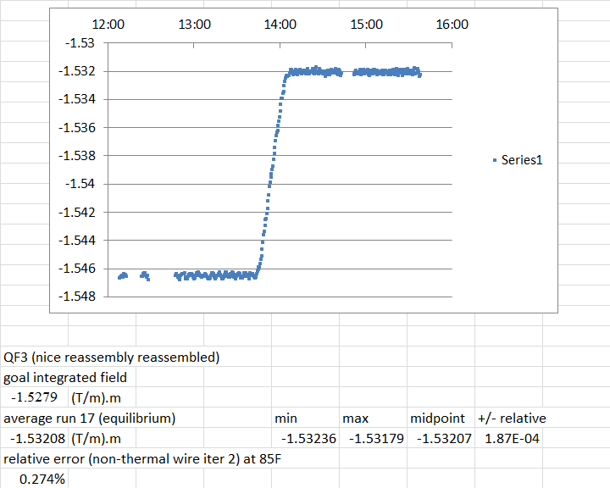
Water Cooling Stability

Slide 23
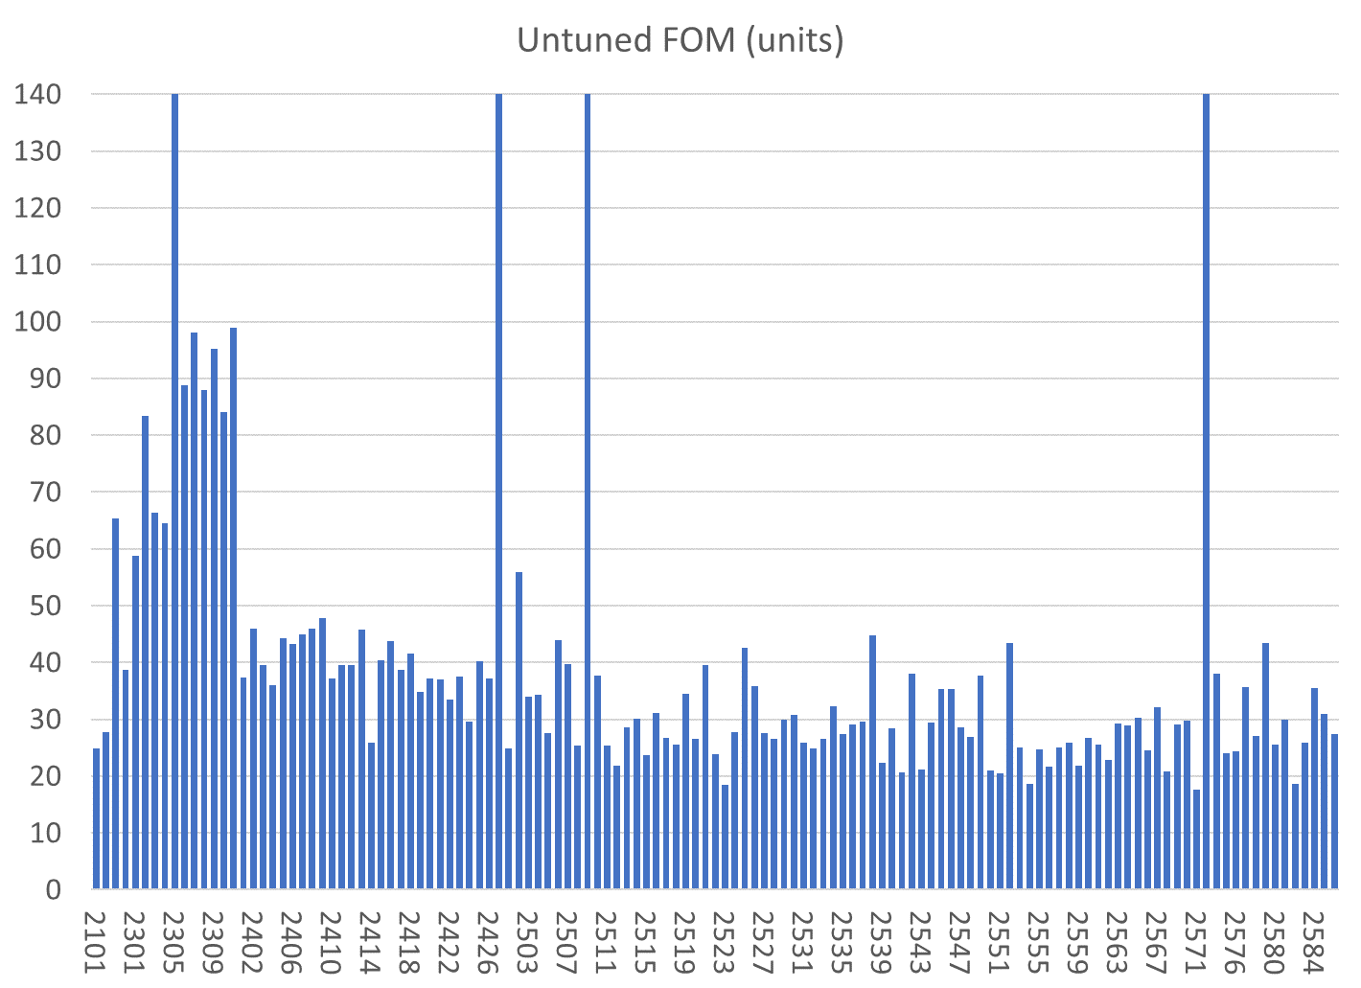
Reversed block
Mislabelled block
Reversed block
Mislabelled block
BD
BDT1
QD
QF
BDT2

Slide 24
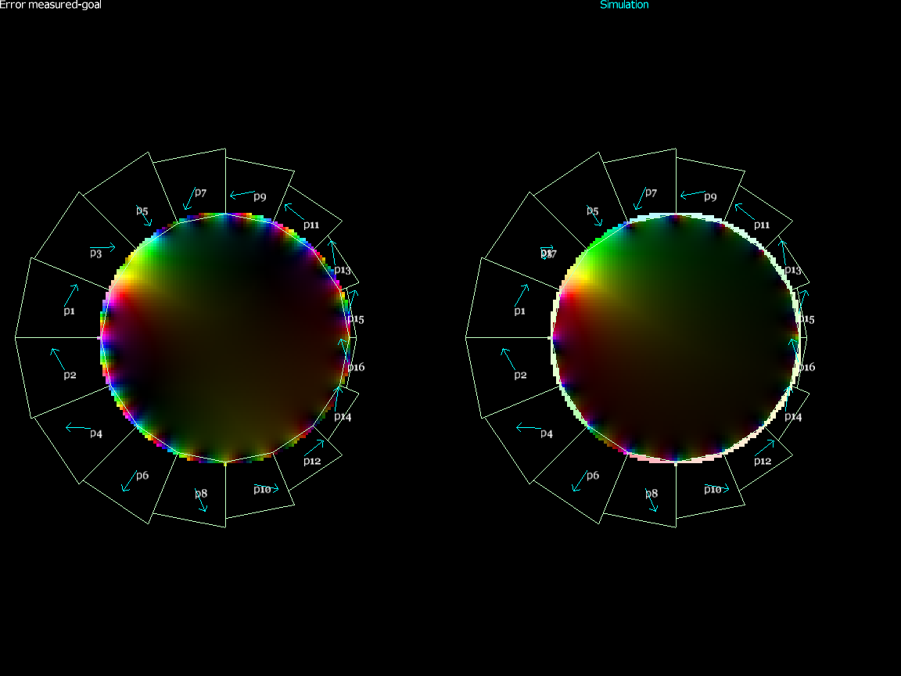
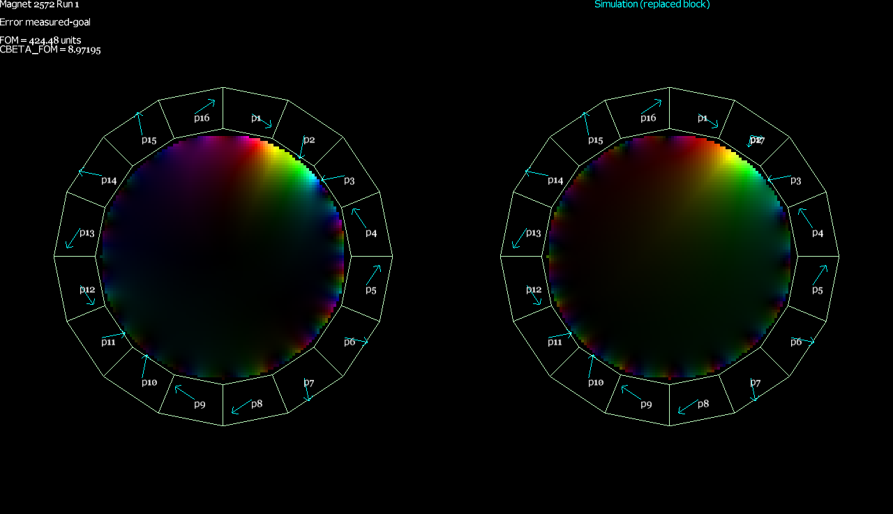
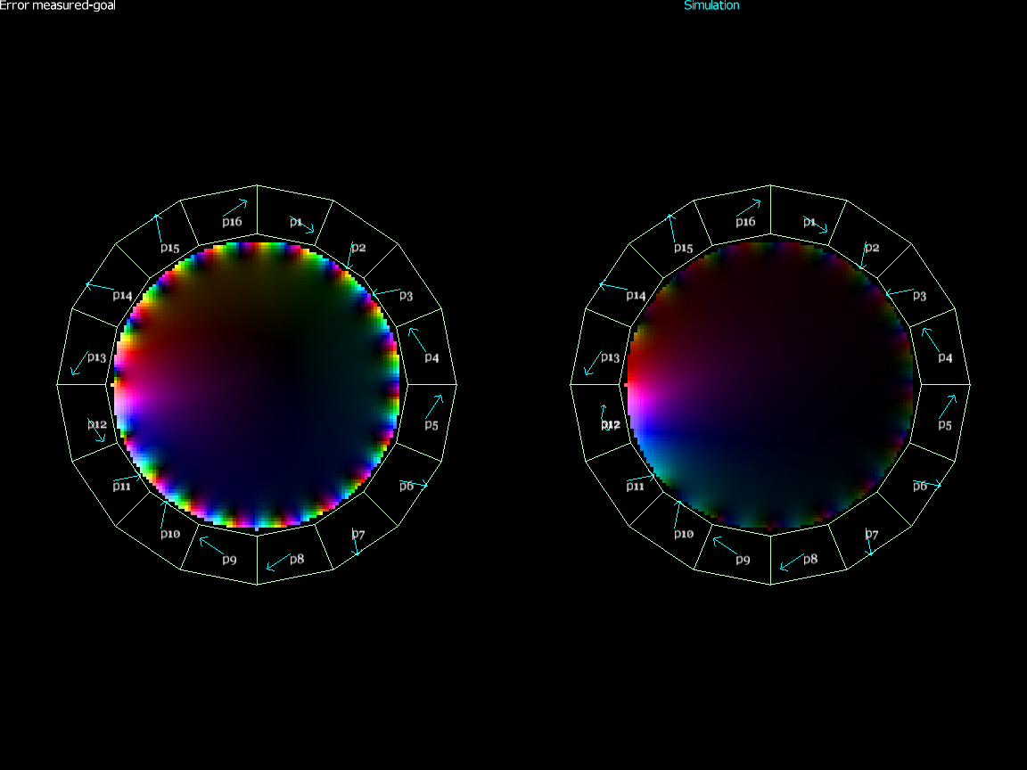
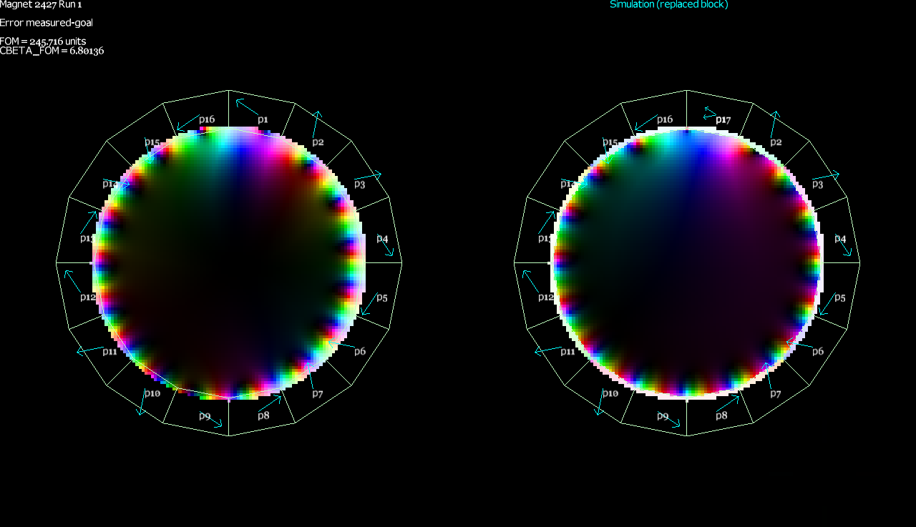
Rejects/Repaired
BD 2305
Harmonics simulation w/swap
QF 2572
Harmonics sim. w/type change
QF 2509
Harmonics simulation w/swap
QD 2427
Harmonics sim. w/type change

Slide 25
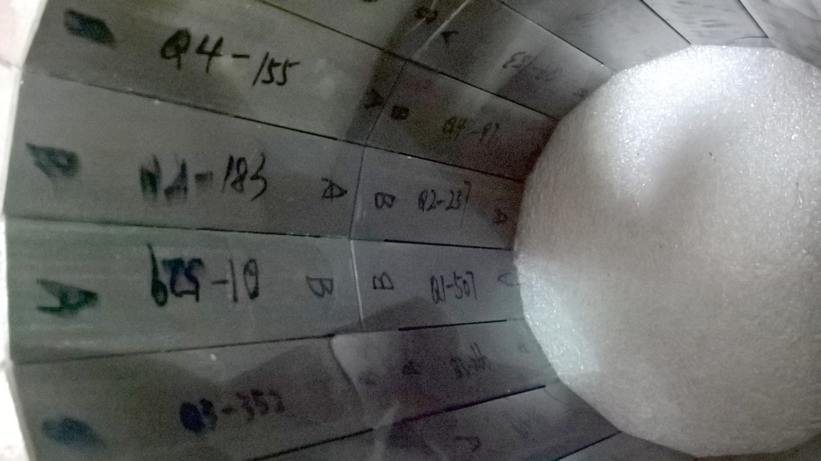
Reversed Block in QF 2509

Slide 26
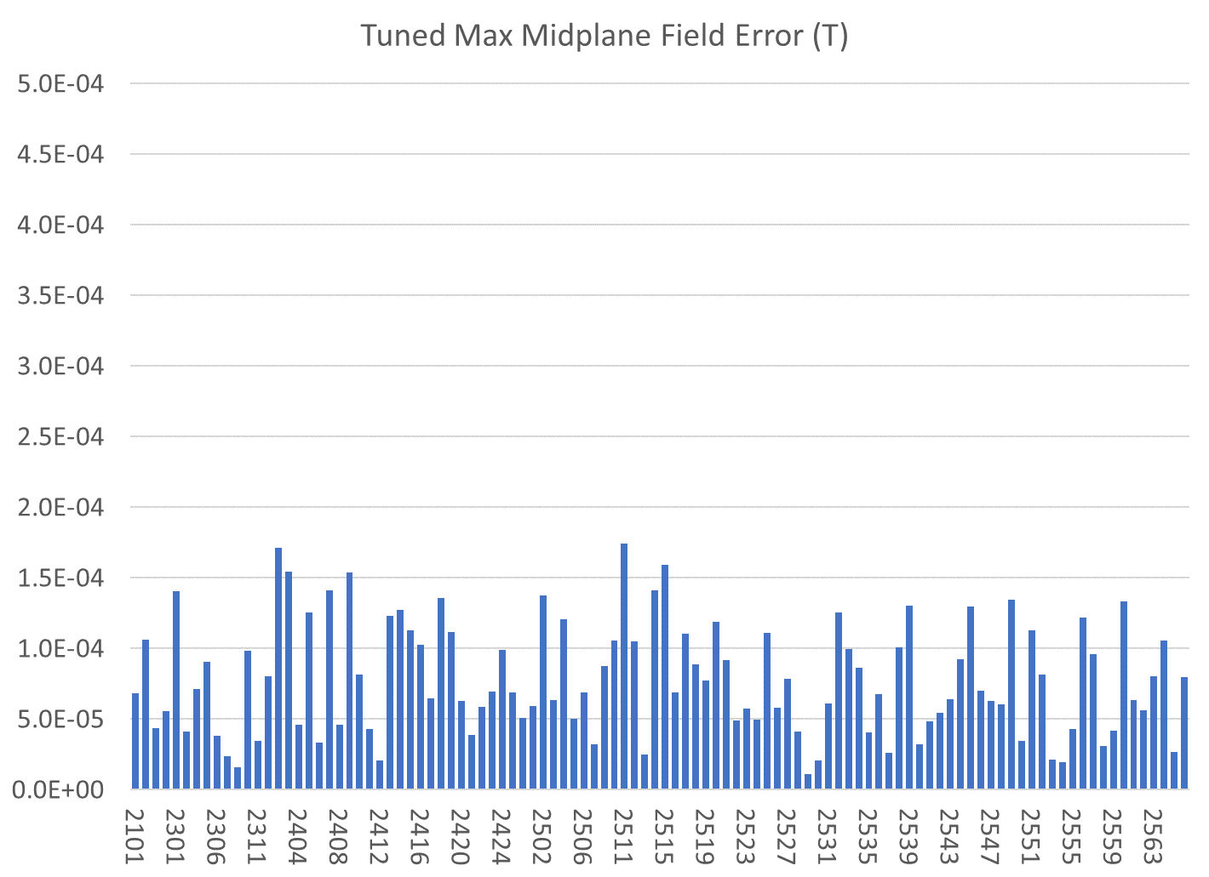
Only tuned magnets shown (4 “rejects” also removed)
BDT1
BD
QD
QF
BDT2

Slide 27
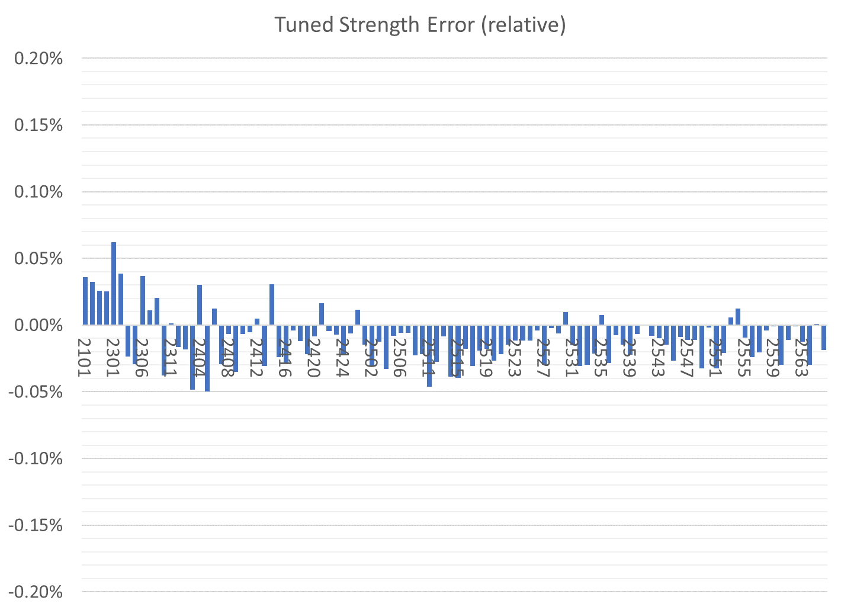
Only tuned magnets shown (4 “rejects” also removed)
BDT1
BD
QD
QF
BDT2

Slide 28
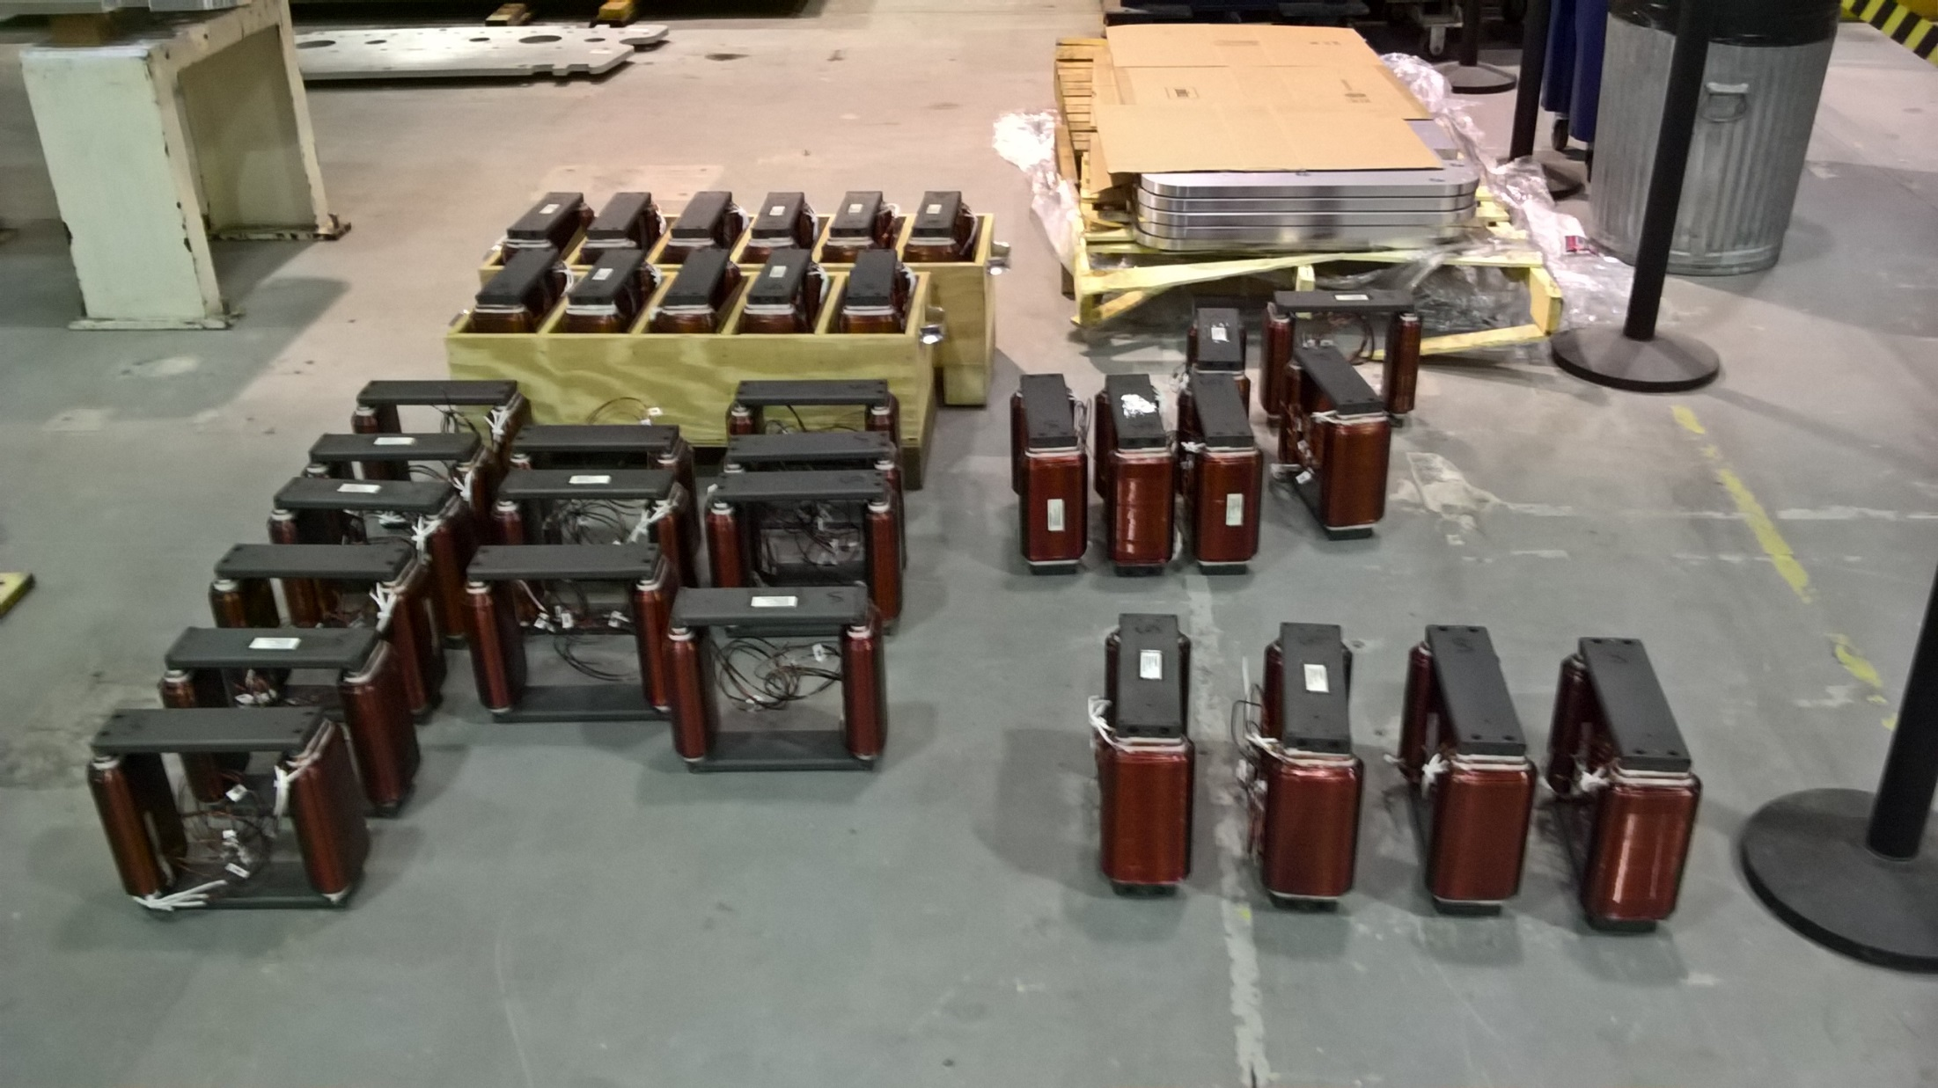
CBETA windowframe correctors at BNL

Slide 29
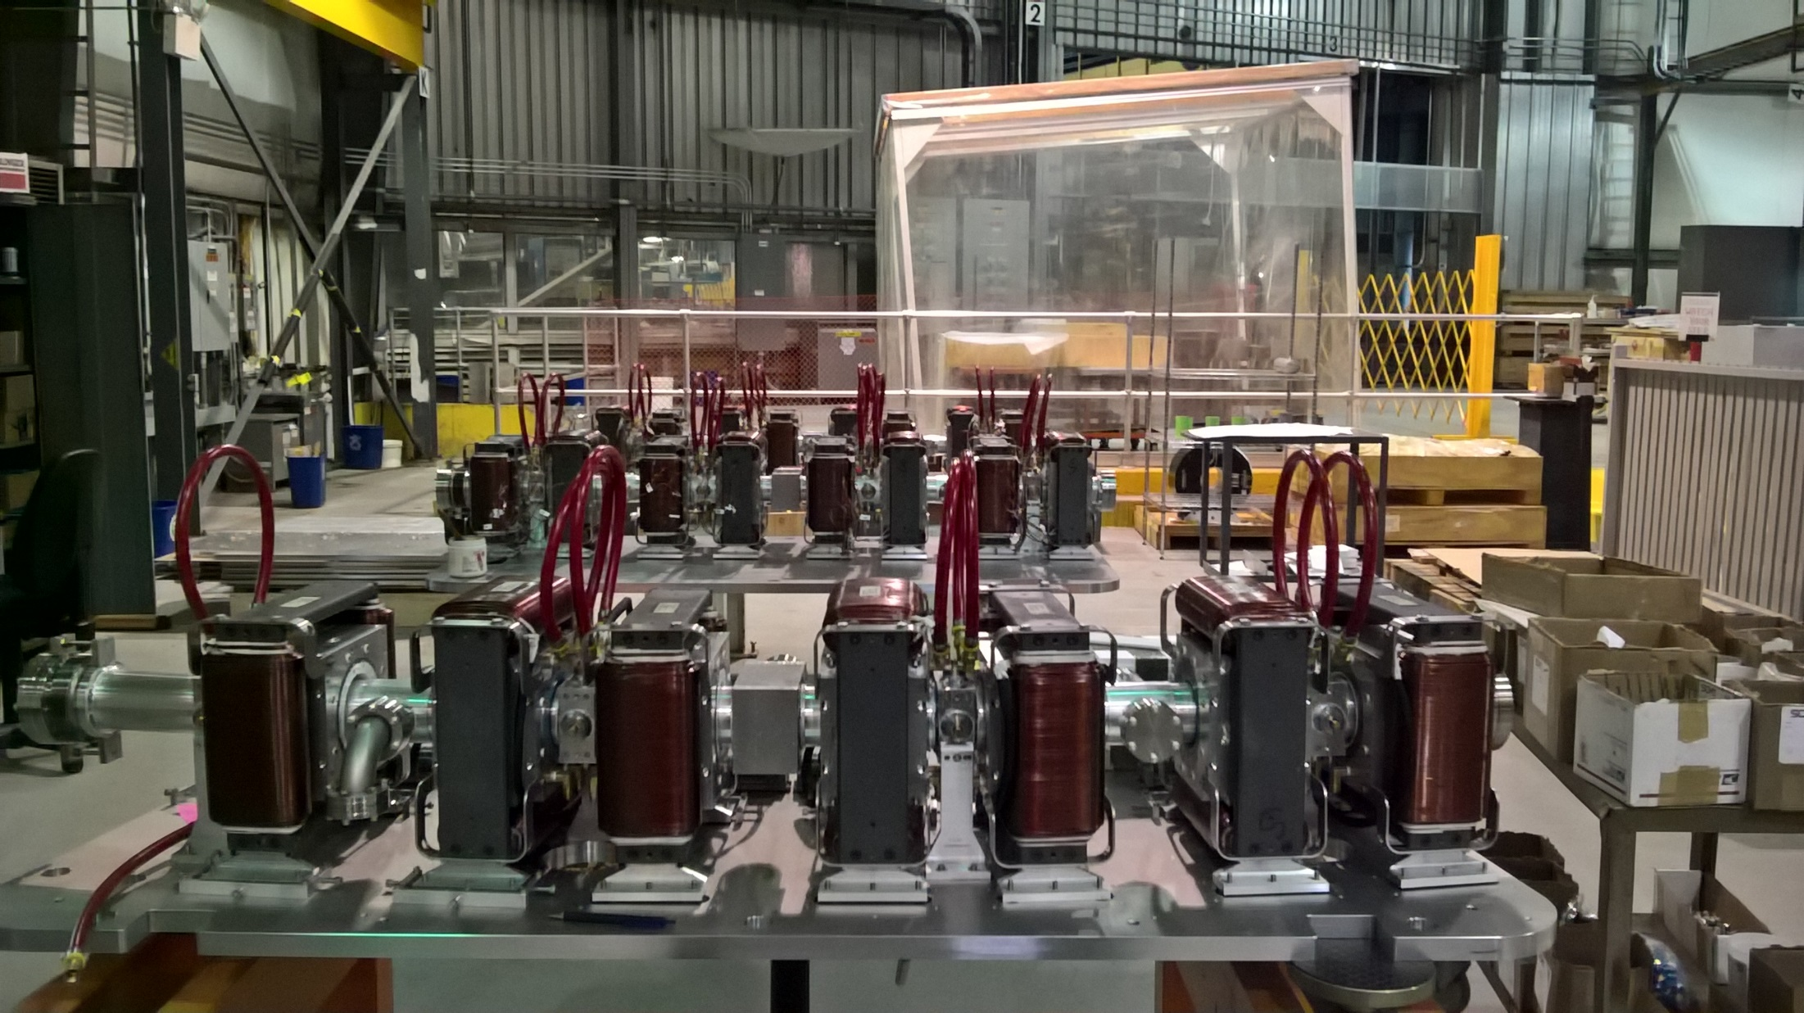
CBETA girder production at BNL

Slide 30
Other Problems/Lessons Learned
@BNL
  Warehouse roof leaks, hence tent in photo
  Gaps when reassembling magnets from halves
@AllStar
  Some blocks went rusty (not passivated?), had them re-made
  One type magnetisation angle was out-of-spec, had them re-made
@KYMA
  Couple of blocks inserted backwards
  One glue failure, exploding magnet, repaired
Team effort
  Block width with chamfer was not communicated clearly to AllStar, meaning blocks slightly larger than needed, had trouble fitting
  Chinese sign convention for magnetisation was opposite, had to invert blocks

Slide 31
Backup

Slide 32
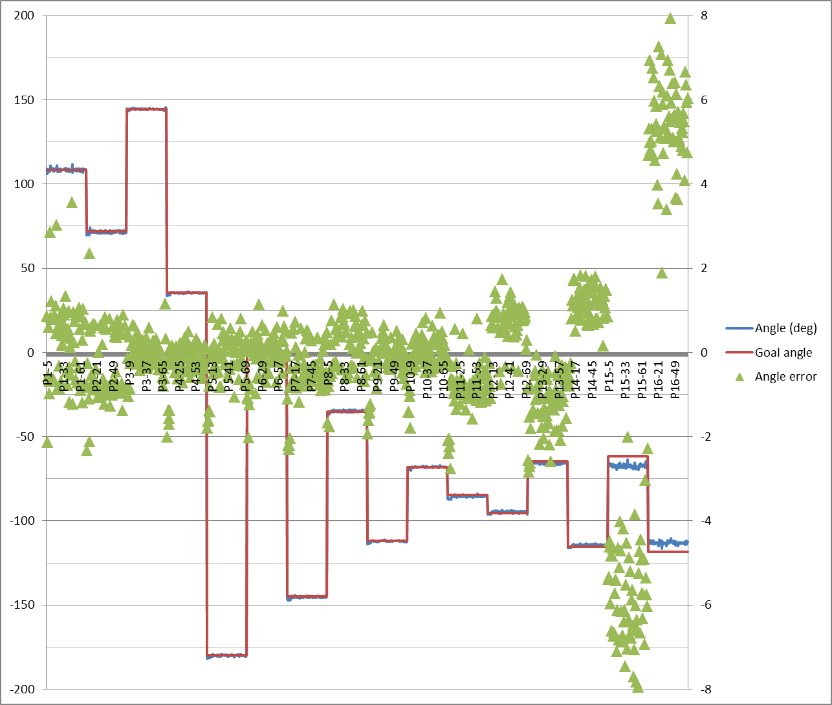
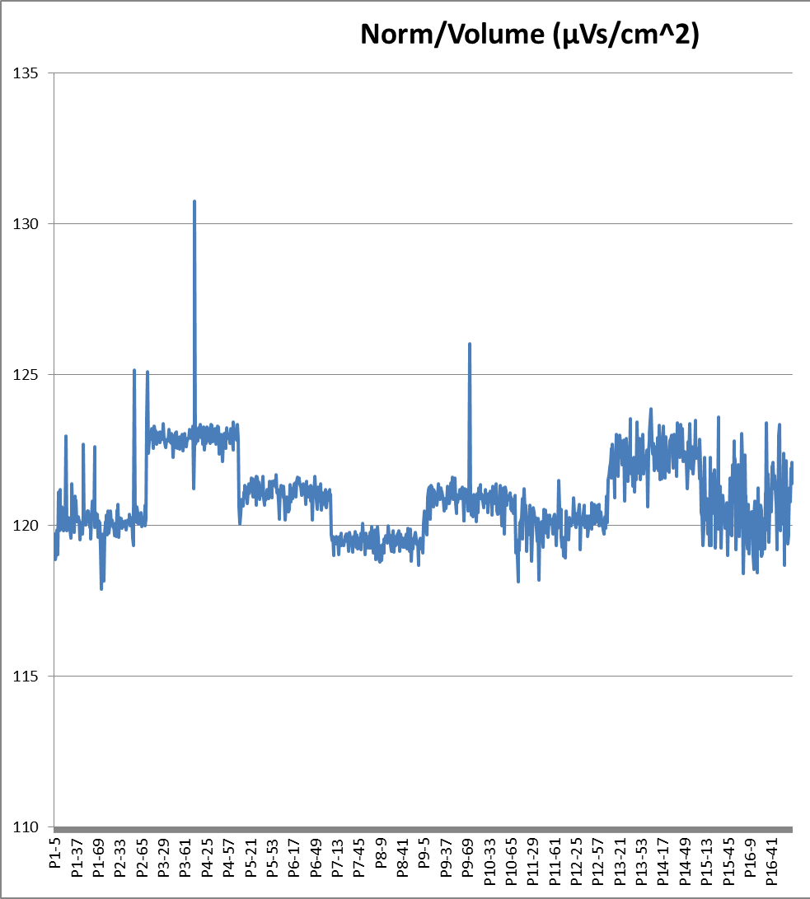
Helmholtz Measurements
Example: AllStar data for wedge types P1 through P16 (BD magnet)
Angle errors Strength variation

Slide 33
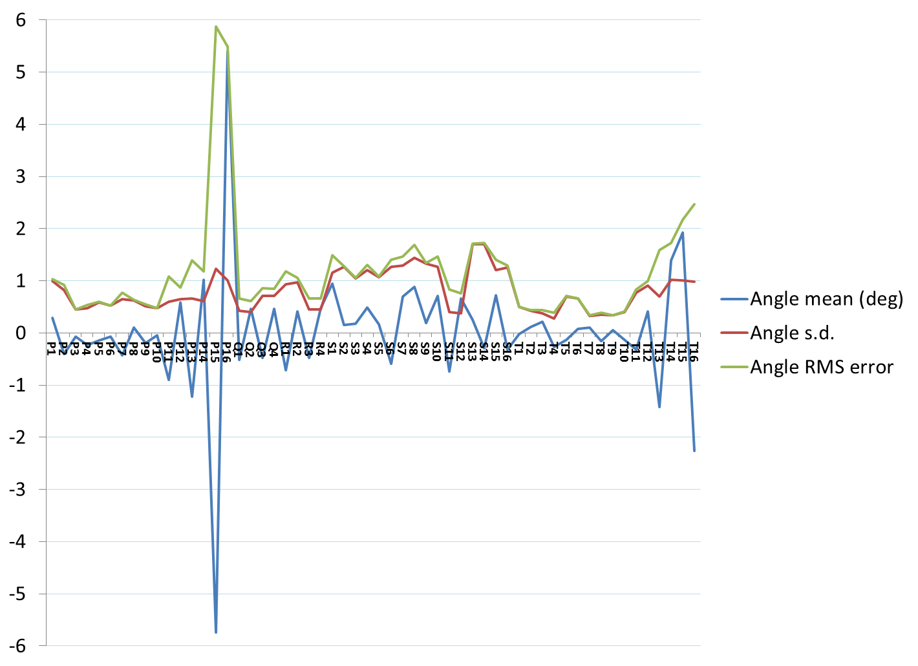
Magnetisation Angle Distributions
Requested that factory re-make types P15 and P16 to reduce systematic error.
These are the smallest blocks, so not critical, but re-make will improve quality of untuned magnets.
General request was for 1 degree RMS error, but can cope with some above and some below as we have here (see next slide)

Slide 34
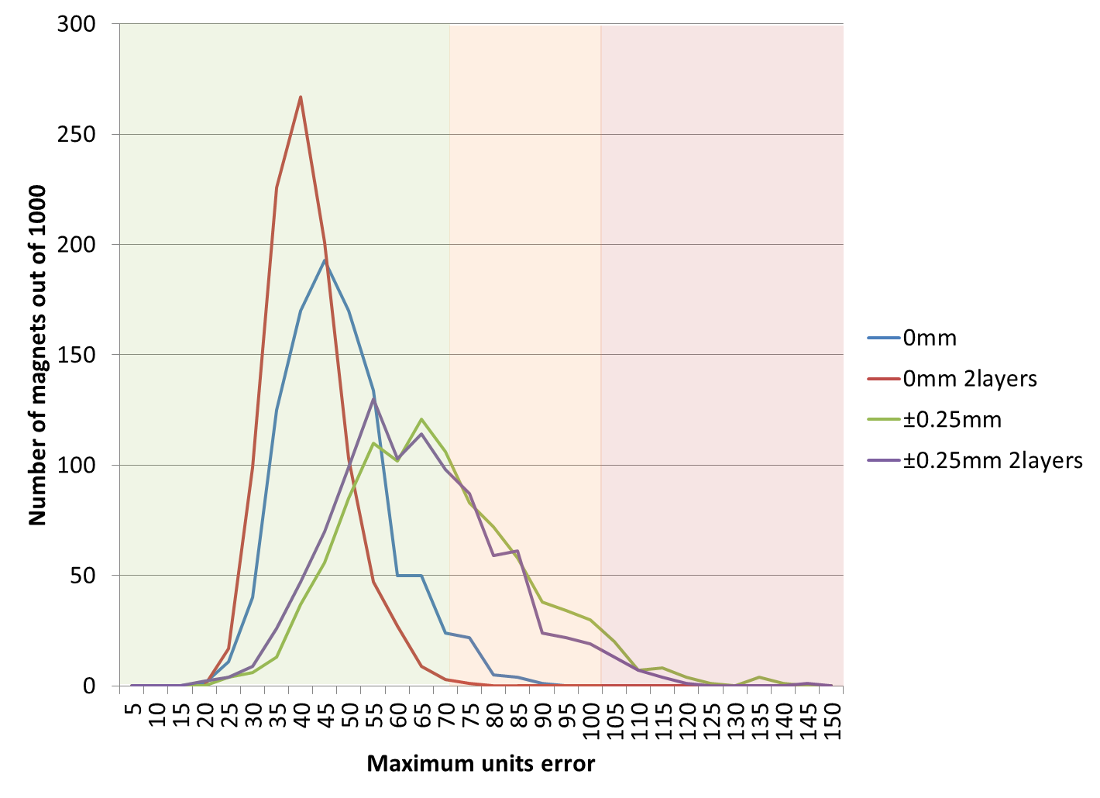
Magnet Error Model
Both the strength and angle error distribution can be put back into the field simulation
Example: BD magnet using AllStar’s data set.
1000 magnets were generated, some with position errors. Histogram is binned by the “units FOM”.
Green = easy to tune
Red = possible problems
Based on first girder experience.

