Slide 1
CBETA: a 4-pass superconducting ERL with permanent FFA magnet return arc

Slide 2
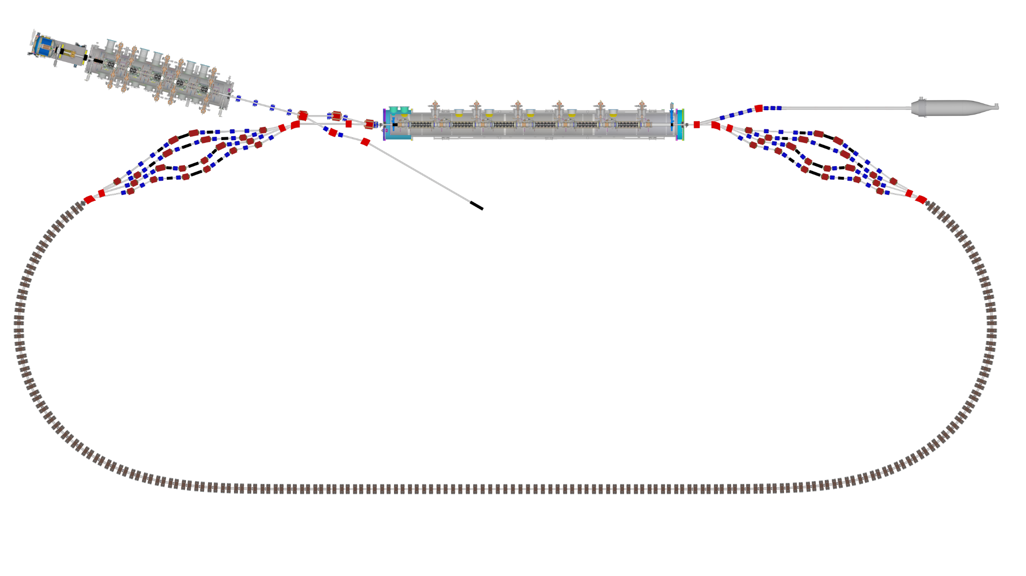

Layout & Parameters
Main linac is a 1.3GHz SCRF module with six 5-cell cavities
Source
±36MeV
Beam stop
Main linac cryomodule
Injector cryomodule
6MeV
6MeV
Diagnostic line
Splitter B
Splitter A
42,78,114,150MeV
Arc A
Arc B
42-150MeV
Transition B
Straight
Transition A

Slide 3
Bunch Pattern (one option)
Time structure as seen by the main linac

Slide 4
What can an ERL do?
 | Advantages | Disadvantages
Compared to linac | Energy recovery: circulating beam power can be much higher than RF power input | Can’t use stopping targets! Disrupted beam must survive 1 turn (or a few turns)
Compared to ring | Equivalent to ring with cooling system that cools in one turn! (small emittance) Can disrupt beam more than in a ring where beam has to survive millions of turns | Source current must equal circulating current; Current in linac is circulating current multiplied by 2 or more (important for higher order modes)
Applications: thin targets, electron coolers, Compton backscattering, light sources, electron-ion colliders (LHeC/FCC-eh)

Slide 5
CBETA Energy Saving Technologies
Permanent magnets
Superconducting RF
Energy recovery (above 6MeV)
Recirculation: 4x beamline reuse, 4x energy
Funded by NYSERDA
  (NY State Energy R&D Authority)
  $25M grant
  Cornell already had the injector & cryomodule

Slide 6
Project Timeline
Construction
Beam operation

Slide 7
Fixed-Field Return Loop Optics
Beams with 4x rigidity range transmitted through same overall radius of curvature in arcs
Adiabatically merged to zero curvature, separation in straights
Beam cell tune decreases as a function of energy

Slide 8
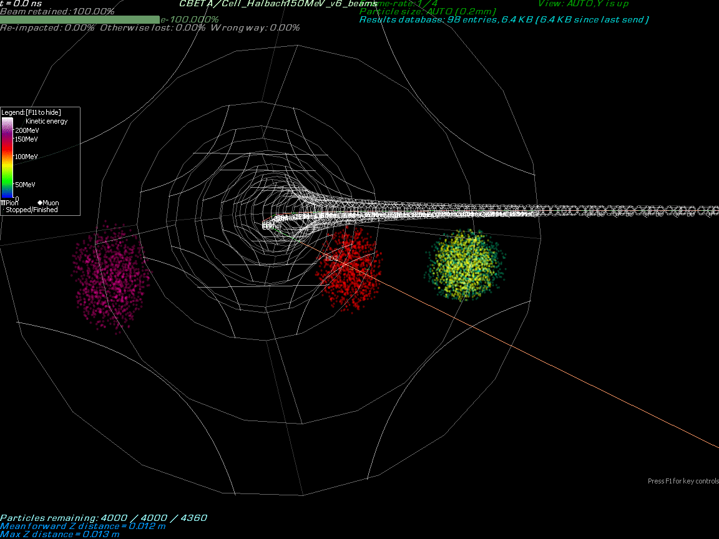

Slide 9
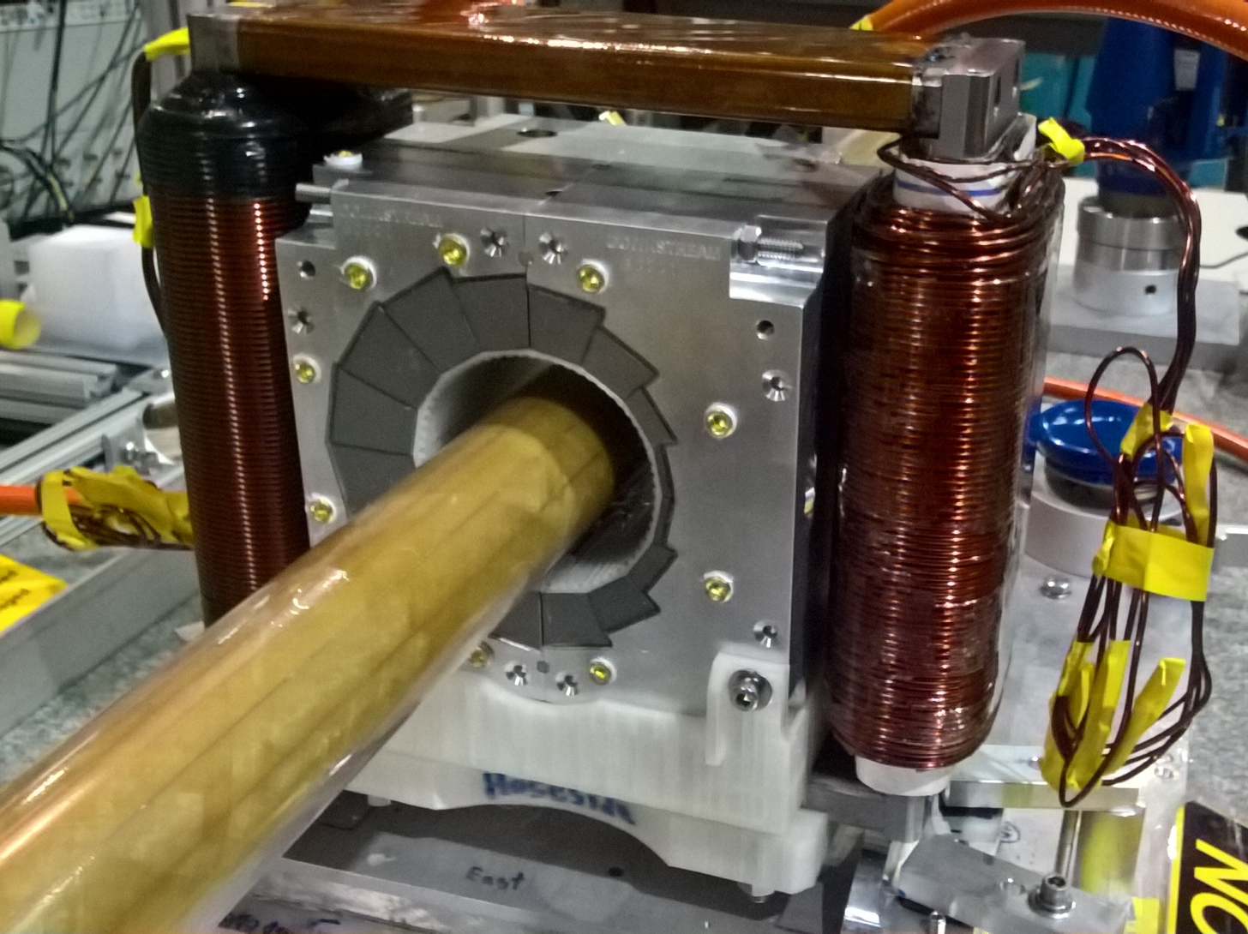
Permanent Magnet Design
Halbach design made of NdFeB material
This is a combined dipole+quad
Being measured on rotating coil at BNL
3D printed multipole corrector pack inside
Windowframe corrector coil outside
Temperature stabilised by water (orange hoses)

Slide 10
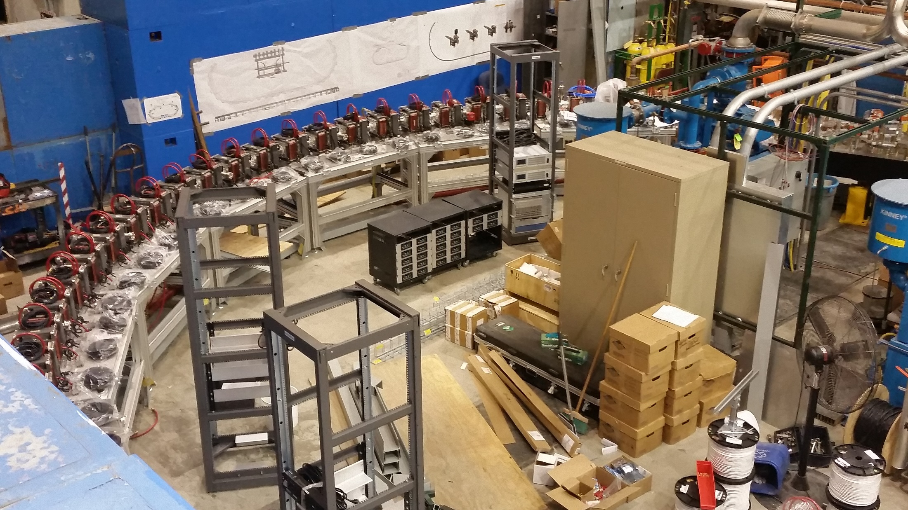
Fixed-Field Return Arc

Slide 11
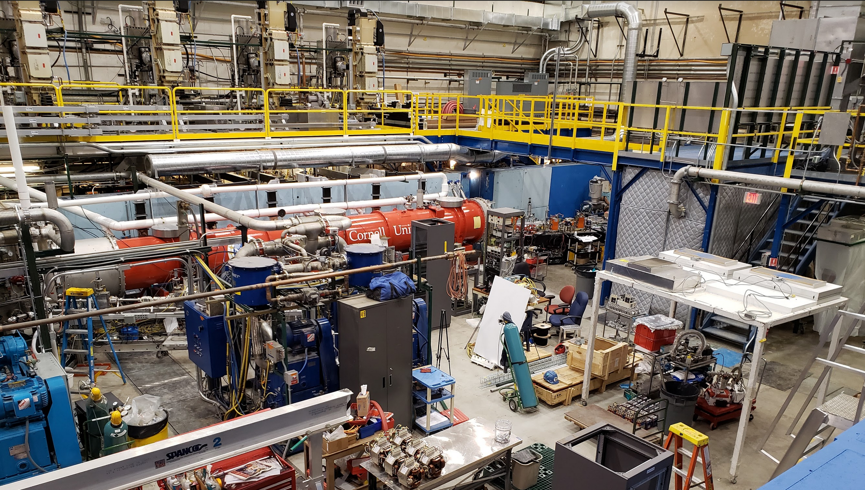
Main Linac Cryomodule

Slide 12
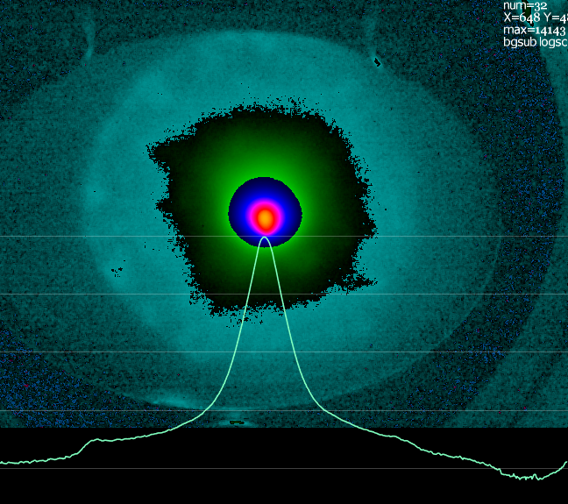
Possible Halo after Injector
3×10⁻⁴ relative intensity
~100x beam core area
About 3% of total charge
Probably from photocathode
(April 17, 2019)
Selectively-activated photocathode has been used before at Cornell to suppress this sort of thing
Collimators in the injector are possible but harder due to high beam powers

Slide 13
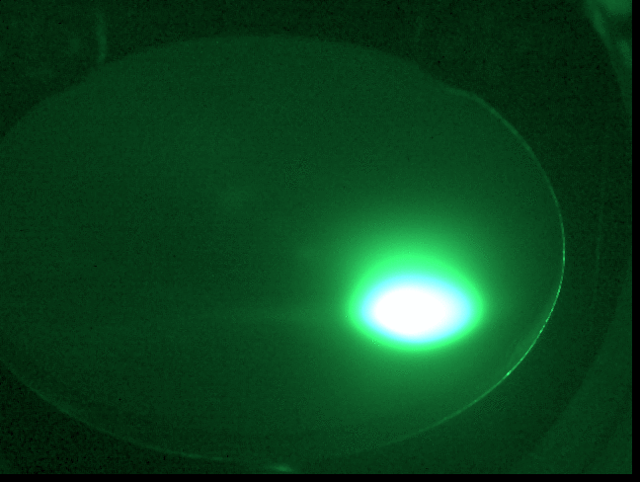

Slide 14
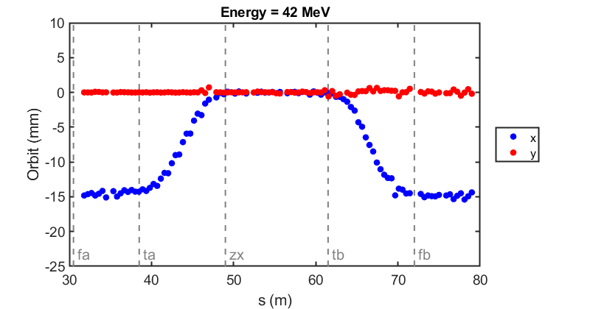
Commissioning results: orbit correction in fixed-field loop
The very first beam through the fixed-field loop on May 7, 2019
Corrected beam
(June 12, 2019)

Slide 15
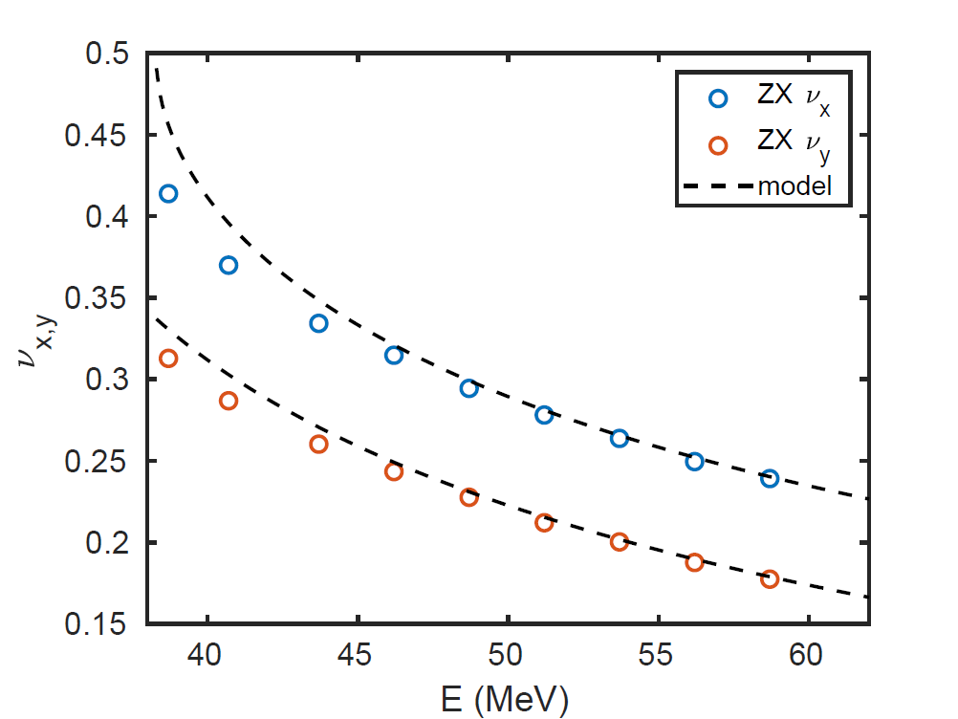
Cell Tunes in Beam Energy Scan
Fixed-field arcs
Fixed-field straight
(June 12, 2019)

Slide 16
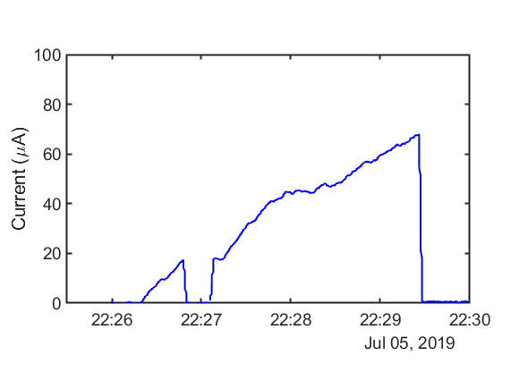
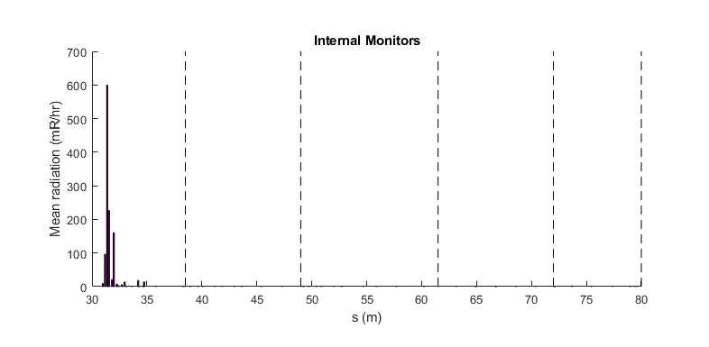
Higher Current Test / Radiation
Using ~3pC bunches
Halo just went through
Current limited by uninteresting things:
Wrong gun photocathode
Fast EPS not installed (10uA limit)
Gun resistor needs changing
External radiation monitors (70uA limit)
No “physics” current limit seen
Extrapolating internal FFA losses gives 70uA*(10000/600) = 1.17mA limit
1mA should be fine
Probably 1-10mA CSR limit

Slide 17
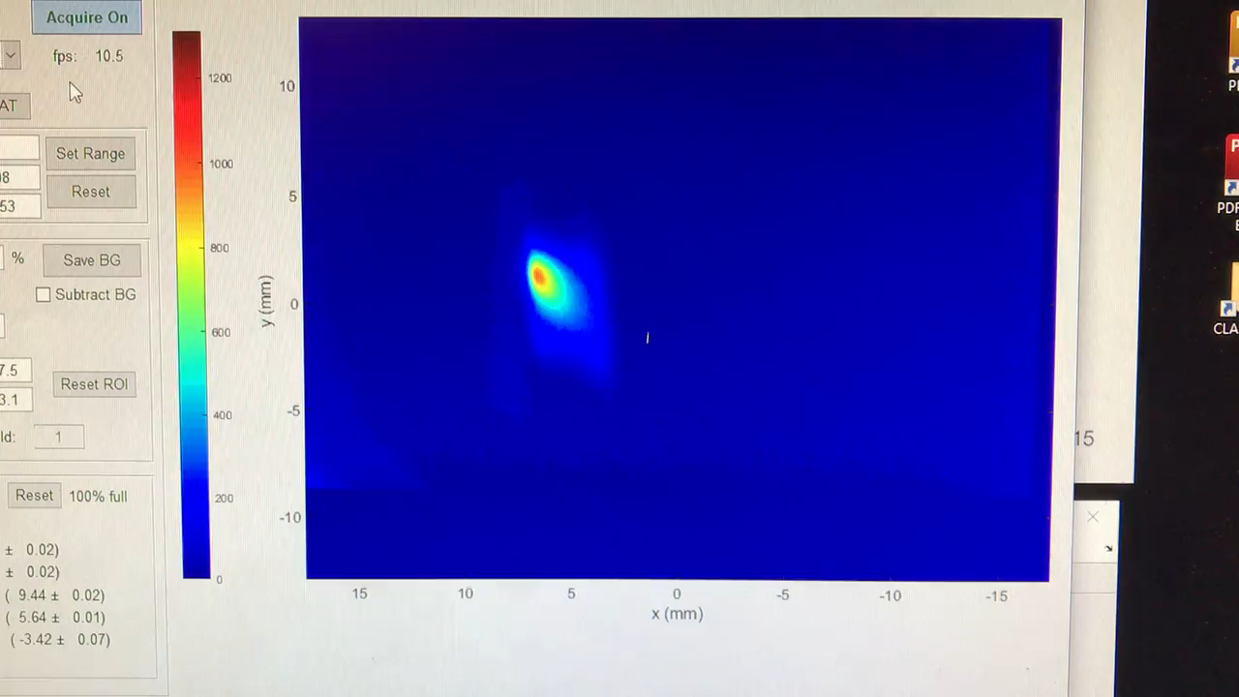
Dispersion, R₅₆ correction
Beam entering the dump line is steady, free of RF energy jitter (July 13, 2019)

Slide 18
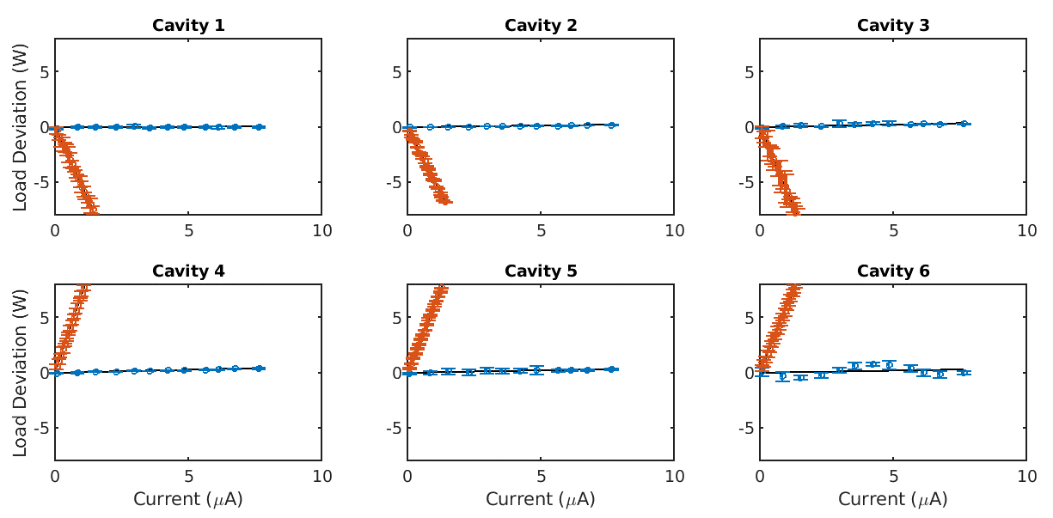
Energy Recovery Efficiency
Transmission improved to
99.6 ± 0.1%
Average current increased to 8 μA
Beam loading for each cavity shown on the right
-•- ER mode -•- Non-ER mode
Load Deviation (W)
Load Deviation (W)
Current (μA)
Current (μA)
K. Deitrick - kd324@cornell.edu
NAPAC 2019 - Status of the CBETA Prototype

Slide 19
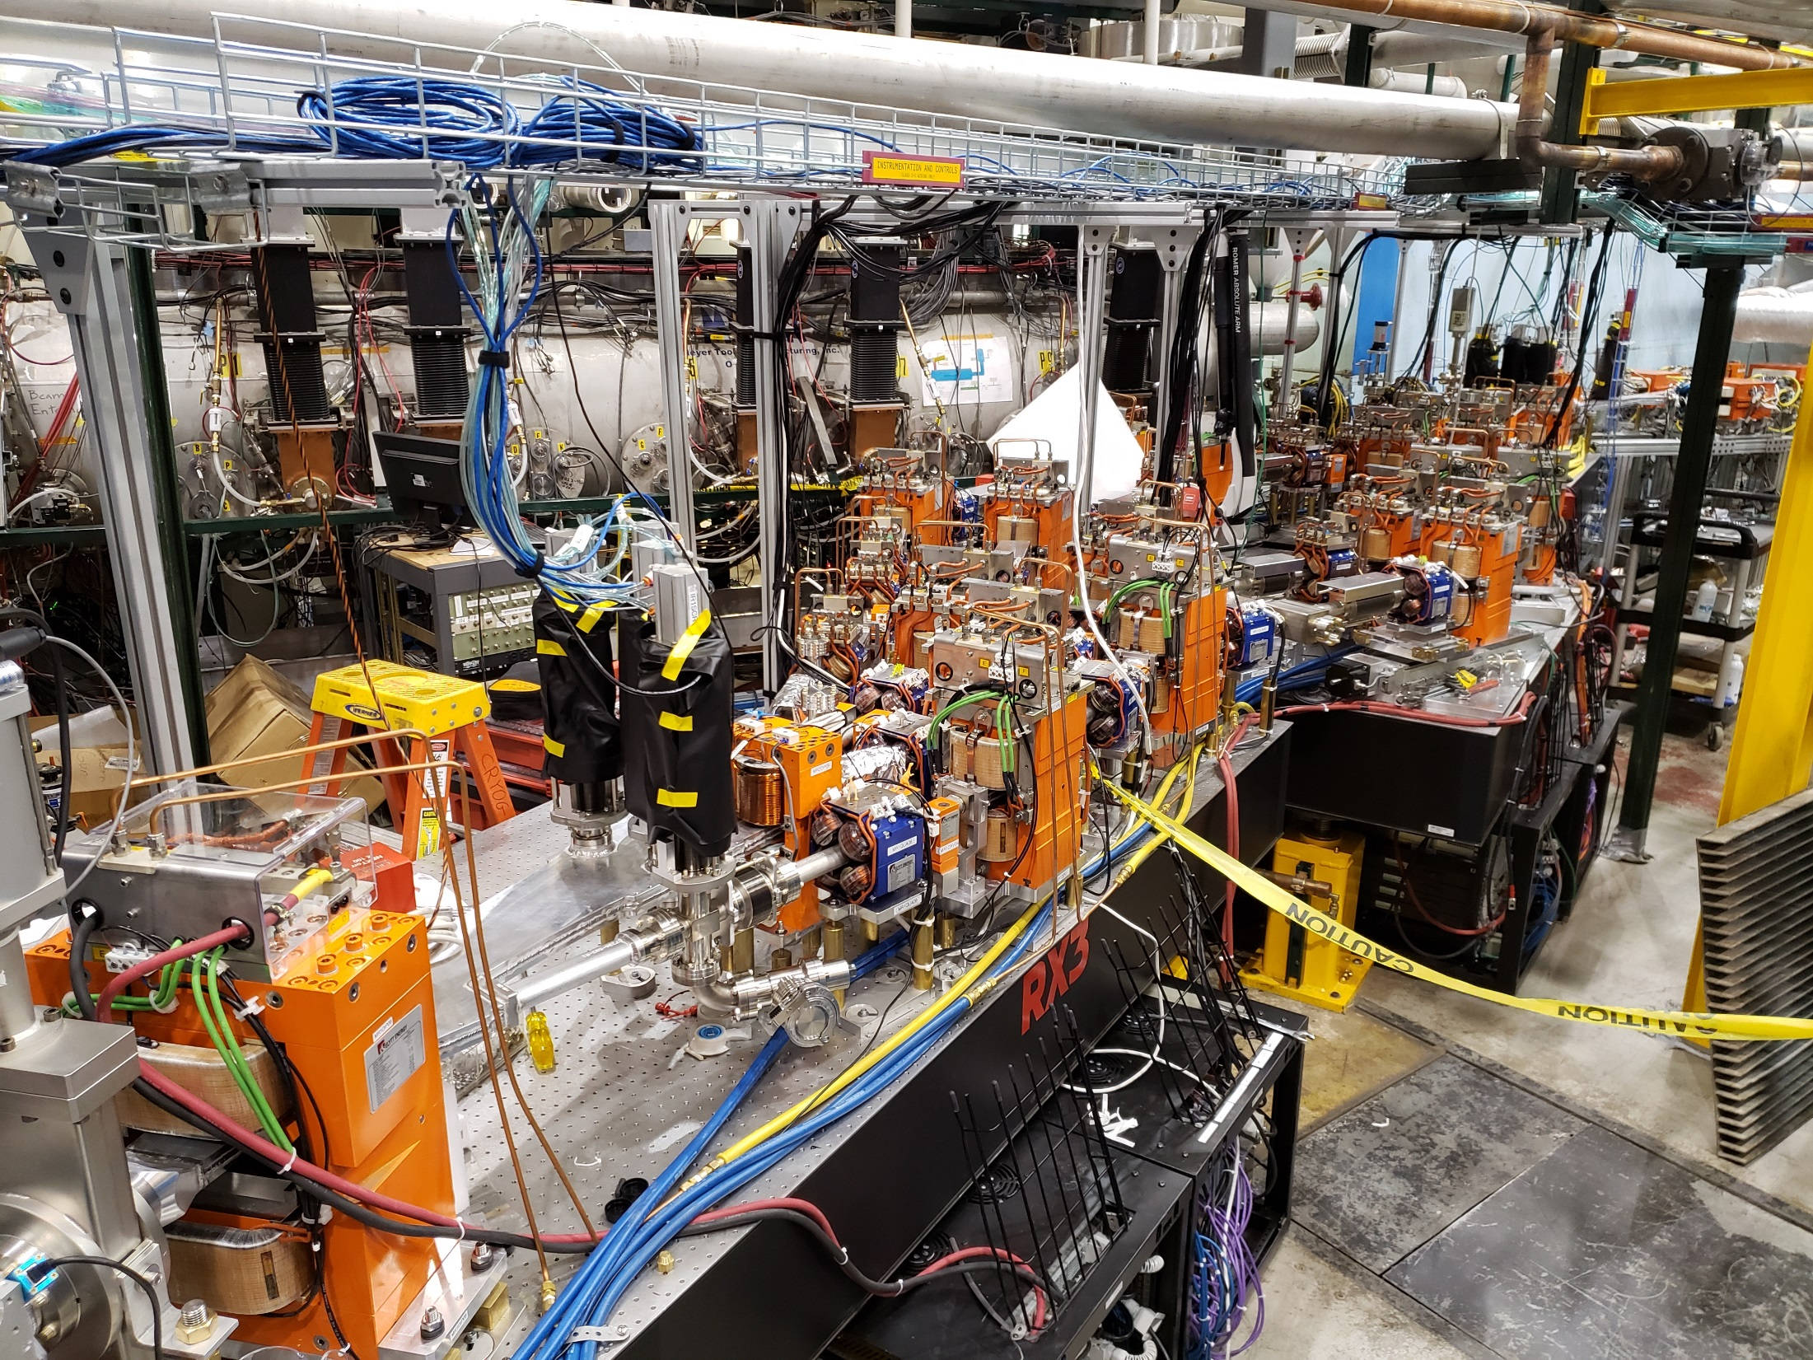
Next: 4-turn operation
CBETA run 2 started mid-October
Other splitter lines have been installed during summer shutdown

Slide 20
Multi-turn Response Matrix
FFA BPMs
42MeV 78MeV 114MeV 150MeV
S1
S2
S3
S4
FFA correctors
make_oval
Two S1 corrector bumps should in theory give a set of phase advances through all turns at once, including turn-to-turn advances, plus phase space oval for each turn

Slide 21
Multi-turn Response Matrix with Orbit+Dispersion Correction in RX Splitters
FFA BPMs
42MeV 78MeV 114MeV 150MeV
S1
S2
S3
S4
FFA correctors
make_oval
R
R
R
R
R
R
The RX lines are set (as a linear function of x, x’, D_{x}, D_{x}’ in each plane) to steer the beam correctly back into the MLC

Slide 22
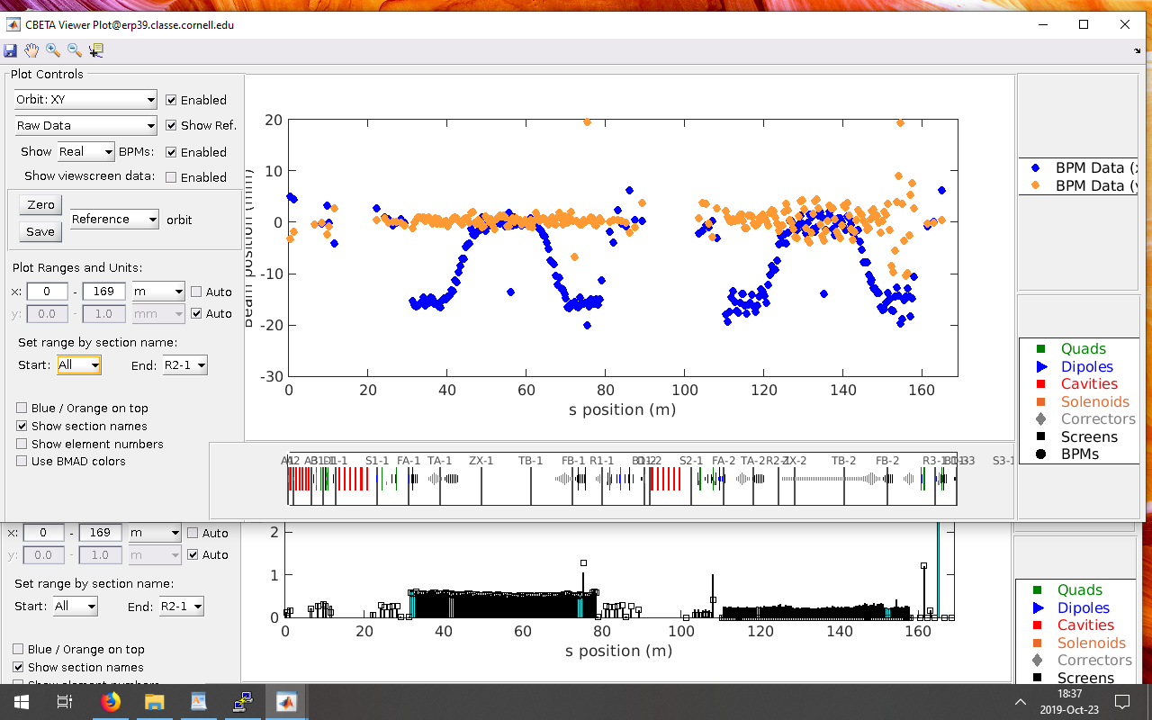
Two Turns
(October 23, 2019)

Slide 23
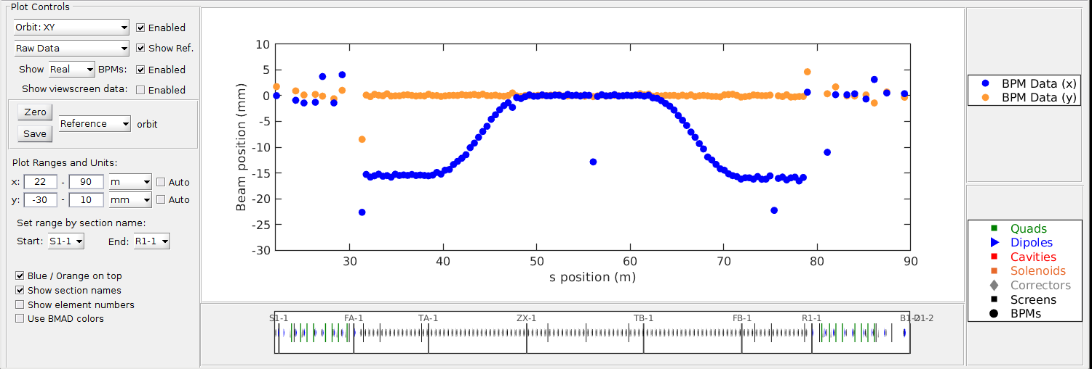
One-turn Whole-FFA SVD Correction
This used an FFA response matrix generated semi-empirically from the phase advances of the first two corrector orbit bumps in each plane
(October 24, 2019)

Slide 24
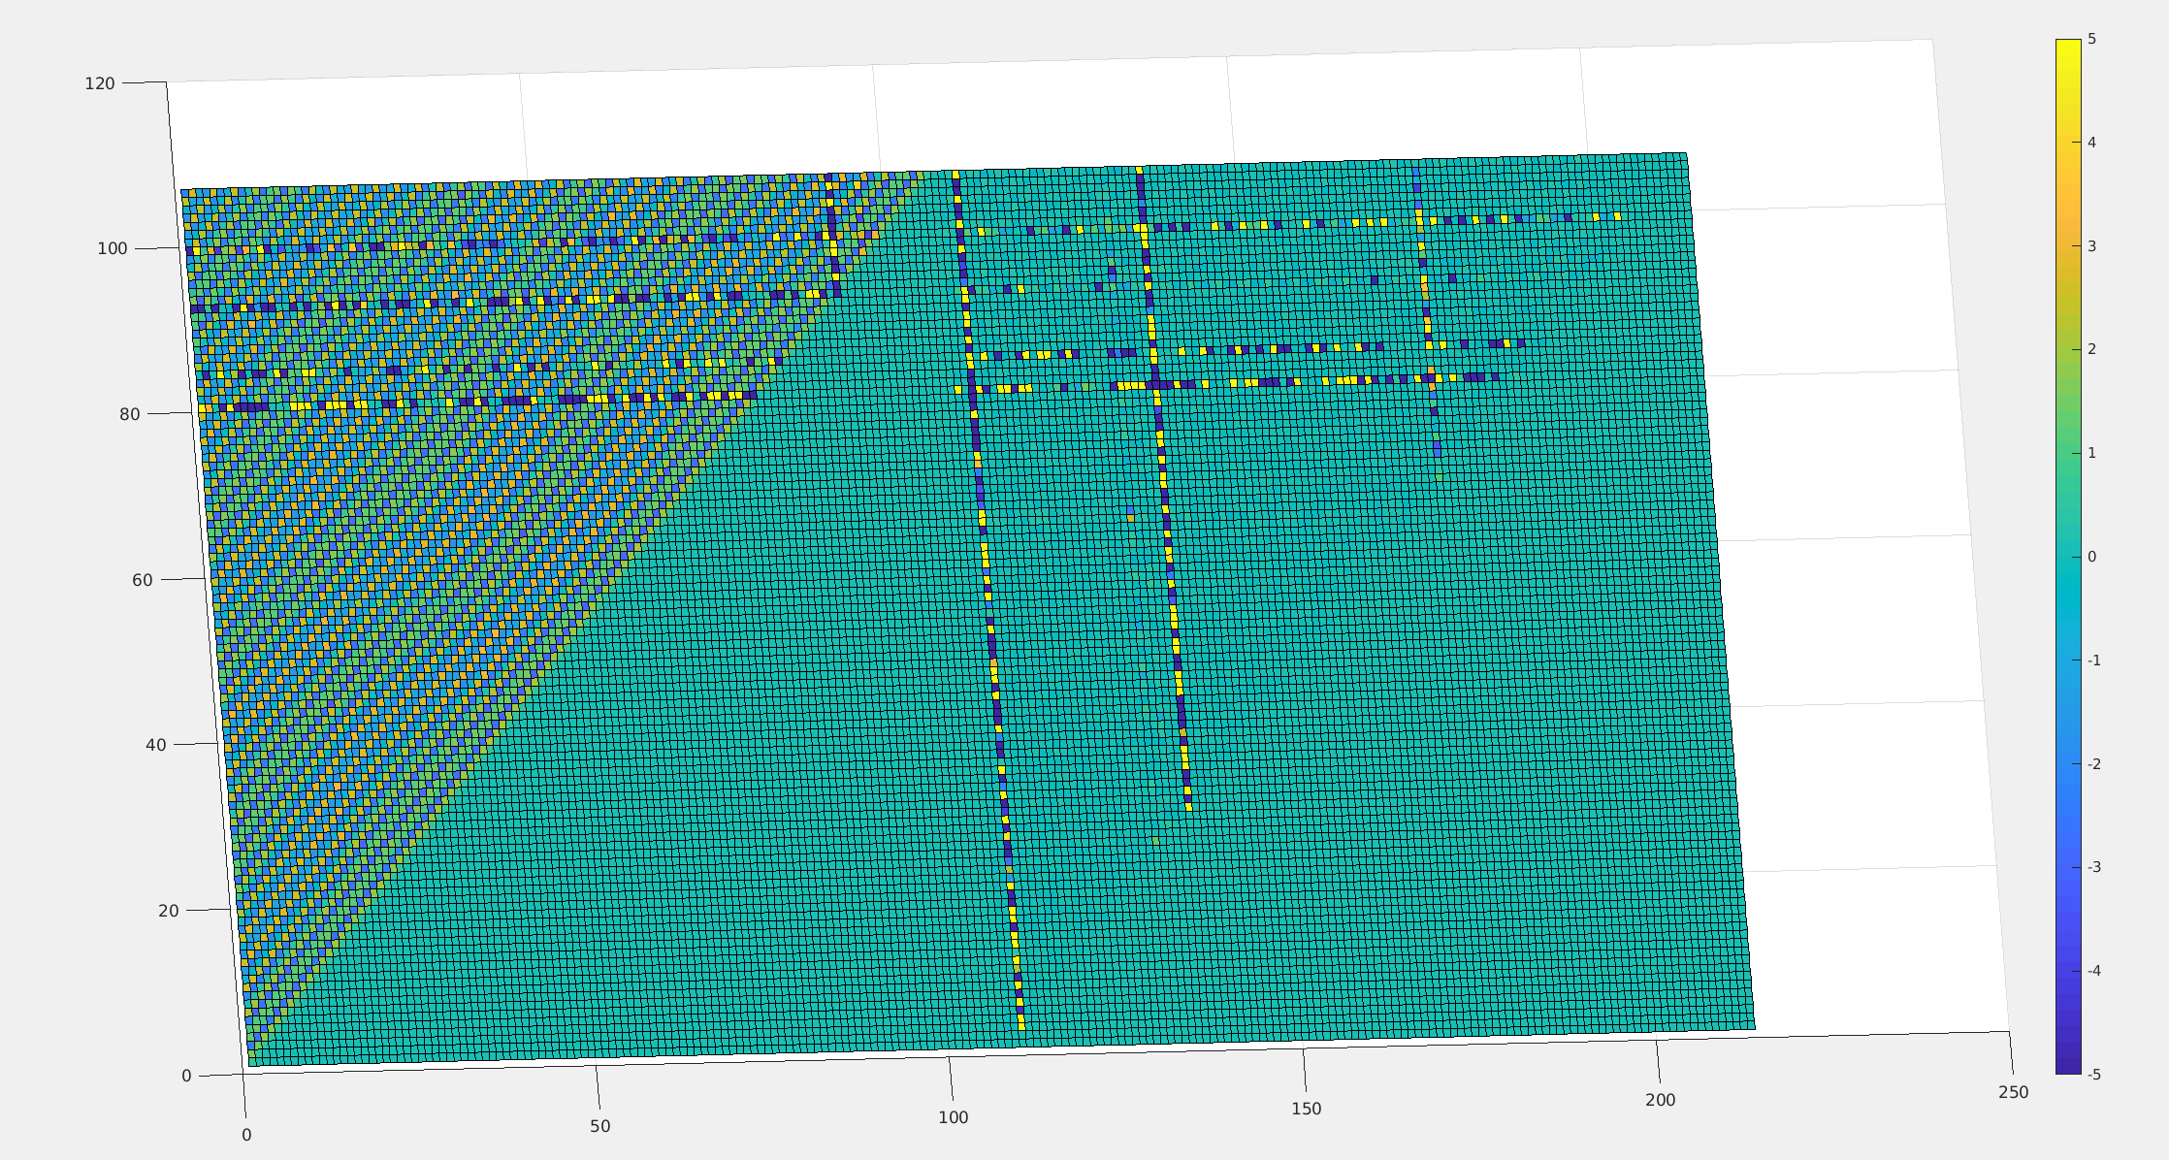
Real Machine Response Matrix
(October 25, 2019)

Slide 25
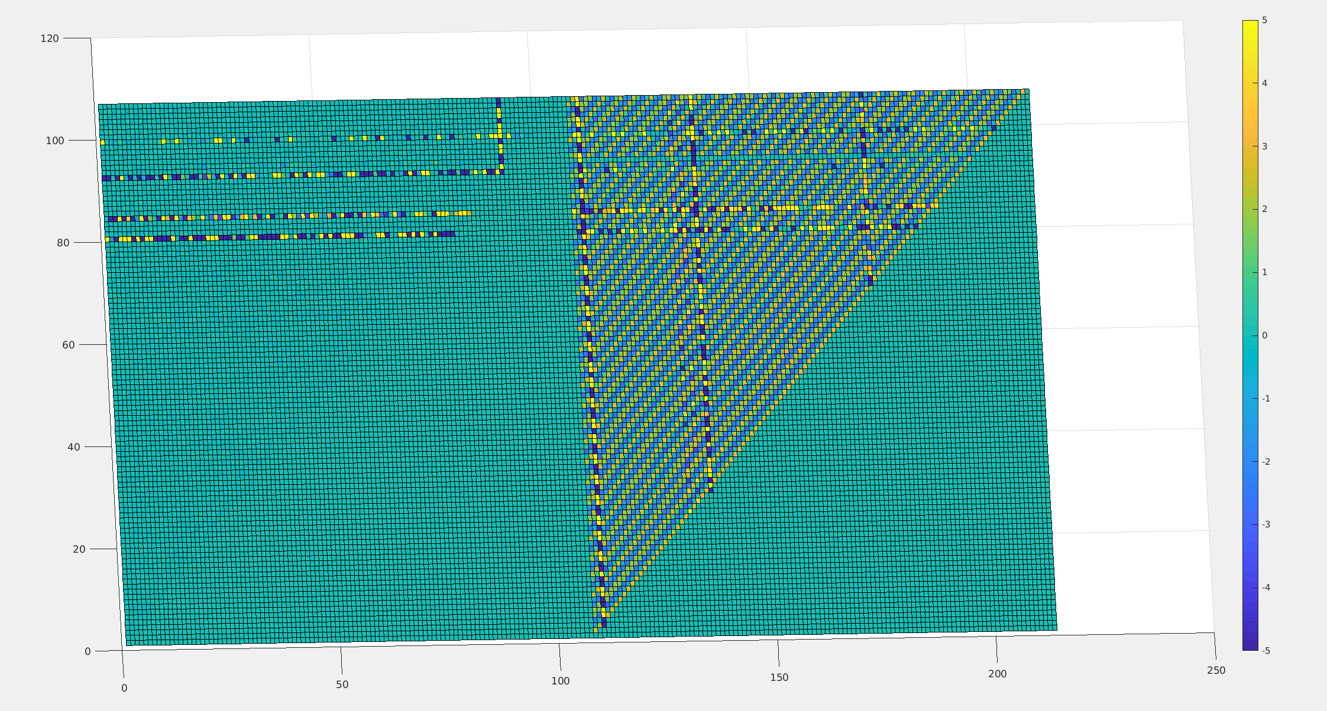
and the Y BPM Plane
(October 25, 2019)

Slide 26
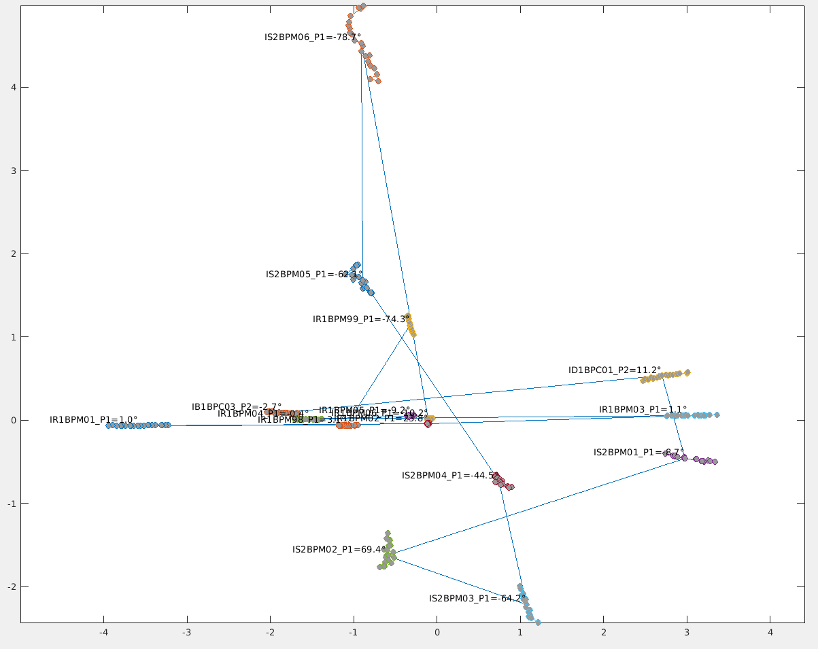
Skew Mystery in {R1,linac,S2}
(November 4, 2019)
Horizontal beam scan early in R1 propagating as diagonal/vertical in S2, evidence of large skew quad

Slide 27
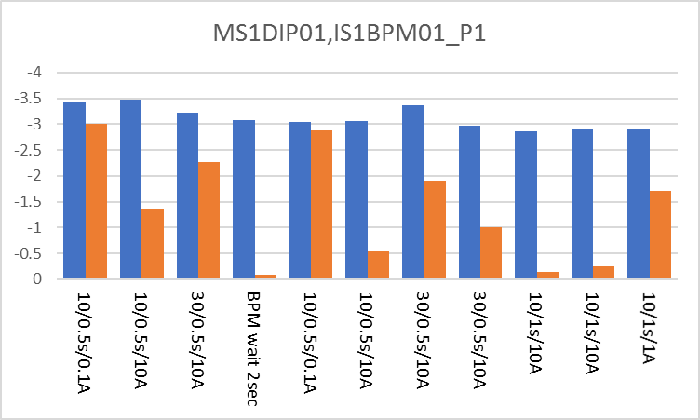
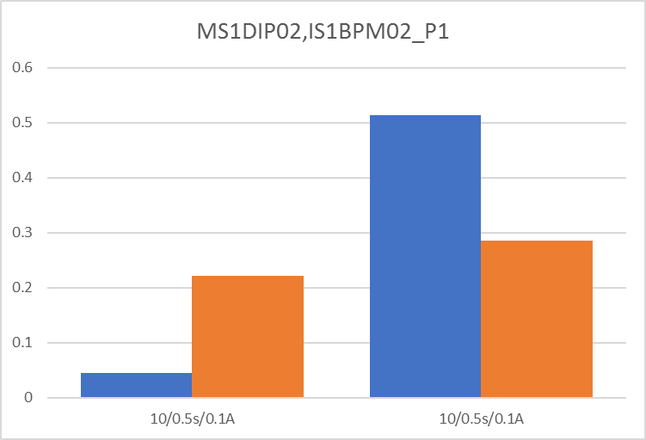
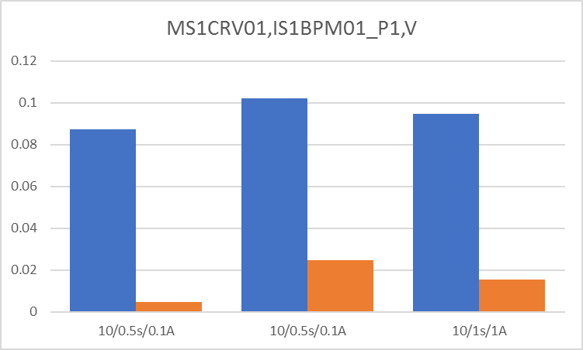
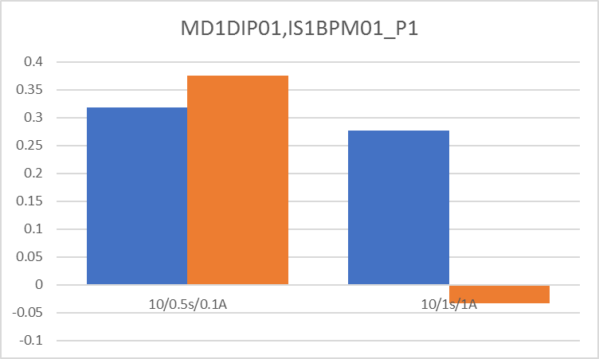
Degaussing Test of Iron Magnets
(November 5, 2019)
Tested beam screen position differences from previous dipole set from + and – directions.
Blue = without degaussing
Orange = with degaussing (various settings)

Slide 28
Closed Orbit Bumps
(November 6, 2019)

Slide 29
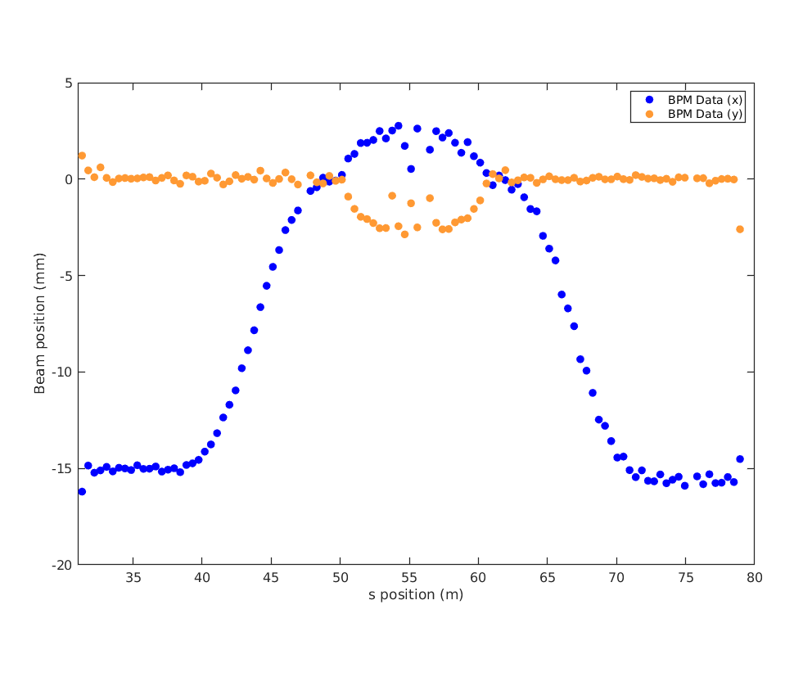
Closed Orbit Bumps (1-turn)
(November 6, 2019)

Slide 30
Source of Tune Variation
Around Nov-07 I noticed the main source of tune variation was day-to-day variations in tunes (maybe from beam energy changes from the RF) and not section-to-section variations through the FFA line
  Wrote a program to generate artificial response matrices using just flat tunes, or flat tunes per FFA section

Slide 31
get_all_tunes
Script produces orbit bumps
  Puts in beam screens as necessary
Derives tune from the Fourier transform of the bumps
(November 7, 2019)

Slide 32
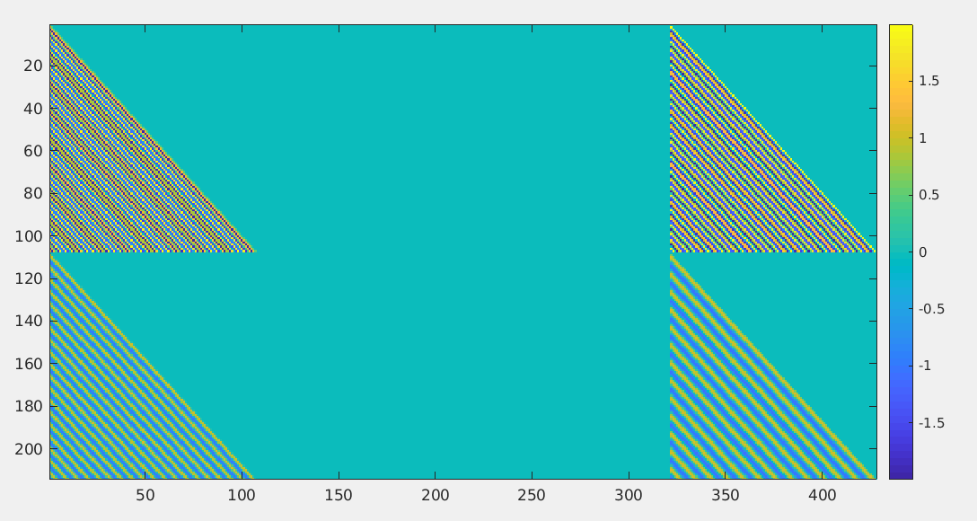
2-Turn Generated Response Matrix
x → x
Uses constant tunes
y → y
Turn 1 BPMs
Turn 2 BPMs

Slide 33
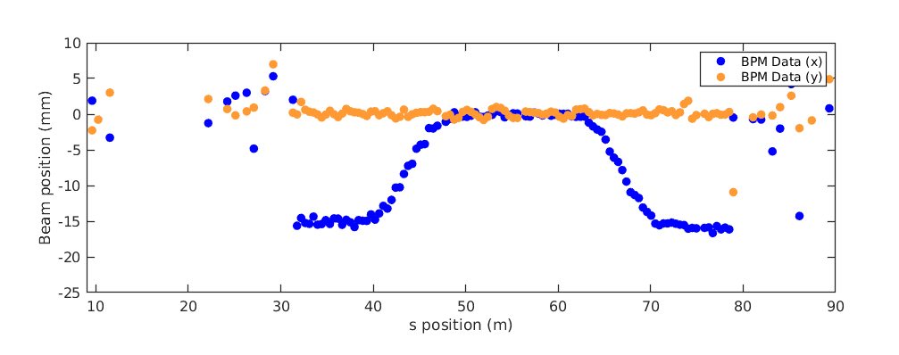
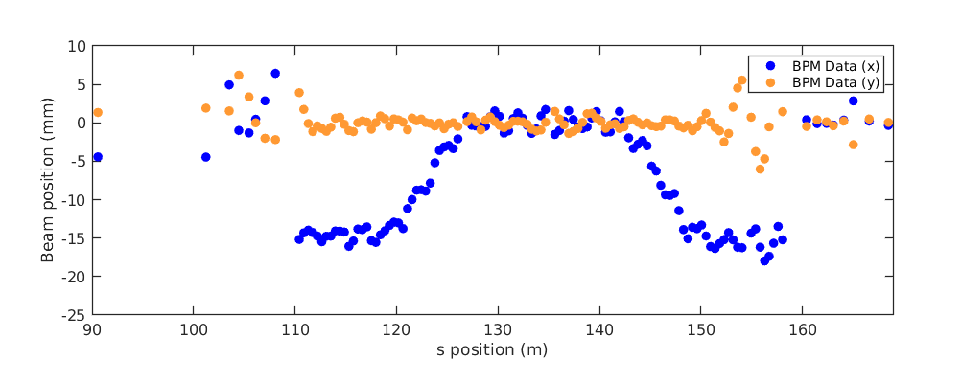
Trying 2-pass SVD correction but with bad beam
(November 7, 2019)

Slide 34
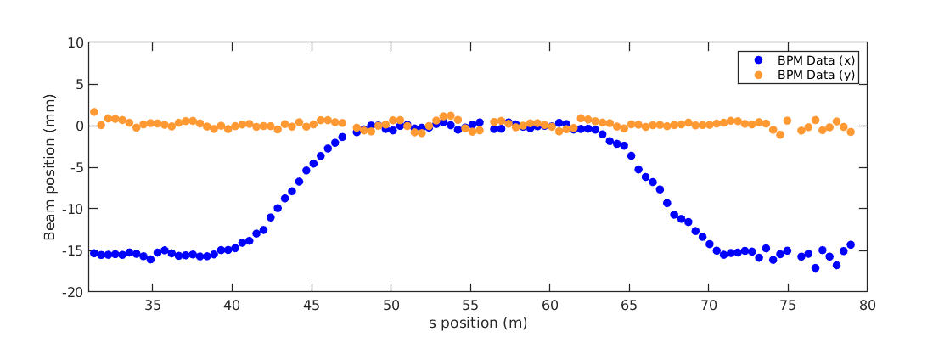
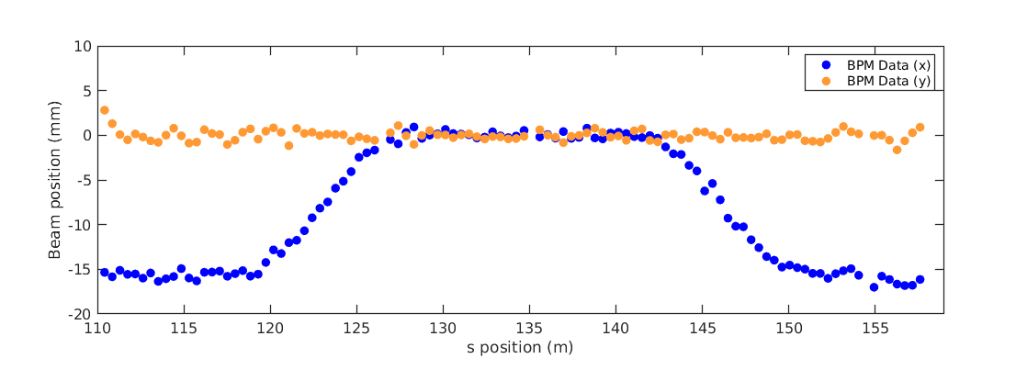
2-pass SVD correction with actually good beam
(November 8, 2019)

Slide 35
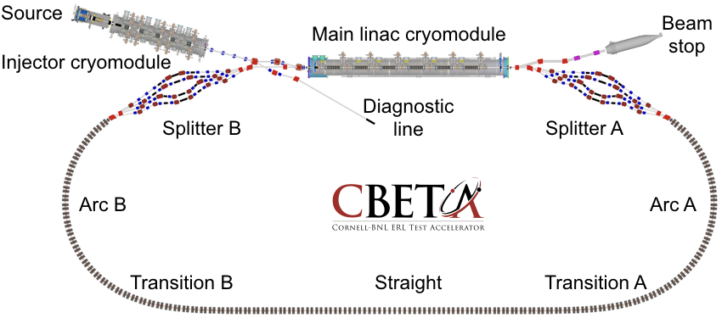
Future: CBETA Facility?
Vertical double chicane
ERL experiment
ERL experiment
RLA experiment
User experiments platform
Single-turn mode with reduced CSR and increased current 40+mA, 55MeV
High energy mode with 3 turns in fixed-field arc, 1-10mA, 200MeV

Slide 36
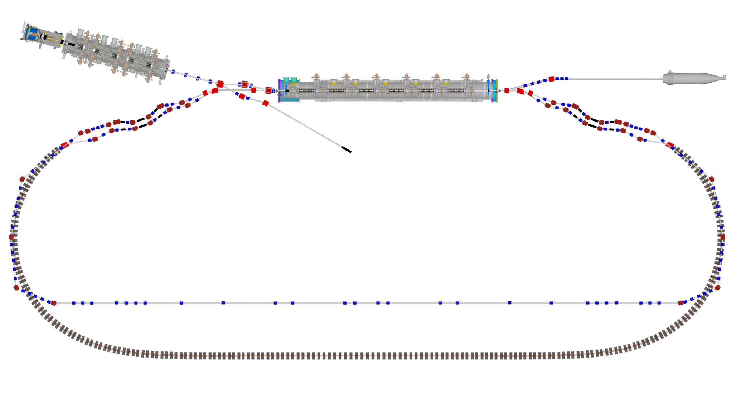
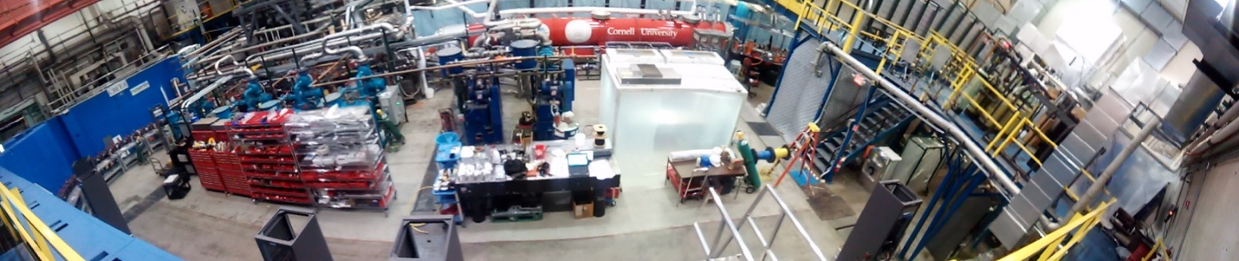
Bypass Design (Kirsten Deitrick)
Single-turn mode with reduced CSR and increased current 40+mA, 55MeV
High energy mode with 3 turns in fixed-field arc, 1-10mA, 200MeV
One possible route is for the bypass to follow above the FFA arcs

Slide 37
BACKUP

Slide 38


Energy Recovery
Increased beam current to calculate transmission using RF load due to beam on MLC cavities
  Total RF load = RF load for cavity field + RF load due to beam (rough approximation)
  As beam current changes, the load deviation is due to the changing RF load due to beam
First, demonstrate measurable load deviation in the MLC up to 1 μA without recirculated beam (non-ER mode)
In perfect energy recovery mode, two conditions are satisfied:
  There is no load deviation at any beam current
  The linear fit of load deviation as a function of beam current is zero
To measure energy recovery transmission, determine linear fit of load deviation as a function of current for each MLC cavity
  The closer each linear fit slope is to zero, the better the energy recovery
K. Deitrick - kd324@cornell.edu
NAPAC 2019 - Status of the CBETA Prototype

Slide 39
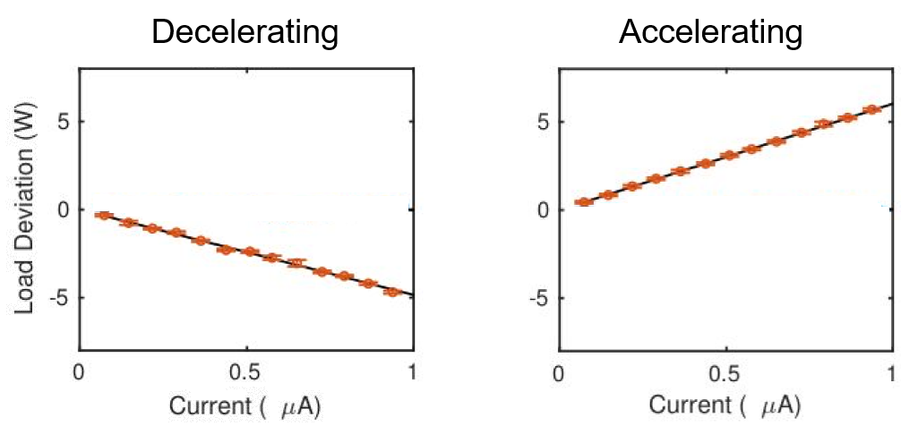
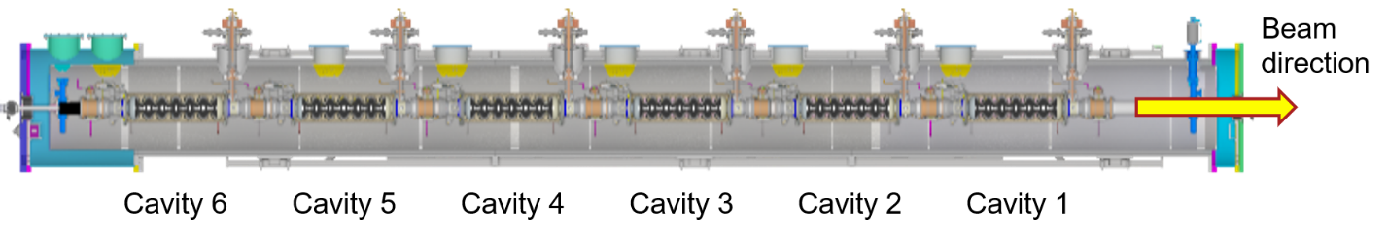
Energy Recovery
To demonstrate load deviation in MLC cavity, the each cavity was set up near typical field – but the last three cavities decelerated the beam, sending it directly into the beam stop
MLC labeled layout shown below, typical beam loading plots for accelerating (cavities 4-6) and decelerating (cavities 1-3) shown to the right
Load Deviation (W)
Current (μA)
Load Deviation (W)
Current (μA)
K. Deitrick - kd324@cornell.edu
NAPAC 2019 - Status of the CBETA Prototype

Slide 40
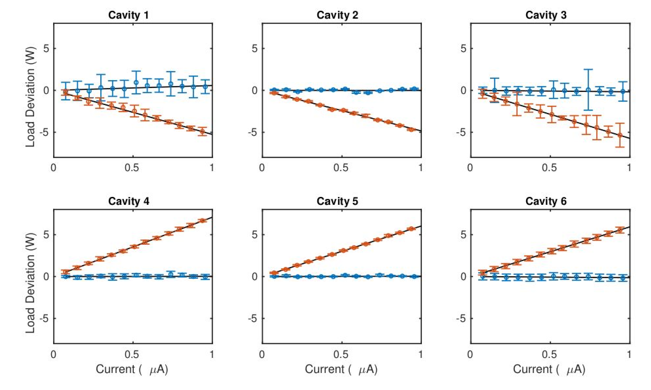
Energy Recovery
ER mode Non-ER mode
First transmission calculation of 87.0 ± 0.6%
on June 24, 2019
Beam loading for each cavity shown on the right
Load Deviation (W)
Load Deviation (W)
Current (μA)
Current (μA)
Current (μA)
K. Deitrick - kd324@cornell.edu
NAPAC 2019 - Status of the CBETA Prototype

Slide 41
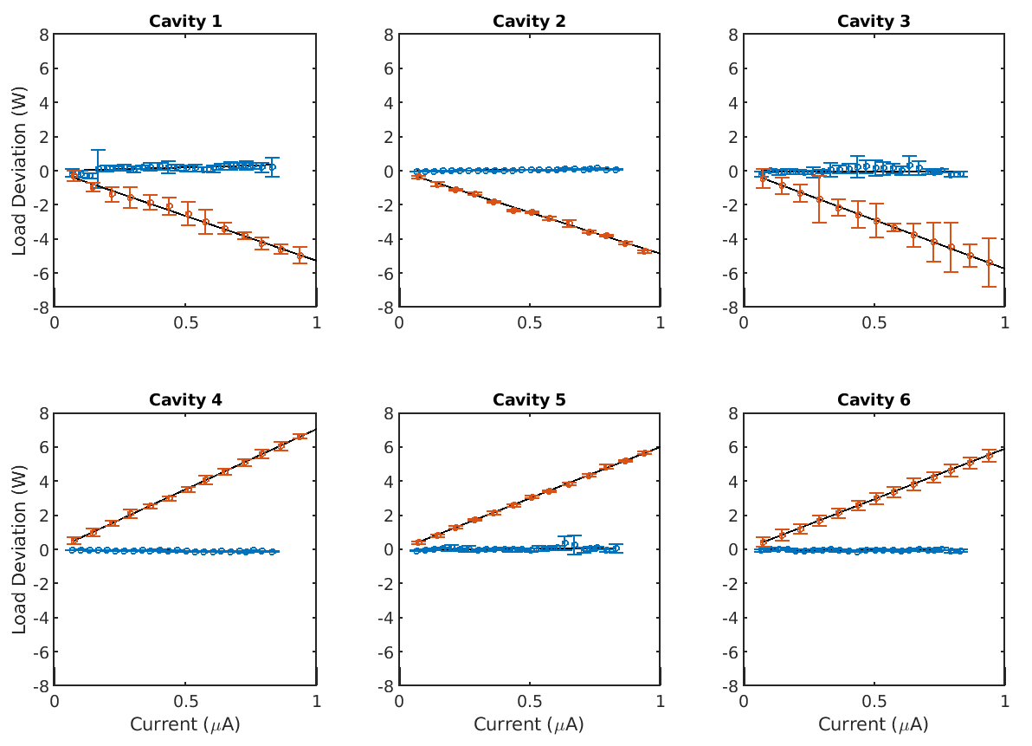
Energy Recovery
ER mode Non-ER mode
Transmission improved to
99.3 ± 0.2%
(two days later)
Beam loading for each cavity shown on the right
Load Deviation (W)
Load Deviation (W)
K. Deitrick - kd324@cornell.edu
NAPAC 2019 - Status of the CBETA Prototype
Current (μA)
Current (μA)
Current (μA)

Slide 42
Better Energy Recovery, Higher Current
Transmission improved to
99.6 ± 0.1%
Average current increased to 8 μA
Beam loading for each cavity shown on the right
ER mode Non-ER mode
Load Deviation (W)
Load Deviation (W)
Current (μA)
Current (μA)
Current (μA)
K. Deitrick - kd324@cornell.edu
NAPAC 2019 - Status of the CBETA Prototype

Slide 43
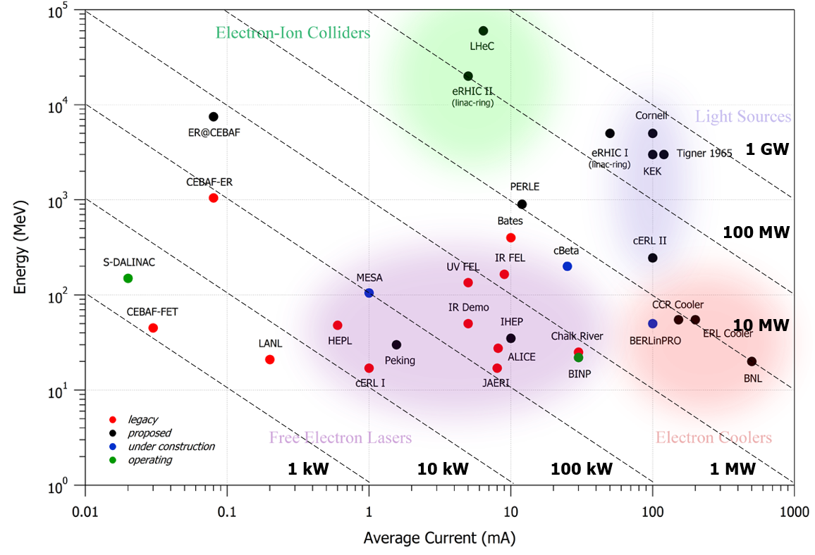
ERL Frontier: Tennant Plot
eRHIC cooler
K. Deitrick - kd324@cornell.edu
NAPAC 2019 - Status of the CBETA Prototype

