Slide 1
Test of Linear-Field Fixed-Field Arc with a Wide Energy Range
Tested at the BNL ATF-1 facility

Slide 2
Outline of Main Components
Beam stop
Fixed table
Injection X position and angle adjustment
Beam direction
Movable table
Screen (POP11)
Screen (POP10)
ATF beam pipe
1” diam.
2” diam.
Triplet
Beam screen (FFA) and camera
FFA pipe through magnets
Steerer (GT7)
Steerer (GT3)
Flexible bellows and flange size adapter
For each energy, do 2D steerer current scans
  GT3X, GT7X (x,x’)
  GT3Y, GT7Y (y,y’)
  GT7X, GT7Y (x,y)
Plus four larger-range 1D scans and a quad scan of the triplet

Slide 3
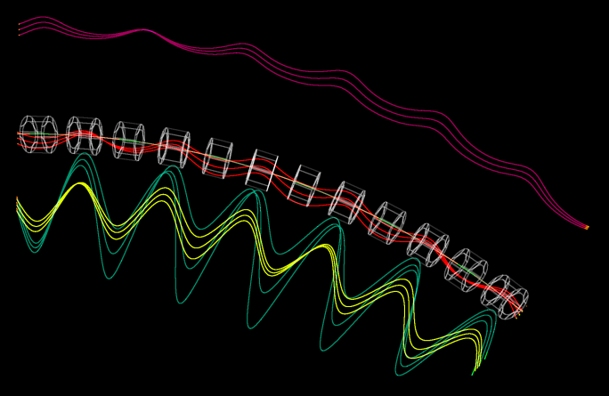
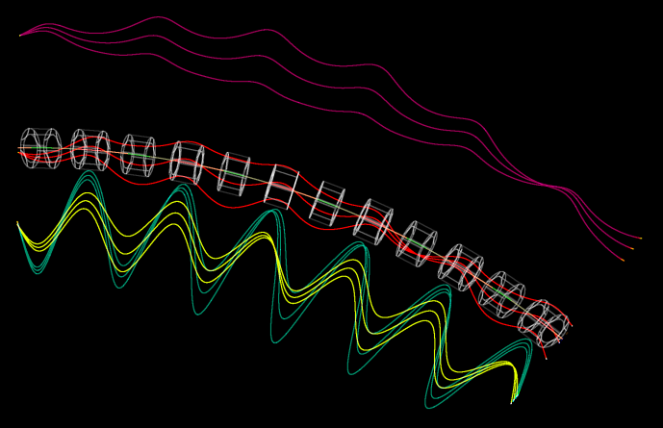
Tracking of (x,x’) Offsets
Trajectories have been magnified transversely by 16x for visibility
x_{in} ±1mm
x’_{in} ±10mrad

Slide 4
ATF-FFA Beamline Parameters
Parameter | Value | Units
Particle species | Electron
Energy range | 18-72 | MeV
Cell Length | 0.234301 | m
Cell Angle | 6.666… | degrees (54 per turn)
R = avg. radius of curvature | 2.01367 | m
Max orbit excursion | 18.21 | mm (from circle radius R)
Tune range per cell | Q_{y,72} = 0.029, Q_{x,18} = 0.411 | cycles
Cell lattice | halfD2, QF, D1, BD, halfD2
Drift lengths | D1 = 57.35, D2 = 57.65 | mm
Number of cells | 6
Total length | 1.40581 | m
Total angle | 40 | degrees

Slide 5
EMMA Comparison (pros and cons)
Parameter | EMMA | ATF-FFA | Units
Energy range | 10.0–20.0 | 18.0–70.489 | MeV kinetic energy
Momentum ratio | 1.952 | 3.837 | ×
Radius of curvature | 2.63720 | 2.01367 | m
Effective avg. dipole | 0.02593 | 0.11761 | T
Total angle | 360 | 40 | degrees
Operation mode | Storage ring | Transfer line
Acceleration? | Yes (lots!) | None
Lattice | Doublet | Very close to FODO
Cell length | 0.394524 | 0.234301 | m
Cells per turn | 42 | 54 (extrapolated)
Length built | 16.57 | 1.40581 | m

Slide 6
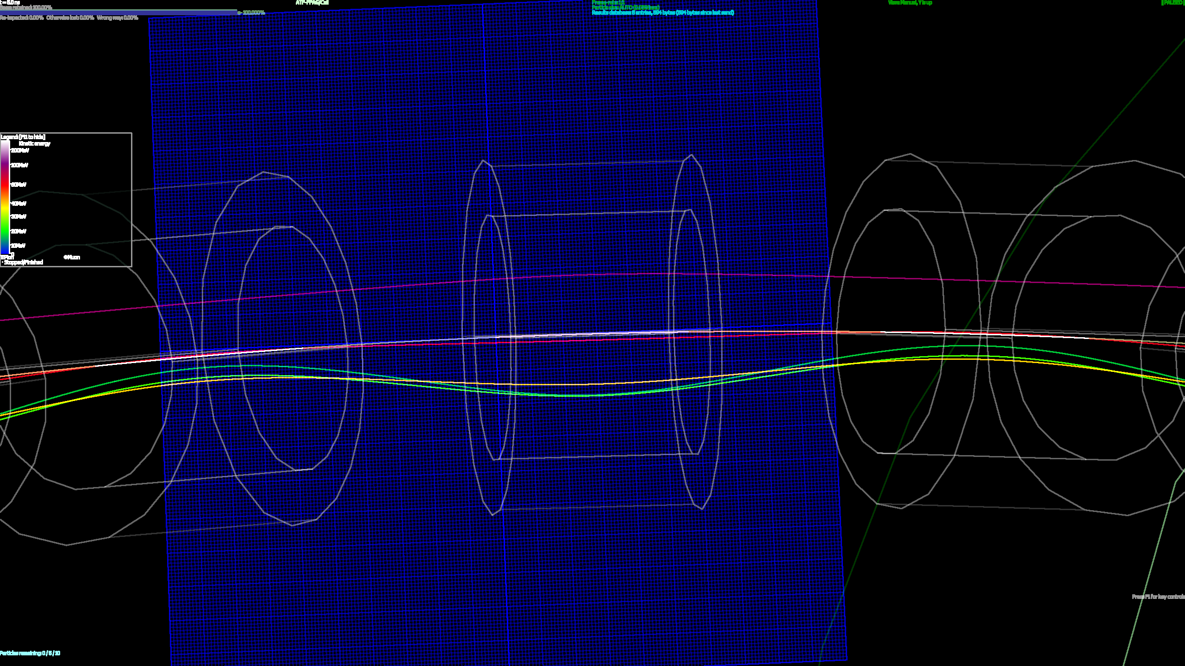
Matched Orbits through Fieldmaps
18, 24, 36, 54, 72MeV

Slide 7
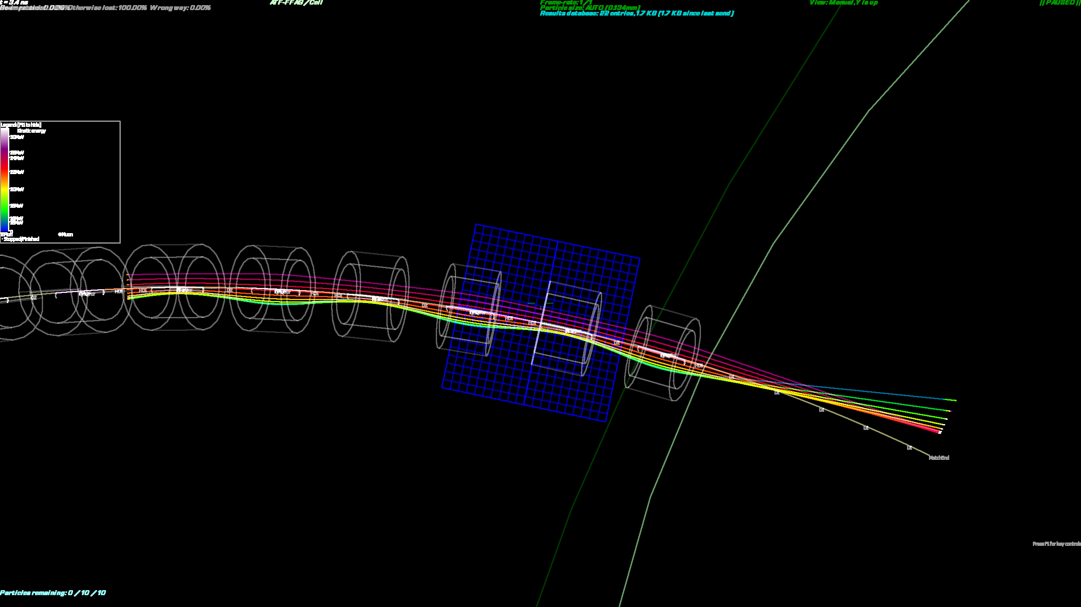
Beams Exit from Periodic Cell

Slide 8
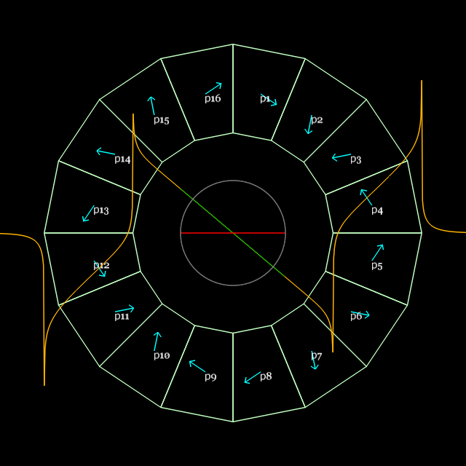
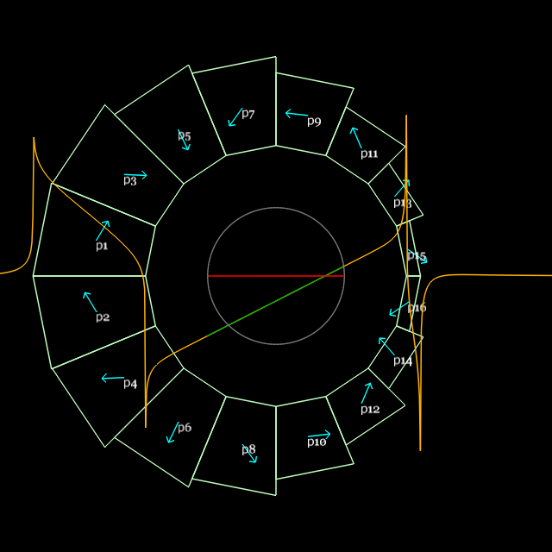
Magnet Design and Parameters
S.J. Brooks, “Production of Low Cost, High Field Quality Halbach Magnets”, Proc. IPAC’17
QF
BD
Parameter | “QF” magnet | “BD” magnet | Units
Length | 57.44 | 61.86 | mm
Dipole B_{y}(x=0) | 0 | -0.37679 | T
Quadrupole dB_{y}/dx | -23.624 | 19.119 | T/m
Inner radius (magnet pieces) | 37.20 | 30.70 | mm
(shim holder) | 34.70 | 27.60 | mm
“Pole-tip” field (magnet pieces) | 0.879 | (-)0.964 | T
Outer radius (magnet pieces) | 62.45 | 59.43 | mm
(tubular support) | 76.2 | 76.2 | mm

Slide 9
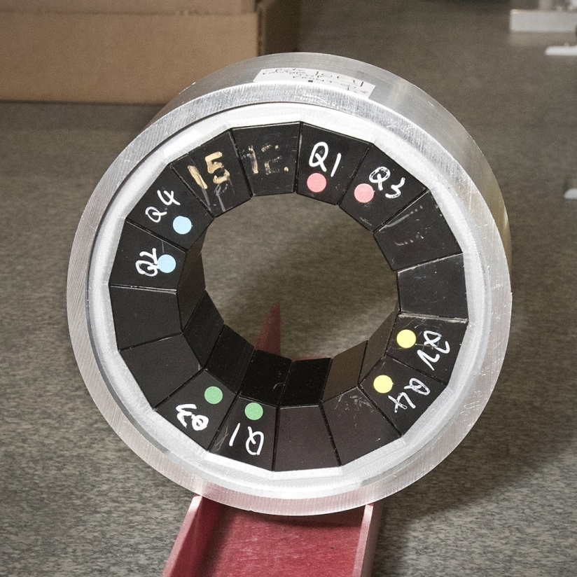
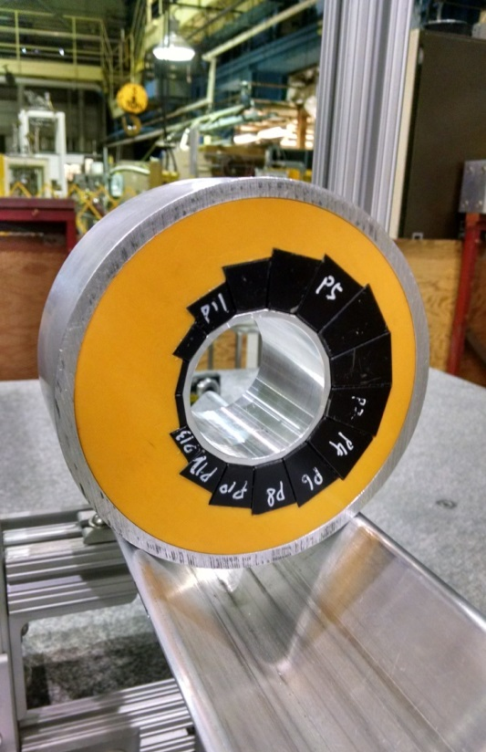
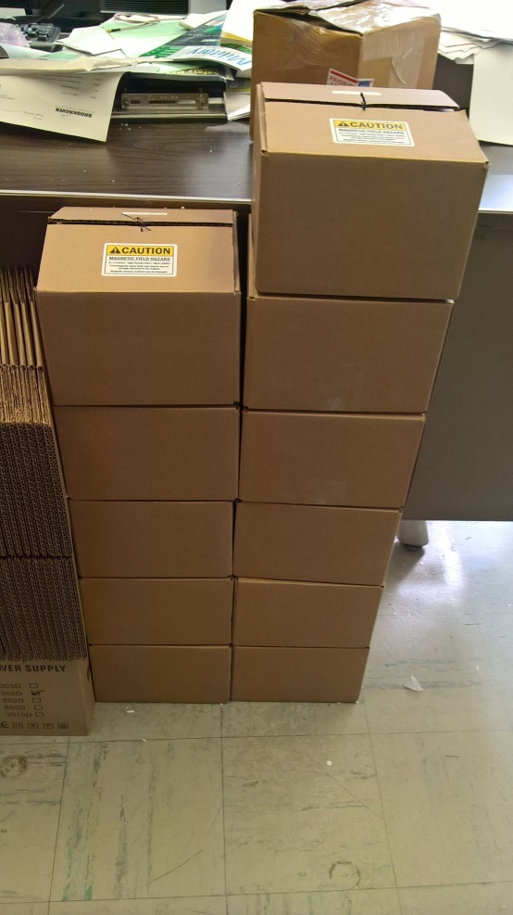
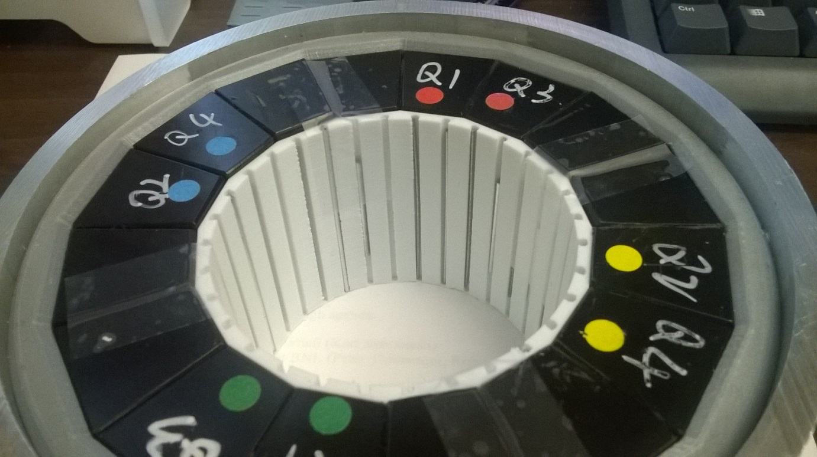
All the magnets had already been built as part of CBETA R&D and all have had iron wires inserted.

Slide 10
Radii/Clearances
 | Radius wrt torus (mm) | Distance to previous (mm)
Maximum beam excursion | 18.21
Vacuum pipe inside | 23.75 | 5.54 (12.00 in CBETA)
Vacuum pipe outside | 25.40 | 1.65 (pipe thickness)
Shim holder inside (BD) | 27.45 (27.60 straight) | 2.05 (air gap)
PM block inside edges (BD) | 30.55 (30.70 straight) | 3.10 (shim holder)
May have been a bit over-optimistic with beam clearance, seeing scraping near 36MeV
Re-aligned pipe after 36MeV run because it was being pulled off-centre by bellows

Slide 11
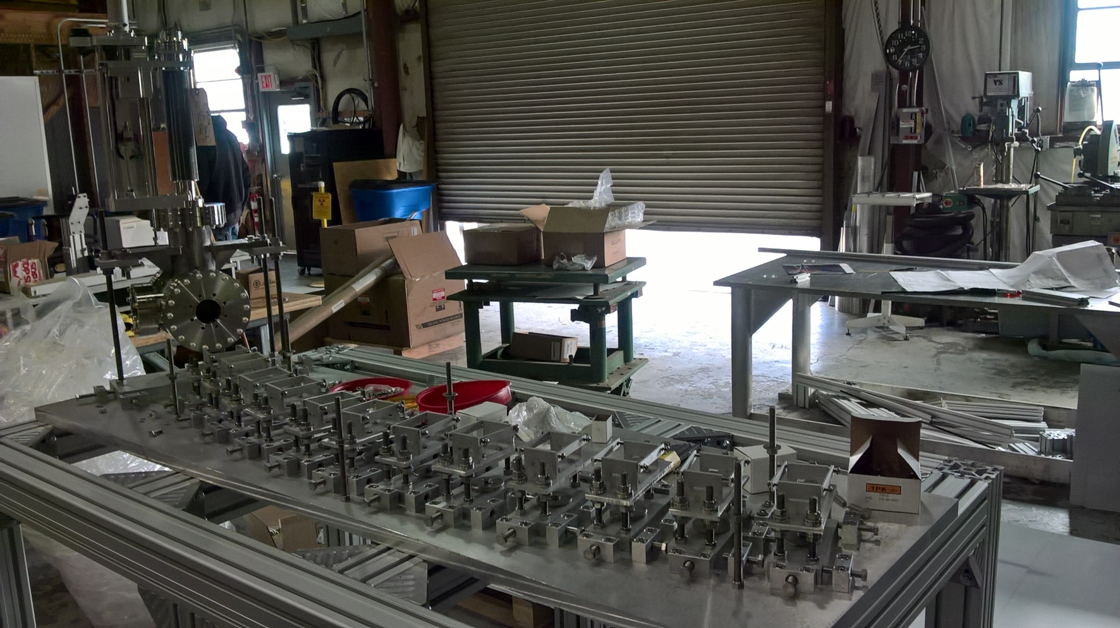
Girder and Supports Construction
Feb 22, 2017

Slide 12
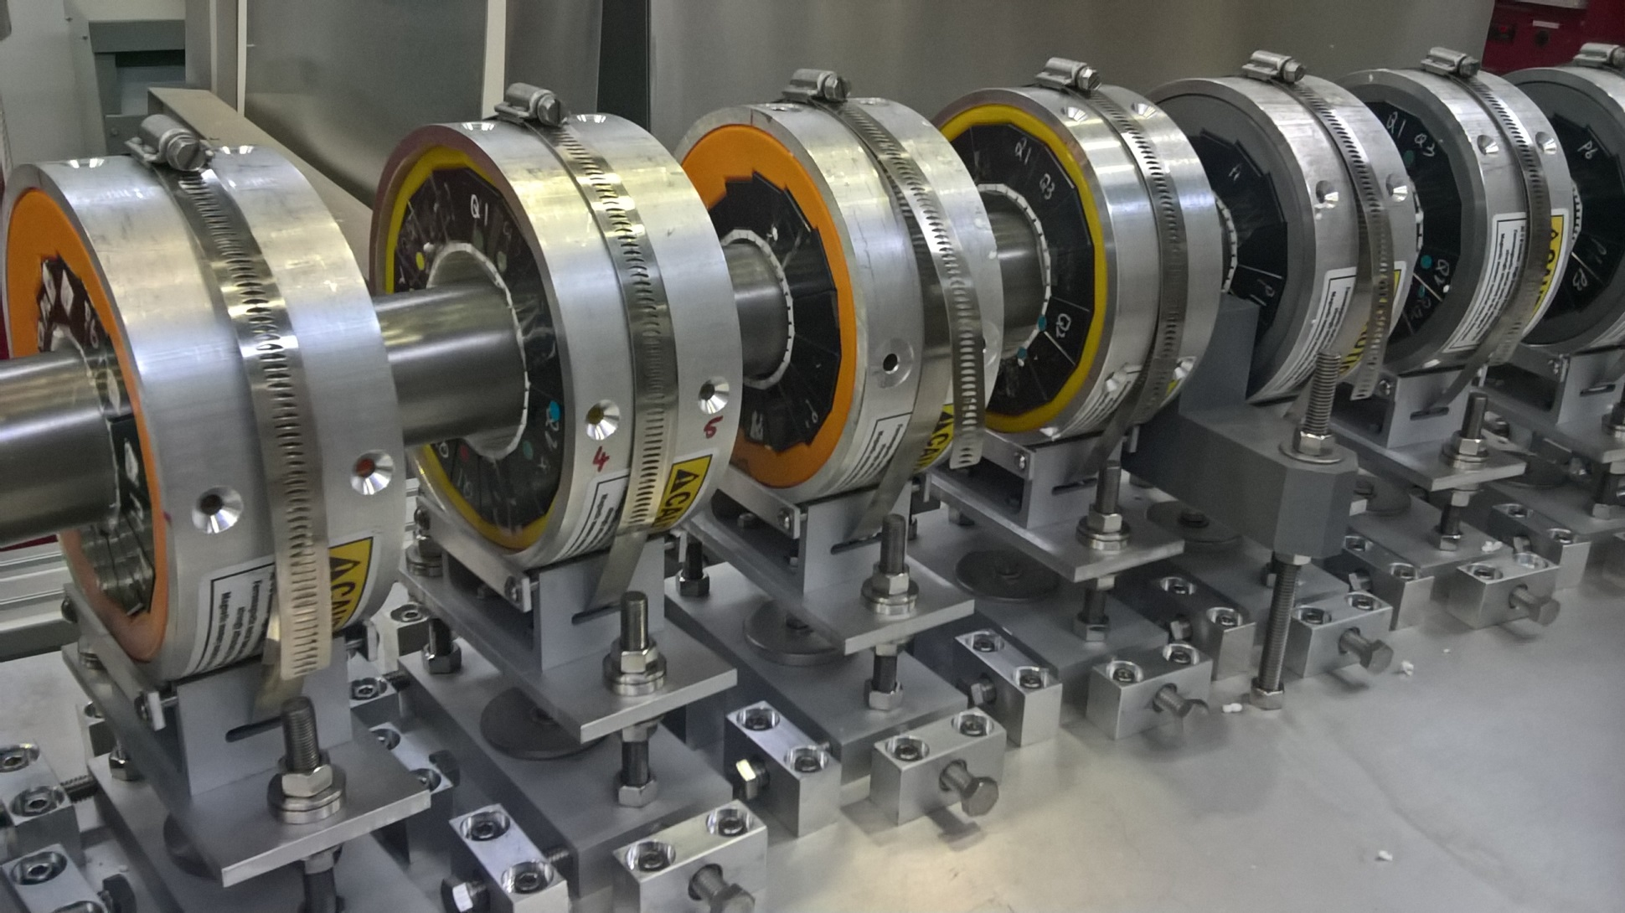
Detail: Magnets on the Girder
Apr 7, 2017

Slide 13
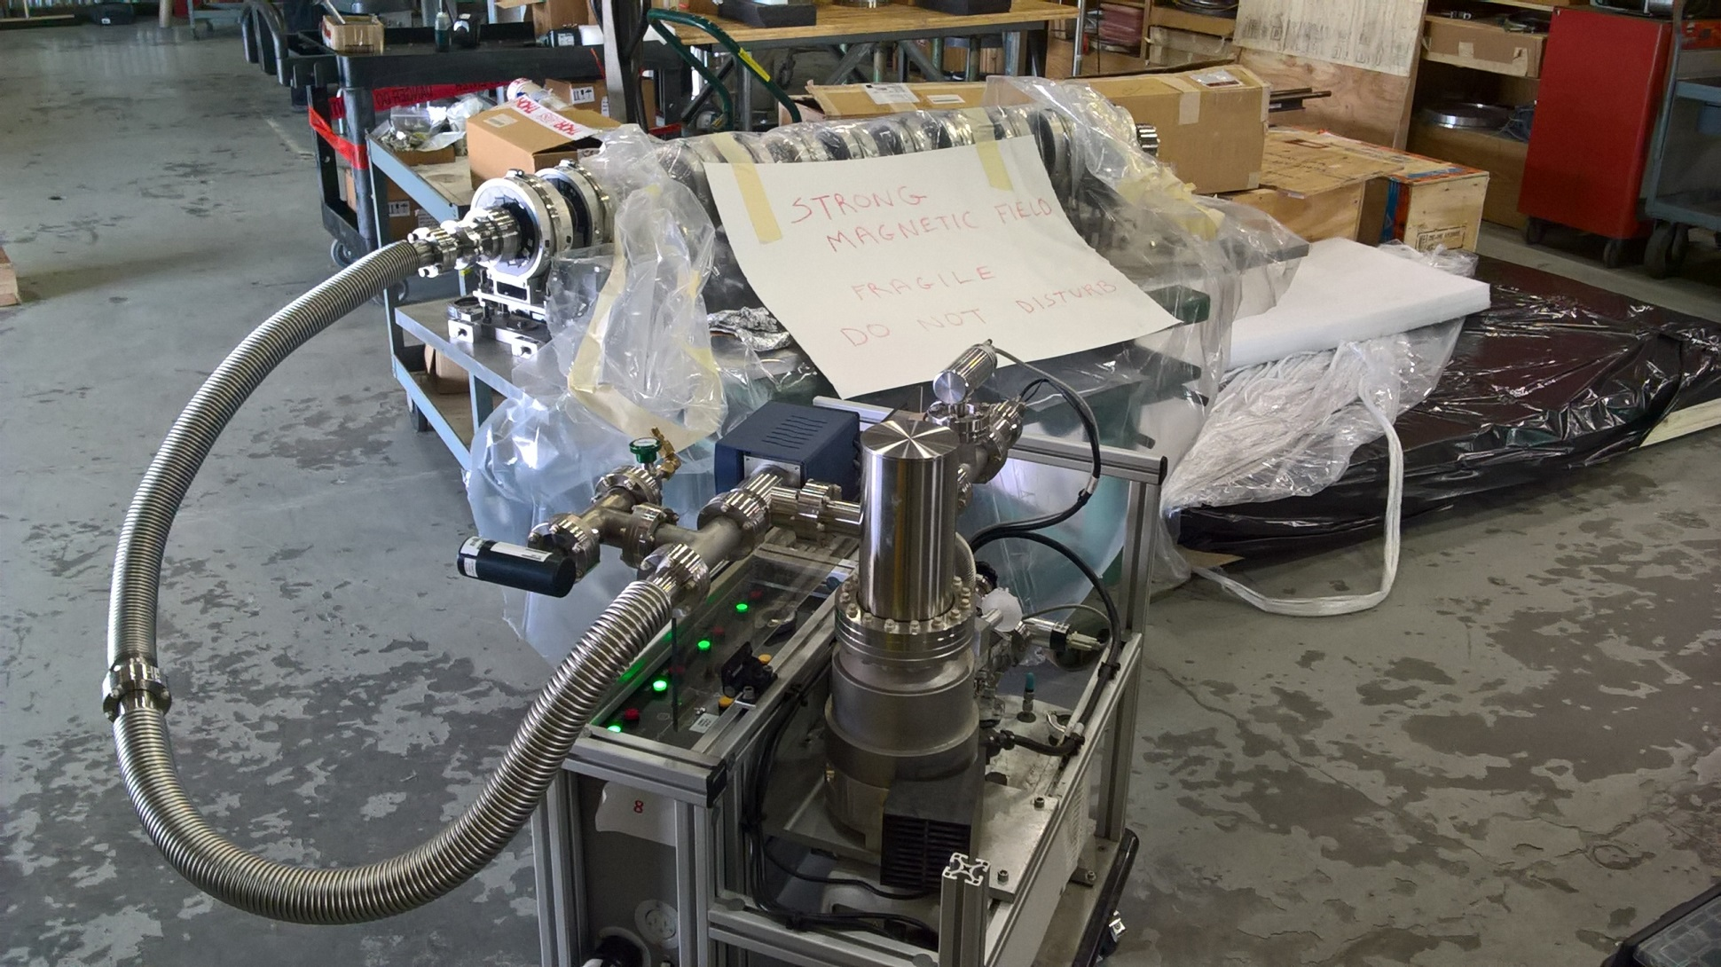
Pipe undergoing Leak Check
Apr 14, 2017

Slide 14
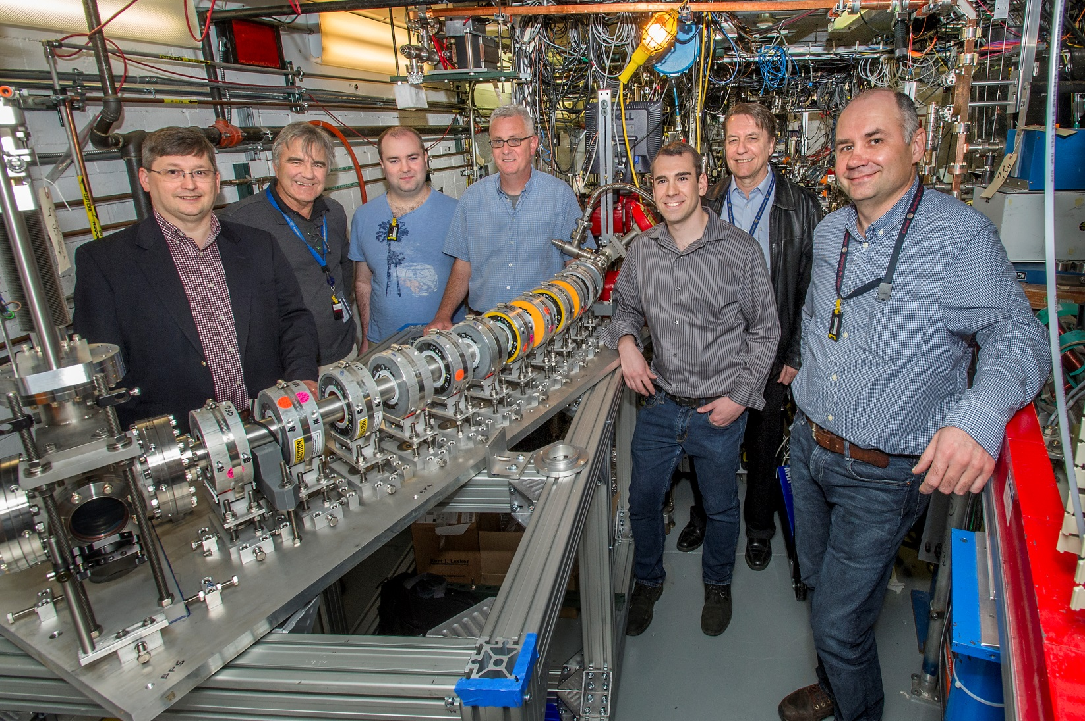
Picture of Everyone Standing By It
ATF experiment AE79
May 1, 2017

Slide 15
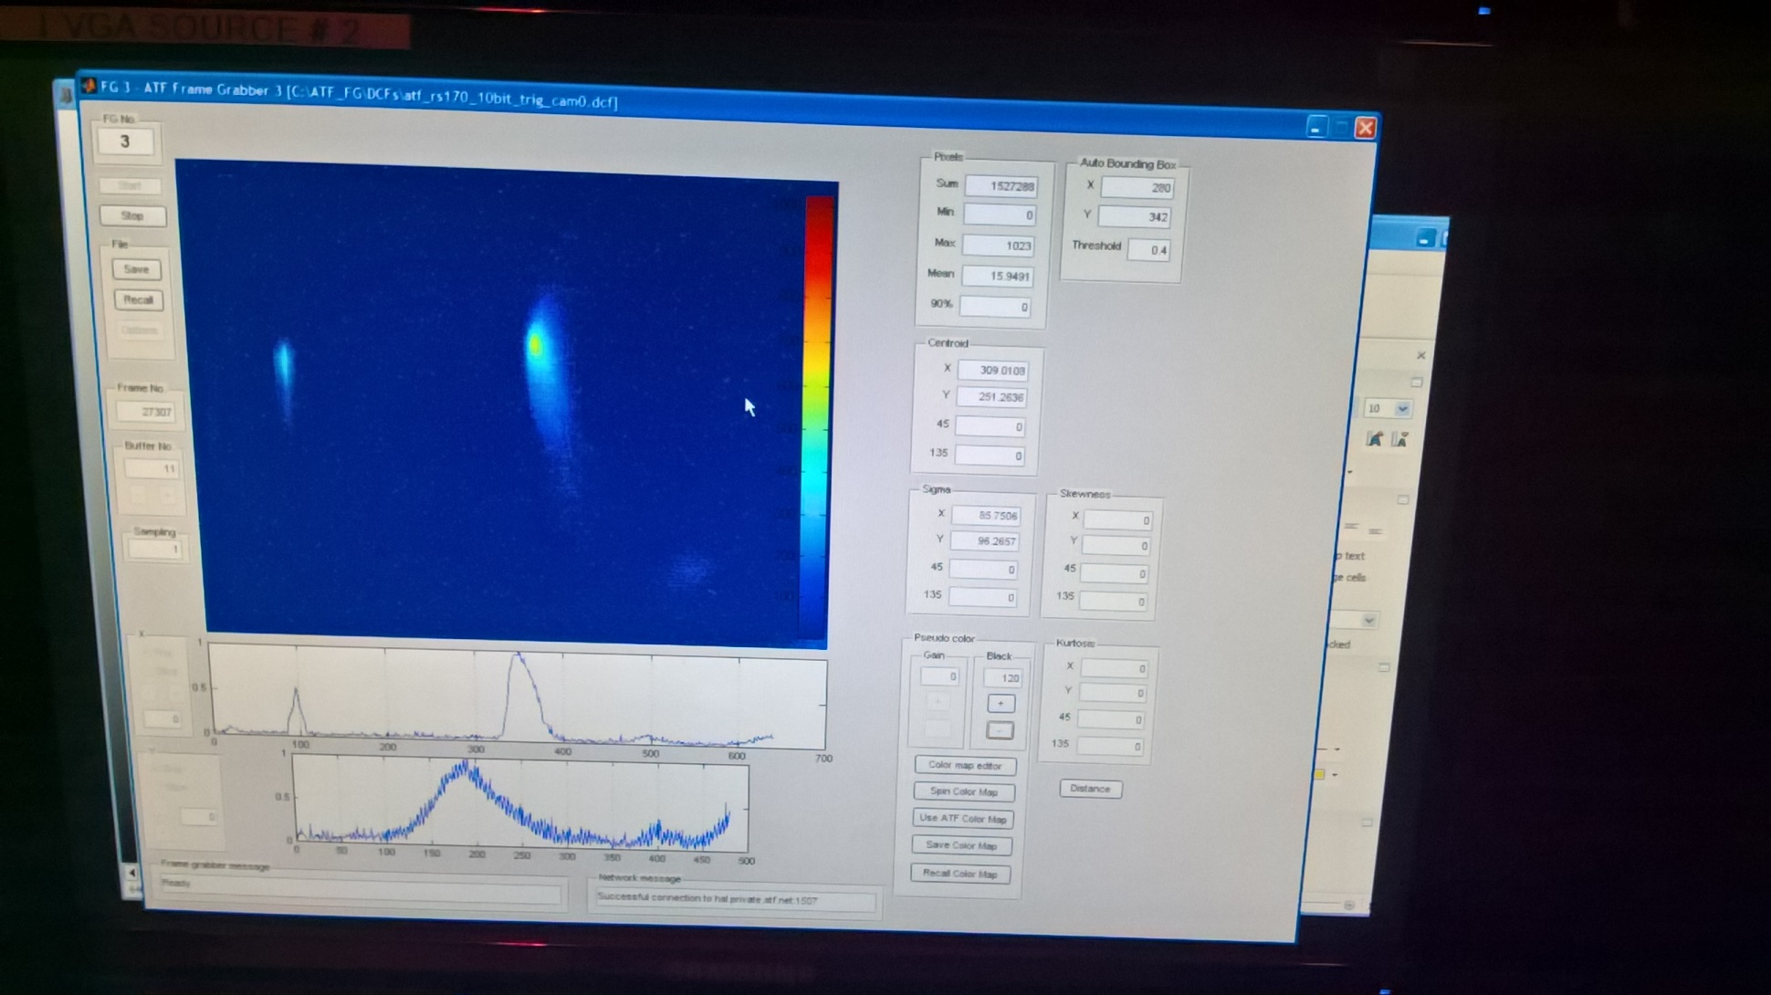
First Beam during Fault Studies
54MeV was the first energy to be tested
May 4, 2017

Slide 16
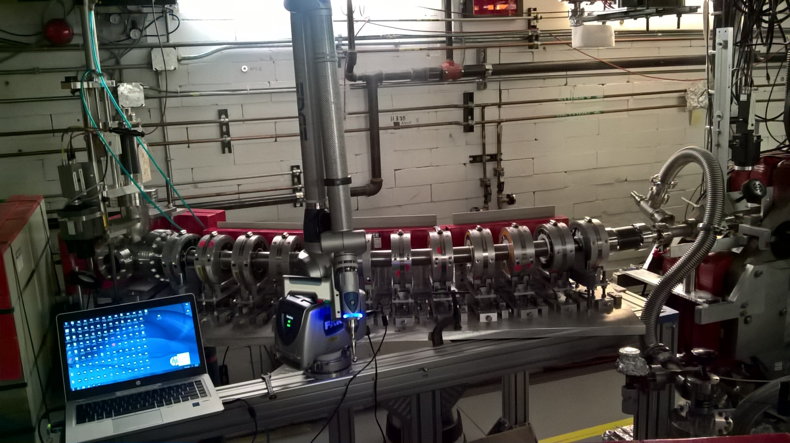
With Survey “Faro Arm” Attached
Most magnet offsets <0.2mm; RMS 0.1mm or better
May 5, 2017

Slide 17
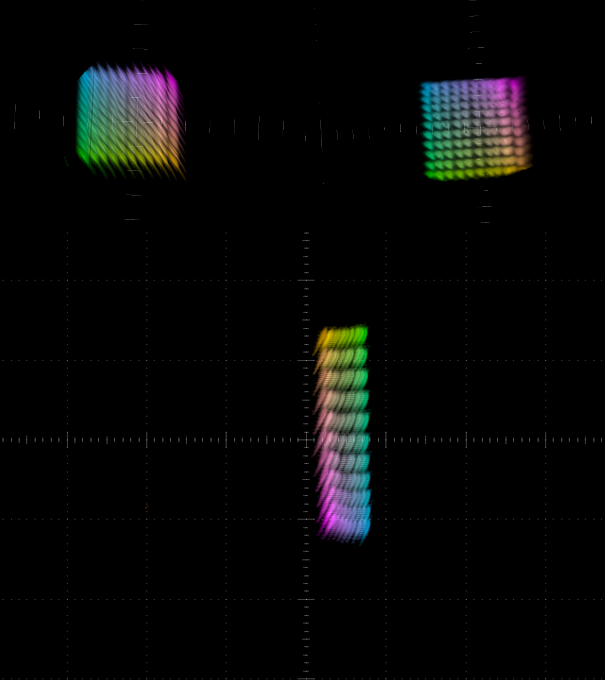
Beam X,Y Scan at 54MeV
May 8-9, 2017
POP10
POP11
Each setting in the 2D current scan is given a colour and all the 11*11 beams at each diagnostic overlayed
Tracking model:
Q_{x} = 0.119
Q_{y} = 0.055
6Q_{x} = 0.713
6Q_{y} = 0.329
FFA

Slide 18
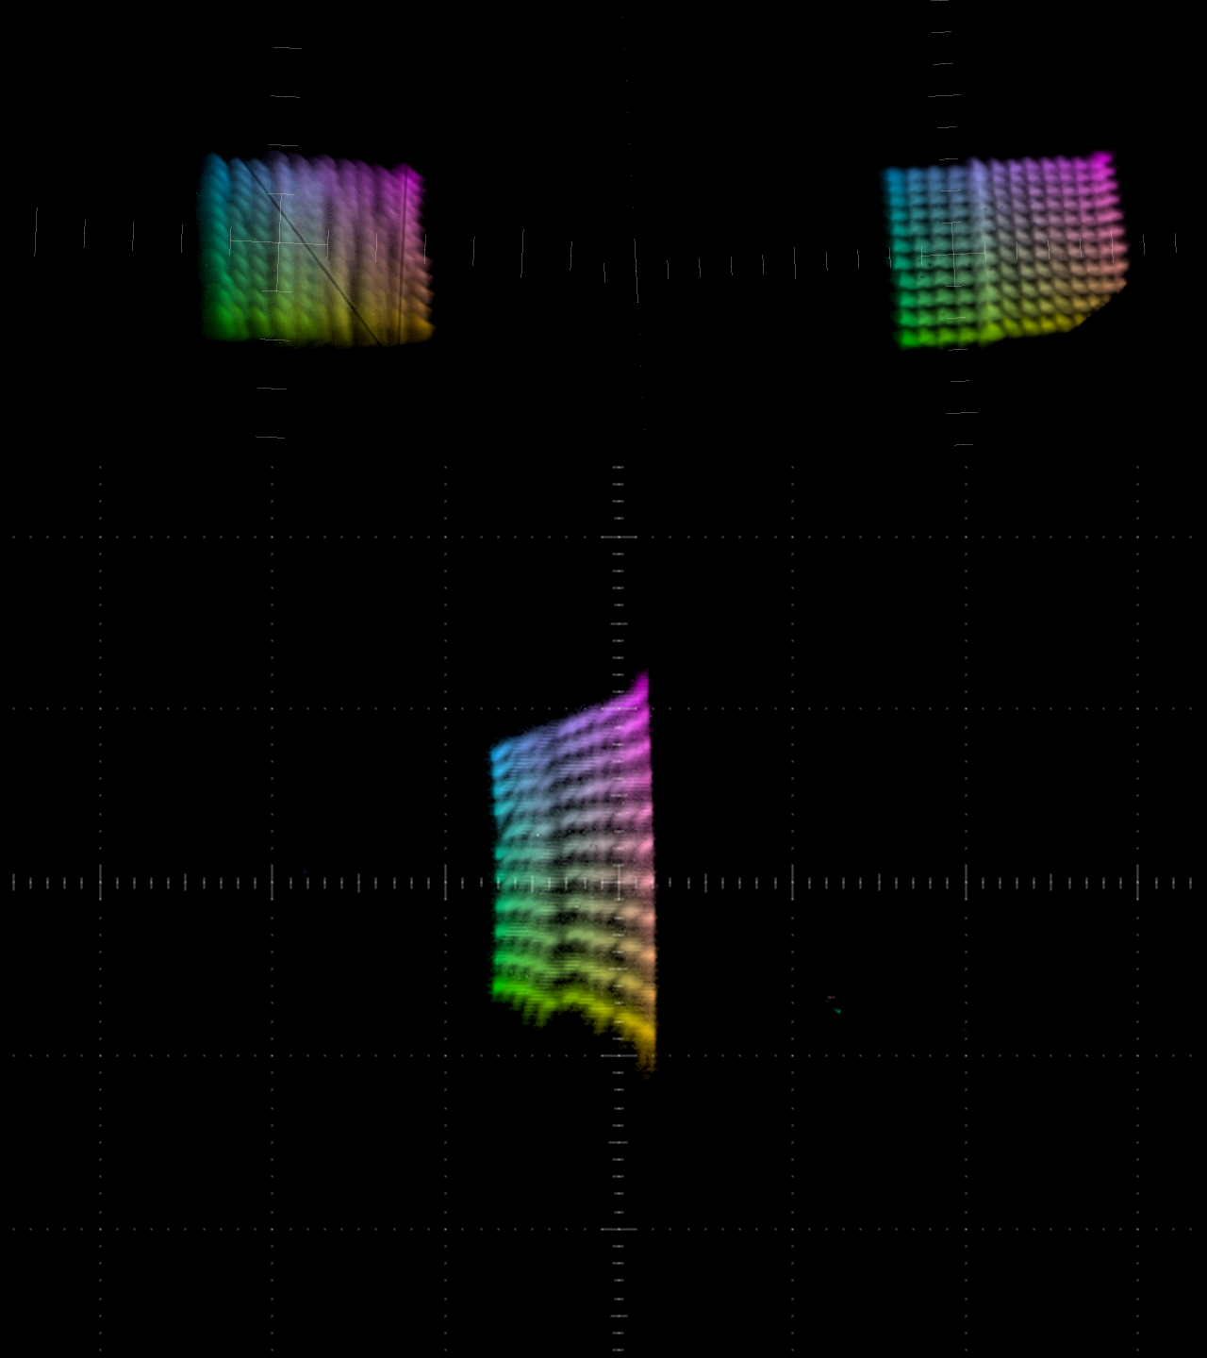
Beam X,Y Scan at 36MeV
May 11-12, 2017
POP10
POP11
Here we encountered beam scraping quite close (~2mm away) to the nominal closed orbit
Later turned out to be injection and pipe misalignment, fixed on later runs
Tracking model:
Q_{x} = 0.176
Q_{y} = 0.122
6Q_{x} = 1.056
6Q_{y} = 0.734
FFA

Slide 19
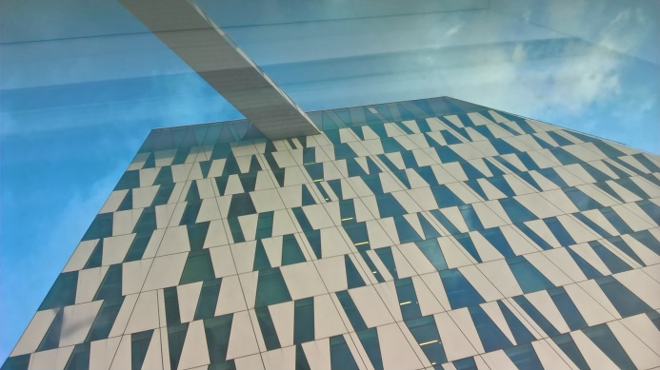
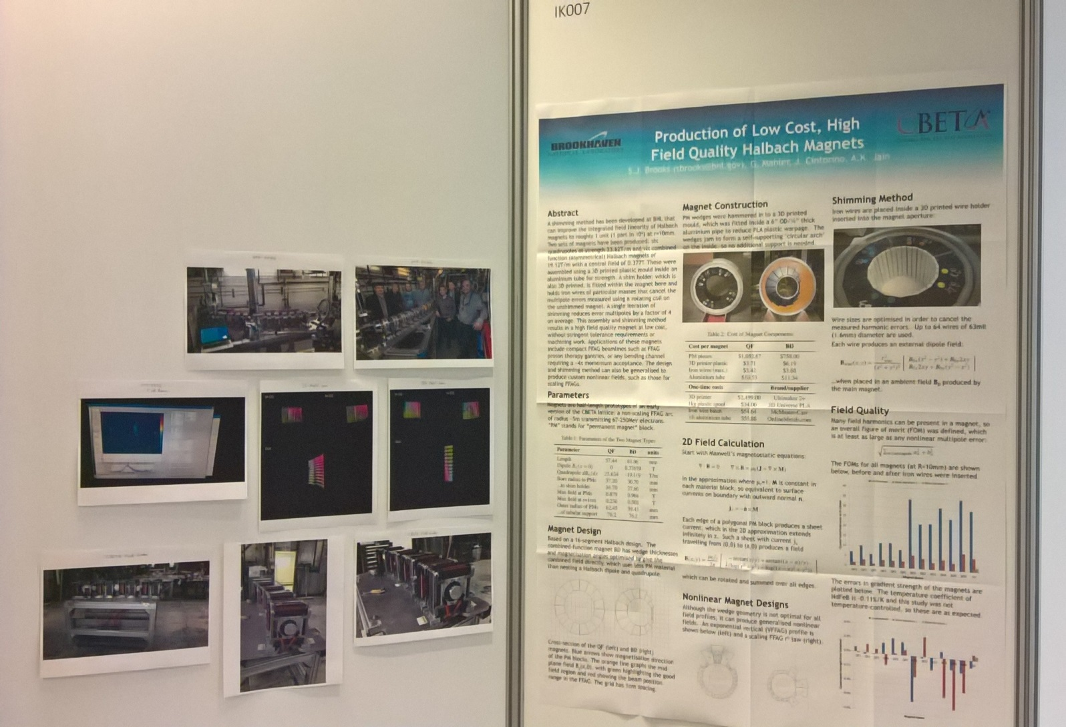
Interlude: IPAC’17
May 18, 2017

Slide 20
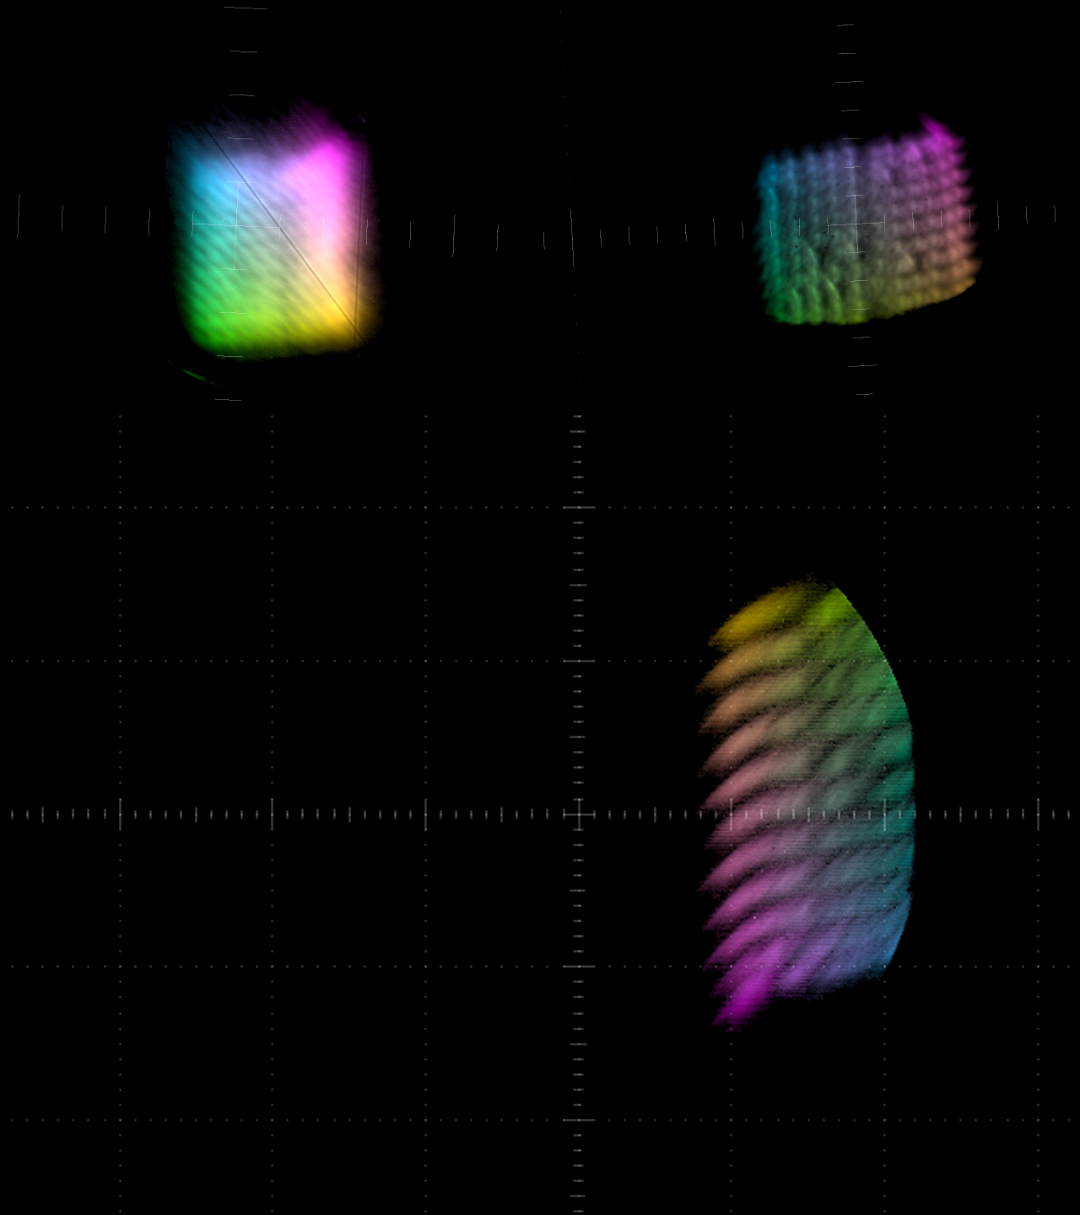
Beam X,Y Scan at 70MeV
Jun 20, 2017
POP10
POP11
The FFA was aligned for 72MeV k.e. but ATF could only do 70.489MeV
Accepted results taking energy error into account in tracking (hence rightward shift)
Tracking model:
Q_{x} = 0.098
Q_{y} = 0.029
6Q_{x} = 0.587
6Q_{y} = 0.175
FFA

Slide 21
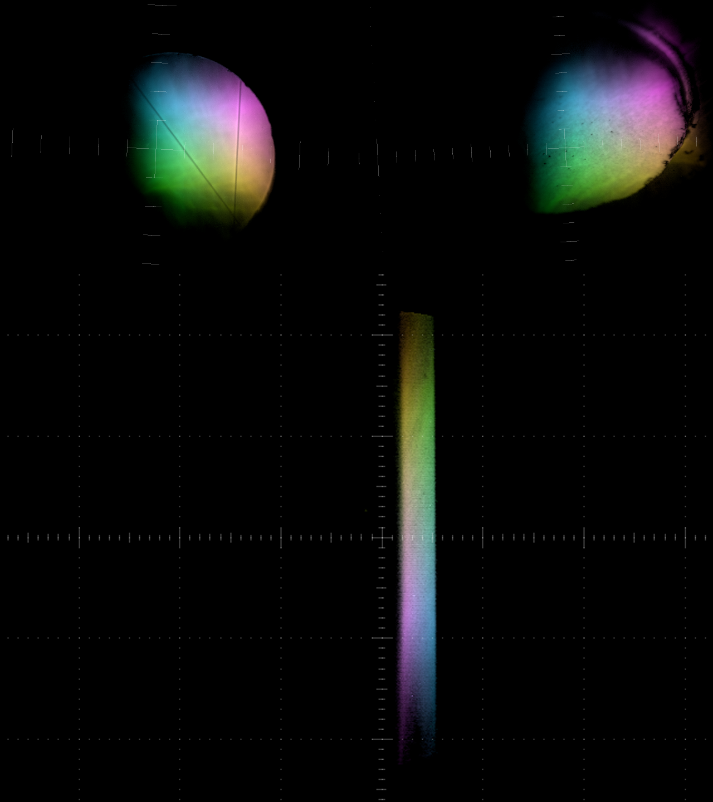
Beam X,Y Scan at 24MeV
Jun 23, 2017
POP10
POP11
At 24MeV and below, the ATF beam becomes much larger due to deceleration in second linac section
Horizontal scraping on the vacuum pipe is visible on both sides
Tracking model:
Q_{x} = 0.271
Q_{y} = 0.212
6Q_{x} = 1.629
6Q_{y} = 1.274
FFA

Slide 22
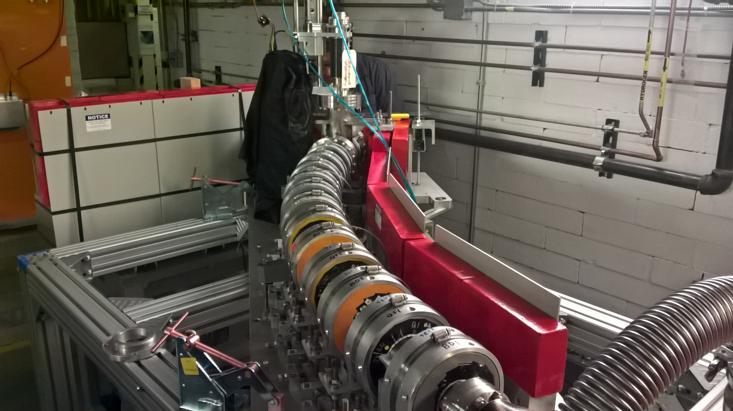
Aligned at 18MeV: Extreme Angle
Jun 28, 2017

Slide 23
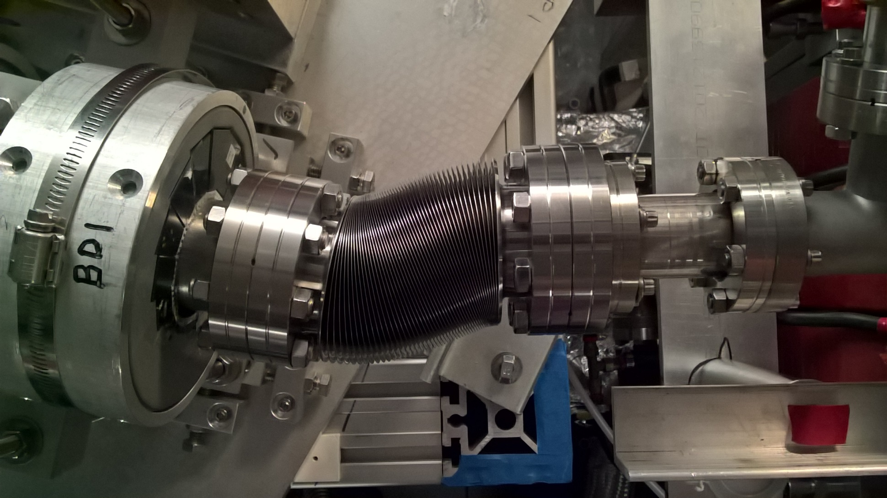
Aligned at 18MeV: Kinked Bellows
Jun 28, 2017

Slide 24
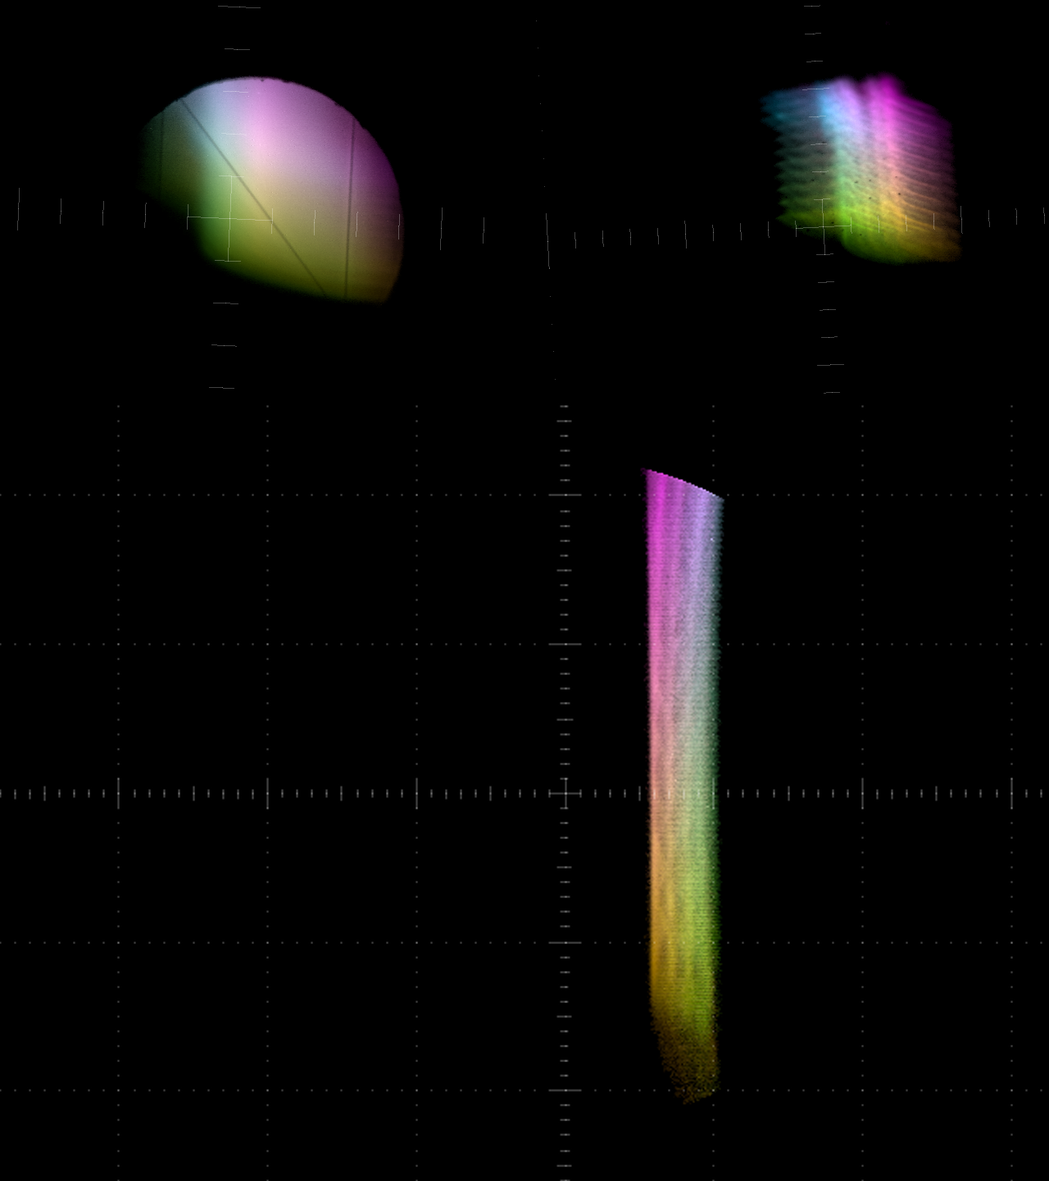
Beam X,Y Scan at 18MeV
Jul 3, 2017
POP10
POP11
Beam got through once again showing X scraping on both sides, but with different vertical phase advance
Experiment complete!
Uninstalled by end of July
Tracking model:
Q_{x} = 0.411
Q_{y} = 0.312
6Q_{x} = 2.463
6Q_{y} = 1.871
FFA

Slide 25
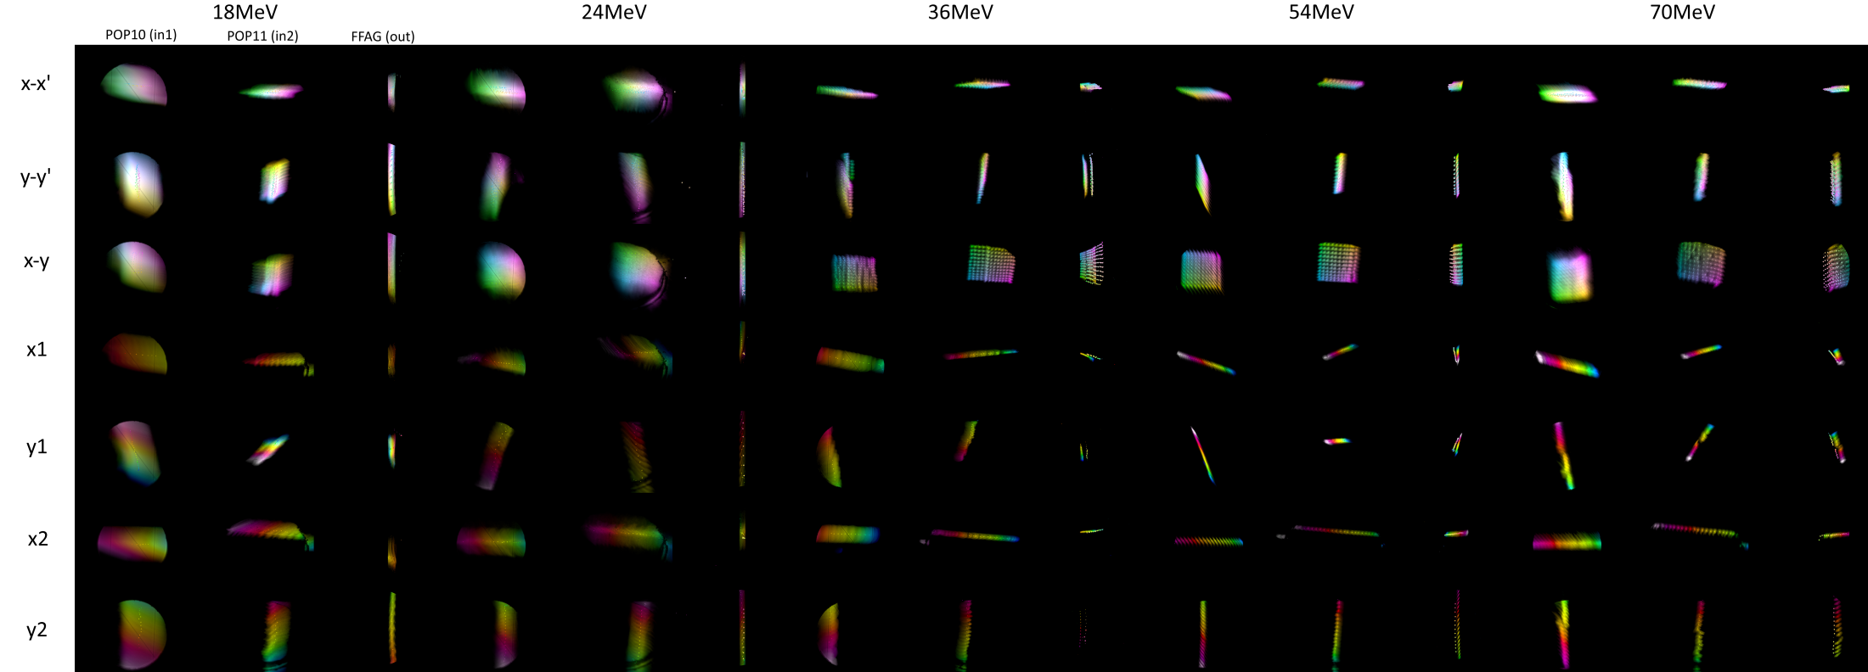
(Almost) all the Data
(5 energies)*(8 scans)*(31–121 points)*(3 screens)*(3–5 pulses) = 25113 images
Quad scan is not on this plot
Torrent of the results is available at http://stephenbrooks.org/ap/ATF-FFA

Slide 26
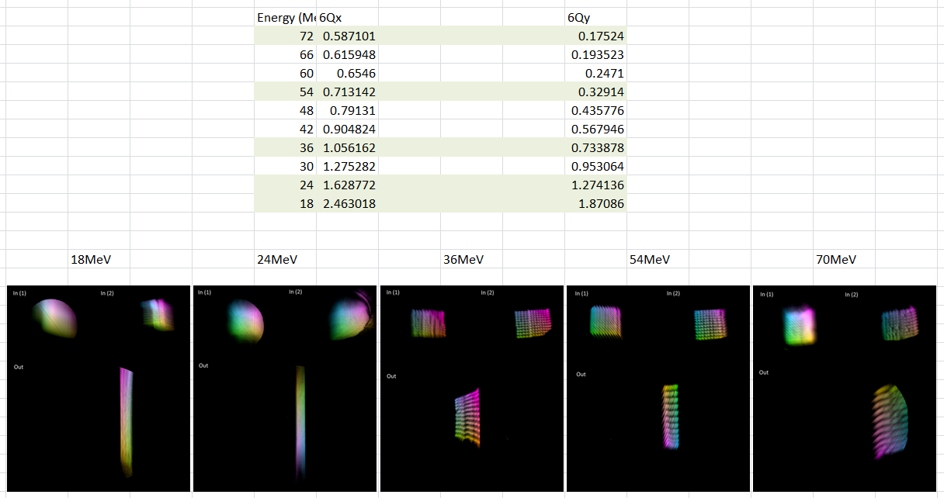
All Energies Phase Advance

Slide 27
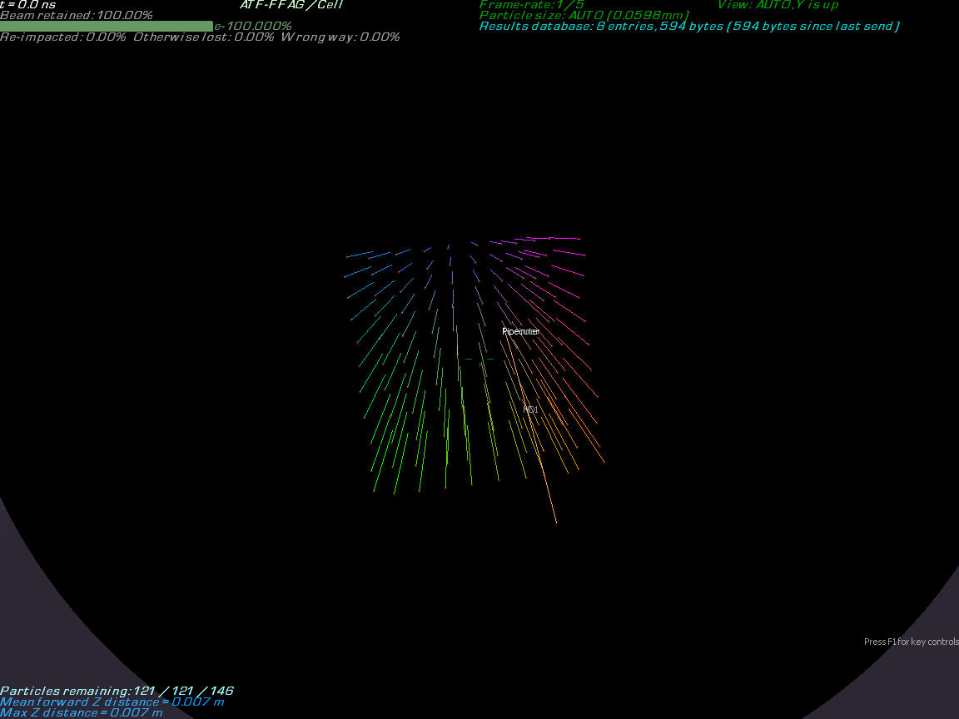

Slide 28
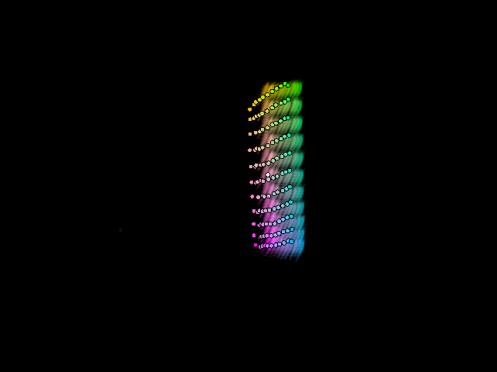
54MeV Results vs. Raw Tracking

Slide 29

Input Camera Roll Angle Correction
Looks better, has some offset.

Slide 30

Fitting X,Y Offset at Output
Required shift:
(1.84,0.38)mm

Slide 31
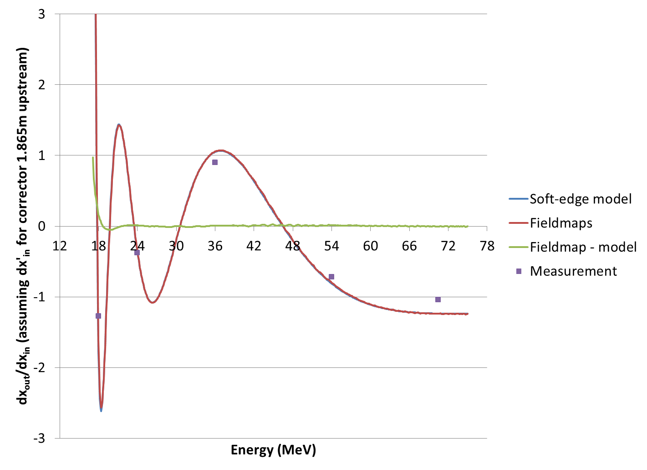
Transfer Matrix XX Element
“Measurement” is just taking the difference of a pair of centroids in the good area of the scan

Slide 32
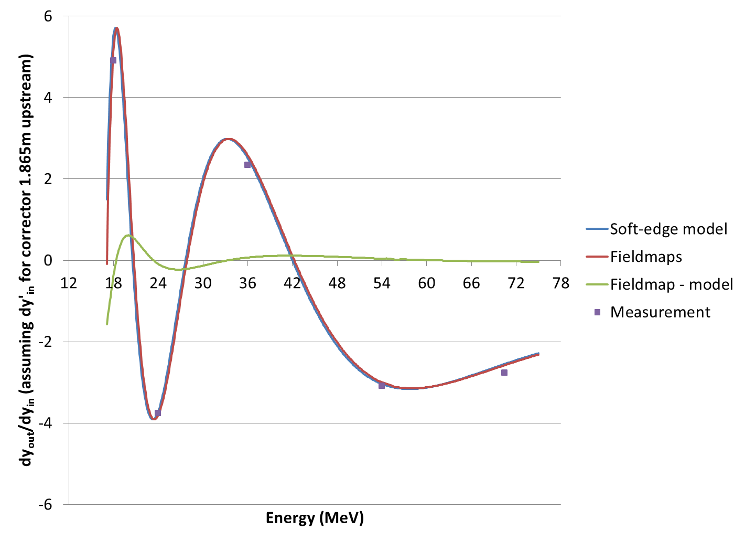
Transfer Matrix YY Element

Slide 33
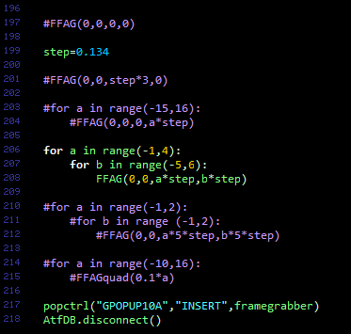
Source Code, Open Data
Torrent of the results is available at http://stephenbrooks.org/ap/ATF-FFA

Slide 34
Conclusion & Future Plans
Beam has turned a nontrivial angle (40°) in six cells of a non-scaling FFA
  Over a 3.8x momentum range (NS-FFA record)
  At an energy of up to 70MeV (NS-FFA record)
  Using compact permanent magnet technology
No highly nonlinear aberrations seen
  More data processing needed to get good fit to tracking at lower energies
Demonstrates technology for CBETA and more

Slide 35
CBETA Magnet Production
and non-scaling FFA proliferation

Slide 36
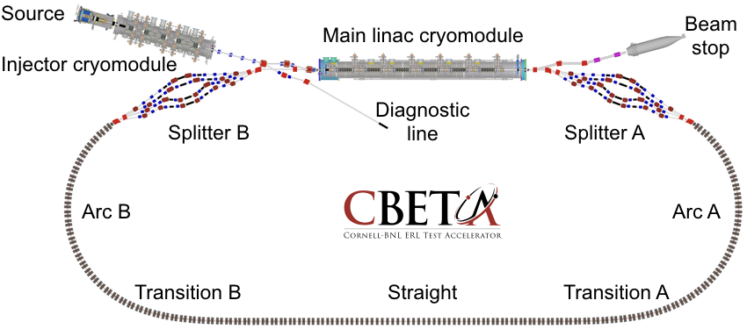
What is CBETA?
It’s a non-scaling (linear field) FFA
It’s an energy-recovery linac (ERL)
It’s both at the same time
  EMMA was an FFA ring with ERL injector (ALICE)
  CBETA is a racetrack FFA with linac inside it
Dejan has probably explained this already

Slide 37
EMMA/ATF/CBETA Comparison
Parameter | EMMA | ATF-FFA | CBETA girder | CBETA (future) | Units
Energy range | 10.0–20.0 | 18.0–70.5 | 37.5–58.5 | 41.5–149.5 | MeV k.e.
Momentum ratio | 1.953 | 3.837 | 1.553 | 3.572 | ×
Radius of curvature | 2.63720 | 2.01367 | 5.08787 | 5.08787–∞ | m
Effective avg. dipole | 0.02594 | 0.11761 | (0.09834) | 0.09834 | T
Total angle | 360 | 40 | 20 | 280 | degrees
Operation mode | Storage ring | Transfer line | Transfer line | ERL
Acceleration? | Yes (lots!) | None | None | Yes (linac)
Lattice | Doublet | Close to FODO | Doublet | Doublet
Cell length | 0.394524 | 0.234301 | 0.444 | 0.444 | m
Cells per turn | 42 | 54 (extrapolated) | 72 (extrapolated) | 107.5 (racetrack)
Length built | 16.57 | 1.40581 | 1.776 | 47.73 | m

Slide 38
Timeline
Summer 2017: ATF-FFA girder with beam at BNL, 3.8x momentum range (my FFA’17 talk)
  12 permanent magnets
May 2018: CBETA girder beam test at Cornell
Nov 2018: CBETA magnet+girder production complete
  216 permanent magnets
March 2019: CBETA commissioning starts

Slide 39
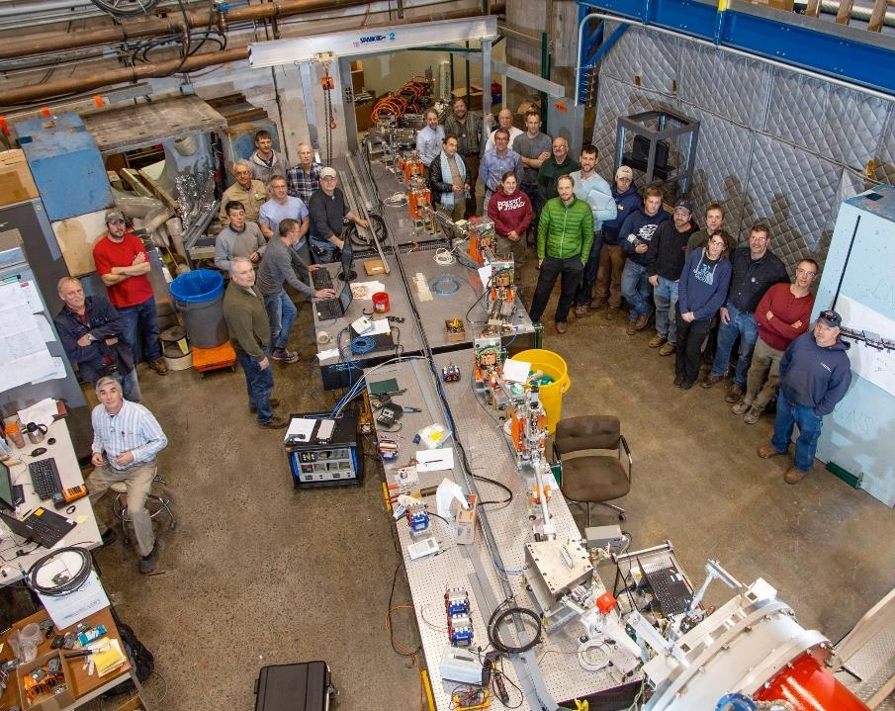
FFA girder
CBETA first splitter line and first FFA girder at Cornell (May 2018)

Slide 40
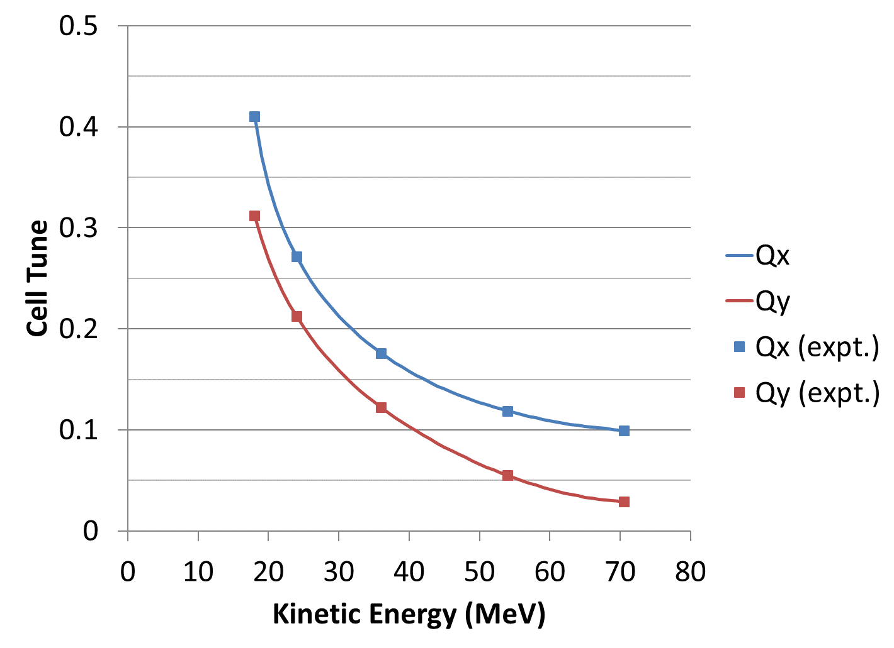
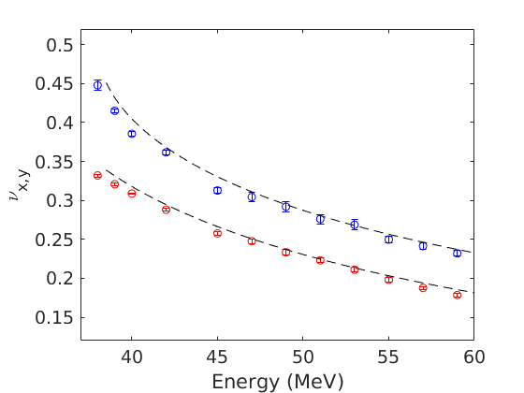
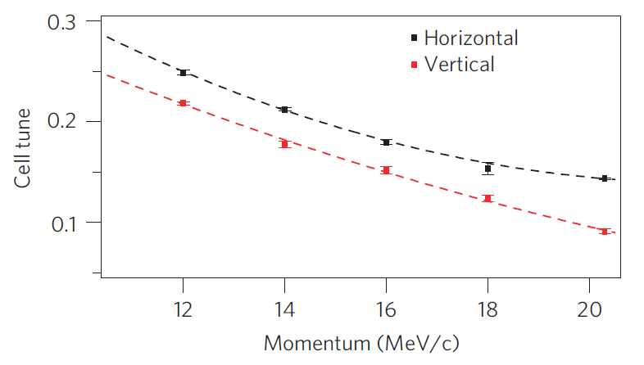
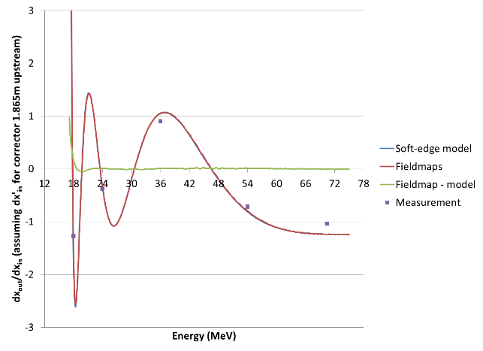
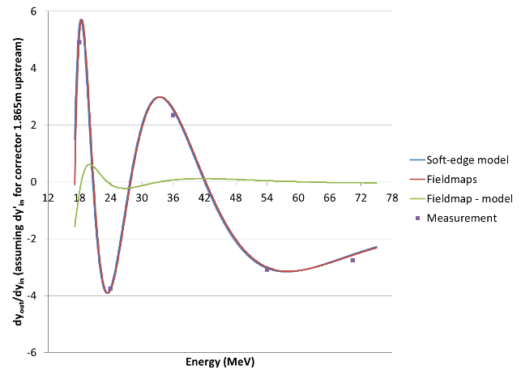
Cell Tunes × 3
ATF-FFA
CBETA girder test
EMMA
model
data
NB: ATF-FFA’s data fit is on matrix elements not tunes (graphs on bottom row)

Slide 41
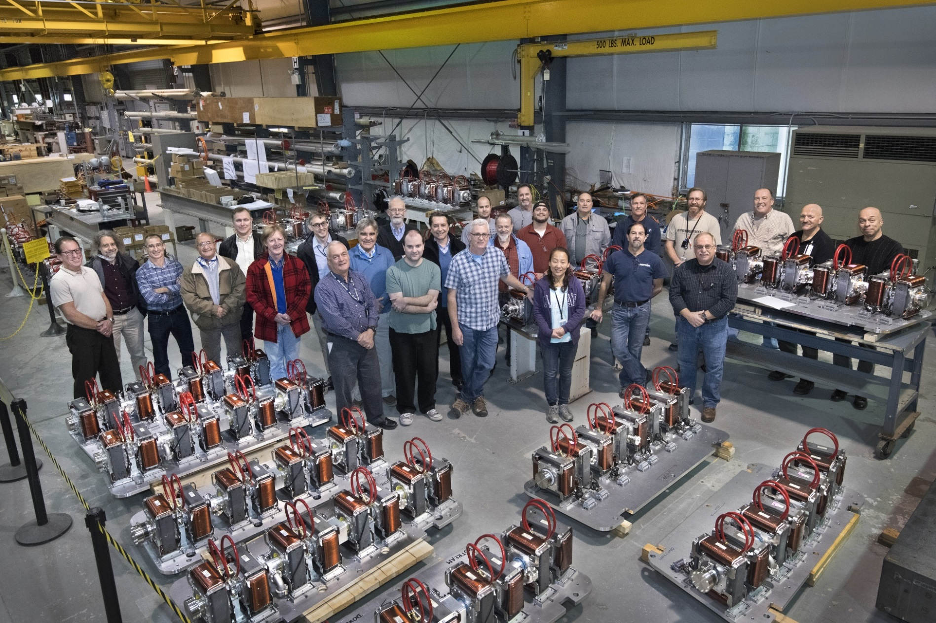
Girder Production Complete
(Nov 2018 at BNL)

Slide 42

CBETA as of Jan 1, 2019 (at Cornell)

Slide 43
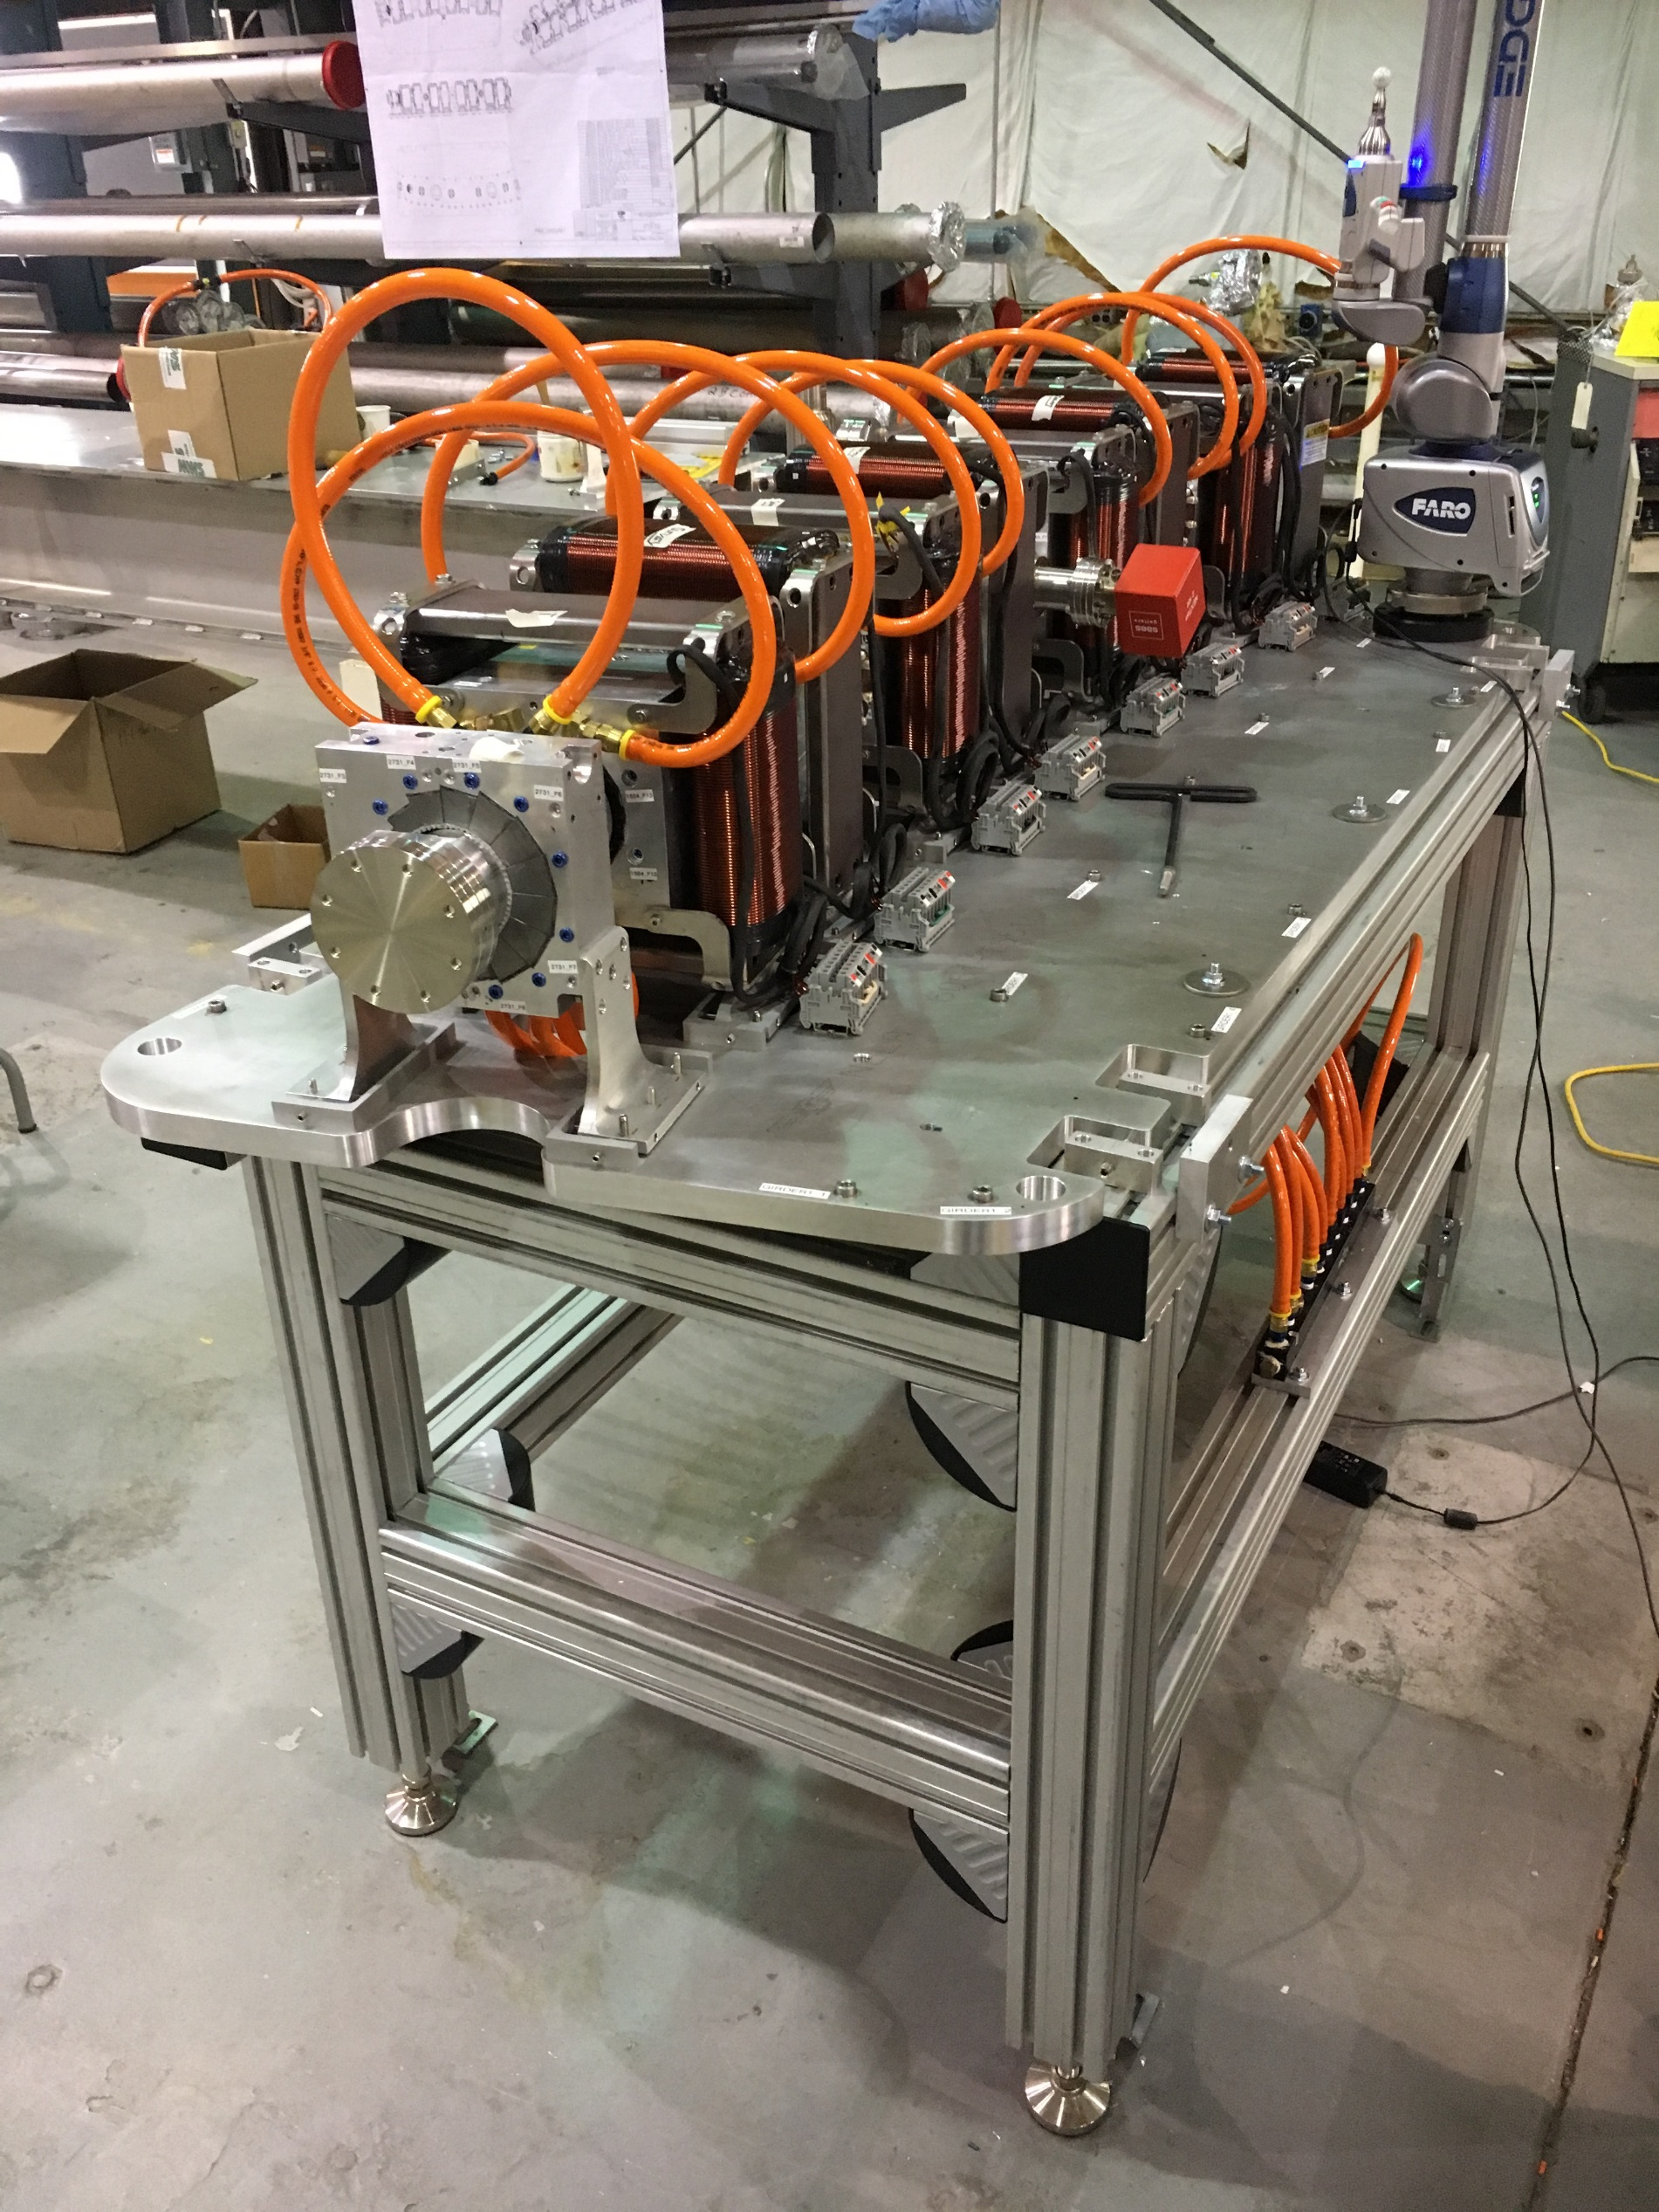
CBETA first FFA girder at BNL
Half-length magnet for matching

Slide 44
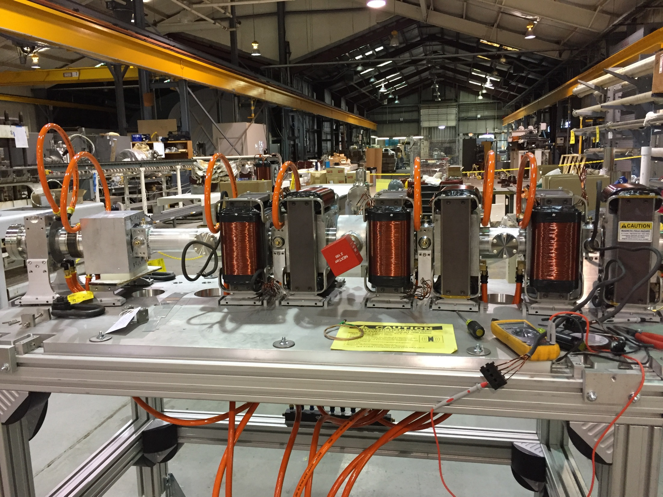
CBETA first FFA girder under construction at BNL

Slide 45
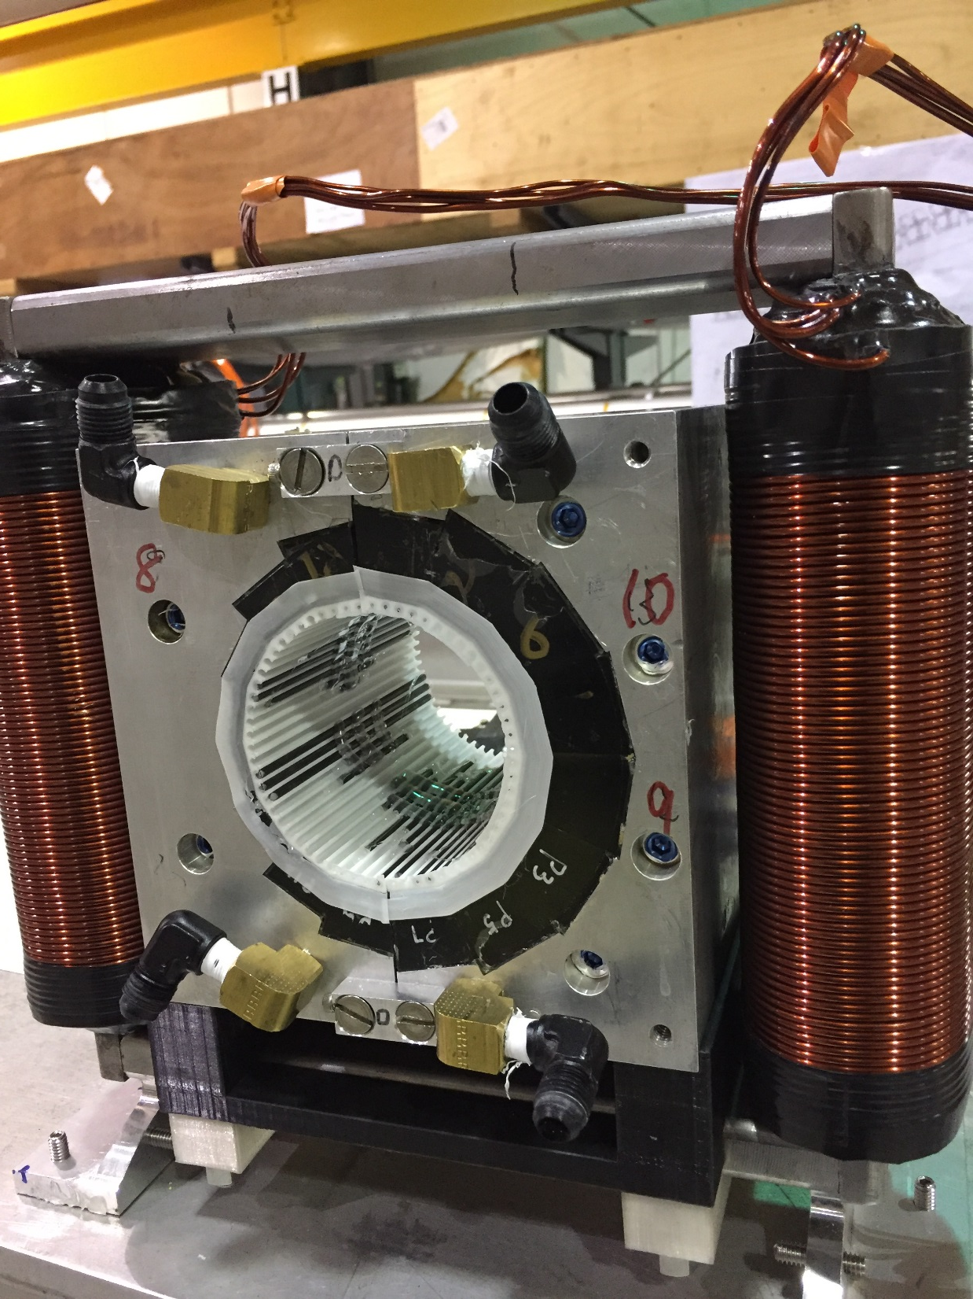
CBETA permanent magnet containing tuning wire insert

Slide 46
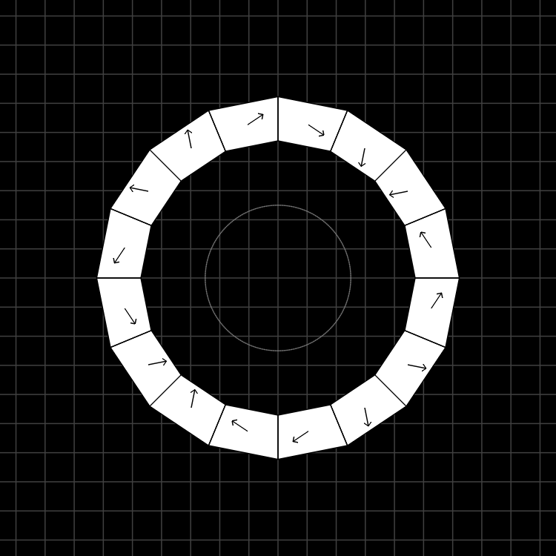
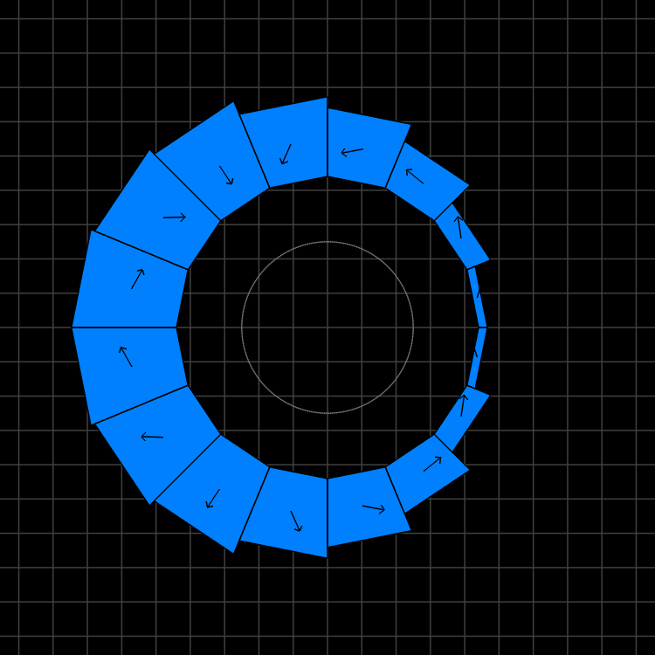
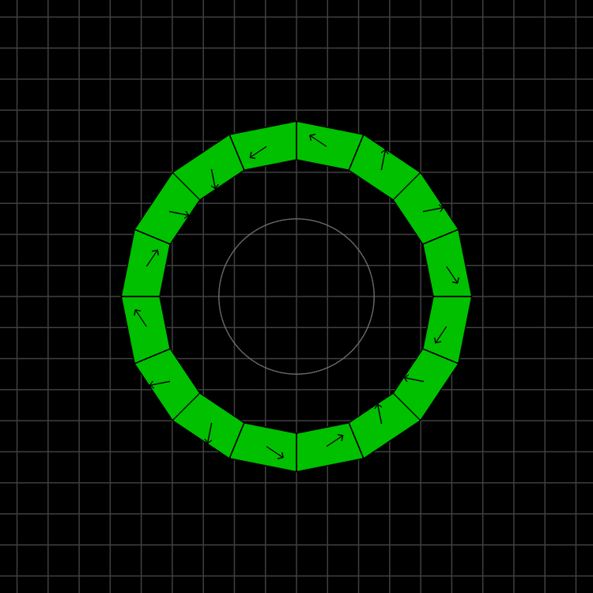
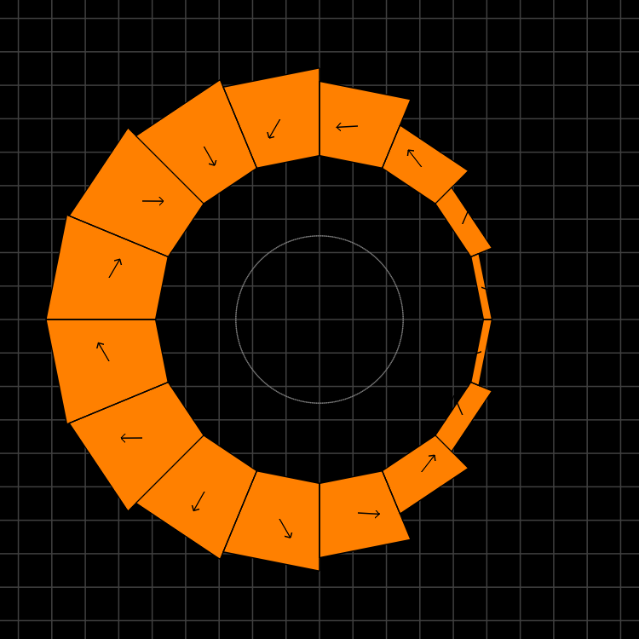
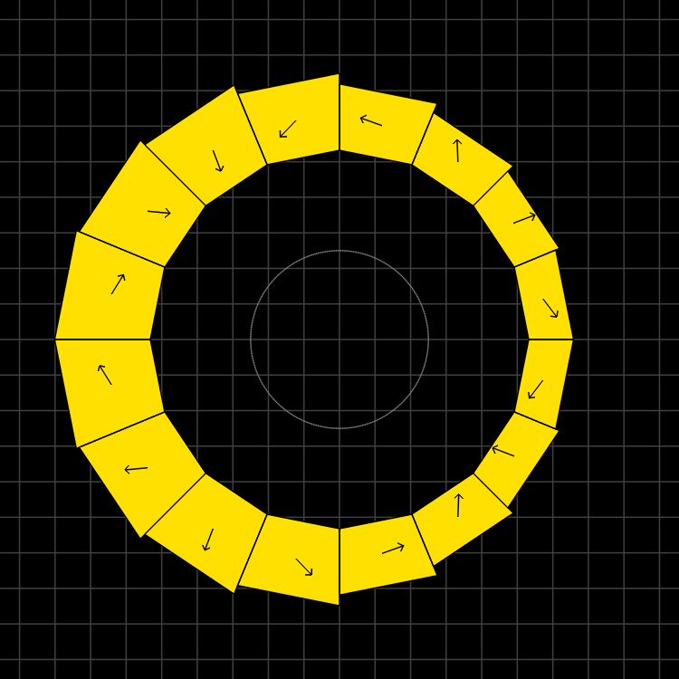
Magnet Types and Parameters
QF
BD
QD
BDT2
BDT1
Magnet | Dipole (T) | Quad (T/m) | Good field radius (mm) | Aperture radius (mm) | Max field (T) (good region) | Max field (T) (aperture)
QF | 0 | -11.5624 | 25 | 43.1 | 0.2891 | 0.4983
BD | -0.3081 | 11.1475 | 25 | 40.1 | 0.5868 | 0.7551
BDT2 | -0.2543 | 11.1475 | 25 | 44.938 | 0.5330 | 0.7552
BDT1 | -0.1002 | 11.1475 | 25 | 49.085 | 0.3789 | 0.6474
QD | 0 | 11.1434 | 25 | 40.1 | 0.2786 | 0.4469

Slide 47
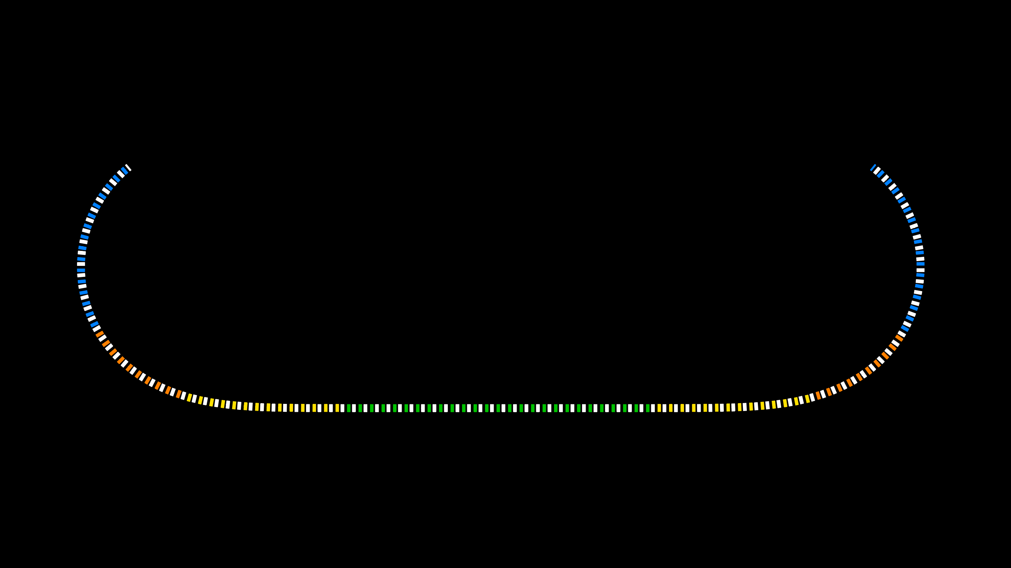
Layout and Magnet Counts
Permanent magnet total: 216
QF: 107
BD: 32
BDT2: 20
BDT1: 28
QD: 27
QFH: 1 (half length)
BDH: 1

Slide 48




Production and Testing Flow
KYMA
assembly
3
4
AllStar
PM wedges
1
BNL
tuning
2
Helmholtz testing at AllStar, 100% of blocks but not temperature controlled
Temperature-controlled Helmholtz test of ~15% sample at BNL for verification
Remainder of blocks shipped directly to KYMA, who also re-test ~10% sample
Rotating coil measurement of bare magnet at BNL
Rotating coil measurement of tuned magnet at BNL
5
Accept

Slide 49
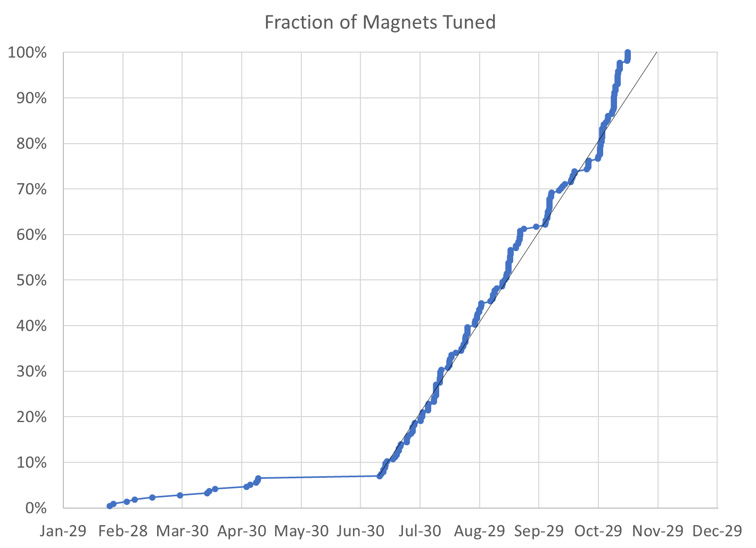
100% complete (excl. spares*)
215 / 215 magnets (0 remaining)
* We have 4 “spare” QFs, 2 BDs for replacing first girder magnets, plus two spare BDT2 magnets, with more spares to be delivered from KYMA

Slide 50

BDT1 28 / 28 magnets (0 remaining)
BDT2 22 / 20 magnets (2 spare)
BD 30 / 32 magnets (2 remaining*)
QD 27 / 27 magnets (0 remaining)
QF 107 / 107 magnets (0 remaining)
QFH 1 / 1 magnet (0 remaining)
* Total of 32 includes 4 spares for replacing the first girder BDs (same applies to QF total)

Slide 51
Final Measurement Rate
Main Production
Magnets tuned | 200 (excl. early samples)
Rotating coil measurements | 545
Start date | July 9, 2018
End date | November 14, 2018
Total weeks | 18.2
Magnets tuned per week (avg.) | 10.96
Rotating coil meas. per week (avg.) | 29.88
Rotating coil meas. per magnet (avg.) | 2.73

Slide 52

Permanent magnets shipped from KYMA

Slide 53

Rotating coil magnet measurement at BNL

Slide 54

Rotating coil magnet measurement at BNL

Slide 55

Wire tuning packs for CBETA magnets

Slide 56
Tuned Magnets Criteria
Midplane error (G) | Units FOM | CBETA FOM | Quad error at x=0 (rel.)
≤ 1.5 | ≤ 10 | ≤ 0.375 | ≤ 0.05% (Q)
Unit = 10⁻⁴ of main pole
FOM is sqrt(sum of all (multipoles in units)²)
  CBETA FOM is weighted version based on tracking
Midplane error generally hardest to achieve
  May go in and out of spec slightly (~0.5G) due to chiller cycle

Slide 57
Example Harmonics (QF 2566)
Normal
Skew
Integrated strength (T/m.m)
Dipole
Quad
Sext
Oct
etc.
-1.53782 | 0
8.20E-64 | 1.87E-65
10000 | 1.26E-12
-0.2922 | -0.58294
-0.07957 | 0.201785
0.572878 | -0.88759
-0.44538 | -0.60878
0.015517 | -0.12825
0.064316 | -0.07939
0.038948 | 0.018125
0.051198 | 0.022414
0.037202 | -0.01268
-0.01854 | -0.01006
-0.01217 | -0.07378
-0.09591 | -0.03929
-0.00478 | 0.020399
-0.01032 | -0.01952
0.007539 | 0.007748
0.068582 | 0.001058
-0.00071 | 0.001648
-0.00187 | -0.00071
Displaced magnet by DX (m) | -0.0002
DY (m) | -0.00156
Rotated A/C by (rad) | 0.041074
(deg) | 2.353343
Reference radius (m) | 0.025

Slide 58

Only tuned magnets shown (2 “rejects” removed)
BDT1
BDT2
BD
QD
QF
Reject matched with good half
Reject matched with good half
80 shims
Tuned with 96 shims
QFH

Slide 59

Only tuned magnets shown (2 “rejects” removed)
BDT1
BDT2
BD
QD
QF
QFH

Slide 60

Only tuned magnets shown (2 “rejects” removed)
BDT1
BDT2
BD
QD
QF
QFH

Slide 61

Water Cooling Stability

Slide 62




Rejects/Repaired
BD 2305
Harmonics simulation w/swap
QF 2572
Harmonics sim. w/type change
QF 2509
Harmonics simulation w/swap
QD 2427
Harmonics sim. w/type change

Slide 63

Reversed Block in QF 2509

Slide 64

CBETA windowframe correctors at BNL

Slide 65

CBETA girder production at BNL

Slide 66
Other Problems/Lessons Learned
@BNL
  Warehouse roof leaks, hence tent in photo
  Gaps when reassembling magnets from halves
@AllStar
  Some blocks went rusty (not passivated?), had them re-made
  One type magnetisation angle was out-of-spec, had them re-made
@KYMA
  Couple of blocks inserted backwards
  One glue failure, exploding magnet, repaired
Team effort
  Block width with chamfer was not communicated clearly to AllStar, meaning blocks slightly larger than needed, had trouble fitting
  Chinese sign convention for magnetisation was opposite, had to invert blocks

Slide 67
Backup (CBETA magnets)

Slide 68


Helmholtz Measurements
Example: AllStar data for wedge types P1 through P16 (BD magnet)
Angle errors Strength variation

Slide 69

Magnetisation Angle Distributions
Requested that factory re-make types P15 and P16 to reduce systematic error.
These are the smallest blocks, so not critical, but re-make will improve quality of untuned magnets.
General request was for 1 degree RMS error, but can cope with some above and some below as we have here (see next slide)

Slide 70

Magnet Error Model
Both the strength and angle error distribution can be put back into the field simulation
Example: BD magnet using AllStar’s data set.
1000 magnets were generated, some with position errors. Histogram is binned by the “units FOM”.
Green = easy to tune
Red = possible problems
Based on first girder experience.

Slide 71
BACKUP (ATF)

Slide 72


Evidence of Camera Roll Angle
These scan patterns formed by energising the same corrector
POP10 estimated 2.6° clockwise
POP11 estimated 3° anticlockwise
y
y
x
x
Could also be mirror angle errors (multiple mirrors also involved)

Slide 73

36MeV Results vs. Raw Tracking

Slide 74

Input Camera Roll Angle Correction
“Perspective” nonlinearity reproduced.
Looks like offset
could be at start
of beamline not
end.
NB: input positions measured relative to HeNe laser, which has thermal drifts, not necessarily actual axis of ATF beamline…

Slide 75

Fitting X,Y Offset at Output
Required shift:
(-3.96,0.21)mm

Slide 76


Slide 77

70MeV Results vs. Tracking

Slide 78

Fitting X,Y Offset at Output
Required shift:
(3.15,-0.09)mm

Slide 79

24MeV Results vs. Tracking
Seems to be at an X focus.
Tracking has different sign of X movement, but near zero in either case.

Slide 80

18MeV Results vs. “Tracking”
Tracking went wrong with measured centroids (particles falling out of fieldmap?)
Probably need to apply input shift in order to make the tracked particles go through (white dot is periodic orbit).

Slide 81

18MeV with Input Shift (arbitrary)
Picked a beam that got through and applied an input shift to put it on the closed orbit.
Required shift:
(-2.60,-2.65)mm

Slide 82

18MeV with Input Shift (no FM)
Replaced OPERA-3D fieldmaps by Muon1 soft-edge field model.
Much better!
Should check not going out of bounds in fieldmaps or something.

Slide 83


Input/Output Position at 54MeV

Slide 84


Input/Output Position at 36MeV

Slide 85

24MeV Results vs. Tracking (no FM)
Replaced OPERA-3D fieldmaps by Muon1 soft-edge field model.
X movement has right sign.

Slide 86

Compensating for Output Offset

Slide 87

Errors vs. Tracking, Output Offset

Slide 88

Best Fit X,Y Offsets at Output

Slide 89

Best Fit X,Y Offsets at Output

