Slide 1
CBETA: a 4-pass superconducting ERL with combined permanent magnet return arc

Slide 2
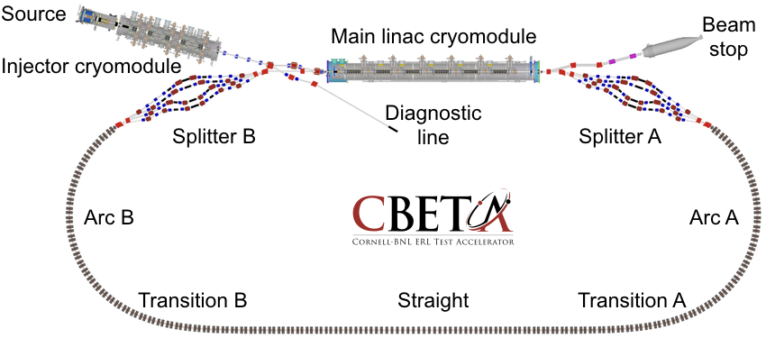
Layout & Parameters
Main linac is a 1.3GHz SCRF module with six 5-cell cavities
±36MeV
6MeV
6MeV
42,78,114,150MeV
42-150MeV

Slide 3
Bunch Pattern (one option)
Time structure as seen by the main linac

Slide 4
What can an ERL do?
 | Advantages | Disadvantages
Compared to linac | Energy recovery: circulating beam power can be much higher than power input | Can’t use stopping targets! Disrupted beam must survive 1 turn (or a few turns)
Compared to ring | Equivalent to ring with cooling system that cools in one turn! (small emittance) Can disrupt beam more than in a ring where beam has to survive millions of turns | Source current must equal circulating current; Current in linac is circulating current multiplied by 2 or more (important for higher order modes)
Applications: thin targets, electron coolers, Compton backscattering, light sources, electron-ion colliders (LHeC/FCC-eh)

Slide 5
CBETA Energy Saving Technologies
Permanent magnets
Superconducting RF
Energy recovery (above 6MeV)
Recirculation: 4x beamline reuse, 4x energy
Funded by NYSERDA
(NY State Energy R&D Authority)
$25M grant
Cornell already had the injector & cryomodule

Slide 6
Project Timeline
Construction
Beam operation

Slide 7
Fixed-Field Return Loop Optics
Beams with 4x rigidity range transmitted through same overall radius of curvature in arcs
Adiabatically merged to zero curvature, separation in straights
Beam cell tune decreases as a function of energy

Slide 8
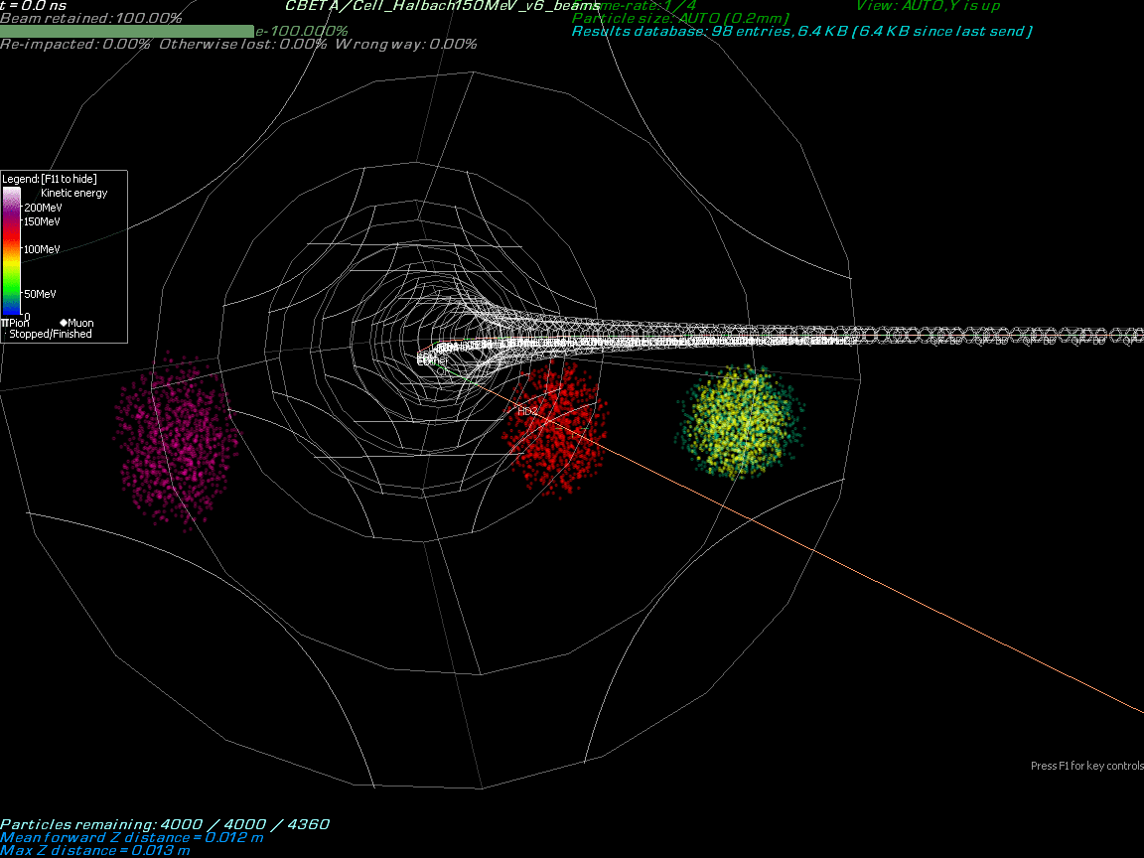

Slide 9
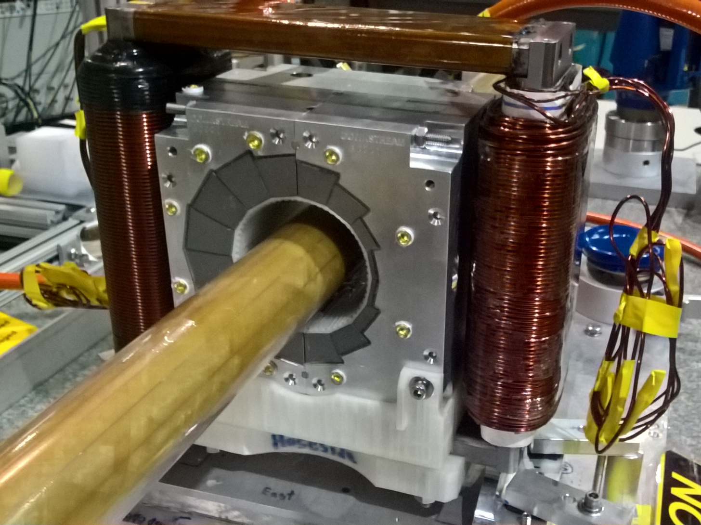
Permanent Magnet Design
Halbach design made of NdFeB material
This is a combined dipole+quad
Being measured on rotating coil at BNL
3D printed multipole corrector pack inside
Windowframe corrector coil outside
Temperature stabilised by water (orange hoses)

Slide 10
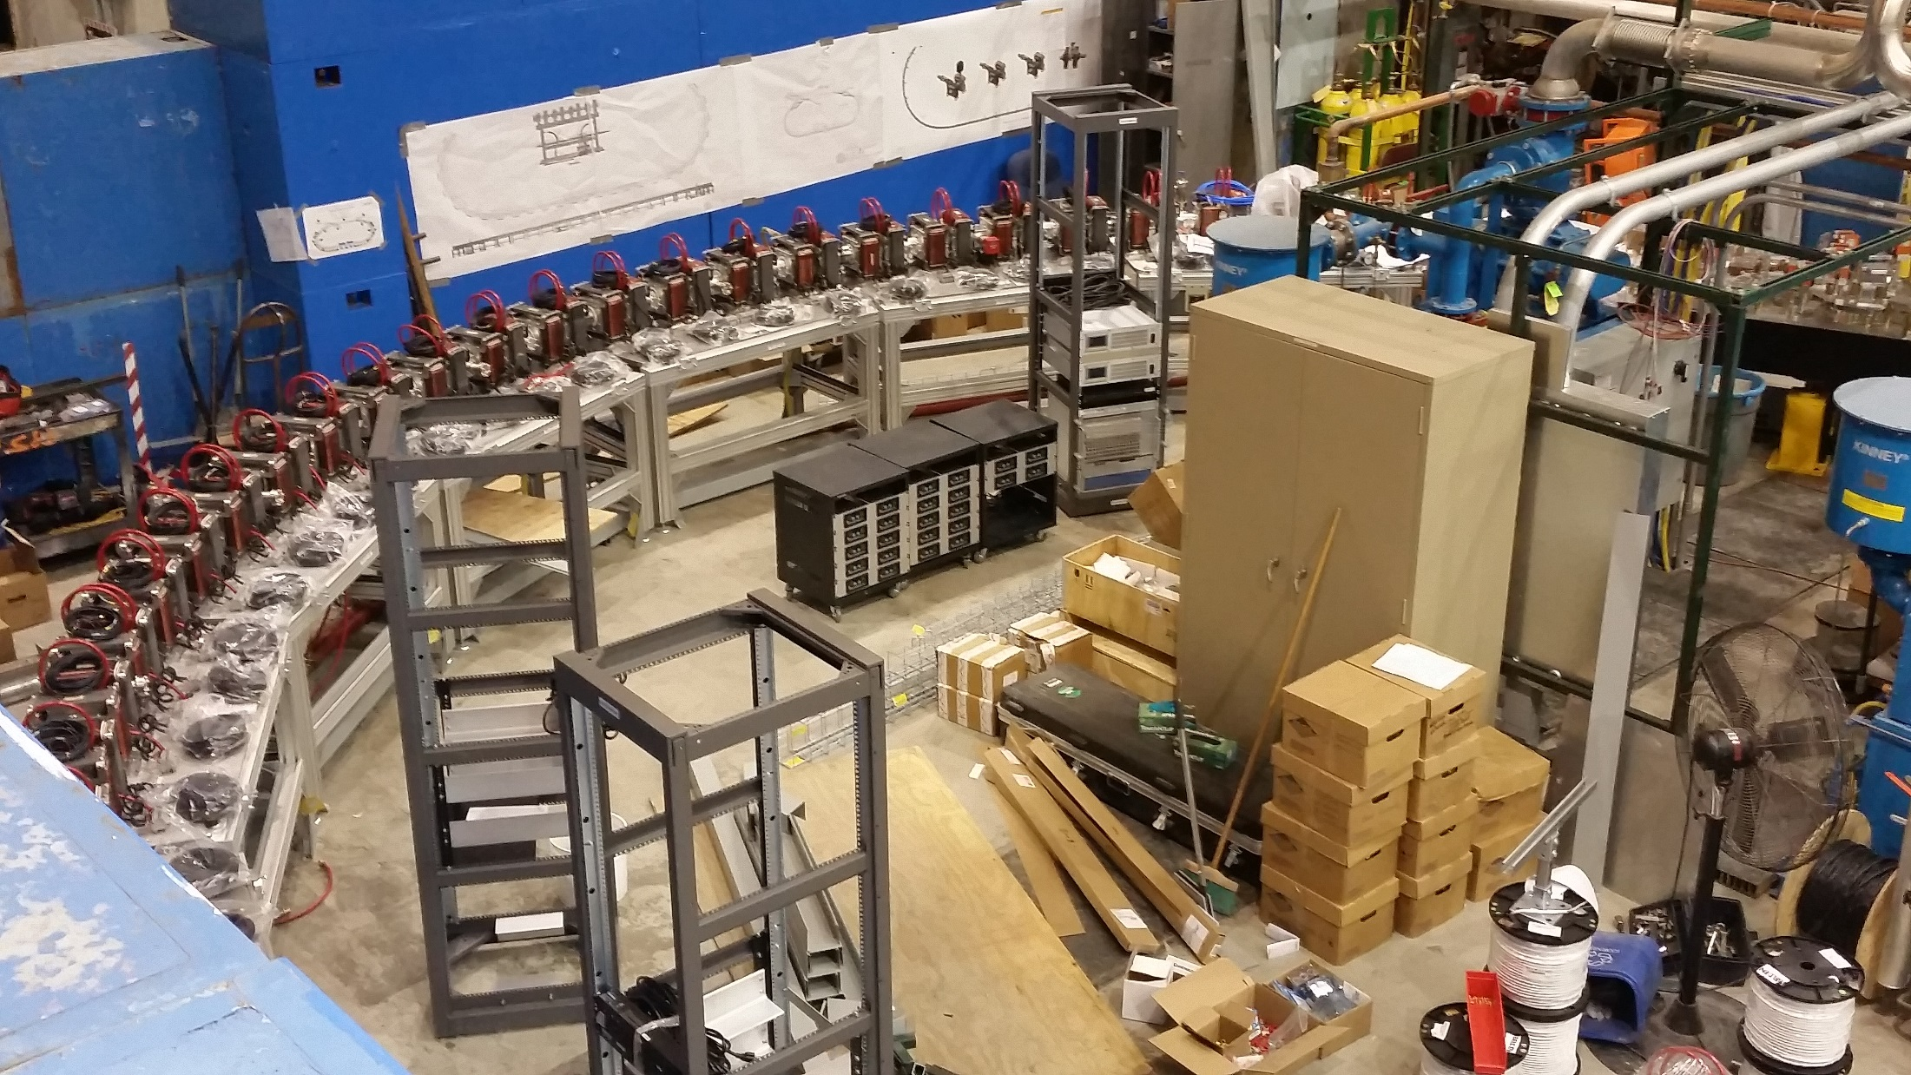
Fixed-Field Return Arc

Slide 11
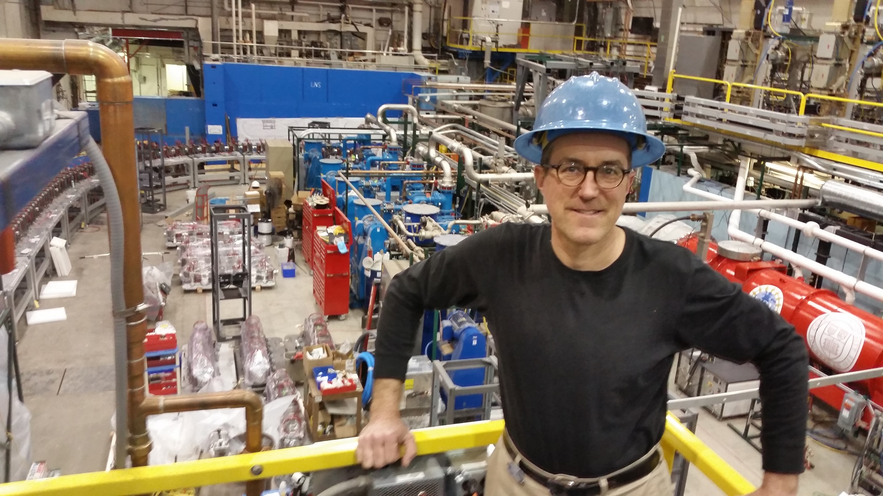
Karl Smolenski & Main Linac

Slide 12
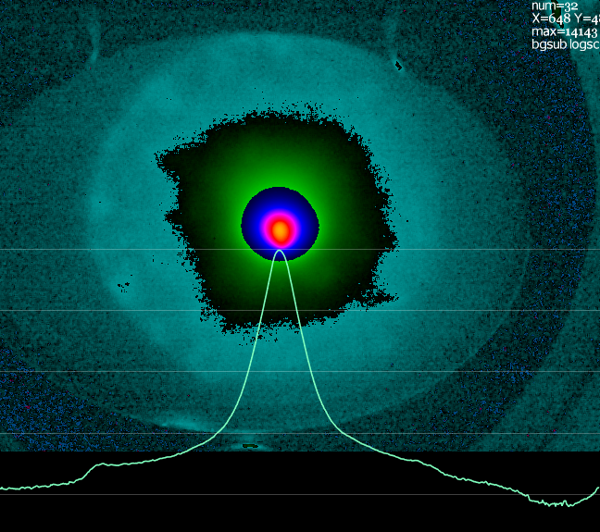
Possible Halo after Injector
3×10⁻⁴ relative intensity
~100x beam core area
About 3% of total charge
Probably from photocathode
(April 17, 2019)
Selectively-activated photocathode has been used before at Cornell to suppress this sort of thing
Collimators in the injector are possible but harder due to high beam powers

Slide 13
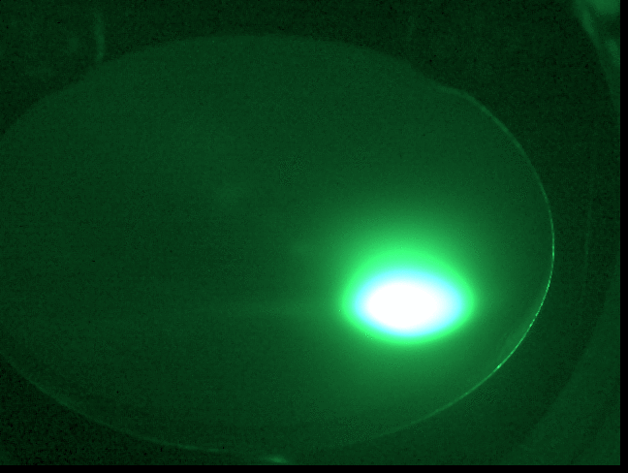

Slide 14
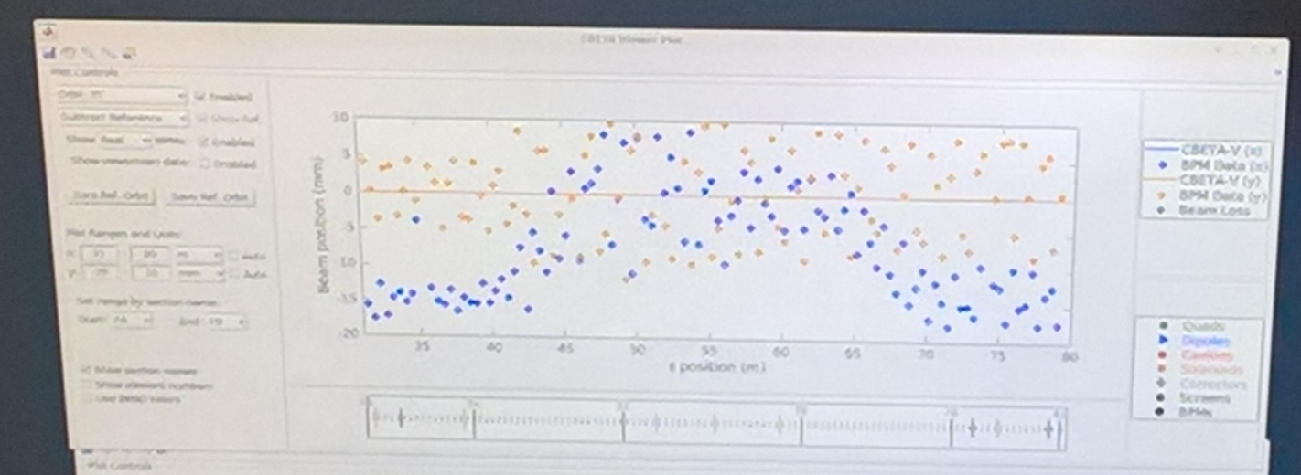
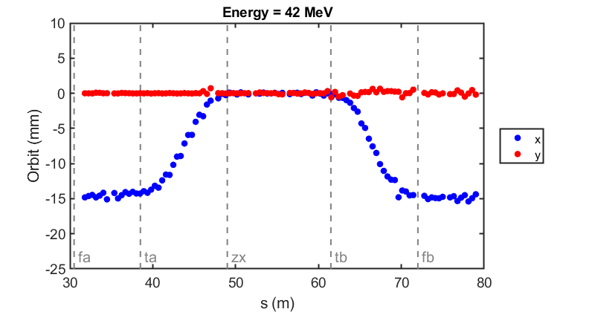
Commissioning results: orbit correction in fixed-field loop
Tune graph too?
The very first beam through the fixed-field loop on May 7, 2019
Corrected beam
(June 12, 2019)

Slide 15
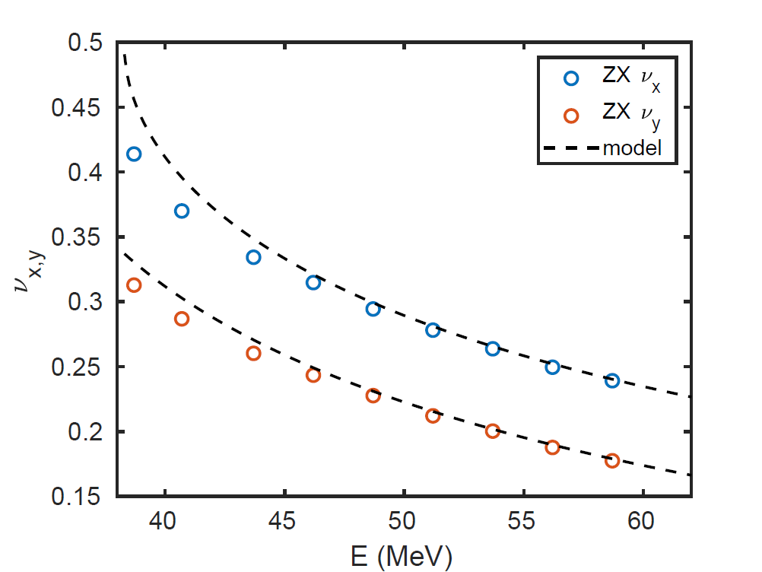
Cell Tunes in Beam Energy Scan
Fixed-field arcs
Fixed-field straight
(June 12, 2019)

Slide 16
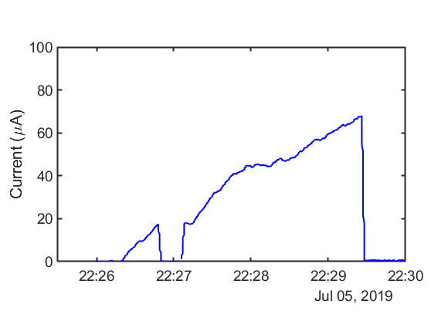
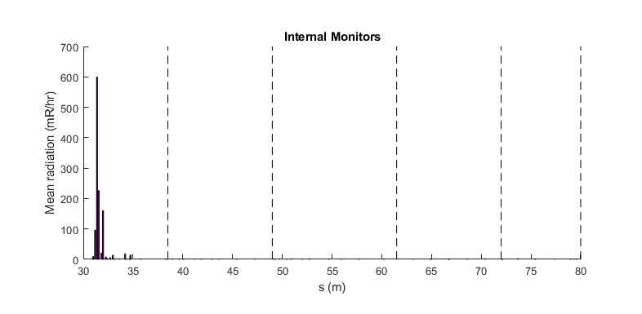
Higher Current Test / Radiation
Using ~3pC bunches
Halo just went through
Current limited by uninteresting things:
Wrong gun photocathode
Fast EPS not installed (10uA limit)
Gun resistor needs changing
External radiation monitors (70uA limit)
No “physics” current limit seen
Extrapolating internal FFA losses gives 70uA*(10000/600) = 1.17mA limit
1mA should be fine
Probably 1-10mA CSR limit

Slide 17
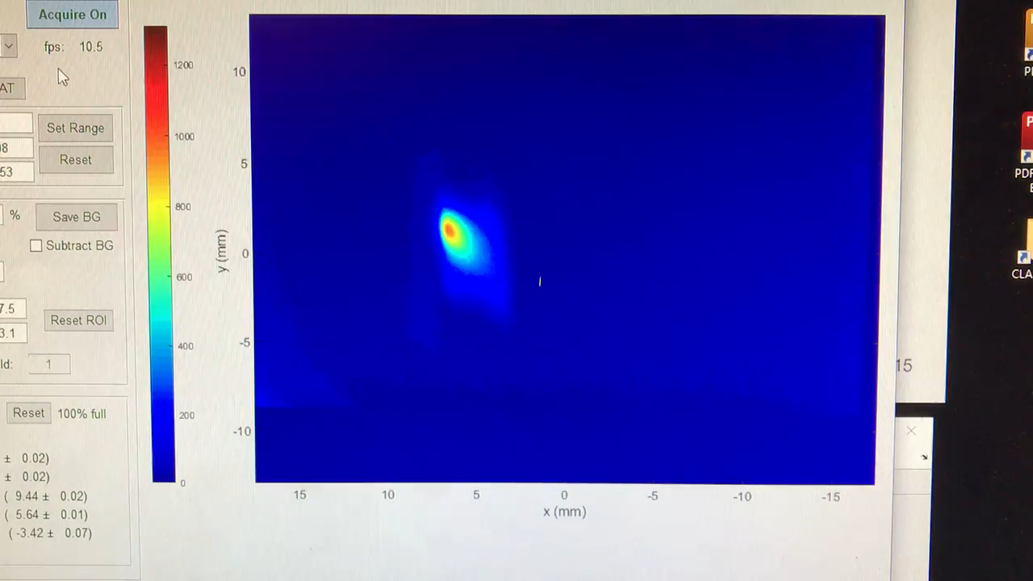
Dispersion, R₅₆ correction
Beam entering the dump line is steady, free of RF energy jitter (July 13, 2019)

Slide 18
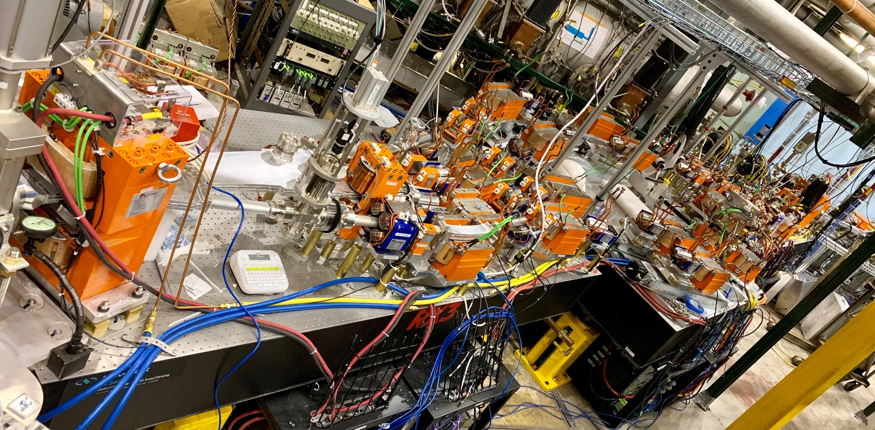
Next: 4-turn operation
July-Sep 2019 shutdown
Aligned with CESR facility shutdown at Cornell
We are installing the other turns in the splitters

Slide 19
Future: CBETA Facility?
Vertical double chicane
ERL experiment
ERL experiment
RLA experiment
User experiments platform
Single-turn mode with reduced CSR and increased current 40+mA, 55MeV
High energy mode with 3 turns in fixed-field arc, 1-10mA, 200MeV

