Slide 1
Permanent Magnet VFFA for 18GeV Electron Acceleration

Slide 2
Status
In Mar/Apr submitted a proposal for BNL lab R&D funding for VFFA design work in 2020-21
In Oct got negative response (passed 2/3 stages)
But in the preparation of the proposal:
Built and tuned a prototype VFFA magnet using permanent magnet material
Searched for VFFA lattice cells for RHIC-sized 18GeV electron machine
Did 3D tracking of a VFFA test cell

Slide 3
Project Description
Design and risk-reduce a fixed-field accelerator (likely using permanent magnets) to produce the 18GeV electron bunches for eRHIC instead of an RCS. This eliminates most magnet power supplies and allows a faster acceleration cycle of ≤100 turns, giving a shorter RF pulse and easier spin preservation.
Cost comparisons showed ~30% cost savings in overall accelerator using eRHIC and CBETA data

Slide 4
Additional Applications
~mA level electron current could be available at BNL at 18GeV
Comparable to SLAC
Can allow beam physics experiments far beyond current ATF reach (70MeV)
Cyclotron-like behaviour at far higher energies
Flexible time structure
VFFA principle applied to proton machines
Currently being considered for 1.2GeV neutron source upgrade at RAL
Forms the basis for waste transmutation “3D cyclotron” facility
S.J. Brooks, Vertical orbit excursion fixed field alternating gradient accelerators, Phys. Rev. ST Accel. Beams 16, 084001 (2013)

Slide 5
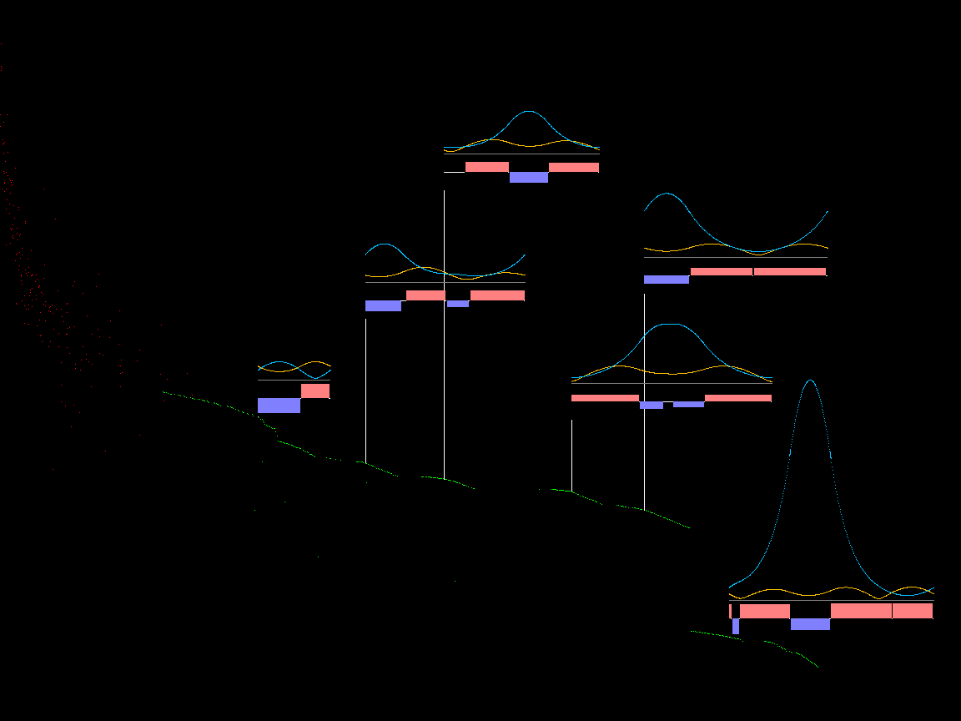
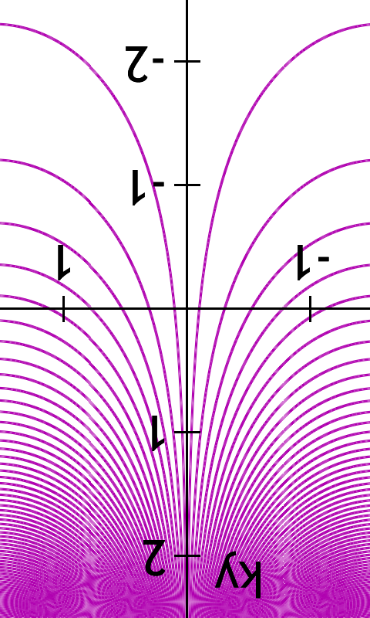
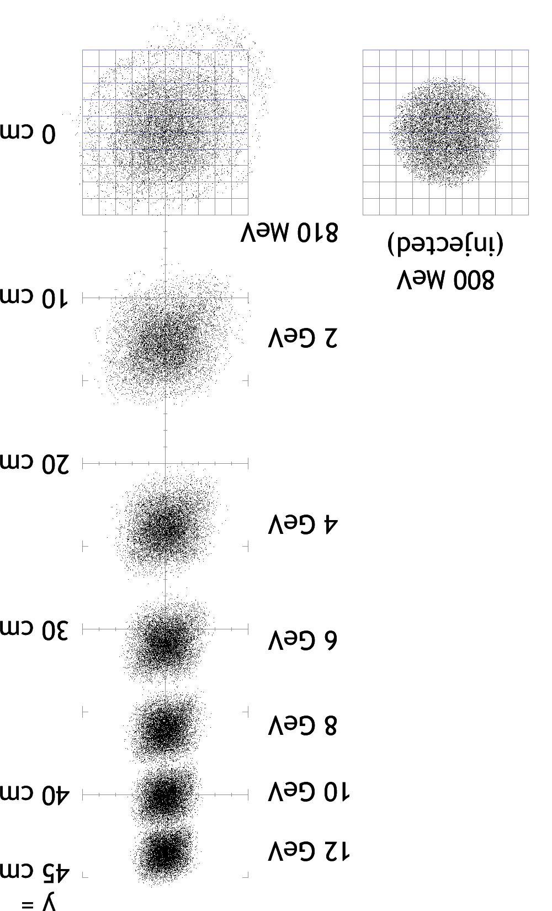
Arc Lattice Cell Candidates
Field B_{y}=B₀e^{-ky}
Scaling law means focussing and bending have the same sign
Estimated dynamic aperture (log)
0.47T
Heuristic √β_{max}ε ≈ 0.1/k
ε ≈ 0.01/(k²β_{max})
0.33T
0.57T
0.82T
0.36T @ 18GeV
Overall radius and top energy are fixed parameters, vary lattice and amount of reverse bend
Magnetic efficiency

Slide 6
Full-Scale Lattice Cell

Slide 7
Demo Magnet Design
k = 20m⁻¹
GFR = 25mm
B_{max} = 0.3T
L = 120mm
5 slices of 24mm
Using left-over 26x20x24mm blocks from CBETA magnet R&D

Slide 8
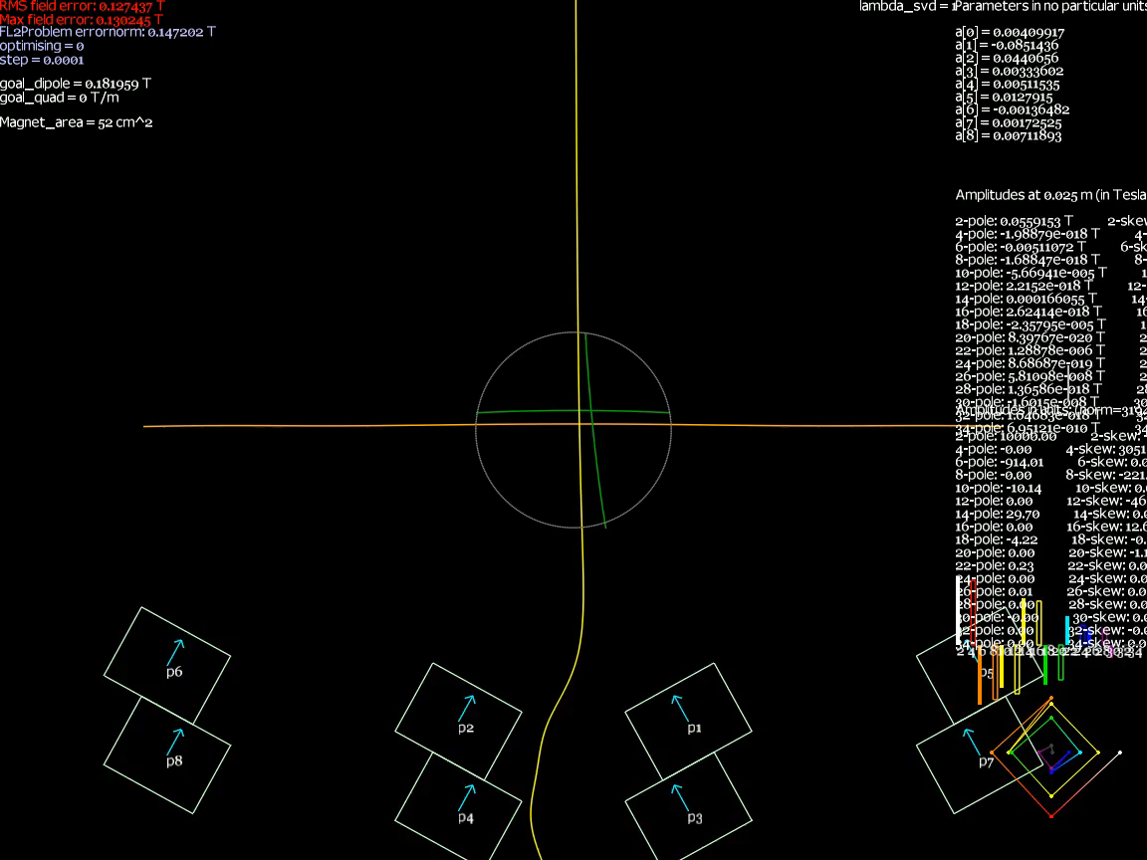
Geometry Optimisation

Slide 9
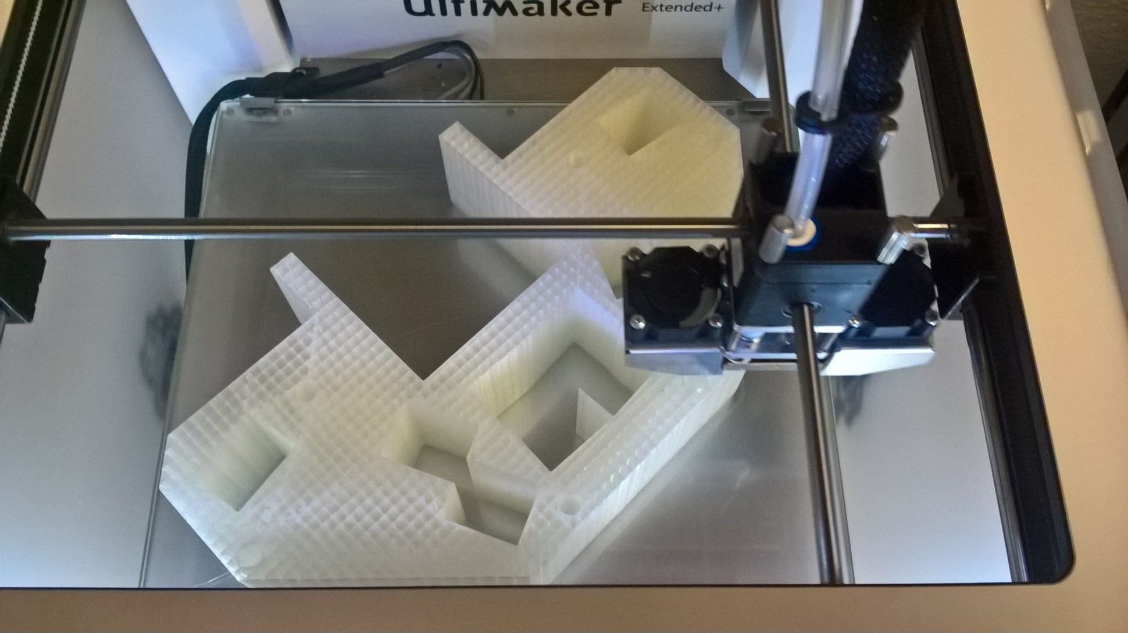
3D Printing from Design

Slide 10
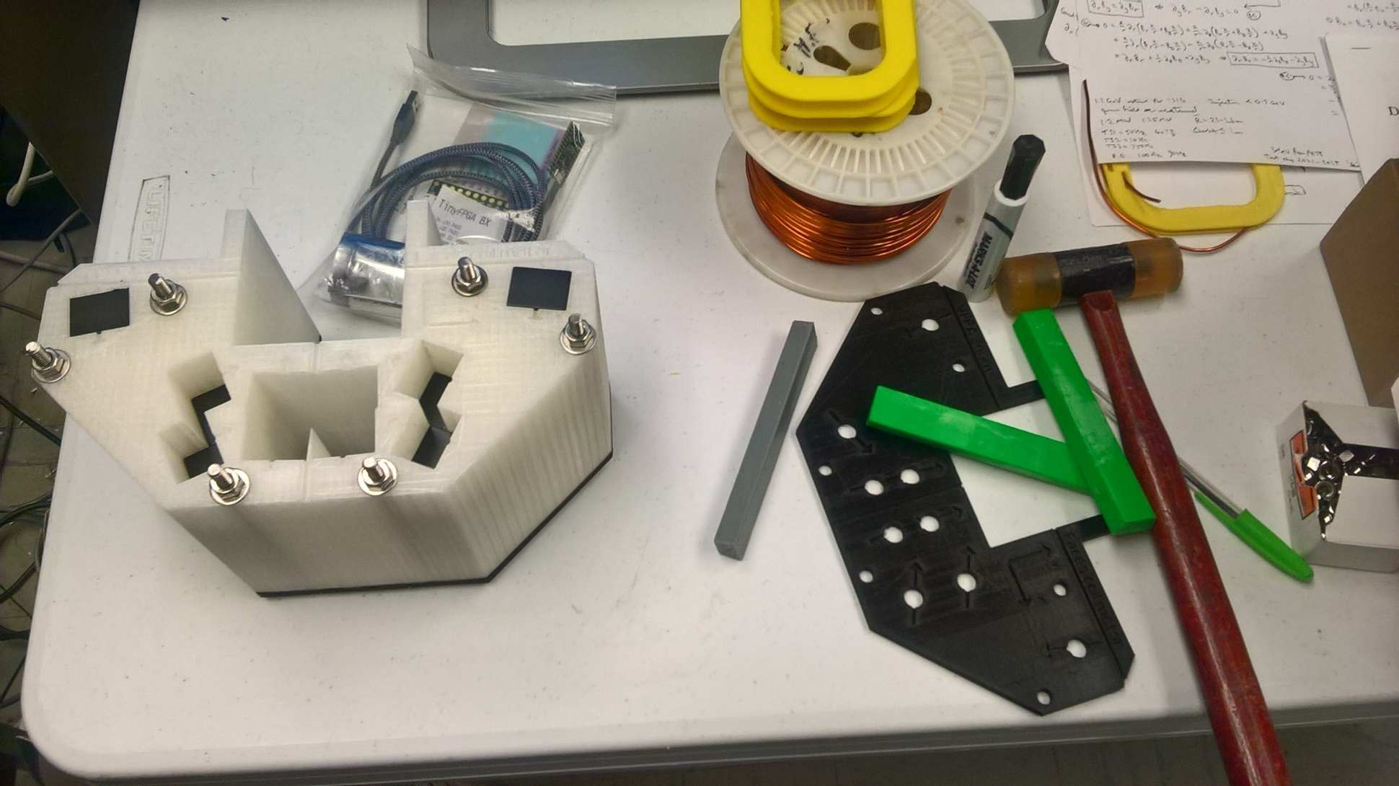
One-piece assembly doesn’t work: blocks roll around in channel

Slide 11
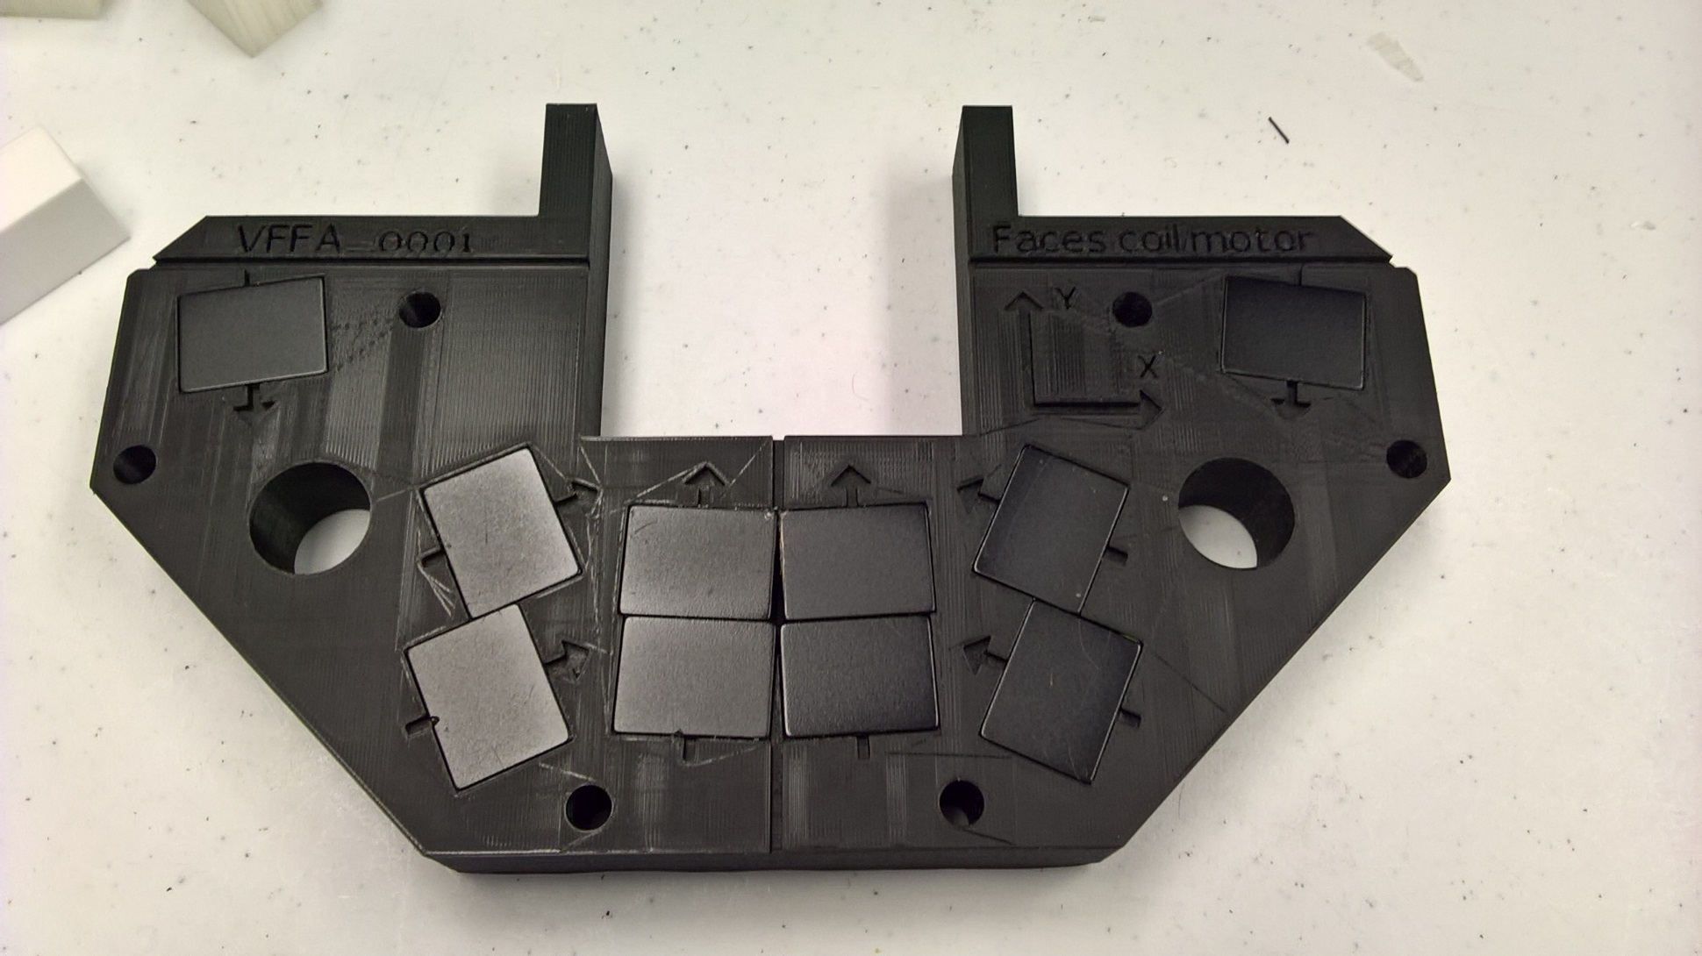
Single 24mm-thick Layer

Slide 12
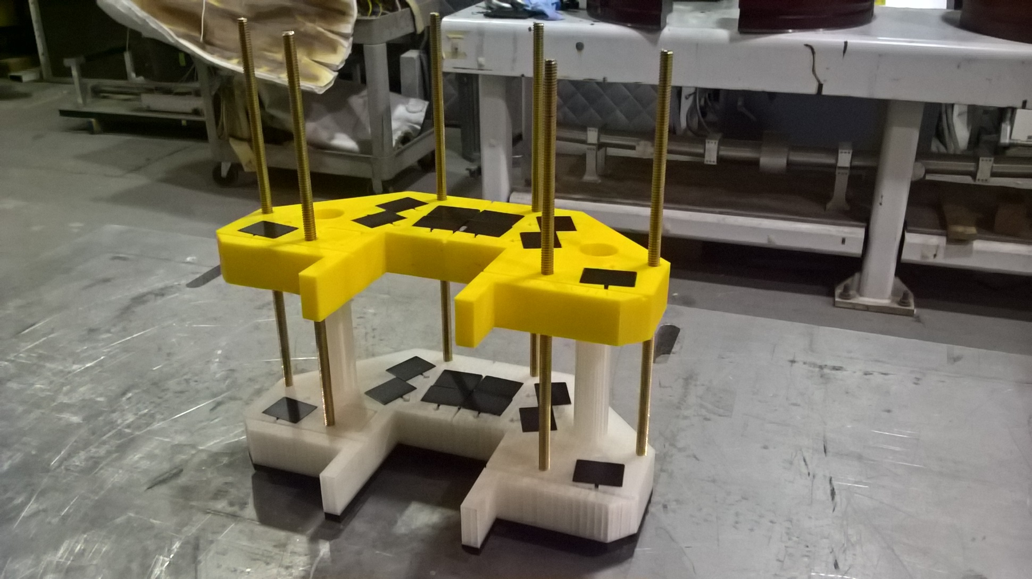
Slice Repulsion: Need Longer Rods!

Slide 13
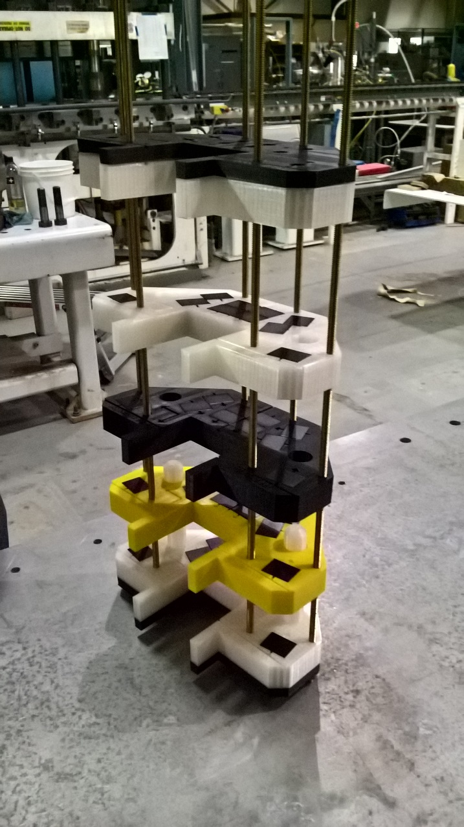
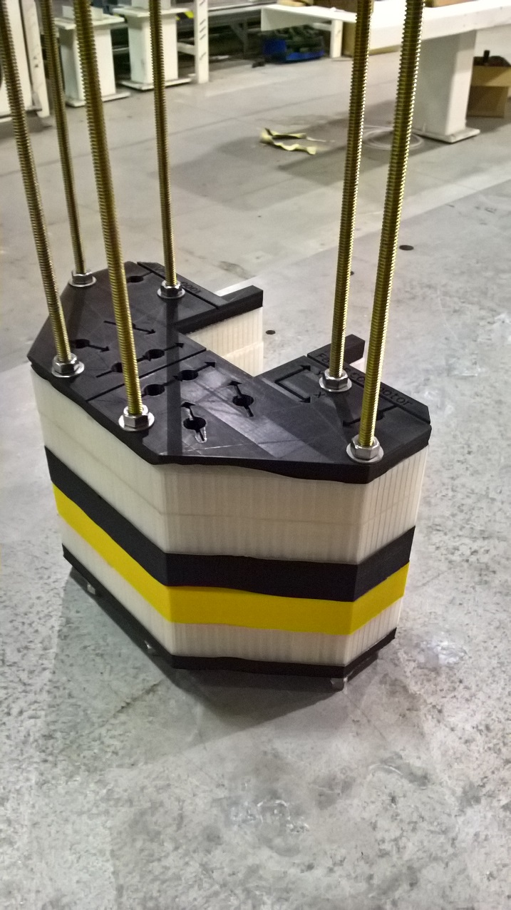
Assembly of Repelling Slices

Slide 14
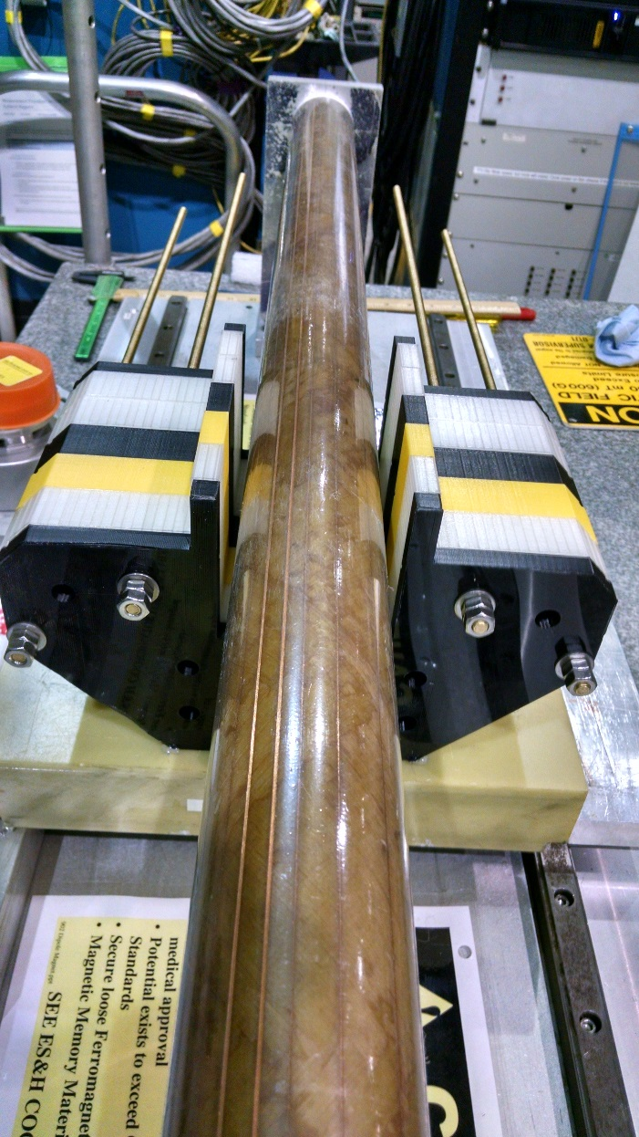
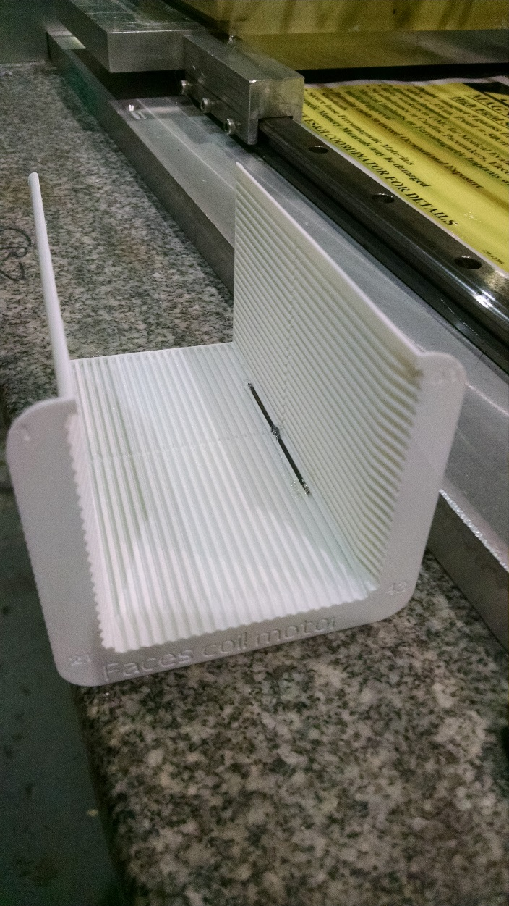
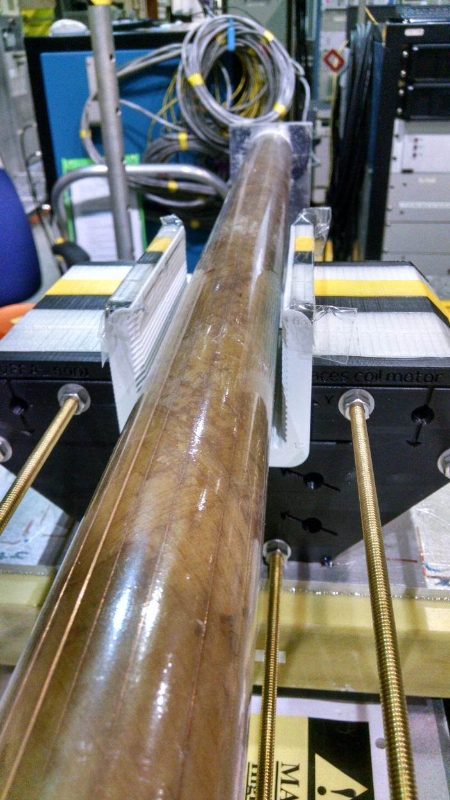
Rotating Coil Measurement
3D-printed shim holder

Slide 15
Harmonics (untuned)

Slide 16
Harmonics (tuned)

Slide 17
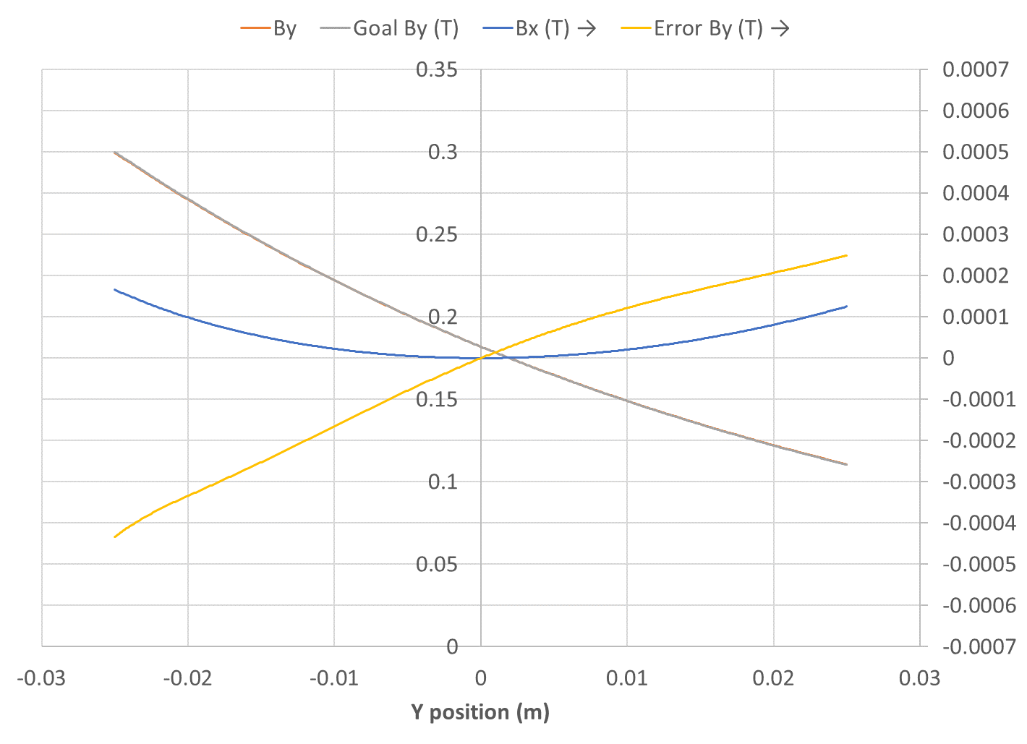
Field and Error (untuned)

Slide 18
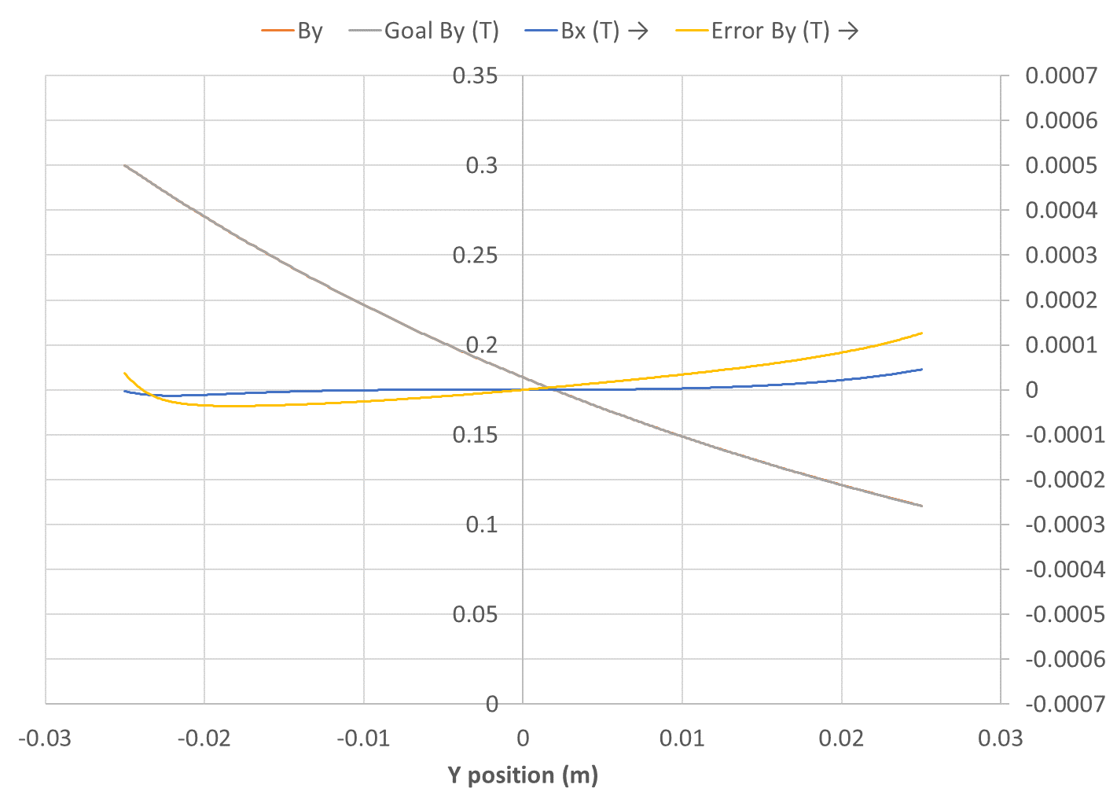
Field and Error (tuned)

Slide 19
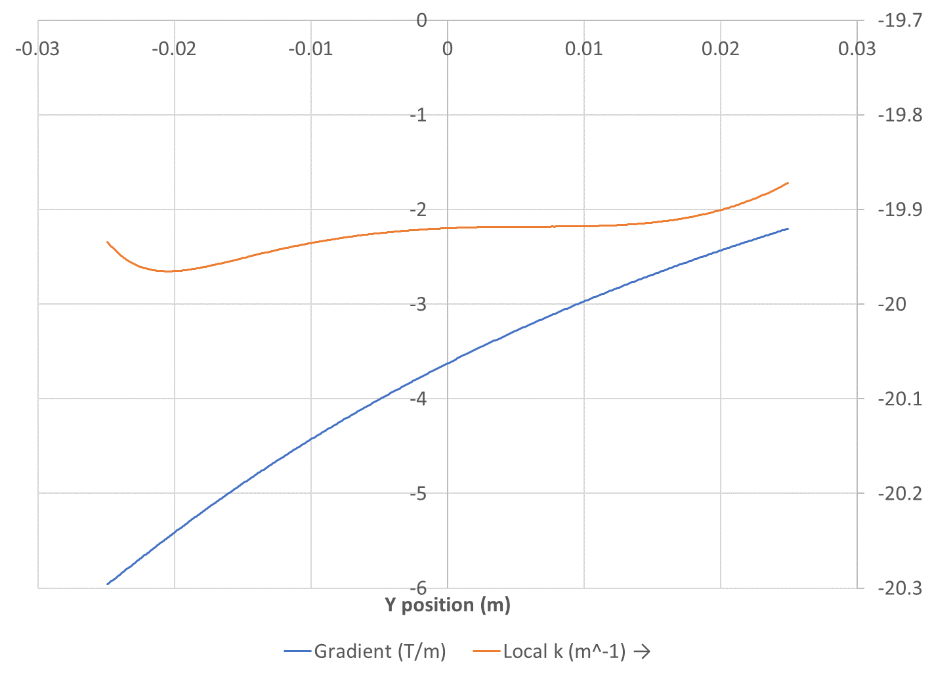
Gradient and Local k (untuned)

Slide 20
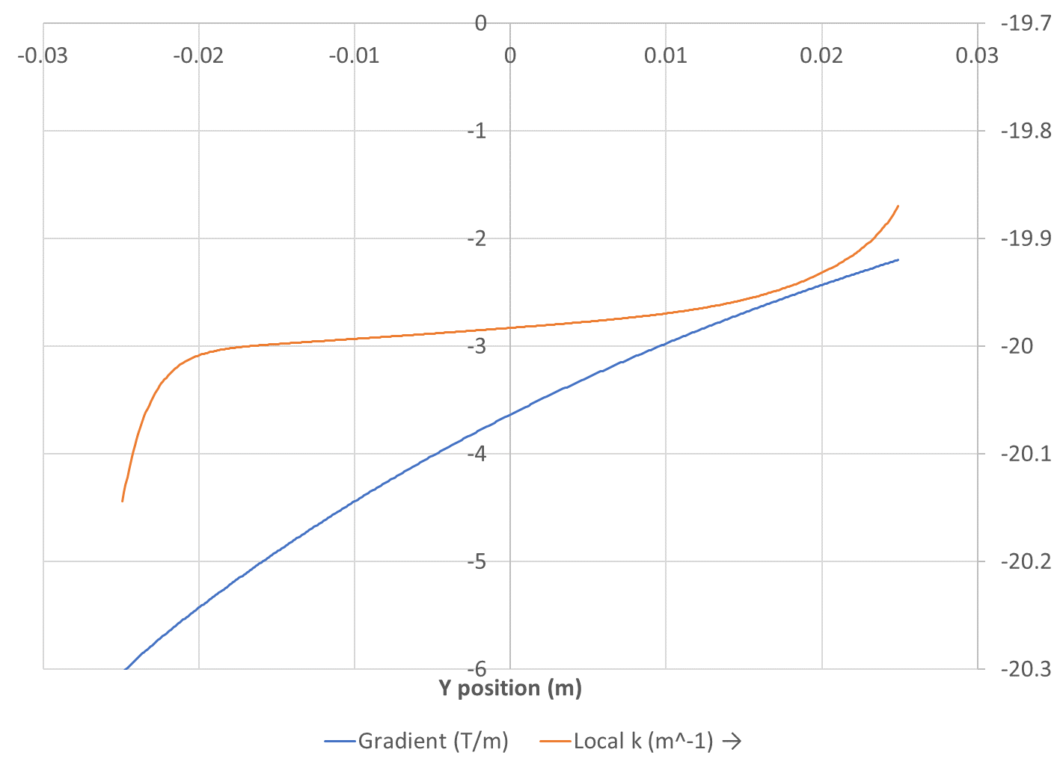
Gradient and Local k (tuned)

Slide 21
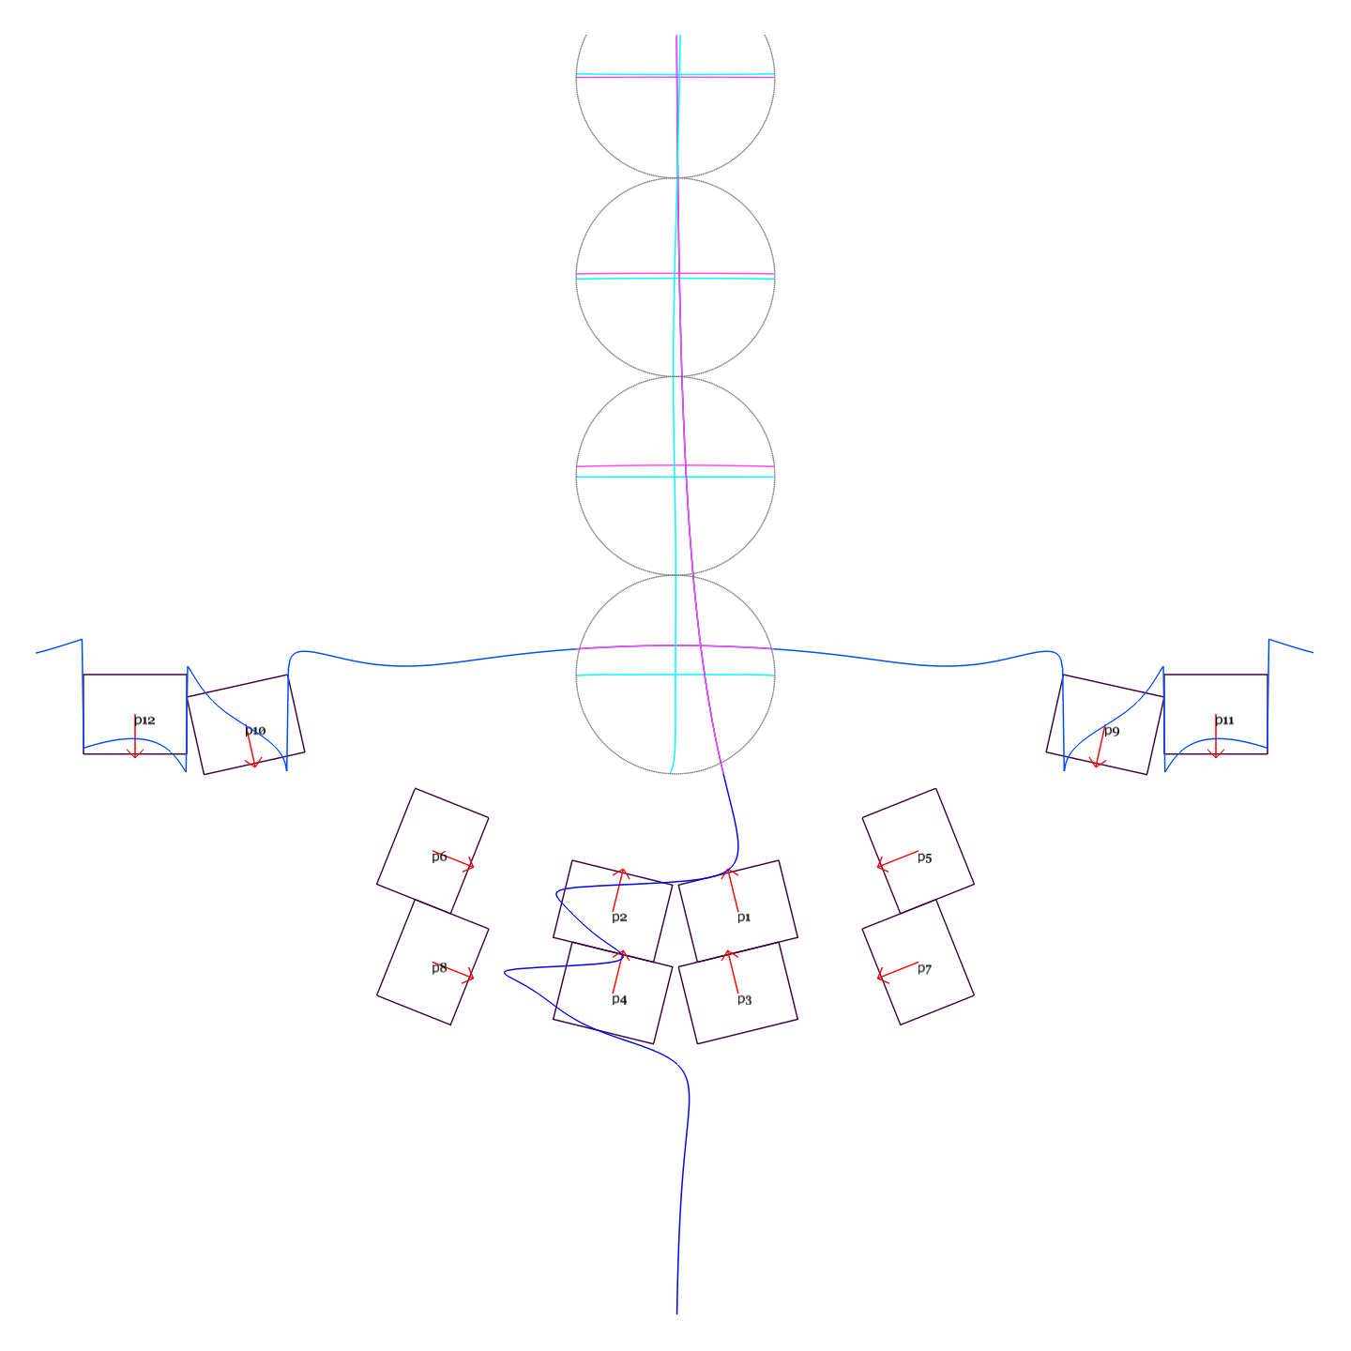
Extension of Design Height
k = 20m⁻¹
GFR = -25mm to +175mm
B_{max} = 0.3T
Max field error ~3 Gauss

Slide 22
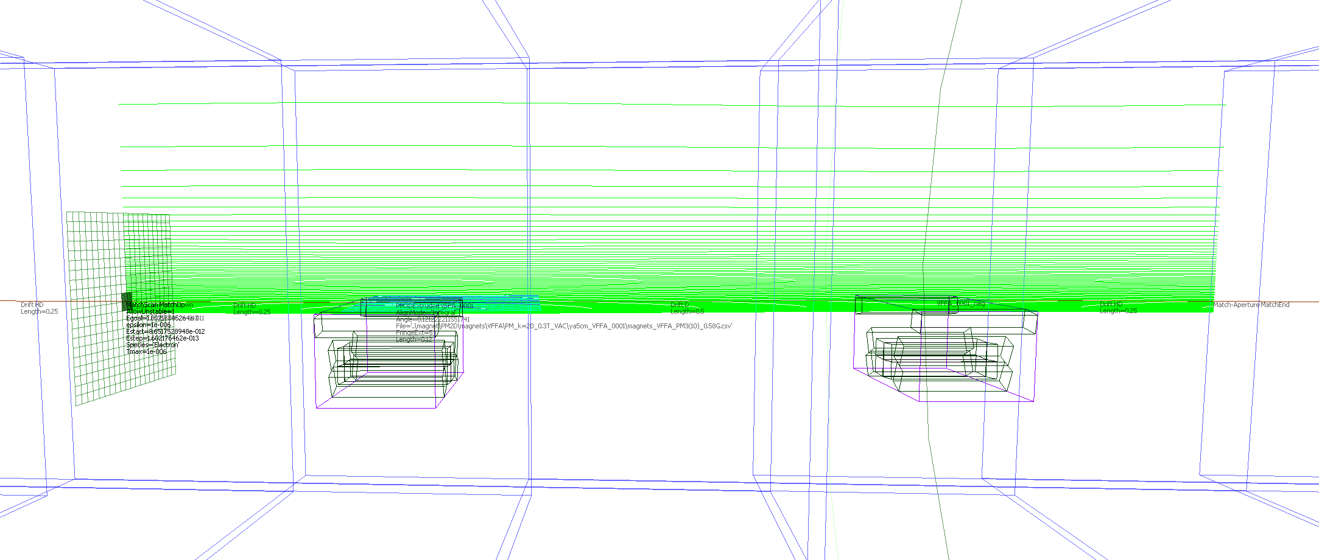
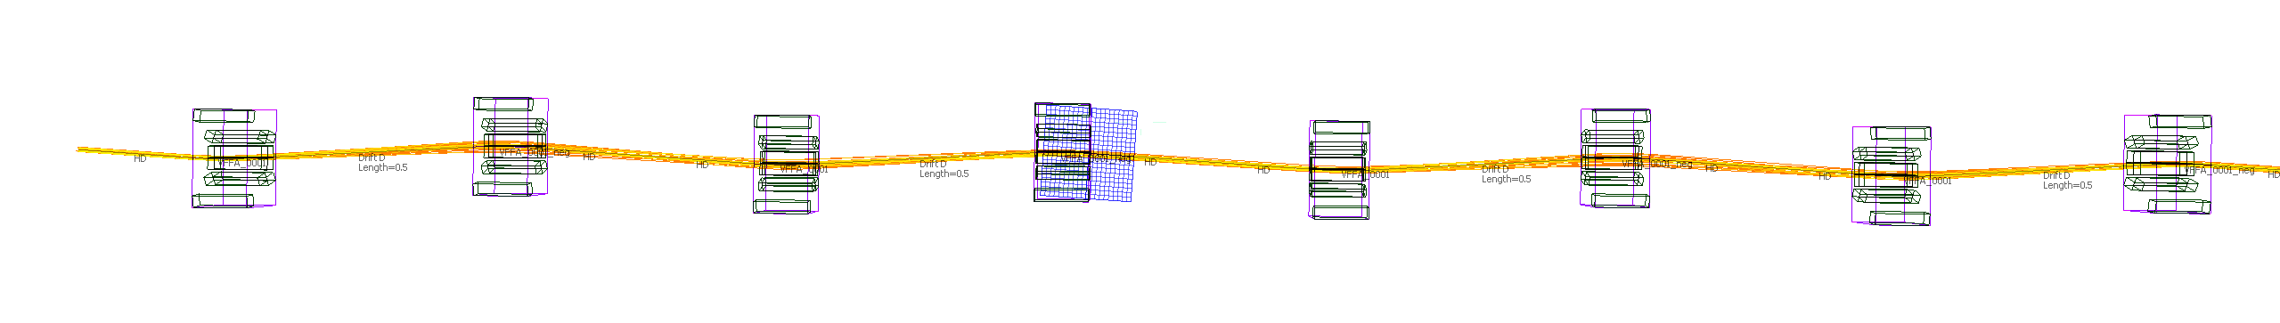
Demo Straight Section (1-72MeV)

Slide 23
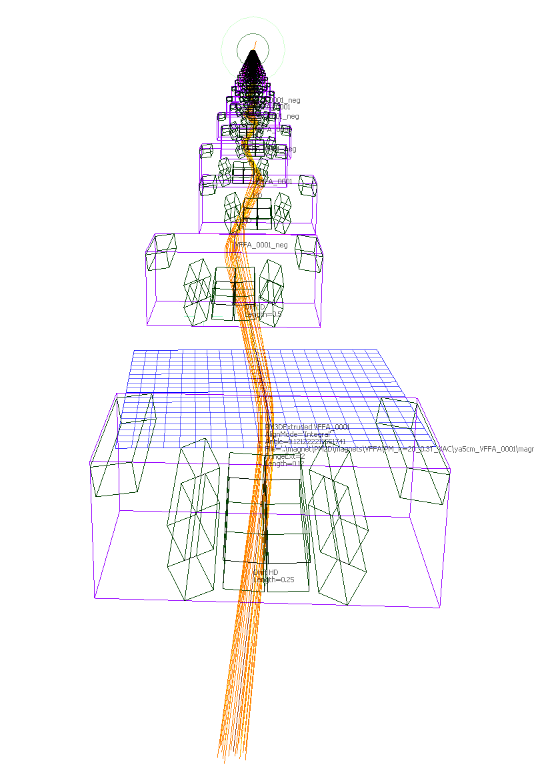
4×4 Transfer Matrix
Usual (x,x’,y,y’) basis

Slide 24
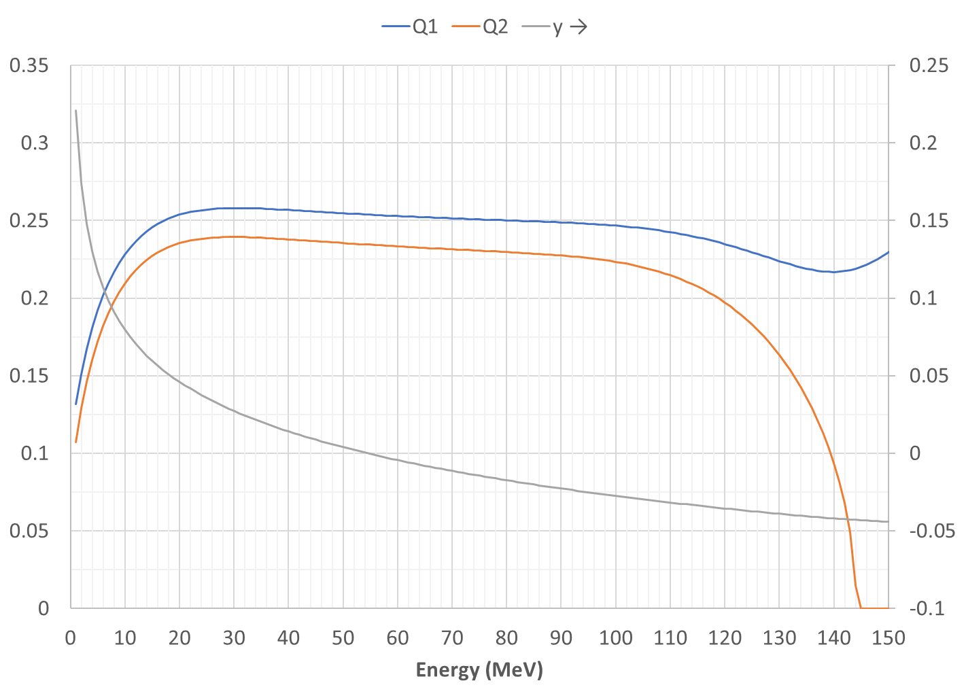
Demo Straight Cell Tunes, Height

Slide 25
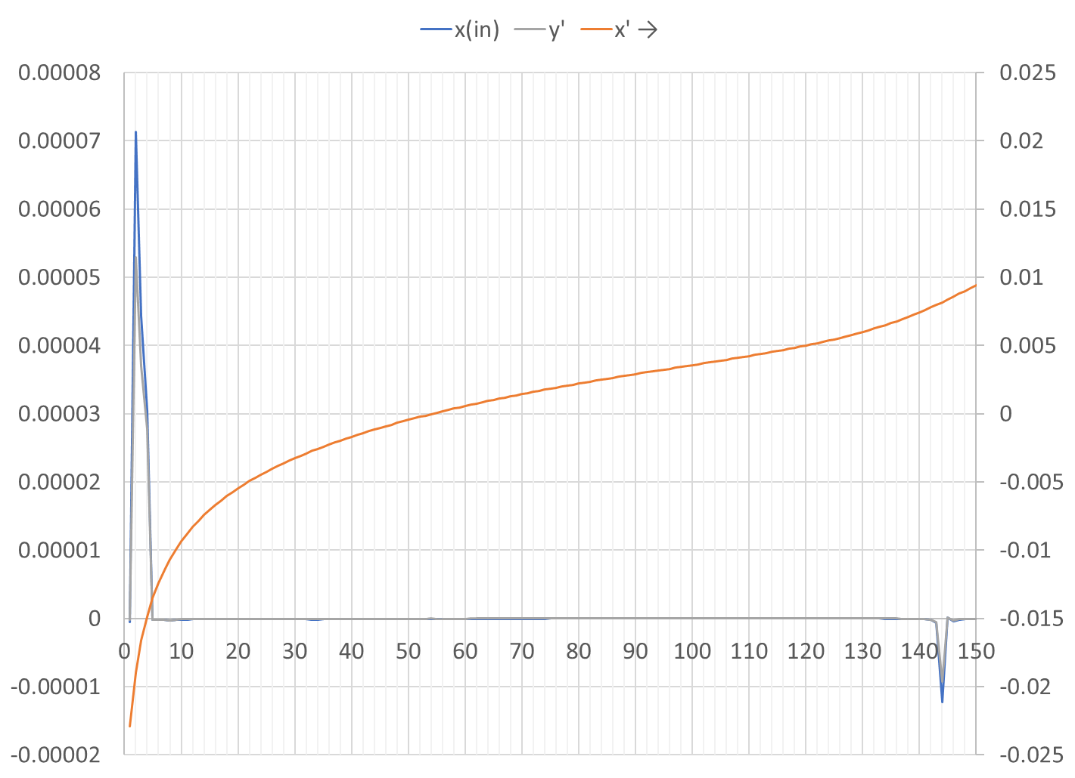
Demo Straight Cell Input Steering

Slide 26
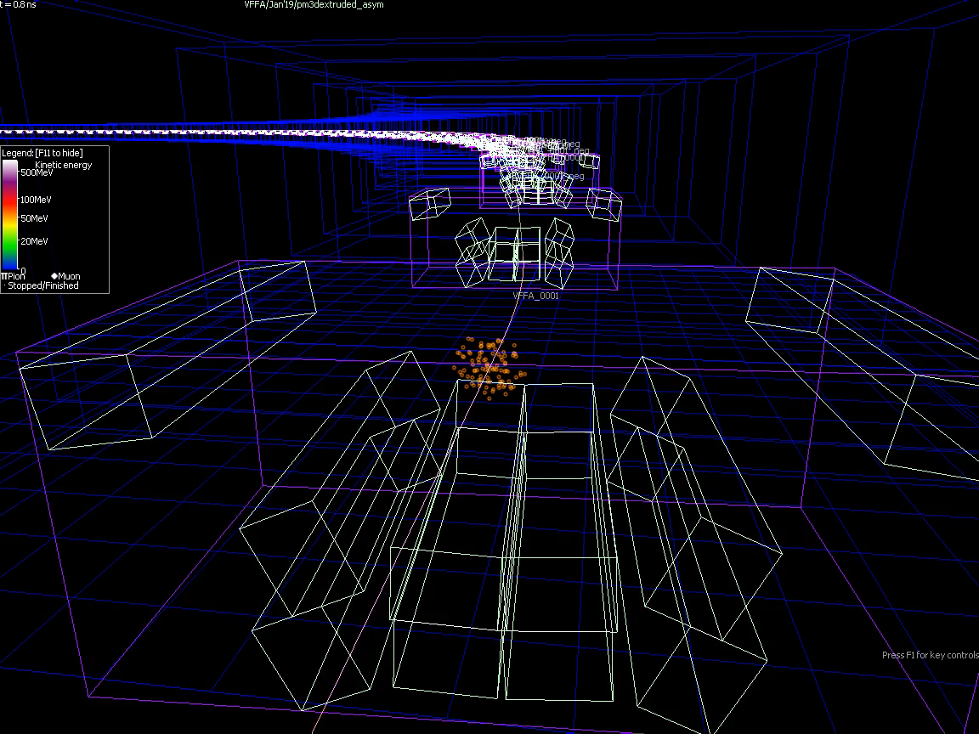
Bent Demo Cell Attempt

Slide 27
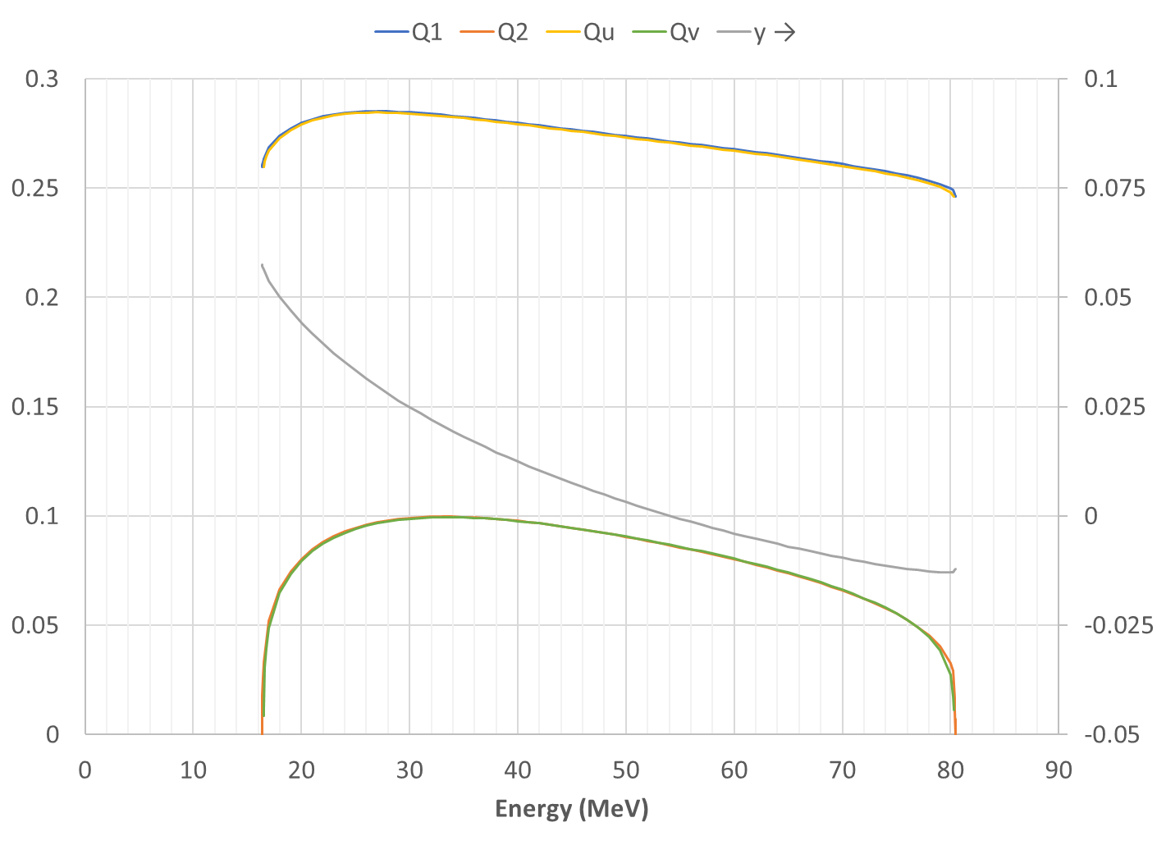
Bent Cell Tunes, Height

Slide 28
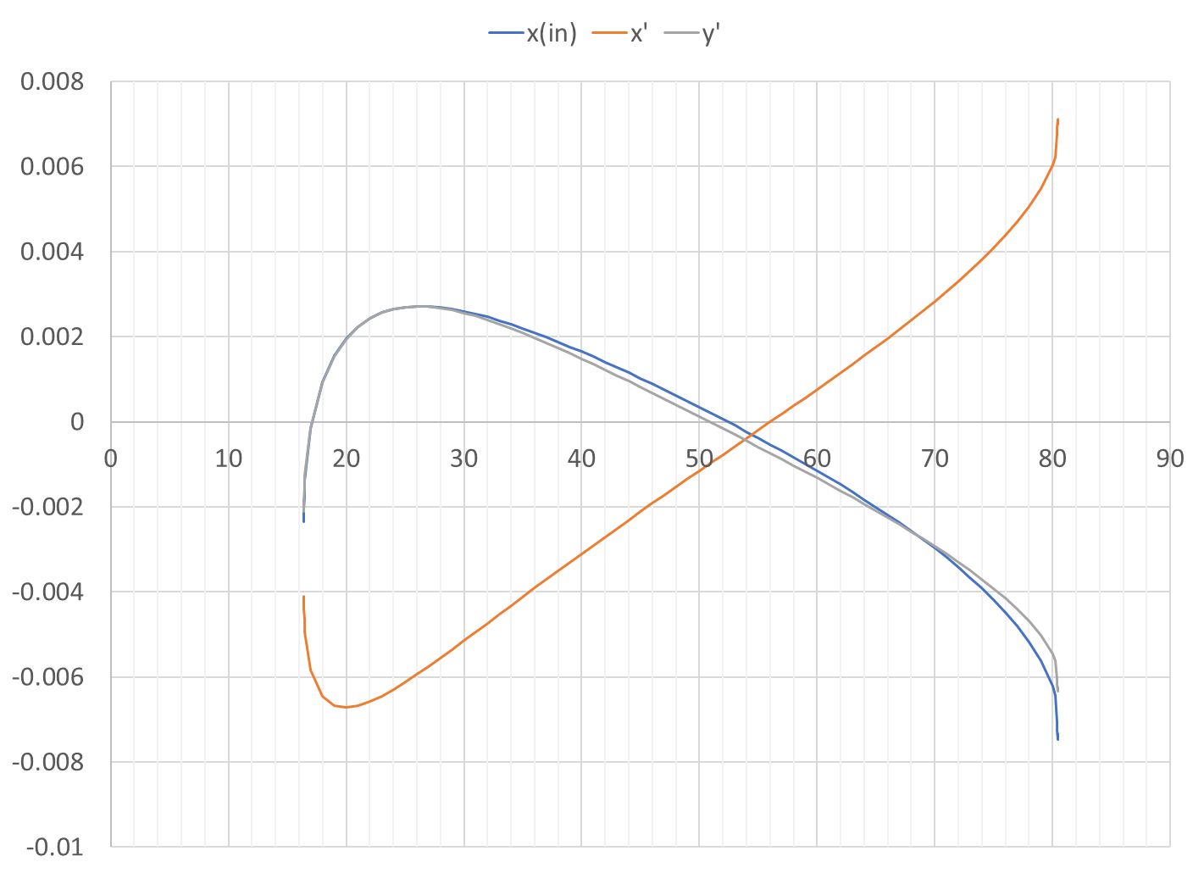
Bent Cell Input Steering

Slide 29
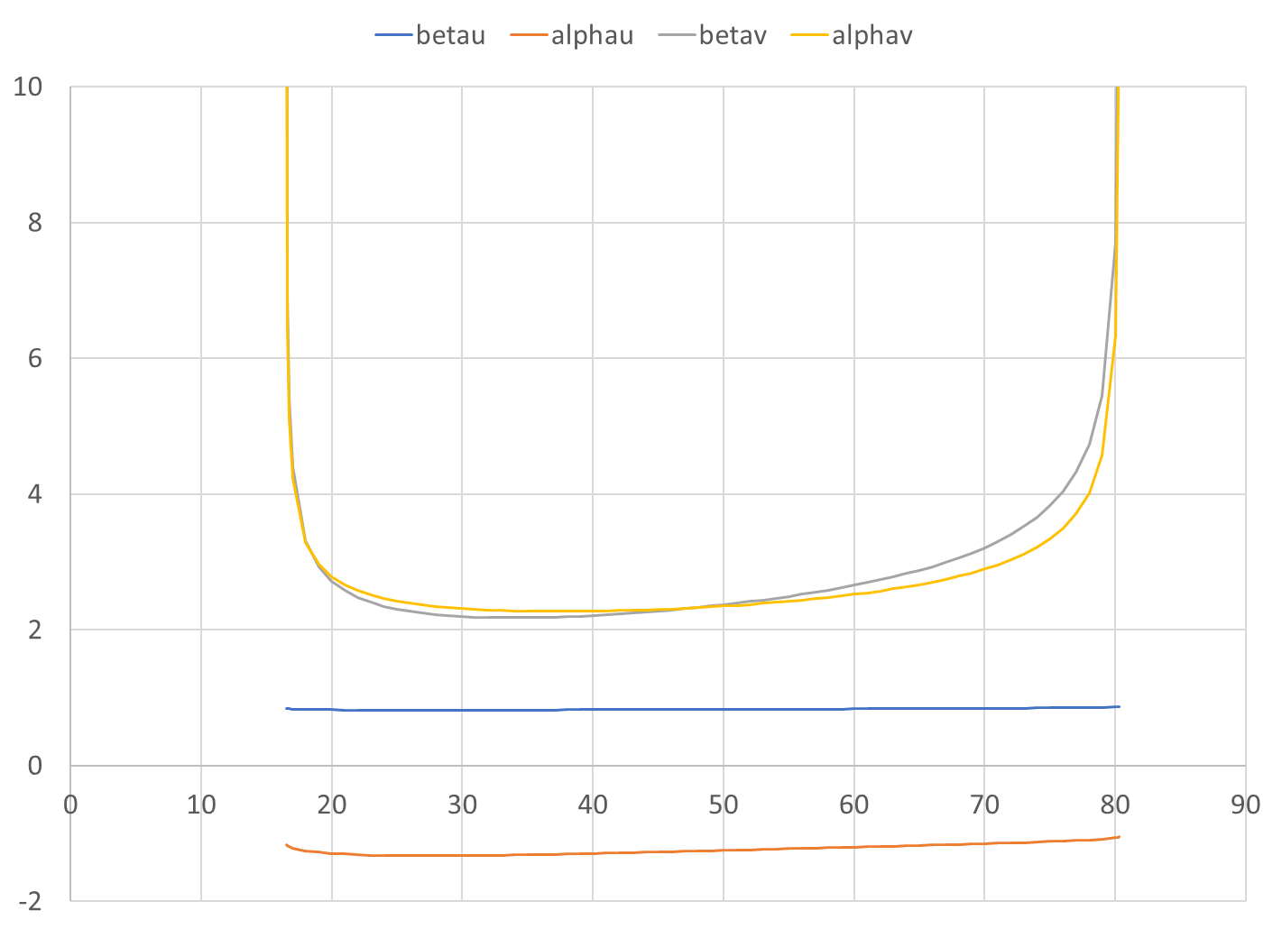
Bent Cell Input Optical Functions

Slide 30
Conclusion
VFFAs with permanent magnets are very well suited for high-energy electron machines
Fields are low to avoid synchrotron radiation, means permanent magnets are applicable
Beams are small, so dynamic aperture in the VFFA is not a bad constraint, so magnets can be reasonably sized
Designs even exist where all magnets are below beam synchrotron radiation plane

Slide 31
BACKUP

Slide 32
Risks to be Investigated
Simulation:
Dynamic aperture (non-linear magnetic fields)
Spin preservation (100 turns is semi-fast acceleration regime)
Lattice integration (arc-to-straight, linac section)
Experimental:
Magnet field errors
Alignment errors after correction (e.g. with piezo movers)
Before correction is well-known, surveyors can do 100-200um easily
Verify VFFA and high-phase-advance lattice works in practice (ATF beamline)

Slide 33
RF, Beam Charge Tradeoffs
200MeV per turn of constant-frequency RF is used, 200MeV injector
If the full 50nC is accelerated in a linac, impedances cause ~3% energy spread, which is too much for the storage ring
Baseline eRHIC uses 5x 10nC bunches to reduce this effect (which is proportional to bunch charge) even when using RCS
Transverse emittance also increases with bunch charge
Early estimates of VFFA dynamic aperture and bunch emittance are comparable, so needs more detailed calculation

Slide 34
References
Fixed-field accelerators
Acceleration in the linear non-scaling fixed-field alternating-gradient accelerator EMMA, S. Machida et al., Nature Physics 8, 243–247 (2012).
CBETA website: https://www.classe.cornell.edu/Research/CBETA/WebHome.html
CBETA Design Report, Cornell-BNL ERL Test Accelerator, G.H. Hoffstaetter et al., https://arxiv.org/abs/1706.04245 [physics.acc-ph] (2017).
CBETA note 032, The CBETA Fractional Arc Test, Ed. C. Gulliford, https://www.classe.cornell.edu/CBETA_PM/index_notes.html
VFFAs
Vertical orbit excursion fixed field alternating gradient accelerators, S. Brooks, Phys. Rev. ST-AB 16, 084001 (2013).
Vertical orbit-excursion Fixed Field Alternating Gradient Accelerators and 3D Cyclotrons, S. Brooks, Proc. IPAC’14 (invited talk)
Permanent Magnets
Production of Low Cost, High Field Quality Halbach Magnets, S. Brooks et al., Proc. IPAC 2017.
CBETA note 035, CBETA Halbach Magnet Production Run, S. Brooks
ATF fixed-field experiment
ATF experiment AE-79 “Test of a Large Energy Acceptance NS-FFAG Arc at the ATF”,
See also talk: Test of Linear-Field Non-Scaling FFAG Arc with a Wide Energy Range, S. Brooks, FFAG’17 workshop: https://indico.bnl.gov/event/2764/

