Slide 1
Modified Halbach Magnets for Emerging Accelerator Applications

Slide 2
Permanent Magnets (PMs) in Accelerator Beamlines
Established uses:
  Wigglers, undulators
  Halbach quads in drift tube linacs
  Halbach quads in interaction region of Cornell CESR collider
  Hybrid magnets (PM+iron) for main bending field of FNAL recycler
CBETA ERL (operating at Cornell 2019-20):
  New uses:
    Halbach magnet is main bending field (compact size, short drifts)
    Combined-function dipole+quad Halbach (fewer lattice elements)
  Done before but not at scale:
    Tuning of Halbach magnets with iron rods for higher field quality
      200+ magnets tuned at BNL
This talk explores from CBETA to future applications

Slide 3
PM Domain of Applicability
Field strength comparable to electromagnets
  But not adjustable without EM corrector or motors
Generally cheaper for small apertures
There is a limit to radiation resistance
  How much? “It depends”
    On PM material, material grade, magnet geometry, field strength
    On accelerator radiation environment near beam pipe
      You must characterise this before getting any useful answers
  Examples (mostly NdFeB material)
    CBETA 1kGy lifetime dose limit (predicted <2×10⁻⁴ field change)
    RHIC beam dump 700Gy, some grades near-unchanged, some bad
    BLIP target area >>MGy, ~90% flux loss, SmCo some flux loss
    CESR 65cm from interaction region(!) SmCo seems to work

Slide 4
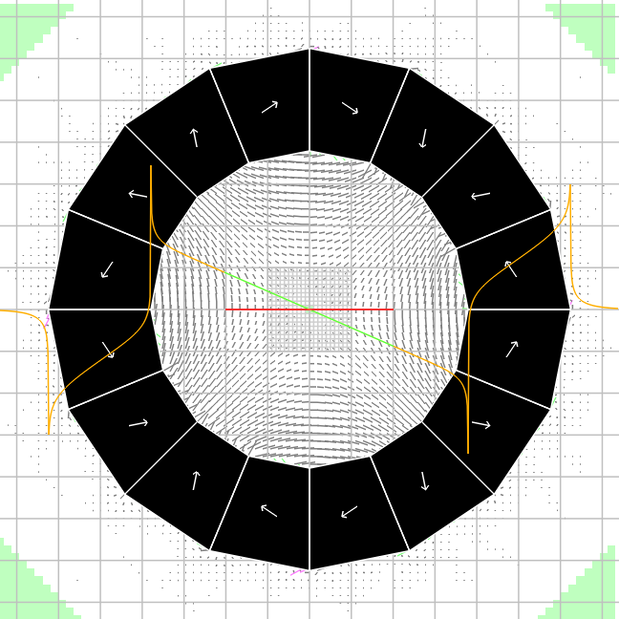
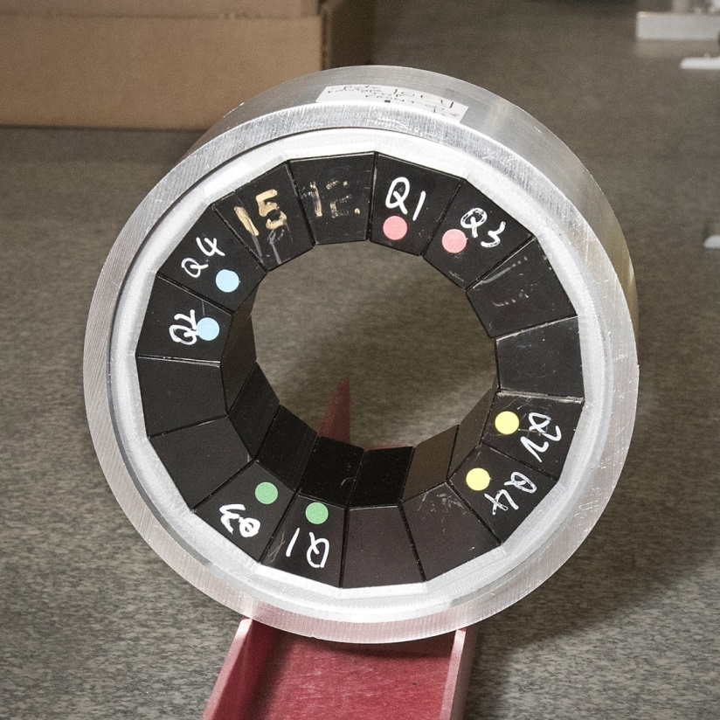
Halbach-style Permanent Magnets
Consist purely of PM material (no iron)
  Generally smaller than PM+iron hybrid magnets: no iron loop
  No cross-talk if placed close together (short drifts)
Orientation of magnetisation in (usually) wedge-shaped PM pieces is used to produce desired harmonics in magnet aperture

Slide 5
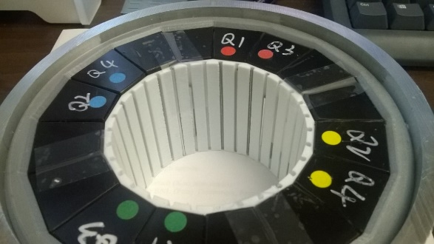
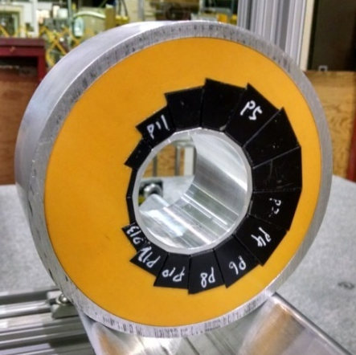
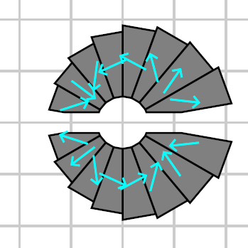
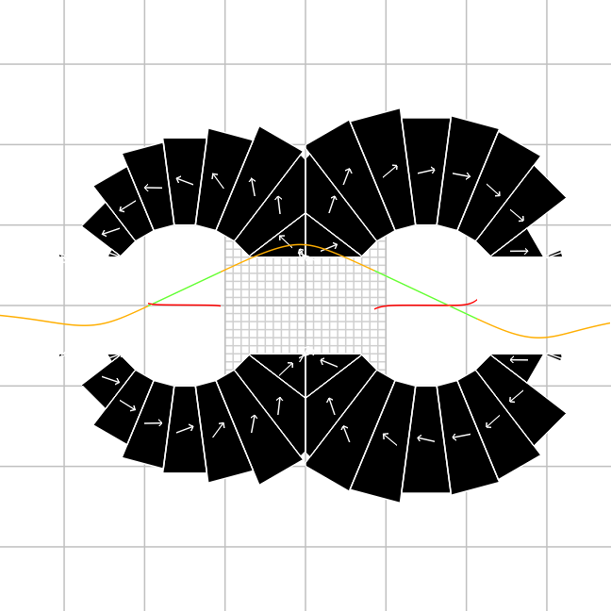
Halbach Magnet Variations
Demonstrated (in accelerator)
  Field tuning with iron rods
  Combined-function magnets
In development
  Open midplane magnets
Future research
  Oval apertures
  Multiple apertures

Slide 6
Halbach Magnet Proposals
Type | Project | Magnet | Dipole at x=0 (T) [Max beam field] | Gradient (T/m) | Needs open midplane?
ERL | CBETA | QF | 0 [0.2891] | -11.5624 | No
 | (built already) | BD | -0.3081 [0.5868] | 11.1475 | No
Hadron therapy gantry |  | QF | 0 [1.364] | 155 | No but oval
(Trbojevic design) |  | BD | 1.8 [2.527] | -97 | No but oval
Light sources | NSLS-II | CBII-F | 0.26 | 250 | Yes
 | upgrade | CBII-D | 0.49 | -250 | Yes
 | PETRA-IV ^{(o)} | quads | 0 | 50 to 95 | Yes
 |  | comb.-fn. | 0.1976, 0.2861 | 25.83, 38.94 | Yes
RLA | CEBAF 20GeV | F | 0.8827 [1.910] | 321.05 | Yes
 | upgrade | D | 0.8827 [1.483] | -187.47 | Yes
ILC damping ring ^{(o)} |  | quads | 0 | 15 | Yes
Plasma accelerator |  | quads | 0 | 100 to 500 | No
^{(o)} = option, not baseline
Table is not exhaustive

Slide 7
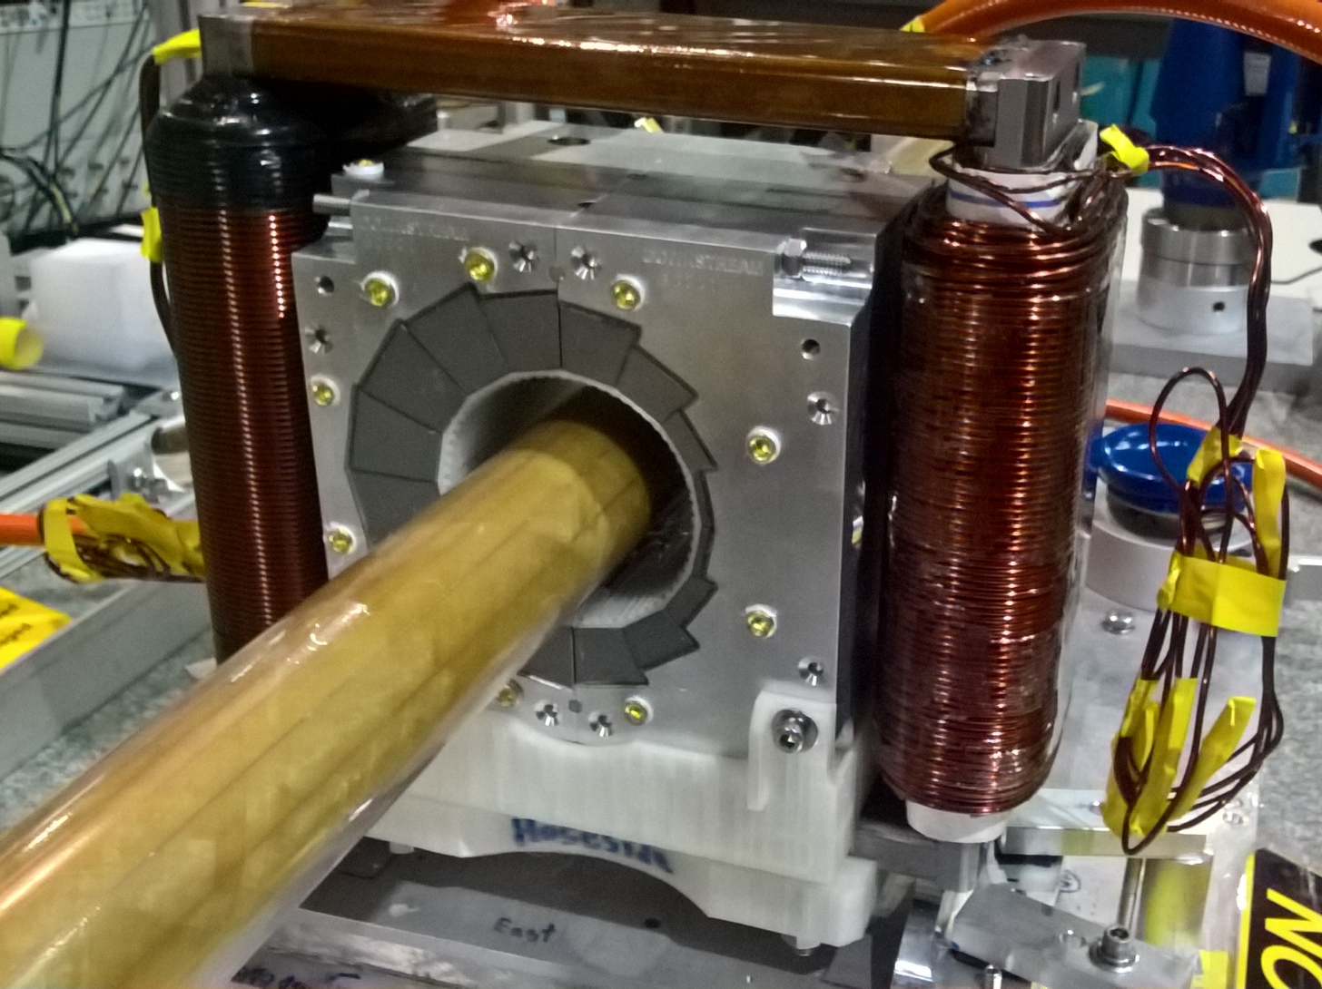
CBETA Permanent Magnet Design
Halbach design made of NdFeB material
This is a combined dipole+quad
Being measured on rotating coil at BNL
3D printed multipole corrector pack inside
EM window-frame corrector coil outside
Temperature stabilised by water (orange hoses)
Stephen Brooks et al., "Permanent magnets for the return loop of the Cornell-Brookhaven energy recovery linac test accelerator", Phys. Rev. Accel. Beams 23, 112401 (2020); doi:10.1103/PhysRevAccelBeams.23.112401

Slide 8
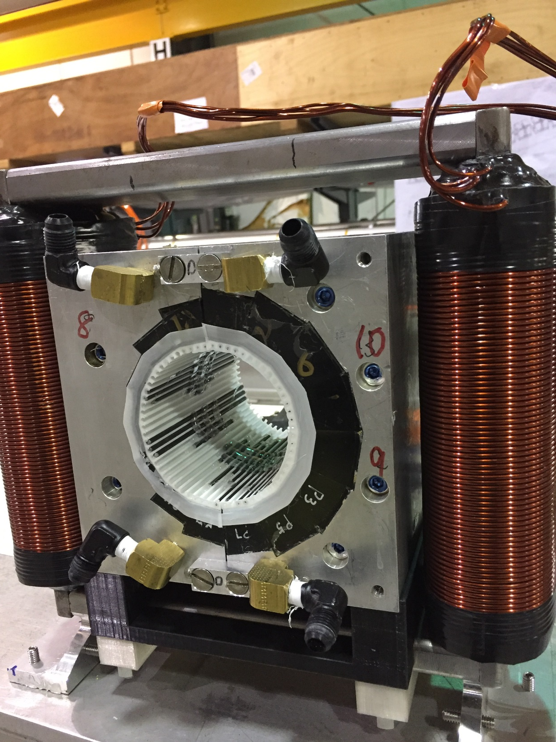
Iron Rod Correction Method
CBETA permanent magnet containing tuning rod insert
Measure bare magnet harmonics
Then calculate lengths of iron rods to be inserted around the aperture
3D printed insert with 64 slots
EM corrector coil outside (up to 4% field)

Slide 9
CBETA permanent magnet containing tuning rod insert

Slide 10
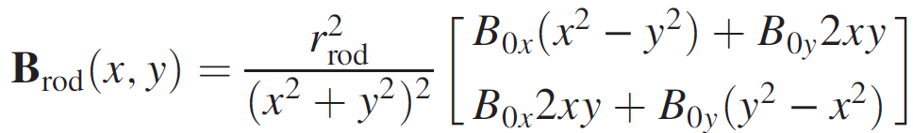
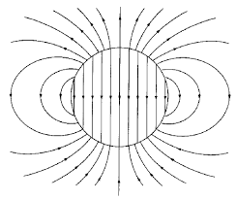
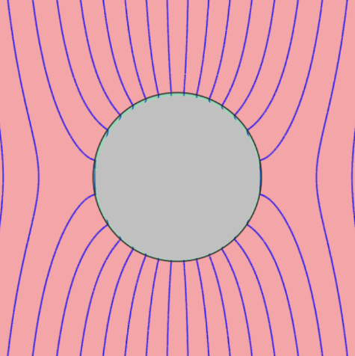
Field Calculation of Iron Rods
Field of 2D perfect μ=∞ iron rod of circular cross-section, centre (0,0), in ambient field B₀:
Rod is magnetised with M=2B₀
B_{rod}
B₀+B_{rod}

Slide 11
Error Sources (~10⁻² level)
Wedge magnetisation vector
  1-2° angle variation
  ~1% strength variation
  Comes from wedge manufacturing process
Wedge position
  0.1-0.2mm XY displacement
  Angle errors (fraction of a degree)
  Comes from magnet assembly
Can’t be fixed with block sorting

Slide 12
Overall Philosophy
Direct approach:
Incorporating correction:
Optimiser
Build
Measure
Simulation
Optimiser
Optimiser
Build
Measure
Correction simulation
Correct
Measure
Simulation

Slide 13

Correction Makes Precision Easier
At ~10⁻⁴ accuracy
Optimiser
Build
Measure
Simulation
$$$$
At ~10⁻² of error
At ~10⁻² accuracy
Optimiser
Optimiser
Build
Measure
Correction simulation
Correct
Measure
Simulation
$
$
Measurement steps still have to be ≤10⁻⁴

Slide 14
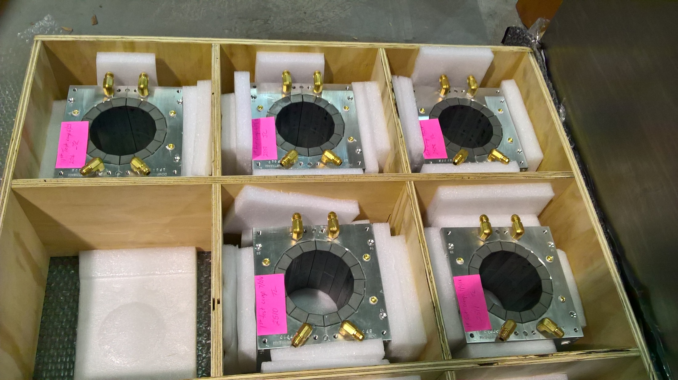
Permanent magnets shipped from KYMA

Slide 15
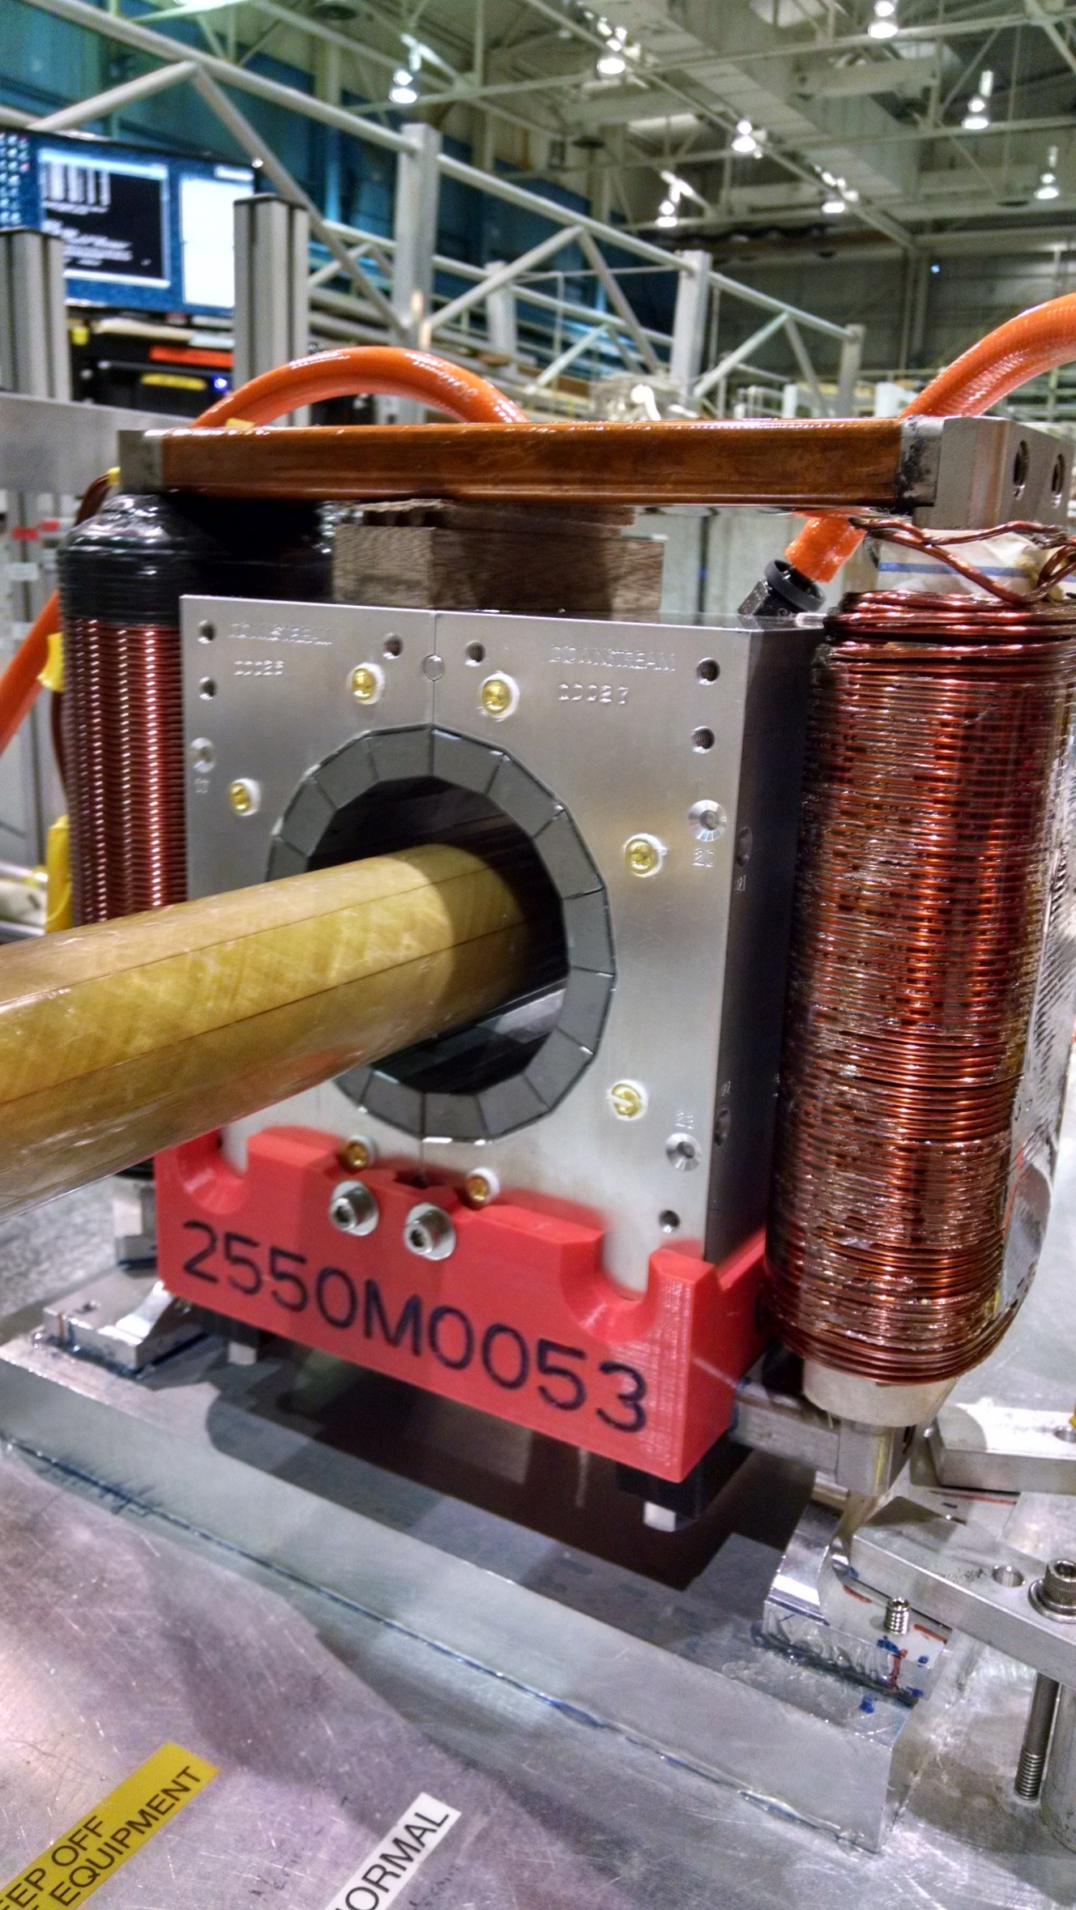
Rotating coil magnet measurement at BNL

Slide 16
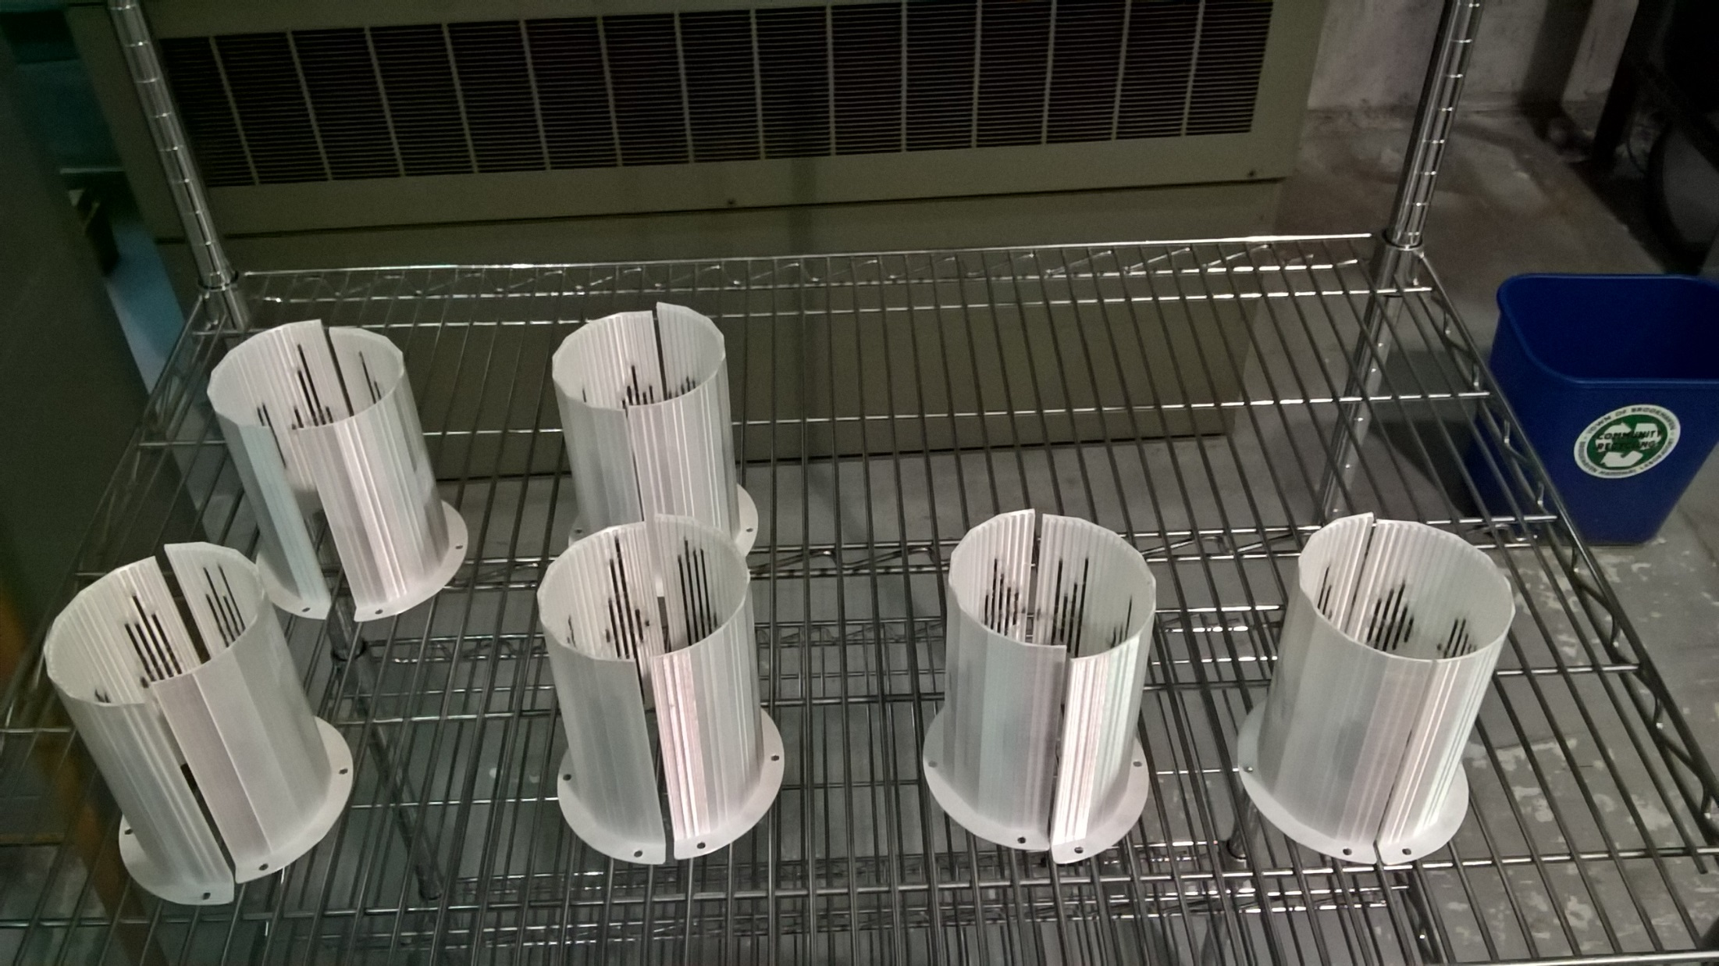
Rod tuning packs for CBETA magnets
Iron rod optimisation program was packaged so that technicians could run it: rotating coil data → rod lengths

Slide 17
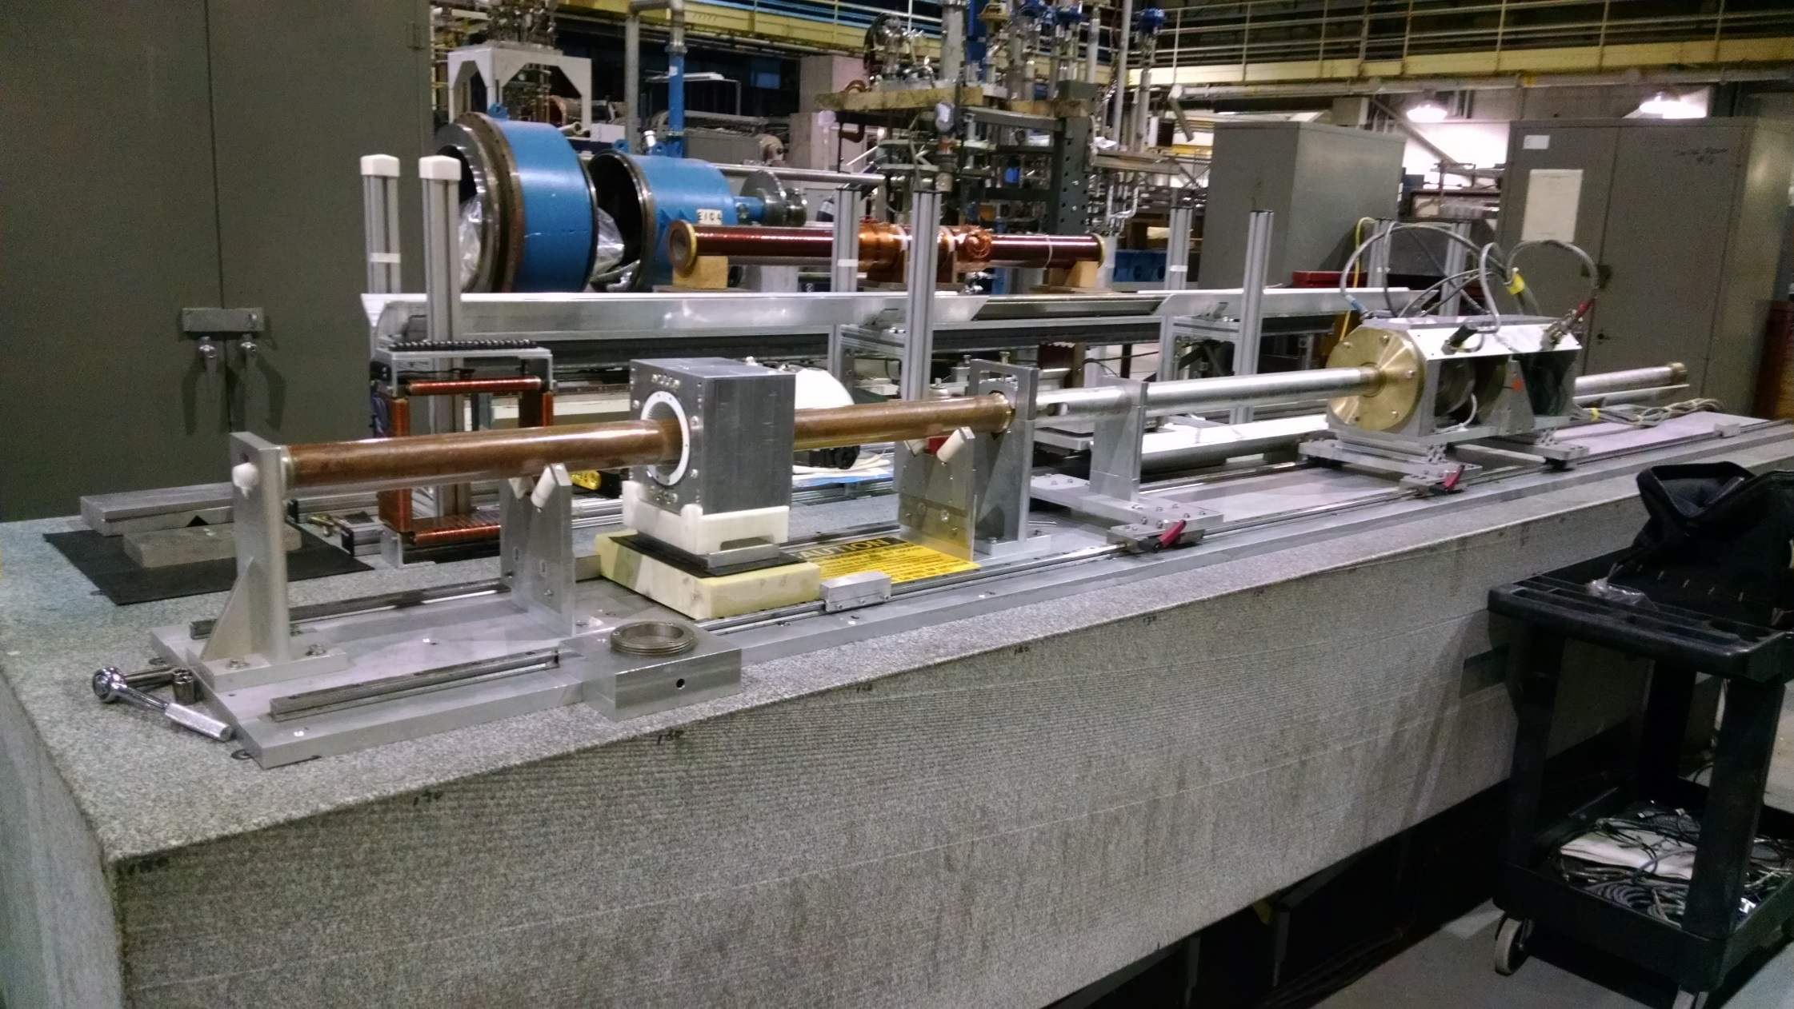
Rotating coil magnet measurement at BNL

Slide 18
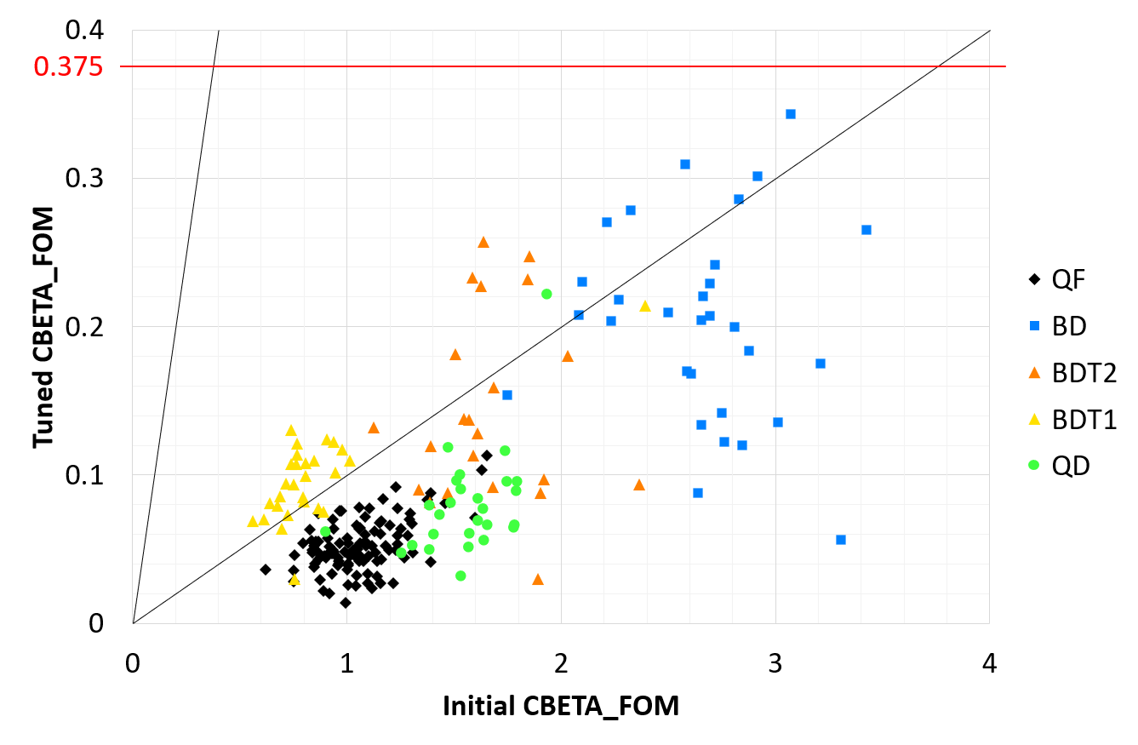
Effect of Tuning (CBETA FOM)
10× improvement

Slide 19
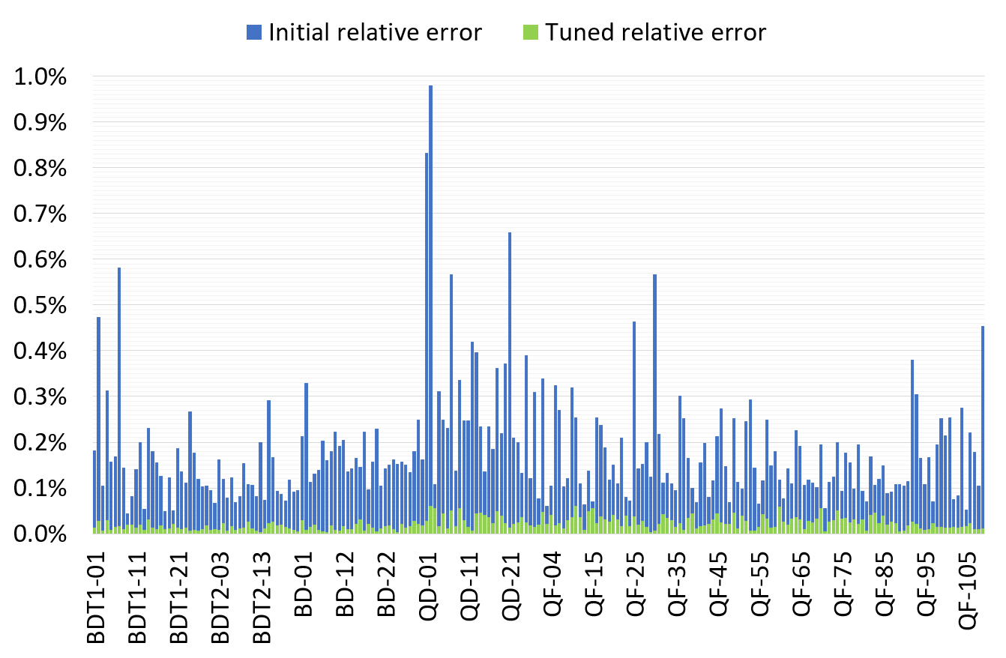
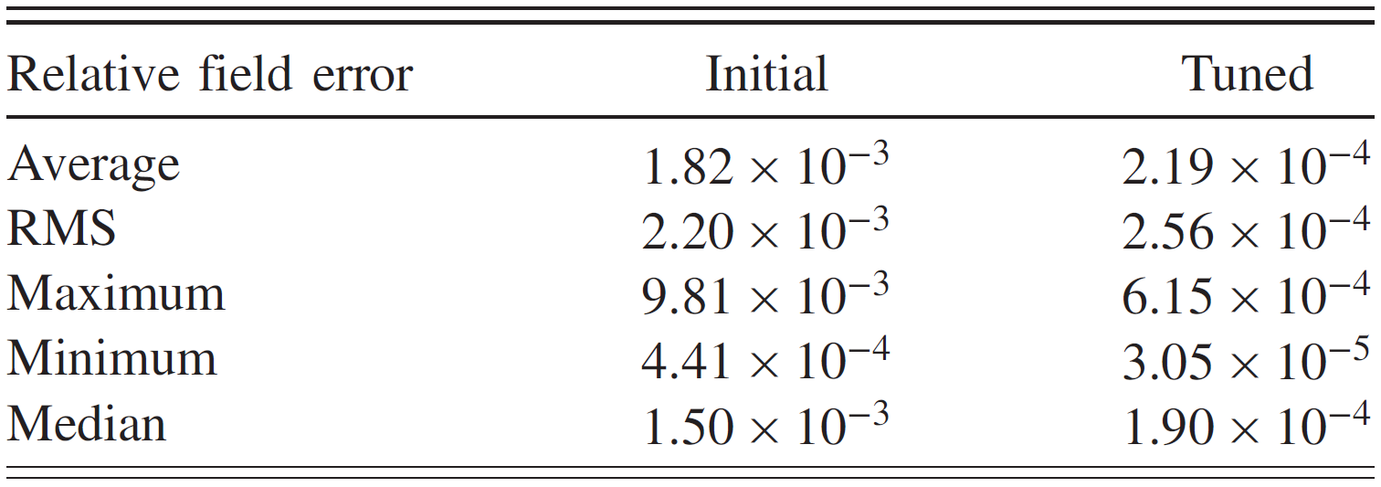
Only tuned magnets shown (2 “rejects” removed)

Slide 20
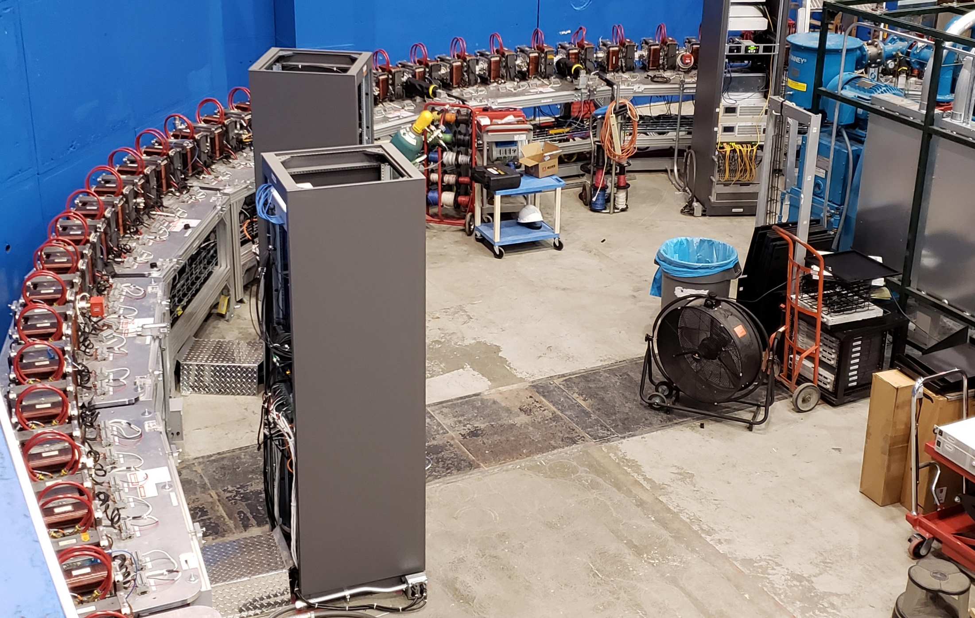
CBETA Fixed-Field Return Arc

Slide 21
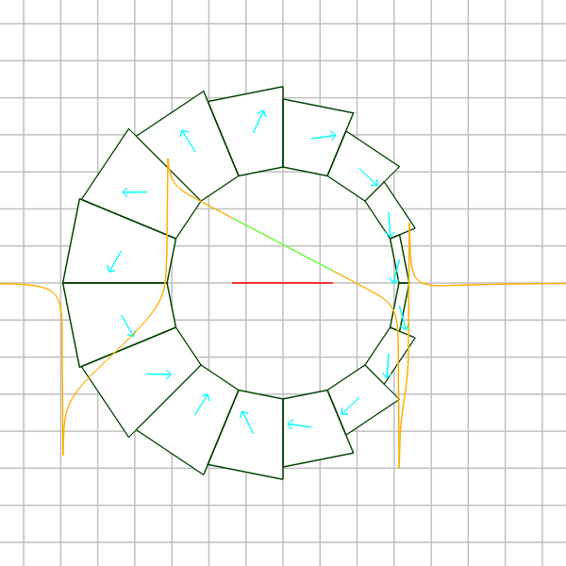
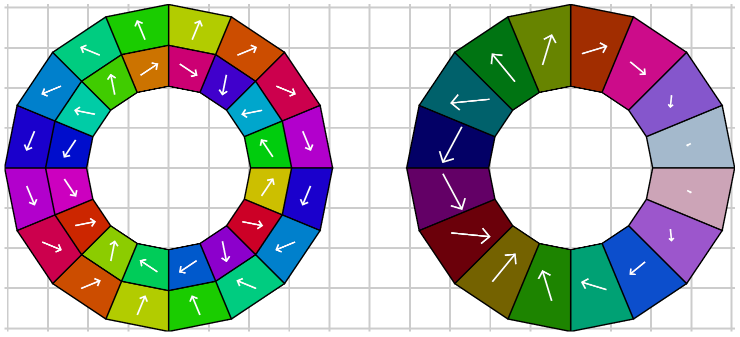
Combined-Function Magnet
Improvement over nested Halbach dipole and quadrupole (shown below) can be made by taking vector sum* of the two layers and implementing as a layer with constant magnetisation magnitude but variable wedge thickness.
* Not exactly a vector sum, needs numerical optimiser for accurate design

Slide 22
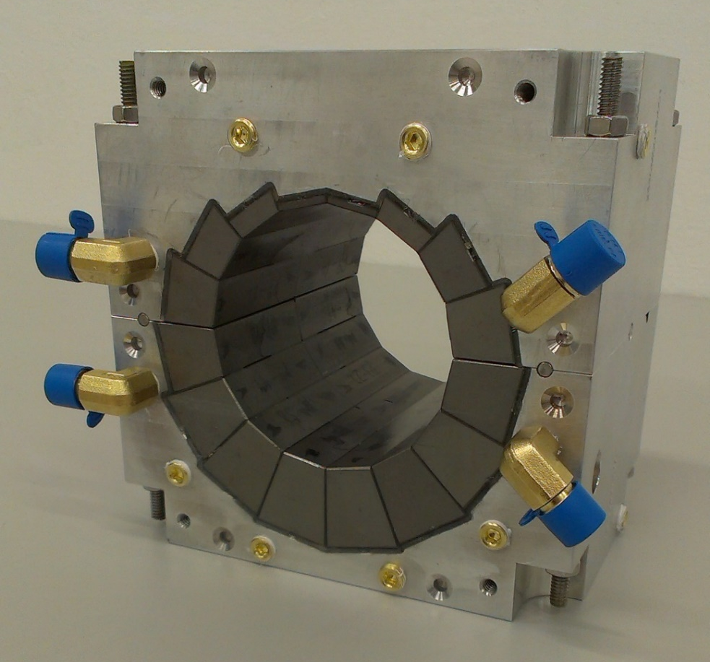
CBETA Combined-Function Magnets
8 different wedge sizes
Machined aluminium holder
Successfully used with 42-150MeV electrons at CBETA
80 such magnets corrected to less than 10⁻³ error on a R=25mm aperture using iron rods
122mm length
-0.3081 T dipole
11.1475 T/m gradient
0.5868 T max field in good field region

Slide 23
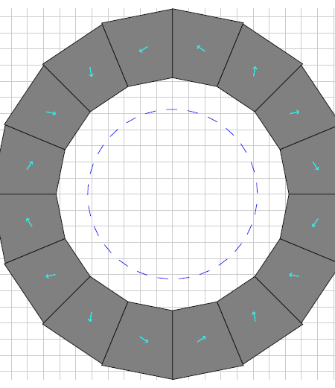
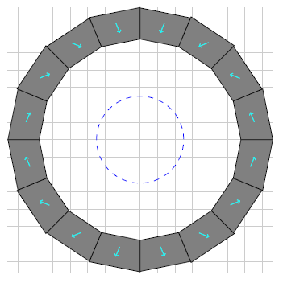
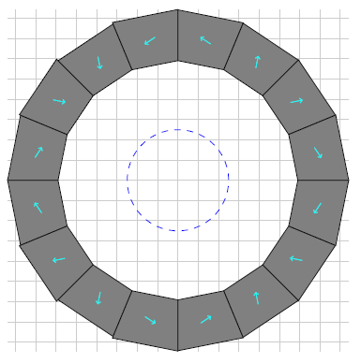
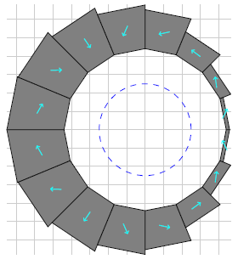
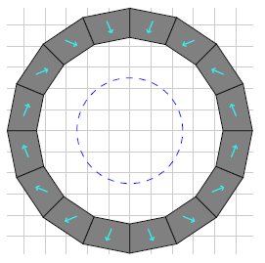
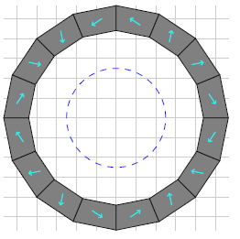
Combined-Function Comparison
Combined-function
(CBETA BD)
Displaced quad
Quad in dipole
Dipole in quad
67.5cm²
Aperture centered where it is needed for beam
234.9cm²
112.9cm²
152.7cm²
Quad scales less well with aperture than dipole
All designs 10⁻³ or better field quality

Slide 24
Combined-Function Uses
Focussing and bending in one magnet
  Fewer lattice elements, dispersion control
  Possibly better dipole packing factor as result
As well as CBETA ERL, found in:
  Low-emittance synchrotron light source lattices
  High energy aperture lines and storage rings
    Permanent magnet hadron therapy gantry
    Fixed-field accelerators e.g. CEBAF 20GeV upgrade
  Some synchrotron accelerators

Slide 25
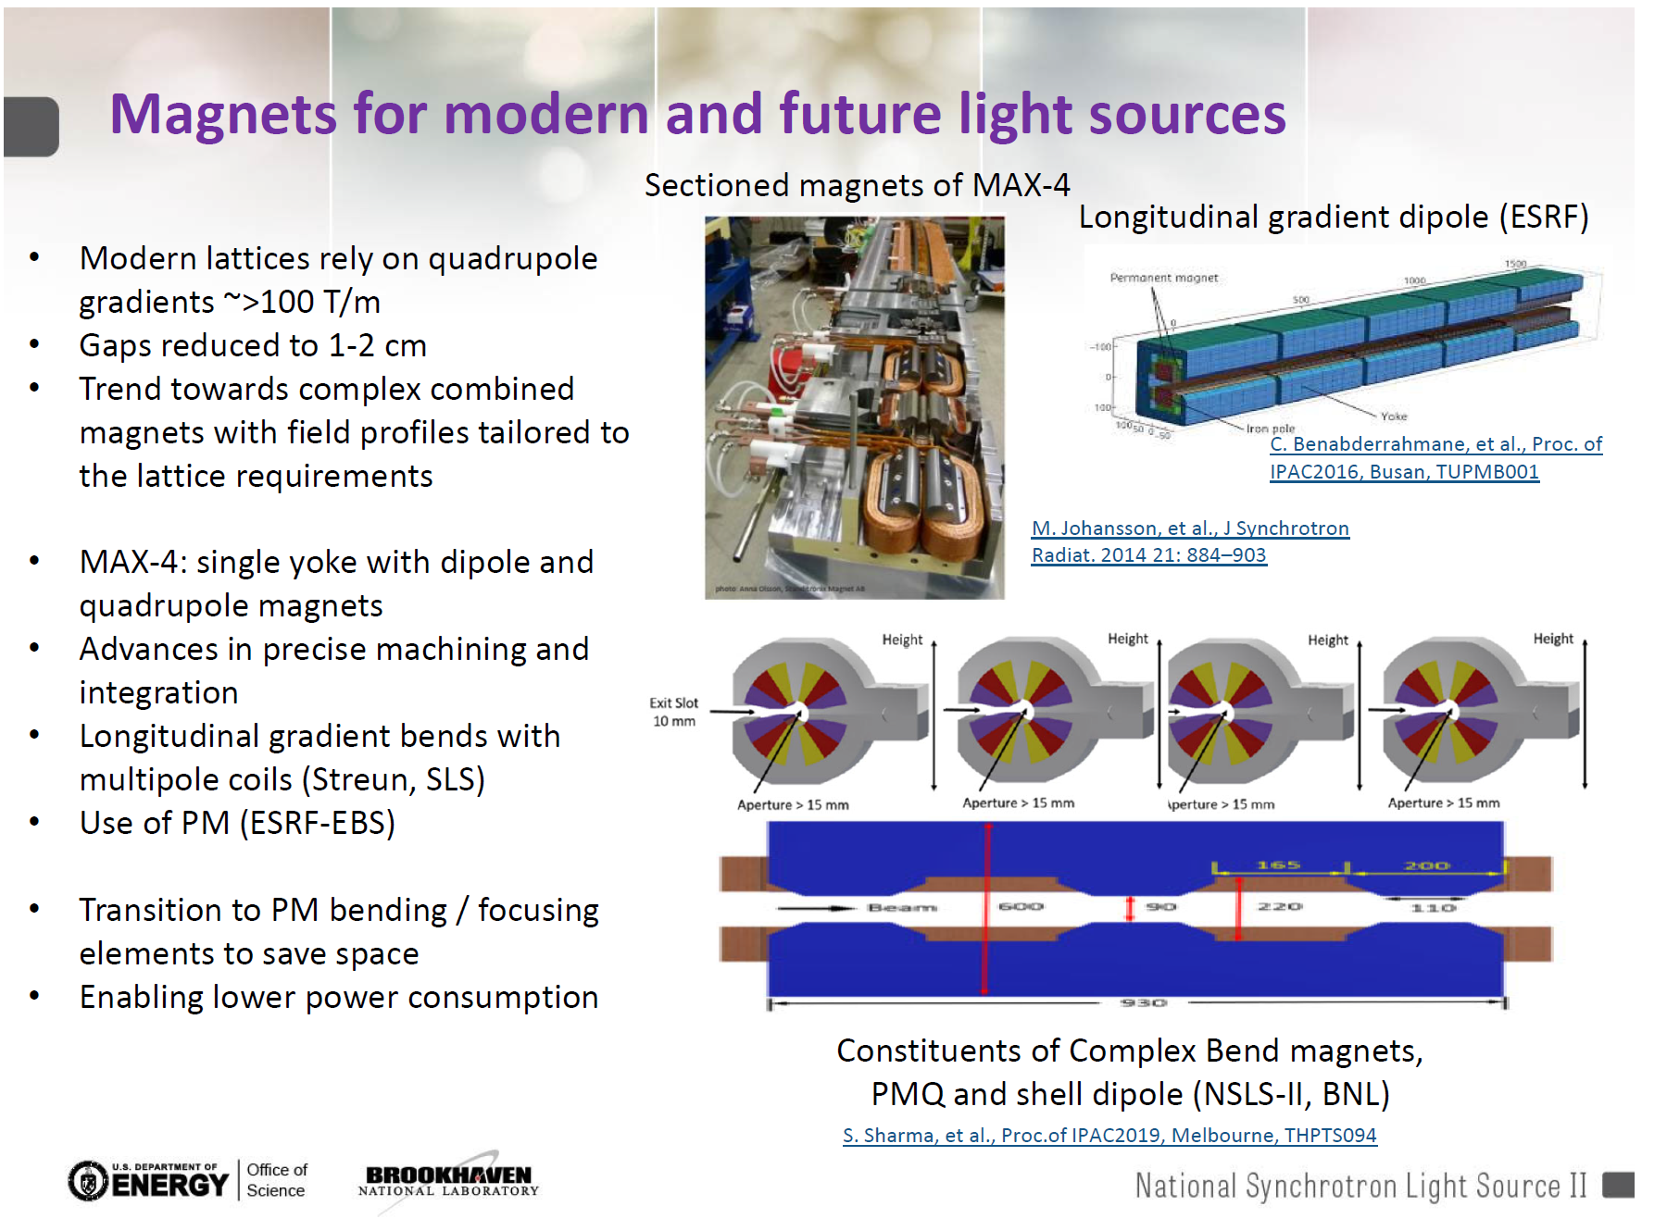

Slide 26
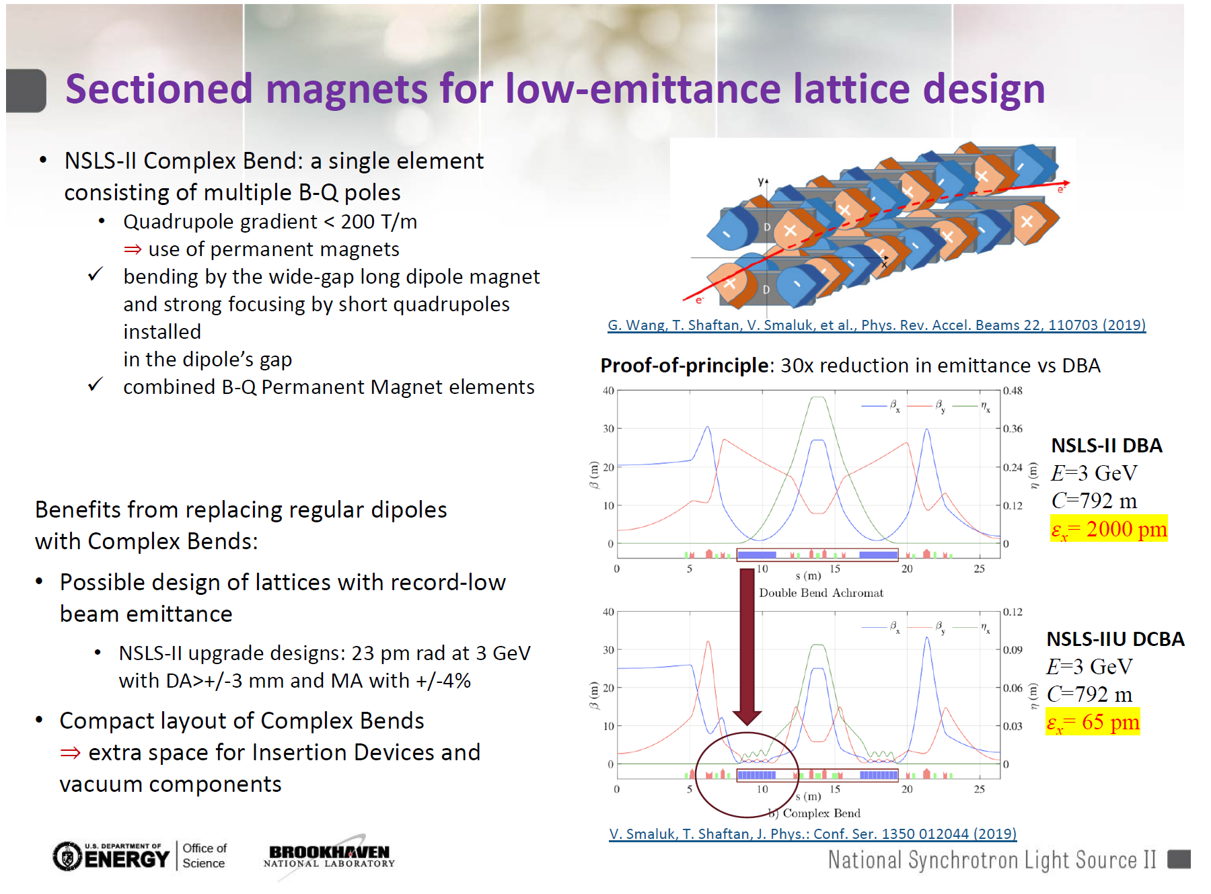

Slide 27
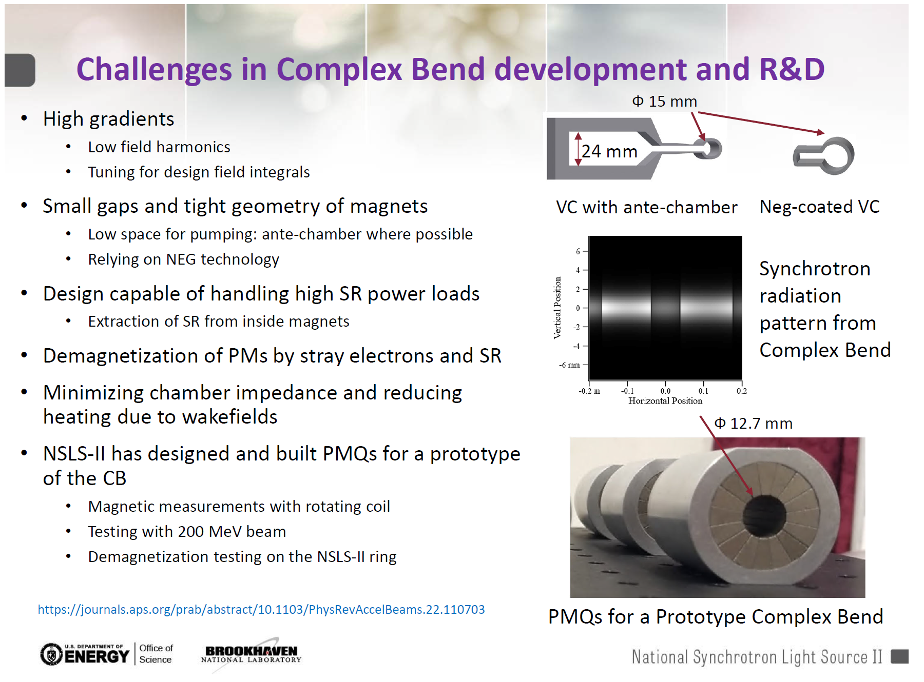

Slide 28
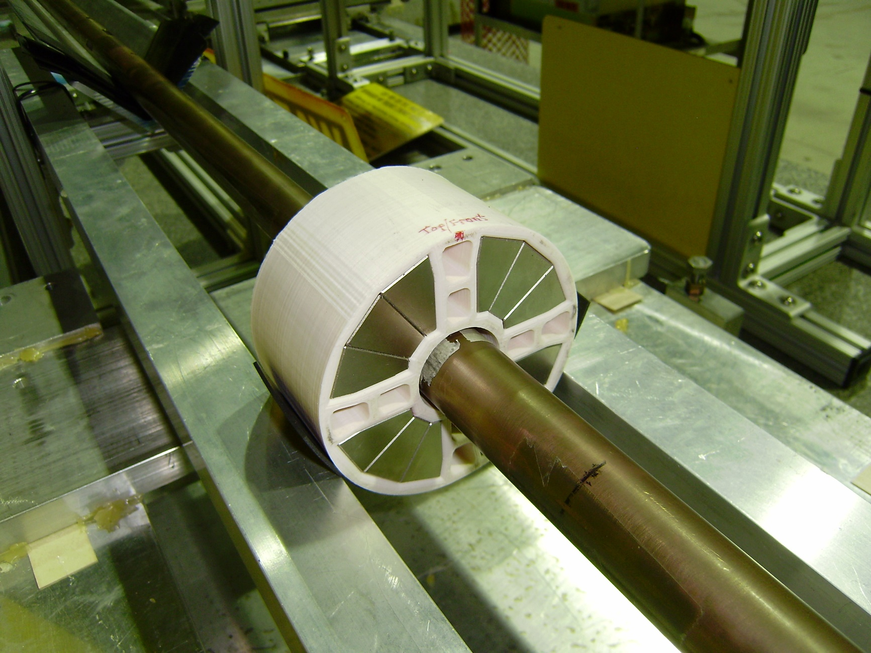
Nick Tsoupas Open Midplane Quad
4-way symmetric prototype being tested on BNL rotating coil in April 2015
60mm length
31.7 T/m gradient (no wire correction, so ~1% field errors)

Slide 29
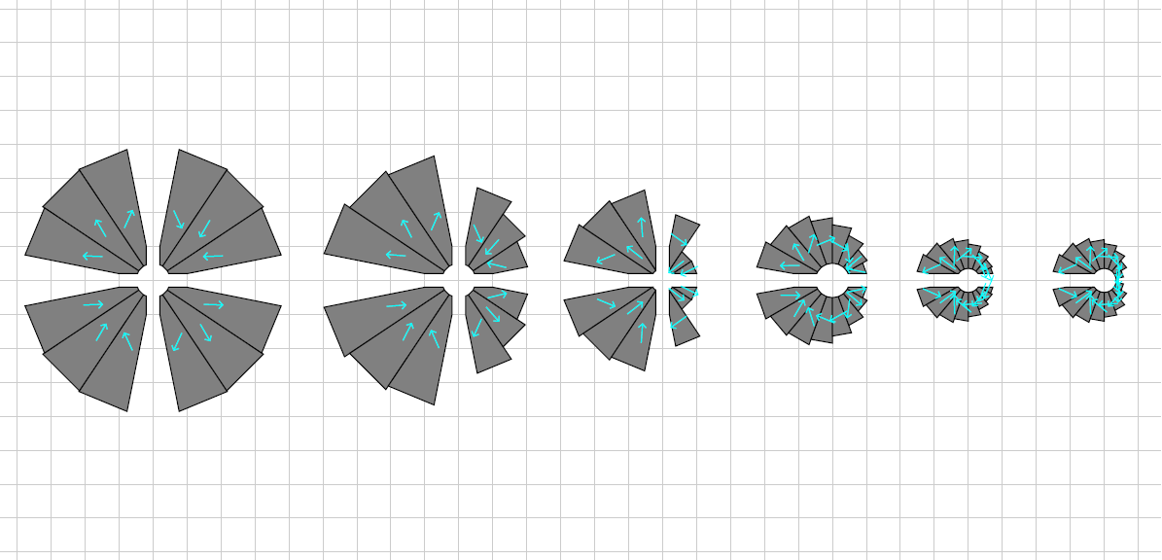
Open Midplane Geometry Study
-250T/m quadrupole combined with 0.49T dipole 5mm Ø aperture, 2mm Ø good field region
  4mm gap open midplane slot
B_{r} = 1.12T material
Horizontal midplane only
offset quad
Combined function
H-only + combined function
Left-only midplane
Offset quad symmetric
Offset quad non-symmetric
Same aperture, same field, same field quality, improvement only by design modifications

Slide 30
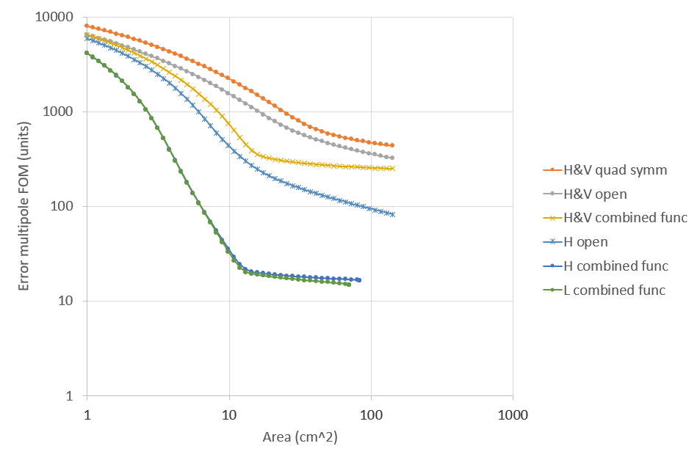
Open Midplane Quality vs. Area
What is the best field quality for a given area of material?
1 unit = 10⁻⁴ of main field
20x better field quality, and/or less material used

Slide 31
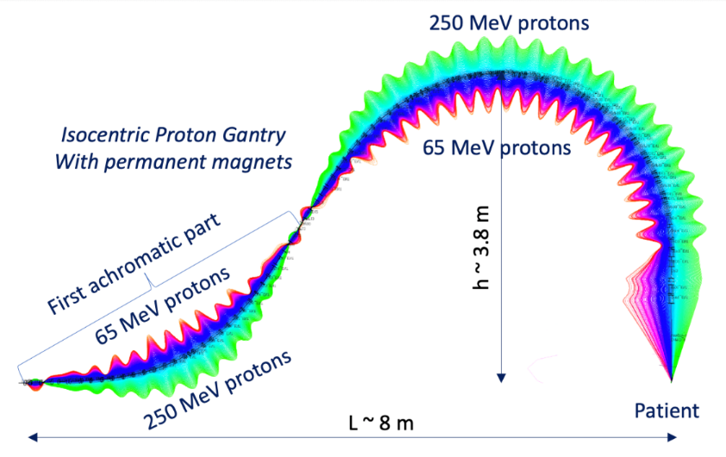
PM Hadron Therapy Gantry
Trbojevic design: a fixed-field gantry transports protons over the wide energy range 65-250MeV to the patient
  Faster depth (energy) scanning because no magnet ramp
  Lighter-weight and less power used than electromagnets
Requires a horizontal beam excursion
  Magnified trajectories shown on right
Higher fields give a smaller rotating gantry
  Want highest possible field gradient magnets!
Dejan Trbojevic et al., Proc. IPAC2017
This conference TUPAB030

Slide 32
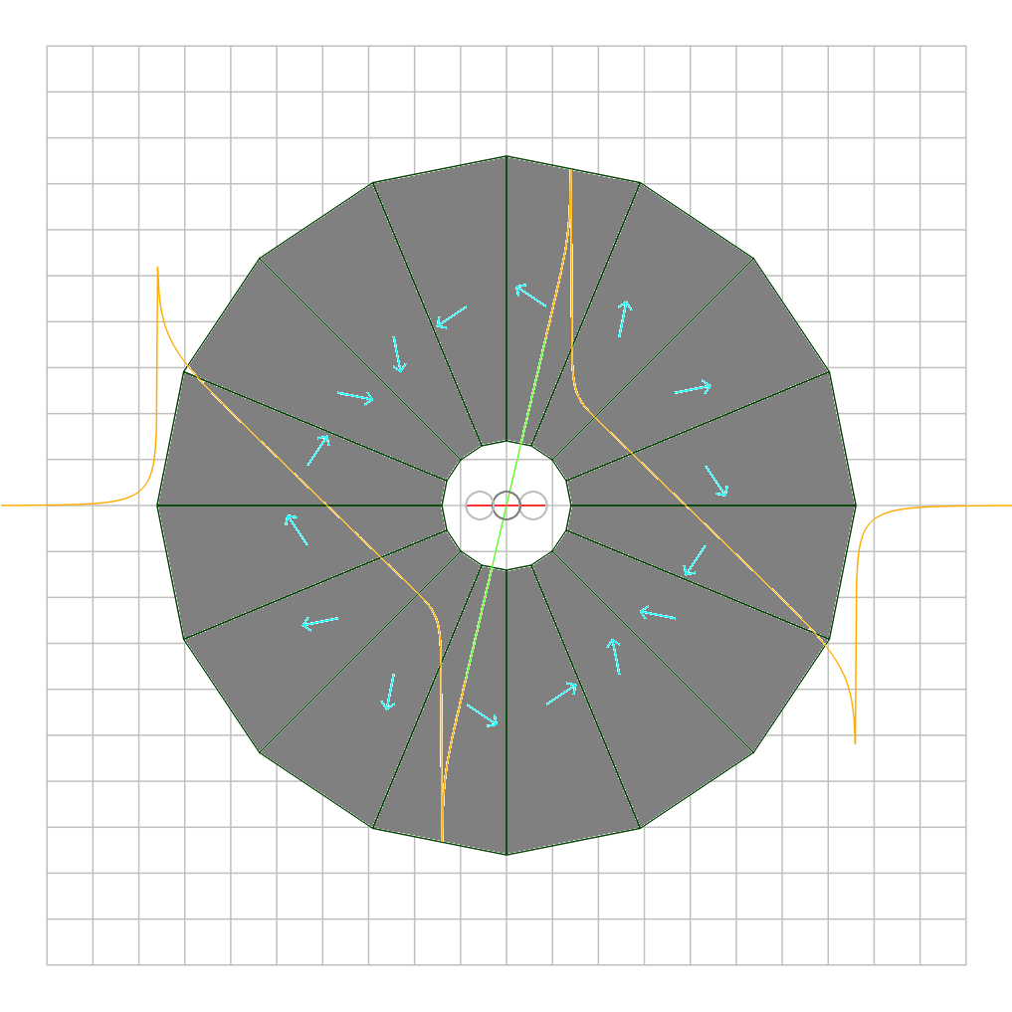
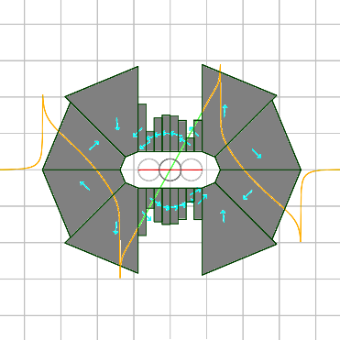
Oval Aperture Comparison
155T/m quadrupole
27.6mm horizontal aperture
B_{r} = 1.4T material
<10⁻⁴ field midplane accuracy
Left: circular aperture
170.9cm² of material
Right: oval aperture
10mm vertical height
24.0cm² of material
Sevenfold reduction in material use by only having aperture in the axis where it is needed
Therapy gantry QF magnet
Same scale!
cm grid

Slide 33
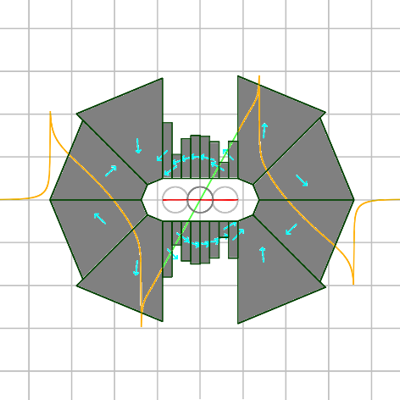
Oval Aperture Area vs. Strength
Or 35% more gradient
7x less area

Slide 34
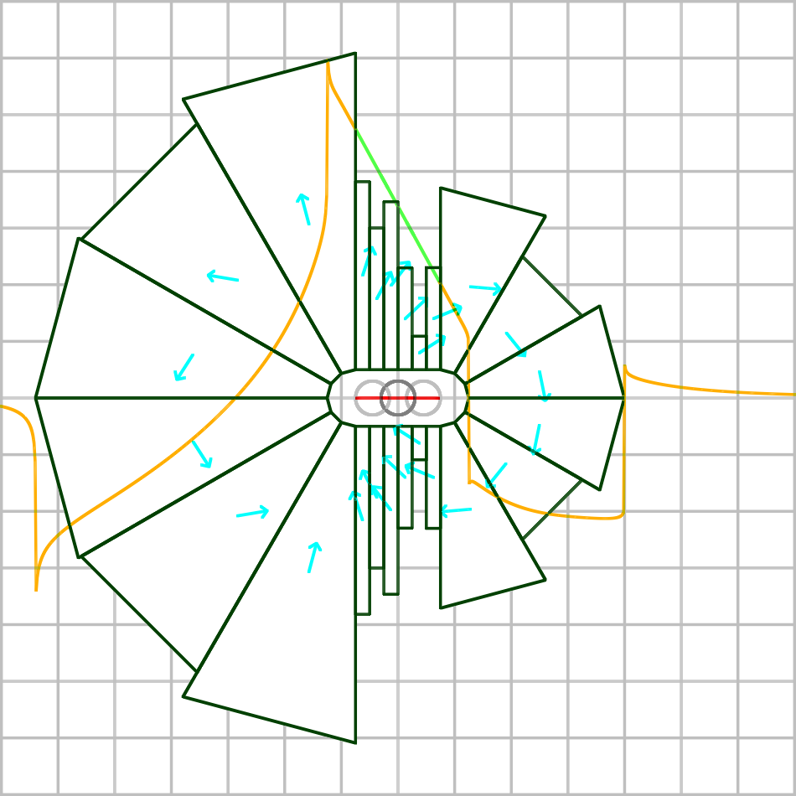
Oval Aperture Combined-Function
1.8 T dipole
-97 T/m gradient
2.527 T max field in good field region(!)
25.0mm horizontal aperture
B_{r} = 1.4T material
<2×10⁻⁴ field midplane accuracy
High fields put material into regime with high opposing flux (negative H field). This means demagnetisation is more likely, depending on grade, especially in presence of radiation. Future R&D will build and test such magnets.

Slide 35
Multiple Aperture Designs
Design produces a different combined function field in each aperture
3cm aperture separation
R10mm circular apertures
±6mm open midplane
0.2190 T +49.515 T/m left
0.1382 T -49.515 T/m right
Good field radii
4.5mm left, 6.4mm right
Units (10⁻⁴) field error
4.7 left, 18.0 right

Slide 36
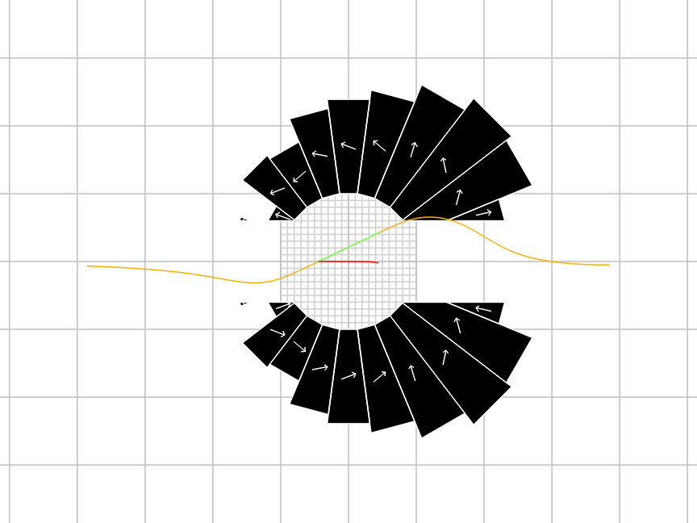
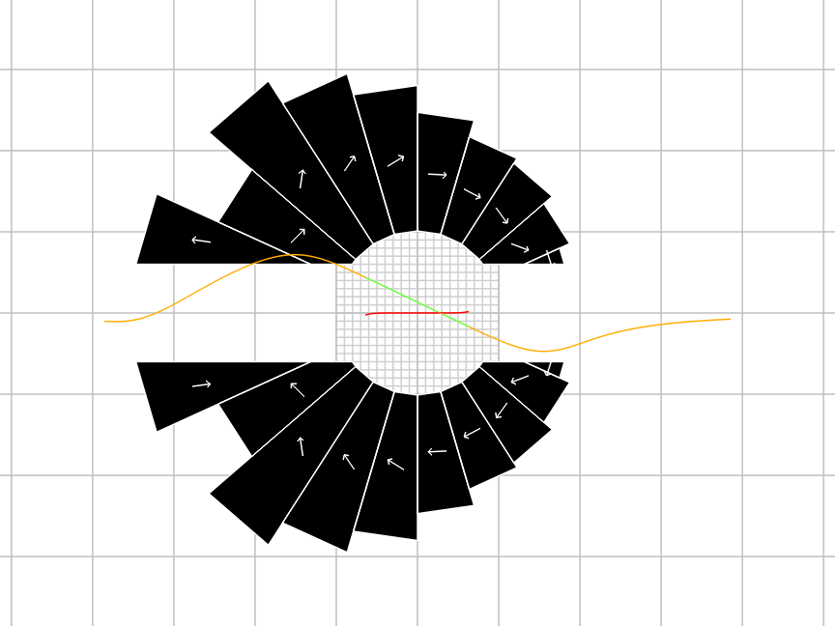
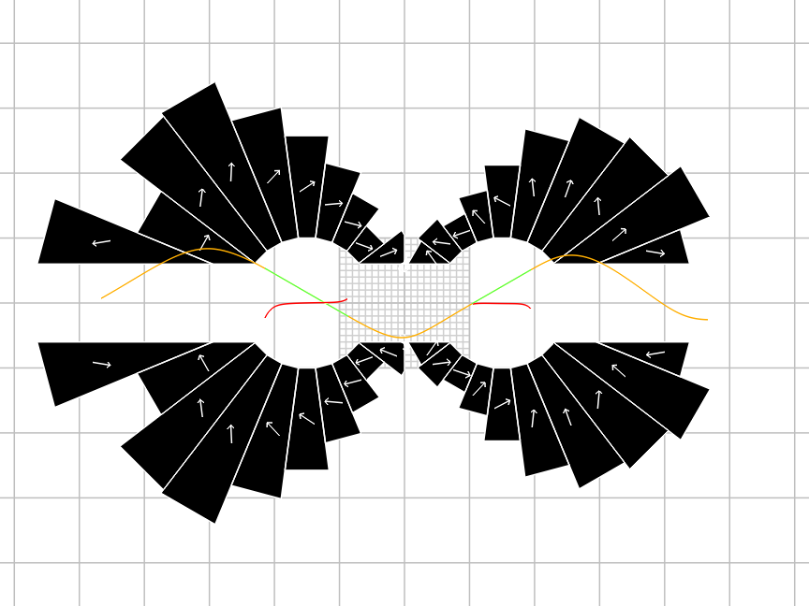
Comparison to Separate Magnets
Just BD (left)
Just BF (right)
Two-hole
11.3cm²
15.4cm²
15.2cm²
Total = 26.6cm²
28.9cm² if you try to combine them in the “backwards” way →

Slide 37
Multiple Aperture Uses
Cost savings
  Some PM material volume savings
  Build as a single component
    Only one vacuum chamber, girder etc.
Operational flexibility
  Modern colliders require rings for many functions
    Acceleration, accumulation, cooling, collision
  Building multiple tracks cheaply allows one beam to be cooled while another is collided for example

Slide 38
Upcoming R&D
Build and test prototypes of Halbach magnet variants discussed here
  Parameter scan, several prototypes
  Field test, field tuning, perhaps radiation test
  $400k approved in total Oct 2021 to Sep 2023
Build engineering prototype of NSLS-II upgrade magnet
  Full field, full gradient, full length
  Proposal underway (at NSLS-II), would be >$1M

Slide 39
Adaptations for Small Aperture
Tuning rod cartridges use too much aperture
  Iron rods could be adhered to tape rather than in grooves of 3D printed cartridge
  Or placed in integrated vacuum chamber grooves
BNL rotating coils too large for many cases
  NSLS-II have a rotating wire measurement system
    Designed for smaller apertures
  Horizontal scans with Hall probe or vibrating wire are possible but positional accuracy may be worse

Slide 40
Conclusions
200+ accelerator quality Halbach permanent magnets produced and tested at CBETA
  Iron rod shimming is a widely applicable method
Many new applications of Halbach magnets proposed in accelerators around the world
  Fixed field magnets in milder radiation areas
  Power and cost saving (no power supply)
Broad R&D activities at BNL
  Exploratory tech development and project-specific

