Slide 1
CEBAF 20GeV FFA Upgrade
First attempts at permanent magnets
Comparison of 1 vs. 2 FFA loops
More-optimised magnet designs

Slide 2
CEBAF ~20GeV FFA Upgrade
More in Ryan Bodenstein’s talk
CEBAF is currently a 5.5-turn racetrack RLA
123MeV injector, 1090MeV North & South linacs
Maximum output energy 12GeV
Five stacked electromagnetic arcs on East & West
Propose replacing one or two EM lines by multi-pass FFAs for extended energy reach
R=80.6m so 20GeV → 0.83T mean bending field
Non-scaling FFAs used for magnetic efficiency
Permanent magnets uses for power, cost savings

Slide 3
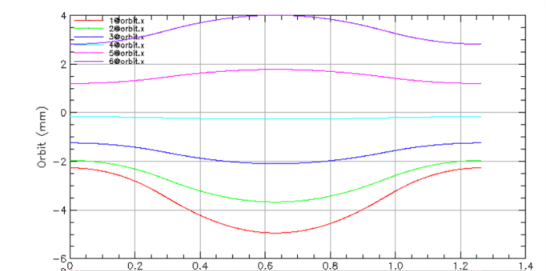
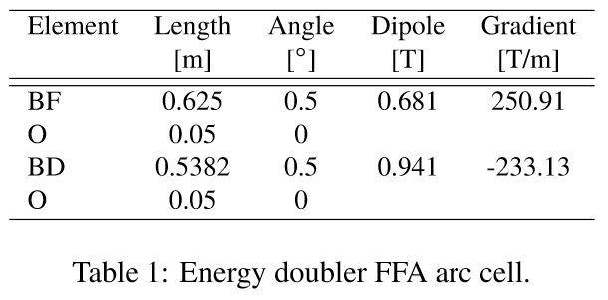

Parameters from IPAC’21 Paper
Take parameters directly from the paper
Note peak fields
20-24 GeV FFA CEBAF Energy Upgrade, S.A. Bogacz et al., Proc. IPAC’21
Magnet | Dipole at x=0 (T) | Gradient (T/m) | Xmin (mm) | Xmax (mm) | B(Xmin) (T) | B(Xmax) (T)
BF | 0.681 | 250.91 | -5 | 4 | -0.574 | 1.685
BD | 0.941 | -233.13 | -5 | 4 | 2.107 | 0.008

Slide 4
Permanent Magnet Design Rules
Open midplane full height of 4mm (y=±2mm)
Same as NSLS-IIU upgrade magnet (2020)
Which is also 250T/m
Beam-centroid-to-magnet clearance of 5mm
Again, same as NSLSII-U, has R=5mm aperture
B_{r}=1.30T material
E.g. AllStar N42EH grade
Intrinsic coercivity H_{cj}=29.0kOe (without radiation)
I.e. demagnetises totally at μ₀H=-2.9T (expect “knee” ~-2.7T)

Slide 5
Run HalbachArea Script
https://stephenbrooks.org/ap/halbacharea/
Good field region of 9mm full width means:
+/-4.5mm if re-centered in magnet
Try R_{aperture}=10mm to give >5mm clearance
Does not converge, fields 25% wrong

Slide 6
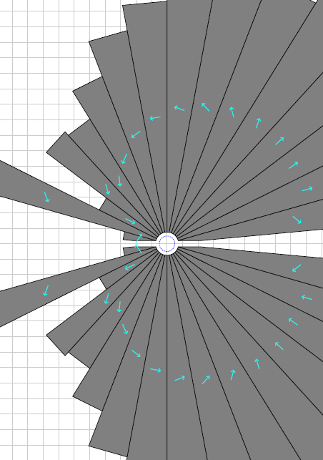
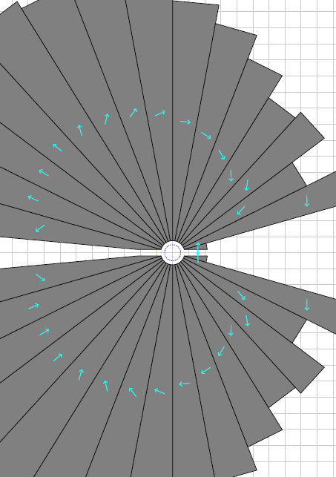
Reduce to R_{aperture}=7.5mm
Magnets converge but come out giant
BF
20.2 units error
BD
14.4 units error
>30cm
Also only 3mm from beam to magnet, probably not feasible

Slide 7
Field Overshoot at High Gradient
The 5mm clearance distance translates to a larger field increase for higher gradients
E.g. at 250.9T/m it corresponds to 1.255T
Makes 2.107T max field into 3.272T at “pole tip”
At 125.5T/m it corresponds to 0.627T
Now only becomes 2.689T at pole tip
Not exact but gives idea of magnet difficulty
Lower gradient can make magnet smaller even though good field aperture becomes larger

Slide 8
FFA scaling* laws
* not scaling FFA laws
Scaling type (by factor a) | Length | Angle | Dipole | Gradient | Quad offset (=dipole/grad) & orbit excursion
Momentum (~energy) | 1 | 1 | a | a | 1
Machine radius | a | 1 | a⁻¹ | a⁻² | a
FFA beta length (fixed bend radius, fixed cell tune) | a | a | 1 | a⁻² | a²
FFA arc-to-straight (=row 3/row 2) | 1 | a | a | 1 | a
FFA radius with fixed orbit excursion and field (row 2*row 1/sqrt(row 3)) | a^{1/2} | a^{-1/2} | 1 | 1 | 1
This one is the knob for changing gradients and orbit range: an engineering trade-off

Slide 9
Lattice Scaled to 50% Gradient
Original
50% gradient, 2x beam excursion
Magnet | Dipole at x=0 (T) | Gradient (T/m) | Xmin (mm) | Xmax (mm) | B(Xmin) (T) | B(Xmax) (T)
BF | 0.681 | 250.91 | -5 | 4 | -0.574 | 1.685
BD | 0.941 | -233.13 | -5 | 4 | 2.107 | 0.008
Magnet | Dipole at x=0 (T) | Gradient (T/m) | Xmin (mm) | Xmax (mm) | B(Xmin) (T) | B(Xmax) (T)
BF | 0.681 | 125.46 | -10 | 8 | -0.574 | 1.685
BD | 0.941 | -116.57 | -10 | 8 | 2.107 | 0.008
NB: length and bend angles of elements to be multiplied by sqrt(2)

Slide 10
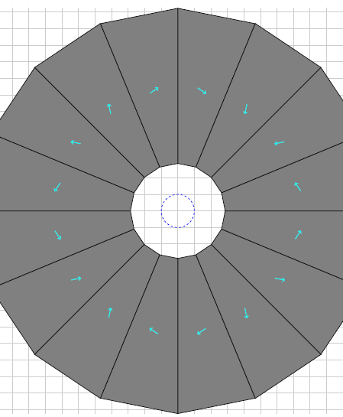
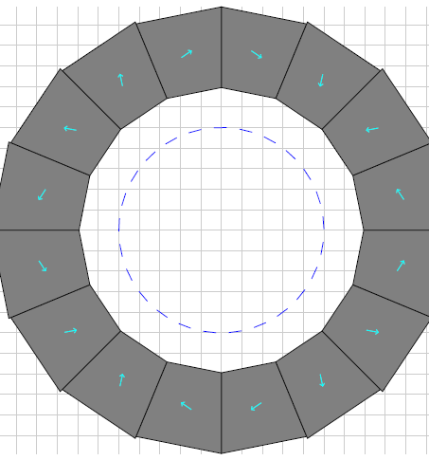
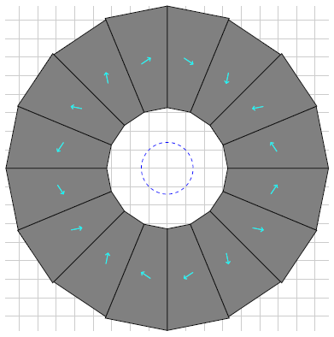
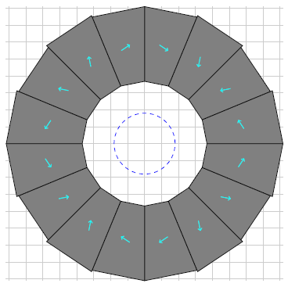
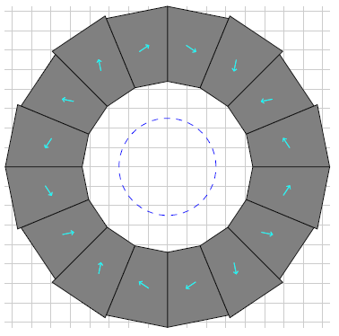
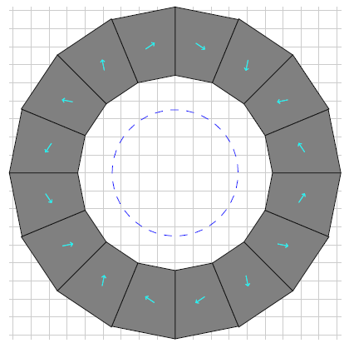
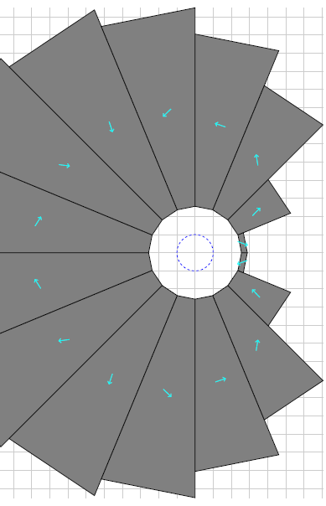
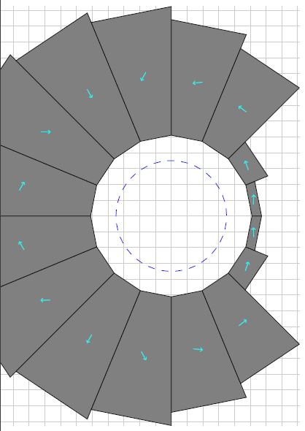
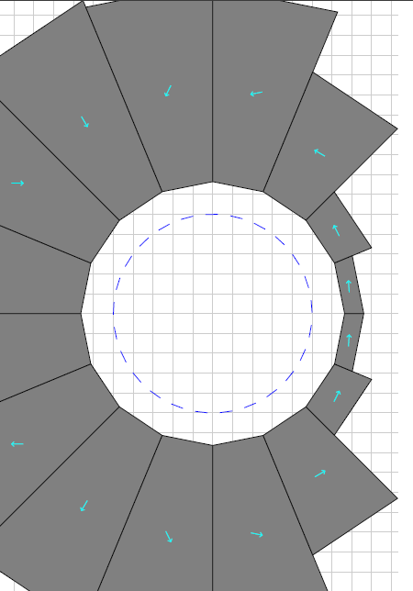
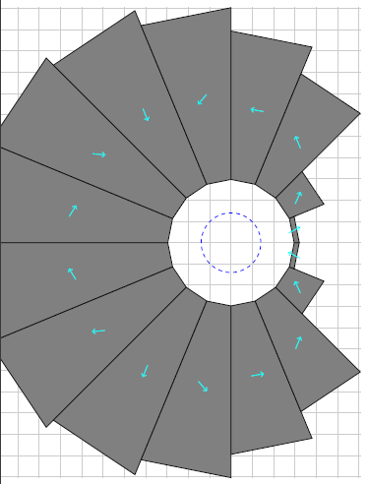
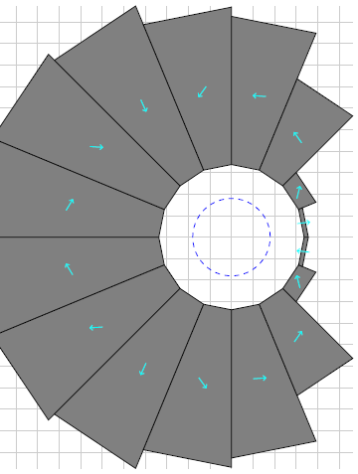
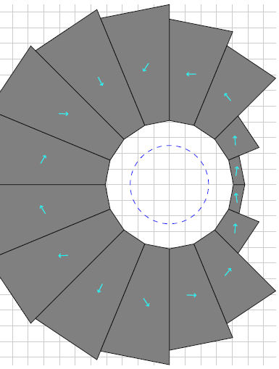
Gradient Tradeoff Example
±10mm
58T/m
±14mm
41T/m
±18mm
32T/m
±25mm
23T/m
±35mm
17T/m
±50mm
12T/m
The gradient of the cell can be scaled, which results in orbits that are closer together but have the same magnetic field at each orbit. In other words, the dipole is constant but the gradient scales inversely with orbit separation.
The clearance requirements create an area optimum.
QF
(All using CBETA clearances)
BD

Slide 11
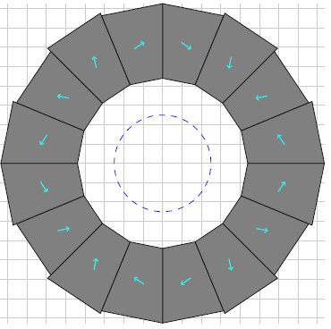
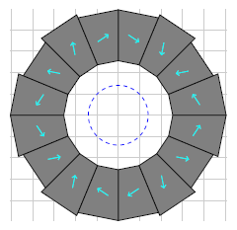
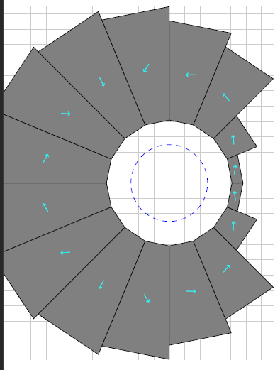
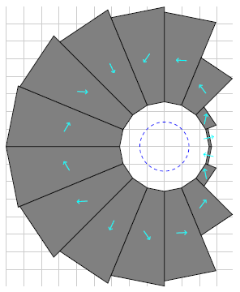
Clearance Tradeoff Example
CBETA clearances
~12+2+3mm
Beam-centroid-to-pipe, pipe, pipe-to-magnet
Reduced clearances
6+2+3mm
and re-optimise gradient
Smaller clearances allow even more efficient magnets by increasing the gradient to the new higher optimum.
However, smaller clearances are harder to engineer and magnify relative errors from position misalignments.
QF
BD

Slide 12
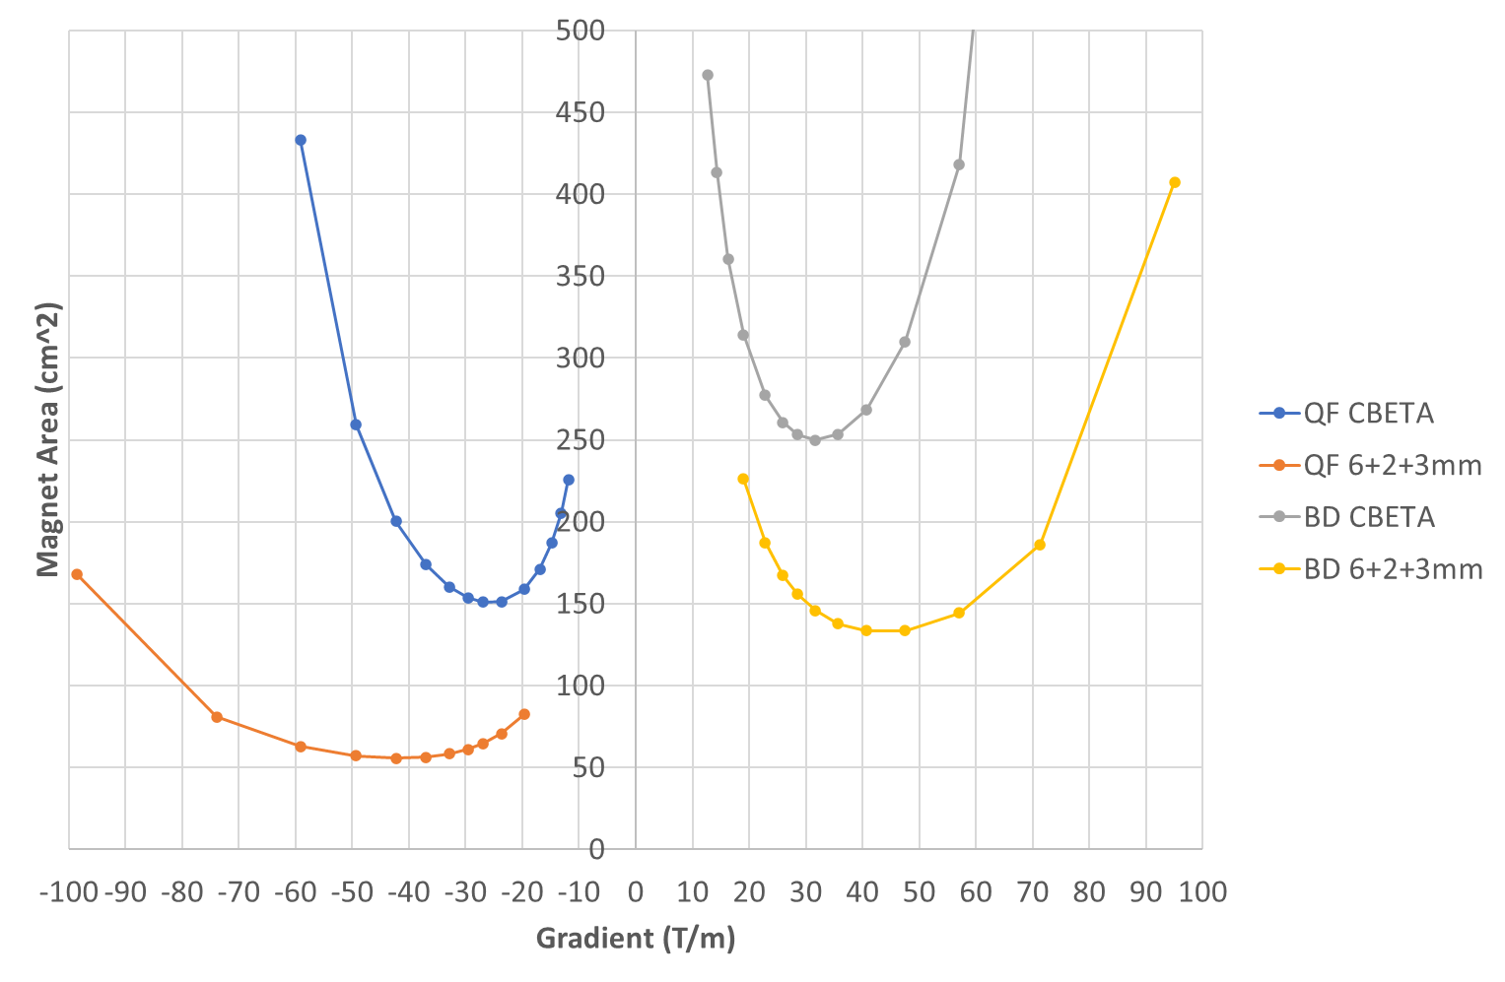
Clearance vs. Gradient Example

Slide 13
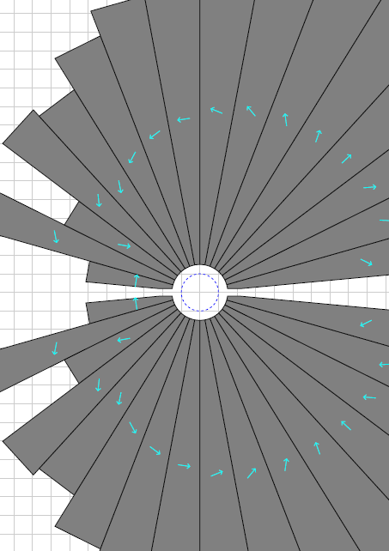
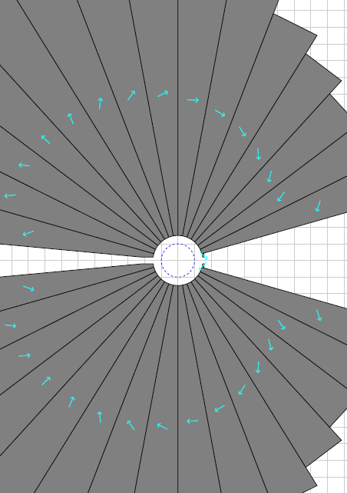
Using R_{aperture}=15mm (R_{field}=10mm)
50% gradient scaled magnet converges with the full 5mm clearance
But the magnets still come out giant!
BF
4.8 units error
BD
1.6 units error
>30cm

Slide 14
Need Some Ideas (idea #1)
Now that R_{aperture}=15mm…
There’s a lot of unused space above and below the beams
Could use “oval aperture” idea from Dejan’s hadron therapy gantry
While still having an open midplane

Slide 15
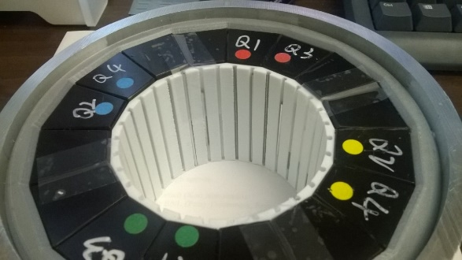


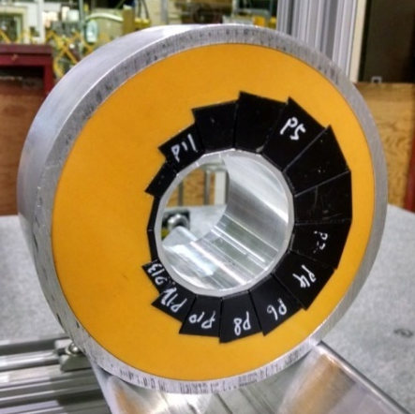
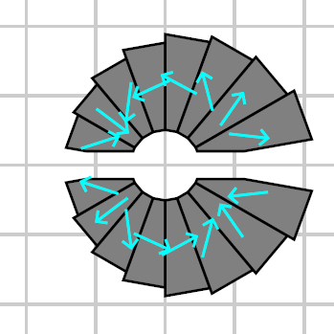
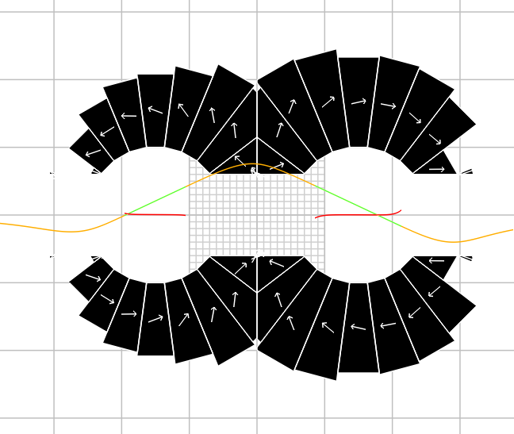

[IPAC’21] Halbach Magnet Variations
Demonstrated (in accelerator)
Field tuning with iron rods
Combined-function magnets
In development
Open midplane magnets
Future research
Oval apertures
Multiple apertures

Slide 16
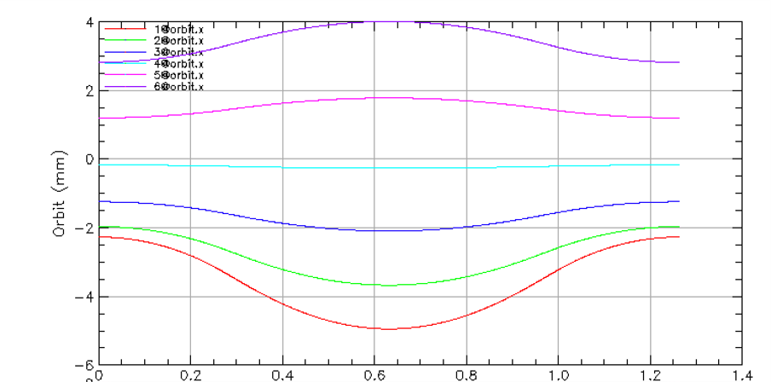
Unused Region in BD (idea #2)
From the orbit diagram it appears that while
the orbits in BF are -5mm < x < 4mm,
the orbits in BD are -3.5mm < x < 3.25mm.
Don’t build magnet where you don’t need it!
BD
BF
BD

Slide 17
Trimming the BD Aperture Range
50% gradient, 2x beam excursion
With reduced BD aperture range
Magnet | Dipole at x=0 (T) | Gradient (T/m) | Xmin (mm) | Xmax (mm) | B(Xmin) (T) | B(Xmax) (T)
BF | 0.681 | 125.46 | -10 | 8 | -0.574 | 1.685
BD | 0.941 | -116.57 | -10 | 8 | 2.107 | 0.008
Magnet | Dipole at x=0 (T) | Gradient (T/m) | Xmin (mm) | Xmax (mm) | B(Xmin) (T) | B(Xmax) (T)
BF | 0.681 | 125.46 | -10 | 8 | -0.574 | 1.685
BD | 0.941 | -116.57 | -7 | 6.5 | 1.757 | 0.183
Peak fields better balanced between magnets (also minimises SR)
NB: length and bend angles of elements to be multiplied by sqrt(2)

Slide 18
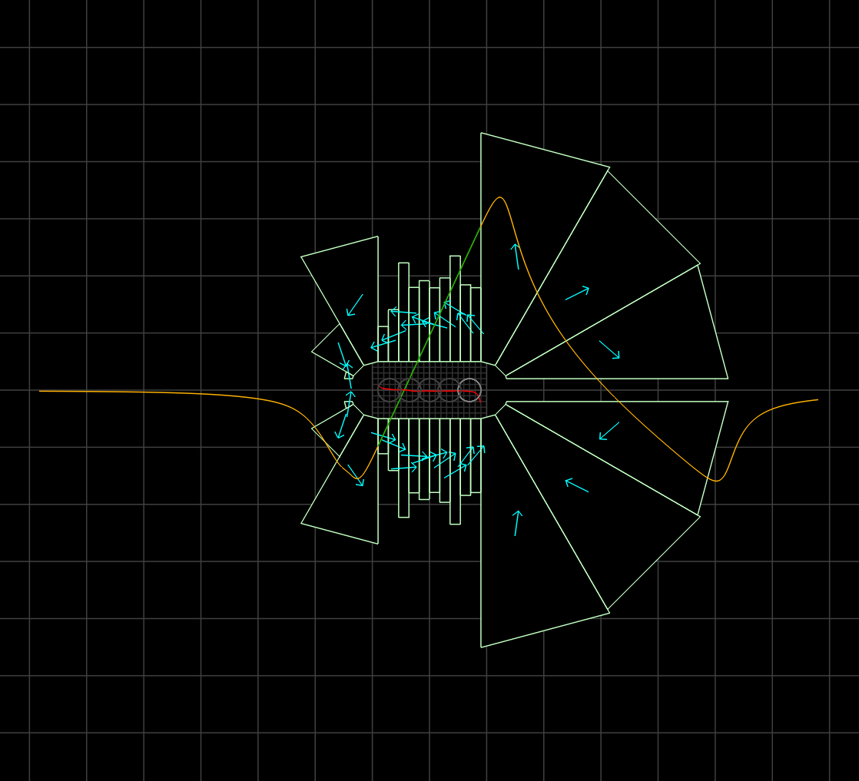
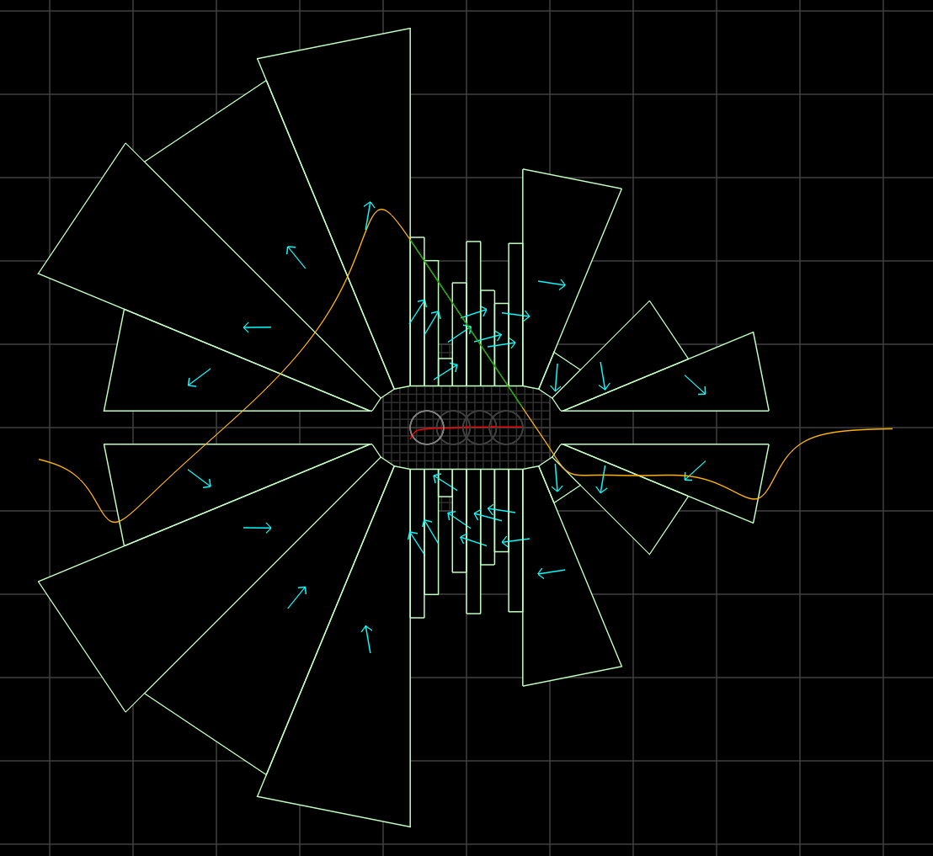
Finally!
Small magnets, good field, full 5mm clearance
36.7cm²
BF
27.8 units error
40.5cm²
BD
24.1 units error
10cm

Slide 19
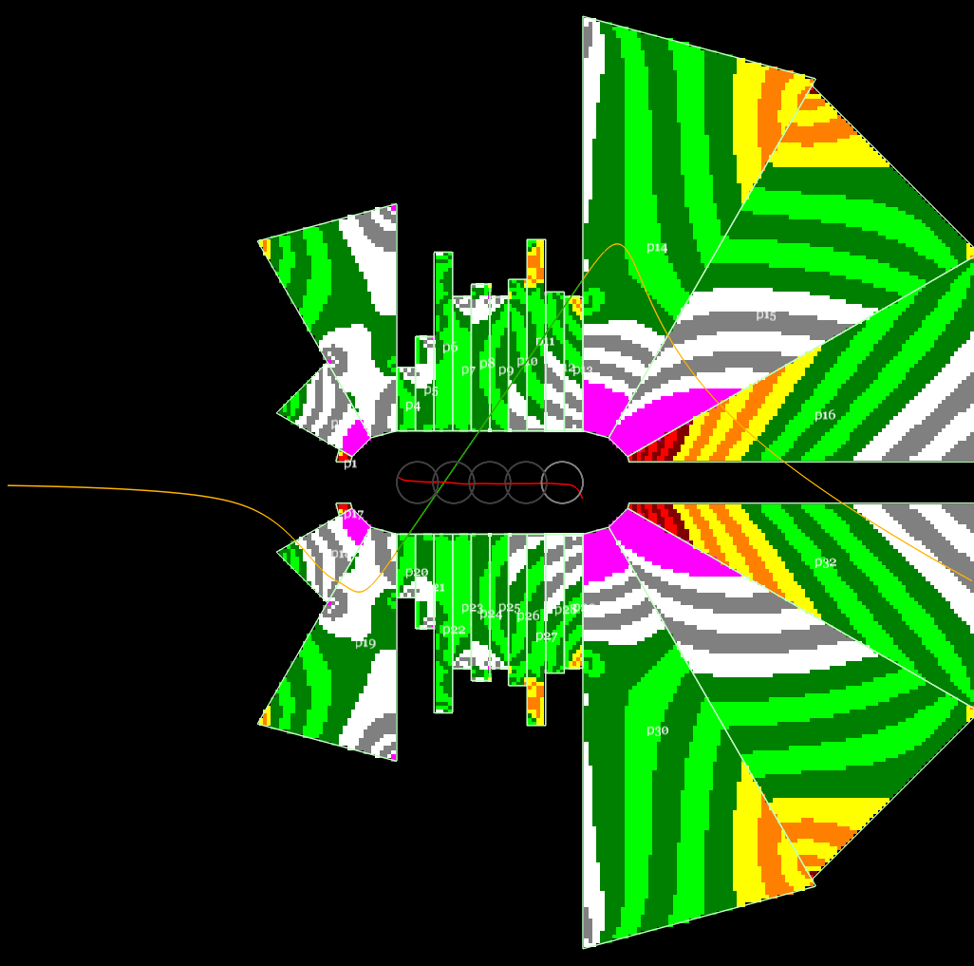
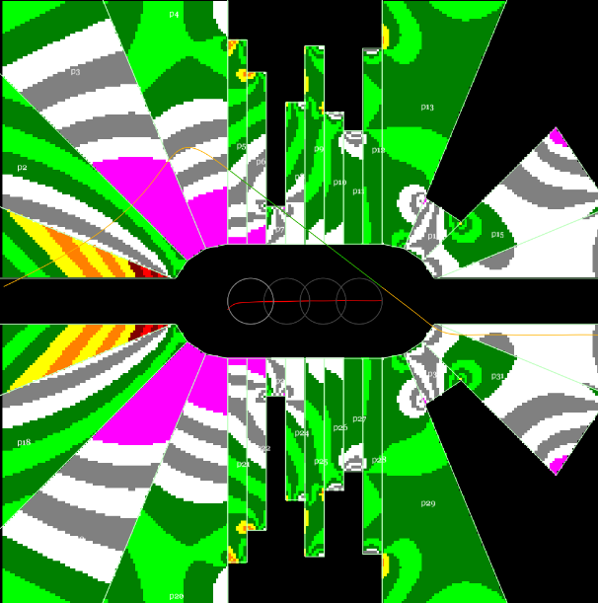
Demagnetisation?
BF
BD
Red areas show μ₀H < -1.5T,
yellow -1.5 < μ₀H < -1.0T, etc.
Stripes are 0.1T intervals.
Looks like worst reverse flux value is around -2.3T, knee is -2.7T, likely OK without radiation but not much margin.

Slide 20
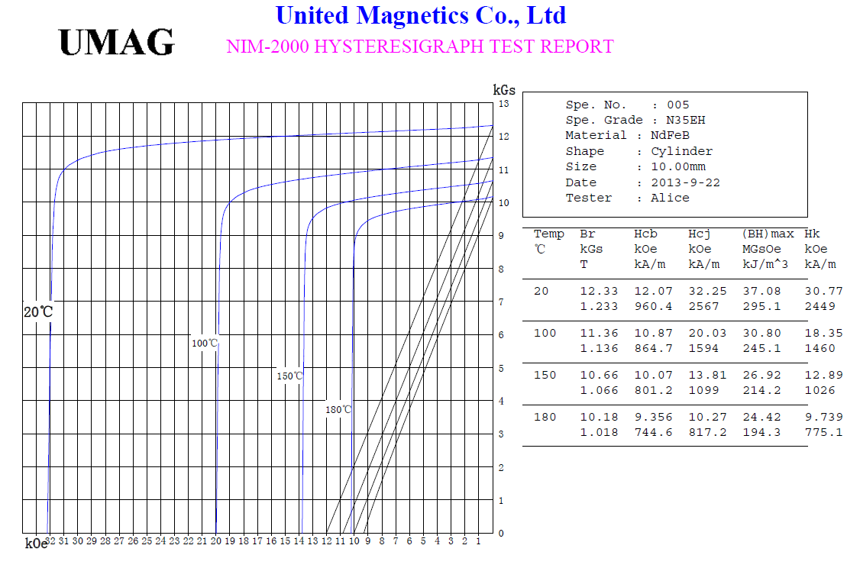
B-H Curve and Demagnetisation
CBETA material grade N35H
H_{cj} value (demagnetisation point,
varies with temperature)
Note: not N42EH, just example
Magnetisation provided by material (μ₀M = B − μ₀H)
Net field (B)
Large opposing fields (negative H in the direction of M) can potentially demagnetise parts of the material in higher field magnets. Not observed or expected in CBETA (-H<1.3T). Depends on material grade H_{cj} value.
External applied field (μ₀H)
opposing magnetisation direction

Slide 21
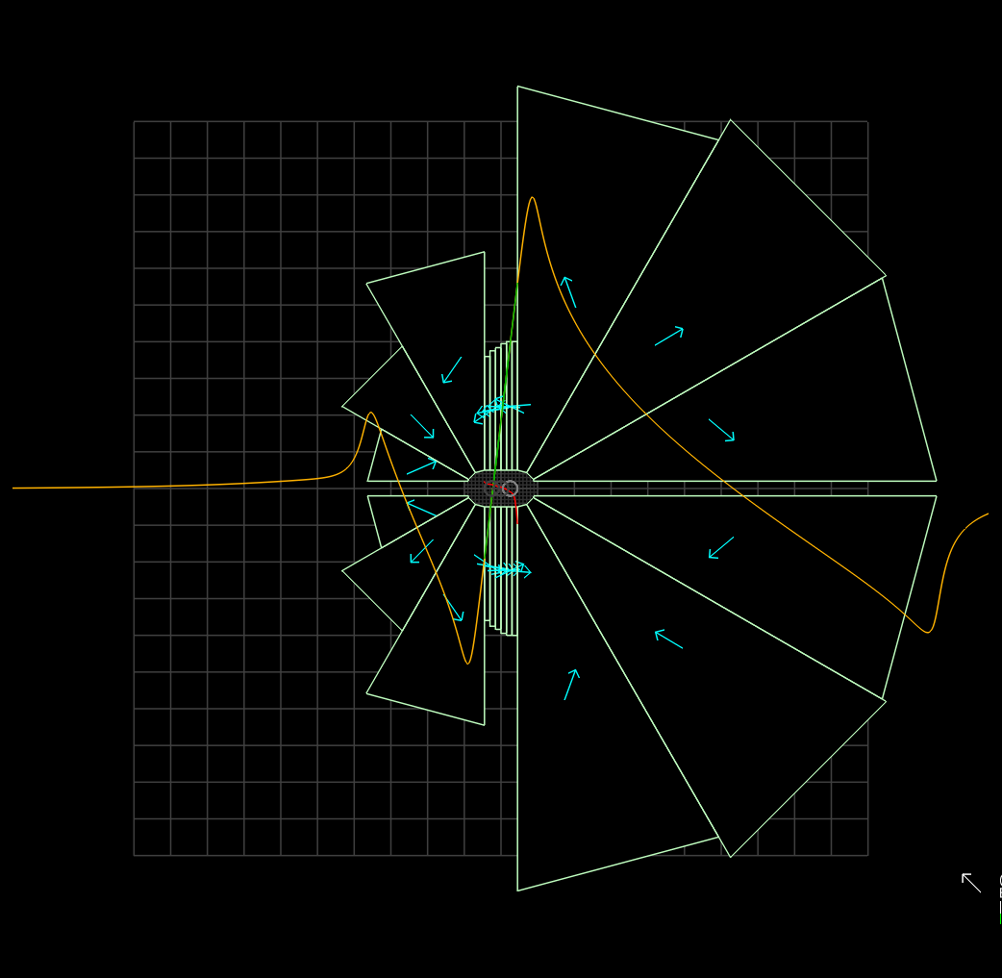
What about with 100% gradients?
BF converges but is still rather large
Probably should avoid super-high (>150T/m) gradients unless good reason
E.g. path length
20cm

Slide 22
Summary (IPAC’21 magnets)
Got a feasible magnet but had to employ several tricks:
Scaled lattice to 50% gradient (double orbit range)
Reduce circular aperture to vertically ±5mm oval
Trim BD good field range to cover only orbits
Future work:
Is 50% (~120T/m) gradient the optimum?
Prediction of radiation dose limit (CBETA model)
Are any design rules/assumptions wrong?

Slide 23
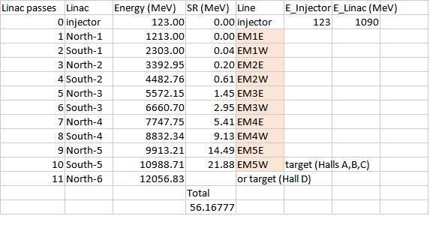
Existing 12GeV CEBAF Energies

Slide 24
Upgraded CEBAF Injector Energy
Avoid large energy ratios in linacs to >20GeV
Three new RF modules of 90MeV each
Two passes through these with a single conventional return loop
Use existing injector at 110MeV
Total energy: 110+2*(3*90) = 650MeV
110
90
90
90

Slide 25
Energies with One FFA (4+7 turns)
Linacs adjusted 925-1090MeV for 50-100% energy tunability

Slide 26
Energies with Two FFAs (3+(4+4))

Slide 27
Energies with Two FFAs (3+(5+3))

Slide 28
Lattice Optimisation Rules
Minimise maximum field on any beam orbit
Cell angle = 2° clockwise (-2°)
Overall radius of curvature = 80.6m
Ensures cell length of 2.81347m
Both drifts are 10cm long
Packing factor 92.9%
All cell tunes between 0.025-0.425, x,y planes
Wide range to compensate for energy adjustment

Slide 29
MAD-style Lattices
Parameter | One FFA | 4+4 FFA1 | 4+4 FFA2 | 5+3 FFA1 | 5+3 FFA2 | Units
Emin | 8.9 | 7.1 | 14 | 7.1 | 16 | GeV
Emax | 23 | 16 | 23 | 18 | 23 | GeV
Eref | 15.95 | 11.55 | 18.5 | 12.55 | 19.5 | GeV
BF length | 1.36109 | 2.09794 | 1.68482 | 1.57127 | 1.49155 | m
BF angle | -0.05722 | -1.73802 | -1.14623 | -0.65227 | -0.98835 | degrees
BF quad | -48.649 | -29.730 | -65.616 | -35.135 | -80.781 | T/m
BD length | 1.25238 | 0.51553 | 0.92865 | 1.04220 | 1.12192 | m
BD angle | -1.94278 | -0.26198 | -0.85377 | -1.34773 | -1.01165 | degrees
BD quad | 43.393 | 93.393 | 86.787 | 42.943 | 76.276 | T/m
Dipoles calculated from length, angle and Eref

Slide 30
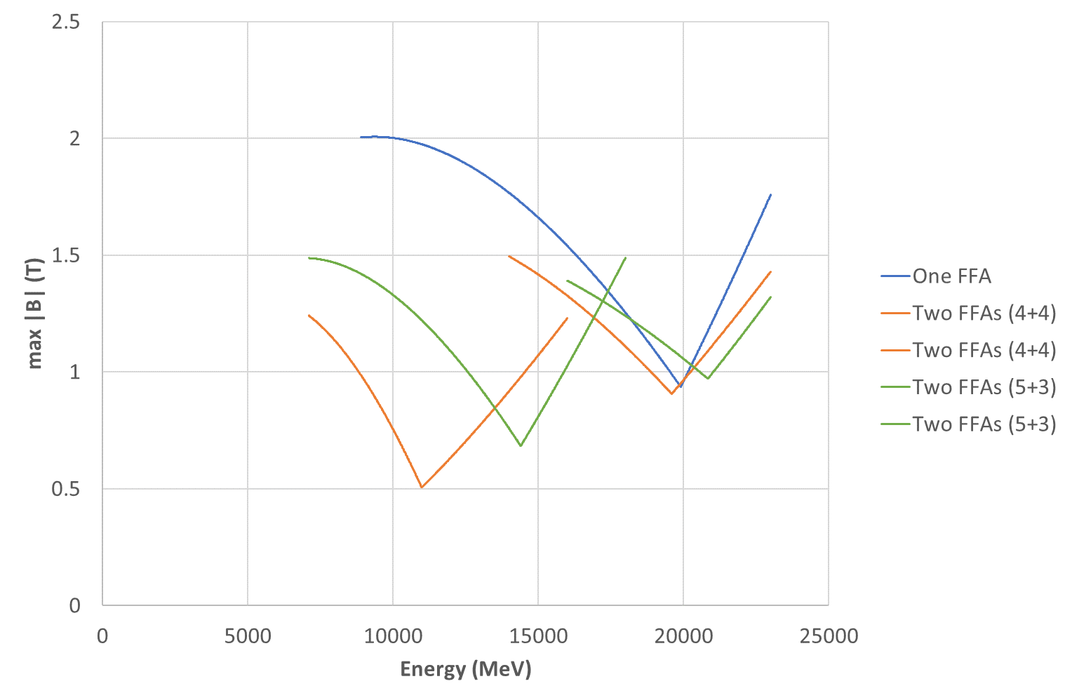
Max Field on Beams

Slide 31
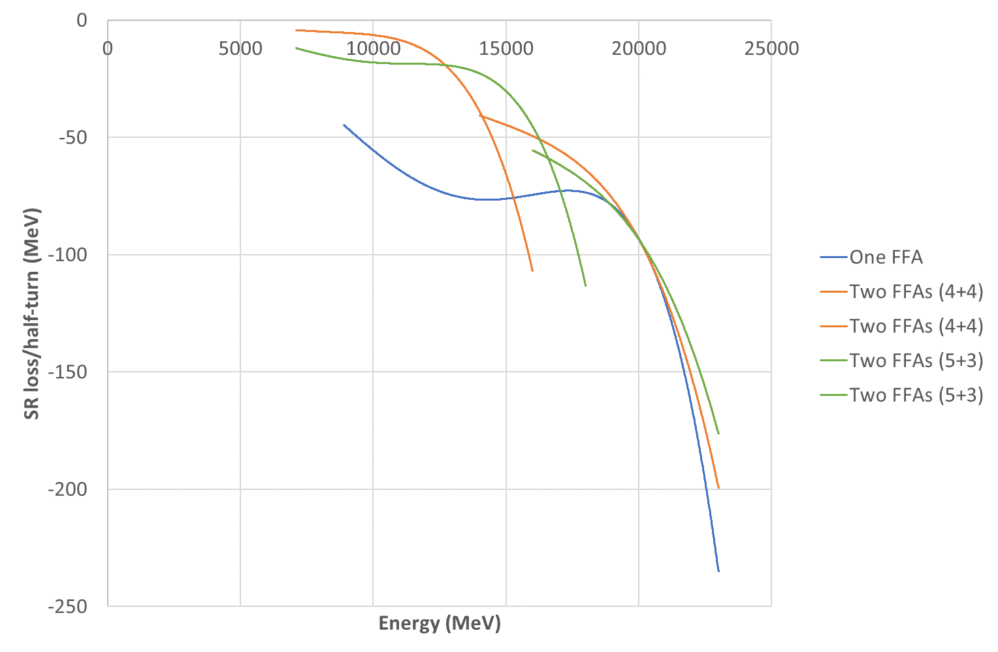
SR Loss Per Half-Turn

Slide 32
Performance Comparison
Option | Max Field (T) | SR Loss (MeV) | Final Energy (MeV)
One FFA | 2.007 | 1211.48 | 23418.52
Two FFAs (4+4) | 1.495 | 964.44 | 23665.56
Two FFAs (5+3) | 1.489 | 935.30 | 23694.70
Two FFAs should be considerably better from magnet point of view, particularly radiation hardness due to the decreased fields

Slide 33
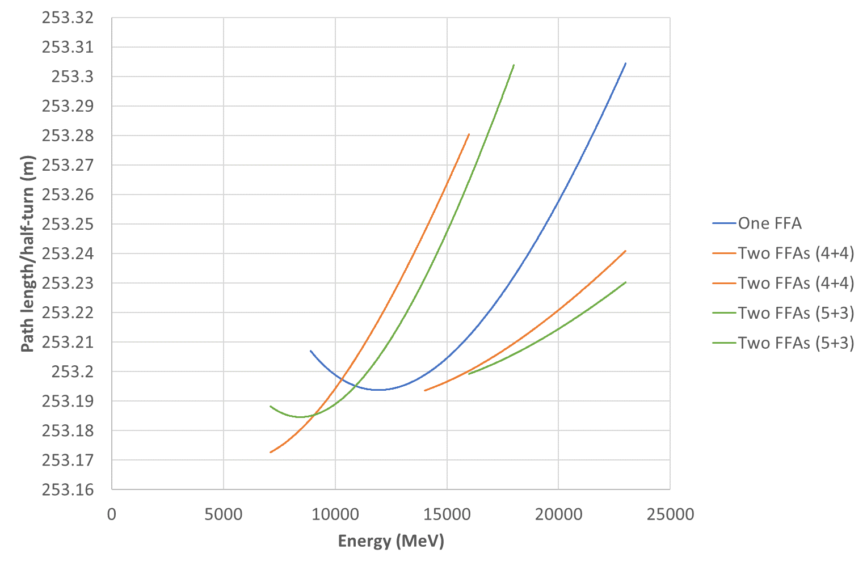
Path Length

Slide 34
Orbit Excursion
Lattice | Orbit range in BF (mm) | Orbit range in BD (mm)
One FFA | 56.74 | 41.57
4+4 FFA1 | 42.61 | 27.89
4+4 FFA2 | 21.34 | 14.05
5+3 FFA1 | 54.79 | 39.07
5+3 FFA2 | 14.95 | 10.66
Values given are full ranges (xmax-xmin)
CBETA would be 50mm in focussing magnet
Generally the low energy FFA has a CBETA-like orbit excursion and FFA2 is much smaller
Could go below 2°/cell in FFA1 to reduce range

Slide 35
Summary (one vs. two FFAs)
Using two FFAs reduced maximum field on beam from ~2.0T to 1.5T
Should lead to a substantial improvement in permanent magnet practicality
Two FFA design has 22% less synchrotron radiation power loss than one FFA
New lattices are baseline as of July 30th 2021
“5+3” is marginally better than “4+4”

Slide 36
Max Field on Beams
Magnet benchmark on 4+4 FFA2
because highest field in high-energy FFA

Slide 37
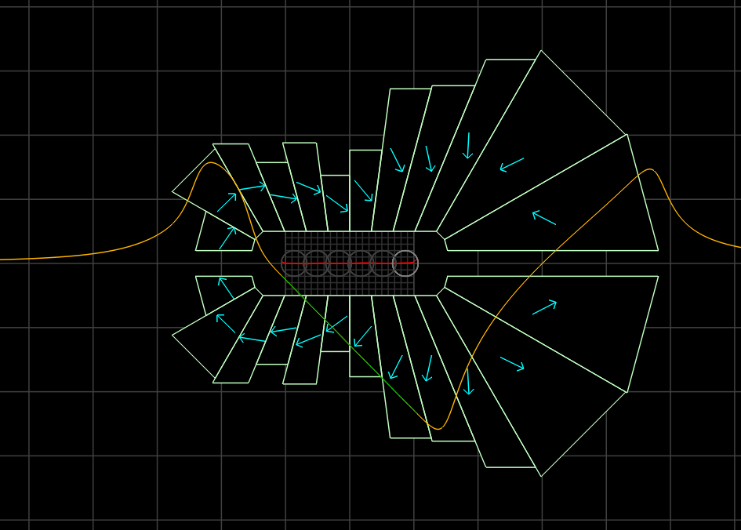
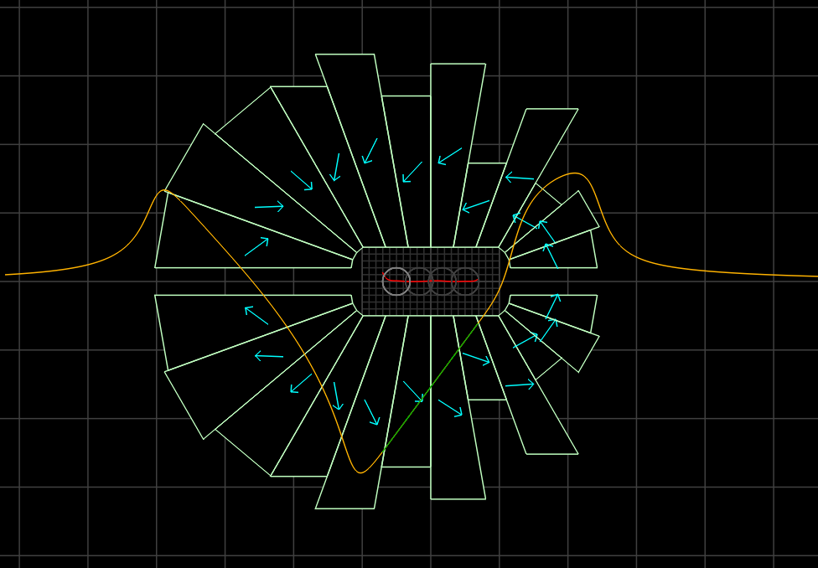
Magnets for July 30th 4+4 FFA2
Wanted to replace central rectangular pieces with wedges to avoid slipping
Reduce 32 to 24 pieces per magnet (CBETA=16)
~25% less area than IPAC’21 magnets
CBETA magnets were from 38cm² to 78cm²
27.8cm²
BF
27.1 units error
27.4cm²
BD
25.8 units error
5cm
-65.6T/m
86.8 T/m

Slide 38
Try Larger Clearances
NSLS-IIU recently doubled their exit slot height from 4mm to 8mm (y=±4mm)
Allows vacuum chamber inside magnet
Could try doing the same
Also double beam-to-magnet clearance from 5mm to 10mm (for 20mm full height central aperture)
Rescale gradients on July 30th lattice to 50% to avoid field overshoot in larger clearance gap

Slide 39
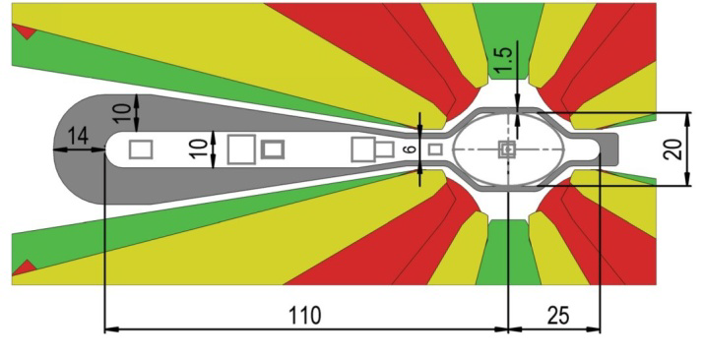
ESRF Upgrade Chamber ~9mm Slot
Layout of the Vacuum System for a New ESRF Storage Ring, M. Hahn et al., Proc. IPAC’14

Slide 40
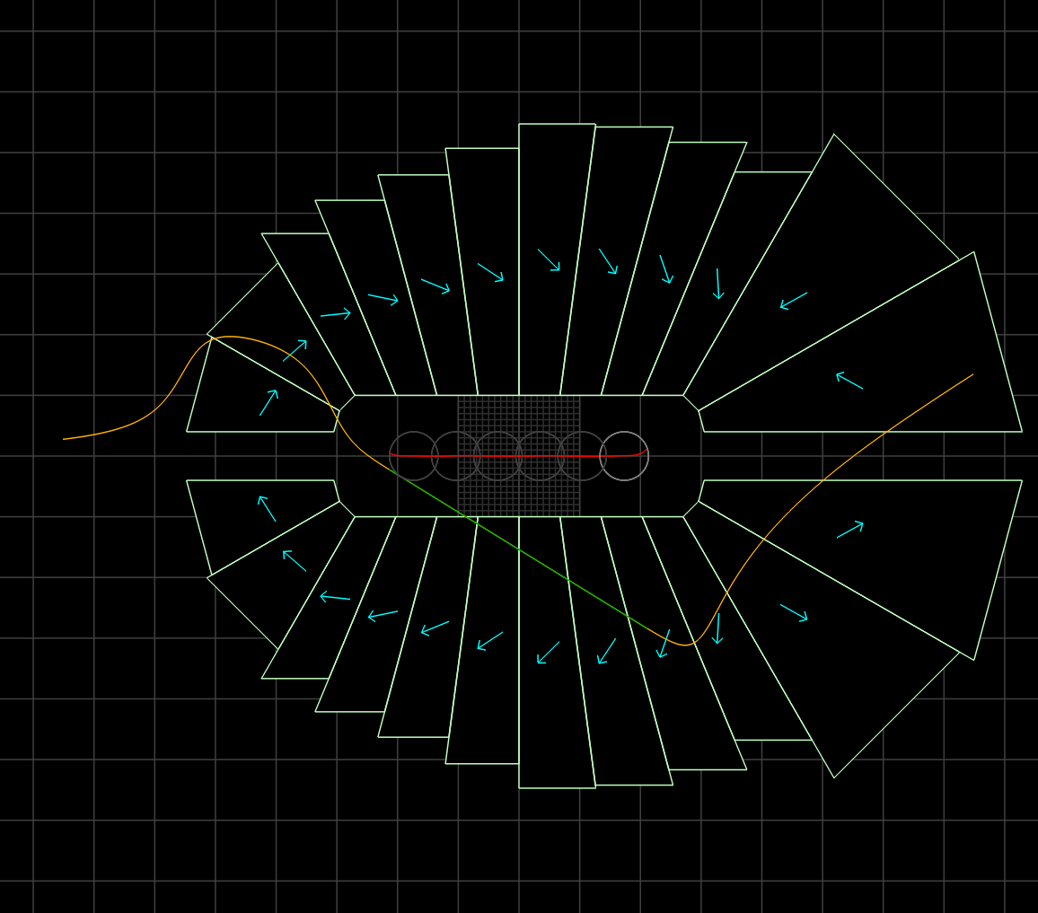
Magnets: 4+4 FFA2, 50% gradient
Should be very similar, but 2x the size and 4x the area
CBETA magnets were from 38cm² to 78cm²
100.4cm²
BF
32.5 units error
105.8cm²
BD
27.1 units error
10cm
September 10, 2021
-32.8T/m
43.4 T/m

Slide 41
Demagnetisation in IPAC’21 magnets
BF
BD
Red areas show μ₀H < -1.5T,
yellow -1.5 < μ₀H < -1.0T, etc.
Stripes are 0.1T intervals.
Looks like worst reverse flux value is around -2.3T, knee is -2.7T, likely OK without radiation but not much margin.

Slide 42
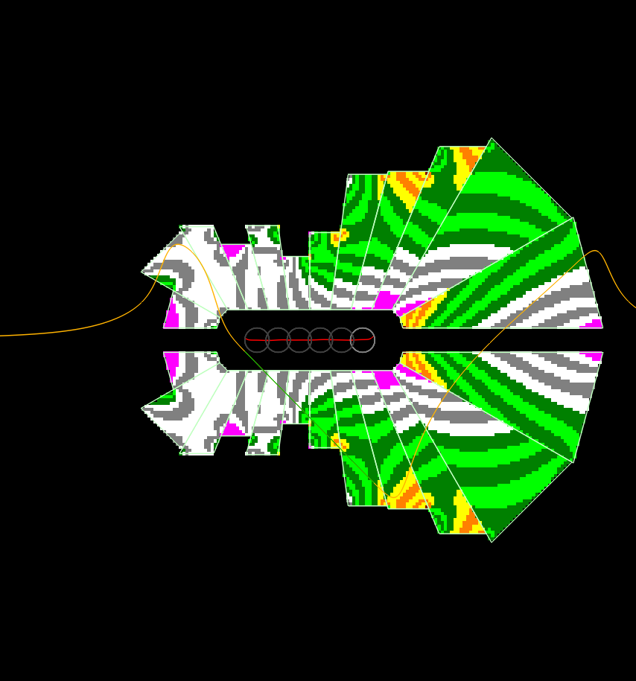
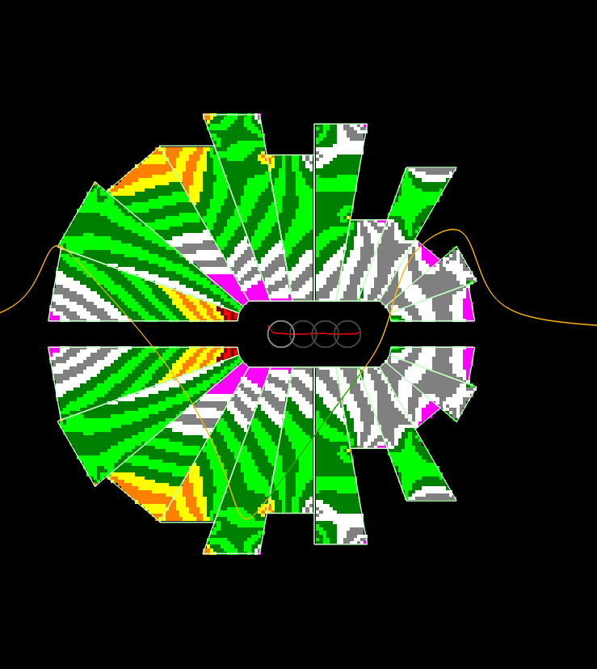
Demagnetisation in new magnets
BF
BD
Could make the “high field” wedge at the end out of a different material grade, or SmCo

Slide 43
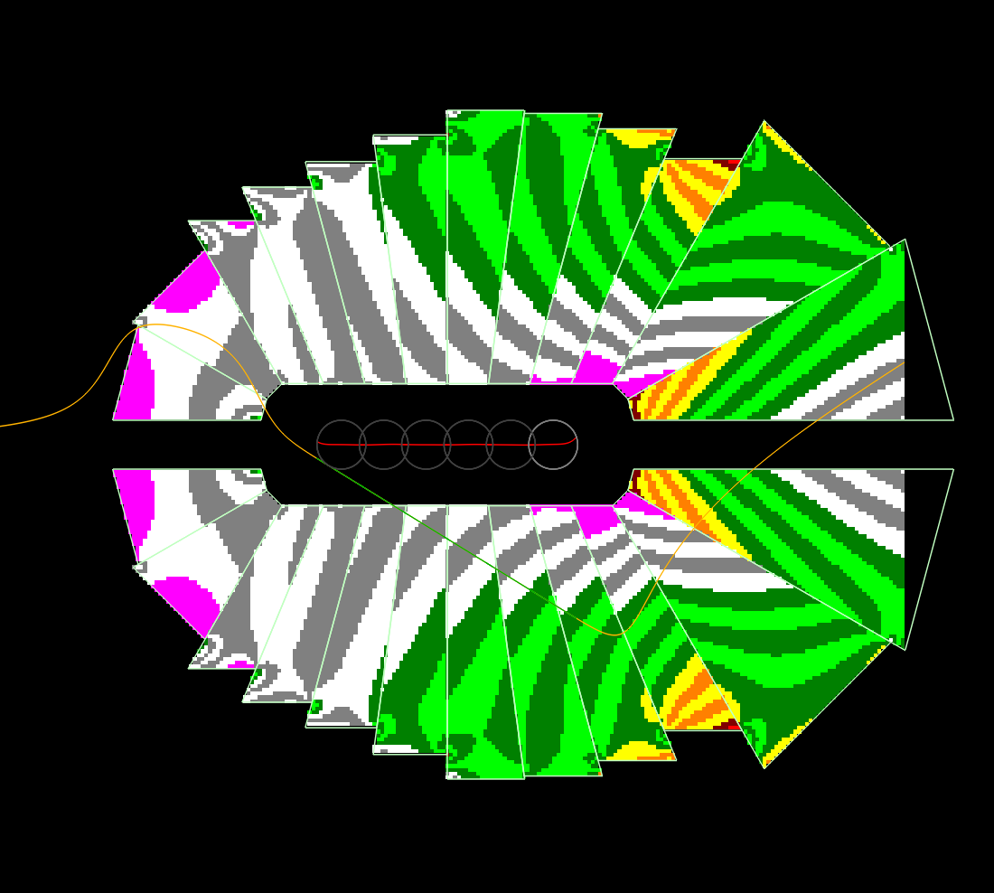
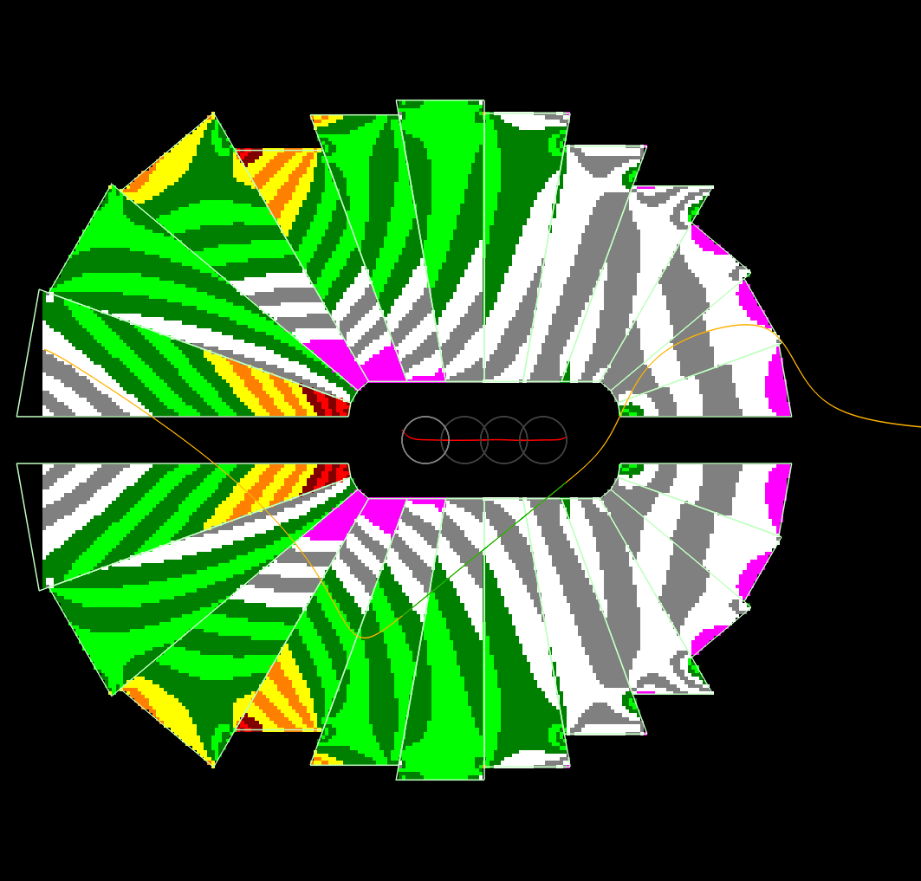
50% gradient / large clearance
BF
BD
Very similar, scaled up 2x

Slide 44
All Magnets for 5+3 FFA1 and FFA2
BF
BD
96.9cm²
107.1cm²
FFA1
10cm
72.8cm²
78.7cm²
All gradients between 35T/m and 43T/m
FFA2
FFA2 magnets scaled to 50% gradient, FFA1 at 100% (aperture already large)

Slide 45
Summary (updated magnets)
Reduced peak field allows larger apertures
Easier to fit vacuum chamber and beam through
The 10mm-to-magnet should give 7-8mm to pipe
What height should the synchrotron radiation slot be?
E.g. 8mm full height minus both sides of chamber
When known, can optimise lattice gradient
Scaling law independent of maximum field, SR etc.
LDRD funding from Oct 2021 → prototypes

