Slide 1
Fixed-Field Accelerators with Fixed Tunes… AND good Magnetic Efficiency
Electromagnets for FETS-FFA-like machine (3-12MeV protons)
Permanent magnets for Trbojevic proton therapy accelerator

Slide 2
Introduction
Recent studies by Dejan Trbojevic have confirmed that non-scaling FFAs can have their tune dependence on momentum flattened by adding non-linear components to the magnet fields, although not necessarily for an unlimited momentum range.
Quadrupole affects tune level, sextupole affects dQ/dp, octupole affects d²Q/dp², etc.

Slide 3
FETS-FFA requirements
3-12MeV protons
4m average radius
Several 1m drifts (one per cell here)
Fixed tunes: ΔQ_{x,y}<0.01 in ring, <0.001 per cell
Q_{x,y} tunable over full range of 1 in ring
  For exploration of the tune plane in R&D
  I chose 12 cells so this is 1/12 range per cell
Geometrical aperture 1250mm.mrad (large)

Slide 4
Algorithm
Runge-Kutta 4th order tracking step
Loop to get trajectory in cell
Finite difference to get transfer matrix
  Also gives tunes if orbit is closed
Iterate (Newton) to find closed orbit
Loop over all FFA energies
Finite difference parameters to get response matrix of tune functions to multipole changes
Iterate (optimiser) to find fixed-tune lattice
Muon1
Muon1 cell optics mode
Muon1 FFA optics mode
Fixed-tune FFA optimiser
(parallel)

Slide 5
Field Model
Midplane field is product of:
  Transverse polynomial up to dodecapole
    Rough initial field coefficients up to octupole were found by Muon1 genetic algorithm before using fixed-tune FFA optimiser
  Longitudinal integral of Gaussian at both ends
    Fringe length given by σ=6cm
Off-midplane fields extrapolated by repeated derivatives of this product of three functions

Slide 6
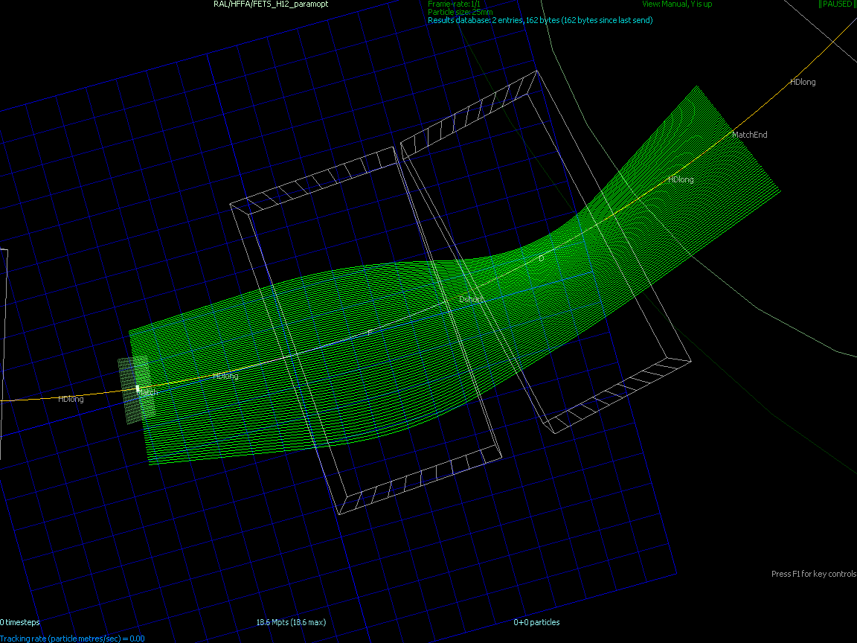
Fixed-Tune Cell Orbits
Target cell tunes Q_{x}=0.216, Q_{y}=0.213

Slide 7
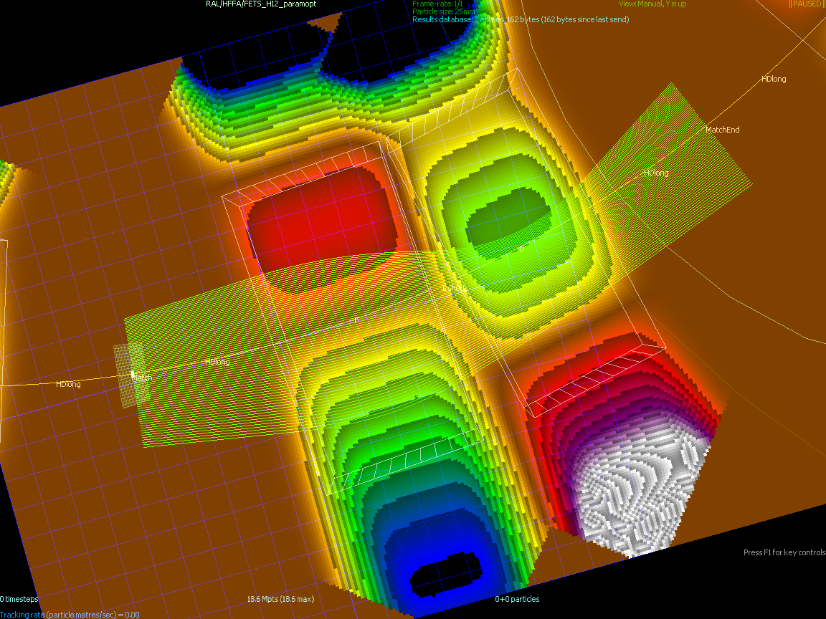
Fixed-Tune Cell Fields
F field +0.15 to -0.43T, D field -0.42 to -0.02T

Slide 8
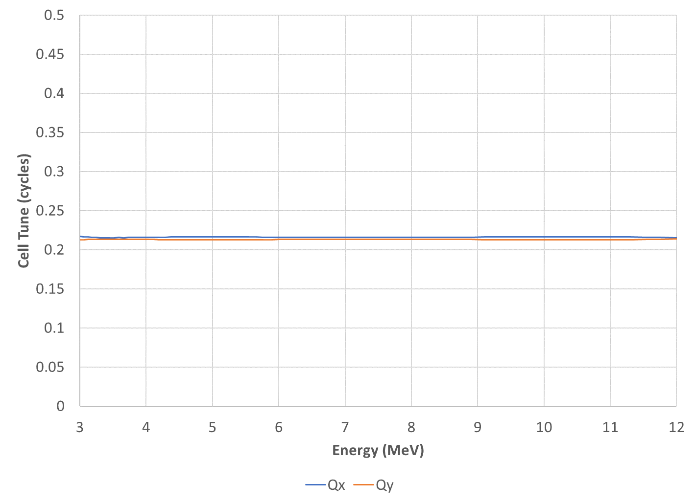
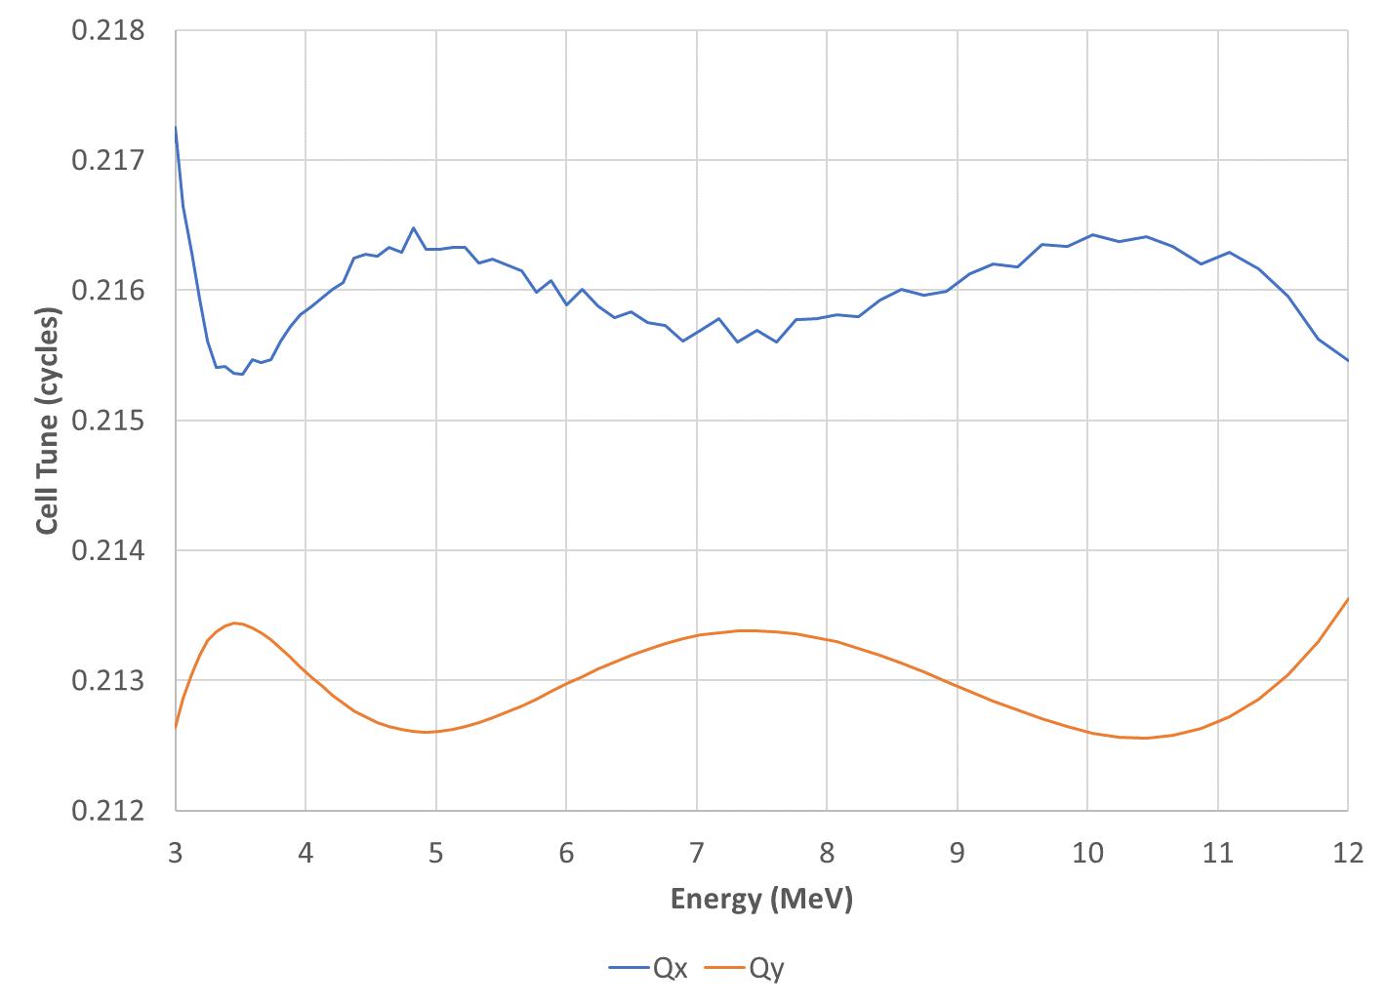
Cell Tunes
Target cell tunes Q_{x}=0.216, Q_{y}=0.213

Slide 9
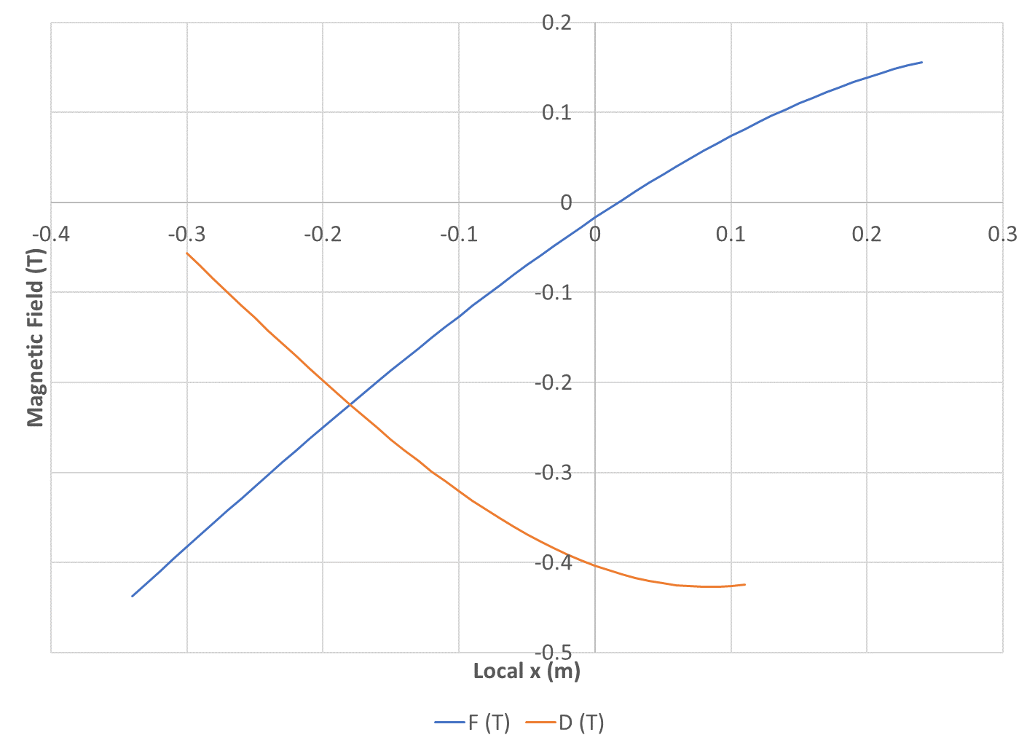
Field Profiles
← 12MeV, ring outside
3MeV, ring inside →
Only plotted in beam region, including sagitta

Slide 10
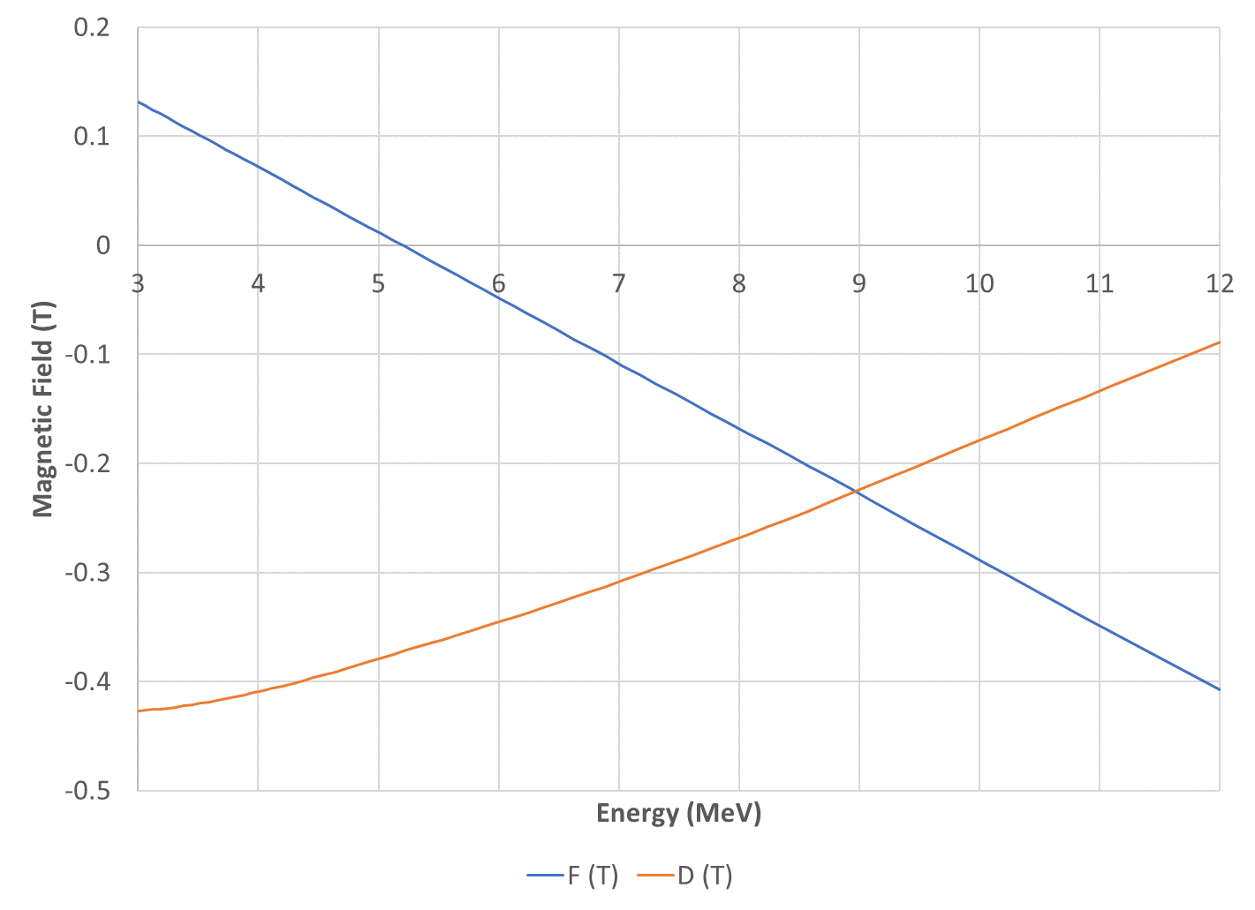
Field vs. Kinetic Energy

Slide 11
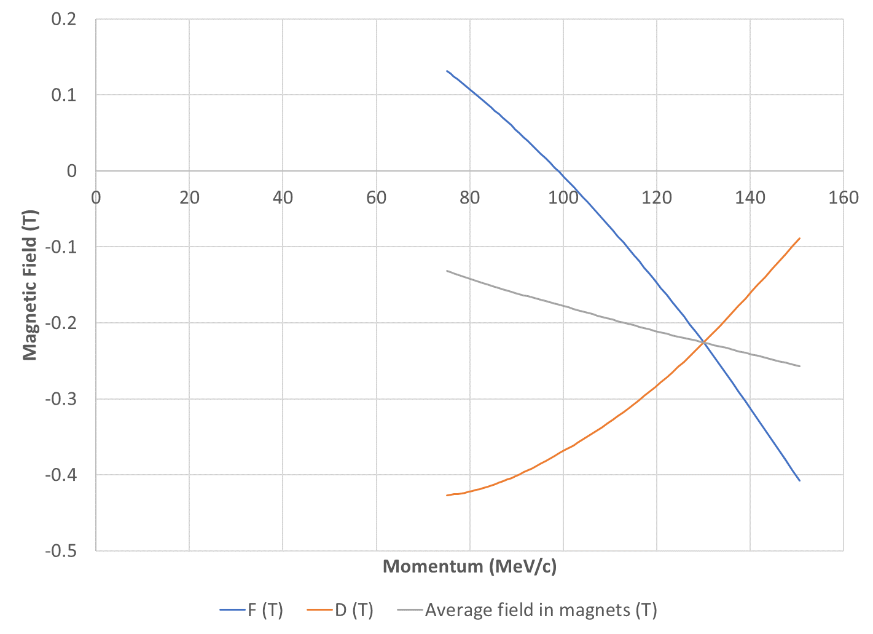
Field vs. Momentum
Average field should be proportional to momentum
Not exactly because I used “average” position in each magnet

Slide 12
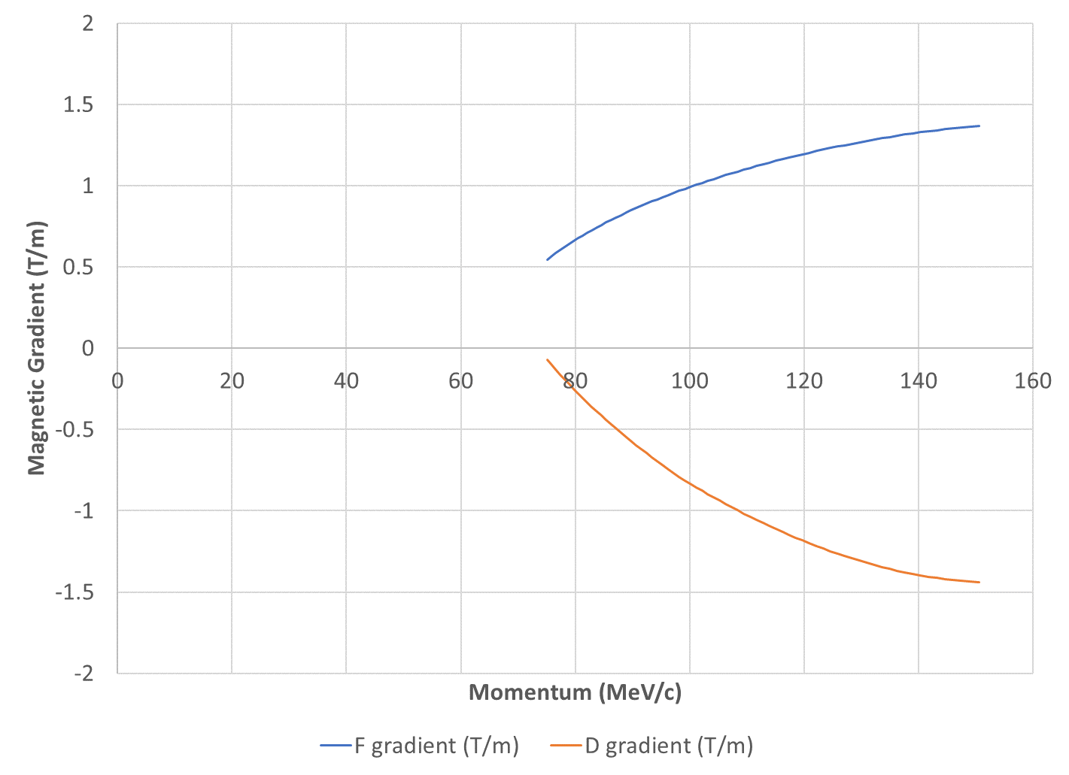
Gradient vs. Momentum
In a thin-lens model, the gradients should be proportional to momentum
Here they are not, I suspect edge focussing

Slide 13
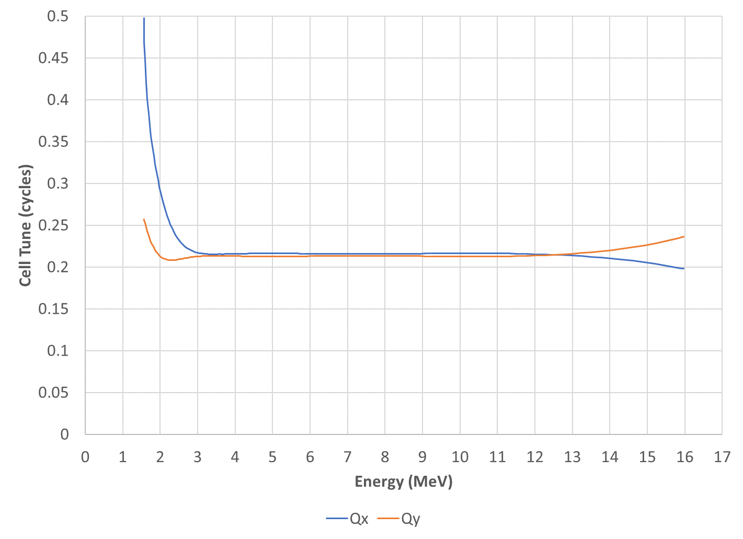
Tunes Beyond Energy Range
Target cell tunes Q_{x}=0.216, Q_{y}=0.213
Hits magnet bounding box

Slide 14
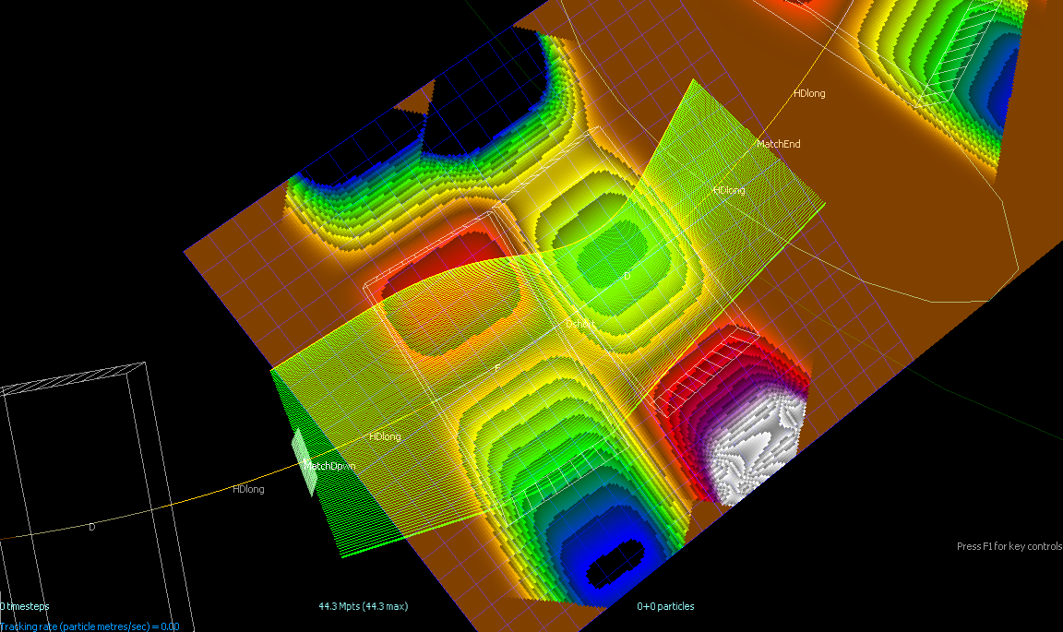
Orbits Beyond Energy Range

Slide 15
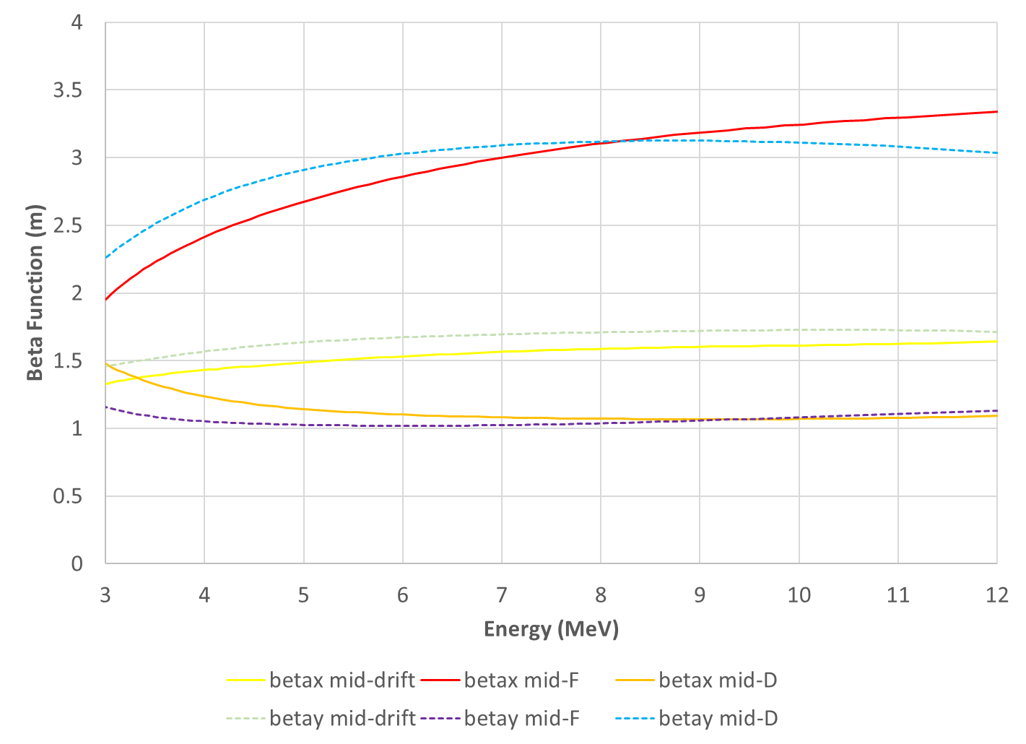
Beta x,y vs. Kinetic Energy

Slide 16
Tune Range Requirement
Q_{x,y} tunable over full range of 1 in ring
  For exploration of the tune plane in R&D
  I chose 12 cells so this is 1/12 range per cell
Q_{x}=0.216, Q_{y}=0.213 would be ring tune of (2.592,2.556)
So choose 2.5 to 3.5 ring tune range in both planes
  0.2083 to 0.2917 cell tune (all combinations)

Slide 17
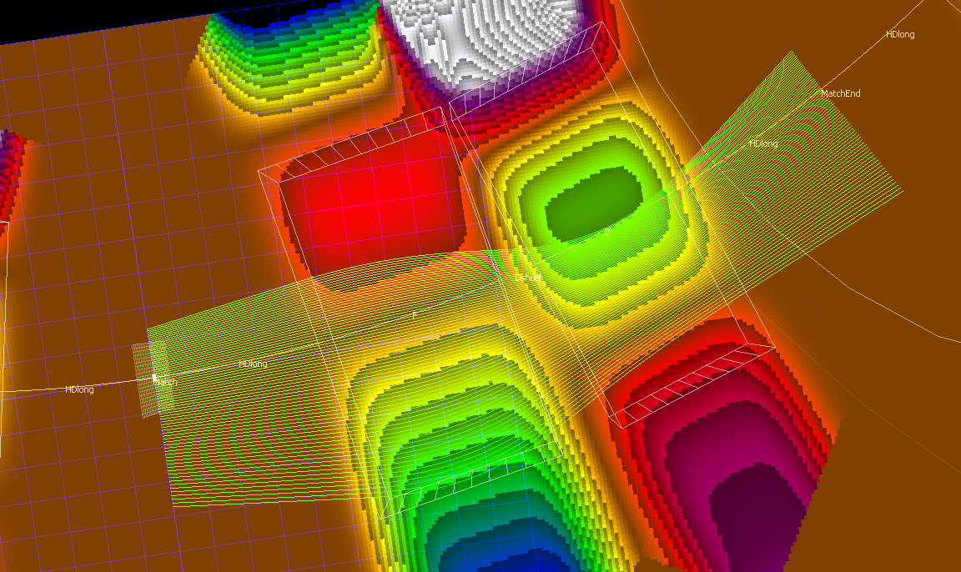
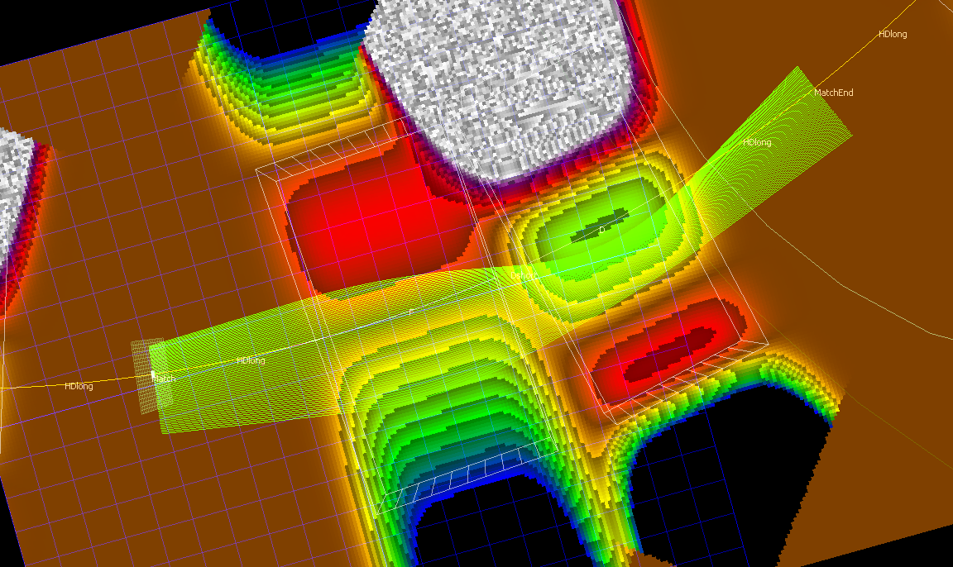
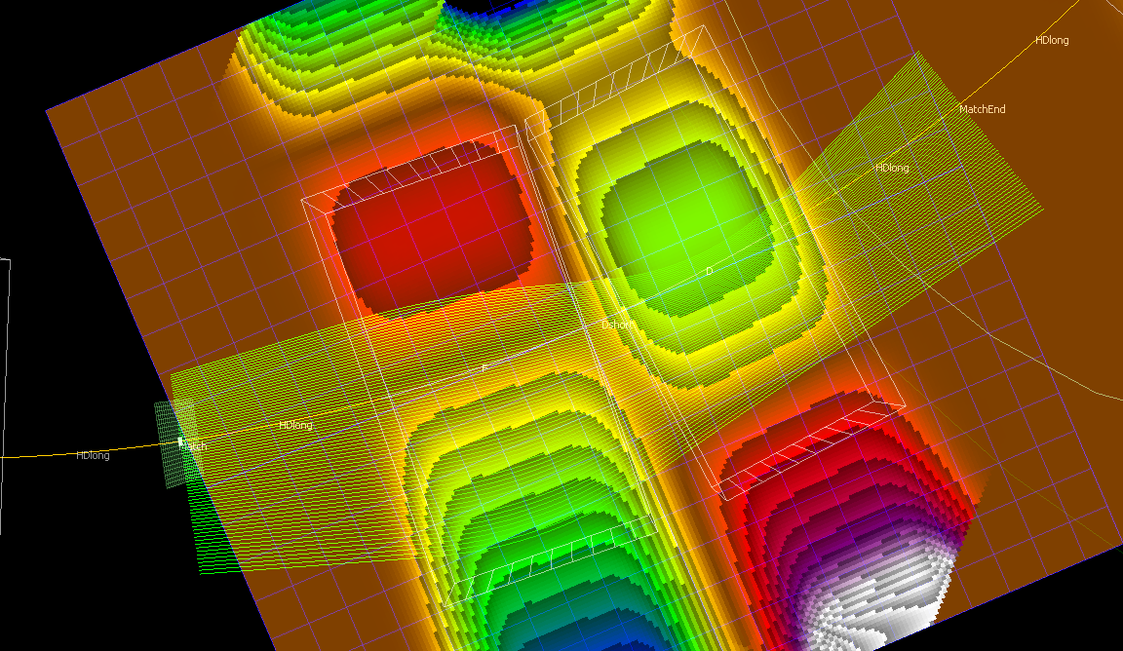
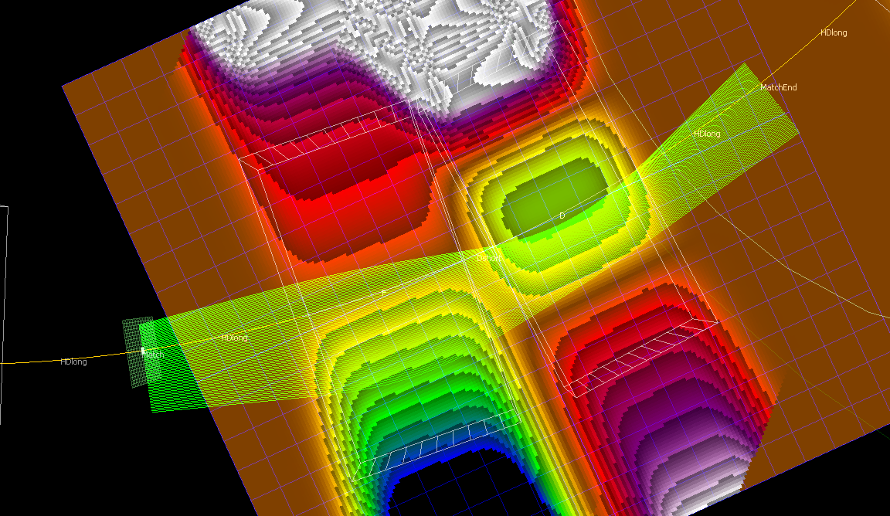
Four Tune “Corners”
Q_{x}=0.2083, Q_{y}=0.2917
Q_{x}=0.2917, Q_{y}=0.2917
Q_{x}=0.2083, Q_{y}=0.2083
Q_{x}=0.2917, Q_{y}=0.2083

Slide 18
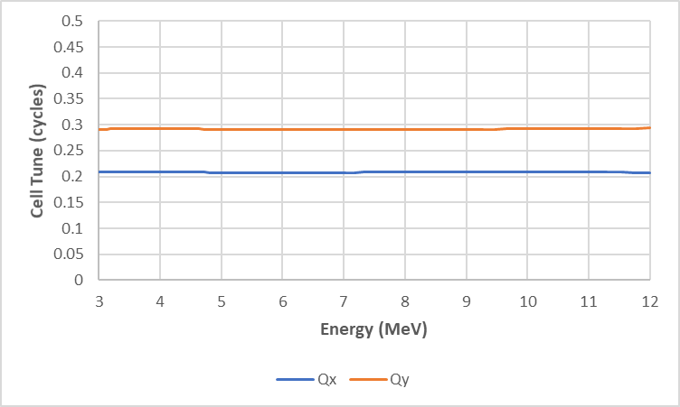
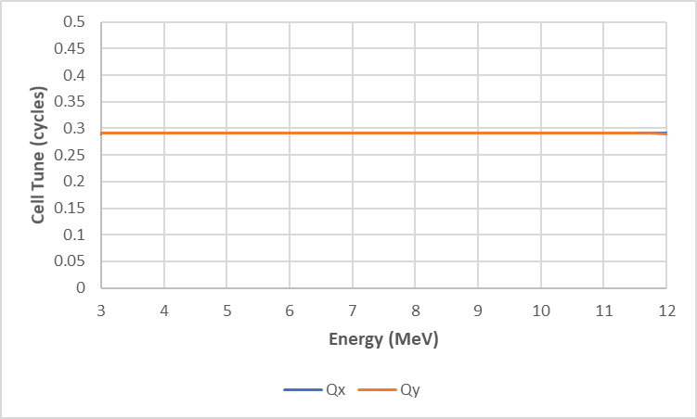
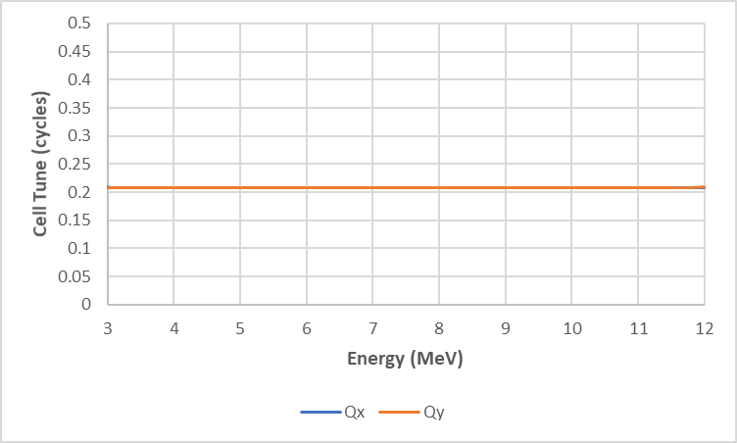
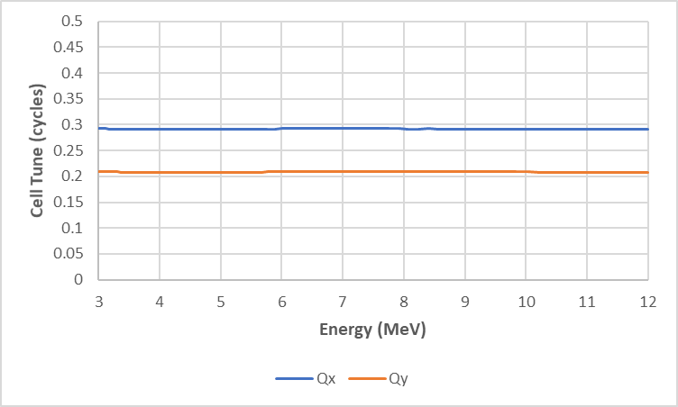
Cell Tunes at Corners
Q_{x}=0.2083, Q_{y}=0.2917
Q_{x}=0.2917, Q_{y}=0.2917
Q_{x}=0.2083, Q_{y}=0.2083
Q_{x}=0.2917, Q_{y}=0.2083

Slide 19
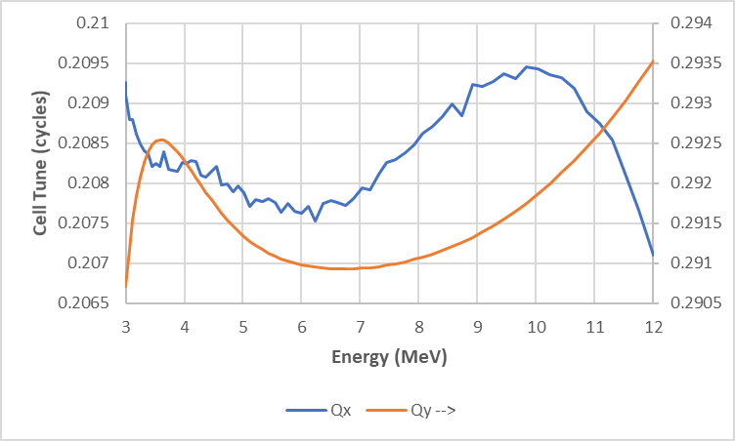
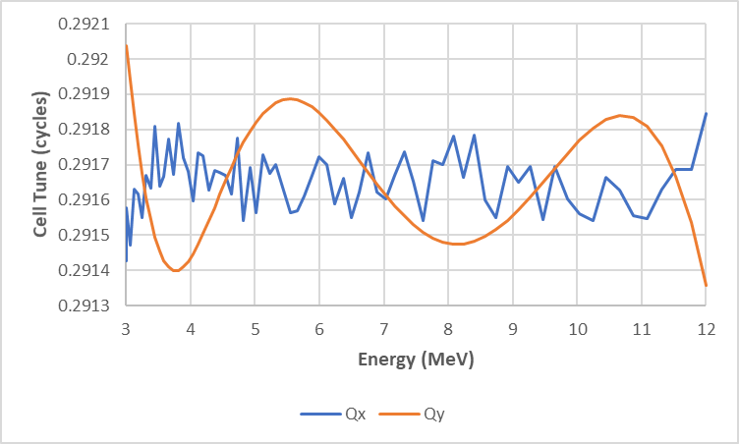
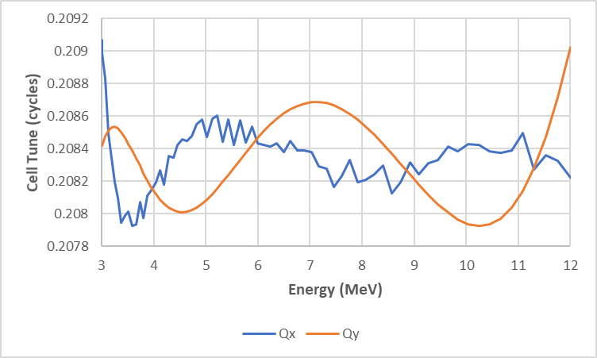
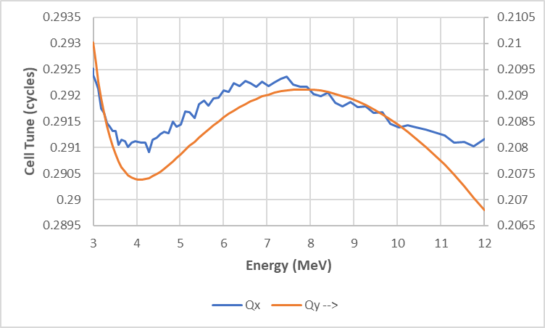
Cell Tunes at Corners (zoom)
Q_{x}=0.2083, Q_{y}=0.2917
Q_{x}=0.2917, Q_{y}=0.2917
Q_{x}=0.2083, Q_{y}=0.2083
Q_{x}=0.2917, Q_{y}=0.2083

Slide 20
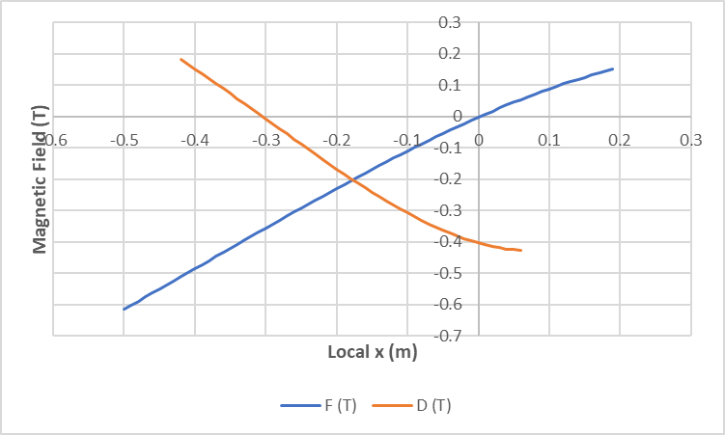
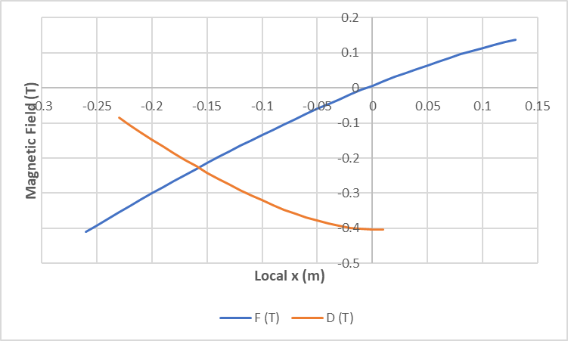
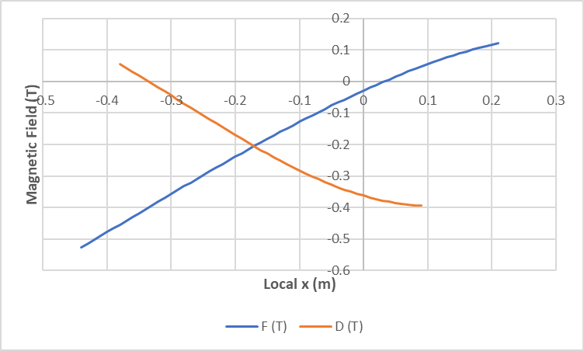
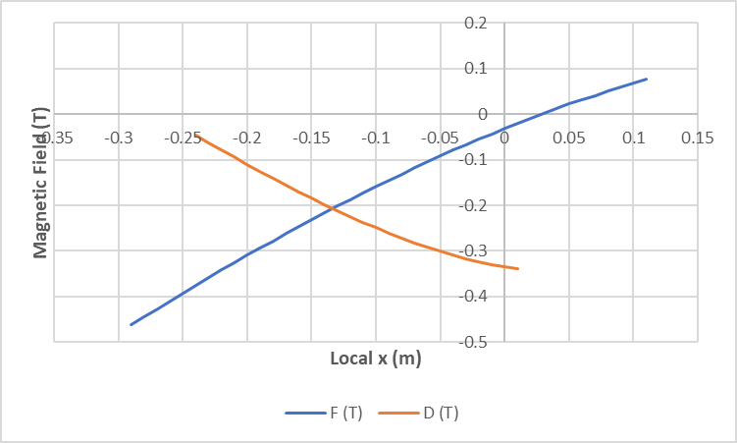
Field Profiles of Corner Designs
Q_{x}=0.2083, Q_{y}=0.2917
Q_{x}=0.2917, Q_{y}=0.2917
Q_{x}=0.2083, Q_{y}=0.2083
Q_{x}=0.2917, Q_{y}=0.2083

Slide 21
Designs Summary Table
Cell Q_{x} | Cell Q_{y} | Max tune error | Max field (T) | Orbit range (m)
0.2083 | 0.2083 | 0.00074 | 0.5204 | 0.641
0.2083 | 0.2917 | 0.00185 | 0.6128 | 0.688
0.2917 | 0.2083 | 0.00168 | 0.4466 | 0.389
0.2917 | 0.2917 | 0.00037 | 0.4004 | 0.381
0.216 | 0.213 | 0.00126 | 0.4310 | 0.573
Q_{x} low, Q_{y} high corner is most “unnatural”
  Largest orbit excursion, highest field
    Had to let optimiser vary dipole to stay in magnet box
Higher Q_{x} tunes greatly improve orbit range

Slide 22
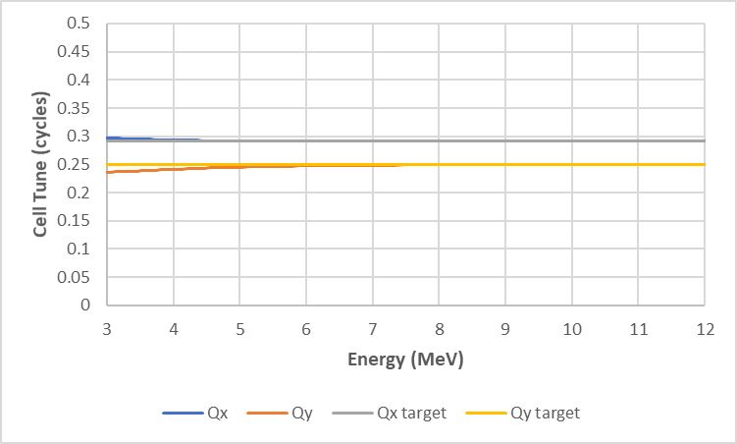
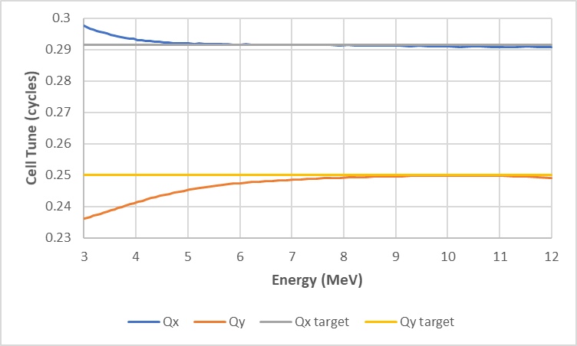
Half-way Interpolation Result
What happens if you average the fields (equivalently, multipole coefficients) between two of the corner designs?
  (0.2917,0.2083),(0.2917,0.2917) → (0.2917,0.25)?
Not so bad, especially at higher energies, but needs re-tuning iteration

Slide 23
Horizontal Omni-Magnets
Round ones were described in my IPAC’13 paper
“Arbitrarily” configurable field B_{y}(x)
  Are their own correctors
Try flat 80cm-wide poles, 8cm full gap, with large embedded pole face windings
  20 windings each top and bottom
  2x4cm cross-section, 4cm horizontal pitch
Main 8x16cm H-magnet-style coil for dipole
Pole face windings return on nearest side
  Produce quadrupole if all have equal current

Slide 24
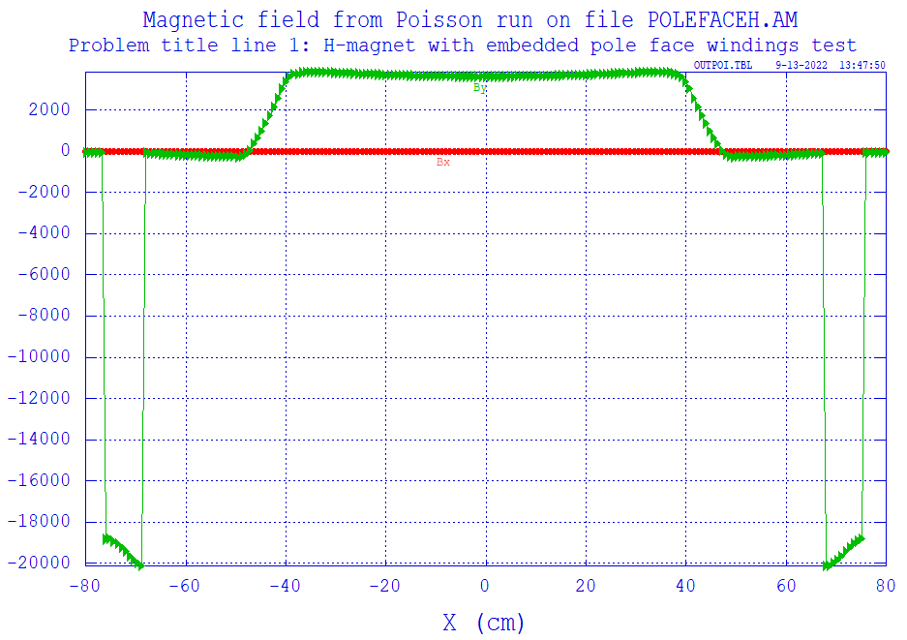
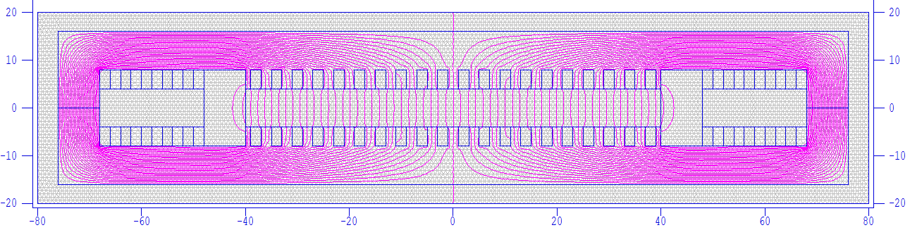
Main Dipole Coil @ 5A/mm²
Roughly flat field, about 0.4T
2D designs in Poisson/SuperFish
(plots are in cm, Gauss)

Slide 25
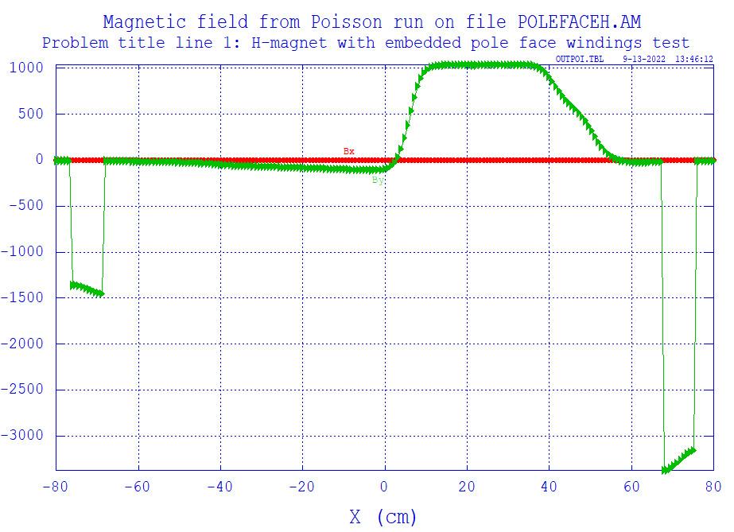
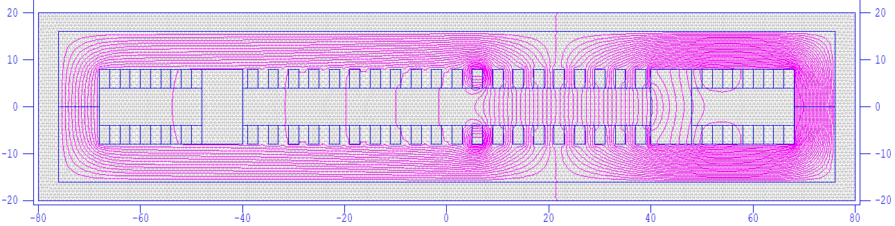
Single Pole Winding @ 5A/mm²
Produces ~0.1T field plateau to return side

Slide 26
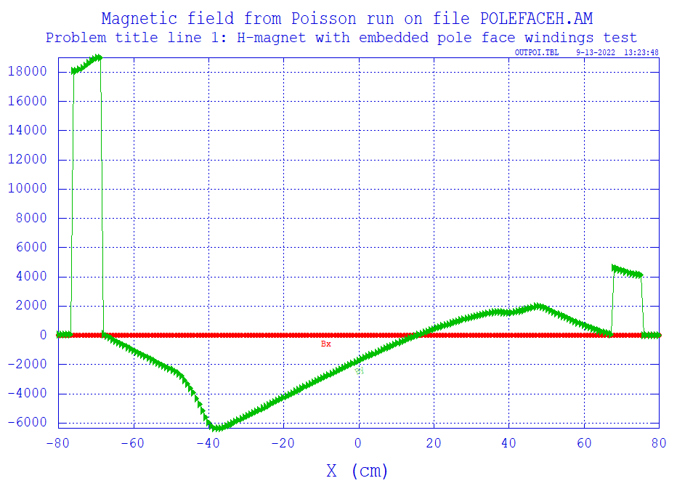
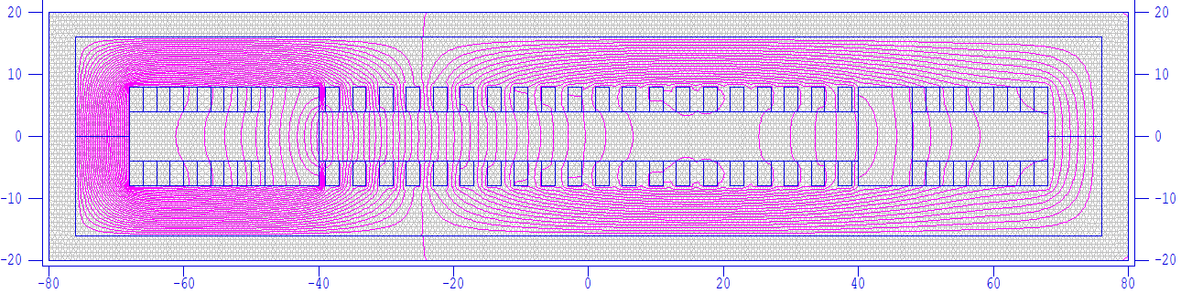
Q_{x}=0.2083, Q_{y}=0.2917 F magnet
0.613T peak field, “hardest case”

Slide 27
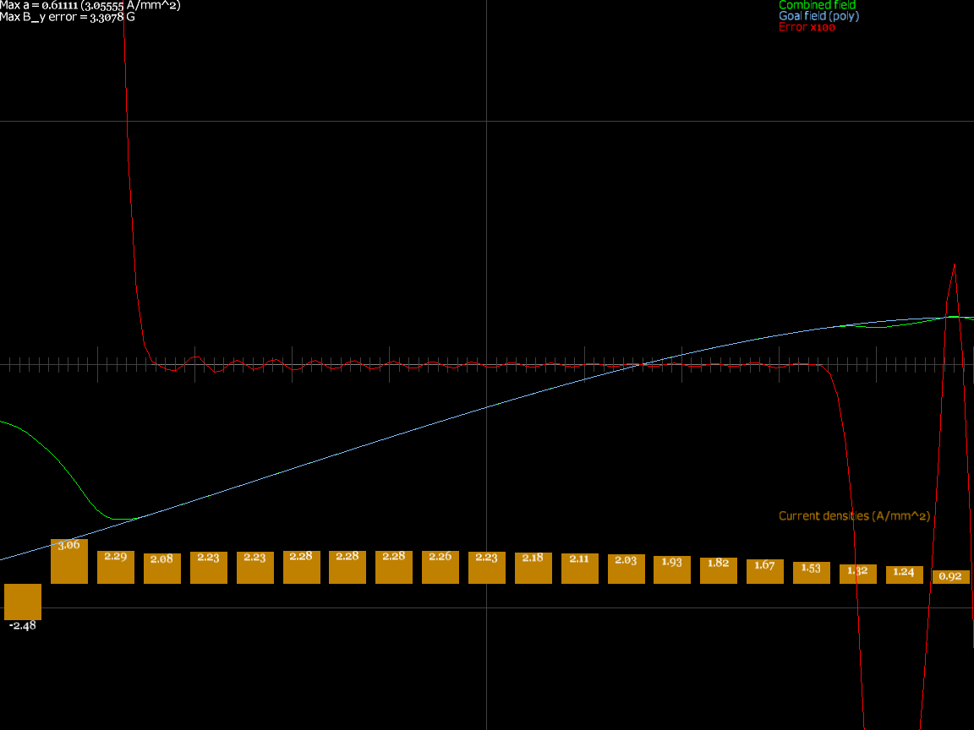
Q_{x}=0.2083, Q_{y}=0.2917 F magnet
Winding current densities were found by SVD / least squares

Slide 28
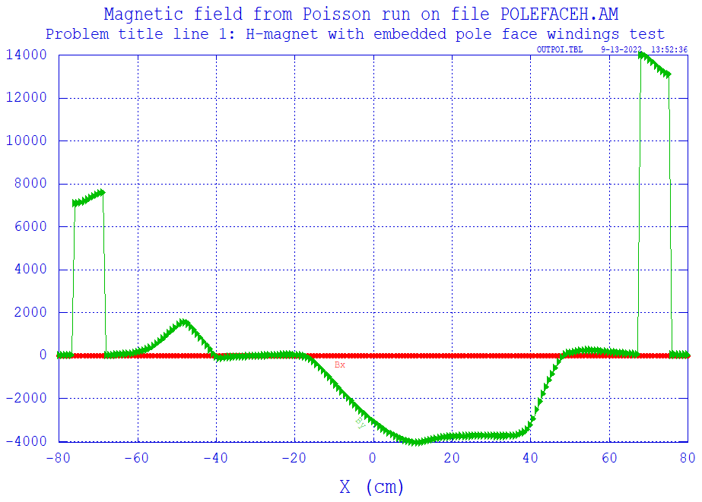
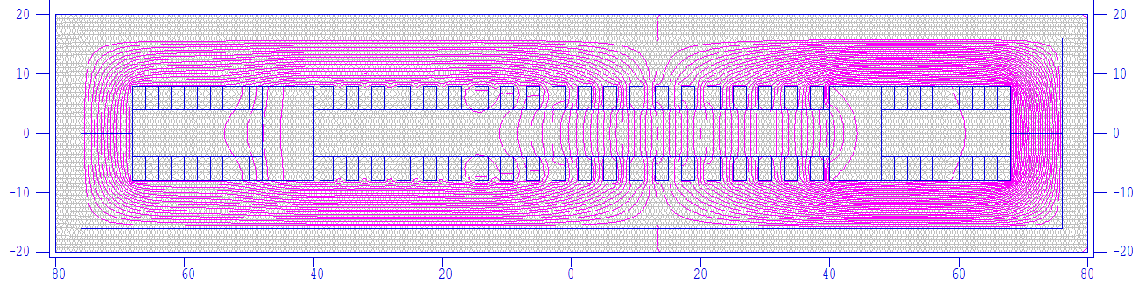
Q_{x}=0.2917, Q_{y}=0.2917 D magnet
0.404T peak field, only requires small part of aperture

Slide 29
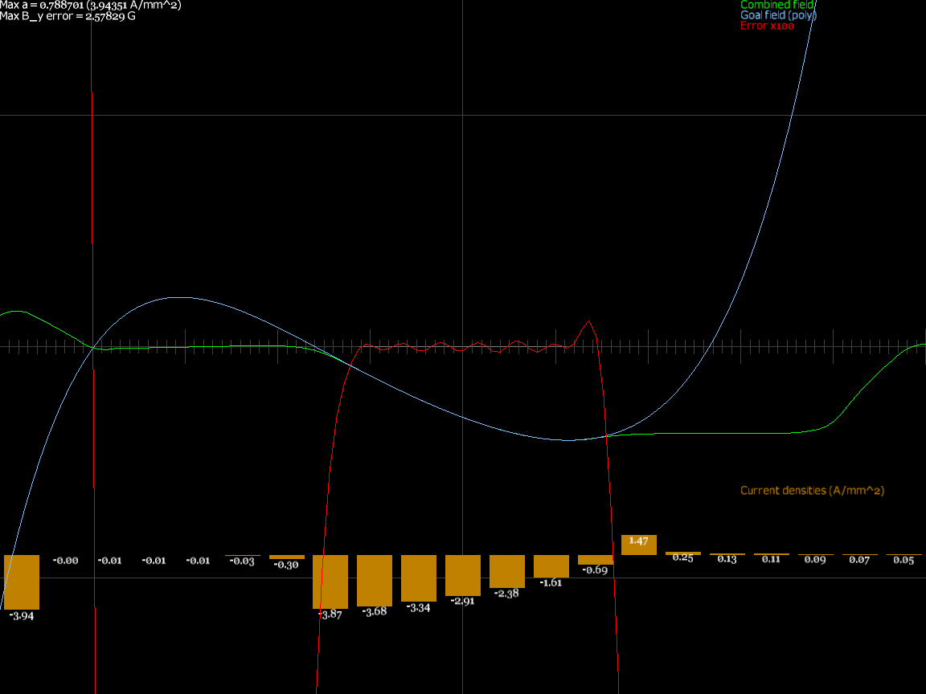
Q_{x}=0.2917, Q_{y}=0.2917 D magnet
SVD only activates coils in the region they have an effect

Slide 30
Magnets Summary Table
Cell Q_{x} | Cell Q_{y} | Magnet name | Max current density (A/mm²) | Max B_{y} error (G) | Max field (T) | Orbit range (m)
0.2083 | 0.2083 | F | 2.090 | 2.25 | 0.5201 | 0.641
 |  | D | 3.111 | 1.98 | 0.3921 | 0.460
0.2083 | 0.2917 | F | 3.056 | 3.31 | 0.6126 | 0.688
 |  | D | 2.955 | 2.31 | 0.4260 | 0.471
0.2917 | 0.2083 | F | 3.073 | 2.23 | 0.4418 | 0.389
 |  | D | 3.189 | 1.89 | 0.3370 | 0.247
0.2917 | 0.2917 | F | 3.480 | 2.50 | 0.3883 | 0.381
 |  | D | 3.944 | 2.58 | 0.4035 | 0.224
0.216 | 0.213 | F | 2.372 | 1.88 | 0.4224 | 0.573
 |  | D | 4.256 | 2.32 | 0.4270 | 0.400

Slide 31
Quick Dynamic Aperture Test
Started 8 particles at (x,y) = (±2.5/0,±2.5/0)cm
  Cell Q_{x}=0.216, Q_{y}=0.213 design
Tracked in ring for 60μs, all survived
Some particles at 3cm did not
Can use ε = x_{inj}²/β_{inj} to get apertures
Energy | Cells (in 60μs) | Turns | ε_{x} (geom.) | ε_{y} (geom.)
3MeV | 697 | 58 | 471 | 428 mm.mrad
6MeV | 954 | 79 | 408 | 374 mm.mrad
12MeV | 1266 | 105 | 381 | 365 mm.mrad

Slide 32
Dynamic Aperture Notes
FETS-FFA request was 100mm.mrad normalised at 3MeV (βγ=0.080)
  = 1250 mm.mrad geometric
β_{y} = 1.46m at 3MeV injection point
  Implies y = ±4.27cm (or ±5.31cm at maximum β_{y})
  Larger than the magnet aperture (±4cm)!
This DA is not the painted beam size, it is a stability margin (all beam ≤ 250 mm.mrad)

Slide 33
Conclusion (part 1)
Found fixed tune lattices to ~0.001 in cell tune
  And automated: eliminated most hand-tuning!
Dynamic aperture low by factor 2-3× in ε
  Not small by most standards: >400mm.mrad
  Haven’t explored the full tune plane yet
Magnetic efficiency about twice as good as (spiral) scaling FFA, magnets buildable
  ~0.6T max field on beam vs. ~1.2T
Very interesting machine type

Slide 34
Future Work (still haven’t done!)
Dynamic aperture search of tune plane
  And maybe other parameters like fringe length or magnet edge angles (rect vs. sector etc.)
Try expressing transverse field as something better-conditioned than polynomials
  Like Fourier series, or Chebyshev polynomials
Maybe investigate low-level tune “noise” in Muon1 tracking/optics algorithm
  Could also be field model nonsmoothness

Slide 35
Permanent Magnets for Hadron Therapy Accelerator

Slide 36
Application
Dejan Trbojevic proposes to accelerate protons with a rapid cycle (100s of Hz to kHz) for FLASH hadron therapy
  Many machine cycles within 100ms allow different energy (depth) slices to be done as well as being quick enough to trigger the biological FLASH effect
Need an FFA ring which also has fixed tunes
  But needs to fit in the hospital, so smaller than a scaling FFA → nonlinear fixed-tune NS-FFA

Slide 37
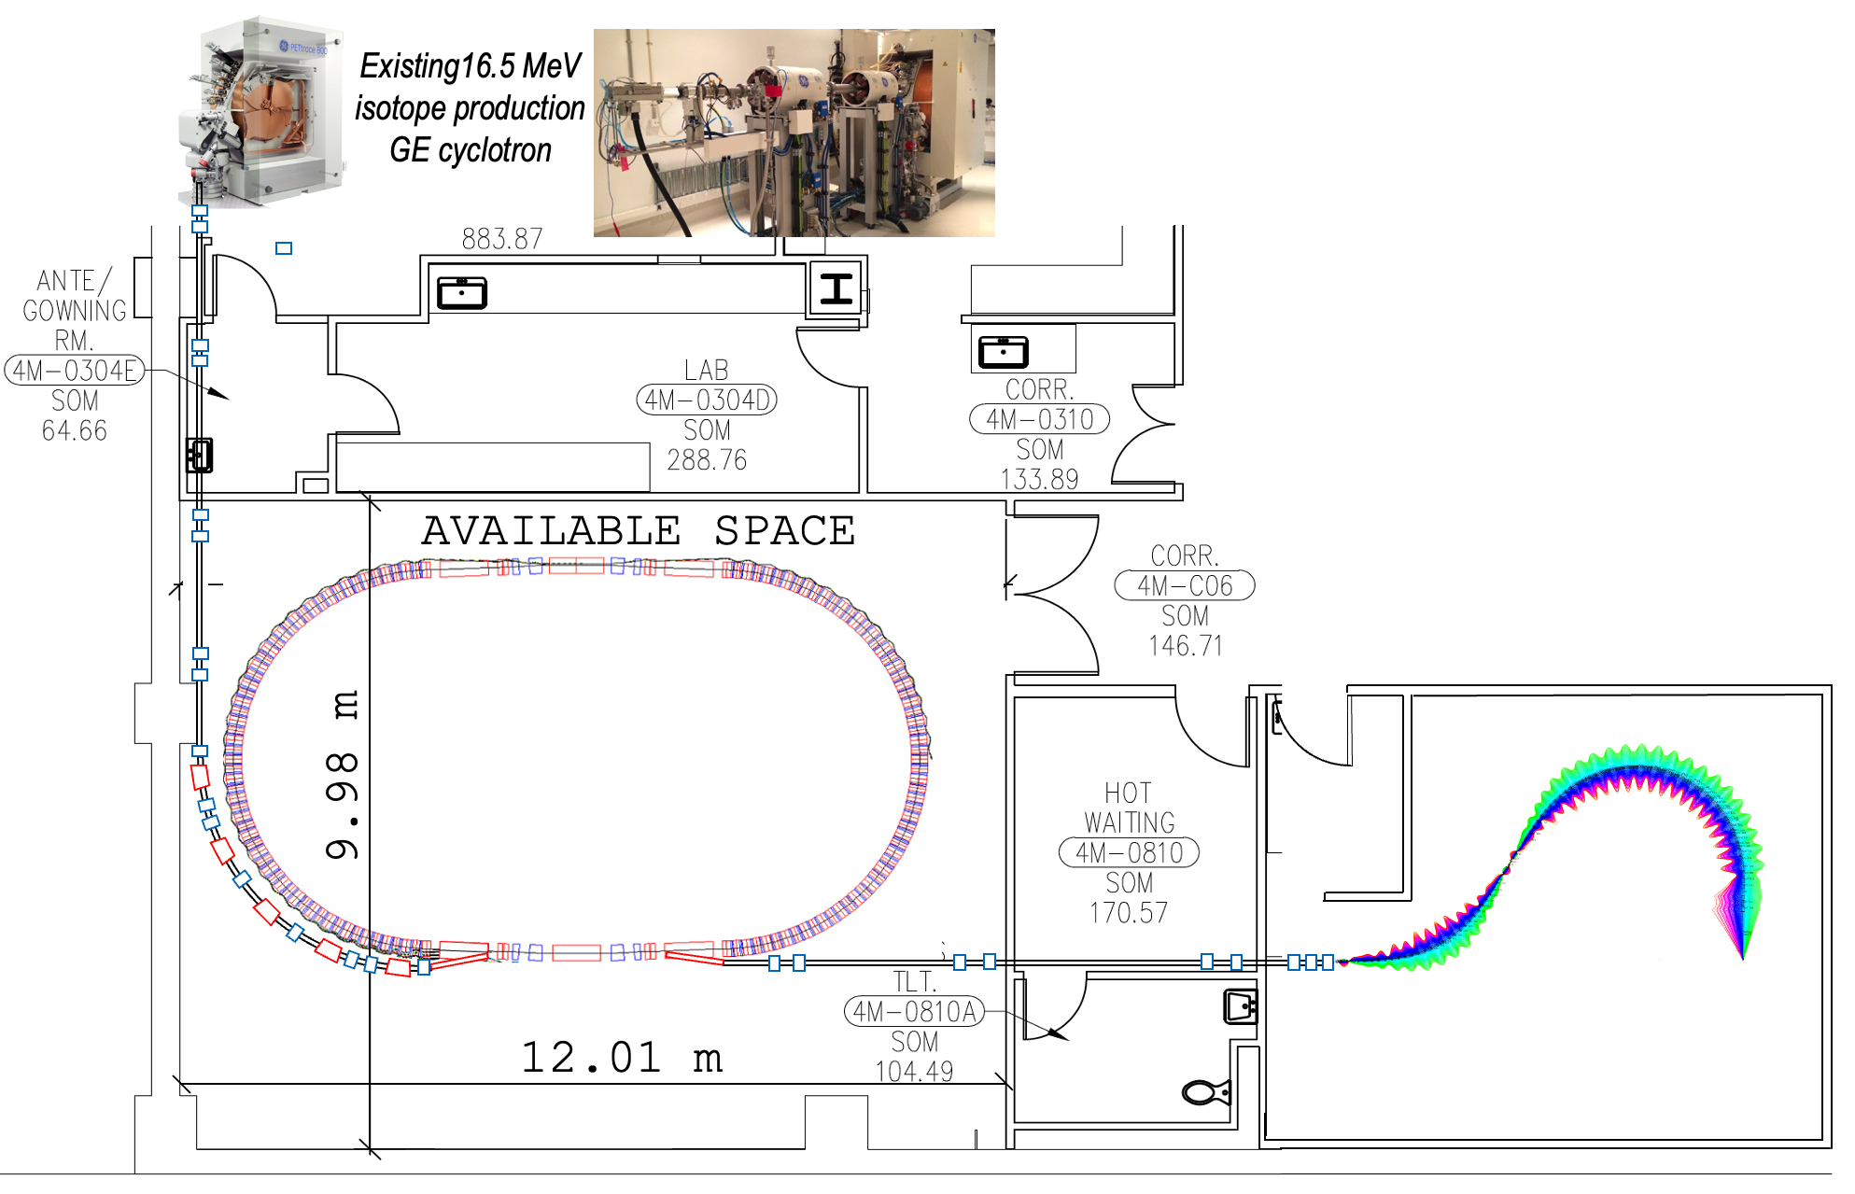
‘FLASH’ Proton Therapy facility:
Stony Brook University Hospital – Radiation Oncology
6. D. Trbojevic, Title: “Non-scaling fixed field alternating gradient permanent magnet cancer therapy accelerator”, patent number: US 9661737 B2, Date of the patent: May 23, 2017 (belongs to the DOE). https://patentimages.storage.googleapis.com/42/5e/92/f7da1cf617d6e3/US9661737.pdf

Slide 38
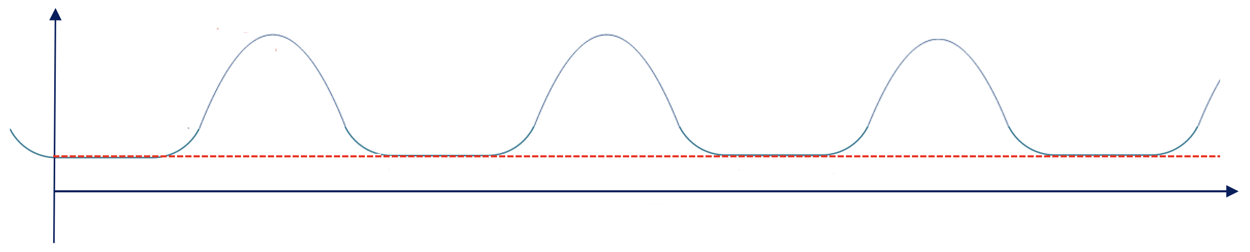
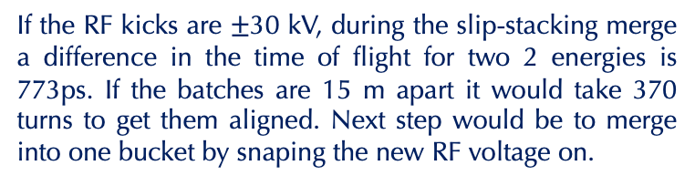
Fast Cycling Synchrotron Cycles
Kinetic
Energy
(MeV)
Extraction #2
250
Ex.1
Ex.2
RF manipulation
Ex.3
16.5-30
Injection
Energy
Second synchrotron cycle
t(ms)
Injection
Porch
One synchrotron cycle
Extraction kicker wave forms
0.8ms < τ < 1.85ms
1.3kHz< f < 540 Hz
If the RF kicks are $±$30 kV, during the slip-stacking merge a difference in the time of flight for two 2 energies is 773ps. If the batches are 15 m apart it would take 370 turns to get them aligned. Next step would be to merge into one bucket by snaping the new RF voltage on.
Time of bunch flight 405-550 ns
At the injection porch time of 926 μs there are 1680 turns. 15 turns for 15 Cyclotron bunches and 1650 turns for RF manipulations

Slide 39
Fast Cycling Acceleration with Ferrite cavities
By Stephen Brooks
 | Choices for injector cyclotron |  |  |  | Units
 | ACSI | GE | TR-19 | IBA
Energy of Injector Cyclotron | 14 | 16.5 | 19 | 30 | MeV
Cyclotron current | 400 | 200 | 400 | 1200 | μA
Treatment charge | 60 | 60 | 60 | 60 | nC
Injection turns | 4 | 4 | 4 | 2 | #
RF acceleration per turn | 29.70 | 29.70 | 29.70 | 44.55 | kV
Calculation | Treatments Options
Turn duration | 585.74 | 540.6 | 504.8 | 405.1 | ns
Charge per turn | 0.234 | 0.108 | 0.151 | 0.486 | nC
Charge per injection | 0.937 | 0.432 | 0.606 | 0.972 | nC
Machine cycles | 65 | 139 | 100 | 62 | #
Machine cycle rate | 540 | 540 | 540 | 809.95 | Hz
Outputs
Treatment time | 120 | 257 | 185 | 76.54 | ms

Slide 40
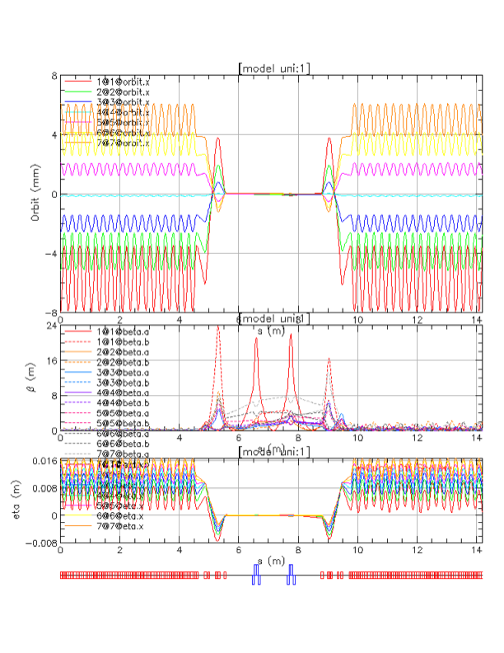
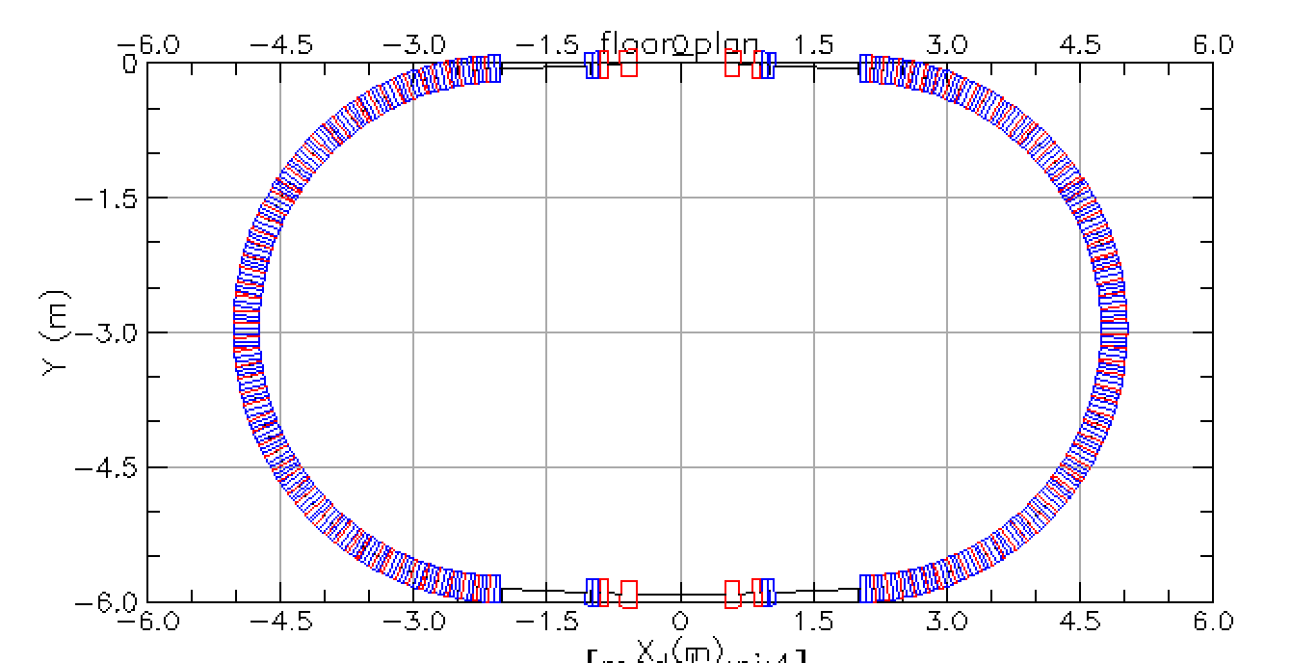
Matching of the Multiple Energy Orbits to the Straight Section
5.8 m

Slide 41
Lattice Converted from BMAD
Three cells for field wrap
Multipoles dipole…dodeca
This worked well in BMAD, fixed stable tunes from 10MeV – 250MeV

Slide 42
BMAD and Muon1 Magnet Models
BMAD has a zero-length end field model
Muon1 has a Maxwellian fringe field model with finite length
  But you have to choose the length yourself!
We also changed from sectors to rectangles but that turned out to be a small effect
Discrepancy shown here is probably because BMAD end fields were accidentally turned off!

Slide 43
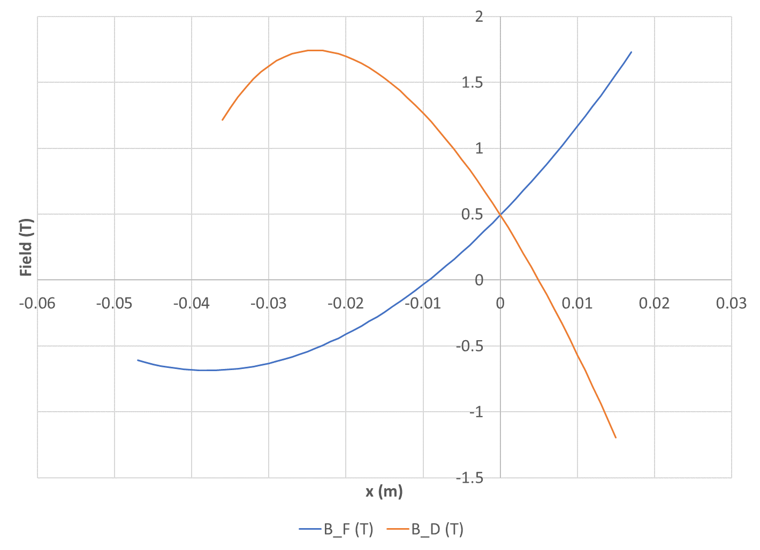
Field Profiles

Slide 44
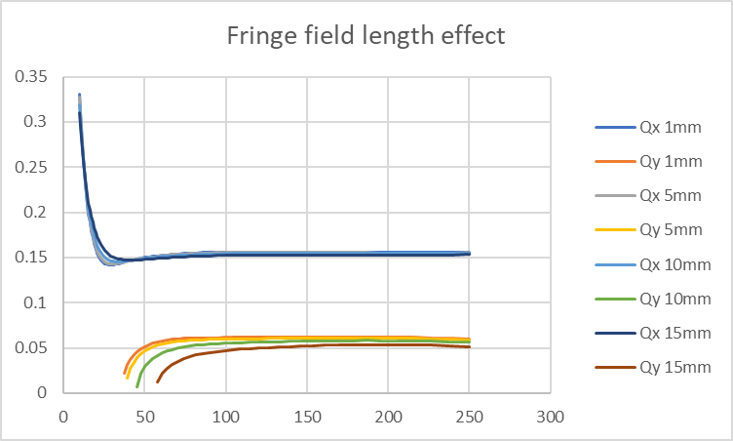
Original Lattice in Muon1
It’s unstable at the low end no matter what fringe field length I choose
Cell tune
MeV

Slide 45
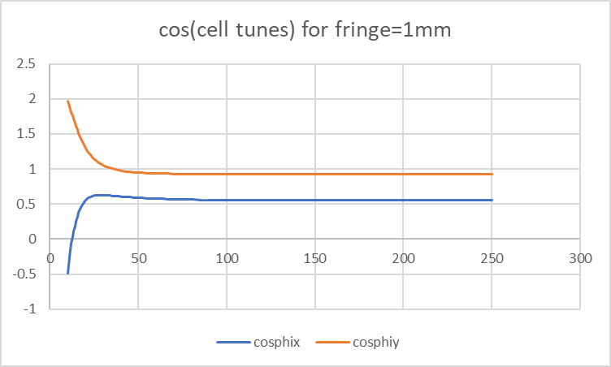
cos(cell tunes)
Even with a fringe=1mm it is unstable, although closed orbits exist
MeV

Slide 46
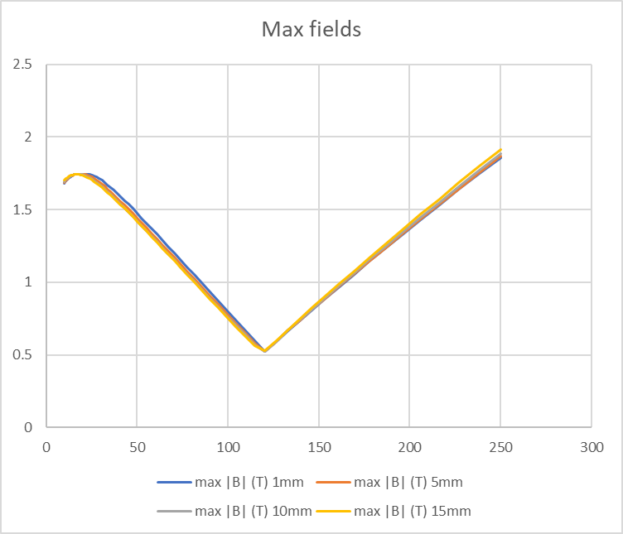
Peak Fields on Orbit (vs. Energy)
T
MeV

Slide 47
This cell can be easily fixed using the same Algorithm
Runge-Kutta 4th order tracking step
Loop to get trajectory in cell
Finite difference to get transfer matrix
  Also gives tunes if orbit is closed
Iterate (Newton) to find closed orbit
Loop over all FFA energies
Finite difference parameters to get response matrix of tune functions to multipole changes
Iterate (optimiser) to find fixed-tune lattice
Muon1
Muon1 cell optics mode
Muon1 FFA optics mode
Fixed-tune FFA optimiser
(parallel)

Slide 48
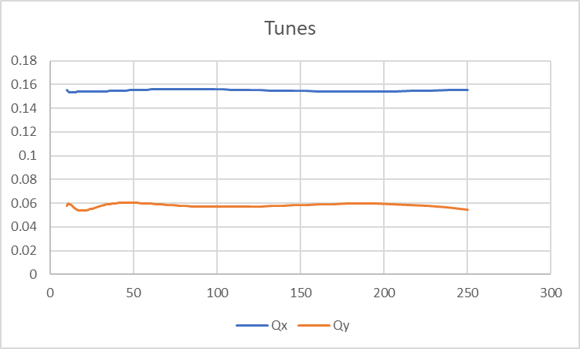
Tunes After Correction in Muon1
Tunes stable from 10MeV – 250MeV and somewhat constant, although could be improved.
(Wiggly near low energy end because rigidity changes fast there).
Cell tune
Qx = 0.1547 ± 0.0013
Qy = 0.0571 ± 0.0034
MeV

Slide 49
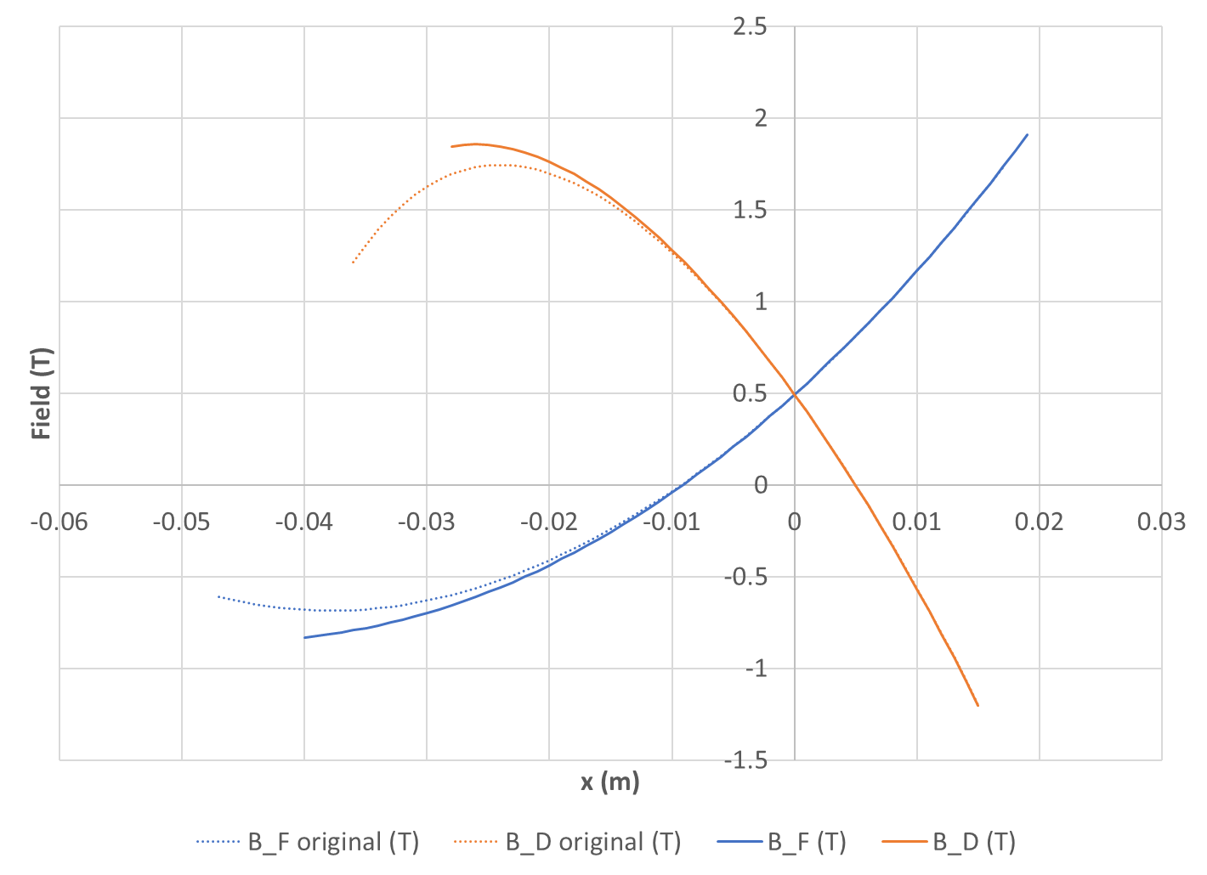
Field Profiles After Correction

Slide 50

Peak Fields After Correction
T
MeV

Slide 51

Orbits and Fields in Muon1

Slide 52

Increase Low Energy to 16.5MeV
Use a bigger cyclotron as an injector
  Momentum ratio 5.31× → 4.13×, easier to do
Tunes a little better but still wiggly
Qx = 0.1547 ± 0.0008
Qy = 0.0581 ± 0.0031

Slide 53

Allow 14- and 16-pole Components
That’s noticably better (2-3× less variation)
Probably polynomial isn’t the best field basis
  Use Fourier series transversely instead?
Qx = 0.1545 ± 0.0004
Qy = 0.0577 ± 0.0010

Slide 54

Field Profiles 12- vs. 16-pole
About 1 part in 1000 change

Slide 55

Orbits and Fields in Muon1

Slide 56

Permanent Magnet Designs (F)
NdFeB material
N42EH grade
B_{r}=1.3T
107.28cm² area
64.4 x 16mm aperture
Good field X±26.2mm
1.88T max field
cm grid

Slide 57

Permanent Magnet Designs (D)
NdFeB material
N42EH grade
B_{r}=1.3T
119.39cm² area
51.8 x 16mm aperture
Good field X±19.9mm
1.85T max field
cm grid

Slide 58

Magnet Field Error Graph (F)
~2×10⁻⁴ relative error

Slide 59

Magnet Field Error Graph (D)
~1×10⁻⁴ relative error

Slide 60

Permanent Magnet Wedges
We bought enough wedges to make two 45mm test sections of the nonlinear D magnet

Slide 61
Conclusion (part 2)
It looks like permanent magnets with small apertures and >1.8T fields can be used as a driver for FLASH proton therapy
  No open midplane needed for protons
  Higher field gives more compact machine
Main challenge is actually RF that sweeps frequency at ~500Hz
  Have had some initial discussions with RAL
  May be similar to 2RF or PAMELA RF study

