Slide 1
VFFA Optics and Magnets
FFA Scaling Laws
VFFA Superconducting Magnet
VFFA Proton Accelerator
Isochronous 3D Cyclotrons
VFFA Electron Accelerator
VFFA Permanent Magnets
VFFA Electromagnets

Slide 2
I. FFA Scaling Laws

Slide 3
Features to Categorise FFAs
Transverse
  Magnetic field (linear, scaling or other nonlinear)
  Orbit motion (horizontal, vertical, diagonal)
  Tune variation (fixed, quasi-fixed or varying)
  Lattice cell (FODO, doublet, triplet, pumplet…)
    Does it use edge angle focussing? (then can use singlet)
Longitudinal
  Time of flight (fixed, quasi-fixed or varying)
  RF acceleration (pulsed or continuous wave)
Often called “isochronous”

Slide 4
Why Does the Orbit Move?
Orbit position is determined by an equilibrium effect: finding a stable closed orbit
  It is not directly “centrifugal force” pushing the beam outward at higher energy
Q: can you design a machine where the orbit moves inward with increasing energy?
Q: can you design a machine with two stable closed orbits?
  These exercises are tricky, maybe try them later
(Slides can be downloaded online)

Slide 5
Scaling Law
Suppose a magnetic field obeys the scaling law B(ax) = a^{k}B(x)
  For any a>0. This is a “continuous symmetry”
Q: how do the sizes of closed orbits in such a field change with momentum?
  Use the Lorentz force law F = q(E + v×B)
How do the tunes vary with momentum?
Are any other forms of scaling law possible?

Slide 6

Other Scaling Laws
Scale
+ rotate
B(r, θ+τ ln r) ∝ r^{k}
B ∝ r^{k}
Translate vertically
B(y, θ+τy) ∝ e^{ky}
B ∝ e^{ky}
General case: B(T ªx) = eªB(x), T any translation + rotation + scaling

Slide 7
Scaling FFA Problem
Just consider the radial direction so the scaling law becomes B(ar) = a^{k}B(r)
  Or by changing variables, B(r) = (r/r₀)^{k}B(r₀)
Exercise: differentiate this with respect to r
B’ has the same sign as B
Defocussing magnets are reverse bending!
  “Circumference factor” C=|B|_{max}/B_{avg}
To close a ring, must have more F than D

Slide 8
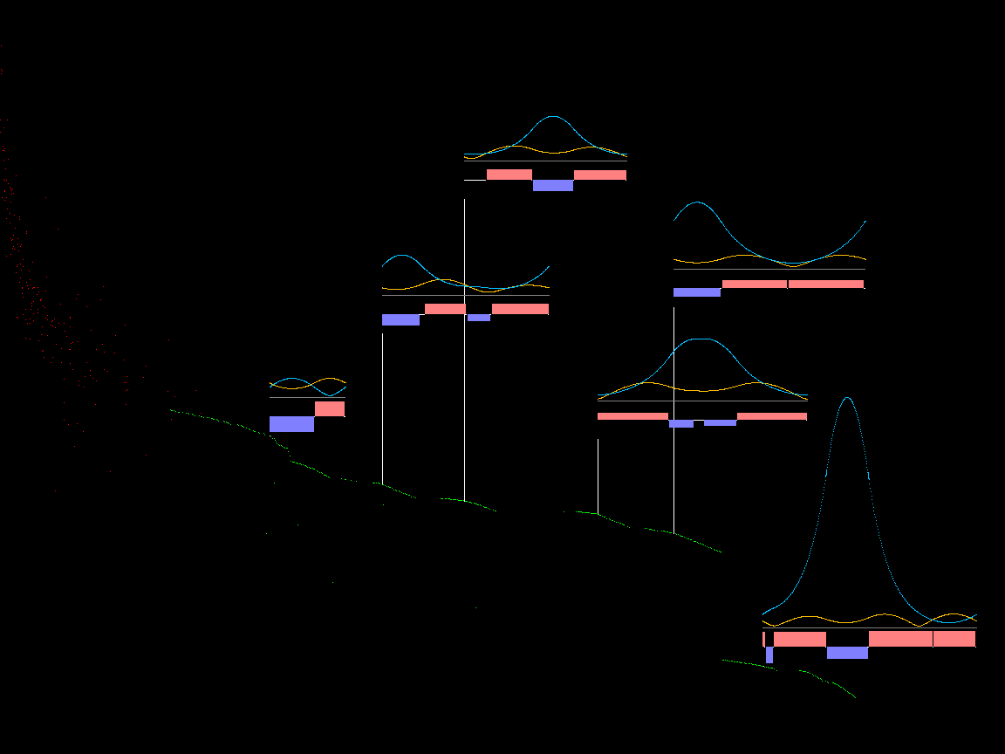
Scaling FFA Lattice Search Example
Estimated dynamic aperture (log)
0.47T
Field ∝ C
0.33T
0.57T
0.82T
0.36T
0.29T
April 29, 2019
Magnetic efficiency
September 10, 2023
Stephen Brooks, FFA’23 Workshop

Slide 9
II. VFFA Superconducting Magnet

Slide 10
Horizontal Aperture SC Magnet
Getting vertical B field requires same-direction current windings on opposing sides
B_{y} proportional to x/(a²+x²): cancels at x=0!
a

Slide 11
Constructive Interference
Getting horizontal B field requires opposite current windings and is easier
B_{x} proportional to a/(a²+x²)
a

Slide 12
Vertical Aperture SC Magnet
But now the field is in the wrong direction!
That's OK, rotate the magnet
The dipole field is there
But what sort of focussing does this magnet give?

Slide 13
“Scaling” VFFA Magnet
Dipole field should increase moving up the magnet, so set B_{y} = B₀e^{ky} on axis (x=0)
Subtracting dipole component leaves the field of a skew quad:
Exponential is good because moving upwards just scales the field and all gradients
Thus closed orbits at different momenta are exactly the same shape, just translated upwards
VFFA = Vertical orbit excursion FFA

Slide 14
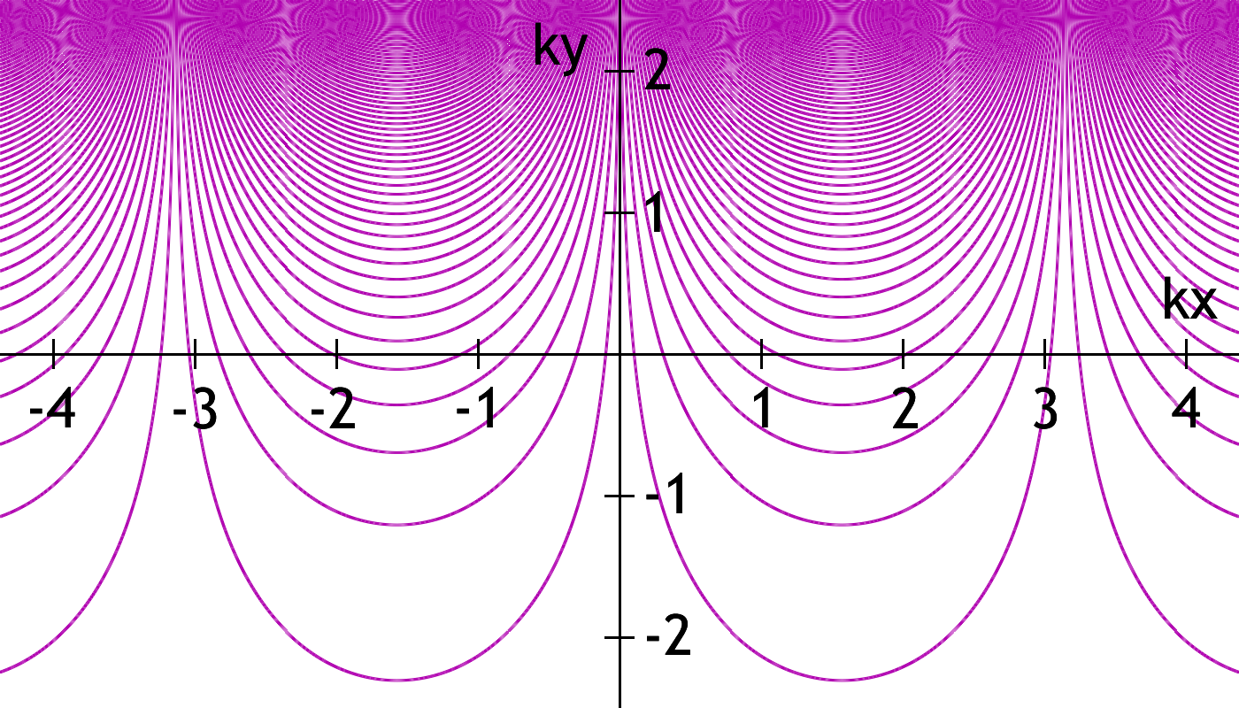
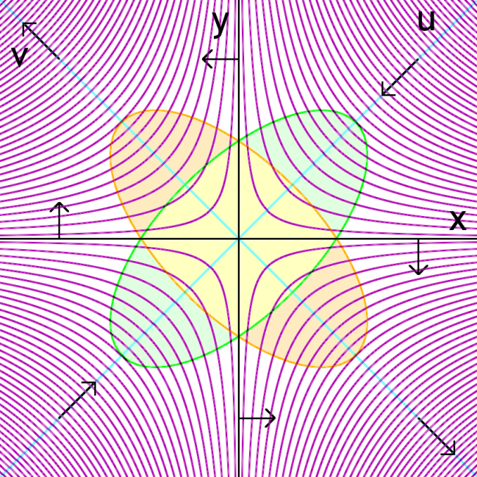
Scaling VFFA Field & Scaling Law

Slide 15
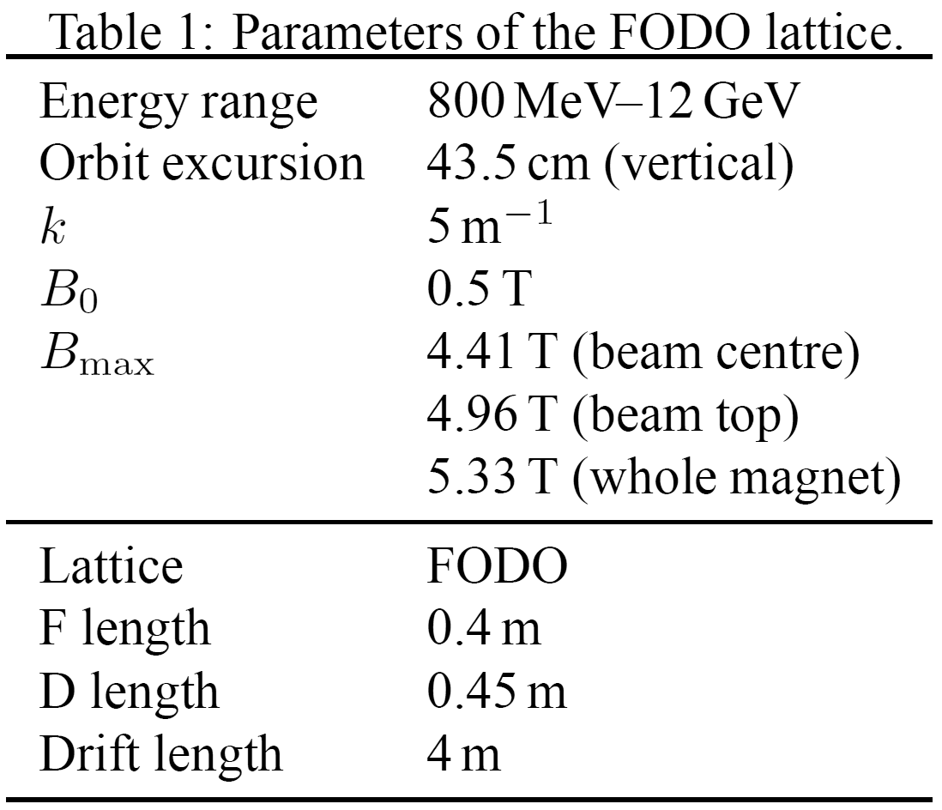
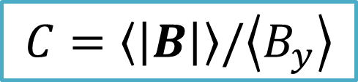
FODO Scaling VFFA Machine
First VFFA tracking simulation, for HB2010
  2D, zero space charge, nonlinear magnets
150mm.mrad ε_{geom} input beam
Proton-driver-like but nasty circumference factor! (C=17)

Slide 16
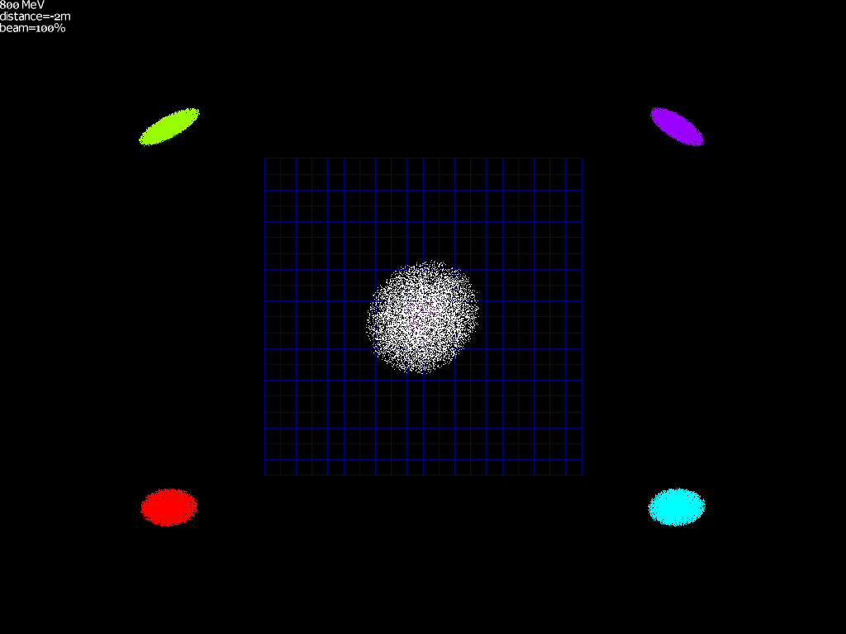

Slide 17
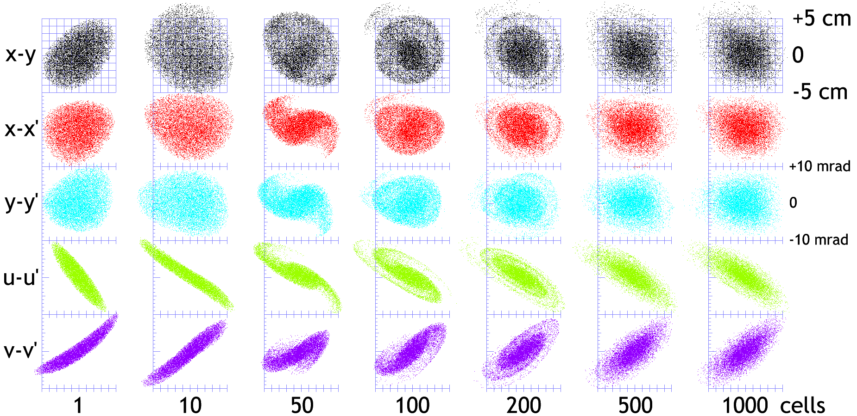
Scaling VFFA with Mismatch

Slide 18
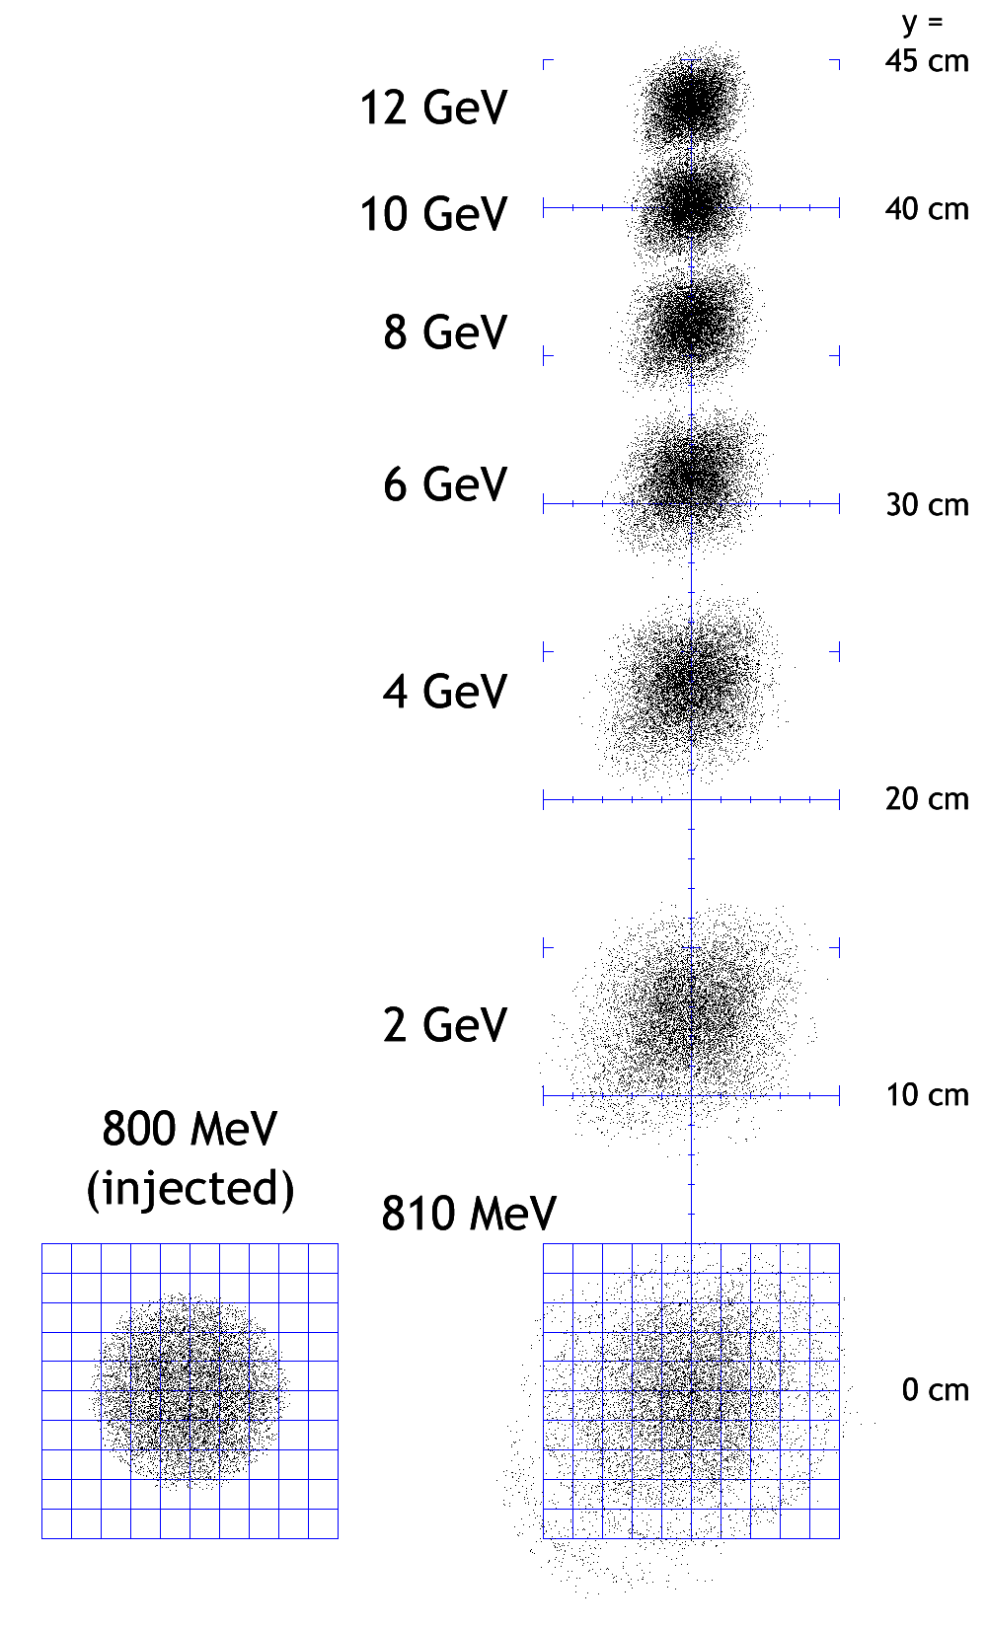
VFFA Acceleration

Slide 19
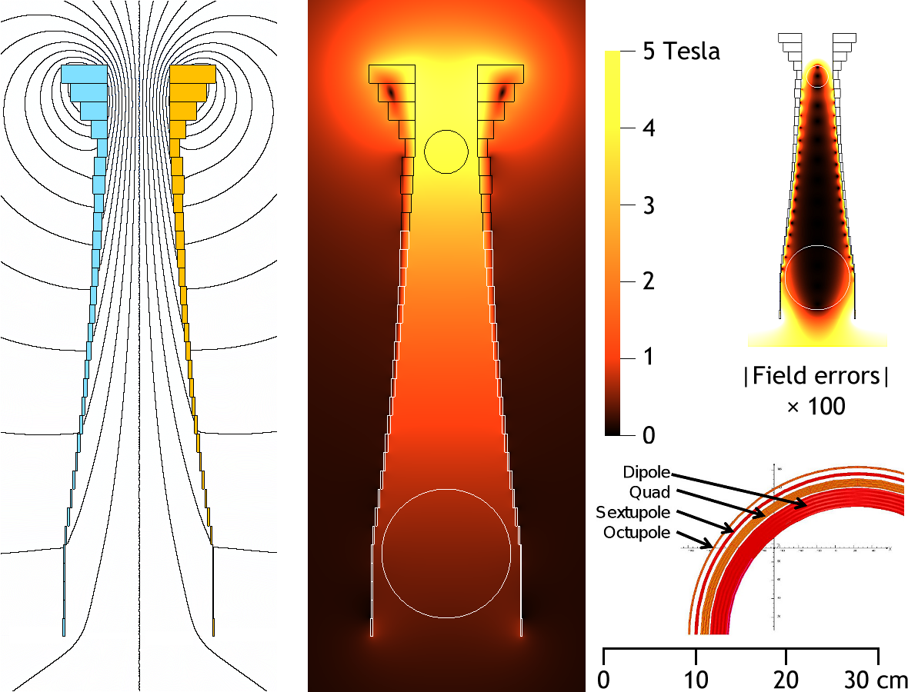
2D Winding Model for Magnet

Slide 20
Application: Hadron Therapy?
Low intensity but high rep-rate machines
  Fixed field useful, space charge not too bad
Small beams
  The VFFA magnet can be a narrow vertical slot
  Less stored energy, smaller windings required
Fixed tune allows slower acceleration, less RF
Disadvantage: we still have the FFA extraction-from-an-orbit-that-moves problem

Slide 21
Historical References
“FFAG Electron Cyclotron” (Ohkawa, 1955)
  T. Ohkawa, Physical Review 100 p.1247, abstract (1955)
  Talk on isochronous electron VFFA with exponential field, with and without edge focussing
“Helicoidal FFAGs” (Leleux, 1959)
  G. Leleux, J. Proy and M. Salvat, Rapport OC 70, Service de Physique Appliquee Section d’Optique Corpusculaire (1959)
  Linear optics analysis of VFFA
“Accelerators with Vertically Increasing Field” (Teichmann, 1960-2)
  J. Teichmann, translated from Atomnaya Énergiya, Vol.12, No.6, pp.475–482 (1962)
  Isochronous, fixed tune electron VFFA, exponential field, suggestion of curved orbit excursion

Slide 22
III. VFFA Proton Accelerator

Slide 23
Motivation: ISIS Energy Booster
FFA to accelerate the 50Hz pulsed ISIS beam
Energy: 800MeV – 12GeV
Superconducting magnets
Ring radius 52m (2x ISIS) could do 2.5x,3x
Mean dipole field in magnets 0.47 – 4.14T
30% RF packing, 20% magnets, 2-4m drifts
Warm 6.2 – 7.3MHz RF
Harmonic number 8 (10,12 in larger ring)

Slide 24
Scaling Law Problem
Defocussing requires reverse bending, as in scaling FFAs → large circumference
Searched for “lopsided” scaling VFFA lattices with good dynamic aperture [HB2010]
  10000 particles were tracked for 1km
  Survival rate plotted on axes of lengths of “F” and “D” type magnets
  This reveals both the lattice stability region and resonance stop-bands

Slide 25
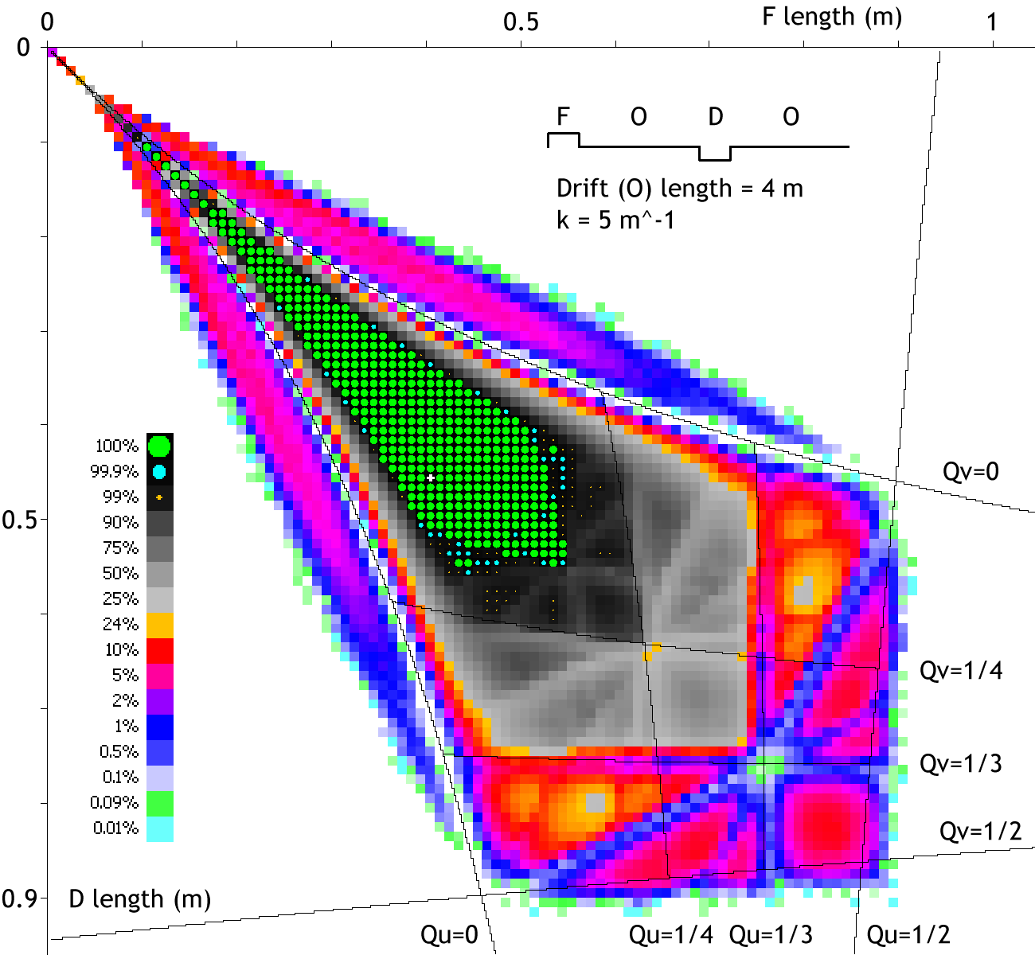
C = ∞ on diagonal

Slide 26
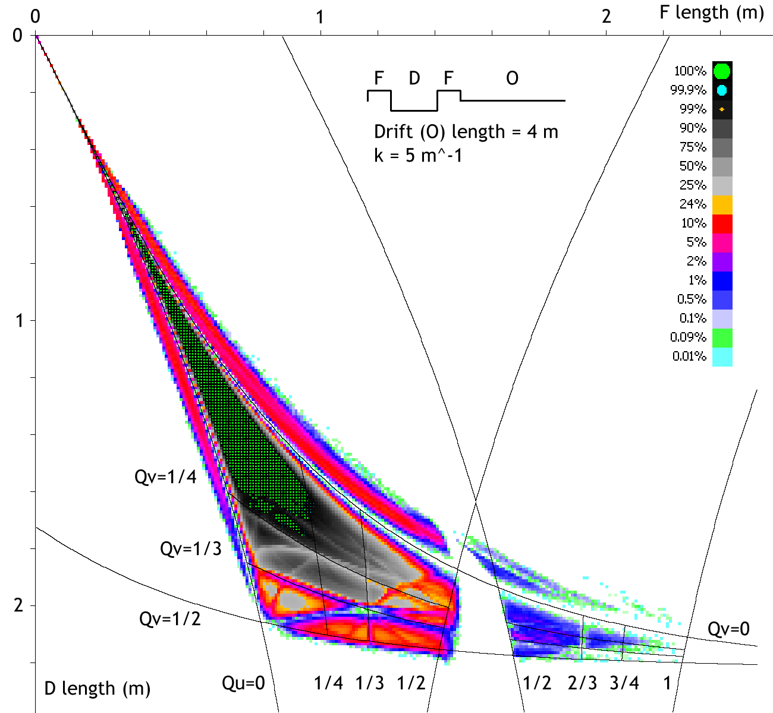
C = ∞ on diagonal

Slide 27
Lattices can't be very lopsided
Unfortunately in all cases the region of dynamic stability sticks very close to the F=D diagonal line
The 2nd FDF stability region does not have enough dynamic aperture
So basic scaling VFFAs will always be big, with much reverse bending
  Could edge focussing avoid reverse bends?

Slide 28
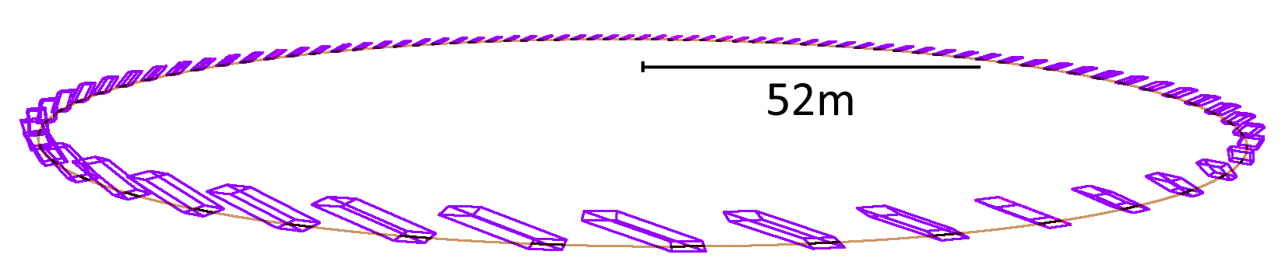
Vertical Edge Focussing [HB2012]
Superconducting magnets allow this to be smaller than synchrotron designs at lower energies

Slide 29
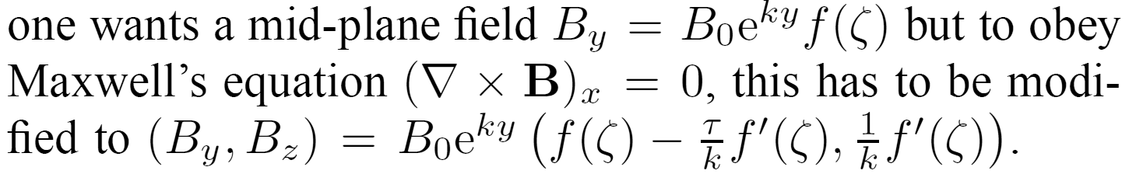

VFFA with Edge Focussing
y
ζ=0
ζ=L
τ = tan θ
ζ = z – τy
θ
z
Scaling law:

Slide 30
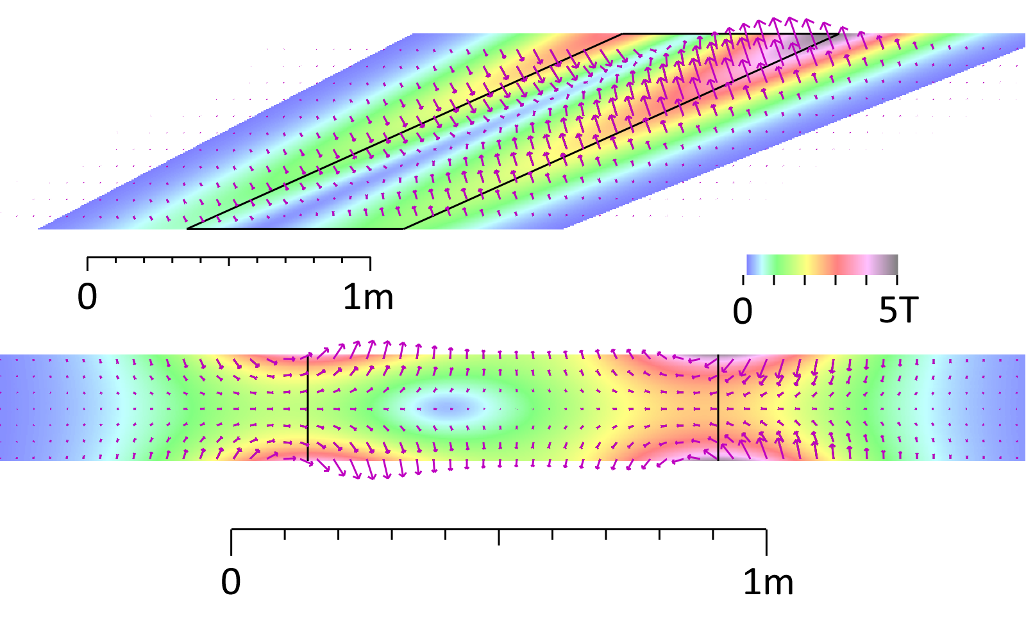
Spiral Scaling VFFA Magnet Field
5GeV
800MeV

Slide 31
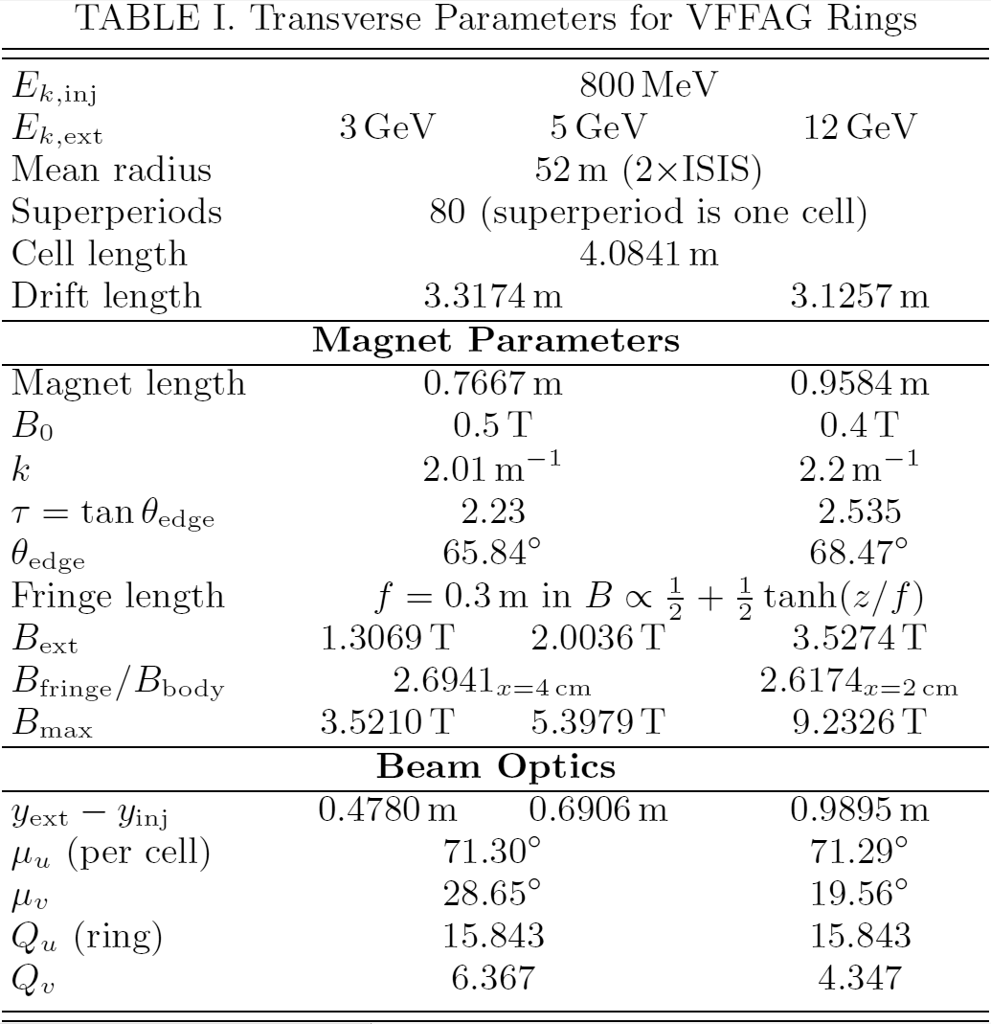

Slide 32
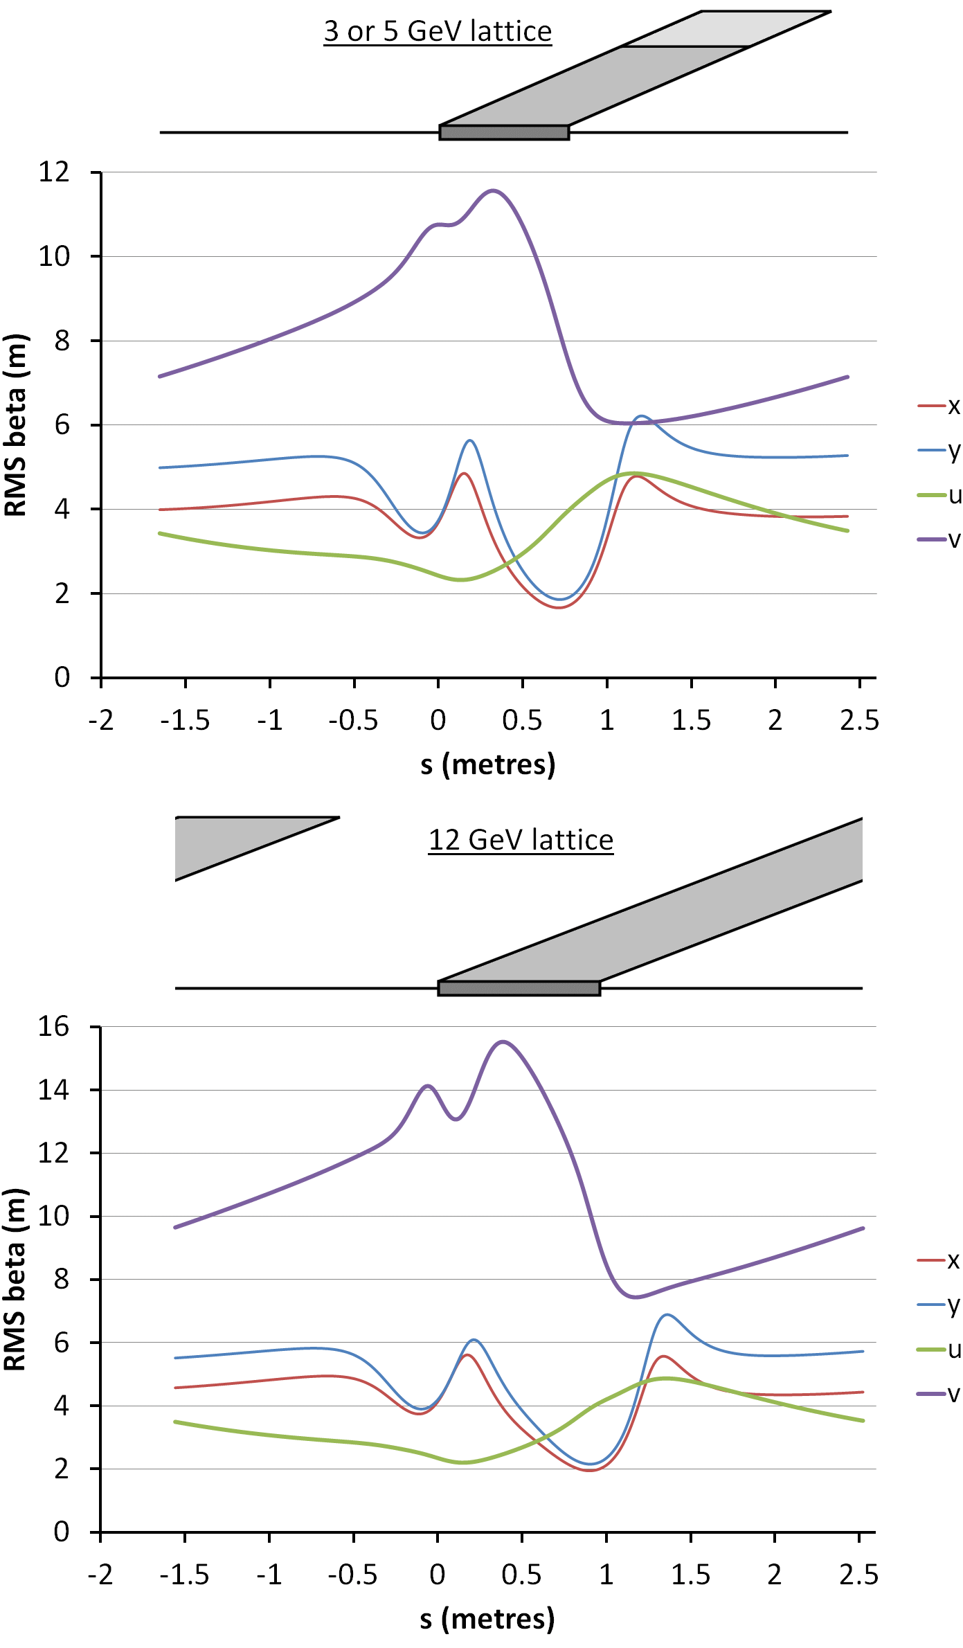
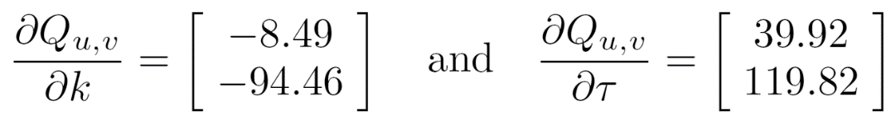
Cell Beta Functions
Doublet focussing nature
  Visible in u,v planes
FfD
  Doublet controlled by τ
  Singlet controlled by k
Ring tune sensitivity:

Slide 33
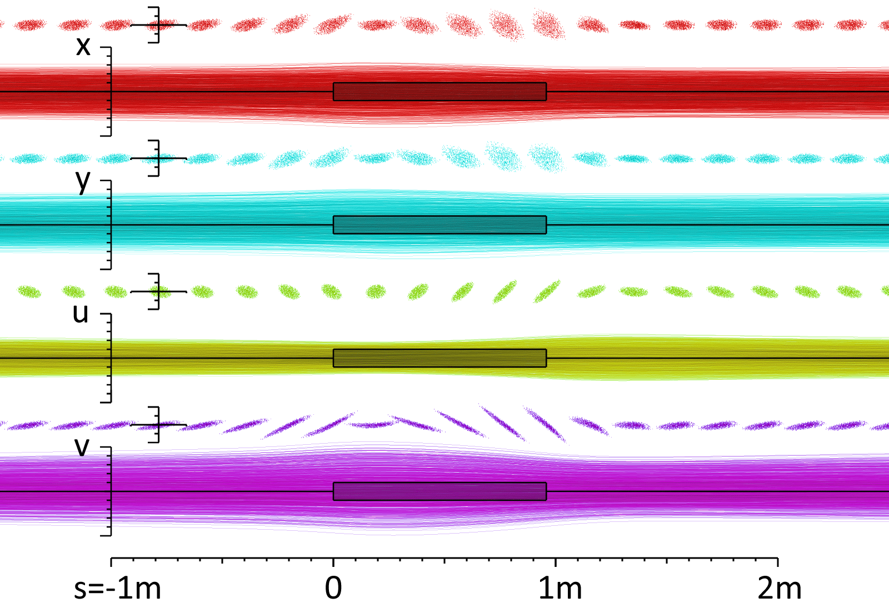

Slide 34
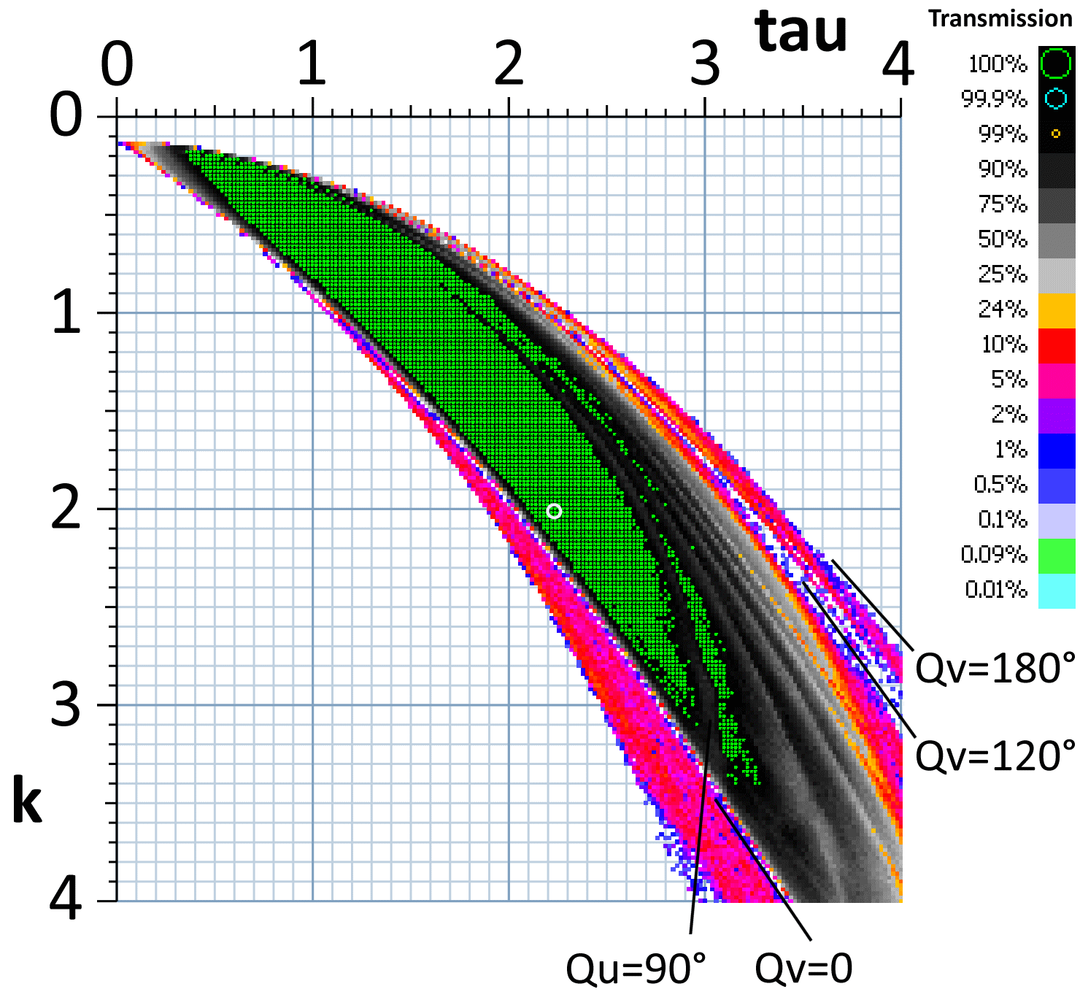

Slide 35
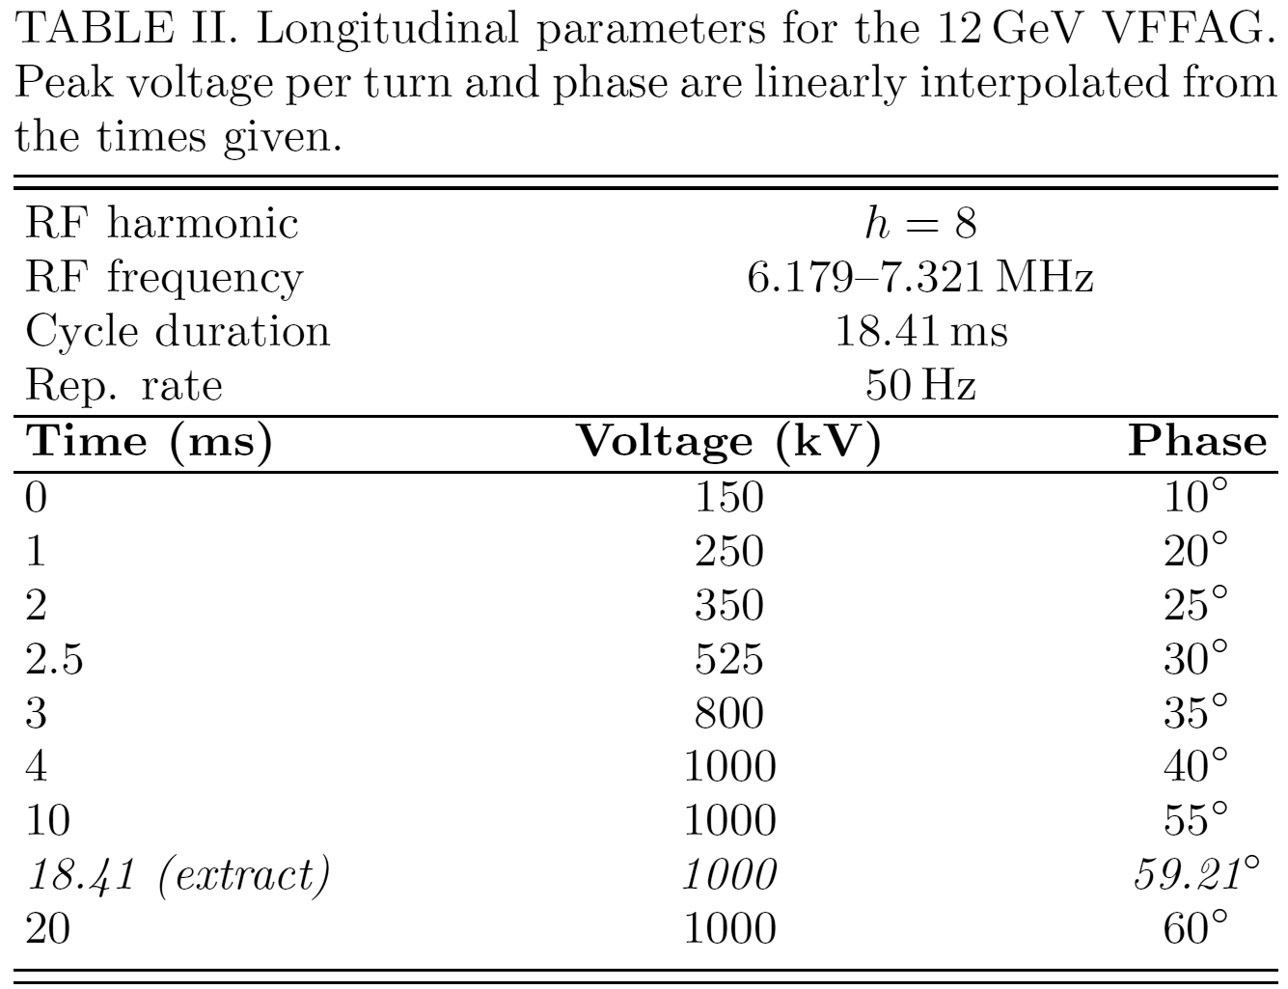

Slide 36
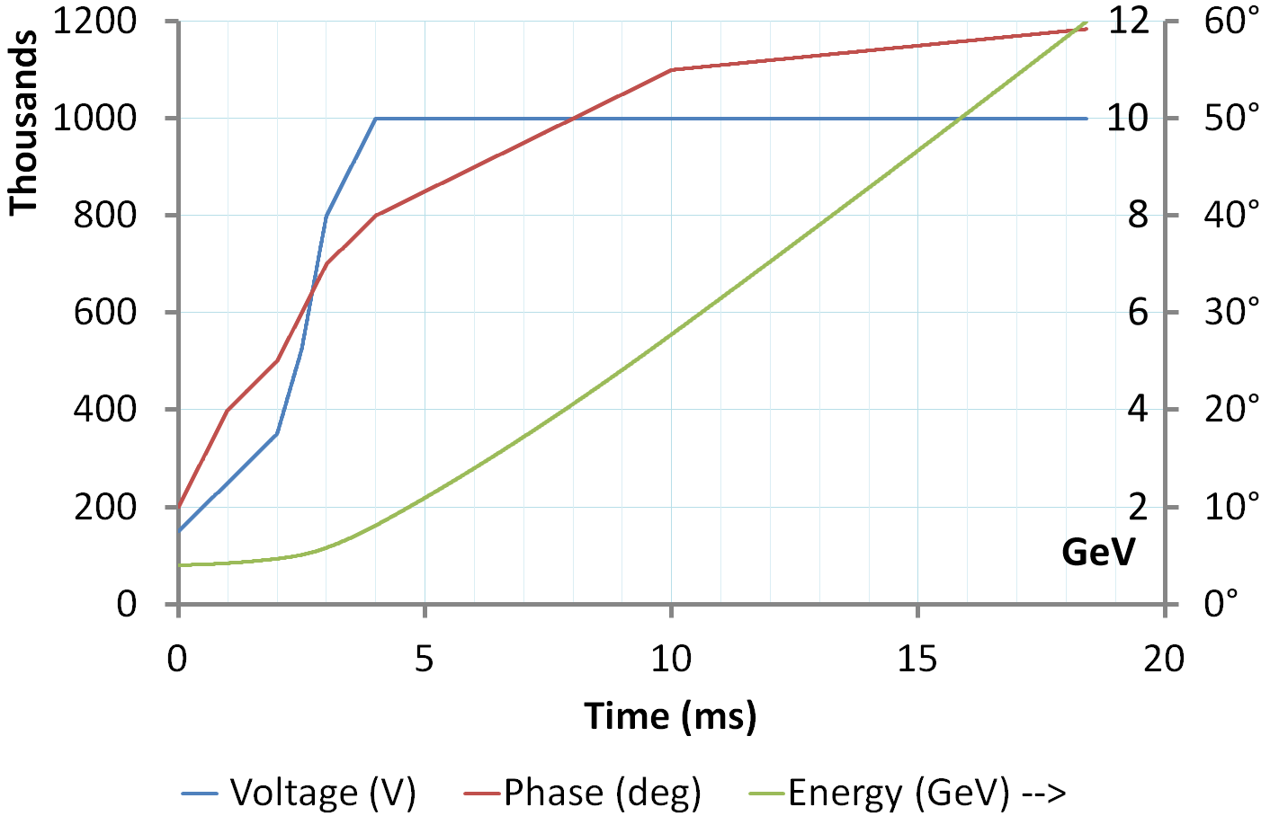
12GeV VFFA RF Programme

Slide 37
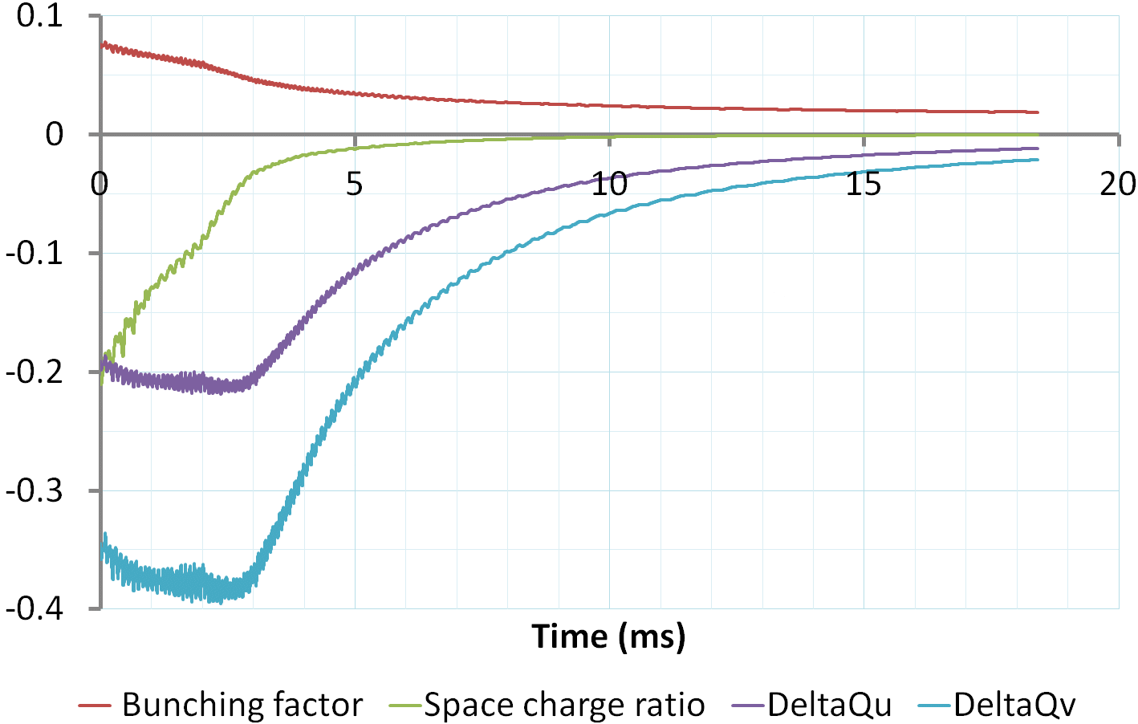

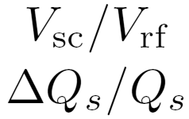
Longitudinal Intensity Effects

Slide 38
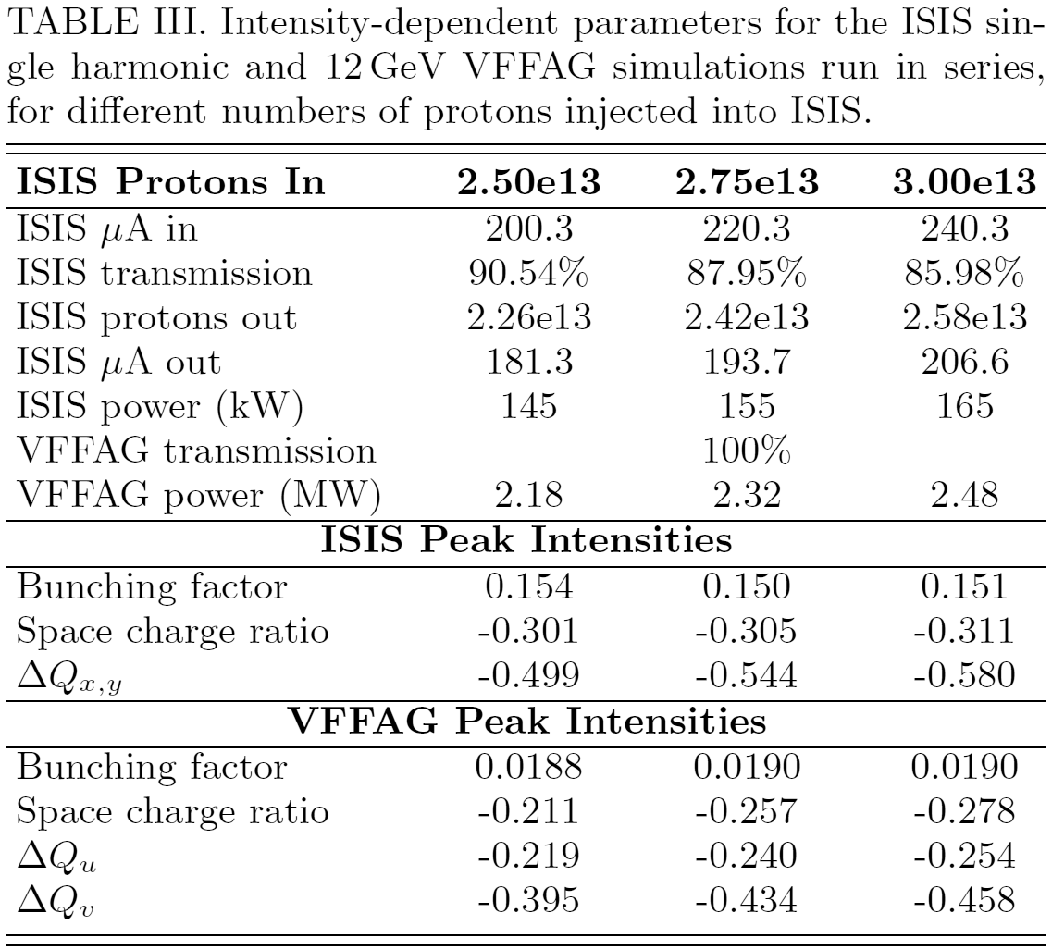

Slide 39
References
“Vertical Orbit Excursion FFAGs”, S. Brooks, Proc. HB2010
“Acceleration in Vertical Orbit Excursion FFAGs with Edge Focussing”, S. Brooks, Proc. HB2012

Slide 40
IV. Isochronous 3D Cyclotrons

Slide 41
Isochronous Cyclotron Problem
Mean radius must satisfy r = βR
  Where R = c/2πf_{rev} is the limiting radius as v → c
Mean B_{y} = p/qr = mβγc/qβR = γ(mc/qR) = γB₀
This produces a quadrupole as radii bunch up:
  dB_{y}/dr = (B₀/R)dγ/dβ = (B₀/R)βγ³
Momentum only increases with βγ
  Eventually quadrupole overfocusses the beam
  Energy limit for any given planar cyclotron
Normalised quadrupole ∝ γ²

Slide 42
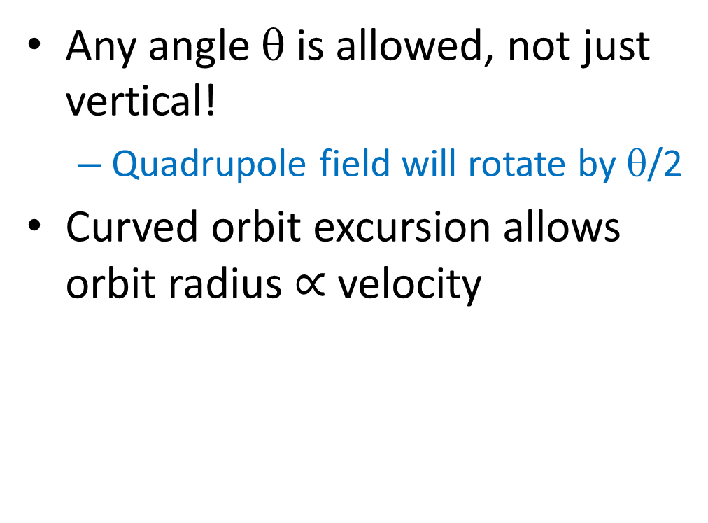
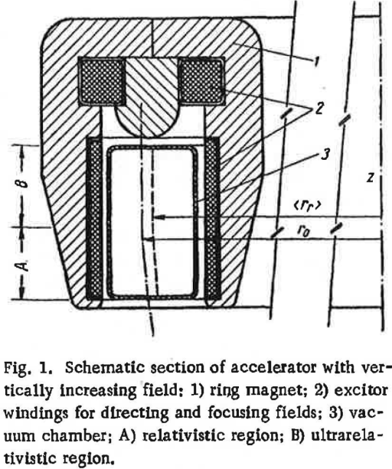
Tilted Orbit Excursion
← Teichmann (1962) also had idea

Slide 43
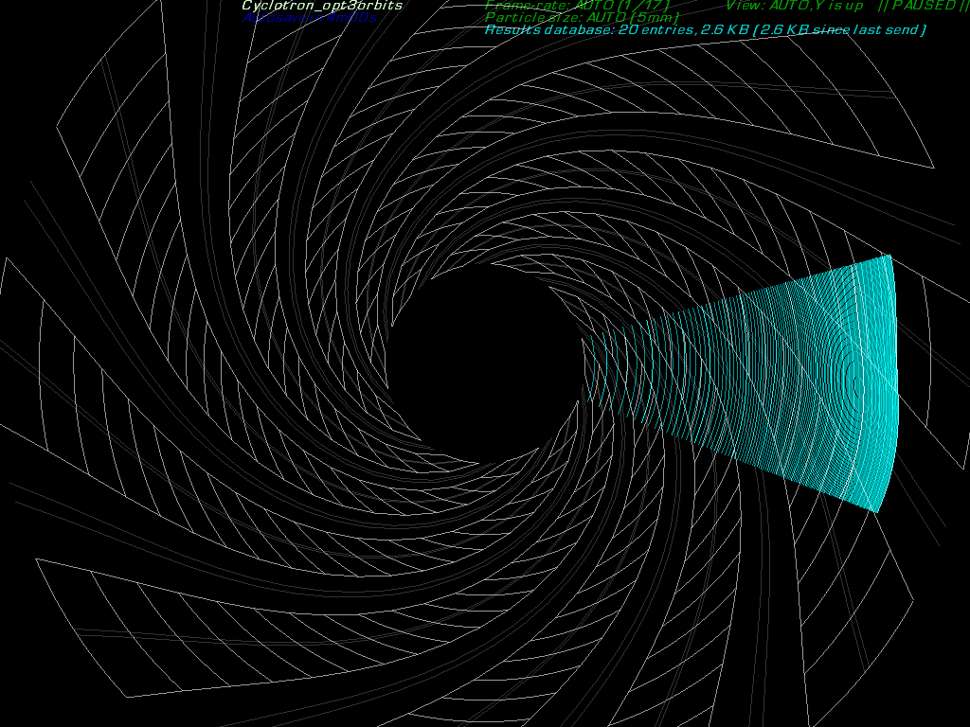

Slide 44
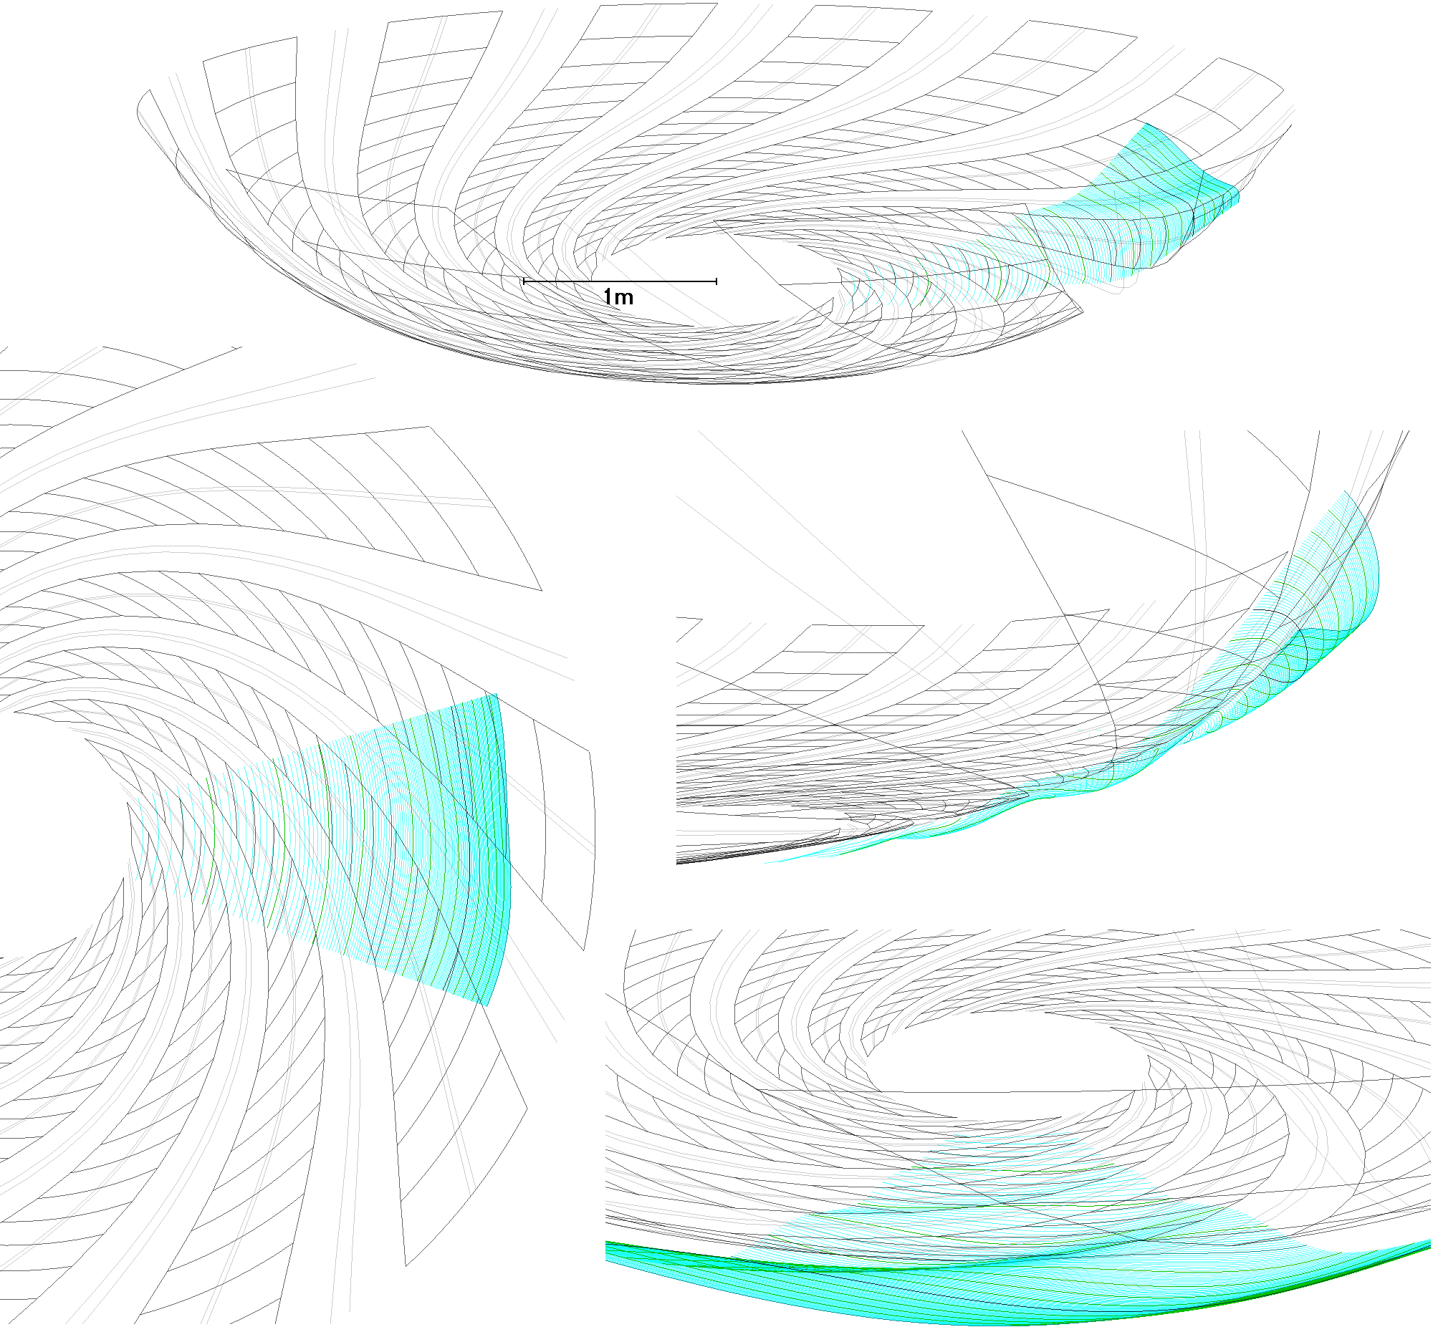

Slide 45
Future Work
Better alignment between the reference plane and the orbits, giving better convergence
Field adjustments to improve isochronism from the current ±0.62% variation
Vary θ_{edge} with energy to improve tune control
Make space for RF by using fewer sectors and/or more field-free space between sectors
Find an example superconducting winding scheme
Build electron model of the 3D cyclotron

Slide 46
Conclusion (II,III,IV) & Applications
Non-isochronous proton VFFAs provide rapid cycling, high fields and compact SC magnet designs
  Neutron, neutrino and hadron therapy sources
Isochronous proton 3D cyclotrons promise cyclotron-like CW acceleration above 1GeV
  High cross sections for nuclear/spallation reactions
  Nuclear waste transmutation, isotope production
Electron VFFAs are already almost isochronous
  Multi-pass VFFA-ERL-FELs with only one recirculating arc

Slide 47
V. VFFA Electron Accelerator

Slide 48
Project Description
Design and risk-reduce a fixed-field accelerator (likely using permanent magnets) to produce the 18GeV electron bunches for eRHIC instead of an RCS. This eliminates most magnet power supplies and allows a faster acceleration cycle of ≤100 turns, giving a shorter RF pulse and easier spin preservation.
  Cost comparisons showed ~30% cost savings in overall accelerator using eRHIC and CBETA data

Slide 49
Additional Applications
~mA level electron current could be available at BNL at 18GeV
  Comparable to SLAC
  Can allow beam physics experiments far beyond current ATF reach (70MeV)
Cyclotron-like behaviour at far higher energies
  Flexible time structure
VFFA principle applied to proton machines
  Currently being considered for 1.2GeV neutron source upgrade at RAL
  Forms the basis for waste transmutation “3D cyclotron” facility
    S.J. Brooks, Vertical orbit excursion fixed field alternating gradient accelerators, Phys. Rev. ST Accel. Beams 16, 084001 (2013)

Slide 50
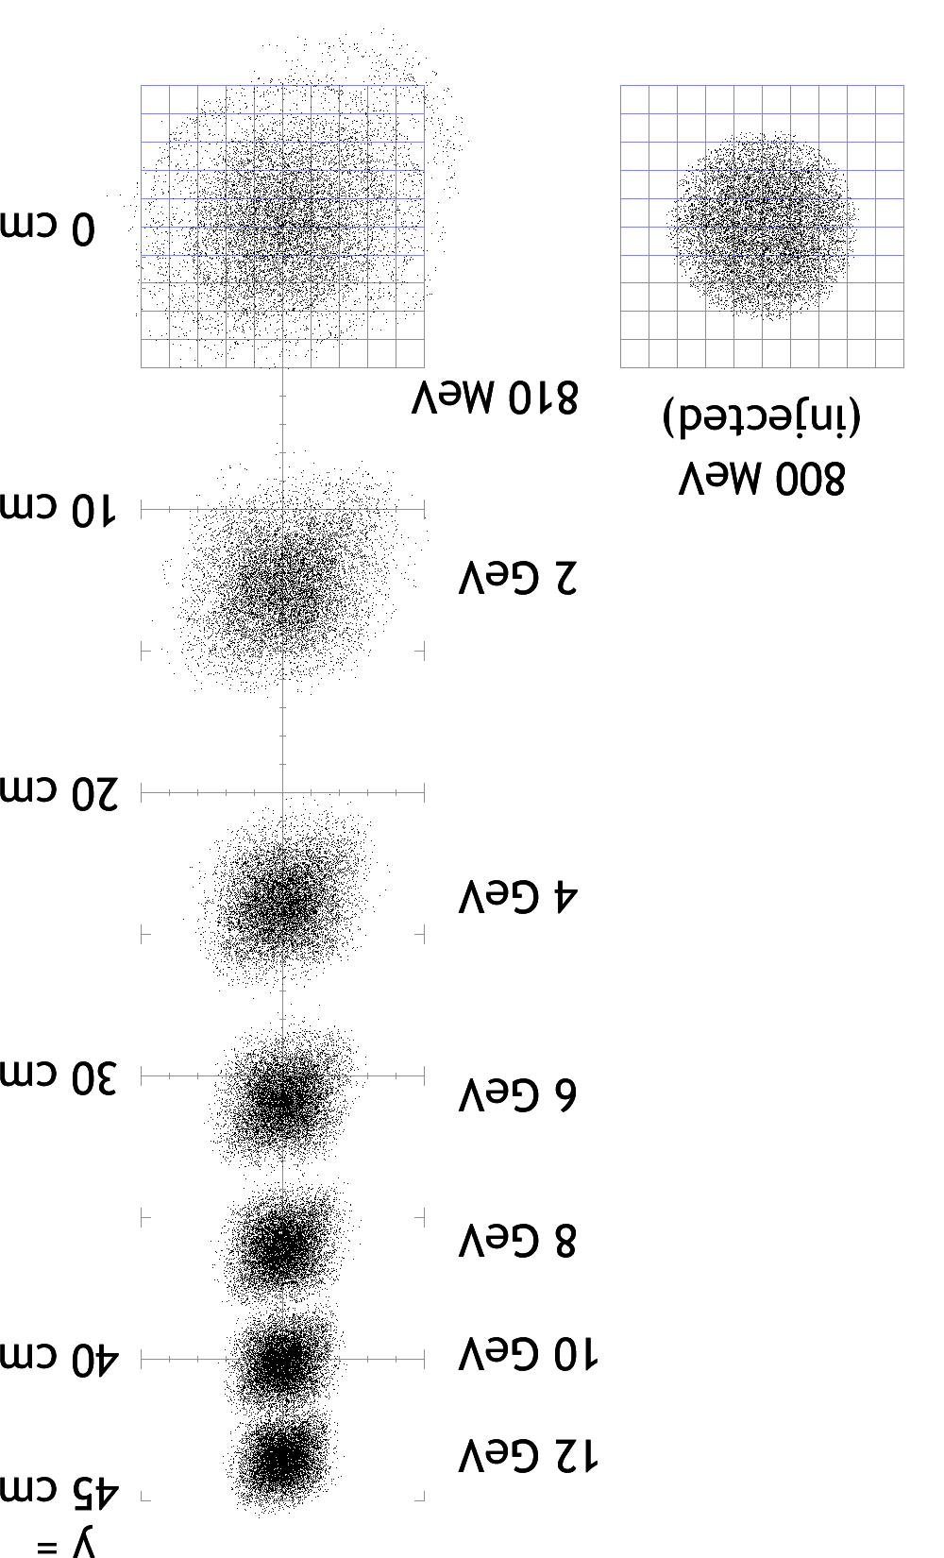
Arc Lattice Cell Candidates
Field B_{y}=B₀e^{-ky}
Scaling law means focussing and bending have the same sign
Estimated dynamic aperture (log)
0.47T
Heuristic √β_{max}ε ≈ 0.1/k
ε ≈ 0.01/(k²β_{max})
0.33T
0.57T
0.82T
0.36T @ 18GeV
Overall radius and top energy are fixed parameters, vary lattice and amount of reverse bend
Magnetic efficiency

Slide 51
Full-Scale Lattice Cell

Slide 52
VI. VFFA Permanent Magnet

Slide 53
Demo Magnet Design
k = 20m⁻¹
GFR = ±25mm
B_{max} = 0.3T
L = 120mm
  5 slices of 24mm
  Using left-over 26x20x24mm blocks from CBETA magnet R&D
(Good Field Region)

Slide 54
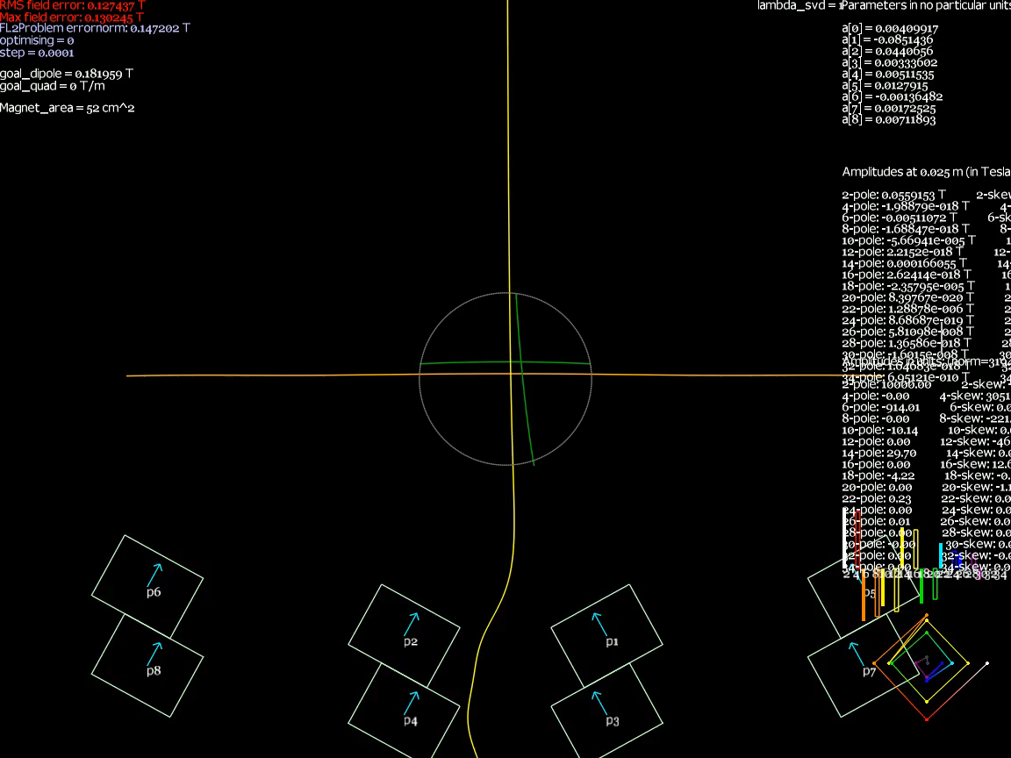
Geometry Optimisation

Slide 55
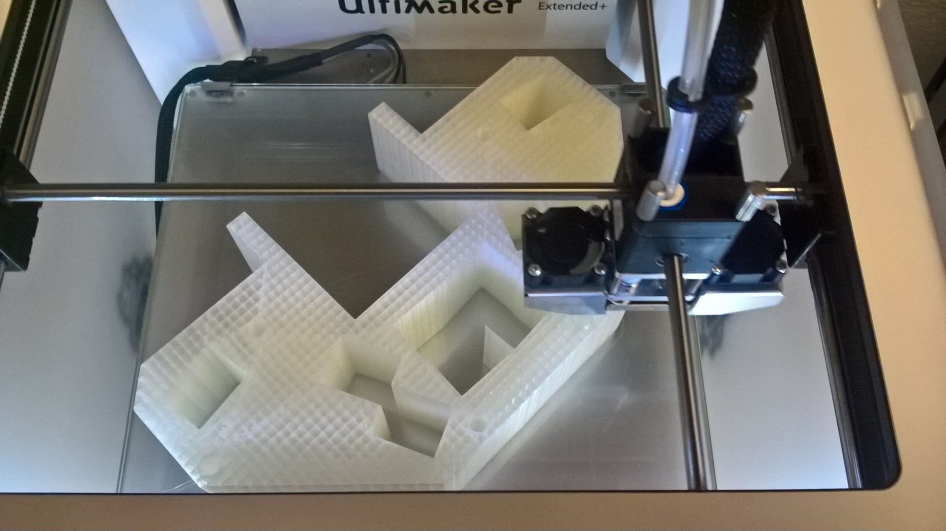
3D Printing from Design

Slide 56
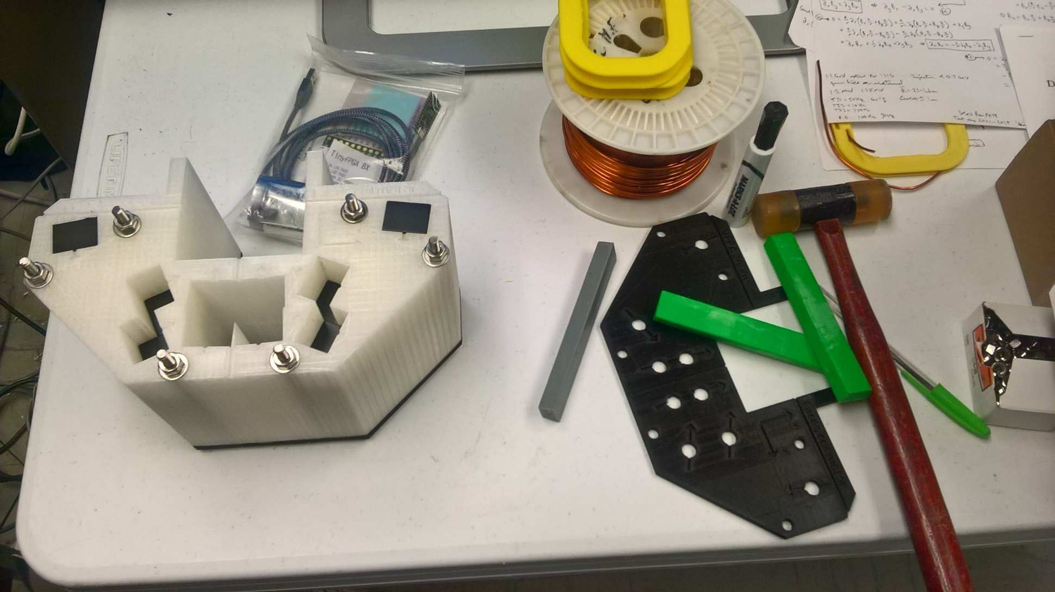
One-piece assembly doesn’t work: blocks roll around in channel

Slide 57
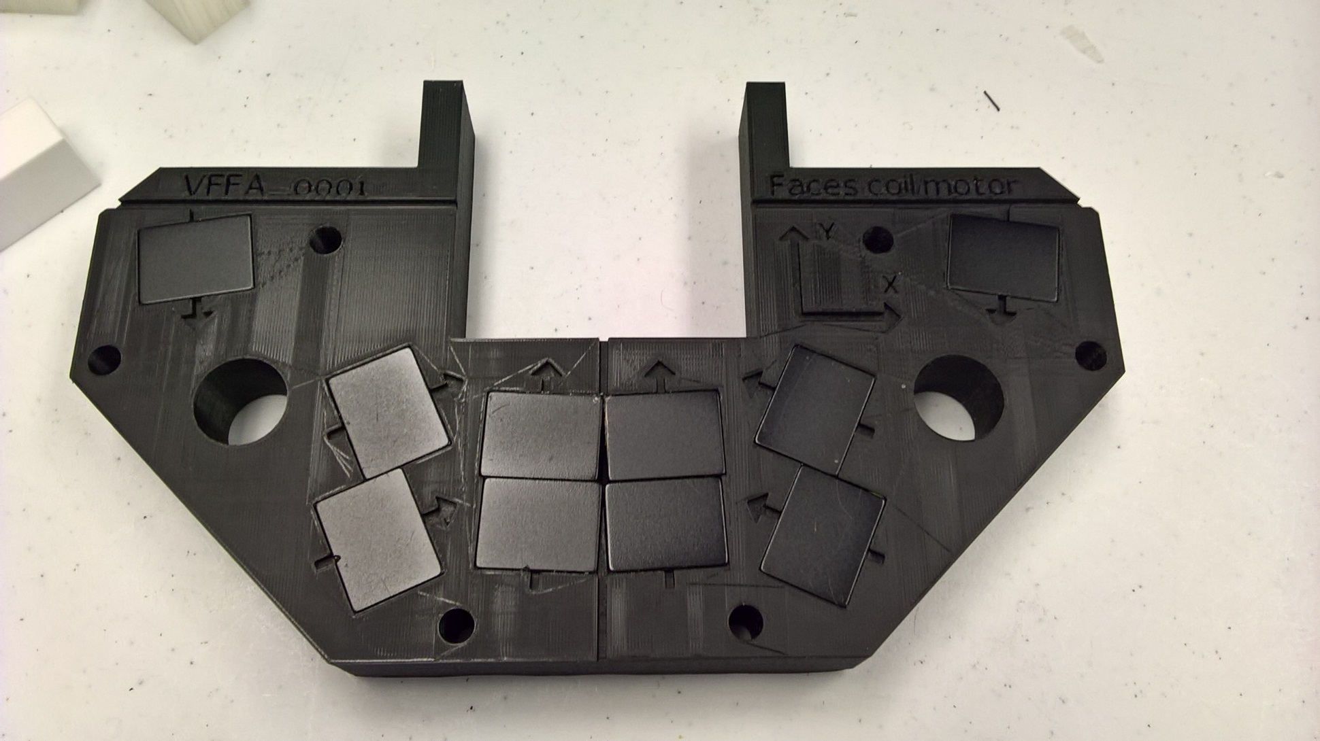
Single 24mm-thick Layer

Slide 58
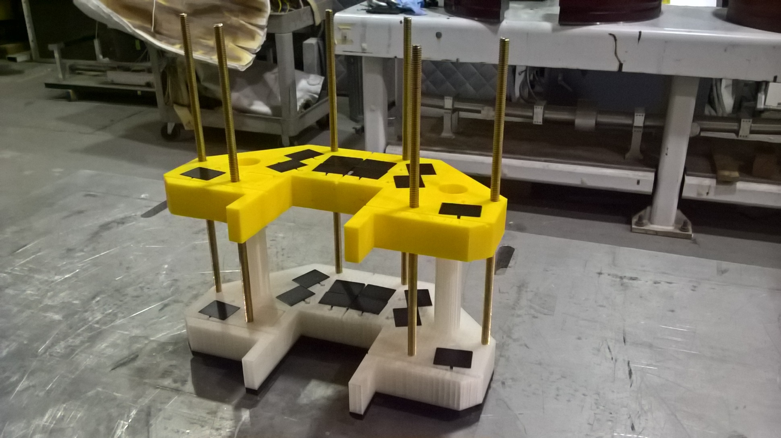
Slice Repulsion: Need Longer Rods!

Slide 59
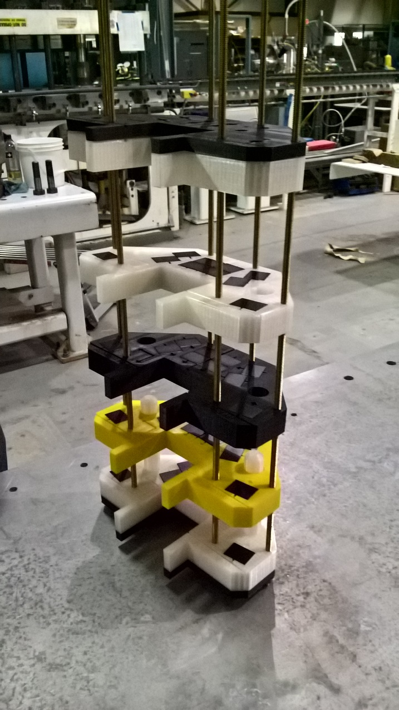
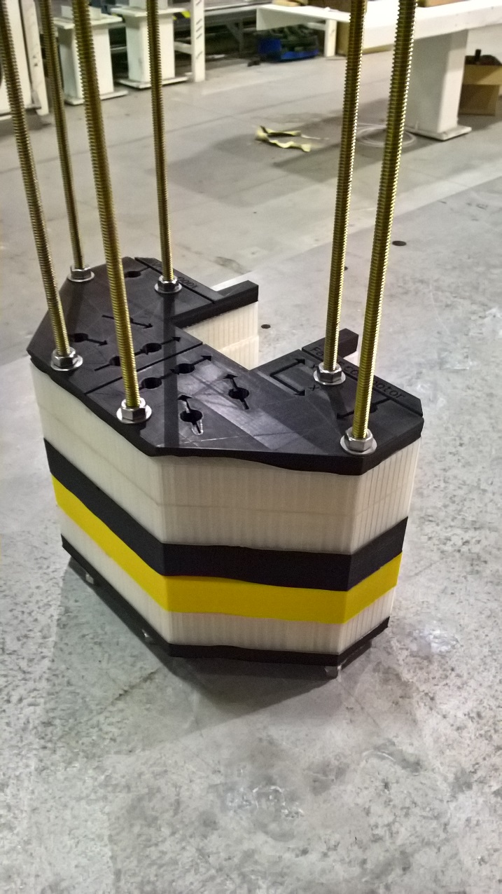
Assembly of Repelling Slices

Slide 60
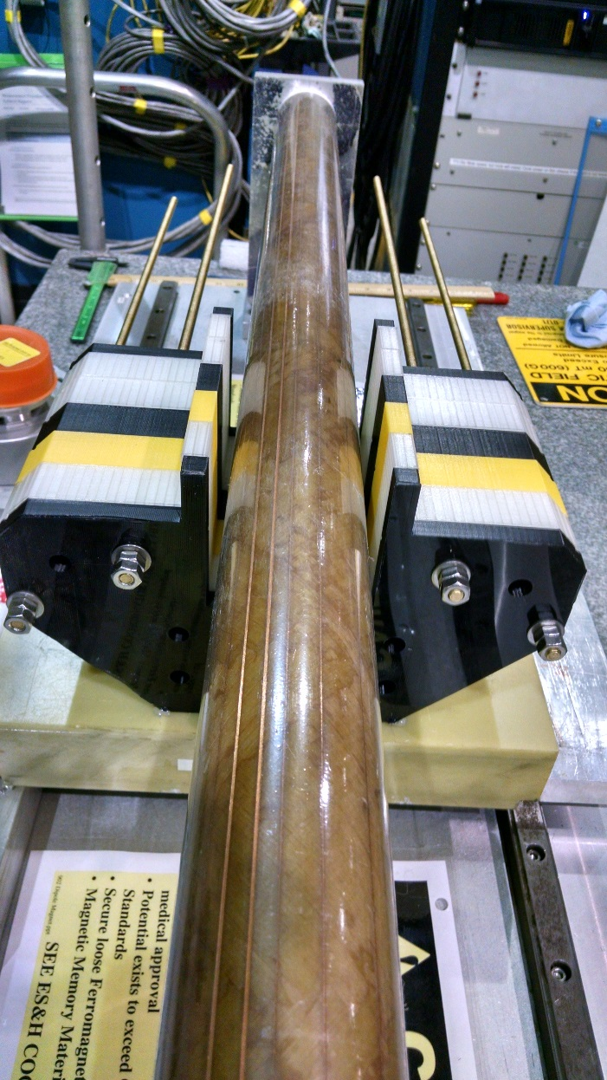
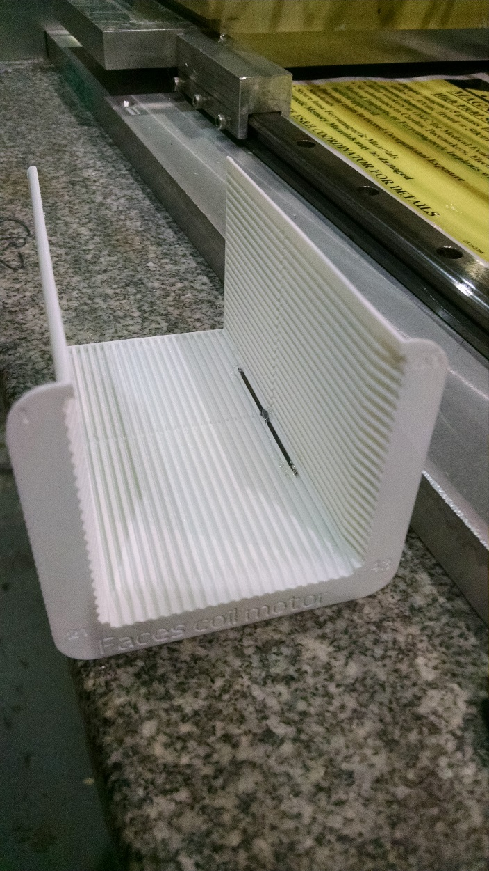
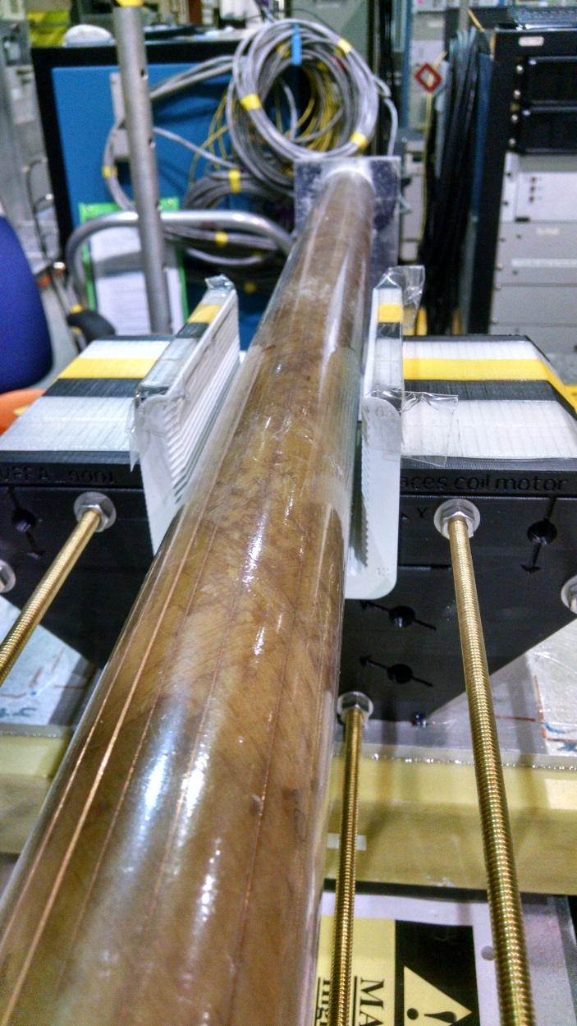
BNL Rotating Coil Measurement
3D-printed shim holder

Slide 61
Harmonics (untuned)
Measured
Ideal
Errors
(Header line)
Dipole
Quadrupole
Sextupole
Octupole
Decapole
Dodecapole
14-pole
16-pole
18-pole
20-pole
22-pole
24-pole
26-pole
28-pole
30-pole
32-pole
34-pole
36-pole
38-pole
40-pole
Units: 10⁻⁴ of main harmonic at measurement radius R=25mm

Slide 62
Harmonics (tuned)
Measured
Ideal
Errors
(Header line)
Dipole
Quadrupole
Sextupole
Octupole
Decapole
Dodecapole
14-pole
16-pole
18-pole
20-pole
22-pole
24-pole
26-pole
28-pole
30-pole
32-pole
34-pole
36-pole
38-pole
40-pole
Units: 10⁻⁴ of main harmonic at measurement radius R=25mm

Slide 63
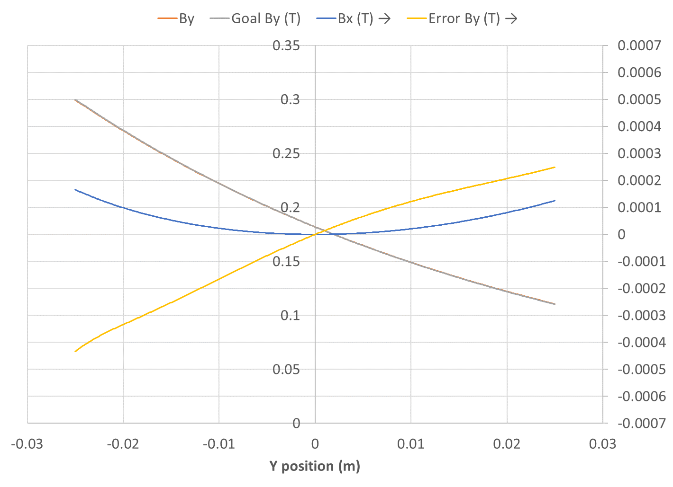
Field and Error (untuned)
Field (T)
Field error (T)

Slide 64
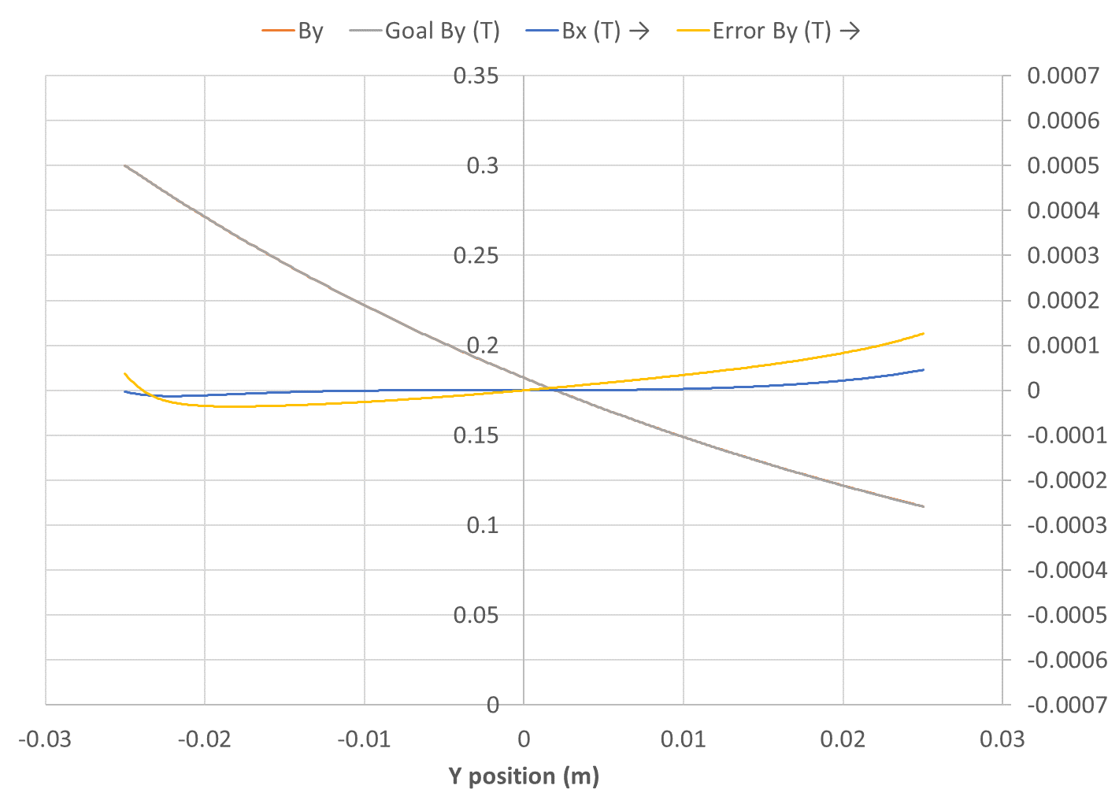
Field and Error (tuned)
Field (T)
Field error (T)

Slide 65
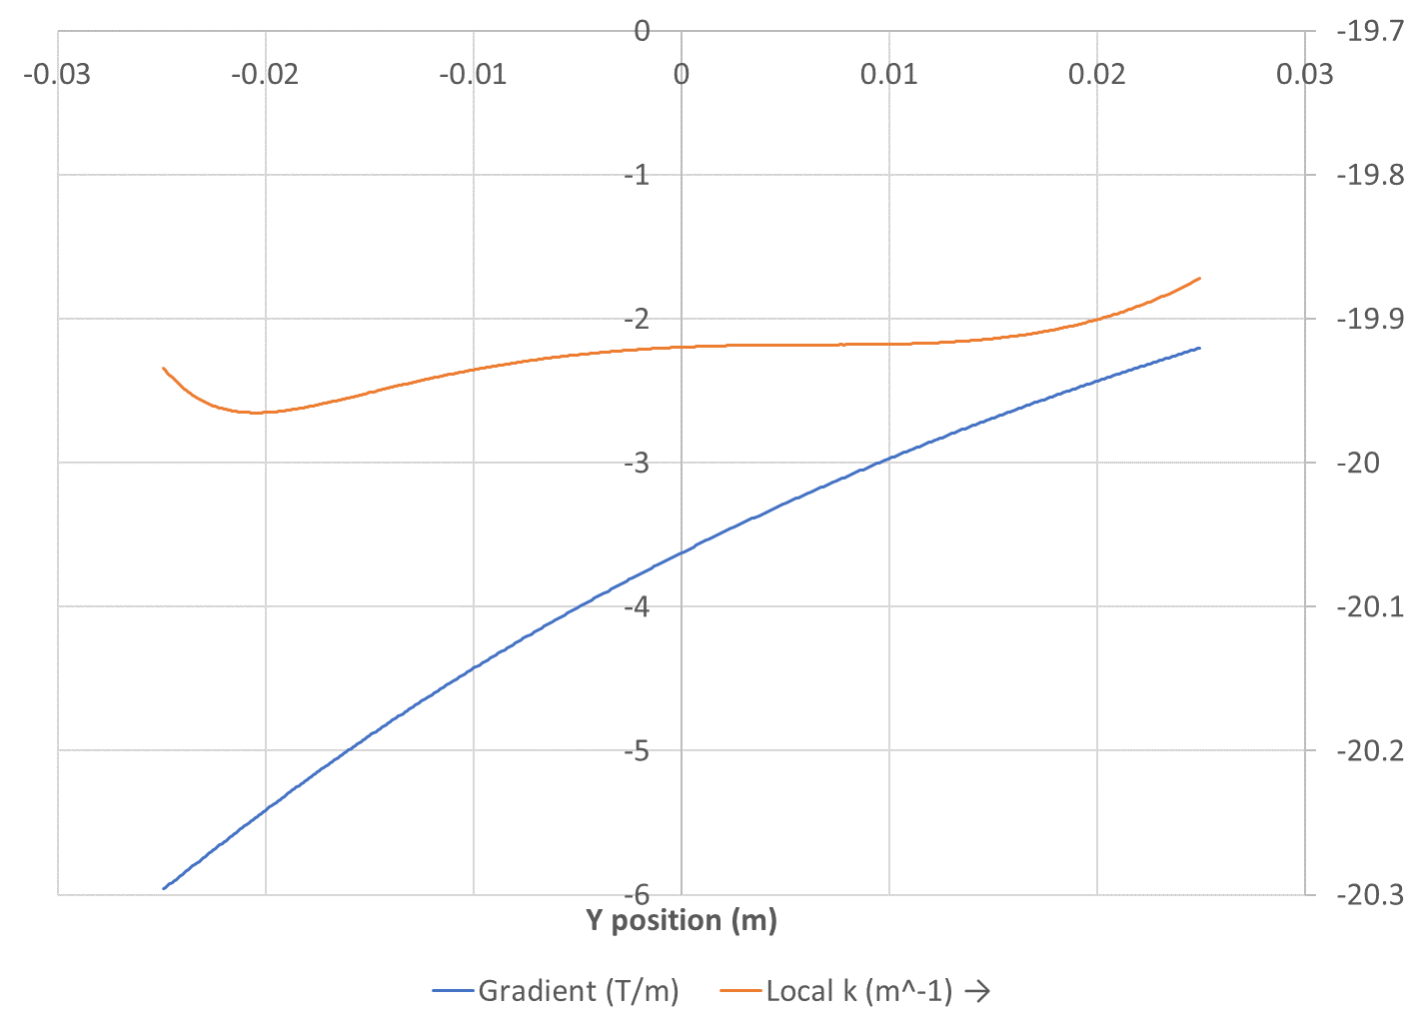
Gradient and Local k (untuned)
Gradient (T/m)
k value

Slide 66
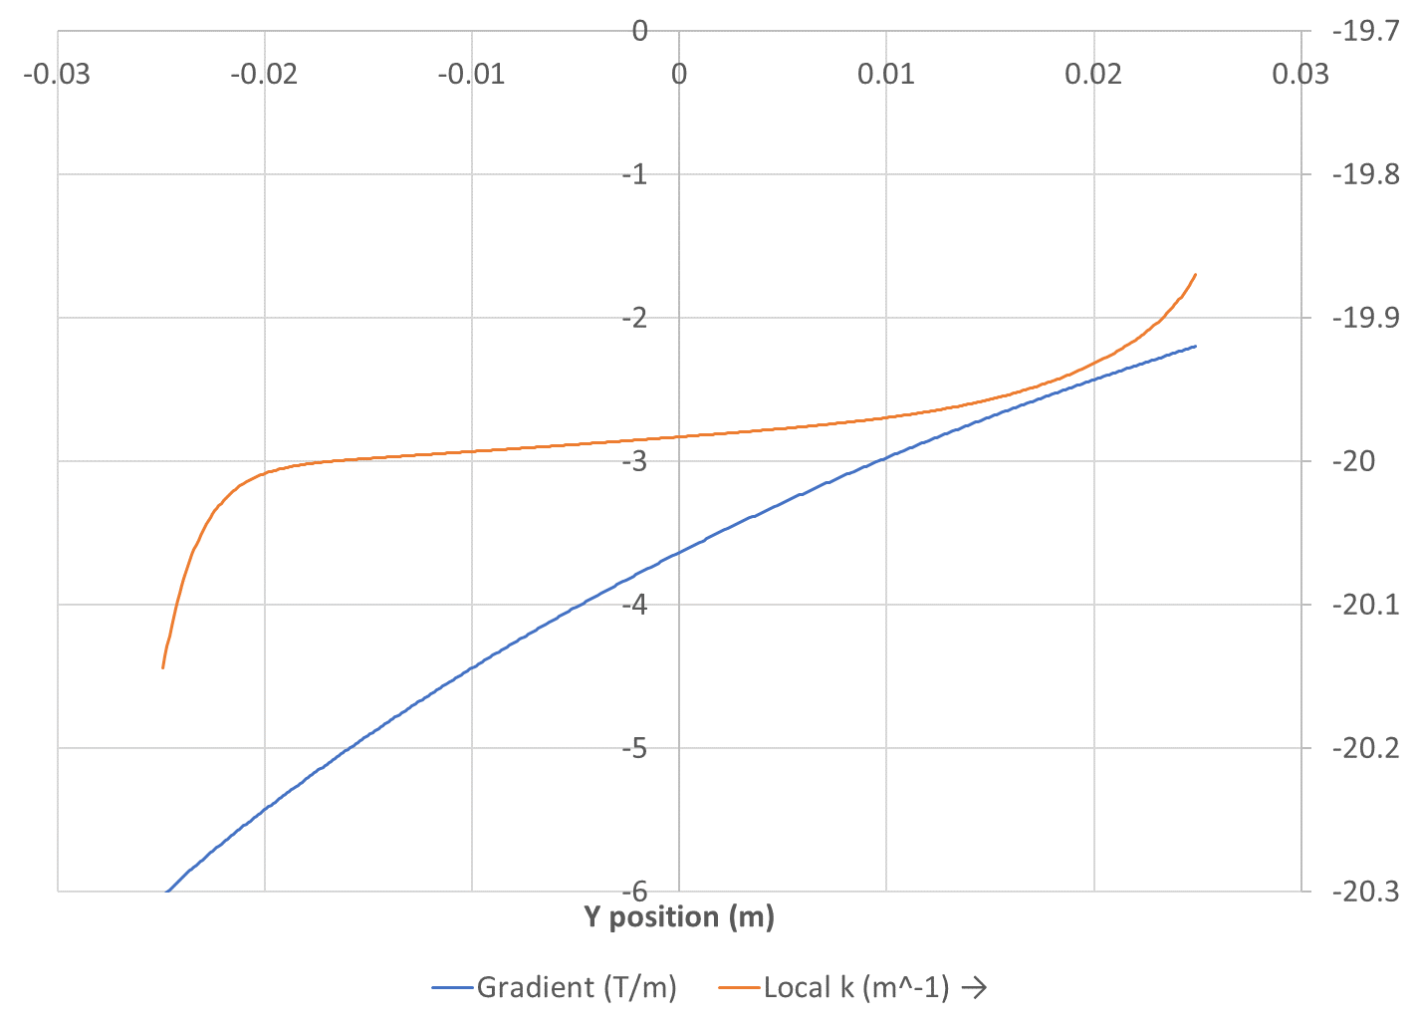
Gradient and Local k (tuned)
Gradient (T/m)
k value

Slide 67
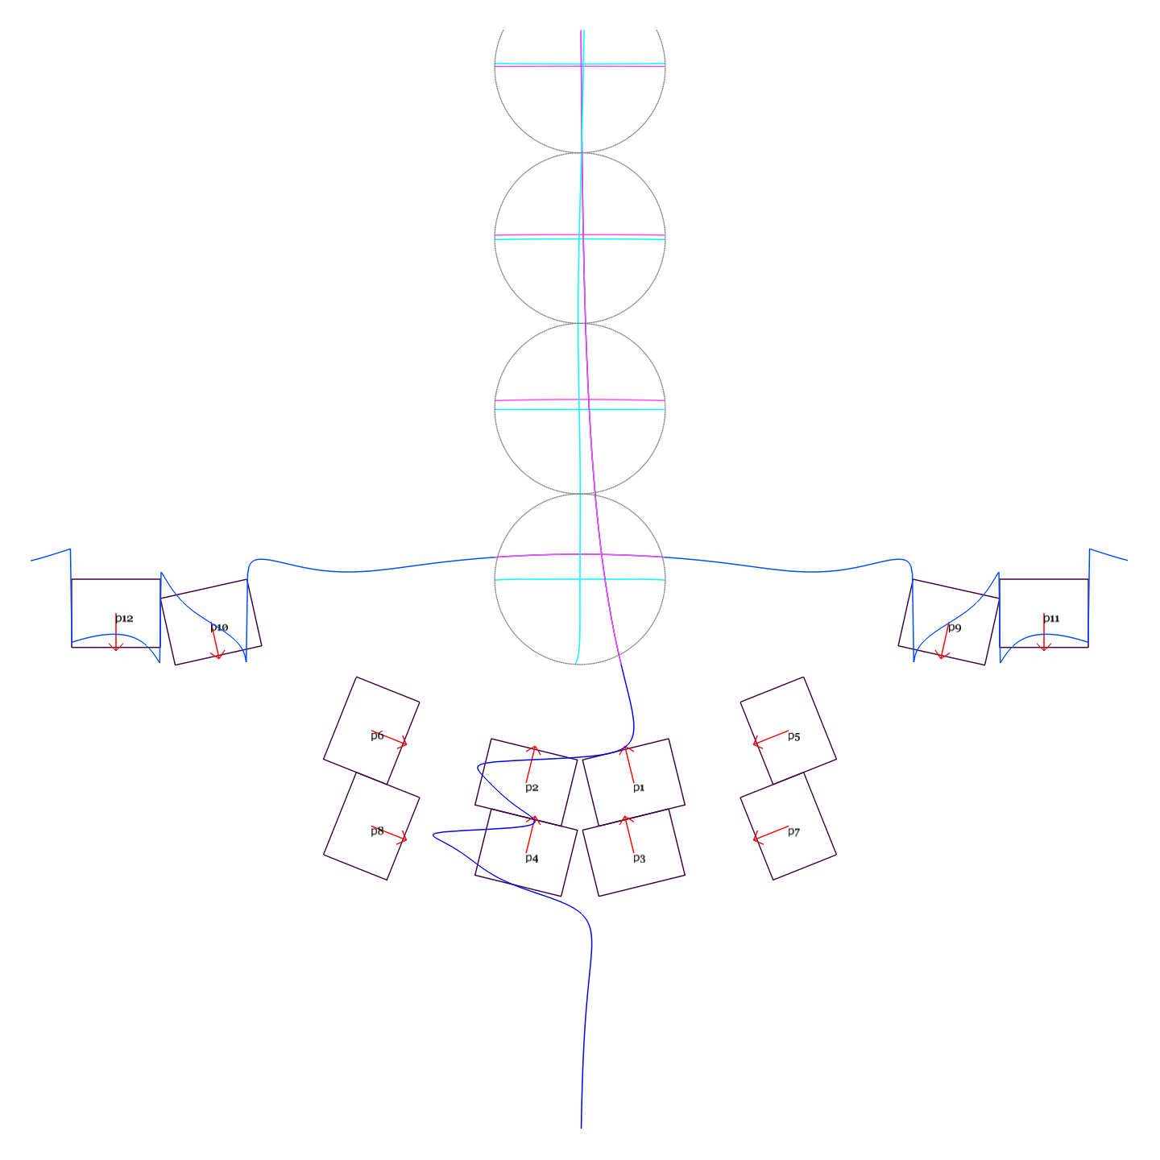
Extension of Design Height
k = 20m⁻¹
GFR y = -25mm to +175mm
B_{max} = 0.3T
Max field error ~3 Gauss

Slide 68
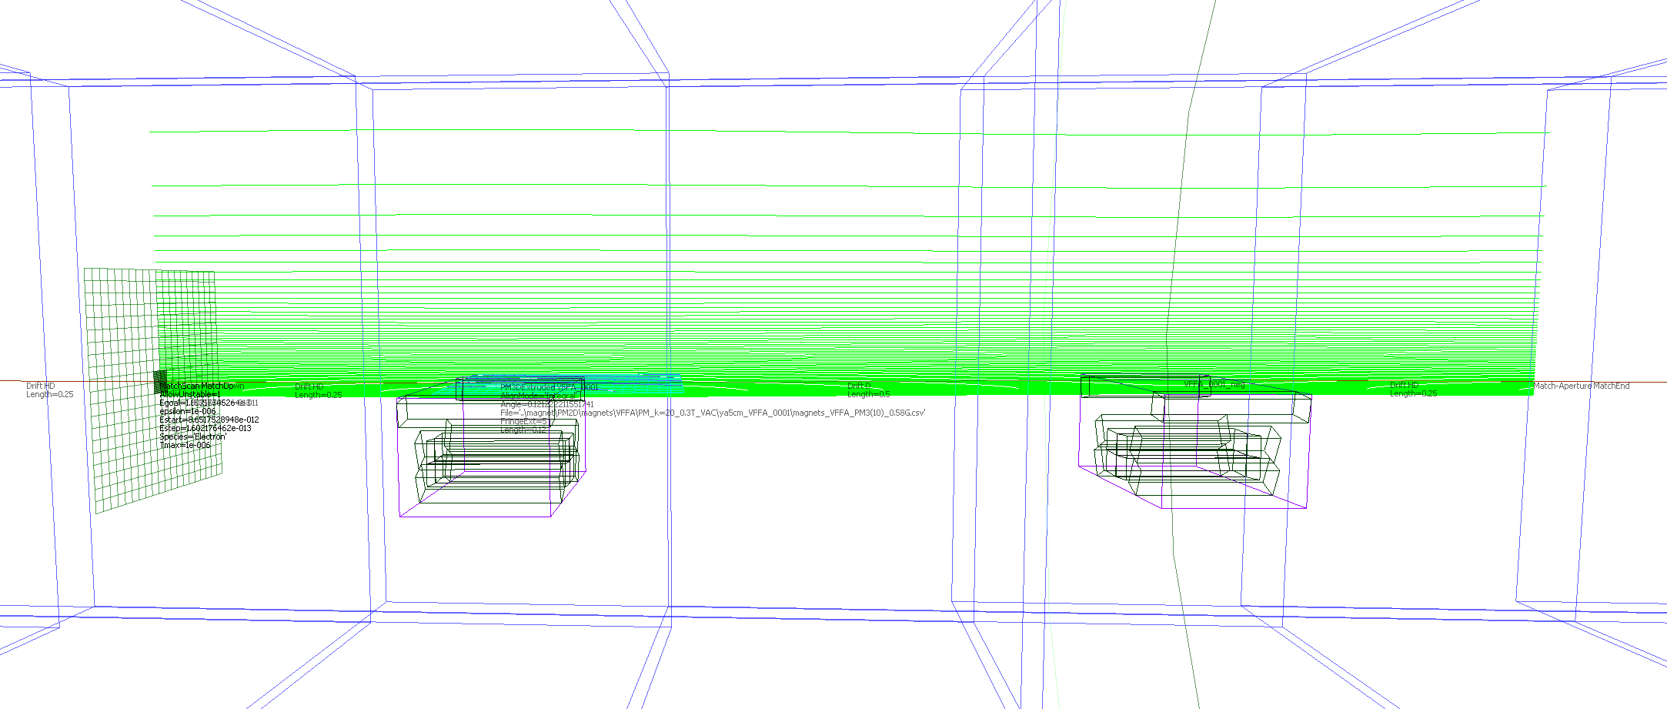
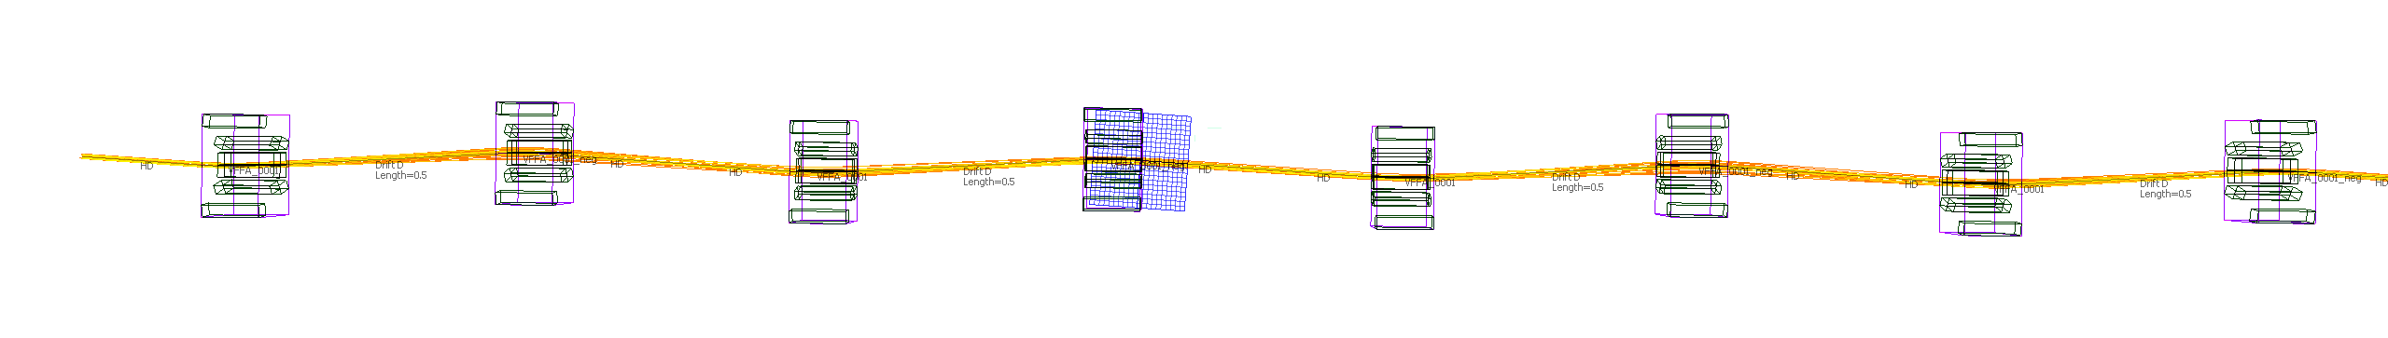
Demo Straight Section (1-72MeV)

Slide 69
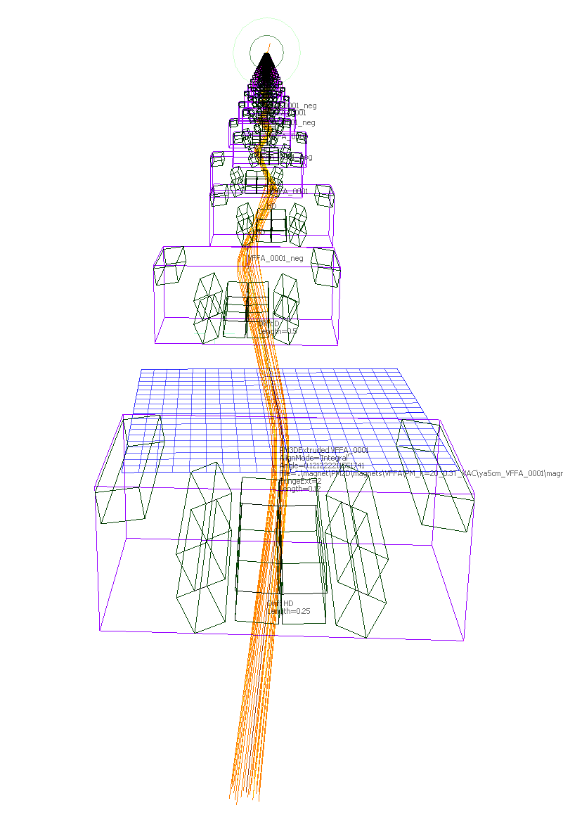
4×4 Transfer Matrix
Usual (x,x’,y,y’) basis
(u,u’,v,v’) basis

Slide 70
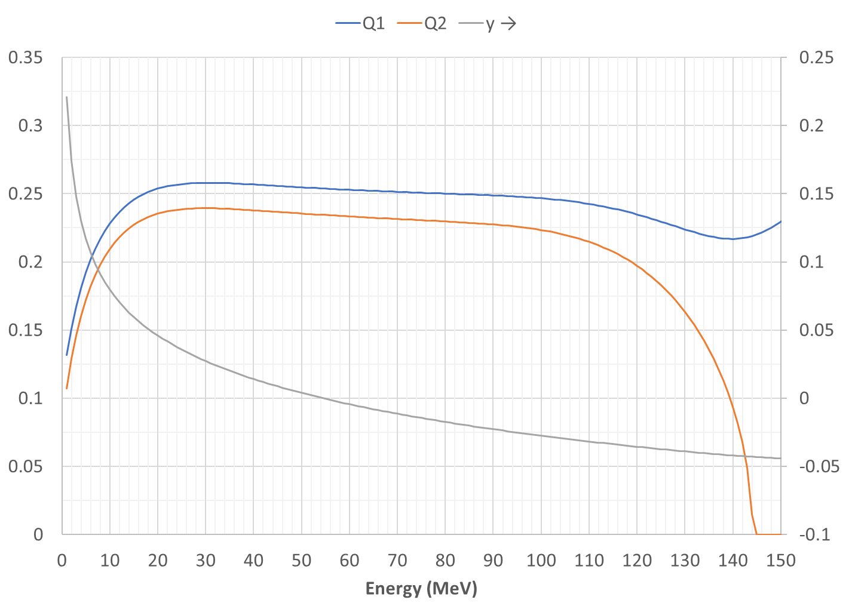
Demo Straight Cell Tunes, Height
Cell tunes
y (m)

Slide 71
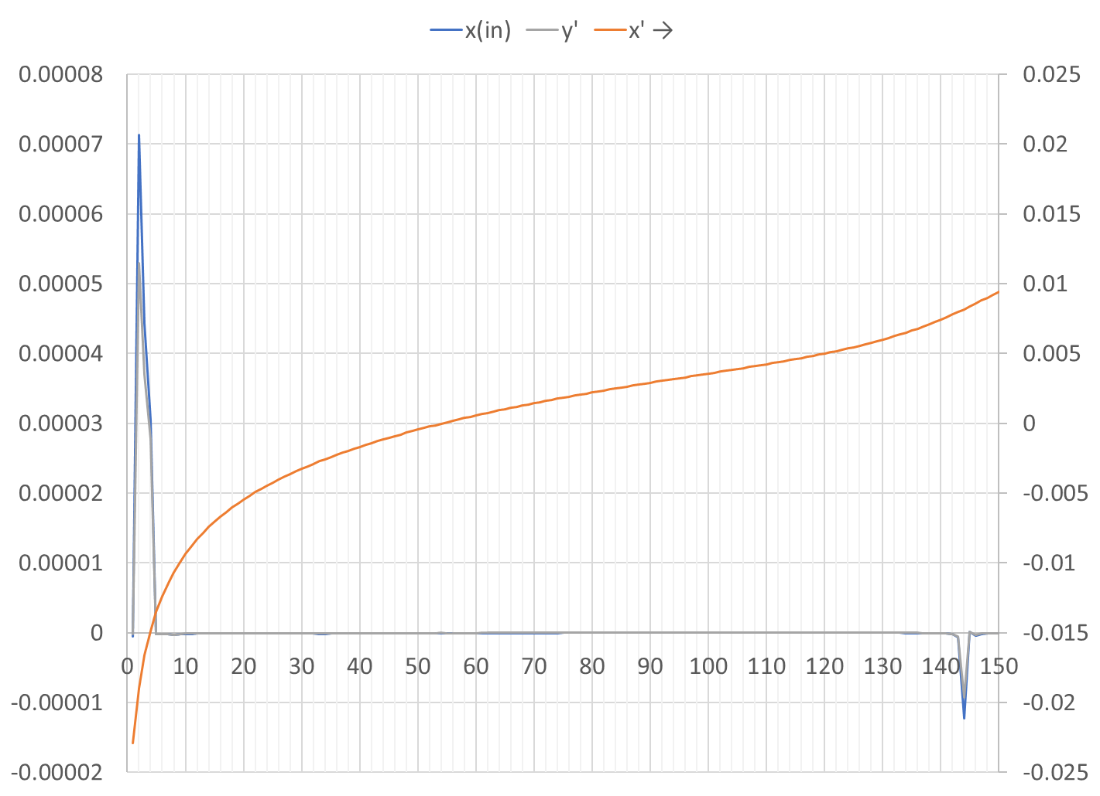
Demo Straight Cell Input Steering
x (m)
y’ (rad)
~= 0
x’ (rad)
Energy (MeV)

Slide 72
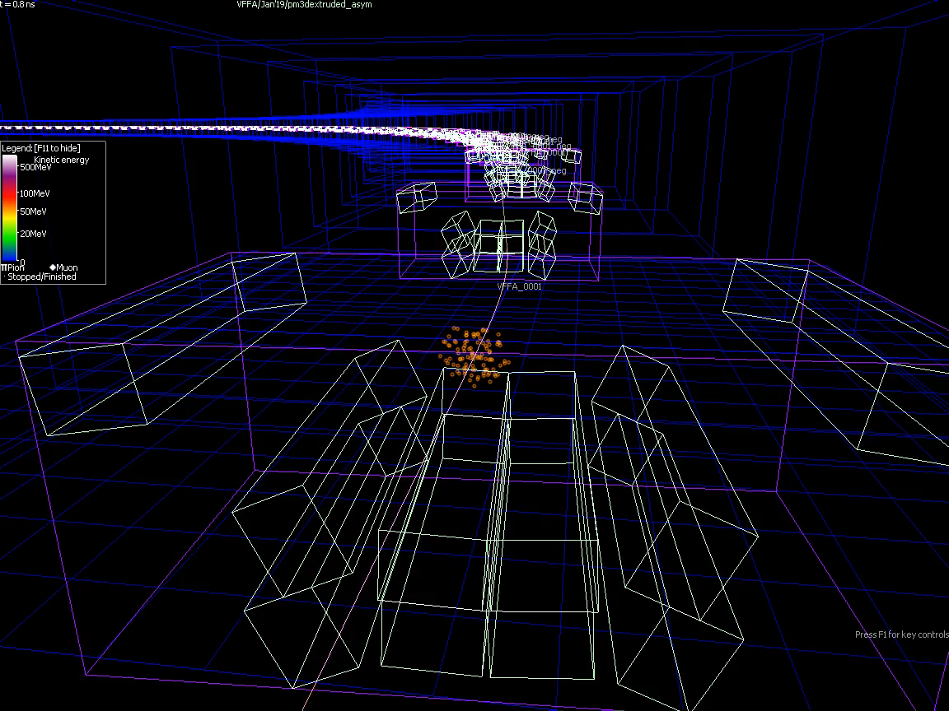
Bent Demo Cell Attempt

Slide 73

Bent Cell Tunes, Height
Cell tunes
y (m)

Slide 74

Bent Cell Input Steering
x (m)
x’ (rad)
y’ (rad)
Energy (MeV)

Slide 75

Bent Cell Input Optical Functions
β_{u,v} (m)
α_{u,v} (m)
Energy (MeV)

Slide 76


Another way: HalbachArea tool
We made a circular VFFA permanent magnet design in November 2023 when I last visited Kyushu U., using this tool:
https://stephenbrooks.org/ap/halbacharea/
This automatically designs permanent magnets with specified field harmonics.

Slide 77
Conclusion (V, VI)
VFFAs with permanent magnets are very well suited for high-energy electron machines
  Fields are low to avoid synchrotron radiation, means permanent magnets are applicable
  Beams are small, so dynamic aperture in the VFFA is not a bad constraint, so magnets can be reasonably sized
  Designs even exist where all magnets are below beam synchrotron radiation plane

Slide 78
Risks to be Investigated
Simulation:
  Dynamic aperture (non-linear magnetic fields)
  Spin preservation (100 turns is semi-fast acceleration regime)
  Lattice integration (arc-to-straight, linac section)
Experimental:
  Magnet field errors
  Alignment errors after correction (e.g. with piezo movers)
    Before correction is well-known, surveyors can do 100-200um easily
  Verify VFFA and high-phase-advance lattice works in practice (ATF beamline)

Slide 79
References
Fixed-field accelerators
  Acceleration in the linear non-scaling fixed-field alternating-gradient accelerator EMMA, S. Machida et al., Nature Physics 8, 243–247 (2012).
  CBETA website: https://www.classe.cornell.edu/Research/CBETA/WebHome.html
  CBETA Design Report, Cornell-BNL ERL Test Accelerator, G.H. Hoffstaetter et al., https://arxiv.org/abs/1706.04245 [physics.acc-ph] (2017).
  CBETA note 032, The CBETA Fractional Arc Test, Ed. C. Gulliford, https://www.classe.cornell.edu/CBETA_PM/index_notes.html
VFFAs
  Vertical orbit excursion fixed field alternating gradient accelerators, S. Brooks, Phys. Rev. ST-AB 16, 084001 (2013).
  Vertical orbit-excursion Fixed Field Alternating Gradient Accelerators and 3D Cyclotrons, S. Brooks, Proc. IPAC’14 (invited talk)
Permanent Magnets
  Production of Low Cost, High Field Quality Halbach Magnets, S. Brooks et al., Proc. IPAC 2017.
  CBETA note 035, CBETA Halbach Magnet Production Run, S. Brooks
ATF fixed-field experiment
  ATF experiment AE-79 “Test of a Large Energy Acceptance NS-FFAG Arc at the ATF”,
  See also talk: Test of Linear-Field Non-Scaling FFAG Arc with a Wide Energy Range, S. Brooks, FFAG’17 workshop: https://indico.bnl.gov/event/2764/

Slide 80
VII. VFFA Electromagnets

Slide 81

“Omni-Magnet”
Many (12) independently-powered poles
Can produce any combination of multipoles if not too strong
“Configurable Field Magnets for a Proton Beam Dynamics R&D Ring”, S. Brooks, Proc. IPAC 2013

Slide 82

VFFA Omni-Magnet
Exponential VFFA fields with k = 5m⁻¹ (left) and k = 10m⁻¹ (right)
Relative field accuracy better than 10⁻³ for B₀ = 0.05T

Slide 83

Multi-Coil Magnet at Kyushu U.
After adjustment
Kyosuke Adachi, FFA’23

