Slide 1
Ultra-low Emittance Bunches from Laser Cooled Ion Traps for Intense Focal Points

Slide 2
Ion Traps & Laser Doppler Cooling
Paul trap configuration has four AC transverse electrodes (like alternating gradient focussing) and DC longitudinal end caps
Temperature limit T_{D} = ℏΓ/2k_{B} = 0.552mK
Longitudinal trap electrodes with injection / extraction hole
Emitted in random direction
Transverse trap electrodes
⁴⁰Ca⁺
397nm photon
Ions
Linewidth Γ = 2π*23MHz, frequency f = c/397e-9 = 755THz
Active over velocity range ~ c(23MHz/755THz) = 9.1m/s
Tune so that force pushes more on ions moving towards laser
Laser

Slide 3
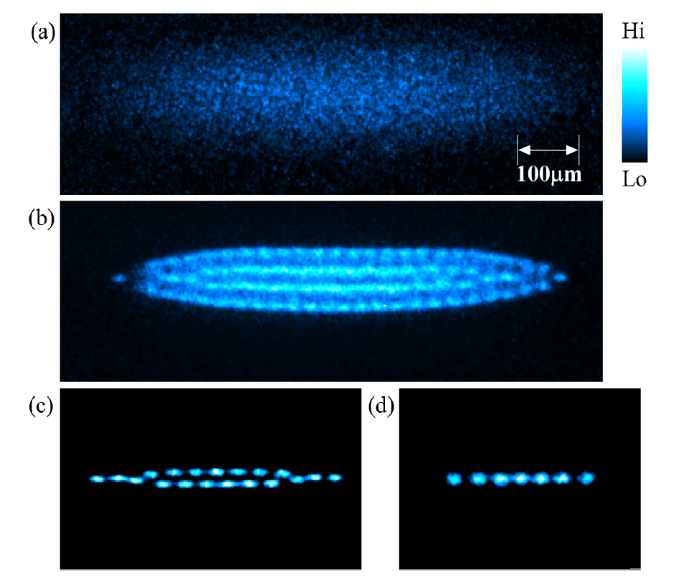
S-POD, IBEX experiments
Fluorescence of Coulomb crystal in S-POD trap, from K. Izawa et al., J. Phys. Soc. Jpn., Vol. 79, No. 12 (U.Hiroshima)
The IBEX Paul trap (RAL) with vacuum chamber opened. The four rods in the center of the image are the transverse trap electrodes.

Slide 4
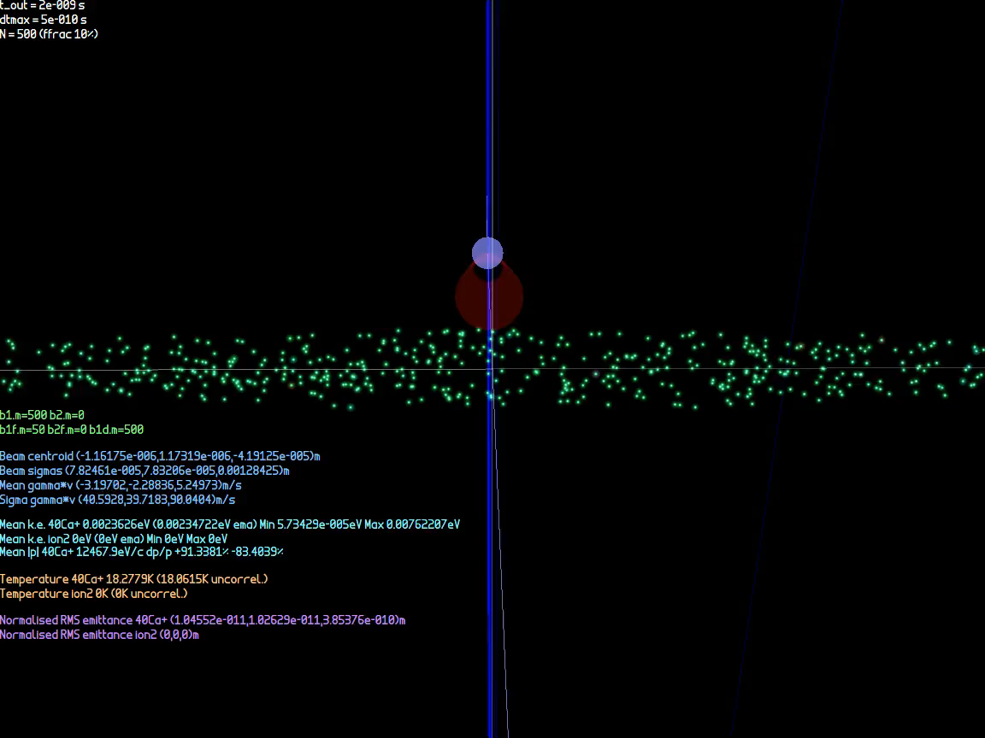
Laser Doppler Cooling Simulation

Slide 5
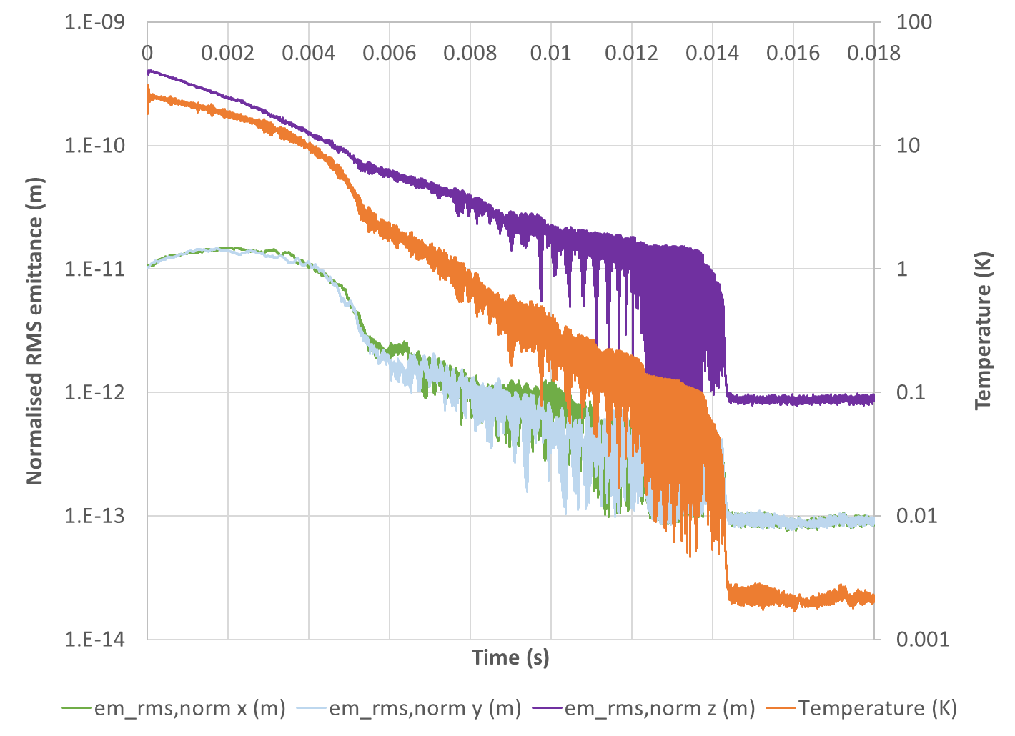
Laser Doppler Cooling Simulation
N = 500 ions

Slide 6
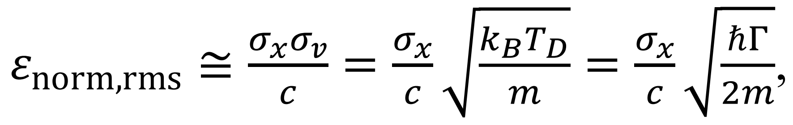
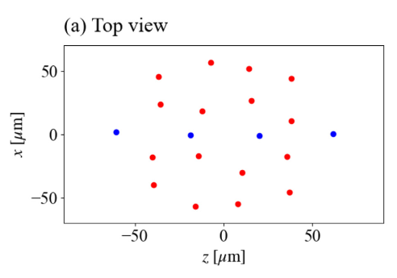
Ion Trap Flexibility
Flexible source with variable parameters over wide range:
Bunch charge (1 to 10⁷ ions)
Via gas pressure, trap voltage
Bunch size, aspect ratio, shape
Via trap voltages, trap geometry, collimation
Emittance/temperature
Stop cooling part way, or tighten trap (→ quantum limit!)
Ion species
Use sympathetic cooling - mix coolable ion e.g. ⁴⁰Ca⁺ ion in contact with desired species
Easily exchangeable electrode configurations
Martin et al., New J. Phys. 21 (2019) 053023
IBEX 10⁶-10⁷
Takai et al., Japan. J. Appl. Phys. 45, No. 6A (2006) 5332-5343
S-POD 1-10⁷
ε_{norm,rms} ≥ ℏ/2mc
Muroo et al., PTEP2023 063G01

Slide 7
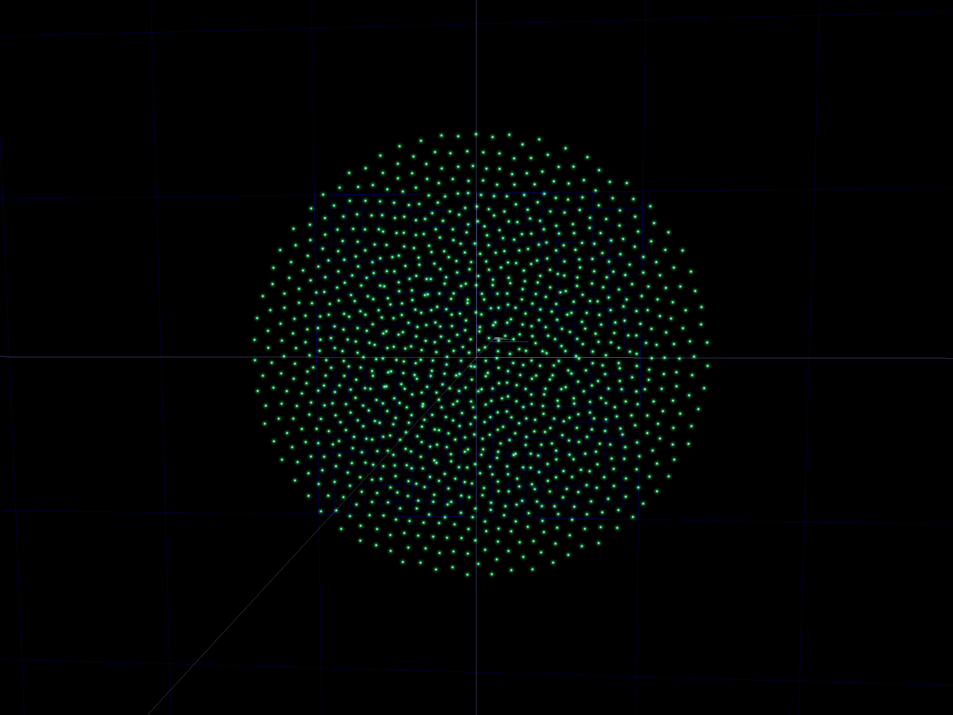
Flexibility e.g.: 2D Coulomb Crystal
Made the transverse trapping voltages much smaller than the longitudinal

Slide 8
What do we do with this beam?
p or γv
p or γv
Accelerate to
1000GeV/u
Focus with
σ_{p}/p = σ*_{θ} = 0.01
x
x
Ion trap beam
Typical ion source beam
Parameter | Ion source | Ion trap
N | 10⁹ | 500
ε_{norm,rms} | 10⁻⁷m | 2×10⁻¹³m
σ_{x} | 1mm | 90μm
σ_{v} | 30km/s | 0.65m/s
T | 4.3MK | 2mK
Parameter | Ion source | Ion trap
N | 10⁹ | 500
ε_{norm,rms} | 10⁻⁷m | 2×10⁻¹³m
σ*_{x} | 9.4nm | 18fm
σ*_{θ} | 10mrad | 10mrad
L/bunch | 9×10²⁸cm⁻² | 6×10²⁷cm⁻²

Slide 9
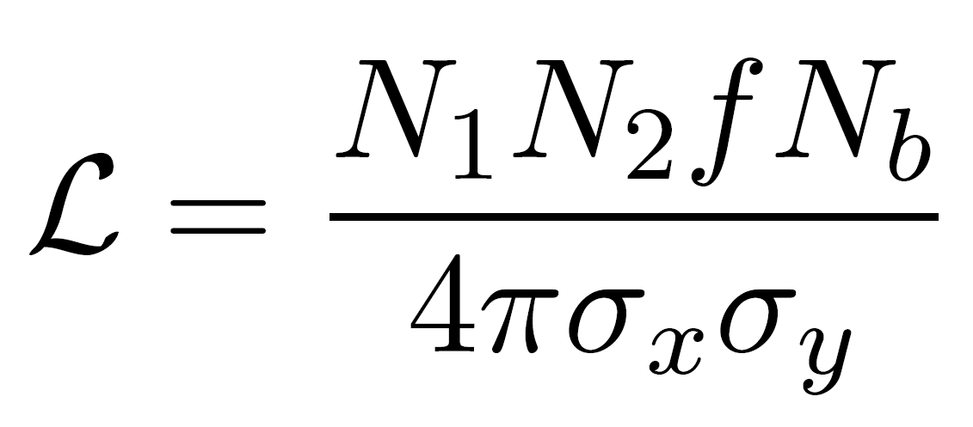
Analytic Model for High Specific Luminosity
Luminosity is held constant if N ∝ σ∗
If σ*_{θ} is also held constant, that’s N ∝ σ∗ ∝ ε
But luminosity per ion increases at smaller N
6×10²⁷cm⁻² from 2×500 ions is 130,000 times more efficient than 9×10²⁸cm⁻² from 2×10⁹ ions
In fact the ion trap saturated the cross section
If σ_{tot} > 84mbarn, then >500 collisions expected
One pass and it’s gone!

Slide 10
What’s going on in the longitudinal plane? and Other Questions
Need short bunch length for good collisions
The ion trap’s emittance is small in all three planes
The bunch seems pretty “opaque”, does it self-interact?
Space charge repulsion prior to the focus?
Why don’t collider interaction points create a sharp focus all three space planes?
Is that even possible?
Yes, but relativity reduces longitudinal Δv_{bunch rest frame}

Slide 11
Bunch Implosion Radius Limits
Model: imploding uniform sphere of charge in the bunch’s rest frame
Space charge dictates r ≥ 1/(4πε₀) Nq²/E_{k,in}
E_{k,in} is inward kinetic energy at sphere surface
Density ρ ∝ N/r³ ∝ E_{k,in}³/N²
Emittance dictates σ_{x} ≥ ε_{norm,rms}/σ_{βγ}
σ_{x} = r/sqrt(5), σ_{βγ} = (βγ)_{in}/sqrt(5)
σ_{βγ,Transv.} = (βγ)_{beam}σ*_{θ}, σ_{βγ,Long.} = β_{beam}σ_{p}/p

Slide 12
Minor Complexities
Ca⁺ will behave as Ca²⁰⁺ once nuclei are within each others’ electron clouds (no shielding)
Space charge forces for a non-spherical uniform charge density ellipsoid are actually coupled between the planes (but still linear)
Just like the 2D KV envelope space charge force
Integrated backwards from focal point and fitted focal ellipsoid size to match incoming σ*_{θ} and σ_{p}/p

Slide 13
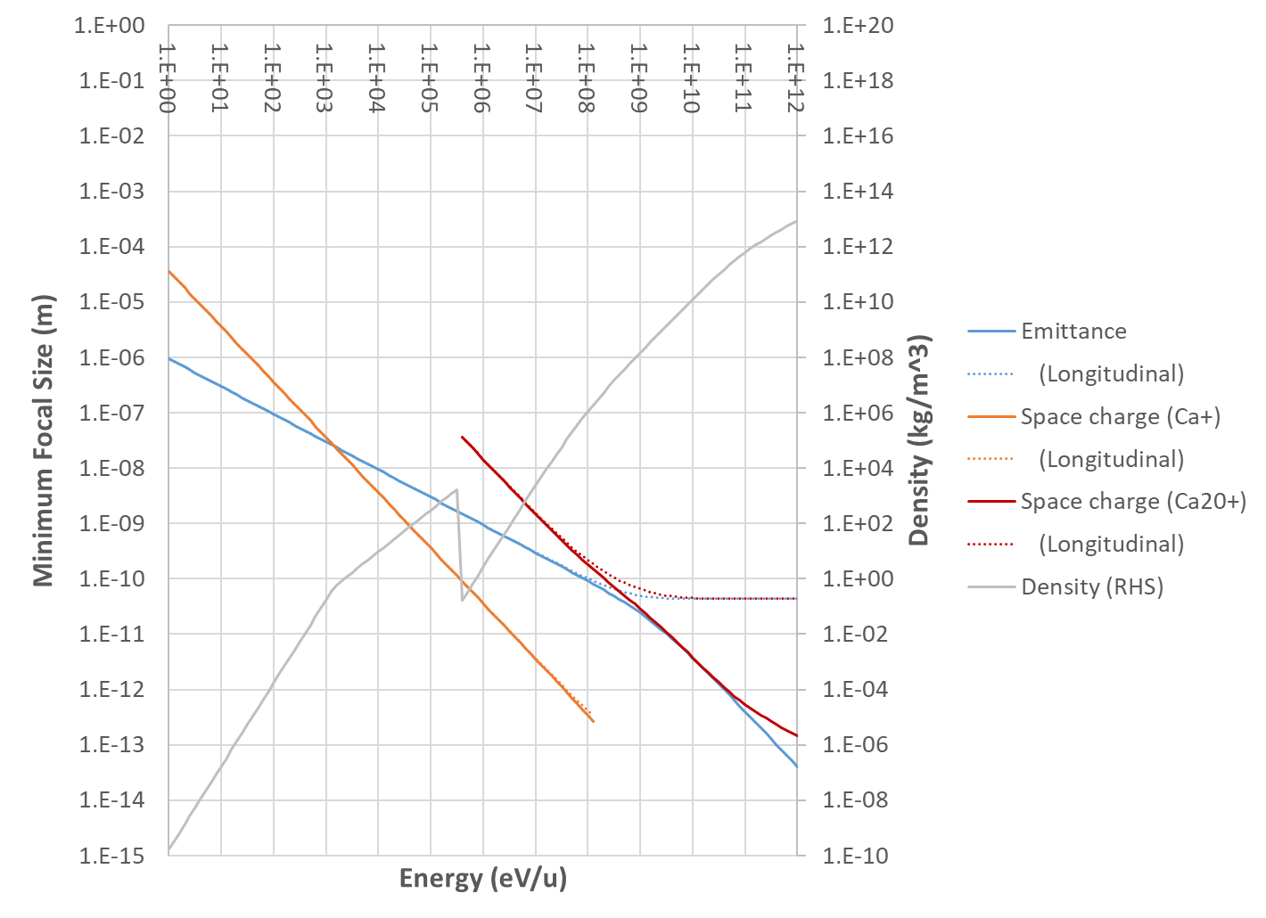
Energy Scaling Graph
Nuclear density 2.5e17
For N = 500 ions
σ_{p}/p = σ*_{θ} = 0.01
Water 1e3
Doesn’t quite get there, mainly because of longitudinal plane
Switch to using fully-stripped ion charge when orbitals touch

Slide 14
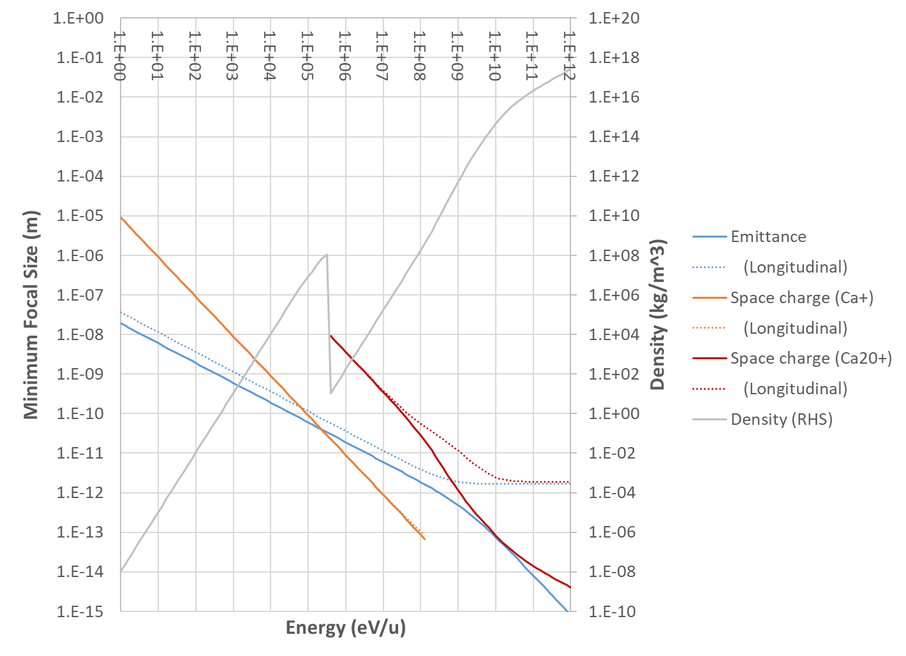
Energy Scaling Graph
“Nuclear spaghetti”
Nuclear density 2.5e17
For N = 500 ions
σ_{p}/p = σ*_{θ} = 0.02
ε_{L} = 1.9ε_{T}
Water 1e3
Can fix by using a tighter ion trap with ~20× smaller emittance (not too hard) and 2× larger dp/p (helps a lot).
Colliding bunches could also work, as might an FFA channel supporting a wider dp/p.

Slide 15
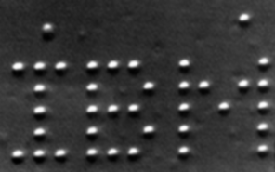
Potential Future Applications
We can already accurately position objects close to the nuclear size (e.g. LIGO mirrors)
The low emittance (entropy) of the ion trap initial state allows nuclei to be placed in particular locations deliberately, e.g.:
Make white dwarf, neutron star matter
3-way and multi-way particle collisions
Synthesise custom shapes of nuclear matter
Possible neutron-rich superheavy elements
Deliberate placement of 35 Xe atoms in 1989

Slide 16

Nonlinear Tracking Study: What can stop us?
Space charge, emittance and energy spread considerations as in analytic model
Optical aberrations!
Lenses are not linear, spherical aberration, chromaticity etc.
Can focussing in all three planes be done?
Experimental noise, jitter etc.
Ideas for feedback using scattered pattern from interaction point
Coulomb scattering has very good resolution

Slide 17
Focussing Beamline Simulation
Test of three-plane focusing and optical aberration correction (at lower energy)
Input N=20000, T=2mK ion trap bunch parameters
Given energy chirp
Curved electrostatic beamline
Point-source ‘electrodes’
Arranged in rings of 12
Generalised multipole lenses
Goal: minimise 3D focal size

Slide 18
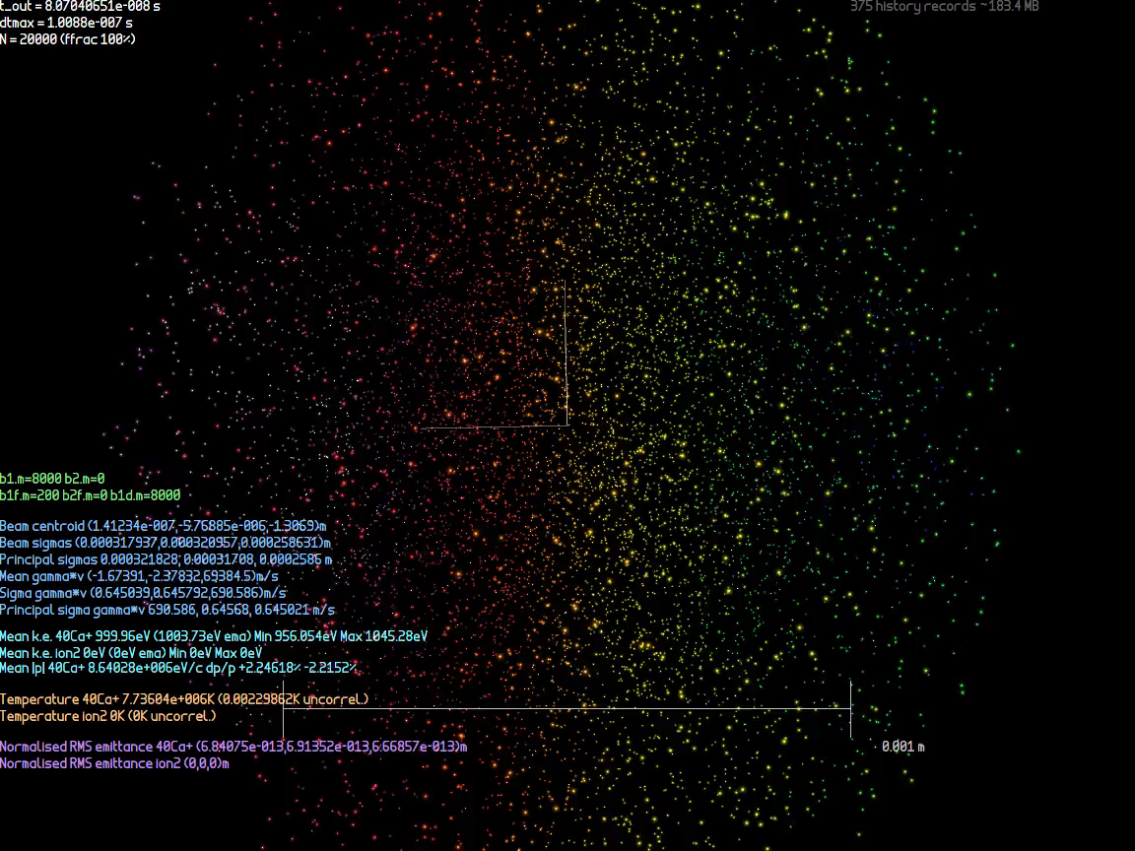
Focussing Beamline Simulation

Slide 19
Optimisation of Electrode Voltages
11 electrode charges were optimised per electrode ring (12 minus one monopole)
The bunch initial chirp was also optimised
So 15 electrode rings → 166 parameters
Used modified Levenburg-Marquardt method with nonlinearity correction
See https://arxiv.org/abs/2307.03820
Response matrix → SVD → try various damped inverses
Sample additional points to infer nonlinear behaviour

Slide 20
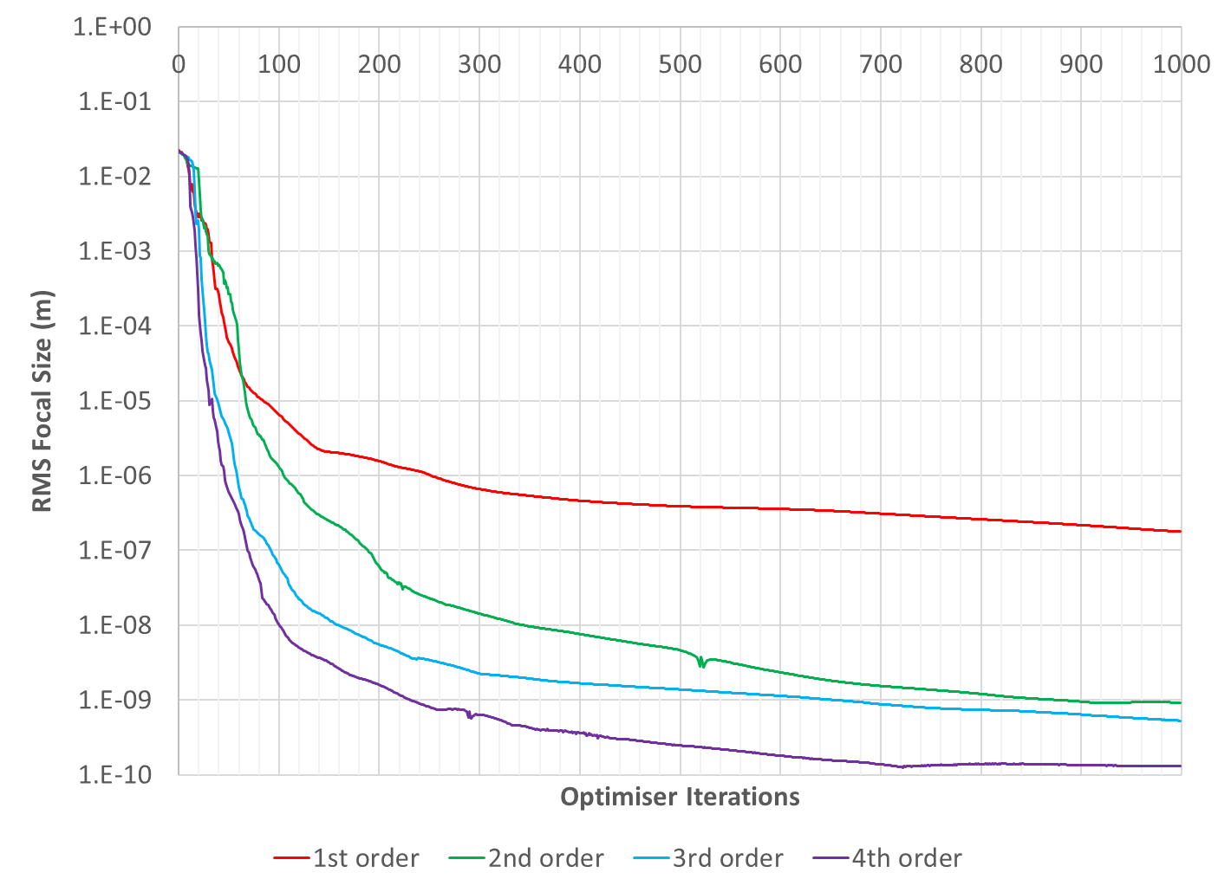
Improved L-M Optimiser

Slide 21
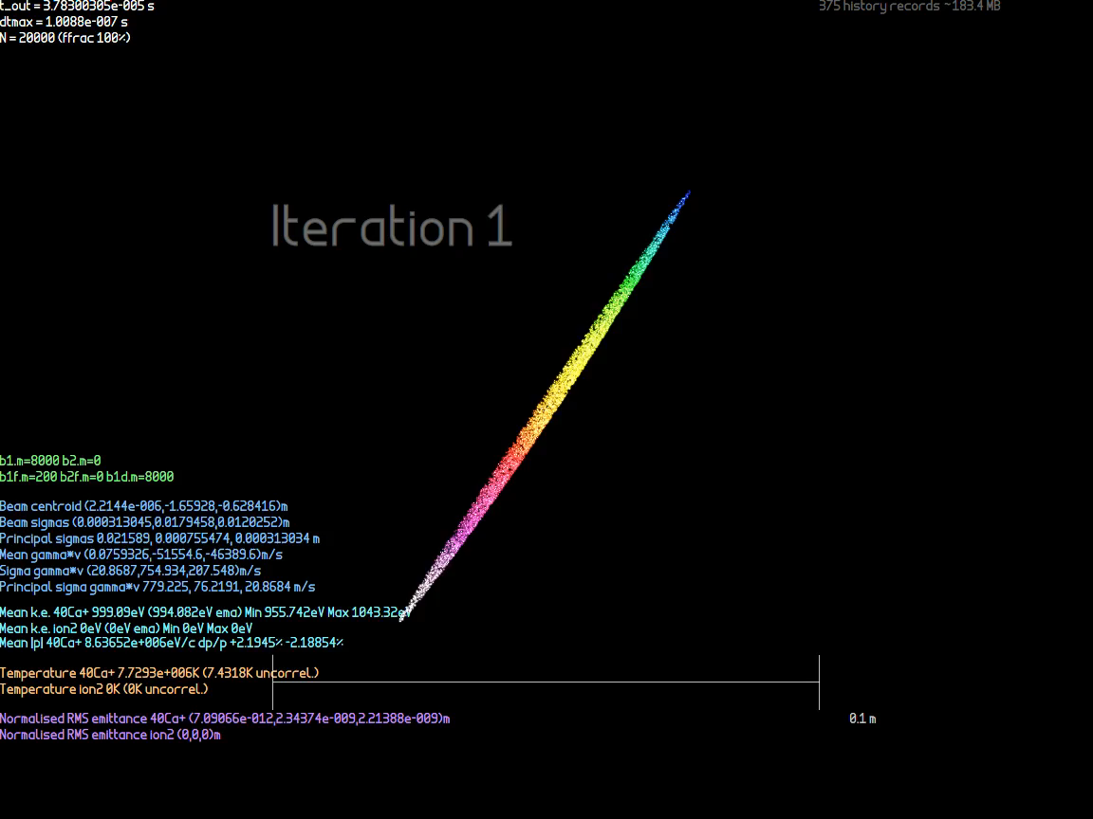
Focal Point Optimisation (T=2mK)

Slide 22

Focal Point Optimisation (T=0)

Slide 23
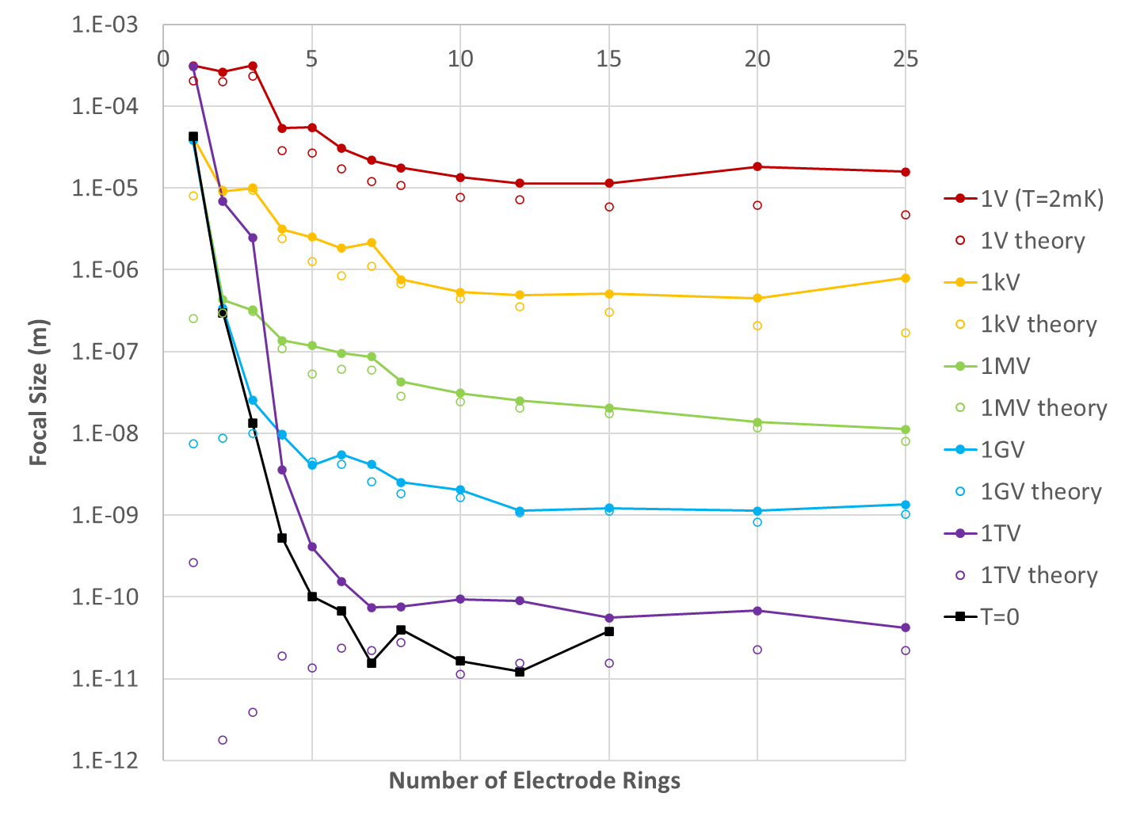
Focal Size vs. Electrodes Used
Lines are limited by normalised emittance (const.) and chosen dp/p chirp (generally increasing)
T=0 line shows limit from pure aberrations
“Theory” is the minimum allowed size taking account the emittance and chirp
Numerical accuracy floor?

Slide 24
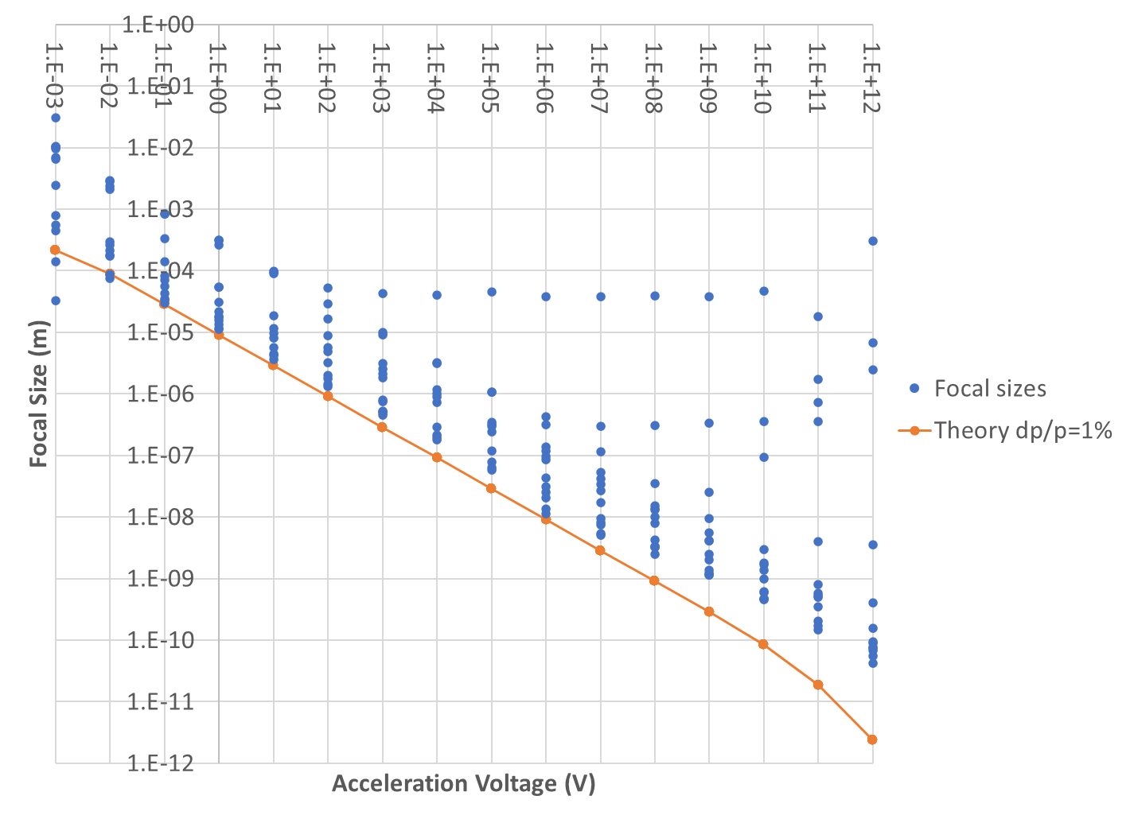
Focal Size vs. Energy
Focal sizes plotted for all numbers of electrode rings
Beamlines with only one electrode ring stop here
Two rings here
Higher energies don’t use 1% dp/p, could need more electrode rings or just be hitting numerical noise

Slide 25
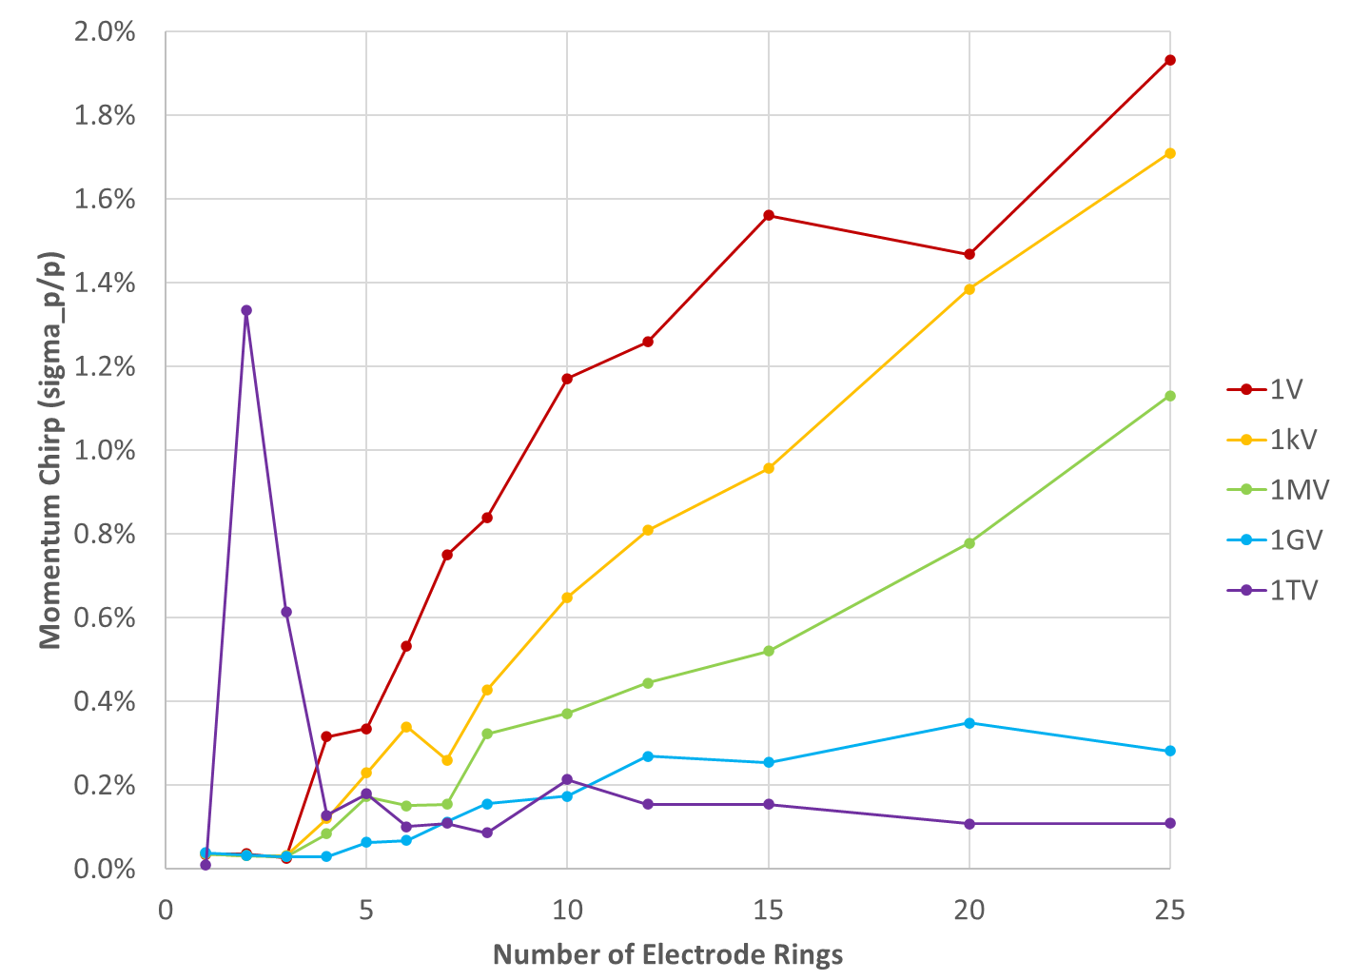
Optimal Chirp vs. Electrodes Used
As more beamline elements are allowed, optimiser can cancel aberrations for a larger momentum range
Higher energies have smaller geometrical emittance already, less incentive to increase dp/p

Slide 26
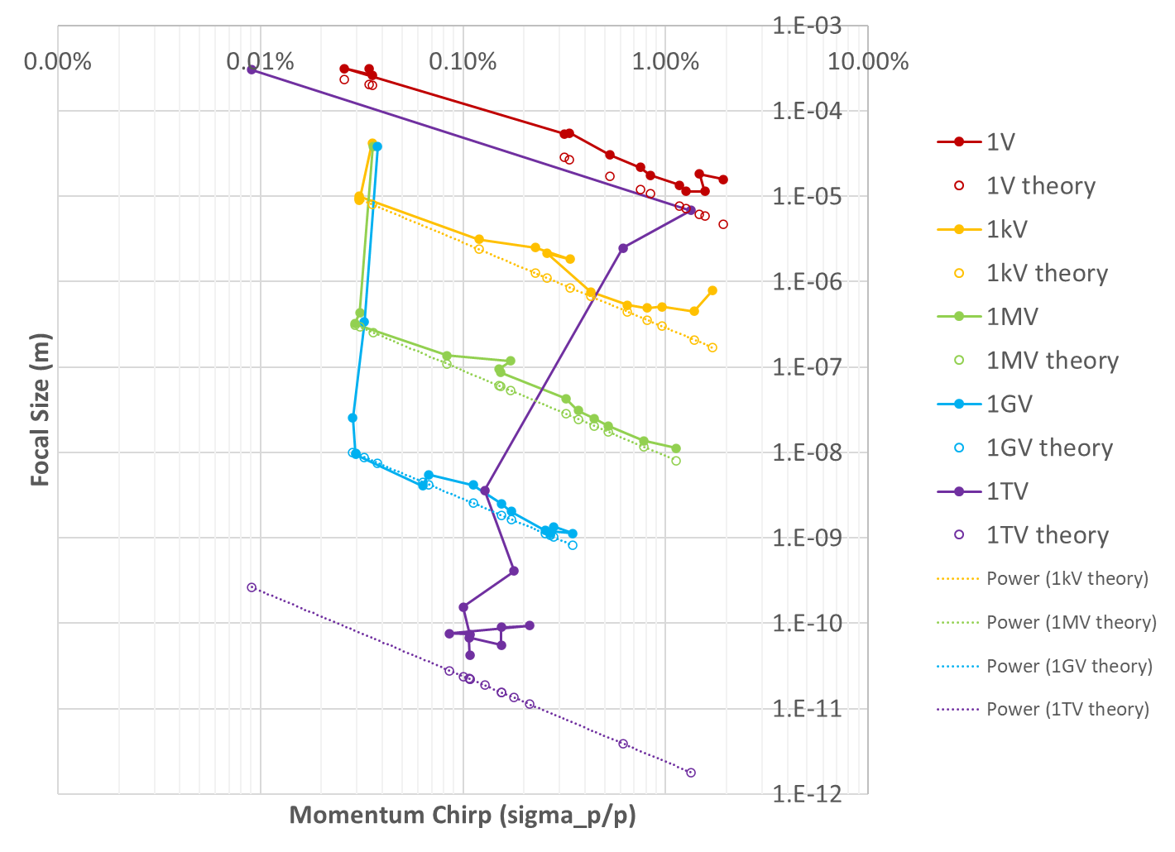
Focal Size vs. Initial Chirp
Scalings as expected, ignoring 1TV that has a bit of trouble

Slide 27
Other Options: Cooling at High Energy?
Doppler cooling also works in a boosted frame
Pros:
Can create cold beams at or near final energy
Bypass jitter from RF and acceleration process
Use blue-shift to cool using harder transitions(?)
Cons:
Needs a low-intra-beam-scattering (IBS) ring lattice
Very low phase advance per cell
Bunch velocity distribution near-Maxwellian
Too much energy or field could strip ions
Ring is more expensive than an at-rest ion trap
PALLAS ring did this, but beam velocity only 2.8km/s
Schramm et al., Plasma Phys. Control. Fusion 44 (2002) B375–B387
Improves cooling rate, but increases limiting temperature

Slide 28
Increasing Current Throughput
Throughput of basic trap isn’t great
10⁷ ions every 16ms (62.5Hz) is 100pA average
But trap is small enough and 10ms is short enough that could make a CW cooling channel at a PALLAS-like speed of 50km/s
Bunches every 100ns (10MHz), spaced by 5mm
Average current could go as high as 16uA
Length of channel 16ms*50km/s = 800m
Could coil it up, trap can be narrow, rods few mm apart

Slide 29
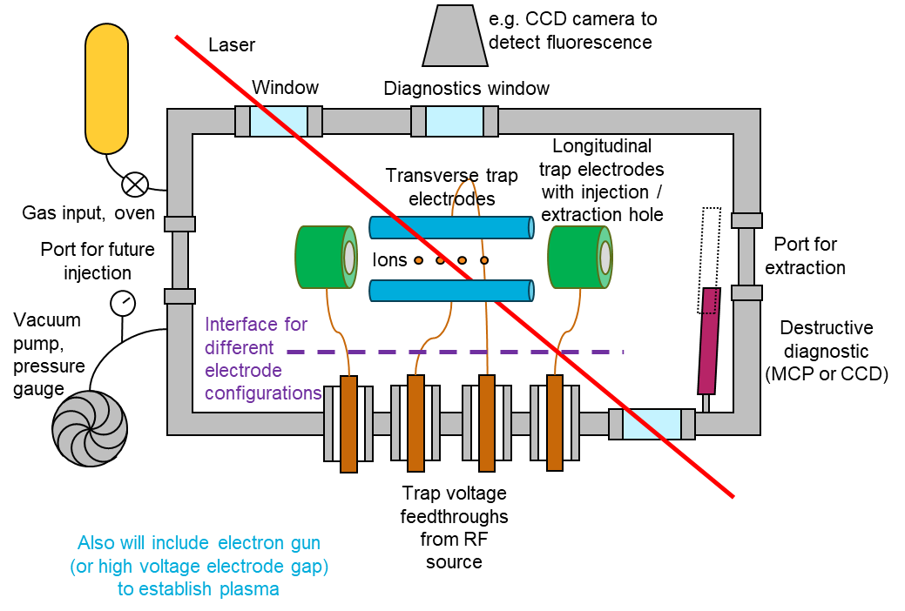
Recent Funding at BNL
Received Lab-Directed R&D (LDRD) funding at BNL, total $400k over 2 years, Oct ‘23-Sep ’25
About $160k actual hardware after labour and overheads
Proposed to “construct a basic foundational system”
Probably without laser cooling to start with

Slide 30
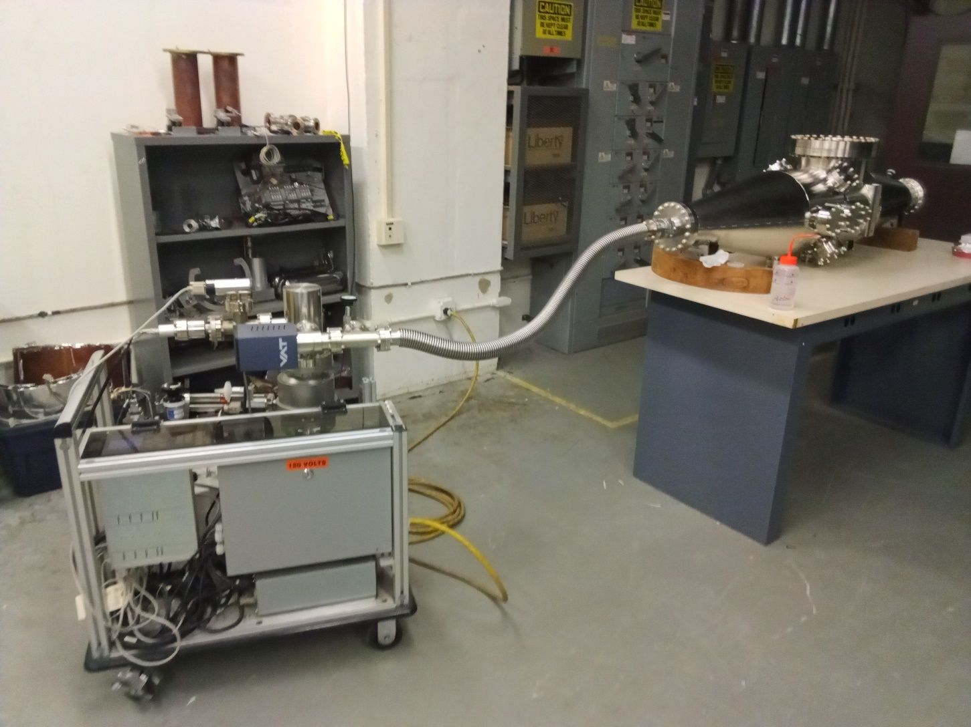
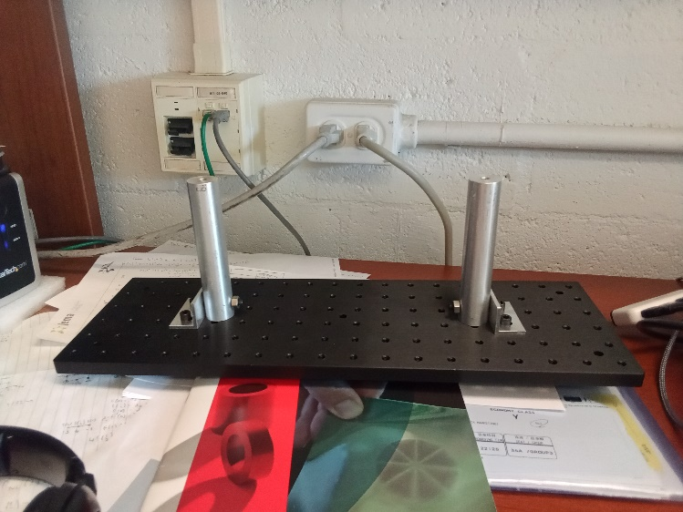
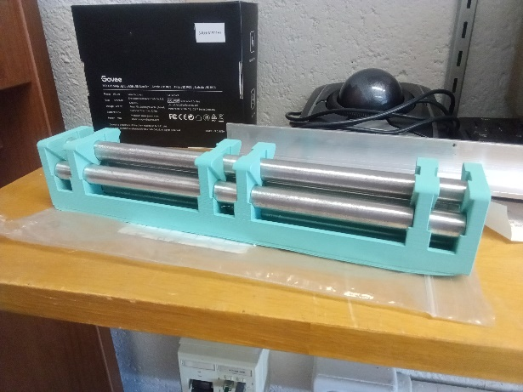
LDRD Hardware Current Status
In Bldg. 938 basement
Old RHIC polarimeter vacuum chamber has pumped down, leak free
Experimental platform for mounting inside chamber
3D printed + aluminium rods
1:1 model ion trap geometry
Requisitions out for: MCP diagnostic, 500eV 100uA electron gun, turbopump system, oscilloscope, 150V/2kV/4kV voltage amplifiers.
Still need: arbitrary waveform generator, broadband voltage amplifiers, feedthroughs, Teflon parts.

Slide 31
Conclusion
Ultra-low emittance bunches provide some interesting unexplored regimes
10⁶ times smaller emittance vs. conventional bunches
Extraction into an accelerator would be new
Lower entropy initial states are going to be the long term trend as experiments improve
Can even achieve the quantum ground state
Produce e.g. entangled spin states in a beam!
Ultimately, appears capable of custom synthesis of nuclear density matter

Slide 32
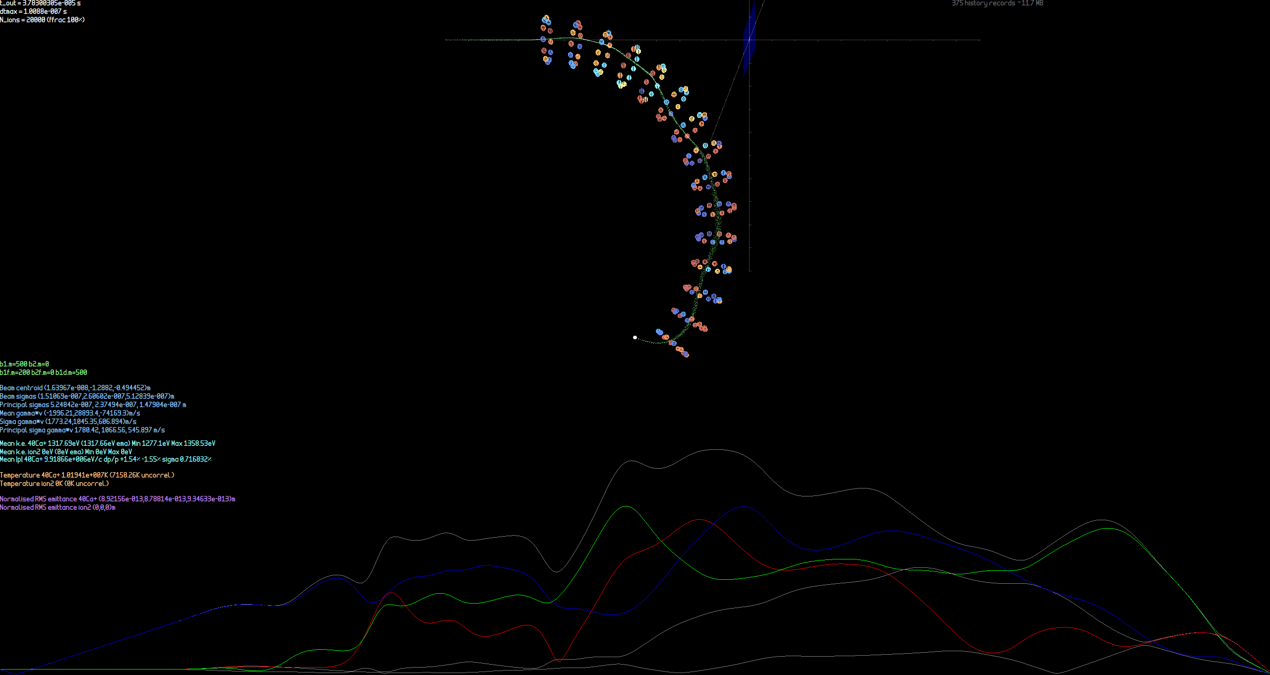
Beam sizes in focussing channel

Slide 33
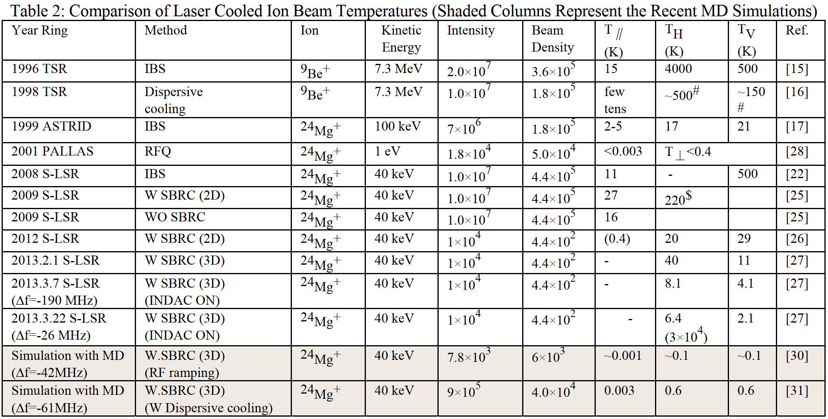
Doppler-cooled rings as of 2014
Noda et al., IPAC2014

Slide 34
Visits to Labs in Japan November 2023
cERL, Fixed-Field Accelerators
and Ion Traps

Slide 35
Locations
1 KEK
cERL 20MeV e⁻ ERL
2 J-PARC
MR 30GeV p synchrotron
3 KURNS (formerly KURRI)
Kyoto University Institute for Integrated Radiation and Nuclear Science
150MeV p FFA
4 Hiroshima University
Ca⁺ ion trap,
~mK Coulomb crystals
5 Kyushu University (Ito Campus)
150MeV p FFA
40keV e⁻ VFFA prototype
Tandem system
2
1
4
3
5

Slide 36
Route of Nozomi Shinkansen
2
1
4
3
5

Slide 37
1. At KEK
Visited the cERL 20MeV 1-turn electron ERL
Currently used for a variety of industrial applications
Hiroshi Sakai is group leader
Plan was to participate in re-commissioning
But cryo problem delay meant they were just starting as I had to leave!
By end of November 2023, they had re-commissioned it to CW 0.9mA beam, near 100% energy recovery
Results will be reported at ERL 2024 conference at KEK in September (they encourage us to attend)
Gave a seminar on CBETA operation, multi-turn orbit correction, path length correction, halo and degaussing

Slide 38
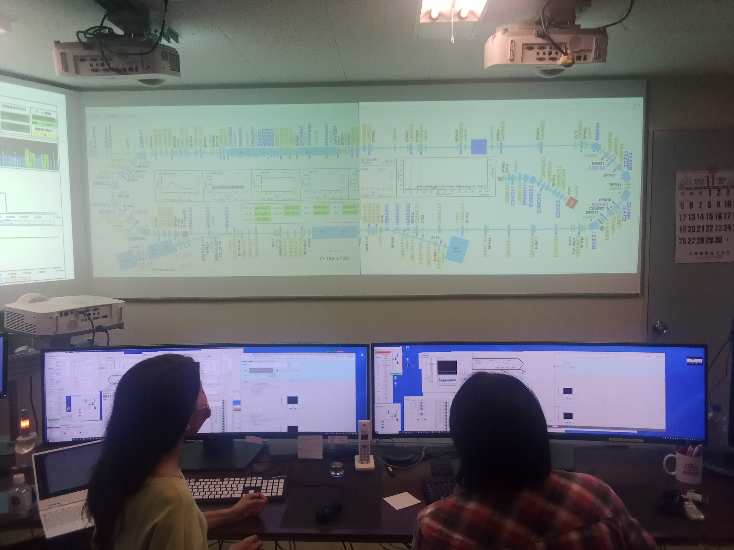
cERL Control Room

Slide 39
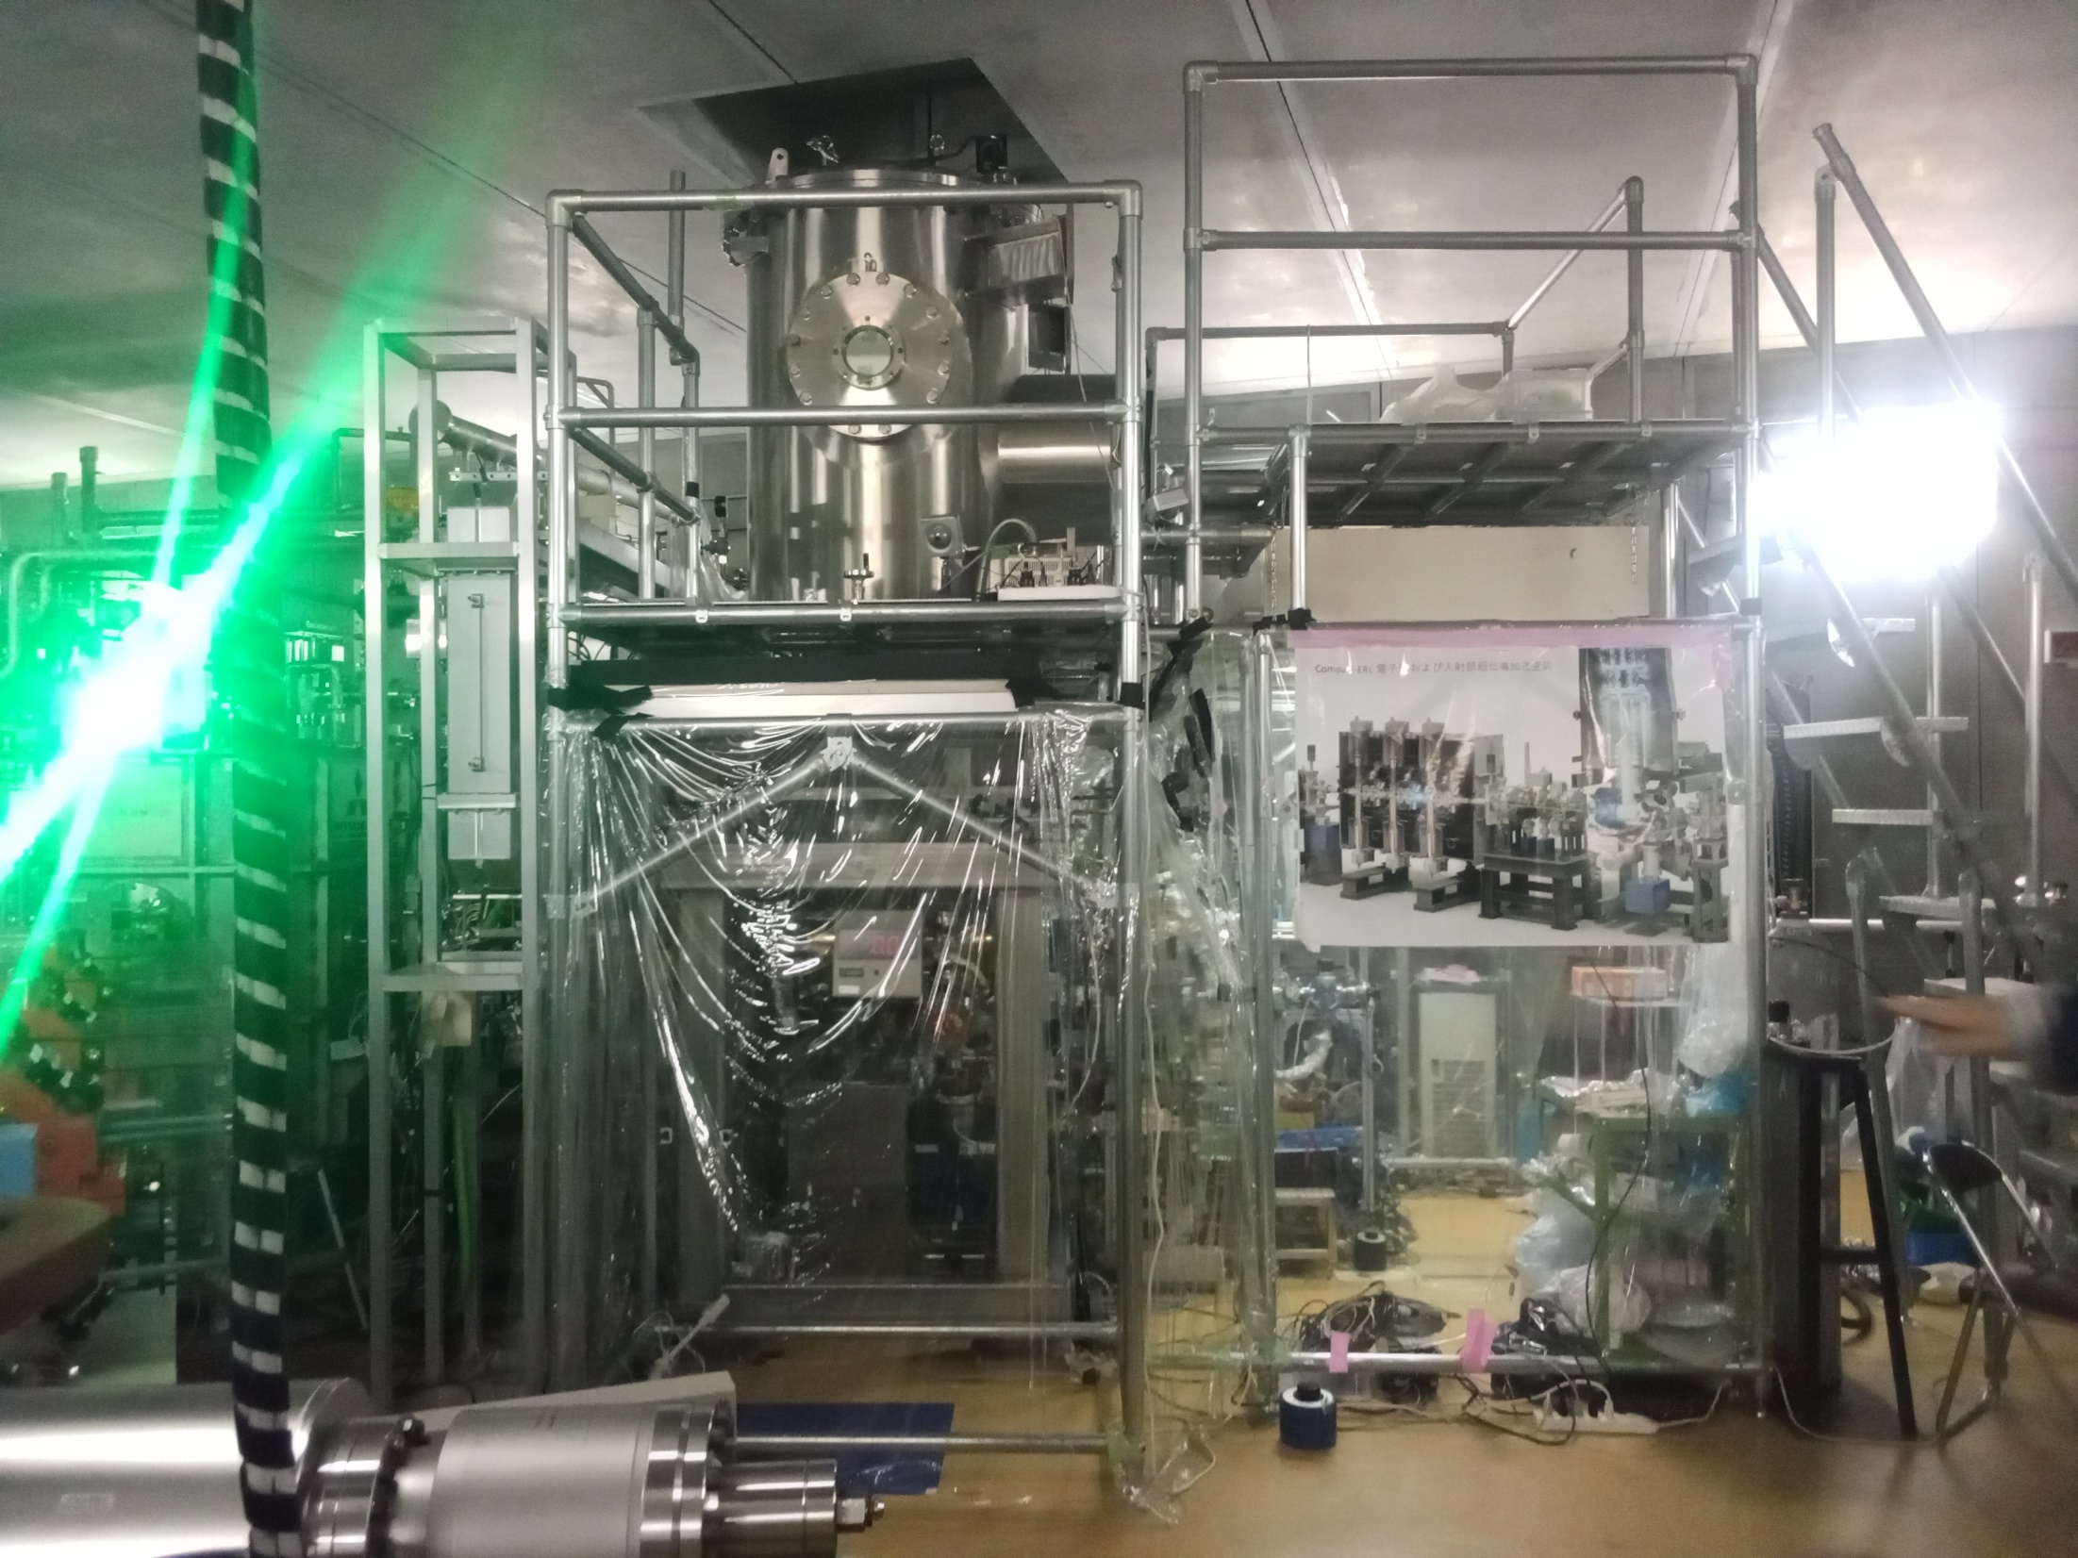
cERL electron gun
500kV DC photocathode gun
Vacuum pressure of 8e-12 mbar

Slide 40
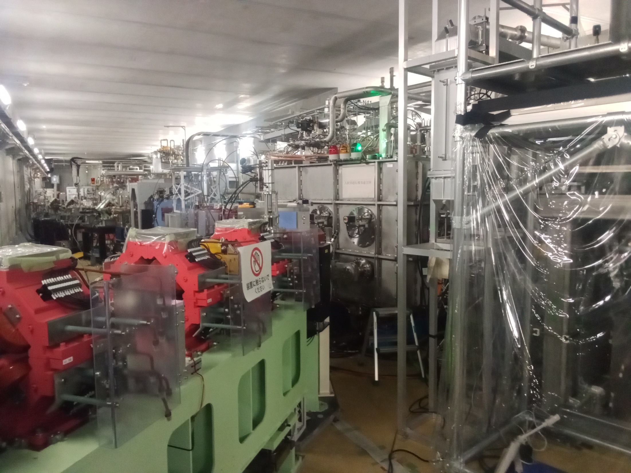
RF Section
Main linac cryomodule (two 9-cell cavities) adds/subtracts 17MeV for 20MeV total
All RF is 1.3GHz
Injector cryomodule (three 2-cell cavities) adds 2.5MeV for 3MeV total

Slide 41
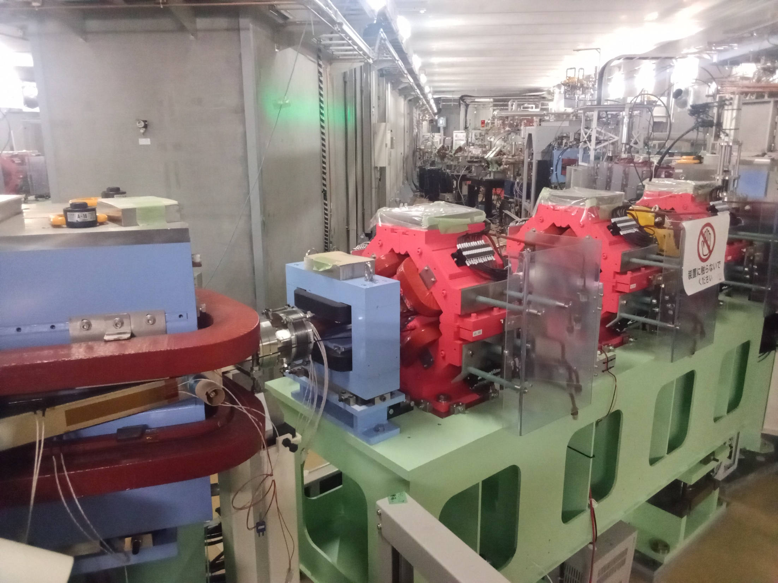
Arc Magnets
Trim dipole

Slide 42
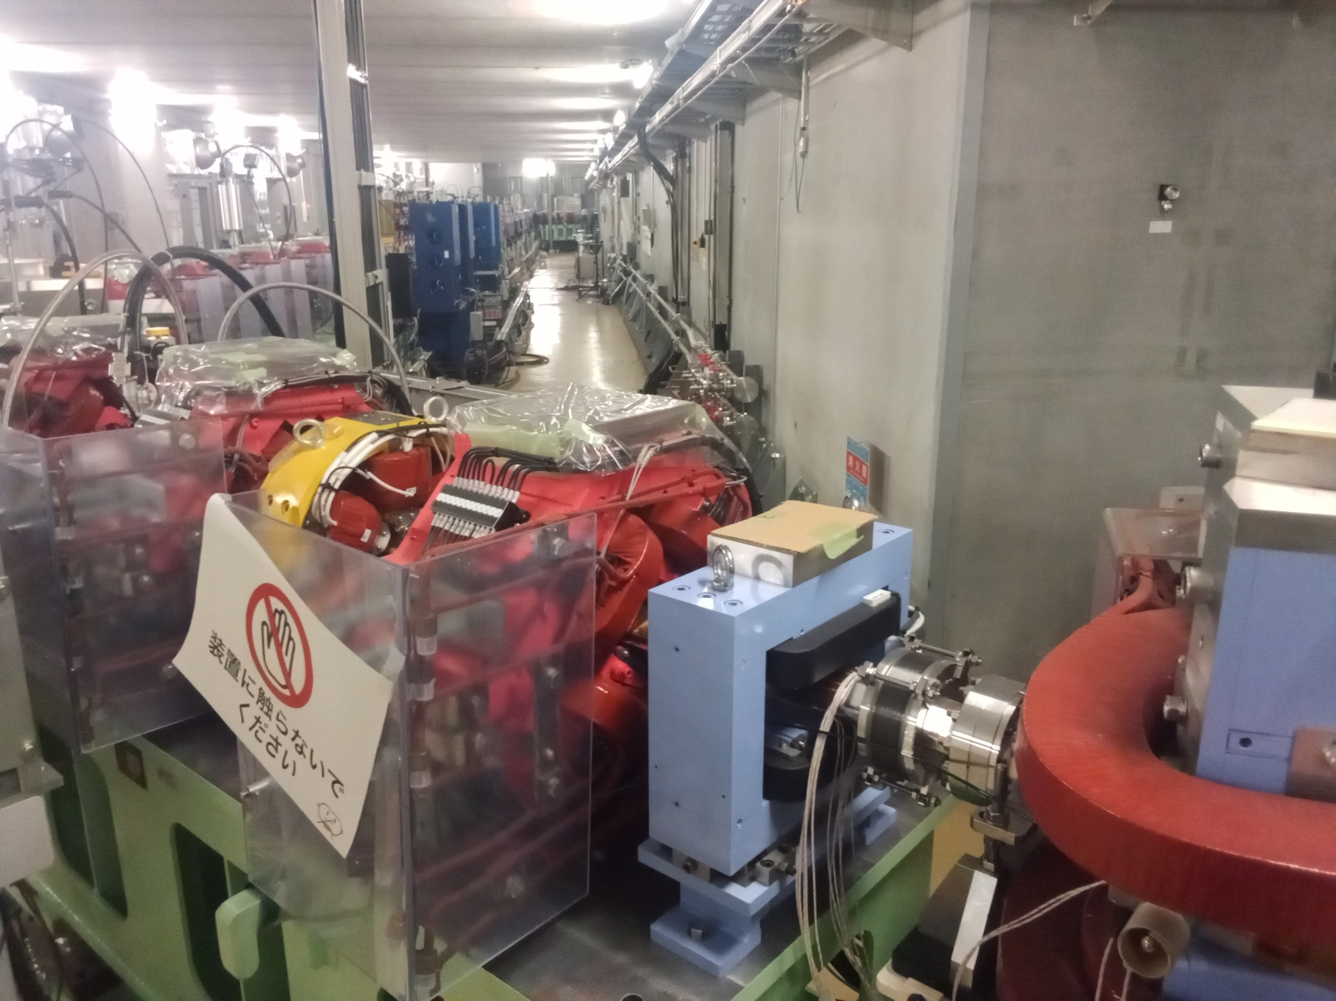
Arc and Experimental Side
← Various experiments:
Wiggler for mid-infrared SASE FEL test
THz source (Resonant Coherent Diffraction Radiation)
Radioisotope production target
Sextupole for chromaticity control

Slide 43
2. At J-PARC
Visit just for the morning, drive from KEK
Chihiro Ohmori organised the tour
J-PARC control room
Tour of 30GeV “Main Ring” (MR)
Also magnetic alloy (MA) RF lab
J-PARC Main Ring is used for:
Hadron Experimental Facility (K, π, μ, ν, Λ, pbar)
Neutrino beam for T2K long baseline experiment

Slide 44
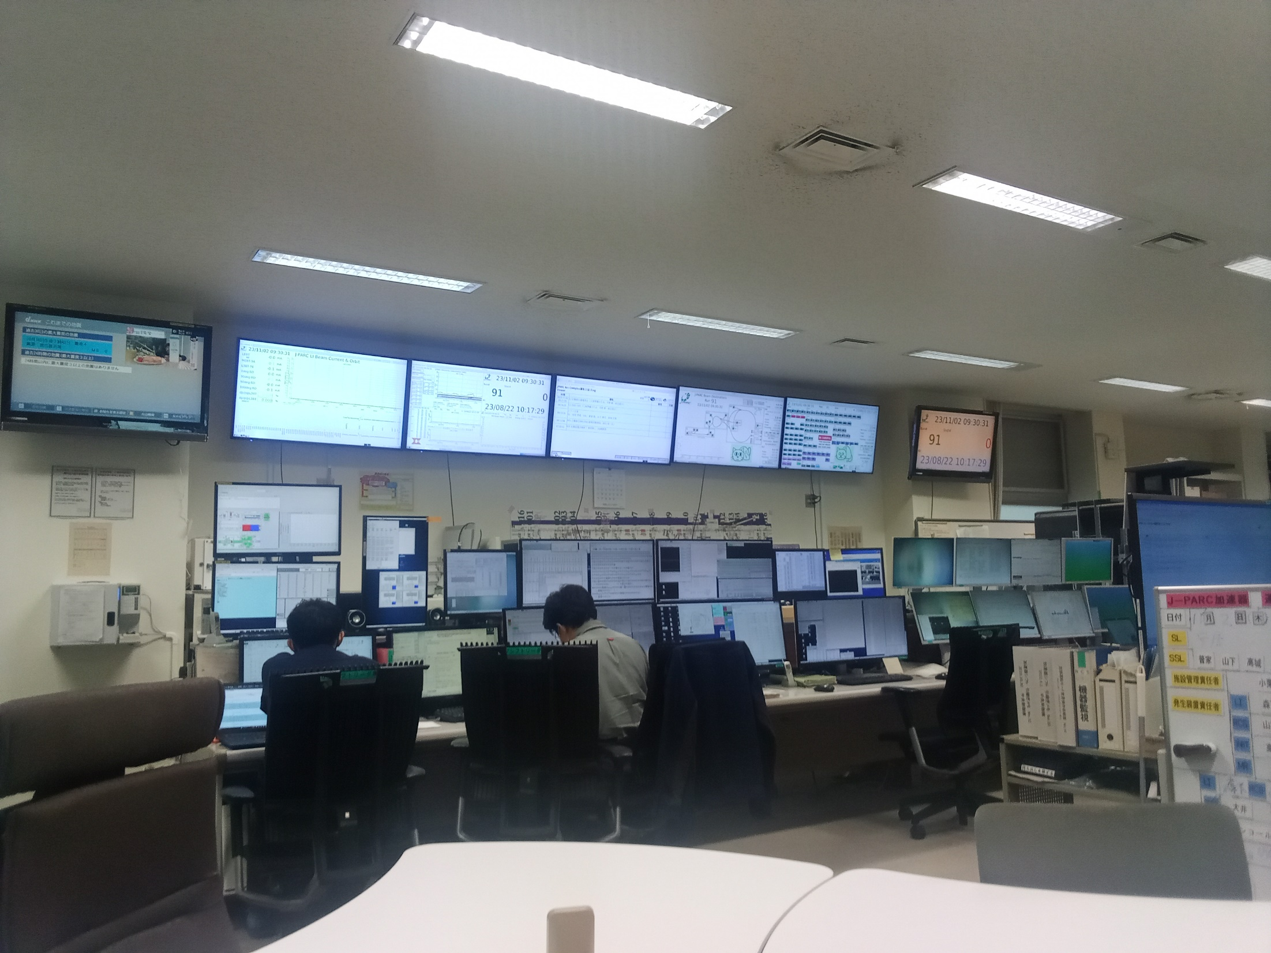
J-PARC Control Room

Slide 45
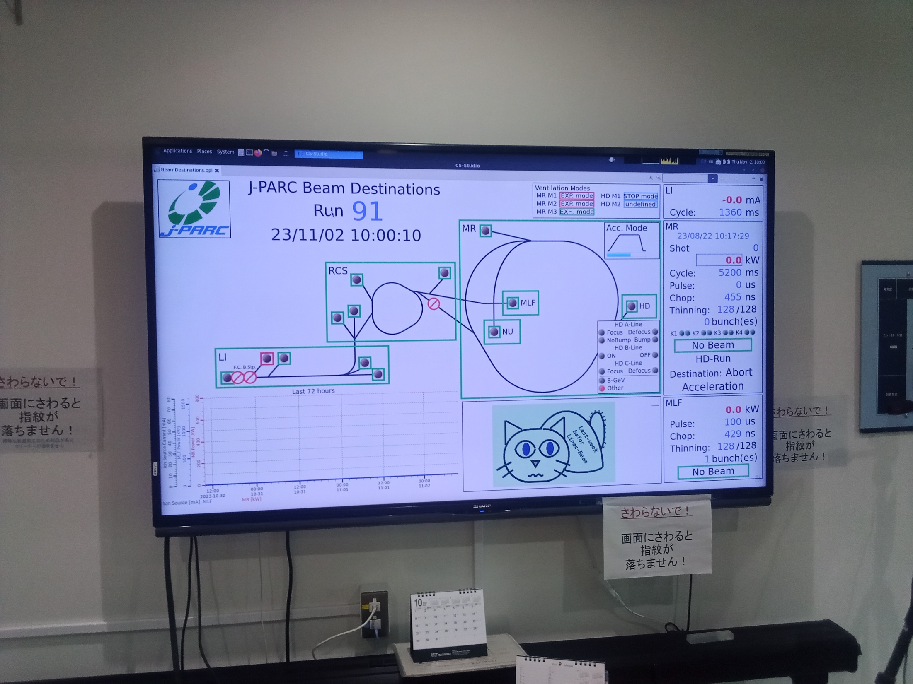
Machine Status
Cat is used to indicate operational mode

Slide 46
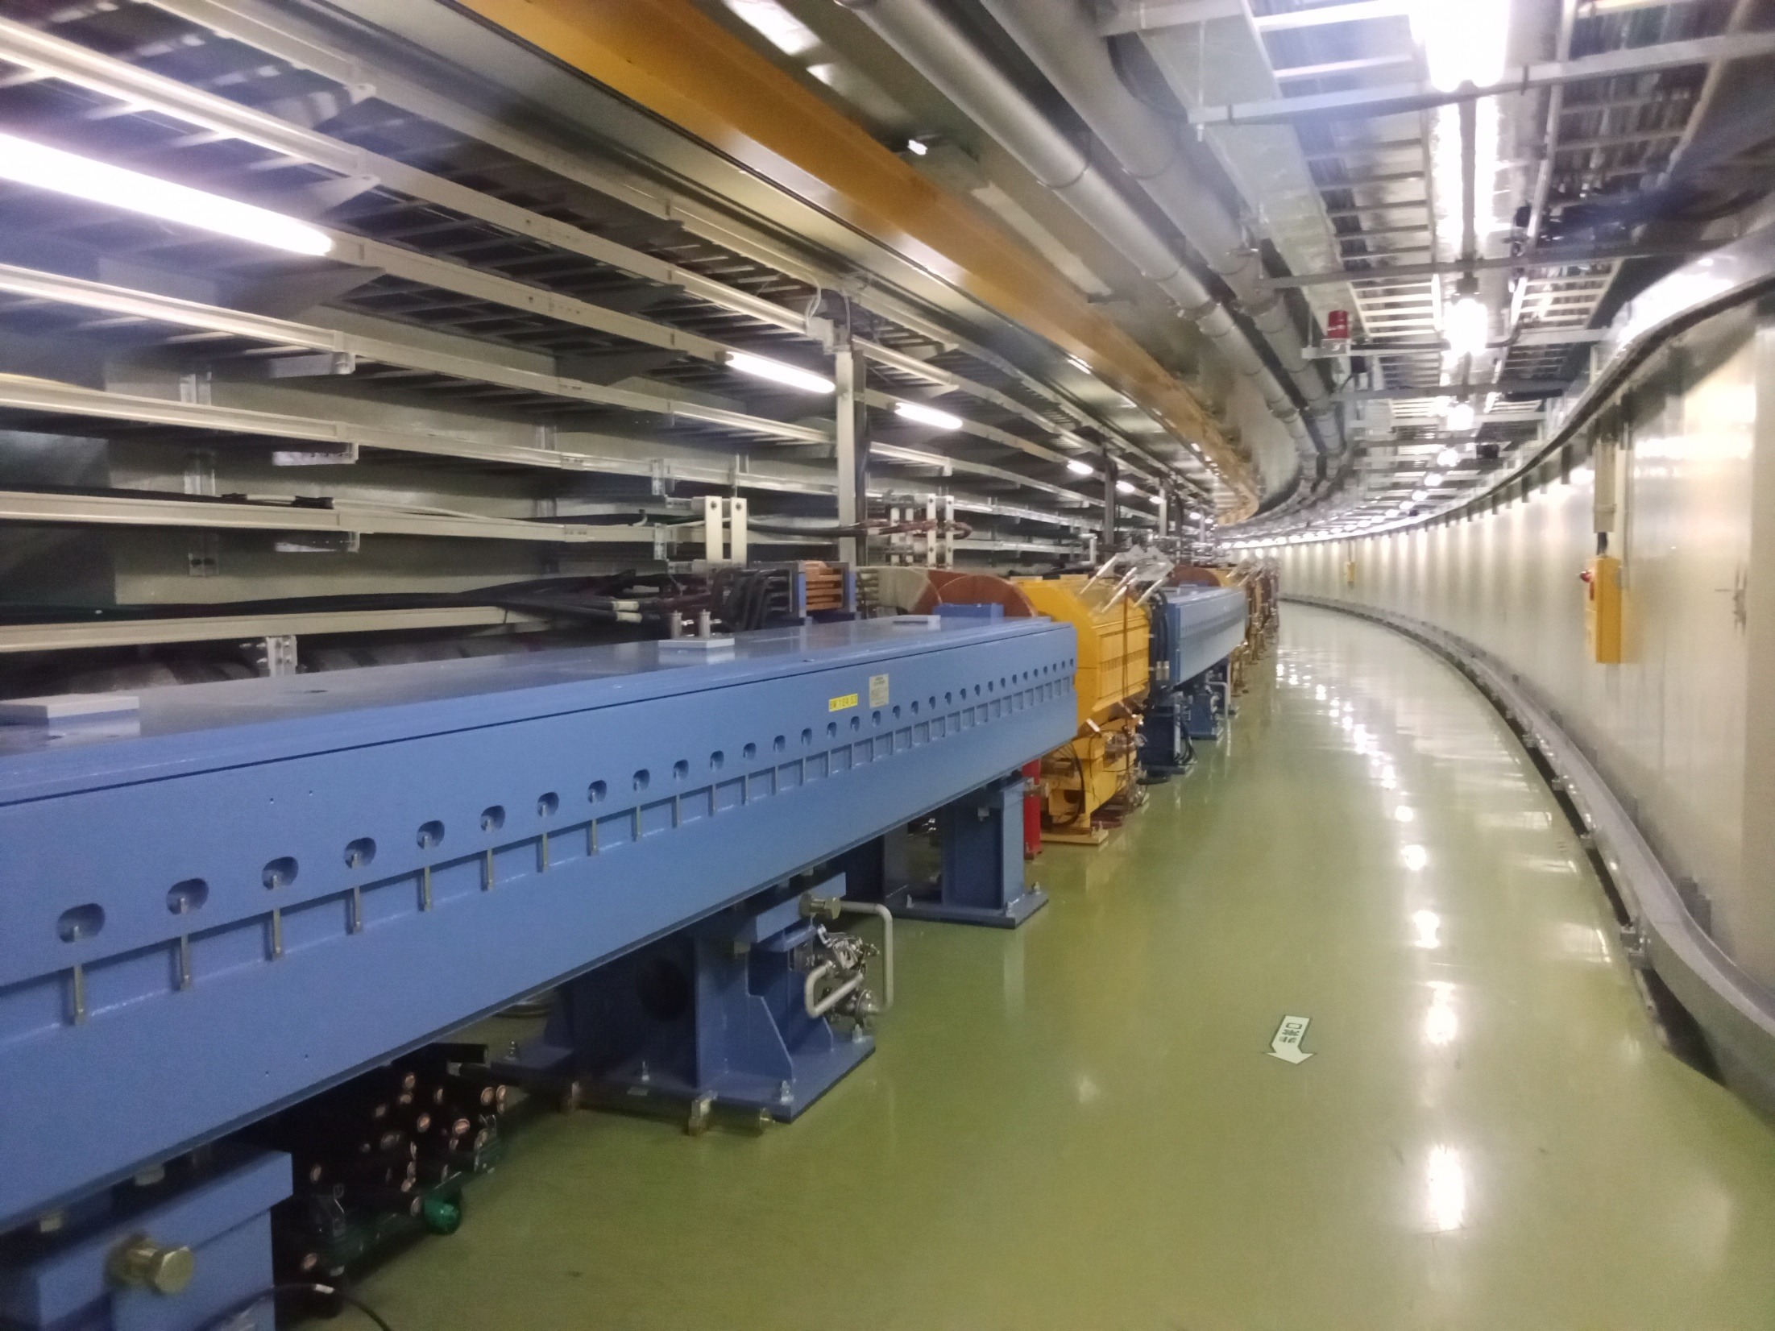
Main Ring Dipoles

Slide 47
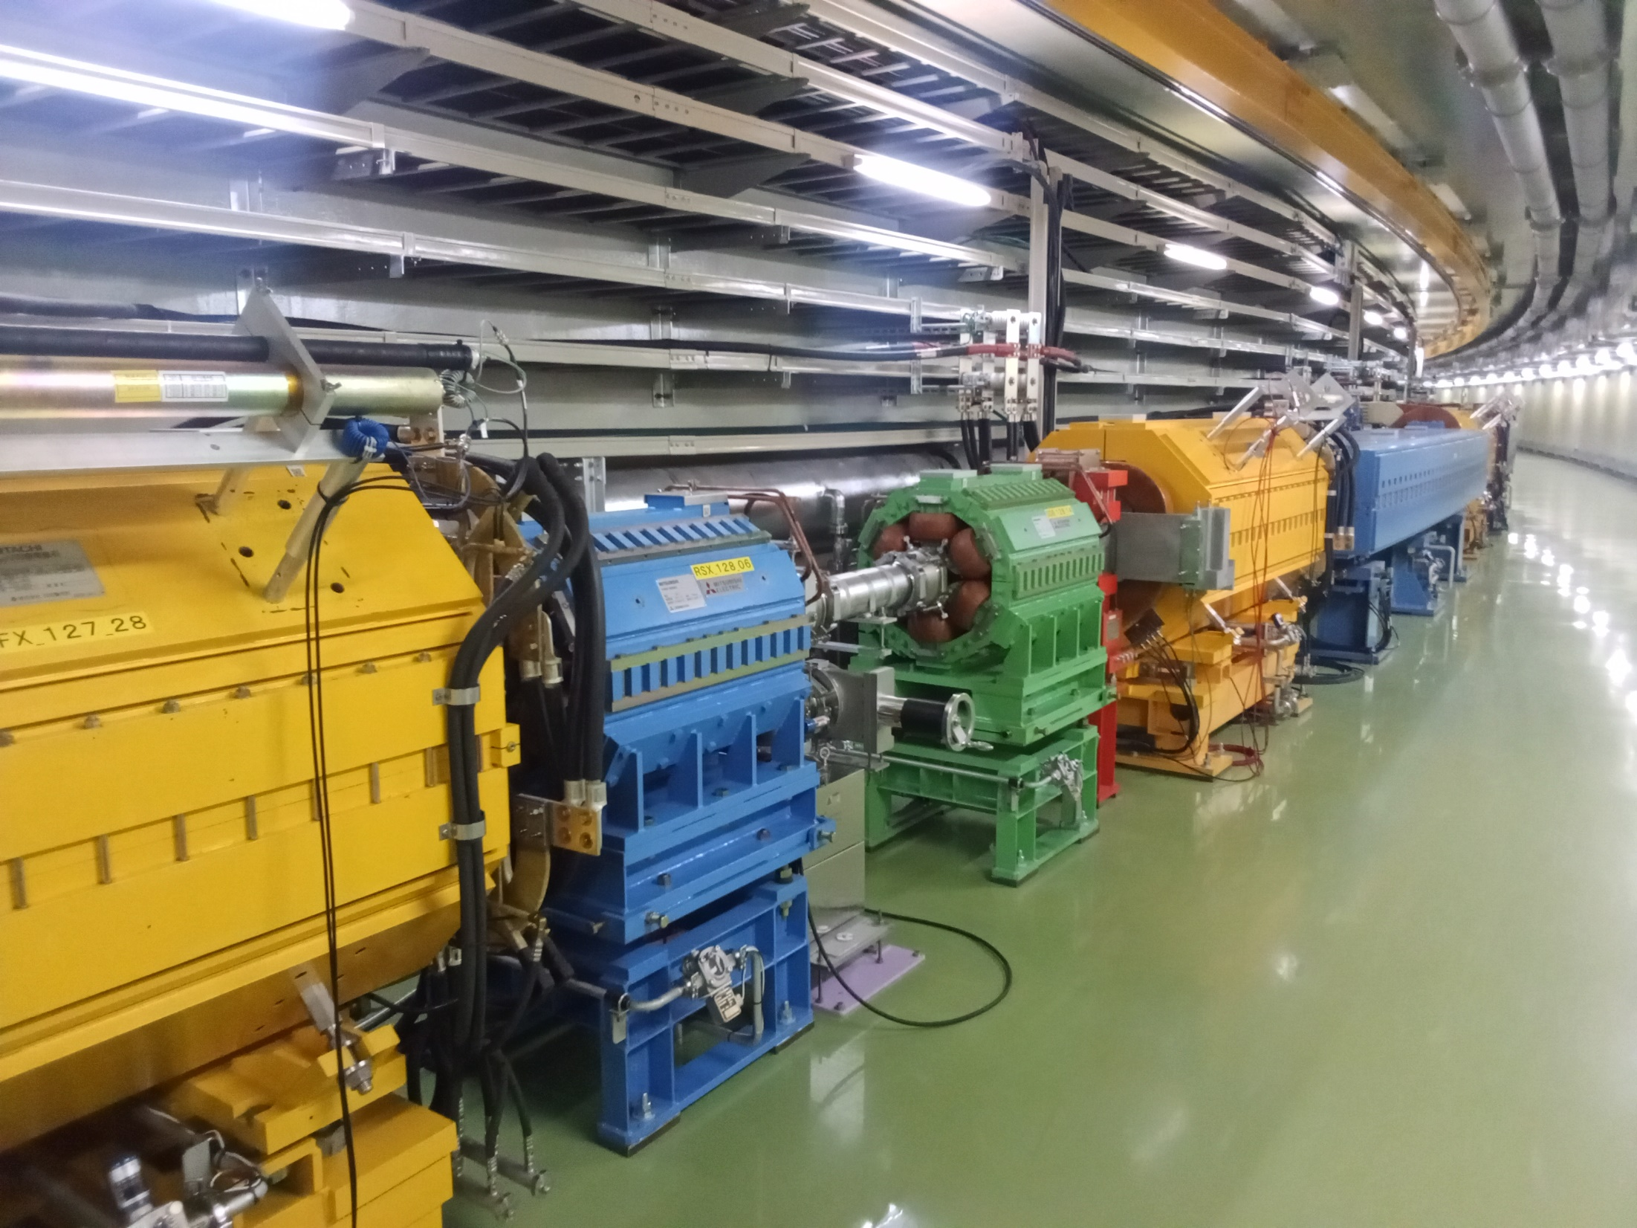
Quadrupoles and Sextupole

Slide 48
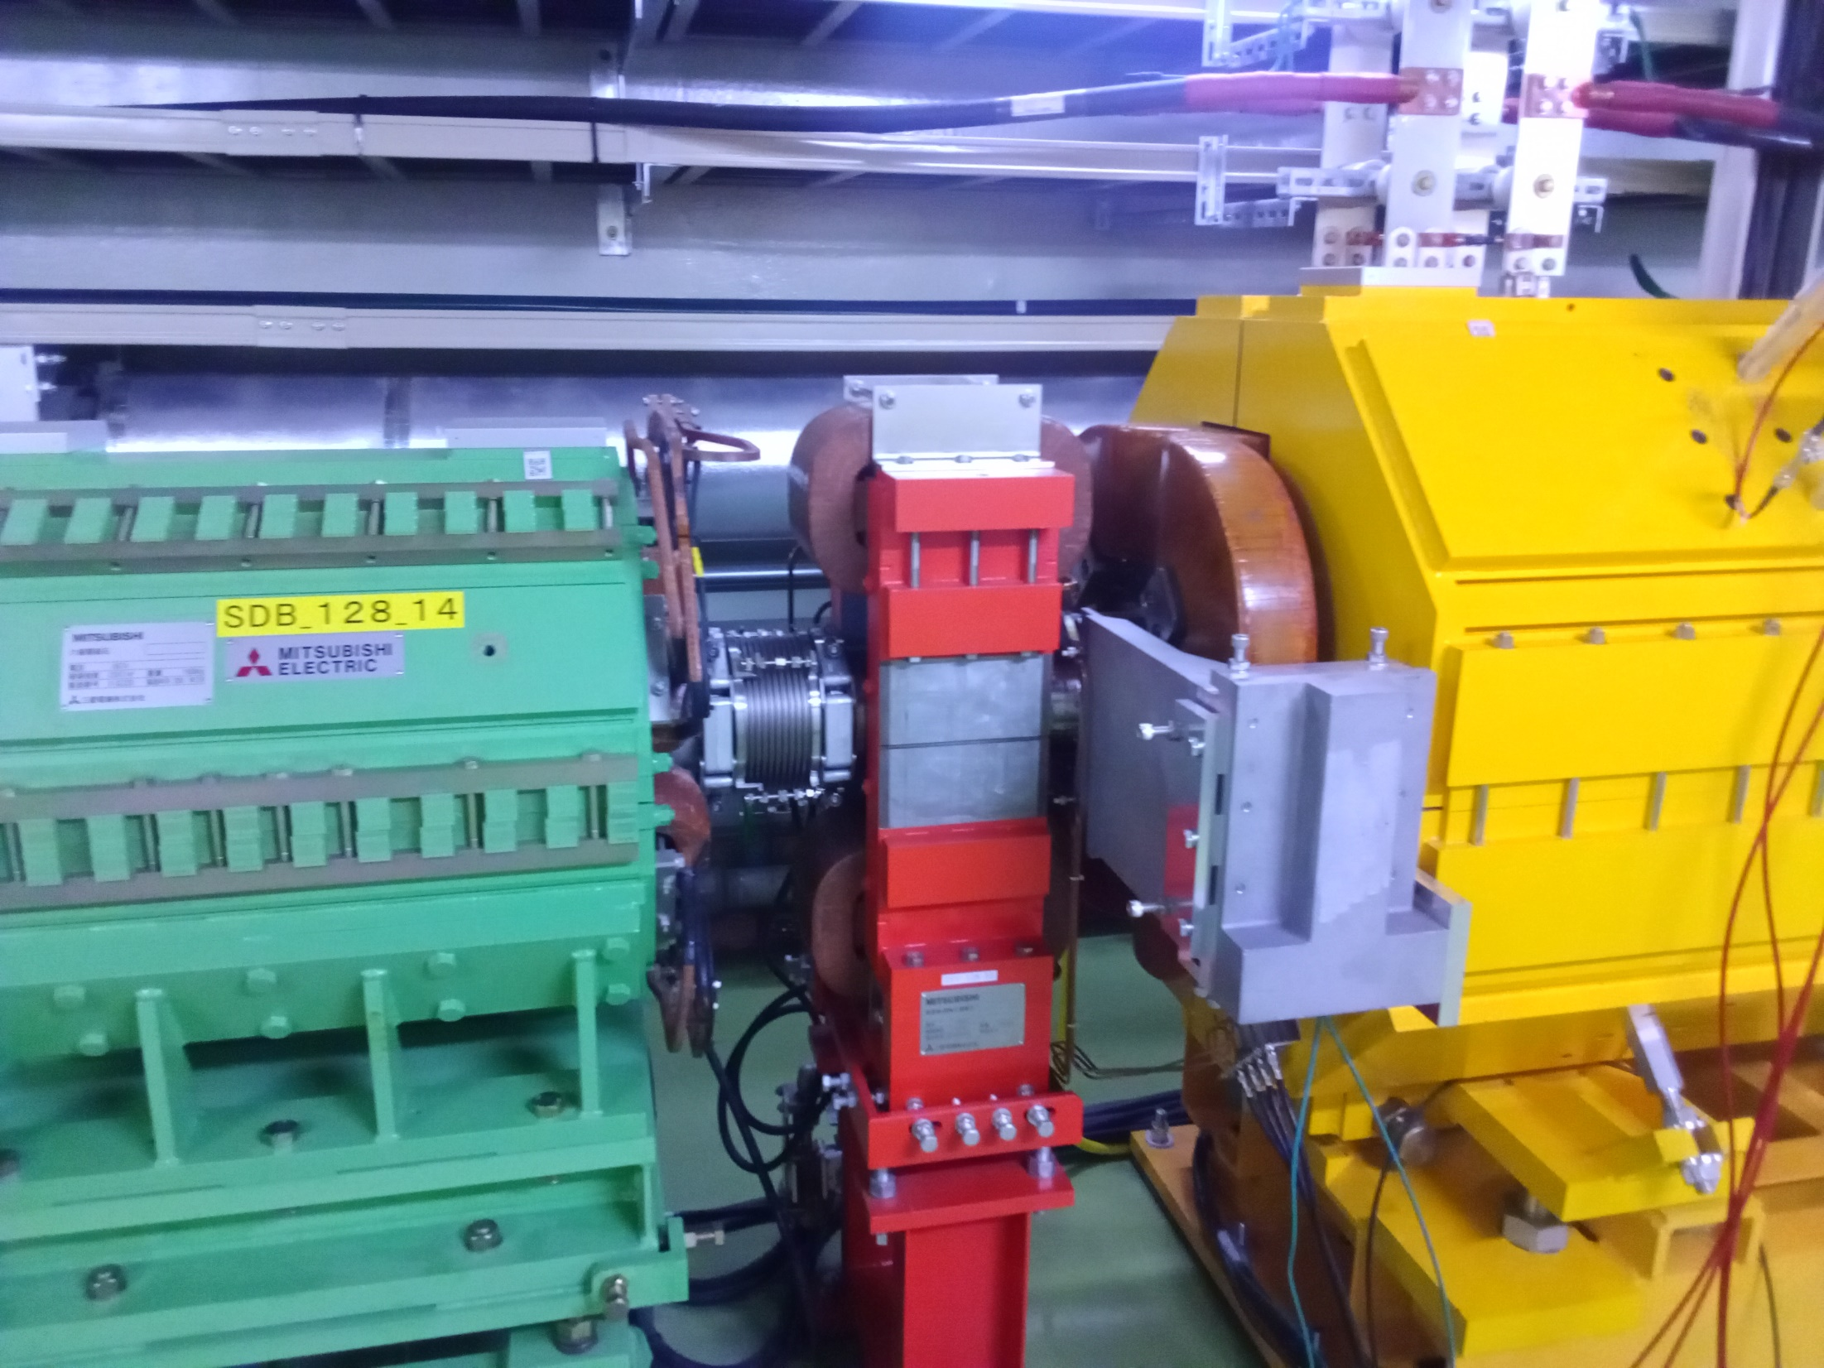
Vertical Dipole Steerer

Slide 49
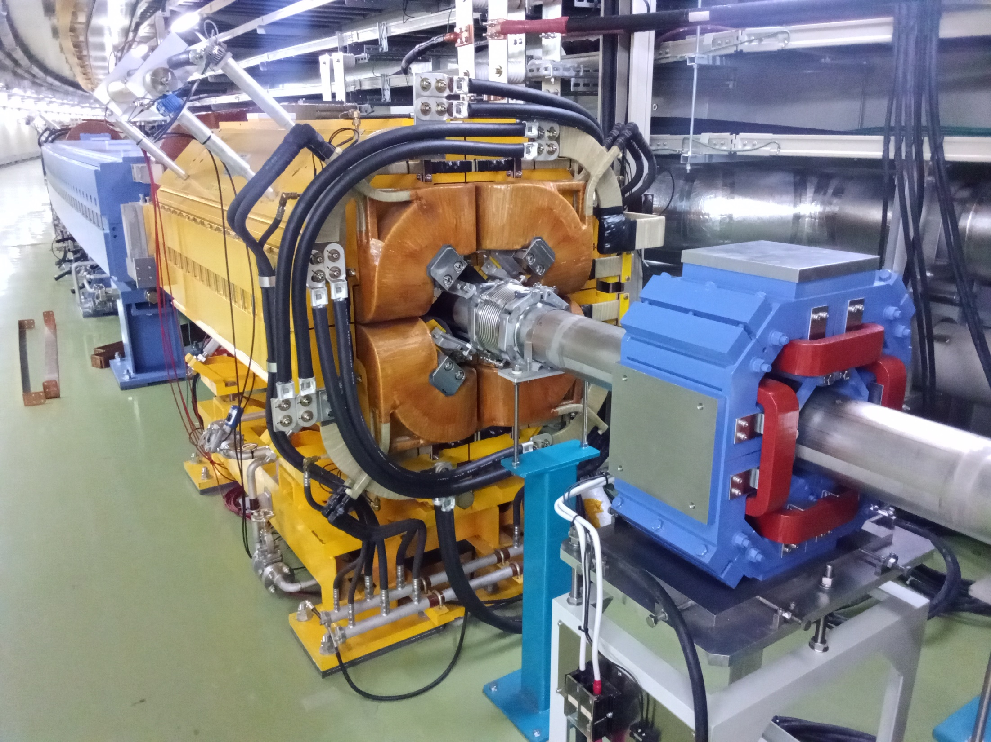
Skew Quadrupole

Slide 50
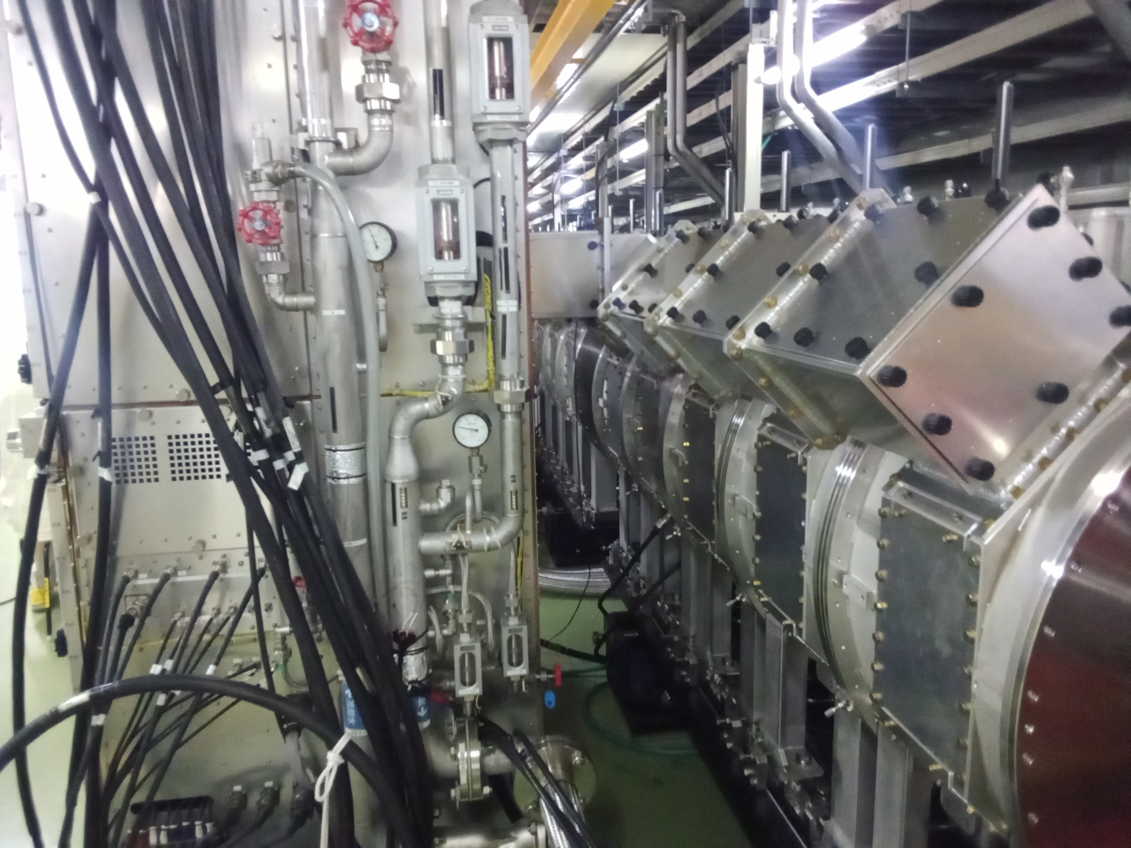
RF Section
Magnetic alloy (MA) RF cavities
High-level amplifier

Slide 51
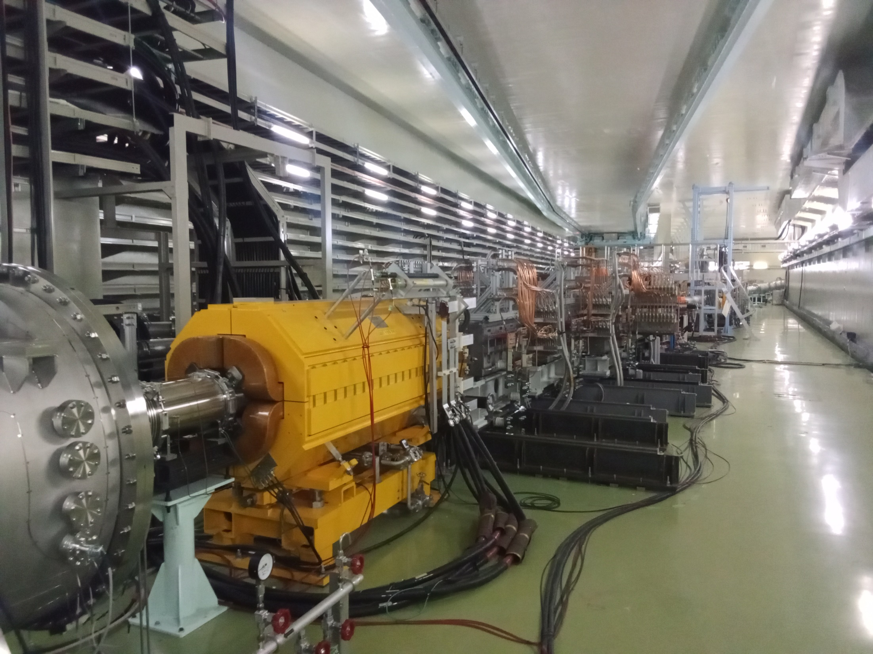
Extraction Kickers

Slide 52
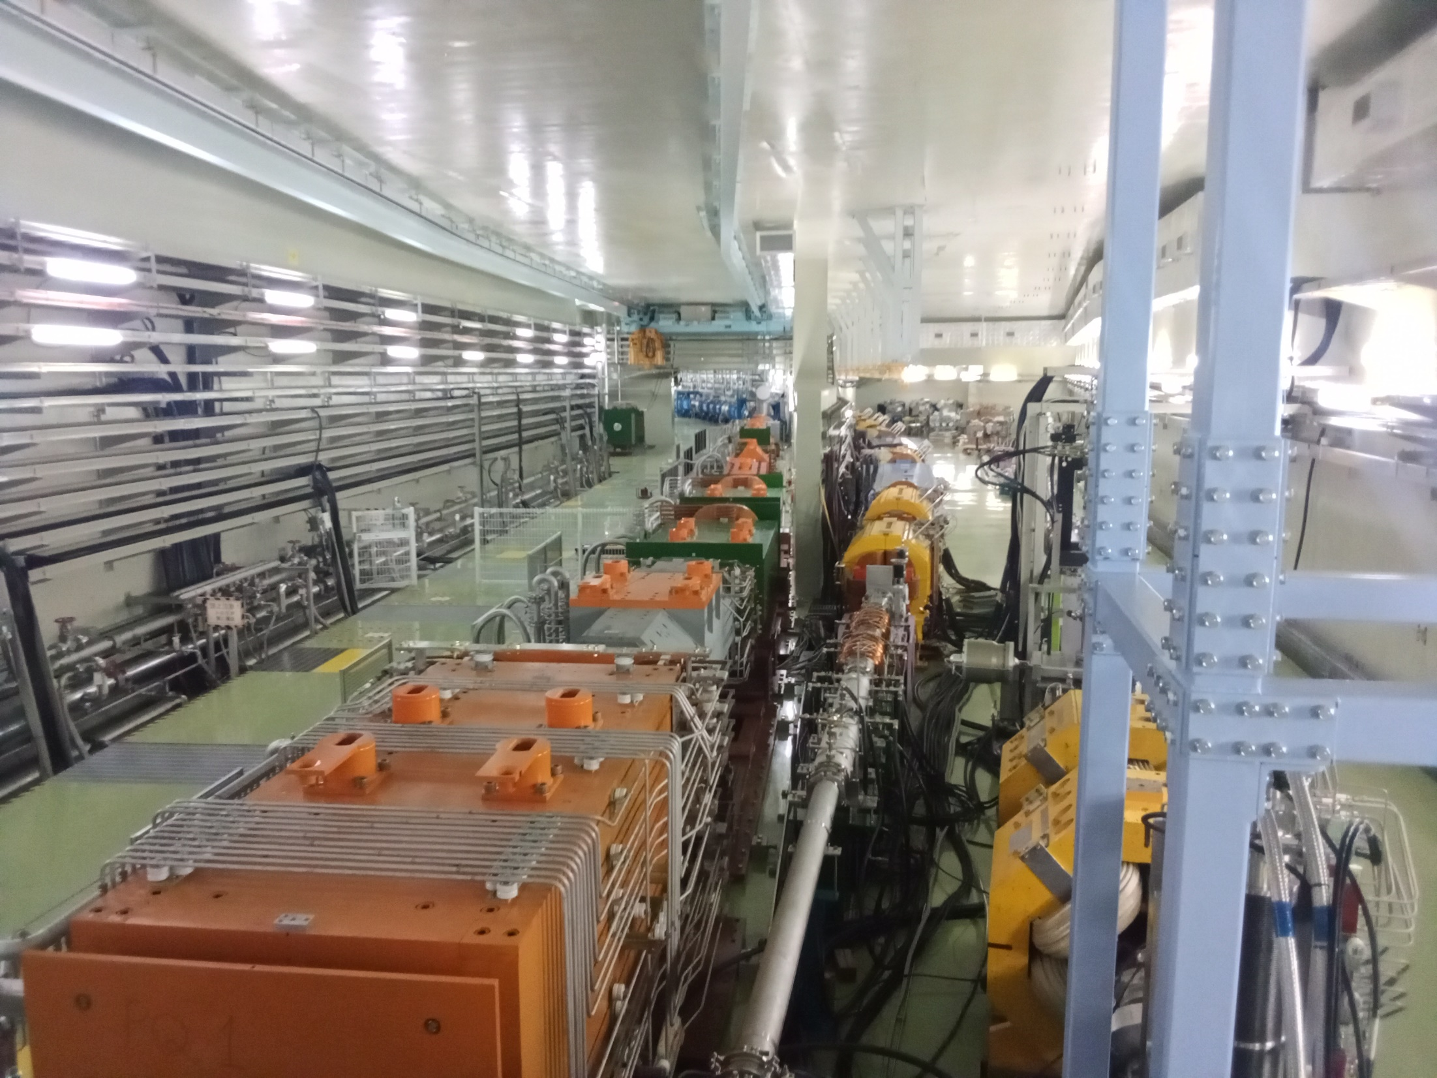
Three-Way Split
To T2K target via superconducting bends
Main ring dump
Main ring continues

Slide 53
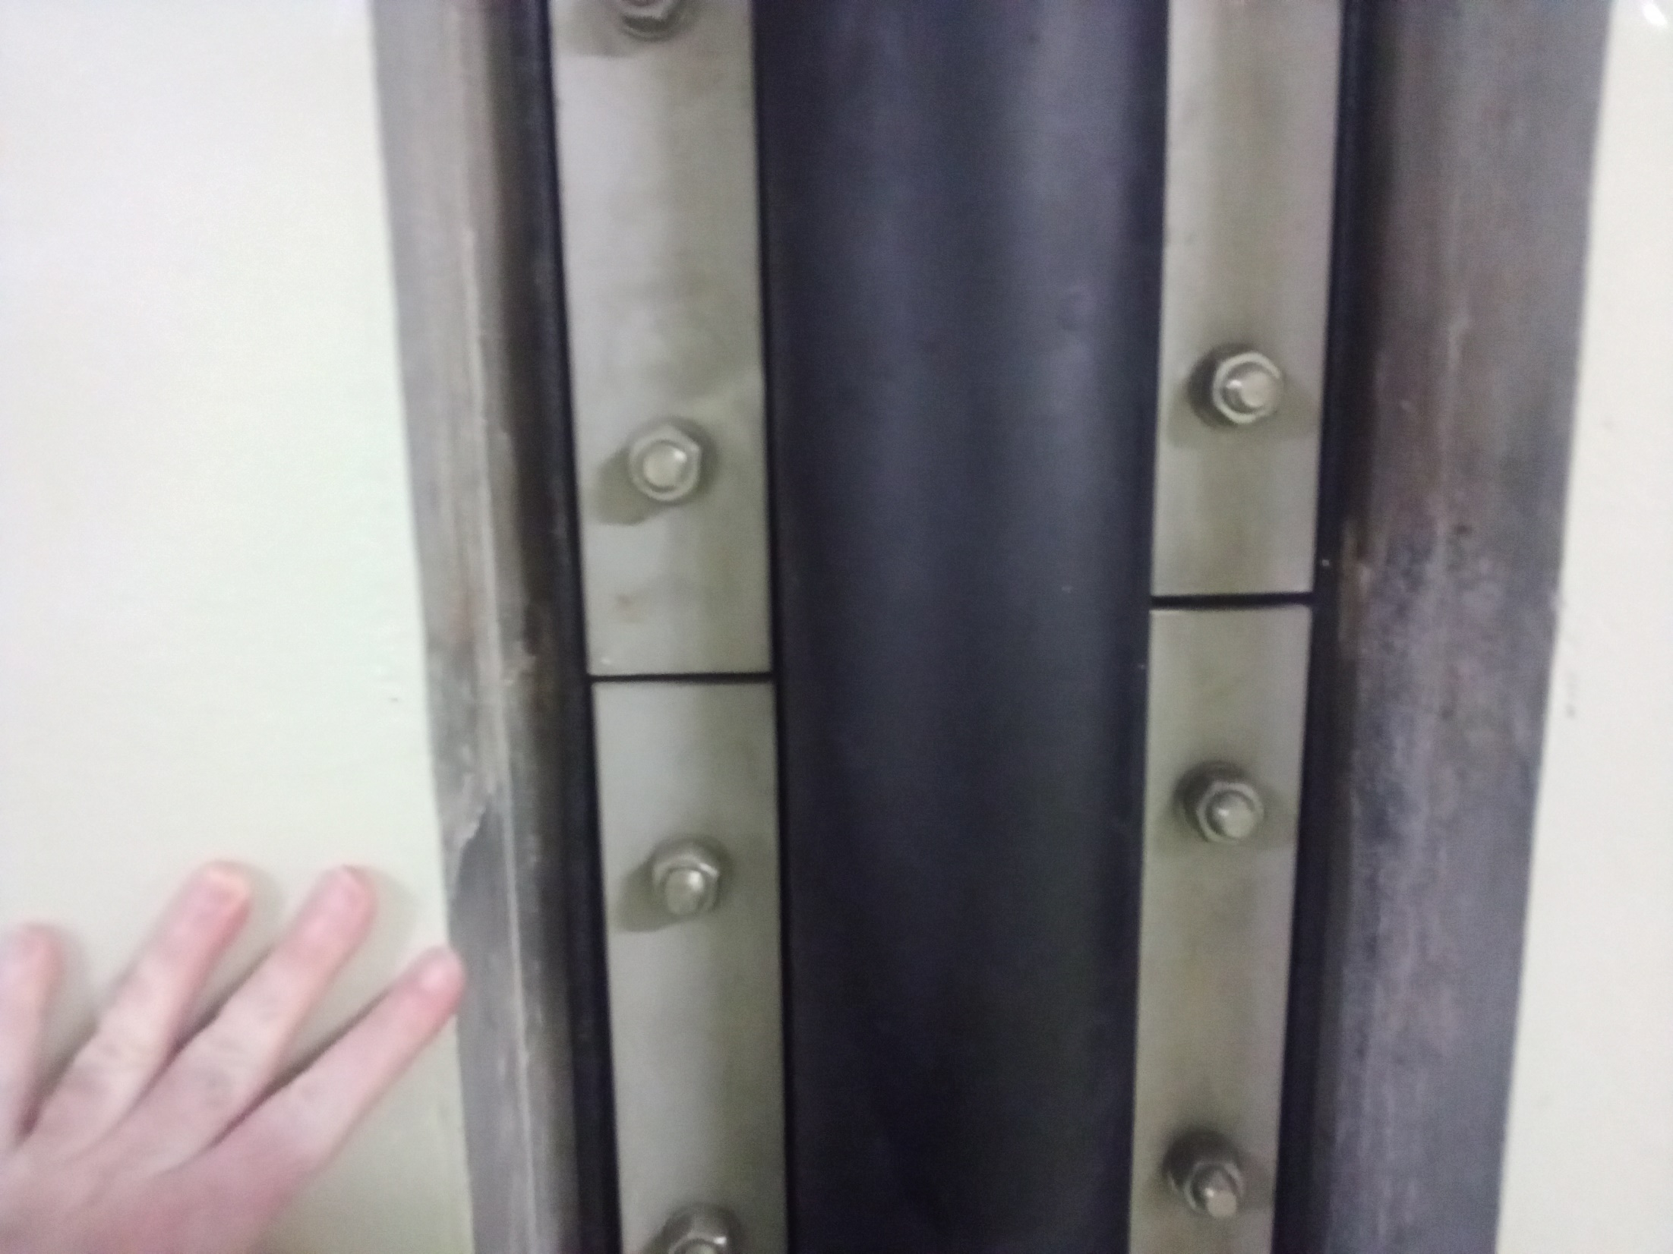
Earthquake Effect
Displacement of a rubber seam between two concrete tunnel sections

Slide 54
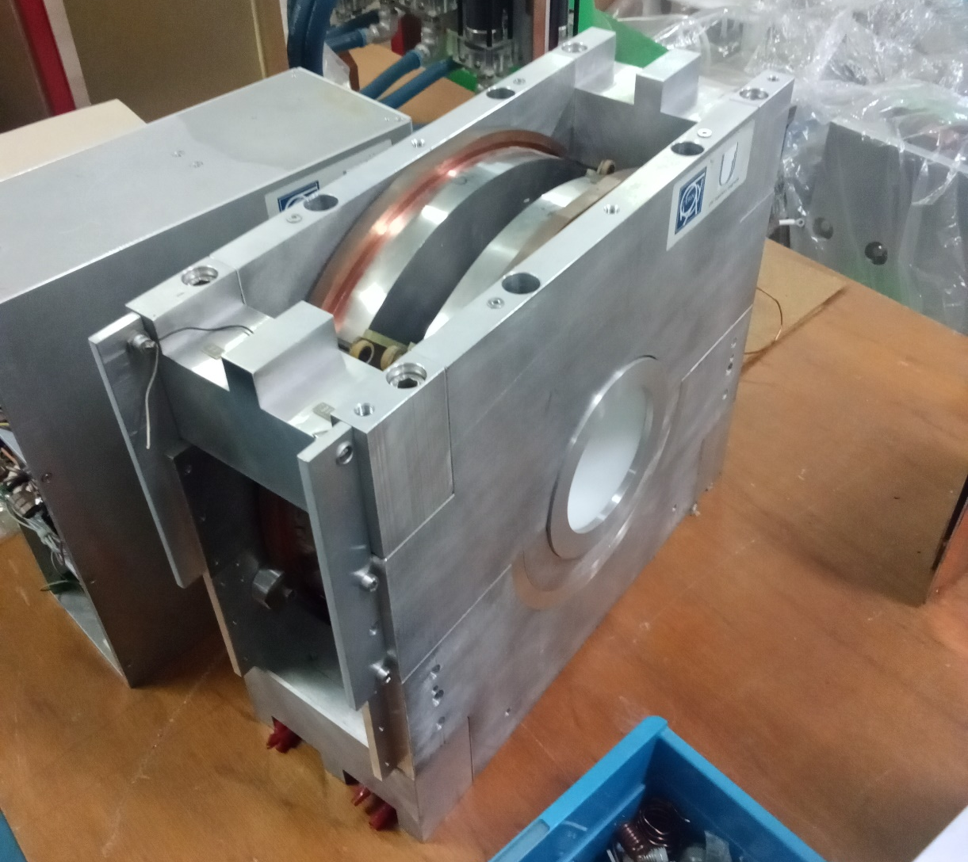
Magnetic Alloy RF Cavity

Slide 55
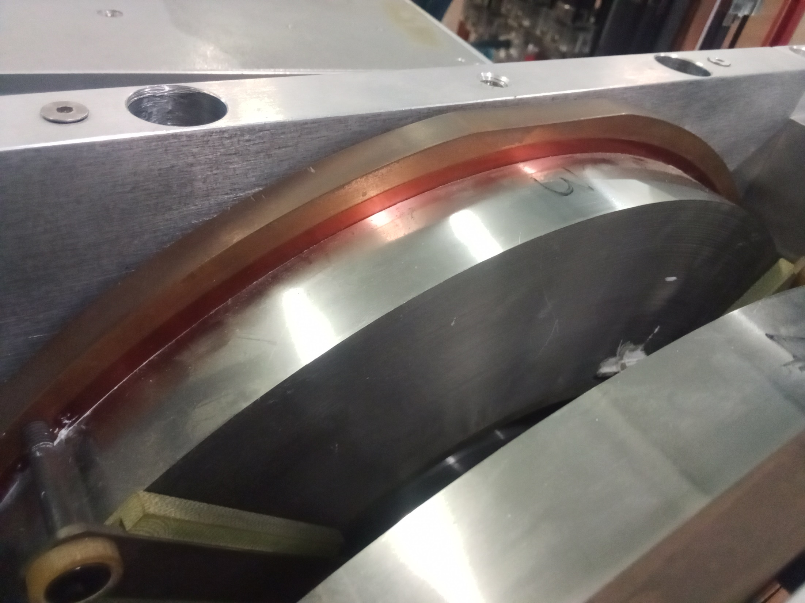
Magnetic Alloy Material
Fine grooves are visible from the many layers

Slide 56
3. At KURNS
Kyoto University Institute for Integrated Radiation and Nuclear Science
Formerly KURRI (Kyoto University Research Reactor Institute)
Yoshiharu Mori is group leader here
11 to 150MeV proton FFA
Scaling type, triplet magnets
Has been used for accelerator-driven reactor studies
Copy of the one originally built at KEK
Which is now moved to Kyushu University
KEK had the first proton FFA system ever built
Gave seminars here on:
Non-scaling fixed-tune FFA design
Ultra-low emittance beams from ion traps
Discussion on μTRISTAN μ-e Higgs factory. Very interesting and relevant to P5, look it up.

Slide 57
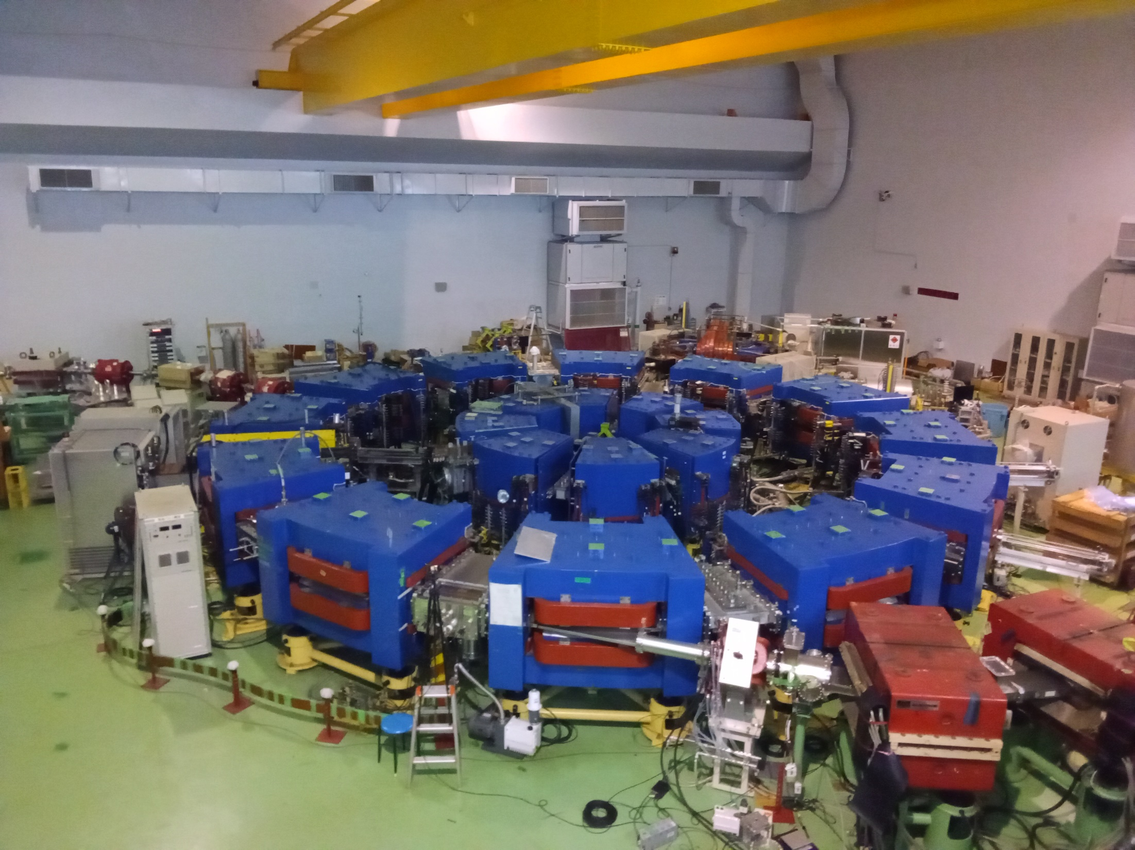
150MeV Fixed-Field Accelerator
1.5 to 11MeV booster FFA (middle) is no longer used
Ion-beta FFA with induction acceleration (old injector, no longer used)
→ From 11MeV linac

Slide 58
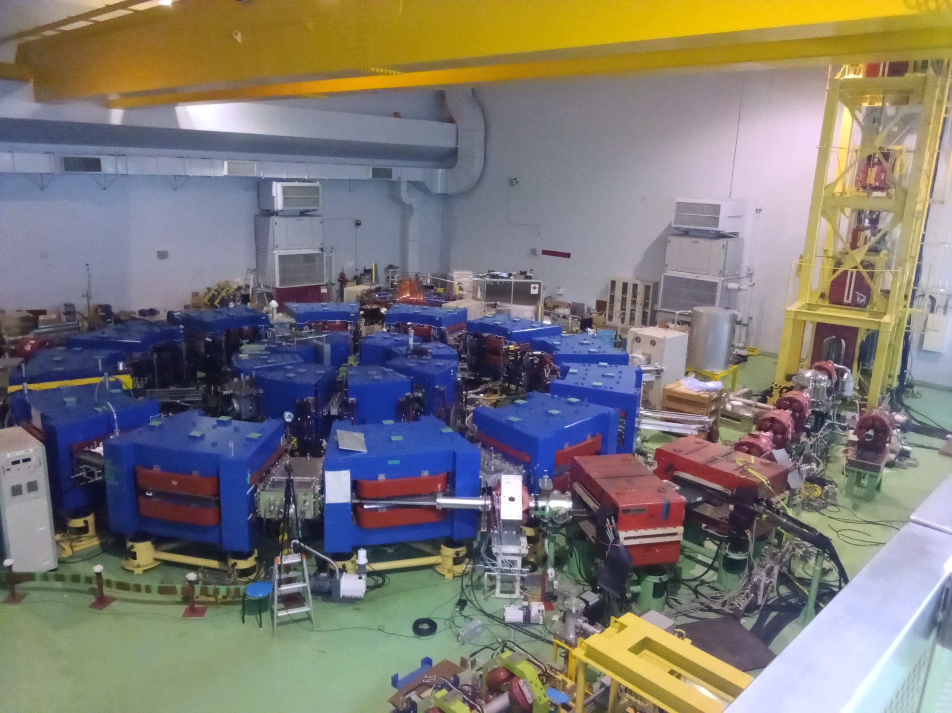
Extraction Line to Reactor

Slide 59
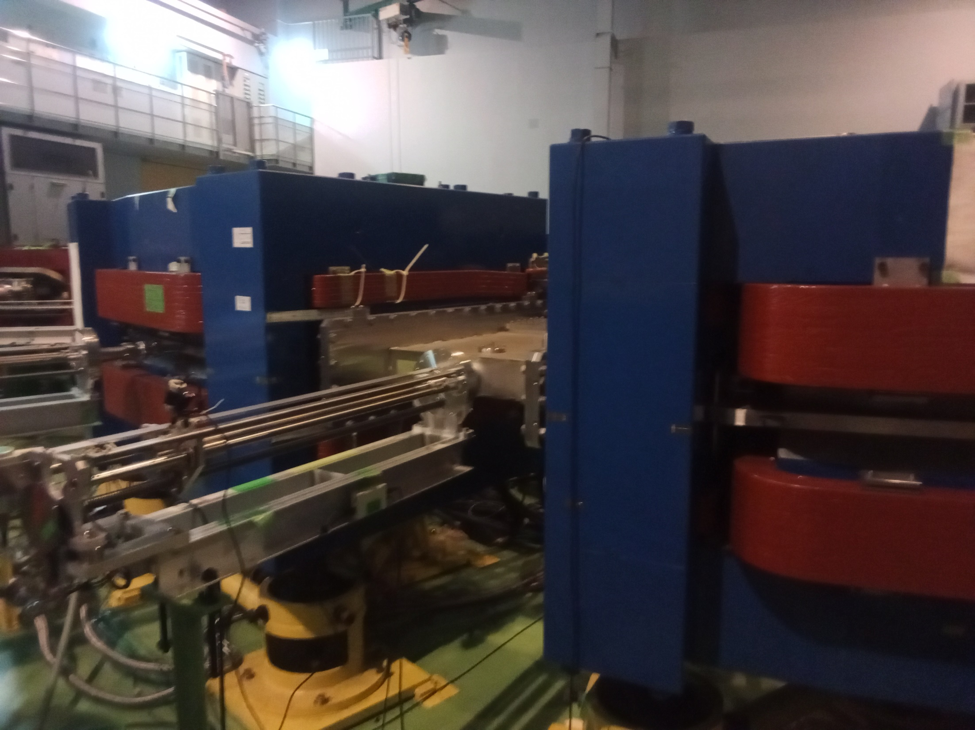
Magnets
Each yoke actually contains three magnets: a DFD triplet.
This design saves power but field quality not great.
Wide vacuum chamber for orbit excursion
←

Slide 60
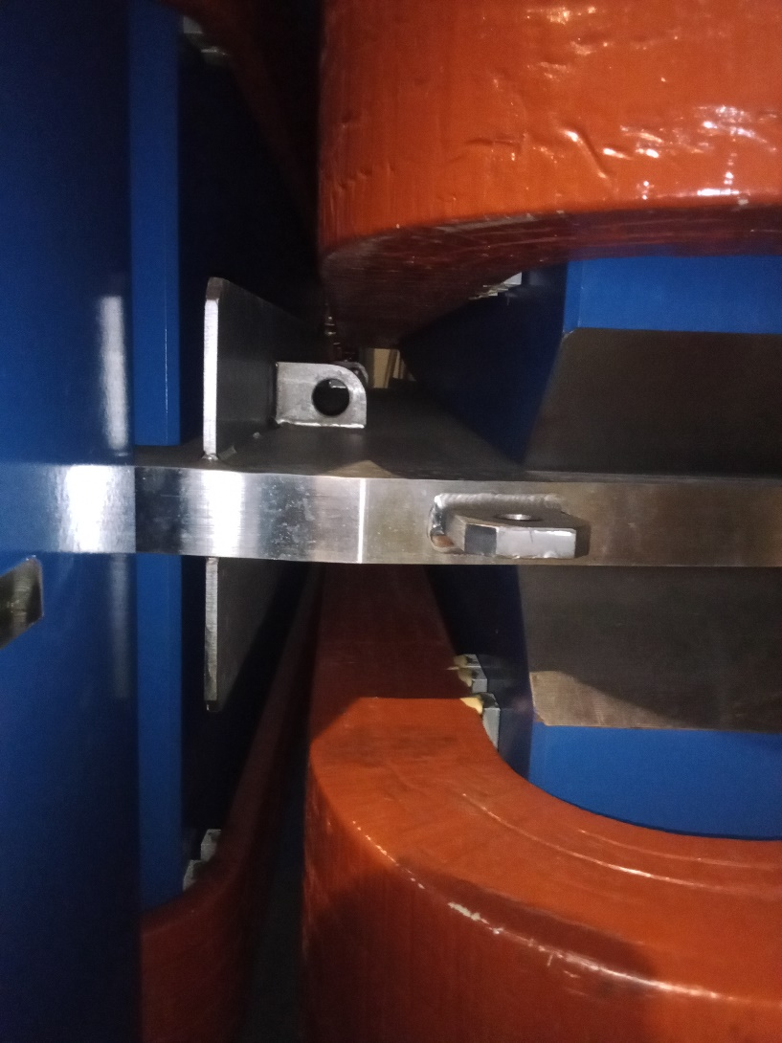
Pole Shape for B ~ r^{k} Scaling Field

Slide 61
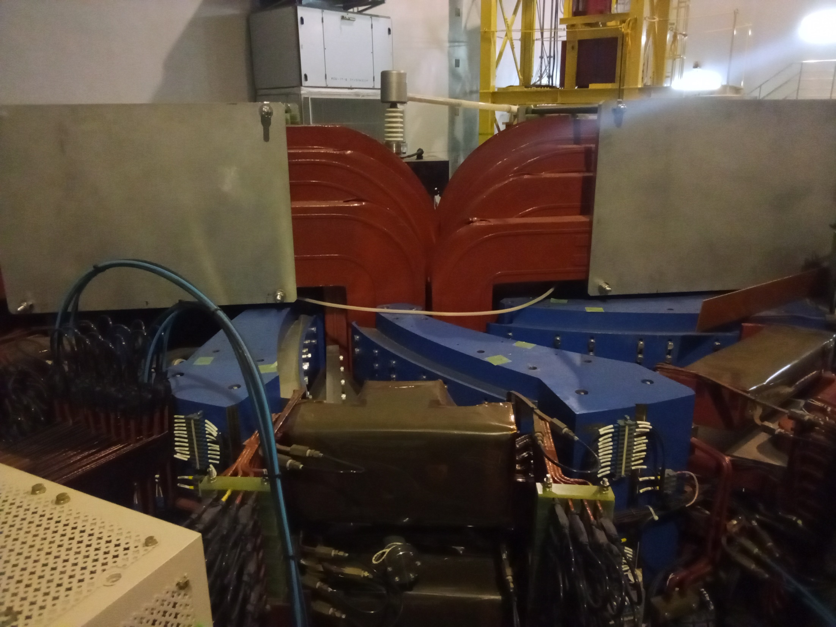
Ion-beta FFA
Central current windings for induction acceleration
This is actually a spiral scaling FFA!
Current leads for magnet pole face windings

Slide 62
4. Hiroshima University
Beam Physics Laboratory at Graduate School of Advanced Science and Engineering
Lead by Hiromi Okamoto
Five Paul trap type Ca⁺ ion trap systems (S-POD I through V) have been constructed here
One has laser Doppler cooling
Can produce Coulomb crystals!
Others are used to study beam physics
Analogue simulation of space charge, resonances etc.
Discussions on hardware for my ion trap LDRD
Gave a seminar on ultra-low emittance beams

Slide 63
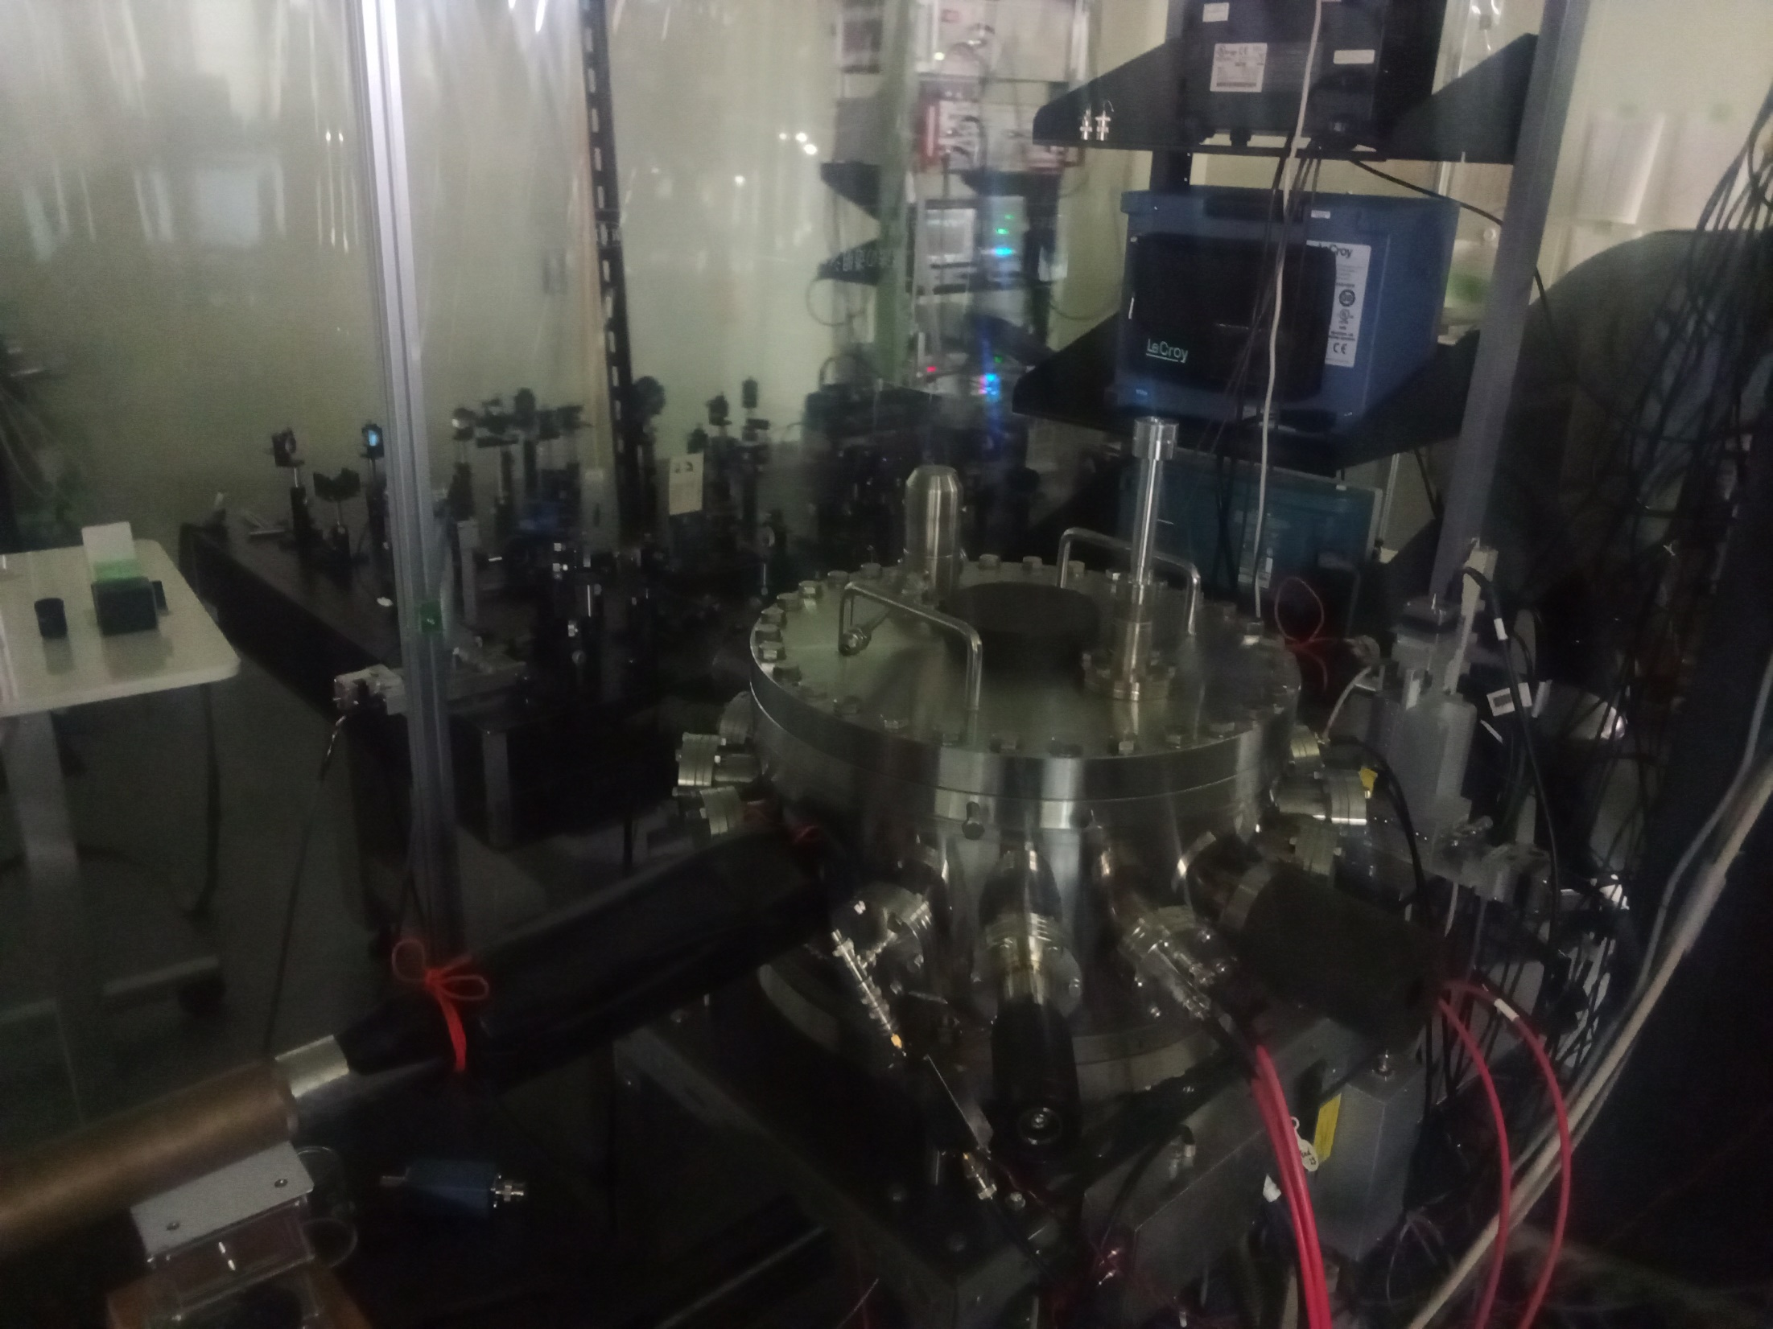
Ion Trap Vacuum Chamber

Slide 64
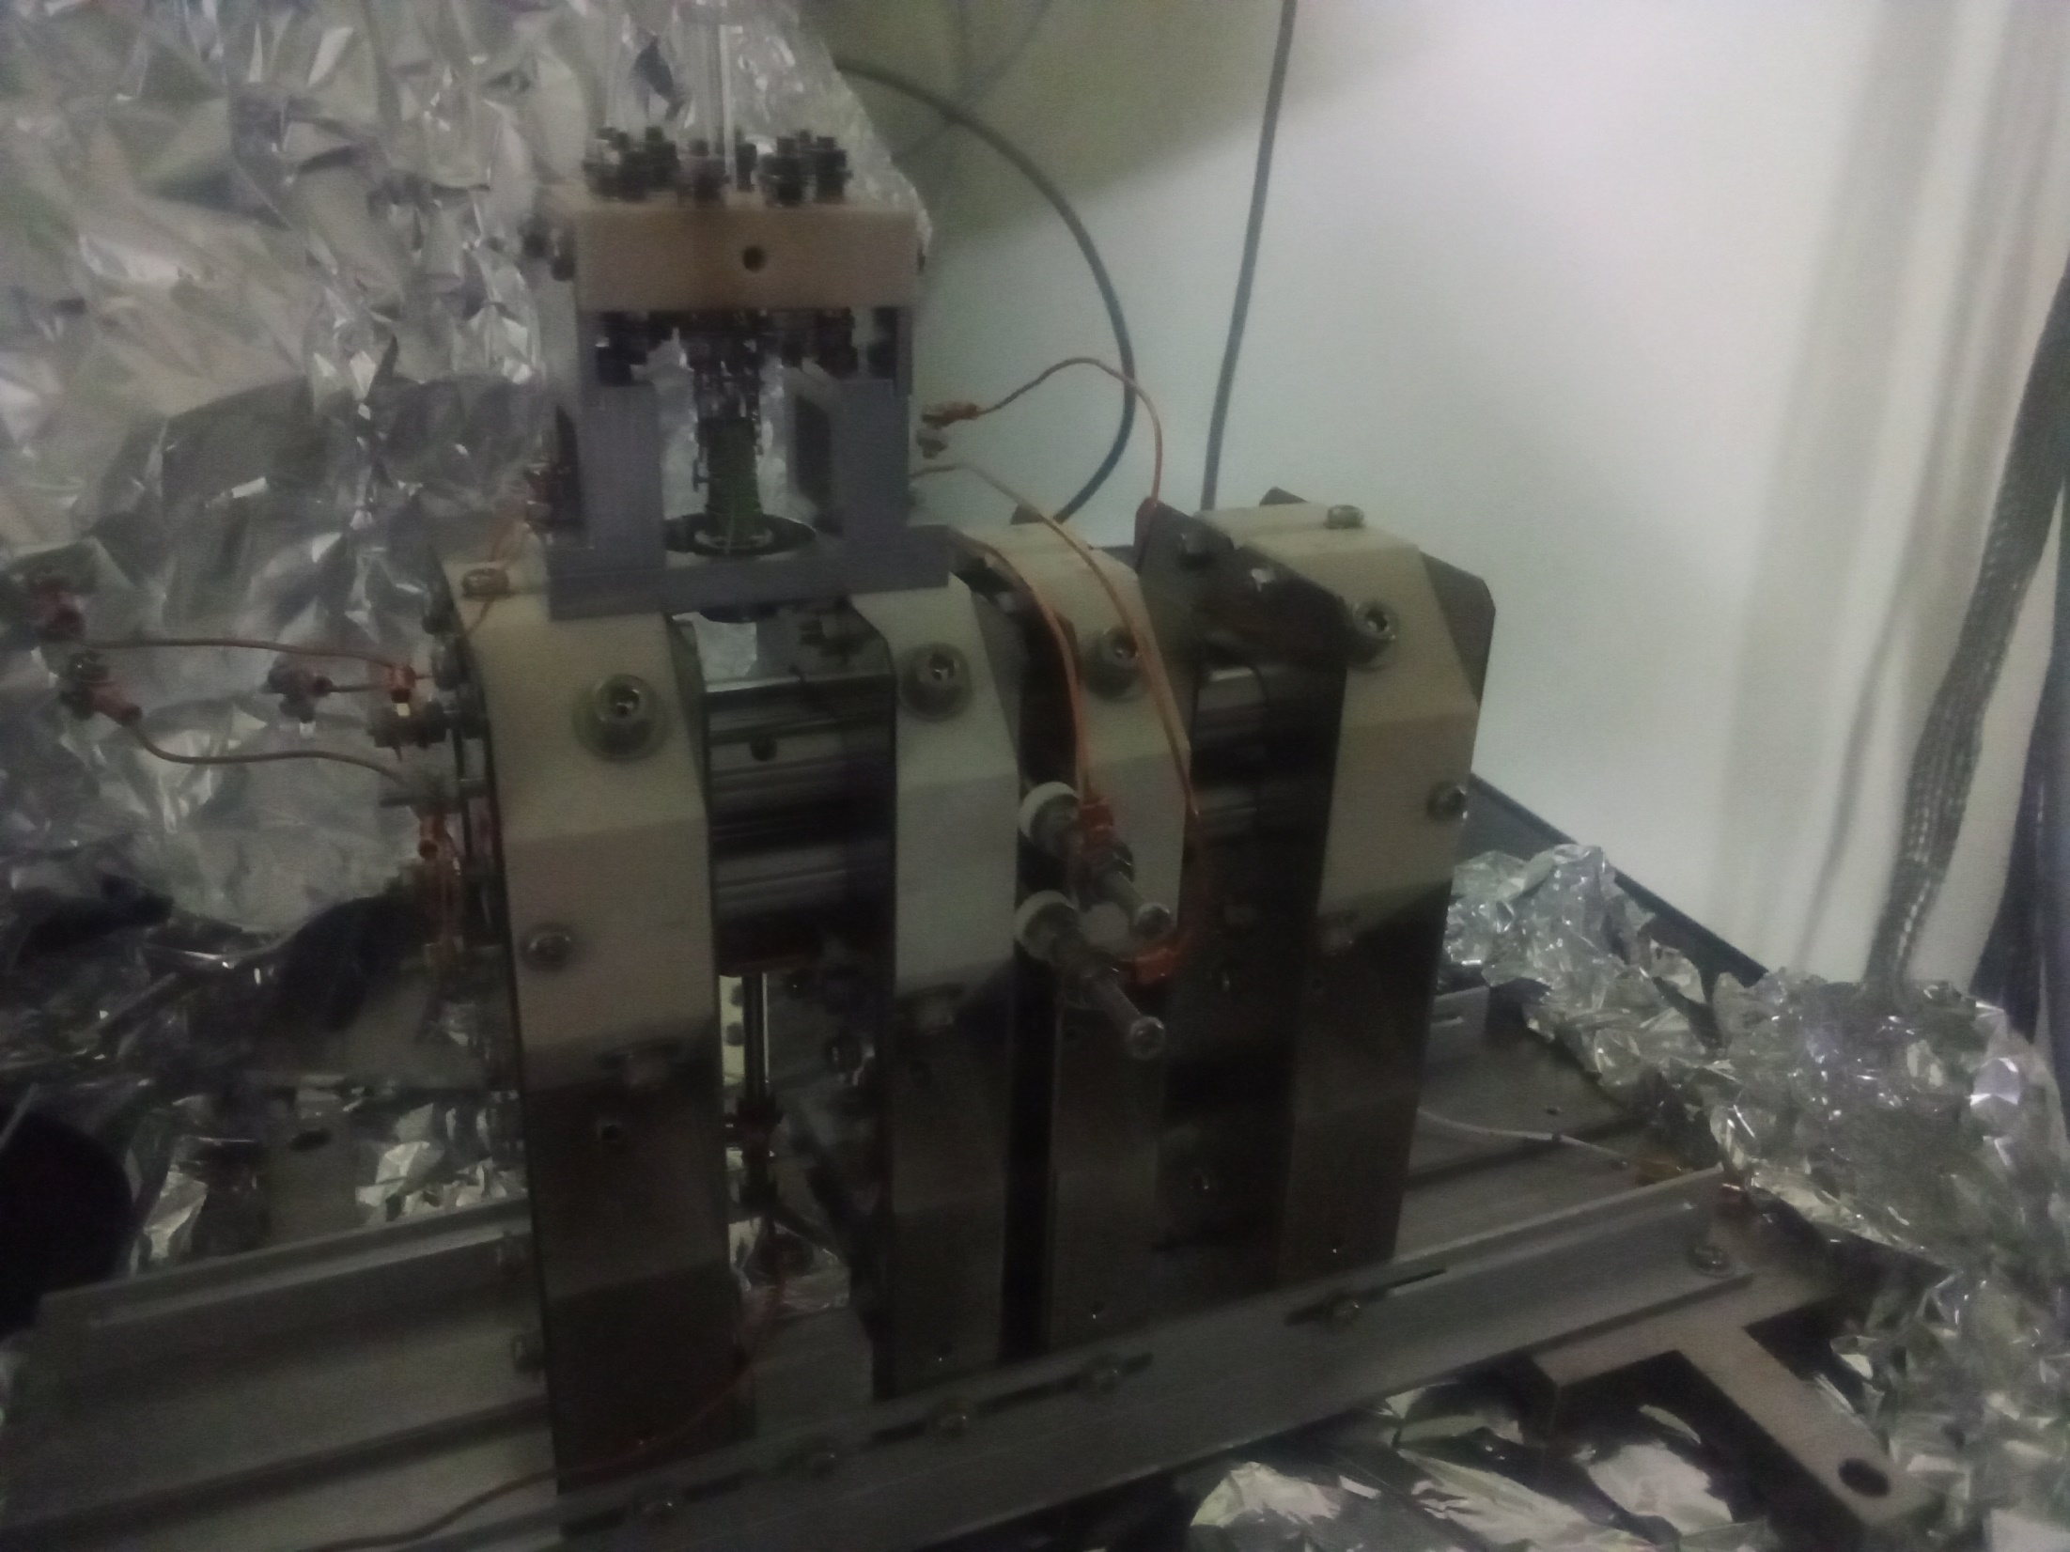
Four-Rod, Two-Section Paul Trap
Several geometries were tried at this lab

Slide 65
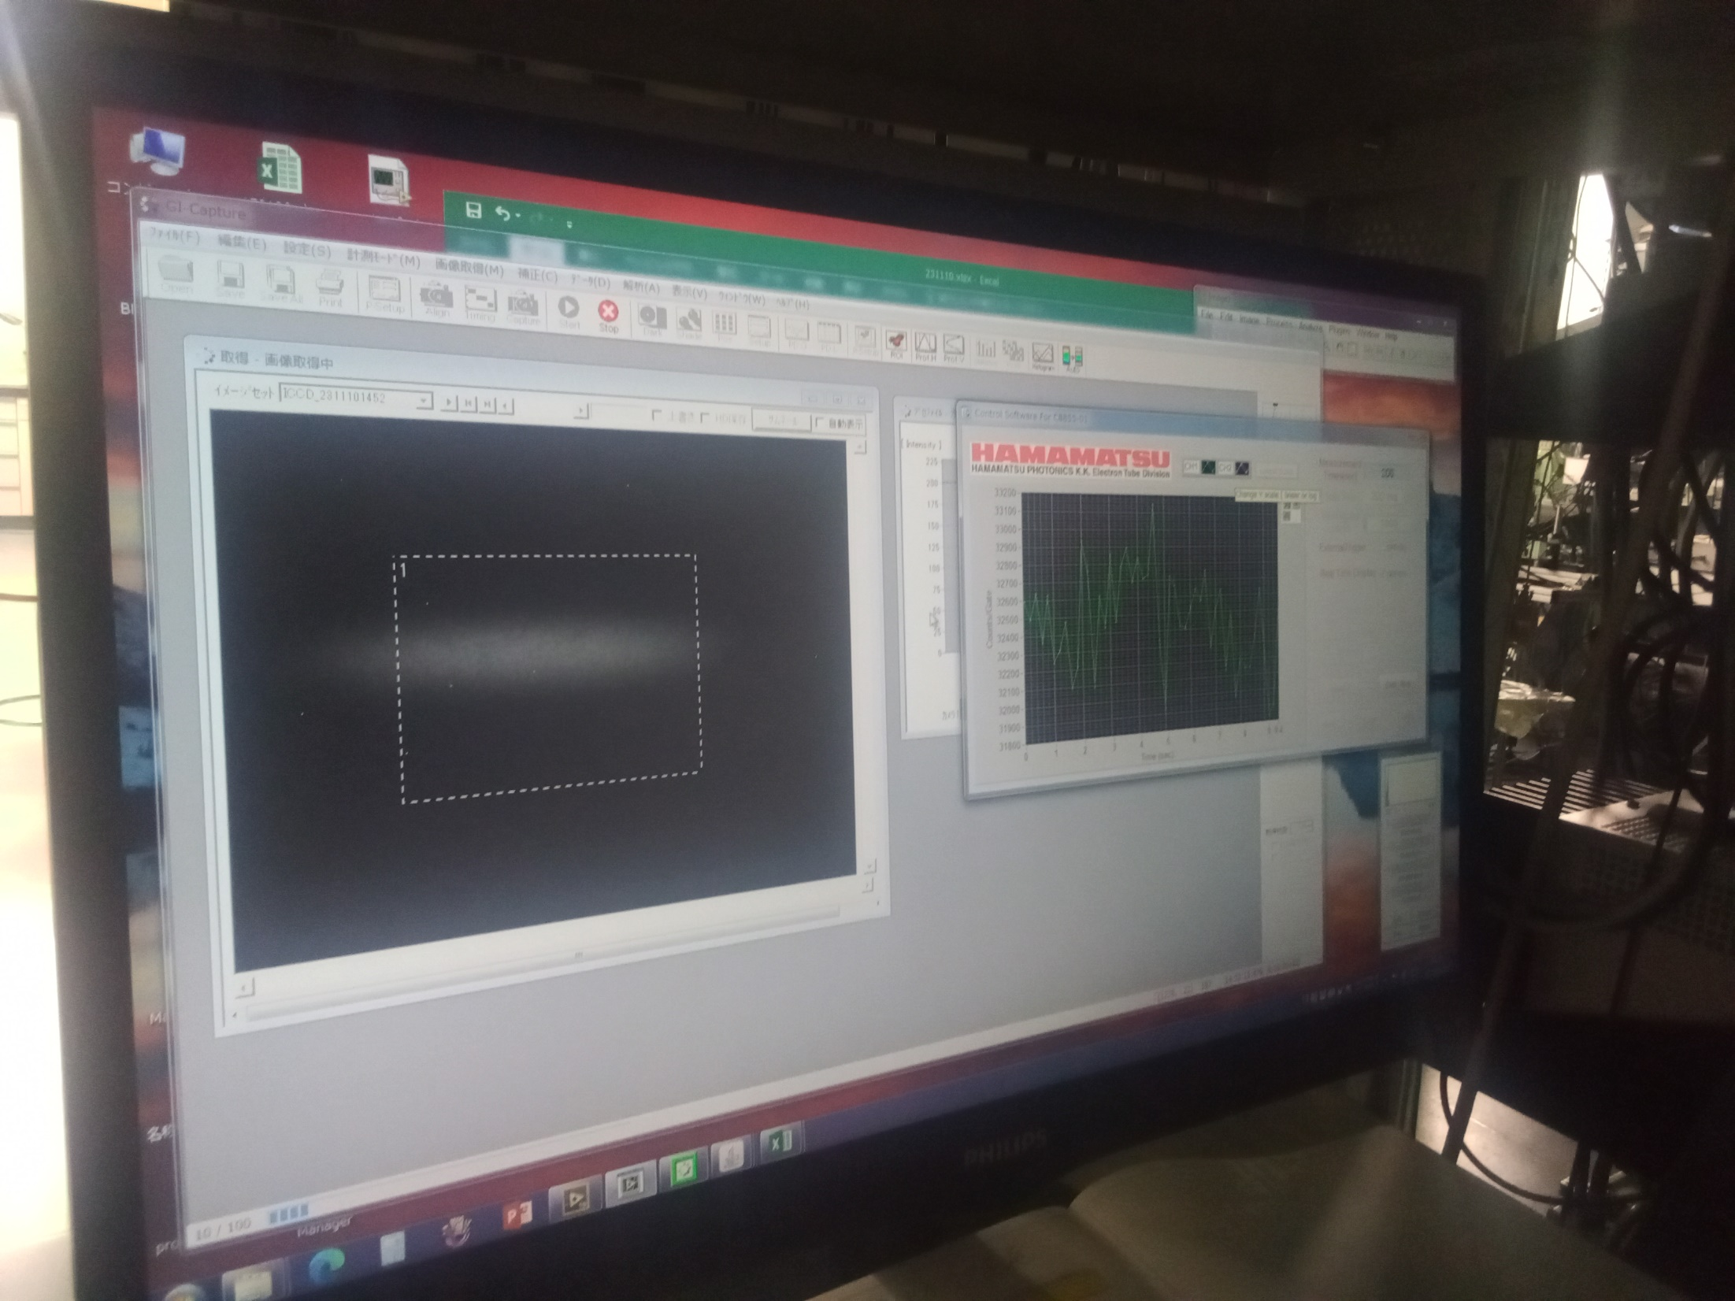
Ion Cloud before Cooling
Camera acquires fluorescence signal

Slide 66
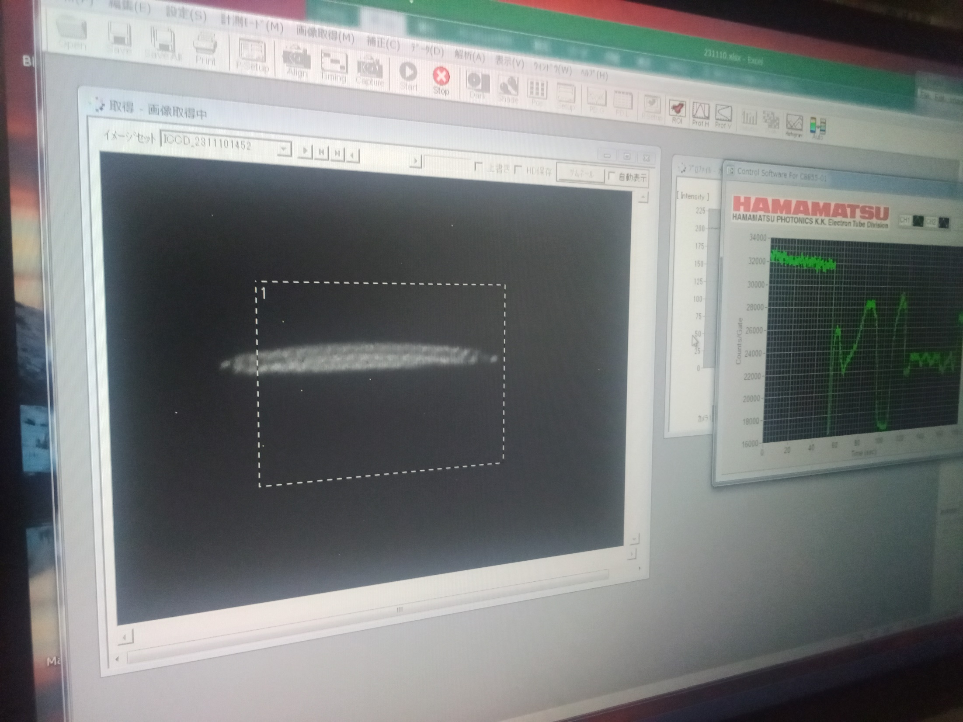
Laser Cooling → Coulomb Crystal
Kento Muroo was operating the experiment
50-100 Ca⁺ ions seen here

Slide 67
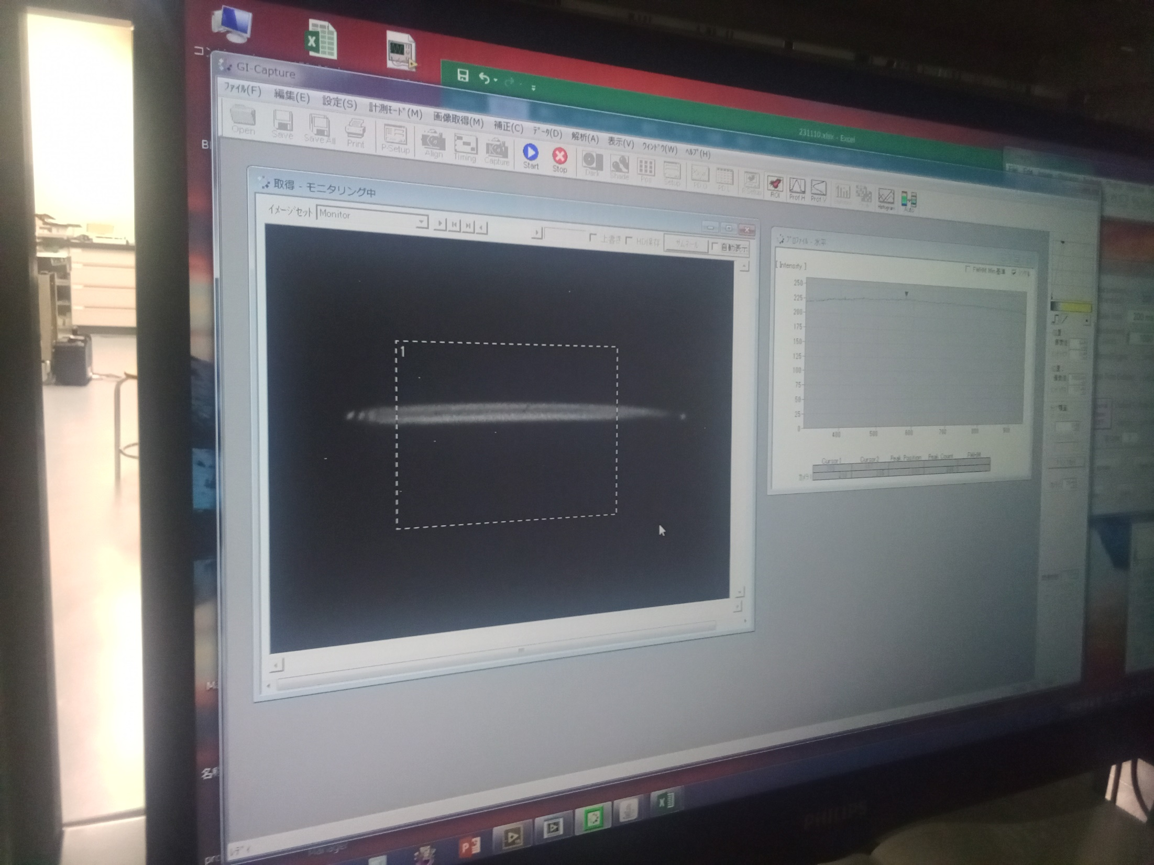
Longer Coulomb Crystal
Reducing the longitudinal trapping voltage makes the crystal longer

Slide 68

Near-Spherical Coulomb Crystal
Increasing the longitudinal trapping voltage makes the crystal shorter and wider

Slide 69

Wavemeter
Precise control of the laser frequency is needed to hit the Ca⁺ absorption line

Slide 70

Laser

Slide 71

1D Coulomb Crystal (N=10)
This gives the smallest transverse emittance

Slide 72

1D Coulomb Crystal (N=9)
After a minute or more, an ion was lost.
“There was a collision”

Slide 73
5. Kyushu University
Center for Accelerator and Applied Beam Science, Ito Campus
Group lead by Yujiro Yonemura
11 to 150MeV proton FFA, identical to KURNS!
Some work on magnet field shimming
Plan to bring protons and ions to an experimental hall in future
Vertical FFA prototype (under construction)
Parts of internal target (FFA-ERIT) ring for neutron source e.g. BNCT
Tandem and foil ion injection scheme
Here, I gave seminars on:
Modified Halbach Magnets for Emerging Accelerator Applications
High-Field Combined Function Permanent Magnet (>1.5T)
Permanent Magnet VFFA for 18GeV Electron Acceleration
I also updated my HalbachArea magnet design software to output .comi input files compatible with Kyushu’s version of OPERA-3D

Slide 74

8MV
Inner cyclotron provides 10MeV protons.
Tandem ion injector is interesting because it can do double stripping, for example:
He⁻ → tandem foil → He⁺ → injection foil → He²⁺

Slide 75

Purple Version of KURNS FFA

Slide 76

Large Slot Aperture MA RF Cavity
Water cooled
MA material

Slide 77

VFFA Prototype Beamline
Vertical steering, diagnostic #1
Four VFFA cells
Diagnostic #2 →
20-40keV electron gun

Slide 78

VFFA Electromagnet Design
Scaling type FFA where the D magnet is also a reverse bend, so alternating bends
Iron frames with multiple independent coils to control field function

Slide 79

Parts of FFA-ERIT
Eight sectors, stored in what will become the hadron experimental hall

Slide 80

The ERIT Target (Beryllium Foil)

Slide 81

Shim Plates for Magnets
Aim to locally control integral of field function B(r), whose derivative B’(r) controls the machine tunes

Slide 82

Shim Plates Installed in One Cell

Slide 83

Import of 2D Permanent Magnet from HalbachArea to OPERA-3D
This is actually a VFFA magnet
.comi file imported successfully

Slide 84

Thanks for listening!

