Slide 1
Permanent Magnets for the Return Loop of CBETA
CBETA = the Cornell-Brookhaven Energy recovery linac (ERL) Test Accelerator

Slide 2
What can an ERL do?
 | Advantages | Disadvantages
Compared to linac | Energy recovery: circulating beam power can be much higher than RF power input | Can’t use stopping targets! Disrupted beam must survive 1 turn (or a few turns)
Compared to ring | Equivalent to ring with cooling system that cools in one turn! (small emittance) Can disrupt beam more than in a ring where beam has to survive millions of turns | Source current must equal circulating current; Current in linac is circulating current multiplied by 2 or more (important for higher order modes)
Applications: thin targets, electron coolers, Compton backscattering, light sources, electron-ion colliders (LHeC/FCC-eh)

Slide 3
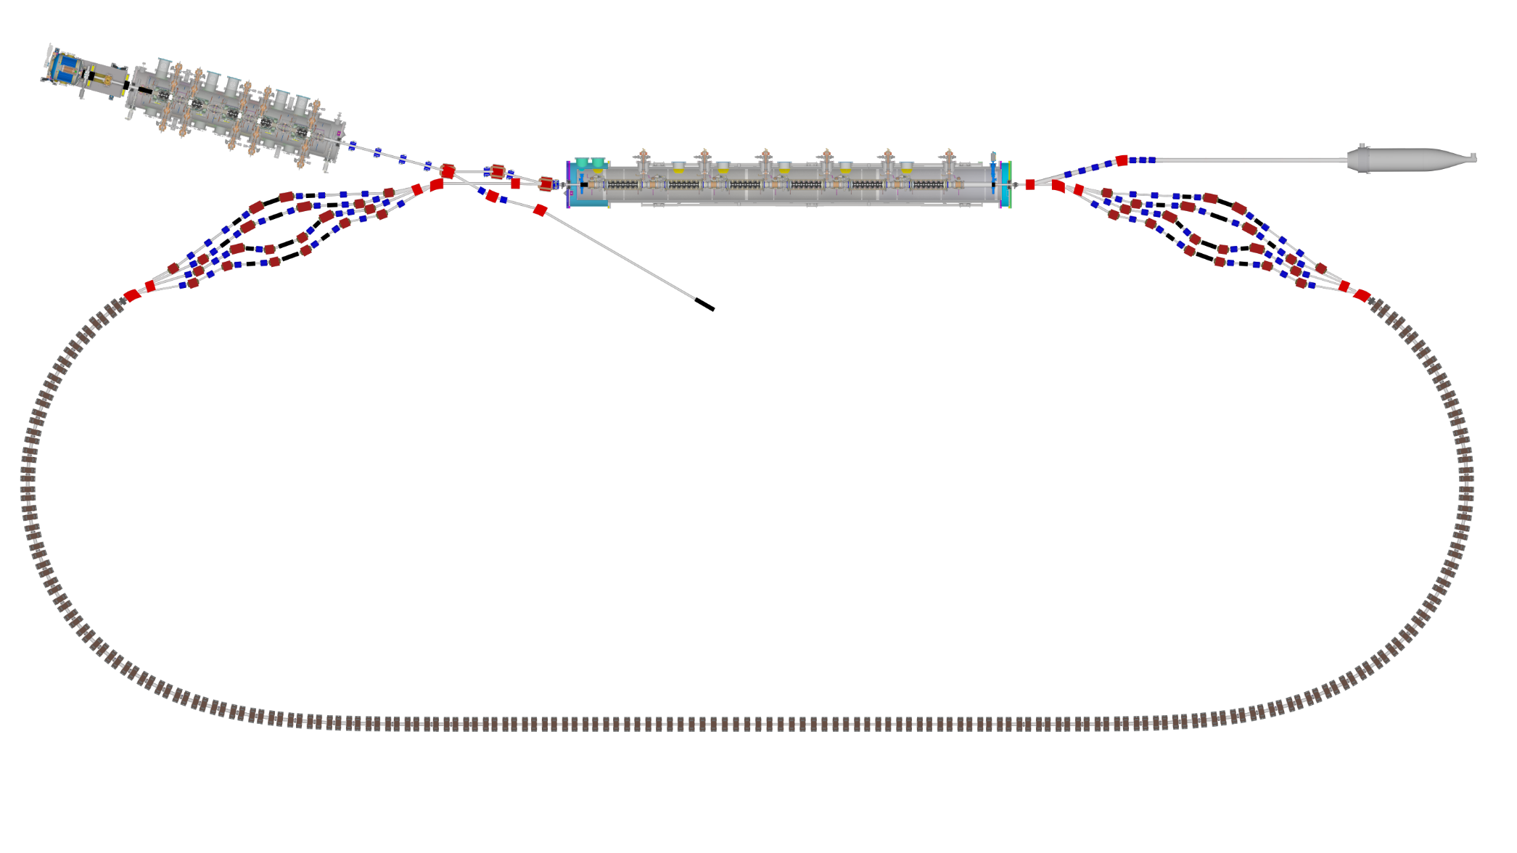

Layout & Parameters
Main linac is a 1.3GHz SCRF module with six 5-cell cavities
Source
±36MeV
Beam stop
Main linac cryomodule
Injector cryomodule
6MeV
6MeV
Diagnostic line
Splitter B
Splitter A
42,78,114,150MeV
Arc A
Arc B
42-150MeV
Transition B
Straight
Transition A

Slide 4
Bunch Pattern (one option)
Time structure as seen by the main linac

Slide 5
CBETA Energy Saving Technologies
Permanent magnets
Superconducting RF
Energy recovery (above 6MeV)
Recirculation: 4x beamline reuse, 4x energy
Funded by NYSERDA
  (NY State Energy R&D Authority)
  $25M grant
  Cornell already had the injector & cryomodule

Slide 6
Project Timeline
Construction
Beam operation

Slide 7
Fixed-Field Return Loop Optics
Beams with 4x rigidity range transmitted through same overall radius of curvature in arcs
Adiabatically merged to zero curvature, separation in straights
Beam cell tune decreases as a function of energy

Slide 8
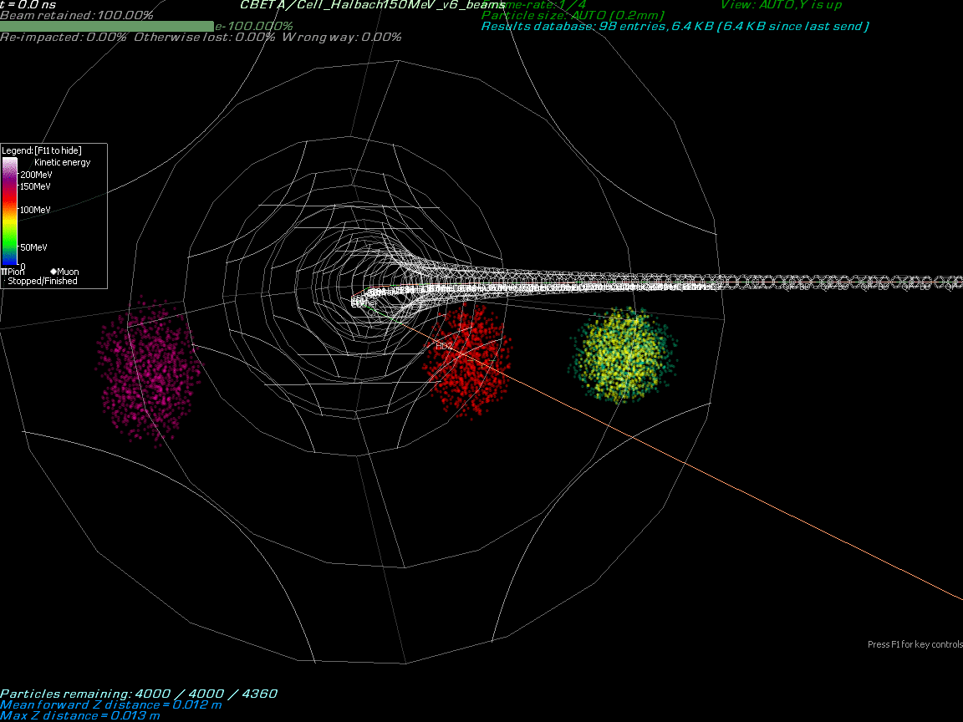

Slide 9
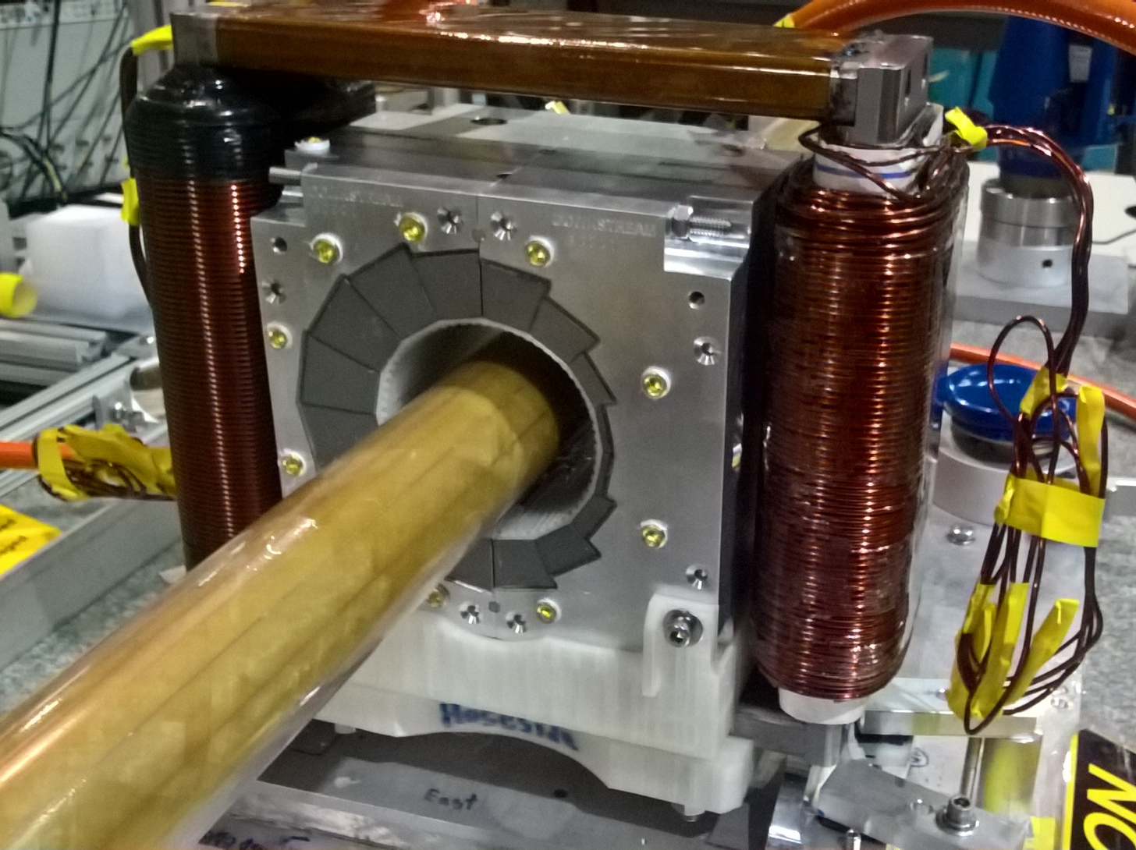
Permanent Magnet Design
Halbach design made of NdFeB material
This is a combined dipole+quad
Being measured on rotating coil at BNL
3D printed multipole corrector pack inside
Windowframe corrector coil outside
Temperature stabilised by water (orange hoses)

Slide 10
Permanent Magnets (PMs) in Accelerator Beamlines
Established uses:
  Wigglers, undulators
  Halbach quads in drift tube linacs
  Halbach quads in interaction region of Cornell CESR collider
  Hybrid magnets (PM+iron) for main bending field of FNAL recycler
CBETA ERL (operating at Cornell 2019-20):
  New uses:
    Halbach magnet is main bending field (compact size, short drifts)
    Combined-function dipole+quad Halbach (fewer lattice elements)
  Done before but not at scale:
    Tuning of Halbach magnets with iron rods for higher field quality
      200+ magnets tuned at BNL

Slide 11
PM Domain of Applicability
Field strength comparable to electromagnets
  But not adjustable without EM corrector or motors
Generally cheaper for small apertures
There is a limit to radiation resistance
  How much? “It depends”
    On PM material, material grade, magnet geometry, field strength
    On accelerator radiation environment near beam pipe
      You must characterise this before getting any useful answers
  Examples (mostly NdFeB material)
    CBETA 1kGy lifetime dose limit (predicted <2×10⁻⁴ field change)
    RHIC beam dump 700Gy, some grades near-unchanged, some bad
    BLIP target area >>MGy, ~90% flux loss, SmCo some flux loss
    CESR 65cm from interaction region(!) SmCo seems to work

Slide 12
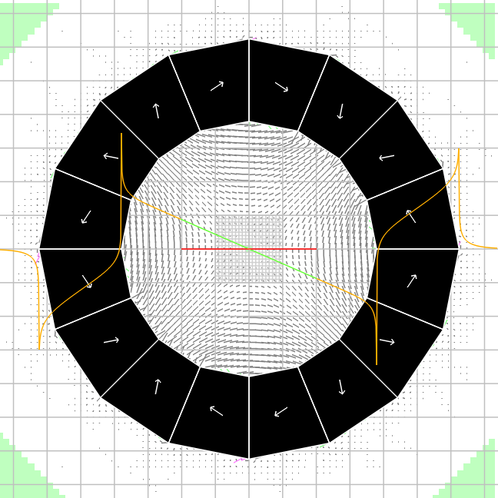
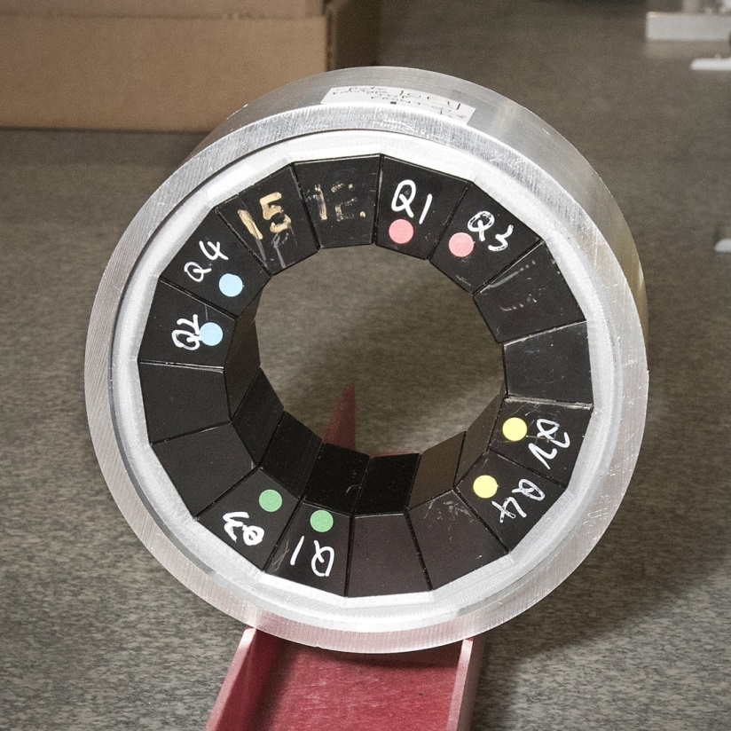
Halbach-style Permanent Magnets
Consist purely of PM material (no iron)
  Generally smaller than PM+iron hybrid magnets: no iron loop
  No cross-talk if placed close together (short drifts)
Orientation of magnetisation in (usually) wedge-shaped PM pieces is used to produce desired harmonics in magnet aperture

Slide 13
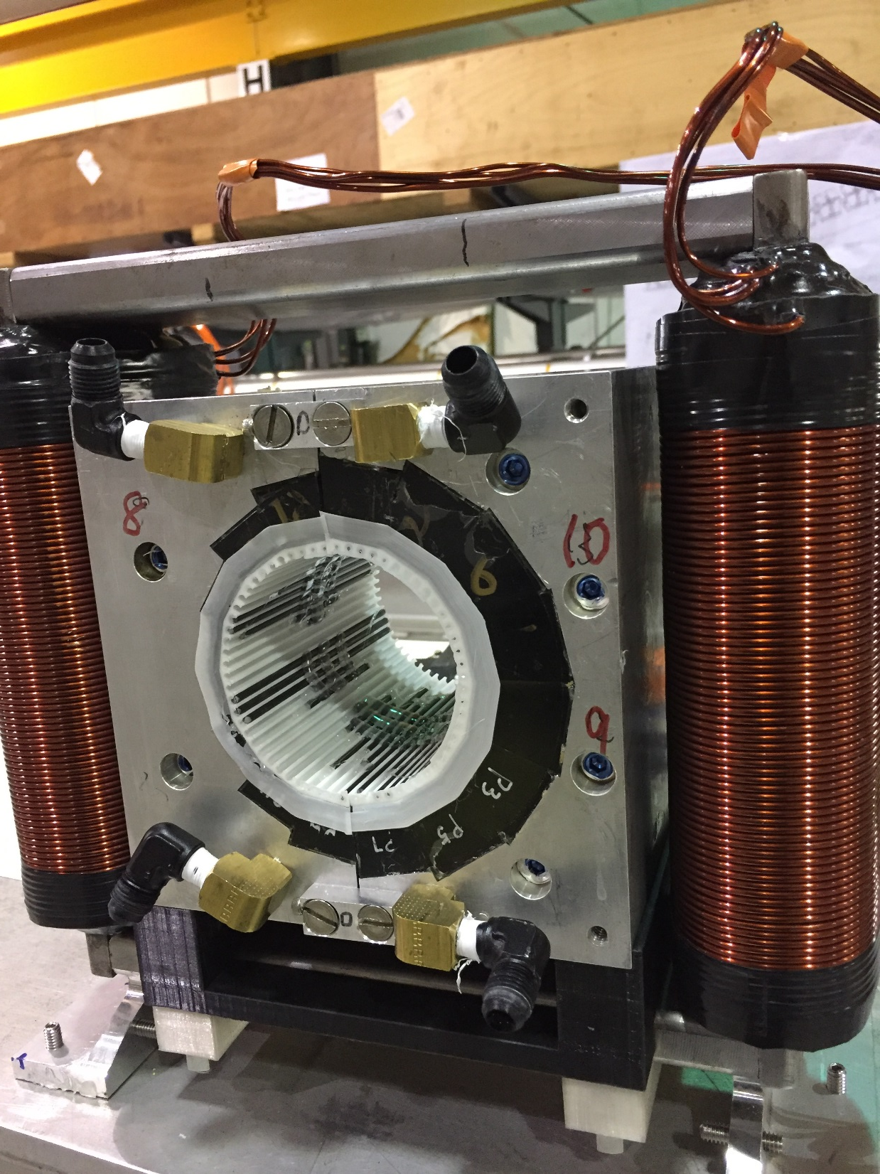
Iron Rod Correction Method
CBETA permanent magnet containing tuning rod insert
Measure bare magnet harmonics
Then calculate lengths of iron rods to be inserted around the aperture
3D printed insert with 64 slots
EM corrector coil outside (up to 4% field)

Slide 14
CBETA permanent magnet containing tuning rod insert

Slide 15
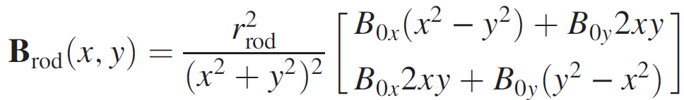
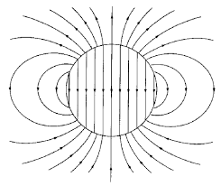
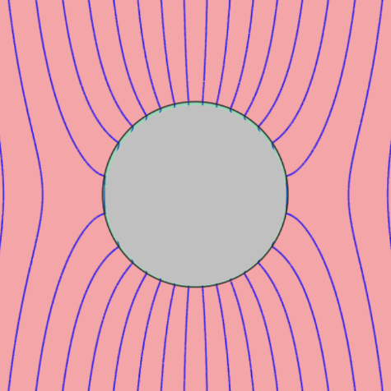
Field Calculation of Iron Rods
Field of 2D perfect μ=∞ iron rod of circular cross-section, centre (0,0), in ambient field B₀:
Rod is magnetised with M=2B₀
B_{rod}
B₀+B_{rod}

Slide 16
Error Sources (~10⁻² level)
Wedge magnetisation vector
  1-2° angle variation
  ~1% strength variation
  Comes from wedge manufacturing process
Wedge position
  0.1-0.2mm XY displacement
  Angle errors (fraction of a degree)
  Comes from magnet assembly
Can’t be fixed with block sorting

Slide 17
Overall Philosophy
Direct approach:
Incorporating correction:
Optimiser
Build
Measure
Simulation
Optimiser
Optimiser
Build
Measure
Correction simulation
Correct
Measure
Simulation

Slide 18

Correction Makes Precision Easier
At ~10⁻⁴ accuracy
Optimiser
Build
Measure
Simulation
$$$$
At ~10⁻² of error
At ~10⁻² accuracy
Optimiser
Optimiser
Build
Measure
Correction simulation
Correct
Measure
Simulation
$
$
Measurement steps still have to be ≤10⁻⁴

Slide 19
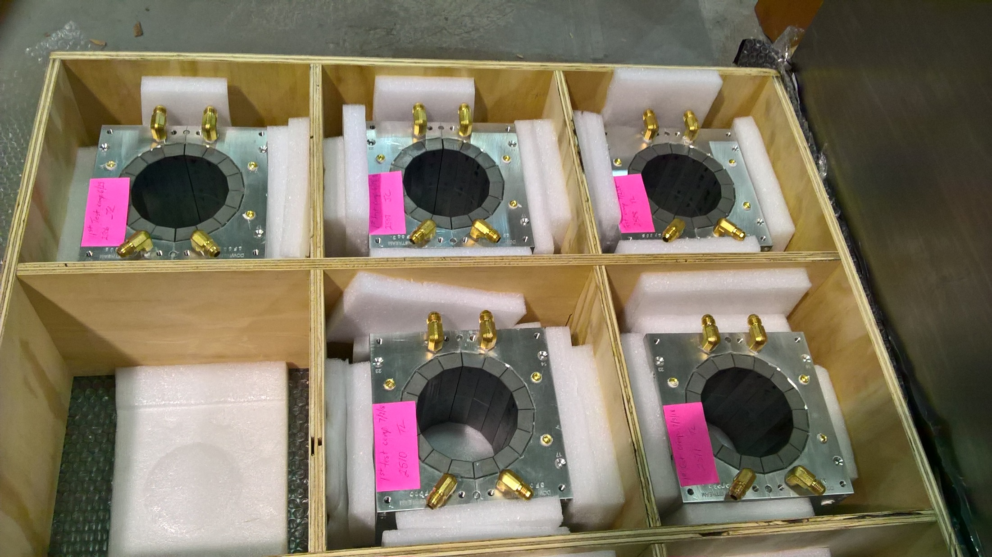
Permanent magnets shipped from KYMA

Slide 20
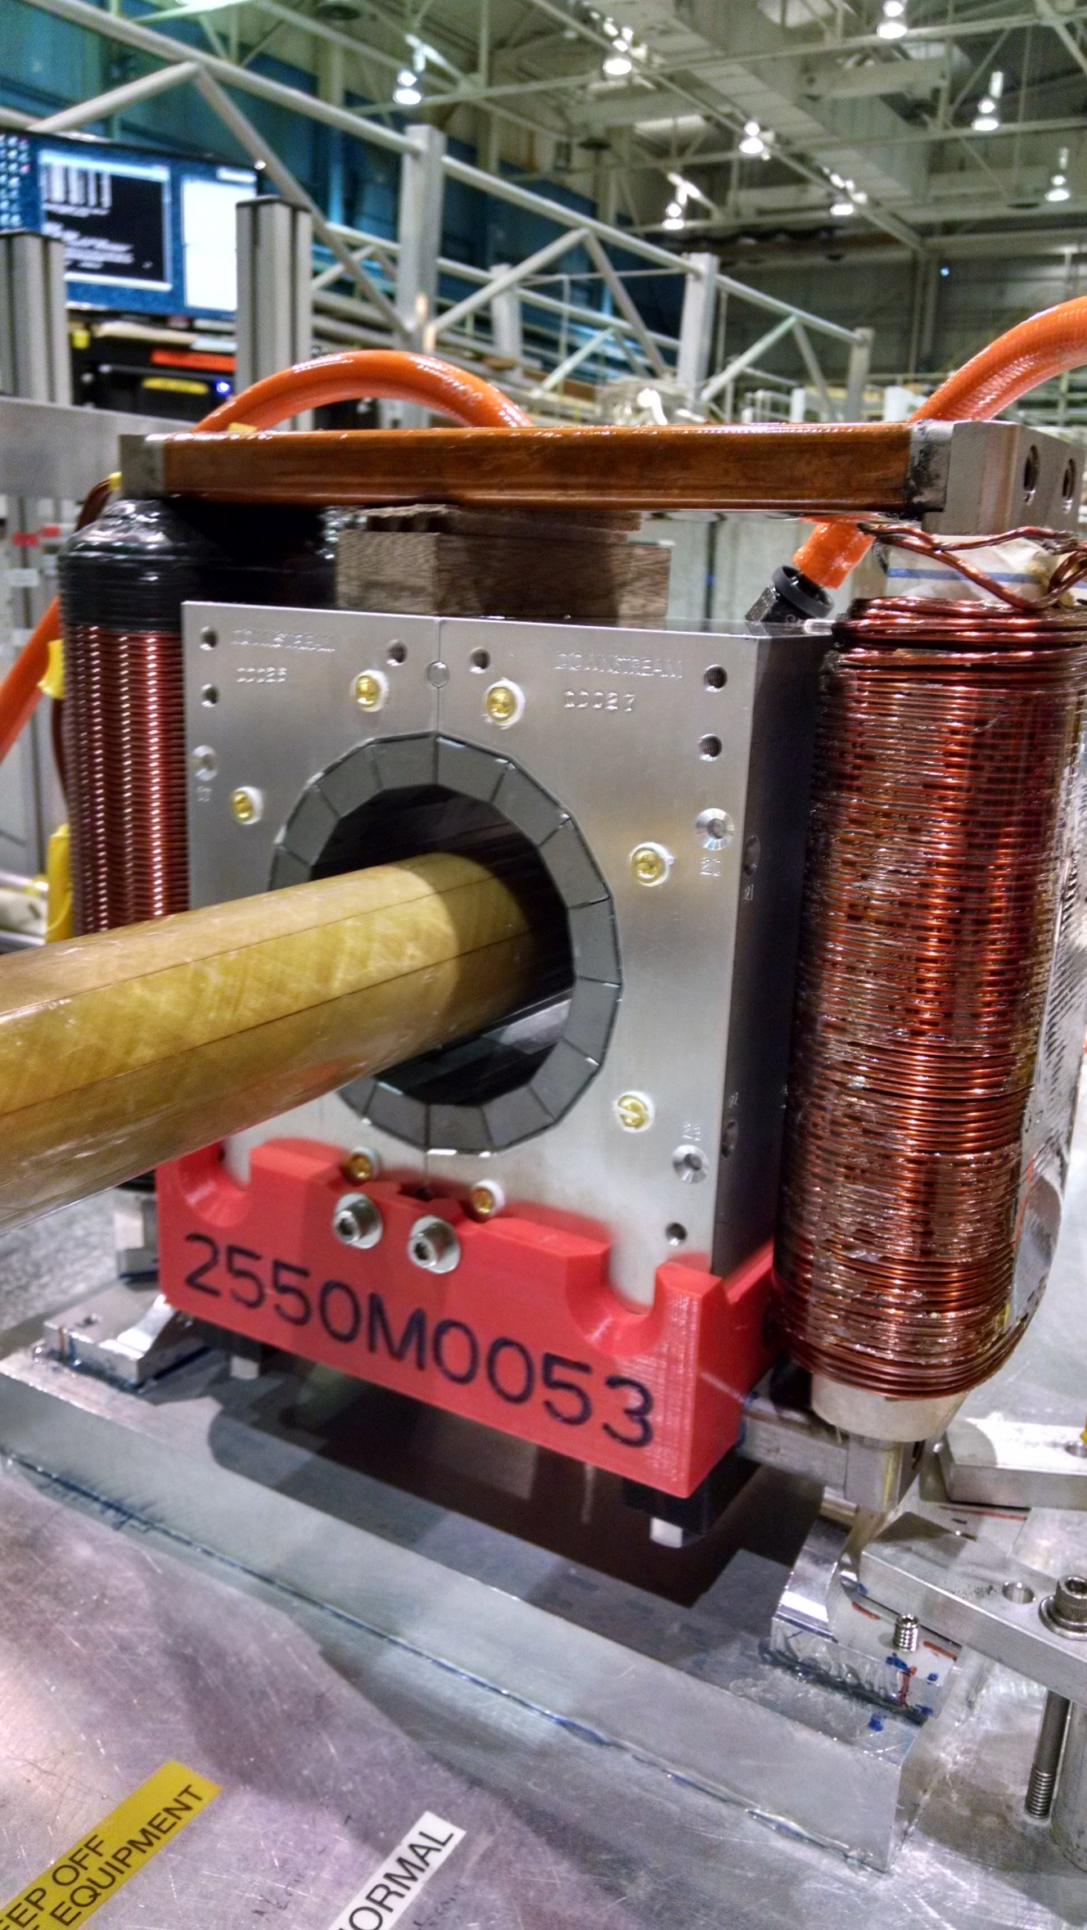
Rotating coil magnet measurement at BNL

Slide 21
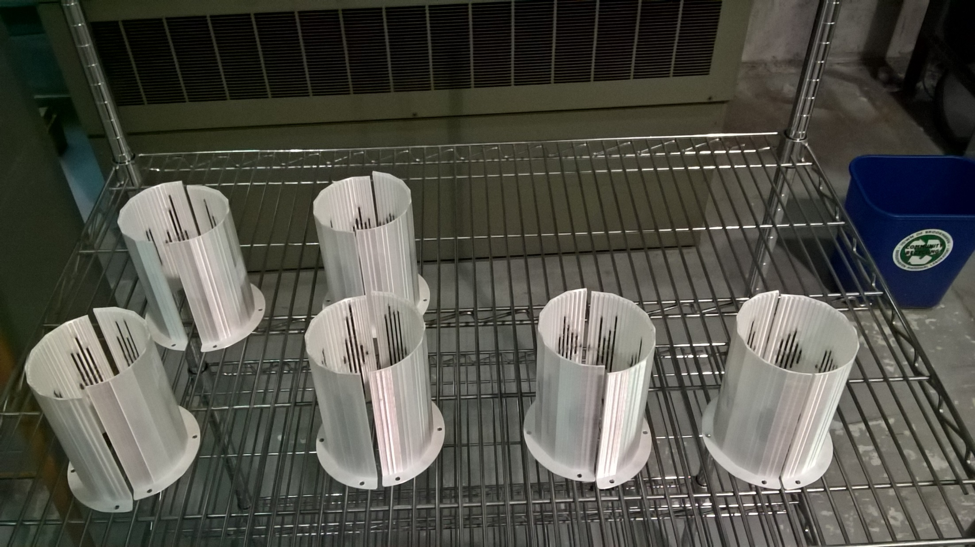
Rod tuning packs for CBETA magnets
Iron rod optimisation program was packaged so that technicians could run it: rotating coil data → rod lengths

Slide 22
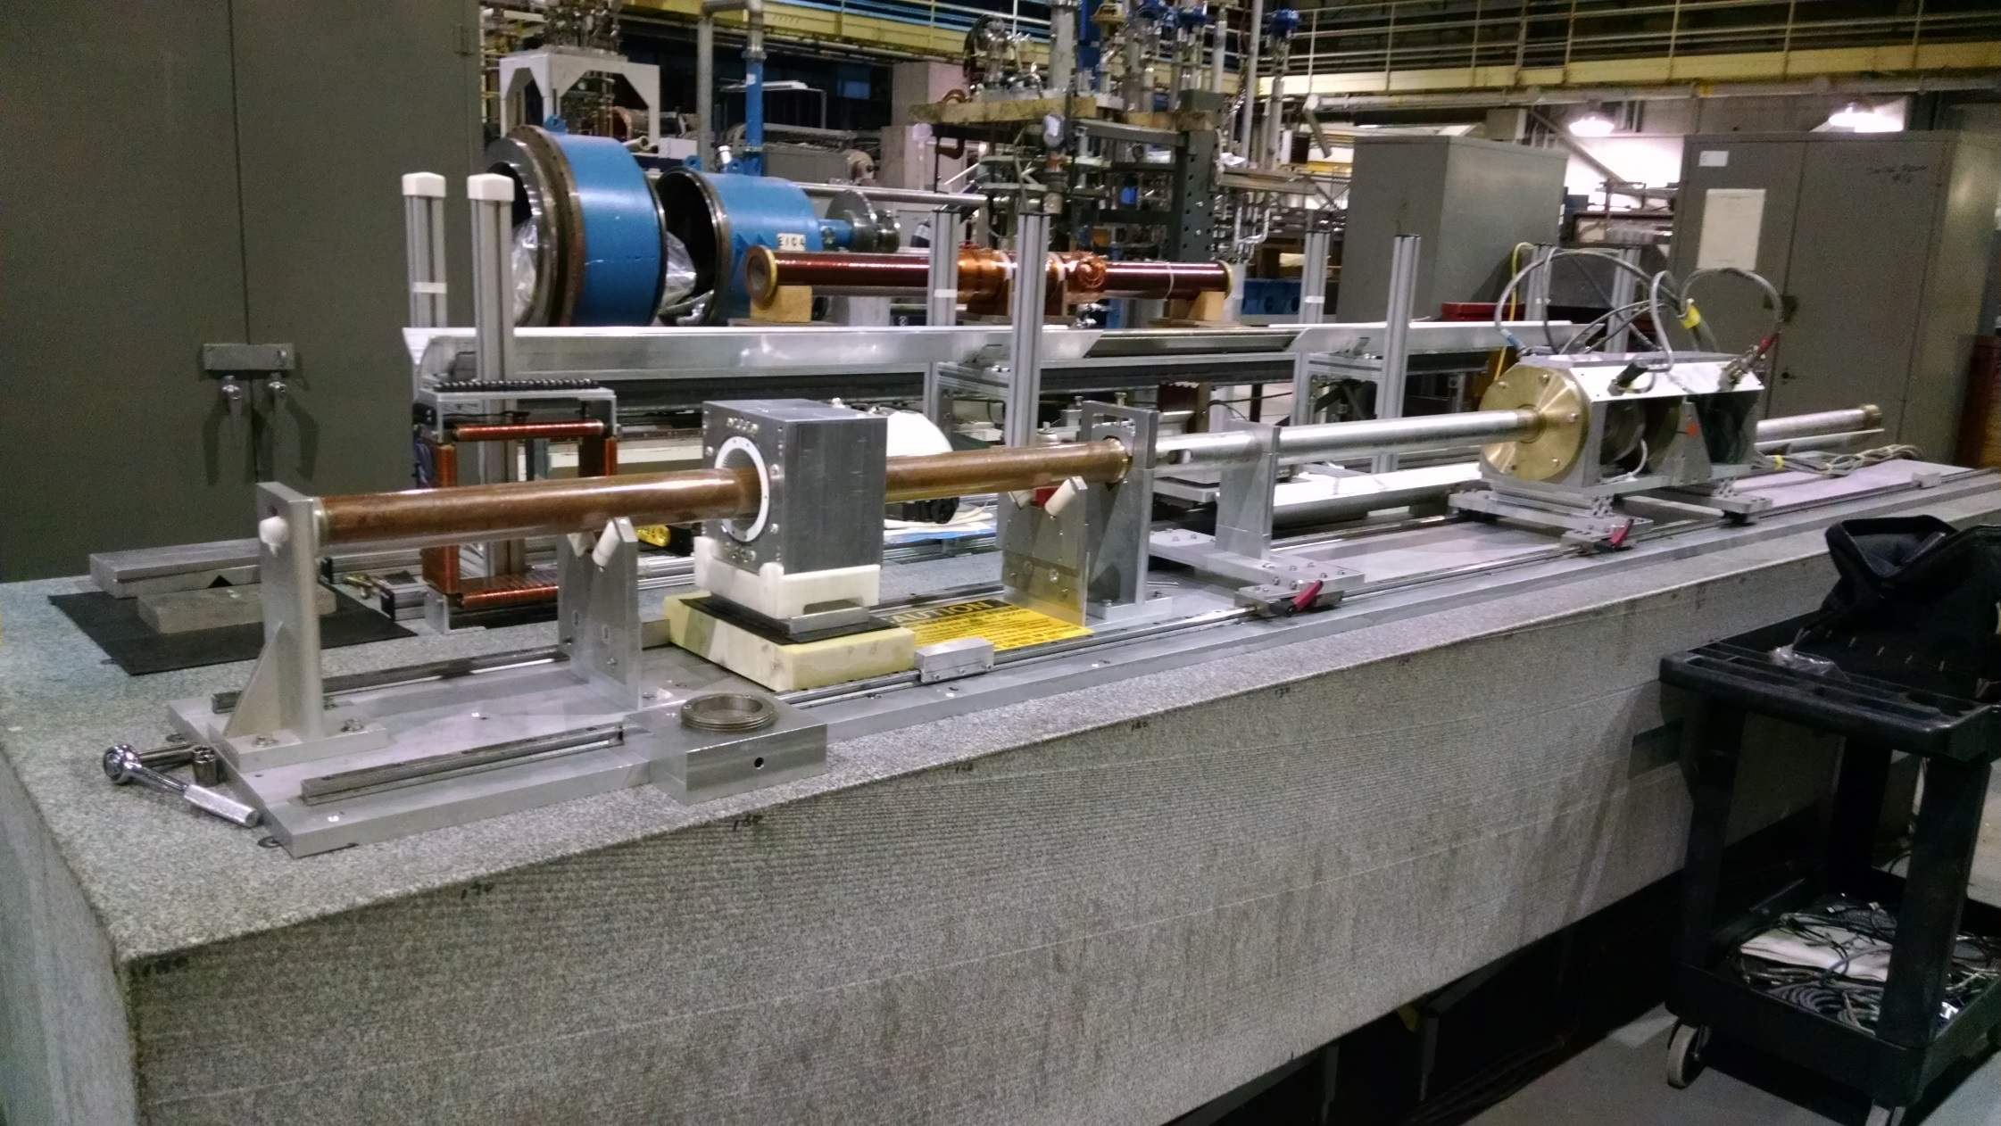
Rotating coil magnet measurement at BNL

Slide 23
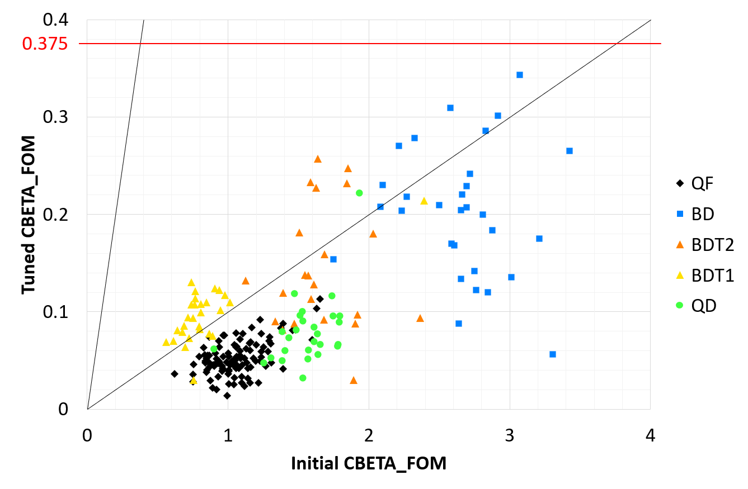
Effect of Tuning (CBETA FOM)
10× improvement

Slide 24
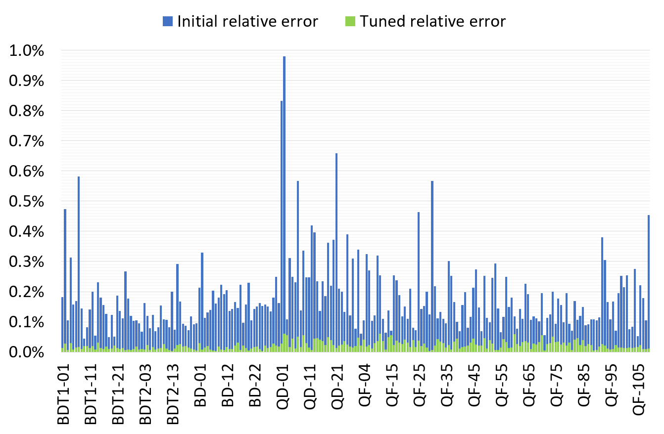
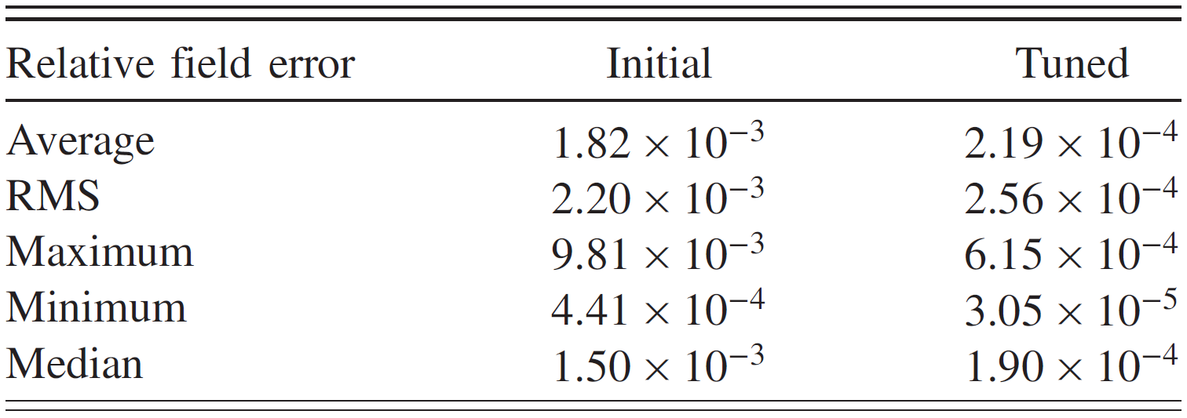
Only tuned magnets shown (2 “rejects” removed)

Slide 25
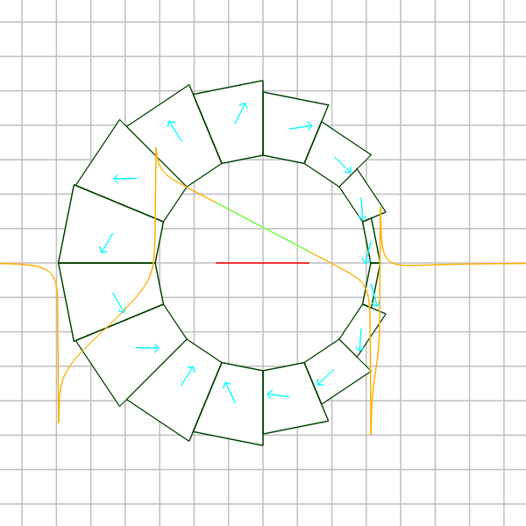
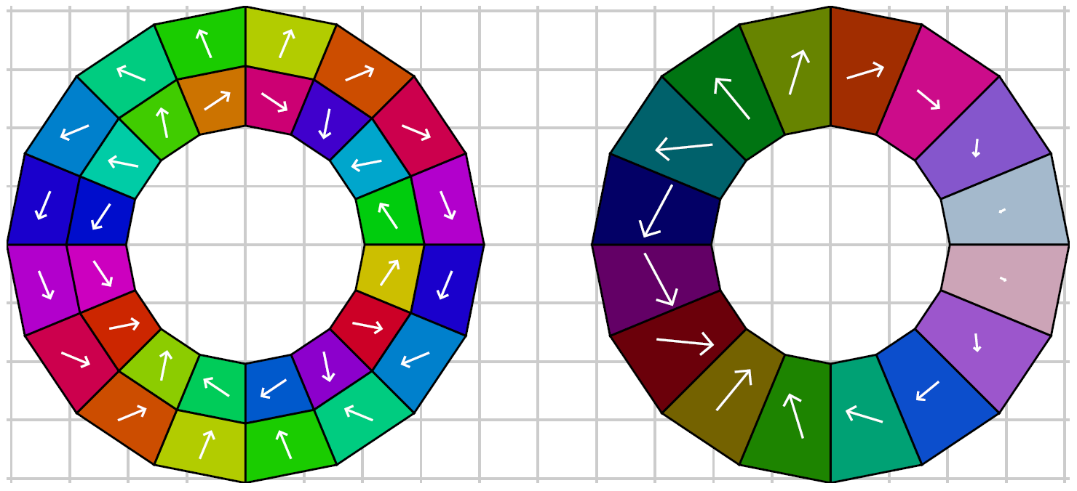
Combined-Function Magnet
Improvement over nested Halbach dipole and quadrupole (shown below) can be made by taking vector sum* of the two layers and implementing as a layer with constant magnetisation magnitude but variable wedge thickness.
* Not exactly a vector sum, needs numerical optimiser for accurate design

Slide 26
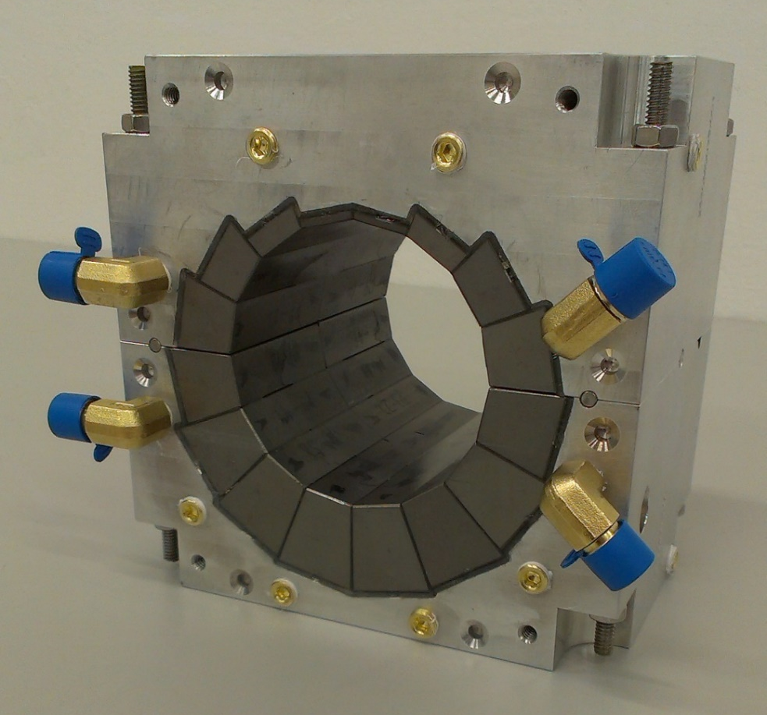
CBETA Combined-Function Magnets
8 different wedge sizes
Machined aluminium holder
Successfully used with 42-150MeV electrons at CBETA
80 such magnets corrected to less than 10⁻³ error on a R=25mm aperture using iron rods
122mm length
-0.3081 T dipole
11.1475 T/m gradient
0.5868 T max field in good field region

Slide 27
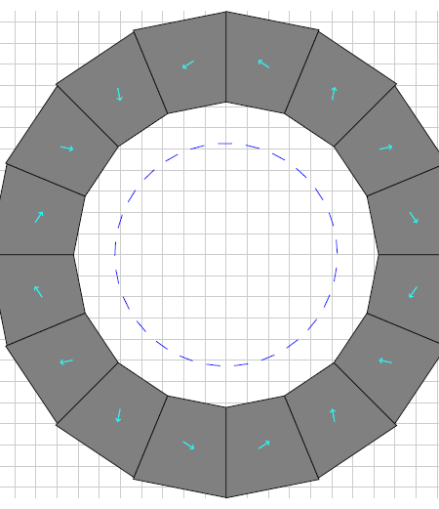
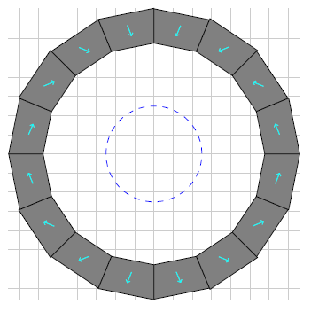
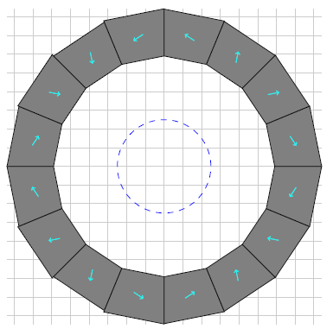
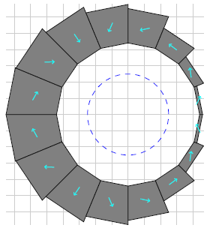
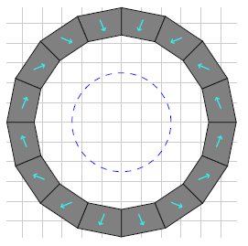
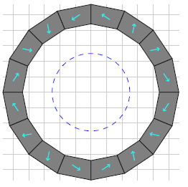
Combined-Function Comparison
Combined-function
(CBETA BD)
Displaced quad
Quad in dipole
Dipole in quad
67.5cm²
Aperture centered where it is needed for beam
234.9cm²
112.9cm²
152.7cm²
Quad scales less well with aperture than dipole
All designs 10⁻³ or better field quality

Slide 28
Combined-Function Uses
Focussing and bending in one magnet
  Fewer lattice elements, dispersion control
  Possibly better dipole packing factor as result
As well as CBETA ERL, found in:
  Low-emittance synchrotron light source lattices
  High energy aperture lines and storage rings
    Permanent magnet hadron therapy gantry
    Fixed-field accelerators e.g. CEBAF 20GeV upgrade
  Some synchrotron accelerators

Slide 29
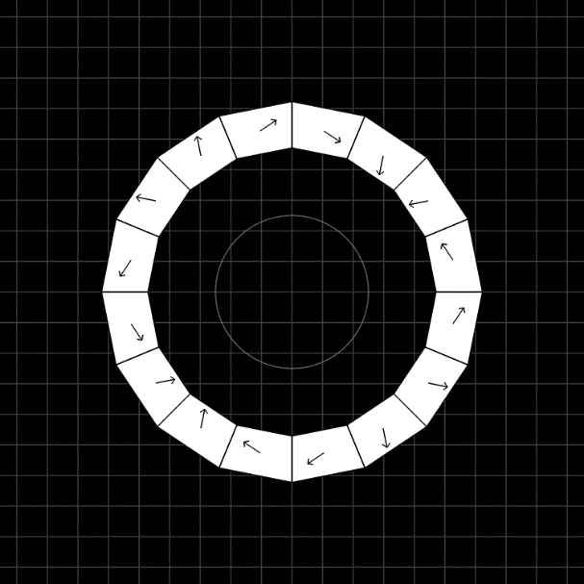
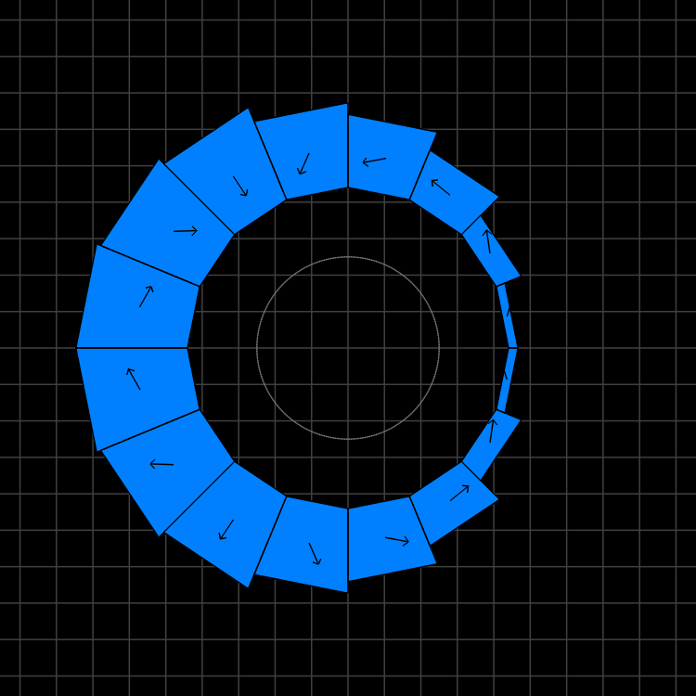
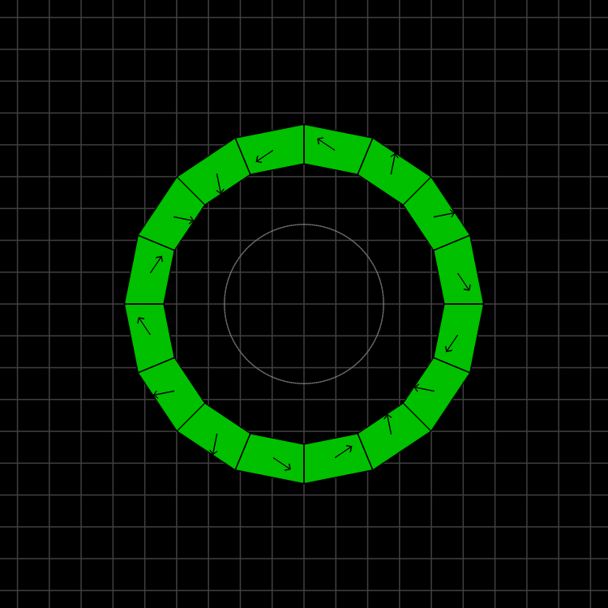
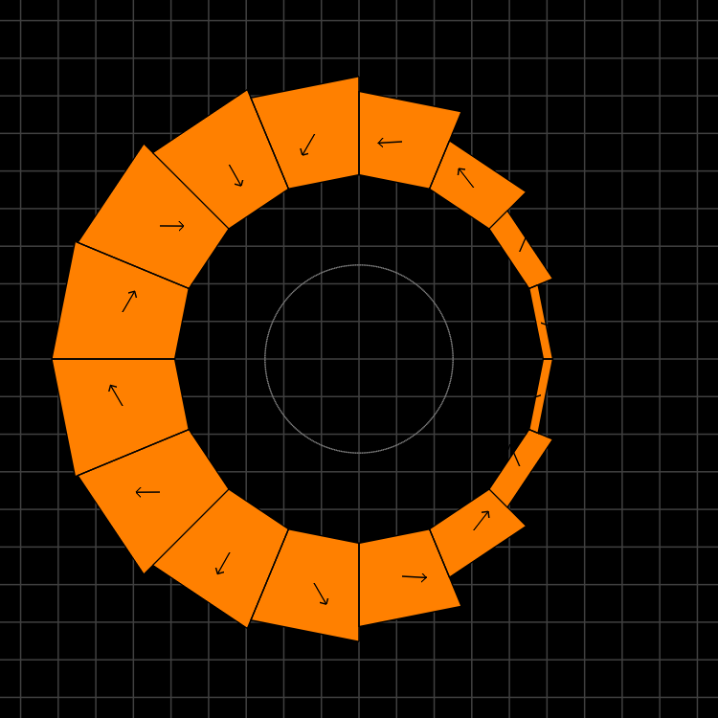
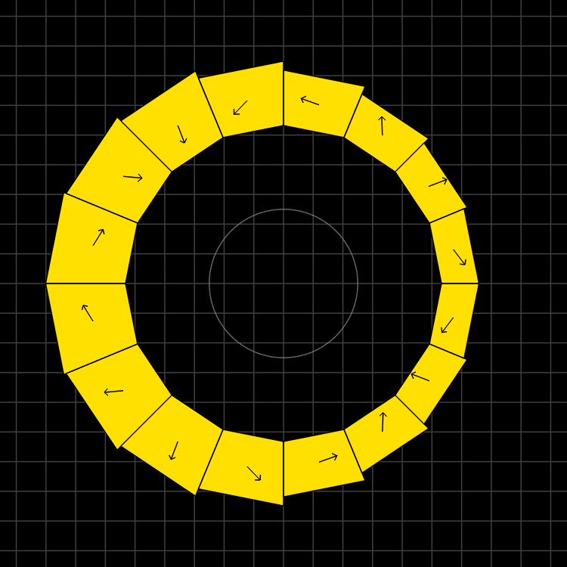
Magnet Types and Parameters
QF
BD
QD
BDT2
BDT1
Magnet | Dipole (T) | Quad (T/m) | Good field radius (mm) | Aperture radius (mm) | Max field (T) (good region) | Max field (T) (aperture)
QF | 0 | -11.5624 | 25 | 43.1 | 0.2891 | 0.4983
BD | -0.3081 | 11.1475 | 25 | 40.1 | 0.5868 | 0.7551
BDT2 | -0.2543 | 11.1475 | 25 | 44.938 | 0.5330 | 0.7552
BDT1 | -0.1002 | 11.1475 | 25 | 49.085 | 0.3789 | 0.6474
QD | 0 | 11.1434 | 25 | 40.1 | 0.2786 | 0.4469

Slide 30
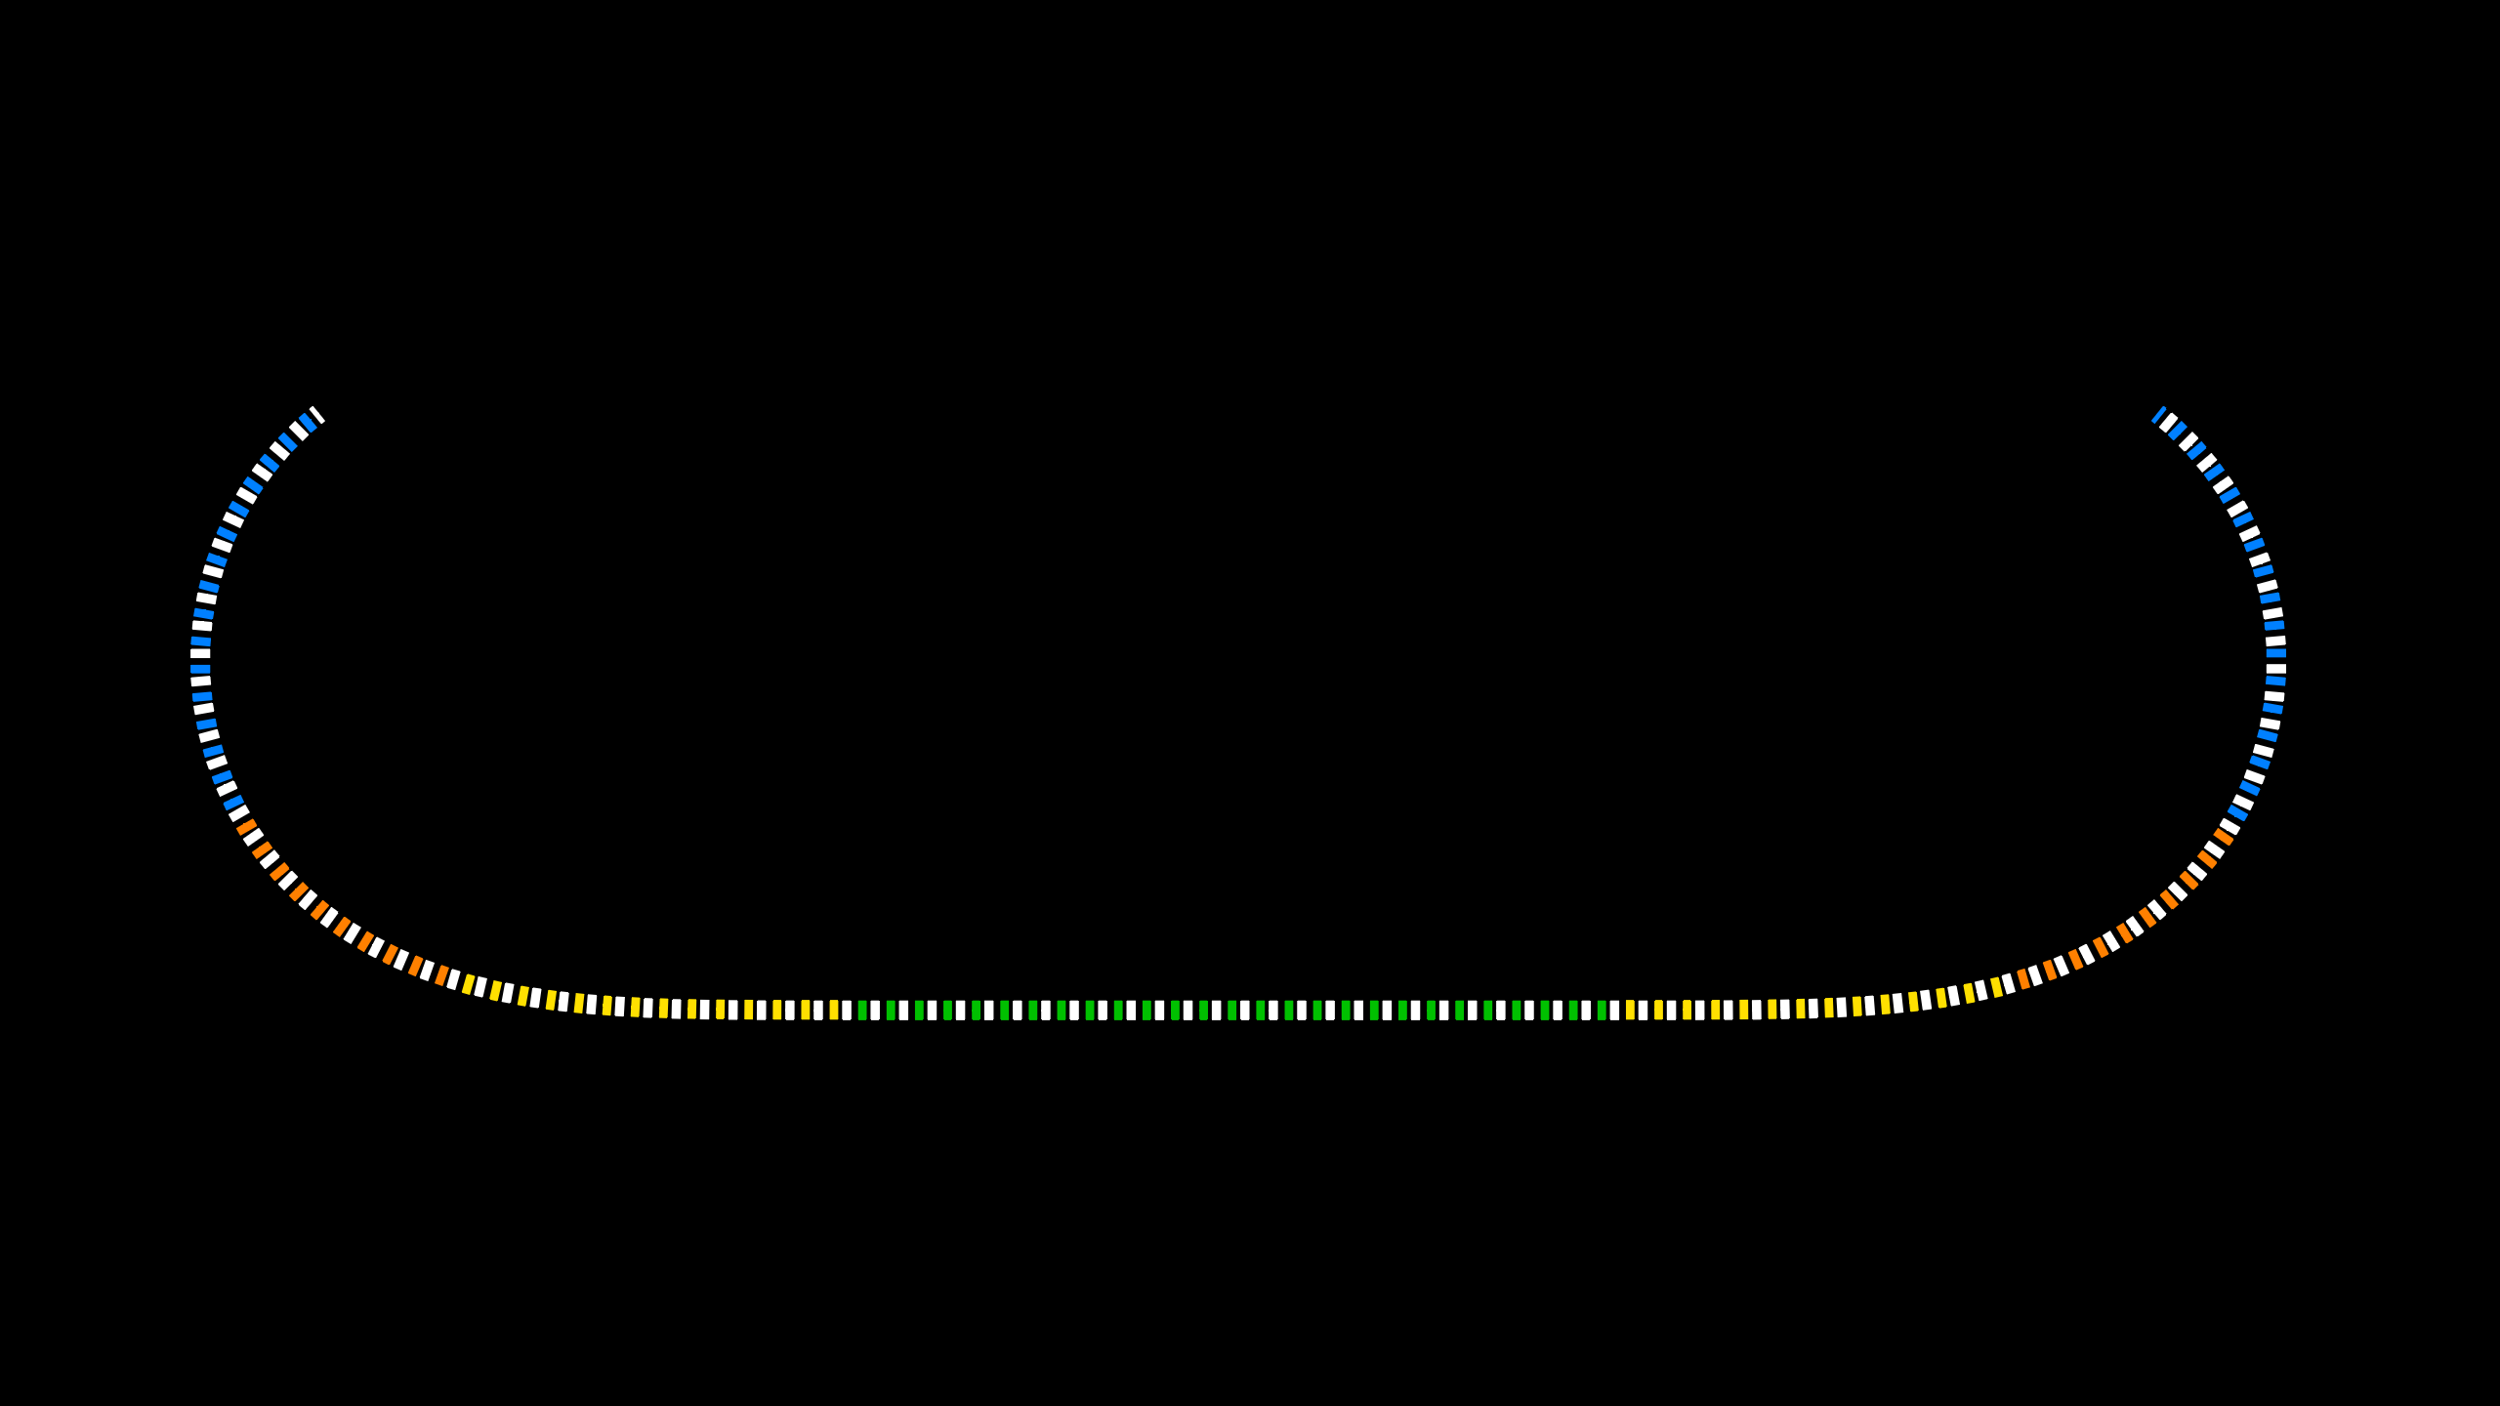
Layout and Magnet Counts
Permanent magnet total: 216
QF: 107
BD: 32
BDT2: 20
BDT1: 28
QD: 27
QFH: 1 (half length)
BDH: 1

Slide 31
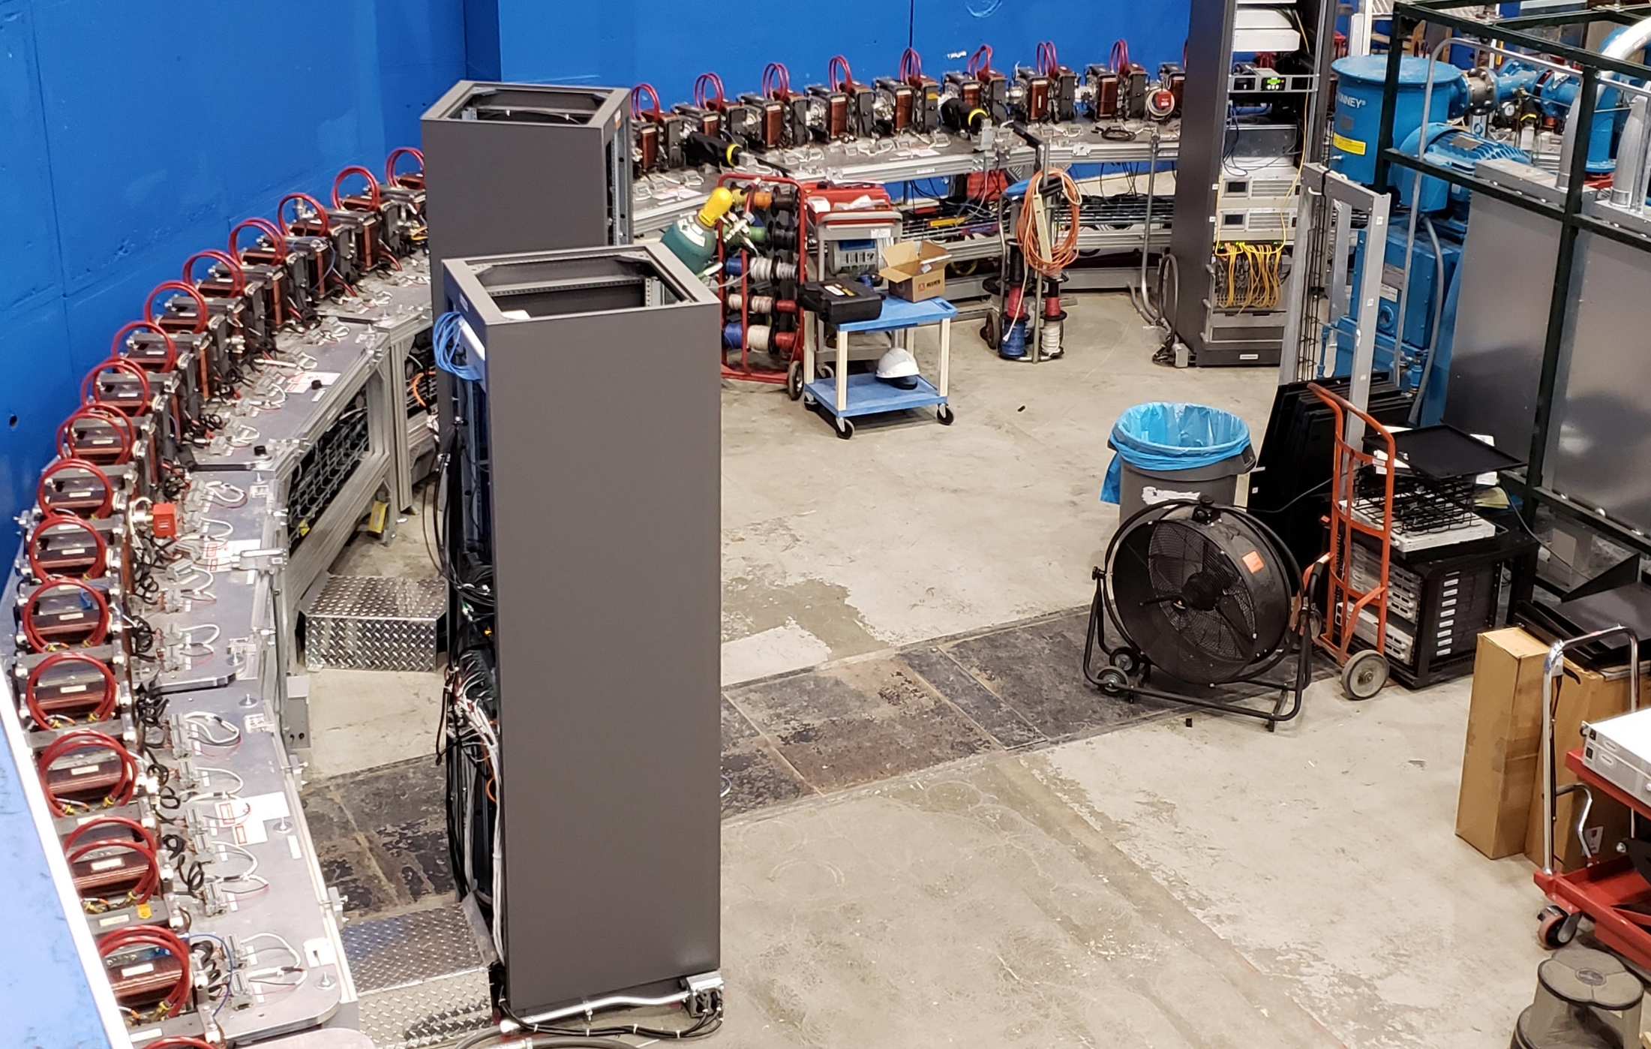
CBETA Fixed-Field Return Arc

Slide 32
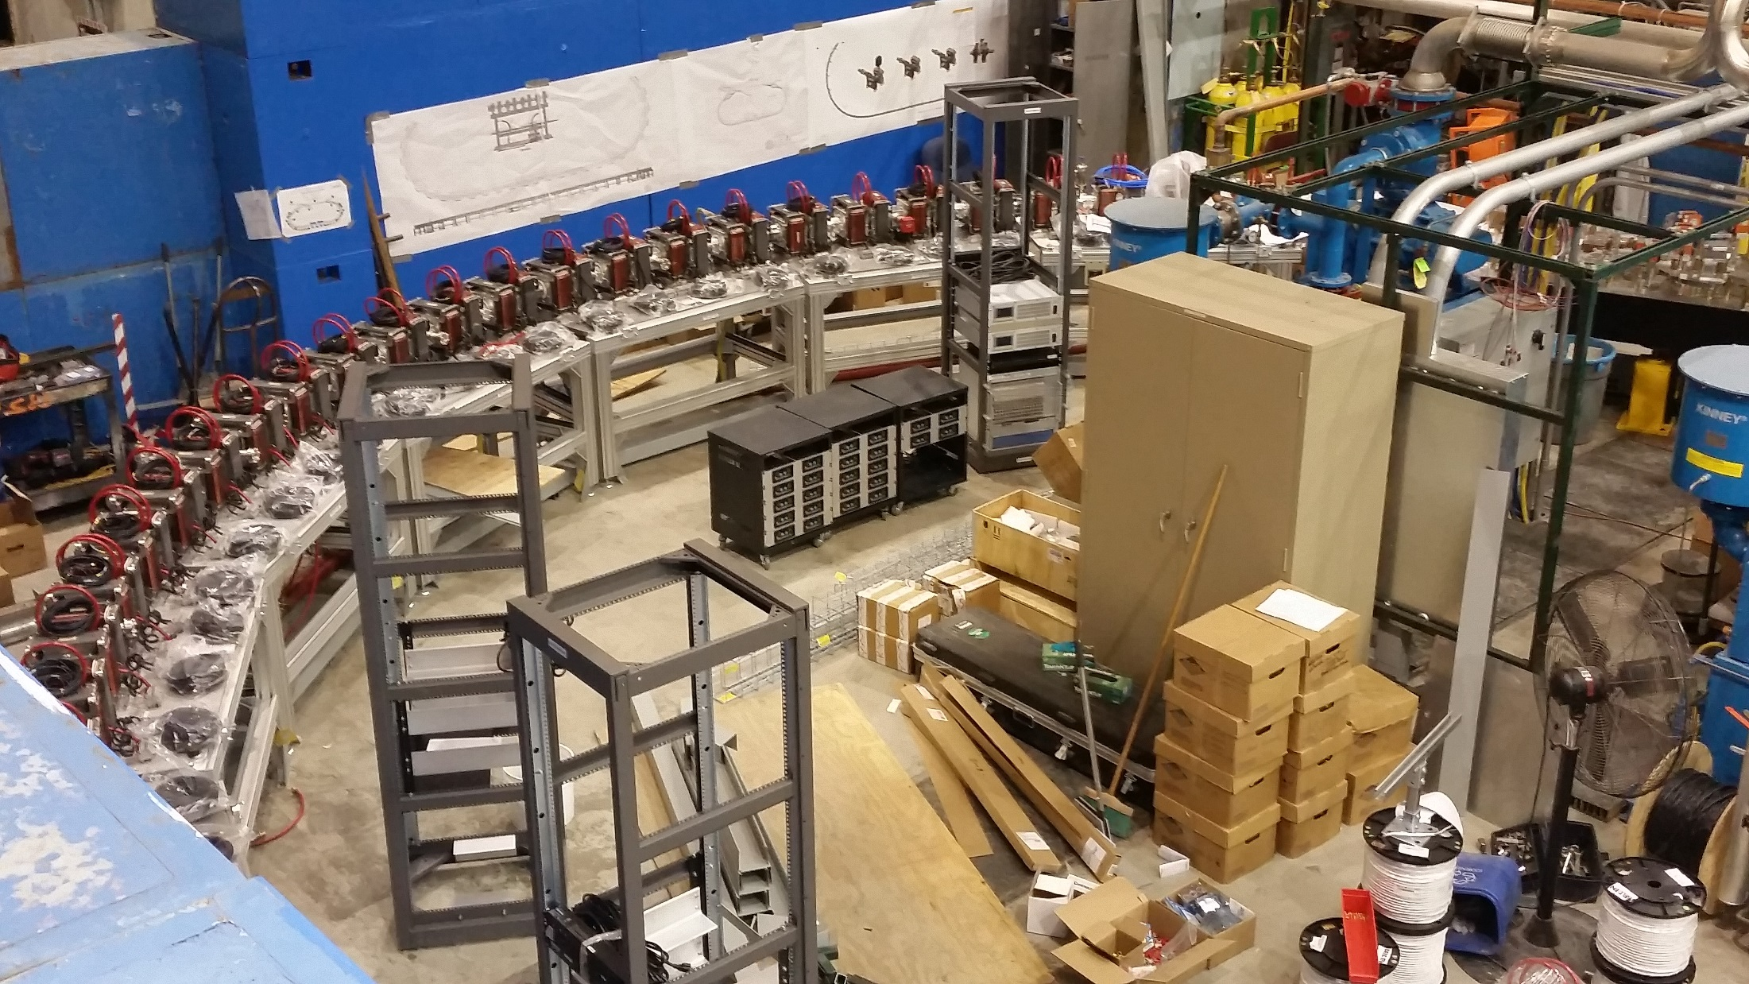
Fixed-Field Return Arc

Slide 33
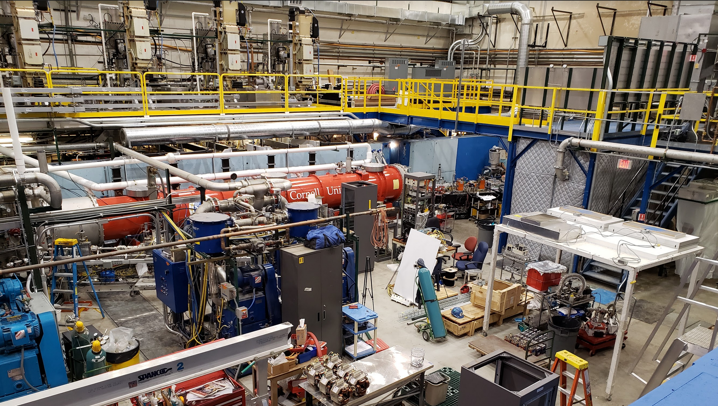
Main Linac Cryomodule

Slide 34
CBETA Energy Saving Technologies
Permanent magnets
Superconducting RF
Energy recovery (99.6 ± 0.1% above 6MeV)
Recirculation: 4x beamline reuse, 4x energy
Funded by NYSERDA
  (NY State Energy R&D Authority)
  $25M grant
  Cornell already had the injector & cryomodule

Slide 35
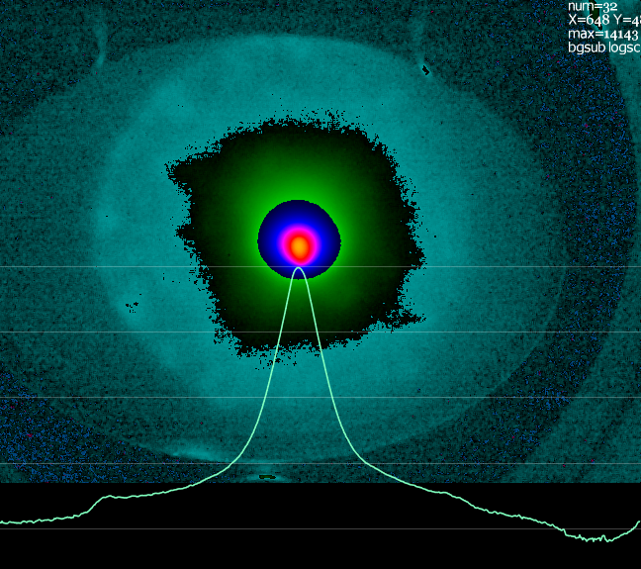
CBETA Commissioning:
Possible Halo after Injector
3×10⁻⁴ relative intensity
~100x beam core area
About 3% of total charge
Probably from photocathode
(April 17, 2019)
Selectively-activated photocathode has been used before at Cornell to suppress this sort of thing
Collimators in the injector are possible but harder due to high beam powers

Slide 36
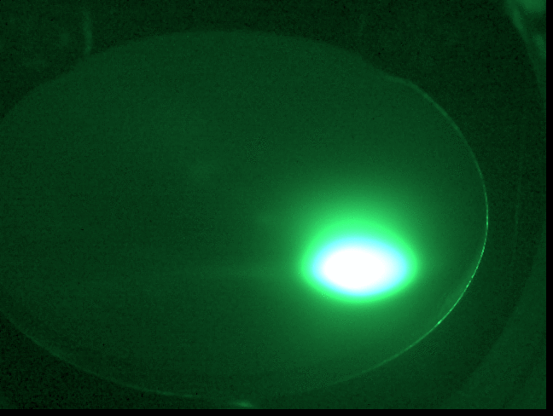

Slide 37
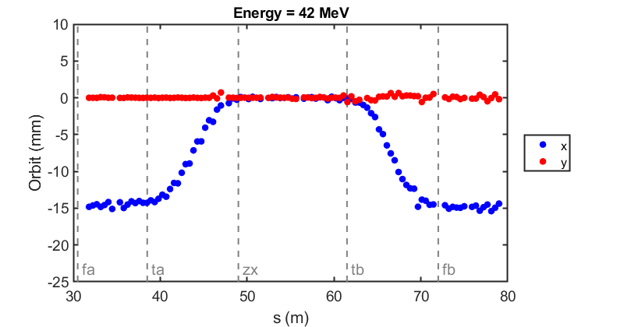
Commissioning results: orbit correction in fixed-field loop
The very first beam through the fixed-field loop on May 7, 2019
Corrected beam using section-by-section local SVD (did not converge for whole FFA)
(June 12, 2019)

Slide 38
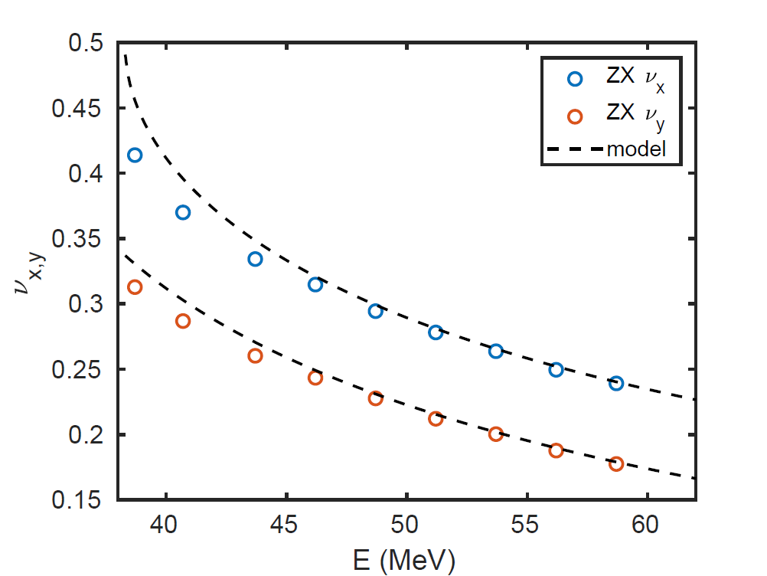
Cell Tunes in Beam Energy Scan
Fixed-field arcs
Fixed-field straight
(June 12, 2019)

Slide 39
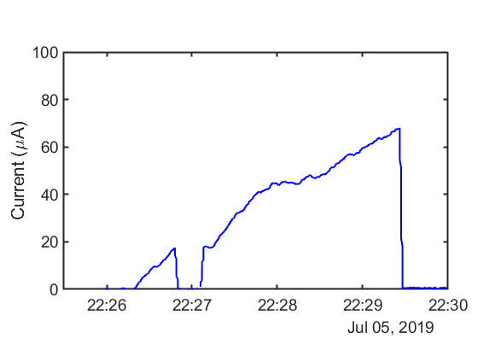
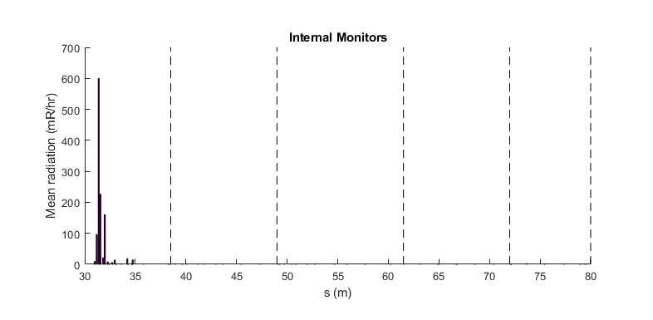
Higher Current Test / Radiation
Using ~3pC bunches
Halo just went through
Current limited by uninteresting things:
Wrong gun photocathode
Fast EPS not installed (10uA limit)
Gun resistor needs changing
External radiation monitors (70uA limit)
No “physics” current limit seen
Extrapolating internal FFA losses gives 70uA*(10000/600) = 1.17mA limit
1mA should be fine
Probably 1-10mA CSR limit

Slide 40


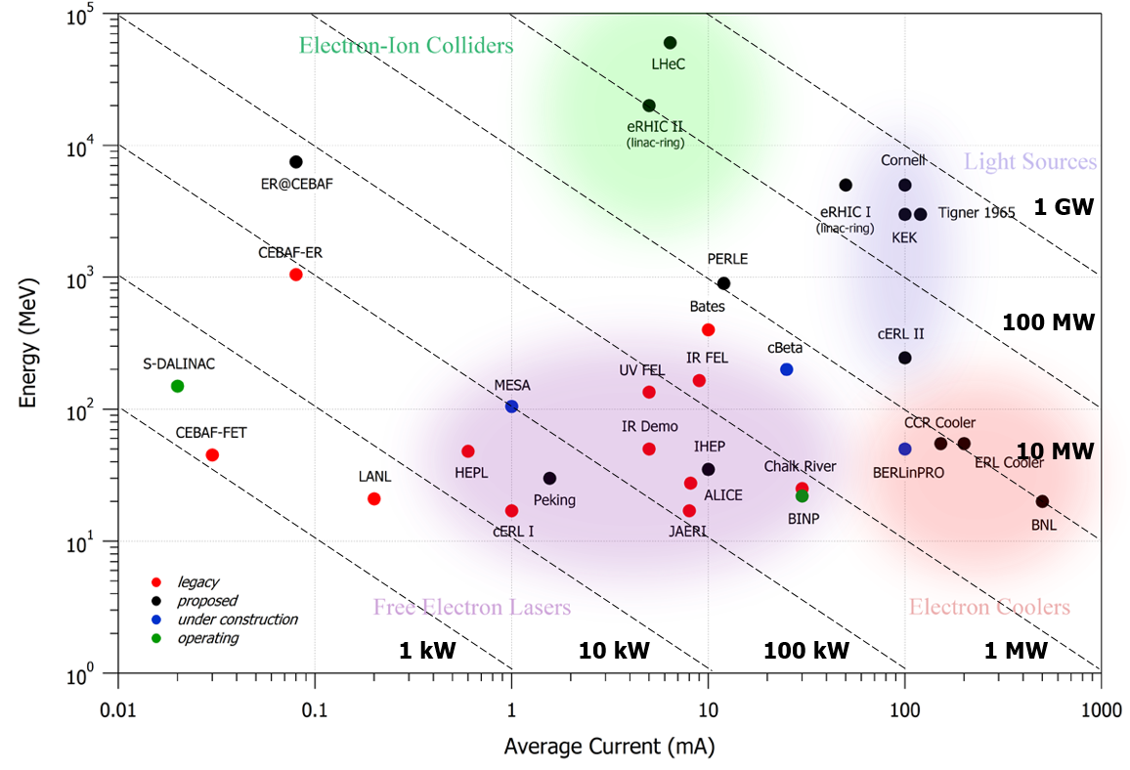
ERL Frontier: Tennant Plot
eRHIC cooler
K. Deitrick - kd324@cornell.edu
NAPAC 2019 - Status of the CBETA Prototype

Slide 41
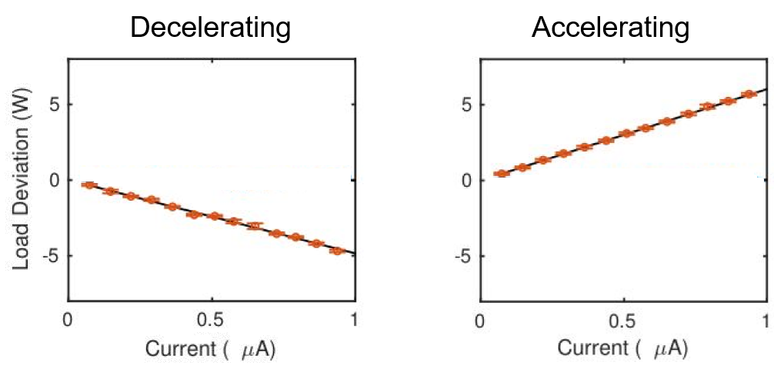
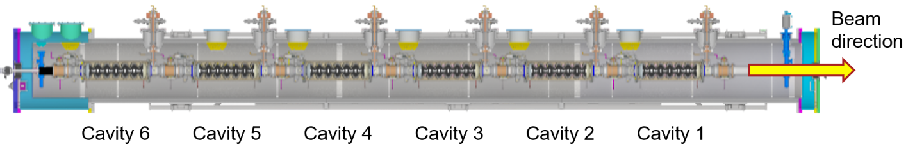
Energy Recovery
To demonstrate load deviation in MLC cavity, the each cavity was set up near typical field – but the last three cavities decelerated the beam, sending it directly into the beam stop
MLC labeled layout shown below, typical beam loading plots for accelerating (cavities 4-6) and decelerating (cavities 1-3) shown to the right
Load Deviation (W)
Current (μA)
Load Deviation (W)
Current (μA)
K. Deitrick - kd324@cornell.edu
NAPAC 2019 - Status of the CBETA Prototype

Slide 42
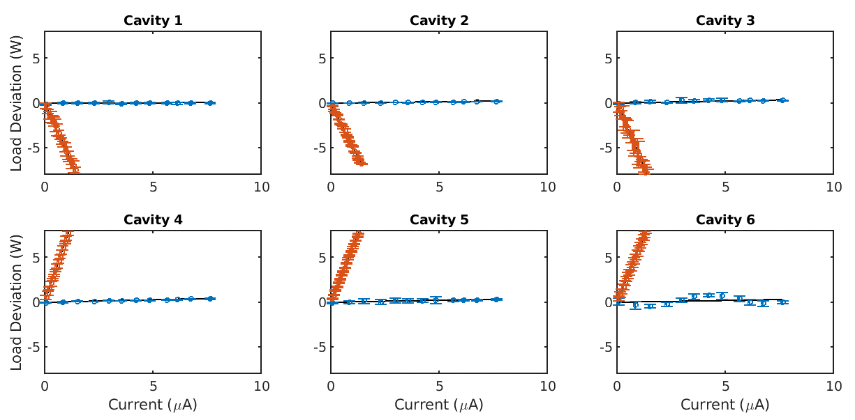
Better Energy Recovery, Higher Current
Transmission improved to
99.6 ± 0.1%
Average current increased to 8 μA
Beam loading for each cavity shown on the right
ER mode Non-ER mode
Load Deviation (W)
Load Deviation (W)
Current (μA)
Current (μA)
Current (μA)
K. Deitrick - kd324@cornell.edu
NAPAC 2019 - Status of the CBETA Prototype

Slide 43
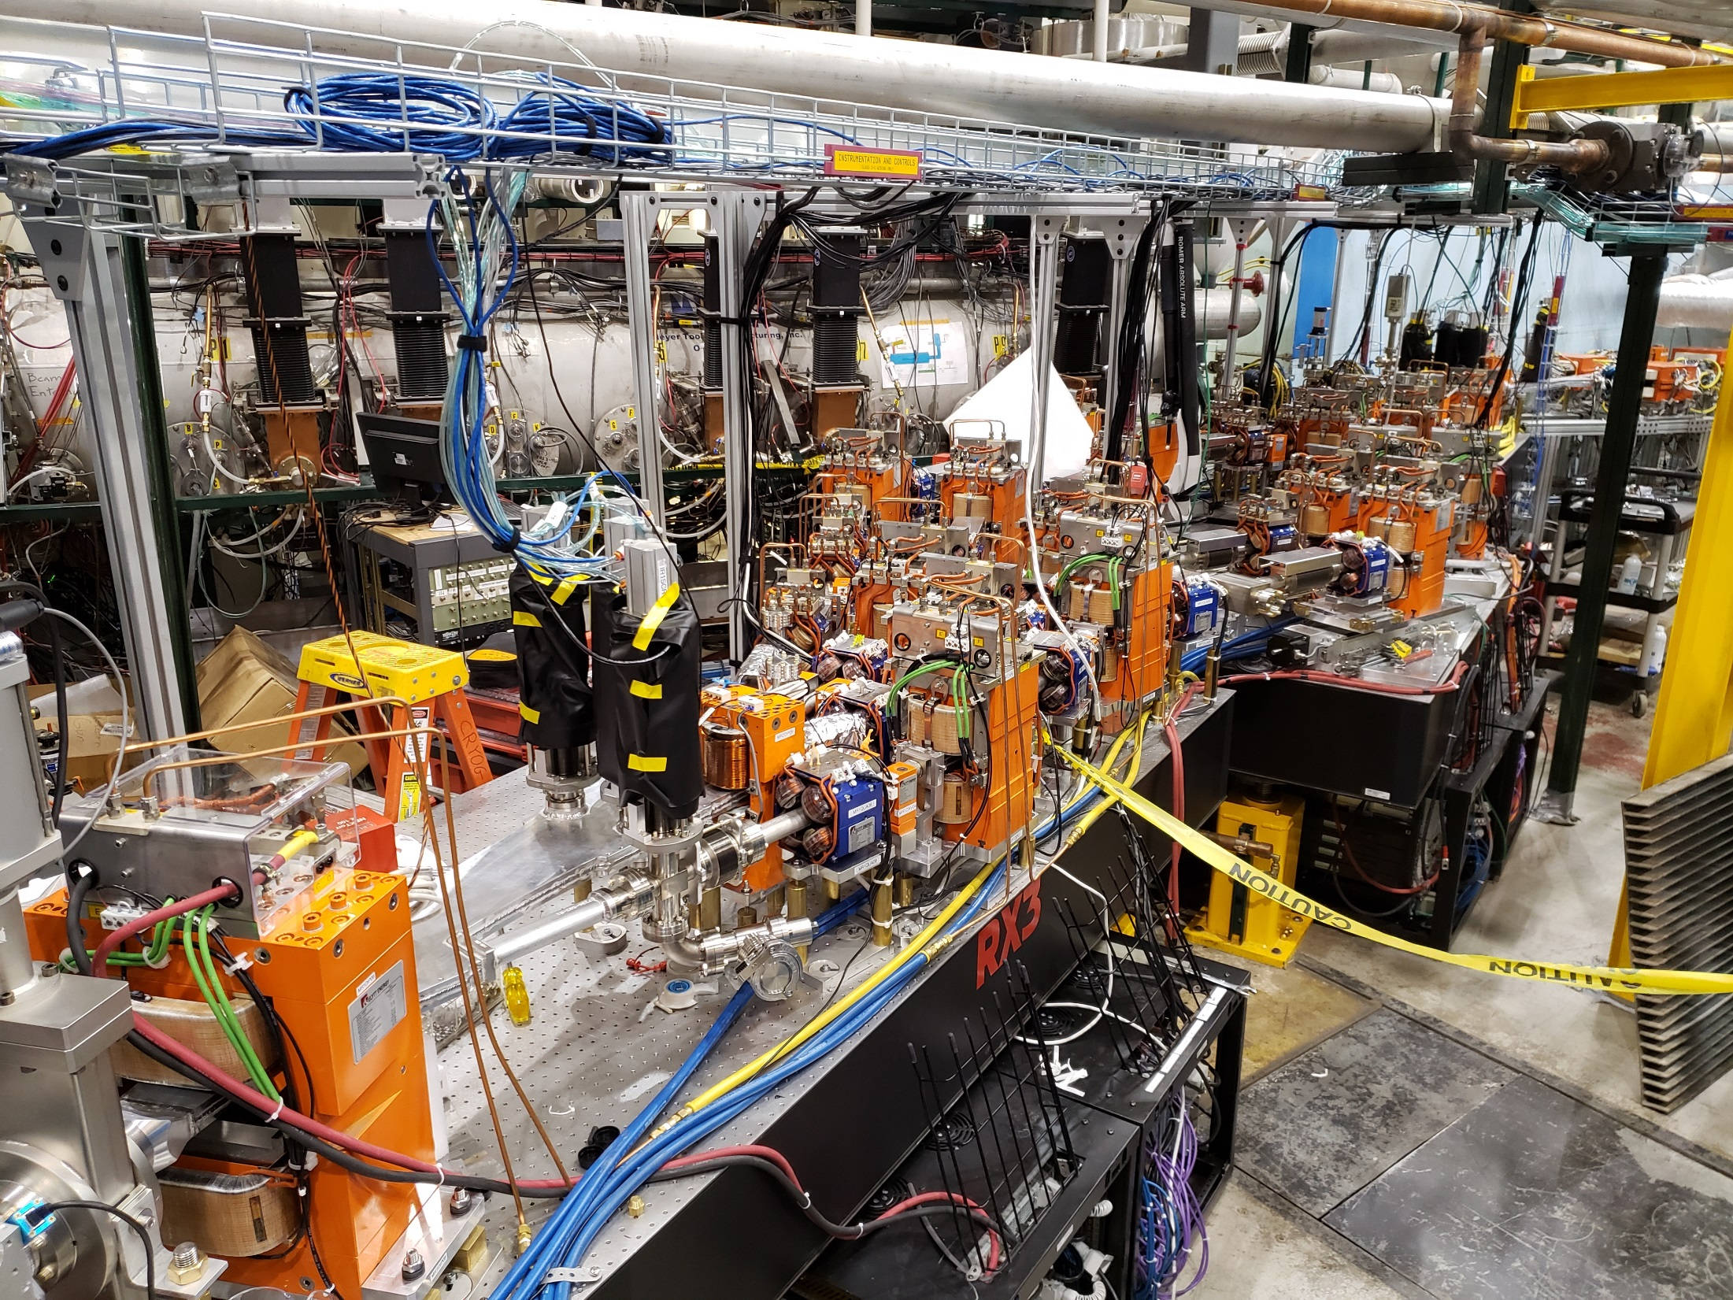
Next: 4-turn operation
CBETA run 2 started mid-October 2019
Other splitter lines have been installed during summer shutdown

Slide 44
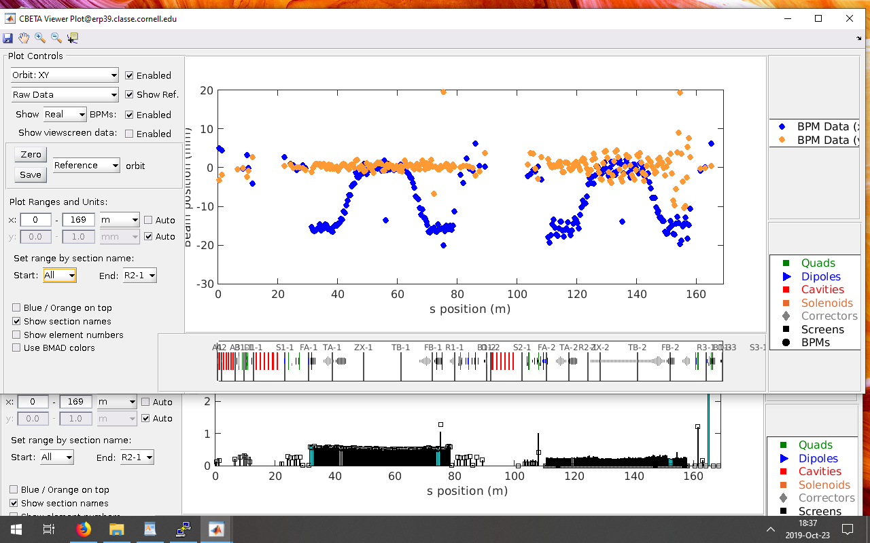
Two Turns Uncorrected
(October 23, 2019)

Slide 45
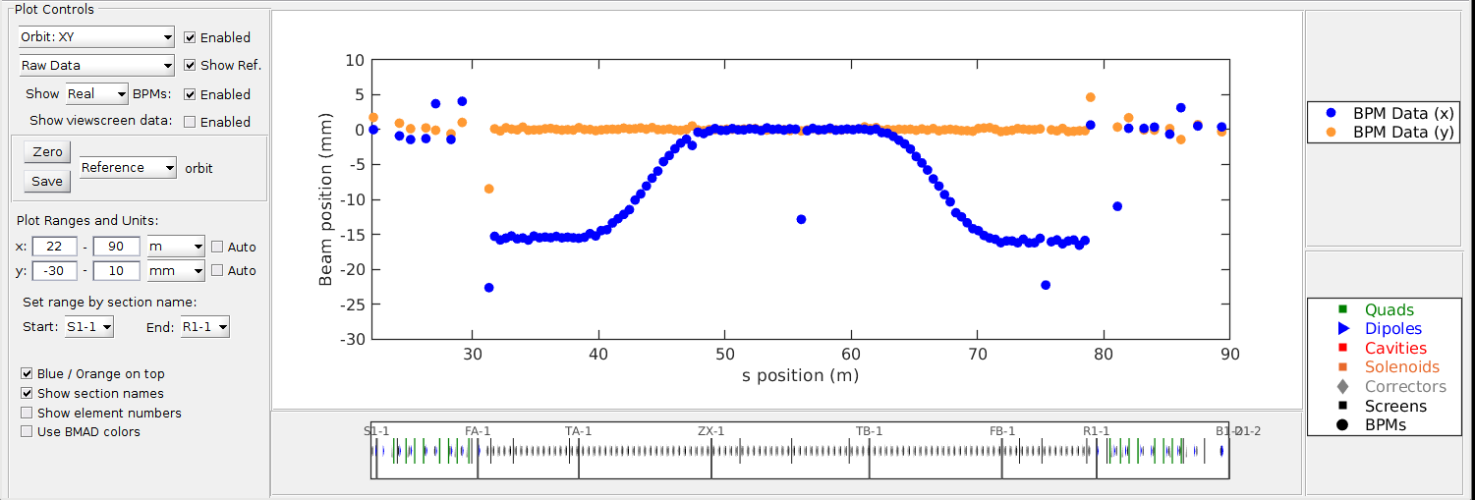
One-turn Whole-FFA SVD Correction
This used an FFA response matrix generated semi-empirically from the phase advances of the first two corrector orbit bumps in each plane
(October 24, 2019)

Slide 46
107x107 real response matrices?
Maybe this takes too long to measure?
Turns out it’s OK if we only do it occasionally
  Kirsten Deitrick did it in 1-2 hours
Why did we want to do this? (once)
  This will show any swapped, disconnected or backwards BPMs as “wrong-looking” rows
  Any swapped, disconnected or backwards correctors as “wrong-looking” columns

Slide 47
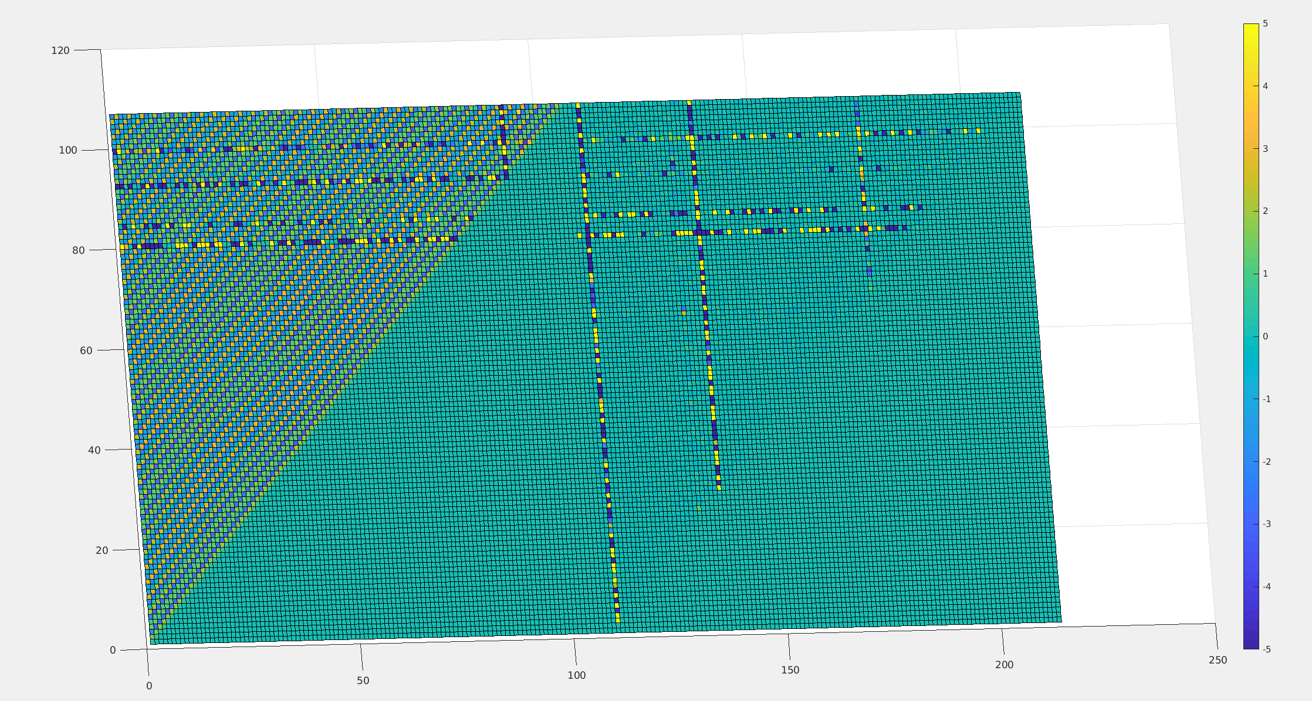
Real Machine Response Matrix
(October 25, 2019)

Slide 48
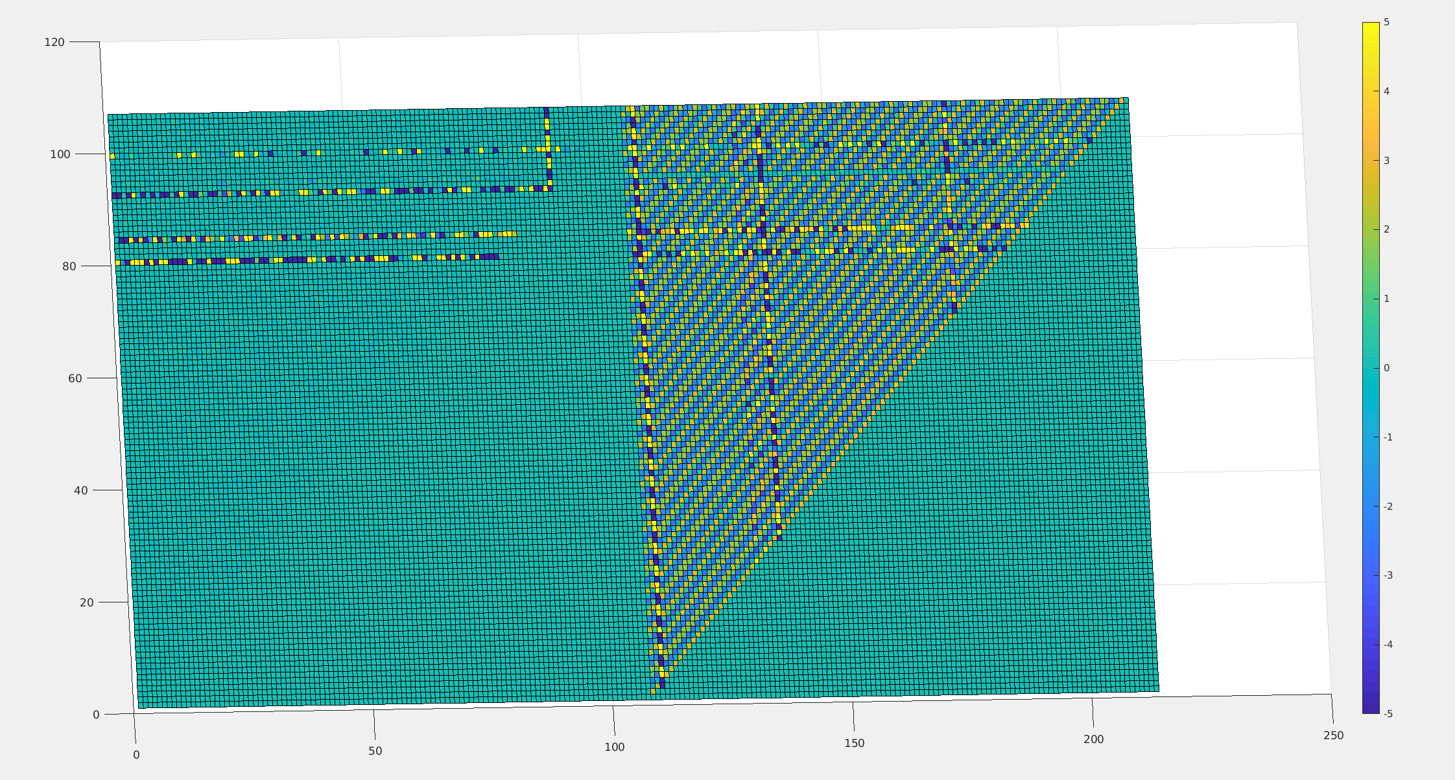
and the Y BPM Plane
(October 25, 2019)

Slide 49
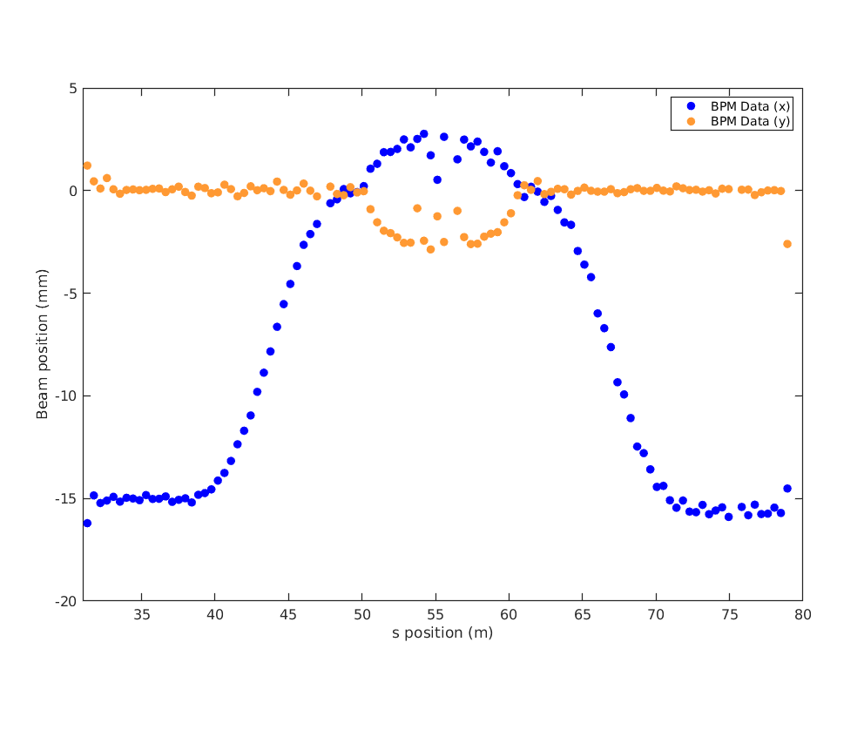
Closed Orbit Bumps (1-turn)
(November 6, 2019)

Slide 50
Multi-turn Response Matrix
FFA BPMs
42MeV 78MeV 114MeV 150MeV
S1
S2
S3
S4
FFA correctors
make_oval
Two S1 corrector bumps should in theory give a set of phase advances through all turns at once, including turn-to-turn advances, plus phase space oval for each turn

Slide 51
Multi-turn Response Matrix with Correction in RX Combiners
FFA BPMs
42MeV 78MeV 114MeV 150MeV
S1
S2
S3
S4
FFA correctors
make_oval
R
R
R
R
R
R
The RX lines are set to steer the beam correctly back into the MLC. Enforced this using SVD with large weights targeting the beam to its previous position in RX.

Slide 52

2-Turn Generated Response Matrix
x → x
Uses constant tunes
y → y
Turn 1 BPMs
Turn 2 BPMs

Slide 53


Two Turns Corrected with SVD
(November 8, 2019)

Slide 54


Eventually got 7-turn ERL operation with turns 1,2,3 SVD corrected

Slide 55


Slide 56



All Four Tunes Compared to Model

Slide 57

Future: CBETA Facility?
Vertical double chicane
ERL experiment
ERL experiment
RLA experiment
User experiments platform
Single-turn mode with reduced CSR and increased current 40+mA, 55MeV
High energy mode with 3 turns in fixed-field arc, 1-10mA, 200MeV

Slide 58


Bypass Design (Kirsten Deitrick)
Single-turn mode with reduced CSR and increased current 40+mA, 55MeV
High energy mode with 3 turns in fixed-field arc, 1-10mA, 200MeV
One possible route is for the bypass to follow above the FFA arcs

Slide 59
CBETA Energy Saving Technologies
Permanent magnets
Superconducting RF
Energy recovery (99.6 ± 0.1% above 6MeV)
Recirculation: 4x beamline reuse, 4x energy
Funded by NYSERDA
  (NY State Energy R&D Authority)
  $25M grant
  Cornell already had the injector & cryomodule

Slide 60
BACKUP

Slide 61


Slide 62


Slide 63


Slide 64

Nick Tsoupas Open Midplane Quad
4-way symmetric prototype being tested on BNL rotating coil in April 2015
60mm length
31.7 T/m gradient (no wire correction, so ~1% field errors)

Slide 65

Open Midplane Geometry Study
-250T/m quadrupole combined with 0.49T dipole 5mm Ø aperture, 2mm Ø good field region
  4mm gap open midplane slot
B_{r} = 1.12T material
Horizontal midplane only
offset quad
Combined function
H-only + combined function
Left-only midplane
Offset quad symmetric
Offset quad non-symmetric
Same aperture, same field, same field quality, improvement only by design modifications

Slide 66

Open Midplane Quality vs. Area
What is the best field quality for a given area of material?
1 unit = 10⁻⁴ of main field
20x better field quality, and/or less material used

Slide 67

PM Hadron Therapy Gantry
Trbojevic design: a fixed-field gantry transports protons over the wide energy range 65-250MeV to the patient
  Faster depth (energy) scanning because no magnet ramp
  Lighter-weight and less power used than electromagnets
Requires a horizontal beam excursion
  Magnified trajectories shown on right
Higher fields give a smaller rotating gantry
  Want highest possible field gradient magnets!
Dejan Trbojevic et al., Proc. IPAC2017
This conference TUPAB030

Slide 68


Oval Aperture Comparison
155T/m quadrupole
27.6mm horizontal aperture
B_{r} = 1.4T material
<10⁻⁴ field midplane accuracy
Left: circular aperture
170.9cm² of material
Right: oval aperture
10mm vertical height
24.0cm² of material
Sevenfold reduction in material use by only having aperture in the axis where it is needed
Therapy gantry QF magnet
Same scale!
cm grid

Slide 69

Oval Aperture Area vs. Strength
Or 35% more gradient
7x less area

Slide 70

Oval Aperture Combined-Function
1.8 T dipole
-97 T/m gradient
2.527 T max field in good field region(!)
25.0mm horizontal aperture
B_{r} = 1.4T material
<2×10⁻⁴ field midplane accuracy
High fields put material into regime with high opposing flux (negative H field). This means demagnetisation is more likely, depending on grade, especially in presence of radiation. Future R&D will build and test such magnets.

Slide 71

Multiple Aperture Designs
Design produces a different combined function field in each aperture
3cm aperture separation
R10mm circular apertures
±6mm open midplane
0.2190 T +49.515 T/m left
0.1382 T -49.515 T/m right
Good field radii
4.5mm left, 6.4mm right
Units (10⁻⁴) field error
4.7 left, 18.0 right

Slide 72



Comparison to Separate Magnets
Just BD (left)
Just BF (right)
Two-hole
11.3cm²
15.4cm²
15.2cm²
Total = 26.6cm²
28.9cm² if you try to combine them in the “backwards” way →

Slide 73
Multiple Aperture Uses
Cost savings
  Some PM material volume savings
  Build as a single component
    Only one vacuum chamber, girder etc.
Operational flexibility
  Modern colliders require rings for many functions
    Acceleration, accumulation, cooling, collision
  Building multiple tracks cheaply allows one beam to be cooled while another is collided for example

Slide 74
Energy Recovery
Increased beam current to calculate transmission using RF load due to beam on MLC cavities
  Total RF load = RF load for cavity field + RF load due to beam (rough approximation)
  As beam current changes, the load deviation is due to the changing RF load due to beam
First, demonstrate measurable load deviation in the MLC up to 1 μA without recirculated beam (non-ER mode)
In perfect energy recovery mode, two conditions are satisfied:
  There is no load deviation at any beam current
  The linear fit of load deviation as a function of beam current is zero
To measure energy recovery transmission, determine linear fit of load deviation as a function of current for each MLC cavity
  The closer each linear fit slope is to zero, the better the energy recovery
K. Deitrick - kd324@cornell.edu
NAPAC 2019 - Status of the CBETA Prototype

Slide 75

Dispersion, R₅₆ correction
Beam entering the dump line is steady, free of RF energy jitter (July 13, 2019)

Slide 76

Skew Mystery in {R1,linac,S2}
(November 4, 2019)
Horizontal beam scan early in R1 propagating as diagonal/vertical in S2, evidence of large skew quad

Slide 77




Degaussing Test of Iron Magnets
(November 5, 2019)
Tested beam screen position differences from previous dipole set from + and – directions.
Blue = without degaussing
Orange = with degaussing (various settings)

Slide 78
Closed Orbit Bumps
(November 6, 2019)

