Slide 1
Permanent Magnets for a Fixed Tune Proton Therapy FFA

Slide 2
Introduction
Recent studies by Dejan Trbojevic have confirmed that non-scaling FFAs can have their tune dependence on momentum flattened by adding non-linear components to the magnet fields, although not necessarily for an unlimited momentum range.
Quadrupole affects tune level, sextupole affects dQ/dp, octupole affects d²Q/dp², etc.

Slide 3
Application
Dejan Trbojevic proposes to accelerate protons in 10-250MeV range with a rapid cycle (100Hz-1kHz) for FLASH hadron therapy
  Many machine cycles within 100ms allow different energy (depth) slices to be done as well as being quick enough to trigger the biological FLASH effect
Need an FFA ring which also has fixed tunes
  But needs to fit in the hospital, so smaller than a scaling FFA → nonlinear fixed-tune NS-FFA

Slide 4
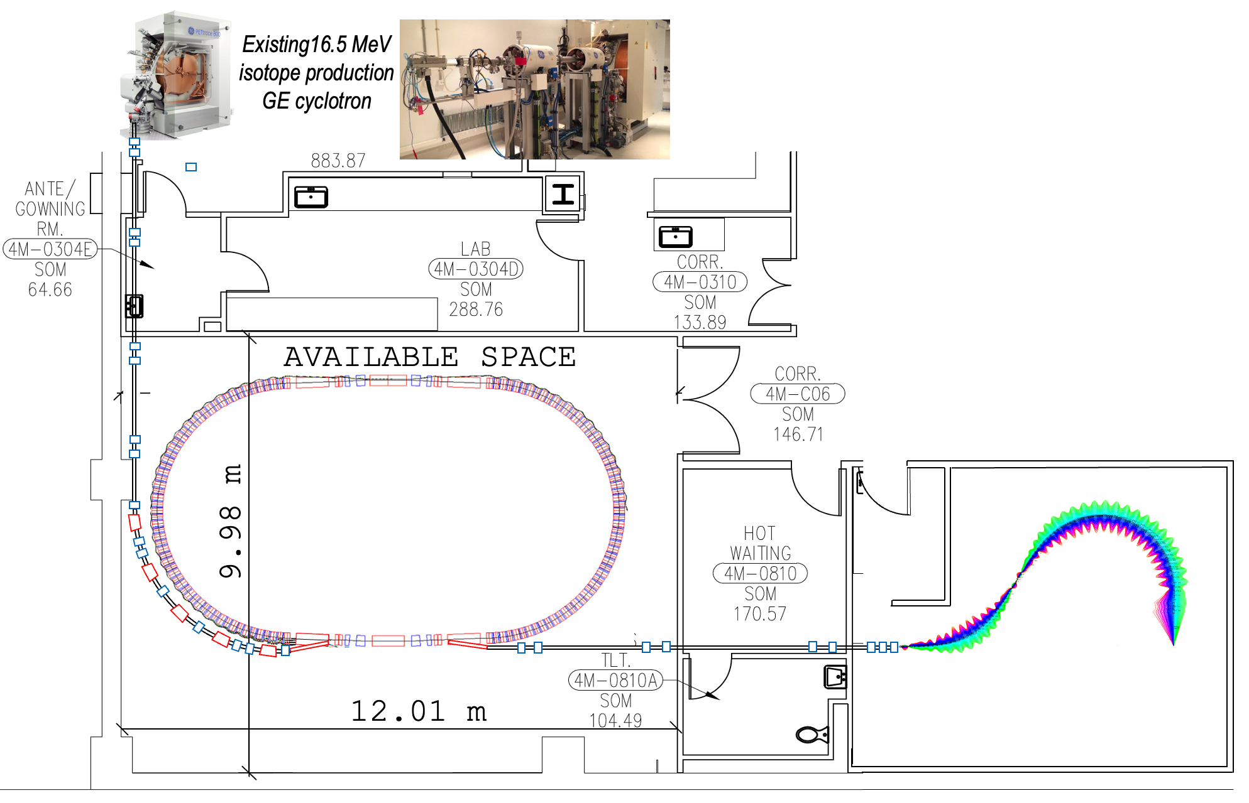
‘FLASH’ Proton Therapy facility:
Stony Brook University Hospital – Radiation Oncology
6. D. Trbojevic, Title: “Non-scaling fixed field alternating gradient permanent magnet cancer therapy accelerator”, patent number: US 9661737 B2, Date of the patent: May 23, 2017 (belongs to the DOE). https://patentimages.storage.googleapis.com/42/5e/92/f7da1cf617d6e3/US9661737.pdf

Slide 5
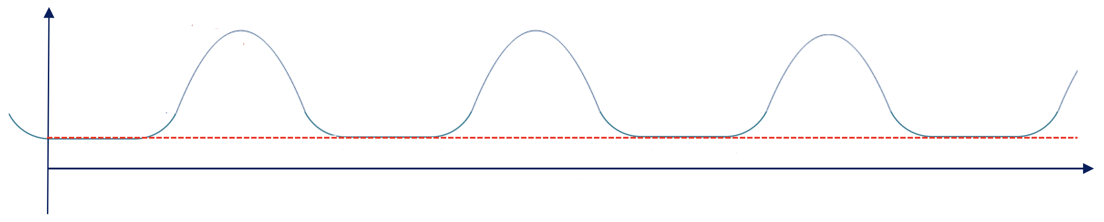
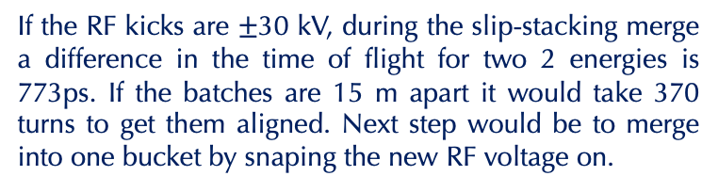
Fast Cycling Synchrotron Cycles
Kinetic
Energy
(MeV)
Extraction #2
250
Ex.1
Ex.2
RF manipulation
Ex.3
16.5-30
Injection
Energy
Second synchrotron cycle
t(ms)
Injection
Porch
One synchrotron cycle
Extraction kicker wave forms
0.8ms < τ < 1.85ms
1.3kHz< f < 540 Hz
If the RF kicks are $±$30 kV, during the slip-stacking merge a difference in the time of flight for two 2 energies is 773ps. If the batches are 15 m apart it would take 370 turns to get them aligned. Next step would be to merge into one bucket by snaping the new RF voltage on.
Time of bunch flight 405-550 ns
At the injection porch time of 926 μs there are 1680 turns. 15 turns for 15 Cyclotron bunches and 1650 turns for RF manipulations

Slide 6
Fast Cycling Acceleration with Ferrite cavities
By Stephen Brooks
 | Choices for injector cyclotron |  |  |  | Units
 | ACSI | GE | TR-19 | IBA
Energy of Injector Cyclotron | 14 | 16.5 | 19 | 30 | MeV
Cyclotron current | 400 | 200 | 400 | 1200 | μA
Treatment charge | 60 | 60 | 60 | 60 | nC
Injection turns | 4 | 4 | 4 | 2 | #
RF acceleration per turn | 29.70 | 29.70 | 29.70 | 44.55 | kV
Calculation | Treatments Options
Turn duration | 585.74 | 540.6 | 504.8 | 405.1 | ns
Charge per turn | 0.234 | 0.108 | 0.151 | 0.486 | nC
Charge per injection | 0.937 | 0.432 | 0.606 | 0.972 | nC
Machine cycles | 65 | 139 | 100 | 62 | #
Machine cycle rate | 540 | 540 | 540 | 809.95 | Hz
Outputs
Treatment time | 120 | 257 | 185 | 76.54 | ms

Slide 7
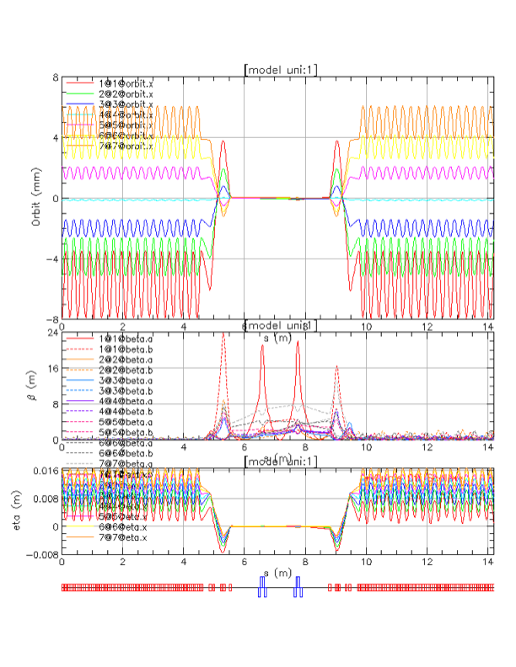
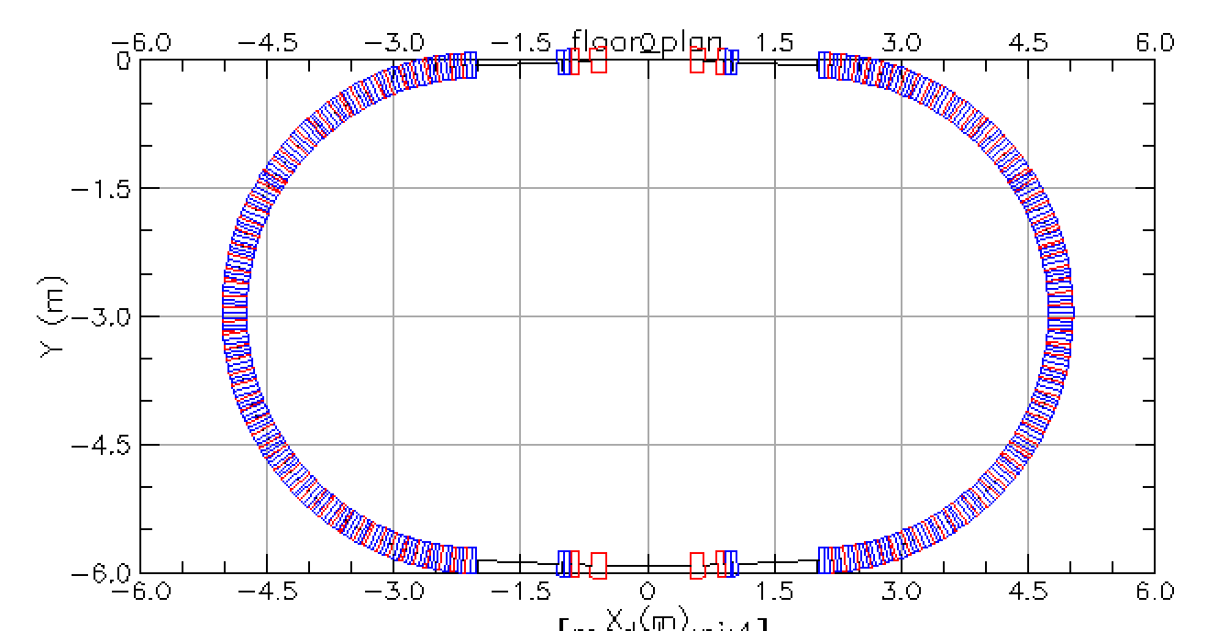
Matching of the Multiple Energy Orbits to the Straight Section
5.8 m

Slide 8
Lattice Converted from BMAD
Three cells for field wrap
Multipoles dipole…dodeca
These slides look a lot like last year’s, but Dejan’s multipole numbers have changed!
Angle 5.625° per cell, 64 cells per turn. Cell length 34.4cm, R=3.5m.
This worked well in BMAD, fixed stable tunes from 10MeV – 250MeV

Slide 9
BMAD and Muon1 Magnet Models
BMAD has a zero-length end field model
Muon1 has a Maxwellian fringe field model with finite length (bit more realistic)
  But you have to choose the length yourself!
  Only way to do this sort of field in BMAD is to generate fieldmaps, so there’s a difference
We also changed from sectors to rectangles but that turned out to be a small effect

Slide 10
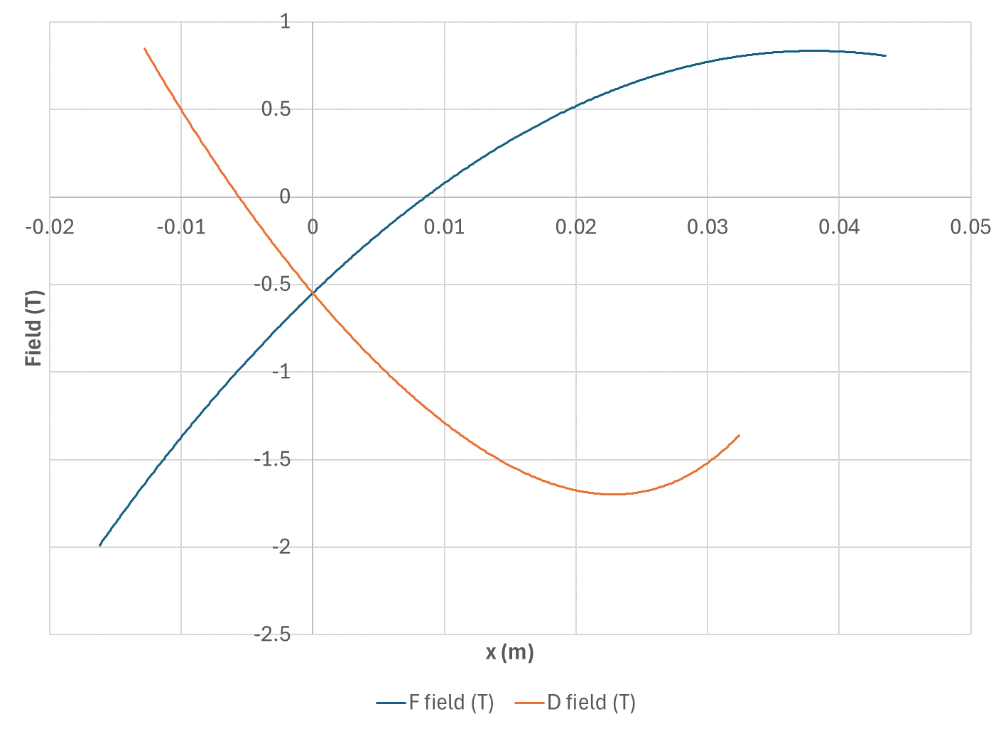
Field Profiles (BMAD)

Slide 11
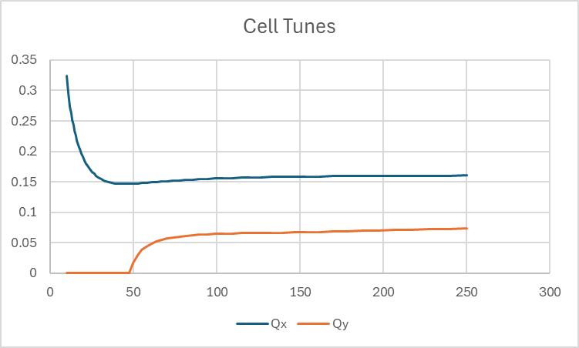
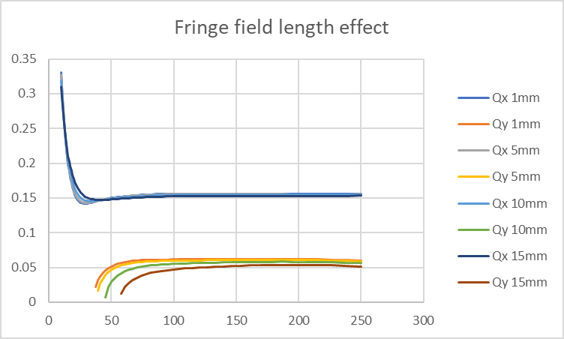
BMAD Lattice in Muon1
Vertical tune is unstable at low energies
  On previous lattice version, this was true no matter what Muon1 fringe field length I chose
Cell tune
MeV

Slide 12
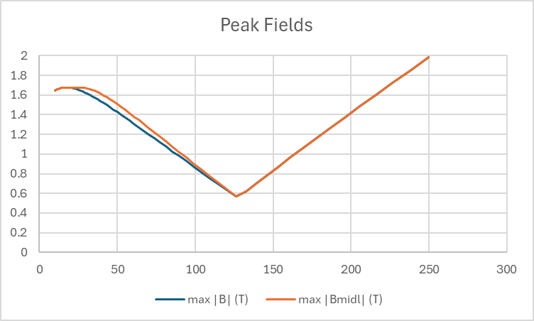
Peak Fields on Orbit (vs. Energy)
D
T
Interesting issue with D magnet: field on orbit never reaches its “infinite-length magnet” asymptotic value, so plot both
MeV

Slide 13
This cell can be “easily” fixed using the Algorithm I used before
Runge-Kutta 4th order tracking step
Loop to get trajectory in cell
Finite difference to get transfer matrix
  Also gives tunes if orbit is closed
Iterate (Newton) to find closed orbit
Loop over all FFA energies
Finite difference parameters to get response matrix of tune functions to multipole changes
Iterate (optimiser) to find fixed-tune lattice
Muon1
Muon1 cell optics mode
Muon1 FFA optics mode
Fixed-tune FFA optimiser
(parallel)
Fourier coefficient

Slide 14
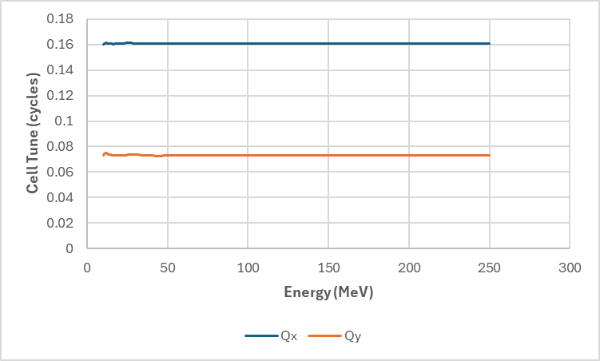
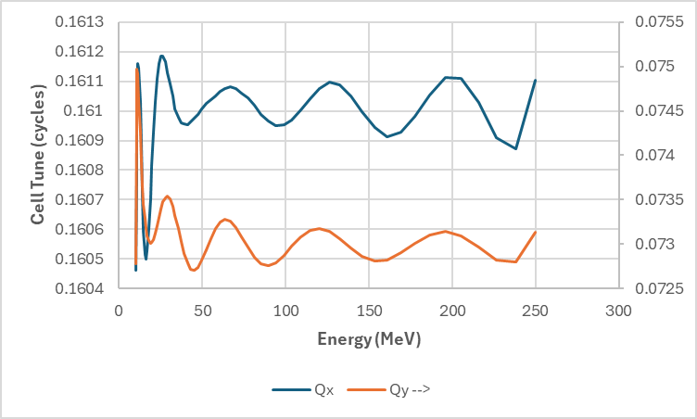
Tunes After Correction in Muon1
Tunes stable from 10MeV – 250MeV and somewhat constant.
(Wiggly near low energy end because rigidity changes fast there).
Cell tune ranges:
Qx = 0.1608 ± 0.0004
Qy = 0.0738 ± 0.0011
Last year’s values:
Qx = 0.1547 ± 0.0013
Qy = 0.0571 ± 0.0034
Made the vertical tune higher for better stability.

Slide 15
Wait, Fourier coefficients?
Representing the transverse midplane field dependence B_{y}(x,0) as a Fourier series made optimisation work better than multipoles
  Suspect this is because sin,cos(nx) are orthogonal whereas polynomials are highly correlated
Used the form
B_{y}(x,0) = c₀ + Σ_{n=1..8} s_{n}sin(nkx) + c_{n}cos(nkx)
…where 2π/k is about twice the orbit excursion

Slide 16
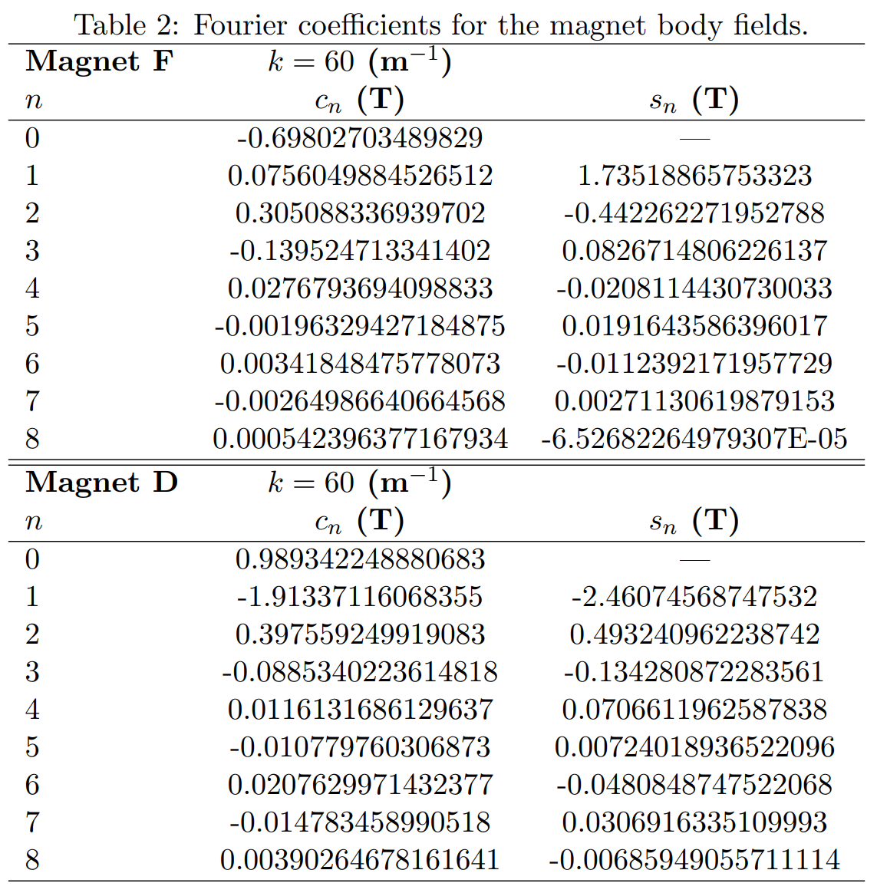

Slide 17
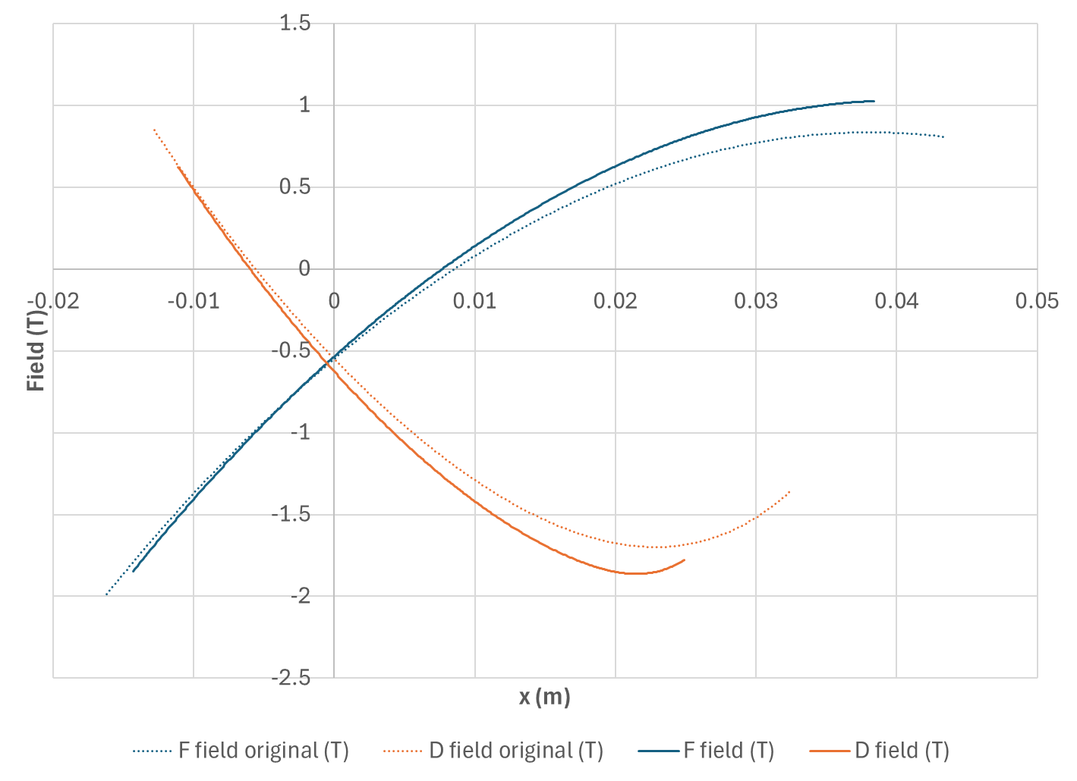
Field Profiles After Correction
Maximum fields equalised at 1.86T rather than 1.99T

Slide 18
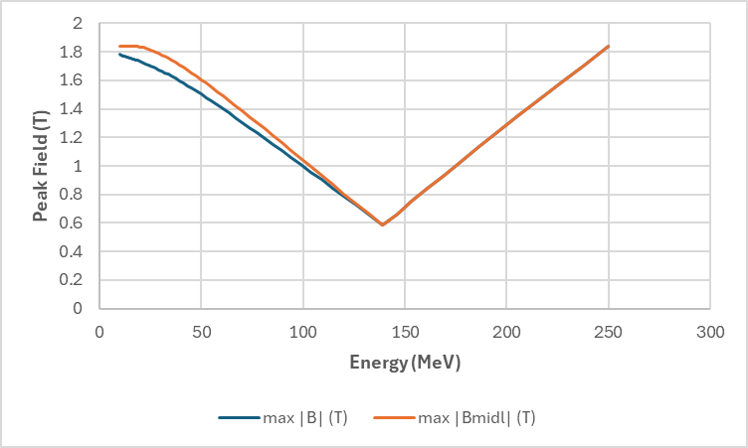
Peak Fields After Correction
D
Orange line is field at magnet longitudinal centre, which is different than at exit (orbit in fringe area) for D magnet.

Slide 19
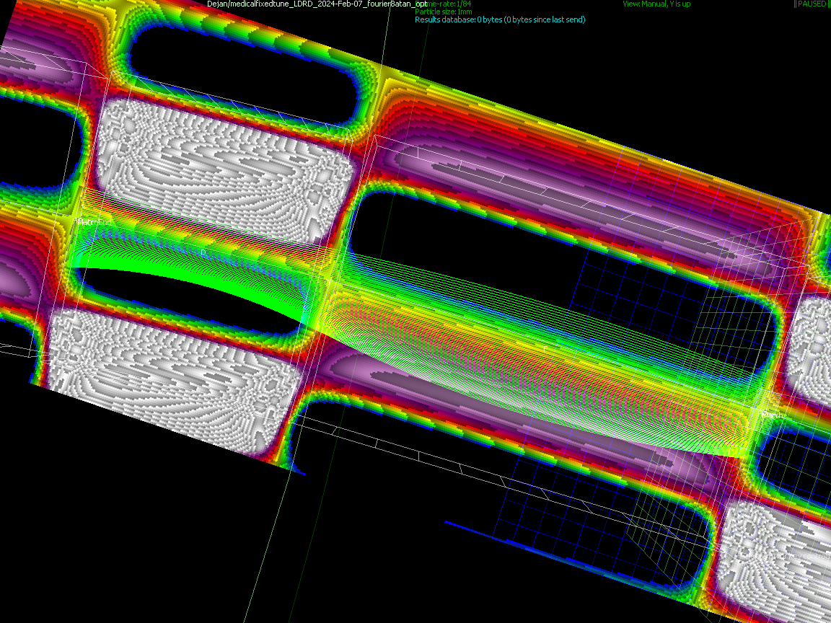
Orbits and Fields in Muon1

Slide 20
Permanent Magnet Designs (F)
NdFeB material
N42EH grade
B_{r}=1.3T
69.90cm² area
64.7 x 12mm aperture
Good field X±26.3mm
1.85T max field
Last year:
107.28cm² area
64.4 x 16mm aperture
Good field X±26.2mm
1.88T max field
cm grid

Slide 21
Permanent Magnet Designs (D)
NdFeB material
N42EH grade
B_{r}=1.3T
93.88cm² area
48.1 x 12mm aperture
Good field X±18.0mm
1.86T max field
Last year:
119.39cm² area
51.8 x 16mm aperture
Good field X±19.9mm
1.85T max field
cm grid

Slide 22
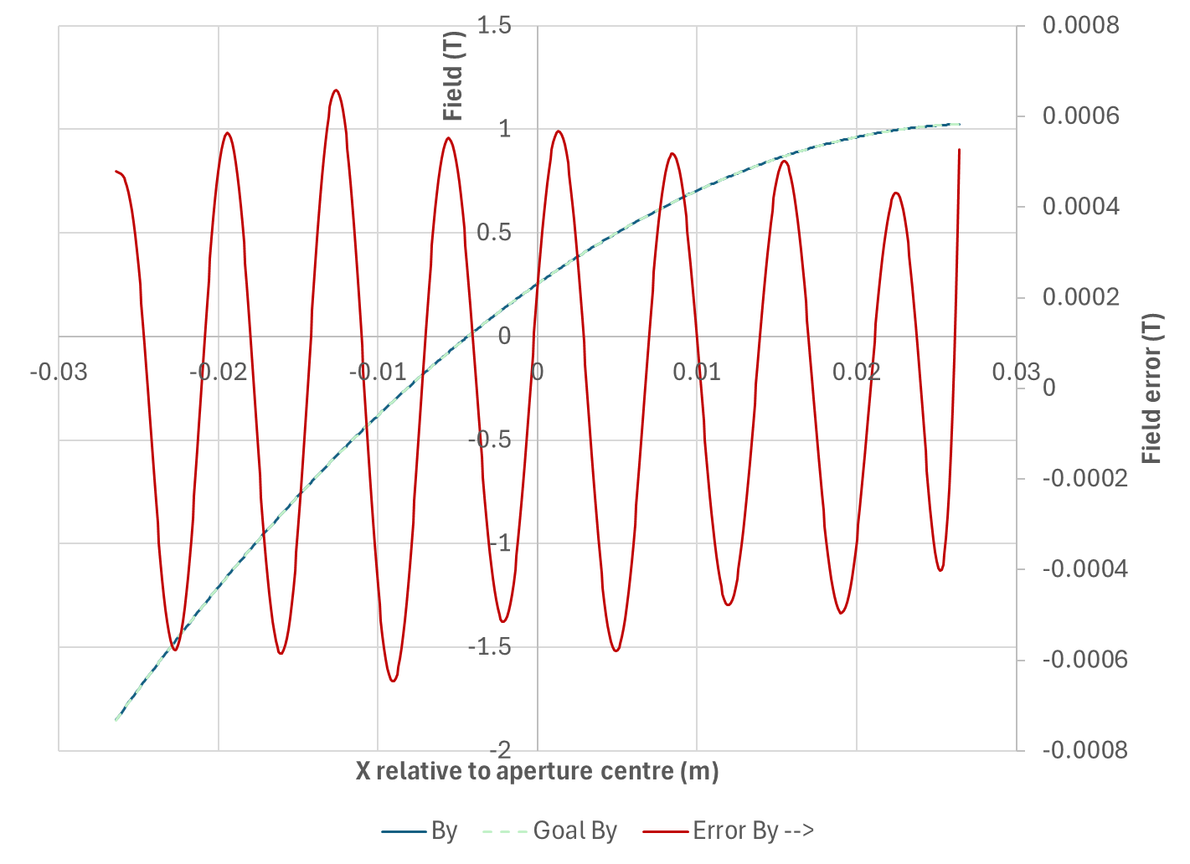
Magnet Sim. Field Error Graph (F)
3.6×10⁻⁴ relative error

Slide 23
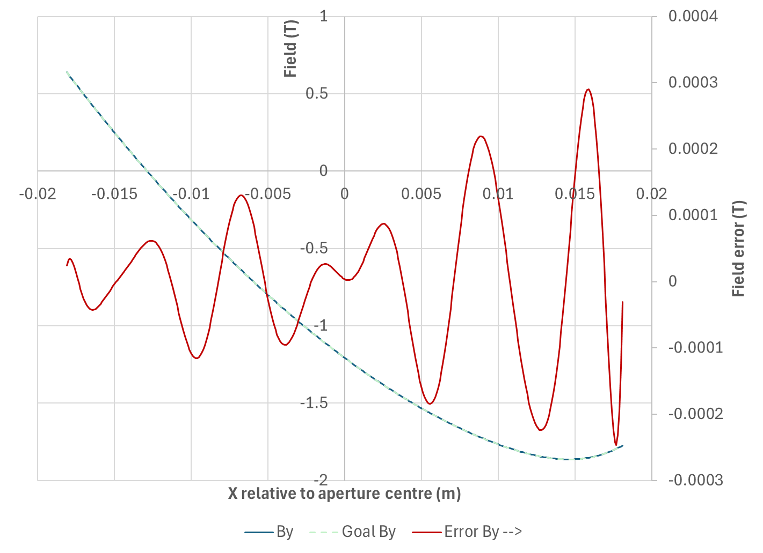
Magnet Sim. Field Error Graph (D)
1.6×10⁻⁴ relative error

Slide 24
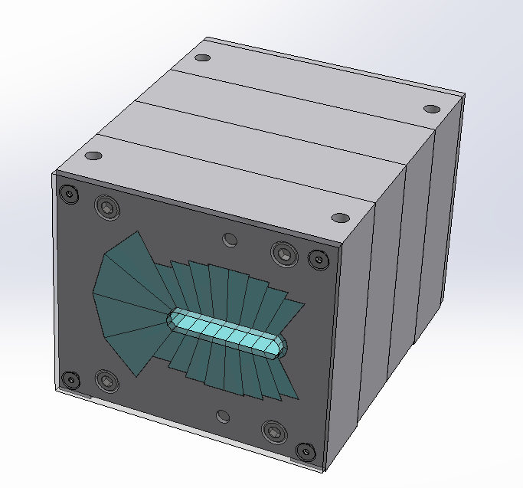
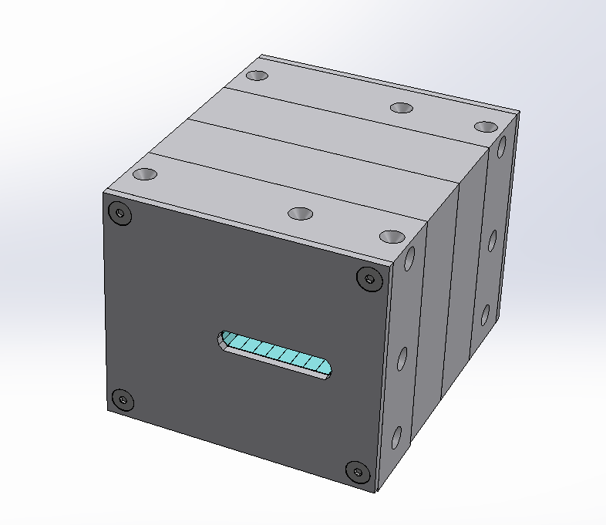
Magnets Ordered from
SABR Enterprises, LLC.

Slide 25
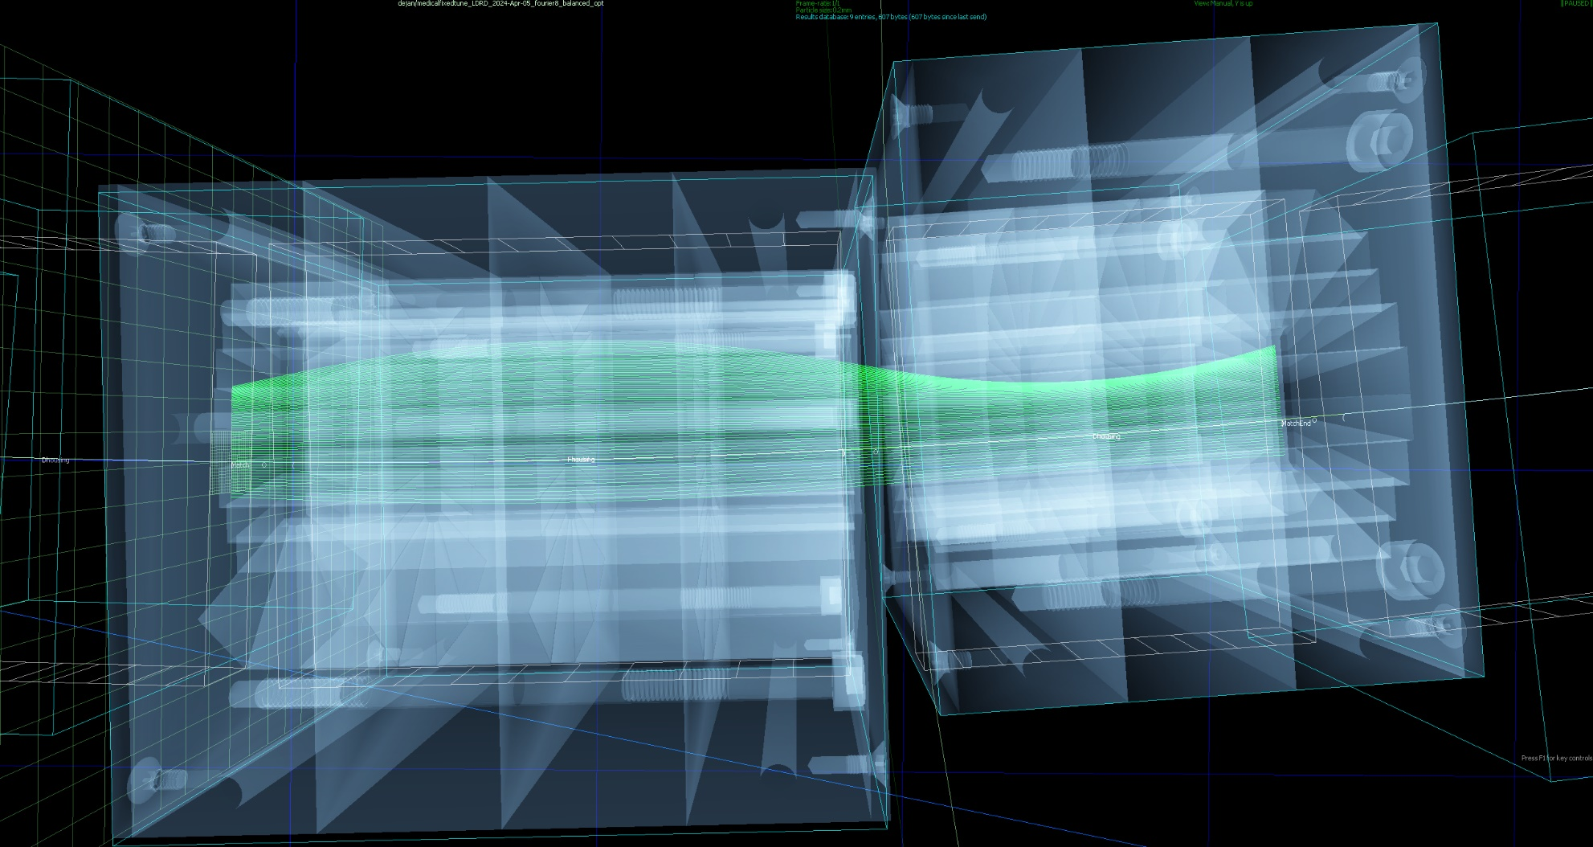
Orbits within Magnets

Slide 26
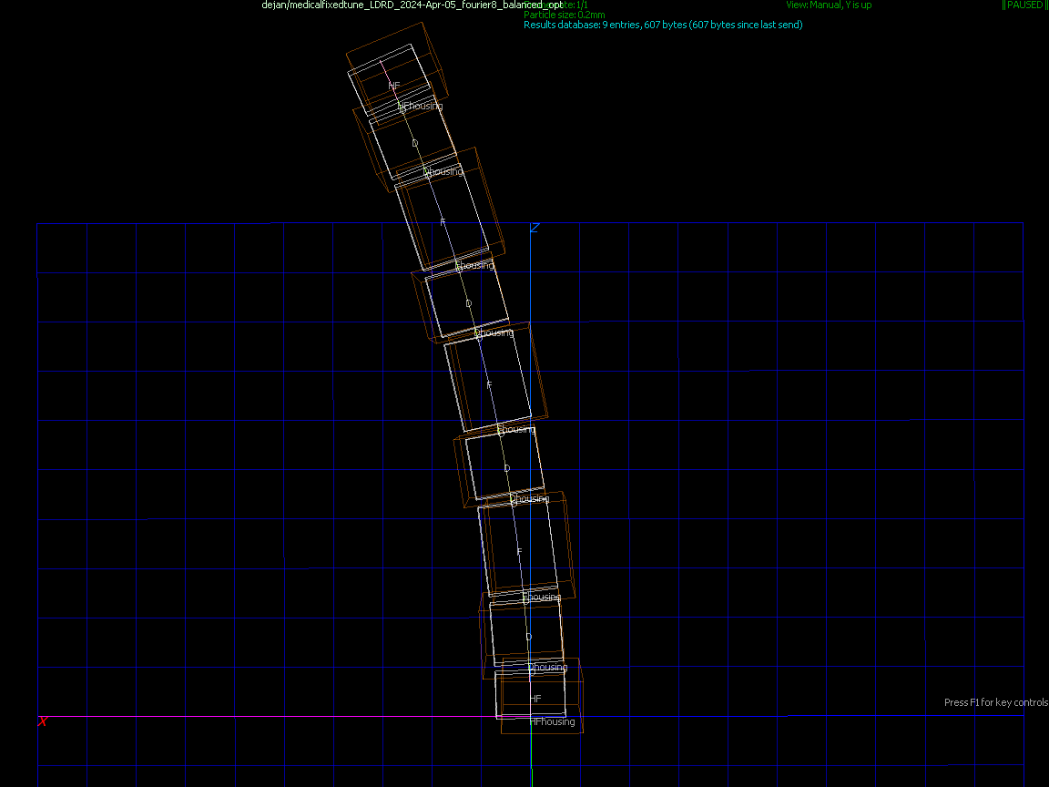
Test Beamline, 4 cells
Will be tested on NSRL proton beamline at BNL next year
Half-F magnets on each end
Angle 5.625° per cell,
4 cells = 22.5°
(1/8 of an 180° arc)
Cell length 34.4cm,
4 cells = 1.374m

Slide 27
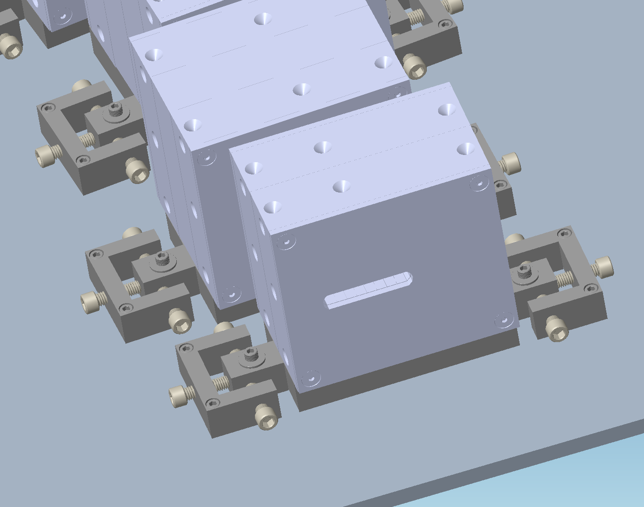
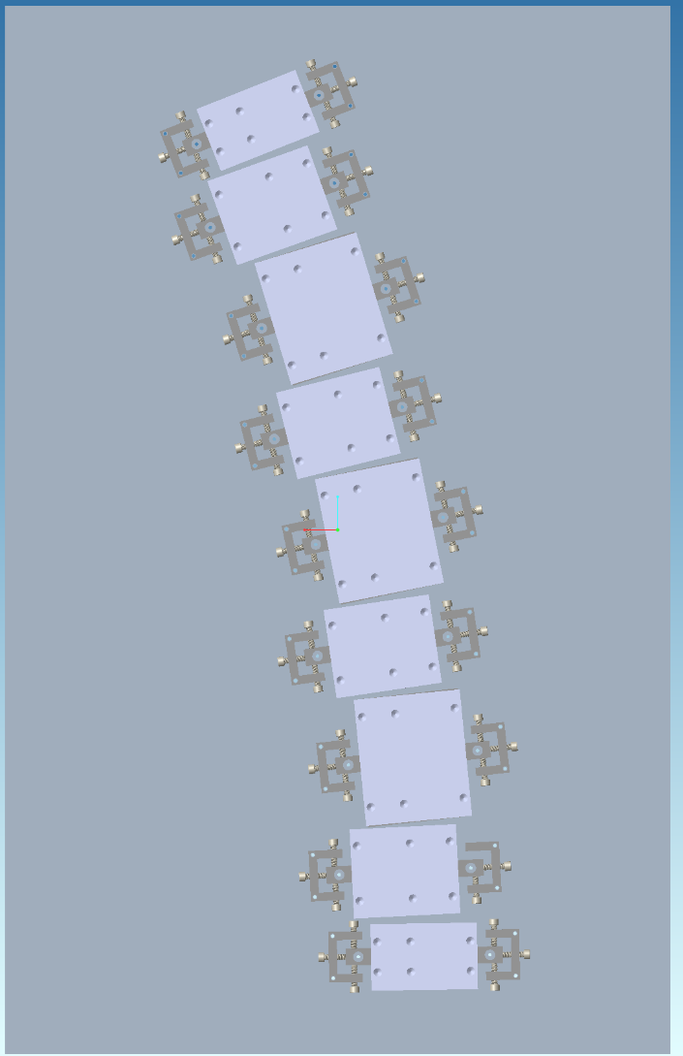
Test Beamline and Mounting

Slide 28
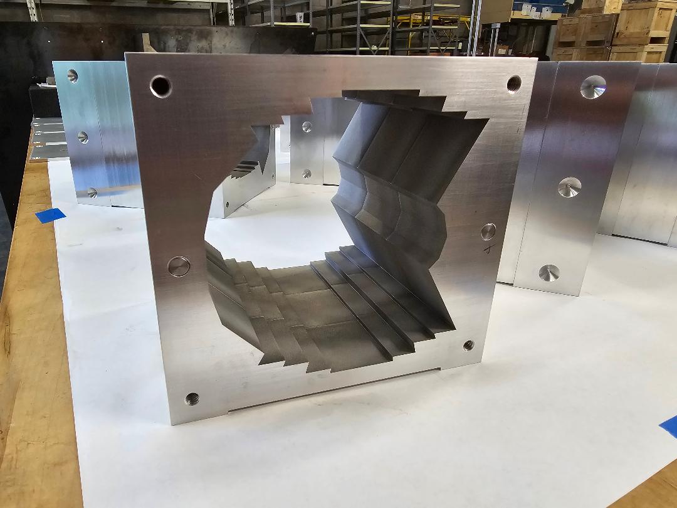
Magnet Holders Machined

Slide 29
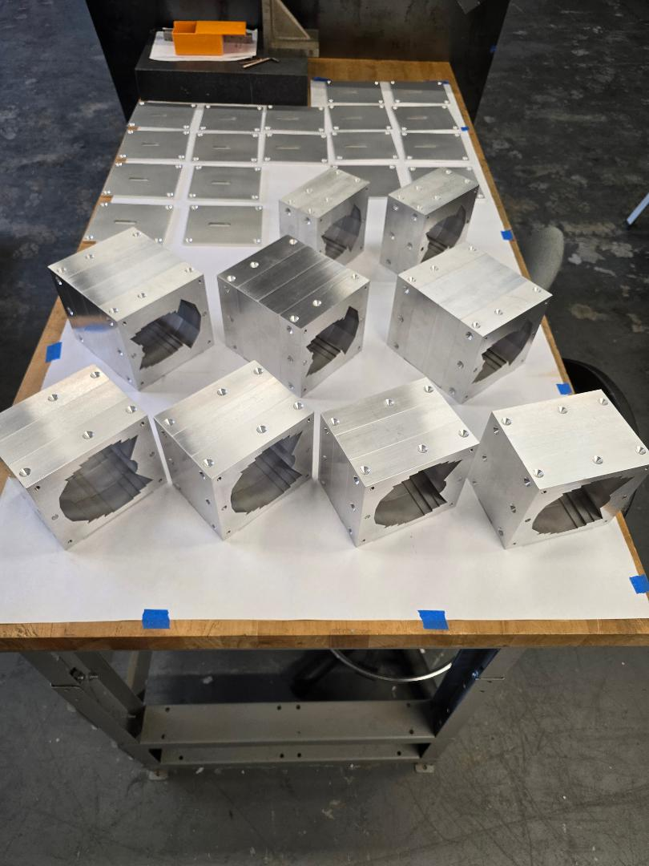
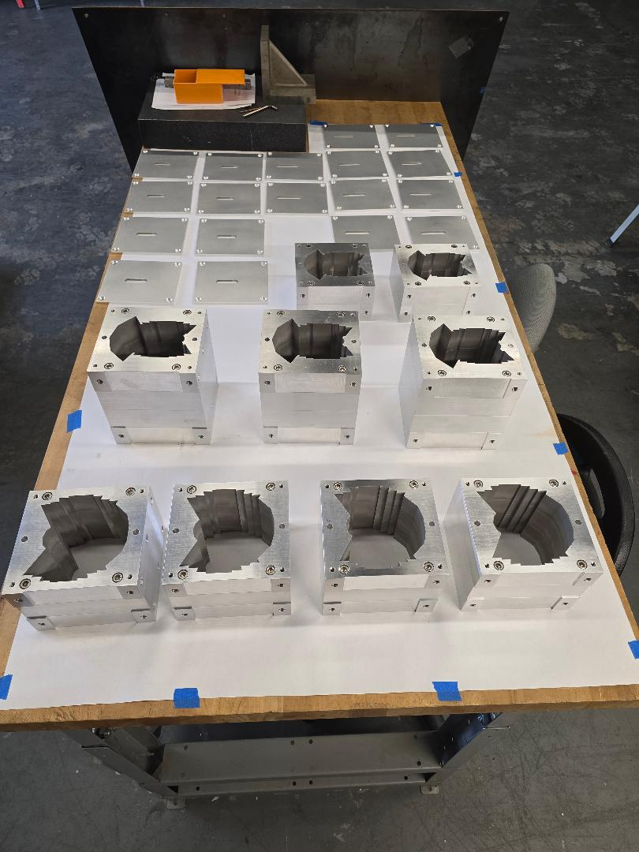
Magnet Holders Machined

Slide 30
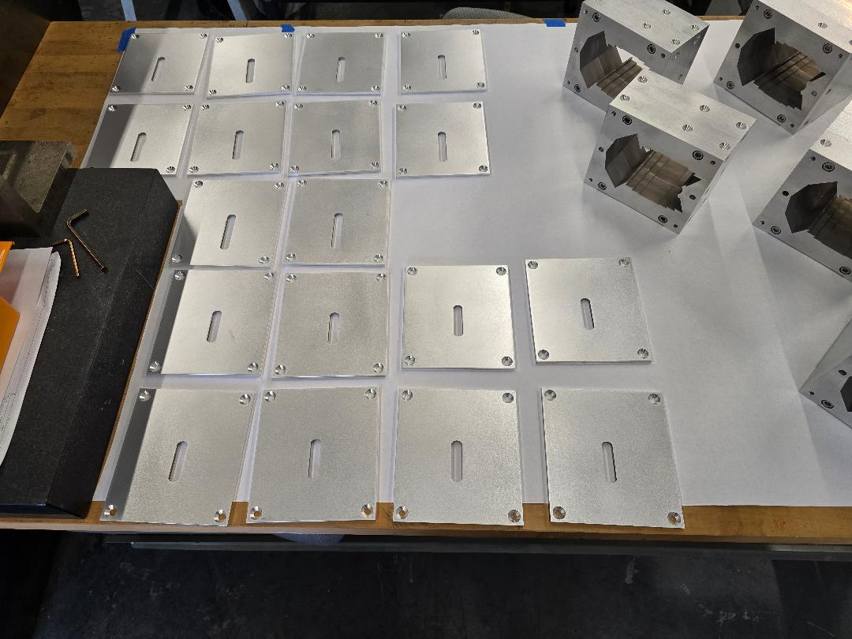
End Plates Machined

Slide 31
Conclusion
It looks like permanent magnets with small apertures and >1.8T fields can be used as a driver for FLASH proton therapy
  No open midplane needed for protons
  Higher field gives more compact machine
Main challenge is actually RF that sweeps frequency at ~500Hz
  Have had some initial discussions with RAL
  May be similar to 2RF or PAMELA RF study

