Slide 1
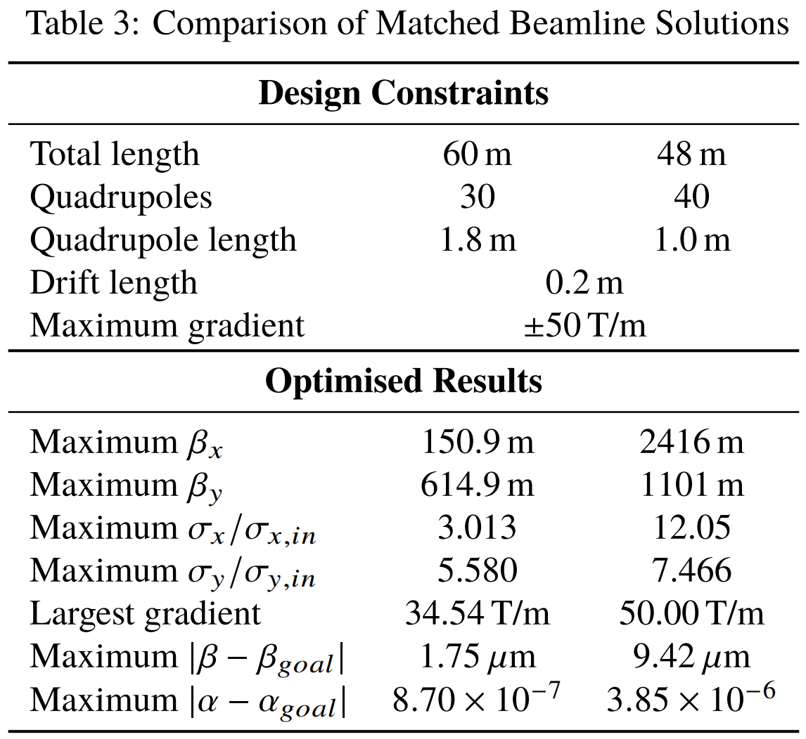
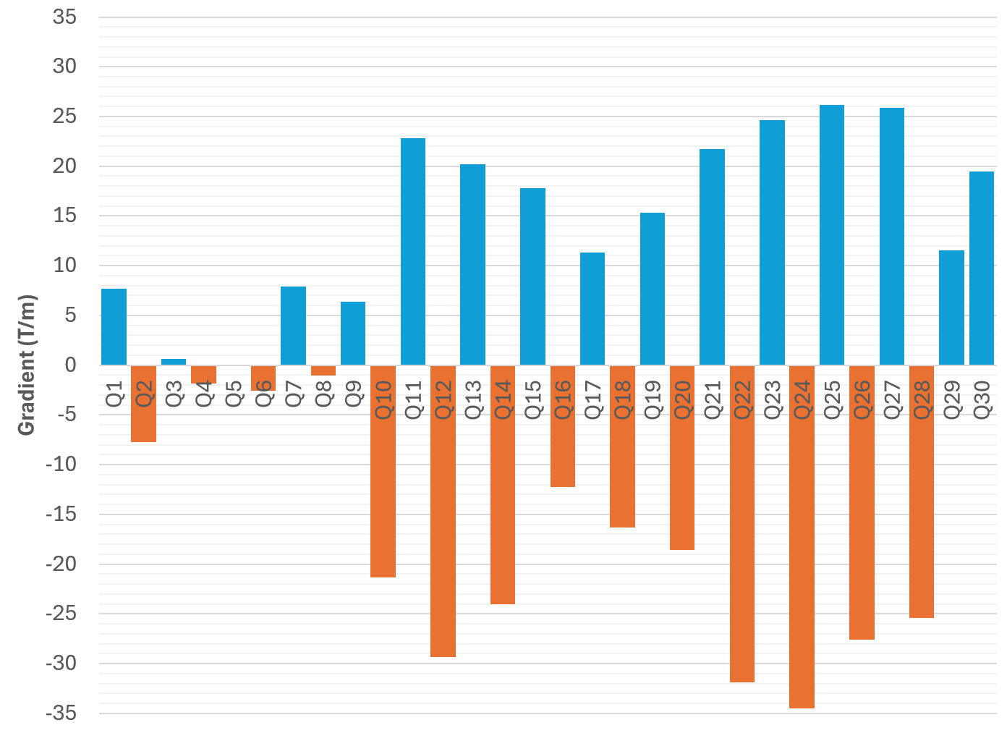
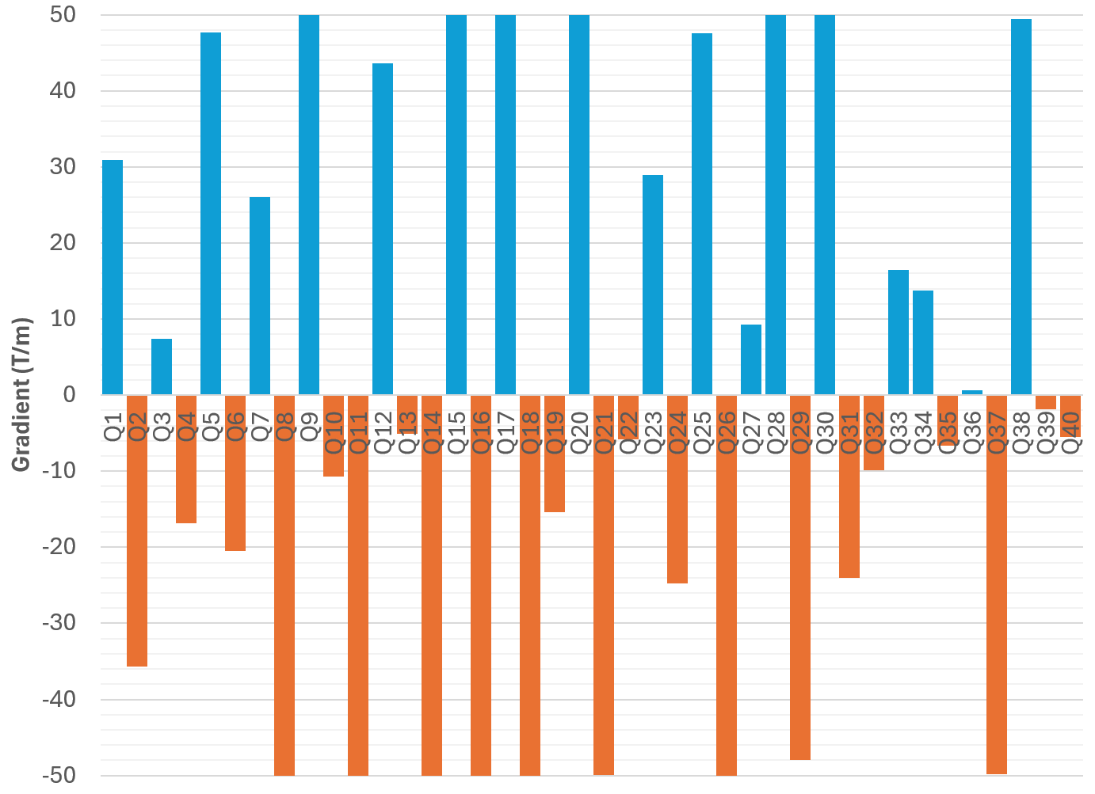
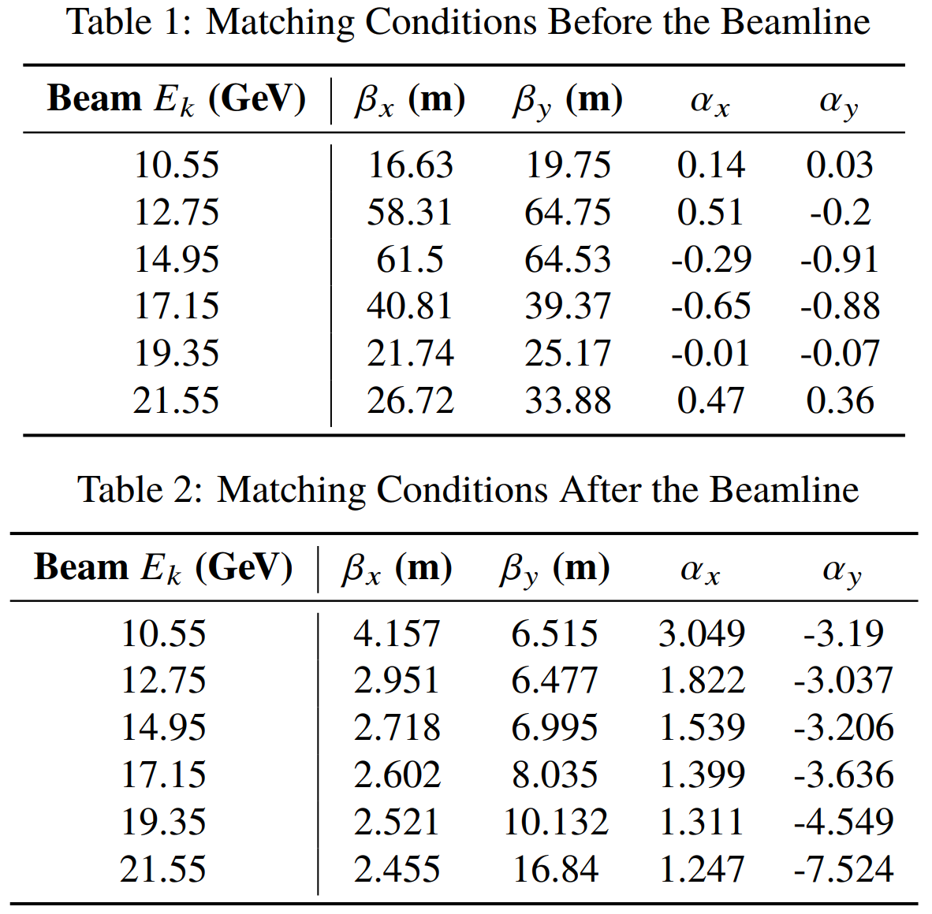
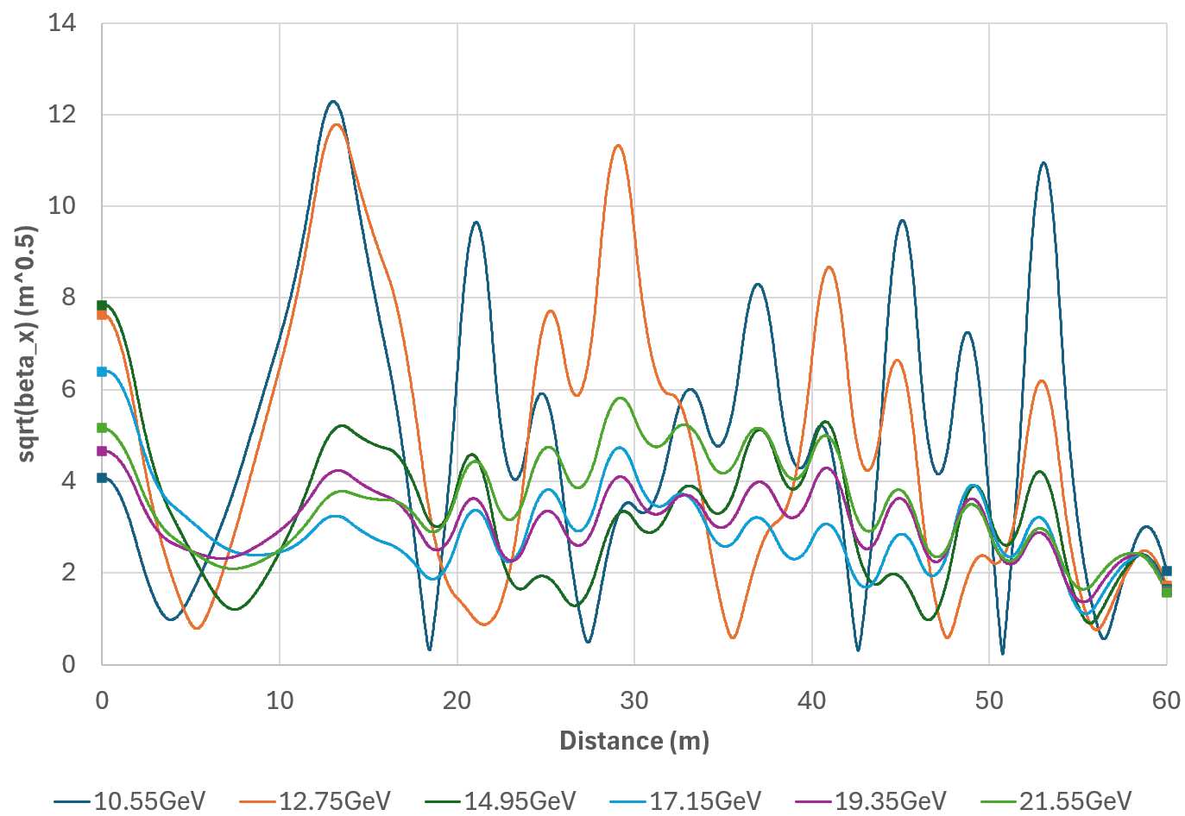
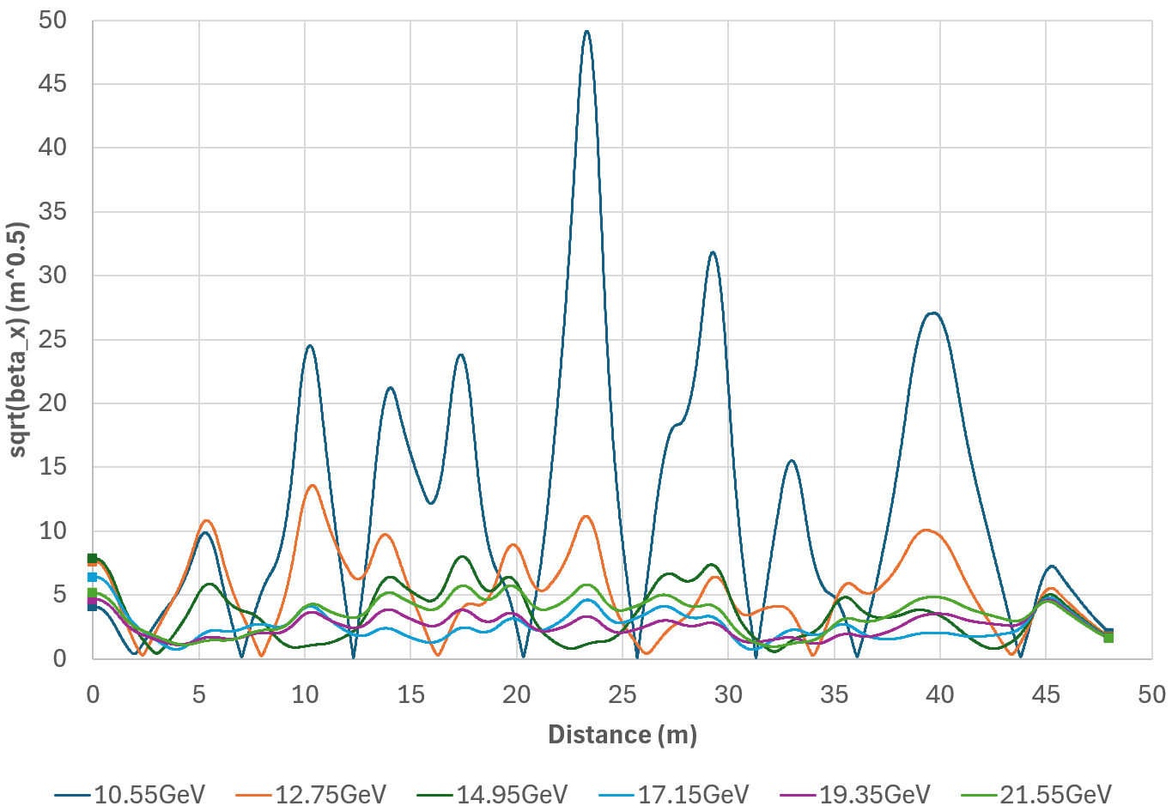
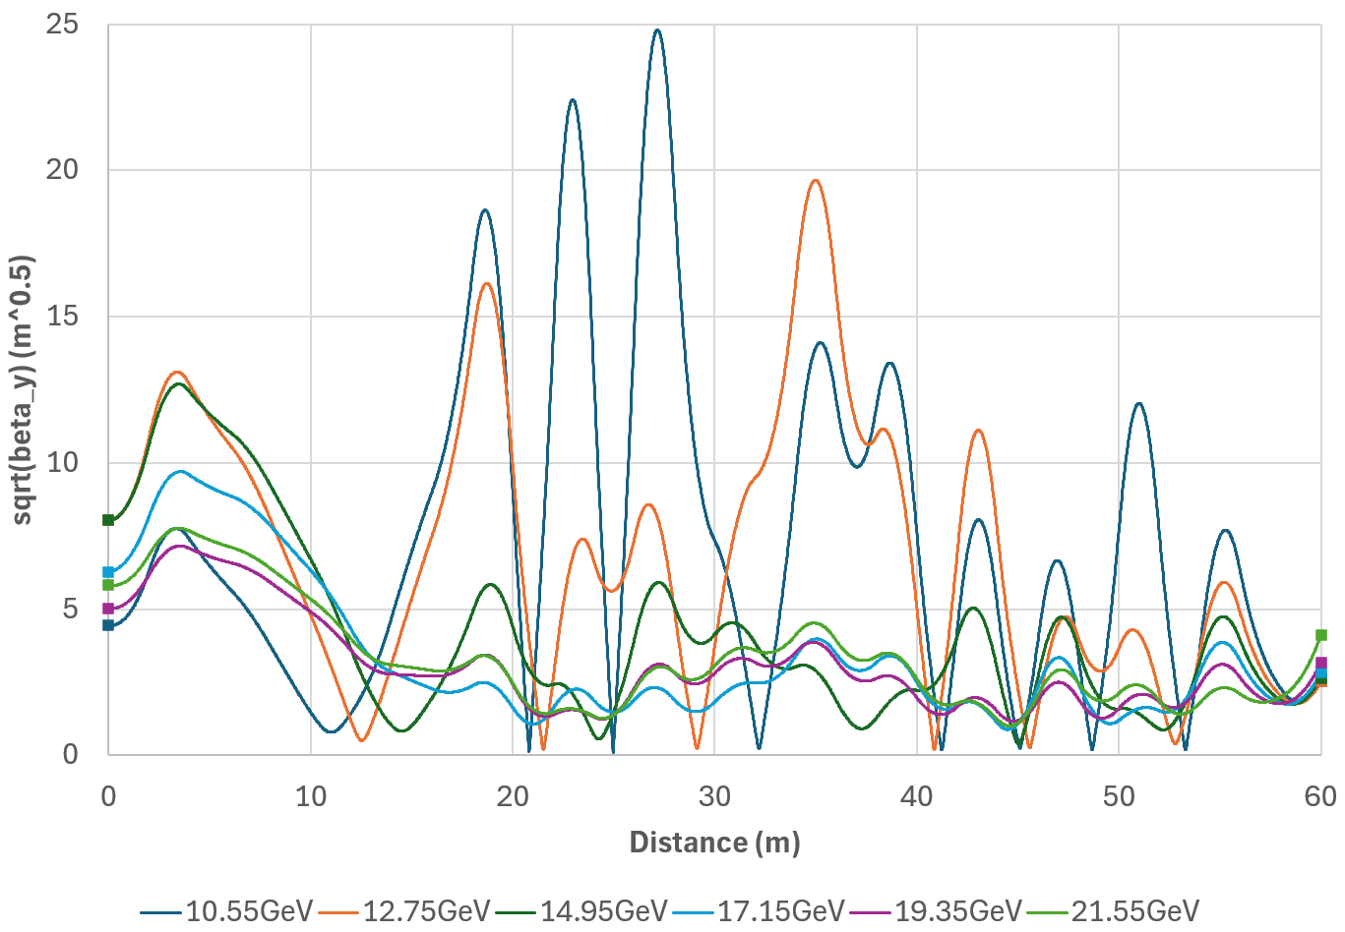
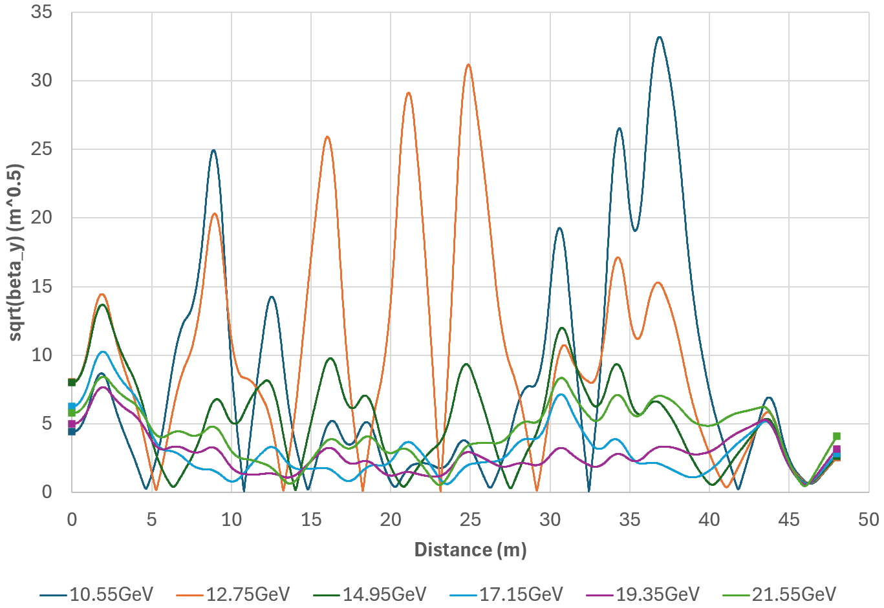
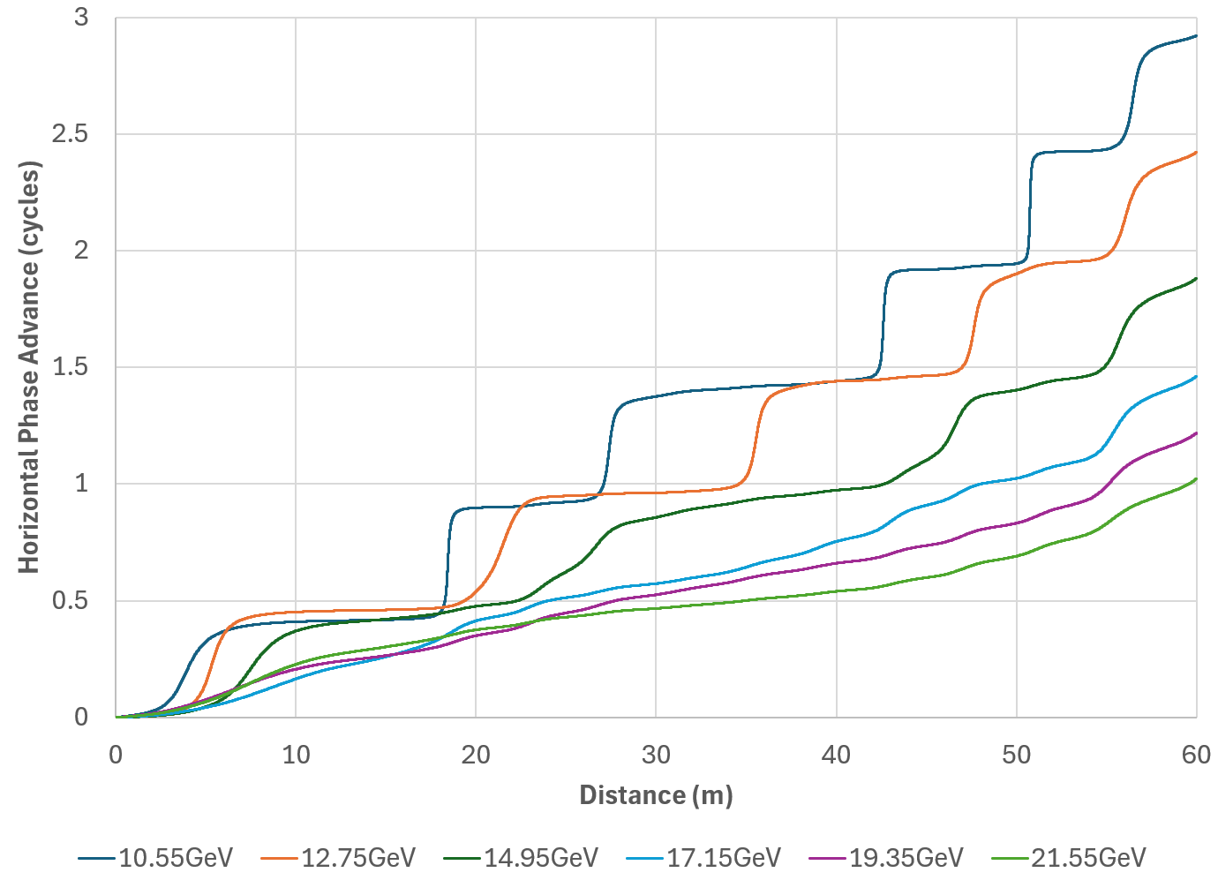
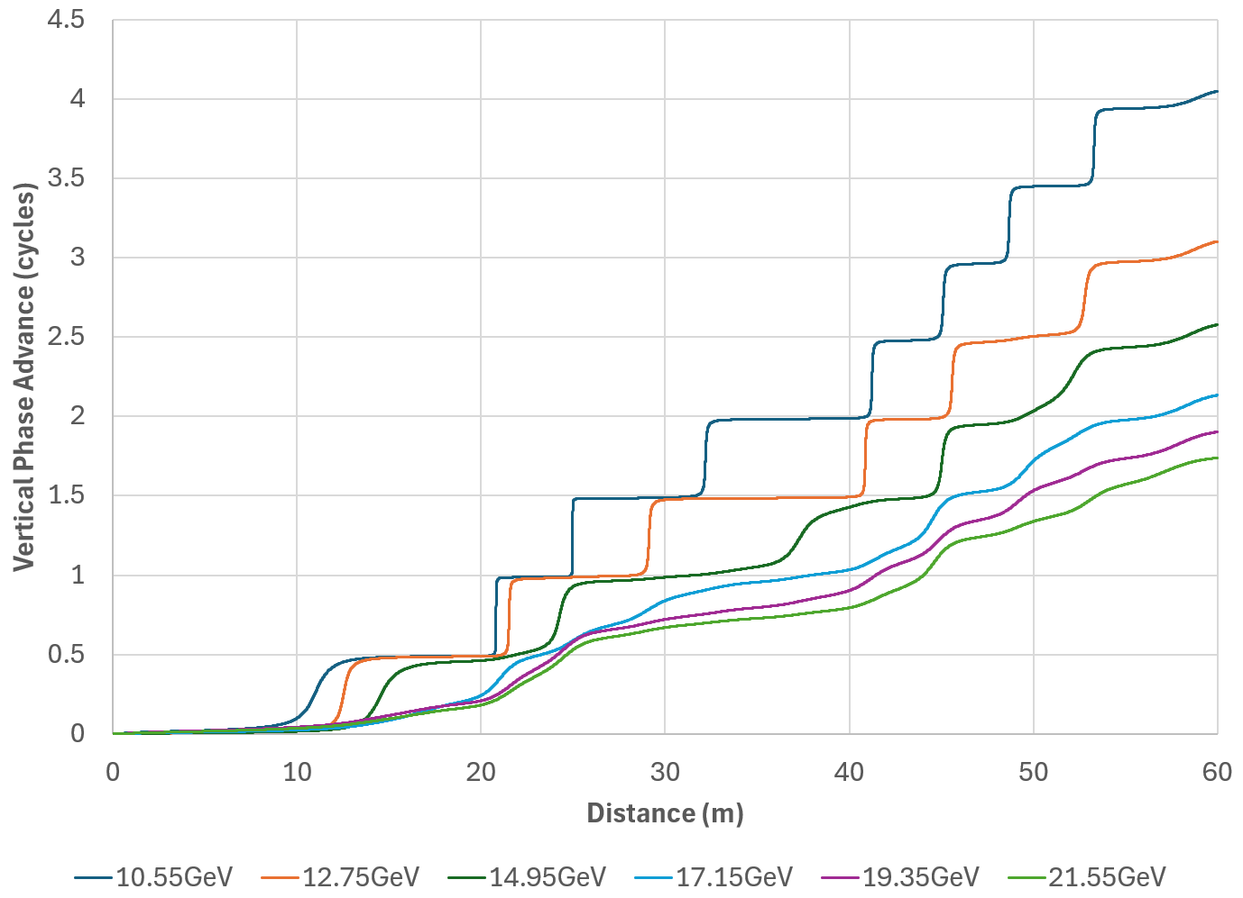
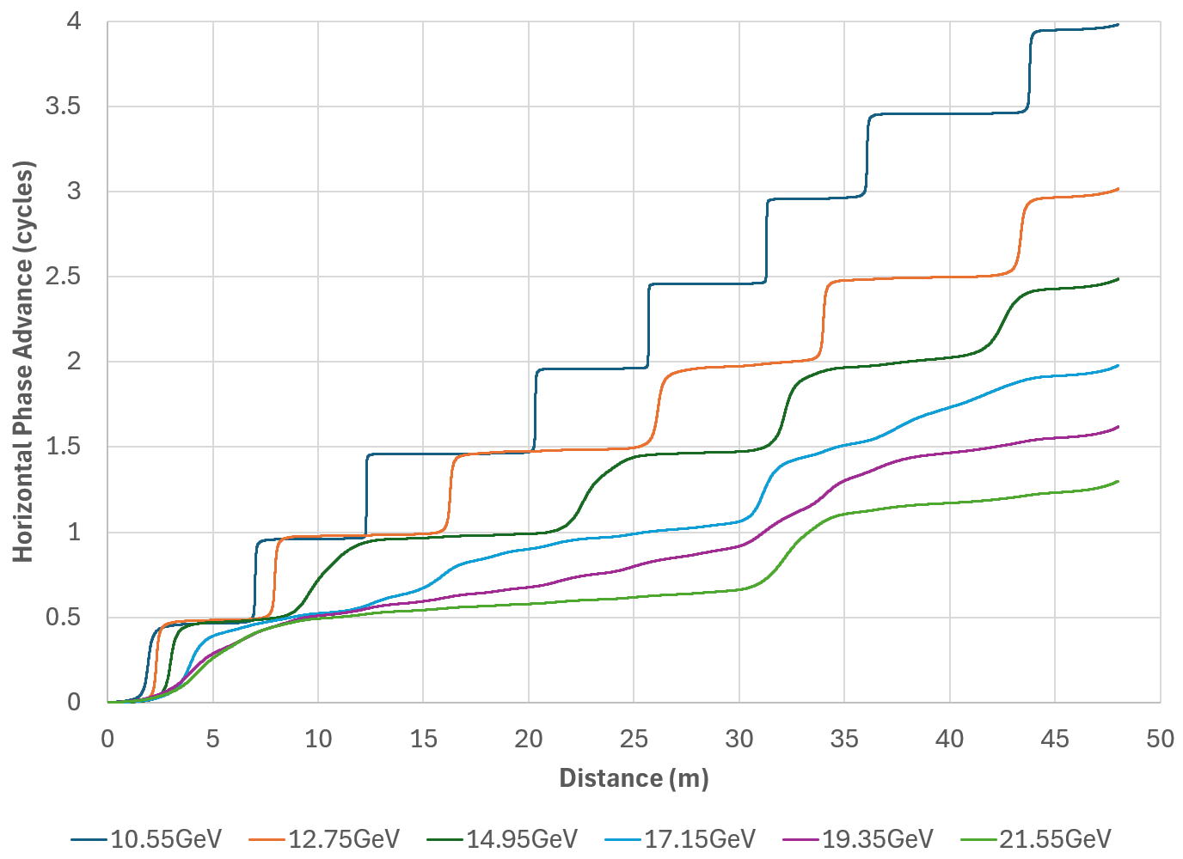
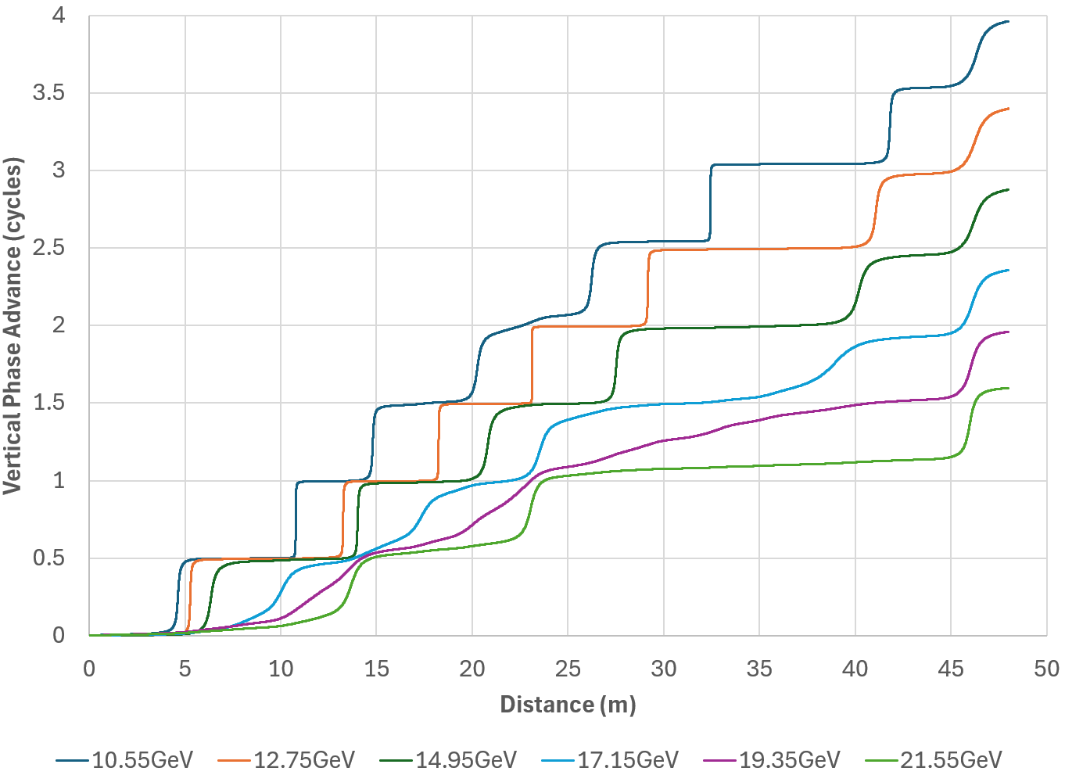
Matching of Multiple Energy Beamlines for the CEBAF Energy Upgrade
S.J. Brooks {sbrooks@bnl.gov}, Brookhaven National Laboratory, Upton, NY, USA
Abstract
It is currently planned to increase the energy of the CEBAF recirculating linear accelerator to 22GeV by adding two new recirculating arcs that contain multiple new energy passes. These new passes at six different energies must be matched to the existing linac simultaneously, as the beam is continuous (CW), so magnets cannot be ramped. This paper studies propagating several energies in the same beam pipe with a line of quadrupoles acting on all of them simultaneously, with the goal that the combined effect produces a match for each energy. Computer optimisation of the performance this system under various constraints (beamline length, number of magnets) is studied.
Matching Constraints
These beamlines match from the optical functions at the exit of the CEBAF linacs, given in Table 1, to the optical functions at the beginning of the fixed field accelerator (FFA) arc in Table 2.
The FFA arc has high gradient magnets and small beta functions to preserve the low dispersion, whereas the linac has high beta functions as its focusing scheme is shared with the lowest energy pass.
Optimisation Methods
Levenberg-Marquardt (LM) optimisation was used to find the 30-magnet beamline. There are many local minima in the sum-of-squares error, so multiple random restarts (basin hopping) also had to be used until finding an exact solution.
The 40-magnet beamline was found by simulated annealing with 10⁻⁴ per step ‘temperature’ reduction and adaptive-length random steps in the problem output space.
Beamline Solutions
60m Length, 30 Magnets
Comparision
Both beamlines are exact matches for all six energies simultaneously.
The 40-magnet beamline is shorter.
The 30-magnet beamline requires a lower quadrupole gradient.
The 30-magnet beamline is likely less sensitive to errors because its beta functions vary less.
The 30-magnet beamline has a smaller beam expansion factor relative to the linac, so fewer problems with aperture or field aberrations.
Overall, the 30-magnet beamline looks more practical unless length is highly constrained.
48m Length, 40 Magnets
Quadrupole Gradients
Beam Sizes
Horizontal
Vertical
Phase Advances
H
V
H
V

