Slide 1
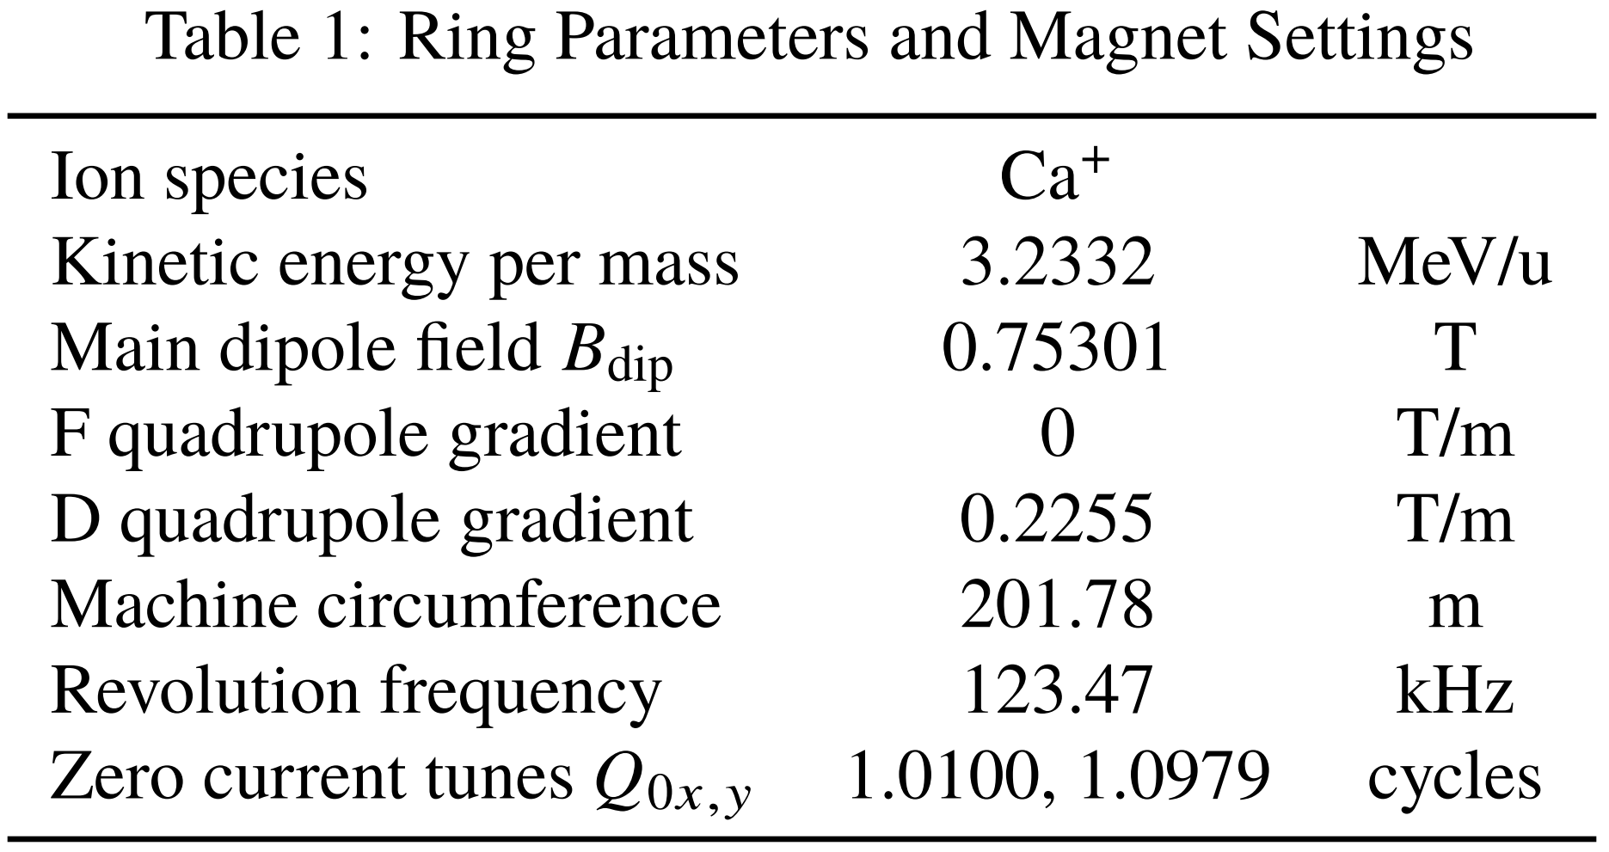
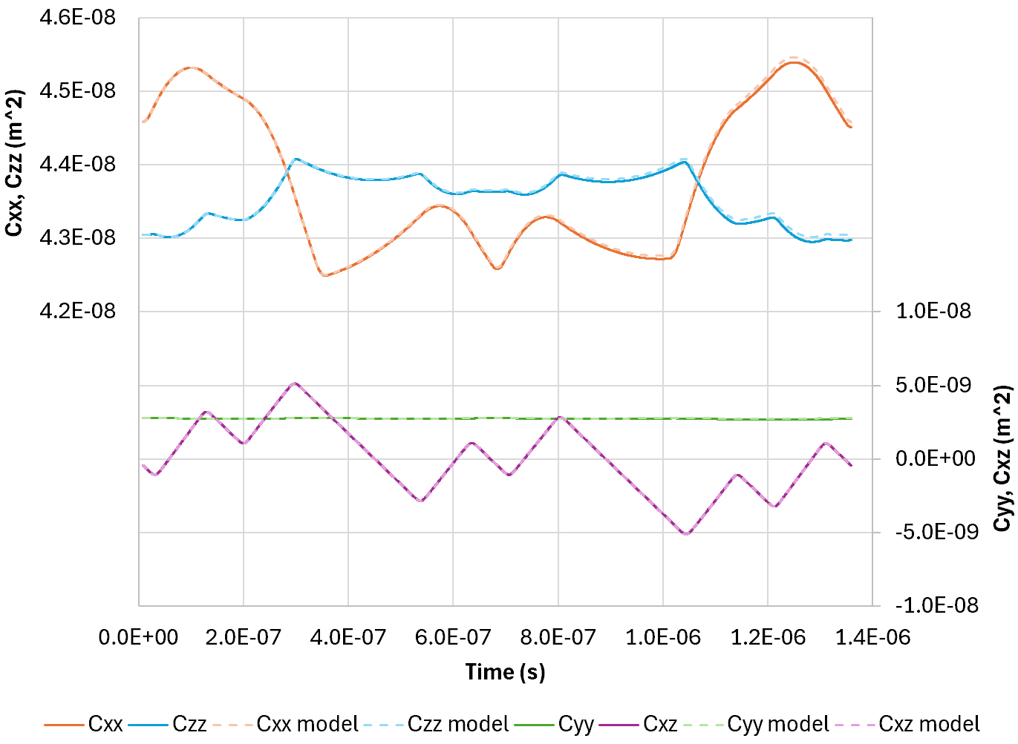
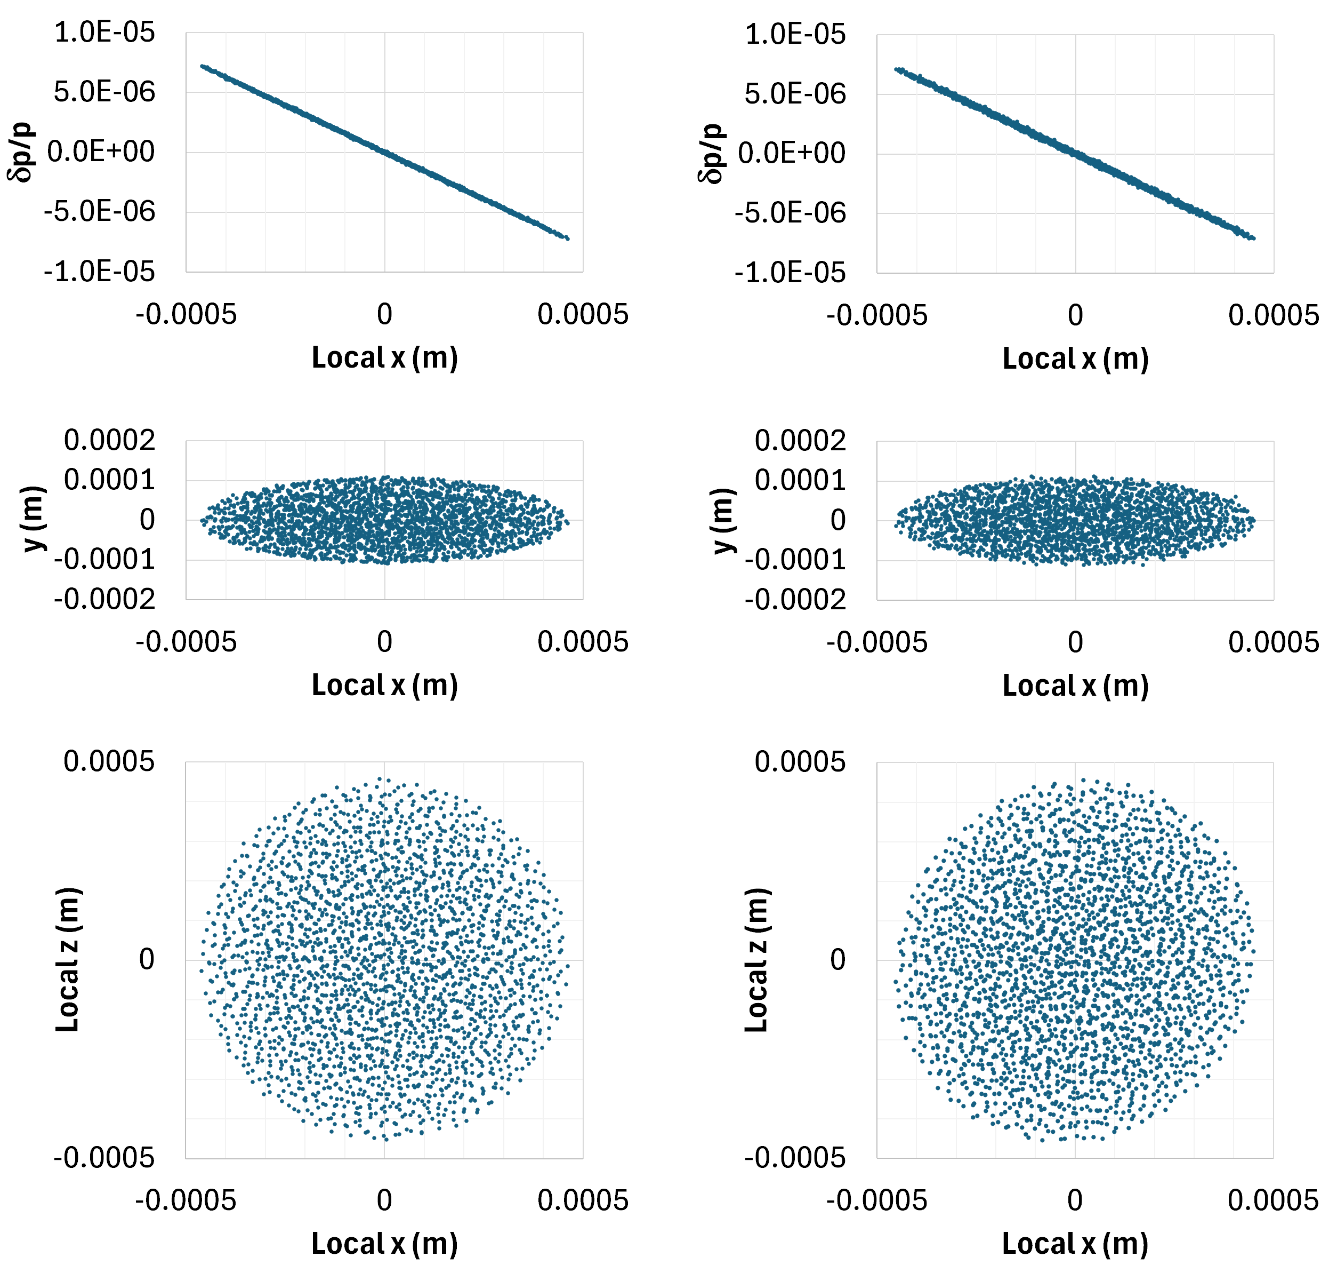
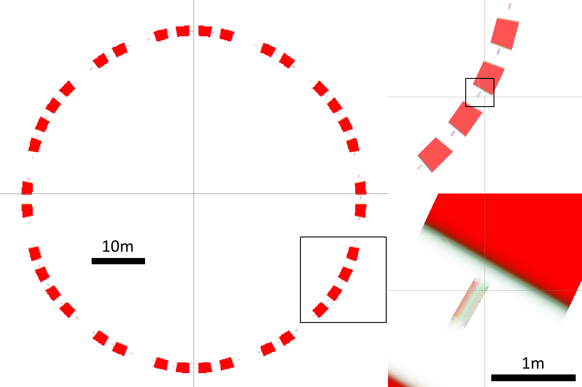
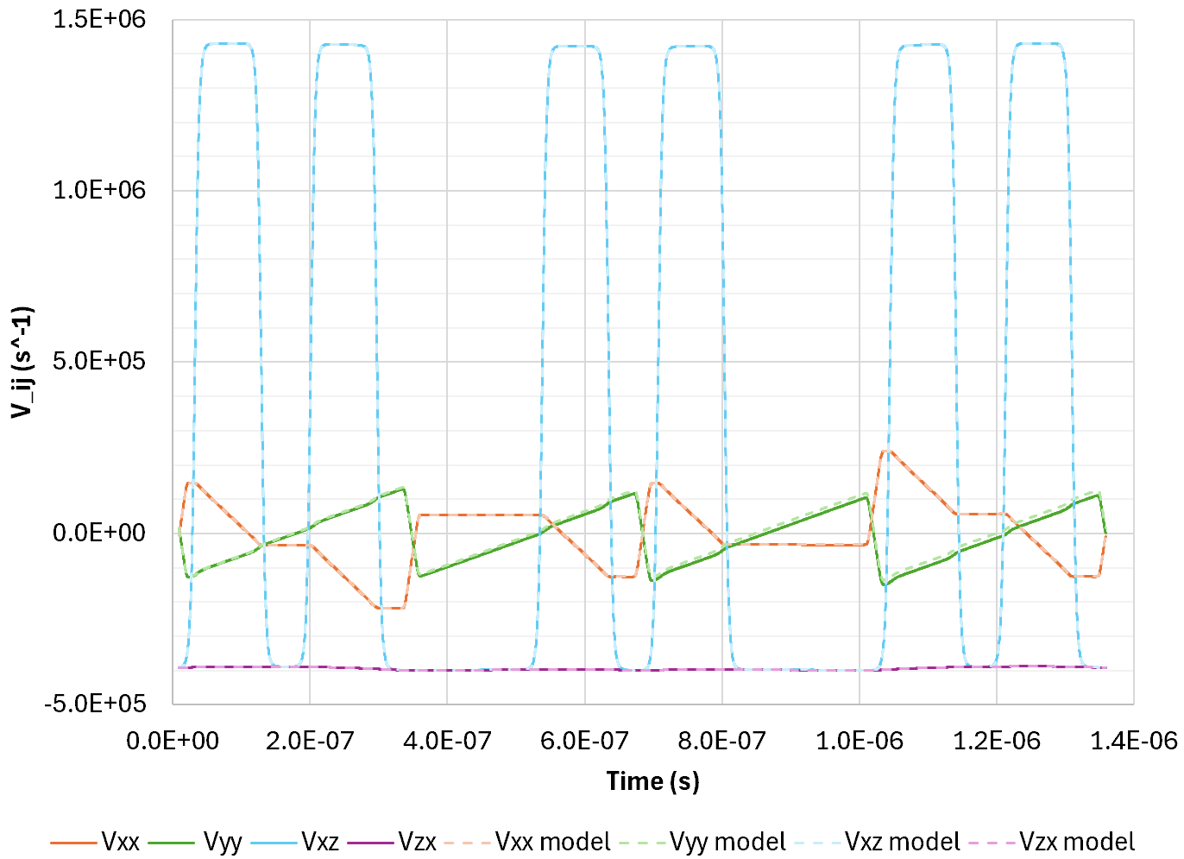
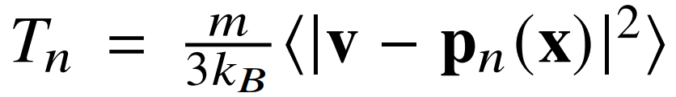
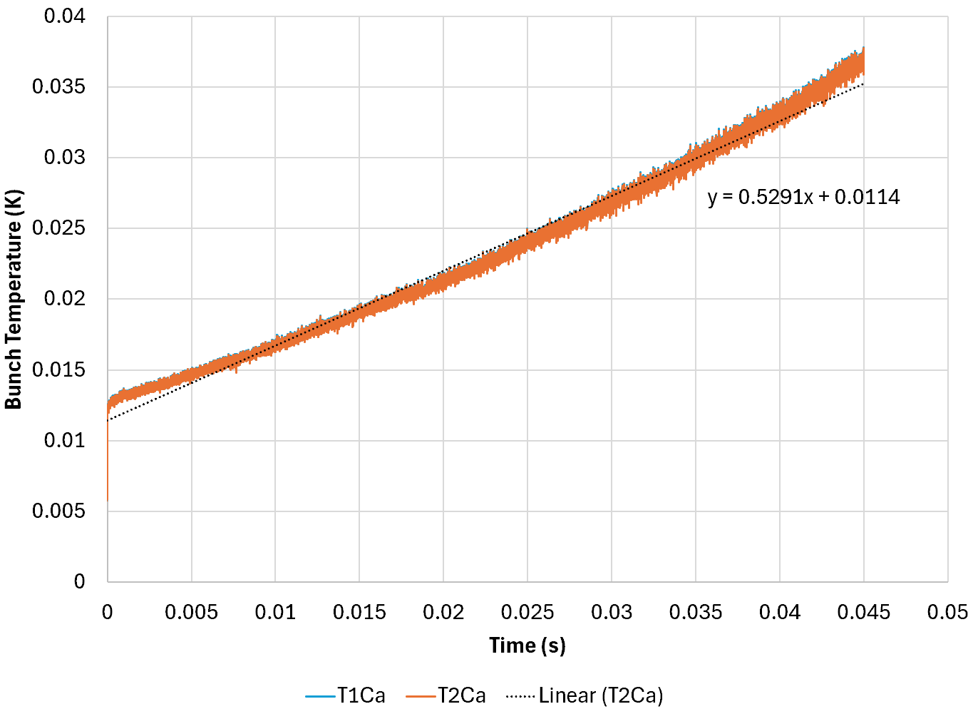
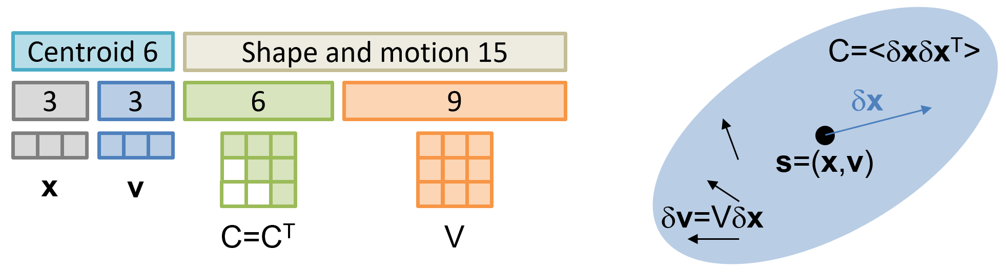
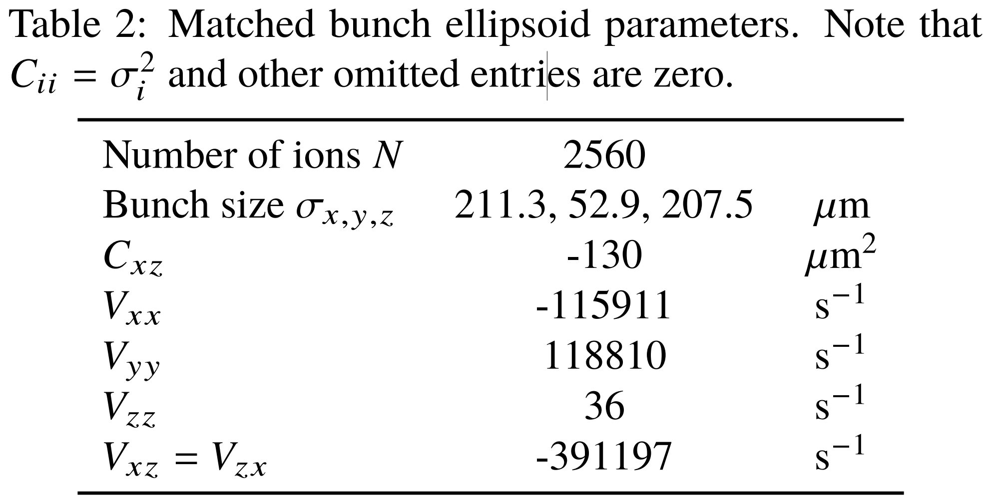
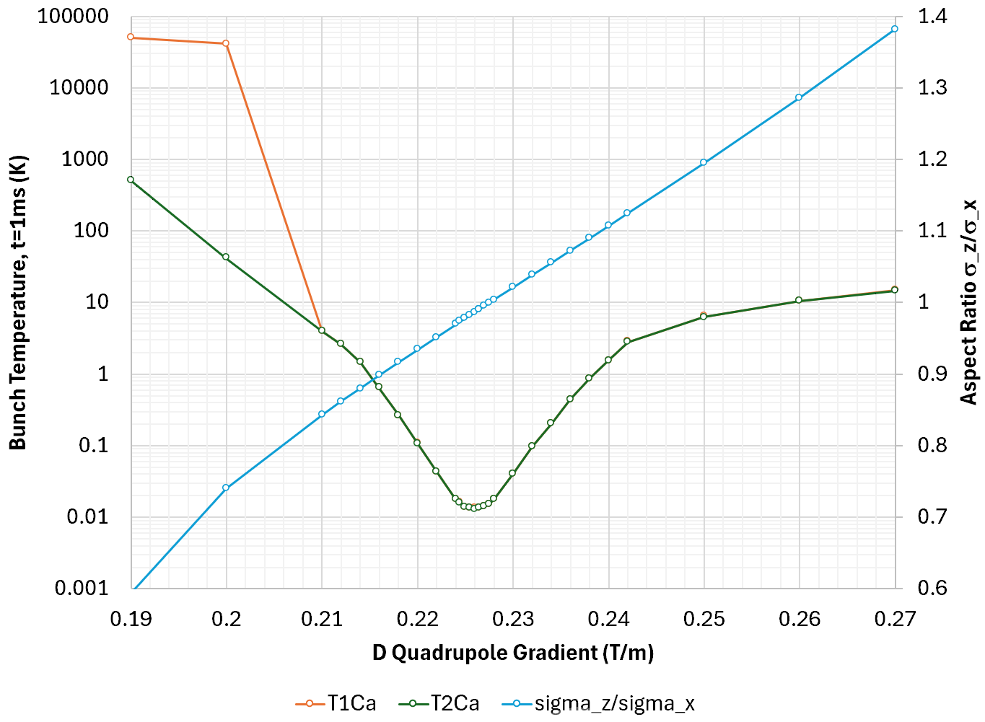
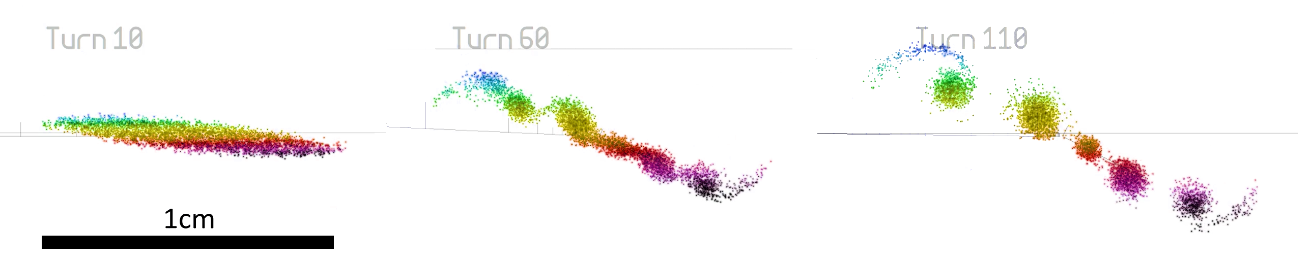
Matching of Crystalline Beams into the BNL Booster
S.J. Brooks {sbrooks@bnl.gov}, Brookhaven National Laboratory, Upton, NY, USA
Abstract
A method has been developed to match large three-dimensional Coulomb crystals into existing accelerators. Simulations show bunch temperatures below 1 Kelvin persisting for thousands of turns in the BNL Booster (with no cooling). Focussing forces balance space charge to give zero net phase advance and the crystal structure can be preserved for tens of milliseconds. Magnetic focussing confines all three dimensions of the bunch without RF, since the bunch rotation in the ring plane is not at the ring revolution frequency. A zero temperature, uniformly-filled ellipsoid of charge gives a 15-parameter model that can be used for matching and linear stability analysis.
Booster Field Model
A smooth, Maxwellian 3D field model of the booster is required to do Runge-Kutta tracking of particles. This was implemented on the GPU using OpenCL.
Matching Method
Consider a uniformly charged ellipsoid with zero temperature and linear internal velocity variation. This is characterised below by 15 parameters, plus 6 for the centroid motion:
These parameters can be matched from start to end of the ring using Newton iteration, similarly to how the closed orbit is found. The resulting values for the booster are below.
Multiparticle Simulation
Temperature
The bunch temperature is defined by
where p_{n}(x) is the n^{th} order polynomial least squares fit to v(x). The evolution of T₁ and T₂ over 45ms (~5500 turns) is plotted below.
Changing the D quadrupole gradient affects the temperature at t=1ms as shown below. Heating rates are lowest when the bunch aspect ratio is circular in the horizontal plane.
Superperiod Optics
Focussing is very gentle in this solution: the sector dipoles alone can make the bunch invert in one axis via edge focussing, so the D quadrupole was powered to reduce horizontal focussing further.
Evolution of the covariance matrix through one superperiod (1/6 turn) is shown above. C_{xx}=σ_{x}² and C_{zz}=σ_{z}² change by little and are almost equal, meaning the bunch stays round in the x-z ring plane, minimising heating from shearing of the crystal lattice.
The velocity distribution has zero vertical angular momentum (V_{xz}=V_{zx}) in drifts and rotates in dipoles via canonical angular momentum conservation. Overall, the bunch rotates 0.495 times each ring revolution.
Vortex Effect?
Observing persistent bunches without RF was puzzling, but a similar effect has been seen in isochronous cyclotrons near the space charge limit, where a Coriolis-like force turns space charge repulsion into rotation. This is called the vortex effect.
To test this hypothesis, a non-crystalline bunch of temperature 10K was put in the booster lattice with the same settings. It spontaneously formed into roughly circular space charge “solitons”, which are stable and the same shape as the crystalline bunch.
t=0ms
ε_{V}=1.13×10⁻¹³m
ε_{H}=8.86×10⁻¹³m
t=45ms
ε_{V}=4.82×10⁻¹³m
ε_{H}=1.90×10⁻¹²m
norm. rms
dipole
quad
Heating rate: 0.5291K/s
These dynamics have recently been confirmed by R. Baartman in the TRANSOPTR envelope code.

