Slide 1
Results from the ATF FFAG experiment
Only 36, 54MeV done so far
18, 24, 72MeV still to-do

Slide 2
Outline of Main Components
Beam stop
Fixed table
Injection X position and angle adjustment
Beam direction
Movable table
Screen (POP11)
Screen (POP10)
ATF beam pipe
1” diam.
2” diam.
Triplet
Beam screen (FFAG) and camera
FFAG pipe through magnets
Steerer (GT7)
Steerer (GT3)
Flexible bellows and flange size adapter
For each energy, do 2D steerer current scans
  GT3X, GT7X (x,x’)
  GT3Y, GT7Y (y,y’)
  GT7X, GT7Y (x,y)
Plus four larger-range 1D scans and a quad scan of the triplet

Slide 3
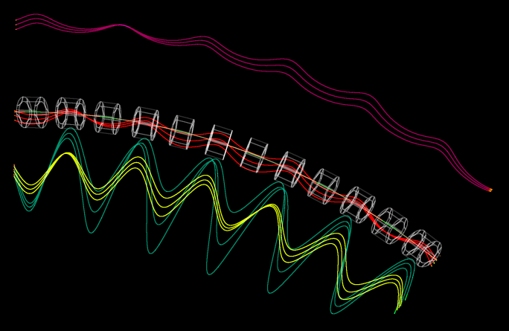
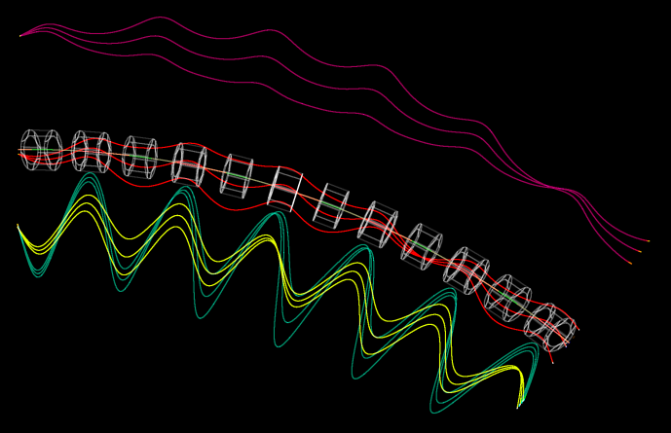
Tracking of (x,x’) Offsets
Trajectories have been magnified transversely by 16x for visibility
x_{in} ±1mm
x’_{in} ±10mrad

Slide 4
NS-FFAG Beamline Parameters
Parameter | Value | Units
Particle species | Electron
Energy range | 18-72 | MeV
Cell Length | 0.234301 | m
Cell Angle | 6.666… | degrees (54 per turn)
R = avg. radius of curvature | 2.01367 | m
Max orbit excursion | 18.21 | mm (from circle radius R)
Tune range per cell | Q_{y,72} = 0.029, Q_{x,18} = 0.411 | cycles
Cell lattice | halfD2, QF, D1, BD, halfD2
Drift lengths | D1 = 57.35, D2 = 57.65 | mm
Number of cells | 6
Total length | 1.40581 | m
Total angle | 40 | degrees

Slide 5
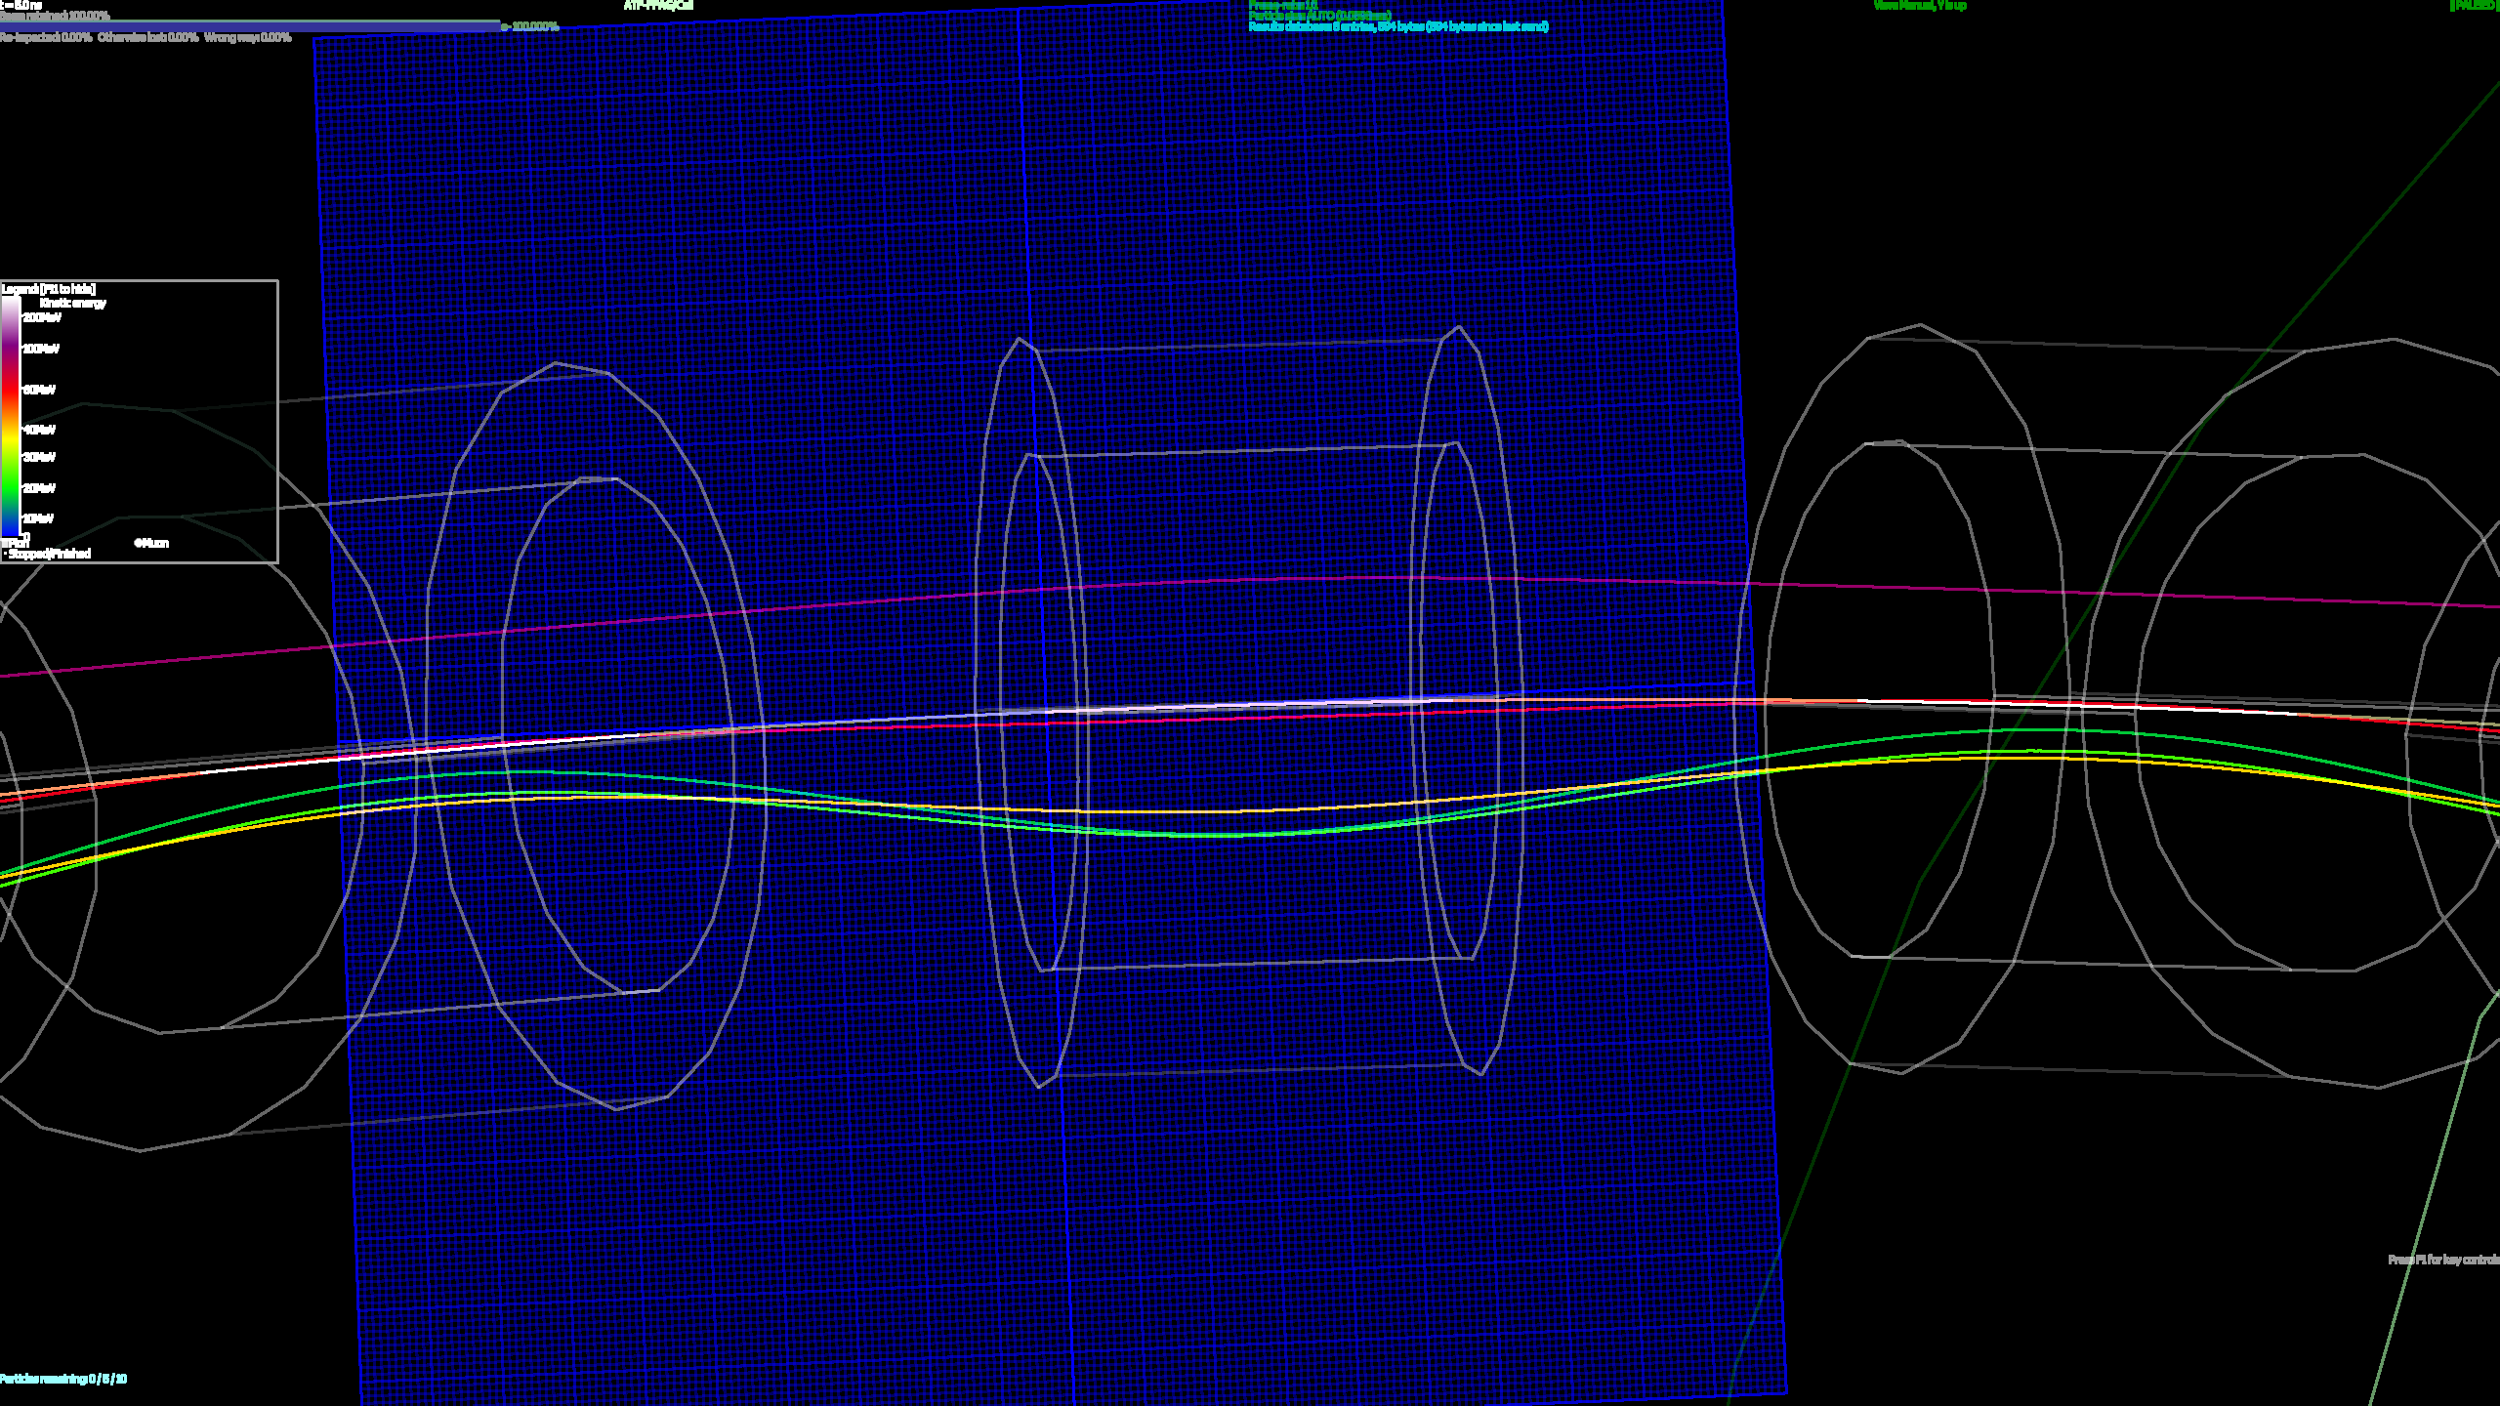
Matched Orbits through Fieldmaps
18, 24, 36, 54, 72MeV

Slide 6
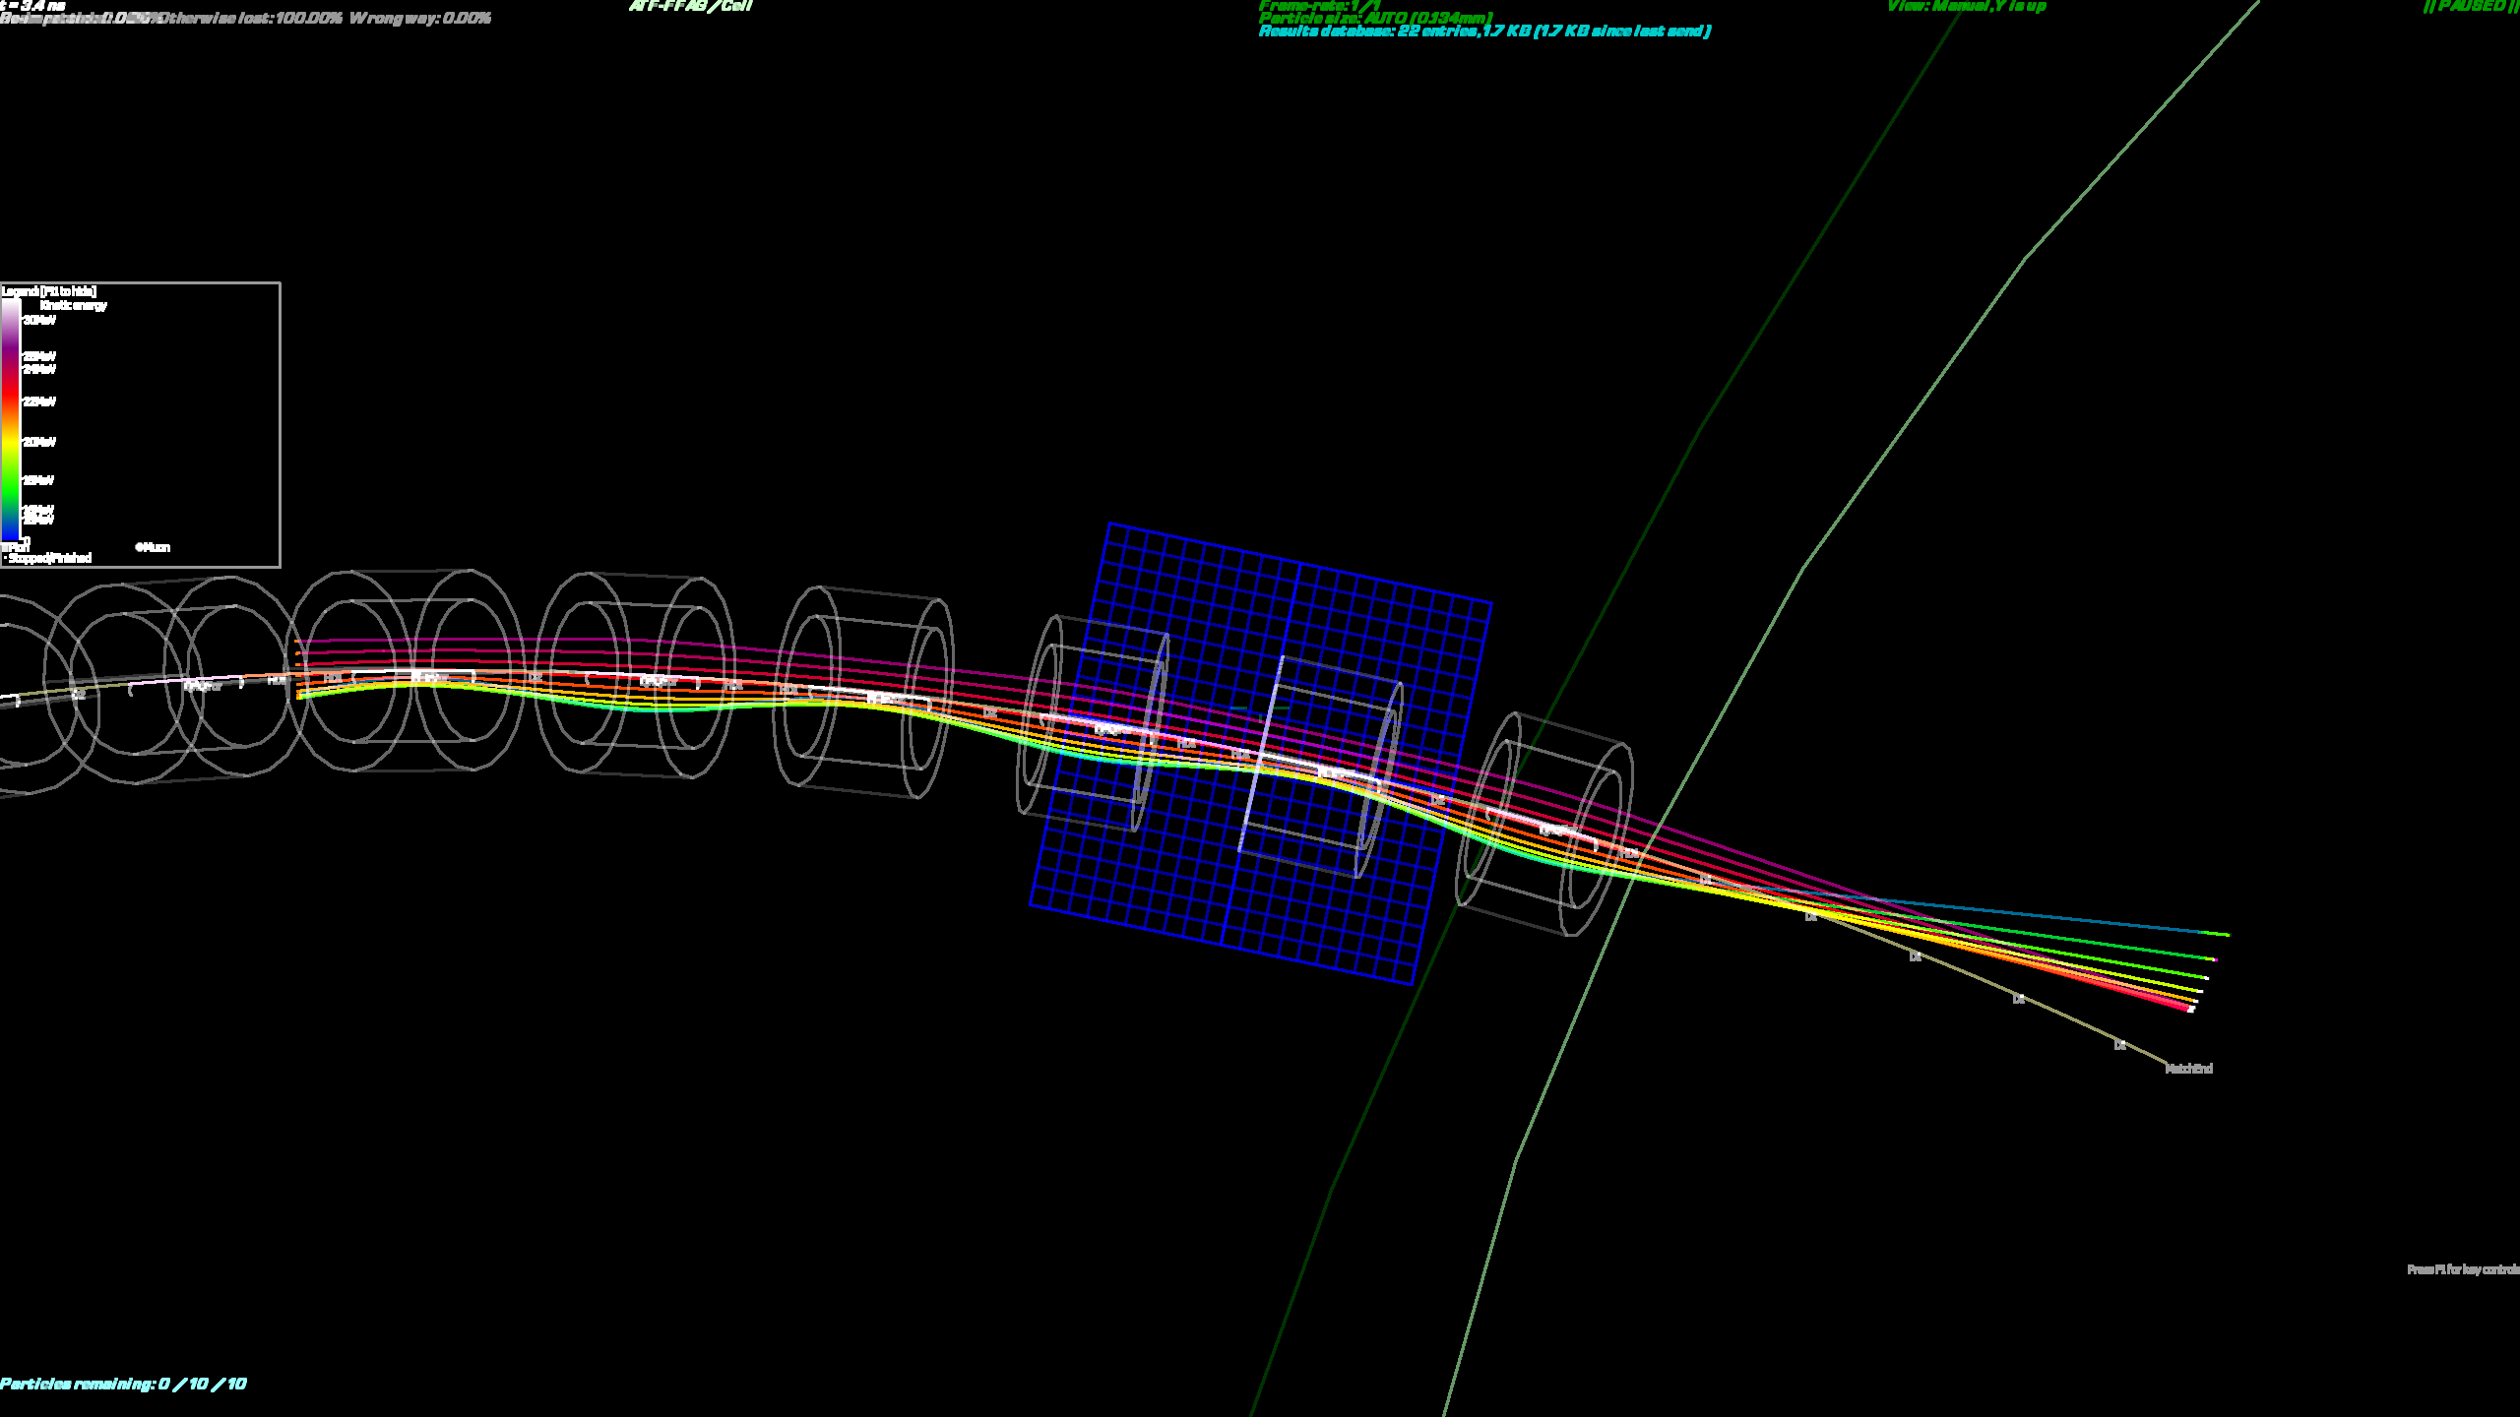
Beams Exit from Periodic Cell

Slide 7
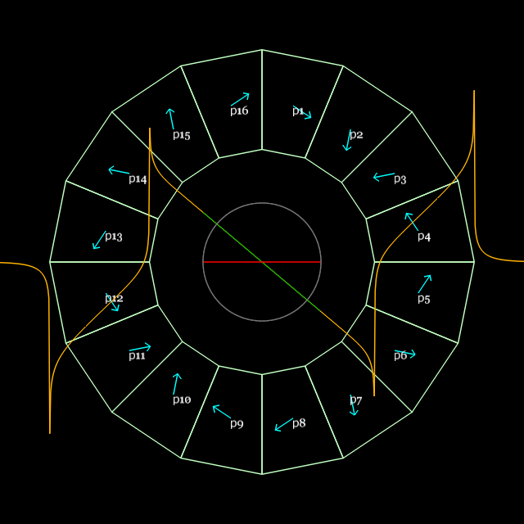
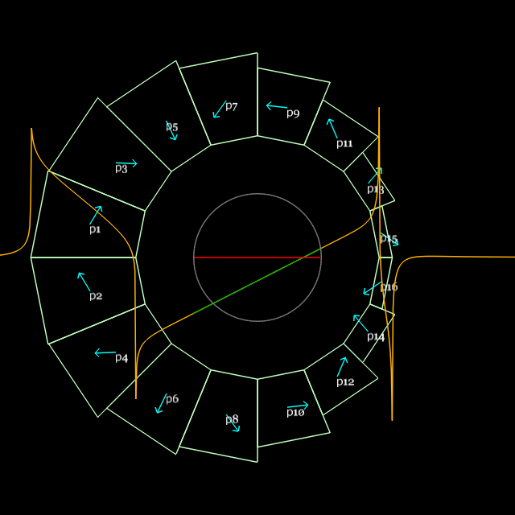
Magnet Design and Parameters
QF
BD
Parameter | “QF” magnet | “BD” magnet | Units
Length | 57.44 | 61.86 | mm
Dipole B_{y}(x=0) | 0 | -0.37679 | T
Quadrupole dB_{y}/dx | -23.624 | 19.119 | T/m
Inner radius (magnet pieces) | 37.20 | 30.70 | mm
(shim holder) | 34.70 | 27.60 | mm
“Pole-tip” field (magnet pieces) | 0.879 | (-)0.964 | T
Outer radius (magnet pieces) | 62.45 | 59.43 | mm
(tubular support) | 76.2 | 76.2 | mm

Slide 8
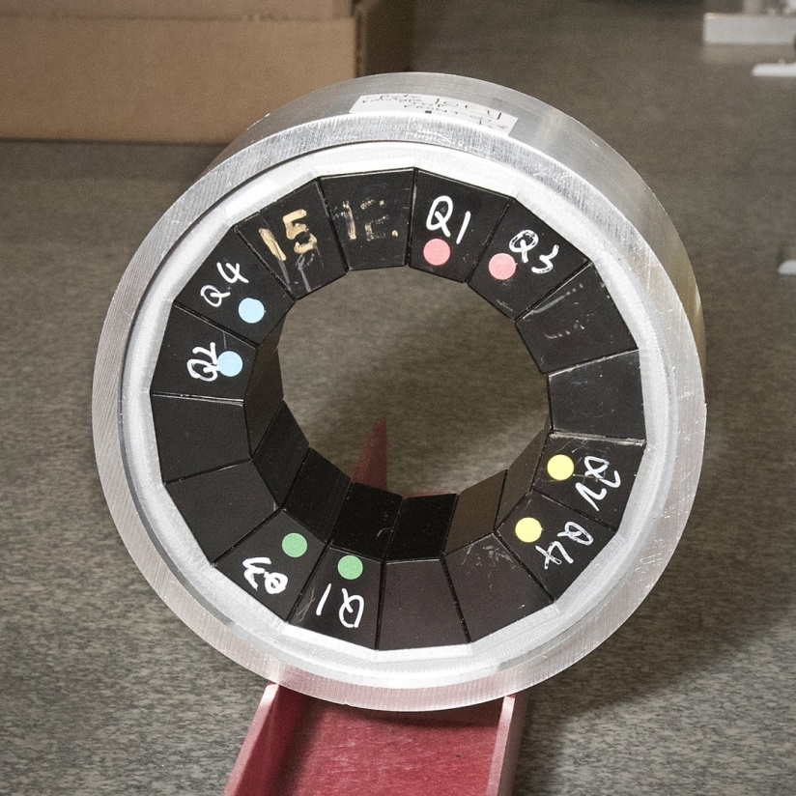
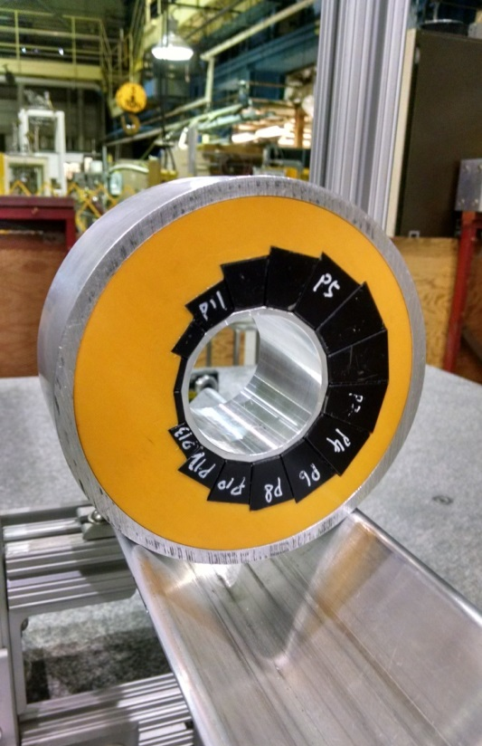
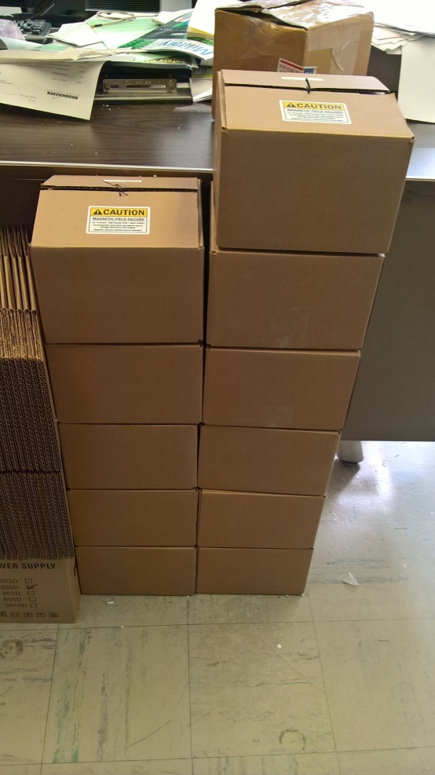
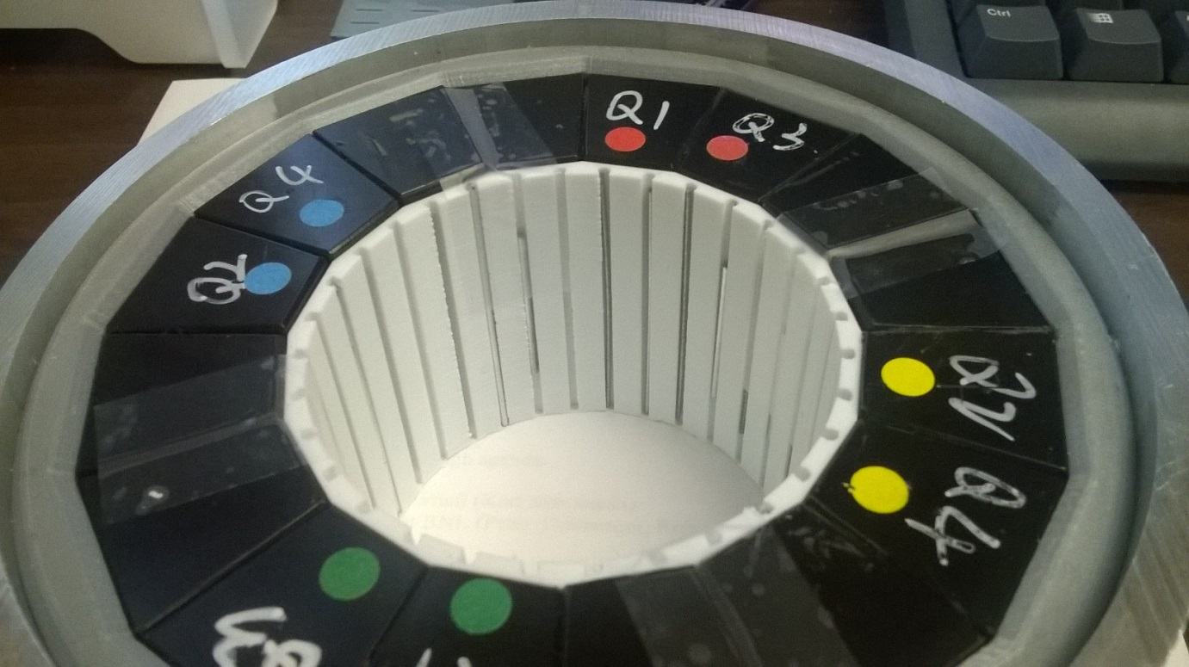
All the magnets had already been built as part of CBETA R&D and all have had iron wires inserted.

Slide 9
Radii/Clearances
 | Radius wrt torus (mm) | Distance to previous (mm)
Maximum beam excursion | 18.21
Vacuum pipe inside | 23.75 | 5.54 (12.00 in CBETA)
Vacuum pipe outside | 25.40 | 1.65 (pipe thickness)
Shim holder inside (BD) | 27.45 (27.60 straight) | 2.05 (air gap)
PM block inside edges (BD) | 30.55 (30.70 straight) | 3.10 (shim holder)
May have been a bit over-optimistic with beam clearance, seeing scraping near 36MeV
Re-aligned pipe recently because it was being pulled off-centre by bellows

Slide 10
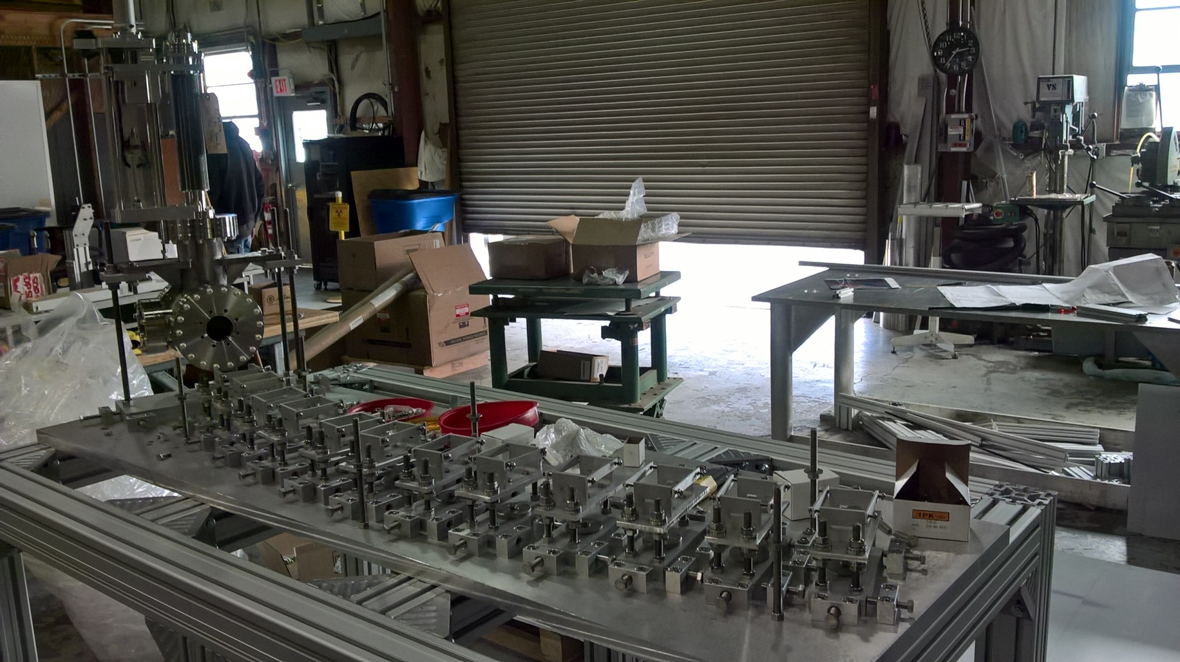
Girder and Supports Construction
Feb 22, 2017

Slide 11
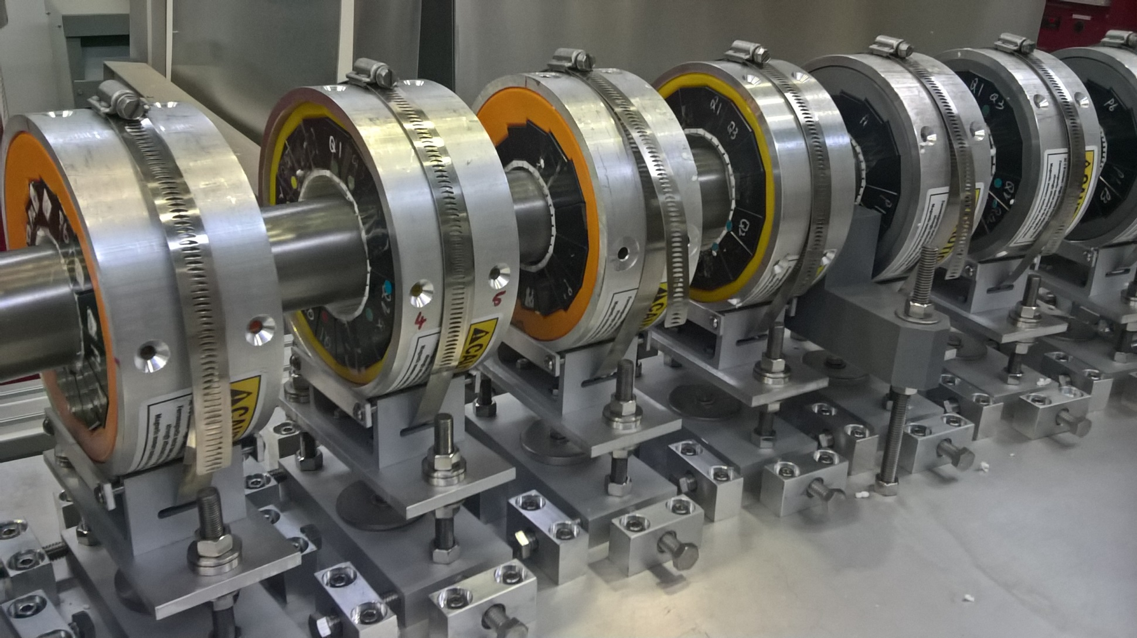
Detail: Magnets on the Girder
Apr 7, 2017

Slide 12
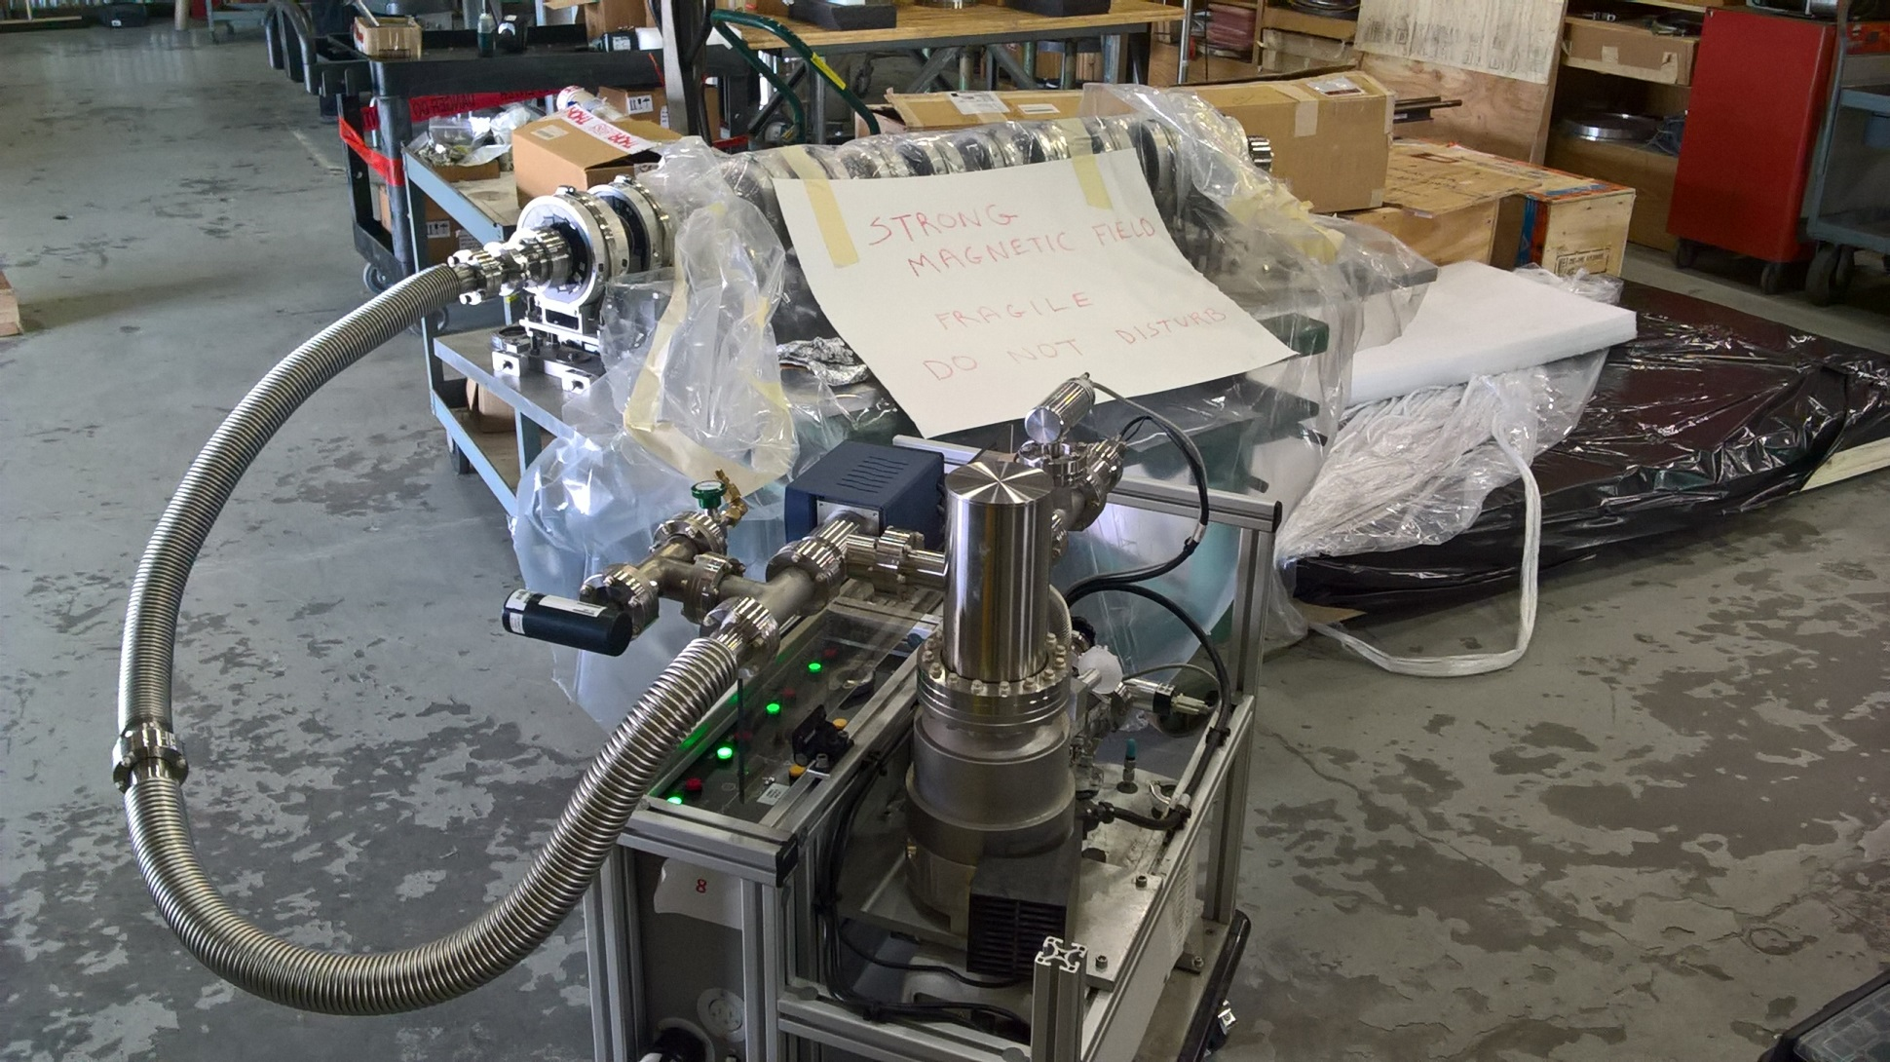
Pipe undergoing Leak Check
Apr 14, 2017

Slide 13
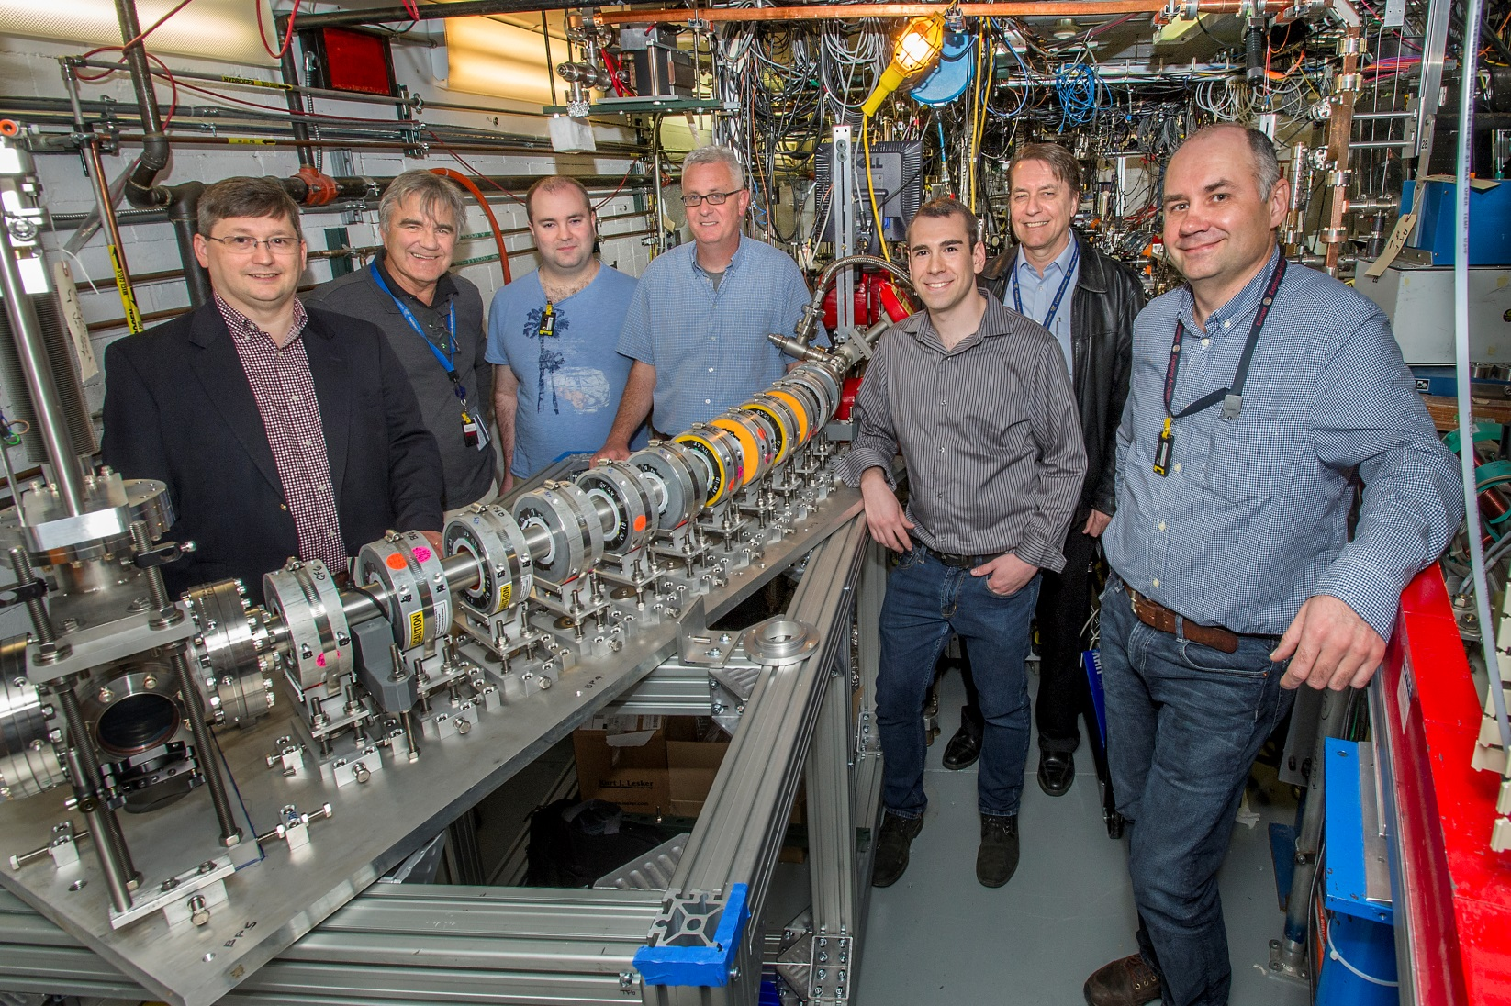
Picture of Everyone Standing By It
ATF experiment AE79
May 1, 2017

Slide 14
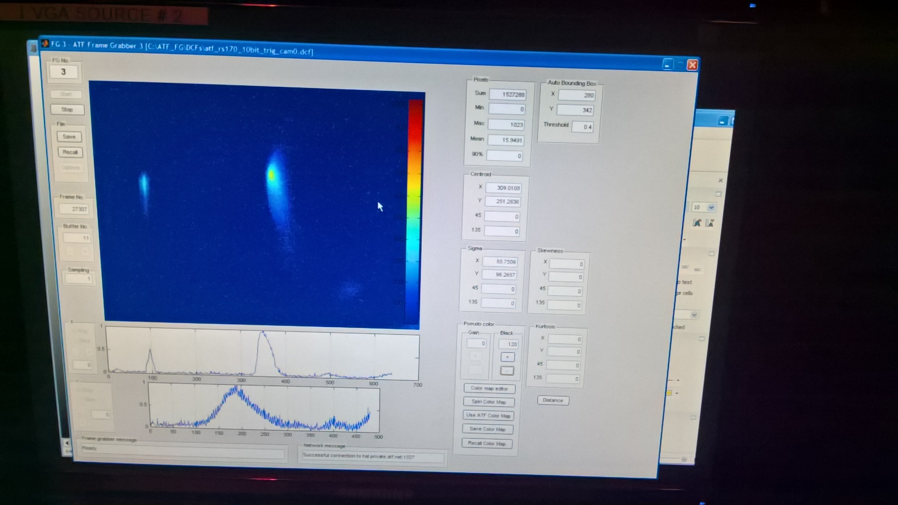
First Beam during Fault Studies
54MeV was the first energy to be tested
May 4, 2017

Slide 15
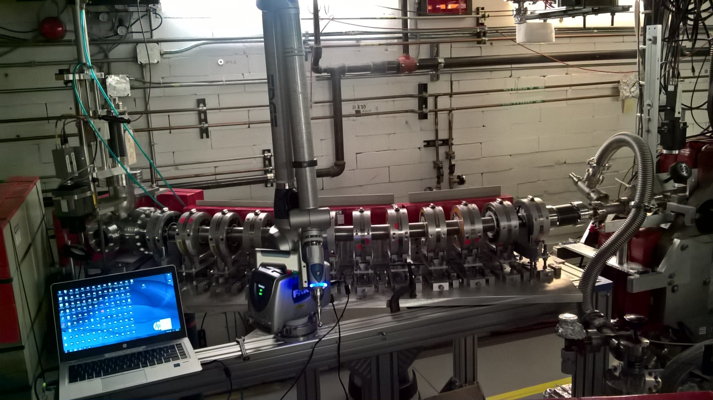
With Survey “Faro Arm” Attached
Most magnet offsets <0.2mm; RMS 0.1mm or better
May 5, 2017

Slide 16
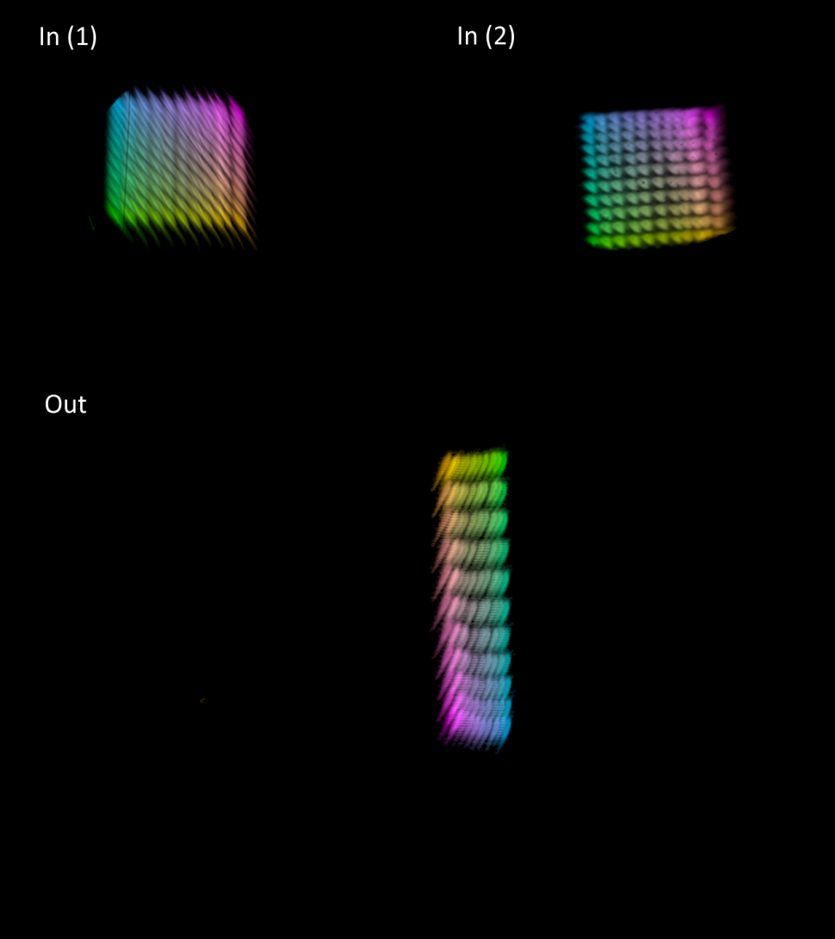
Beam X,Y Scan at 54MeV
May 8-9, 2017
Each setting in the 2D current scan is given a colour and all the 11*11 beams at each diagnostic overlayed
Tracking model:
Qx = 0.119
Qy = 0.055
6Qx = 0.713
6Qy = 0.329
More analysis to do later

Slide 17
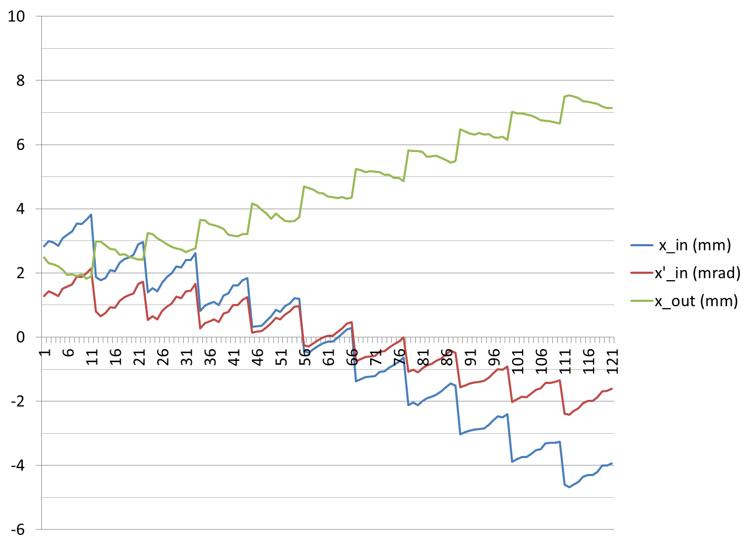
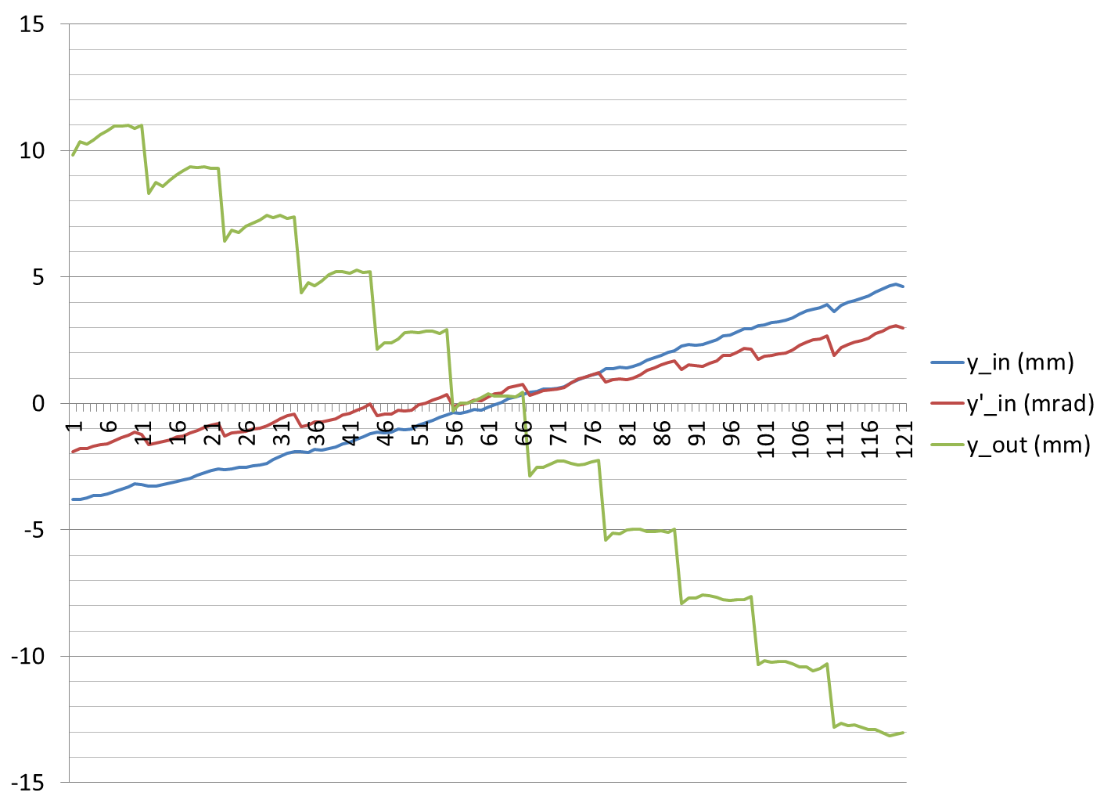
Input/Output Position at 54MeV

Slide 18
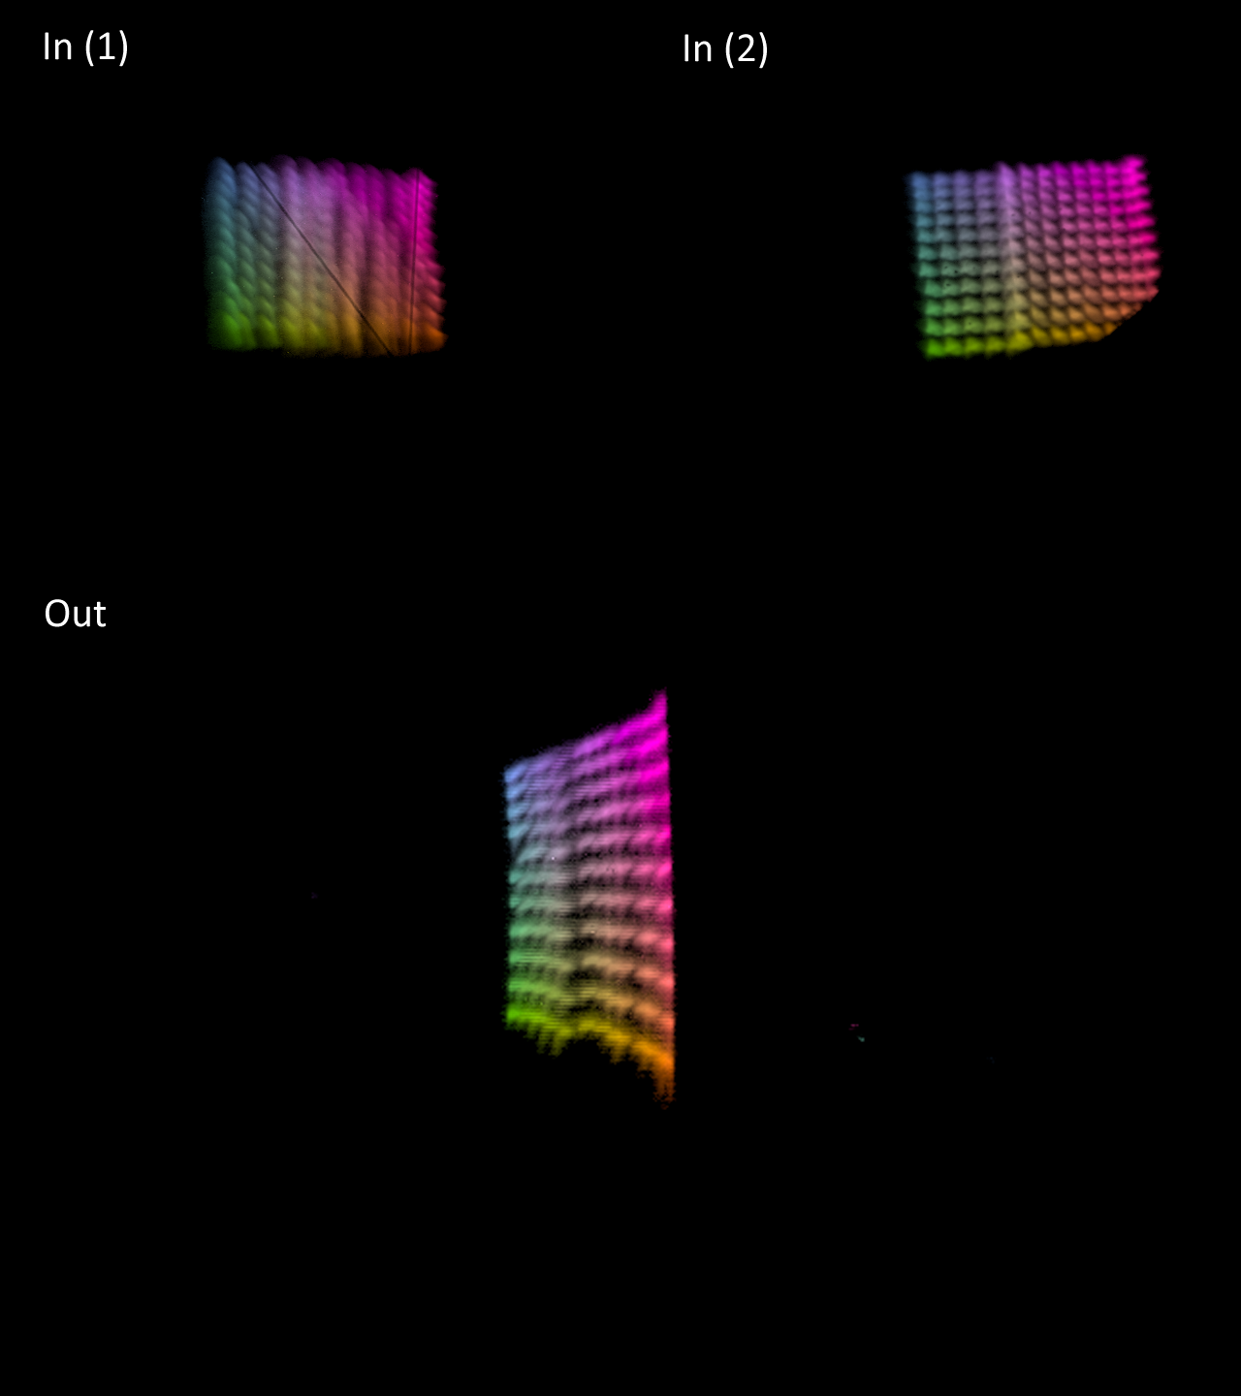
Beam X,Y Scan at 36MeV
May 11-12, 2017
Here we encountered beam scraping quite close (~2mm away) to the nominal closed orbit
Tracking model:
Qx = 0.176
Qy = 0.122
6Qx = 1.056
6Qy = 0.734
More analysis to do later

Slide 19
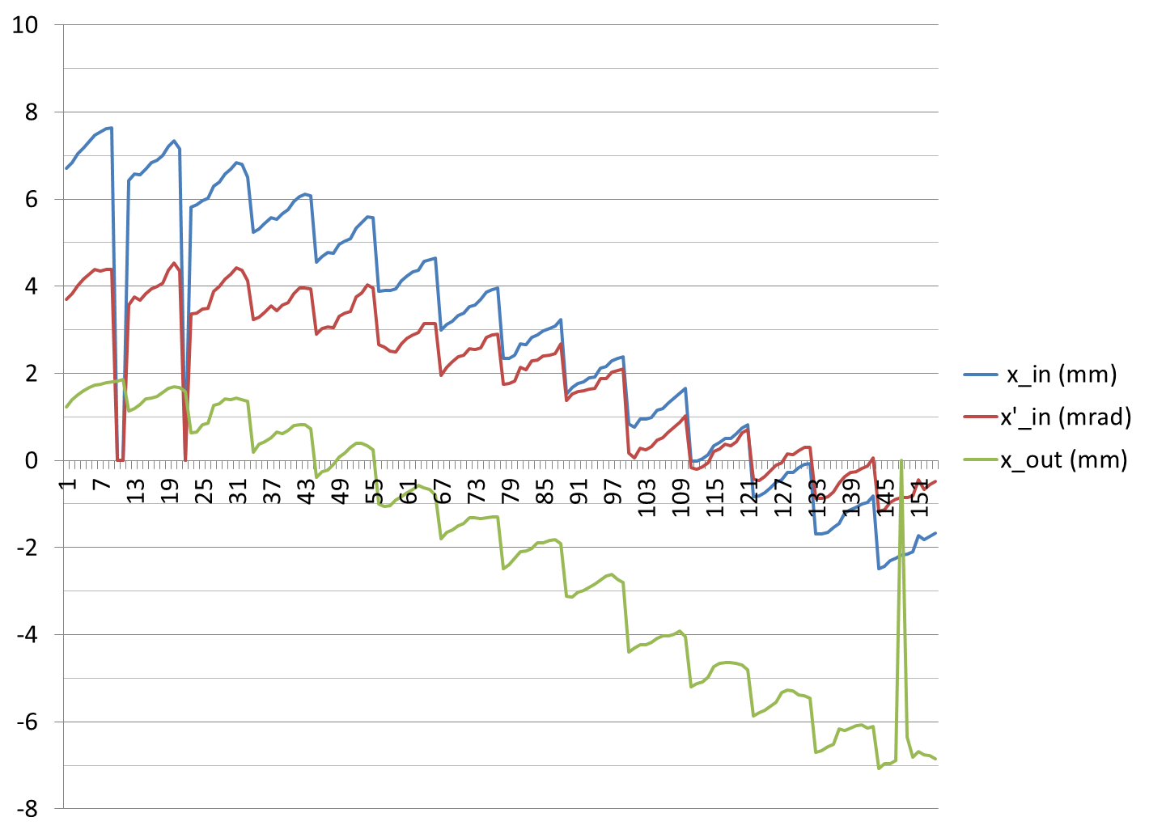
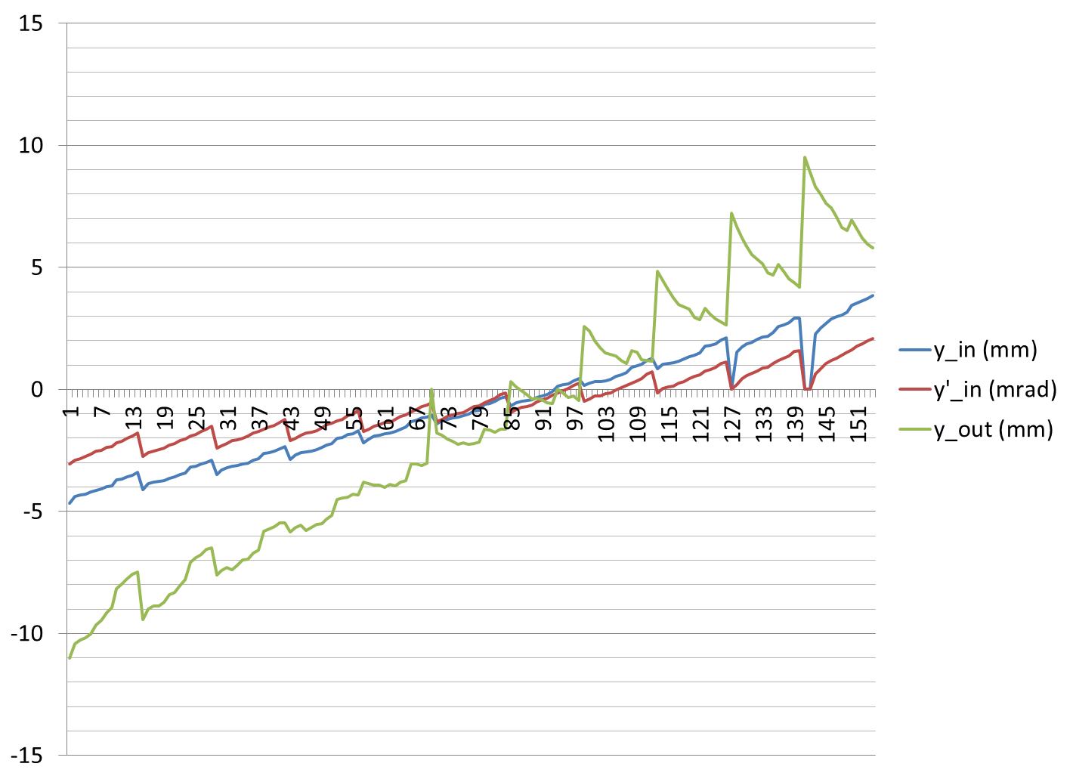
Input/Output Position at 36MeV

Slide 20
Conclusion & Future Plans
Beam has turned a nontrivial angle (40°) in six cells of a non-scaling FFAG, at 36 and 54MeV
  No highly nonlinear aberrations seen
Will do other energies in June and July
  Have to give diagnostic back to RHIC by August
Table is currently aligned to 72MeV position
New pipe restraint near bellows
Pipe realigned to be better centered

Slide 21
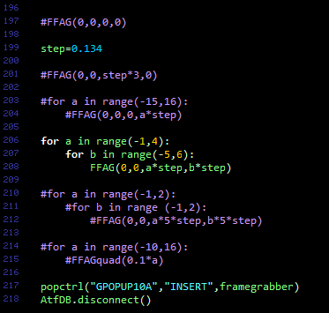
Source Code

