Slide 1
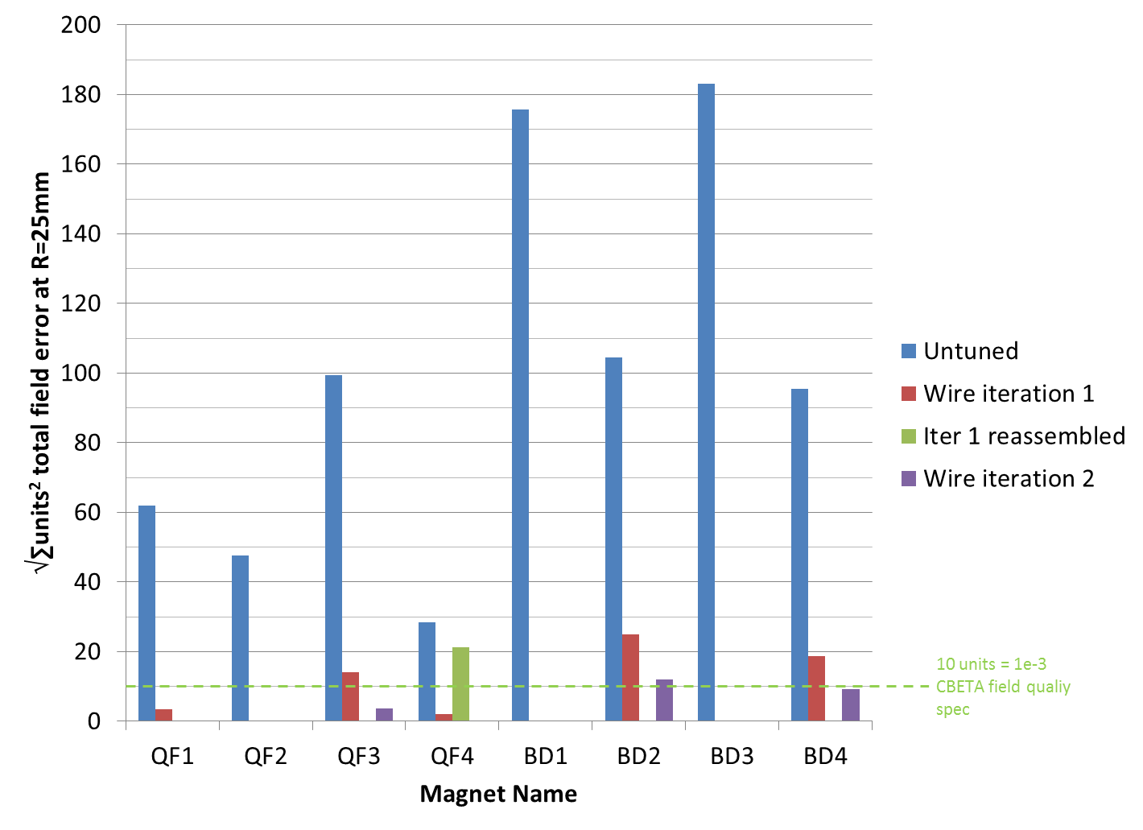
Rotating Coil Results Summary
A = Shimmed with 64x 63mil wires, to arbitrary quad strength
B = Shimmed with 64x 80mil wires, to approximate final strength up to temperature variations in bldg. 902 hall
B
B
B
A
A

Slide 2
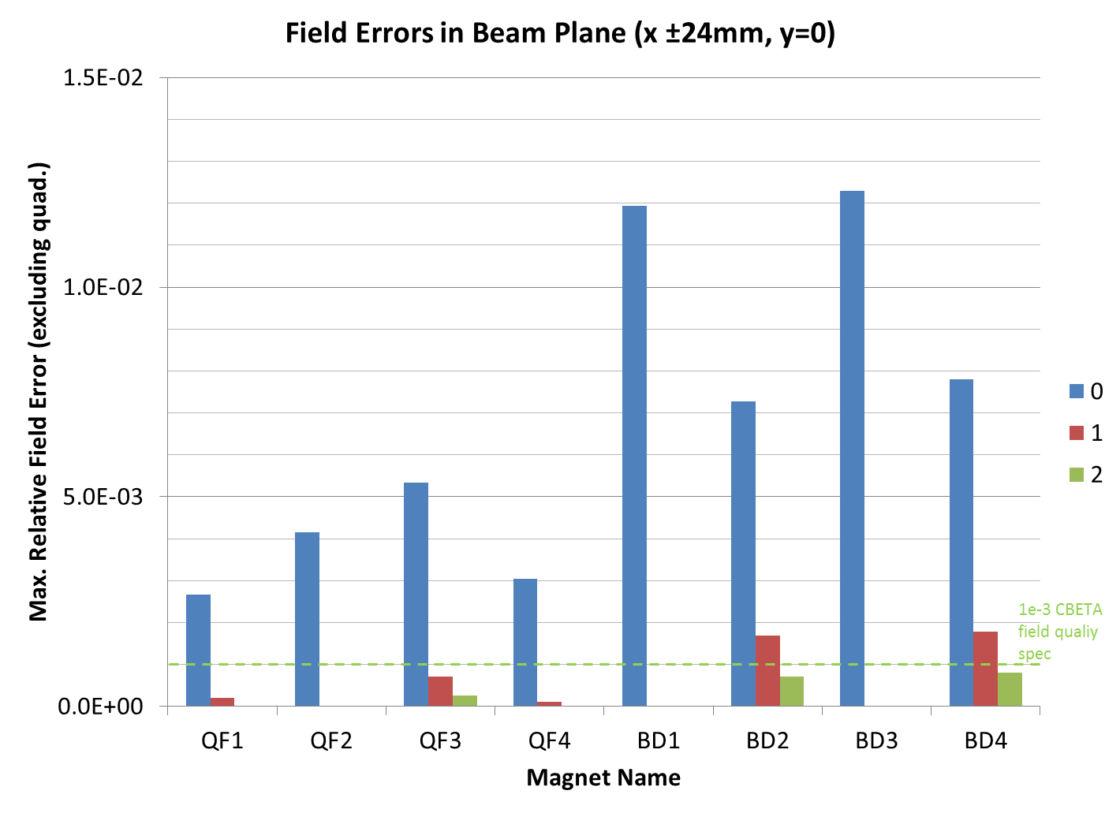
This excludes quadrupole drift from the currently-uncontrolled temperature.
Difference from previous chart comes from taking the max. error on a line rather than √2*RMS on a circle.

Slide 3
Magnet Development Tasks
Task | Status
Multipole reduction | Done for 3 QF magnets. Showed 8-10x improvement but still marginal to spec for 2 BD magnets. May not be possible for other BDs due to construction errors.
Temperature control & field stability | This test is planned as soon as John Cintorino has time to do it.
Strength tuning | Some rough control demonstrated but needs water cooling to do well, this test is planned.
Reassembly repeatability | Did not work well due to construction errors in QF4. Maybe try a better-made magnet?
Effect of window-frame | This test can be done in future. Just need to ensure window-frame does not move multipoles outside tuning range.

Slide 4
BACKUP

Slide 5
FFAG preproduction magnet tests and production testing plan
“Preproduction” = “First girder”

Slide 6
Magnets Made So Far
“ATF/PoP” magnets (6x QF, 6x BD, half length)
  Based on old 250MeV CBETA design
  Slightly smaller bores, unequal for QF and BD
“First girder” magnets (4x QF, 4x BD, 2 layers)
  Based on 150MeV “v3” design, few % different
  Full aluminium surround (stronger)
  Splittable into halves
    Requires use of glue and metal alignment pins
  Water cooling
FFAG’16 talk
IPAC’17 paper
Backup slides

Slide 7
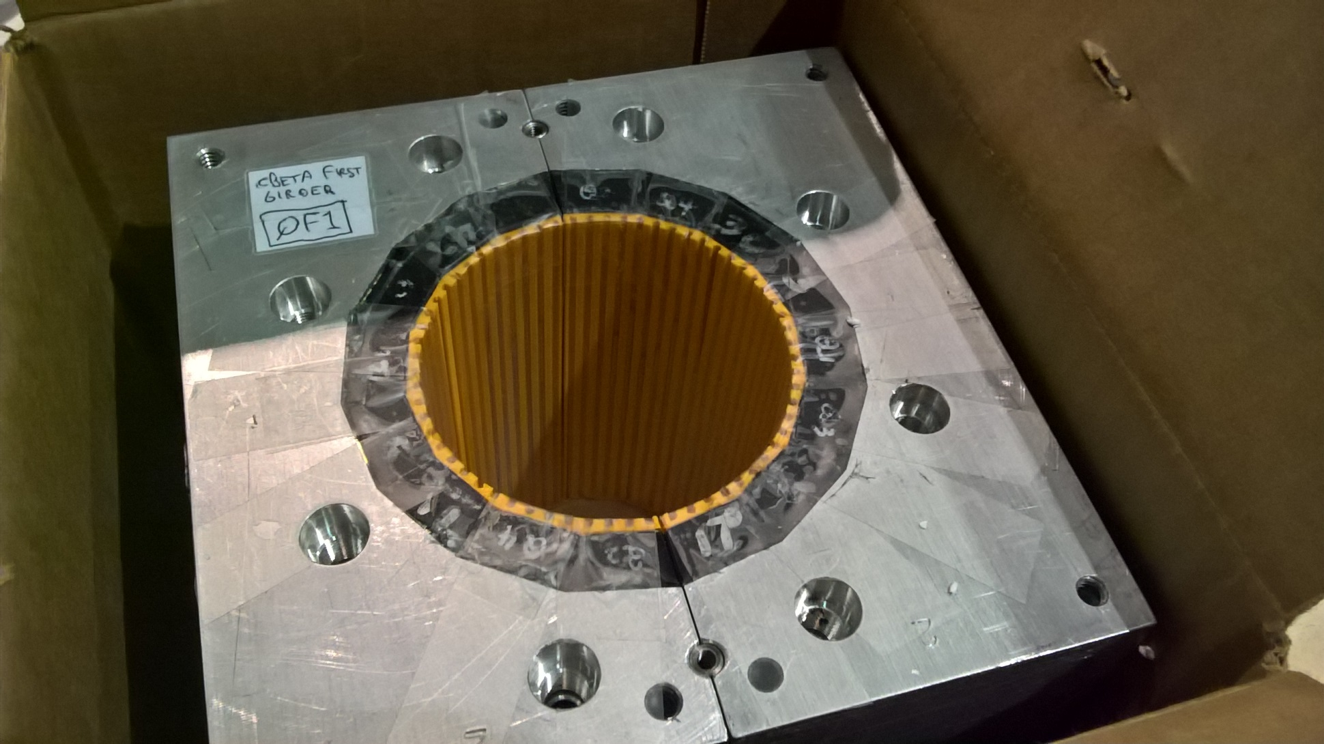
Example First Girder QF

Slide 8
Bad News First
During assembly, after gluing, but before measurement, ~1mm size errors were observed by eye
  Compare ±0.25mm (0.01”) position tolerance
Strategic decision to meet April 30th milestone deadline with “sub-optimal” assembly
  Instead of halting production, finding and fixing the flaw before continuing & being 1-2 weeks late
    In production I hope we choose the latter path

Slide 9
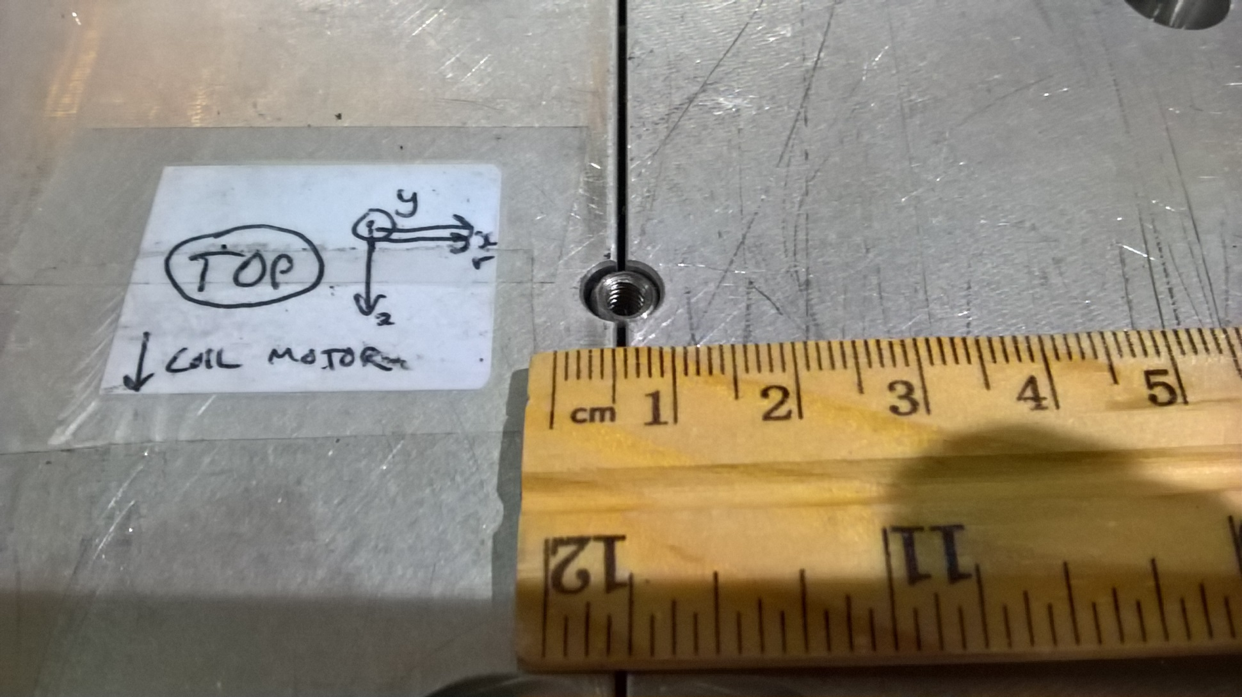
“Panel Gap” Problem (QF4)

Slide 10
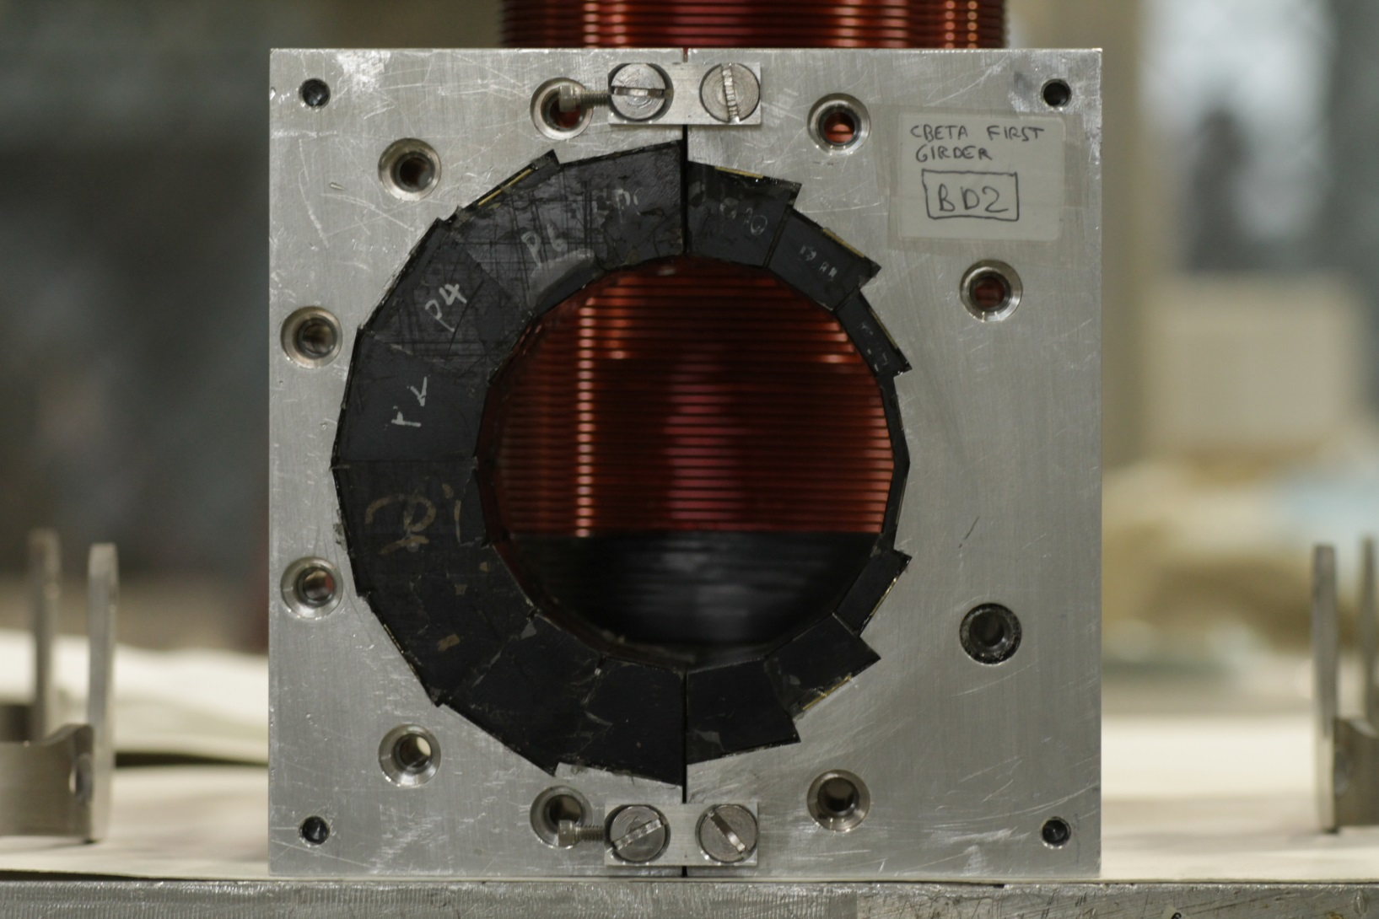
“Panel Gap” Problem (BD2)
Steve Bellavia’s photograph

Slide 11

“Panel Gap” Problem (BD2 zoom)

Slide 12
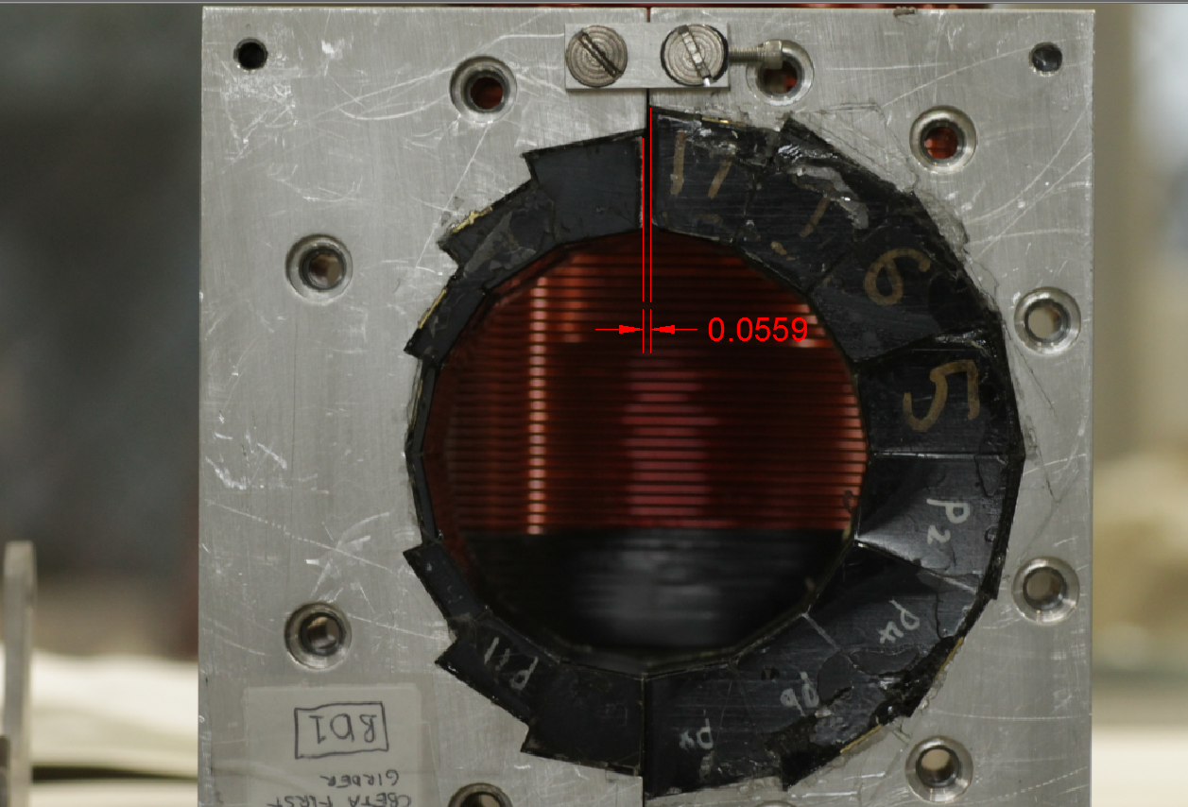
Gap Size from Photography
1.42mm

Slide 13
Fault Tree Investigated
Aluminium halves not touching
  Jammed on alignment pins? No (can happen but fixes itself under force)
  Dirt or glue between halves? Some, but gap remained after careful cleaning of surfaces
  Permanent magnets protruding? Yes: halves are resting on corners/sides of end magnets
    Gradual creep of epoxy glue? No, as far as we can tell
    Misplacement during gluing? Most likely explanation

Slide 14
Misplacement During Gluing
What should happen
What did happen (current theory)
Blue layer is ~1/8” Teflon added to prevent glue adhering to the ½” aluminium plate below
With the two end blocks allowed to move outwards, the rest of the blocks are no longer packed tightly (with the brass shims) so position errors can be everywhere

Slide 15
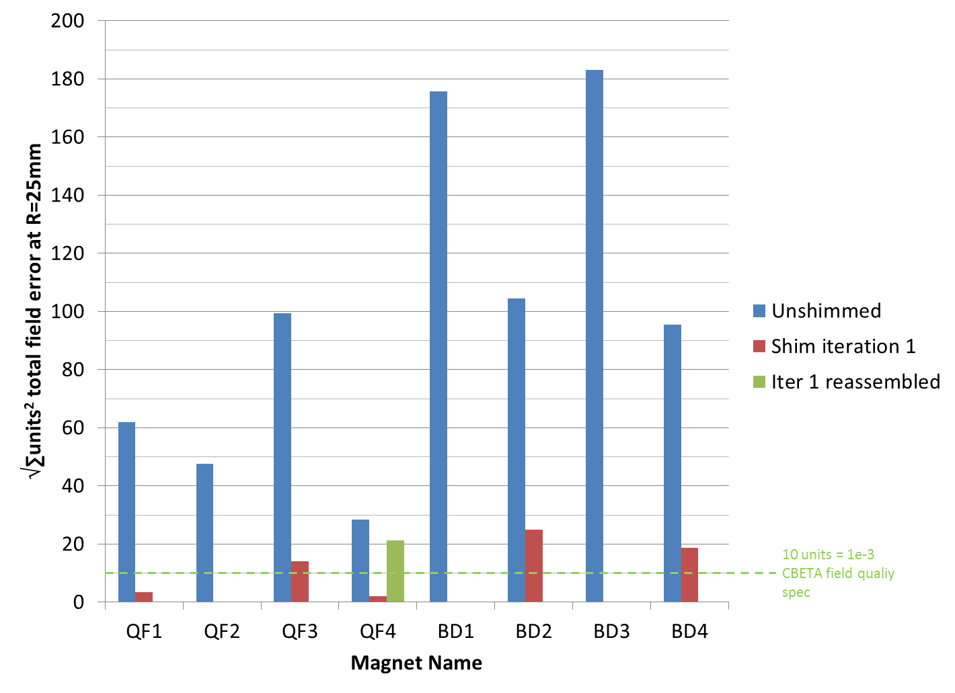
Rotating Coil Results Summary

Slide 16
Rotating Coil Results Summary
A = Shimmed with 64x 63mil wires, to arbitrary quad strength
B = Shimmed with 64x 80mil wires, to approximate final strength up to temperature variations in bldg. 902 hall
B
B
B
A
A

Slide 17
“Panel Gap” Problem (QF4)
This is why reassembly relying on the alignment pins didn’t work well

Slide 18
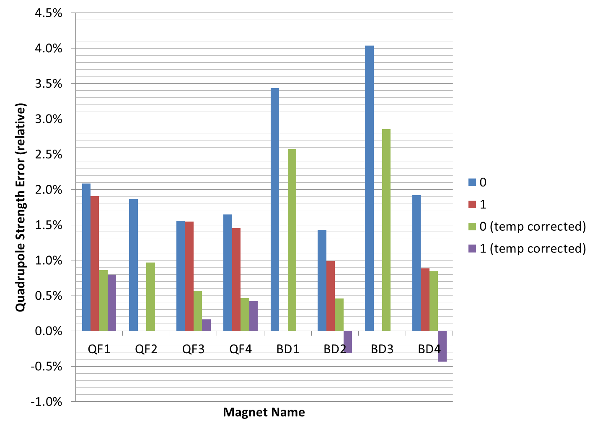
Quadrupole Strength Errors
A = Shimmed with 64x 63mil wires, to arbitrary quad strength
B = Shimmed with 64x 80mil wires, to approximate final strength up to temperature variations in bldg. 902 hall
A
B
B
A
B

Slide 19
Conclusions (whole magnets)
Iron wire tuning works well as long as the original magnet is “within range”
Reassembly won’t be repeatable until we have better construction
To-do:
  Water cooling test (time constant, ripple)
  Absolute strength tuning (requires water cooling)
  Possible rebuild/modification of a magnet

Slide 20
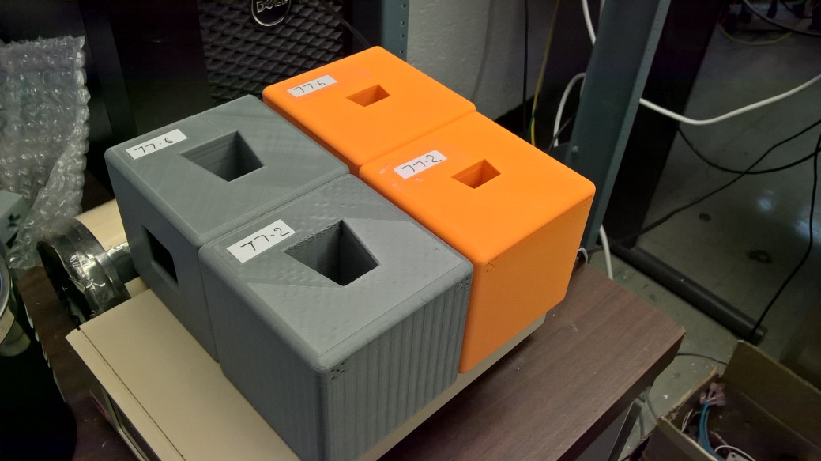
Helmholtz Tests
Thanks to Steve Trabocchi
All the individual PM blocks for the first girder were measured in a 3-axis Helmholtz coil
32 blocks per magnet * 12 magnets = 384 blocks (we had spares)
3D printed holders for each block type

Slide 21
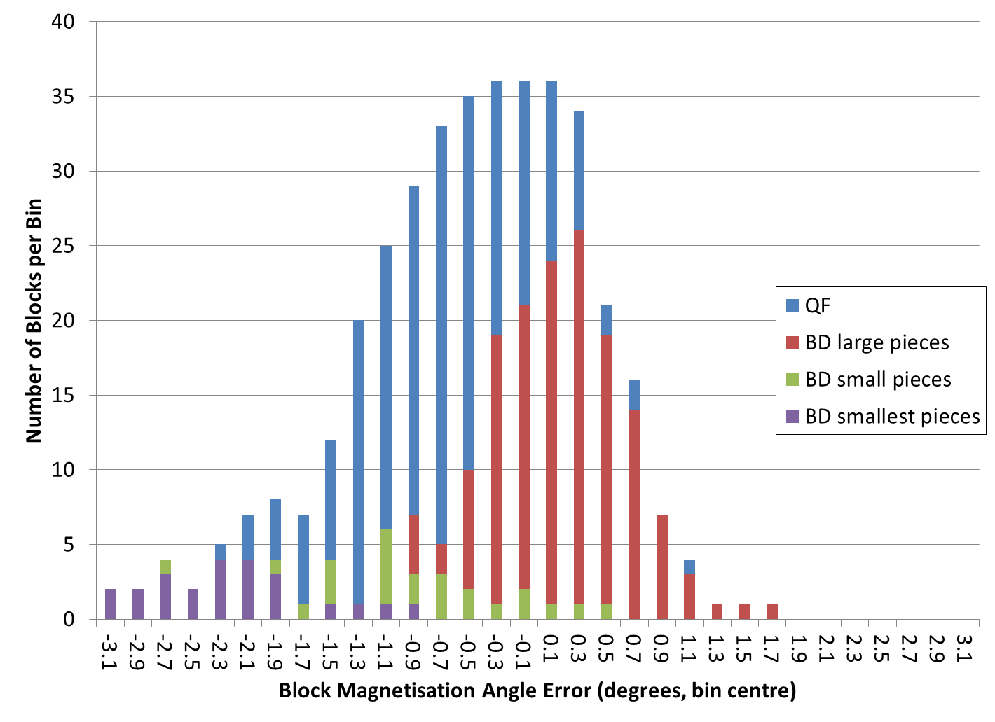
Magnetisation Angle Errors

Slide 22
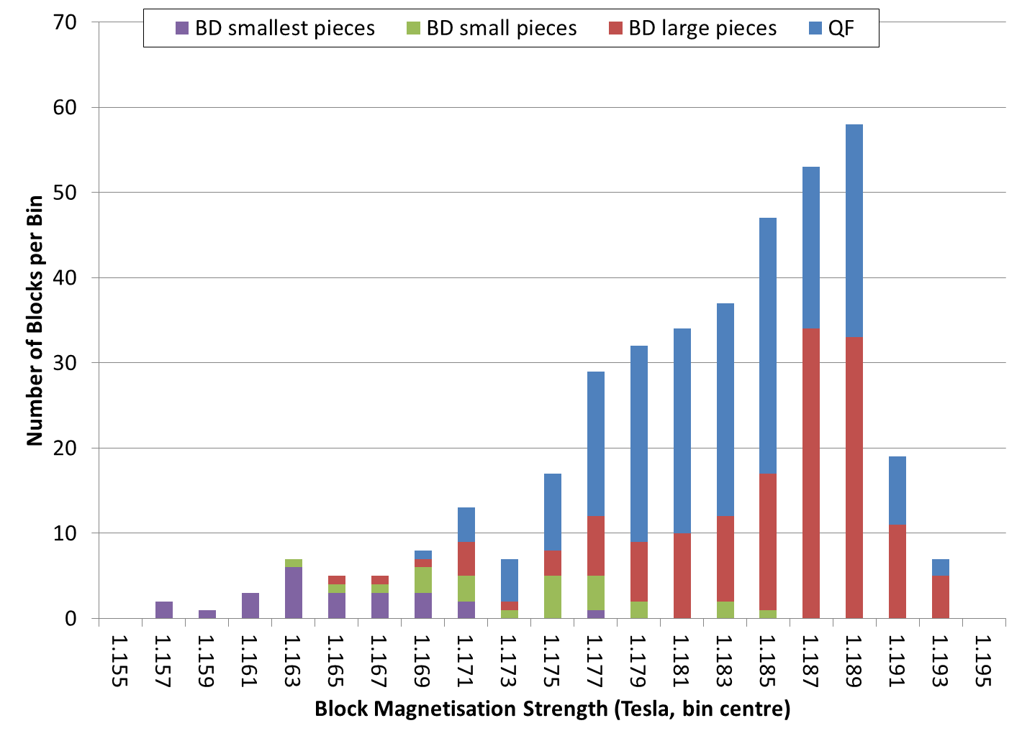
Magnetisation Strength

Slide 23
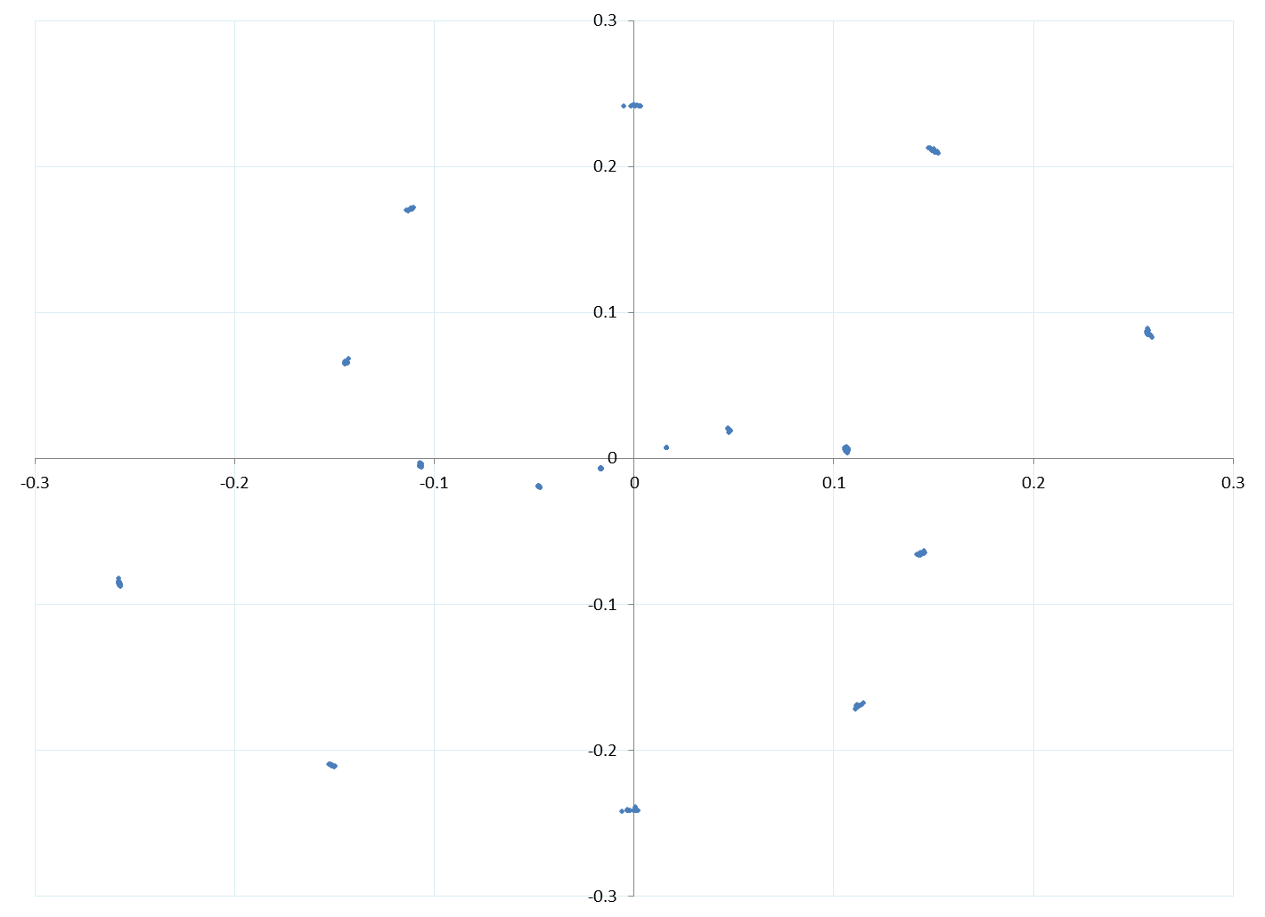
Flux Vector (BD pieces)

Slide 24
Expected vs. Spec
Block Type | Quantity | Average | St.Dev. | RMS | Spec.
QF all | Strength (T) | 1.18275 | 0.00508 (0.429%) | n/a | Average 1.17—1.22 σ ≤ 0.6%
QF all | Angle error (°) | -0.70164 | 0.61195 | 0.92996 | RMS ≤ 1%
BD (P1-12) | Strength (T) | 1.18495 | 0.00553 (0.466%) | n/a | Average 1.17—1.22 σ ≤ 0.6%
BD (P1-12) | Angle error (°) | 0.18826 | 0.47064 | 0.50537 | RMS ≤ 1%
BD all | Strength (T) | 1.18109 | 0.00892 (0.756%) | n/a | Relax on smallest blocks
BD all | Angle error (°) | -0.24124 | 0.96941 | 0.99652
Spec. values from CBETA note 10

Slide 25
Conclusions (Helmholtz)
Results were good
  Mean and standard deviation as expected
  In both block strength and magnetisation angle
  No weird long tails: normal distribution or better
Iron wire tuning should work fine
The part we messed up in these magnets is construction, which is the part BNL is not going to do (the vendor will)

Slide 26
Production Testing Plan
Helmholtz measurements of at least ~10% of individual blocks
  Line item cost options: 100% done by vendor, or 10% done by vendor, or (fallback) 10% at BNL
Rotating coil measurement of whole magnets
  At least 2 measurements: before and after iron wire multipole tuning
  Needs water cooling circuit attached + corrector
  Most likely done at BNL as we have 10⁻⁵ coil
Determines initial thickness of brass inter-block shims
Can also course-correct brass shim thickness

Slide 27
BACKUP
Bellavia’s photo processing
First girder magnets design and ATF magnets results

Slide 28
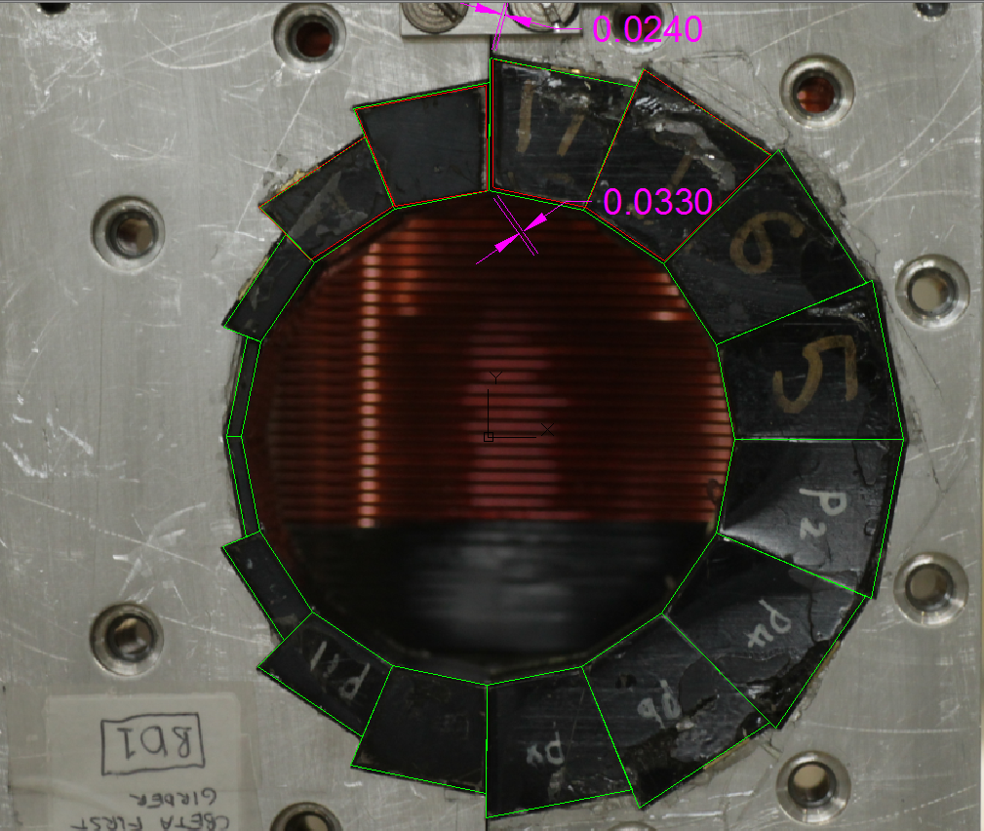
Bellavia photo processing (1/3)

Slide 29
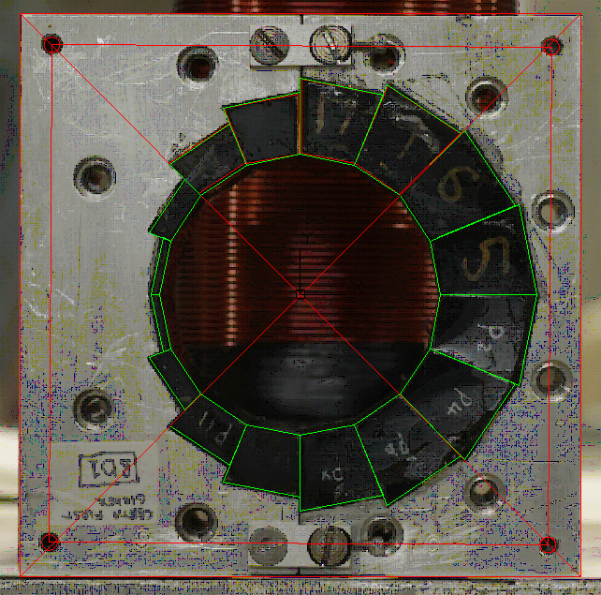
Bellavia photo processing (2/3)

Slide 30
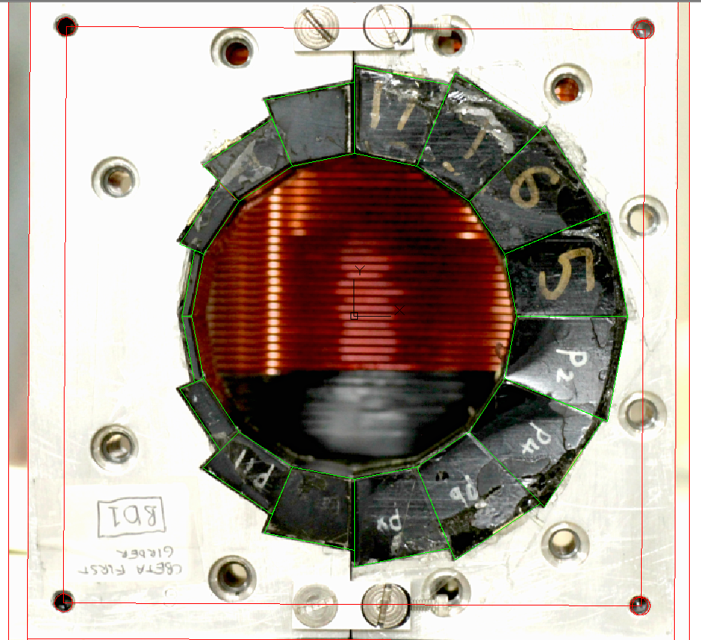
Bellavia photo processing (3/3)

Slide 31
FFAG Magnet Requirements & Specifications
Including results of Halbach proof-of-principle magnets and iron wire shimming

Slide 32
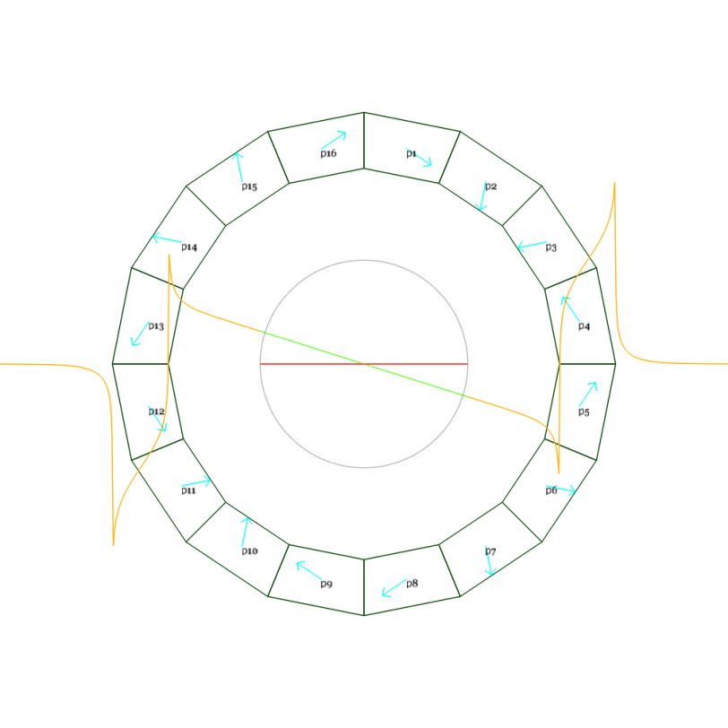
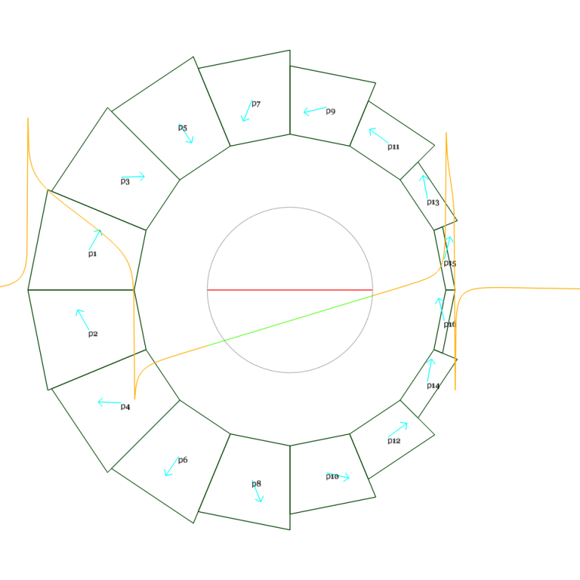
Magnetic Design
CBETA note #1
DR3.1.2
DR2.6.1
DR = Design Report
BP = Baseline Parameters
Magnet name | Length (mm) | Dipole at centre (T) | Quadrupole (T/m) | Radius to magnet pieces (mm) | Radius incl. shim holder (mm)
QF | 133.3 | 0 | -11.5 | 42.5 | 39.4
BD | 121.7 | -0.311 | 11 | 42.5 | 39.4
BP1.5

Slide 33
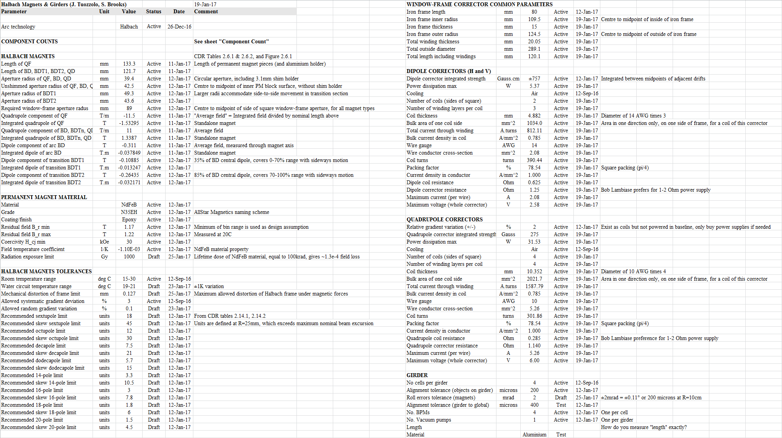
Baseline Parameter Sheet #1.5

Slide 34
Beam-Quadrupole Errors Path
Dotted lines only have a tiny contribution via sextupole feed-down
Magnet position errors
Magnet roll errors
±2mrad = ±0.11°
Conversion factor: 1 (skew)
BP1.5
Quadrupole errors on beams:
±0.2% skew from roll errors
±0.12% from temperature
±0.1% from strength errors
Temperature variation magnet blocks
±1.1K
Conversion factor:
NdFeB temperature coefficient = -1.1e-3/K
Magnet strength errors
±0.1%
Conversion factor: 1
BP1.5
Magnet multipole errors

Slide 35
Quadrupole Corrector not Powered
±0.22% quadrupole error and ±0.2% skew only produces a small beta ripple within the beam
  Acceptable without correction
Quad corrector is not powered in baseline
  Dipole-on-beam effects that feed down from the quadrupole errors can be corrected as “random” dipole errors as shown next
±2% quad corrector is included as an option if there is no water cooling (±18K range)

Slide 36
Beam-Dipole Errors Path
Corrector windings heat source
Magnet position errors
Air temperature variation
Dipole errors on beams (T)
Magnet roll errors
Water temperature variation
Temperature variation magnet blocks
Radiation damage
Block magnetisation angle errors
Magnet strength errors
Required dipole corrector field
Iron wire shimming
Block magnetisation strength errors
Magnet multipole errors
Assembly block placement errors
Each box is a value (or range size)
Each arrow is a conversion factor

Slide 37
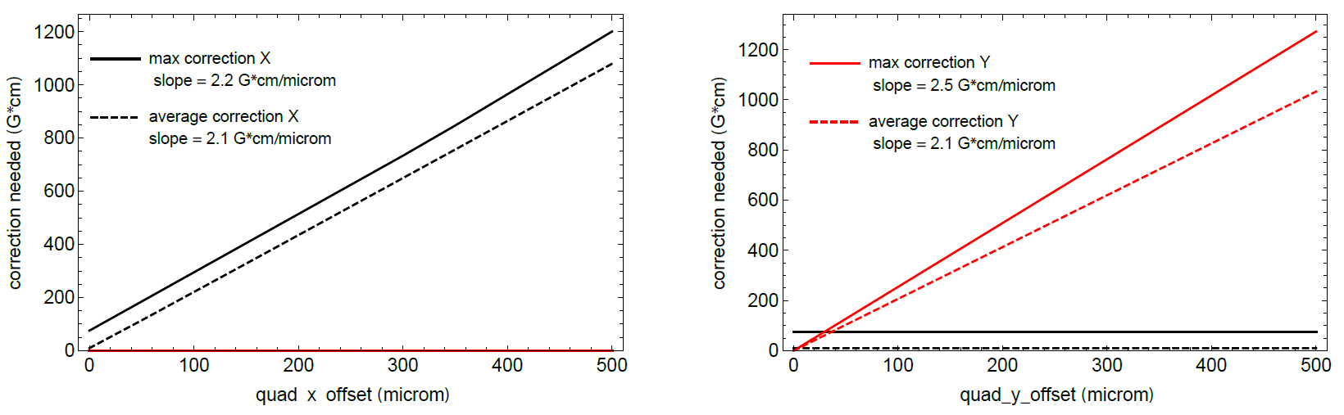
Correction Simulation Result
DR2.13
Simulations done by Chris Mayes using BMAD
2.1 Gauss.cm/(um offset), at >=11T/m
2.1 Gauss.cm/0.11 Gauss = 19.1 cm conversion factor to get integrated field

Slide 38
Required Correction Strength
This uses the current CBETA spec for the dipole corrector
Corrector is 12.01cm long
  Conversion factor is 1.59*L
Can rewire quadrupole coils as dipole for extra strength
Dipole errors on beams
±39.6 Gauss
Conversion factor:
19.1cm
Required dipole corrector field
±757 Gauss.cm
BP1.5
757 G.cm
757 G.cm
+quad
1342 G.cm

Slide 39
Position Errors
Conversion factor: gradient
11.5 T/m worst case
Magnet position errors
±200um
BP1.5
Dipole errors on beams:
±23.0G from position errors
±16.3G from roll errors
Magnet roll errors
±2mrad = ±0.11°
= ±200um at R=10cm
BP1.5
Conversion factor:
central dipole field + gradient * beam radius * 2
0.311 + 11*0.023*2 = 0.817 T worst case

Slide 40
Temperature
Corrector windings heat source
5.37W dipole + 31.53W quadrupole
= 36.9W
Conversion factor:
0.7mK/W
Temperature variation magnet blocks:
±0.99K from water
±0.08K from air
±0.03K from corrector
Total ±1.1K
BP1.5
Conversion factor: 0.01
Air temperature variation
15-30C = ±7.5K
Conversion factor:
relative temperature coefficient of NdFeB material * dipole field on beam
-1.1e-3/K * 0.564 T (worst case)
= 6.2 Gauss/K
BP1.5
Conversion factor: 0.99
Water temperature variation
19-21C = ±1K
BP1.5
Above factors are from George Mahler’s thermal simulations
Dipole errors on beams:
±6.8G

Slide 41
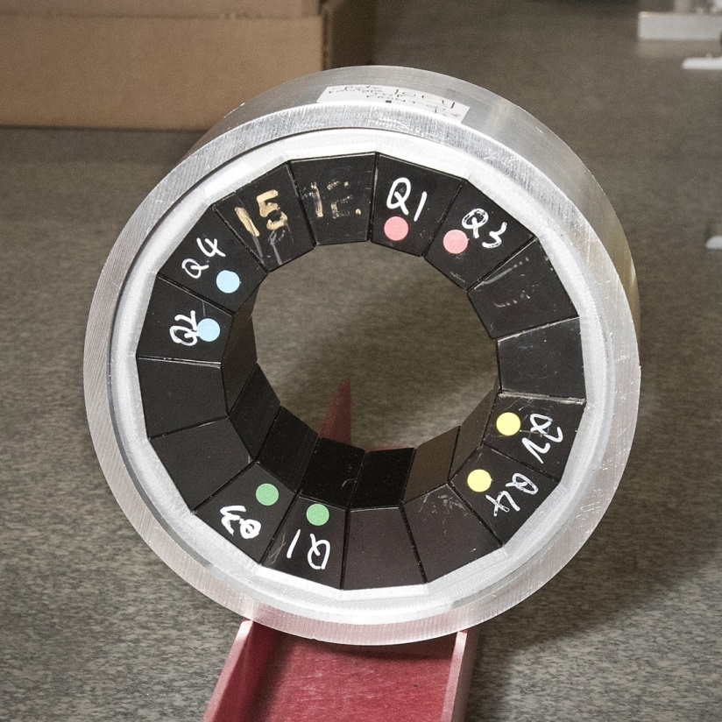
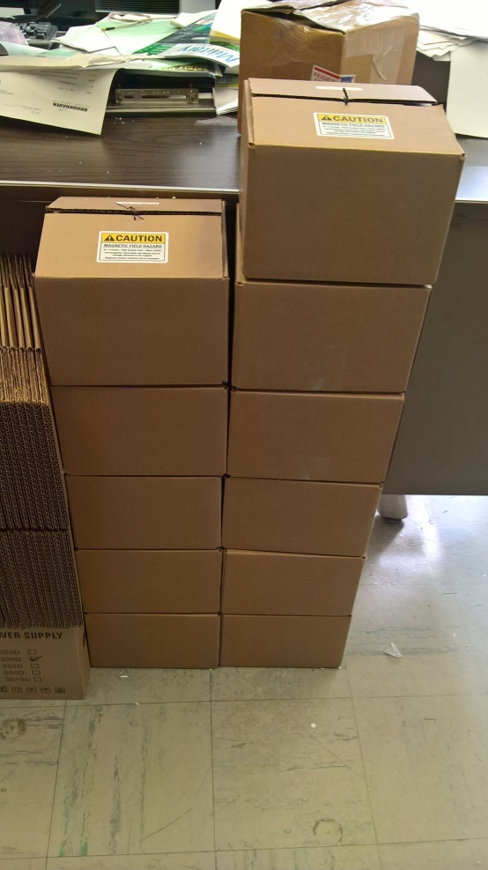
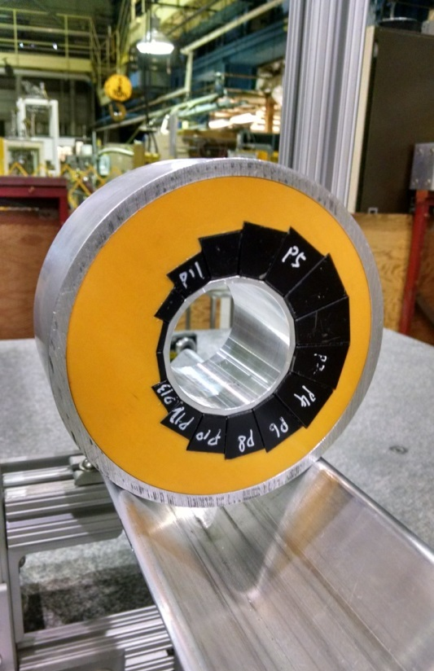
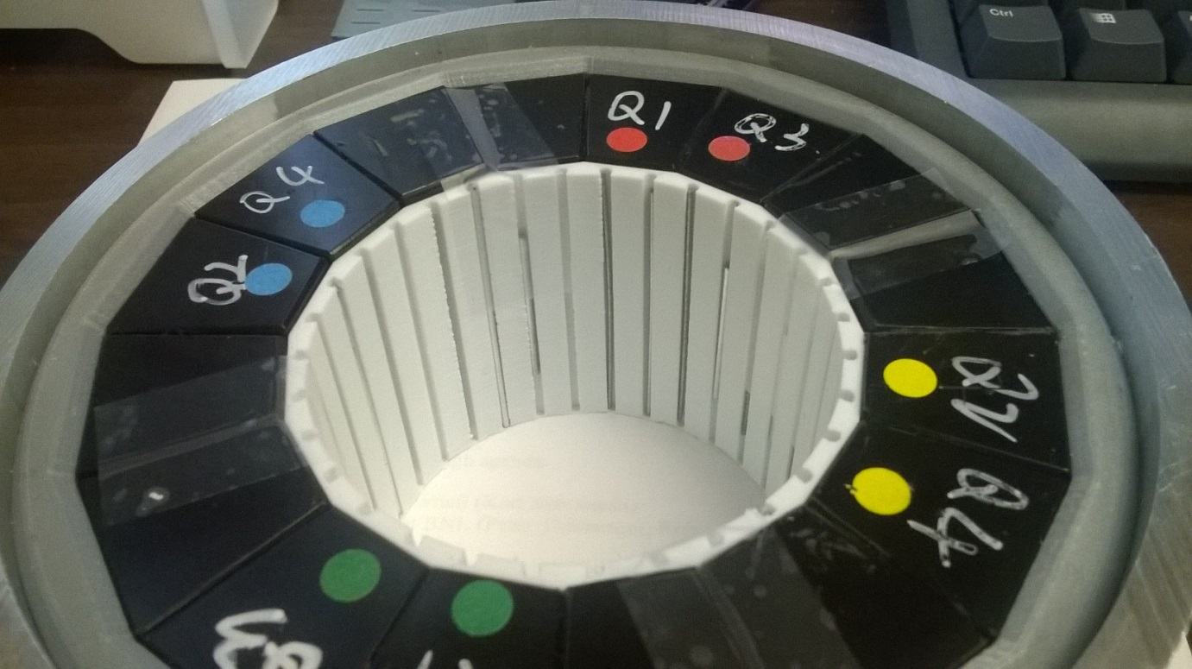
12 proof-of-principle magnets (6 QF, 6 BD) have been built as part of CBETA R&D.
Iron wire shimming has been done on 3 QFs and 6 BDs with good results.
PoP QF
PoP BD
PoP magnet series
Iron wire shims

Slide 42
Proof-of-Principle vs. CBETA
Parameter | CBETA QF | PoP QF | CBETA BD | PoP BD | Units
Length | 133.30 | 57.44 | 121.70 | 61.86 | mm
Gradient | -11.500 | -23.624 | 11.000 | 19.119 | T/m
Dipole at centre | 0 | 0 | -0.31100 | -0.37679 | T
Good field radius | 23.00 | 20.20 | 23.00 | 13.70 | mm
Blocks inner radius | 42.50 | 37.20 | 42.50 | 30.70 | mm
Blocks outer radius | 55.76 | 62.45 | 72.89 | 59.43 | mm
Max field in good field region | 0.265 | 0.477 | (-)0.564 | (-)0.639 | T
Max field at “pole tip” | 0.489 | 0.879 | (-)0.779 | (-)0.964 | T
NdFeB material grade | N35EH | N35SH | N35EH | N35SH
DR3.1.4

Slide 43
Magnet Quality
Iron wire shimming will reduce all initial multipole errors to about the same level unless they exceed a threshold
Block magnetisation angle errors
Initial factory guarantee: ±5°
New factory guarantee: ±3° and 80% within ±2°
Observed RMS: 1.14°
Conversion factor:
gradient * beam radius
11.5*0.023 = 0.2645 T worst case
Magnet strength errors
±0.1%
Dipole errors on beams:
±2.6G from strength errors
±2.6G from multipole errors
Block magnetisation strength errors
Factory guarantee: ±2.1%
NB: mean could be shifted in this range even if RMS is small
Observed RMS: <2%
Iron wire shimming
BP1.5
Magnet multipole errors
~10⁻³ (10 units) at R=25mm
Assembly block placement errors
Estimated: 0.25mm
New aluminium frame gives <0.13mm flex
Detailed multipole tolerances on following slides but for previous lattice, so may change slightly

Slide 44
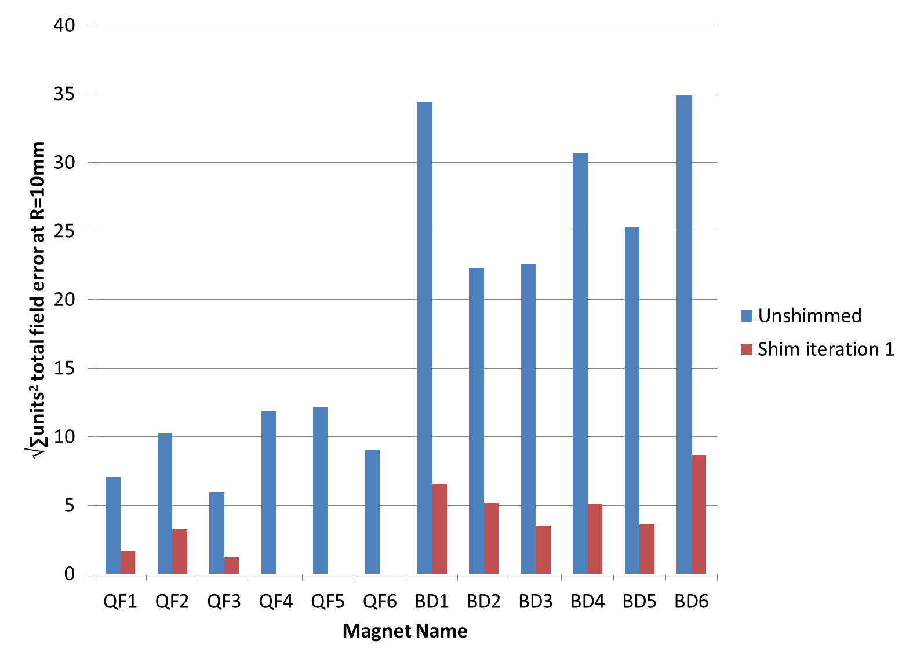
Iron Wire Shimming Improvement
DR3.1.4
Factor of ~4 reduction regardless of starting value
2nd iteration improved further in previous R&D:
29.62 → 6.69 → 1.94

Slide 45
Multipole Error Simulations
DR2.14.6
Effectively, the multipoles just create another combination of dipole errors on each beam
Chris Mayes did the study in BMAD
Created tables of recommended multipoles
Magnet multipole errors
Dipole errors on beams (T)
Beam dynamics
Required dipole corrector field

Slide 46
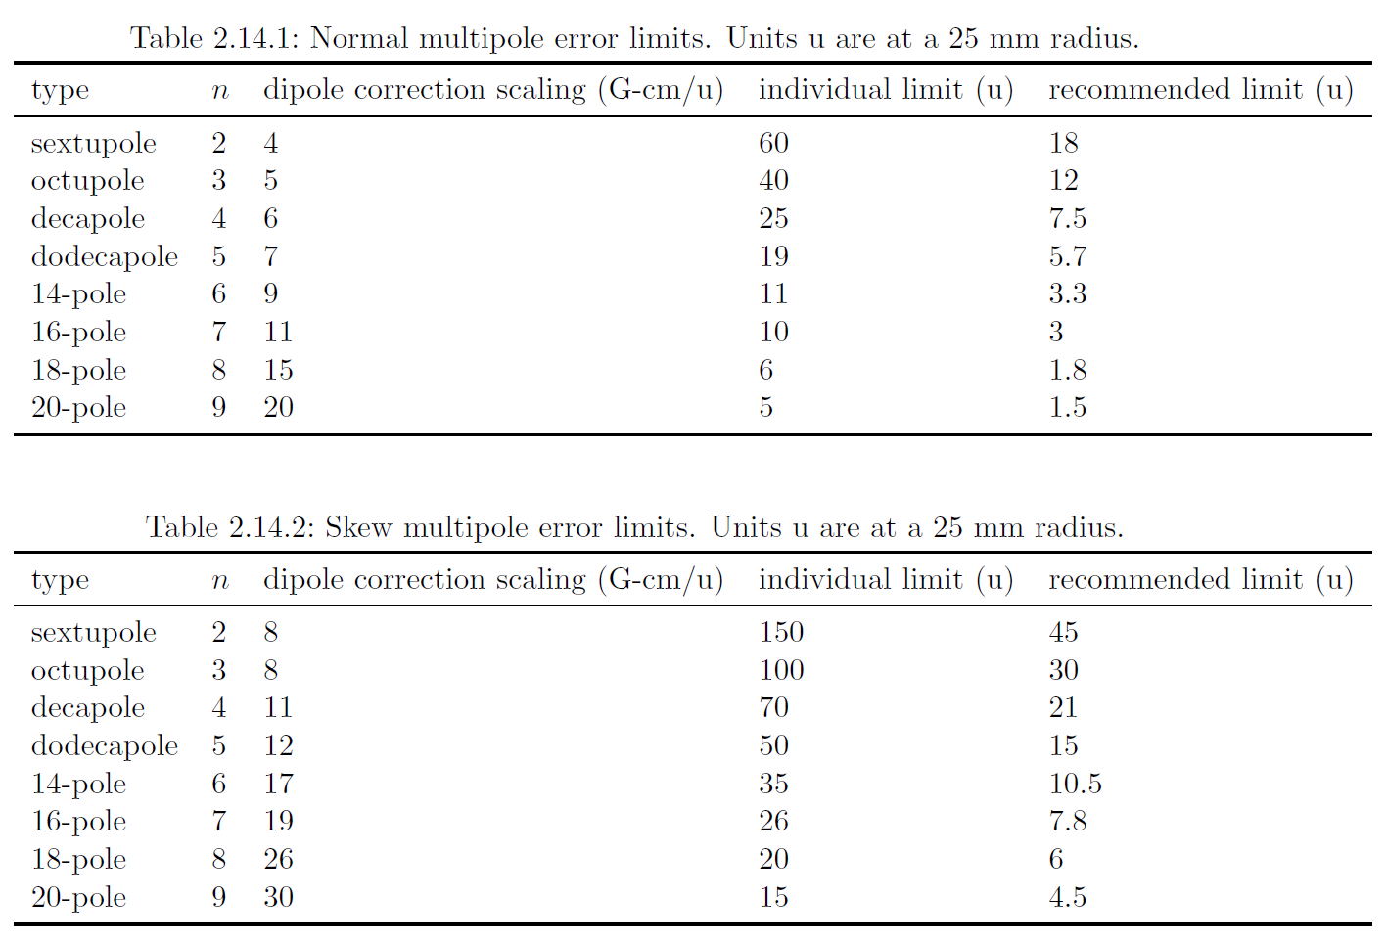
Multipole Tolerances
DR2.14.6

Slide 47
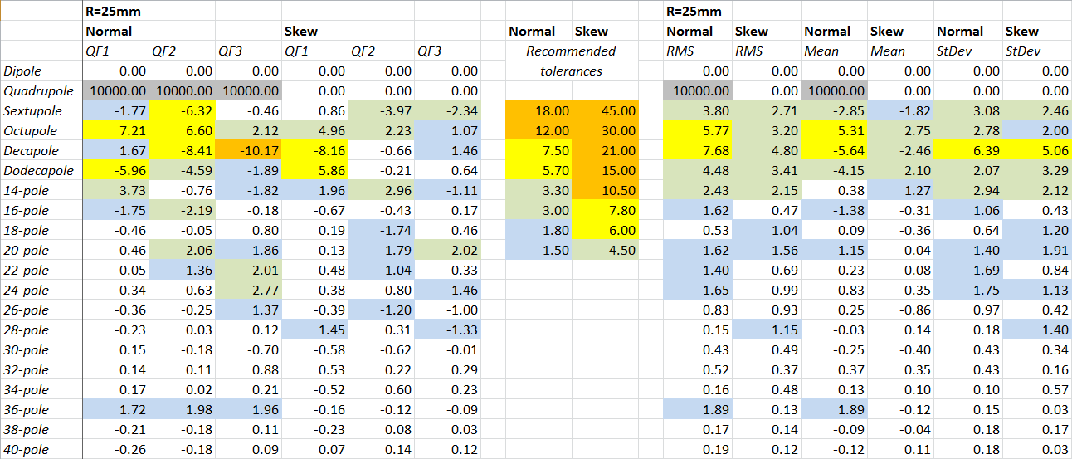
Iron Wire Shimmed QF Results
Below ~10 units at R=25mm, equivalent to 0.1% of main strength
DR3.1.4

Slide 48
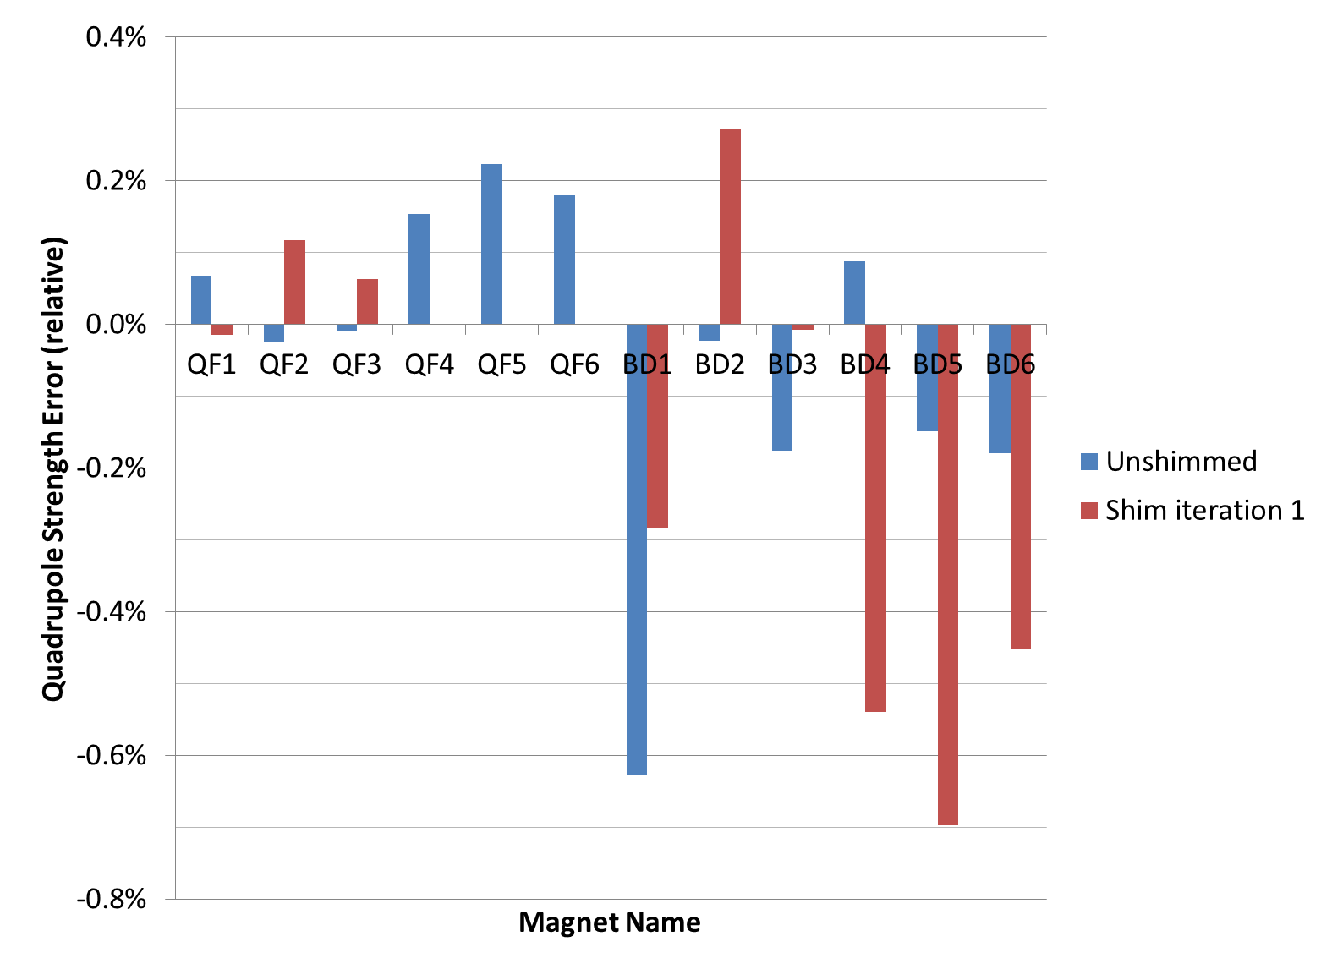
Quadrupole Variation
Larger than 0.1% strength variation
What is different?
Not a ratio: absolute strength, affected by temperature coeff.
DR3.1.4

Slide 49
Improving Strength Consistency
The proof-of-principle magnets had no temperature control during measurement
  Expect 0.11% per K difference between initial unshimmed measurement and re-measurement
  Largest is equivalent to 6.3K difference (902 Hall)
  For first girder magnets will run water circuit
Could also use “reference” magnet mounted backwards on same rotating coil
  Iron wire shim total quadrupole to zero

Slide 50
Improving Average Strength Offset
CBETA note #1
Magnets are designed for low end of stated magnetisation range (“too much” material)
Weakened by moving blocks radially outwards by up to 0.8mm with inter-block Al shims
  Compensates whole-batch average strength
Magnet | Radial block displacement (mm) | Dipole (T) | Quadrupole (T/m) | Change in dipole (%) | Change in quadrupole (%)
QF | 0 | 0 | -11.5
QF | 1 | 0 | -10.8414 | - | -5.727%
BD | 0 | -0.311 | 11
BD | 1 | -0.29991 | 10.4222 | -3.566% | -5.253%

Slide 51
Radiation Tolerance
Lifetime dose limit of 1kGy = 100krad
  10 rad/h at beam pipe average over 10000 hours
  Easily monitorable with dosimeters
Conversion factor:
0.2645 T worst case
Radiation damage
1kGy = 100krad
Magnet strength errors
-1.3 × 10⁻⁴
Dipole errors on beams:
0.36G
BP1.5
Conversion factors:
1% / 74.5kGy
= 0.134/MGy
Magnet multipole errors
1.3 units at R=25mm

Slide 52
Recap: Beam-Dipole Errors Path
Corrector heat source
36.9W
0.7mK/W
Magnet position errors
±200um
11.5 T/m
BP1.5
BP1.5
Air temperature variation
±7.5K
Magnet roll errors
±2mrad = ±0.11°
Dipole errors on beams
Total ±52.0G
0.01
BP1.5
BP1.5
0.817 T
Water temperature variation
±1K
0.99
Temperature variation magnet blocks
Total ±1.1K
BP1.5
19.1cm
6.2 G/K
Radiation damage
1kGy
0.134/MGy
Block magnetisation angle errors
±3° and 80% within ±2°
BP1.5
Magnet strength errors
±0.1%
Required dipole corrector field
±993 Gauss.cm
Iron wire shimming
BP1.5
0.2645 T
Block magnetisation strength errors
±2.1%
Magnet multipole errors
~10 units at R=25mm
0.2645 T
Assembly block placement errors
Estimated: 0.25mm
Each box is a value (or range size)
Each arrow is a conversion factor

Slide 53
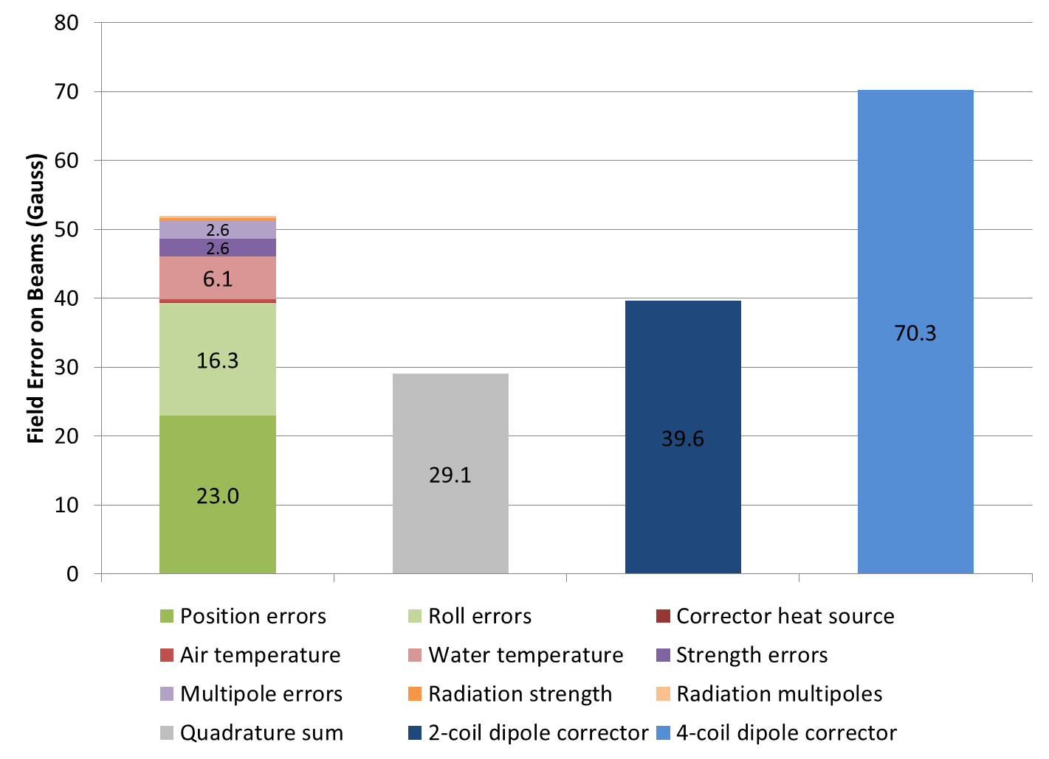
Dipole Error Contributions
BP1.5
1342 G.cm
757 G.cm

Slide 54
Conclusion
All sources of field error on the beam have been estimated
Corrector strength required per unit field error is known from simulations
These have been put into a corrector budget
  We can correct the worst case with the hardware that is currently in our costing

Slide 55
BACKUP

Slide 56
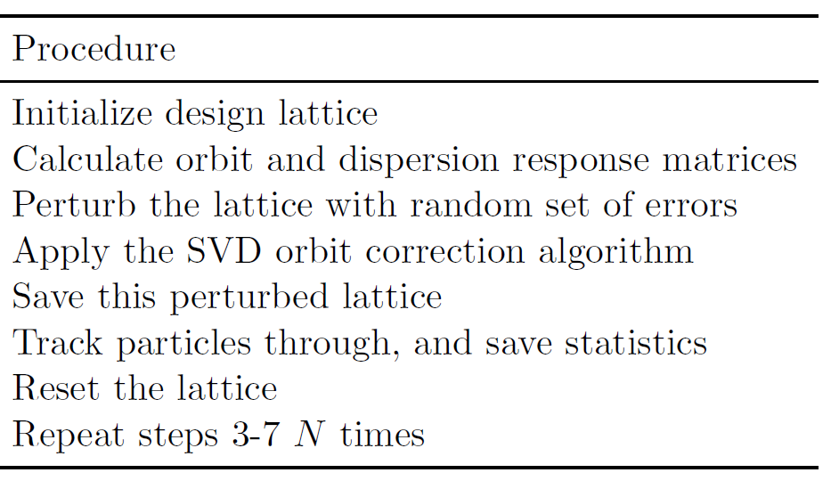
Correction Simulations
Simulations done by Chris Mayes using BMAD
Dipole errors on beams (T)
DR2.13
Beam dynamics
Required dipole corrector field
(N=100)

Slide 57
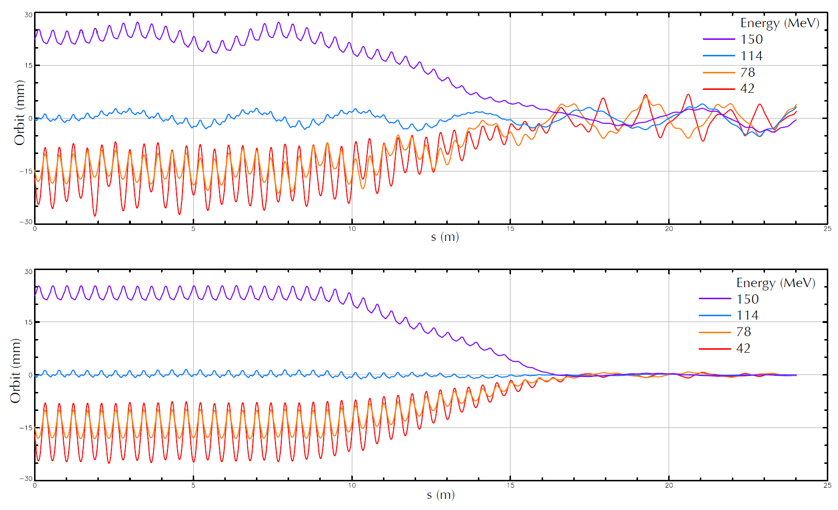
Orbit Correction of 4 Beams
DR2.13

Slide 58
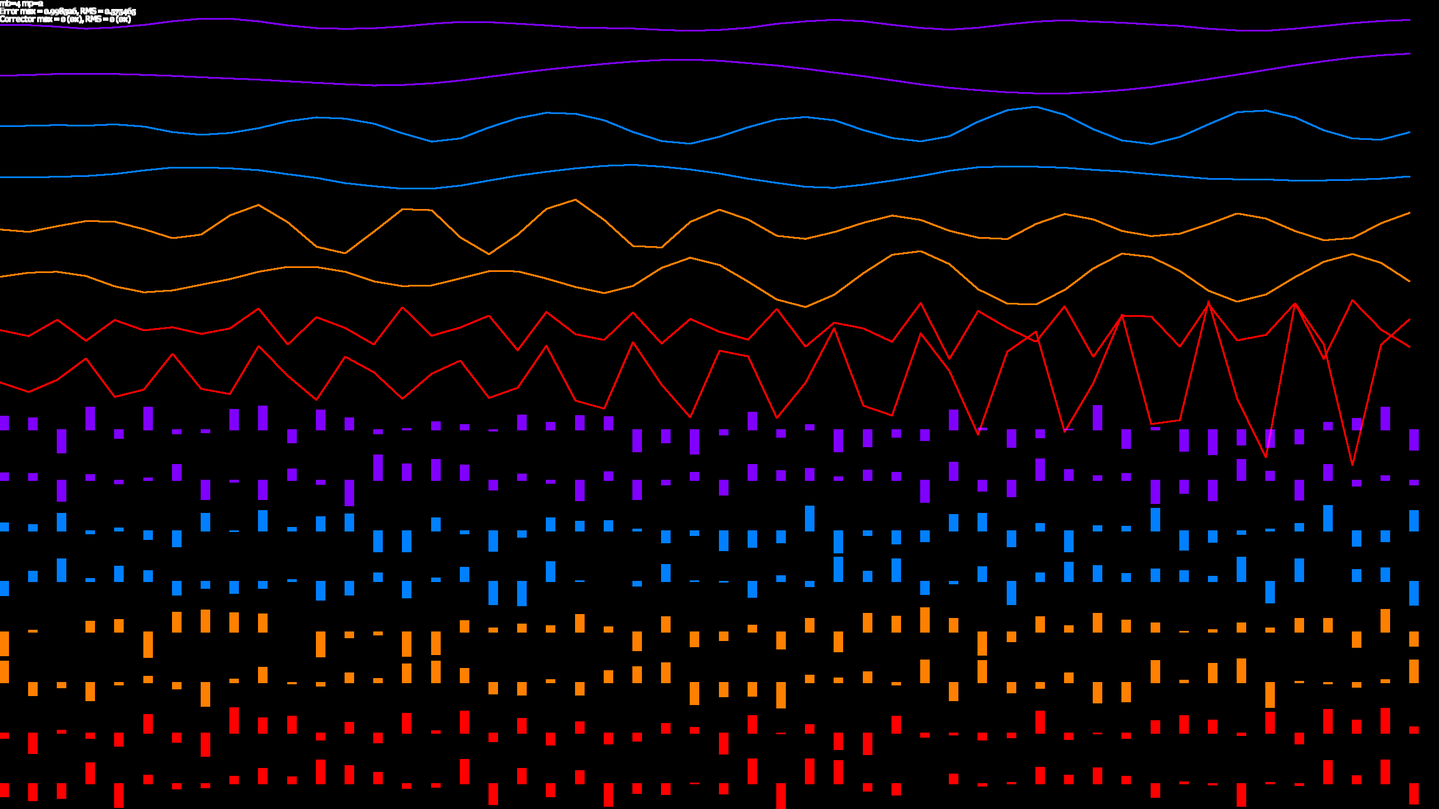
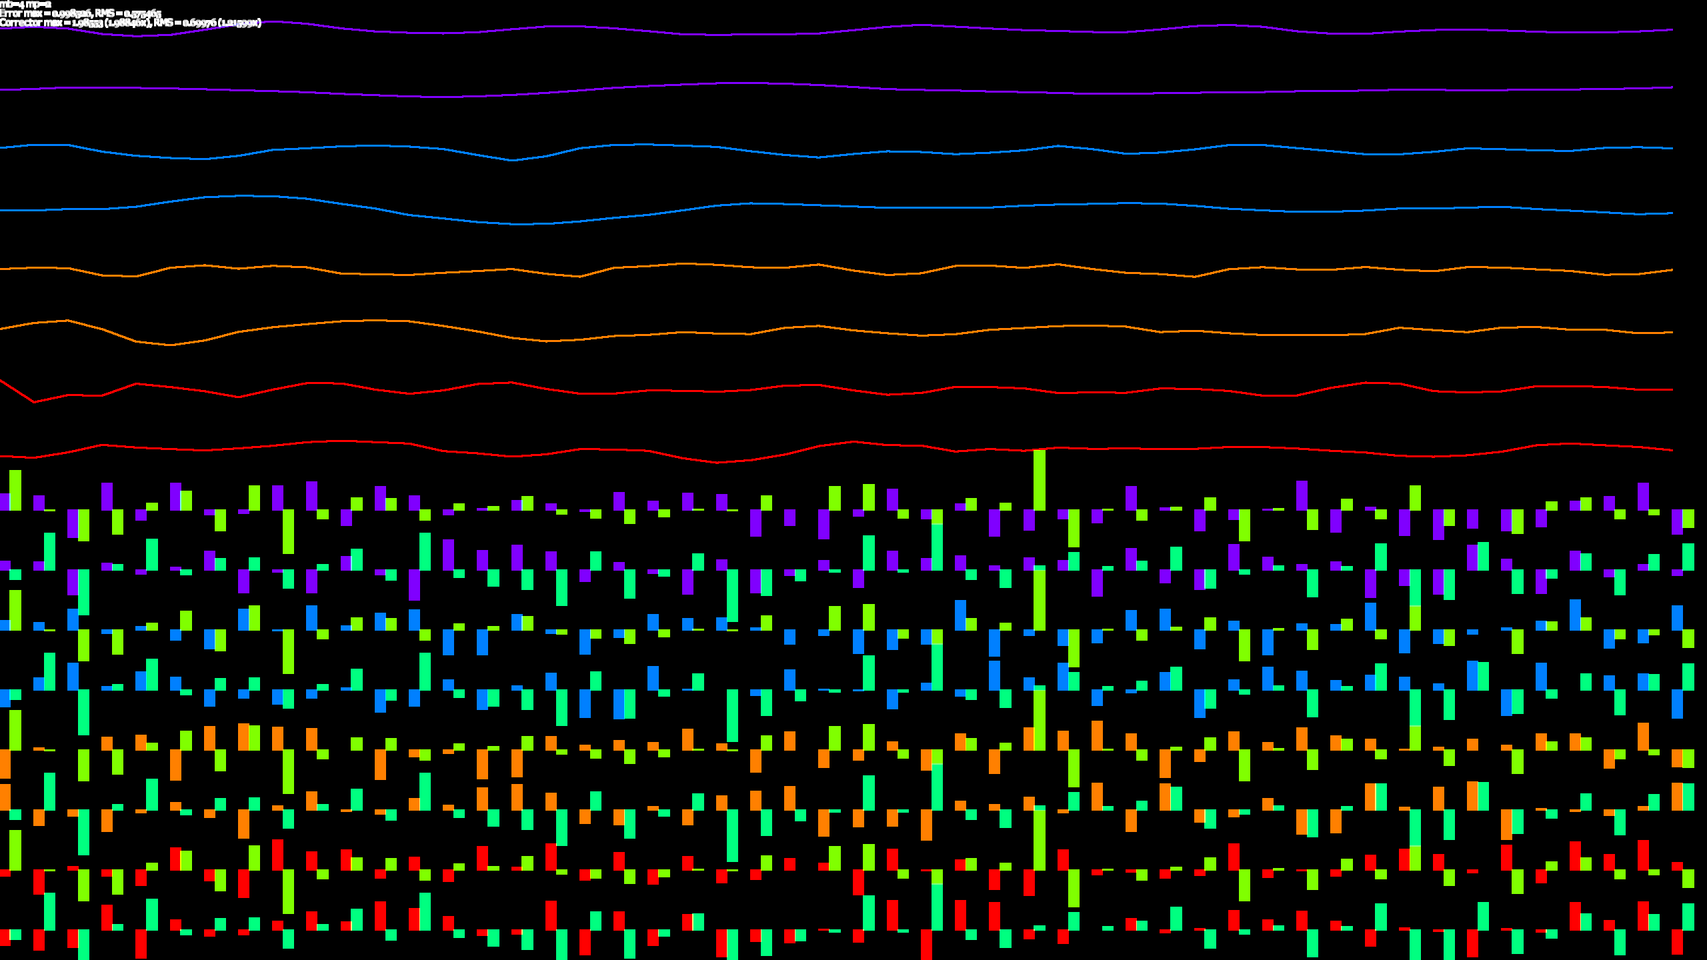
Herding Cats
Before correction
After correction

Slide 59
Herding Cats
After correction
Same X, Y correctors on all 4 beams
Beams have different phase advances
  Over >4 cells correctors become linearly independent on all beams
Max corrector 1.99x max error

Slide 60
Dipole Corrector Boost
Configuration | Coils | Amps | Volts | Watts | Ohms | Turns/coil | Amp.turns/coil | Dipole field (G.cm)
Power supply |  | 3 | 8 | 24 | 2.667
Dipole corrector | 2 | 2.08 | 2.58 | 5.366 | 1.240 | 390.4 | 812.1 | 757
Quad corrector | 4 | 5.26 | 5.995 | 31.53 | 1.140 | 301.9 | 1588 | 1480
Half of quad corrector | 2 | 5.26 | 2.998 | 15.77 | 0.5699 | 301.9 | 1588 | 1480
Dipole + half of quad Everything powered at 2.08A | 4 | 2.08 | 3.765 | 7.832 | 1.810 | 692.3 | 1440 | 1342
BP1.7 & quote
BP1.5
BP1.5

Slide 61
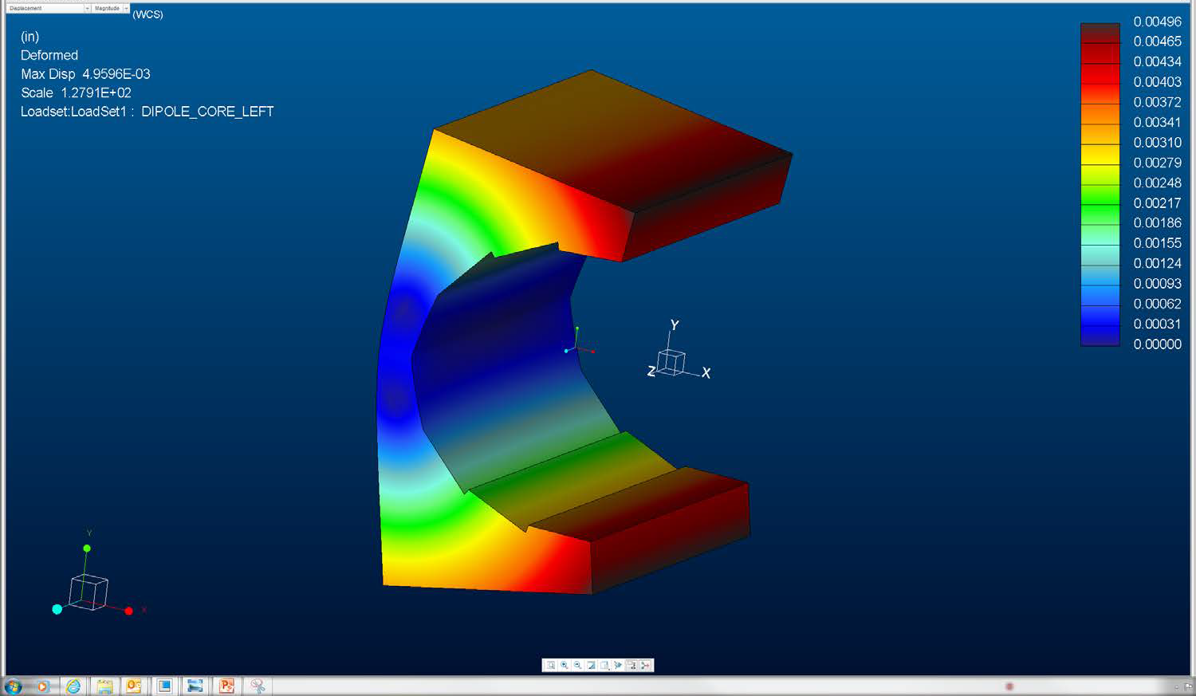
Mechanical Simulation (G. Mahler)
Maximum 0.005” deflection under magnet block forces
= 0.127mm << block random alignment errors in prototypes → shimming OK

Slide 62
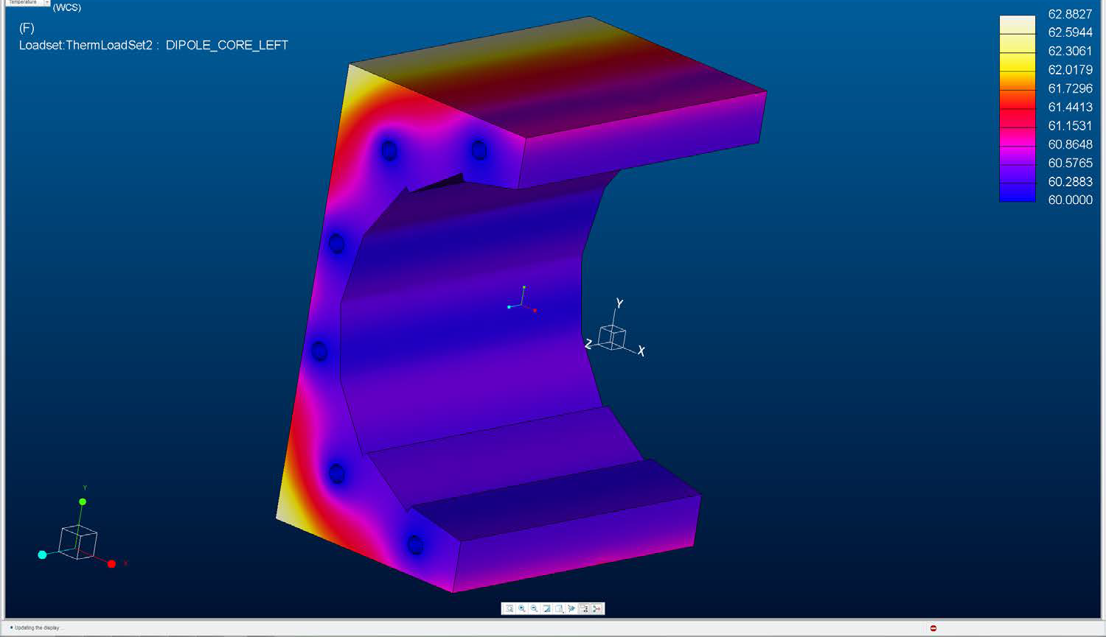
Thermal Simulations (G. Mahler)
60F water temp
5W/m² convection coefficient,
100W top, 50W each side
Maximum 0.5F variation at blocks
0.5F/400W = 0.7mK/W

Slide 63
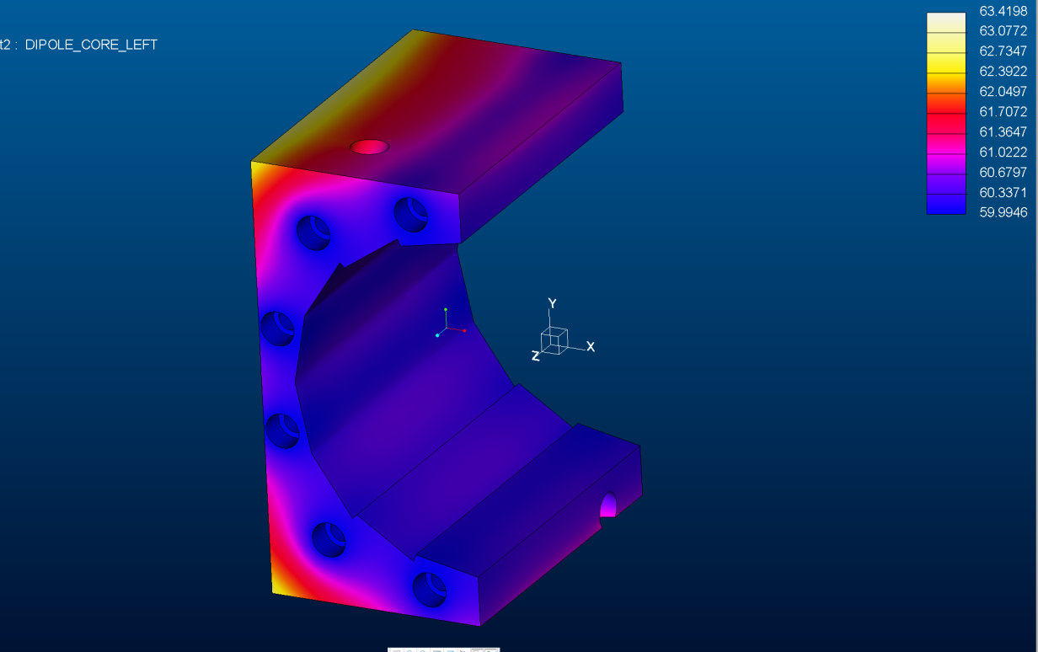
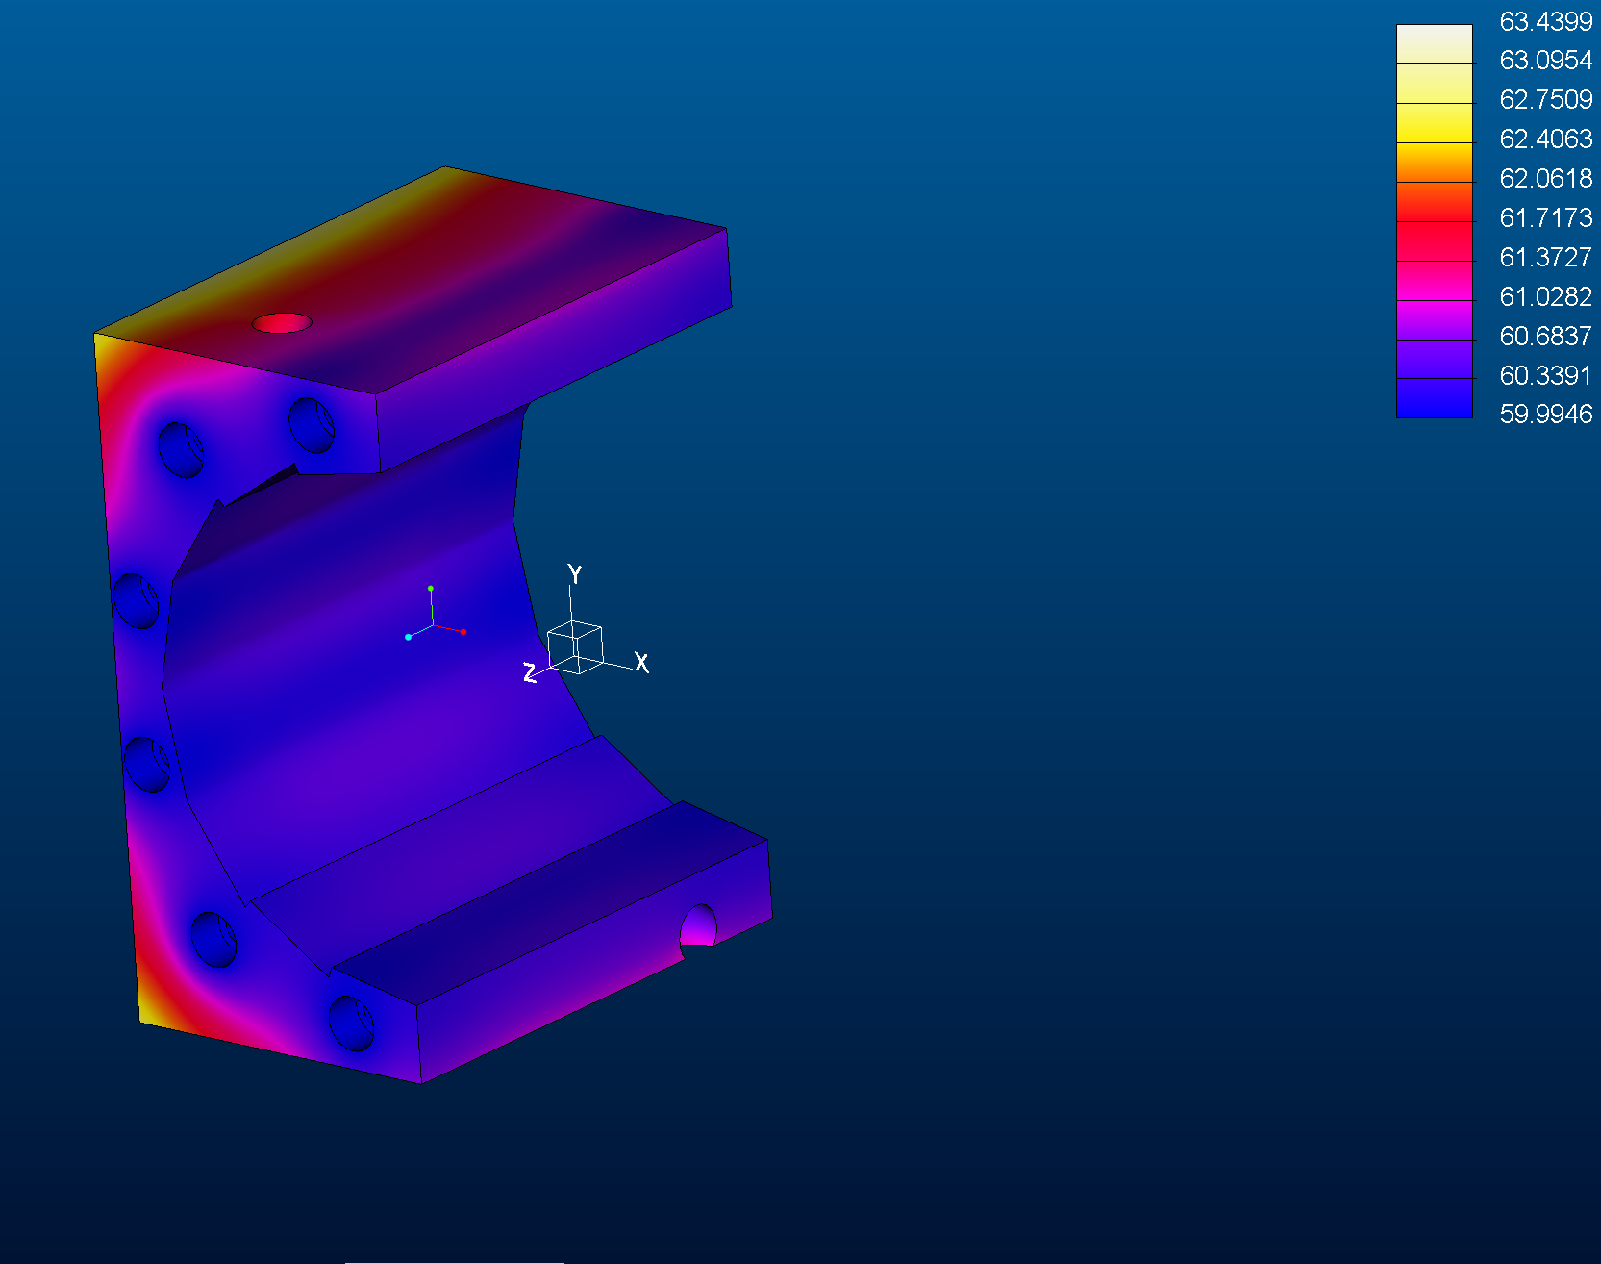
Air Temperature Effect
Air +10F
Almost no change at blocks
<0.1F

Slide 64
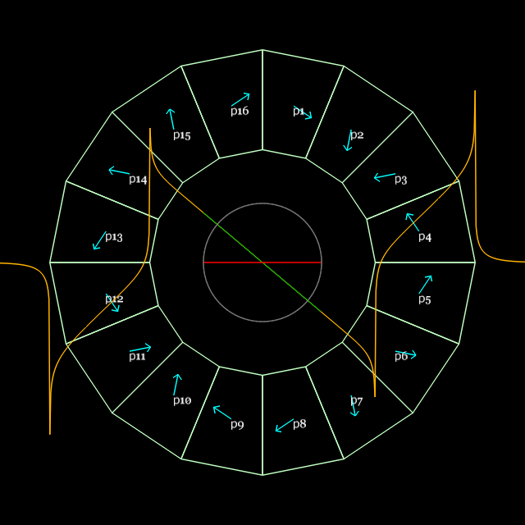
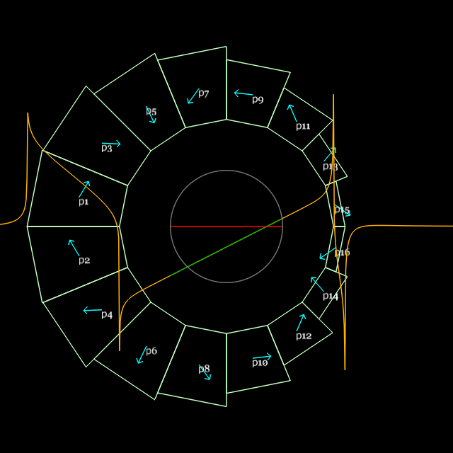
Proof-of principle Design and Parameters
DR3.1.4
QF
Based on Dec 2015 lattice, when pieces were ordered (E_{max}=250MeV)
BD
Parameter | “QF” magnet | “BD” magnet | Units
Length | 57.44 | 61.86 | mm
Dipole B_{y}(x=0) | 0 | -0.37679 | T
Quadrupole dB_{y}/dx | -23.624 | 19.119 | T/m
Inner radius (magnet pieces) | 37.20 | 30.70 | mm
(shim holder) | 34.70 | 27.60 | mm
“Pole-tip” field (magnet pieces) | 0.879 | (-)0.964 | T
Outer radius (magnet pieces) | 62.45 | 59.43 | mm
(tubular support) | 76.2 | 76.2 | mm

Slide 65
Unshimmed Magnet Errors
Magnet | Reference radius | RMS of FOM (units) where FOM = √∑multipoles² | Simulated: X,Y ±0.25mm Strength ±2.1% Mag. angle ±3°
QF | 10mm | 10.2434 | 28.6128
QF | 25mm | 46.9252 | 88.8997
BD | 10mm | 28.8490 | 37.9671
BD | 25mm | Not measured | 116.947
As expected, measured spread is slightly better than the “worst case” of uniform random errors filling the whole ranges

Slide 66
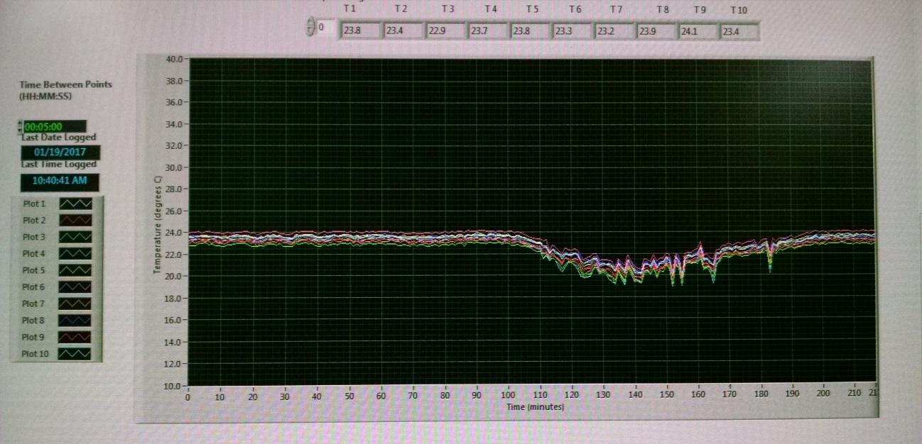
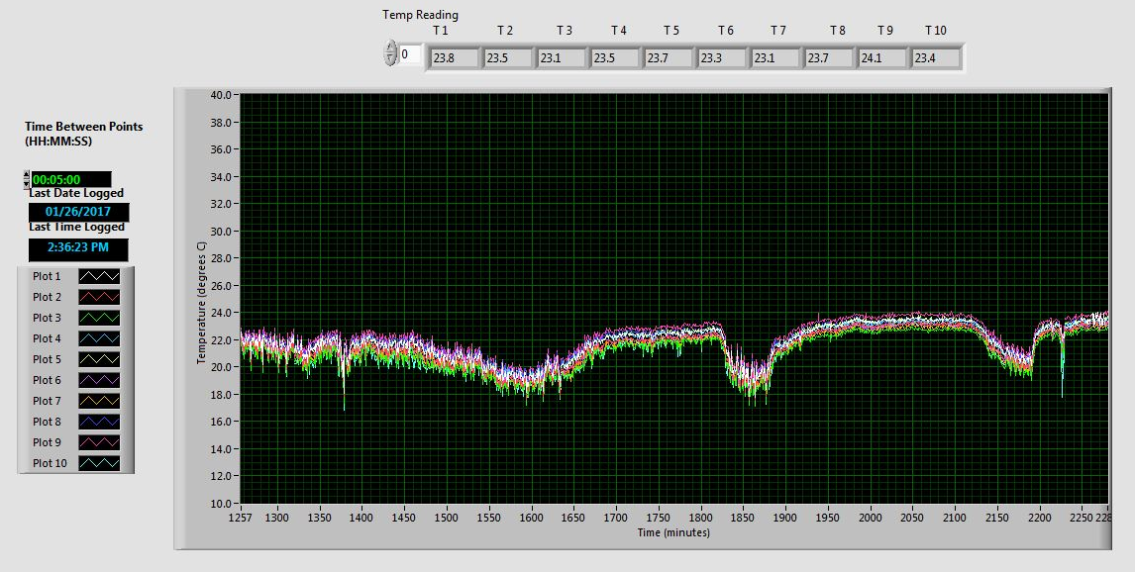
Temperature of 902 Hall
Variations consistent with observed ~0.7% maximum magnet strength variation
(equivalent to 6.3K change)
6K
6K

Slide 67
Radiation Resistance
Temnykh 2008 formula for 1% field loss @ RT
  Dose_{1%}[Mrad] = 10^(-2.68+T_{demag}(°C)/41.4K)
    Where T_{demag} is temperature where material grade would demagnetise given its position in the magnet
The N35EH grade is rated at T_{demag} = 200°C when isolated (self-generated H field only)
  Halbach magnet contains up to 1.3T of reverse flux (antiparallel H field), so reduce this to 147°C
Dose_{1%} = 7.45Mrad = 74.5kGy = 74.5 kJ/kg

Slide 68
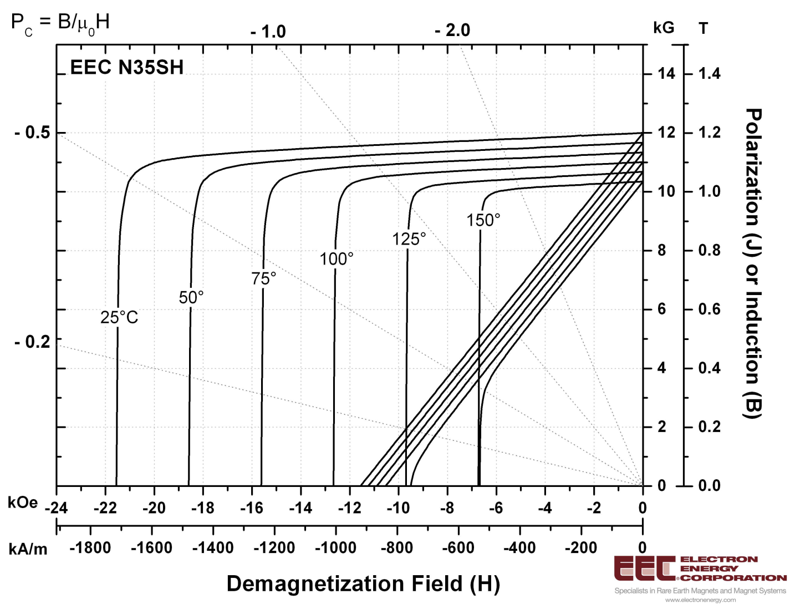
Temperature Dependent B-H Curve
NB: this is N35SH shown for example
kOe is kG with a factor of μ₀
100K change produces 11.9kOe change, i.e. 1.19T
Rated temperature for N35SH is 150°C, at -0.67T X-axis intercept
200-100*(1.3-0.67)/1.19
= 147°C
-1.3T

Slide 69
Multipole Errors within Beams
Negligible, beams are small
  10 units of sextupole at R=25mm becomes 0.4 units or less at R=1mm, regardless of beam centre
Swamped by dynamical nonlinearities
  Dynamic aperture is observed in simulations, but beam will only hit it if its centroid is displaced by several mm

