Slide 1
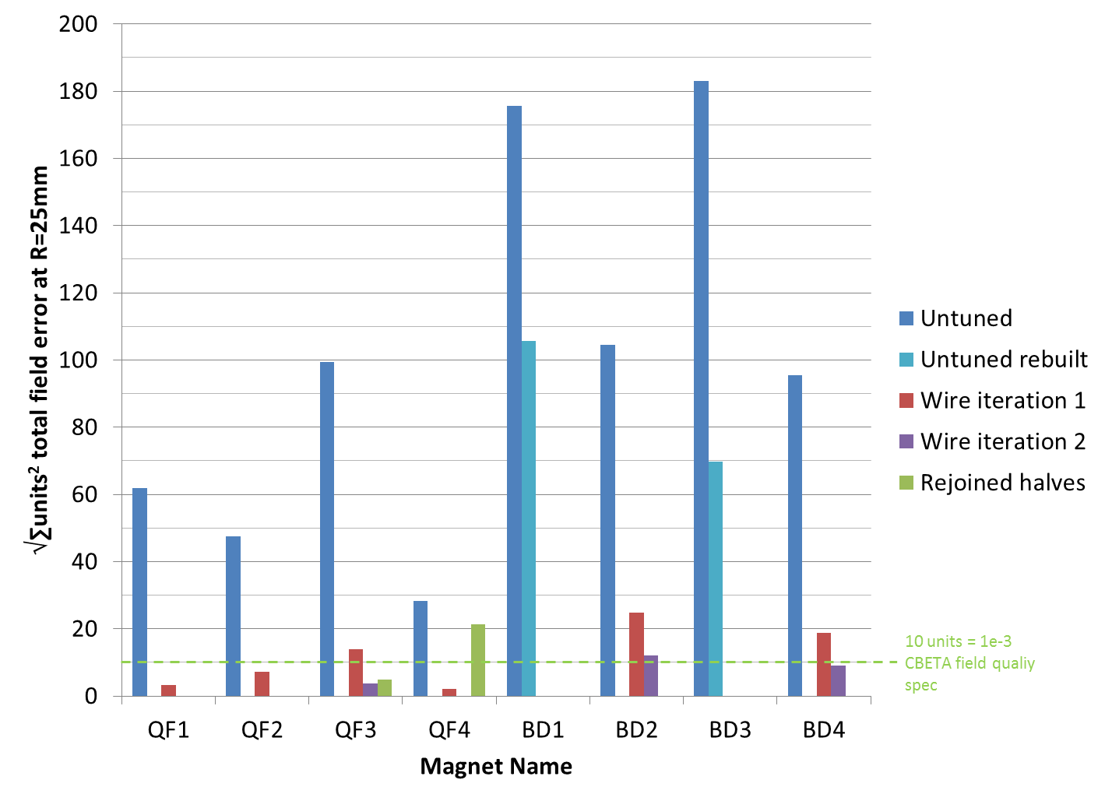
Rotating Coil Results Summary
The magnet QF3 was separated into halves and reassembled.
QF3 had a much better looking join than QF4 that was done previously.
Old
New

Slide 2
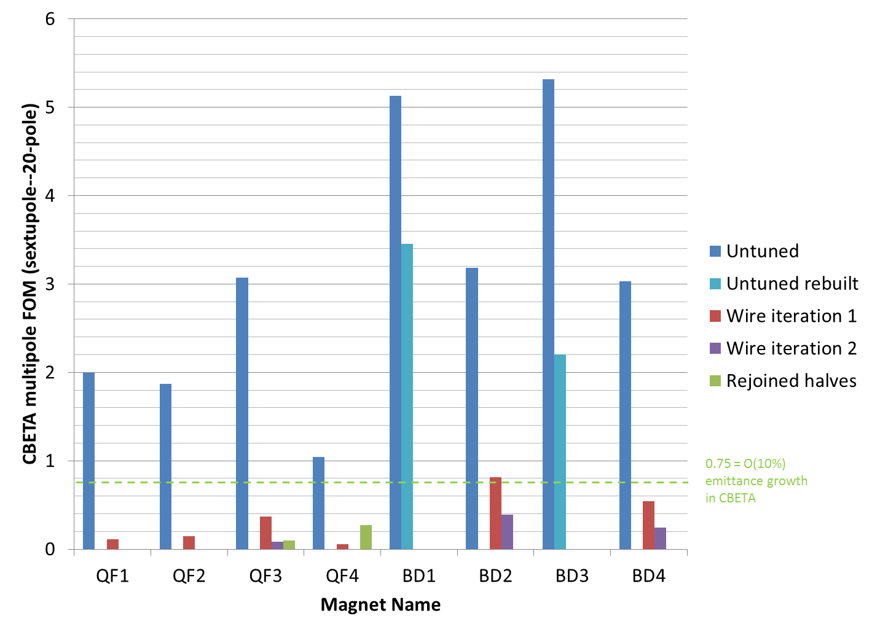
CBETA Figures of Merit
These are the figures that should be <=0.75
Old
New

Slide 3
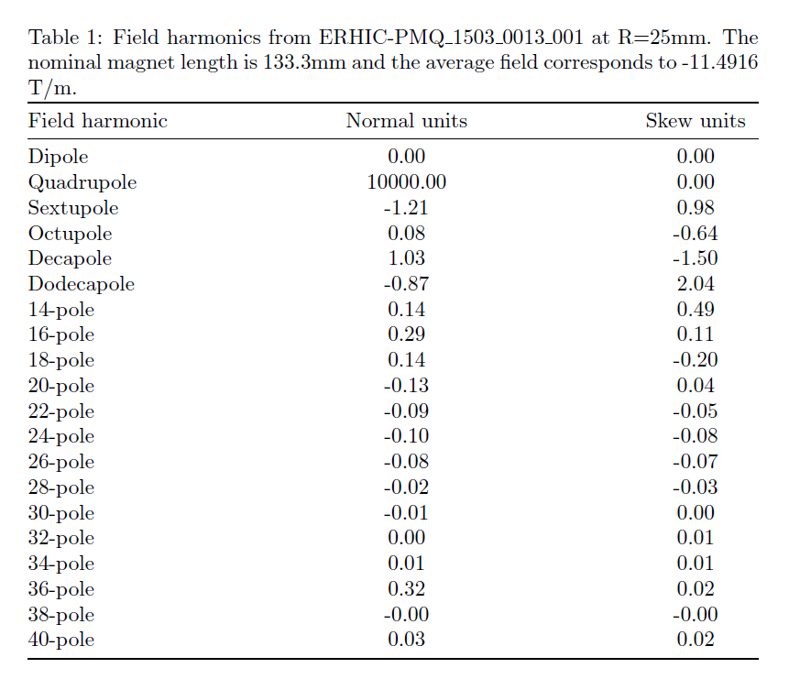
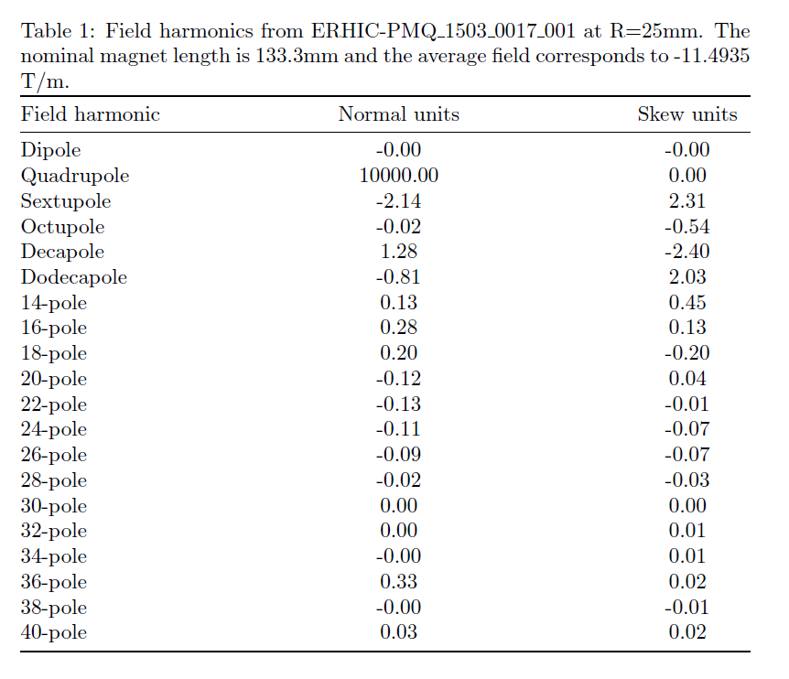
Before/After Harmonics

Slide 4
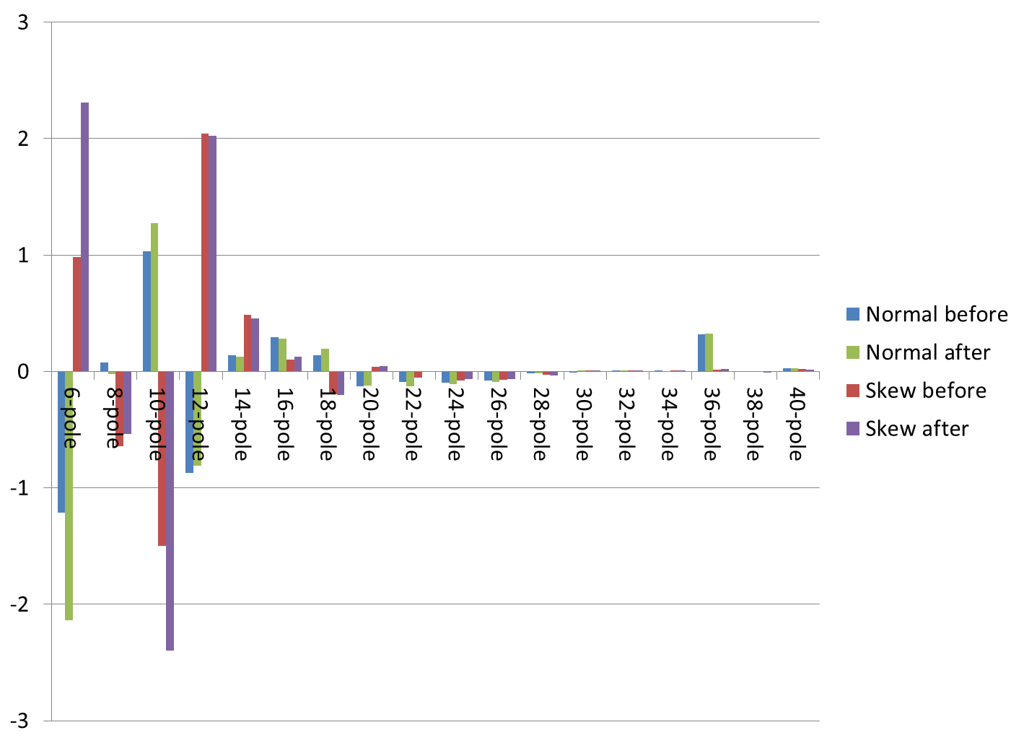
Before/After Harmonics

Slide 5
Magnet Development Tasks (Old)
Task | Status
Multipole reduction | Done for 4 QF and 2 BD magnets. Remaining 2 BD magnets were rebuilt and multipoles can be tuned away in simulation. Waiting for surveyed measurements to do it in reality.
Temperature control & field stability | Done for 2 QF and 2 BD magnets. Will do the rest with surveyed final measurements.
Strength tuning | Successful on QF2, strength within 0.05% of nominal value after 1 tuning iteration.
Reassembly repeatability | Did not work well due to construction errors in QF4. Worked well on QF3.
Effect of window-frame | Done on BD3, very little effect to multipoles, ~0.25% strength decrease

Slide 6
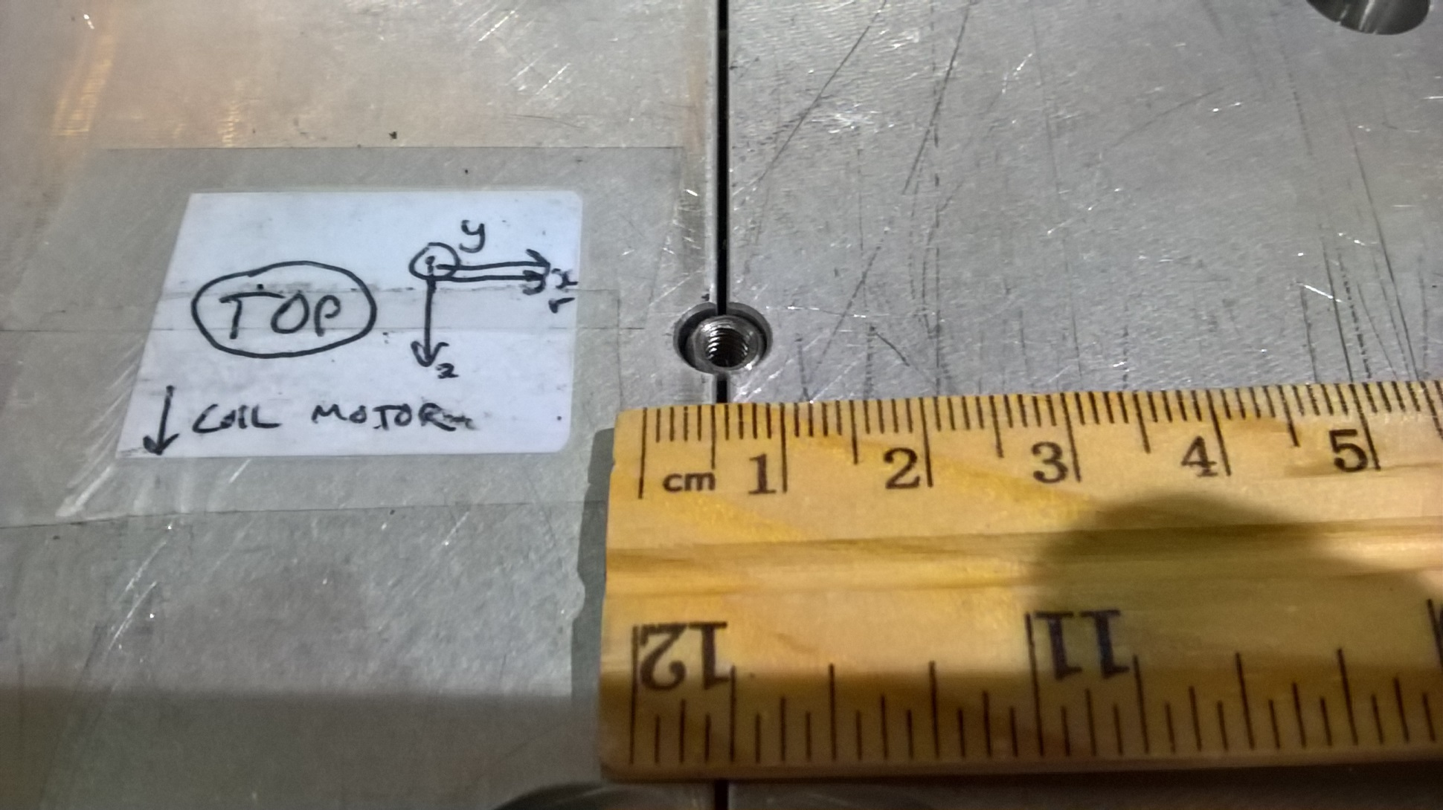
“Panel Gap” Problem (QF4)
This is why reassembly relying on the alignment pins didn’t work well

Slide 7
Magnet Development Tasks (New)
Measure all 8 magnets including:
Water for temperature stabilisation to 85F
Survey fiducials on final run
Many magnets (~6 of 8) were wire-tuned without water, so these need to be redone with an initial water run followed by a tuned, surveyed run
Thus each magnet needs 1 or 2 coil runs
And one bench survey with the final coil run

