Slide 1
Data for Magnets

Slide 2
Types of Data
Original data = “as measured”
  Rotating coil .dat files, include some metadata too
  Survey labelled XYZ points in bench frame
  Metadata: the filename/path
Derived data (produced by a program running on the above stuff)
  Re-centered harmonics, quality measures
  Magnet true axis relative to fiducials
  Final fiducials in L0E frame
← This is the most important to back up

Slide 3
Magnet Identifiers Mapping
SMD uses 4-digit numbers to identify magnets
  Proposal: just use these as the CBETA magnet IDs
  Use in all filenames pertaining to a given magnet
Numerical Range | Count | Magnet Types
2101-21nn | ≥28 | CBETA production BDT1 magnets
2201-22nn | ≥22 | CBETA production BDT2 magnets
2301-23nn | ≥30 | CBETA production BD magnets
2401-24nn | ≥27 | CBETA production QD magnets
2501-26nn | ≥107 | CBETA production QF magnets
2701-270n | 2(?) | Halbach magnets for splitter lines S4, R4
2731 | 1 | BDH (half length BD) magnet
2751 | 1 | QFH (half length QF) magnet

Slide 4
Naming Example
KYMA give us the 17th QD magnet
  They label it “QD” serial number 17
Magnet ID is 2400 (QD offset) + 17 = 2417
Rotating coil filename will look like:
  ERHIC-PMQ_2417_0002_001.dat
  “0002” is run number, increases per measurement
Survey file “survey_2417_0002.csv” or similar
This is not necessarily the 17th QD in beamline

Slide 5
Storage
SMD and survey group have their own backup systems already running
  Proposal: continue to use those
I will also want an “online” store of files
  e.g. a network drive that can be accessed by programs, ideally from any computer on the network
  Makes it much easier to process automatically and generate and analyse the derived data

Slide 6
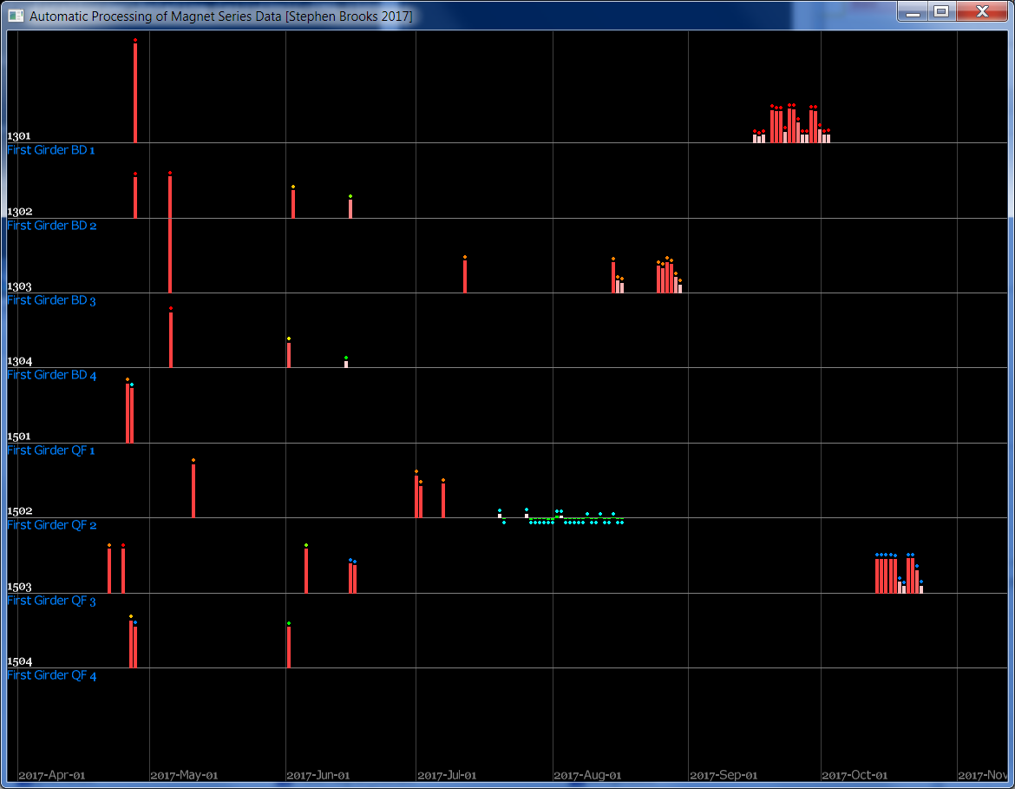
Automated Processing Example

Slide 7
Metadata in Rotating Coil .dat Files
200
ERHIC-PMQ_1503_0011_001.dat
ERHIC C-BETA PROD PMQ PERM MAG QF#3 W/SHIM PK IN HOR WF PRE-CHILLER START 10 RDS COIL#71 FIXTURE NO AMPS NO CHILLER 19C LKFX (JC)
Run: ERHIC-PMQ_1503.0011 16 Oct 2017 16:29:59 Data records: 10
Program: Rot410T03bin Program Date: 9 Oct 2013 09:58:00
File written on: 16 Oct 2017 16:39:27
Coil: 71 (RN17)
Calibration: 30 Jan 2017 18:45:00 by AJ Number of Loops: 7 Ref. radius: 25.000 mm
Loop Names: T D1 D2 Q11 Q12 Q21 Q22
Loop Turns:
30 3 3 3 3 3 3
Loop Lengths (m):
1.0001500 .9999980 .9999980 .9999980 .9999980 .9999980 .9999980
Loop Radii (mm); r1, r2 of each loop:
24.33350 24.34550 24.27760 24.27760 24.26790 24.26790 24.28690 24.28690 24.28690 24.28690
24.29930 24.29930 24.29930 24.29930
Loop angles (degrees); Theta1, Theta2 of each loop:
2.0249 347.0669 35.3344 215.3344 133.8949 313.8949 14.7693 284.7693 194.7693 104.7693
64.4935 334.4935 244.4935 154.4935
Num Vsigs: 5 Sig Names: D1 D2 T Q11Q12 Q21Q22
Loops to Signals Definition Matrix:
+0.0000 +1.0000 +0.0000 +0.0000 +0.0000 +0.0000 +0.0000
+0.0000 +0.0000 +1.0000 +0.0000 +0.0000 +0.0000 +0.0000
+1.0000 +0.0000 +0.0000 +0.0000 +0.0000 +0.0000 +0.0000
+0.0000 +0.0000 +0.0000 +1.0000 +1.0000 +0.0000 +0.0000
+0.0000 +0.0000 +0.0000 +0.0000 +0.0000 +1.0000 +1.0000
Amplifier OFF
Num Isigs: 1 Hterms: 20
Record: 1 16:32:46 Numrevs: 3 Rdgs/Rev: 128
Iavg Istd Imax Imin I(First) I(Last)
+.0021125 +.0002338 +.0026835 +.0015008 +.0023139 +.0024788
Zpos Gs21 Gs22 Incl GsT1 GsT2 RevTimeAvg T_std RevTime_Rev1
+0.000 -0.001 -0.002 +0.073 33.27 33.35 3.4988 0.106 3.4988
+0.00000E+00 +0.00000E+00 +0.00000E+00 +0.00000E+00 +0.00000E+00
H N Bn avg Bn std | Actual Bn Values
1 3 -3.707053E-04 +3.636630E-06 | -3.712853E-04 -3.740172E-04 -3.668136E-04
2 3 -3.827115E-02 +9.264172E-05 | -3.837507E-02 -3.819722E-02 -3.824116E-02
3 1 +4.545167E-06 -9.999000E+01 | +4.545167E-06
4 1 +1.148491E-07 -9.999000E+01 | +1.148491E-07
5 1 -6.220785E-06 -9.999000E+01 | -6.220785E-06
Original filename
Manually-entered description (optional)
Date and time run started
Repeating records start: each has a measurement of all harmonics

