Slide 1

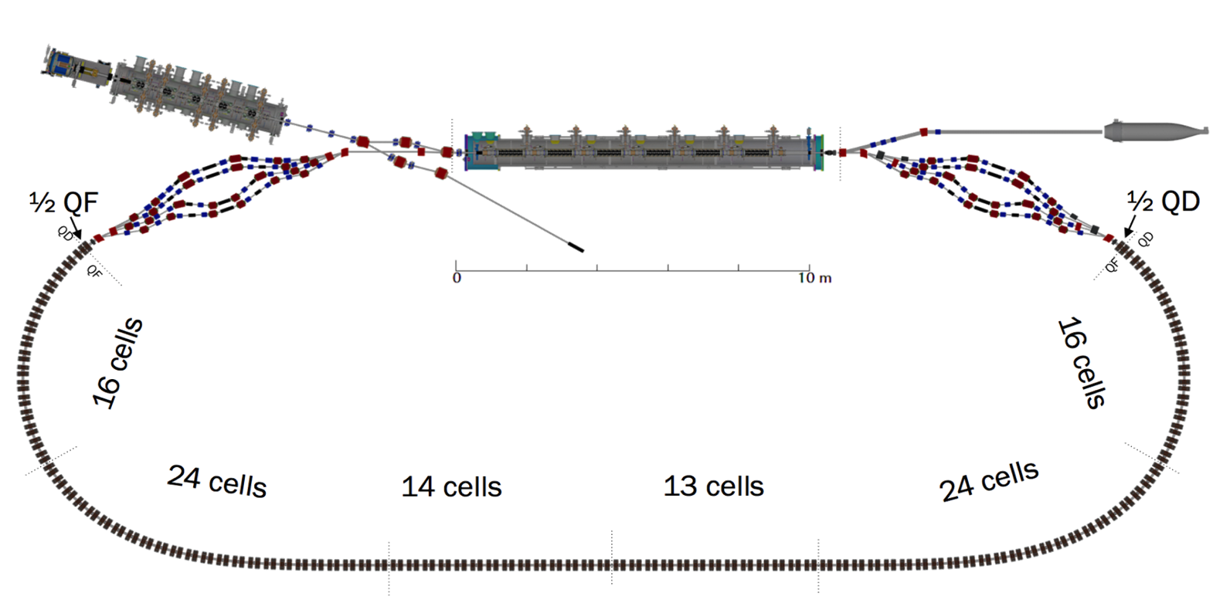



CBETA Halbach Magnets
Stephen Brooks

Slide 2
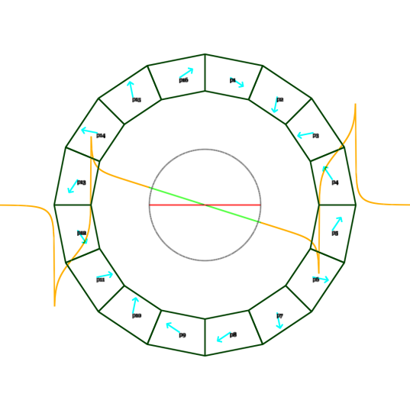
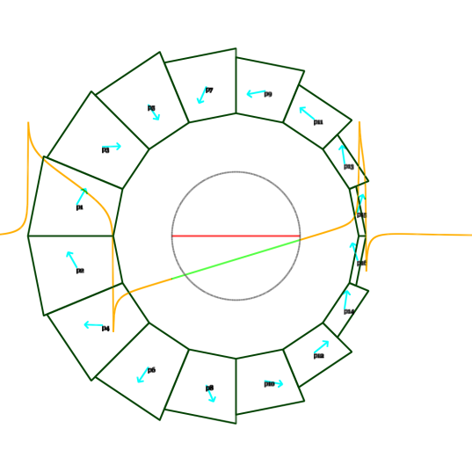
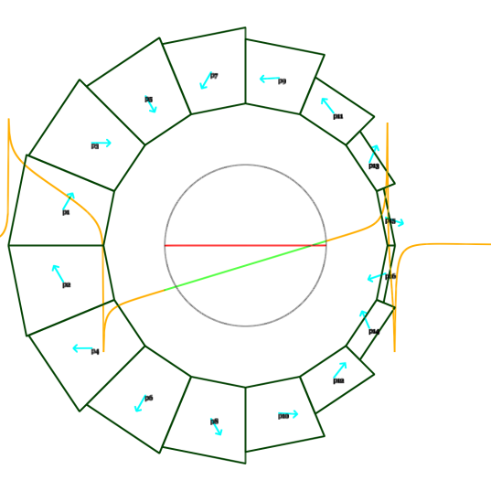
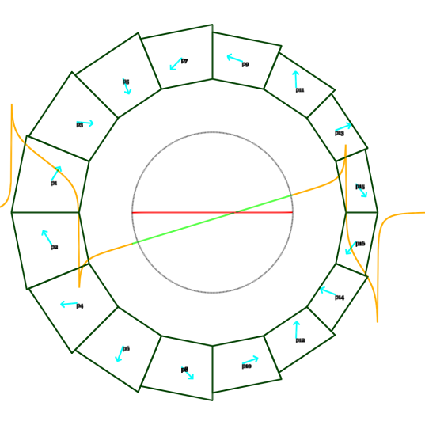
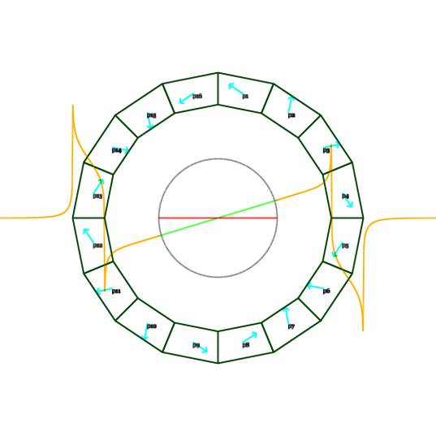
Magnet Types (5 cross-sections)
QF
BD
BDT2
Magnet | Length (mm) | Aperture Radius (mm) | Dipole (T) | Gradient (T/m)
QF | 133 | 43.1 | 0 | -11.562
BD | 122 | 40.1 | -0.3081 | 11.148
BDT2 | 122 | 44.9 | -0.2543 | 11.148
BDT1 | 122 | 49.1 | -0.1002 | 11.148
QD | 122 | 40.1 | 0 | 11.143
QFH | 66.5 | 43.1 | 0 | -11.567
BDH | 61 | 40.1 | -0.3084 | 11.154
First Girder QF | 133.3 | 39.4 | 0 | -11.562
First Girder BD | 121.7 | 39.4 | -0.3081 | 11.148
BDT1
QD

Slide 3
Figures of Merit
Units FOM = sqrt(sum squares (all nonlinear multipoles at max beam radius)), 1 unit=10⁻⁴
CBETA FOM = the above with different multipoles scaled per William Lou’s simulation
  0.75 is acceptable with misalignments but perfect BPMs, so we aim substantially lower than this
Max field error (in Gauss) on beam midplane
  Not on a circle, so can have different emphasis
  10⁻³ of max quad component is 2.8 Gauss

Slide 4
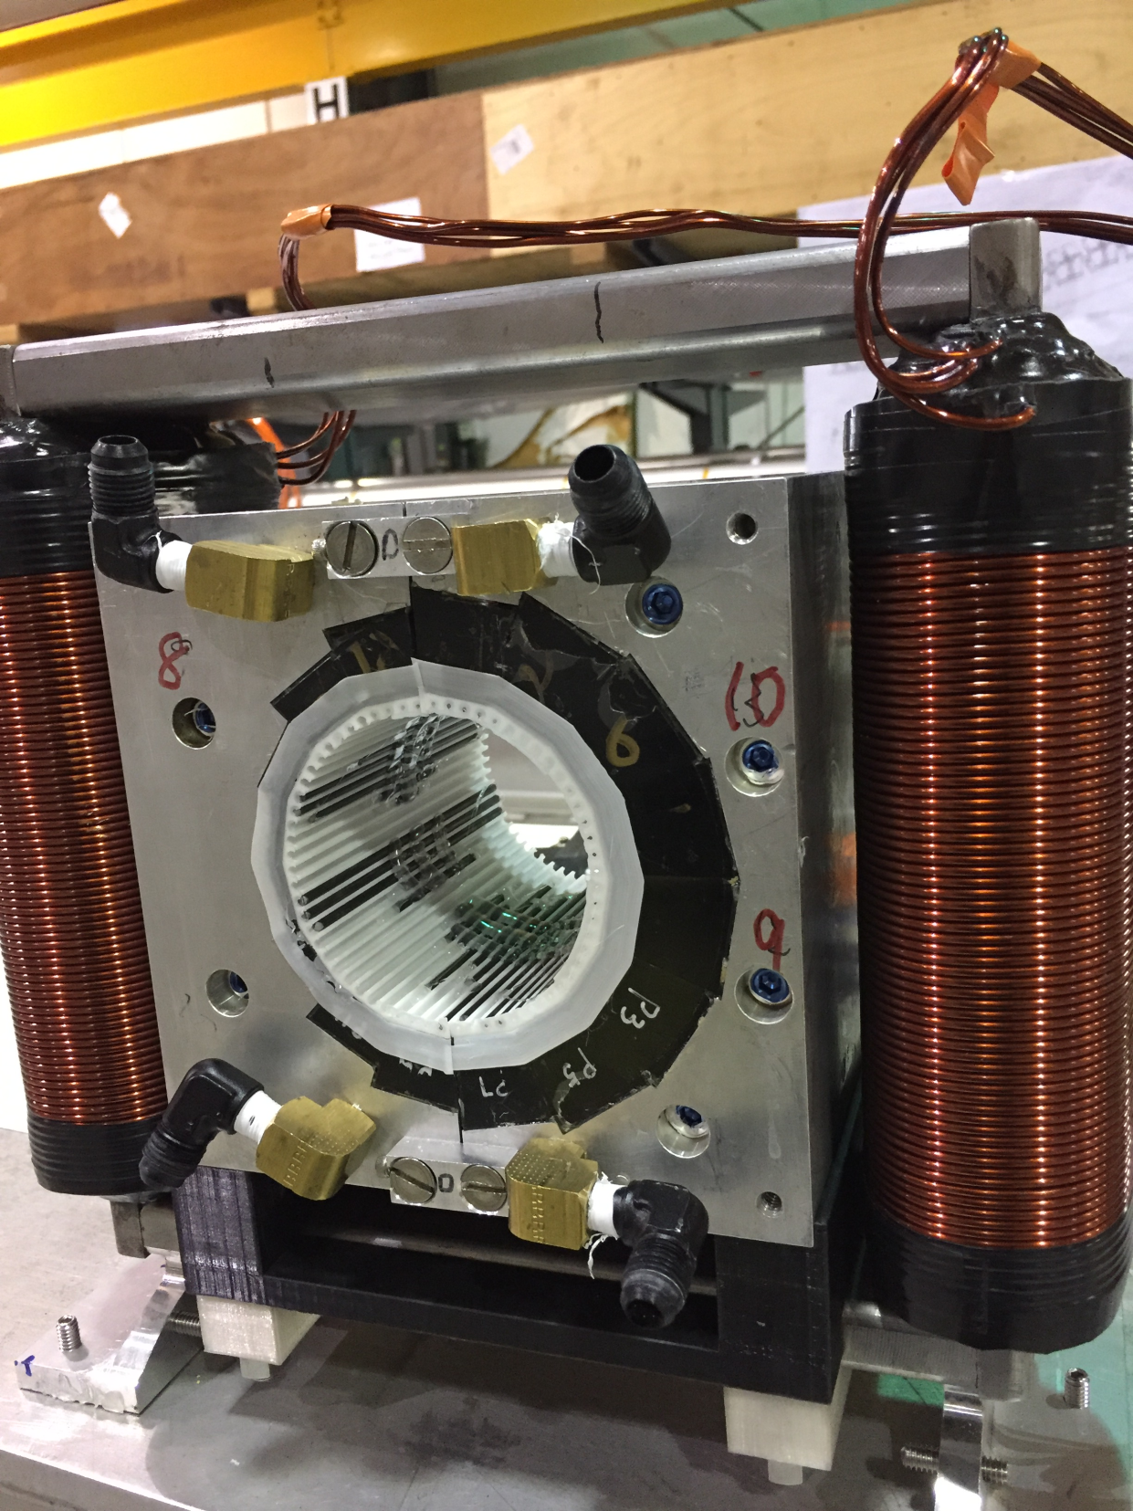
A Real BD Magnet including Tuning Wires
The CBETA “First Girder” consists of 4 BD magnets, 4 QF magnets and one BDH magnet

Slide 5
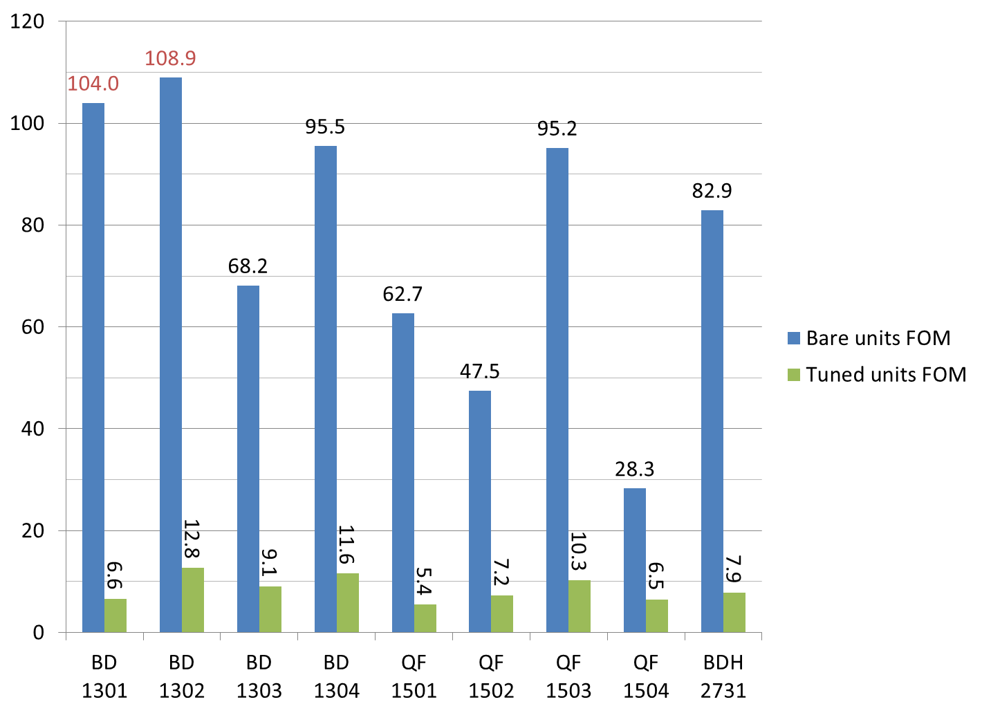
First Girder Results
BD1 and BD2 required thicker 105mil wire, rest used 80mil

Slide 6
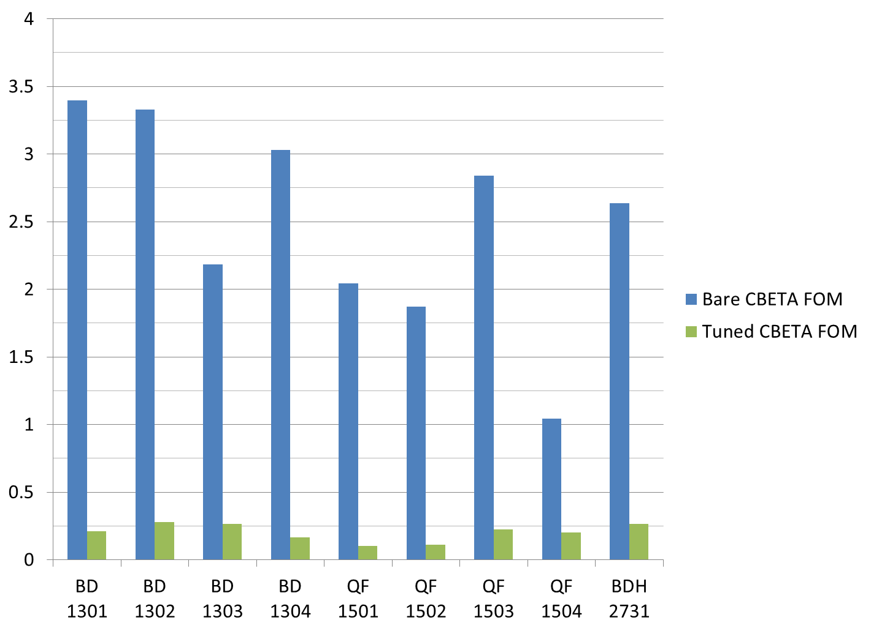
First Girder Results
0.75

Slide 7
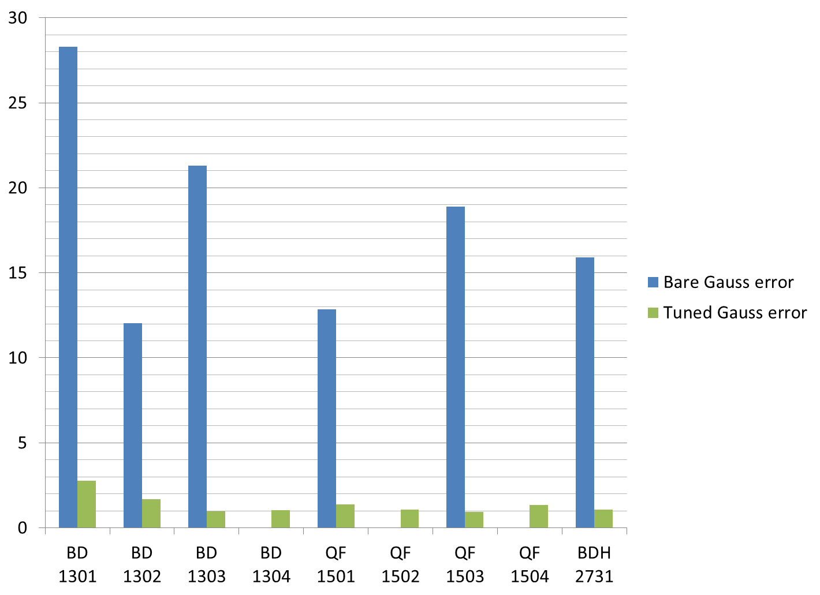
First Girder Results
BD4, QF2 and QF4 were originally measured without temperature control, so no comparable initial data
2.8 Gauss
= 10⁻³ of max quad

Slide 8
First Girder Results
Example harmonics tables
BD1 before/after
Quad is normalised to 10000 units

Slide 9
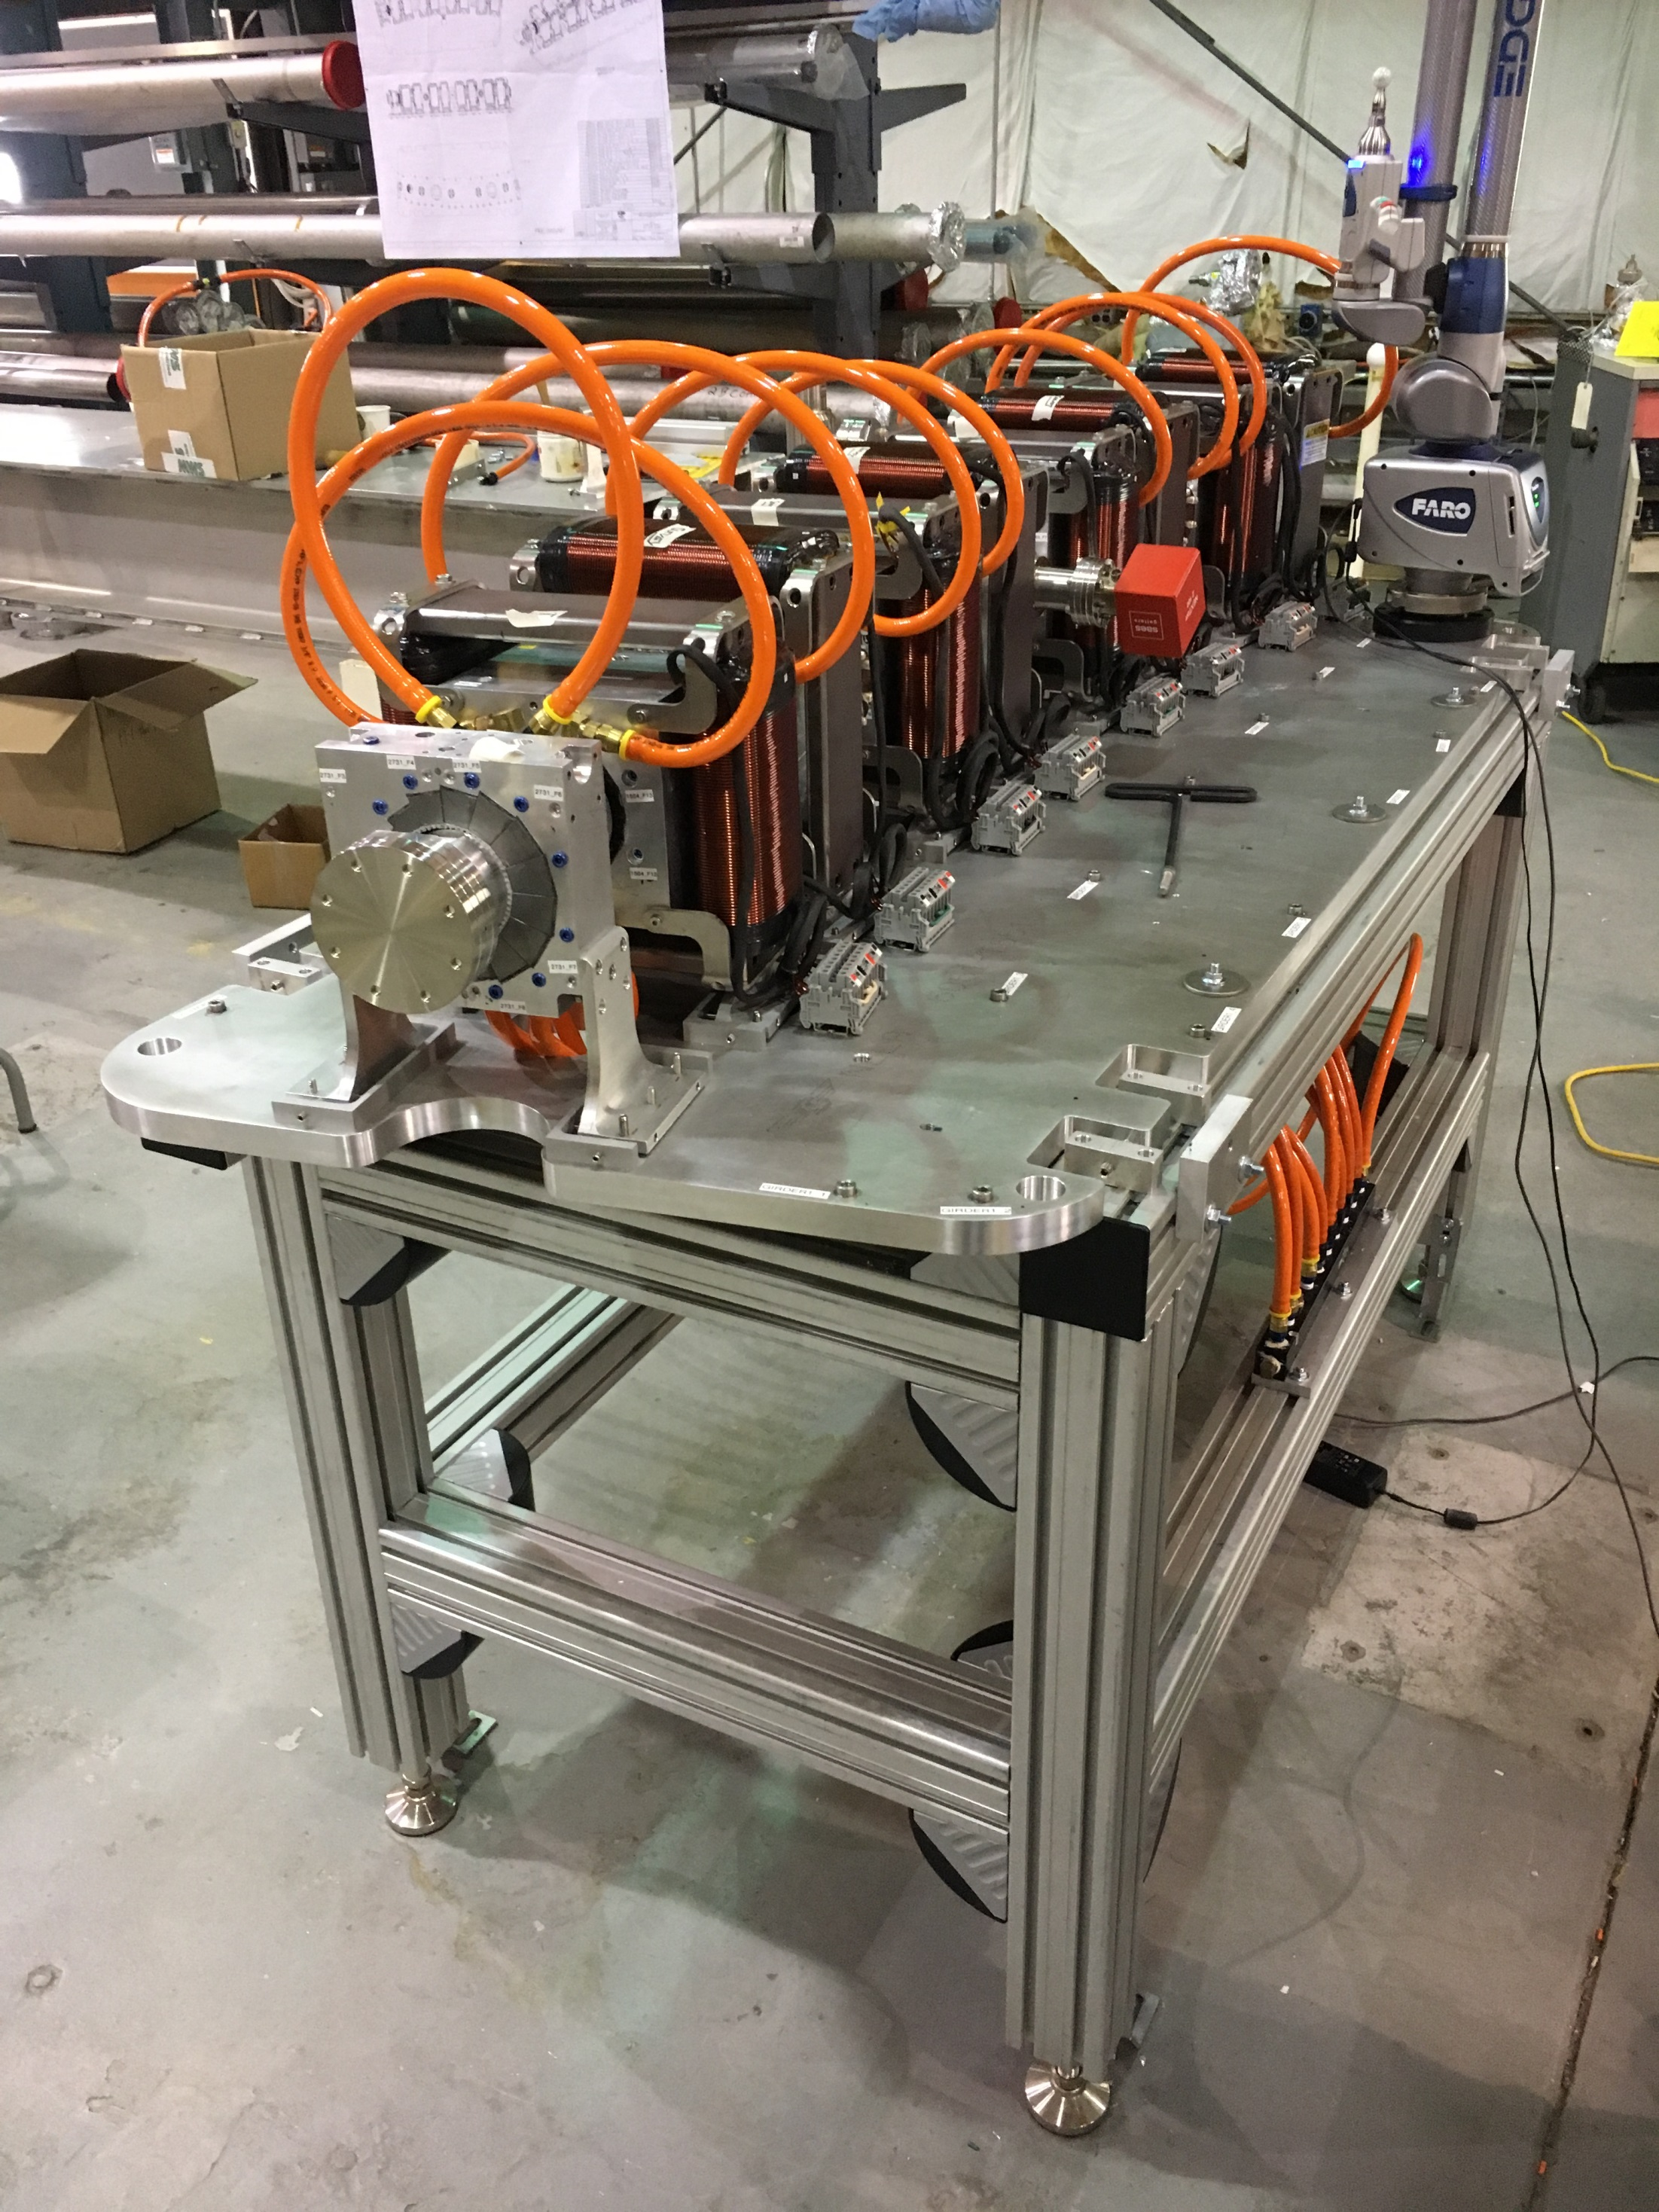
First girder being surveyed with Faro arm

Slide 10
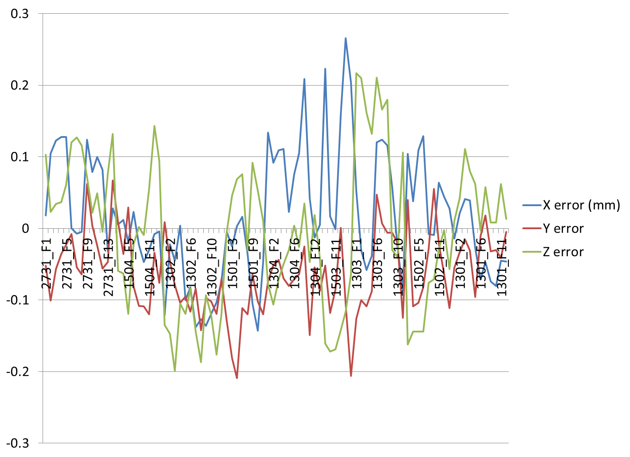
Q. from 2017: Survey Accuracy
Errors in the first girder survey, all magnet fiducials
Generally consistent with +/- 200 micron uniform distribution assumed in simulations, baseline
Error | X (μm) | Y | Z | Distance
RMS | 88 | 83 | 103 | 159
Min | -143 | -209 | -199 | 48
Max | 266 | 67 | 217 | 309
Average | 17 | -62 | -7 | 147

Slide 11
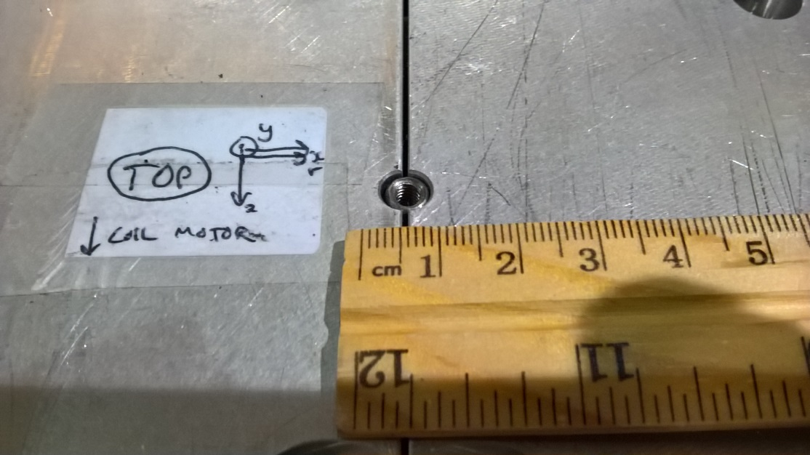
Q. from 2017: Reassembly Quality
BNL magnet with loose pin went from 2.1 → 21.2 units error when reassembled (bad)
We rebuilt the magnets with loose pinning
Magnet with aluminium halves flush went from and 3.4 → 4.8 units error (good)
KYMA checks for no protruding blocks when manufacturing

Slide 12
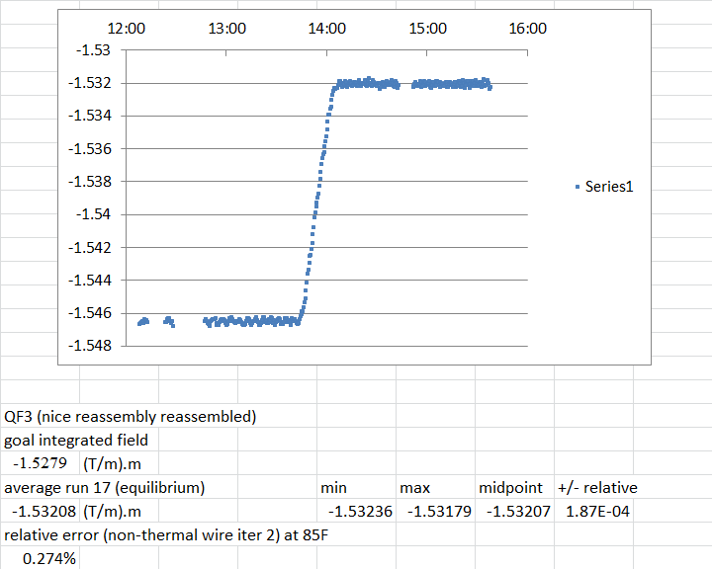
Water Cooling Stability

Slide 13





Production and Testing Flow
KYMA
assembly
3
4
AllStar
PM wedges
1
BNL
tuning
2
Helmholtz testing at AllStar, 100% of blocks but not temperature controlled
Temperature-controlled Helmholtz test of ~15% sample at BNL for verification
Remainder of blocks shipped directly to KYMA, who also re-test ~10% sample
Rotating coil measurement of bare magnet at BNL
Rotating coil measurement of tuned magnet at BNL
5
Accept

Slide 14
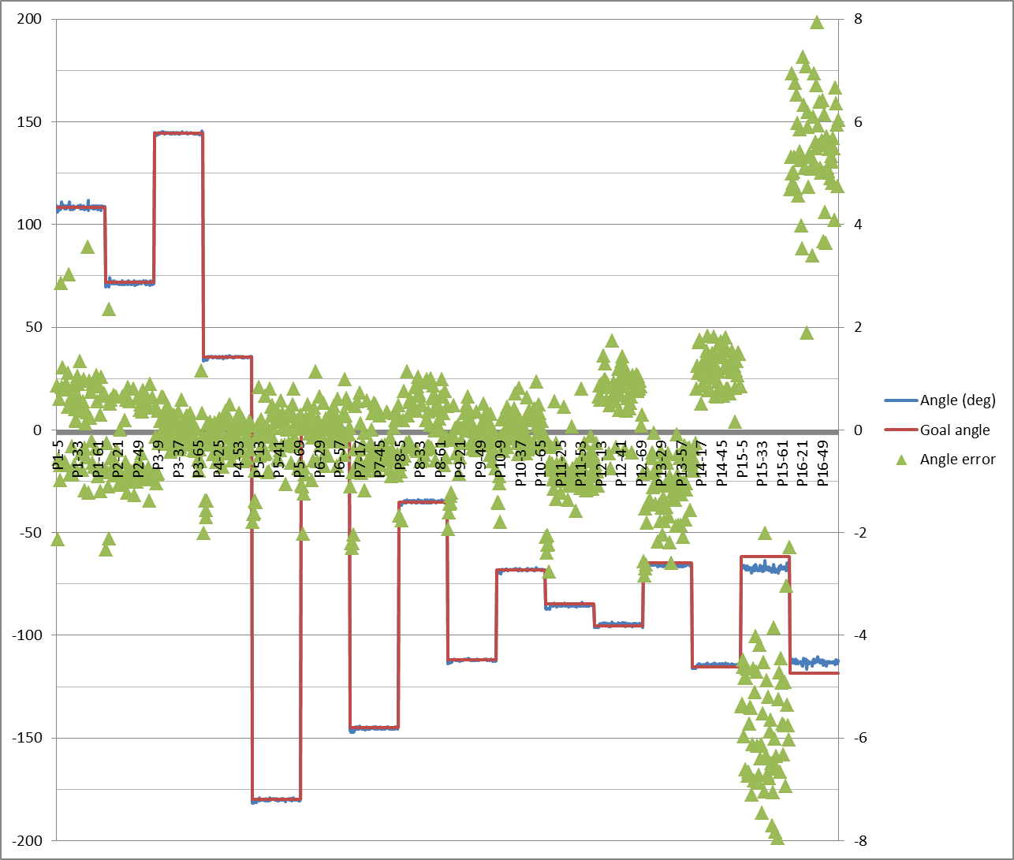
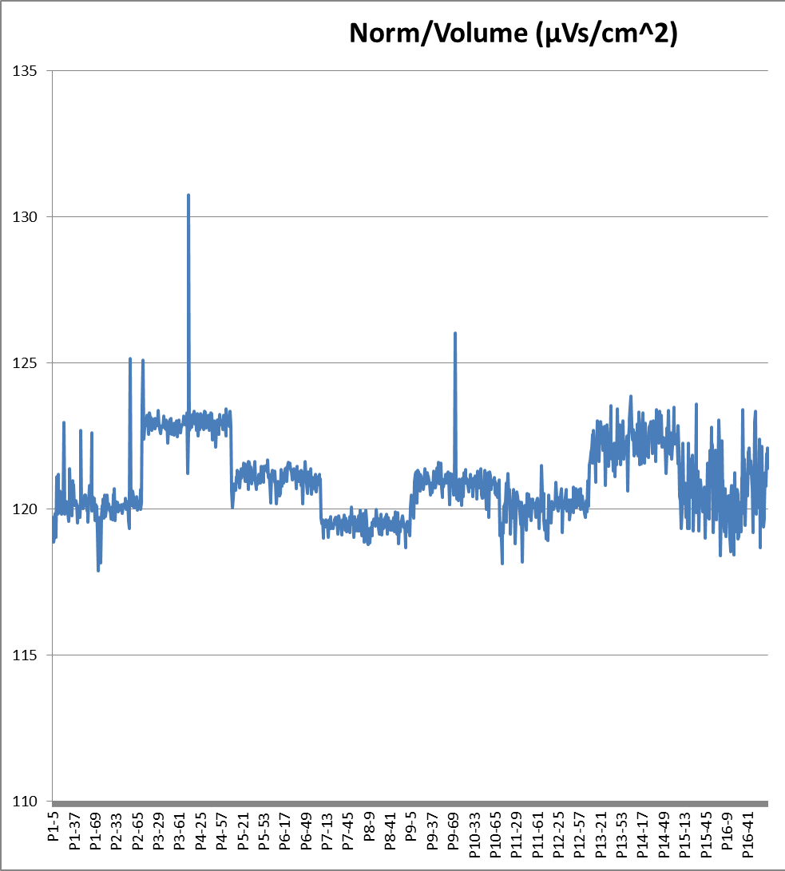
Helmholtz Measurements
Example: AllStar data for wedge types P1 through P16 (BD magnet)
Angle errors Strength variation

Slide 15
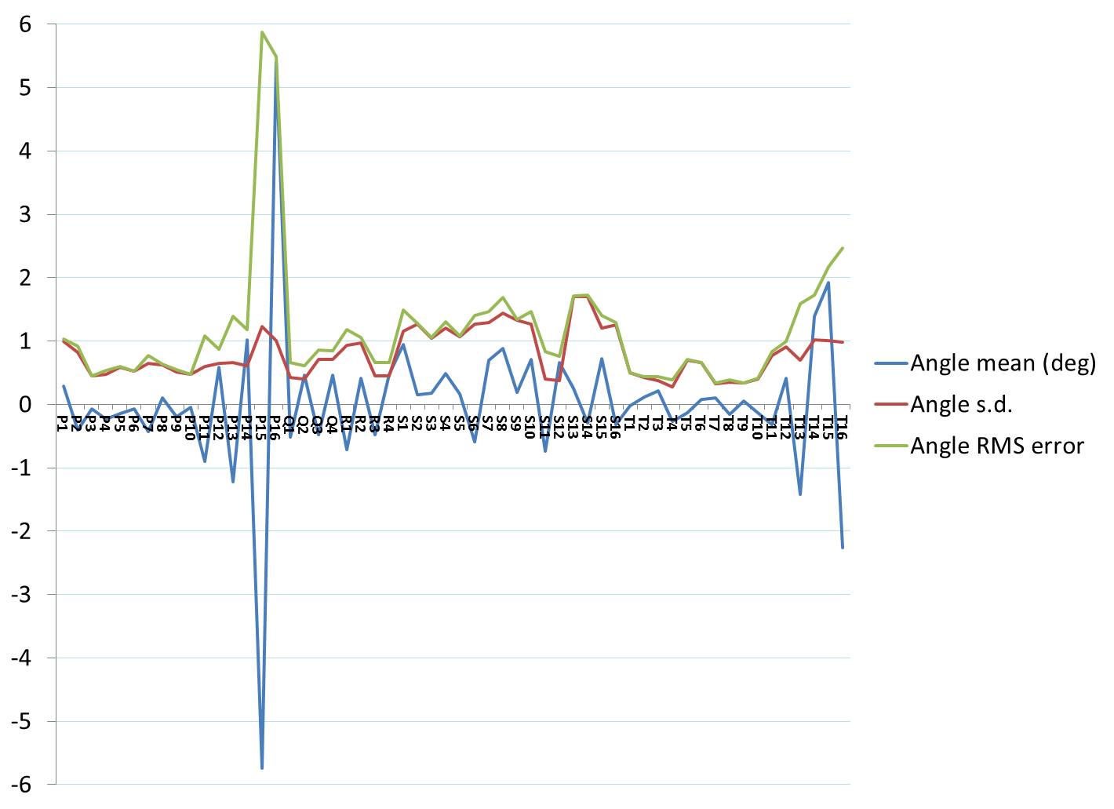
Magnetisation Angle Distributions
Requested that factory re-make types P15 and P16 to reduce systematic error.
These are the smallest blocks, so not critical, but re-make will improve quality of untuned magnets.
General request was for 1 degree RMS error, but can cope with some above and some below as we have here (see next slide)

Slide 16
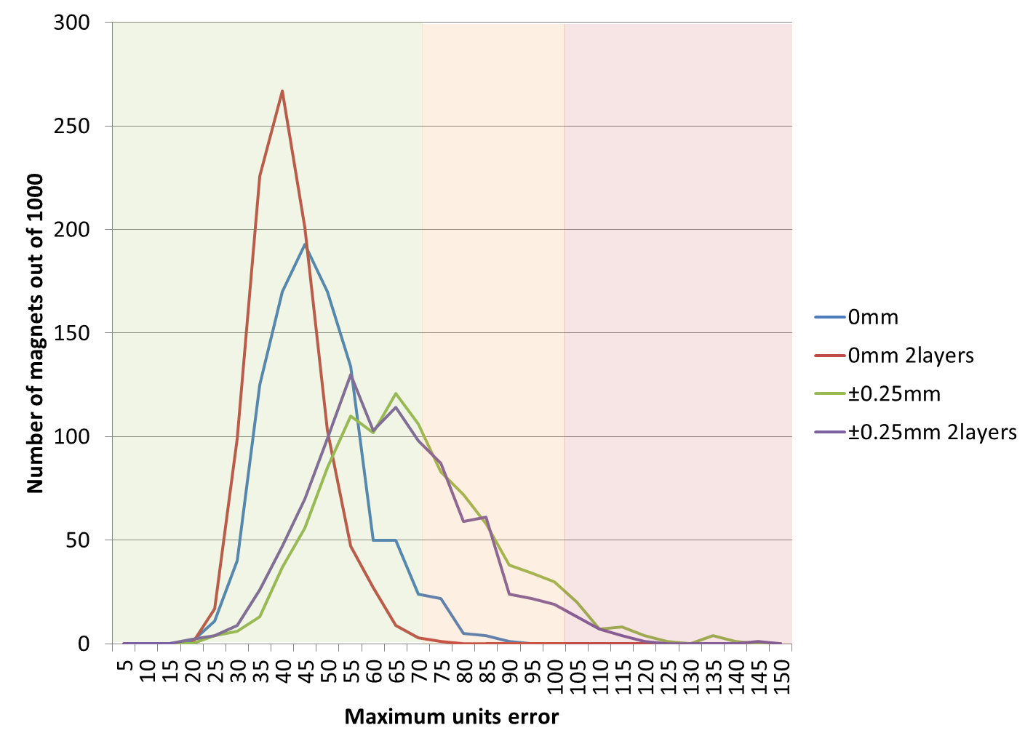
Magnet Error Model
Both the strength and angle error distribution can be put back into the field simulation
Example: BD magnet using AllStar’s data set.
1000 magnets were generated, some with position errors. Histogram is binned by the “units FOM”.
Green = easy to tune
Red = possible problems
Based on first girder experience.

Slide 17
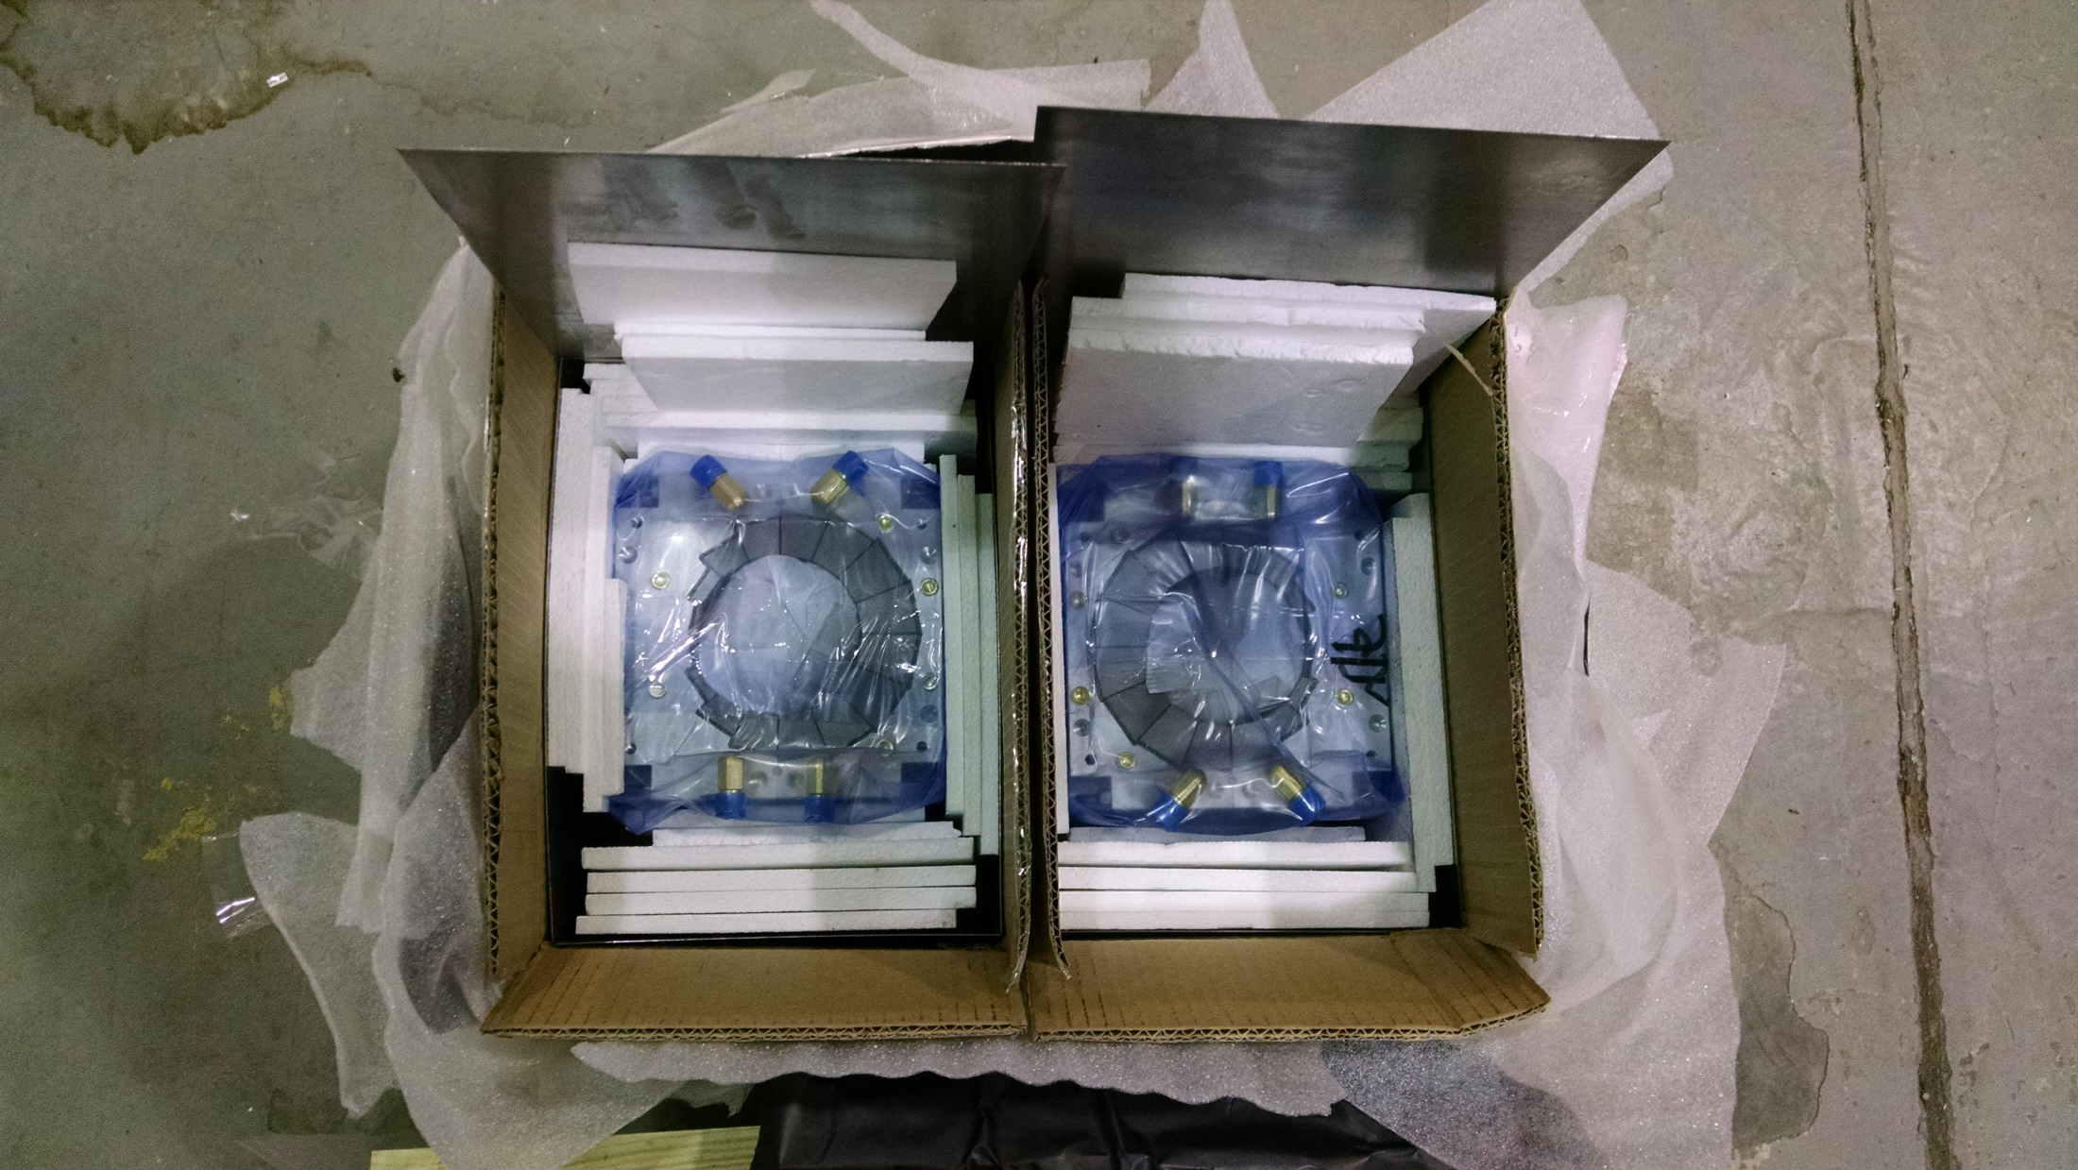
BD First Articles from KYMA

Slide 18
BD First Articles from KYMA
Measurements of bare magnets (last week):
Magnet type, identifier # | Units FOM | CBETA FOM | Midplane error (Gauss) | Gradient error at x=0
BD 2301 | 58.72 | 1.746 | 10.13 | -0.091%
BD 2302 | 83.41 | 2.498 | 15.64 | -0.065%
First girder BD magnets
First two BD magnets are consistent with simulated distribution including expected position errors.
Tuning works in simulation, testing in practice this week.
Three more will be tested before full BD production run approved.
2301
2302

Slide 19
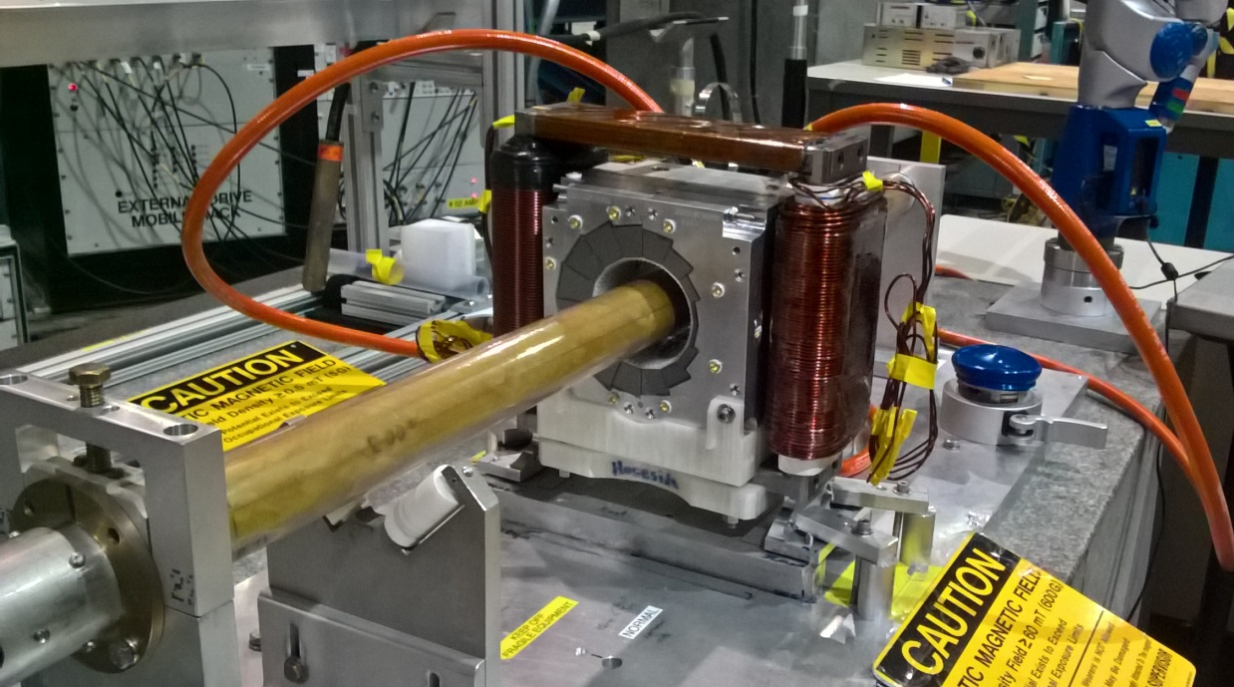
BD First Article Tuned
Measurements of tuned magnet (yesterday):
BD magnet 2301 | Units FOM | CBETA FOM | Midplane error (Gauss) | Gradient error at x=0
Bare | 58.72 | 1.746 | 10.13 | -0.091%
Tuned | 6.58 | 0.151 | 1.28 | 0.057%

Slide 20
Conclusion / Next Steps
We’ve tuned 9 magnets to suitable field quality (21 if you include FFAG line at ATF)
Production magnets are coming in as expected
Next, will test and tune first articles of the other types, then go to production
Tuning wire holders are being 3D printed at Cornell
Wire cutting machine will be used for wires

