Slide 1
CBETA Magnets 2303-4, 2403-5
3rd, 4th BD magnets
3rd-5th QD magnets

Slide 2
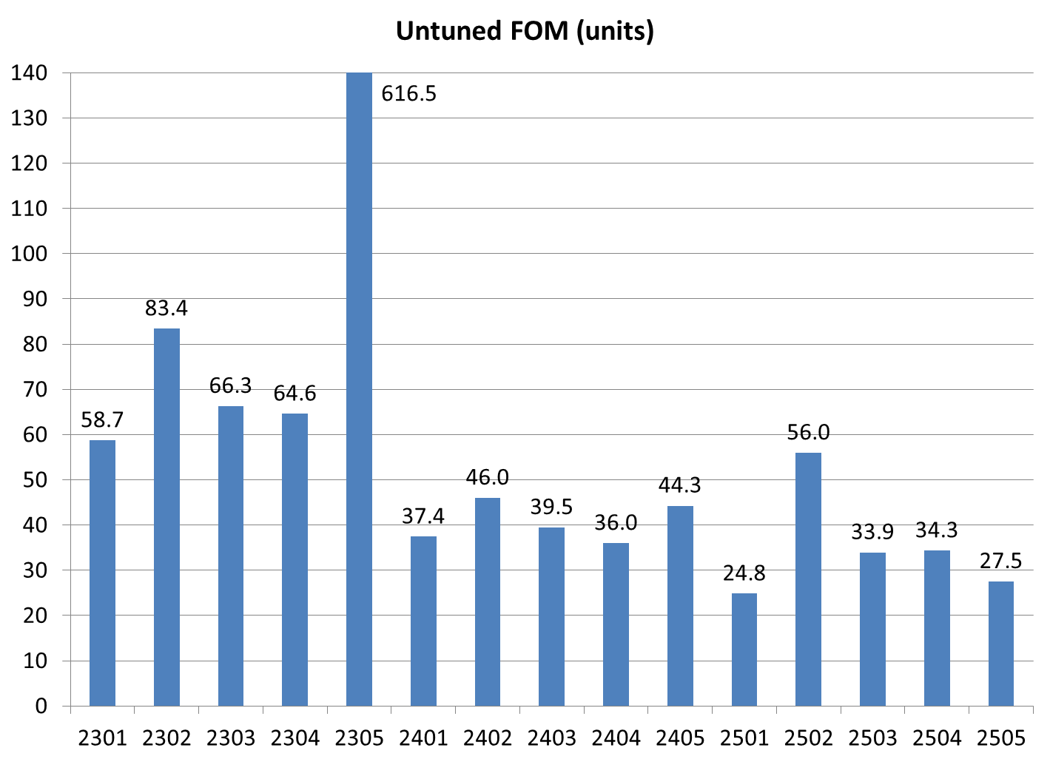
BD magnet with block in backwards (not accepted)
BD
QD
QF

Slide 3
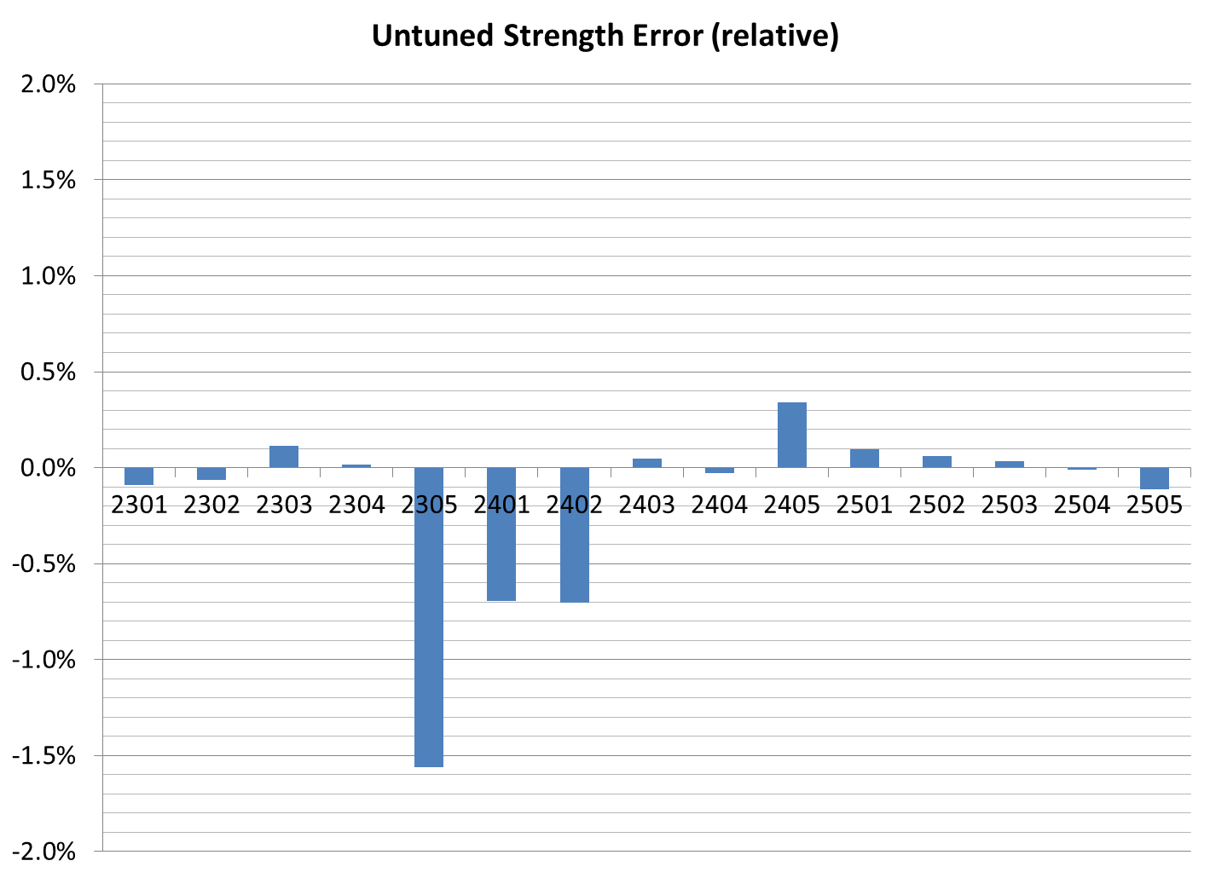
BD
QD
QF
Applied +0.7% strength correction after these two QDs
BD magnet with block in backwards (n/a)

Slide 4
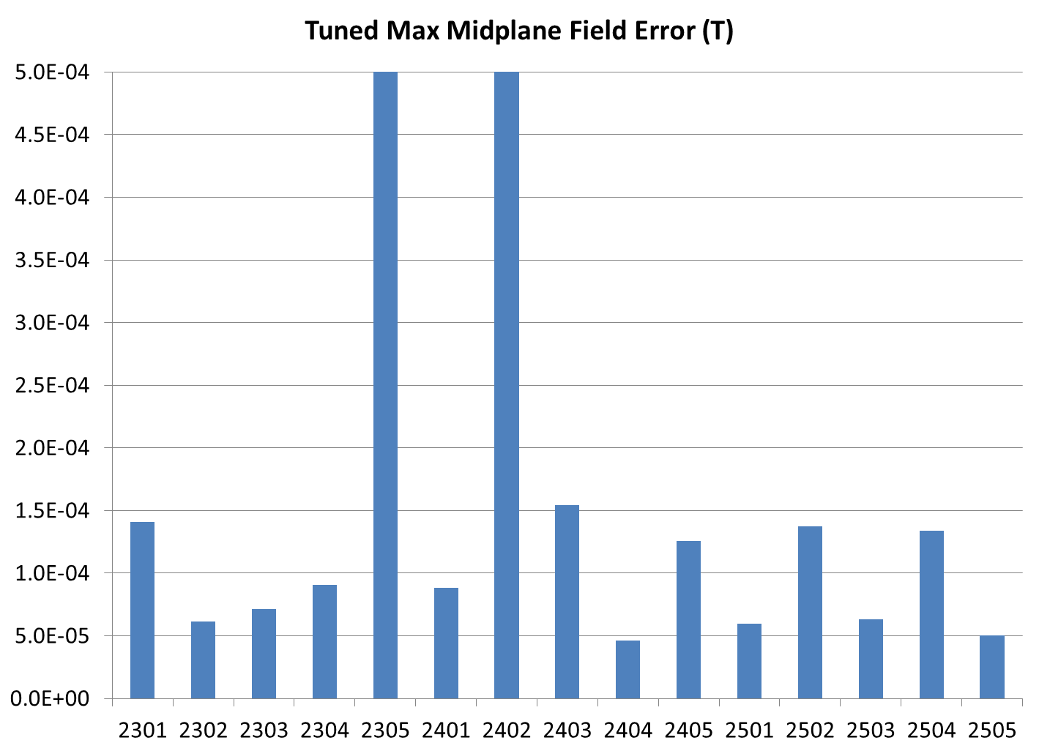
BD
QD
QF
QD 2402 still being used as calibration magnet (i.e. not tuned yet)
BD magnet with block in backwards

Slide 5
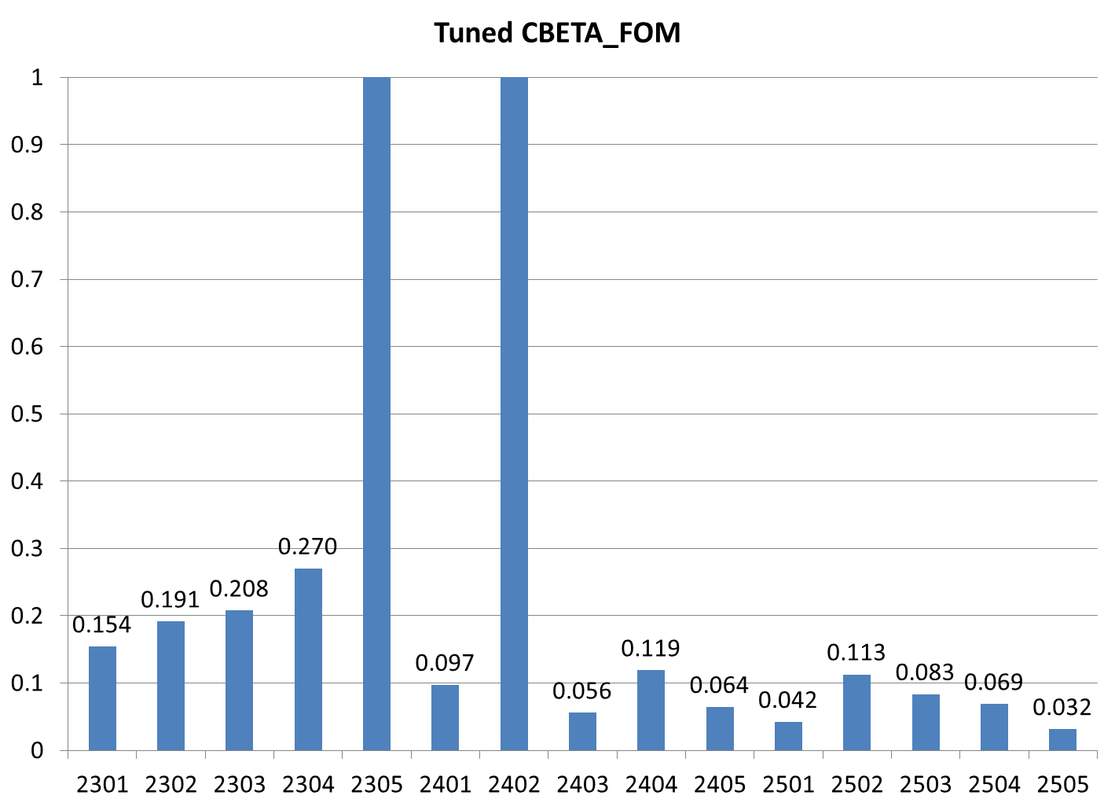
BD
QD
QF
QD 2402 still being used as calibration magnet (i.e. not tuned yet)
BD magnet with block in backwards

Slide 6
Tuning of Magnets
Magnet # | Run # | Midplane error (G) | Units FOM | CBETA FOM | Quad error at x=0 (rel.)
2303 | 1 | 5.36 | 66.29 | 2.082 | 0.112%
 | 2 | 0.71 | 8.03 | 0.208 | -0.024%
2304 | 1 | 6.22 | 64.59 | 2.214 | 0.017%
 | 2 | 0.91 | 8.09 | 0.269 | -0.029%
2403 | 1 | 3.01 | 39.47 | 1.641 | 0.049%
 | 2 | 1.38 | 1.48 | 0.056 | -0.044%
2404 | 1 | 8.70 | 35.99 | 1.473 | -0.029%
 | 2 | 0.46 | 4.18 | 0.119 | 0.030%
2405 | 1 | 6.95 | 44.27 | 1.779 | 0.339%
 | 2 | 1.79 | 7.47 | 0.221 | 0.081%
 | 3 | 1.24 | 2.71 | 0.064 | -0.049%
Goals |  | ≤ 1.5 | ≤ 10 | ≤ 0.375 | ≤ 0.05% (Q)

Slide 7
Harmonics of Tuned Magnets
Magnet 2303
Magnet 2304
Magnet 2403
Magnet 2404
Magnet 2405
1.359676 | 0
-11058.5 | 7.31E-13
10000 | -1.85E-14
1.584402 | -3.96229
-4.48989 | -2.94631
2.237461 | 2.934606
1.581638 | 0.303577
0.786293 | 0.03654
-0.64209 | 0.010552
0.039227 | -0.18229
-0.02677 | -0.0913
-0.17061 | 0.016739
-0.06967 | -0.00953
0.054428 | -0.0171
0.032432 | 0.007713
-0.05601 | -0.02611
-0.07922 | -0.04564
-0.07931 | 0.001628
0.143009 | 0.049931
0.068319 | 0.014258
0.010929 | 0.000125
Displaced magnet by DX (m) | -0.00029
DY (m) | 0.000897
Rotated A/C by (rad) | 0.030585
(deg) | 1.752419
1.3596 | 0
-11059.1 | 6.52E-13
10000 | 4.73E-14
3.58957 | -0.28814
-6.36379 | 0.347291
1.771774 | 1.570351
1.696354 | -0.62679
1.26182 | -0.5966
-0.86504 | 0.130973
-0.11723 | 0.080365
0.445429 | 0.030411
-0.16763 | -0.05721
-0.14311 | 0.087266
0.008703 | 2.06E-05
0.069243 | -0.0402
0.024533 | 0.000245
0.008323 | -0.00277
-0.03098 | -0.00869
0.062522 | -0.00446
0.027628 | -0.01352
0.023048 | 0.000268
Displaced magnet by DX (m) | -0.00032
DY (m) | 0.000815
Rotated A/C by (rad) | 0.032941
(deg) | 1.88737
1.358904 | 0
2.56E-66 | -6.50E-66
10000 | 1.10E-14
0.021152 | 0.451678
-0.16072 | -0.07271
0.808439 | 0.045658
-0.8508 | -0.50102
-0.1377 | -0.10428
0.308095 | -0.08051
-0.12935 | 0.170445
0.095912 | 0.011719
-0.03368 | -0.04736
0.045984 | 0.016508
-0.03364 | -0.03854
-0.24398 | 0.010799
0.002486 | 0.044277
-0.01101 | -0.08062
-0.00435 | 0.016788
0.240674 | 0.00293
0.007092 | -0.03882
0.021337 | -0.00658
Displaced magnet by DX (m) | 0.000518
DY (m) | -0.0007
Rotated A/C by (rad) | 0.029031
(deg) | 1.663377
1.359907 | 0
2.32E-62 | -6.98E-64
10000 | 1.54E-14
-1.21169 | -1.76104
-0.64658 | 2.481611
-0.3253 | -0.61894
-1.94966 | -0.80659
0.79649 | 0.377398
0.531621 | 0.06394
0.179374 | 0.116755
-0.33573 | -0.2045
-0.11414 | 0.037679
-0.02726 | -0.05704
0.045858 | -0.056
0.042984 | 0.001009
-0.01084 | 0.001447
-0.08314 | -0.00759
0.031779 | 0.044074
0.150161 | -0.07828
-0.1447 | 0.041664
0.062315 | -0.01189
Displaced magnet by DX (m) | 0.000655
DY (m) | -0.00062
Rotated A/C by (rad) | 0.028111
(deg) | 1.610666
1.358832 | 0
1.83E-64 | -3.93E-64
10000 | -3.31E-15
-0.77049 | 0.215947
-0.16519 | -1.40996
0.88444 | 0.48457
0.695894 | 1.636611
-0.28753 | -0.46543
-0.2061 | 0.295925
-0.02814 | 0.107015
0.076383 | -0.12625
0.021175 | -0.05384
0.000857 | 0.035685
0.064546 | 0.037034
0.000588 | 0.013908
0.006888 | -0.00625
-0.02934 | 0.008304
0.006583 | -0.00379
0.10612 | -0.00735
0.013015 | 0.024587
0.017455 | -0.03074
Displaced magnet by DX (m) | 0.000941
DY (m) | -0.00069
Rotated A/C by (rad) | 0.027824
(deg) | 1.594182

Slide 8
Status
BD magnets 2303 and 2304
QD magnets 2403, 2404, 2405
are tuned + surveyed
QD 2405 required a 2nd iteration but turned out good after that
Rest of this week:
Testing 2 production windowframe correctors
Calibrating coil measurement stand #2

