Slide 1
CBETA Production Magnets
BD 2306, 2307, 2308
QD 2402
QF 2506, 2507, 2508, 2510, 2511

Slide 2
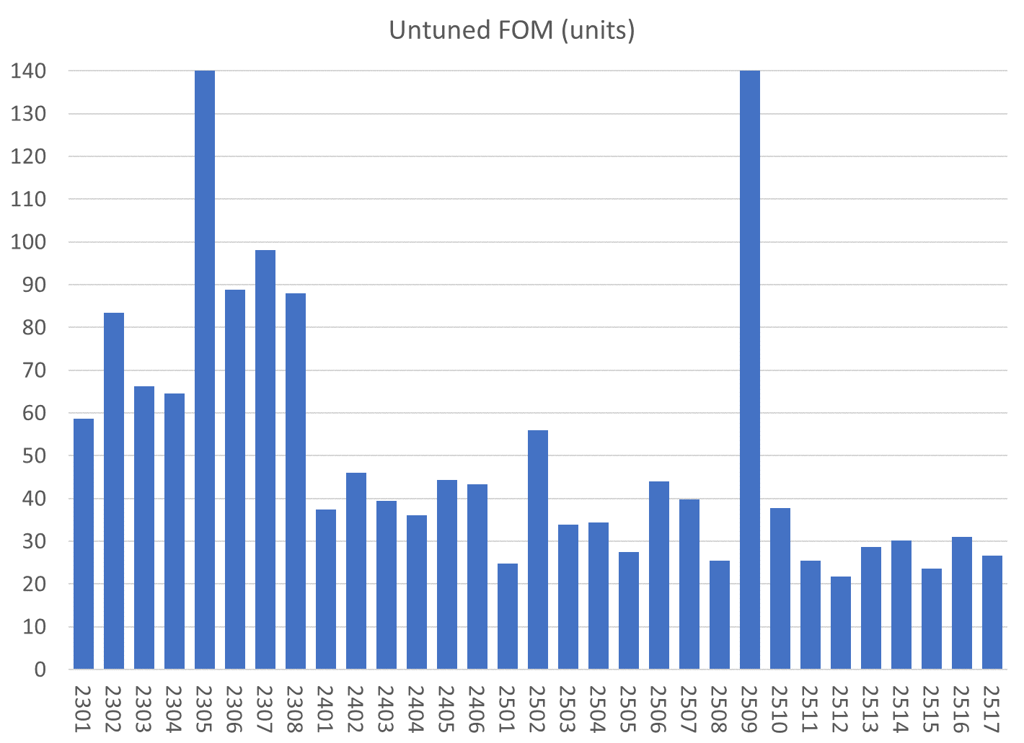
QF magnet with block in backwards (not accepted)
BD
QD
QF
All magnets are shown, those under consideration this week are under light blue bars

Slide 3
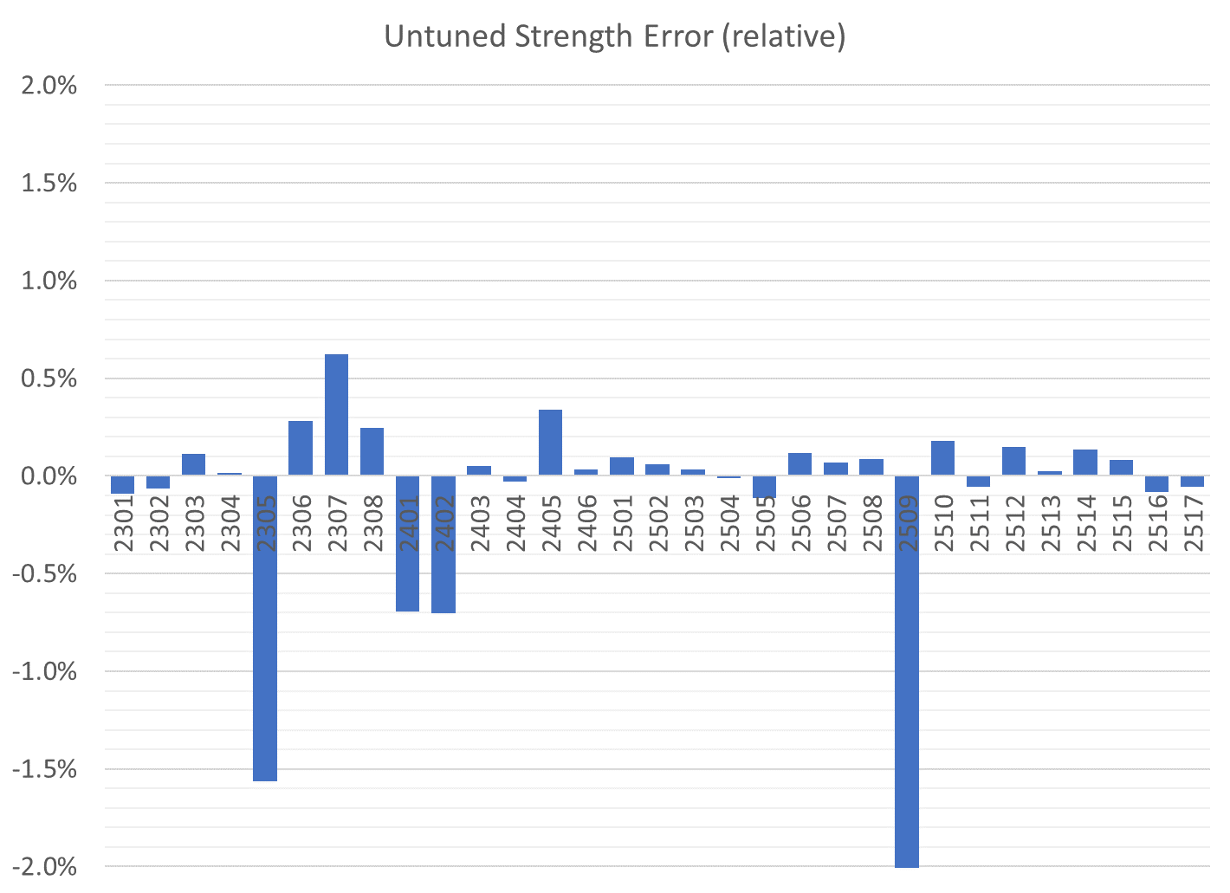
All magnets are shown, those under consideration this week are under light blue bars
BD
QD
QF
QF magnet with block in backwards

Slide 4
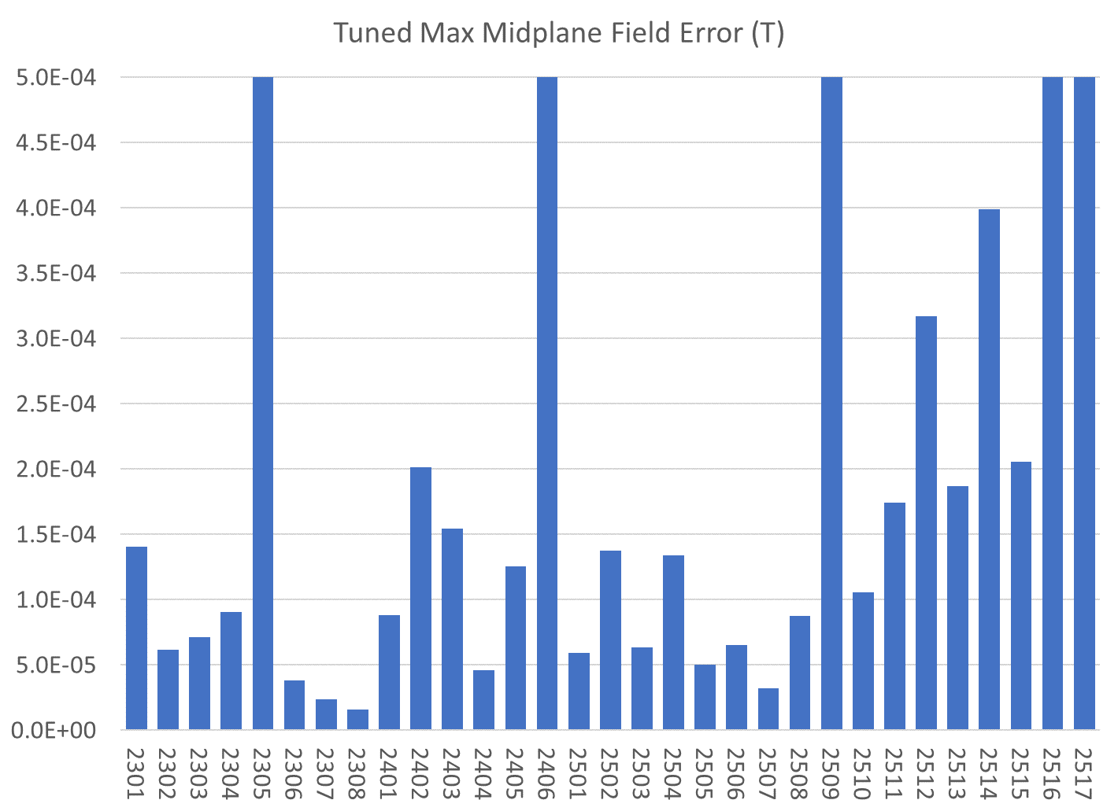
If magnets are not tuned yet, the untuned value is shown
All magnets are shown, those under consideration this week are under light blue bars
QF magnet with block in backwards
BD
QD
QF

Slide 5
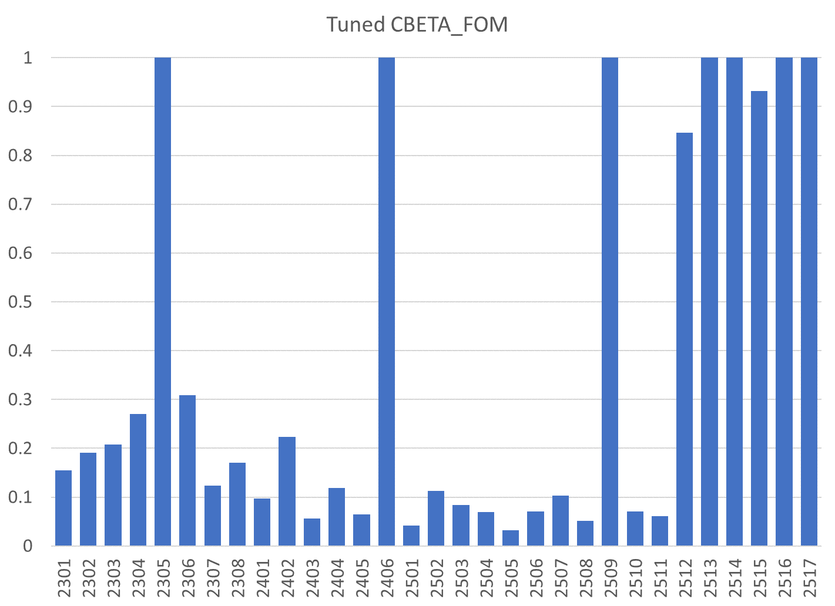
All magnets are shown, those under consideration this week are under light blue bars
If magnets are not tuned yet, the untuned value is shown
BD
QD
QF
QF magnet with block in backwards

Slide 6
Tuned Magnets Summary
Magnet # | Run # | Midplane error (G) | Units FOM | CBETA FOM | Quad error at x=0 (rel.)
2306 |  | /**/5.36 | 66.29 | 2.082 | 0.112%
2307
2308
2402
2506
2507
2508
2510
2511
Goals |  | ≤ 1.5 | ≤ 10 | ≤ 0.375 | ≤ 0.05% (Q)

Slide 7
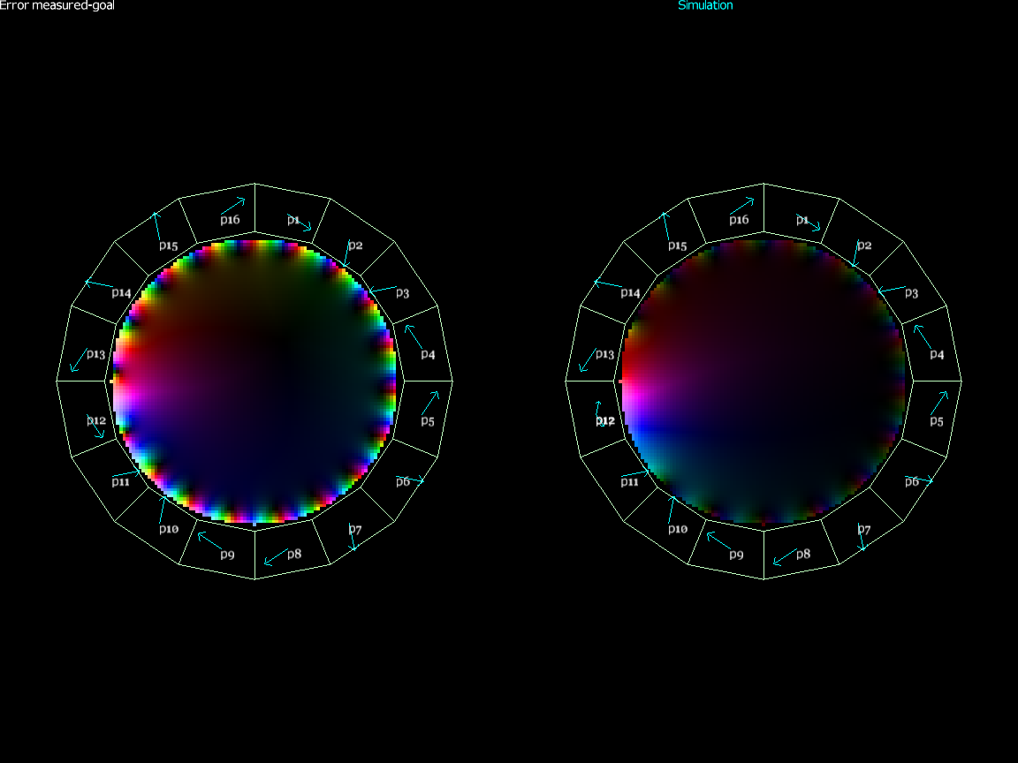
QF 2509 Backwards Block
This analysis told us where to look for a reversed block
Measured field
Simulation with one block reversed

Slide 8
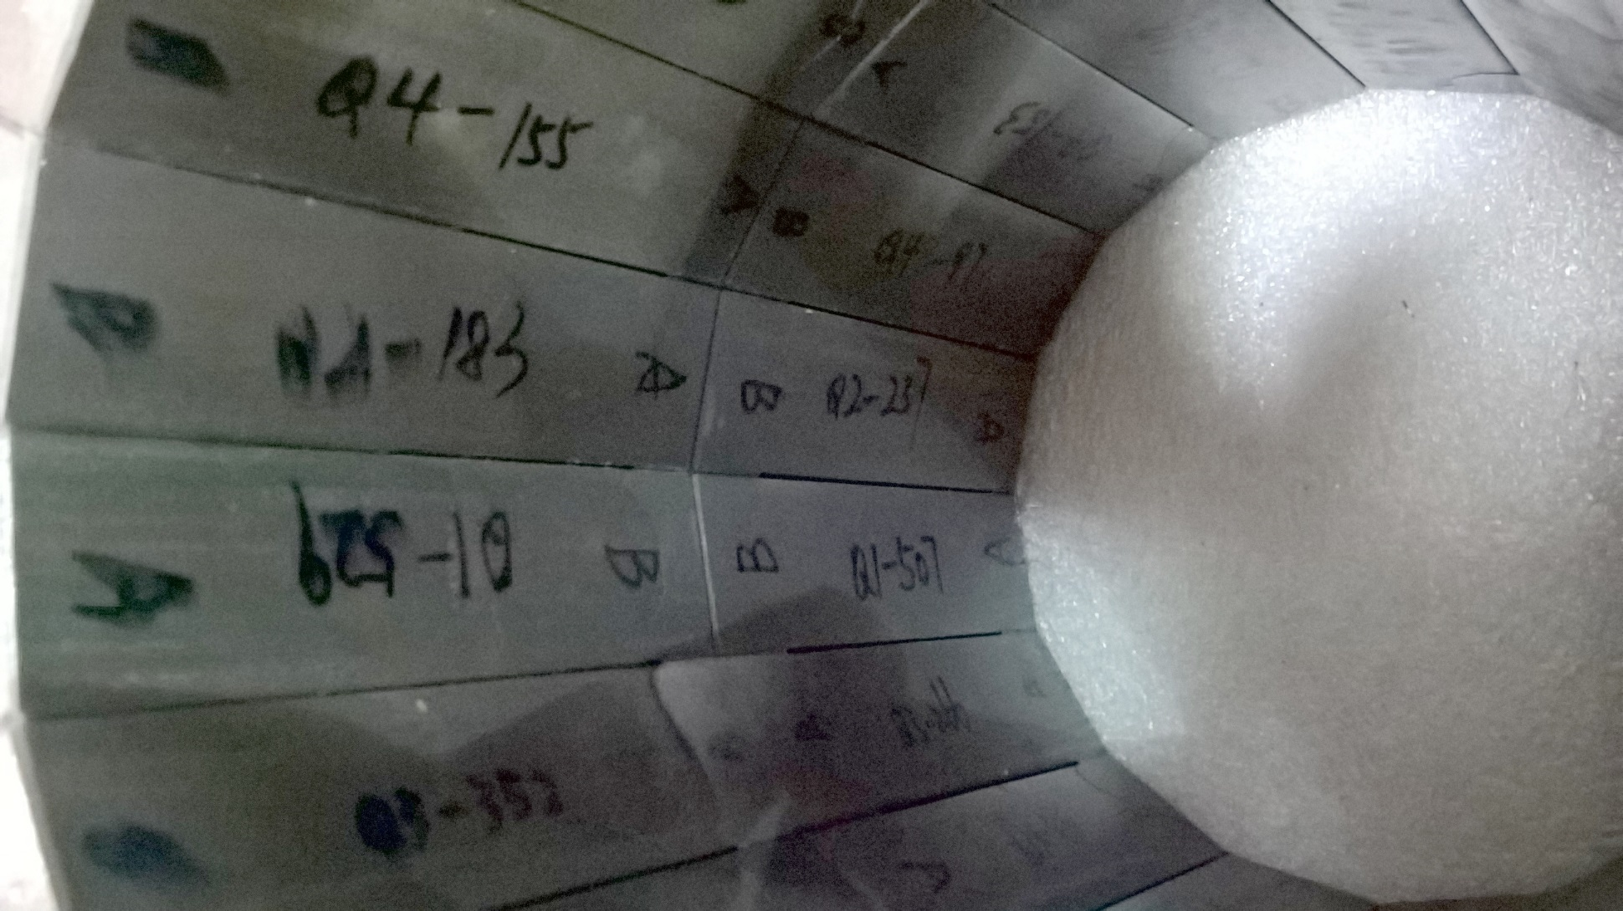
QF 2509 Backwards Block

Slide 9
Status
BD production approved last week
  Of last 3 samples, one tuned in one iteration, two took two iterations, using standard 64 wires
BDT1,2 samples (2 of each) found on Monday
  Measuring, experimenting with tuning this week
Tuning of existing QF, QD batch ongoing
  We have up to QF 2524 and QD 2413 in stock
  Last week was consistent with 8.2 magnets/week

