Slide 1
CBETA Production Magnets
QD 2414-20, 2422, 2423
QF 2518-26, 2529, 2530, 2534-37

Slide 2
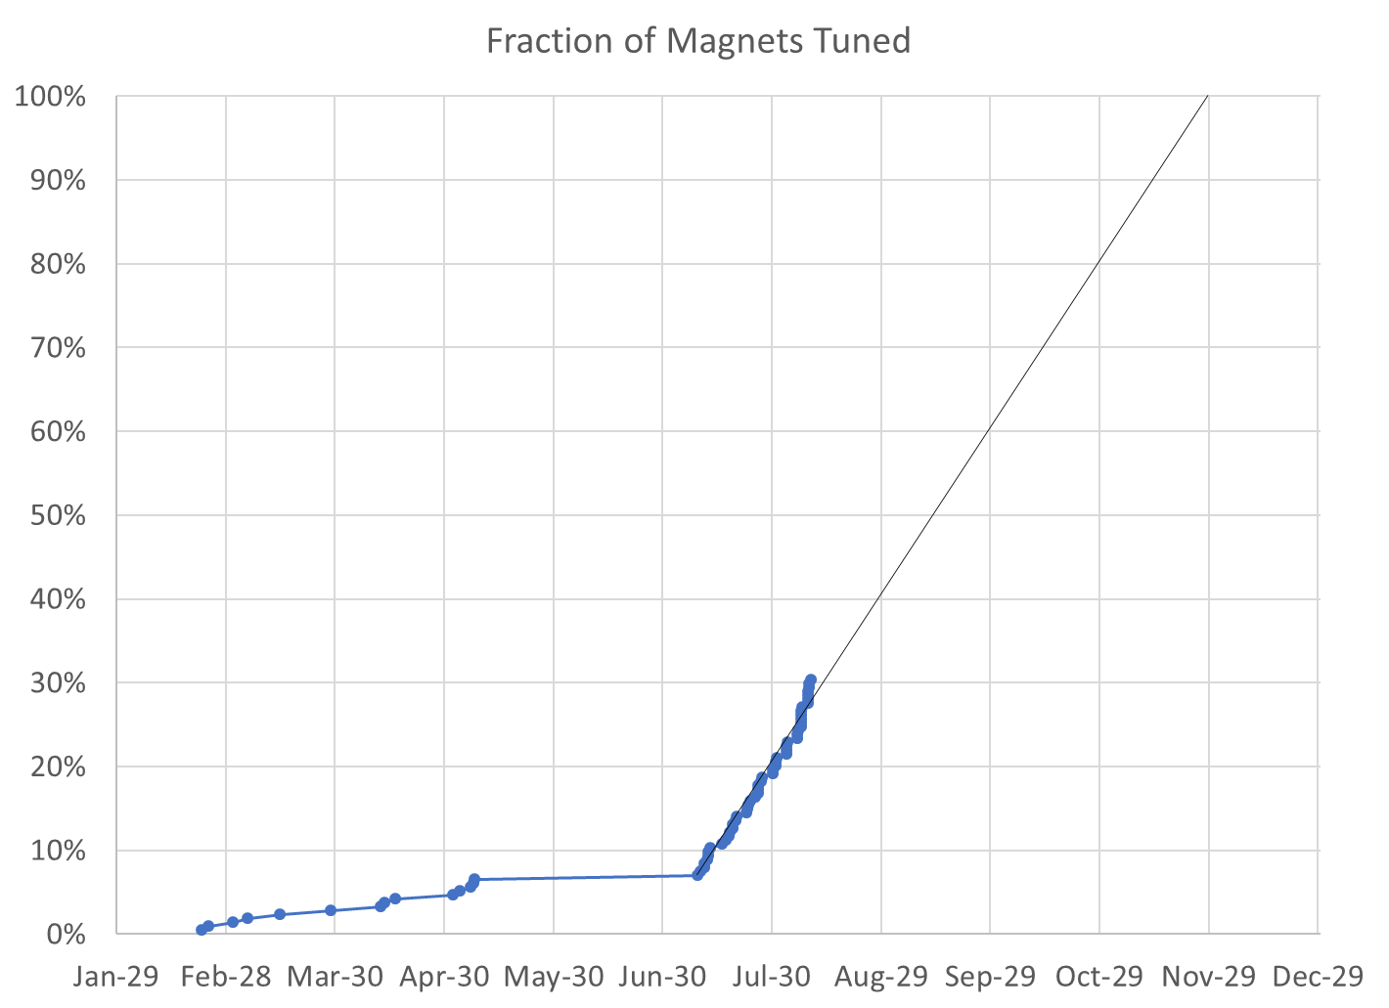

Slide 3
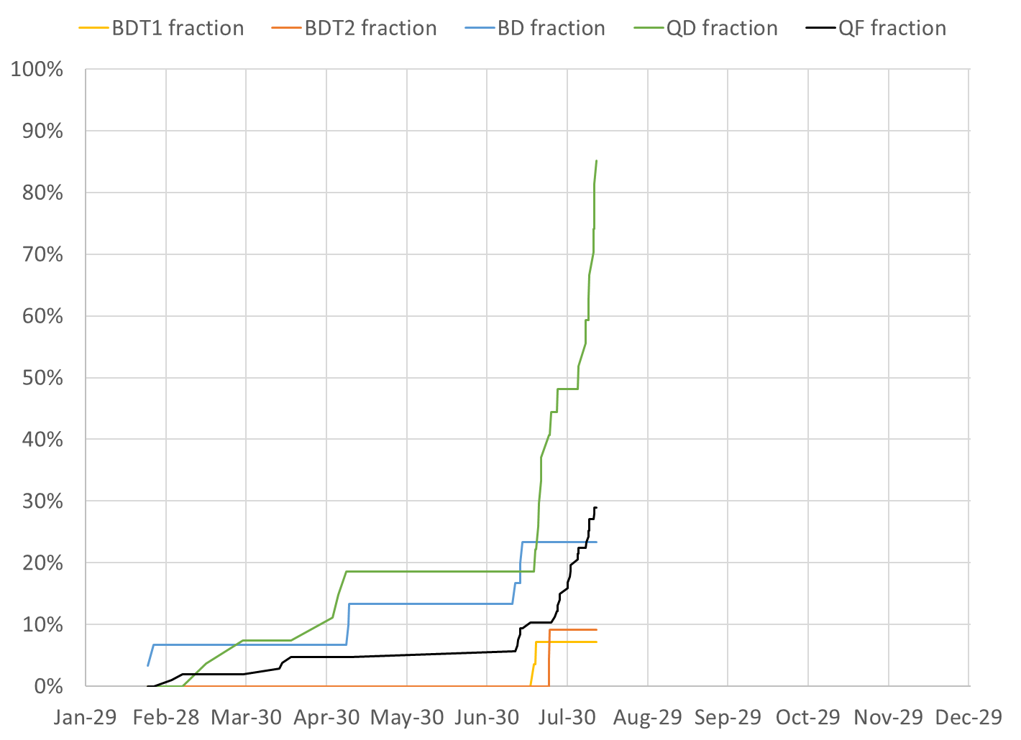

Slide 4
Projections
Method | Rotating Coil Measurements per Week | Magnets Tuned per Week | Projected Finish Date | Speed-up Required to Finish Nov-30
Magnets rate since main production start |  | 11.01 | Nov-15 | 15 calendar days spare
Rotating coil rate last 3 weeks plus production model | 29.3 | 10.39 (includes assumption for more iterations for future BD, coil slips etc.) | Nov-21 | 9 calendar days spare
Required to hit deadline (using model) | 27.2 | 9.57 | Nov-30 | 0%

Slide 5
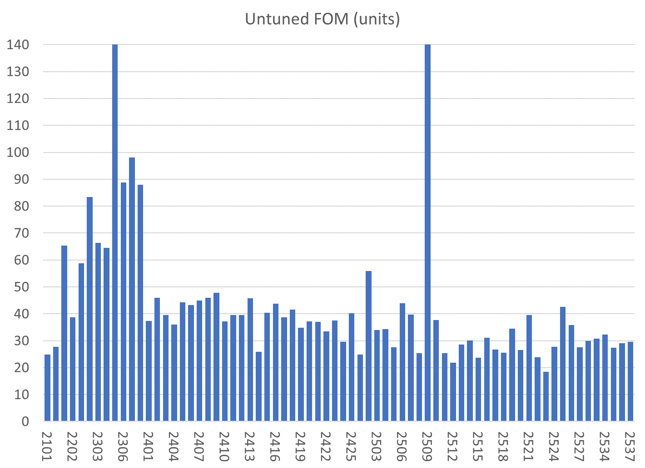
All magnets are shown, those under consideration this week are under light blue bars
BDT1
BD
QD
QF
BDT2

Slide 6
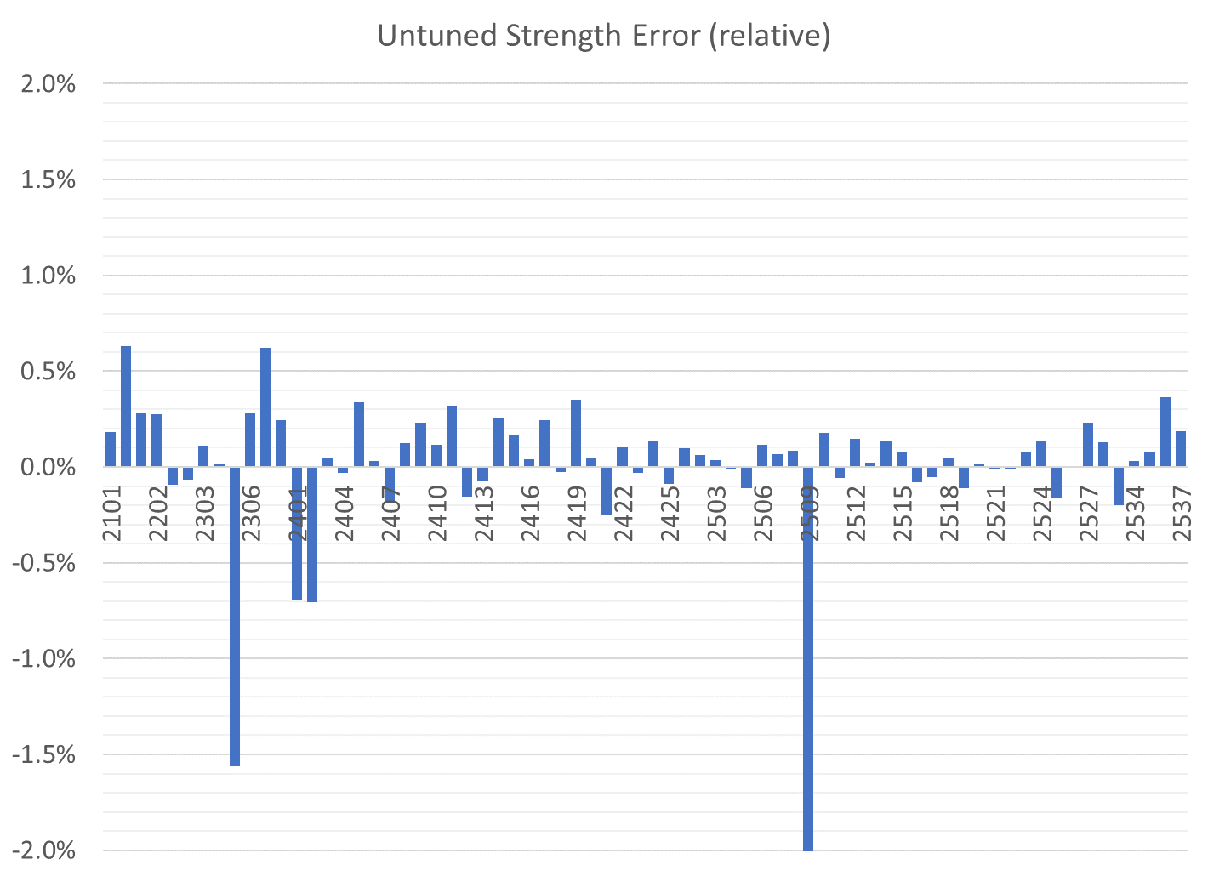
All magnets are shown, those under consideration this week are under light blue bars
BDT1
BD
QD
QF
BDT2

Slide 7
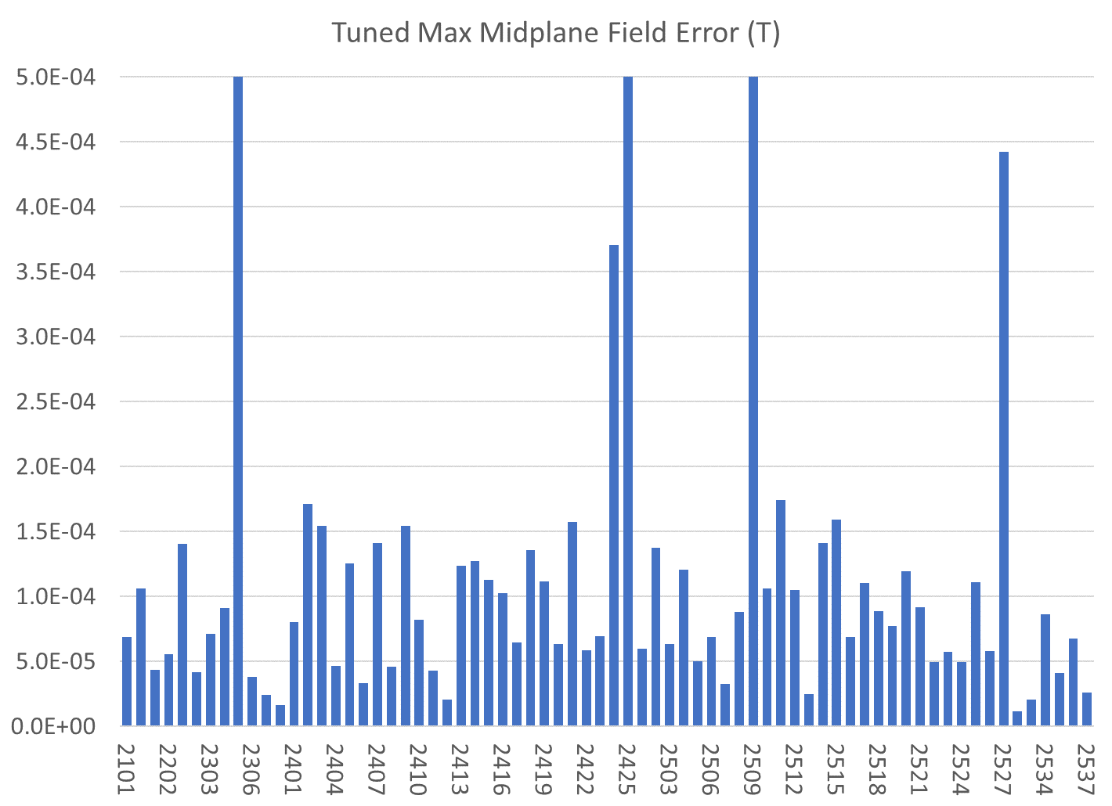
All magnets are shown, those under consideration this week are under light blue bars
If magnets are not tuned yet, the untuned value is shown
BDT1
BD
QD
QF
BDT2

Slide 8
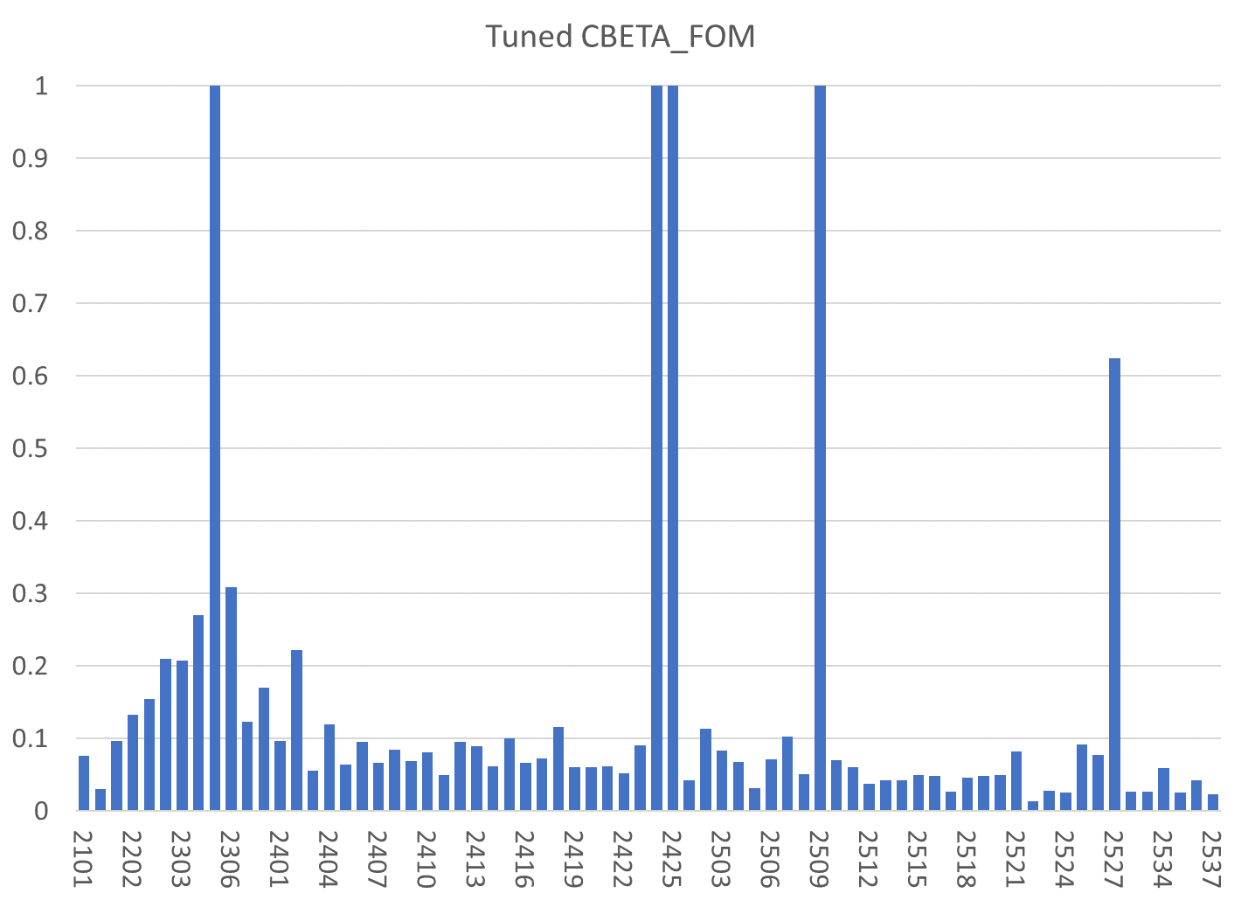
All magnets are shown, those under consideration this week are under light blue bars
If magnets are not tuned yet, the untuned value is shown
BDT1
BD
QD
QF
BDT2

Slide 9
Tuned Magnets Criteria
Midplane error (G) | Units FOM | CBETA FOM | Quad error at x=0 (rel.)
≤ 1.5 | ≤ 10 | ≤ 0.375 | ≤ 0.05% (Q)
For full data see spreadsheets “initialmagnets” “finalmagnets”
Midplane error generally hardest to achieve
  May go in and out of spec slightly (~0.5G) due to chiller cycle
Achieving all the above triggers “quick accept”

Slide 10
Status
Tuning of 2nd crate containing QFs and all remaining QD magnets nearly done
3rd crate to arrive this week, containing only QFs
Separate delivery of 3 BD magnets coming at some point to complete an arc girder
4th crate also only QF magnets
  >90 QFs manufactured at KYMA

