Slide 1
CBETA Production Magnets
BD 2309-2311
QF 2528, 2541, 2542, 2545, 2546, 2549-2552, 2557-2566, 2568, 2569, 2571, 2573-2578, 2586-2591

Slide 2
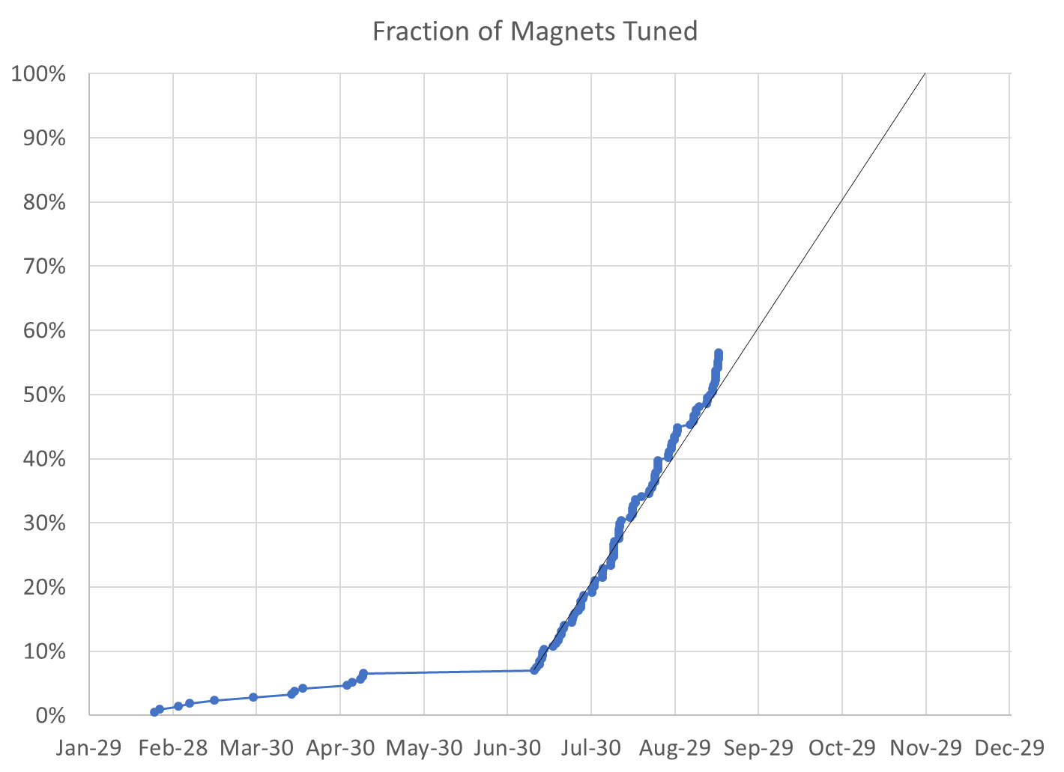
56% complete
121 / 214 magnets (93 remaining)

Slide 3
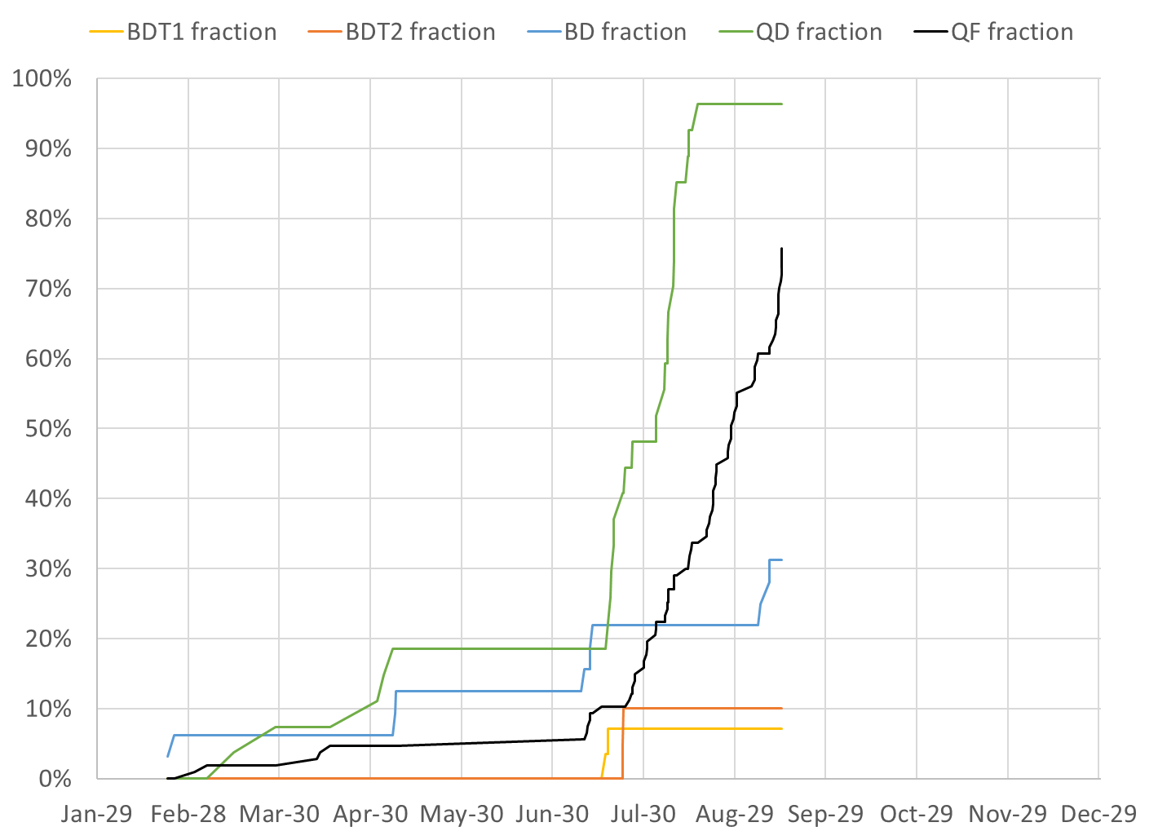
BDT1 2 / 28 magnets (26 remaining)
BDT2 2 / 20 magnets (18 remaining)
BD 10 / 32 magnets (22 remaining)
QD 26 / 27 magnets (1 remaining)
QF 81 / 107 magnets (26 remaining)

Slide 4
Projections
Method | Rotating Coil Measurements per Week | Magnets Tuned per Week | Projected Finish Date | Speed-up Required to Finish Nov-30
Magnets rate since main production start |  | 11.07 | Nov-11 | 19 calendar days spare
Rotating coil rate last 3 weeks plus model | 30.6 | 10.88 | Nov-12 | 18 calendar days spare
Rotating coil rate since start | 27.4 | 9.67 | Nov-20 | 10 calendar days spare
Required to hit deadline | 24.3 | 8.46 | Nov-30 | 0%

Slide 5
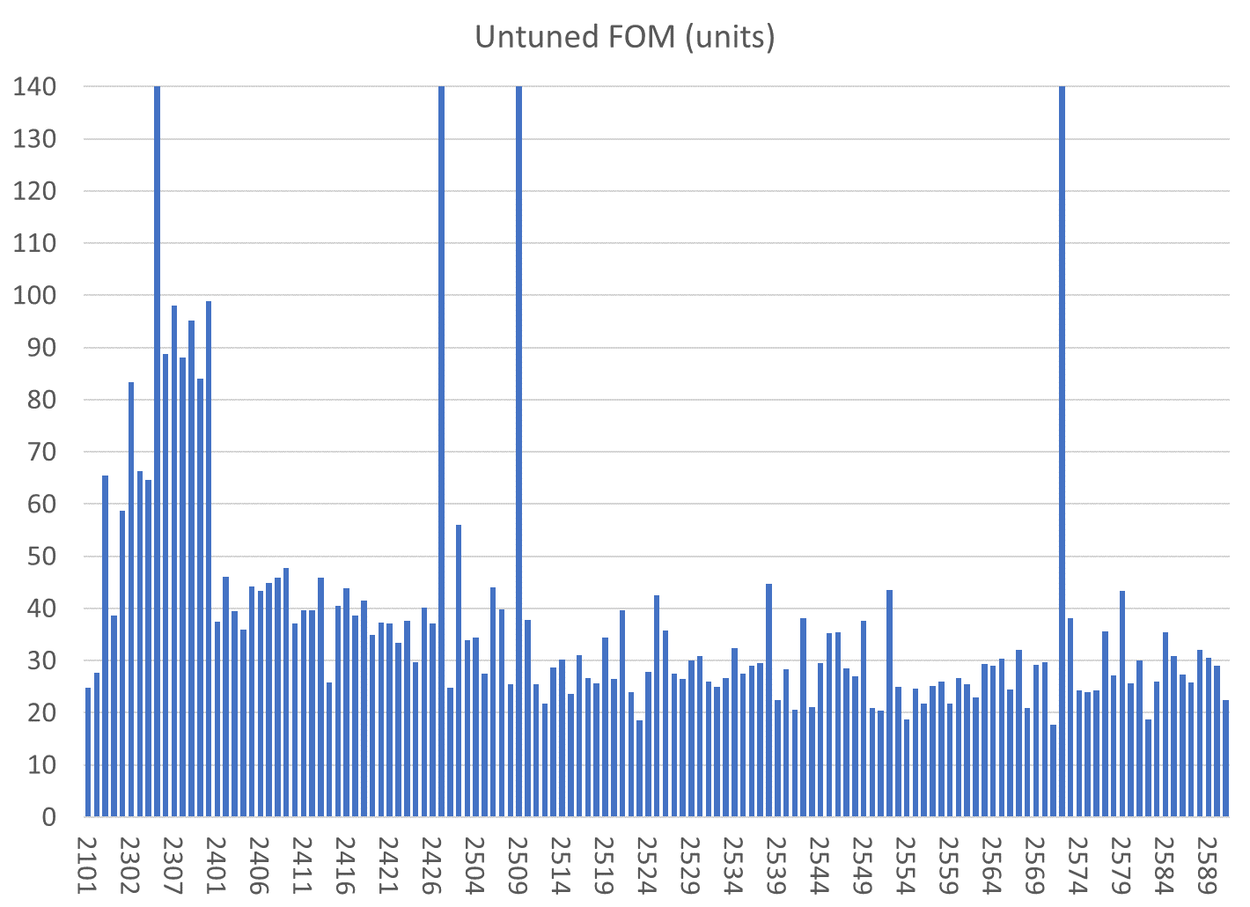
All magnets are shown
Reject
Reject
Reject/will replace half
Reject/will rebuild
BDT1
BDT2
BD
QD
QF

Slide 6
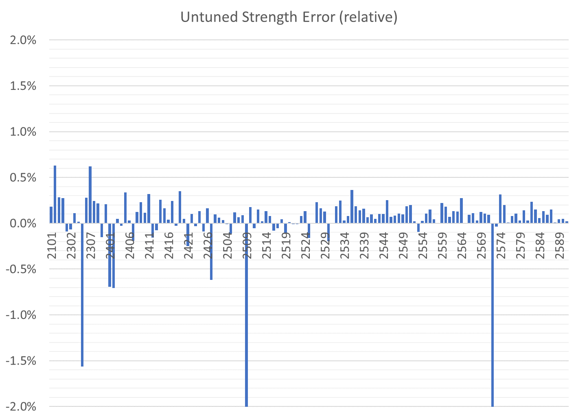
All magnets are shown
BDT1
BD
QD
QF
BDT2
Correcteed in aluminium
Reject/will replace half
Reject
Reject/will rebuild
Reject

Slide 7
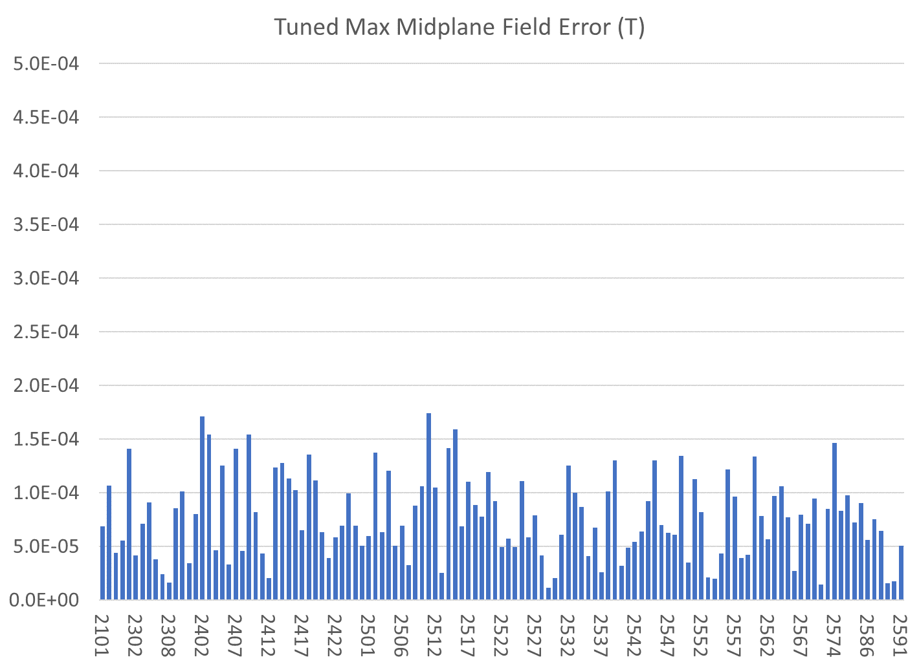
Only tuned magnets shown (4 “rejects” also removed)
BDT1
BD
QD
QF
BDT2

Slide 8
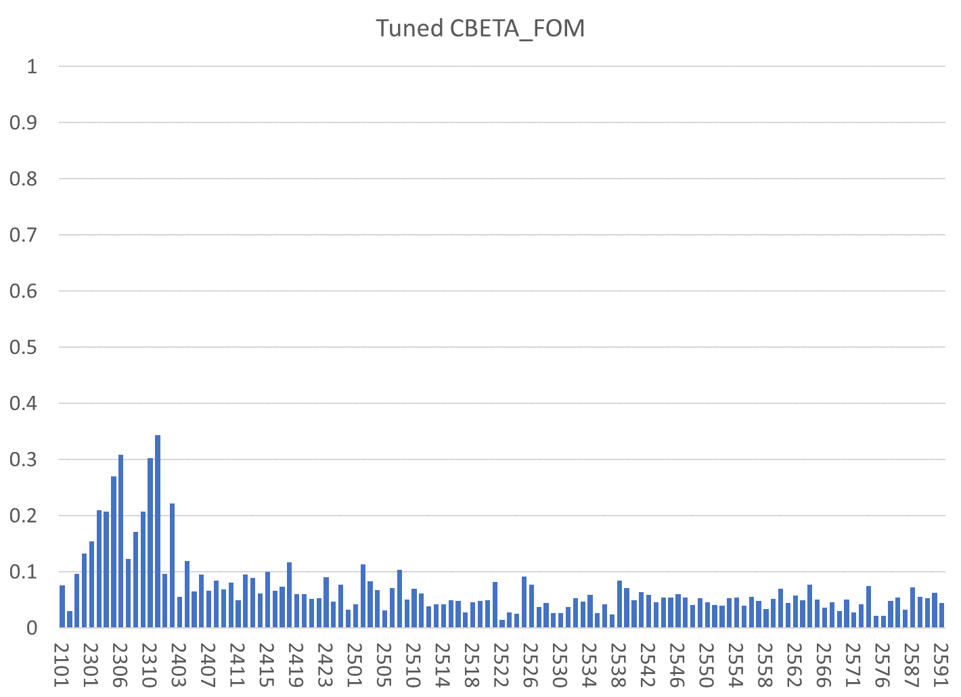
Only tuned magnets shown (4 “rejects” also removed)
BDT1
BD
QD
QF
BDT2

Slide 9
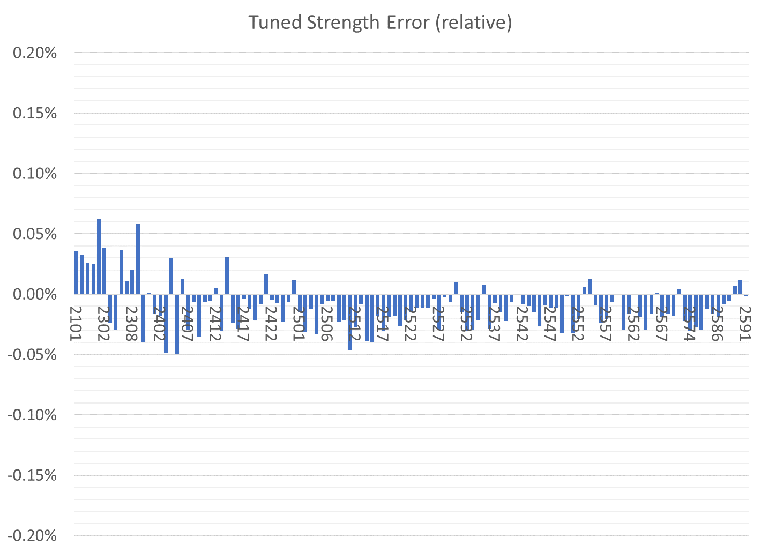
Only tuned magnets shown (4 “rejects” also removed)
BDT1
BD
QD
QF
BDT2

Slide 10
Tuned Magnets Criteria
Midplane error (G) | Units FOM | CBETA FOM | Quad error at x=0 (rel.)
≤ 1.5 | ≤ 10 | ≤ 0.375 | ≤ 0.05% (Q)
For full data see spreadsheets “initialmagnets” “finalmagnets”
Midplane error generally hardest to achieve
  May go in and out of spec slightly (~0.5G) due to chiller cycle
Achieving all the above triggers “quick accept”

Slide 11
Status
Tuning of last crate containing only QF magnets is almost complete
Crate with BDs to arrive this week(?)
  Will allow girder construction to continue
George has made the QFH (2751) magnet for the end of the beamline
  Waiting for pins to be drilled before measurement and tuning

Slide 12
Rejects / Waiting for Fixed Halves
The left half of BD 2305
  Backwards block by KYMA
The left half of QF 2509
  Backwards block by KYMA
The right half of QD 2427
  Unknown: best match is wrong type block caused by a R1/R2 mislabelling at the AllStar factory
The right half of QF 2572
  Another possible block type mislabelling
  Will be combined with QF 2509 good half

