Slide 1
CBETA Production Magnets
BDT1 2103-2106
BD 2312-2331
QF 2592, 2593

Slide 2
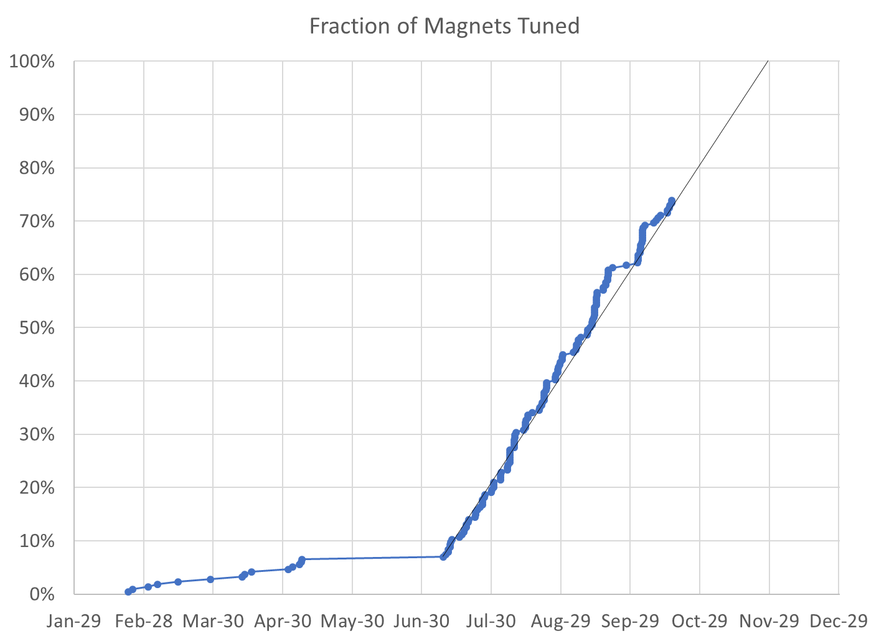
73% complete
158 / 215 magnets (57 remaining)

Slide 3
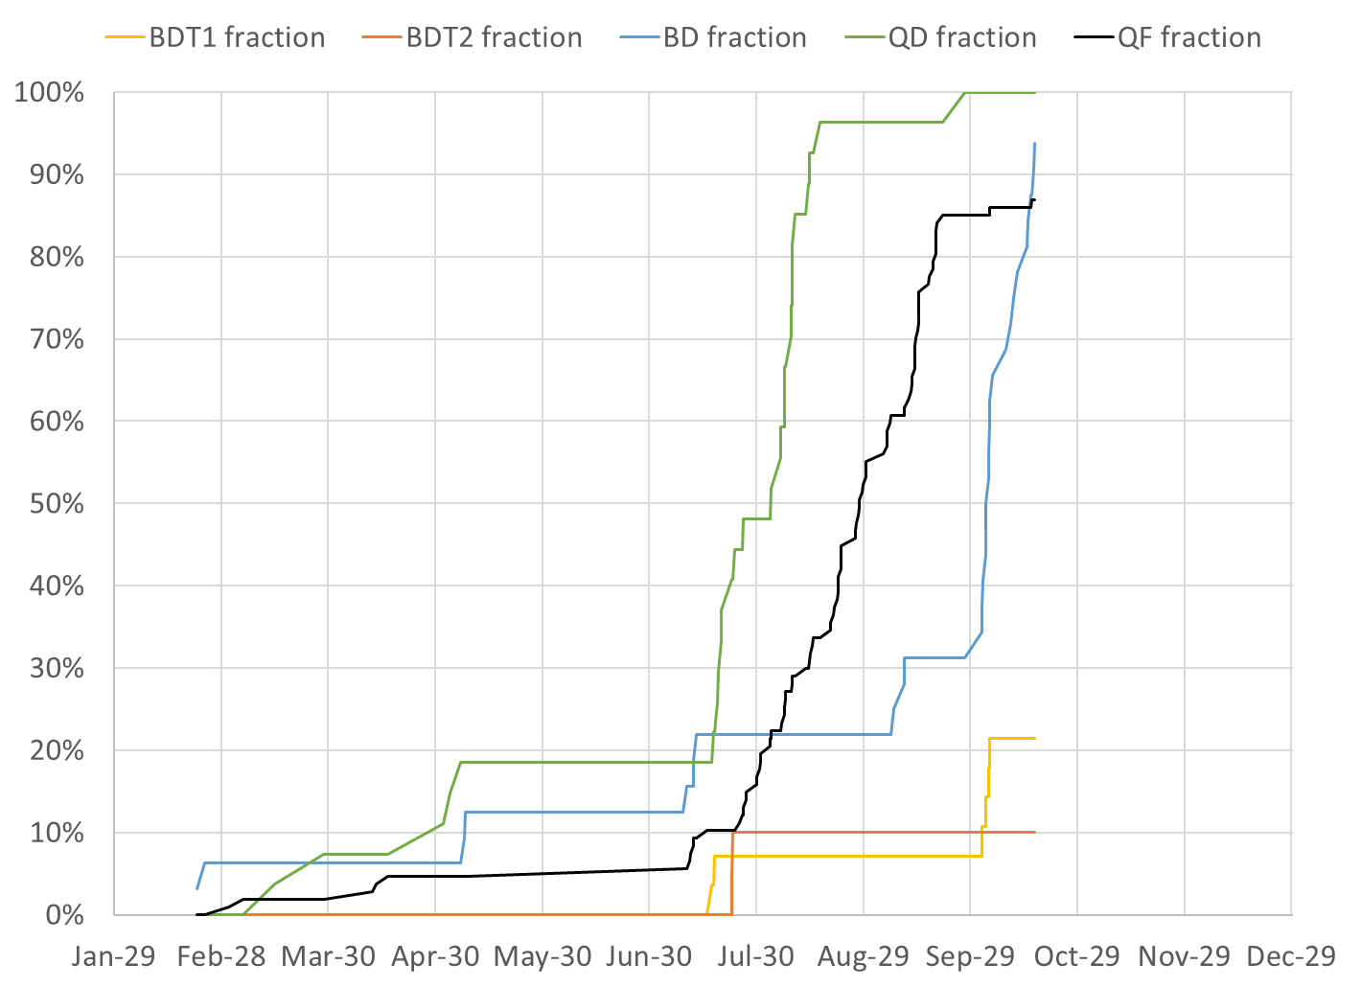
BDT1 6 / 28 magnets (22 remaining)
BDT2 2 / 20 magnets (18 remaining)
BD 30 / 32 magnets (2 remaining)
QD 27 / 27 magnets (0 remaining)
QF 92 / 107 magnets (15 remaining)
QFH 1 / 1 magnet (0 remaining)

Slide 4
Projections
Method | Rotating Coil Measurements per Week | Magnets Tuned per Week | Projected Finish Date | Speed-up Required to Finish Nov-30
Magnets rate since main production start |  | 10.02 | Nov-30 | 0.3%
Rotating coil rate last 3 weeks plus model | 22.3 NB: broken coil, will do extended shifts | 7.84 | Dec-11 | 28.2%
Rotating coil rate since start | 25.3 | 8.98 | Dec-04 | 11.9%
Required to hit deadline | 28.1 | 10.05 | Nov-30 | 0%

Slide 5
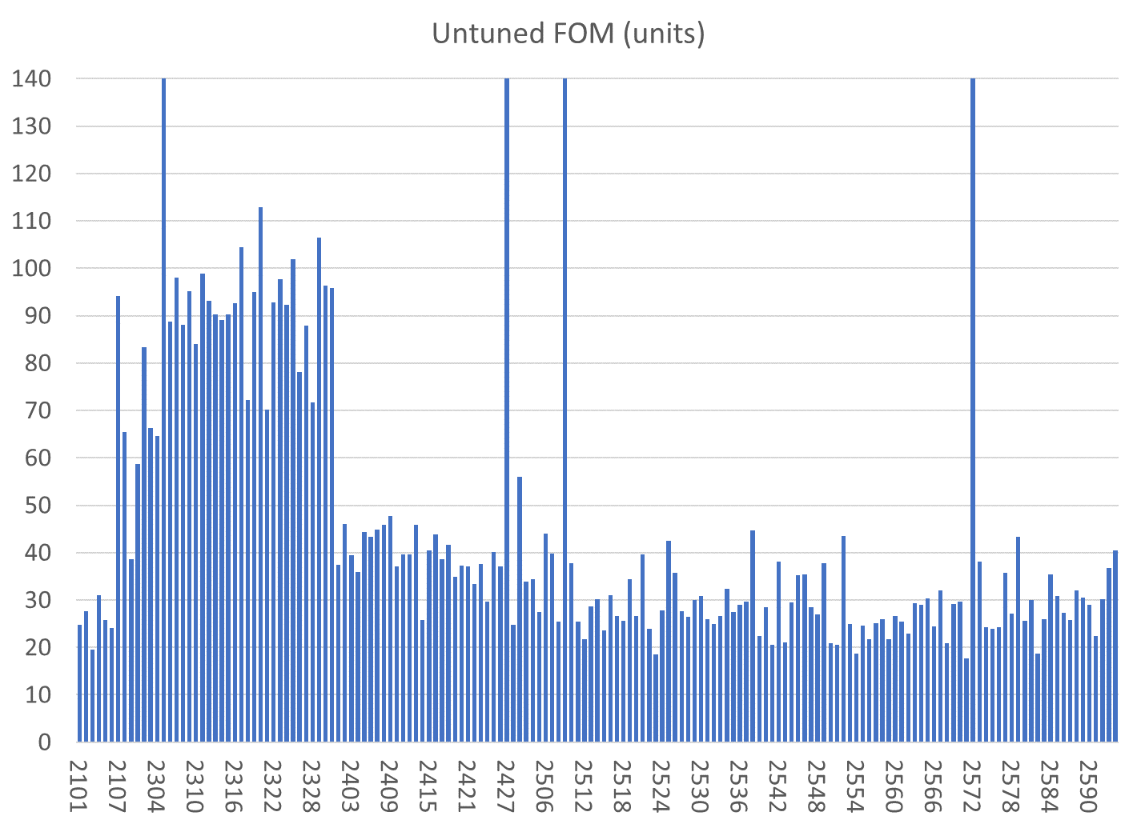
All magnets are shown
Reject
BDT1
BDT2
BD
QD
QF
Reject/com,bined with 2572
Reject/have replaced half
Reject/have replaced half
QFH

Slide 6
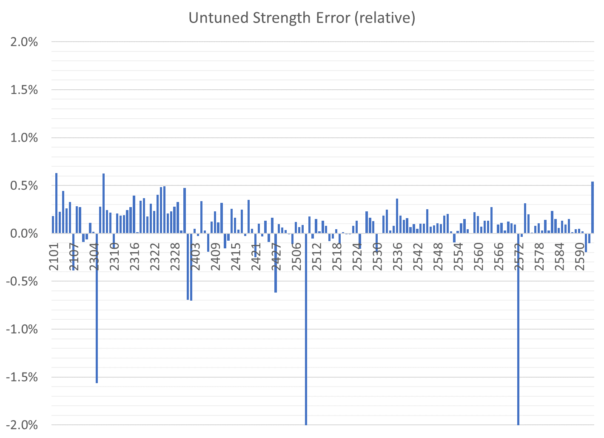
All magnets are shown
BDT1
BD
QD
QF
BDT2
QFH
Correcteed in aluminium
Reject
Reject/have replaced half
Reject/com,bined with 2572
Reject/have replaced half

Slide 7
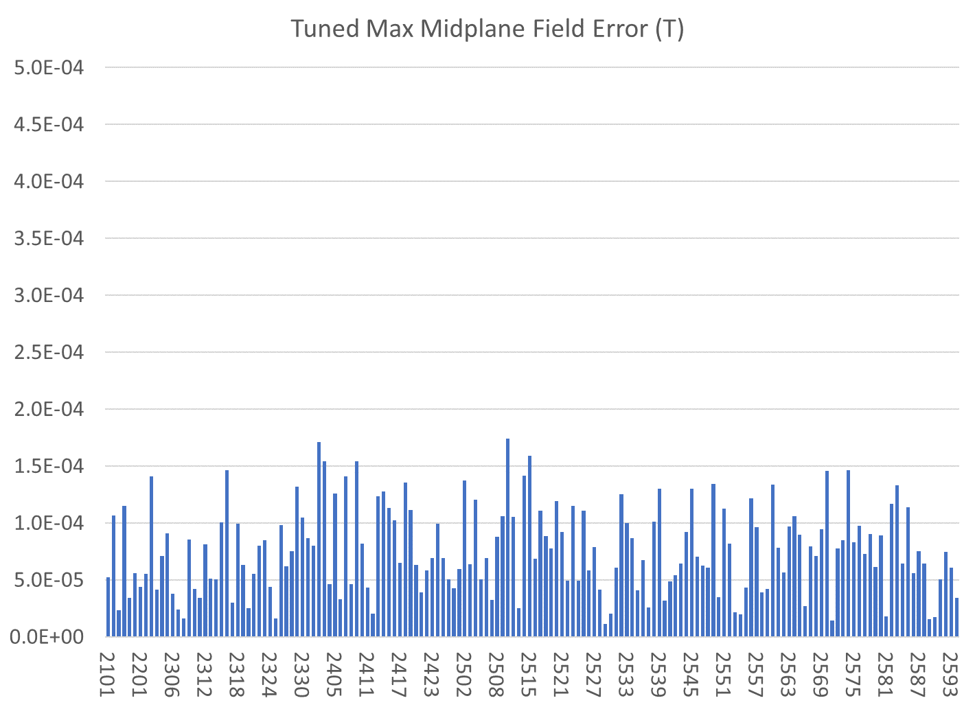
Only tuned magnets shown (2 “rejects” also removed)
BDT1
BD
QD
QF
BDT2
QFH

Slide 8
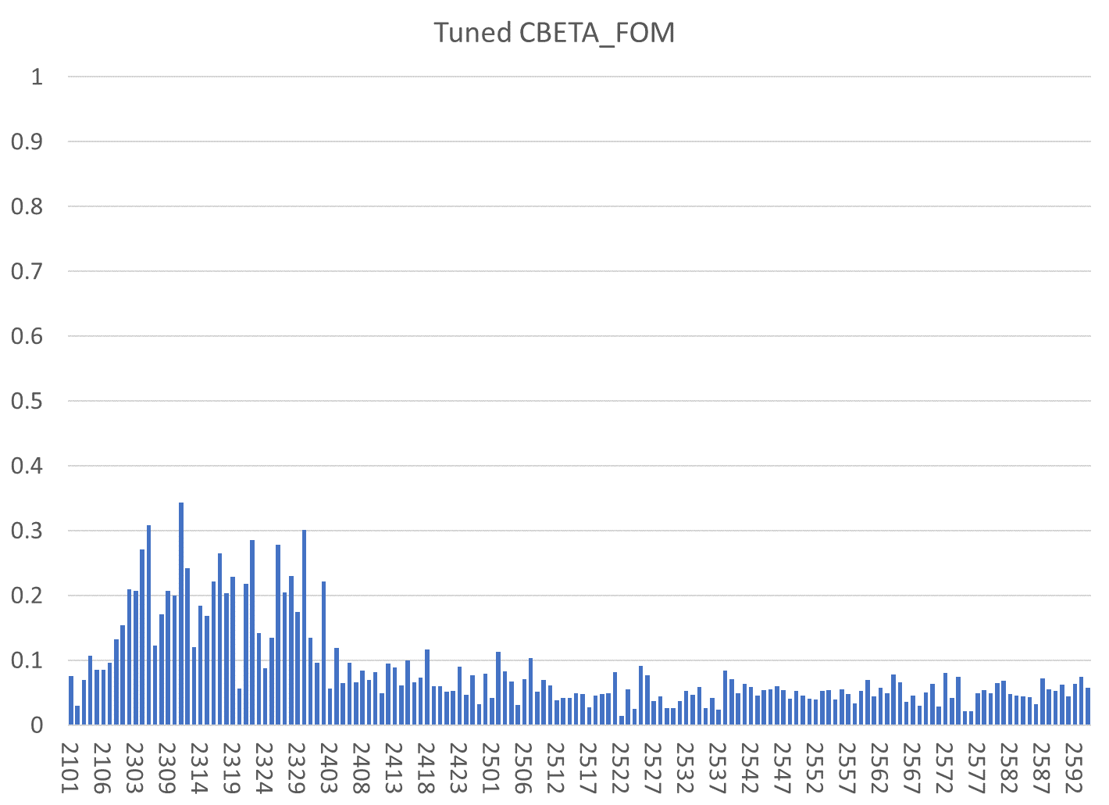
Only tuned magnets shown (2 “rejects” also removed)
BDT1
BD
QD
QF
BDT2
QFH

Slide 9
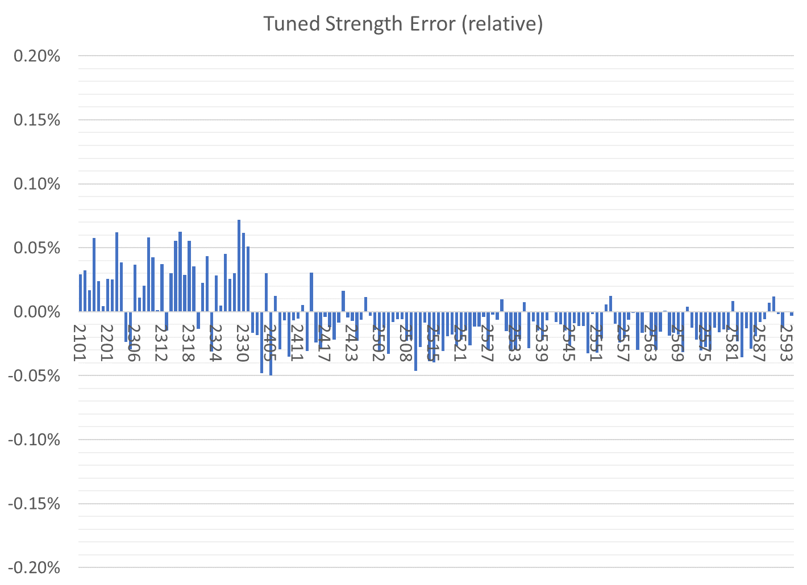
Only tuned magnets shown (2 “rejects” also removed)
BDT1
BD
QD
QF
BDT2
QFH

Slide 10
Tuned Magnets Criteria
Midplane error (G) | Units FOM | CBETA FOM | Quad error at x=0 (rel.)
≤ 1.5 | ≤ 10 | ≤ 0.375 | ≤ 0.05% (Q)
For full data see spreadsheets “initialmagnets” “finalmagnets”
Midplane error generally hardest to achieve
  May go in and out of spec slightly (~0.5G) due to chiller cycle
Achieving all the above triggers “quick accept”

Slide 11
Status
Reduced coil rate last 2 weeks
  Coil #76 electronics problem, out of service
  Difficult to fix, John C. now on vacation
  Will run with just the coil #71 and extended hours
Glue failures on QF 2560, 2565, 2570
  Re-epoxyed by George M.
  Immediately acceptable after repair! (re-survey)
  Only ~0.5 units change in multipoles

Slide 12
Girders
All arc girders except the final FB GD4 (waiting for vacuum chamber) are done
  Ran out of vacuum pipe support legs!
Next: transition girders that use BDT1 magnets
ZA GD1
ZA GD2
ZA GD3
ZM GD
ZB GD1
ZB GD2
ZB GD3
FA GD1 old
FA GD1 new
FA GD2
FA GD3
FA GD4
FB GD1
FB GD2
FB GD3
FB GD4
TA GD1
TA GD2
TA GD3
TA GD4
TA GD5
TA GD6
TB GD1
TB GD2
TB GD3
TB GD4
TB GD5
TB GD6
Not started
U/C Chamber only
Under construction
Complete at BNL
Delivered to Cornell
In crates

