Slide 1
CBETA Production Magnets
BDT2 2203-2221 (2222 pending file)
QF 2595-2608
Production complete excl. spares!

Slide 2
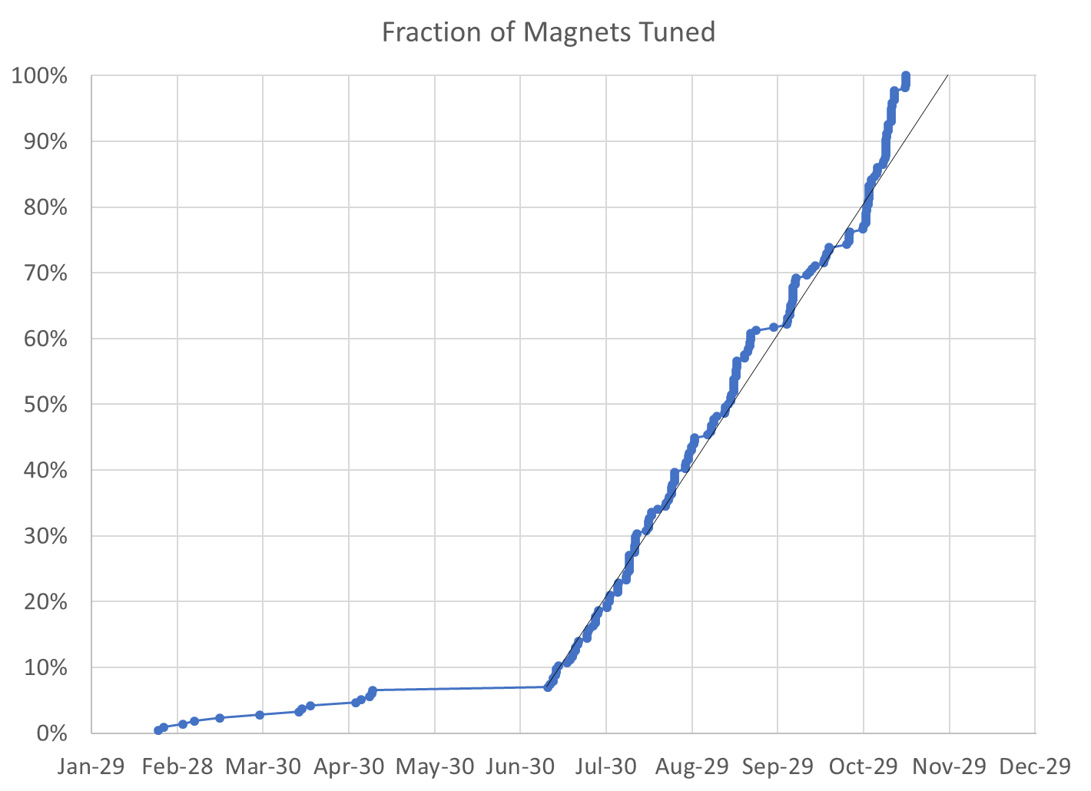
100% complete (excl. spares*)
215 / 215 magnets (0 remaining)
* We have 4 “spare” QFs, 2 BDs for replacing first girder magnets, plus two spare BDT2 magnets, with more spares to be delivered from KYMA

Slide 3
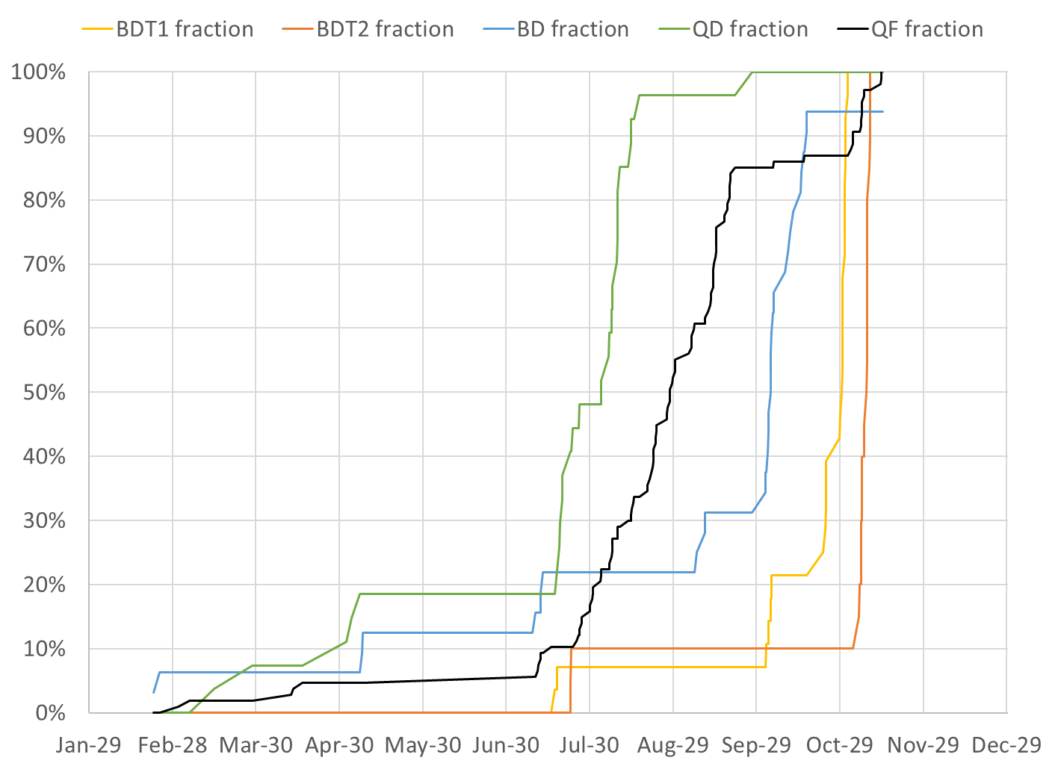
BDT1 28 / 28 magnets (0 remaining)
BDT2 22 / 20 magnets (2 spare)
BD 30 / 32 magnets (2 remaining*)
QD 27 / 27 magnets (0 remaining)
QF 107 / 107 magnets (0 remaining)
QFH 1 / 1 magnet (0 remaining)
* Total of 32 includes 4 spares for replacing the first girder BDs (same applies to QF total)

Slide 4
Final Measurement Rate
Main Production
Magnets tuned | 200 (excl. early samples)
Rotating coil measurements | 545
Start date | July 9, 2018
End date | November 14, 2018
Total weeks | 18.2
Magnets tuned per week (avg.) | 10.96
Rotating coil meas. per week (avg.) | 29.88
Rotating coil meas. per magnet (avg.) | 2.73

Slide 5
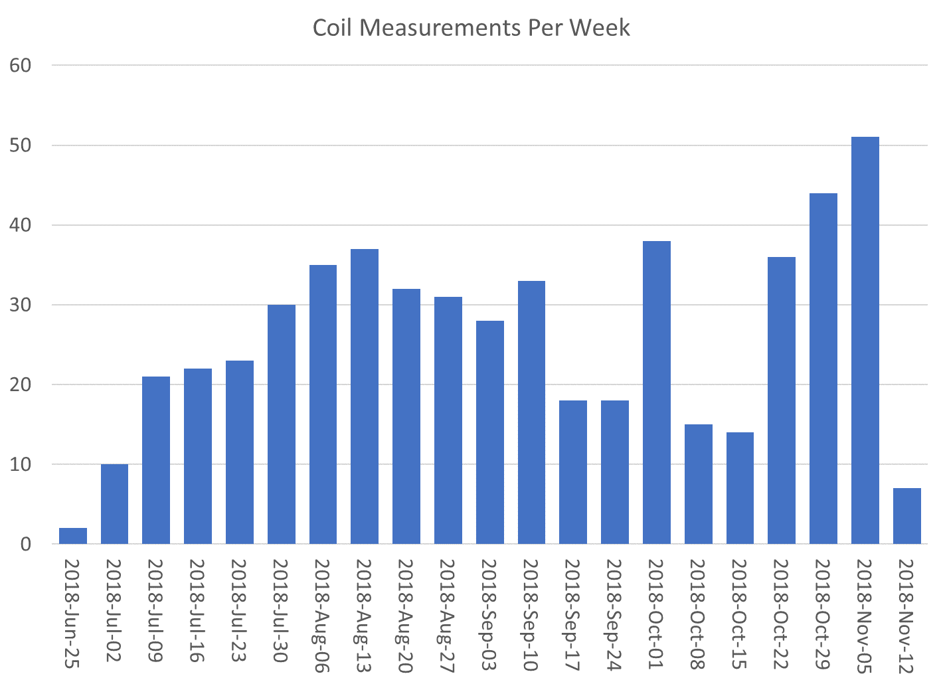

Slide 6
Tuned Magnets Criteria
Midplane error (G) | Units FOM | CBETA FOM | Quad error at x=0 (rel.)
≤ 1.5 | ≤ 10 | ≤ 0.375 | ≤ 0.05% (Q)
For full data see spreadsheets “initialmagnets” “finalmagnets”
Midplane error generally hardest to achieve
May go in and out of spec slightly (~0.5G) due to chiller cycle
Achieving all the above triggers “quick accept”

Slide 7
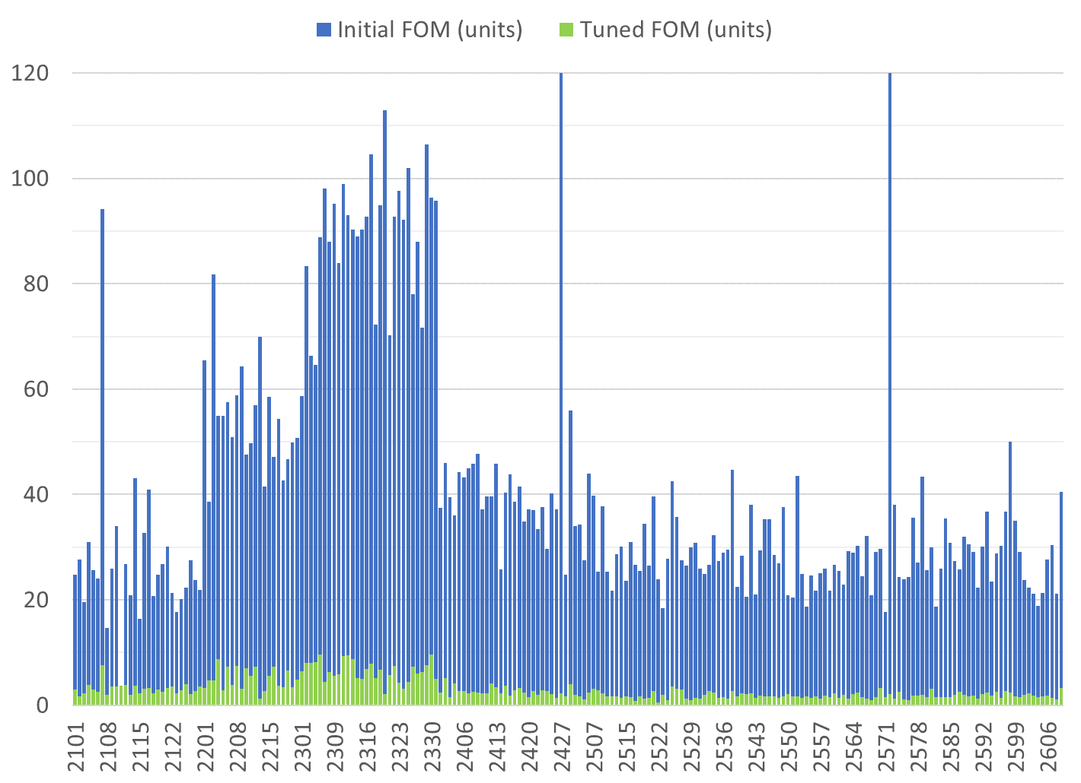
Only tuned magnets shown (2 “rejects” removed)
BDT1
BDT2
BD
QD
QF
Reject matched with good half
Reject matched with good half
80 shims
Tuned with 96 shims
QFH

Slide 8
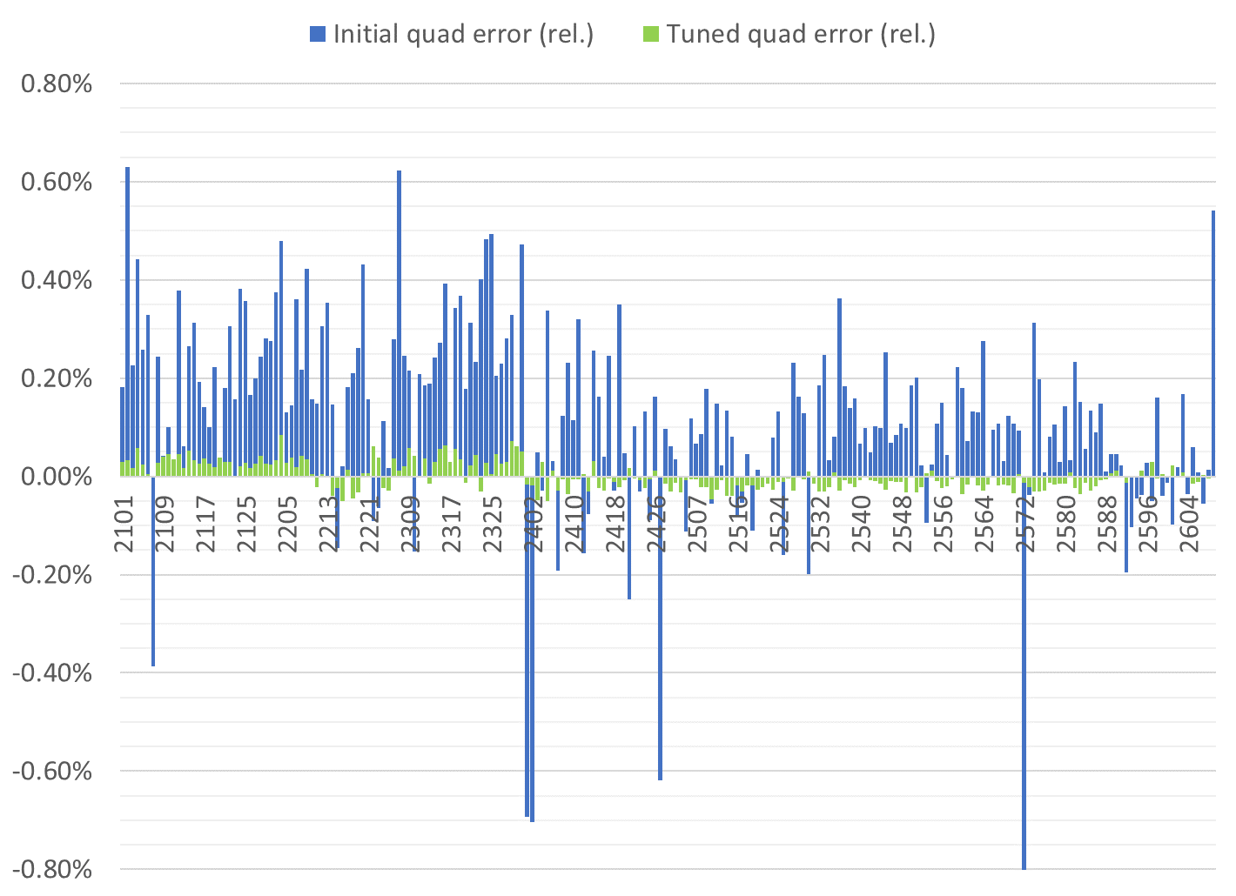
Only tuned magnets shown (2 “rejects” removed)
BDT1
BDT2
BD
QD
QF
QFH

Slide 9
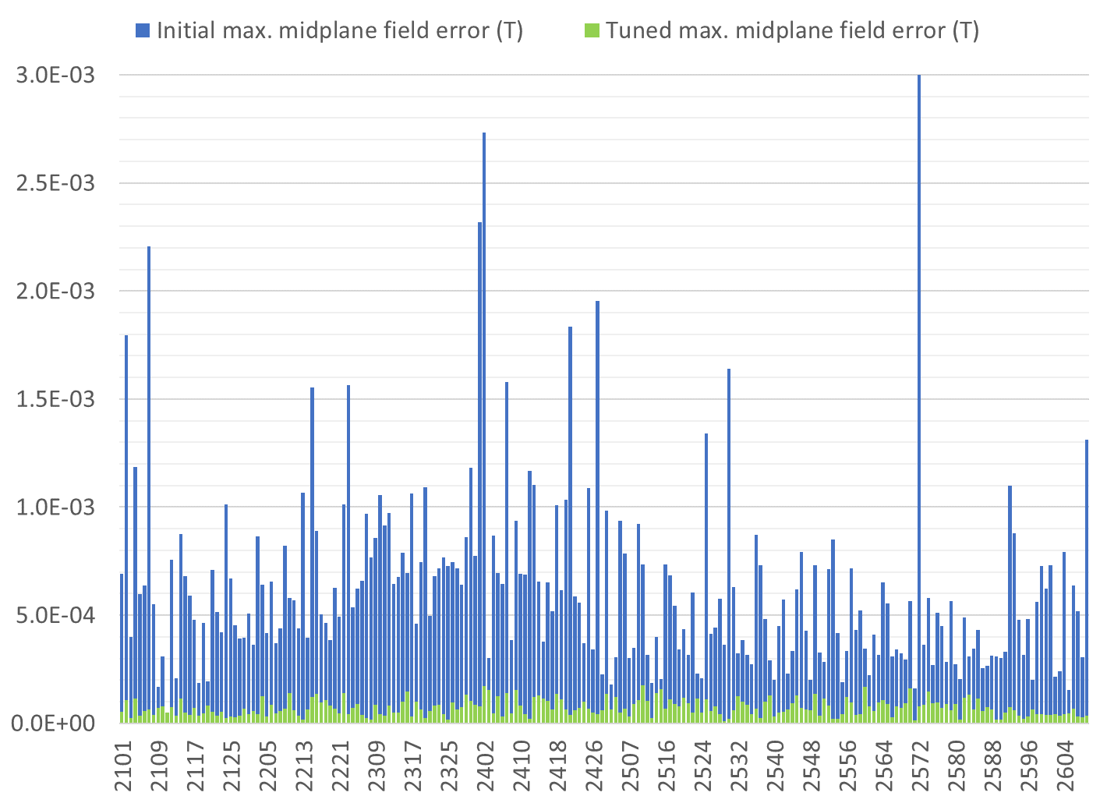
Only tuned magnets shown (2 “rejects” removed)
BDT1
BDT2
BD
QD
QF
QFH

Slide 10
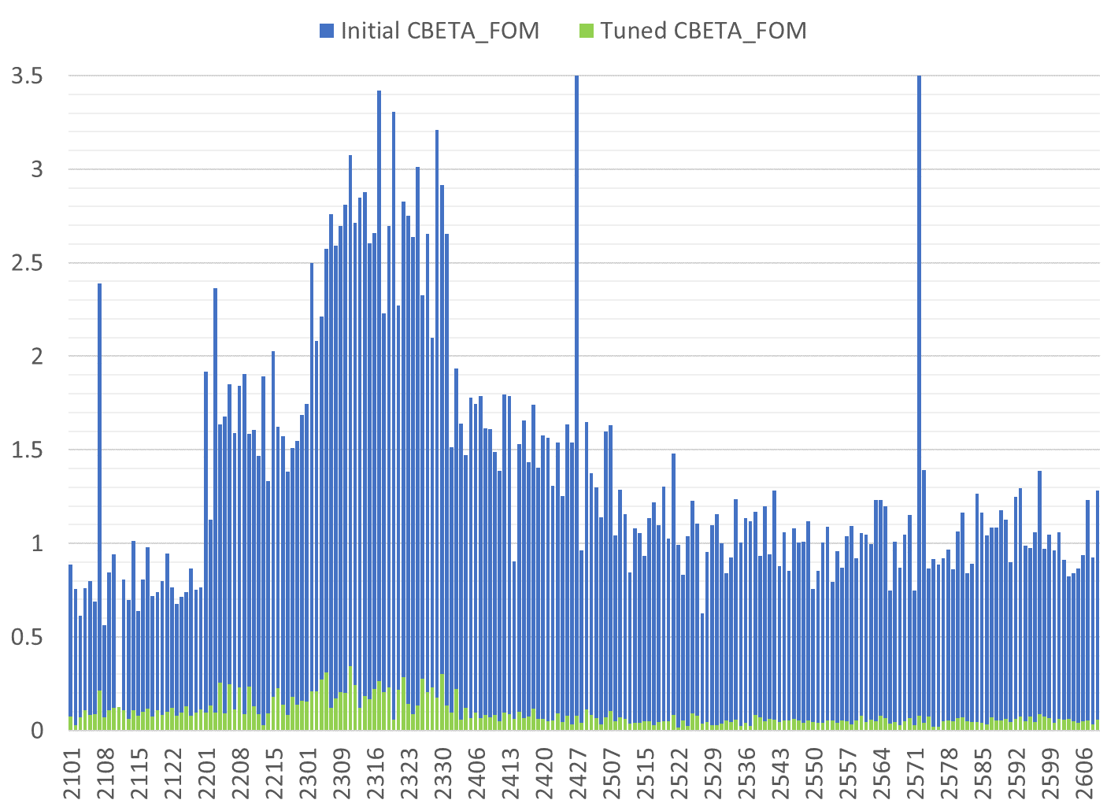
Only tuned magnets shown (2 “rejects” removed)
BDT1
BDT2
BD
QD
QF
QFH

Slide 11
Status
All magnets required for deadline are measured, all magnets at BNL are measured
For replacing first girder
Four QF magnets 2605-2608 are measured
Two BD magnets measured, two to be delivered
Other spares
Two BDT2 magnets measured
Two each of QD, BDT1 to be delivered

Slide 12
Girders
As of Monday 19th 10am, need windowframe corrector magnets for FB GD4 and TB GD1
Delivery might be later Monday?
Then just wiring and final gaps check
ZA GD1
ZA GD2
ZA GD3
ZM GD
ZB GD1
ZB GD2
ZB GD3
FA GD1 old
FA GD1 new
FA GD2
FA GD3
FA GD4
FB GD1
FB GD2
FB GD3
FB GD4
TA GD1
TA GD2
TA GD3
TA GD4
TA GD5
TA GD6
TB GD1
TB GD2
TB GD3
TB GD4
TB GD5
TB GD6
Not started
U/C Chamber only
Under construction
Complete at BNL
Delivered to Cornell
In crate

Slide 13
Misc to-do (Mon a.m.)
One magnet on girder has gaps, needs reassembly
4 holes need to be drilled and tapped in girder FB GD4
~6 pairs of base brackets need holes drilled and tapped
One (spare) BD magnet has block coming out, needs to be re-epoxied, remeasured later

