Slide 1
CBETA FFA Response Matrix
And some vague ideas about commissioning

Slide 2
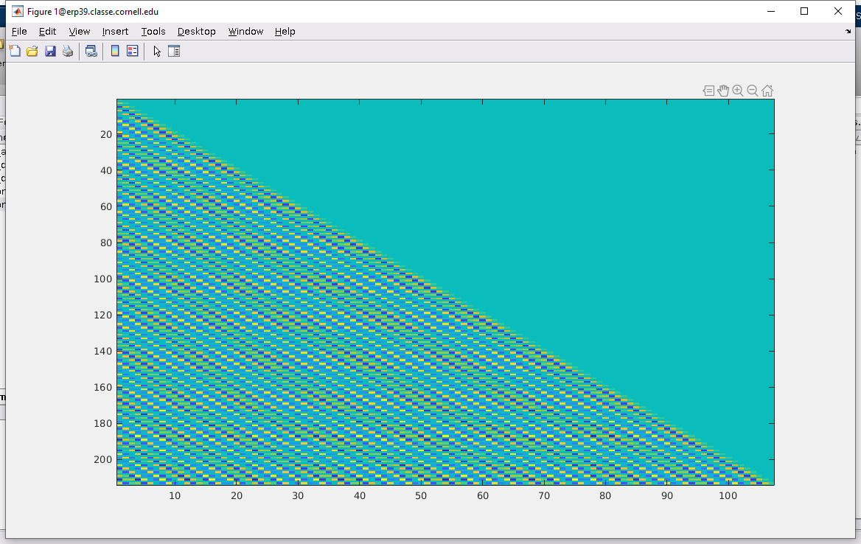
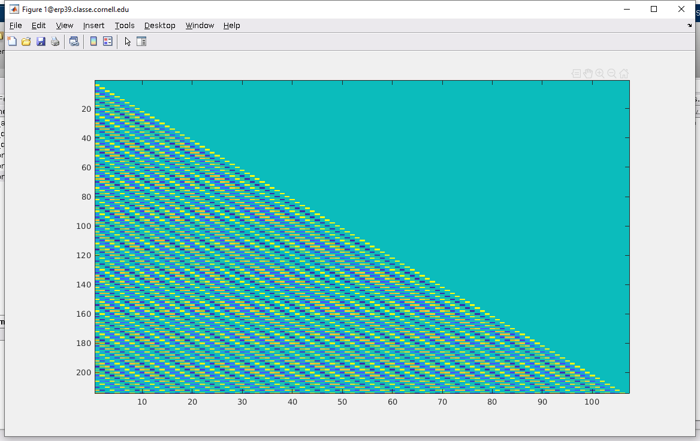
Full Response Matrices from CBETA-V
FFA correctors → FFA BPMs
One baseline setting and then one-sided differences (1+107=108 settings total)
Horizontal correctors
Vertical correctors

Slide 3
Get the 107x107 real matrices?
Scott says this takes too long
I say it’s OK if we use the crappy one-sided difference
108 sets of corrector settings ~15 mins
Why do I want to do this? (once)
This will show any swapped, disconnected or backwards BPMs as “wrong-looking” rows
Any swapped, disconnected or backwards correctors as “wrong-looking” columns

Slide 4
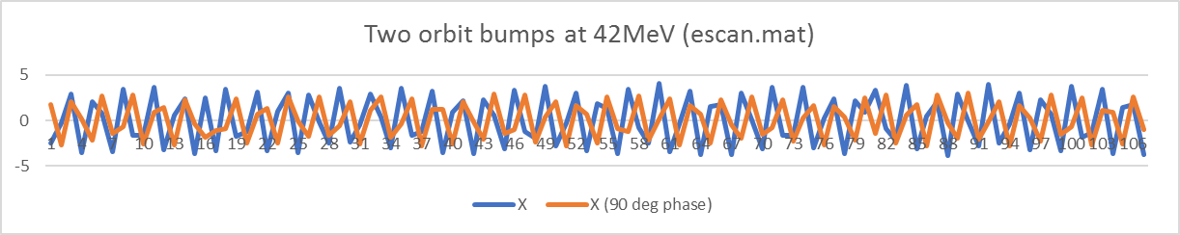
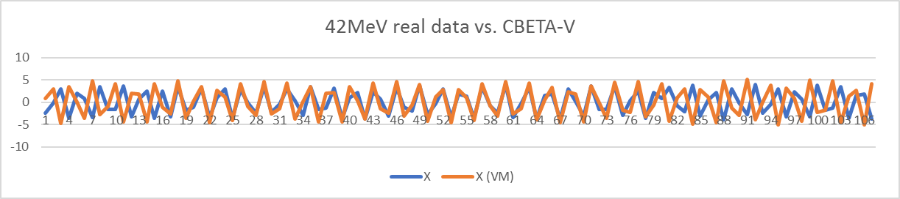
Compare to Real Data (escan.mat)
Below: CBETA-V goes in and out of phase with reality so no wonder we can’t correct globally

Slide 5
FFA Correction should use Empirical Phase Advances
Many things can make real FFA phase advances be different than CBETA-V
Hard edge vs. fieldmap vs. actual magnet
Absolute calibration of magnet strength might be up to ~1% off
Temperature changes will change quad strength too
The phase advances are the sum over 100+ cells, so they build up over distance
Not a good idea to use “dead reckoning” from a model that has some errors
Instead, measure phase advances from the machine
Do this for each energy in a multi-pass configuration
But don’t want to measure 107x107 matrices!
Solution: make semi-empirical matrix from just 2 kicks

Slide 6

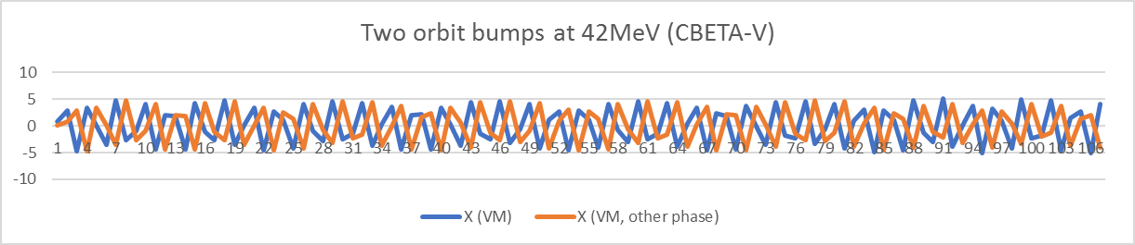
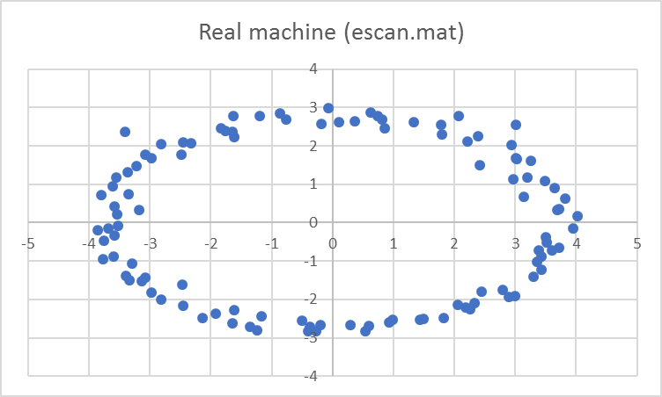
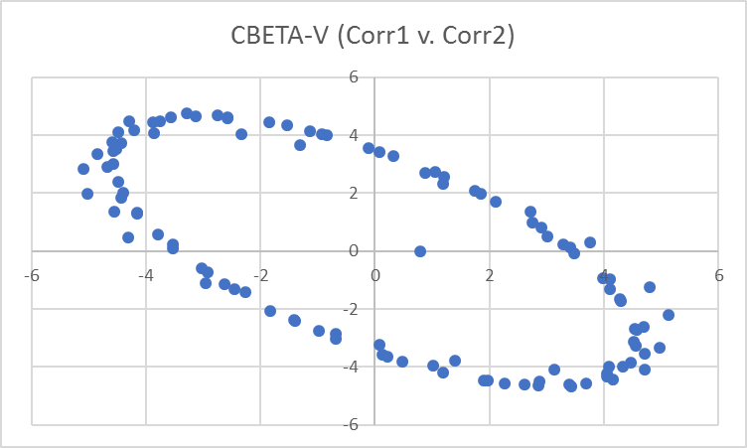
Calculating Phase Advances from Two Bumps
Energy scan had nice 90deg phase difference, I didn’t bother and just used 2 FFA correctors
As it happens, this can be fixed afterwards

Slide 7
Going to Normalised Space
This code makes an oval into not an oval
a[ofs][] and a[ofs+1][] hold the two bumps

Slide 8
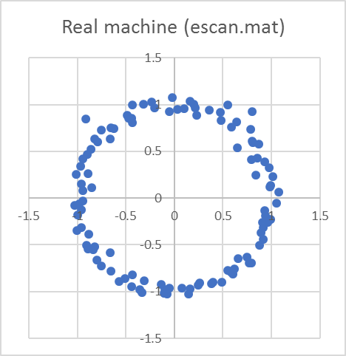
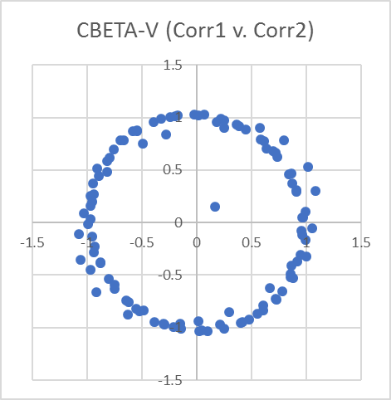
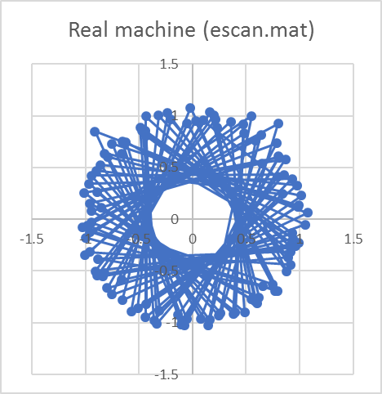
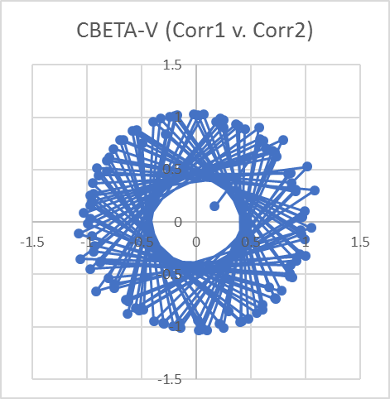
They are both round now I guess
Can get phase advances just by measuring angles from one point to the next

Slide 9
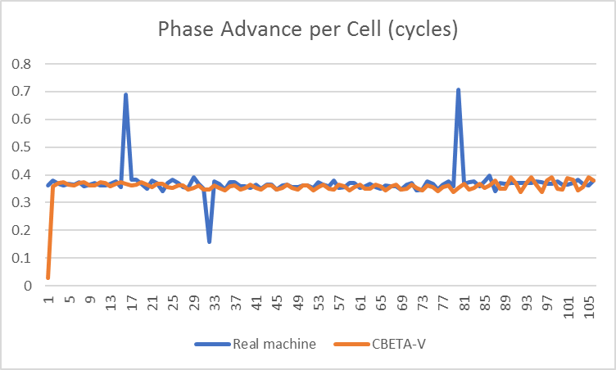
Phase Advance per Cell
Bad BPMs maybe
I used FFA correctors 1 and 2, so cell 1 is wrong

Slide 10
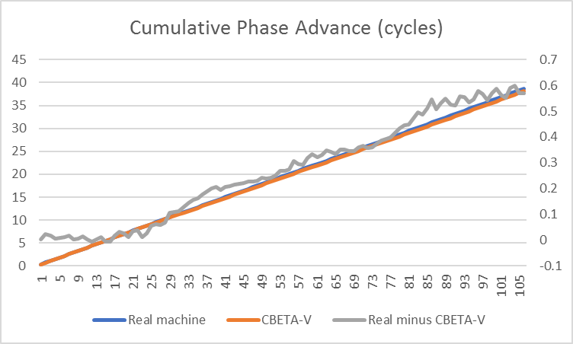
Cumulative Phase Advances
I replaced obviously bad data points by the average of their neighbours
(RHS)

Slide 11
Semi-Empirical Response Matrix
Take the oval shape from the CBETA-V response matrix
Take the phase advances from the real data
Matrix[a→b] = make_oval(sin(θ),-cos(θ))
where θ = phase[b] - phase[a] + 0.1696 radians
where 0.1696 radians is a fudge that I fit to get the a→a diagonal entries right, in other words the phase advance from the corrector to the same cell BPM
make_oval is just the inverse of unoval
In this case the escan.mat used bumps made from dipoles in the splitter, whereas we want to get the response to FFA correctors like was done in the virtual machine response matrix

Slide 12
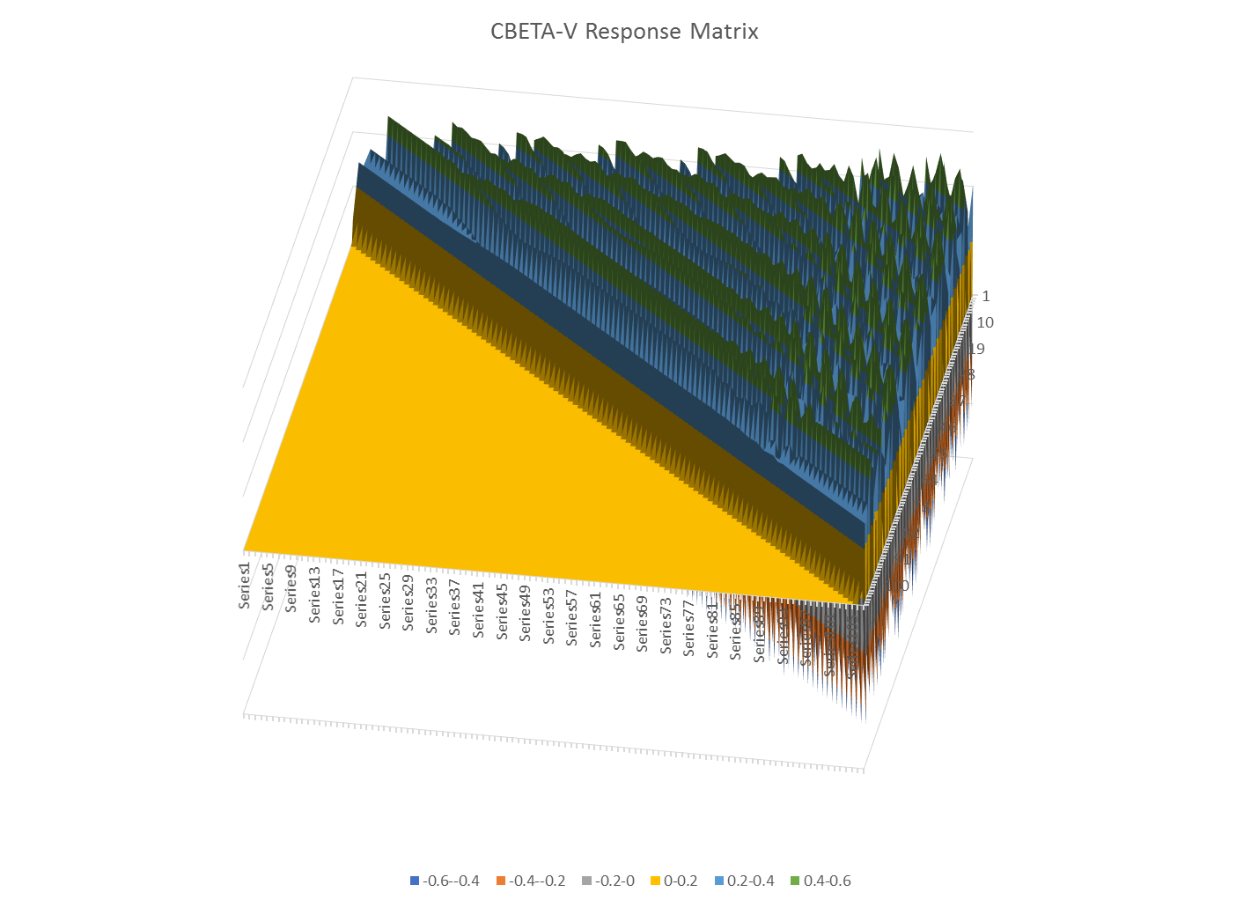

Slide 13
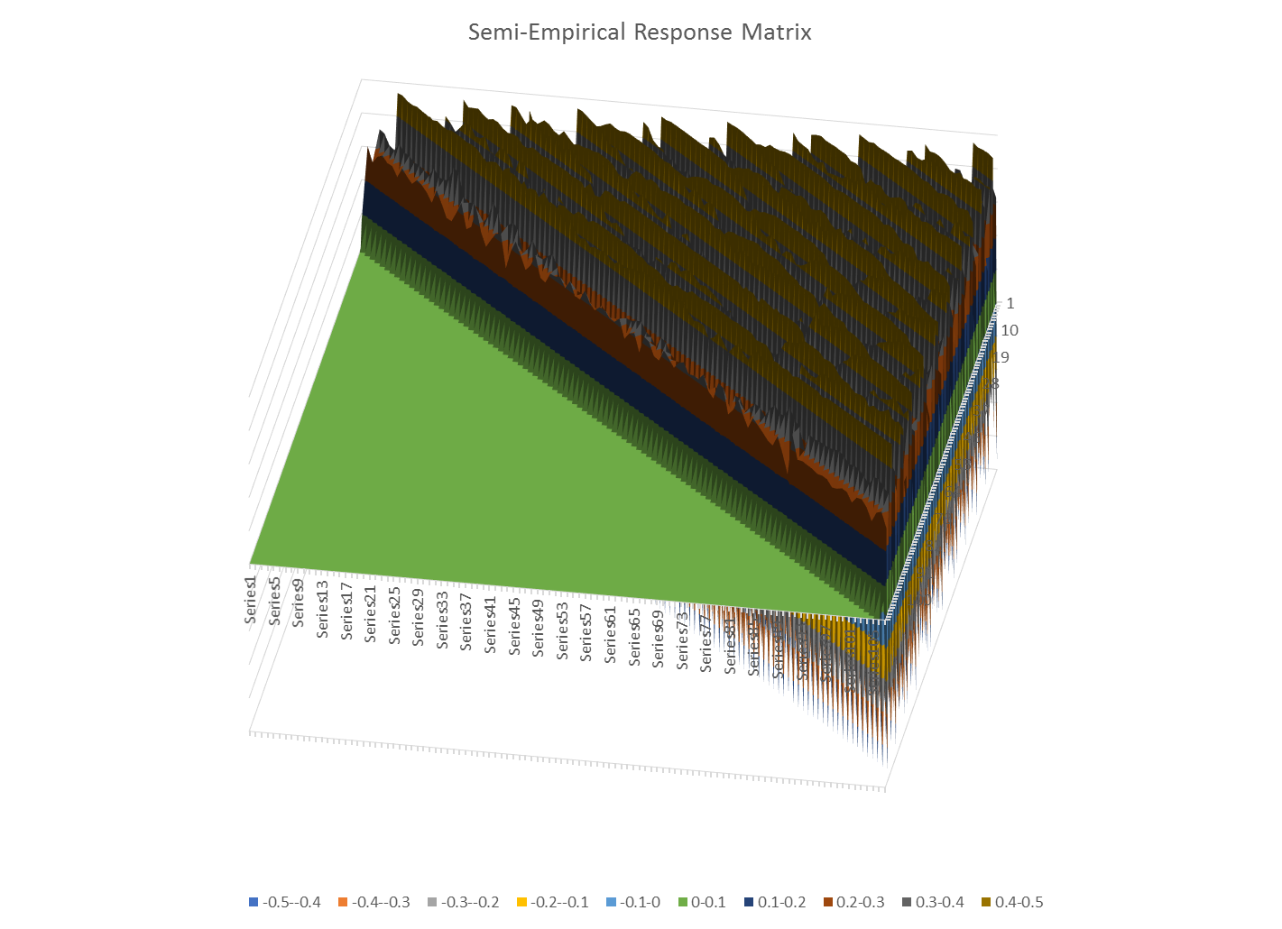

Slide 14
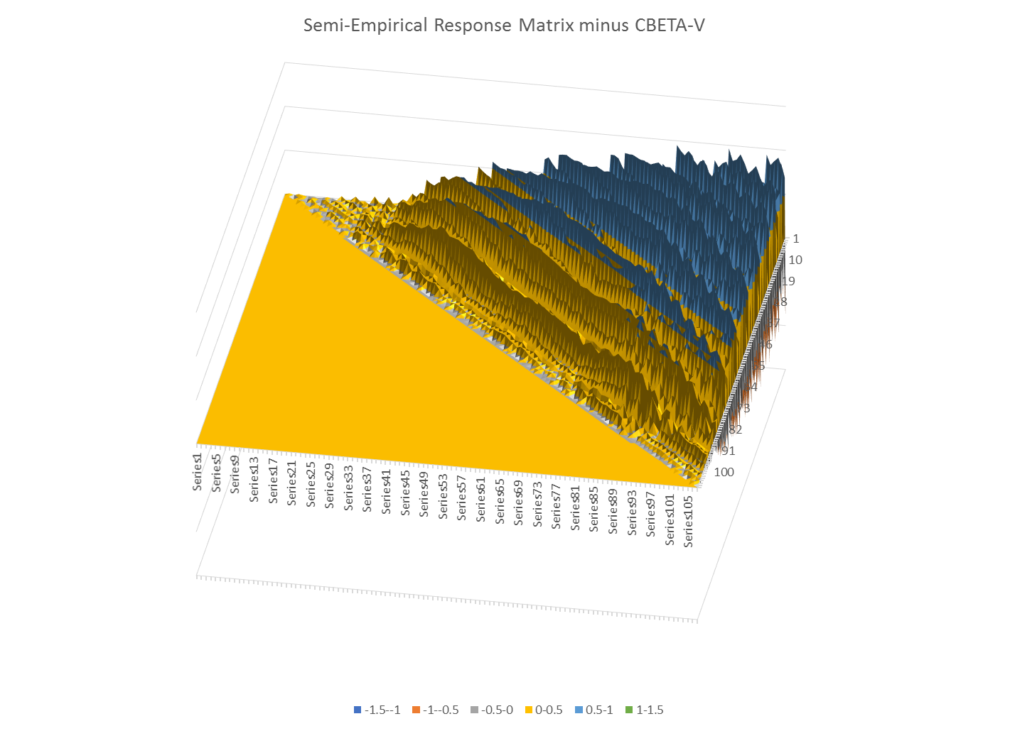

Slide 15
Commissioning Prerequisites
Hysteresis correction for splitter magnets
We have lots of splitters to set up, so need saved states to load deterministically
Either “degaussing” oscillation or (difficult but faster to set) state history model
“Pipe cleaning”
Run grid scans (grid_a_dude) on each splitter line
Finds any big nonlinear/stray fields
Do full FFA response matrix (rough) once
Finds all swapped, missing or reversed correctors and BPMs (rows and columns of response matrix)

Slide 16
FFA Correction Method
Measure a baseline orbit and then two bump orbits using first two FFA correctors
Calculate the empirical phase advances
Generate the semi-empirical response matrix
Use that matrix in the SVD algorithm for setting the FFA correctors
Can combine with measured FFA responses to splitter magnets too (extra matrix columns)

Slide 17
Multi-Turn FFA Correction
Repeat the previous slide each time there is a new turn/new energy
Responses for different energies should be quite orthogonal because tunes are different
Can put all this into one SVD, should work well
Can also use orbit differences x2-x1, x3-x2 etc.
Removes BPM position errors but not scale errors

Slide 18
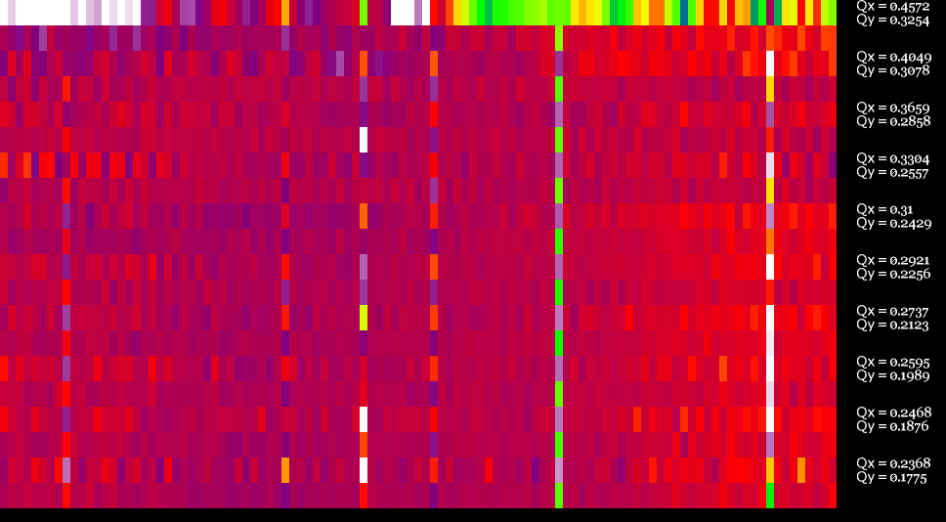
BPM Scale Errors from escan.mat
Here I’ve plotted the normalised amplitude of all the energy scan bump pairs
About 6 BPMs with scale errors are visible (generally different scales in X and Y)

