Slide 1
Permanent Magnets for the ILC Damping Ring
BNL capabilities

Slide 2
BNL Capabilities
Magnet design, simulation
Construction of prototypes
Magnet measurement (R&D and production)
  BNL harmonic rotating coil with 10⁻⁵ repeatability
  NSLS-II magnet diagnostics (vibrating wire etc.)
Magnet tuning/shimming
  Used in the production run of 216 permanent magnets for the CBETA multi-turn ERL

Slide 3
Magnet Parameters Outline
Fields, gradients and apertures
Field quality, good field region
Field adjustability range and how often
Field stability (temperature, vibration)
Radiation resistance
Cost envelope
(material grade)

Slide 4
Fields, Gradients and Apertures
Parameter | DR dipole | DR quad. | DR sext. | CBETA QF | CBETA BD
Dipole | 0.14 T |  |  | 0 | -0.3081 T
Gradient |  | 15 T/m |  | -11.562 T/m | 11.147 T/m
Sextupole |  |  | 75 T/m²
Aperture Ø | 65mm | 65mm | 65mm | 86.2mm | 80.2mm
Length | 5.0m | 0.6m, 0.3m | 0.3m | 0.133m | 0.122m
Number | 150 | 450 + 213 | 600 | 107 | 32 + others
Some similarity to CBETA magnet parameters
Easy to make magnets longer (join segments)
Mass production @ good quality already done

Slide 5
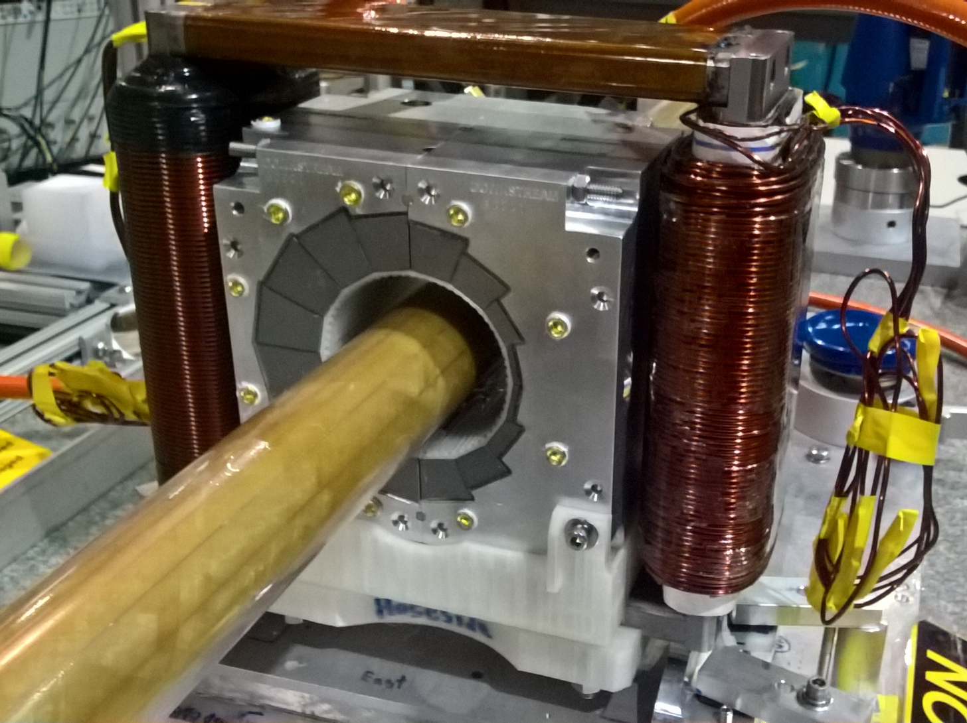
CBETA Permanent Magnets
Halbach design made of NdFeB material
This is a combined dipole+quad
Being measured on rotating coil at BNL
3D printed multipole corrector pack inside
Windowframe corrector coil outside
Temperature stabilised by water (orange hoses)

Slide 6
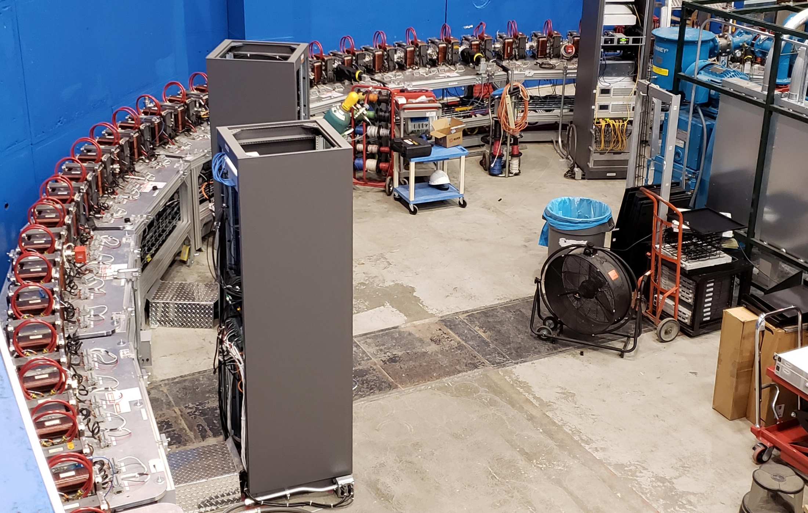
CBETA Fixed-Field Return Arc

Slide 7
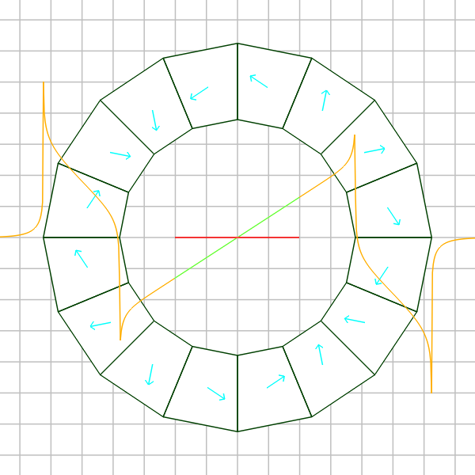
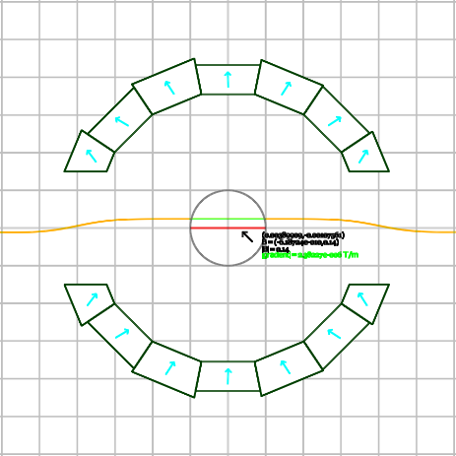
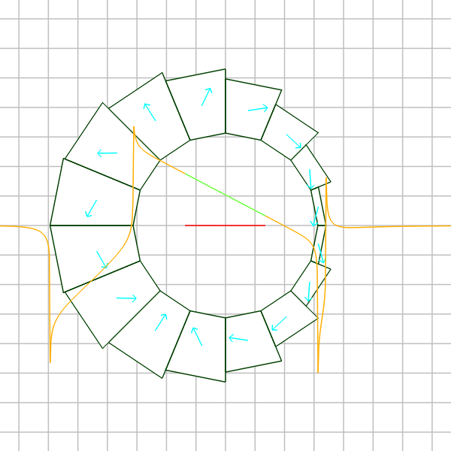
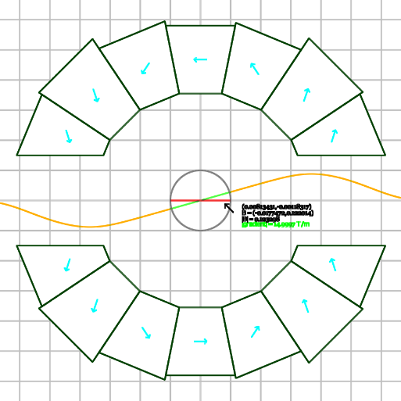
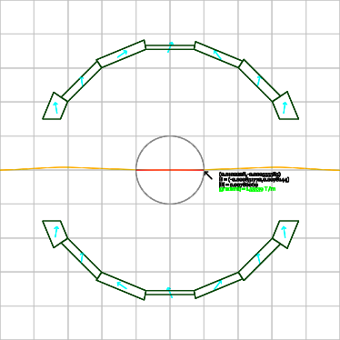
Magnet Cross-Sections (to scale)
CBETA QF
DR dipole
Design rules:
R=10mm good field
<5×10⁻⁵ harmonic error
30mm gap for synchrotron radiation
B_{r}=1.12T material (NdFeB high rad. tol.)
B_{r}=1.158T for CBETA (NdFeB N35EH grade)
DR quadrupoles
CBETA BD
DR sextupole
Could use SmCo with slightly larger area

Slide 8
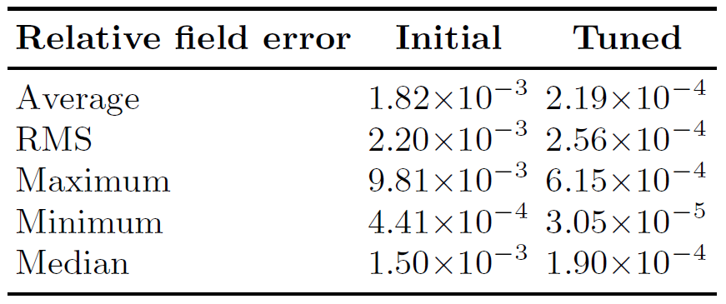
Field Quality, Good Field Region
Field quality depends strongly on good field region radius definition (smaller R is easier)
CBETA achieved <10⁻³ on R=25mm (quite big)
  Absolute strength <5×10⁻⁴

Slide 9
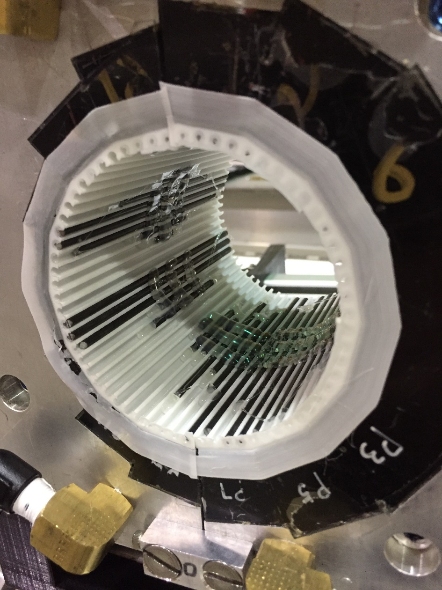
Shimming/Tuning Methods
Shimming/tuning methods are critical for permanent magnet field quality
  CBETA inserted iron rods within the bore (~8× improv.)
    3D printed insert
    Process can be automated
  Other options:
    Mechanically adjust (CESR IR)
    Block sorting (B_{r} only)

Slide 10
Adjustability Requirements
Magnet | Adjust Range | Adjust Frequency
Arc dipole | fine adjustment | During commissioning only
Arc quad. | 30%
Straight quad. | 0-100%
Arc sextupole | 30%
CBETA’s windowframe EM corrector gives a field change of 0.027 T at ~24W power
  This is a 9% relative field correction = 2.5mm shift
Other methods for larger but less frequent adjustments include mechanical, rotation etc.

Slide 11
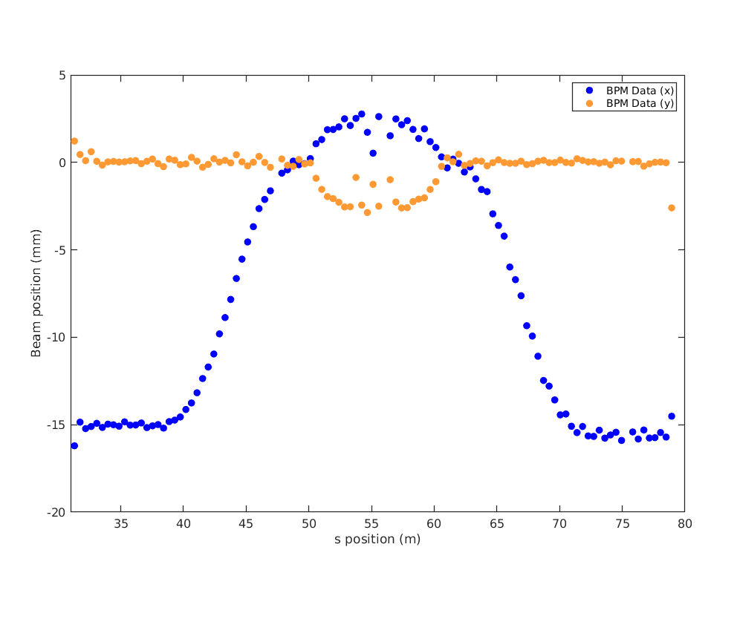
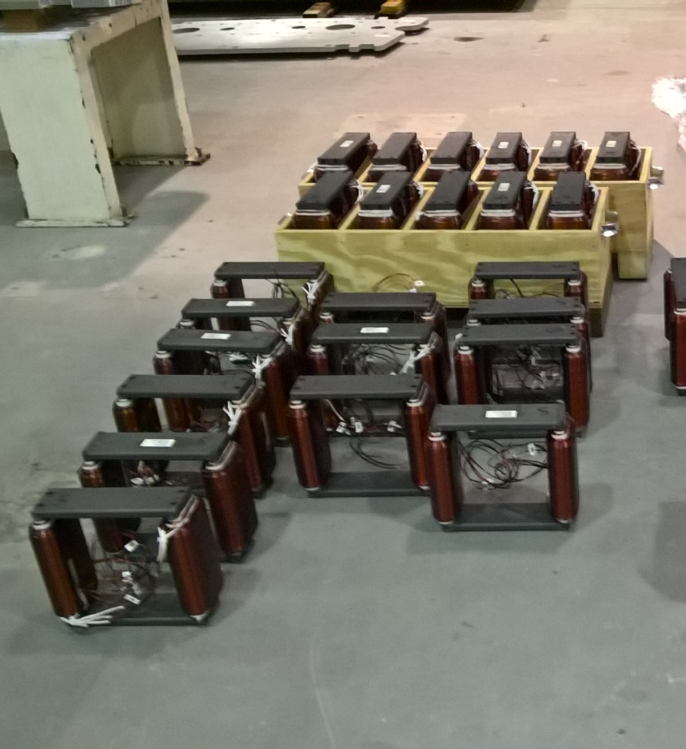
CBETA Closed Orbit Bumps (1-turn)
Use of EM correctors on beam orbit
(November 6, 2019)

Slide 12
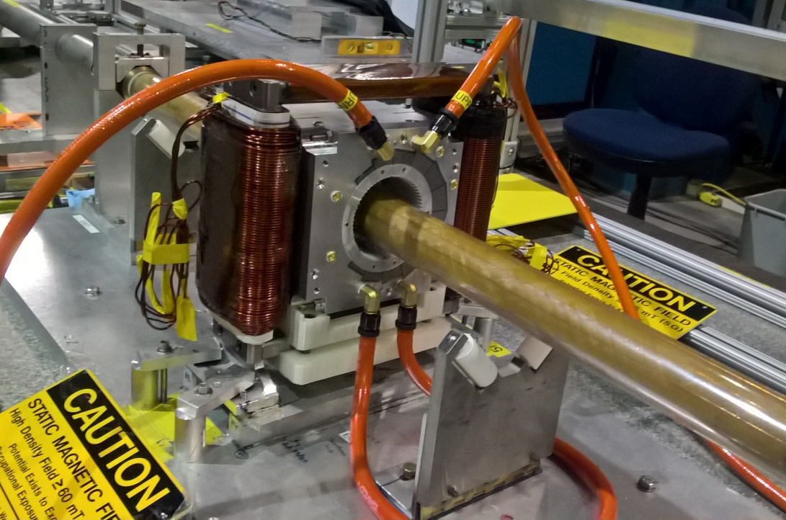
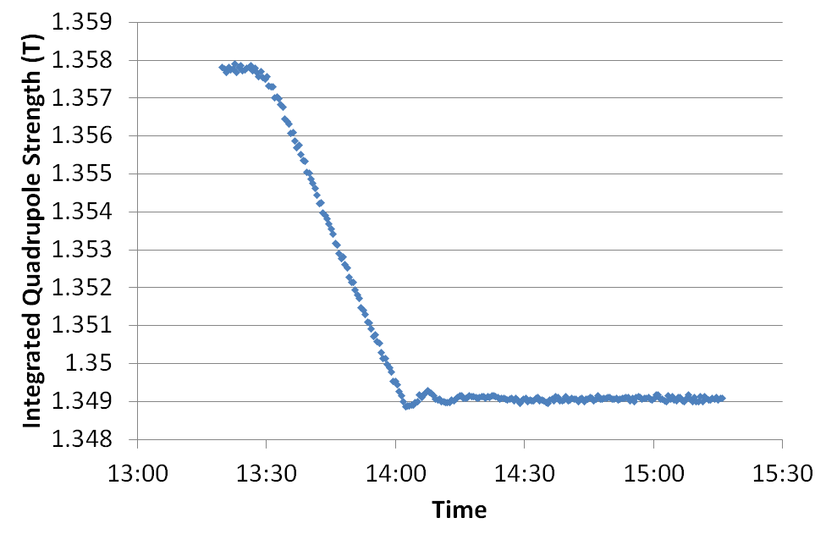
Stability (Temperature)
NdFeB temperature coefficient is -1.1×10⁻³
Magnet housing contains water channels
  Temperature stability better than ±0.2K
  Strength variation less than 10⁻⁴

Slide 13
Radiation Resistance
Depends strongly on material coercivity grade
  High field strength can also reduce resistance
CBETA used NdFeB (N35EH) with 1kGy limit
  Projected 74kGy = 1% field loss
  Magnets instrumented with CsI dosimeters
SmCo material is ~20% weaker field but ~100x more resistant to radiation
See also A. Temnykh, NIM A 587, 13 (2008)

Slide 14
Material Cost
CBETA 27.3m length for $700k in PM material
  DR 1264m for $33M material using length scaling
By volume, $4.48/cm³ for CBETA (incl. spares)
  DR $15.6M, or $5.8M for just the arc dipoles
  Price could go lower for larger orders
Parameter | DR dipole | DR quad. | DR sext. | CBETA QF | CBETA BDx
Length | 5.0m | 0.6m, 0.3m | 0.3m | 0.133m | 0.122m
Number | 150 | 450 + 213 | 600 | 107 | 107
Total length | 750m | 333.9m | 180m Σ=1264 | 14.2m | 13.1m Σ=27.3
Area | 17.3cm² | 62.9cm² | 4.72cm² | 50.9cm² | 65.3cm²
Volume/cm³ | 8665 | 3776, 1888 | 141 | 676 | 797
Total vol./m³ | 1.30 | 2.10 | 0.085 Σ=3.49 | 0.072 | 0.085 Σ=0.158

Slide 15
Recommendations
Looks like a CBETA-derived design could be a good fit for the ILC DR arc dipoles
  Other magnets require more adjustment
Building and measuring a prototype at BNL is comparatively easy
  A few person-months effort, maybe $20k material
Should try to define other issues
  Radiation levels in the tunnel environment
  Required field quality, size of good field region

