Slide 1
CEBAF 20GeV FFA Magnets
First attempts

Slide 2
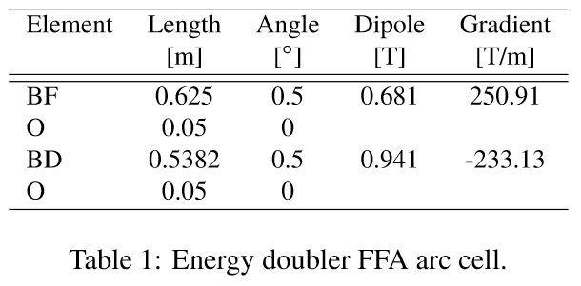

Parameters from IPAC’21 Paper
Take parameters directly from the paper
Peak fields below
Magnet | Dipole at x=0 (T) | Gradient (T/m) | Xmin (mm) | Xmax (mm) | B(Xmin) (T) | B(Xmax) (T)
BF | 0.681 | 250.91 | -5 | 4 | -0.574 | 1.685
BD | 0.941 | -233.13 | -5 | 4 | 2.107 | 0.008

Slide 3
Other Design Rules
Open midplane full height of 4mm (y=±2mm)
  Same as NSLS-IIU upgrade magnet
    Which is also 250T/m
Beam-centroid-to-magnet clearance of 5mm
  Again, same as NSLSII-U, has R=5mm aperture
B_{r}=1.30T material
  E.g. AllStar N42EH grade
    Intrinsic coercivity H_{cj}=29.0kOe (without radiation)
      I.e. demagnetises totally at μ₀H=-2.9T (expect “knee” ~-2.7T)

Slide 4
Run HalbachArea Script
Good field region of 9mm full width means:
  +/-4.5mm if re-centered in magnet
  Try R_{aperture}=10mm to give >5mm clearance
Does not converge, fields 25% wrong

Slide 5
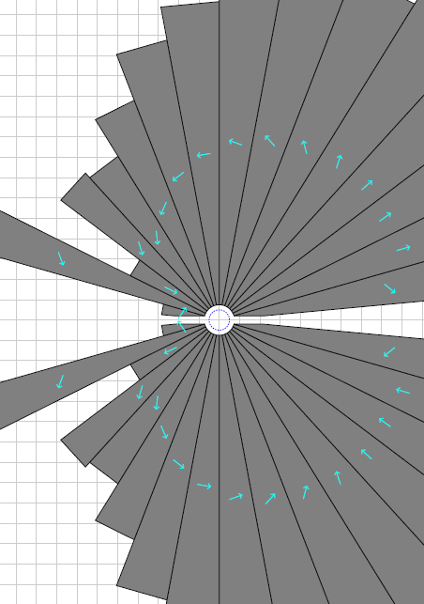
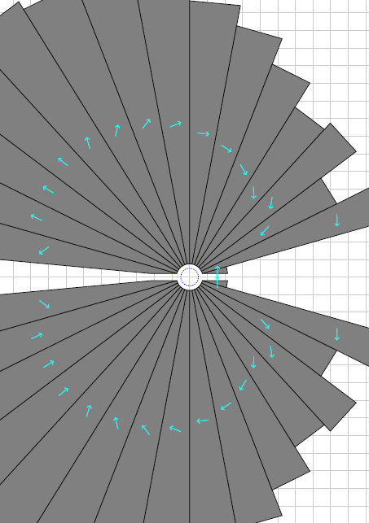
Reduce to R_{aperture}=7.5mm
Magnets converge but come out giant
BF
20.2 units error
BD
14.4 units error
>30cm
Also only 3mm from beam to magnet, probably not feasible

Slide 6
Field Overshoot at High Gradient
The 5mm clearance distance translates to a larger field increase for higher gradients
  E.g. at 250.9T/m it corresponds to 1.255T
    Makes 2.107T max field into 3.272T at “pole tip”
  At 125.5T/m it corresponds to 0.627T
    Now only becomes 2.689T at pole tip
Not exact but gives idea of magnet difficulty
  Lower gradient can make magnet smaller even though good field aperture becomes larger

Slide 7
FFA scaling* laws
* not scaling FFA laws
Scaling type (by factor a) | Length | Angle | Dipole | Gradient | Quad offset (=dipole/grad) & orbit excursion
Momentum (~energy) | 1 | 1 | a | a | 1
Machine radius | a | 1 | a⁻¹ | a⁻² | a
FFA beta length (fixed bend radius, fixed cell tune) | a | a | 1 | a⁻² | a²
FFA arc-to-straight (=row 3/row 2) | 1 | a | a | 1 | a
FFA radius with fixed orbit excursion and field (row 2*row 1/sqrt(row 3)) | a^{1/2} | a^{-1/2} | 1 | 1 | 1
This one is the knob for changing gradients and orbit range: an engineering trade-off

Slide 8
Lattice Scaled to 50% Gradient
Original
50% gradient, 2x beam excursion
Magnet | Dipole at x=0 (T) | Gradient (T/m) | Xmin (mm) | Xmax (mm) | B(Xmin) (T) | B(Xmax) (T)
BF | 0.681 | 250.91 | -5 | 4 | -0.574 | 1.685
BD | 0.941 | -233.13 | -5 | 4 | 2.107 | 0.008
Magnet | Dipole at x=0 (T) | Gradient (T/m) | Xmin (mm) | Xmax (mm) | B(Xmin) (T) | B(Xmax) (T)
BF | 0.681 | 125.46 | -10 | 8 | -0.574 | 1.685
BD | 0.941 | -116.57 | -10 | 8 | 2.107 | 0.008
NB: length and bend angles of elements to be multiplied by sqrt(2)

Slide 9
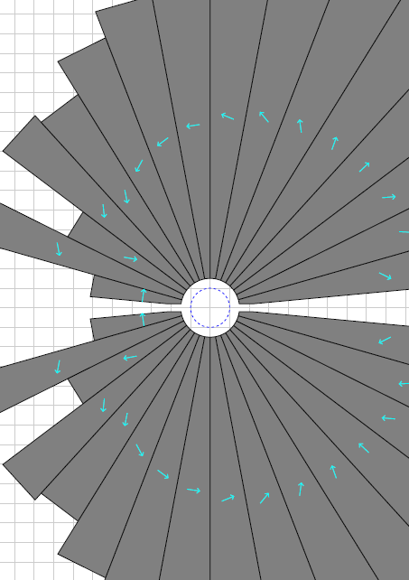
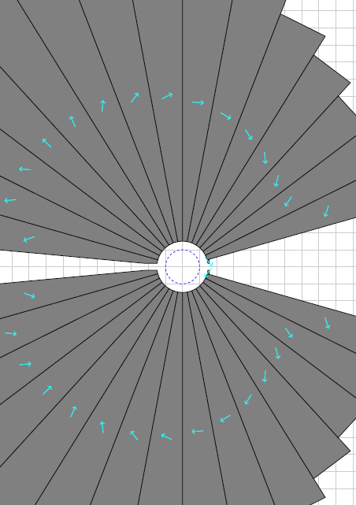
Using R_{aperture}=15mm (R_{field}=10mm)
Now it converges with the full 5mm clearance
But the magnets still come out giant!
BF
4.8 units error
BD
1.6 units error
>30cm

Slide 10
Need Some Ideas (idea #1)
Now that R_{aperture}=15mm…
There’s a lot of unused space above and below the beams
Could use “oval aperture” idea from Dejan’s hadron therapy gantry
  While still having an open midplane

Slide 11
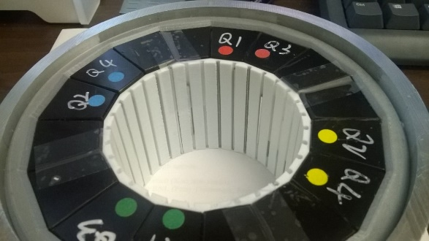


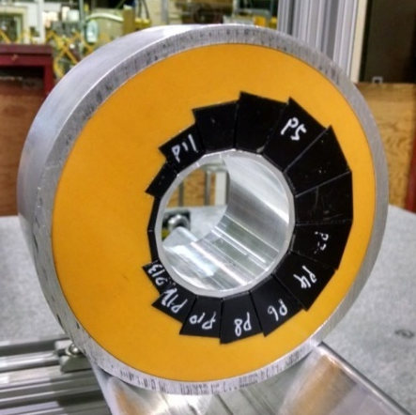
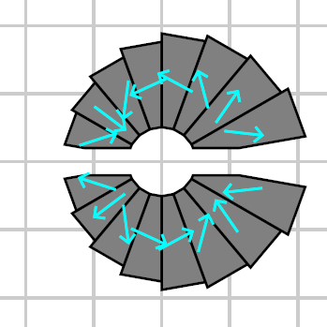
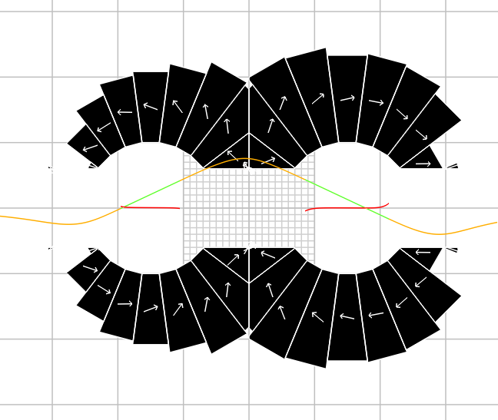

[IPAC’21] Halbach Magnet Variations
Demonstrated (in accelerator)
  Field tuning with iron rods
  Combined-function magnets
In development
  Open midplane magnets
Future research
  Oval apertures
  Multiple apertures

Slide 12
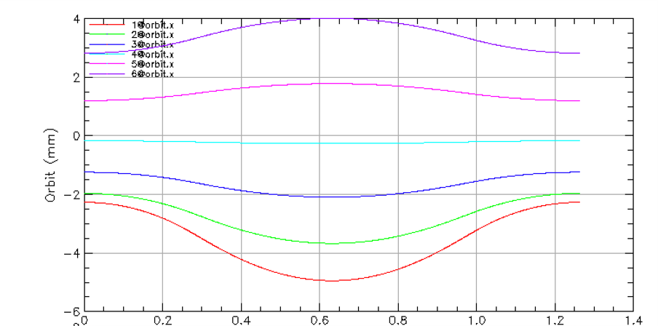
Unused Region in BD (idea #2)
From the orbit diagram it appears that while
the orbits in BF are -5mm < x < 4mm,
the orbits in BD are -3.5mm < x < 3.25mm.
Don’t build magnet where you don’t need it!
BD
BF
BD

Slide 13
Trimming the BD Aperture Range
50% gradient, 2x beam excursion
With reduced BD aperture range
Magnet | Dipole at x=0 (T) | Gradient (T/m) | Xmin (mm) | Xmax (mm) | B(Xmin) (T) | B(Xmax) (T)
BF | 0.681 | 125.46 | -10 | 8 | -0.574 | 1.685
BD | 0.941 | -116.57 | -10 | 8 | 2.107 | 0.008
Magnet | Dipole at x=0 (T) | Gradient (T/m) | Xmin (mm) | Xmax (mm) | B(Xmin) (T) | B(Xmax) (T)
BF | 0.681 | 125.46 | -10 | 8 | -0.574 | 1.685
BD | 0.941 | -116.57 | -7 | 6.5 | 1.757 | 0.183
Peak fields better balanced between magnets (also minimises SR)
NB: length and bend angles of elements to be multiplied by sqrt(2)

Slide 14
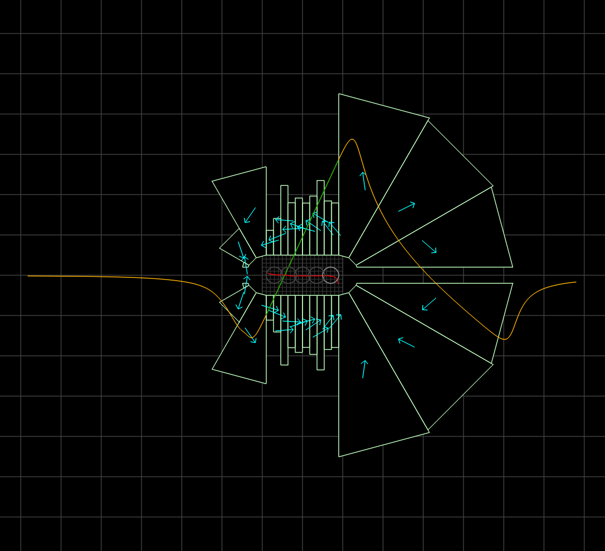
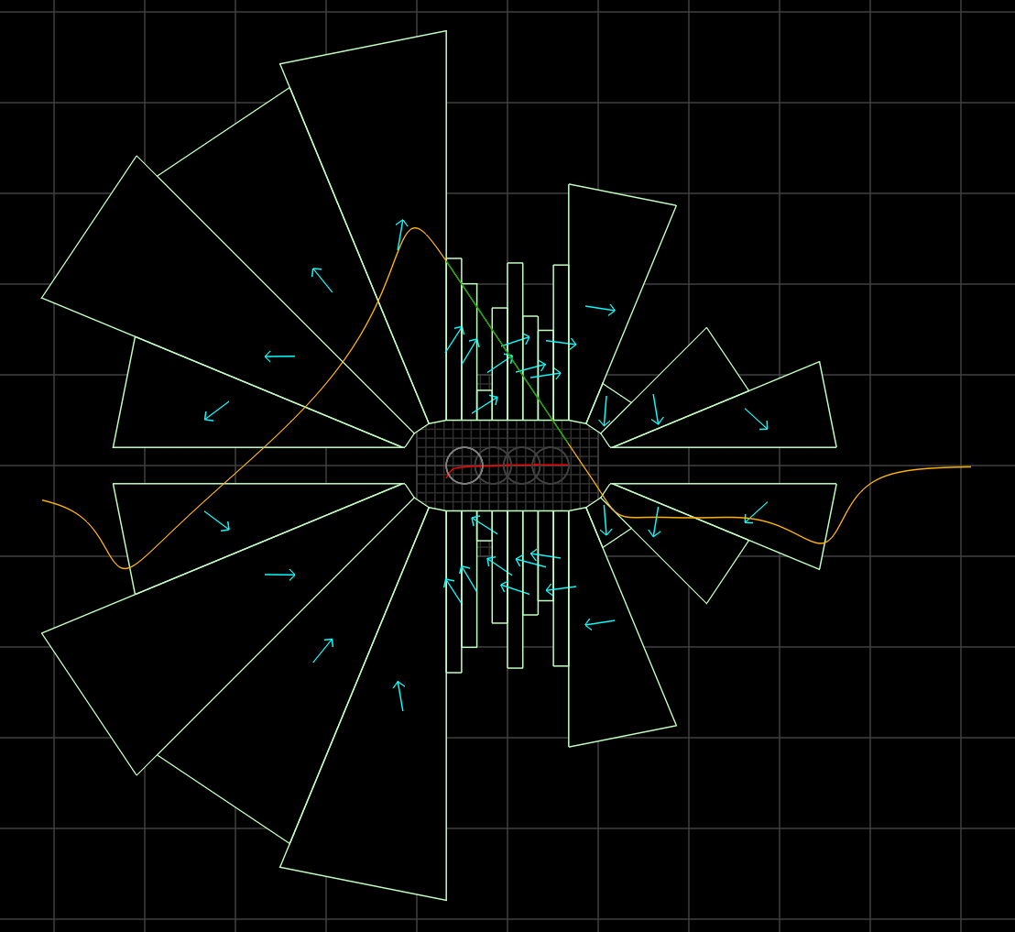
Finally!
Small magnets, good field, full 5mm clearance
36.7cm²
BF
27.8 units error
40.5cm²
BD
24.1 units error
10cm

Slide 15
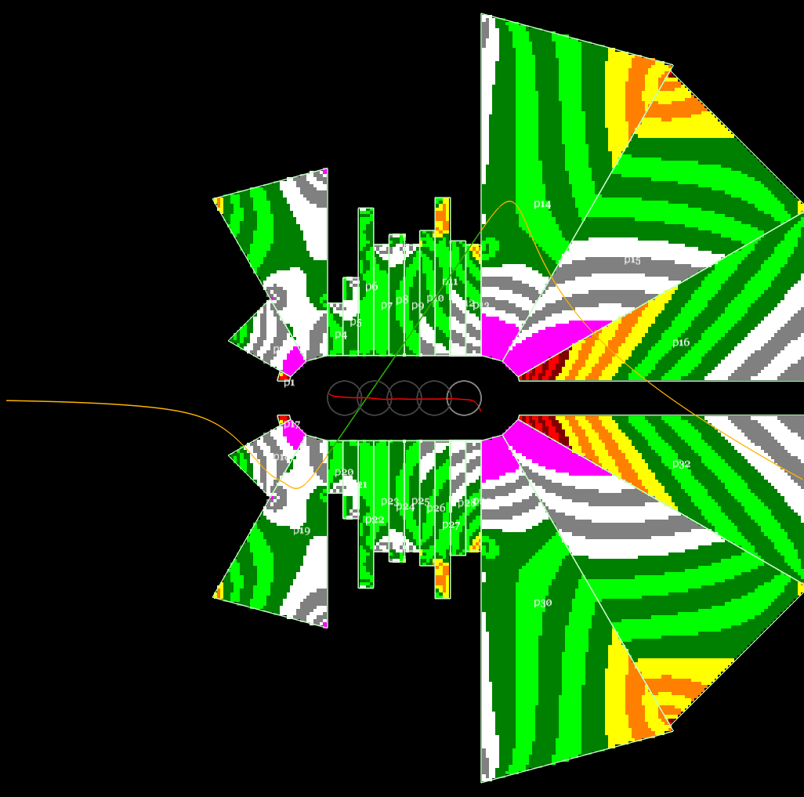
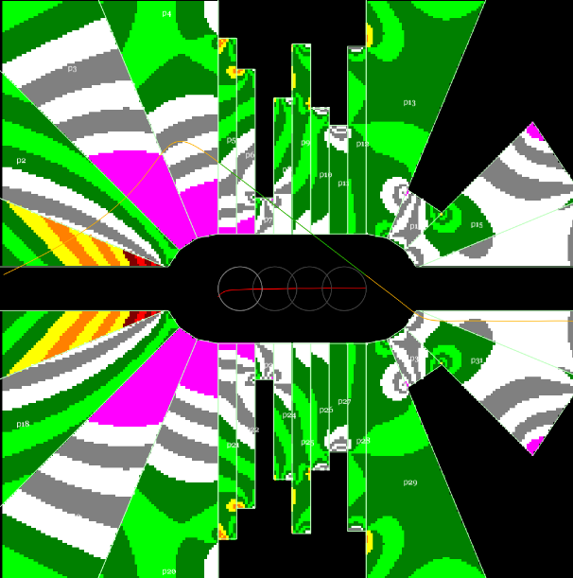
Demagnetisation?
BF
BD
Red areas show μ₀H < -1.5T,
yellow -1.5 < μ₀H < -1.0T, etc.
Stripes are 0.1T intervals.
Looks like worst reverse flux value is around -2.3T, knee is -2.7T, likely OK without radiation but not much margin.

Slide 16
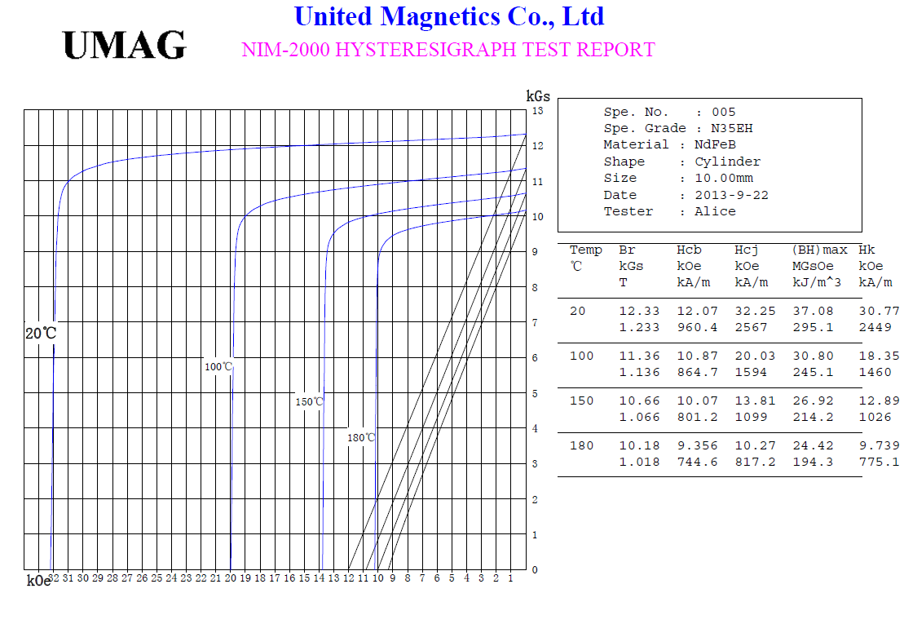
B-H Curve and Demagnetisation
CBETA material grade N35H
H_{cj} value (demagnetisation point,
varies with temperature)
Note: not N42EH, just example
Magnetisation provided by material (μ₀M = B − μ₀H)
Net field (B)
Large opposing fields (negative H in the direction of M) can potentially demagnetise parts of the material in higher field magnets. Not observed or expected in CBETA (-H<1.3T). Depends on material grade H_{cj} value.
External applied field (μ₀H)
opposing magnetisation direction

Slide 17
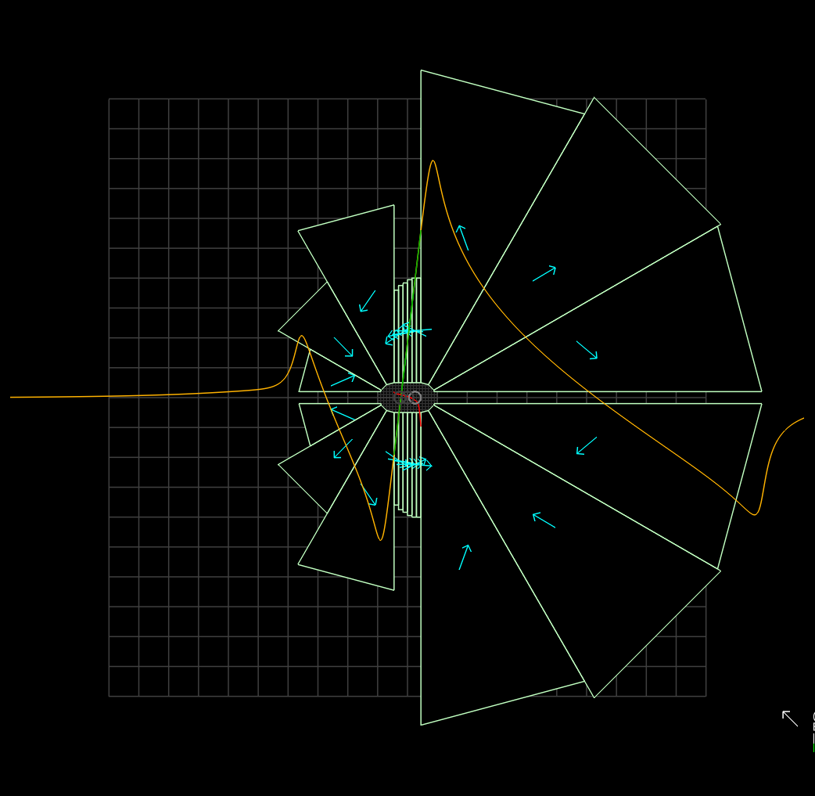
What about with 100% gradients?
BF converges but is still rather large
Probably should avoid super-high (>150T/m) gradients unless good reason
  E.g. path length
20cm

Slide 18
Summary
Got a feasible magnet but had to employ several tricks:
  Scaled lattice to 50% gradient (double orbit range)
  Reduce circular aperture to Y±5mm oval
  Trim BD good field range to cover only orbits
Future work:
  Is 50% (~120T/m) gradient the optimum?
  Prediction of radiation dose limit (CBETA model)
Are any design rules/assumptions wrong?

