Slide 1
CEBAF 20GeV FFA Upgrade
Energies/turns for 650MeV injector

Slide 2
Upgraded Injector Energy
Three new RF modules of 90MeV each
Two passes through these with a single conventional return loop
Use existing injector at 110MeV
Total energy: 110+2*(3*90) = 650MeV

Slide 3
Energies with One FFA (4+7 turns)
Linacs adjusted 925-1090MeV for 50-100% energy tunability

Slide 4
Energies with Two FFAs (3+(4+4))

Slide 5
Energies with Two FFAs (3+(5+3))

Slide 6
Questions
Is continuous energy tunability needed or is it enough to tap off different turns at ~2GeV spacing?
  Jay suggested a small range around each turn energy might be sufficient, this would help
I’ve assumed “11 turns” doubling the current 5.5 turns but if Hall D is a priority for highest energy, JLAB might prefer 10.5 or 11.5 turns?

Slide 7
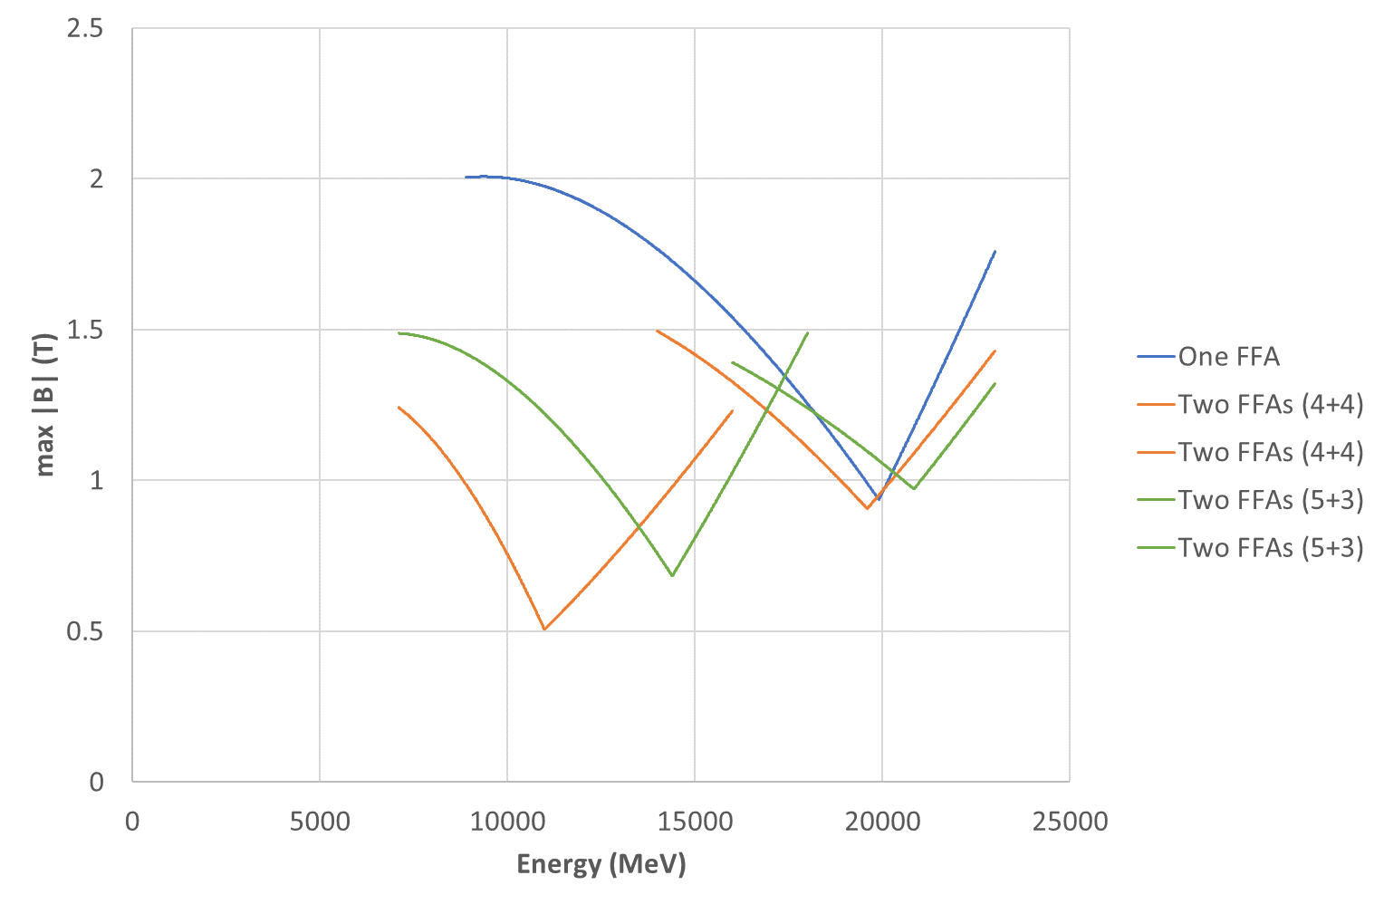
Max Field on Beams

Slide 8
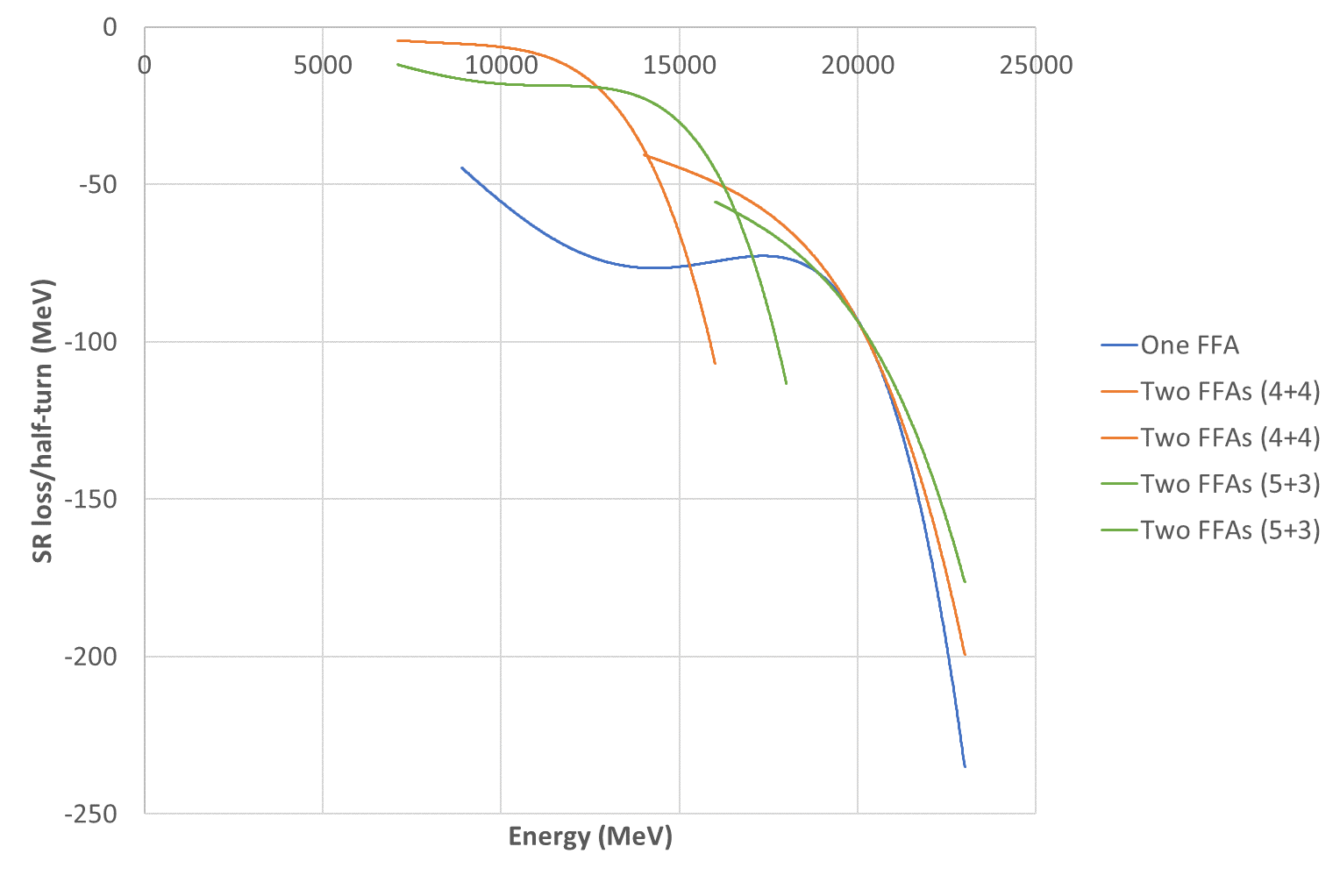
SR Loss Per Half-Turn

Slide 9
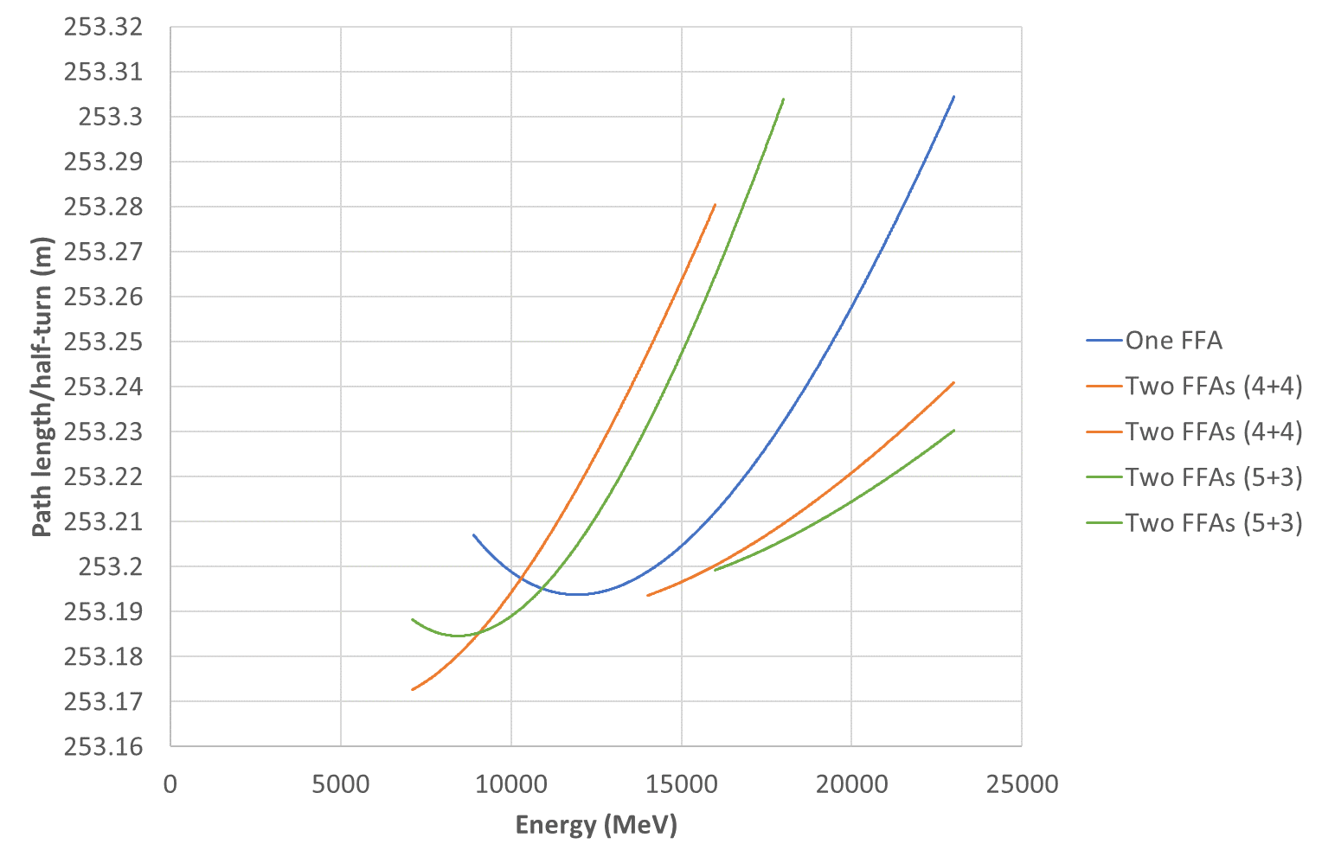
Path Length

Slide 10
Performance Comparison
Option | Max Field (T) | SR Loss (MeV) | Final Energy (MeV)
One FFA | 2.007 | 1211.48 | 23418.52
Two FFAs (4+4) | 1.495 | 964.44 | 23665.56
Two FFAs (5+3) | 1.489 | 935.30 | 23694.70
Two FFAs should be considerably better from magnet point of view, particularly radiation hardness due to the decreased fields

Slide 11
Optimisation Rules
Cell angle = 2° clockwise (-2°)
Overall radius of curvature = 80.6m
  Ensures cell length of 2.81347m
Both drifts are 10cm long
  Packing factor 92.9%
Maximum tune 0.425 in either plane
Minimum tune 0.025 in either plane
  Wide range to compensate for energy adjustment

Slide 12
MAD-style Lattices
Parameter | One FFA | 4+4 FFA1 | 4+4 FFA2 | 5+3 FFA1 | 5+3 FFA2 | Units
Emin | 8.9 | 7.1 | 14 | 7.1 | 16 | GeV
Emax | 23 | 16 | 23 | 18 | 23 | GeV
Eref | 15.95 | 11.55 | 18.5 | 12.55 | 19.5 | GeV
BF length | 1.36109 | 2.09794 | 1.68482 | 1.57127 | 1.49155 | m
BF angle | -0.05722 | -1.73802 | -1.14623 | -0.65227 | -0.98835 | degrees
BF quad | -48.649 | -29.730 | -65.616 | -35.135 | -80.781 | T/m
BD length | 1.25238 | 0.51553 | 0.92865 | 1.04220 | 1.12192 | m
BD angle | -1.94278 | -0.26198 | -0.85377 | -1.34773 | -1.01165 | degrees
BD quad | 43.393 | 93.393 | 86.787 | 42.943 | 76.276 | T/m
Dipoles calculated from length, angle and Eref

Slide 13
Orbit Excursion
Lattice | Orbit range in BF (mm) | Orbit range in BD (mm)
One FFA | 56.74 | 41.57
4+4 FFA1 | 42.61 | 27.89
4+4 FFA2 | 21.34 | 14.05
5+3 FFA1 | 54.79 | 39.07
5+3 FFA2 | 14.95 | 10.66
Values given are full ranges (xmax-xmin)
  CBETA would be 50mm in focussing magnet
Generally the low energy FFA has a CBETA-like orbit excursion and FFA2 is much smaller
  Could go below 2°/cell in FFA1 to reduce range

Slide 14
FFA scaling* laws
* not scaling FFA laws
Scaling type (by factor a) | Length | Angle | Dipole | Gradient | Quad offset (=dipole/grad) & orbit excursion
Momentum (~energy) | 1 | 1 | a | a | 1
Machine radius | a | 1 | a⁻¹ | a⁻² | a
FFA beta length (fixed bend radius, fixed cell tune) | a | a | 1 | a⁻² | a²
FFA arc-to-straight (=row 3/row 2) | 1 | a | a | 1 | a
FFA radius with fixed orbit excursion and field (row 2*row 1/sqrt(row 3)) | a^{1/2} | a^{-1/2} | 1 | 1 | 1
This one is the knob for changing gradients and orbit range: an engineering trade-off

