Slide 1
CEBAF 20GeV FFA Magnets
Recap IPAC’21 50% gradient magnet
Updated for a July 30th lattice

Slide 2
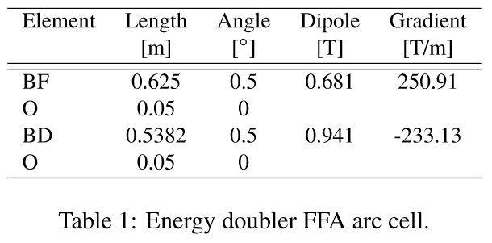

Parameters from IPAC’21 Paper
Take parameters directly from the paper
Peak fields below
Magnet | Dipole at x=0 (T) | Gradient (T/m) | Xmin (mm) | Xmax (mm) | B(Xmin) (T) | B(Xmax) (T)
BF | 0.681 | 250.91 | -5 | 4 | -0.574 | 1.685
BD | 0.941 | -233.13 | -5 | 4 | 2.107 | 0.008

Slide 3
Other Design Rules
Open midplane full height of 4mm (y=±2mm)
  Same as NSLS-IIU upgrade magnet
    Which is also 250T/m
Beam-centroid-to-magnet clearance of 5mm
  Again, same as NSLSII-U, has R=5mm aperture
B_{r}=1.30T material
  E.g. AllStar N42EH grade
    Intrinsic coercivity H_{cj}=29.0kOe (without radiation)
      I.e. demagnetises totally at μ₀H=-2.9T (expect “knee” ~-2.7T)

Slide 4
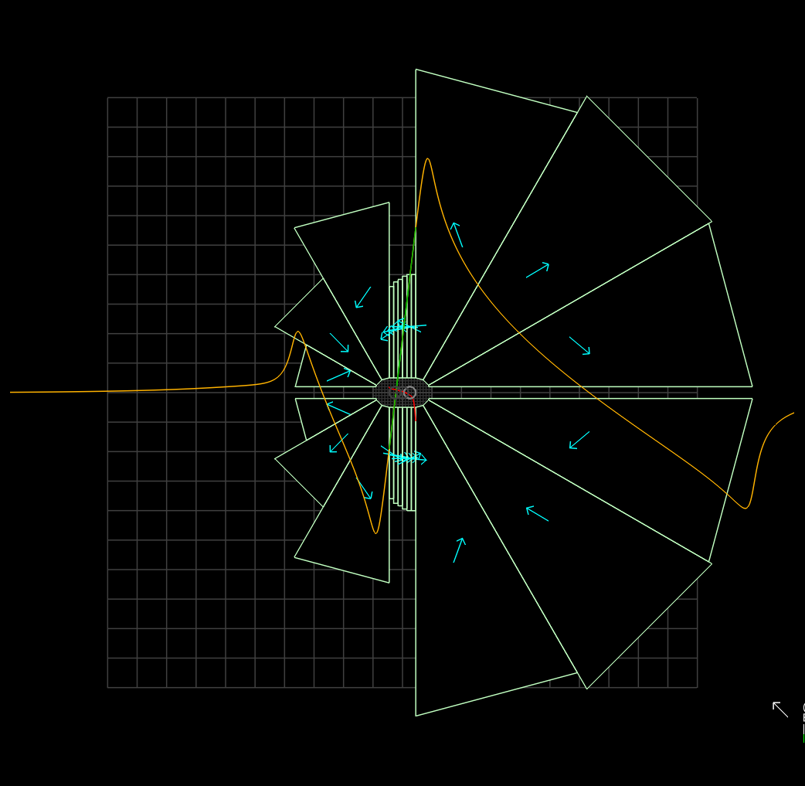
What about with 100% gradients?
BF converges but is still rather large
Probably should avoid super-high (>150T/m) gradients unless good reason
  E.g. path length
20cm

Slide 5
Trimming the BD Aperture Range
50% gradient, 2x beam excursion
With reduced BD aperture range
Magnet | Dipole at x=0 (T) | Gradient (T/m) | Xmin (mm) | Xmax (mm) | B(Xmin) (T) | B(Xmax) (T)
BF | 0.681 | 125.46 | -10 | 8 | -0.574 | 1.685
BD | 0.941 | -116.57 | -10 | 8 | 2.107 | 0.008
Magnet | Dipole at x=0 (T) | Gradient (T/m) | Xmin (mm) | Xmax (mm) | B(Xmin) (T) | B(Xmax) (T)
BF | 0.681 | 125.46 | -10 | 8 | -0.574 | 1.685
BD | 0.941 | -116.57 | -7 | 6.5 | 1.757 | 0.183
Peak fields better balanced between magnets (also minimises SR)
NB: length and bend angles of elements to be multiplied by sqrt(2)

Slide 6
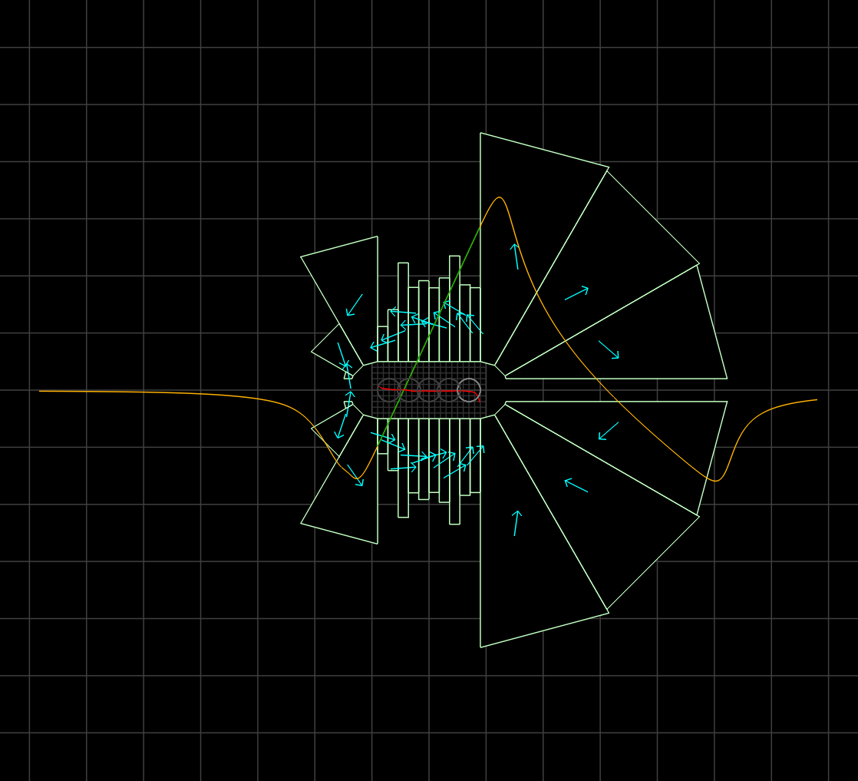
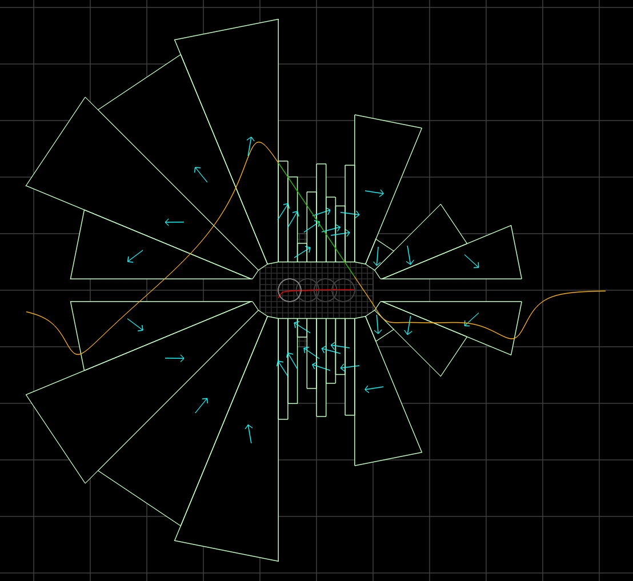
Finally!
Small magnets, good field, full 5mm clearance
36.7cm²
BF
27.8 units error
40.5cm²
BD
24.1 units error
10cm

Slide 7
Peak Fields in Updated Lattices
IPAC’21, 50% gradient, BD trimmed design
July 30th lattices
Magnet | Dipole at x=0 (T) | Gradient (T/m) | Xmin (mm) | Xmax (mm) | B(Xmin) (T) | B(Xmax) (T)
BF | 0.681 | 125.46 | -10 | 8 | -0.574 | 1.685
BD | 0.941 | -116.57 | -7 | 6.5 | 1.757 | 0.183
One FFA but only for ~20GeV – energy range issues
Option | Max Field (T) | SR Loss (MeV) | Final Energy (MeV)
One FFA | 2.007 | 1211.48 | 23418.52
Two FFAs (4+4) | 1.495 | 964.44 | 23665.56
Two FFAs (5+3) | 1.489 | 935.30 | 23694.70
Better

Slide 8
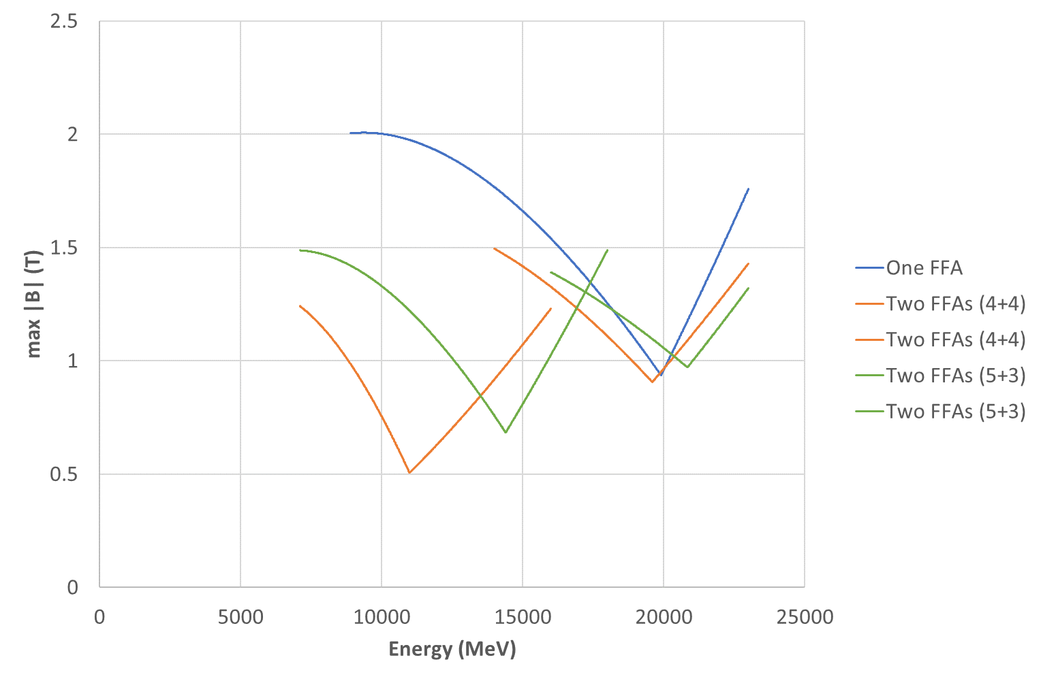
Max Field on Beams
Benchmark on 4+4 FFA2
because highest field in high-energy FFA

Slide 9
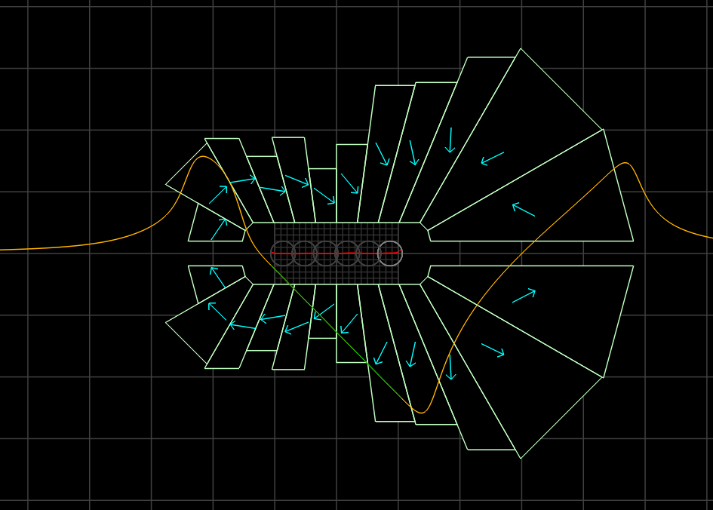
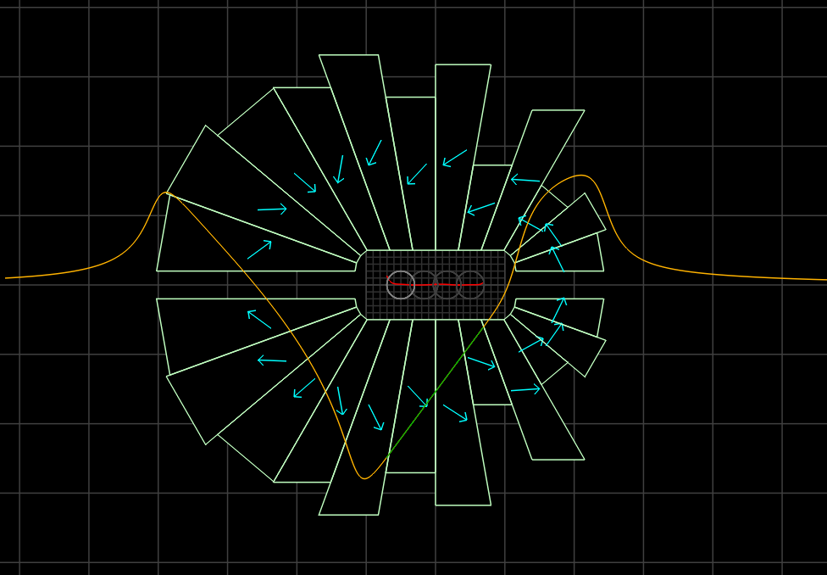
Magnets for July 30th 4+4 FFA2
Wanted to replace central rectangular pieces with wedges to avoid slipping
  Reduce 32 to 24 pieces per magnet (CBETA=16)
~25% less area
CBETA magnets were from 38cm² to 78cm²
27.8cm²
BF
27.1 units error
27.4cm²
BD
25.8 units error
5cm

Slide 10
Try Larger Clearances
NSLS-IIU recently doubled their exit slot height from 4mm to 8mm (y=±4mm)
  Allows vacuum chamber inside magnet
Could try doing the same
  Also double beam-to-magnet clearance from 5mm to 10mm (for 20mm full height central aperture)
Rescale gradients on July 30th lattice to 50% to avoid field overshoot in larger clearance gap

Slide 11
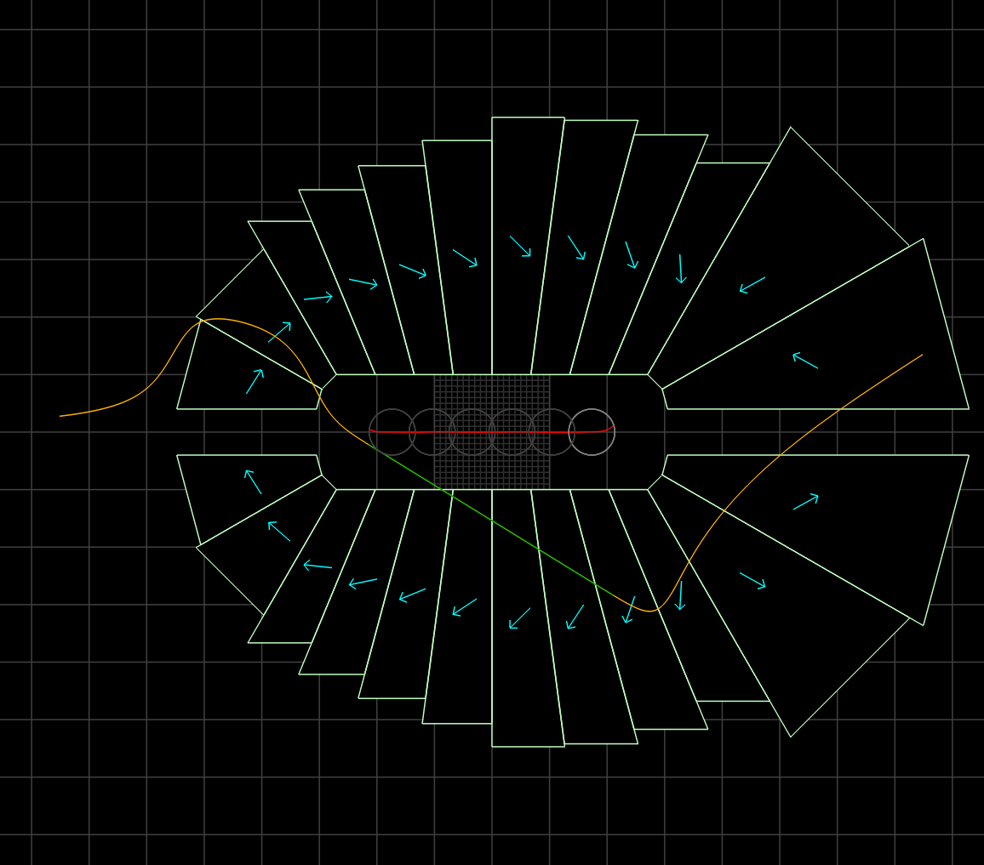
Magnets: 4+4 FFA2, 50% gradient
Should be very similar, but 2x the size and 4x the area
CBETA magnets were from 38cm² to 78cm²
100.4cm²
BF
32.5 units error
105.8cm²
BD
27.1 units error
10cm
September 10, 2021

Slide 12
Questions for CEBAF
What beam-centroid-to-pipe distance is considered practical?
  The 10mm-to-magnet should give 7-8mm to pipe
  5mm-to-magnet gives hardly anything
What height should the synchrotron radiation slot be?
  E.g. 8mm full height minus both sides of chamber
  4mm full height seems to small for chamber?
When known, can optimise lattice gradient

Slide 13
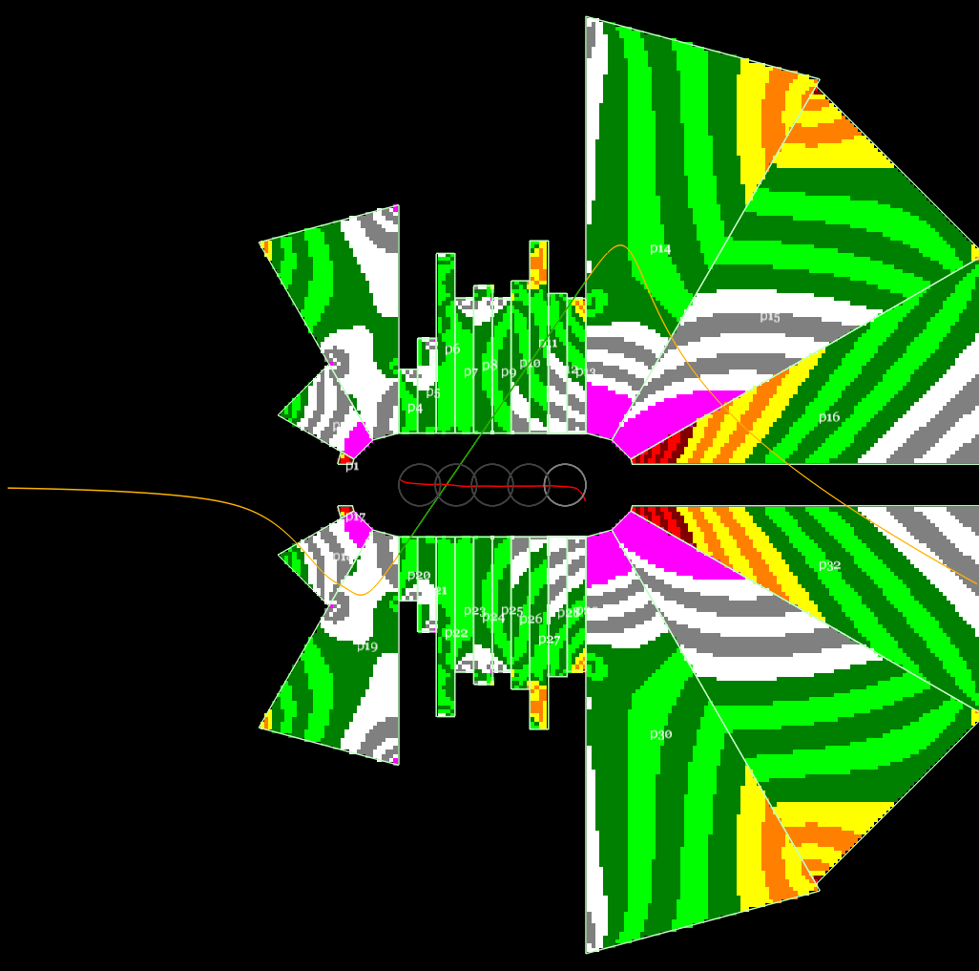
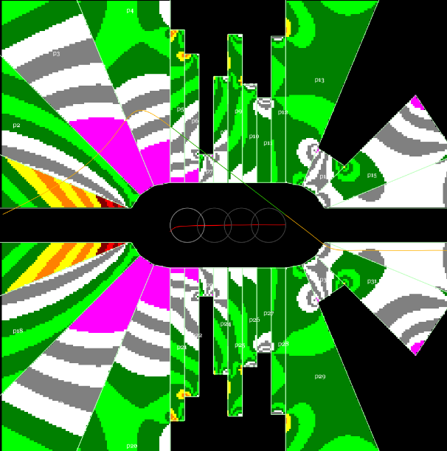
Demagnetisation in IPAC’21 magnets
BF
BD
Red areas show μ₀H < -1.5T,
yellow -1.5 < μ₀H < -1.0T, etc.
Stripes are 0.1T intervals.
Looks like worst reverse flux value is around -2.3T, knee is -2.7T, likely OK without radiation but not much margin.

Slide 14
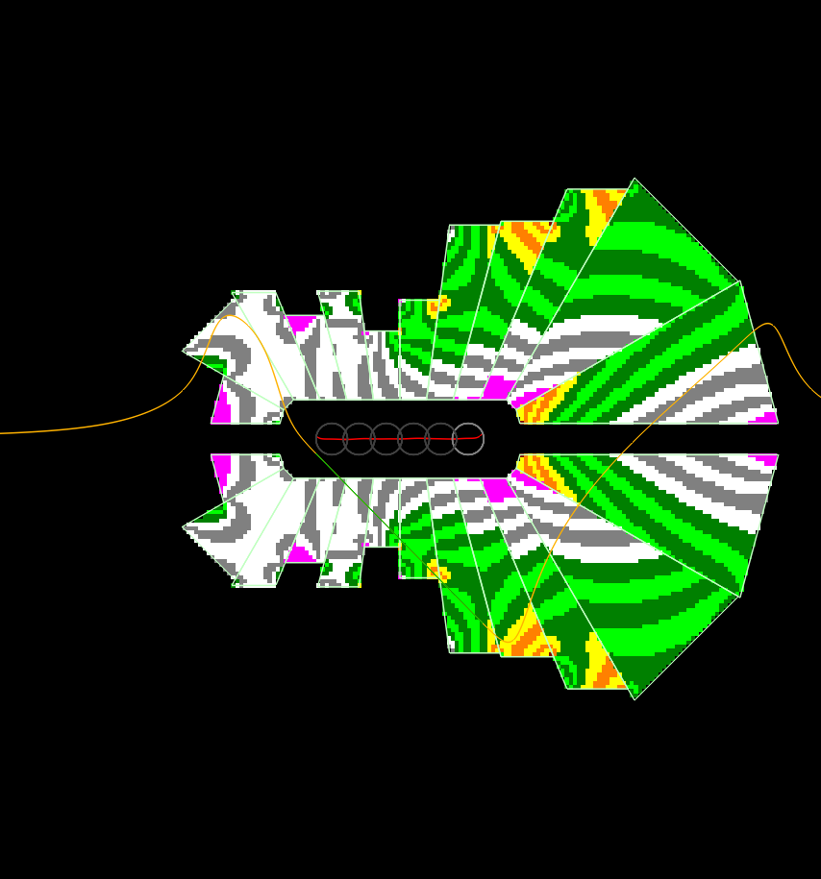
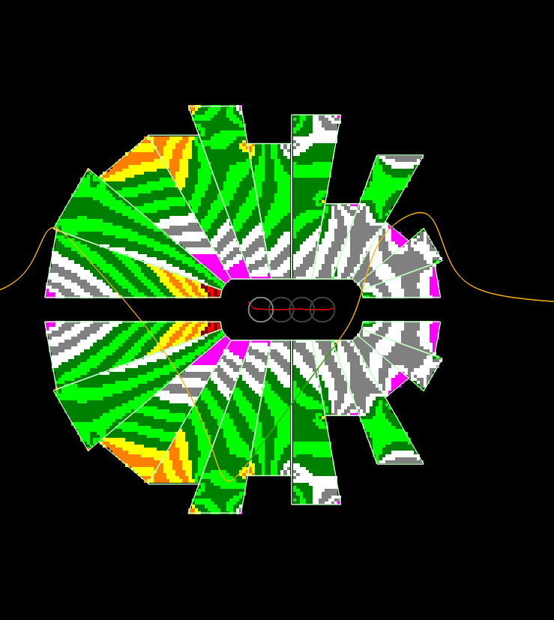
Demagnetisation in new magnets
BF
BD
Could make the “high field” wedge at the end out of a different material grade, or SmCo

Slide 15
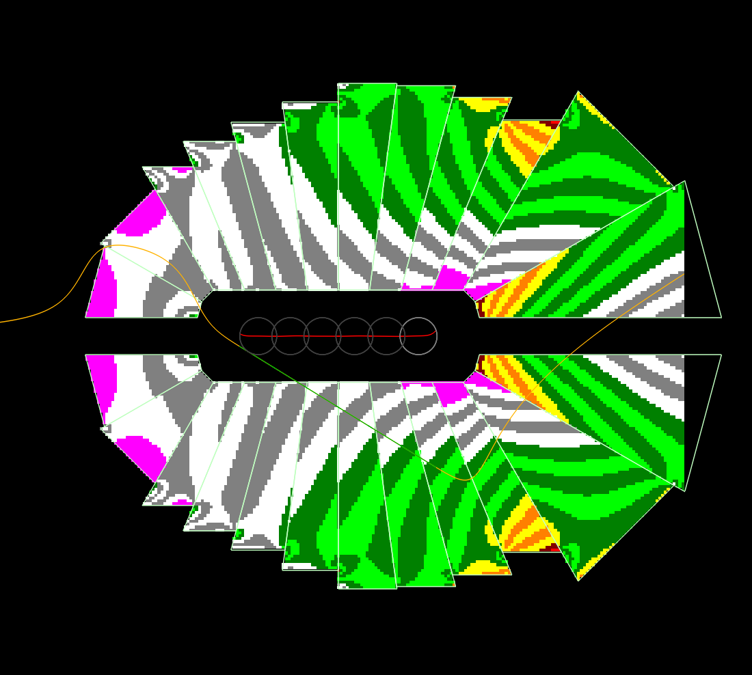
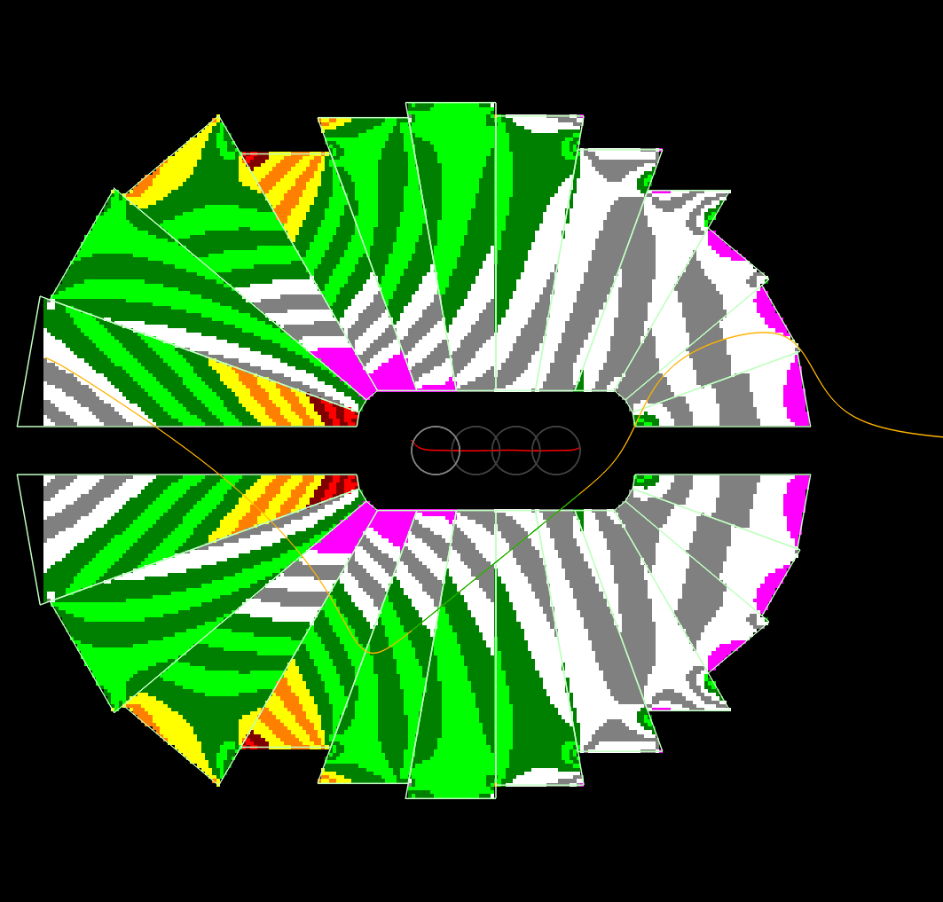
50% gradient / large clearance
BF
BD
Very similar, scaled up 2x

