Slide 1
Performance Comparison
Option | Max Field (T) | SR Loss (MeV) | Final Energy (MeV)
One FFA | 2.007 | 1211.48 | 23418.52
Two FFAs (4+4) | 1.495 | 964.44 | 23665.56
Two FFAs (5+3) | 1.489 | 935.30 | 23694.70
Two FFAs should be considerably better from magnet point of view, particularly radiation hardness due to the decreased fields

Slide 2
MAD-style Lattices (two FFAs, 4+4 turns, 50% gradient scaling)
Parameter | 4+4 FFA1 | 4+4 FFA2 | Units
Emin | 7.1 | 14 | GeV
Emax | 16 | 23 | GeV
Eref | 11.55 | 18.5 | GeV
BF length | 2.96693 | 2.38270 | m
BF angle | -2.45793 | -1.62101 | degrees
BF dipole | -0.55706 | -0.73273 | T
BF quad | -14.865 | -32.808 | T/m
BD length | 0.72907 | 1.31331 | m
BD angle | -0.37050 | -1.20742 | degrees
BD dipole | -0.34171 | -0.99019 | T
BD quad | 46.697 | 43.393 | T/m

Slide 3
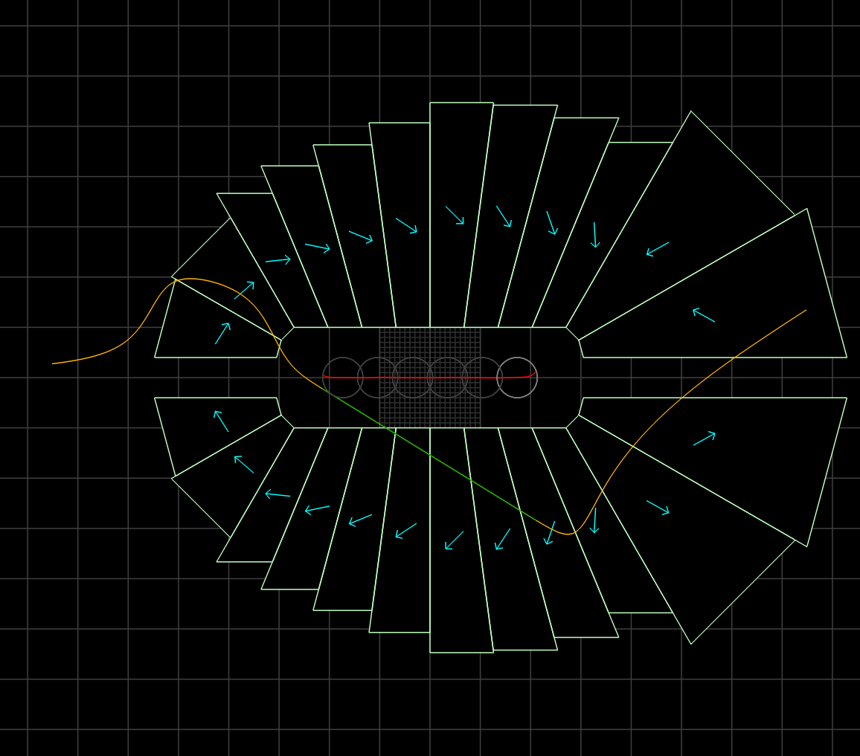
Magnets: 4+4 FFA2, 50% gradient
CBETA magnets were from 38cm² to 78cm²
100.4cm²
BF
32.5 units error
105.8cm²
BD
27.1 units error
10cm
September 10, 2021

