Slide 1
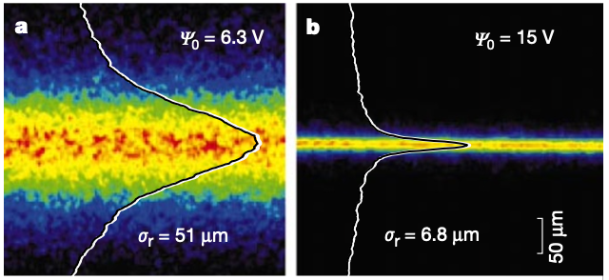
Laser cooling test bench for ultralow emittance accelerator studies
Principal Investigator: Kevin Brown
March 1, 2022

Slide 2
FY2023 NPP LDRD Type B Proposal
Program: NP, ARDAP, Multiprogram.
Laser cooling test bench for ultralow emittance accelerator studies
We propose to study ultralow emittance ion beams via both theory/design studies and an experimental test bench. This enables research opportunities in low energy beam dynamics, such as: formation of crystalline beams, quantum computing within beams, new methods for creating high brightness ion beams (e.g., sympathetic cooling), and exploring the limits of dense low energy beams (e.g., in collision).
Return on Investment:
Potential future funding from DOE Office of Science - NPP, ATRO. Potential SBIR and SBTT opportunities.
This is exploratory, interdisciplinary research. It has the potential to improve beam quality of the hadron facilities at BNL. There are likely patent opportunities, as research progresses. We expect multiple publications to come from this work.

Slide 3
Why do this?
  Cold trapped ions allow study of several physics applications
    In the recent concept of storage ring quantum computing, ions need to be cooled enough that quantum vibrational states of the Coulomb crystal can be resolved
    By colliding ultralow emittance beams, the limits of high luminosity per particle (i.e., per unit beam power) can be explored, which requires correspondingly small focal sizes and careful magnetic aberration correction
    Creating dense beams at low energy will improve understanding of crystalline beams (Coulomb crystal phenomena also apply to astromaterial sciences)
    Studying methods to create ultralow emittance beams could benefit beam quality at hadron facilities
    Laser cooled ions can be applied for sympathetically cooling other ions
    Careful control of beam ‘temperature’ can lead to optimized conditions for transport efficiencies and avoiding resonance conditions. Possibly can benefit polarization of protons and helions
    Low emittance beams can be used as probes to better understand space charge phenomena, residual gas interactions, intra-beam scattering, and emittance growth during acceleration
All of the above require BNL to have a cooled ion trap and to combine accelerator and cold ion physics disciplines.

Slide 4
Ion Trap Test Chamber
Flexible source with variable parameters over wide range:
  Bunch charge
    Via gas pressure, trap voltage
  Bunch size
    Via trap voltage, collimation
  Emittance/temperature
    Stop cooling part way
  Maybe ion species
    Use sympathetic cooling - mix coolable ion e.g. ⁴⁰Ca⁺ ion in contact with desired species
  Easily exchangeable electrode configurations
Learn from existing skills
  BNL ion sources, RF
  Ion traps in universities, etc.
  Beam laser cooling at accelerator labs
Laser
Window
Diagnostics window
Transverse trap electrodes
Gas input, valve
Longitudinal trap electrodes with injection / extraction hole
Port for future injection
Port for future extraction
Ions
Vacuum pump, pressure gauge
Interface for different electrode configurations
May also need high voltage electrodes to establish plasma
Trap voltage feedthroughs
from RF source

Slide 5
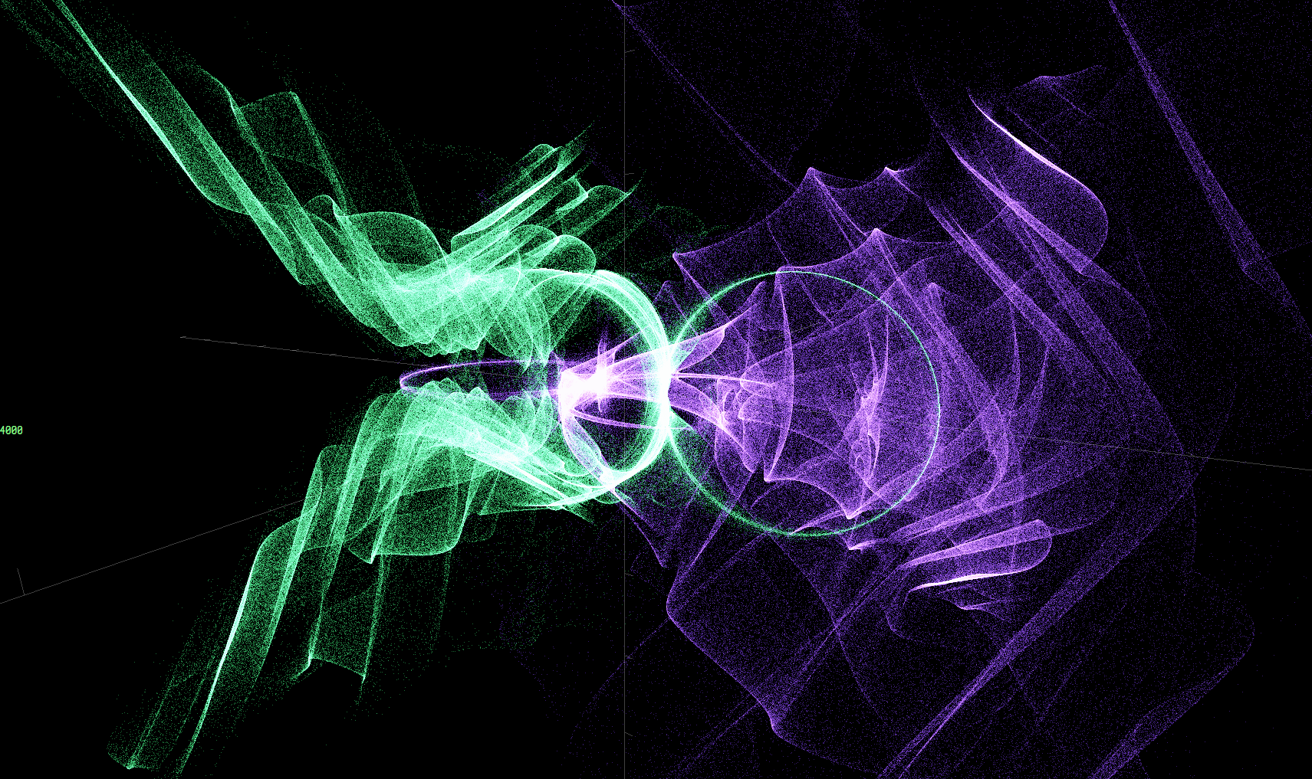
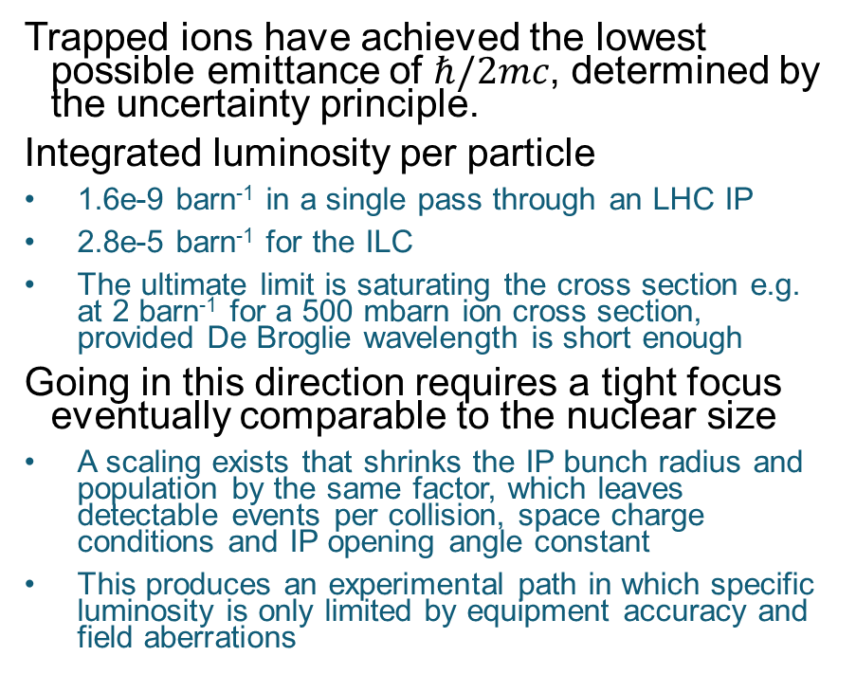
Application Study: High Specific Luminosity Collisions
Trapped ions have achieved the lowest possible emittance of $ℏ/2mc$, determined by the uncertainty principle.
Integrated luminosity per particle
1.6e-9 barn⁻¹ in a single pass through an LHC IP
2.8e-5 barn⁻¹ for the ILC
The ultimate limit is saturating the cross section e.g. at 2 barn⁻¹ for a 500 mbarn ion cross section, provided De Broglie wavelength is short enough
Going in this direction requires a tight focus eventually comparable to the nuclear size
A scaling exists that shrinks the IP bunch radius and population by the same factor, which leaves detectable events per collision, space charge conditions and IP opening angle constant
This produces an experimental path in which specific luminosity is only limited by equipment accuracy and field aberrations
Above: aberrated focus in 4D simulation
Below: 6D simulation on GPU of beam aberrations (test case, 1M particles)

Slide 6
High Specific Luminosity Tracking – Recent Results (Nov 2022)
Code module has been written to give initial beam distributions in ion traps
  Balancing space charge against effective trap potential/force
Optimisation of an electrostatic transfer line between two traps to increase luminosity of collisions at ~few keV
  Enough lumi to detect hard Coulomb scatters at low energy
  Shrinks bunch in all 3 dimensions if initial energy spread allowed
  No energy spread or time dependence → only transverse shrink
  Still working on optimiser to fully take advantage of small ε
Particle interactions are possible on the GPU so could be used to simulate Couloumb crystals in the trap in future

Slide 7
Goals, Deliverables, Methods
Goals:
Design an ion trap test bench for laser cooling studies and construct a basic foundational system
Develop and characterize low emittance beam applications
Deliverables:
Publications based on design, theory, and simulations efforts
Initial test bench as platform for cooling experiments
Methods:
Design and simulation studies to identify components to be used in test stand and determine beam parameter ranges
Theoretical work to focus on cooling methods, use of molecular dynamics models, and standard simulation tools [pylion (Oxford), Vsim (TechX), ion-phys (Oxford), etc.]

Slide 8
Personnel, Procurements
Direct Personnel:
C-AD Engineer, to assist in design
Stephen Brooks: theory, design, and simulations
Kevin Brown: theory, design, and simulations
Procurements:
Vacuum chamber (in hand, no cost)
Cleaning and preparing vacuum chamber
Materials for ion trap, imaging system, vacuum systems, power supplies, lasers & optics

Slide 9
Summary
This project will focus on two specific things:
The design and construction of a basic test bench to begin learning and developing laser cooling techniques
Studies of physics applications that the cooled ion trap could provide in an accelerator setting
The motivations are:
Applications to storage rings for quantum computing
Applications to high specific luminosity collisions
Fundamentally improving our understanding of the limitations in creating ultralow emittance beams and associated phenomena
Understanding the formation and structure of crystalline beams
Developing new techniques for 3D cooling of beams

Slide 10
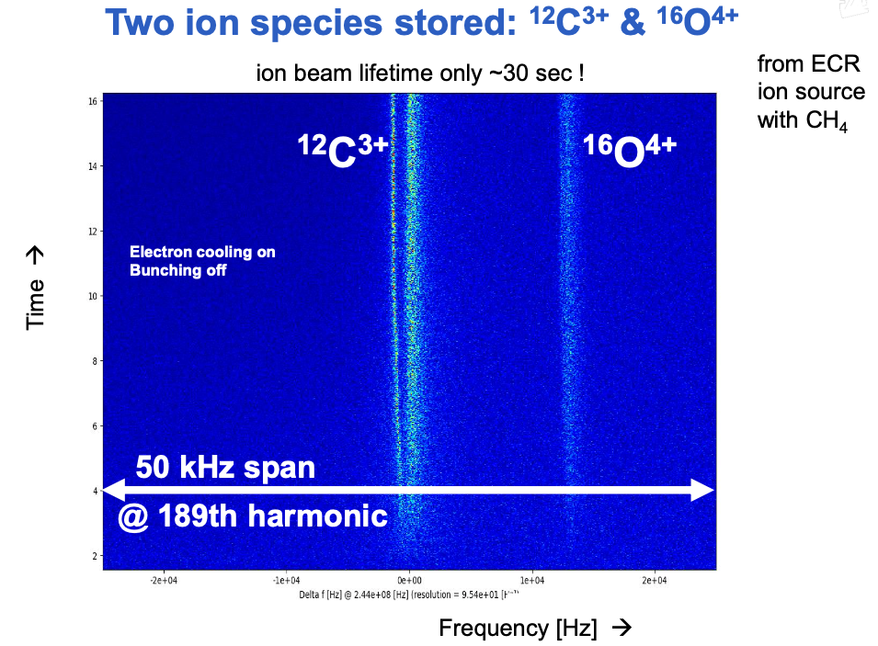
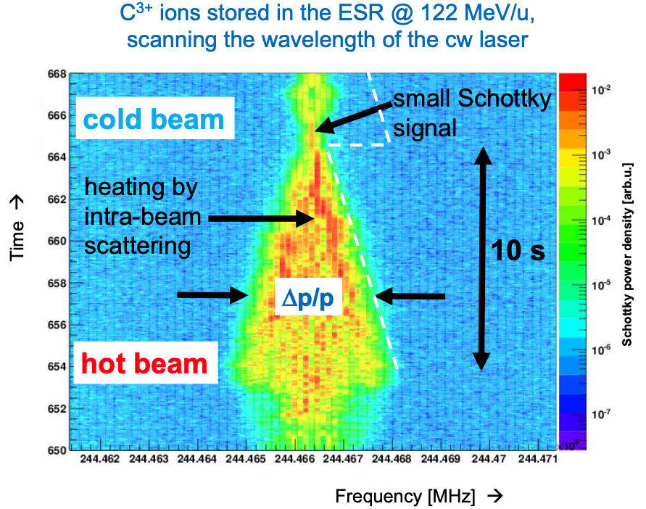
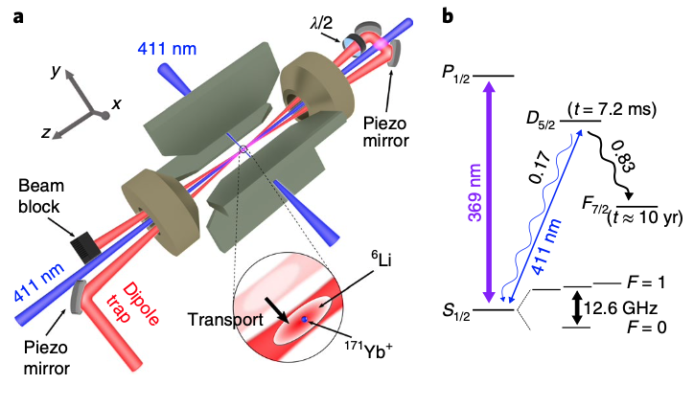
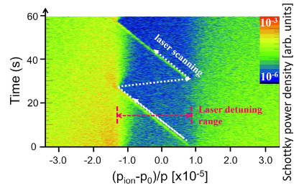
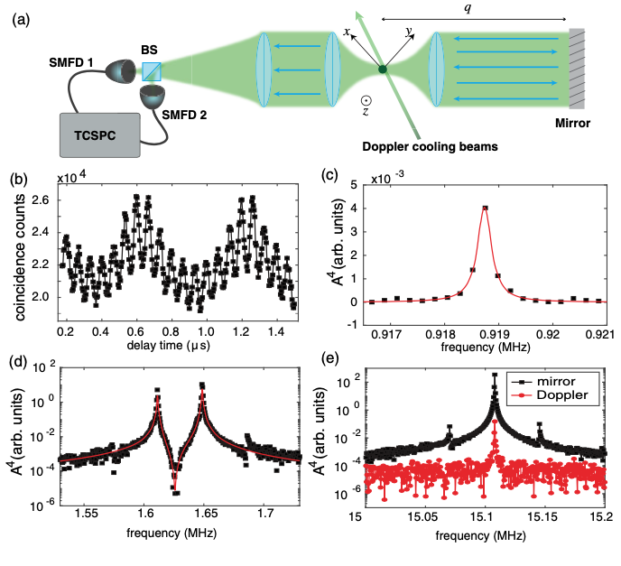
Possibilities
Transverse beam profiles before and after laser cooling phase transition (from cold unordered beam to ordered/crystalline beam)
U Schramm, T Schätz, M Bussmann and D Habs
Plasma Phys. Control. Fusion 44 (2002) B375–B387
Measuring Ion Oscillations at the Quantum Level with Fluorescence Light
G. Cerchiari, G. Araneda, L. Podhora, L. Slodička, Y. Colombe, and R. Blatt
Phys. Rev. Lett. 127, 063603 – Published 4 August 2021
Buffer gas cooling of a trapped ion to the quantum regime
T. Feldker, H. Fürst, H. Hirzler, N. V. Ewald, M. Mazzanti, D. Wiater, M. Tomza and R. Gerritsma, Nature Physics Vol 16 April 2020 413–416
D Winters, et al., Laser cooling of relativistic heavy-ion beams for FAIR,
Phys. Scr. T166 (2015) 014048 (6pp)

Slide 11
PALLAS - setup
Extreme Storage Rings 2022 – Tobias Schaetz, LMU...Freiburg

