Slide 1
Ion Traps Ideas/Status
Some papers
Contact made with Hiromi Okamoto
Long-term applications and ideas

Slide 2
Paper on Quantum Shuttling
https://arxiv.org/abs/quant-ph/0702175v3
“On the Transport of Atomic Ions in Linear and Multidimensional Ion Trap Arrays”
Very long paper (72 pages), only read part
Adiabatic transport from one quantum well to another (like RF bucket change)
Numerical and quantum simulation techniques
Lots of technical detail on trap too, very nice

Slide 3
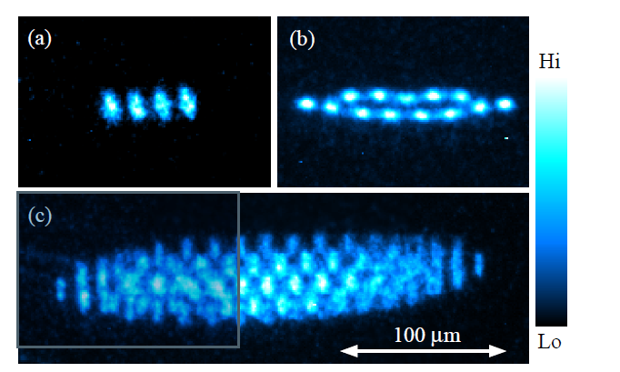
Hiroshima U. IPAC’10 Paper
https://accelconf.web.cern.ch/IPAC10/papers/thobmh03.pdf
“COULOMB CRYSTAL EXTRACTION FROM AN ION TRAP FOR APPLICATION TO NANO-BEAM SOURCE”
Produced Coulomb crystals
Extracted ~3 ions
“normalized rms emittance reaches the order of 10⁻¹³ m or less.”!!

Slide 4
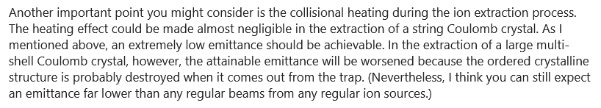
E-mailed Hiromi Okamoto
Has four ion traps, calls them all “S-POD”s
  The first one includes cooling, rest are like IBEX
Sympathetically cooled nitrogen ions, now thinks normalised emittance could be 10⁻¹⁶ m
Commented on ion extraction:

Slide 5
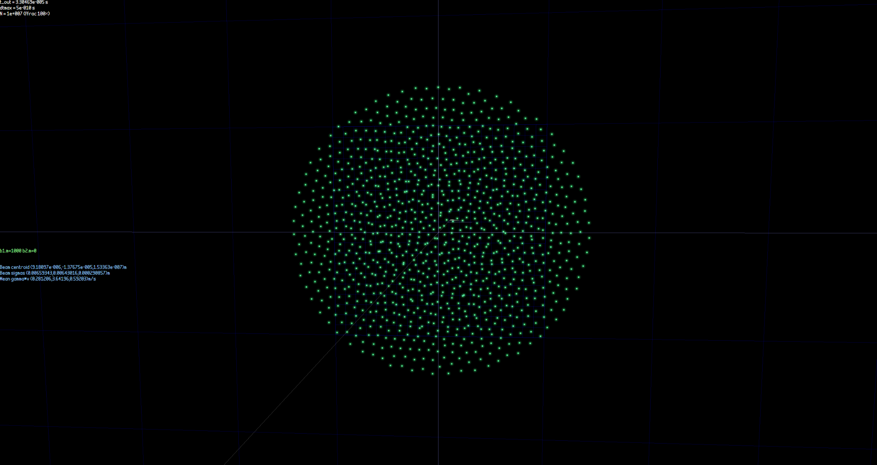
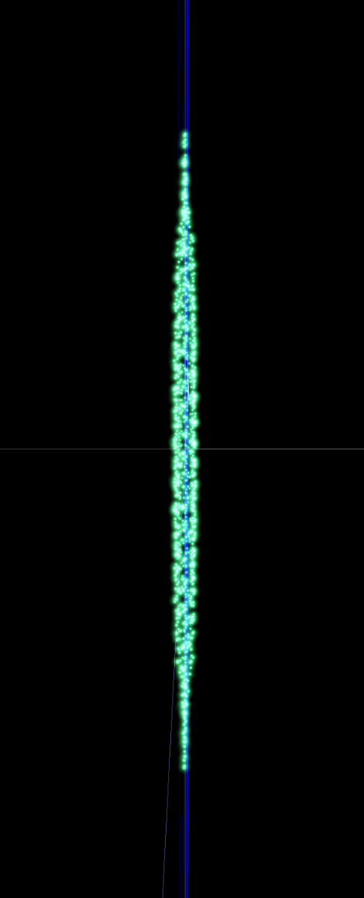
Ion Trap Simulation
Pancake-shaped beam with low transverse focussing and higher longitudinal
40Ca+, 1000 ions, cooling is “fake” because I haven’t got absorption spectra yet

Slide 6
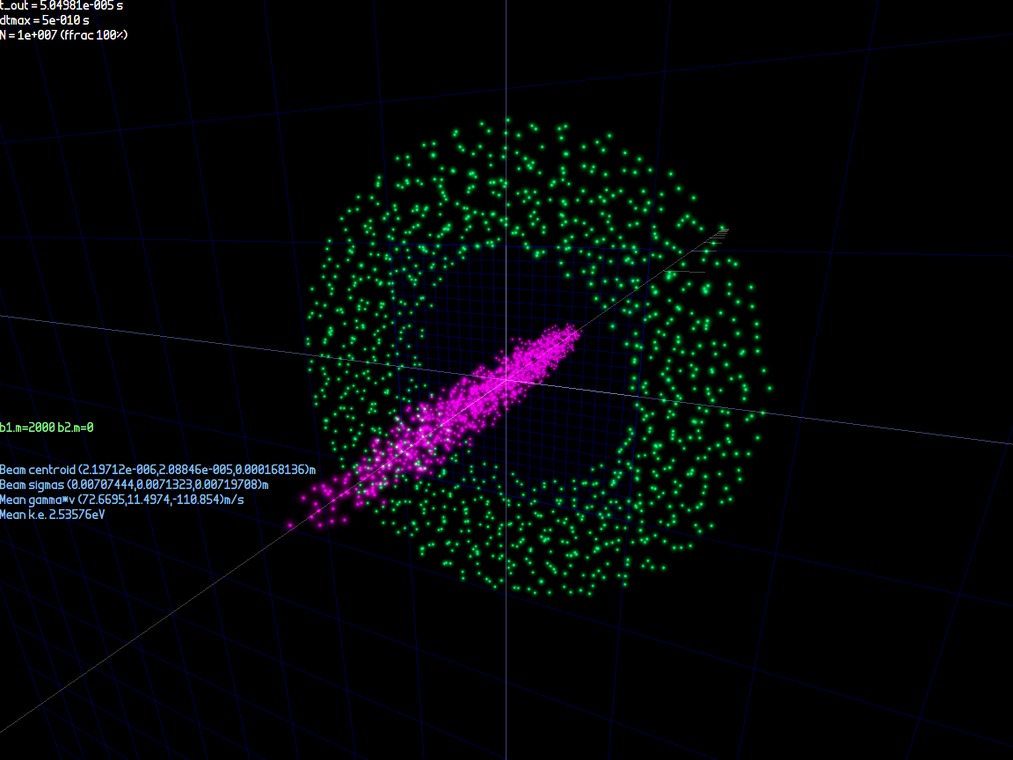
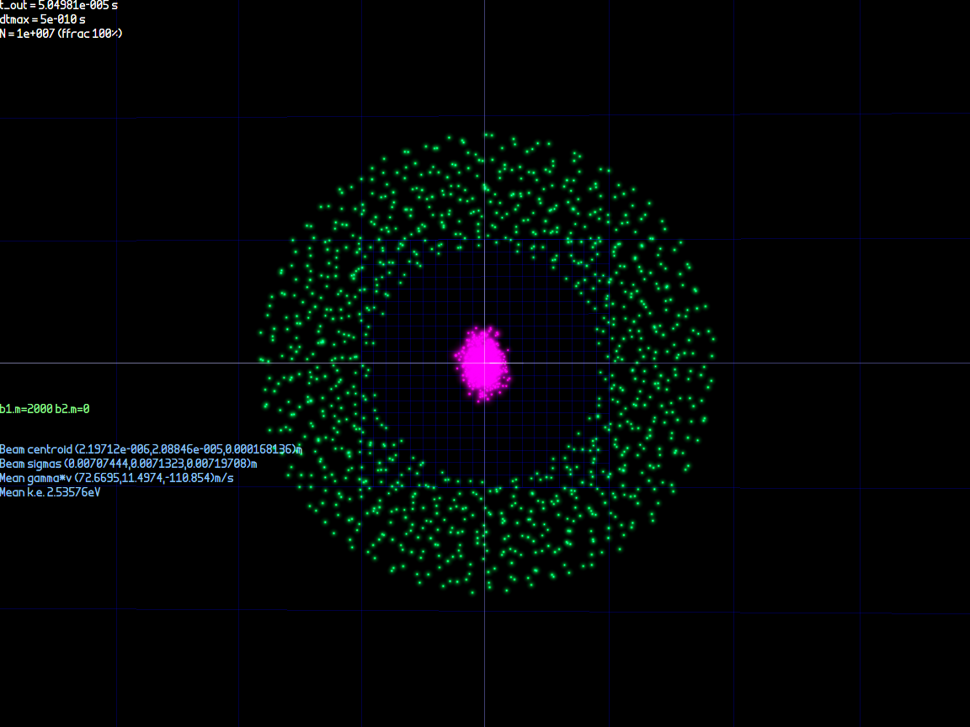
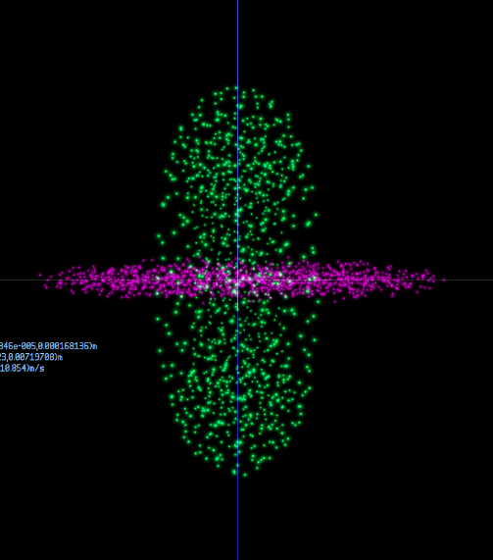
Two-Species Ion Trap Simuation
Tried protons and calcium – both stable but very different rigidity & ellipsoid shapes
Species separate themselves so not much thermal conduction between them?
Did have some better luck sympathetically cooling very small numbers of protons that get embedded in the Ca crystal lattice

Slide 7
Experimental Pathway
Produce ions
Trap ions
Measure ions
Cool ions
Extract ions
Focus ions
Collide ions
IBEX
S-POD
Proposal
Take bunches out of equilibrium to make dense collisions (as interaction points do in rings)

Slide 8
“Zero” Emittance Focus
What limits you when you make a focus but there is no/minimal emittance? From physics:
  Coulomb repulsion
  Matter wave diffraction (lighter species)
  Possibly Pauli exclusion principle (large N)
From experimental errors:
  Optical aberrations (distortion etc.)
  Vibrations, noise

Slide 9
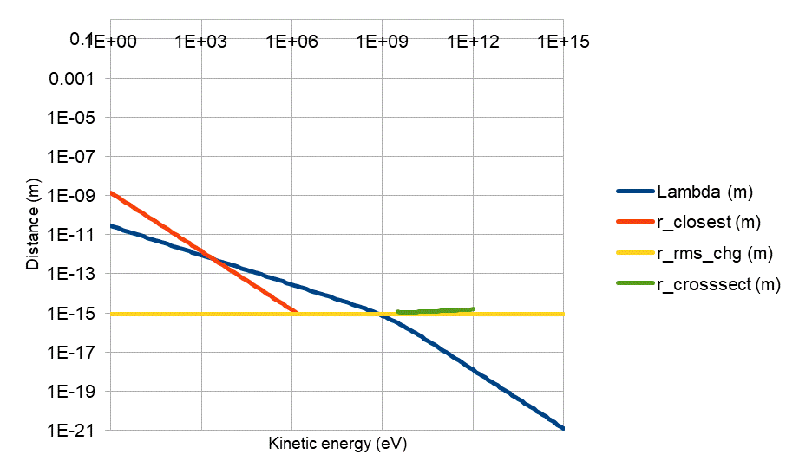
Colliding Two Protons
Closest approach distances determined by energy, Coulomb repulsion, matter wavelength and true hadron size
Coulomb bounce
De Broglie wave diffraction
Inelastic “direct hit”

Slide 10
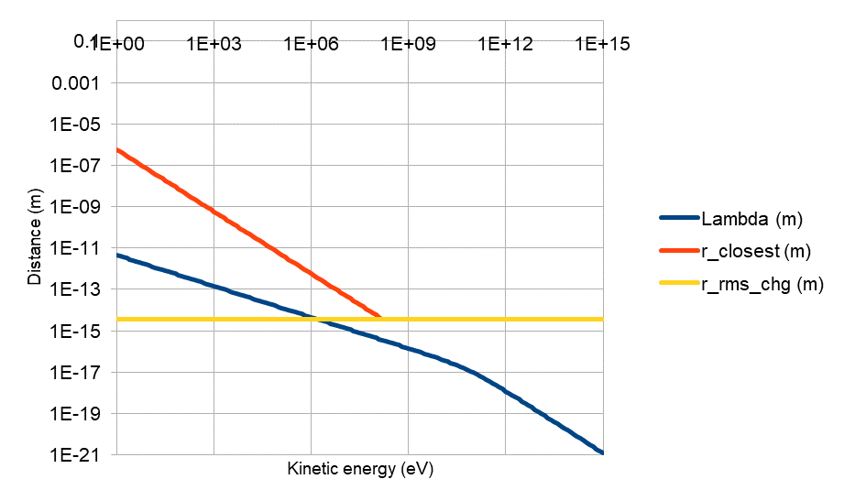
Colliding Two Ca+ Ions
Closest approach distances determined by energy, Coulomb repulsion, matter wavelength and true hadron size
Coulomb bounce
Inelastic “direct hit”
No significant diffraction

Slide 11
Imploding Sphere of Charge
Coulomb potential energy is (1/4πε₀)qQ/r
  Set this equal to initial k.e. in implosion rest frame to find r_{min} (and ignore some geometrical factor)
  Q = Nq for N ions
r_{min} = (1/4πε₀)Nq²/E_{k}
Density scaling is crazy with E_{k}
ρ = M/V = Nm/((4/3)πr_{min}³)
= (1/4πε₀)³/((4/3)π) (m/q⁶) (E_{k}³/N²)

Slide 12
Some Numbers
With N=20000 Ca+ ions
x’*=100mrad and dp/p=10% chirp
  Important to make boosted imploding sphere(s)
Required normalised emittance is βγr_{min}x’*
  Heisenberg bound for 1-plane ε = (hbar/2mc)N^{1/3}
E_{k} or voltage | r_{min} (m) | ρ/ρ_{water} | Normalised 1-plane emittance (m) | Heisenberg lower ε bound (m)
100keV | 28.8nm | 0.0133 (dense gas) | 6.67e-12 | 7.19e-17
1MeV | 2.88nm | 13.3 (~Hg) | 2.11e-12 | 7.19e-17
10MeV | 0.288nm | 13300 (white dwarf) | 6.67e-13 | 7.19e-17
Requires feedbacks
Already attained by S-POD

Slide 13
Feedbacks (rough notes)
Can use coherent beam-beam interaction
  i.e. when bunches have a near miss they bend away from each other via electrostatic repulsion
This will give the direction and magnitude of the near miss using a position detector
Can “telescope” down from a large high-charge bunch to a smaller bunch later
  Avoids problem of not being able to find the beam

Slide 14
Aberrations (rough notes)
I’ve done optimisations of a set of configurable electrostatic multipoles that show they can manipulate the beam in a variety of nonlinear ways to cancel aberrations
If the initial beam has some energy spread or “chirp”, it can focus the bunch to almost a point in all three dimensions
  Otherwise only in two transverse dimensions because time symmetry with constant fields

Slide 15
Reducing N (rough notes)
Having a small N (e.g. 3) leads to an extreme situation where the densities can approach the nuclear density but positional accuracy requirements are similarly severe (like LIGO)
This is exciting because it could be an alternate route to stable superheavy elements (more neutrons from multi-way fusion)
  Or to study high-density stellar nucleosynthesis
Przybylski's Star contains unstable actinides in its spectrum, one theory is that they are daughters of a comparatively stable superheavy element

Slide 16
Efficiency (rough notes)
The extremely small foci possible using these methods mean collisions would have very high “specific luminosity” (luminosity per particle or per Watt)
Preserving the ultra-low emittance to collider energy scales might be hard but could alleviate “intensity effects” or power limits in future colliders

