Slide 1
Ion Traps Ideas/Status
ECA preproposal
Extraction initial simulation
Emittance at Doppler cooling limit

Slide 2
Early Career Award Preproposal
3-page preproposal was submitted Dec 29th
  Will get encourage/discourage response for full proposal on Feb 6th
Potentially $500k/year for 5 years
  Only ~10% of applications accepted though
  Mainly a way to get my thoughts on paper!
(See document)

Slide 3
Ion Trap Extraction
Q: does the low emittance of the beam survive extraction from the trap?
Replaced the quadratic potential in the trap simulation by six “point electrodes”
  With the same quadratic terms at x,y,z=0
  Then turn the +Z electrode off after cooling
  With ~+100V bias so ions come out accelerated
First try, probably now need to decouple acceleration voltage from trapping voltage

Slide 4
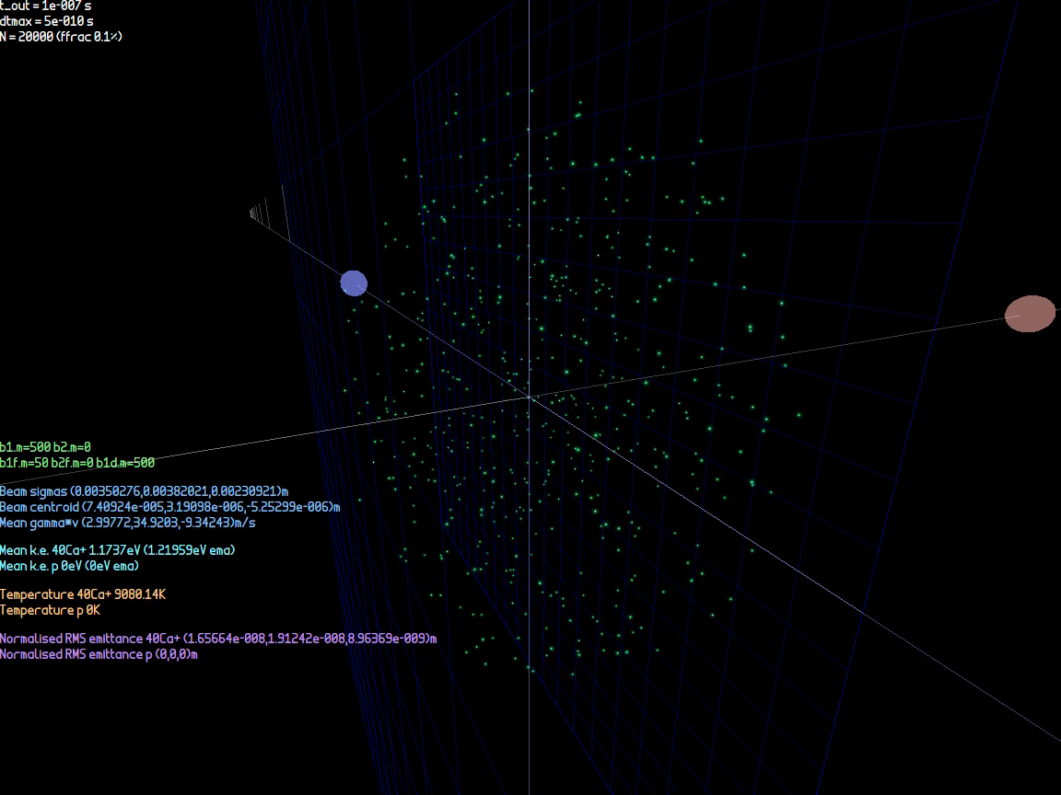
Extraction Animation

Slide 5
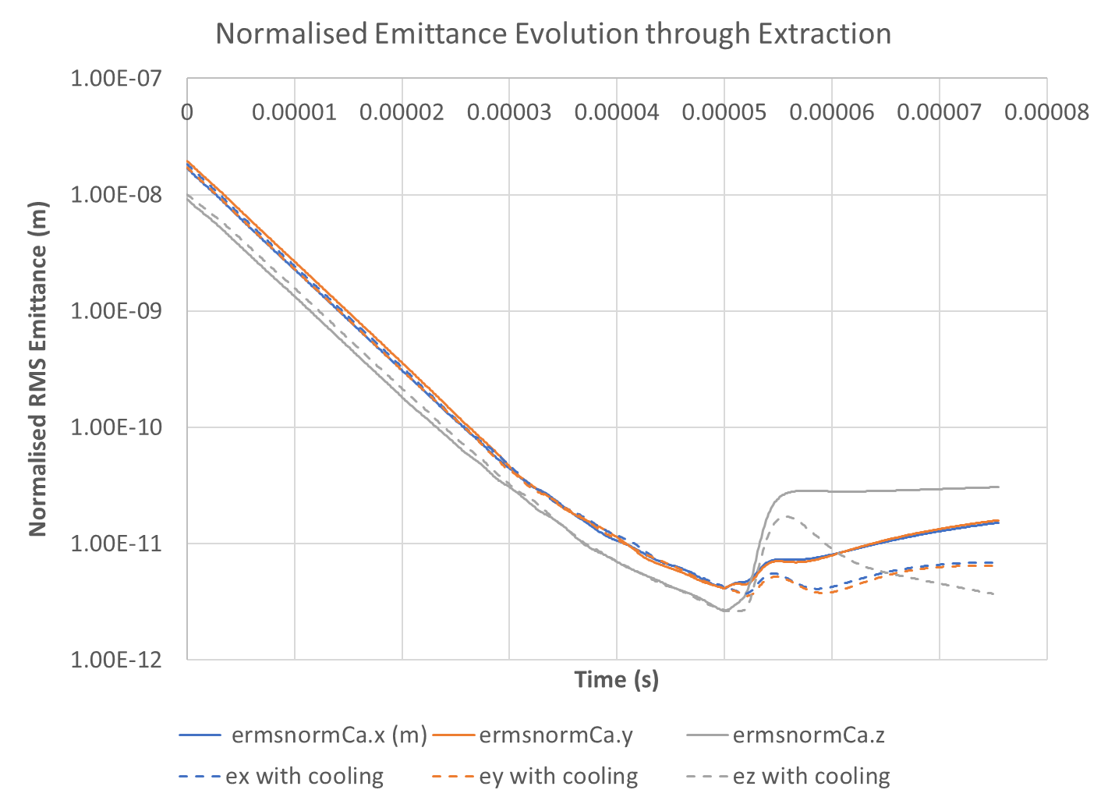

Slide 6
Doppler Cooling Force Formula
So far have used ad hoc cooling rate of 2e5/s applied to particle velocities
van Mourik arXiv:2104.10623 (thanks David!) has explicit cooling force formula (eqn. 30)
  So does Metcalf “Laser Cooling and Trapping of Neutral Atoms” chapter in “The Optics Encyclopedia” (2007)
  Slightly different notation, cross-checked with this and Steane (1997) Appl. Phys. B 64, 623–642

Slide 7
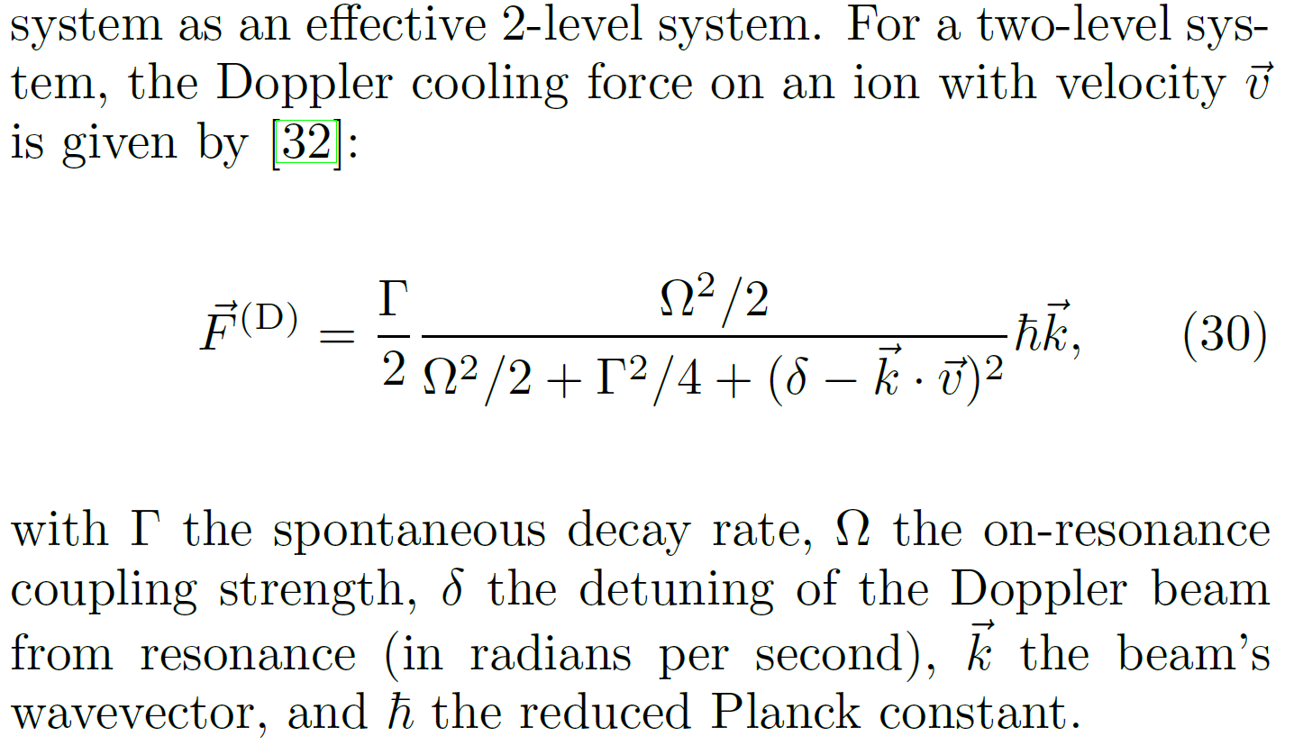
Formula in arXiv:2104.10623
a.k.a. “line width”
a.k.a. “Rabi frequency”

Slide 8
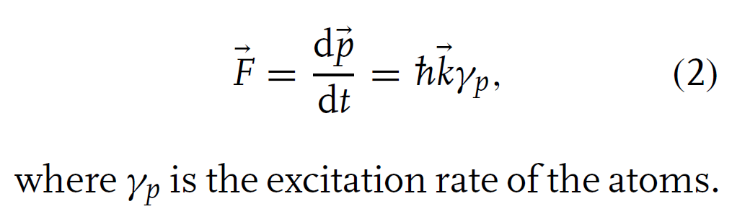
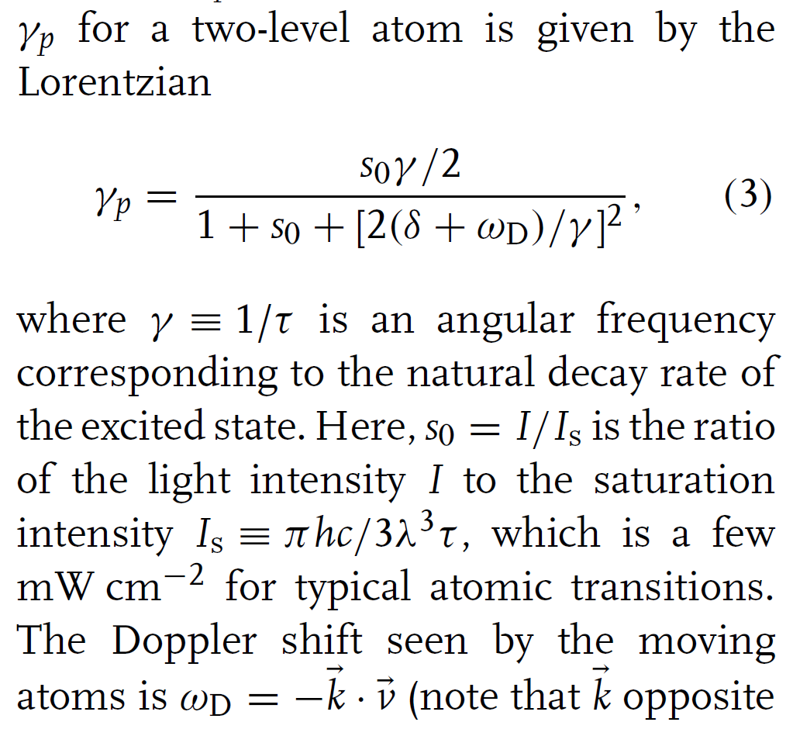
Formula in Metcalf book chapter
Small γ is used here instead of Γ
Can compare to previous formula and derive that Ω² = Γ² s₀/2
Steane agrees with I_{sat} definition and provides Γ = 23MHz * 2π as an example for Ca⁺ trapping
Note this is an averaged force, does not include random heating term

Slide 9
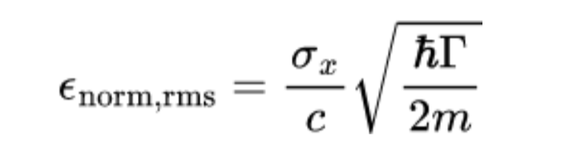
Emittance at Doppler Cooling Limit
Metcalf and Steane both have T_{Dopp,min}=ℏΓ/2k_{B}
For one axis only, so <½mv²>=k_{B}T/2
  Thus can derive σ_{v} = sqrt(<v²>) = sqrt(ℏΓ/2m)
For upright, non-relativistic beam,
  ε_{norm,rms} = σ_{x}σ_{v}/c
Therefore:
Small enough for parameters in proposal!

Slide 10
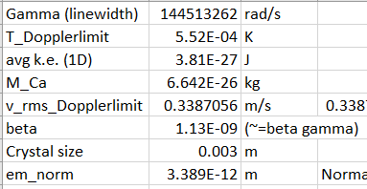
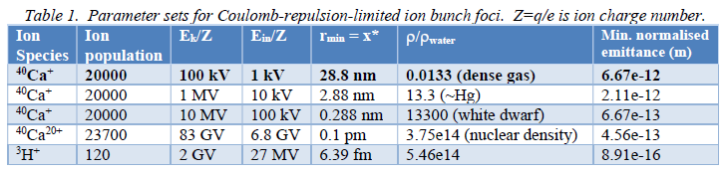
Example Values

Slide 11
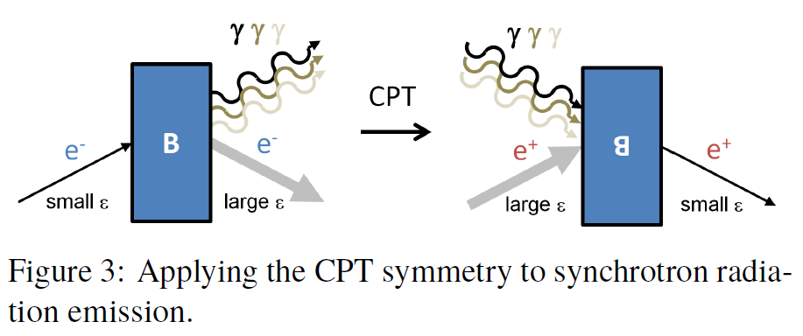
Future Benefits of Quantum Trap
Entangled initial conditions in particle physics experiments can give more ideal final states
E.g. synchrotron radiation under time reversal

Slide 12
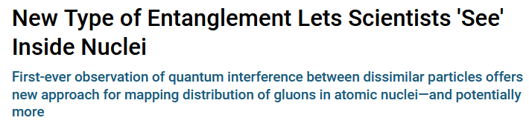
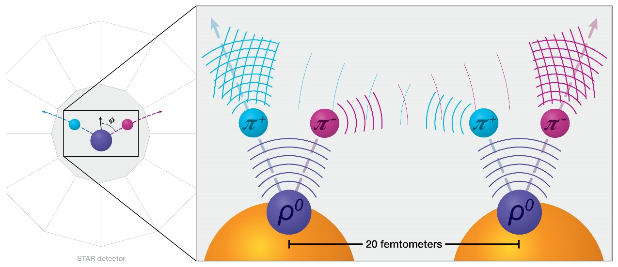
Talking of Entanglement…
Entanglement of high energy pions
https://www.bnl.gov/newsroom/news.php?a=120816

Slide 13
Visit to RAL (and IBEX trap)
I will be at RAL from Monday 30th Jan to Friday 3rd Feb
Hope to discuss ideas for future of IBEX trap

