Slide 1
Ion Trap LDRD Approval and Focussing Beamline Simulation
LDRD budget and hardware list
Beamline focussing optimisation

Slide 2
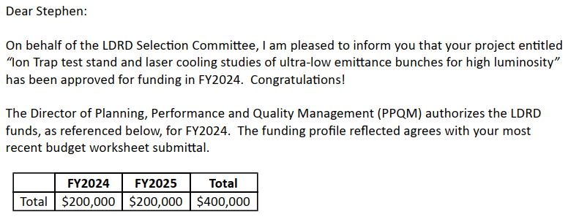
Ion Trap LDRD Approved!
Equates to 20% of my time for 2 years
Plus $193,462 (2 year total) of hardware once lab overheads have been taken off
  Can show LDRD presentation slides now

Slide 3
What the LDRD Proposes to do
https://stephenbrooks.org/ap/report/2023-8/24-006_pages1-5.pdf
Experimental apparatus
  “The experimental campaign will produce the foundational ion trap system […]”
  Vacuum chamber, ions, trap, maybe not cooling
Application studies
  Simulation/theory/design, accelerator uses, e.g.:
    Increasing current throughput of cooling
    Transporting ultra-low emittance beams
    Novel dense focal points

Slide 4
Micro-Milestones (in-vacuum)
Vacuum chamber holds vacuum
Electron gun to Faraday cup
Electron gun to beam screen (CCD?)
Electron beam deflected by electrodes
Production of ions, detected on screen or cup
Verify positive charge ions with deflection
Pull ions through four-rod AC quadrupole to verify temporal alternating gradient focussing
Trap ions with endcap electrodes then release
Configuraiton 1
Config 2
Config 3

Slide 5
Hardware Guesstimate Budget Prepared for Early Career Proposal
Still haven’t heard back from the Early Career Award ($2.5M) proposal
  It’s a long shot, assume didn’t get it
I did prepare a larger budget for $540k of hardware
  (2.8× what the LDRD provides)
  Also includes an external focussing beamline chamber that we won’t be needing right away

Slide 6
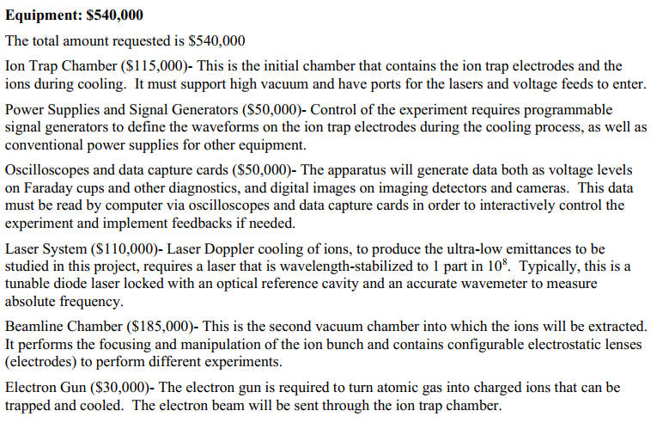
Hardware Guesstimate Budget Prepared for Early Career Proposal
Compare: LDRD hardware = $193,462
More than required for LDRD
Probably beyond LDRD scope
Beyond LDRD scope

Slide 7
More Fine-Grained Guesstimate
Compare: LDRD hardware = $193,462
Ion trap chamber (~145k total)
  Vacuum chamber (in hand)
  Roughing pump (~5k)
  Turbopump (~25k)
  Voltage feedthroughs (~15k)
  Trap electrodes (~10k)
  Gas source: oven or bottle/pinhole valve (~15k)
  Electron gun for ionization (~30k)
  Diagnostics (~35k total)
    Faraday cup(s) (~5k)
    CCD, MCP or phosphor screen (~25k)
    Camera (~5k)
  Other hardware: pressure gauges, flanges etc. (~10k)
Power supplies and signal generators (~50k)
Oscilloscopes and data capture cards (~50k)
Laser system (~110k total)
  Tunable diode laser (~30k)
  Optical reference cavity (~30k)
  Accurate wavemeter (~40k)
  Laser table (in hand)
  Other hardware: lenses, adjustable mirrors etc. (~10k)
(Probably) More than required for LDRD
Probably beyond LDRD scope unless can “borrow” an unused laser at BNL
Beamline chamber not listed

Slide 8
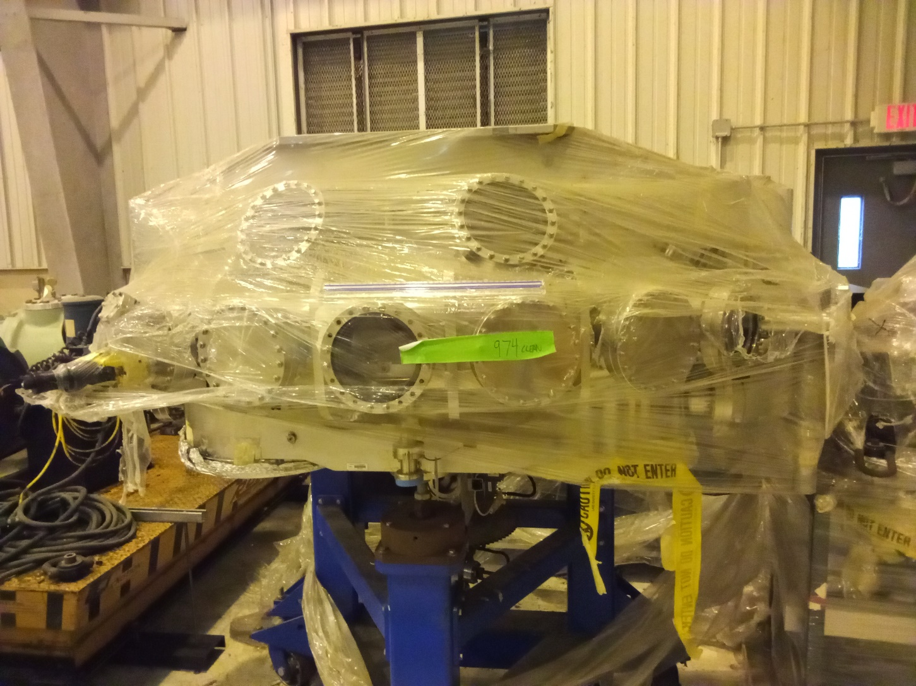
Reminder of our chamber
https://stephenbrooks.org/ap/report/internal/iontrap/2023-03-22/vacchamberphotos/

Slide 9
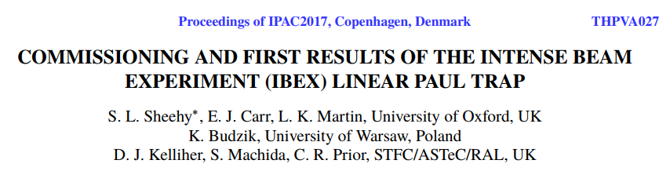

Useful Paper from IBEX
Mentions some hardware used in IBEX (RAL)
  LeCroy WS2052 arbitrary waveform generator
  Falco WMA300 amplifiers (€2450 each)
  Tuoma thermionic electron gun
  VAT Series 59 variable leak valve (gas control)

Slide 10
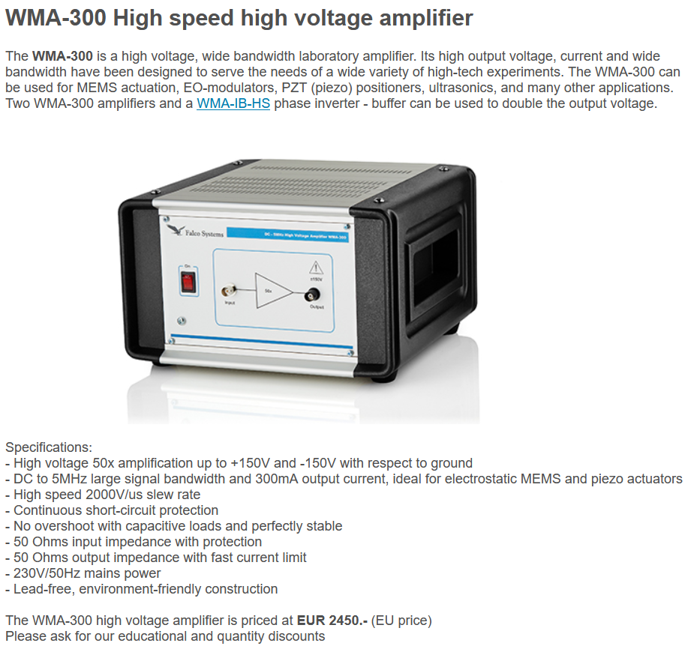

Slide 11
Beamline Focussing Optimisation
15 rings of 12 electrodes form a bent channel
  Bends by 135 degrees total
  Each ring of 12 is a configurable electrostatic multipole lens
Put the cooled ion trap beam down it, accelerated to 1keV with a 1% dp/p chirp
Optimise all 180 electrode values* ^{(no monopole allowed)}
Goal: minimise RMS focal size (in 3D)

Slide 12
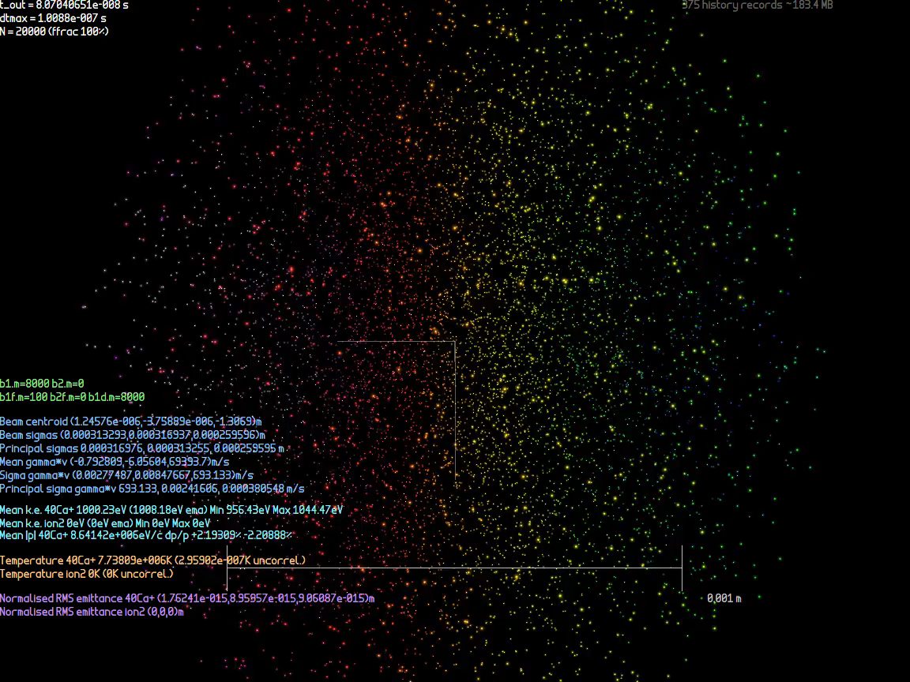
Movie – Zero Temperature Start

Slide 13

Movie – T=2mK Start

Slide 14
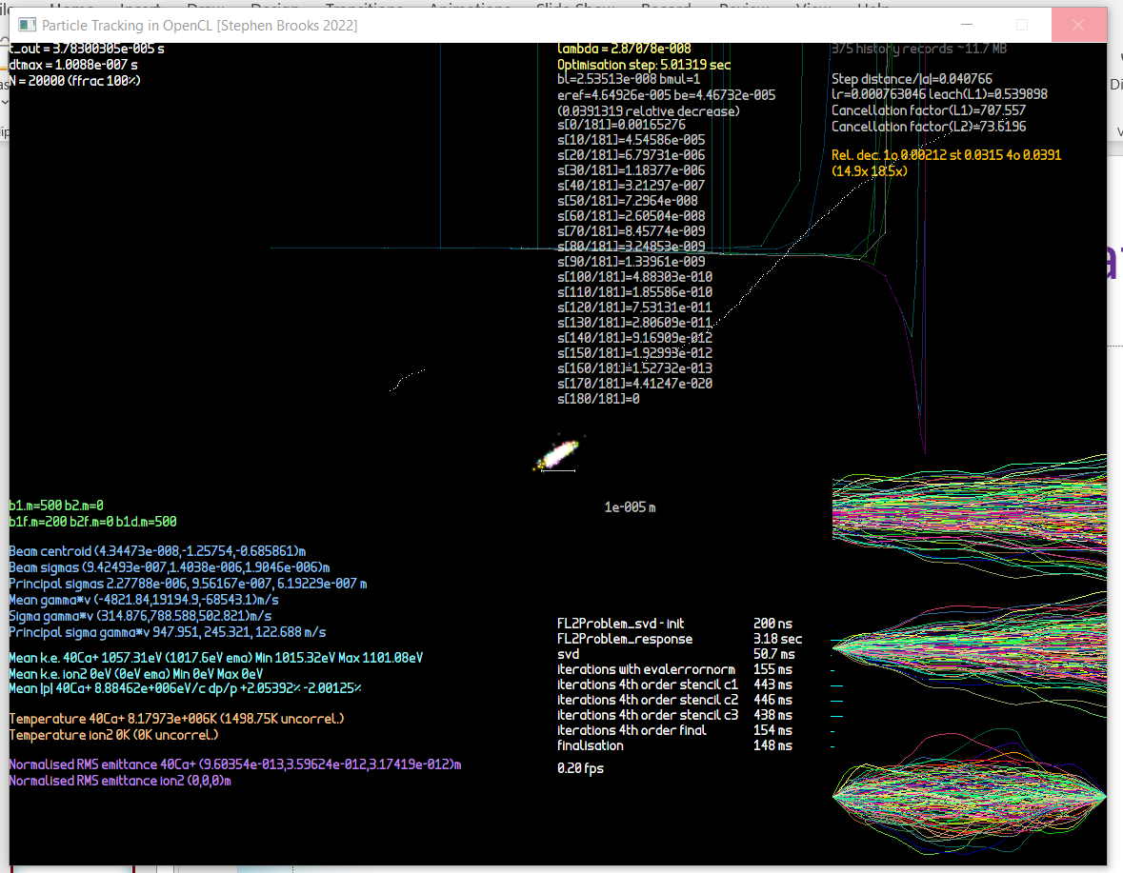
Optimisation
These are graphs of the optimised parameters – turning lots of “corners”!

Slide 15
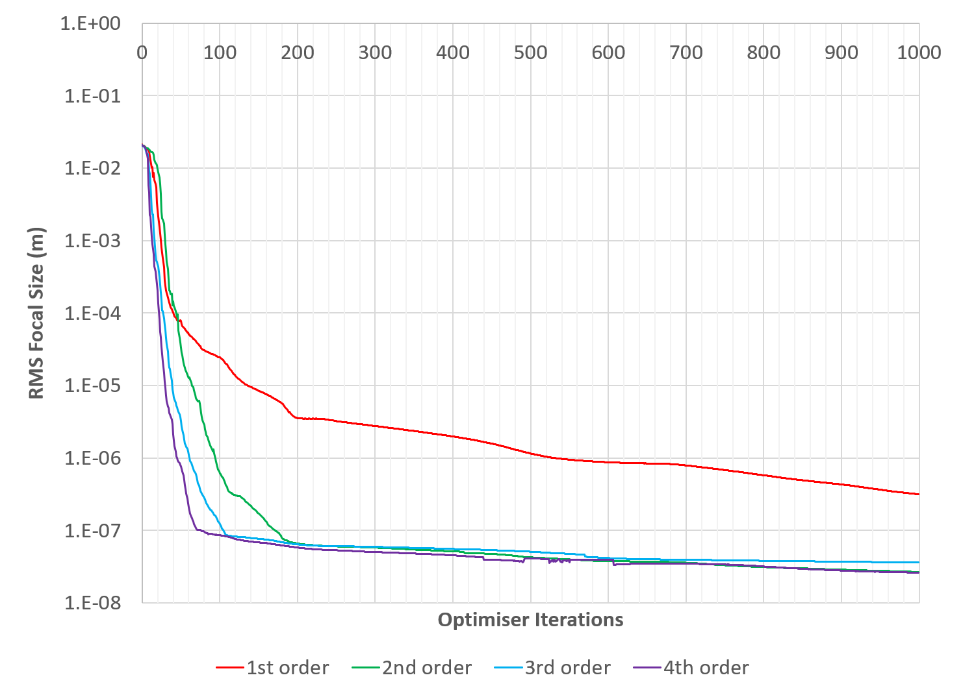
Spin-off: Paper on Optimiser Improvements
https://arxiv.org/abs/2307.03820

Slide 16
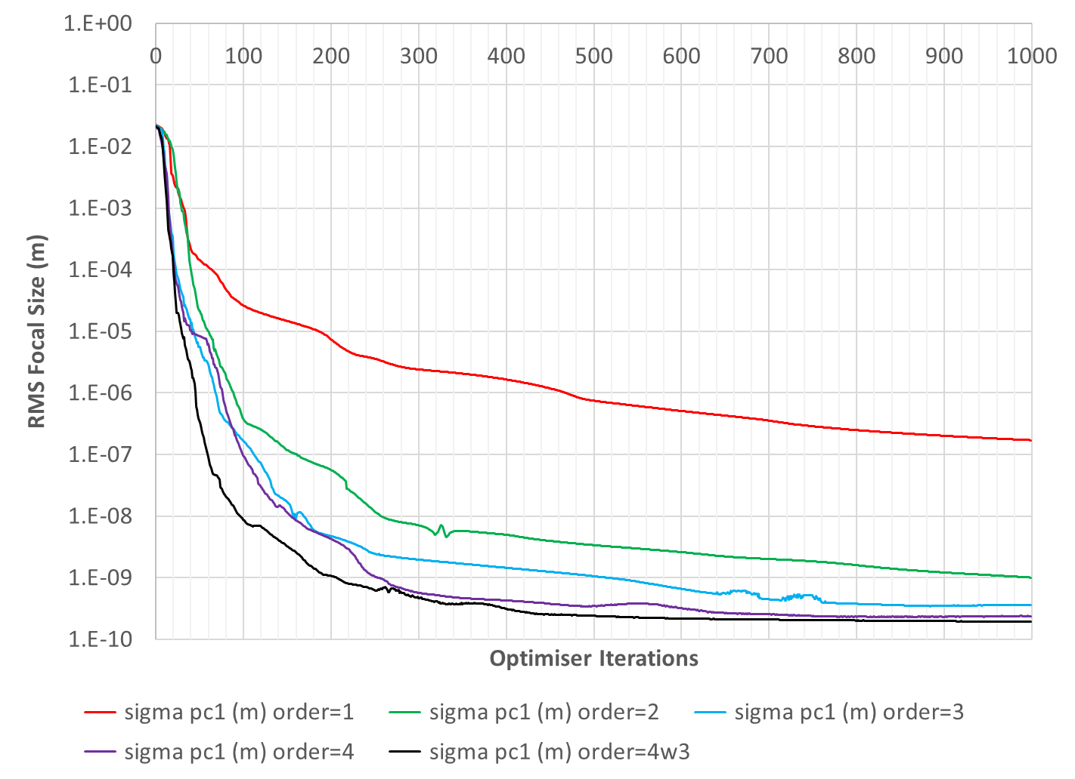
The Same Graph After I Removed Coding Mistake in Derivative

